Slide 1
Ecosystem Spectral Information System (EcoSIS):
Integration of Spectral Data with
Measurements of Vegetation Functional Traits
Alphabetically:
Phil Dennison, University of Utah
John Gamon, University of Alberta, SpecNet
Simon Hook and Rob Green, JPL
Shelley Petroy and Tom Kampe, NEON, Inc.
Dar Roberts, UC-Santa Barbara
Phil Townsend and Shawn Serbin, University of Wisconsin
Susan Ustin, UC-Davis
Art Zygielbaum, University of Nebraska
…..and…..
You!

Slide 2
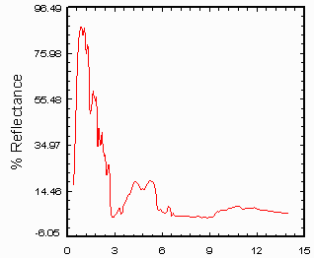
Why Spectral Libraries?
Tool for discovery.
Document species characteristics and map them.
Characterize the diversity of function and its variability on earth.
Deliver scientifically vetted data to an international and open community of researchers…
…and metadata to ensure inter-comparability.
Tools to facilitate the synthesis of large data sets by community.
Precedents:
Aster
Spectral
Library
Notes:
Be sure to indicate that we are looking at spectra covering the entire UV-VIS-NIR-SWIR-TIR
The thermal infrared is of particular importance to full characterization of ecosystems.

Slide 3
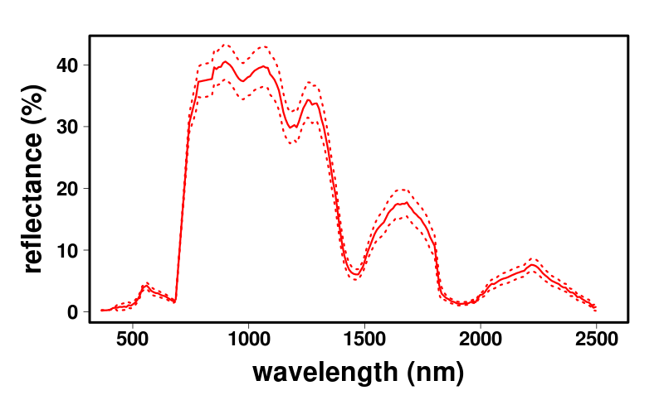
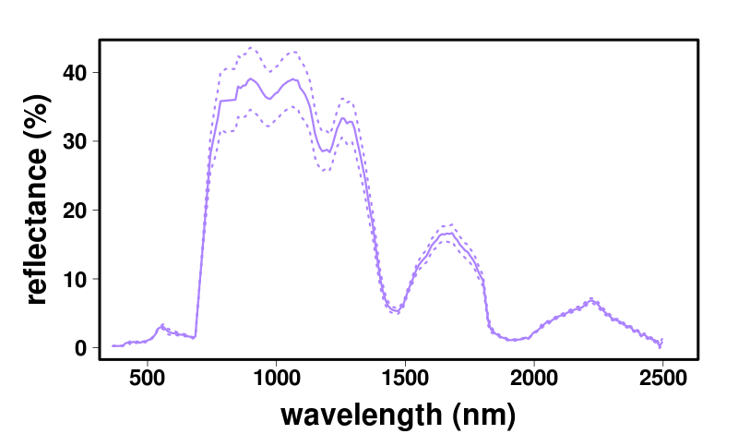
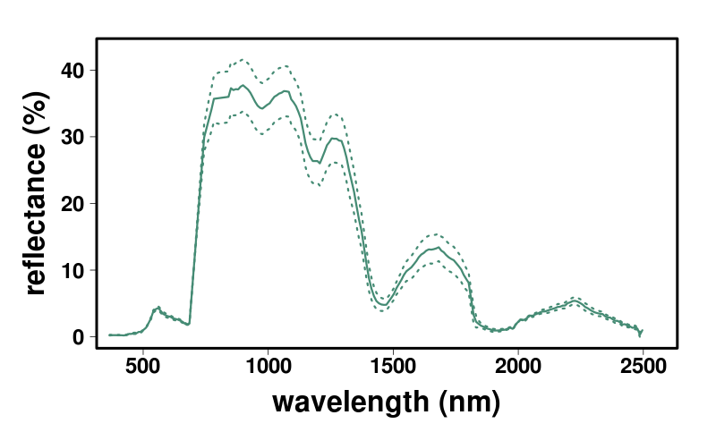
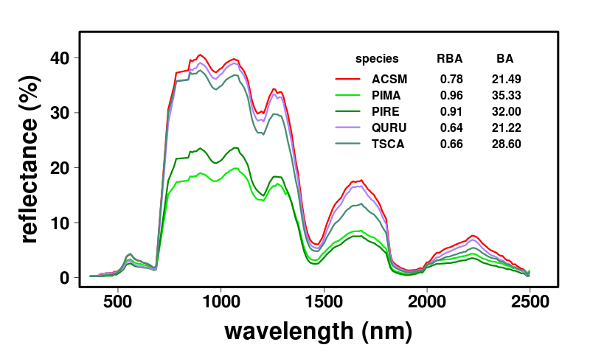
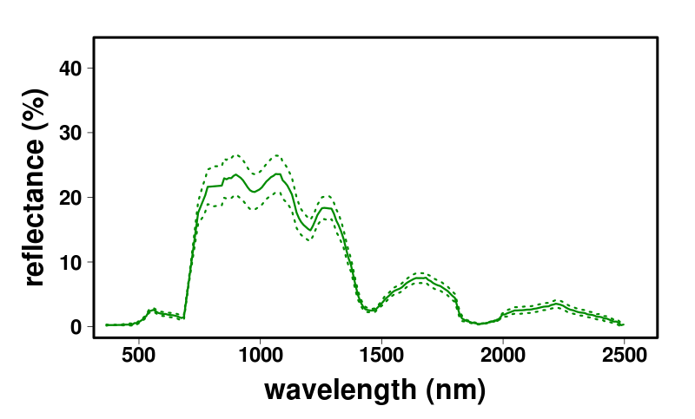
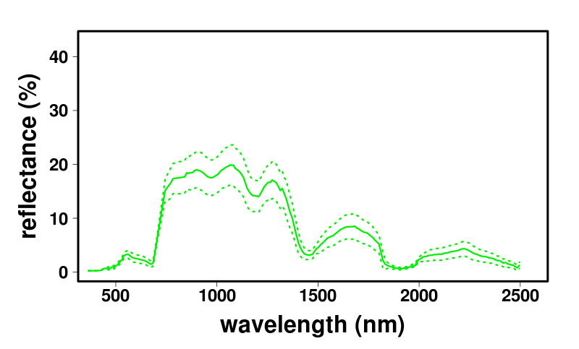
Sugar Maple
Red Oak
Hemlock
Red Pine
Black Spruce
Notes:
Spectral information can be about about species, differences between species, and geographic variations within a species.
It can also be at the canopy and the leaf level.

Slide 4
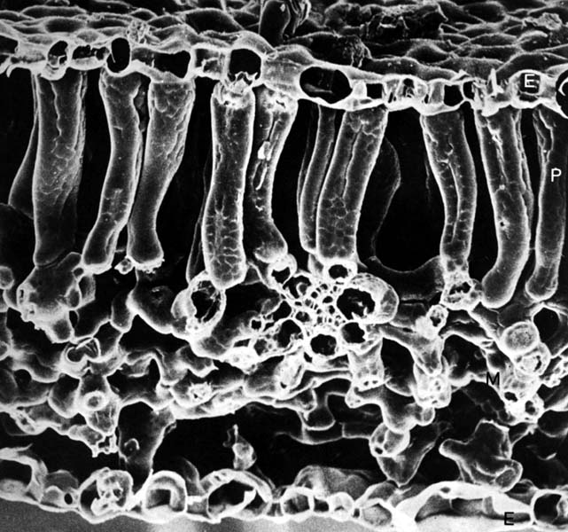
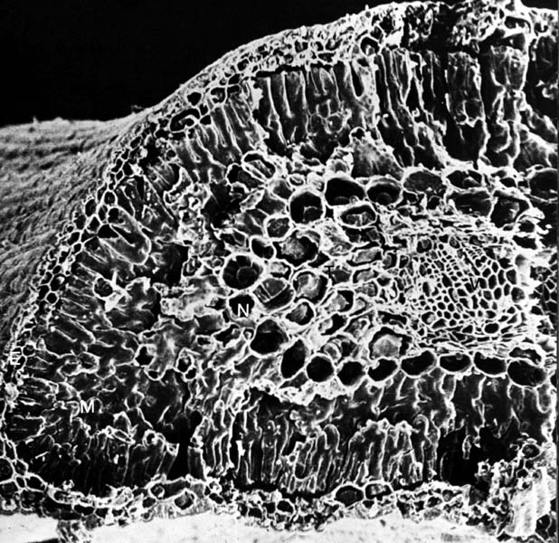
Leaf-level spectra
Maple
Pine
Broadleaf trees
Conifer trees
Notes:
Spectral information can be about differences in reflectance through the canopy of a tree.

Slide 5
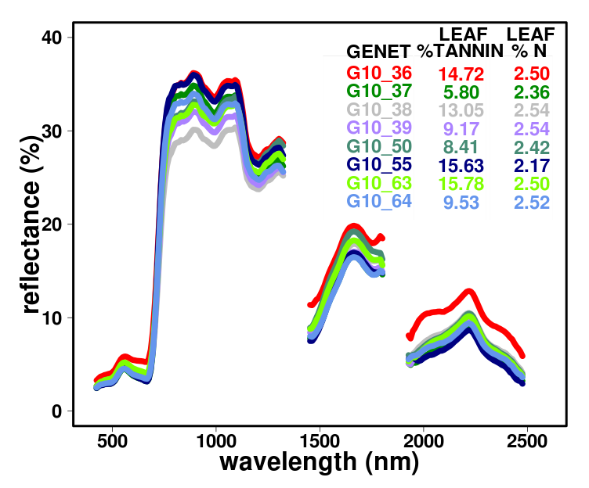
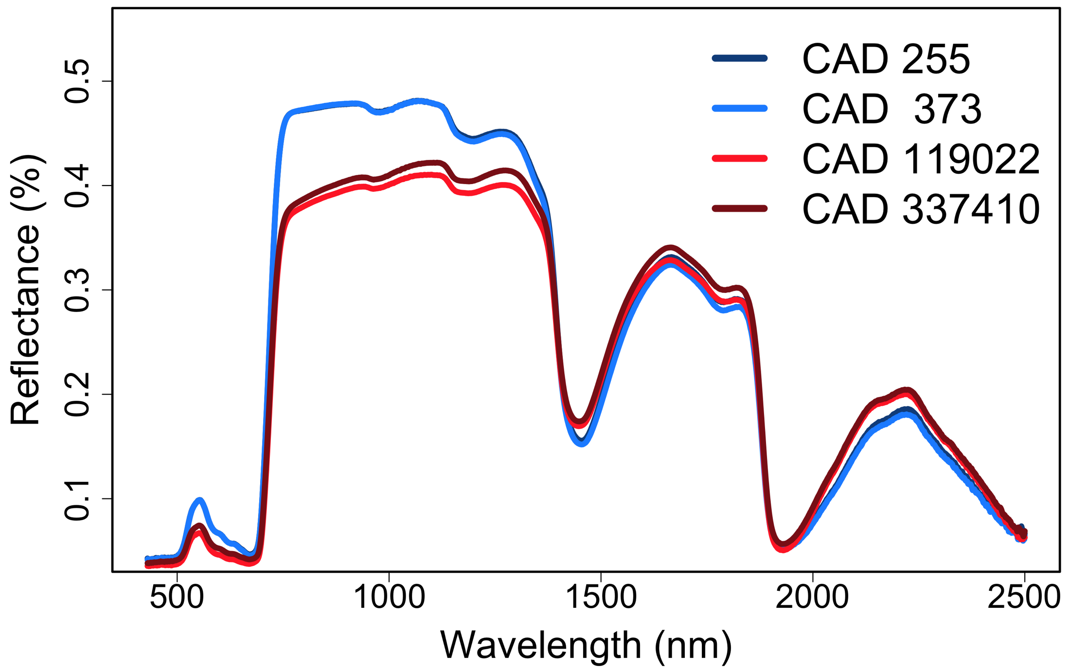
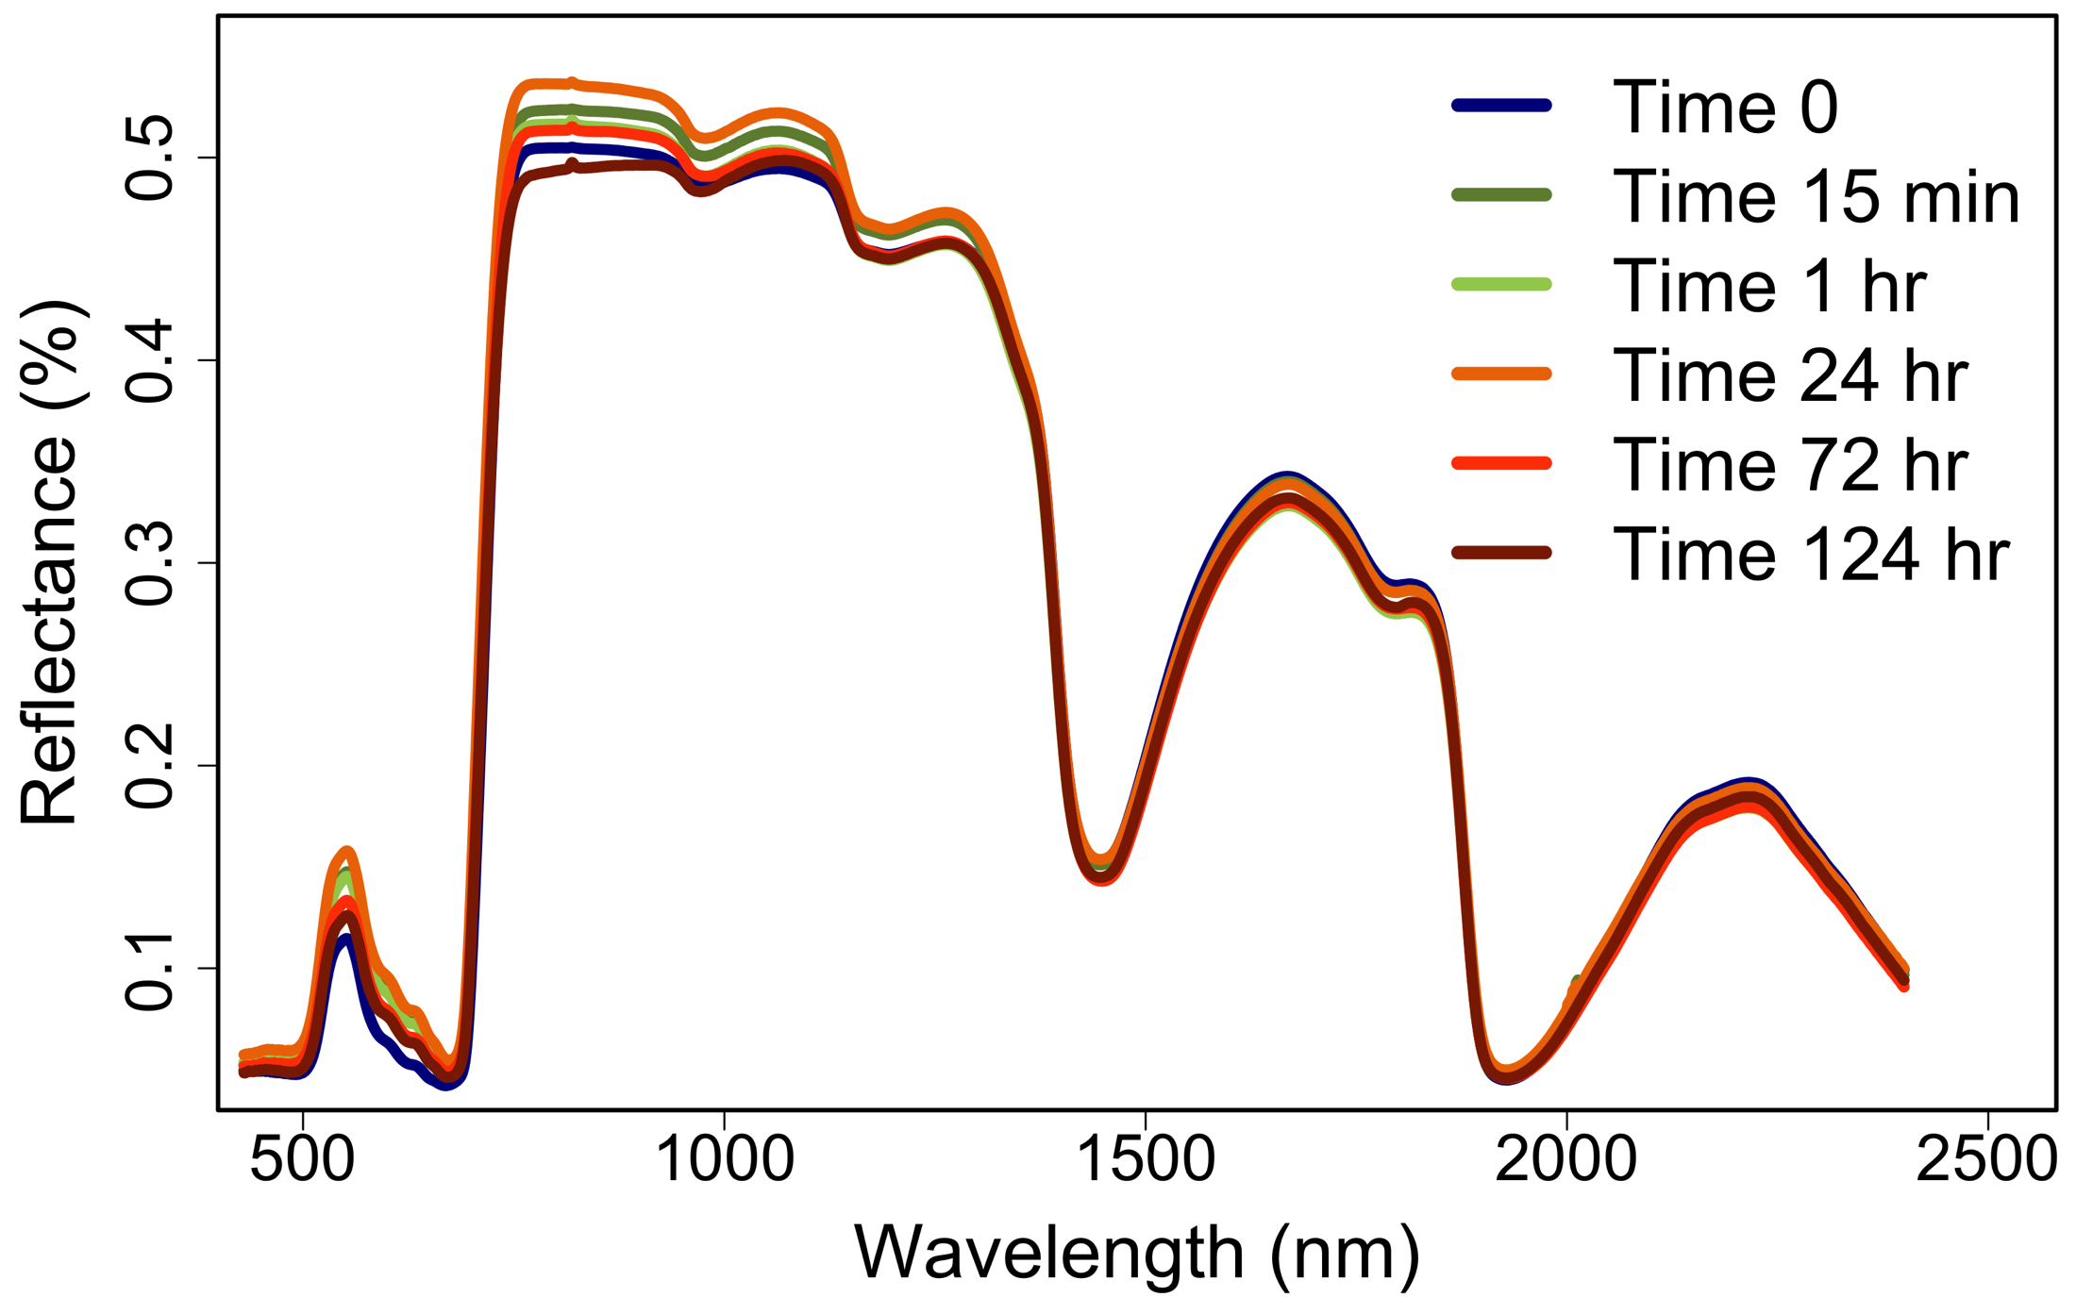
Genotypes of aspen.
Different reflectance.
Different chemistry.
Soybeans: same variety, different levels of pest pressure.
Milkweed.
Rapidly induced chemical defenses to perturbations.
Notes:
Spectral information can be about the traits associated with foliage.

Slide 6
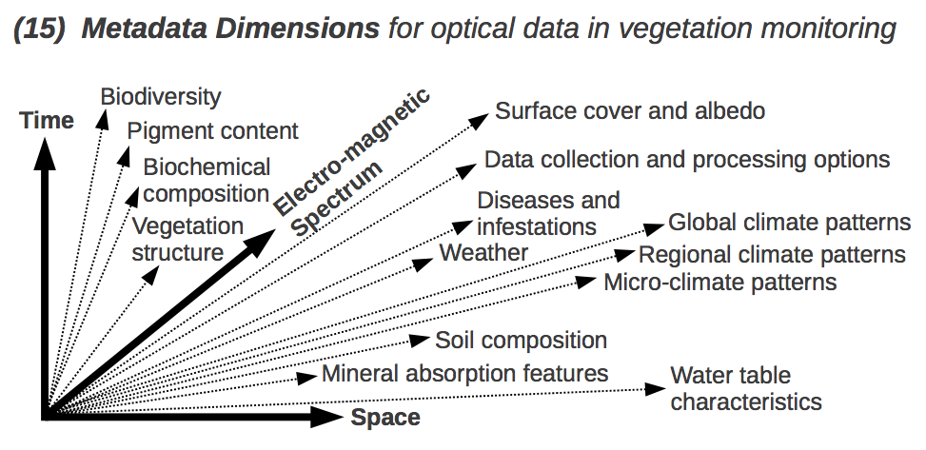
Spectral data serve as “proxy” measurements for all ranges of underlying properties and functions in ecosystems that are costly, impractical, inconvenient or impossible to otherwise characterize at broad spatial and temporal scales.
Plant stress and mitigation
G. Pastorello and J. Gamon

Slide 7
EcoSIS
Deliverable
EcoSIS Activities
(lead institutions)
EcoSIS Outcomes
(via community engagement)
Develop Database Back-End
(UC-Davis, JPL)
Accommodation of Legacy and New Data Sets
EcoSIS Public Database
Develop EcoSIS User Interface
(UC-Davis, JPL, UW)
Spectral Library
(0.35-13.0 μm)
Evolution of Open-source Tools for Discovery & Analysis
Metadata Standards
(UW, NEON, Alberta, UNL)
Metadata
Best Practices
(UCSB, NEON, Alberta, UNL)
Synthesis Studies &
Meta-Analyses
Associated measurements
(species, chemistry, etc.)
Populate EcoSIS
(all members, coordinated by UW)
EcoSIS Tools (Open Source)
Development of a Broader EcoSIS User Community
QAQC, Error Assessment
(UW, JPL)
Visualization, Query, Discovery
Growth of EcoSIS to Reflect Evolving Science Needs
EcoSIS Tools
(UW, Alberta, community)
Notes:
Art Z suggests adding User Support and Consulting under EcoSIS outcomes.

Slide 8
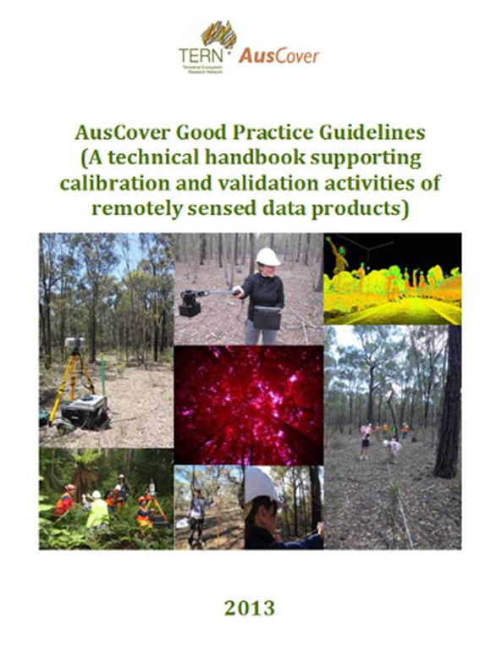
International linkages are important:
c/o Andy Hueni
Moving Forward:
Community participation is essential:
Decision-making open process
Review/oversight committee
Your data contributions to EcoSIS
Open source data and tools
Virtual meetings, side meetings at AGU, etc.
join-ecosis-community@lists.wisc.edu
Notes:
Art Z suggests adding “User Support and Quality Control” in the bar under data ingestion.

