Slide 1
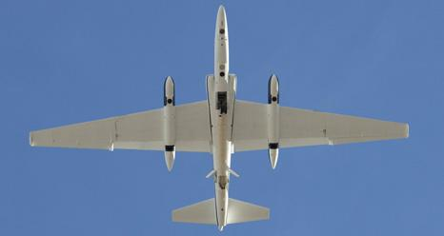
New and existing airborne measurement capabilities for NASA Terrestrial Ecology
Dar. A. Roberts
UC Santa Barbara
ER-2: http://airbornescience.nasa.gov/

Slide 2
Recent Developments in Airborne Assets
VNIR/VSWIR Imaging Spectrometers
  Portable Remote Imaging SpectroMeter (PRISM)
  AVIRIS-Next Generation (AVIRIS-NG)
Thermal IR Imaging Spectrometers
  Hyperspectral Thermal Emission Spectrometer (HYTES)
VSWIR FTIS Spectrometers
  Carbon in Arctic Reservoirs Vulnerability Experiment (CARVE)
Waveform LIDAR
  LVIS Global Hawk (LVIS-GH)
Microwave
  UAVSAR Global Hawk
  Airborne Microwave Observatory of Subcanopy and Subsurface (AirMOSS)
  EcoSAR
Sensor Fusion
  Goddard’s Light, Hyperspectral, and Thermal Airborne Imager (G-LiHT)

Slide 3
Broad Utility in Terrestrial Ecology
VNIR/VSWIR Imaging Spectrometers
  Biochemistry, Biophysical retrievals, Species/Functional Type Identification, Plant Physiology, Trace Gases
Thermal IR Imaging Spectrometers
  Land-Surface Temperature, Biochemistry, Plant Physiology, Heat Flux (ET/Sensible Heat), Trace Gases
VSWIR FTIS Spectrometers
  Trace Gases (i.e., CO₂, CH₄, CO, H₂O)
Waveform LIDAR
  Vertical Canopy Structure, Surface Elevation, Above Ground Biomass
Microwave
  Root Zone Soil Moisture, Vertical Canopy Structure, Above Ground Biomass
  All weather imaging, flooded vegetation, freeze/thaw-status of soils
G-LiHT
  Biochemical, temperature and canopy structure benefits of a VNIR imaging spectrometer, thermal imager and discrete return Lidar

Slide 4
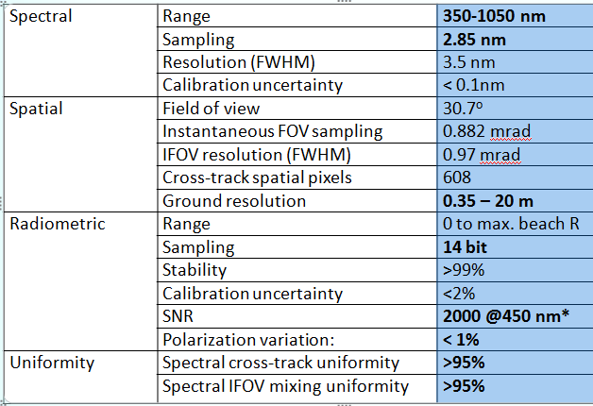
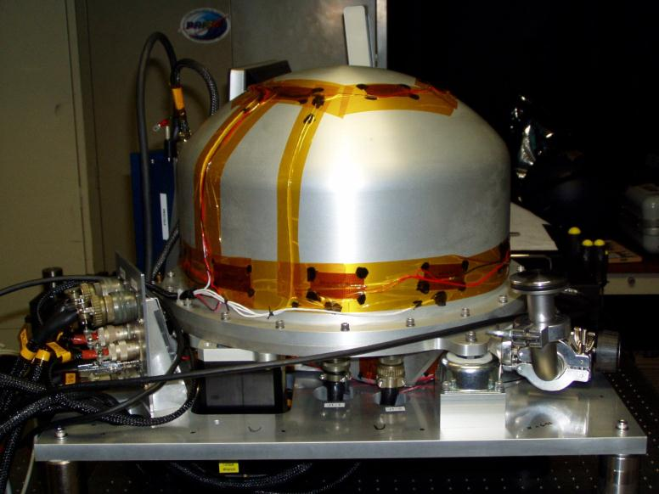
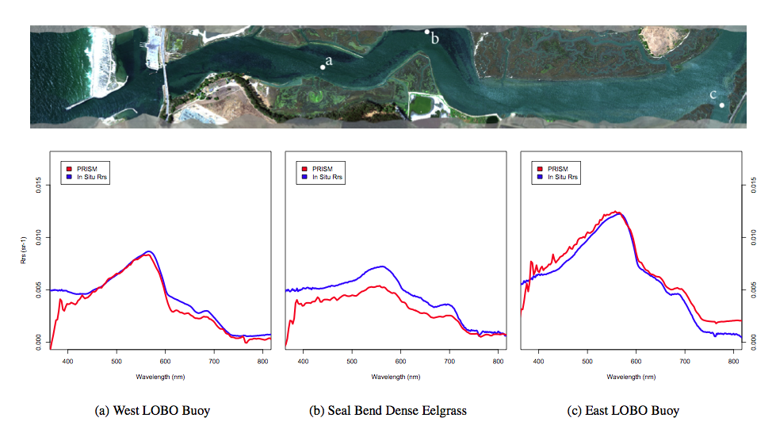

Portable Remote Imaging SpectroMeter (PRISM): NASA Coastal Applications
22”
Built in 2012 by NASA JPL funded by NASA Ocean Biology and Biogeochemistry to address challenges of coastal remote sensing. Integrated on Twin Otter Platform.
Contributor: Heidi Dierssen
Dierssen: PRISM Validation

Slide 5
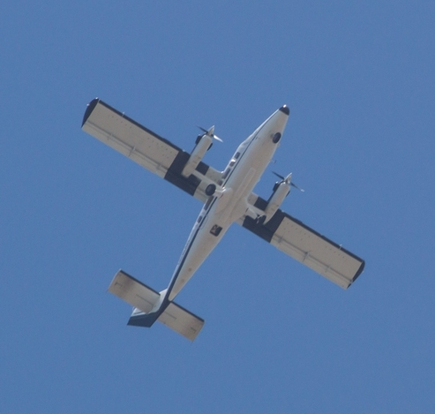
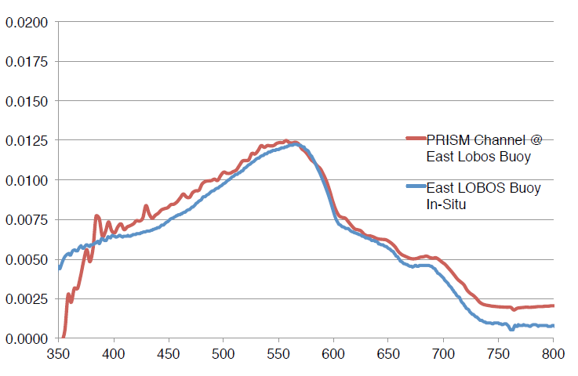
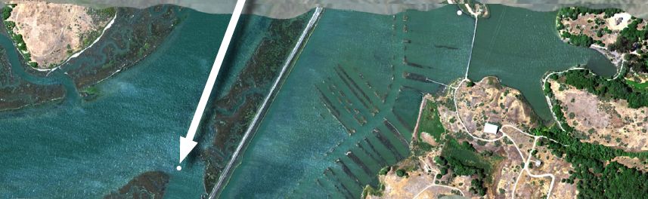
PRISM Field Validation
First PRISM overflight
July 17-28 2012
Initial atmospheric and glint correction shows data highly consistent with field measurements
Remote Sensing Reflectance
East Lobos Buoy

Slide 6
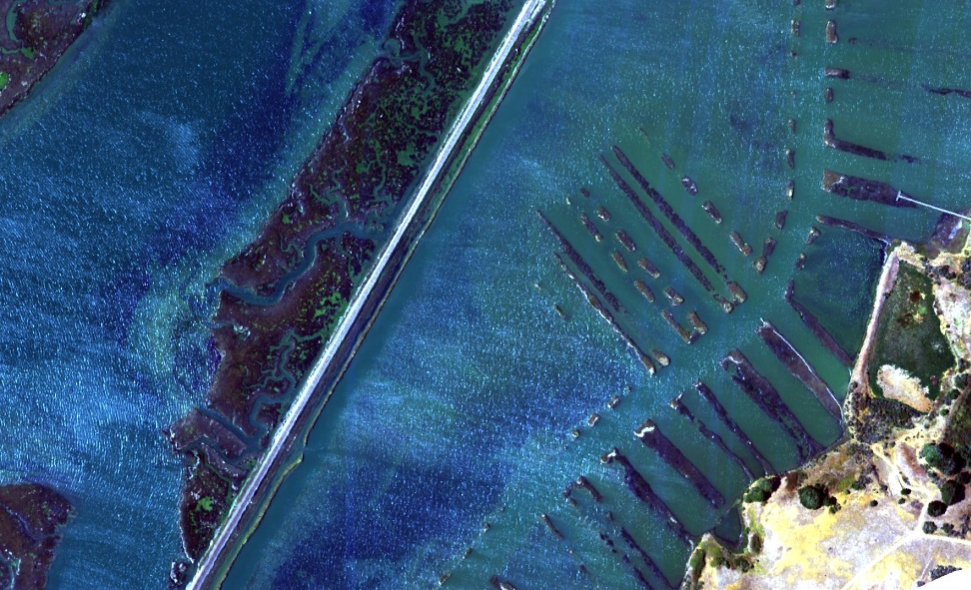
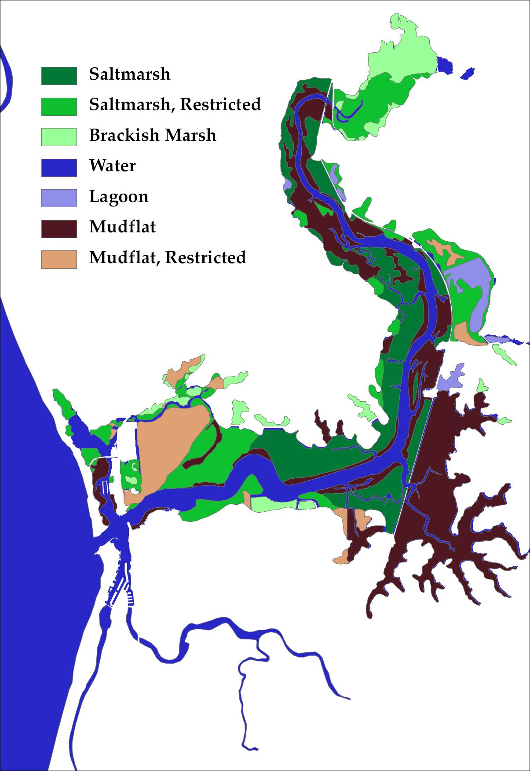
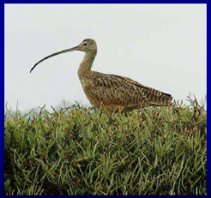
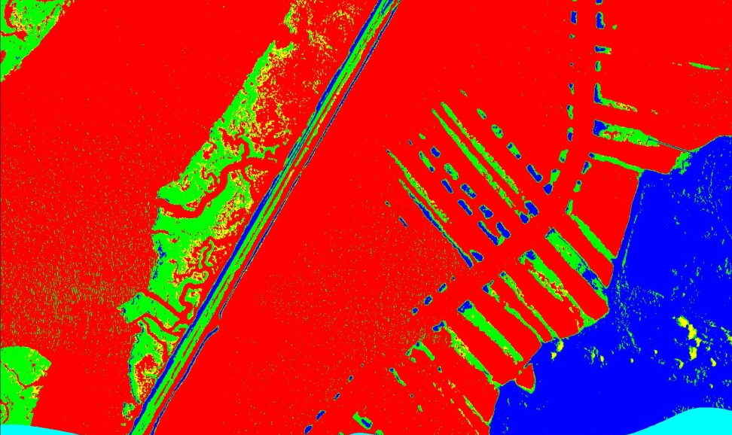
PRISM Science: Mapping Coastal Habitats Salt Marsh Restoration
Elkhorn Slough, CA
PRISM Imagery
Prelim. Classification,
Green= salt marsh
PRISM quantifies marsh growth in response to restoration efforts
Notes:
Elkhorn Slough is a nationally important natural resource that is facing unprecedented rates of tidal marsh loss and impairments to tidal creeks, mudflats, and channel habitats. The marsh habitats that took thousands of years to develop in the Slough are being lost in decades. In fact, approximately 50 percent of the tidal marsh in Elkhorn Slough has been lost in the past 70 years. These rapid changes not only affect the Slough’s animals and plants, but also impact neighboring private lands, public access sites, and transportation infrastructure.
Elkhorn Slough provides:
• critical habitat for over 200 bird, marine mammal, and fish species, including some that are threatened or endangered
• hundreds of acres of wetlands that act as buffers to minimize shoreline erosion and improve water
After four years of work and input from more than one hundred scientists, specialists, and lawmakers, the Parsons Slough Project is complete. This project, funded through the American Recovery and Reinvestment Act and managed by the Tidal Wetland Project—a joint effort between the Elkhorn Slough National Estuarine Research Reserve (ESNERR), was the most efficient and lowest risk approach to reducing erosion and wetland loss in Elkhorn Slough.
The construction of an underwater sill – 200 feet wide, 10 to 15 feet tall and five feet under water – started on November 10, 2010 and was completed on time in February of this year. The sill acts as an underwater barrier to slow the flow of the tide and reduce erosion. The finishing touches – repaving the staging area at Kirby Park and leaving behind a dock for public use – were completed in early May.
http://www.elkhornslough.org/tidalwetland/parsons.htm

Slide 7

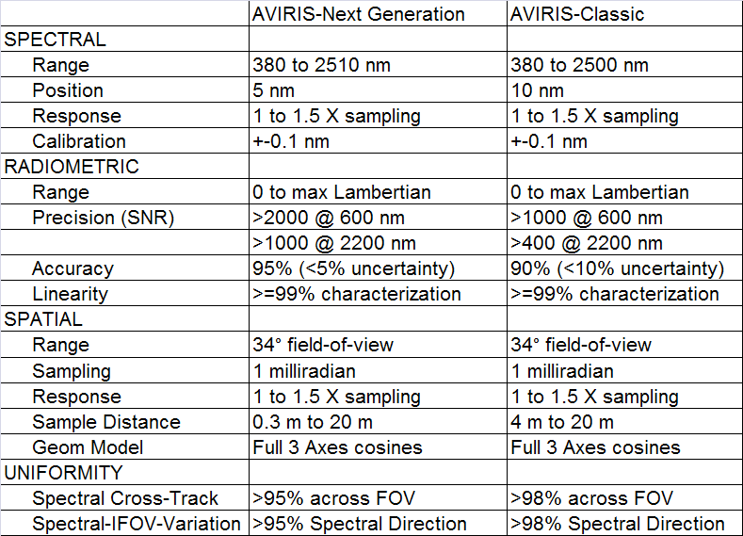
AVIRIS Next Generation Compared to AVIRIS Classic
 | AVIRIS-Next Generation | AVIRIS-Classic
 | 380 to 2510 nm | 380 to 2500 nm
 | 5 nm | 10 nm
 | 1 to 1.5 X sampling | 1 to 1.5 X sampling
 | +-0.1 nm | +-0.1 nm
 | 0 to max Lambertian | 0 to max Lambertian
 | >2000 @ 600 nm | >1000 @ 600 nm
 | >1000 @ 2200 nm | >400 @ 2200 nm
 | 95% (<5% uncertainty) | 90% (<10% uncertainty)
 | >=99% characterization | >=99% characterization
 | 34° field-of-vie | 34° field-of-view
 | 1 milliradian | 1 milliradian
 | 1 to 1.5 X sampling | 1 to 1.5 X sampling
Sample Distance | 0.3 m to 20 m | 4 m to 20 m
 | Full 3 Axes cosines | Full 3 Axes cosines
 | >95% across FOV | >98% across FOV
 | >95% Spectral Direction | >98% Spectral Direction
Contributor: Robert Green

Slide 8
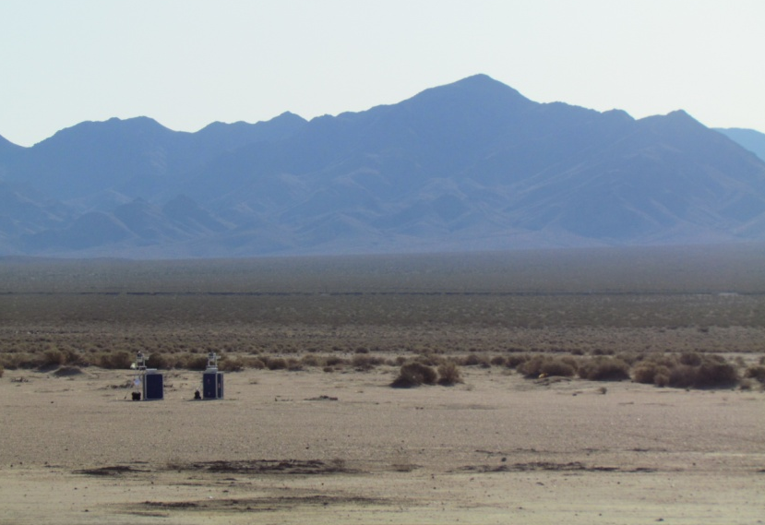
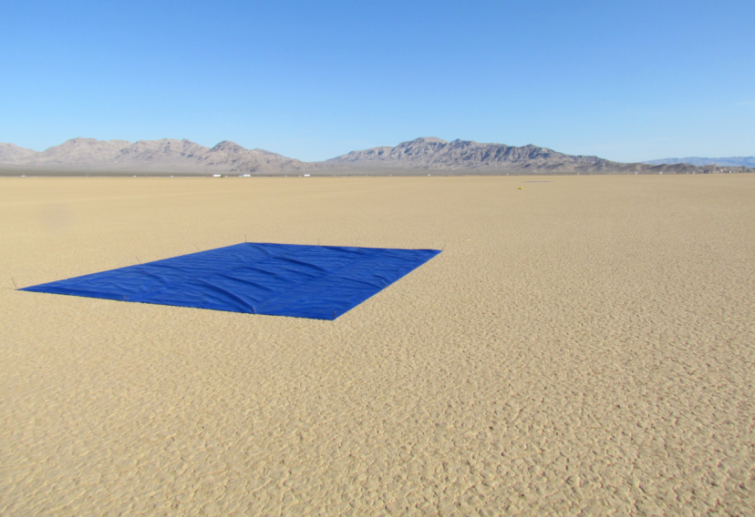
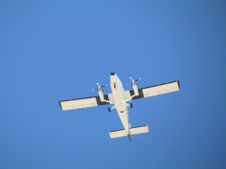
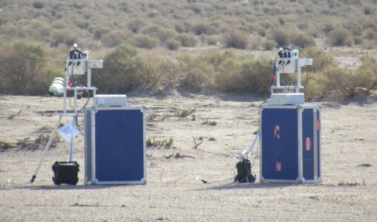
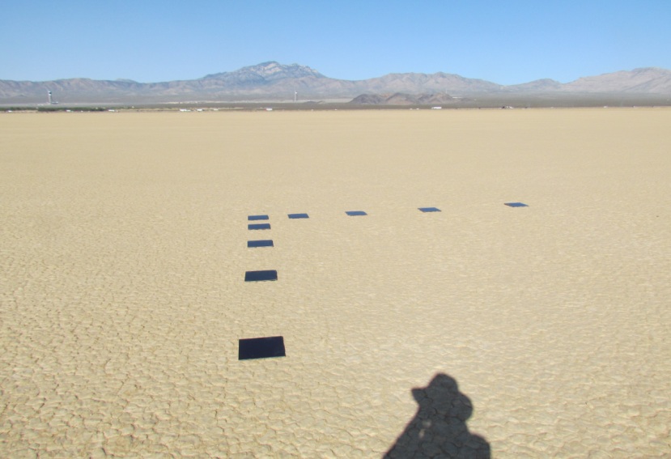
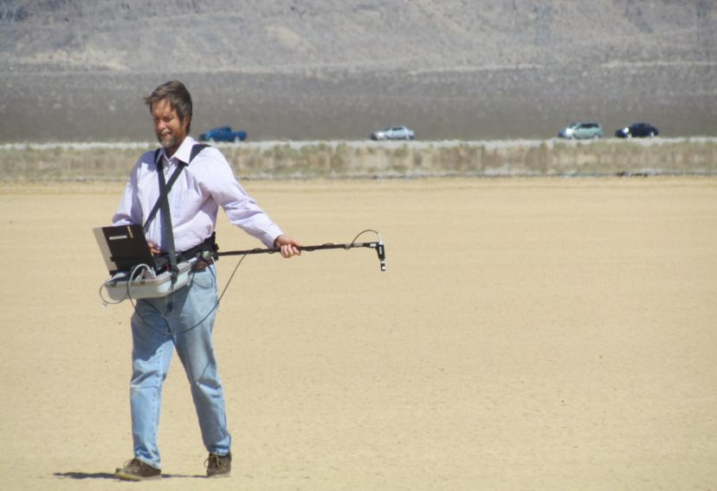
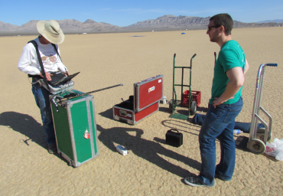
AVIRIS-NG Calibration Validation
Ivanpah Playa Calibration Site 2012

Slide 9
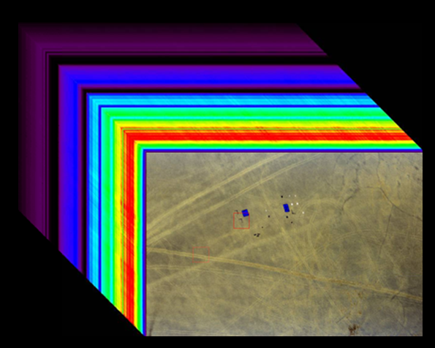
AVIRIS-NG Cube 427 Spectral Channels

Slide 10
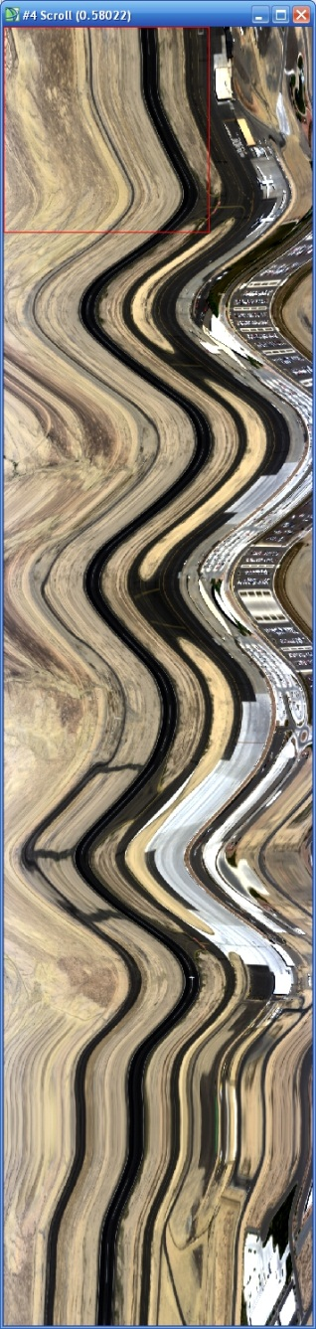
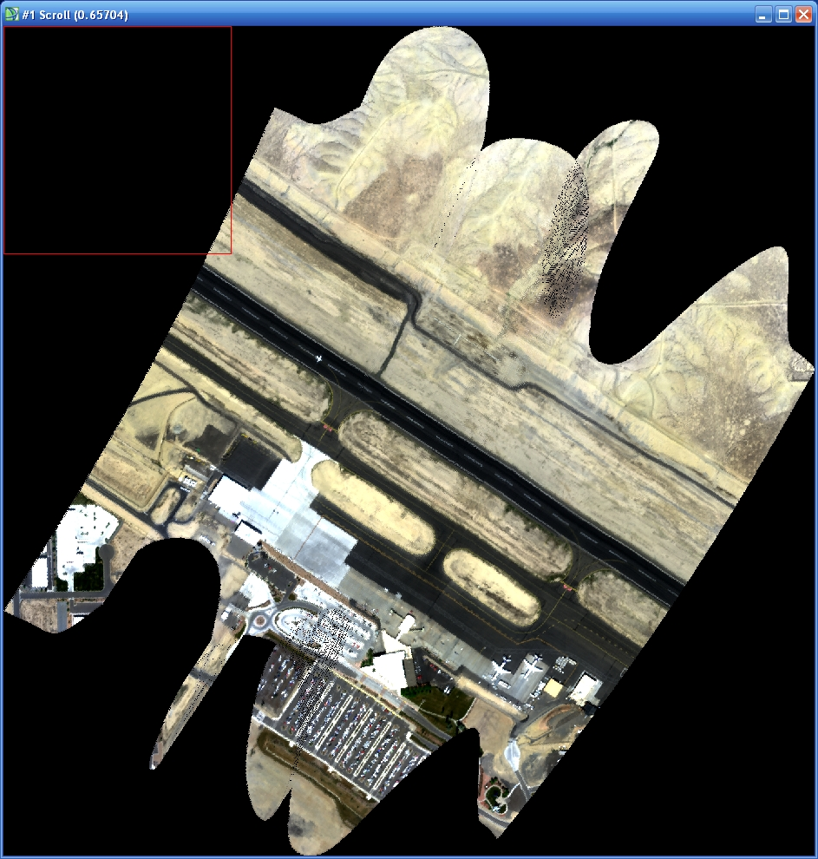
AVIRIS-NG Orthorectification Test
Raw Data
AVIRIS-NG Orthorectified
Successful
Orthorectification

Slide 11
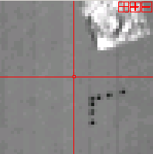
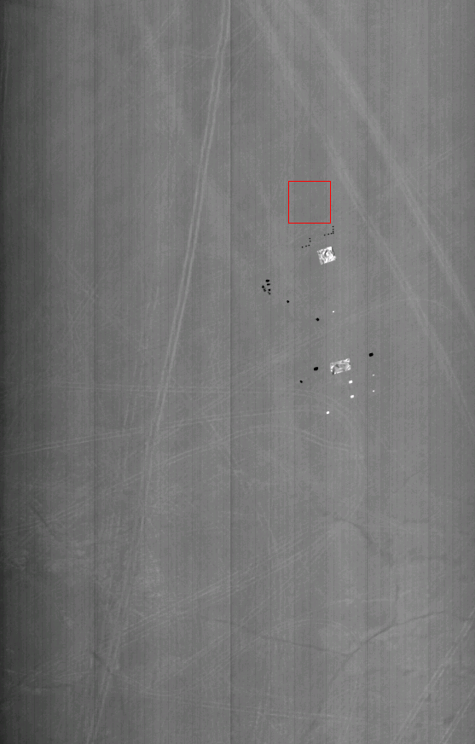
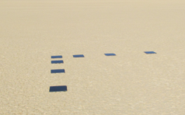
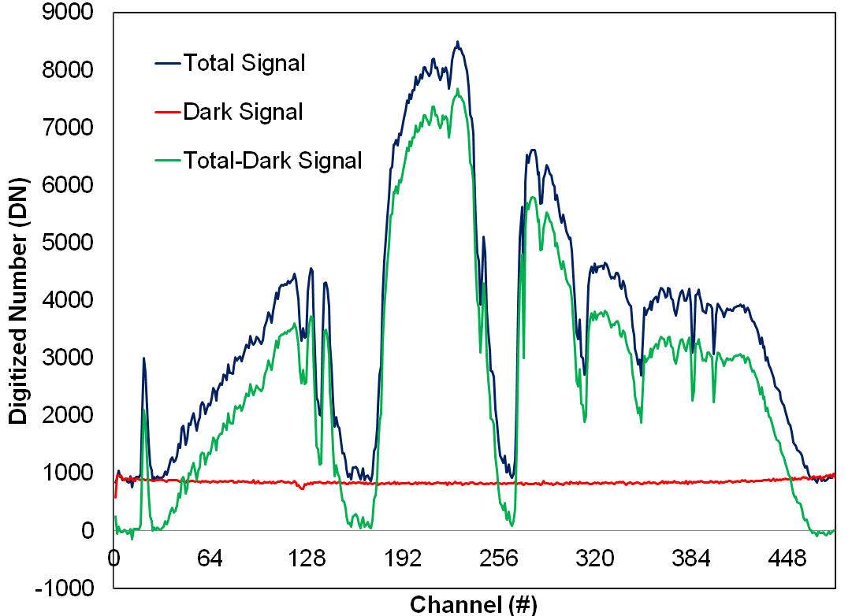
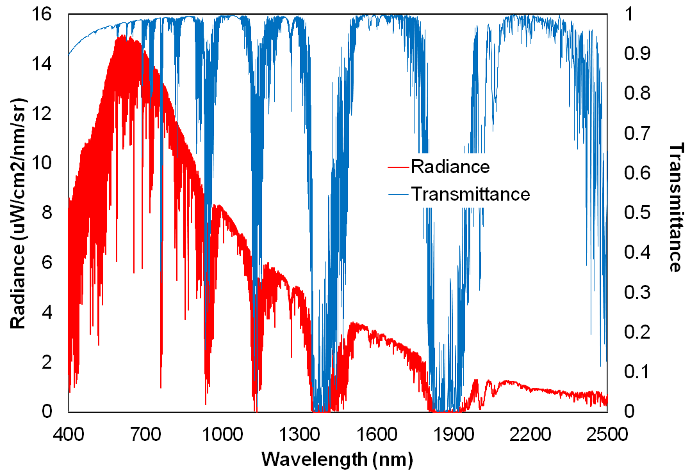
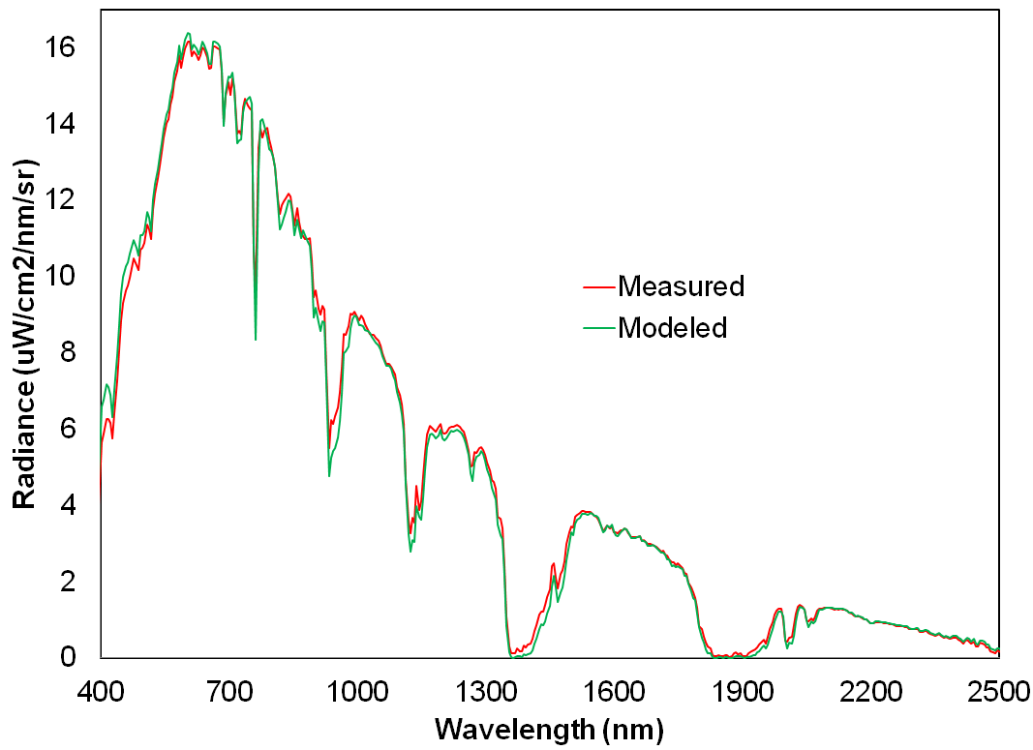
AVIRIS-NG Calibration Validation Experiment Results
30 cm tiles

Slide 12
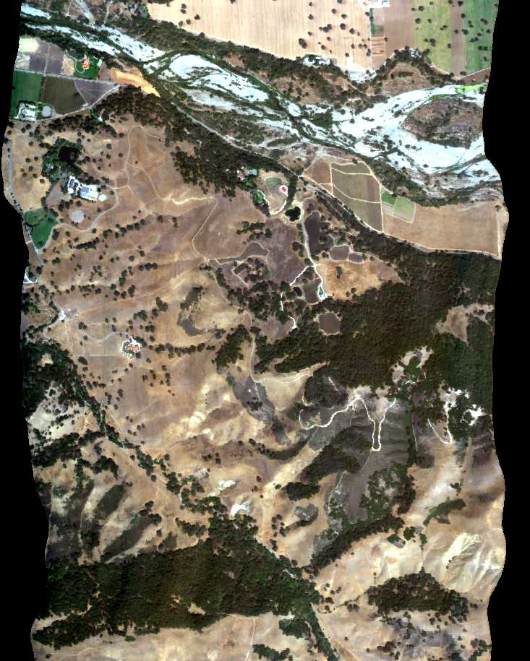
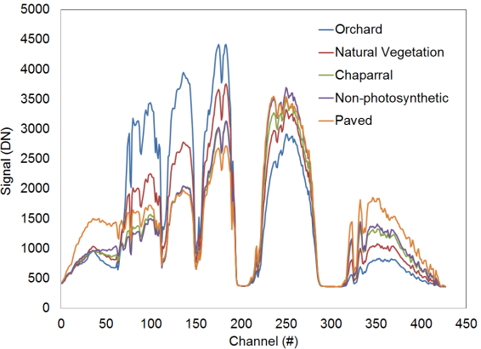
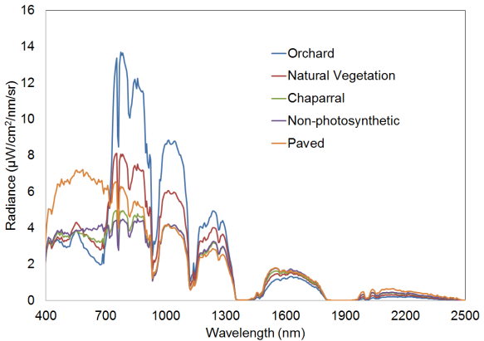
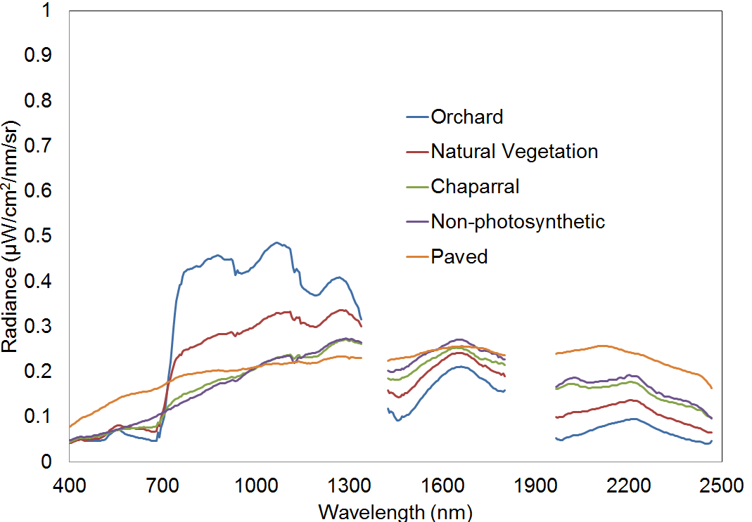
AVIRIS-NG Measurements Near Santa Barbara, California 120901

Slide 13
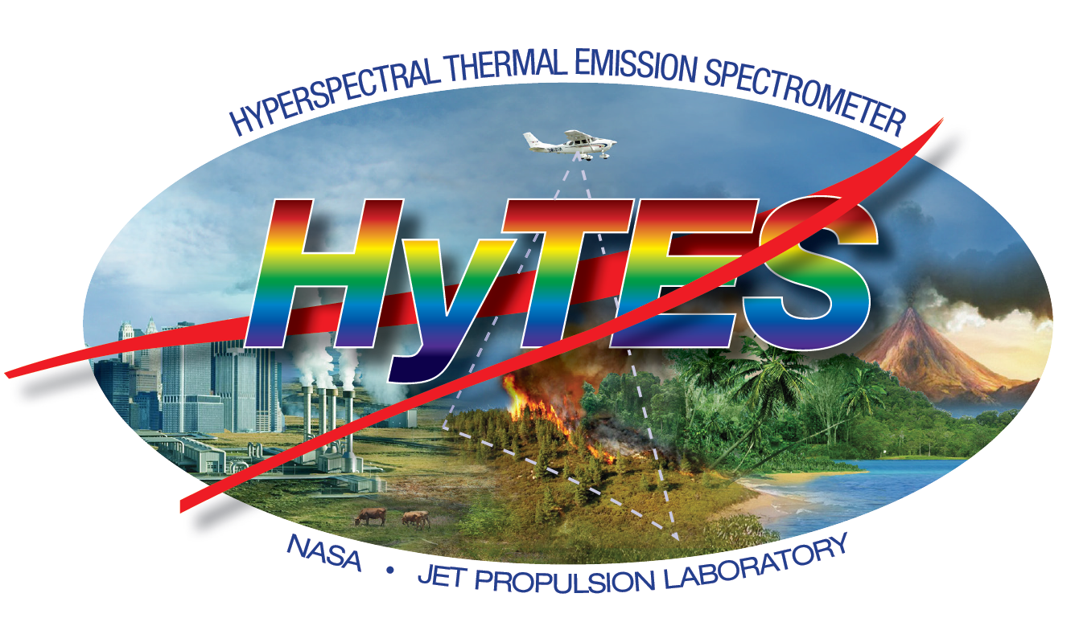
Contributor: Simon Hook
© 2013 California Institute of Technology. Government sponsorship acknowledged.

Slide 14

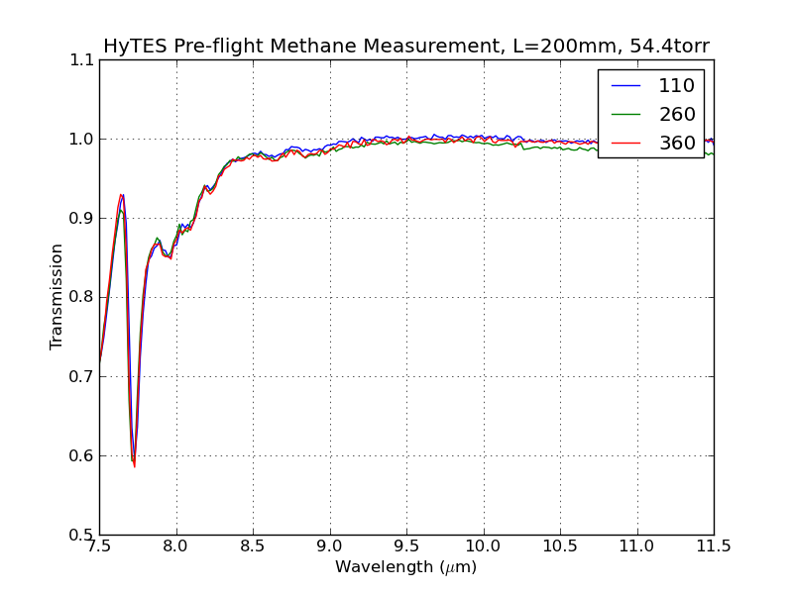
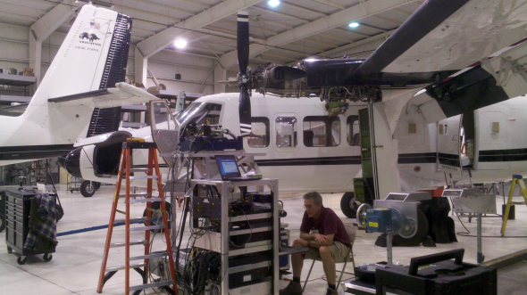
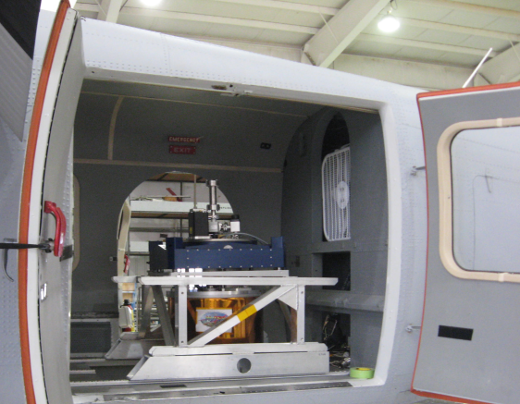
HyTES Sensor Attributes
Hangar measurements with HyTES in the Twin Otter
Instrument Characteristic | HyTES
Mass (Scanhead)¹ | 12kg
Power | 400W
Volume | 1m x 0.5m (Cylinder)
Number of pixels x track | 512
Number of bands | 256
Spectral Range | 7.5-12 µm
Frame speed | 35 or 22 fps
Integration time (1 scanline) | 28 or 45 ms
Total Field of View | 50 degrees
Calibration (preflight) | Full aperture blackbody
Detector Temperature | 40K
Spectrometer Temperature | 100K
Slit Length and Width | 20 mm x 39 μm
IFOV | 1.7066
Pixel Size/Swath at 2000 m flight altitude² | 3.41m/1868.33m
Pixel Size/Swath at 20,000 m flight altitude² | 34.13m/18683.31m
Methane

Slide 15
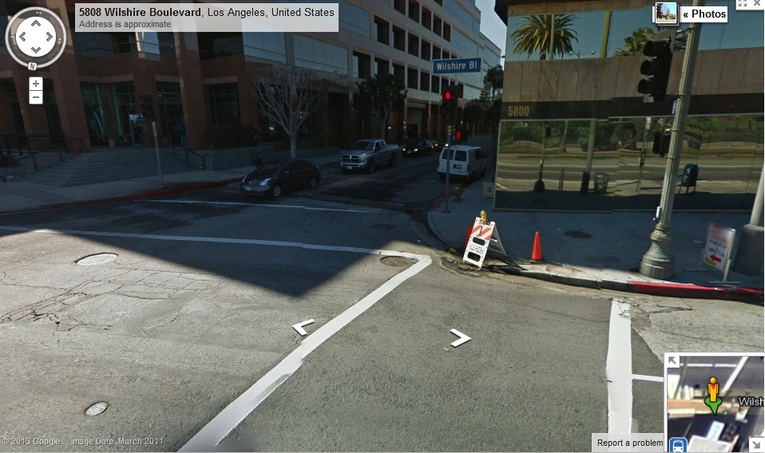
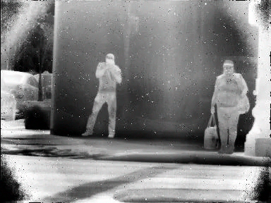
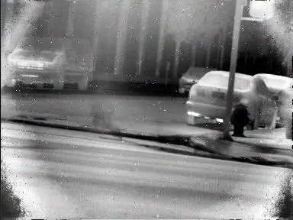
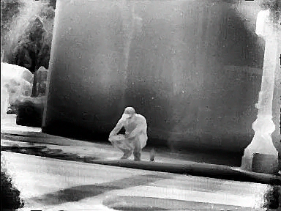
Map of sources (short video clips embedded) – Courtesy Riley Duren JPL
#3
#1
#2
Max emission
There’s a mix of emission and absorption seen in the videos.
Moderate emission

Slide 16
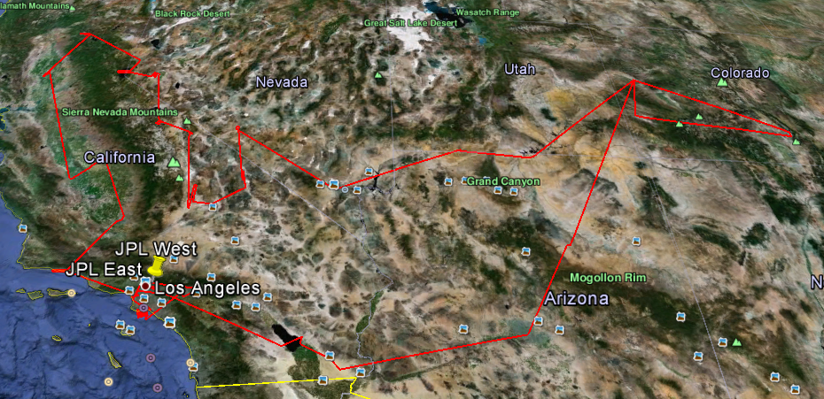
First Science Campaign May 2013
Objectives
  Acquire data from a range of targets for evaluation in various disciplines: Solid Earth, Ecosystems, Atmospheric composition
  Evaluate upgrades made to instrument after previous engineering campaign
  Evaluate whether current detector has sufficient sensitivity to detect enhanced methane emissions
HyTES first science flights are underway.
Parameter | Value
Duration | 7 days
Hours | 40 hours
Area | Southwest USA
Aircraft | Twin Otter (Commercial) – Grand Junction Co
Sitename | Purpose
La Brea Tarpits | Urban/Methane
Salton Sea | Calibration/Ammonia
Huntington Gardens | Ecosystems
Cuprite | Surface Composition
Death Valley | Surface Composition
Navajo Generating Station | Sulfur dioxide

Slide 17
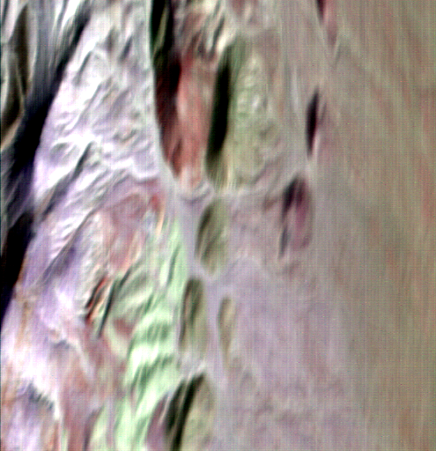
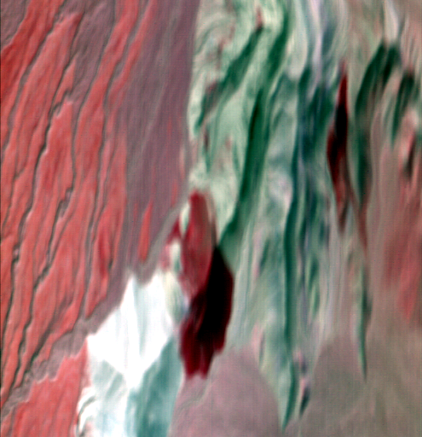
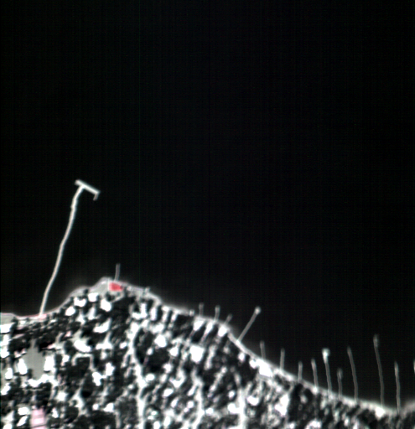
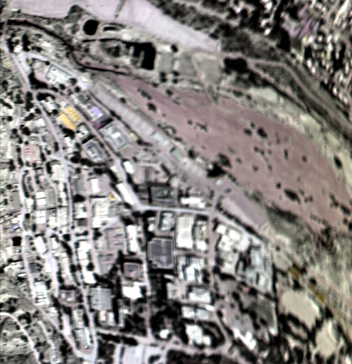
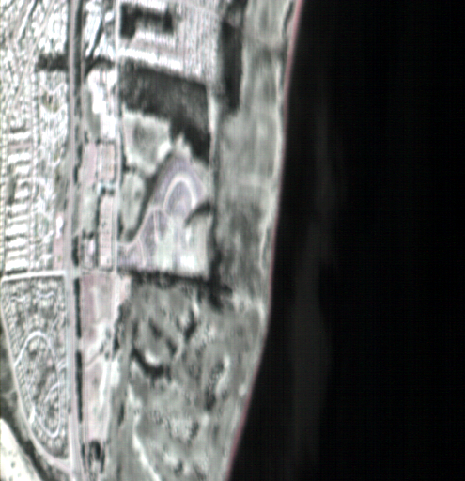
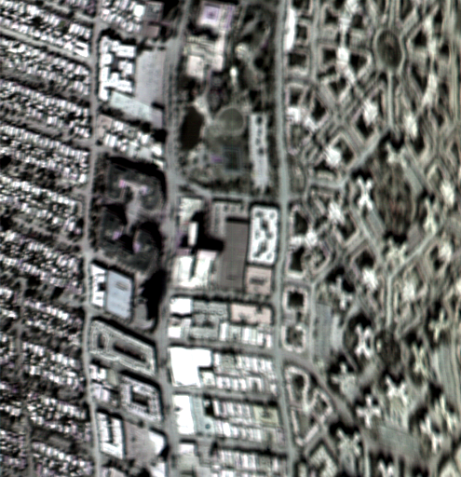
April 2013 Campaign Snapshots
Cuprite, NV
Death Valley, CA
Lake Tahoe, CA/NV
Calibration
Geology
Geology
NASA/JPL, CA
Santa Barbara, CA
La Brea, CA
Urban
Methane
Methane
bands 150 (10.08 µm), 100 (9.17 µm), 58 (8.41 µm), 58 displayed at RGB each image is 485 x 512 pixels

Slide 18

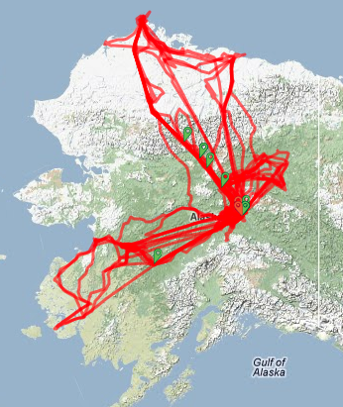
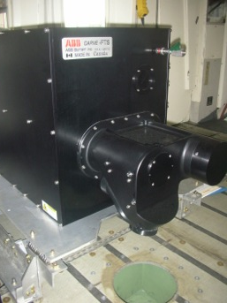
CARVE FTS: Column CO₂, CH₄, CO and Chlorophyll Fluorescence
MAY-OCT
2012
CARVE FTS mounted in the C-23
CARVE 2012 Flight Tracks
  Carbon in Arctic Reservoirs Vulnerability Experiment (CARVE)
Contributor: Charles Miller
Notes:
CO2 levels can be compared/contrasted to Chlorophyll Fluorescence to determine the relative contributions of photosynthesis vs respiration in the net CO2 signal
CH4 used to determine anaerobic respiration from permafrost soils
CO used to distinguish combustion sources – both natural (biomass burning) and anthropogenic (pollution)
CO2+CH4+CO crucial for developing accurate Cemissions inventories from boreal fires

Slide 19
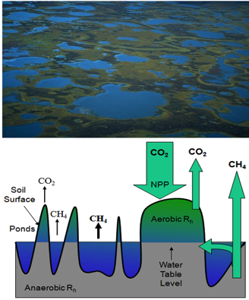
CARVE Characterizes C Flow in
Vulnerable Arctic-Boreal Ecosystems
What are the sensitivities of the Alaskan Arctic carbon cycle and ecosystems to climate change?
How does interannual variability in surface controls (e.g., soil moisture) affect landscape-scale atmospheric concentrations and surface-atmosphere fluxes of CO₂ and CH₄ in the Alaskan Arctic?
What are the impacts of fire and thawing permafrost on the Alaskan Arctic carbon cycle and ecosystems?
A mosaic of wet and dry areas is common for regions in the Arctic. Microtopography dictates the partitioning of soil respiration into aerobic processes (CO₂ release) and anaerobic processes (CH₄ release). The partitioning of carbon fluxes from Arctic ecosystems is not known accurately.

Slide 20
Hypotheses Test the
Key Unanswered Science Questions
Each CARVE Science Question is associated with a hypothesis that will be tested by CARVE measurements and analyses.
H1: There exist early warning signatures that identify the tipping point for rapid release of vulnerable Arctic soil C reservoirs into the atmosphere.
H2: Local surface-atmosphere fluxes of CO₂ (or CH₄) correlate with coincident surface controls or atmospheric concentrations of CO₂ (or CH₄).
H3: Fires in boreal forests or tundra will accelerate permafrost thaw, mobilizing vulnerable C reservoirs into dynamic carbon cycling and increasing the seasonal amplitude of high latitude atmospheric CO₂ concentrations.
Distribution of fire burn areas and recovery zones in the Alaskan interior [Lyons et al. 2008]. Ecosystem recovery times >50 years have been monitored; however, the impact recovery has on CO₂ and CH₄ fluxes is unquantified.
Notes:
Scientific method: Formulate hypotheses to test our science questions
Make measurements
Analyze and refine theories/questions
Repeat as necessary until convergence (acceptable uncertainty levels)

Slide 21





2013 CARVE FTS Results
Innoko Wilderness-Bethel AK 4/6/13
T. Kurosu
Notes:
Example of data from a single flight day. Accumulated data over each region/month allows for the construction of regional C flux estimates

Slide 22


Regional Surface Mapping:
LVIS-GH Capabilities,
Development Status, and
Plan for Demonstration Flights
Bryan Blair
NASA/GSFC
Laser Remote Sensing Laboratory

Slide 23




NASA’s Land, Vegetation and Ice Sensor on the Global Hawk (LVIS-GH)
Multi-year effort to replicate NASA’s LVIS sensor
for operation on the Global Hawk UAV
at 65,000’ altitude for up 30 hrs.
LVIS-GH vs LVIS*:
Records full transmit and receive waveforms
Wider swath (4 km vs. 2 km)
Smaller footprints (15 m vs. 20 m)
Better vertical resolution
Wider dynamic range (3 detector receiver,
adds 100X more dynamic range,
no saturation)
Higher altitude and longer flight duration of
Global Hawk UAV provides tremendous coverage:
  2,400 km²/hour for up to 28 hours (Global Hawk)
  Compared to 1,000 km²/hour for 10 hours (G-V),
  or 700 km²/hour for 4 hours (KingAir B-200)

Slide 24


NASA’s Land, Vegetation and Ice Sensor on the Global Hawk (LVIS-GH)
Full-waveform, highly-sensitive swath-mapping laser altimeter
Maps ground topography, canopy height and vertical structure profile for estimating Biomass and quantifying changes in structure, for example.
~1 m horizontal location accuracy
Current status:
  Instrument complete
  Environmental testing complete
  Installation, compatibility testing (with UAVSAR), and test flights in May
  Potential science flight to Canada/Canadian Arctic in June
(Image to the right: Ground elevation (left) and Vertical Extent (right) collected by LVIS over Central Maryland)

Slide 25




UAVSAR: Global Hawk Payload Bay 25 Configuration
L-band GH Configuration:
Flight demonstration in May 2013
Provide POLSAR data from the Long Range, High Endurance Global Hawk Uninhabited Aerial Vehicle (UAV).
Provide long range (~ 9000 nmi) to enable data collection of distant areas of interest without complicated deployments.
Provide long term persistent observations of major events like earthquakes and volcanoes.
antenna
custom pallet
radar electronics
Radar backend electronics are mounted upside down to the custom pallet
L-band antenna frame
Custom pallet
Contributor: Bruce Chapman

Slide 26



AirMOSS
NASA Gulfstream-III
P-band antenna
Ultra-high frequency P-band SAR, fully polarimetric
Frequency range: 280-440 MHz band capability, 80 MHz total bandwidth, currently transmits 420-440 MHz band
Resolution
  Imagery: 0.5 – 3.0 arcsec
  L2/3-Root Zone Soil Moisture (RZSM) products: 3 arcsec
  L4-RZSM and L4-NEE products: 3-30 arcsec
Contributor: Mahta Moghaddam

Slide 27
AirMOSS Questions and Objectives
  Questions:
What are the local-, regional-, and continental-scale heterogeneities of root-zone soil moisture (RZSM) in North America?
How does RZSM control ecosystem carbon fluxes at each of these scales?
By how much will the estimates of North American net ecosystem exchange (NEE) improve with the accurate knowledge of both the mean and the variance of RZSM?
Objective: new NEE estimate for North America with reduced uncertainty
Provide high-resolution observations of RZSM over regions representative of the major North American biomes
Quantify the impact of RZSM on the estimation of regional carbon fluxes
Upscale the reduced-uncertainty estimates of regional carbon fluxes to the continental scale of North America

Slide 28










North American Biomes to Cover
Biome IV
Biome I
Biome III
Biome II
Biome VI
Biome V
Biome IX
Biome VII
Biome VIII
4/30/13
28

Slide 29




Sample Images: Walnut Gulch
Area of roughly 25 km x 100 km covered by 6 flight lines (3 shown at left)
9/20/2012
HH/HV/VV RGB overlay

Slide 30




Walnut Gulch Retrieved Soil Moisture
9/20/2012
Surface soil moisture
soil moisture @ -10 cm
soil moisture @ -30 cm
soil moisture @ -75 cm
Tabatabaeenejad, Burgin, Duan, Moghaddam

Slide 31


EcoSAR P-band InSAR
EcoSAR is an advanced airborne polarimetric and interferometric P-band (435 MHz, 6 to 200 MHz bandwidth) SAR instrument in development at NASA/Goddard Space Flight Center through the ESTO Instrument Incubator Program (IIP).
  EcoSAR will provide two- and three dimensional fine scale measurements of terrestrial ecosystem structure and biomass:
    Height measurements from InSAR better than 1 m
    Ground resolution ranges from 1.5m to 30m
    Swath width of 4km to 8 km
    Biomass from backscatter in medium to high biomass forests up to 200 Mg/ha
    Biomass from tree height with no saturation
Contributor: Temilola Fatoyinbo

Slide 32






DBSAR Digital Beamforming SAR
The EcoSAR design is based on the L-band DBSAR instrument, which is a reconfigurable circular pol SAR, scatterometer and altimeter
Carried out DBSAR flights on the East coast in 2011 and 2012 as part of the Eco3D flight campaign
1
2
3
H H
V V
H V
V H
4
5
6
7
8
DBSAR SAR data over Howland, Maine
Notes:
DBSAR is an L-band airborne imaging radar system developed at Goddard to formulate, implement and test new radar techniques in support of Earth Science and planetary applications.

Slide 33




Present status
First science campaign to high biomass tropical and mangrove forests in Central America planned in January 2014
We can still add flight hours in Central America.
If you are interested, please contact lola.fatoyinbo@nasa.gov
Siaan Ka’an Biospheric Reserve
Wallops Flight Facility
La Selva
Hot off the presses: Howland Maine and
Duke Forest, North Carolina will be flown this Friday
Osa Peninsula

Slide 34

Goddard’s Lidar, Hyperspectral, and Thermal (G-LiHT) airborne imager
G-LiHT is a portable, airborne imaging system that simultaneously maps the composition, structure, and function of terrestrial ecosystems using:
lidar to provide 3D information about the spatial distribution of canopy elements;
imaging spectroscopy to discern species composition and variations in biophysical variables (e.g., photosynthetic pigments, nutrient and water content); and
thermal measurements to quantify surface temperatures and detect heat and moisture stress.
Contributor: Bruce Cook

Slide 35
G-LiHT Products for Distribution*
1 m spatial resolution and common data formats (LAS, GeoTiFF, BIL, ASCII, KML)
Instrument | L1 | L2 | L3
Oxford RT-4041 GPS-INS 250 Hz measurement rate | Trajectory data (coordinates, roll, pitch, yaw) | Aircraft elevation Aircraft altitude AGL Geographic Look-Up Table (GLT) | Aircraft elevation Aircraft altitude AGL View angle View azimuth
Riegl VQ-480 Scanning Lidar 1550 nm laser discrete returns (≤8 pulse⁻¹) 150 Hz measurement rate | Return data (coordinates, scan angle, return number, apparent reflectance) | Classified return data (ground, non-ground) AGL heights | LiDAR returns (“point clouds”) DTM CHM LiDAR metrics
Headwall Hyperspec Imaging Spectrometer 417 to 1007 nm 402 bands, ≤5 nm FWHM 1004 pixels per line 50 Hz measurement rate | At-sensor radiance spectra (W m⁻² sr⁻¹ nm⁻¹) | At-sensor reflectance computed with observed irradiance Surface reflectance computed with atmospheric correction Fluorescence [experimental] | At-sensor reflectance computed w/observed irradiance Surface reflectance computed w/atmospheric correction Common vegetation indices Fluorescence [experimental]
Ocean Optics USB 4000 Irradiance Spectrometer cosine diffusor 346 to 1041 nm 1.5 nm FWHM 1 Hz measurement rate | Solar irradiance spectra (W m⁻² sr⁻¹ nm⁻¹) | Incoming PAR Cloudiness index Modeled solar zenith angle Modeled solar azimuth angle | Incoming PAR Cloudiness Index Modeled solar zenith angle Modeled solar azimuth angle
Xenics Gobi 384 Thermal Camera 8 to 14 nm 25 Hz measurement rate | Temperature data (ºC) | Atmospherically corrected surface temperature | Atmospherically corrected surface temperature
* Lidar products are currently available at http://gliht.gsfc.nasa.gov

Slide 36

G-LiHT 2011/12 Acquisitions http://gliht.gsfc.nasa.gov
Total data collection area:
6,511 km²
Total number of laser pulses:
39 billion
ICESat-GLAS footprints flown:
43,380
USDA-FS FIA plots flown: 920
Flux tower sites: 6
Stem mapped areas: 120 ha
Plans for 2013 include: LDCM/LS7 cross-calibration; Mexico; Siberia; Florida Everglades

Slide 37

Discussion
How do improved capabilities improve the quality of our current research?
What new science questions can be asked with these capabilities?

Slide 38
Contacts
General Information on Airborne Platforms
  http://airbornescience.nasa.gov/
  Marilyn Vasques (Marilyn.Vasques@nasa.gov)
Specific sensors
  EcoSAR
    Temilola Fatoyinbo : lola.fatoyinbo@nasa.gov
  AirMOSS
    Mahta Moghaddam : mmoghadd@umich.edu
  LVIS/LVIS-GH
    Online access: http://lvis.gsfc.nasa.gov/
    Bryan Blair/Michelle Hofton
    James.B.Blair@nasa.gov, MHofton@umd.edu
  UAVSAR-GH
    Bruce Chapman: bruce.d.chapman@jpl.nasa.gov

