Slide 1
NASA Terrestrial Ecology Program
Diane E. Wickland
Earth Science Division
NASA HQ
April 30, 2013

Slide 2
Top-Level Messages from NASA HQ
Budget: Overall, NASA Earth Science is a priority and we are seeing a fairly stable budget that allows us to continue with our priority activities. We did get some new work in the 2014 President’s budget (Land imaging planning, climate sensors for JPSS, etc.)
Scientific Results: Please keep us informed of major results: publications, data products, major milestones. We need to show progress and productivity on a near-weekly basis.
Community Service: Thank you so much for your service as a peer reviewer. We are so thankful for and appreciative of the work you do and the value you add to our review/selection processes.
→ Thank you!

Slide 3
Goals and Science Questions
Goal: The goal of NASA’s Terrestrial Ecology research is to improve understanding of the structure and function of global terrestrial ecosystems, their interactions with the atmosphere and hydrosphere, and their role in the cycling of the major biogeochemical elements and water.
Primary Science Questions:
How are global ecosystems changing?
How do ecosystems, land cover and biogeochemical cycles respond to and affect global environmental change?
What are the consequences of land cover and land use change for human societies and the sustainability of ecosystems?
How will carbon cycle dynamics and terrestrial and marine ecosystems change in the future?

Slide 4
NASA’s Approach to TE Research
NASA’s approach to investigating global ecosystems and the carbon cycle is broad-based, emphasizing NASA’s unique capabilities and strengths. NASA research:
Focuses on utilizing existing satellite data and developing new capabilities for space-based global observations of carbon stocks, primary productivity, vegetation composition, physiology, phenology, successional processes, biodiversity, and the biophysics of remote sensing these phenomena.
Uses spatial information from remote sensing data to scale up site-based measurements to regional and global scales
Analyzes time series remote sensing data records to document and understand variability and changes over time in ecosystems and carbon cycling
Conducts calibration/validation of satellite data; algorithm development; field campaigns; process investigations; and data analysis/integration/assimilation
Develops and exercises advanced, quantitative carbon and ecosystems models, data assimilation models, and coupled land-ocean-atmosphere models
Demonstrates innovative uses and practical benefits of NASA Earth science data, scientific knowledge, and technology
Develops and demonstrates technologies that enable improved future
capability for the nation

Slide 5
NASA TE Research Cooperation
NASA conducts its ecosystems and carbon cycle research in close coordination with other U.S. agencies, other nations, and relevant international programs. Important cooperation includes:
Close partnerships with other federal agencies (principally USDA, DOE, USGS, NOAA, and NSF), especially for ensuring efficient links to surface measurement networks, process studies, and decision support (coordination is primarily through the USGCRP; IARPC is beginning to play a role)
The Global Carbon Project (GCP) of IGBP, WCRP, IHDP; Future Earth is new on the horizon
The Group on Earth Observations (GEO) Carbon Community of Practice (and GFOI and Forest Carbon Tracking Project) and the U.S. SilvaCarbon program in support Reducing Emissions from Deforestation and Forest Degradation in Developing Countries (REDD+)
The Committee for Earth Observing Satellites (CEOS) and its Carbon Task Force; virtual Constellations for Land Surface Imaging and Atmospheric Composition; and Working Groups on Calibration/Validation and Information Systems
CarbonNA for Canada-Mexico-U.S. cooperation on North American carbon dynamics

Slide 6
Terrestrial Ecology Program: Scope
Goals & Objectives
To improve understanding of the structure and function of global terrestrial ecosystems, their interactions with the atmosphere and hydrosphere, and their role in the cycling of the major biogeochemical elements and water.
remote sensing to observe terrestrial ecosystems/carbon and their responses
field campaigns and related process studies to elucidate ecosystem/carbon cycle function; and
modeling to analyze and predict responses
Missions & Instruments
Systematic: Terra/Aqua MODIS, AVHRR; SNPP/JPSS (VIIRS); Landsat-8
Exploratory: Terra MISR, ASTER, MOPITT; EO-1, OCO-2
Decadal Survey: L-band SAR (aka DESDynI), HyspIRI, SMAP, ICESat-2, ASCENDS, others
Climate Initiative:
Airborne: AVIRIS/AVIRISng; users of lidars and UAVSAR
Funded Research (FY2013 est.: $23.6M)
Terrestrial Ecology R&A: (-$0.8M) $13.1M
Carbon
Ecosystems
Remote Sensing Science
Carbon Cycle Science (+$2.1M TE) $ 1.8M
Terra/Aqua Science $ 3.9M
Suomi NPP Science Team $ 1.4M
Interdisciplinary Science $ 2.6M
Carbon Monitoring System (+tbd) $ 0.8M
Key Interactions
ORNL DAAC, others
Carbon Cycle Interagency Working Group
Interagency Arctic Research Policy Committee
USDA, NSF, DOE, NOAA
GEO Carbon Community of Practice
CEOS Carbon Task Force, Working Groups and Virtual Constellations
CarboNA (Canada and Mexico)

Slide 7
Opportunities and Challenges
Arctic-Boreal Vulnerability Experiment (ABoVE): Terrestrial Ecology Program’s next field campaign (in collaboration with DOE’s NGEE, and hopefully other partners, including Canada)
There is a compelling call out for problem-oriented global change research with strong elements of both social and natural sciences: coupled human-natural systems
Creating and optimizing synergies across Earth science missions, field programs, data collections, basic and applied research.
Every year we learn more about the Earth system using satellite data, yet there is little public appreciation of these accomplishments. We also contradict ourselves and create confusion as we learn more and confront complexity in the tightly coupled, changing Earth system.

Slide 8
Major Issues
Securing the long-term time series observations of land cover, vegetation properties, and fire. Suomi NPP, JPSS, and Landsat-8 are the path forward for most of these. There are many plans yet to be made and issues to address . . .
Filling the gap in our satellite carbon observation strategy for terrestrial carbon stocks.
Flying HyspIRI sometime in the foreseeable future.
Prioritizing TE investments in light of these mission-related issues and challenges.
Providing appropriate and useful documentation of errors and uncertainties associated with our data, data products, analyses, and model results.

Slide 9
Continuing Program Management Challenges
Timely obligation and costing of funded projects (we have been losing funds due to “excessive” uncosted carryover every year!)
[Definition: Costing is what happens when an institution receiving NASA funding reports back to NASA through official financial channels that that it has spent funds awarded. If you have not spent or reported back some of your year’s allocation, that amount will be considered “uncosted.”]
→ This is serious and important because our research program is losing money every year (impacts not felt until 1-2 years into the future).
→ We now have management’s blessing to not restore unspent funds in future years.

Slide 10
Major Program Management Challenges
Reporting our accomplishments both within and outside the agency. We need help!
Copies of publications, ideally with an accompanying ppt slide(s) and narrative explaining the result(s) and their scientific and societal significance would be most helpful [at time of publication, or, if newsworthy, at time of acceptance for publication]
Responsible data stewardship, in all of its forms, presents us with many challenges.
Nurturing , promoting and maintaining a healthy, constructive, and cooperative discourse within the community so as to foster interdisciplinary collaboration and ensure our scientific results are properly understood, receive appropriate recognition, and are used to inform decision making.

Slide 11
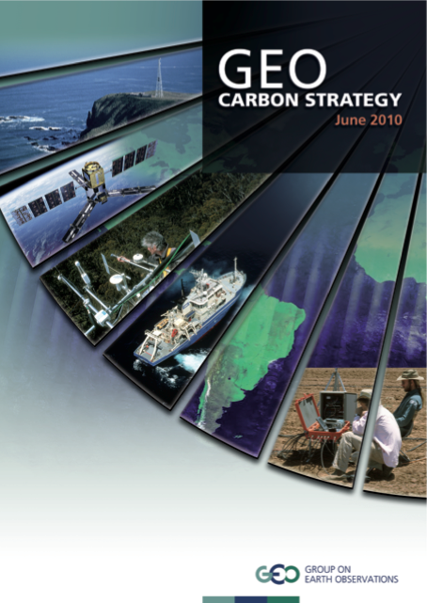
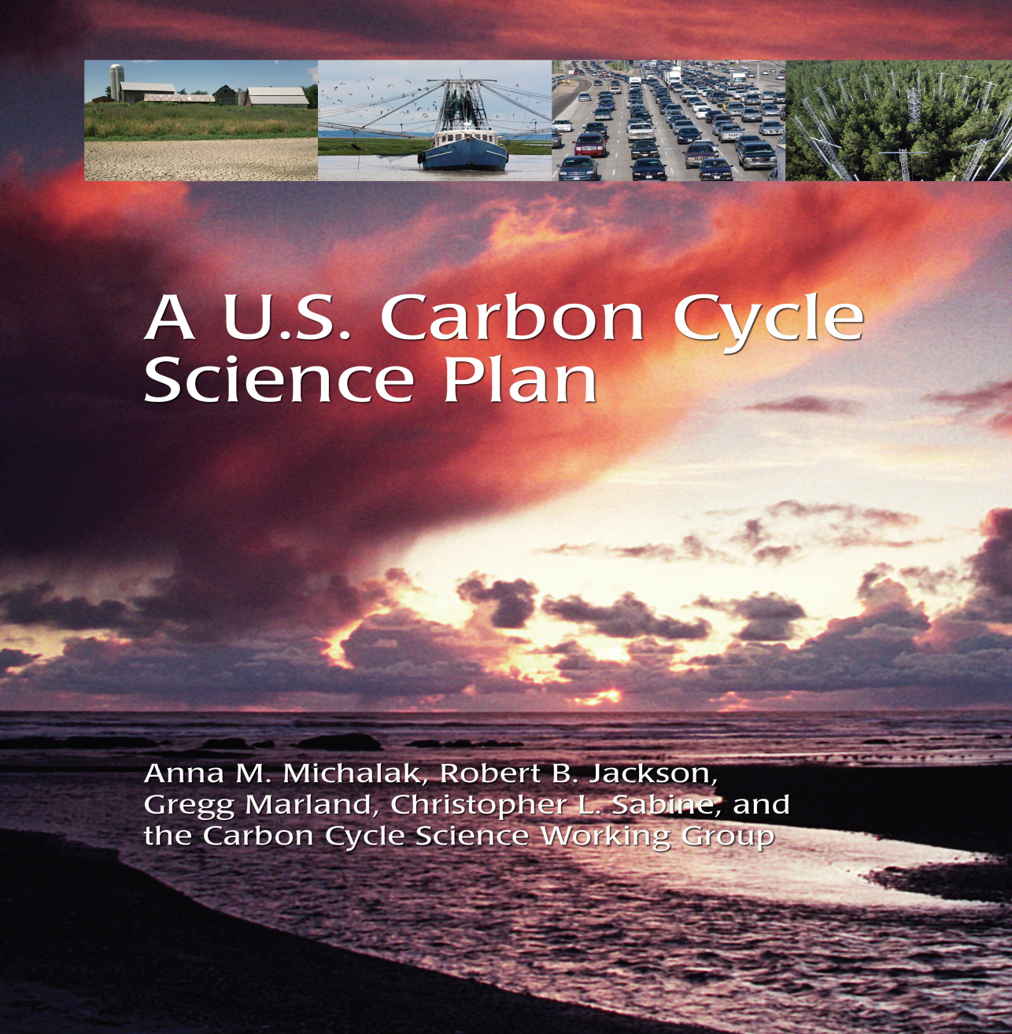
Science Priorities for the Future
There are excellent, up-to-date plans available for carbon cycle research. Defining NASA’s role is our main challenge.
We lack such comprehensive plans for ecosystems science would benefit from some advance planning in this area . . .

Slide 12
Science Priorities for the Future
Conducting integrative, cross-disciplinary research, focusing on major societal problems (e.g., land-ocean-atmosphere; carbon, water, people)
Advancing our models; many needs, several perspectives on what NASA should address
Documenting global change (quantitatively), attributing causes, projecting impacts and feedbacks and providing useful uncertainty assessments

Slide 13
Terrestrial Ecology Meetings
To cultivate a continuing sense of community and involvement in setting future directions for NASA TE
To share research findings and discuss their implications
To engage TE researchers in some problem solving and priority setting for the program
Currently striving for meetings every ~18 mos. So next meeting should be in conjunction with Joint CC&E Focus Area Workshop (tentatively set for ~April 2015)
We should begin planning soon; suggestions welcomed!
. . .Or, are these meetings of sufficient value to be worth fighting for? → what do you think?

Slide 14
My Aspirations for this Meeting
I would like to receive some inputs on community priorities for non-carbon ecological research within the NASA TE Program (we have a breakout session planned and a small group will bring some ideas forward to initiate that discussion)
I would like to hear from the TE community regarding utility/effectiveness of the Working Groups established at prior meetings.
I would be pleased to consider suggestions on how to better manage / implement the TE program
I am making a plea for help and would like to begin working toward solutions.

Slide 15
I Need Help!
I haven’t been able to successfully recruit a detailee or IPA to assist in the management of he TE Program and CC&E Focus Area since Bill Emanuel left several years ago
Good News: Libby Larson, a AAAS Science Policy Fellow will be working with me for the next ~1 ½ years
Bad News (sort of): We still need a lot more help!
Volunteers, nominations, ideas of all sorts are welcome!

Slide 16
I Need Help!
The next 10 months are going to be intense with peer review and selection work (Interdisciplinary science, carbon cycle science, TE, Terra/Aqua, Suomi-NPP ST, etc).
Good News: Lots of opportunities to get funded!
Bad News (sort of): Lots of proposals to write and NASA will need lots of peer reviewers.
Volunteers and nominations for peer reviewers are hereby sought!

Slide 17
Peer Reviewer Pool
Name of Candidate Reviewer:
Reviewer’s Institution:
Reviewer’s Expertise (keywords or 1-2 sentences):
Reviewer’s Web site(optional):
“Best Fit” Solicitation (optional)
Requisite qualifications: PhD or equivalent experience in a relevant Earth science discipline
Self nominations welcome!
→ Send email to: libby.larson@nasa.gov or diane.e.wickland@nasa.gov

