Slide 1
The Decadal Survey, aka
Earth Science and Applications from space: National Imperatives for the Next Decade and Beyond
National Research Council, 2007
http://www.nap.edu/catalog.php?record_id=11820

Slide 2
Chapters by Societal Benefit Area
6. Human health and security
7. Land use change, ecosystem dynamics and biodiversity
8. Solid-earth hazards, natural resources and dynamics
9. Climate variability and change
10. Weather science and applications
11. Water resources and the global hydrological cycle

Slide 3
Statement of Task
Review the status of the field to assess recent progress in resolving major scientific questions outlined in relevant prior NRC, NASA, and other relevant studies and in realizing desired predictive and applications capabilities via space-based Earth observations.
Develop a consensus of the top-level scientific questions that should provide the focus for Earth and environmental observations in the period 2005-2015.
Take into account the principal federal- and state-level users of these observations and identify opportunities and challenges to the exploitation of the data generated by Earth observations from space.
Recommend a prioritized list of measurements, and identify potential new space-based capabilities and supporting activities within NASA and NOAA to support national needs for research and monitoring of the dynamic Earth system during the decade 2005-2015. In addition to elucidating the fundamental physical processes that underlie the interconnected issues of climate and global change, these needs include: weather forecasting, seasonal climate prediction, aviation safety, natural resources management, agricultural assessment, homeland security, and infrastructure planning.
Identify important directions that should influence planning for the decade beyond 2015. For example, the committee will consider what ground-based and in-situ capabilities are anticipated over the next 10-20 years and how future space-based observing systems might leverage these capabilities. The committee will also give particular attention to strategies for NOAA to evolve current capabilities while meeting operational needs to collect, archive, and disseminate high quality data products related to weather, atmosphere, oceans, land, and the near-space environment.

Slide 4
Land-Use Change, Ecosystem Dynamics, and Biodiversity:
Chapter 7
RUTH S. DeFRIES, University of Maryland, Chair
OTIS B. BROWN, JR., University of Miami, Vice Chair
MARK R. ABBOTT, Oregon State University
CHRISTOPHER B. FIELD, Carnegie Institution of Washington
INEZ Y. FUNG, University of California, Berkeley
MARC LEVY, Center for International Earth Sciences Information Network
JAMES J. McCARTHY, Harvard University
JERRY M. MELILLO, Marine Biological Laboratory
DAVID S. SCHIMEL, University Corporation for Atmospheric Research

Slide 5
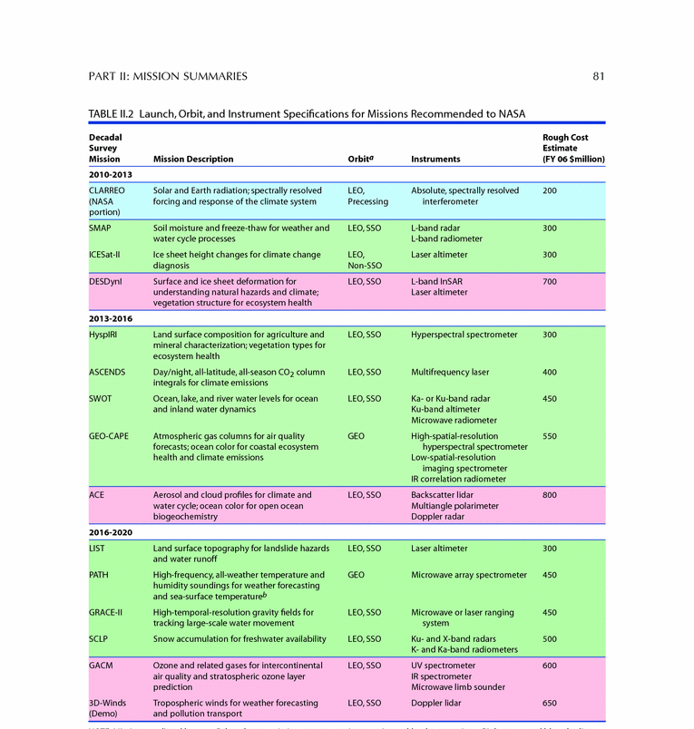
Recommended missions

Slide 7
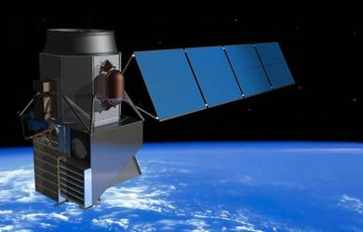
HyspIRI: Ecosystem Function
Mission summary—ecosystem structure and Biomass
VariablesOrbit/coverage: Panel synergies: New science: Applications:
Standing biomass; vegetation height and canopy structure; habitat structure :
Sensor(s): Lidar and InSAR
LEO/global
Climate, Health, Solid Earth
Global biomass distribution, canopy structure, ecosystem extent, disturbance, recovery
Ecosystem carbon and interactions with climate, human activity, disturbance (including deforestation, invasive species, wildfires); carbon management; conservation and biodiversity

Slide 8
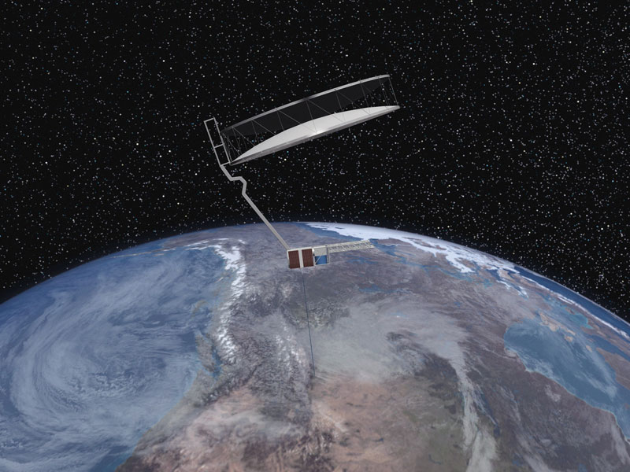
DESDYNi: Ecosystem Structure and Biomass
Mission summary—ecosystem structure and Biomass
Variables: Standing biomass; vegetation height and canopy structure; habitat structure
Sensor(s):Lidar and InSAR
Orbit/coverage: LEO/global
Panel synergies: Climate, Health, Solid Earth
New science: Global biomass distribution, canopy structure, ecosystem extent, disturbance, recovery
Applications: Ecosystem carbon and interactions with climate, human activity, disturbance (including deforestation, invasive species, wildfires); carbon management; conservation and biodiversity

Slide 9
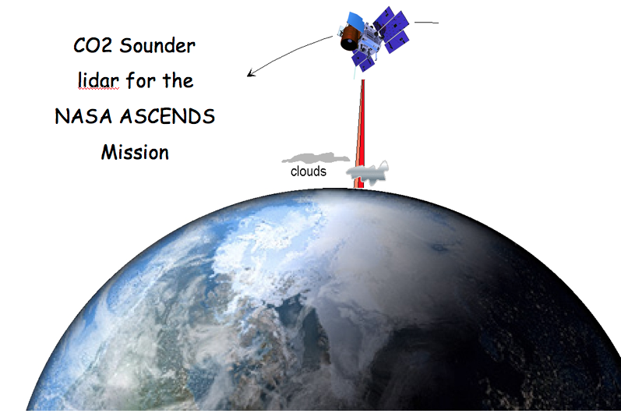
ASCENDS: carbon budgets
Mission Summary—Carbon Budget
Variables: CO₂ mixing ratio, CO concentrations Sensor(s): Lidar
Orbit/coverage: LEO/global
Panel synergies: Climate, Weather
New science: Active measurements of CO₂ mixing ratio at high spatial and temporal resolution during night and cloudy conditions, CO as a tracer
Applications:
High-resolution global distribution of carbon sources and sinks

Slide 10
Outreach

Slide 11
Lessons learned: 1
It is a BIG deal!
-The DS determined NASA strategy and investment for a decade, and will influence it for longer!

Slide 12
Lessons learned: 2
Prior engagement is essential
  By the time the RFI (or equivalent) for concepts appears, concepts need to have been explored, technology evaluated, and some degree of community support generated.
  Community consensus on requirements for new observations is critical.
  Talk to your friendly neighborhood NASA center or University-based engineering groups to find out what new technologies may be available.
  I “believe” many program officials have ways of supporting community workshops towards the DS.

Slide 13
Lessons learned: 3
The job is not done until it is done… Continuing community engagement is critical
  The task is not complete when the report is delivered.
  Many factors influence the implementation of the DS, updated costs, risk, administration policy.
  As a result, the transfer function from the DS to the NASA implementation is complex.
  The DS panels are disbanded when the report is delivered, so the stakeholders in missions are on their own for advocacy.
  Without that advocacy, NASA can only interpret the written report.

Slide 14
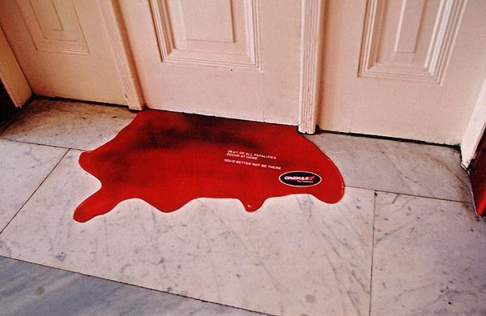
Effective community planning
to advance TE science in DS-2
Robust discussion
Decisions
Community support for the decisions
Keep the blood behind closed doors-backbiting after the decisions hurts everybody.
Effective communities learn how to make and stick with hard decisions.

Slide 15
Earth Science and Applications from Space
A Midterm Assessment of NASA’s Implementation of the Decadal Survey
COMMITTEE ON THE ASSESSMENT OF NASA’S EARTH SCIENCE PROGRAM
DENNIS L. HARTMANN, University of Washington, Chair
MARK R. ABBOTT, Oregon State University
RICHARD A. ANTHES, University Corporation for Atmospheric Research
PHILIP E. ARDANUY, Raytheon Intelligence and Information Systems
STACEY W. BOLAND, Jet Propulsion Laboratory
ANTONIO J. BUSALACCHI, JR., University of Maryland
ANNY CAZENAVE, Centre National d’Etudes Spatiales, France
RUTH DeFRIES, Columbia University
LEE-LUENG FU, Jet Propulsion Laboratory
BRADFORD H. HAGER, Massachusetts Institute of Technology
ALLEN HUANG, University of Wisconsin, Madison
ANTHONY C. JANETOS, University of Maryland and Pacific Northwest National Laboratory
DENNIS P. LETTENMAIER, University of Washington
JENNIFER A. LOGAN, Harvard University
MOLLY K. MACAULEY, Resources for the FutureANNE. W. NOLIN, Oregon State University
JOYCE E. PENNER, University of Michigan
MICHAEL J. PRATHER, University of California, Irvine
DAVID S. SCHIMEL, National Ecological Observatory Network, Inc.
WILLIAM F. TOWNSEND, Independent Consultant, Annapolis, Maryland
THOMAS H. VONDER HAAR, Colorado State University

Slide 16
Statement of Task
How well NASA’s current program addresses the strategies, goals and priorities
Progress towards realizing these…
In the context of current and forecast resources, any actions that could be taken to optimize the science value of the program.

Slide 17
Committee recommendations:
NASA responded favorably and aggressively to the 2007 decadal survey, embracing its overall recommendations for Earth observations (well done)…
------------------------------------------------------------------------------
NASA’s Earth Science Division (ESD) should implement its missions via a cost-constrained approach, (build to cost, not requirements)
NASA’s ESD should interpret the 2007 decadal survey’s estimates of mission costs as an expression of the relative level of investment (maintain science balance)…
NASA’s ESD should establish a cross-mission Earth system science and engineering team to advise NASA on execution of the broad suite of decadal survey missions within the interdisciplinary context (make decisions in a broad science context, not stovepiped. The committee was VERY concerned about managing mission-by-mission with no overarching science strategy)…

Slide 18
Grand Challenges for TE:
Just my personal take
Functional diversity: global observations, models and theory.
Global distributions of biomass, plant properties.
Closing the terrestrial carbon budget using global NEE, GPP and biomass from space.
Constraining carbon-climate-water feedbacks, β and γ

Slide 19
Space-based observations for carbon budget closure
BIOMASS/DESDYNi
HyspIRI
ASCENDS
  NEE = GPP (T, PAR, H₂O, CO₂, nutrients..) – R_{e}(T, H₂O, τ)
OCO-2
MODIS/VIIRS
SMAP

Slide 20
Challenges and opportunities for TE
Limited experience from new TE-related spaceborne sensors (OCO-2, SMAP) implemented prior to DS-2.
TE DS-1 missions could be revisited as part of DS-2 plan.
Capitalize on successes in EV-S program to advance TE science in DS-2.
Take advantage of international assets to advance TE science in DS-2.

Slide 21
TE to-do list before the next Decadal Survey
Identify good panel members!
Evaluate requirements for “sustained observations”.
Identify new measurements (technologies) and emerging requirements (science).
Studies, workshops, prepare for RFI call.
Get the word out to the broader ecosystems community and build support.
Talk to your program scientists, ESD leadership about needs, get TE requirements on the radar screen.

