Slide 1
Observation Networks and Collaboration Opportunities
Michael Keller
NEON, Inc. and USDA Forest Service
Thanks to: Brent Holben, Crystal Schaaf, Ellsworth Dutton, Joanne Nightingale, Josef Kellndorfer, Linda Heath

Slide 2
CCOLD Criteria for Environmental Observatories
Consistent
Calibrated and traceable to national and international standards
Open data policy (ideally data are freely available as soon as processed with no priority period for PIs)
Long-term (>10 years)
Documented

Slide 3
Observatory Examples
Examples of observatories with very different models, suites of variables, funding, and operational approaches.
FIA – Biometric Inventories +
AERONET – Aerosols and Radiation
NPN – Phenology
NEON – Multi-resource ecological

Slide 4
Qualities of Observatories
Observing approach & variables
Spatial extent and temporal resolution
Data time series & history
QA/QC approaches & standards
Documentation
Data policy

Slide 5
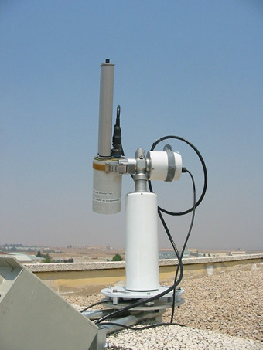
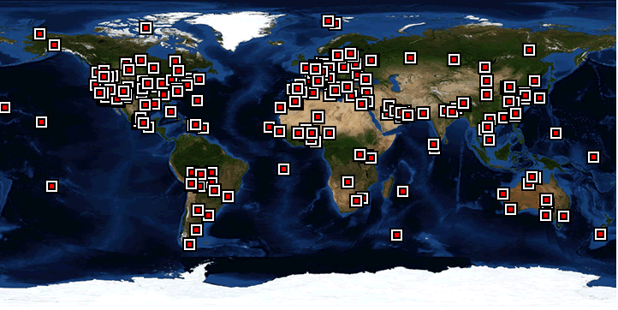
AERONET
Aerosol Optical Properties Research & Enabling Project
  Program of long term systematic network measurements
Mission Objectives
  Validation of Satellite Aerosol Retrievals
  Characterization of aerosol optical properties
  Synergism with Satellite obs., Climate Models

Slide 6
AERONET
Measurement: spectral (340 nm to 1,640 nm) solar irradiance and almucantar and principle plane spectral radiance sequence at a large range in scattering angles.
Variables retrieved (partial list): AOD, angstrom exponent, fine and coarse mode aerosol AOD at 500 nm, single scattering albedo (SSA), particle size distribution, complex index of refraction, phase function, % sphericity
~400 instruments at ~250 Operational sites
15 minute / hourly time resolution
>5 x 10⁸ AOD observations since 1993

Slide 7

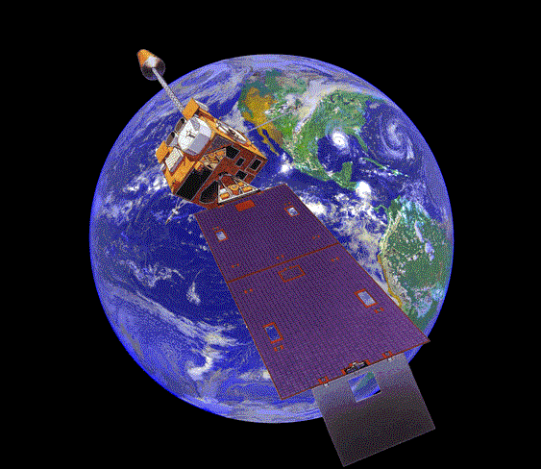

AERONET web site
Level 2.0
Level 1.5
GOES (East / West), METEOSAT, GMS
Cloud screening and quality control
Cloud screening
Level 1.0
Main archive
CIMEL sun/sky radiometer
Processing system
Data Collection System Automatic Processing System
Raw archive
Calibration system

Slide 8
Documentation & Data Policy
Holben et al.
RSE, 1998
Holben et al.
JGR, 2001
http://aeronet.gsfc.nasa.gov
Dubovik &King
JGR, 2000
Dubovik et al.
JGR, 2000
Eck et al.
JGR, 1999
Smirnov et al.
RSE, 2000
Data Policy (presented with each download):
  All data in public domain and available at website
  PI of a particular dataset should be offered co-authorship if it involves a related subject of research
  For multi-sites use, only request a general AERONET acknowledgment
  Honor system that has worked well save for a few isolated cases.

Slide 9

FIA – USDA Forest Service
Forest Inventory & Analysis Program
The Nation’s forest census, includes all states, US territories and some Pacific Islands
Many partners; State Foresters play key role
As a traditional inventory: includes remote sensing layer, field data collection, analysis, data dissemination, techniques development, data products, tools
Many nations have national forest inventories
Notes:
“Some” Pacific Islands means “Trust Territory of the Pacific Islands” which is now: The Republic of the Marshall Islands, Federated States of Micronesia, Commonwealth of the Northern Mariana Islands, and Republic of Palau

Slide 10
FIA – Forest Inventory & Analysis
An unbiased subset of forest ground plots are measured every year throughout the US, with re-measurements every 5-10 years depending on the State
Notes:
Hawaii plots will be installed this year, interior Alaska not yet surveyed. The present system of 80 Experimental Forests and Ranges has been established progressively since 1908; many sites are more than 50 years old. EFRs have detailed TEMPORAL datasets at selected sites;
FIA has detailed SPATIAL datasets at several points in time

Slide 11
FIA – Forest Inventory & Analysis
1 plot/2,410 ha: Typical live tree data. Subset: 1 plot/38,850 ha: standing dead; coarse & fine woody debris; sample forest floor & soil C
Remote sensing used to increase precision of forest area estimation
Intensified FIA plot network on FS Expt. Forests & Ranges (EFRs)
Notes:
Hawaii plots will be installed this year, interior Alaska not yet surveyed. The present system of 80 Experimental Forests and Ranges has been established progressively since 1908; many sites are more than 50 years old. EFRs have detailed TEMPORAL datasets at selected sites;
FIA has detailed SPATIAL datasets at several points in time

Slide 12
FIA – Forest Inventory & Analysis
Data publicly available, http://fia.fs.fed.us
All variables, includes carbon stocks
To use exact plot coordinates enter into MOU, work w/ Spatial Data Services unit
Acknowledge program for use of data; authorship to FIA collaborators as appropriate
Documented methods: field guides, database guide, techniques guide
QA program with field visits, publication summaries
Notes:
All documentation, data, and tools can be reached from this web site. QA/QC information is being gathered in one place, currently it is spread around in publications and among regions.

Slide 13
FIA – Forest Inventory & Analysis
Human use affects forests so additional national surveys are conducted:
Timber products output surveys: provides information on removals for timber products, logging residue, and mill residue.
National Woodland Owner Survey: surveys owners for current and future mgmt intentions
Expertise in inventory design, assist internationally and domestically
http://fia.fs.fed.us/

Slide 14

USGS – National Phenology Network
A new data resource—a national network of integrated phenological observations across space and time
Understand how plants, animals and landscapes respond to environmental variation and climate change
Partners: Gov’t agencies, NGOs, academia, the public
Integrate with other environmental monitoring networks
Target: 1000's of observation locations
Standardized protocols for plants & animals
Contemporary & legacy data

Slide 15

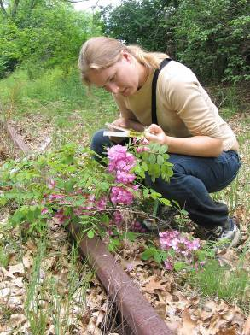

NPN - National Phenology Monitoring System
On-line user interface
315 plant species
160 animal species
Beginning to advanced protocols
Status monitoring
  sampling intensity
  absence data
species
Notes:
15

Slide 16
USGS – National Phenology Network
National Phenology Network
NCO Information Management System
Data
User interface
Data curation
Products
Search
Synthesis
Visualizations
Work platform
Datasets
Databases
Decision-
support
Contemp-orary
Legacy
Partners
Ancillary
Education
Metadata
Research

Slide 17
NEON GOALS
The overarching goal of NEON is to enable understanding and forecasting of climate change, land use change, and invasive species on continental-scale ecology by providing infrastructure to support research in these areas.
Information infrastructure: Consistent, continental, long-term, multi-scaled data-sets and data products that serve as a context for research and education.
Physical Infrastructure: A research platform for investigator-initiated sensors, observations, and experiments providing physical infrastructure, cyberinfrastructure, human resources, and expertise, and program management and coordination.

Slide 18
NEON’s Scientific Approach
Forcing
Interactions
Feedbacks
Responses
Drivers of ecological and biological
change.
Processes mediating the response of ecological systems, feedbacks influencing the drivers
Ecological and organismal responses.

Slide 19
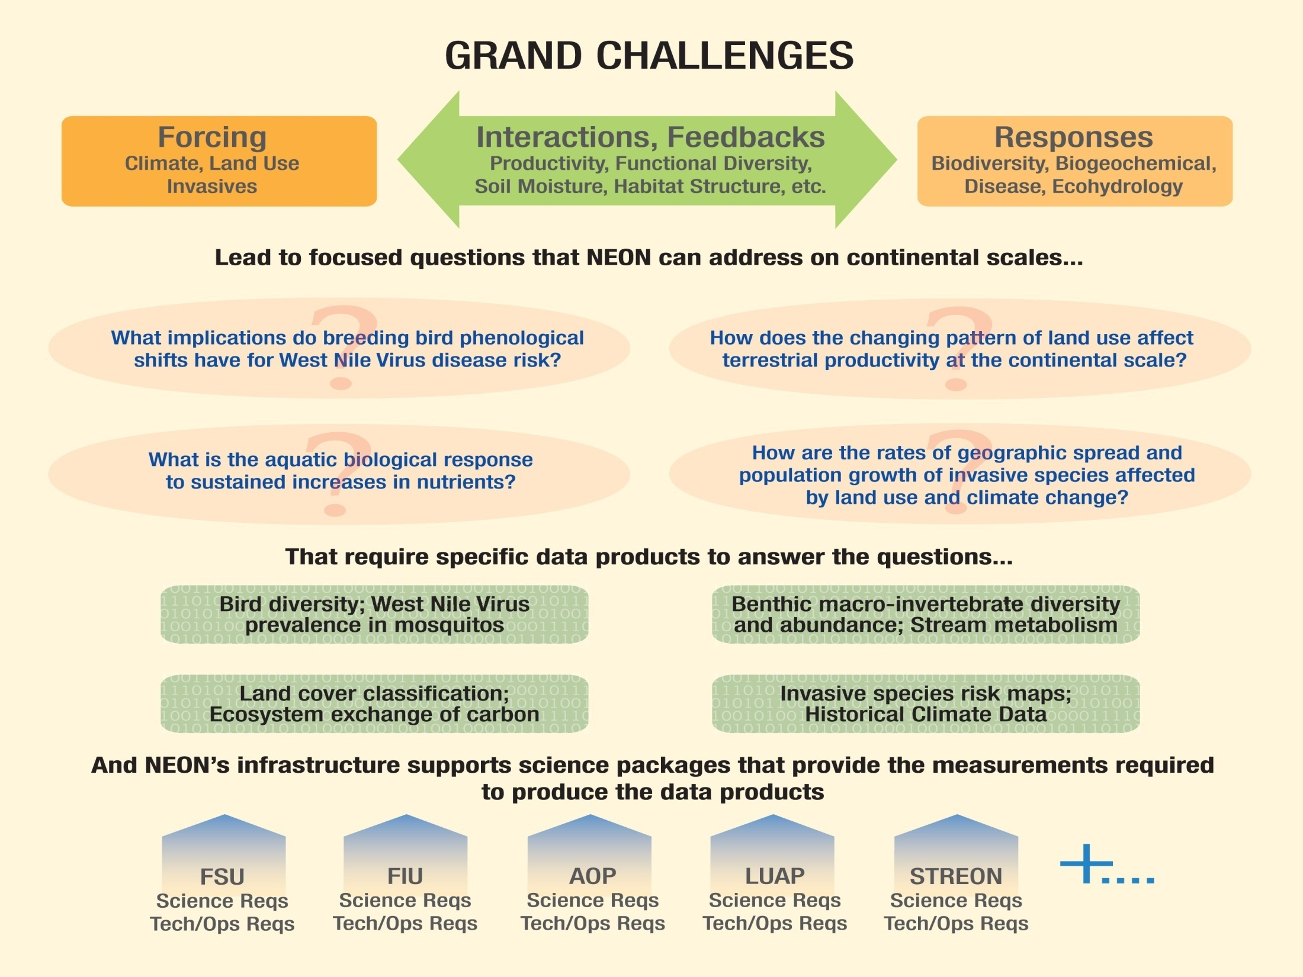

Slide 20
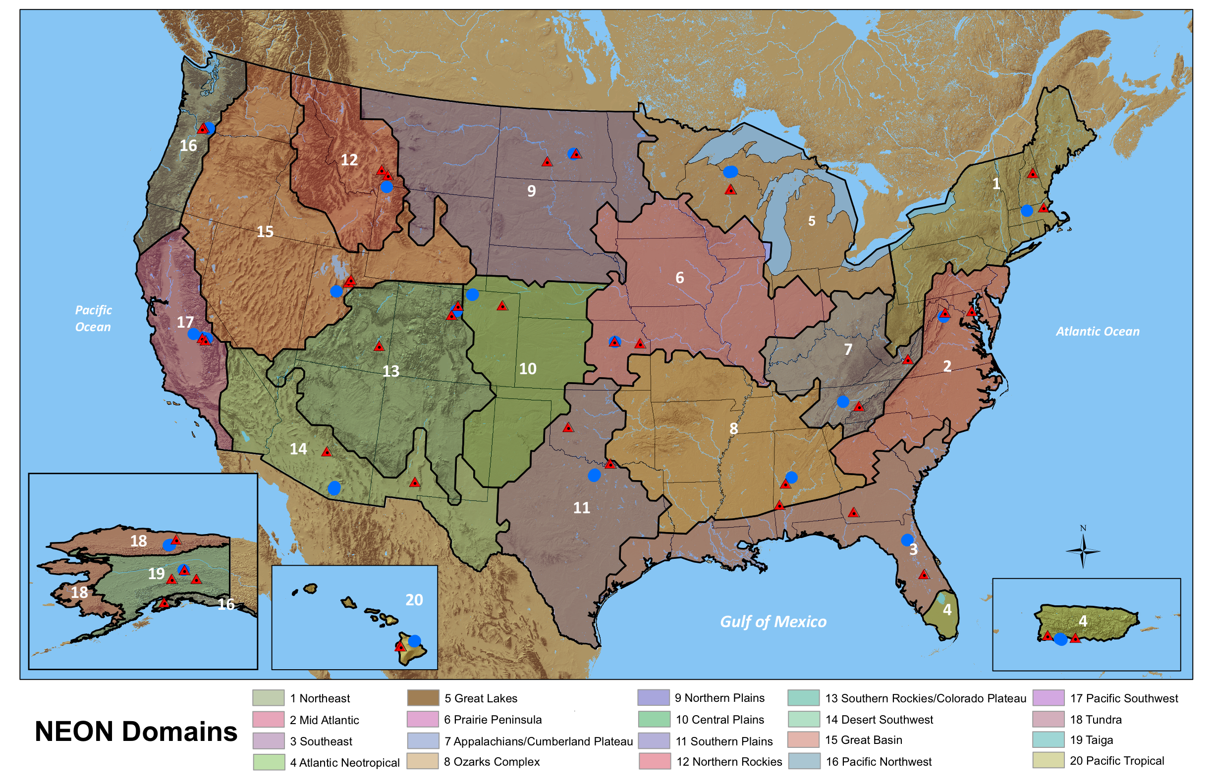
A National Observatory: 20 Eco-climatic Domains

Slide 21
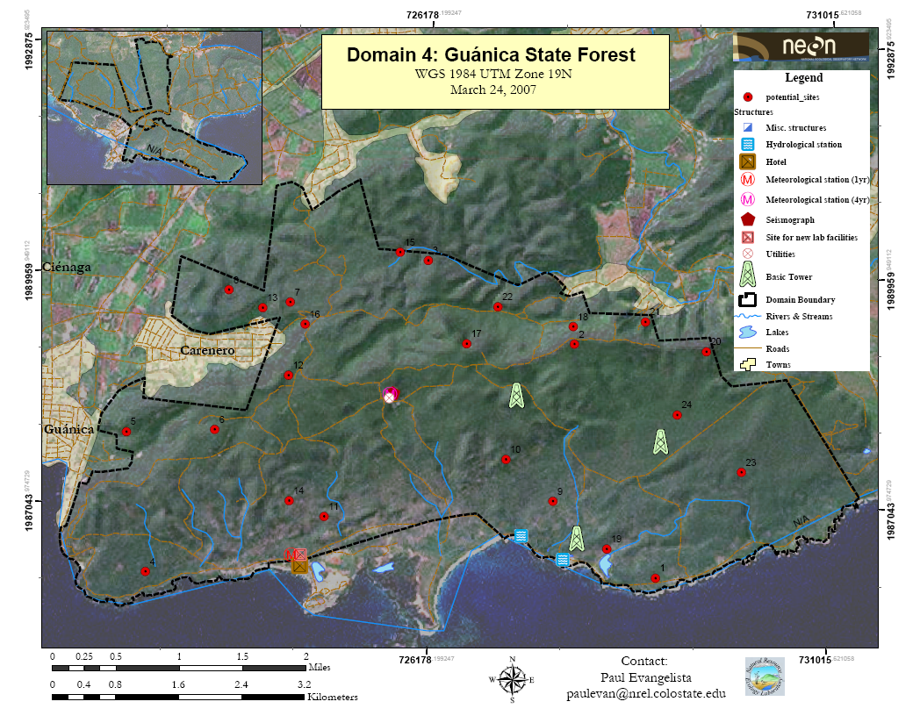
Candidate Core Site

Slide 22
NEON Deployment
  Headquarters (incl. CI, labs, etc.) - Boulder
  20 Domains
    20 Core sites (wildland)
    40 Relocatable sites (land-use sites)
  10 Mobile laboratories (AK, HI, CONUS+PR)
  3 Airborne Observation Platforms
  Land Use Analysis Package
  STREON Experiment

Slide 23
Low and High Level Data Products
Level 1-3 Products
Level 4 Products
Carbon and water fluxes and parameters: GPP, R_{A}, R_{H}, WUE, A_{max}
Plant phenology
Population parameters: abundance, survival, recruitment, fecundity
Winds, CO₂ concentration, H₂O vapor concentration
Human observers, canopy photography
Small mammal species ID, small mammal age, small mammal gender
Flux assimilation model
Image analysis calibration
Mark-recapture model
542 L1 products + 35 L2-L3 products
118 L4 products

Slide 24
Key NEON Data
Bioclimate Suite
  Temperature, precipitation, humidity, radiation
Biodiversity Suite (includes invasive spp.)
  Abundance and diversity (mosquitoes, aquatic invertebrates, beetles, fish, birds, plants, …)
  Phenology (mosquitoes, beetles, plants)
  Microbial function and diversity (functional genes, metagenomes)
  Bioarchive (all taxa, substrates)
Biogeochemistry Suite
  Carbon stocks, fluxes, isotopes
  Nutrient stocks, fluxes, isotopes
  Chemical climate (N-deposition, Ozone)

Slide 25
Key NEON Data
Ecohydrology Suite
  Water balance components (storage and flows)
Infectious Disease Suite
  Disease prevalence (Dengue, Hanta virus, Lyme disease, West Nile Virus)
Land Use and Land Cover Suite
  Remote sensing data (vegetation performance and structure)
  Geographic data (topography, historical climate, etc.)
  Statistical data (human geography)
NEON Data Product Catalogs
  http://www.neoninc.org/science/433

Slide 26
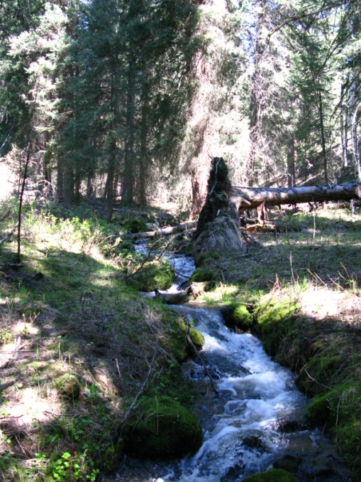
Fundamental Sentinel Unit: Human Observers & Laboratory Analysis
Biodiversity
Population Dynamics
Productivity
Phenology
Infectious Disease
Biogeochemistry
Microbial Diversity and Function
Ecohydrology

Slide 27
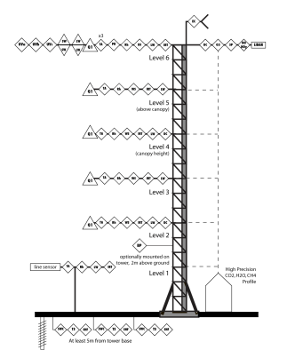
Fundamental Instrument Unit
Physical and chemical climate forcing
Ecosystem responses
Stand/plot level sampling
Automated instrumentation
Micrometeorological scalars and fluxes
Soil array
Aquatic array
Over 100 L1 data products for all sites based on measurements at frequencies of ~0.1 to 20 Hz

Slide 28
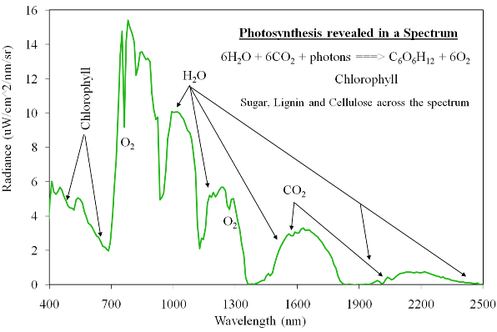

Airborne Remote Sensing (AOP)
Spectroscopy
  Vegetation biochemical & biophysical properties
  Cover type & fraction
LiDAR altimetry
  Vegetation Structure
  Sub-canopy topography
  biomass
High resolution imagery
  Land use & land cover

Slide 29
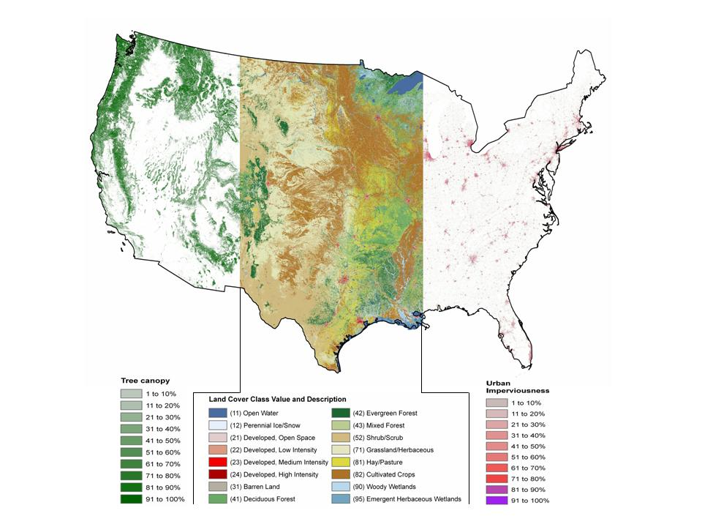
Land Use Analysis Package for Continental Extrapolation
Continental coverage
Land cover
Land use
Vegetation biophysical properties
Geographic data including census data
User interface to facilitate geographic analysis by the non-specialist

Slide 30
NEON Opportunities for
Scientists and Educators
Deployments:
  Mobile Deployment Platform
  Airborne Observing Platform
Data Products
  NEON will produce 584 Level 1 and 117 Level 4 data products.
  New data products will be developed based on community inputs
Bioarchive
  ~130,000 samples per year (species and substrates)
Experiments
  Externally funded experiments using NEON sites and infrastructure

Slide 31
NEON Status
The National Ecological Observatory Network (NEON), Inc. recently completed its Final Design Review (FDR) of their plan for a continental-scale observatory, a major milestone in the design and execution of the project.
Funds for NEON construction ($433 M) have been included in the President’s FY 2011 budget request to congress.
If all else goes well … construction will start in 2011.

Slide 32
NEON Opportunities for
Scientists and Educators
Deployments:
  Mobile Deployment Platform
  Airborne Observing Platform
Data Products
  NEON will produce 542 Level 1 and 118 Level 4 data products.
  New data products will be developed based on community inputs
Bioarchive
  ~130,000 samples per year (species and substrates)
Experiments
  Externally funded experiments using NEON sites and infrastructure

Slide 33
Concluding Remarks
Observatories and CCOLD Criteria
 | AERONET | FIA | NPN | NEON
Calibrated | ✔ | ✔ | Planned | Planned
Consistent | ✔ | ✔ | Planned | Planned
Open Data | ✔ | ✔ (w/ limits) | Planned | Planned
Long Term | ✔ | ✔ | Planned | Planned
Documented | ✔ | ✔ | Planned | Planned

Slide 34
Questions
What data resources exist?
How are those data resources used?
What can we do to improve and/or augment the products from existing observatories?
What new measurements do we need and how can we get them?
What are the ideal operating procedures and policies for observatories and how do we encourage existing and future observatories to move toward those ideals?

Slide 35

The National Ecological Observatory Network is a project sponsored by the National Science Foundation and managed under cooperative agreement by NEON Inc.
www.neoninc.org
mkeller@neoninc.org

Slide 36
NEON CI and Data Strategy
Basic infrastructure designed around high availability (no data loss) and 30-year sustainability.
  Solution: COTS/OS strategy (~70%) to capitalize on existing commercial investment for the long term
Data infrastructure designed around providing information as well as data.
  Solution: High level data products, including continental-scale extrapolation, forecasting, innovative informatics for publishing information and data.
Notes:
These tasks no longer research area – computing community

Slide 37
Waveform LIDAR Specifications
System Parameter | AOP Requirement | Optech ALTM Gemini Specification
Laser wavelength | 1064 nm | 1064 nm
Laser pulse width | ≤ 10 nsec | 10 nsec @ 70 kHz
Laser divergence | ≤ 1 mrad | User choice (two selections)
Pulse repetition frequency | 33 to 100 kHz (selectable) | 33 – 167 kHz (full waveform up to 70 kHz; sub-samples at higher rates)
Waveform sampling | > 8 bits, 1 nanosecond interval | 8 bits, 1 ns interval
Scan frequency | > 50 Hz (selectable) | 0 – 70 Hz
Scan angle | ≥ 35 degrees | 0 – 50 degrees
Elevation error | < 25 cm (1 σ) | < 5 – 30 cm (1 σ)
Horizontal position error | ≤ 0.8 m (1 σ) | 1/5,500 x altitude (m AGL) (1 σ)
Operating Temperature | -10°C and +35°C | Control rack: +10°C and +35°C Sensor head: -10°C and +35°C
Storage Temperature | -10°C to +50°C | Control rack: -10°C to +50°C Sensor head: 0°C to +50°C
Aircraft altitude | 1,000 to 3,000 meters | 150 – 4000 m AGL
Ground footprint (nadir) | 1 to 3 meters | Altitude dependant
Total Weight | < 150 kg | Control Rack: 53.2 kg Sensor Head: 23.4 kg Waveform Digitizer: ~ 25 kg
Volume of sensor head | Fit within a 31 cm x 31 cm x 61 cm cube | 26 cm x 19 cm x 57 cm
Power | ≤ 36 Amps, 28 VDC | 35 Amps, 28 VDC

Slide 38
Applanix DSS 439 Specifications
Parameter | Specification
Image size | 39 Megapixel; 5412 (track) x 7216 (x-track) pixels
Pixel Size | 6.8 um
Applanix Aerolens, Carl Zeiss) | 60 mm F.L., F/3.5 ; Format: 44 mm x-track, 34 mm in-track
Cross-track Field of View | 36.3 deg
IFOV | 0.11 milliradian
Shutter Speed | 125 – 4000 sec⁻¹
Size | Camera sensor head: 180 x 180 x 360 mm
Weight | Camera w/o Az mount: 7 kg Camera mount tray: 2 kg
Power | 28 VDC 280 W (max)
Operational Temperature Range | Camera: 0⁰ C to +40⁰ C Computer system: -20⁰ C to +50⁰ C
Computer System | Data Logger w/ removable ruggedized hard drives

Slide 39
Key Flight Ops Parameters
Parameters | Value
Flight Season | 7 months
Total Flight Days | 458 days
Total Fight Hours | 1,093 hours
Required Flight Period(s): Continental Flights Puerto Rico Alaska / Hawaii | April to September June/July October / March
Number of Domain/sites per year | 20/60
Flight duration for data collection | 4 hours (max.) per site + travel to/from local airport
Base of Science Operation | Boulder, CO
Field operations | Local airports at each domain
Flight altitudes for data collection | 1,000 to 3,000 m AGL
Ground Speed for data collection | 90 to 110 knots
Number of flight tracks over site | ~ 20 (or less)
Time of day for science data | 10 am to 2 pm (local time)

Slide 40
AOP Higher Level Data Products
Data Product | Description | Sensor | Expected Accuracy*
Leaf water content | Upper canopy water content measured as equivalent water thickness | Imaging spectrometer | 0.19 ± 0.02 mm invasive trees 0.25 ± 0.04 mm introduced trees (Asner et al., 2008)
Leaf nitrogen content | Upper canopy nitrogen content | Imaging spectrometer | 0.5% absolute (Schimel, 1995)
Pigment concentrations | Vegetation indices sensitive to concentrations of Chlorophyll (NDVI), Xanthophylls (PRI), carotenoid and anthocyanin | Imaging spectrometer | Species Mean S.E. Chl-a (mg g⁻¹) 3.45 ± 0.12 Chl-b (mg g⁻¹) 1.37 ± 0.05 Carotenoids (mg g⁻¹) 1.13 ± 0.03 Anthocyanins (mmol g⁻¹) 0.36 ± 0.03 (Asner et al., 2008)
Lignin concentration | Normalized Difference Lignin Index (NDLI) used to estimate relative amounts of lignin in structural components of vegetation canopies | Imaging spectrometer | 5.0% lignin concentration (Kokaly and Clark, 1998)
Fraction of photosynthetic active radiation | Fraction of photosynthetic active radiation (fPAR) is a measure of available radiation in specific wavelengths absorbed by canopy | Imaging spectrometer | [TBD]
Albedo | The fraction of the total incident radiation striking a surface that is reflected by that surface | Imaging spectrometer | Uncertainty of < 5% (Coddington et al., 2008)
Leaf area index | LAI defines as one-half the total green area of per unit ground surface area | Imaging spectrometer | 20% relative uncertainty; 1.0 LAI absolute uncertainty (Fernandes et al., 2003)**
* Representative values. Domain specific requirements will be determined during commissioning
** Accuracy of LAI estimates are strongly dependent on canopy density and vegetation type

Slide 41
AOP Higher Level Data Products
Data Product | Description | Sensor | Expected Accuracy*
Digital Elevation Map | Bare earth elevation data (topographic information with vegetation and man-made structures removed) | Waveform-LiDAR | < 1 m error (Asner et al., 2007)
Canopy Height | Horizontal distribution of the height profile of canopy components measured as the distance between the canopy top and ground | Waveform-LiDAR | < 1.0 m error (Asner et al., 2008)
Canopy Structure | Position, extent, quantity, volume and shape of above ground vegetation in both vertical and horizontal directions | Waveform-LiDAR | [TBD]
Surface roughness | Calculated as the standard deviation of measured canopy heights | Waveform-LiDAR | [TBD]
Cover fraction | Relative amount of photosynthetic or green vegetation (GV) and non-photosynthetic vegetation (NPV) including bark, litter, branches, etc. | Waveform-LiDAR and Imaging Spectrometer | [TBD]
Leaf area index (LAI) | Total leaf surface area exposed to incoming light energy per unit area of total ground surface beneath the plant(s) | Waveform-LiDAR and/or Imaging Spectrometer | 20% relative uncertainty; 1.0 LAI absolute uncertainty (Fernandes et al., 2003)**
* Representative values. Domain specific requirements will be determined during commissioning
** Accuracy of LAI estimates are strongly dependent on canopy density and vegetation type

Slide 42
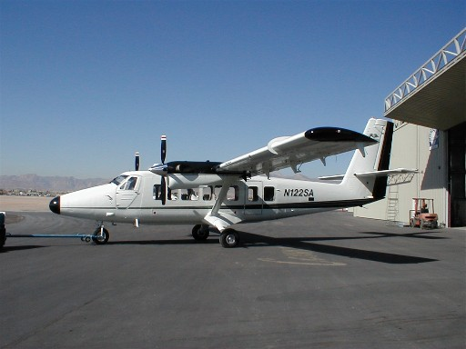
Baseline Aircraft: Twin Otter
Accommodates baseline payload with some room to grow
Low stall speed, excellent low speed handling and stability
Safety: Two engines, excellent track record
Two engines eliminates prop wash issues
Rugged, easy to maintain, easily modified
Well-known to scientific researchers (used by NOAA, NASA, DoD, etc. regularly in the field
Parameter | AOP Platform Requirement | DeHavilland DHC-6-300
Target Ground Speeds | 90 – 110 knots | 80 – 175 knots
Cruise Speeds | > 150 knots | Up to 175 knots
Survey Altitudes | 3280 – 9843 ft AGL | Up to 25,000 ft ASL
Science Instrument Power | > 3880 W (139 Amps @ 28 VDC) | 8400 W Max Scientific Power (300 Amps @ 28 VDC)
Payload Accommodation: Integration | > 4 ft wide cabin door | 4.7 x 4.2 ft
Payload Accommodation: Weight | 700 lbs + 2 crew | 4500-7000 lbs useful load
Payload Accommodation: Volume | Sensor head approx 2.5 (H) x 2.4 (W) x 4 (L) ft 2 standard electronics racks | 4.9 (H) x 5.27 (W) x 18.5 (L) ft

Slide 43
The Human Dimension
The ecological scientific and educational community forms a network (or many networks) of interacting autonomous peer groups collaborating on issues of mutual interest.
NEON is a continental observatory and a facility for the scientific, educational and environmental management community to use…
While the NEON staff must envision how NEON might be used to advance the field, NEON staff will not be the ones doing this…
NEON’s success or failure of NEON will be determined by how it is used by investigators and educators (by you) in hundreds of future research and education projects, in the field, in the lab, in classrooms, offices, in public, etc.…

