Slide 1
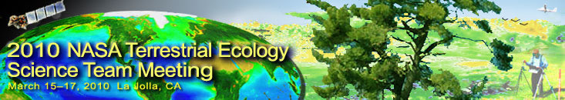
NASA Data Products and Data Systems for Terrestrial Ecology
Jeff Masek, NASA GSFC
March 16, 2010

Slide 2
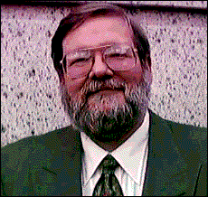
New Scientist, March 7 1992
Plans for massive NASA database 'too vague'
NASA came under fire last week over its plans for an Earth observation database which would be the largest database ever developed by a civilian agency.
When complete, the database will contain about 11,000 terabytes of data distributed among seven archiving centres around the US. The largest commercial databases hold gigabytes of data
NASA's director of modelling, data and information systems, Dixon Butler, says: 'It is a significant challenge, but it is not beyond the state of the art.'

Slide 3
Data/Analysis Products
Distribution
“Question
Based”
PI-driven Data Products
Project Computing / Distribution Facilities
MEASURES
Earth System Data Records (ESDRs)
“Parameter
Based”
ESIP Federation
(GLCF, EOS-Webster)
EOS Standard Products
“Instrument
Based”
…
Science Data Centers
(DAACs, SIPS, MODAPS)
MODIS
MISR
ASTER
AIRS
ACCESS Projects
(Technology Infusion)

Slide 4


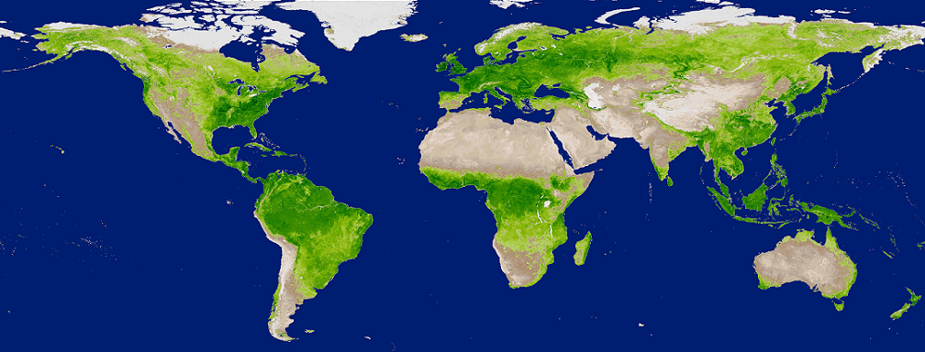
MODIS Land Collection 6
MODIS/Terra: 10+ years MODIS/Aqua: 7.5+ years
C6 L1B, Geolocation and
Cloud Mask/Profiles
- All products will reprocessed
and archived in LAADS by
January 2011
C6 Land and Atmospheres
- Land C6 products will be
available for community evaluation in Oct./Nov. 2010
- Land C6 reprocessing will start in Jan. 2011, proceed at 20-30x and complete in Fall 2011
- Atmosphere schedule will be similar to Land
All C5 products will be forward processed and archived during the C6 reprocessing (C5 reprocessing completed Spring 2008 – 2 years ago)
- Complete overlap with C6 to allow users to switch over gracefully
ROSES Terra/Aqua supports L2-4 algorithm refinement and incorporation of new products
Terra and Aqua missions could continue for an additional 5+ years
- Would allow community to switch over to VIIRS Land products

Slide 5
Status of EOS Standard Products: ASTER, MISR
ASTER Global DEM (GDEM) released 2009; now being updated
Some little-used product lines to be deleted:
AST_04: On-demand L2 Brightness Temperature at sensor
AST_06: On-demand L2 De-correlation Stretch (SWIR, TIR, VNIR)
AST13POL: On-demand L2 Polar surface and cloud classification
MISR – recently completed first reprocessing of earlier products

Slide 6
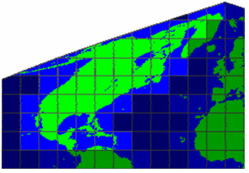
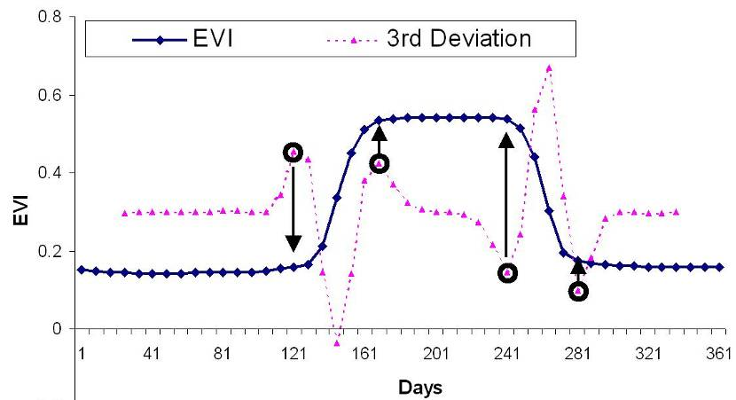
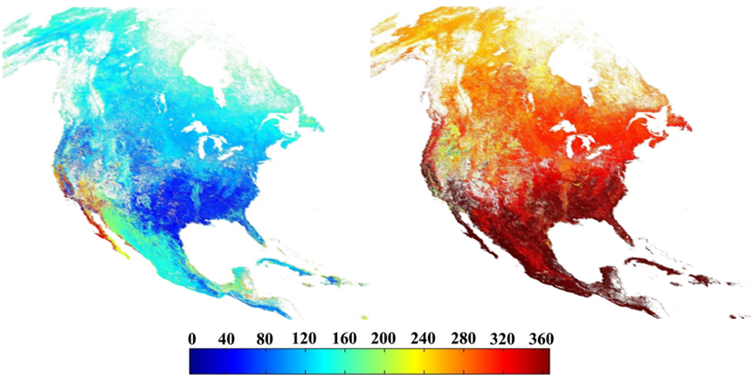
ACCESS MODIS4NACP: Improving access to science products from EO Satellites (R. Wolfe, GSFC)
Helping NACP investigators better utilize MODIS data products.
Products that meet researcher’s needs:
- Data through time with user-defined area
- One data set, appropriately filtered by the associated QA layer (smoothed and gap filled)
- Post processing options: reprojection, mosaicing, reformatting, etc.
NACP Region
Key phenology dates:
Greenup
Browndown
0
360
Recent progress:
- Smoothing and gap-filling algorithm is being extended to MODIS C5 land products (NDVI/EVI @ 250/500m and BRDF @ 500m)
- Web Service methods are now available to access post processing capabilities

Slide 7

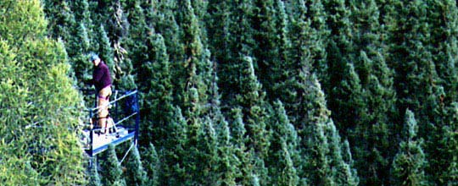
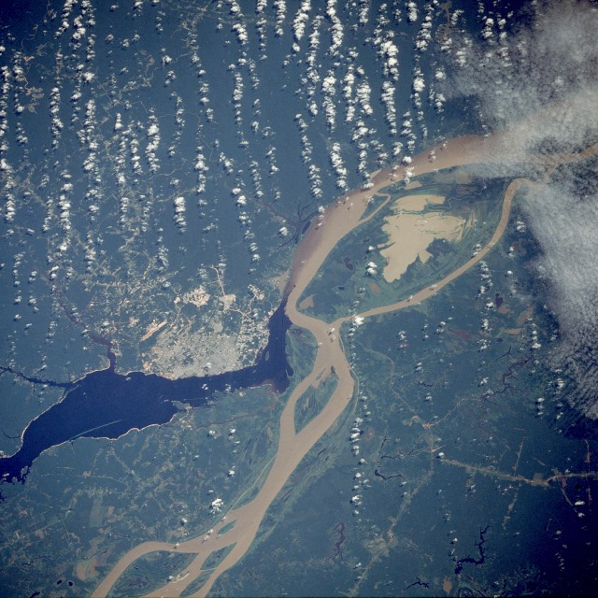
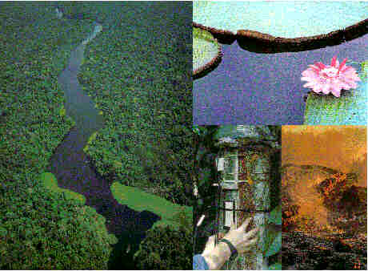
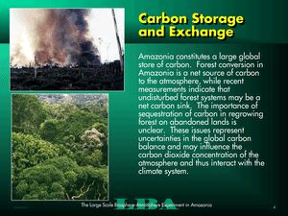
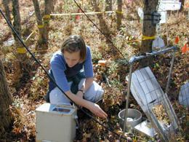
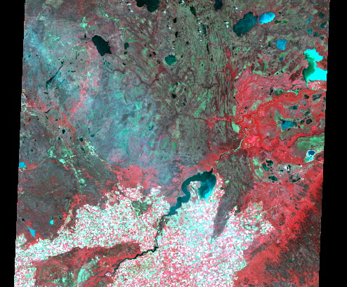
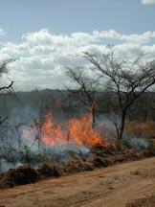
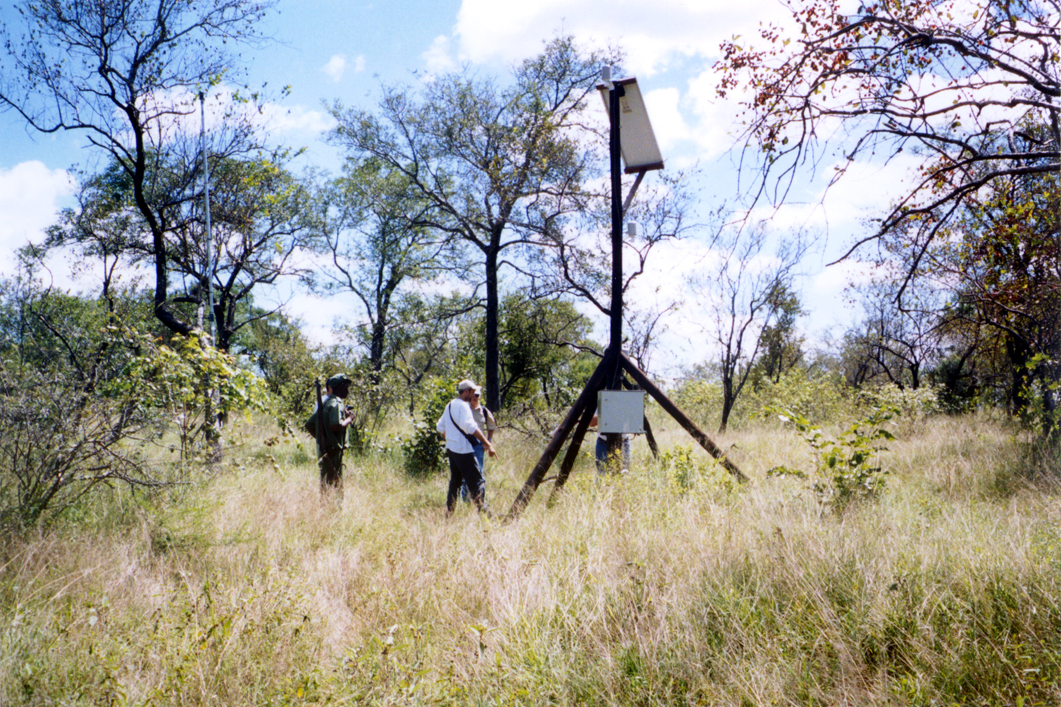
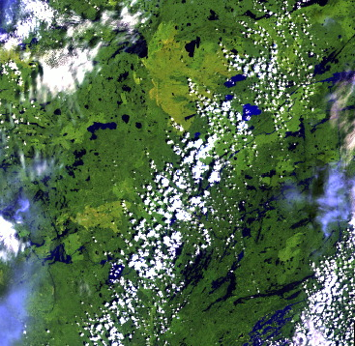

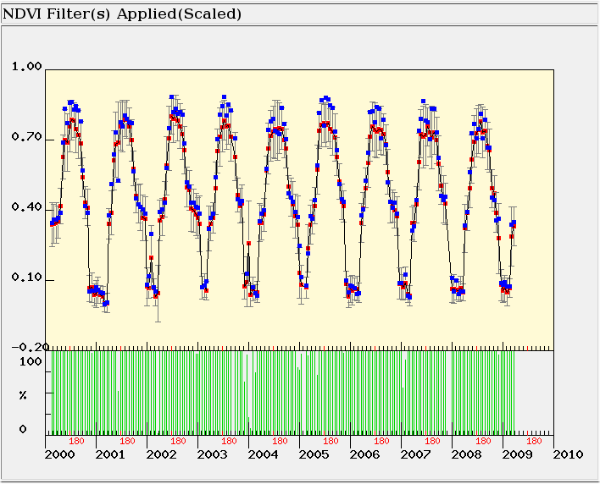
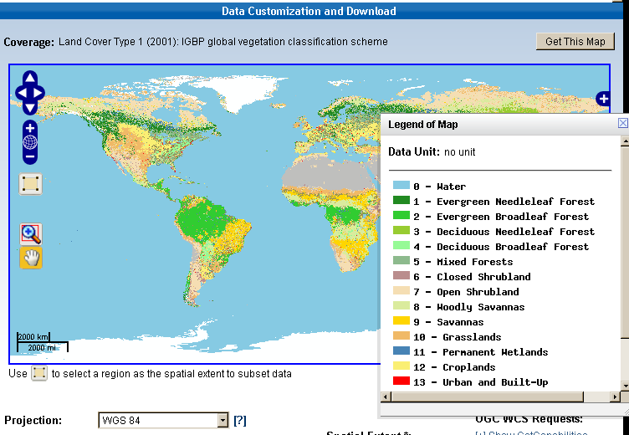
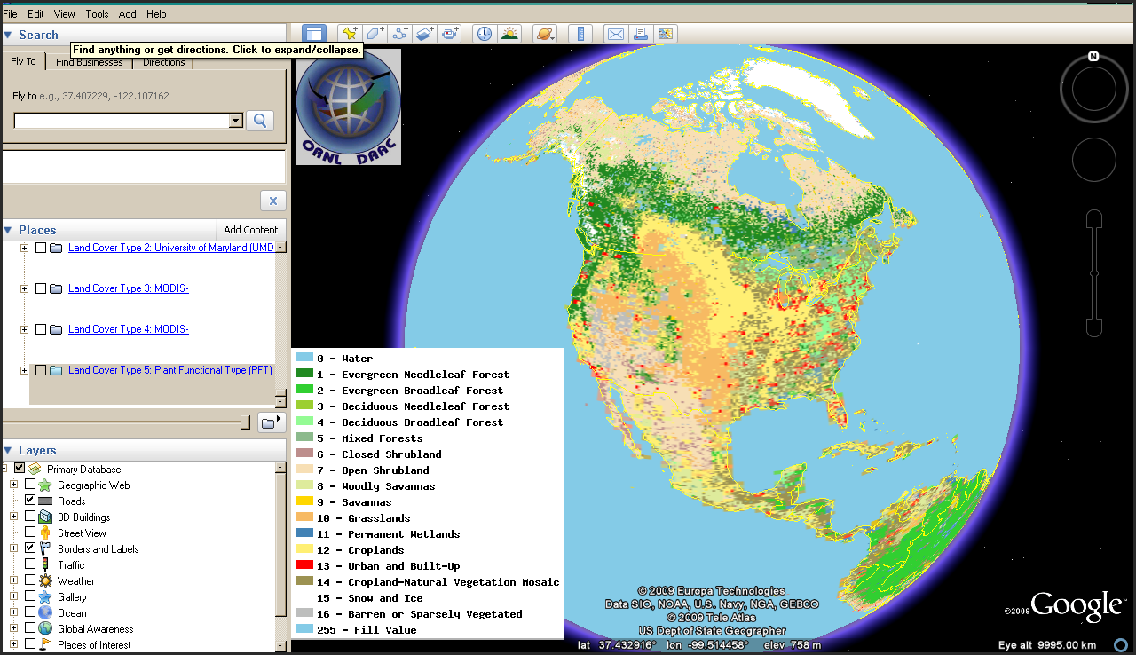
Distributed Active Archive Center for
Biogeochemical Dynamics (ORNL DAAC)
Contact: Bob Cook (cookrb@ornl.gov)
Holds and delivers data on NASA Field campaigns, regional and global data for biogeochemistry, and satellite validation
  Also manages site information for FLUXNET
Provides a range of tools for data discovery, data visualization, and data subsetting
  Tools to make remote sensing data accessible to field scientists
BOREAS
In-situ
Observations
Remote Sensing
LBA
?
LBA
LAI/fPAR
NPP
LAI/fPAR NPP
S2K
S2K
Field Campaigns
Validation
Center Pixel
Mean Value of Pixels
Percent of Pixels that meet QC Criteria
MODIS Land Product Subsets (NDVI)
MODIS Land Cover Displayed in Google Earth
Spatial Data Access Tool (MODIS Land Cover)

Slide 8
Earth System Data Records (ESDRs)
“Missions to Measurements”
Focus on the long-term parameter rather than the sensor
Fusion/reconcilation across multiple sensors
Intercalibration across time (e.g. AVHRR – MODIS – VIIRS)
NASA Earth System Data Record
An ESDR is defined as a unified and coherent set of observations of a given parameter of the Earth system, which is optimized to meet specific requirements in addressing science questions.
…Like NOAA CDR (Climate Data Record) but more expansive
Fundamental CDR –radiance, reflectance, temperature, backscatter
Thematic CDR – Earth Science parameter
…or GCOS ECV (Essential Climate Variable)

Slide 9
GCOS/GTOS Terrestrial ECVS
“These … ECVs were originally identified in the implementation plan developed by GCOS and its partners as the observations that are currently feasible for global implementation, and have a high impact on the requirements of the UNFCCC”
River Discharge
Water Use
Global Terrestrial Network for Groundwater
Lake/Reservoir Levels and Volumes
Snow Cover
Glaciers and Ice Caps
Global Terrestrial Network for Permafrost
Albedo and Reflectance Anisotropy
Land Cover
Fraction of Absorbed Photosynthetically Active Radiation (fPAR)
Leaf Area Index (LAI)
Biomass
Fire Disturbance

Slide 10
MEASURES (Making Earth System Data Records for Use in Research Environments)
NASA program to fund implementation of ESDR’s
- peer reviewed submissions from community
- selections based on panel + Program Manager
- no “master list” of required/desired ESDRs**
- emphasis on cross-sensor, long-term data records
- algorithms must be established
- science / user community input required
- five-year period of performance
**MODIS Land Team assembled white papers on Land ESDRs in 2007/2008.

Slide 11
MEASURE: Land Cover/Vegetation
PI First name | PI Last name | Organization | Title
Kamel | Didan | University of Arizona | Vegetation Phenology and Enhanced Vegetation Index Products from Multiple Long Term Satellite Data Records
David | Roy | South Dakota State University | Web-enabled consistent large area Landsat data streams and derived surface characterizations - a MODIS-Landsat data fusion for the terrestrial user community
John | Townshend | University of Maryland | Earth Science Data Records of Global Forest Cover Change

Slide 12
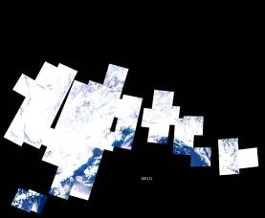
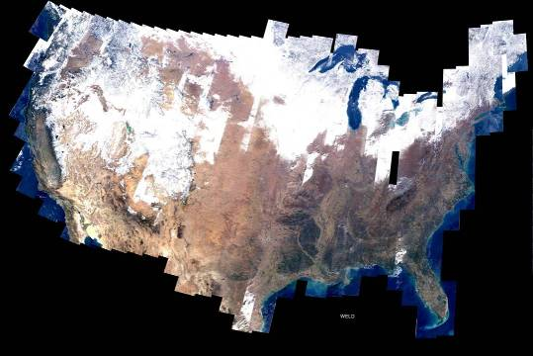
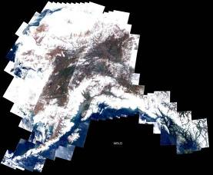
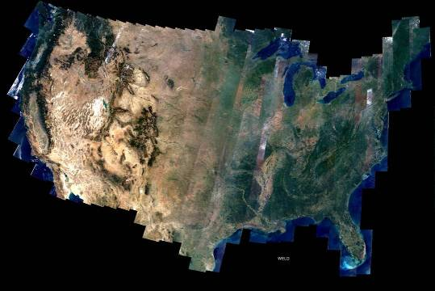
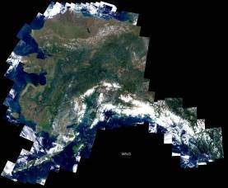
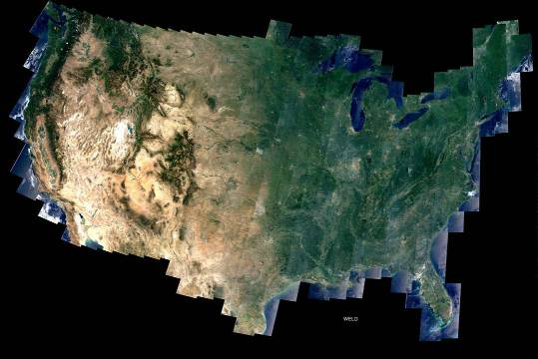
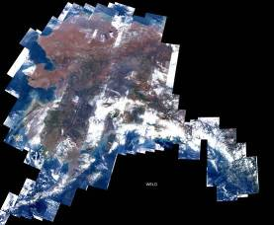
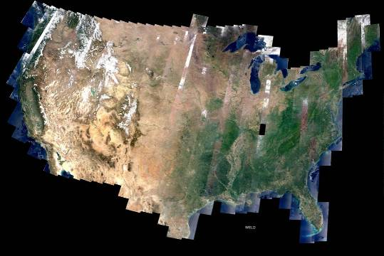
Web-Enabled
Landsat Data (WELD)
(David Roy & Junchang Ju, SDSU)
30m ETM+ composited mosaics
  Weekly
  Monthly
  Seasonal
  Annual
Alaska
Conterminous United States
7 years
Generated from every L1T ETM+ acquisition in the US archive with cloud cover ≤80%

Slide 13
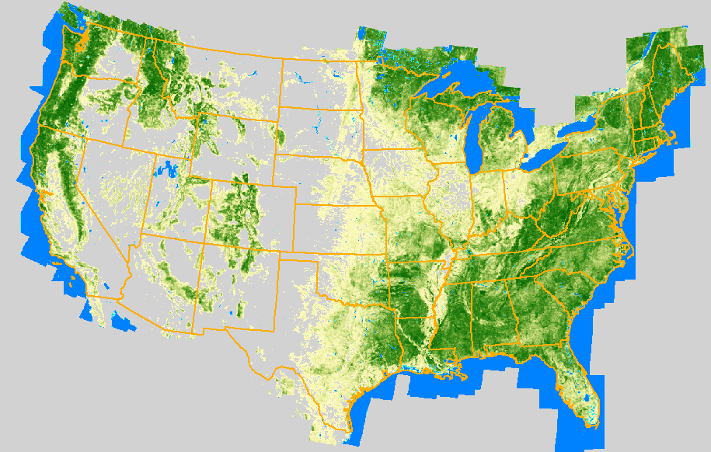


Latest version of the 30m WELD 2008 Landsat
Percent Tree Cover and Water classification
% Tree
cover
% Water
100
100
0
(Matt Hansen & Alexey Egorov)
0

Slide 14
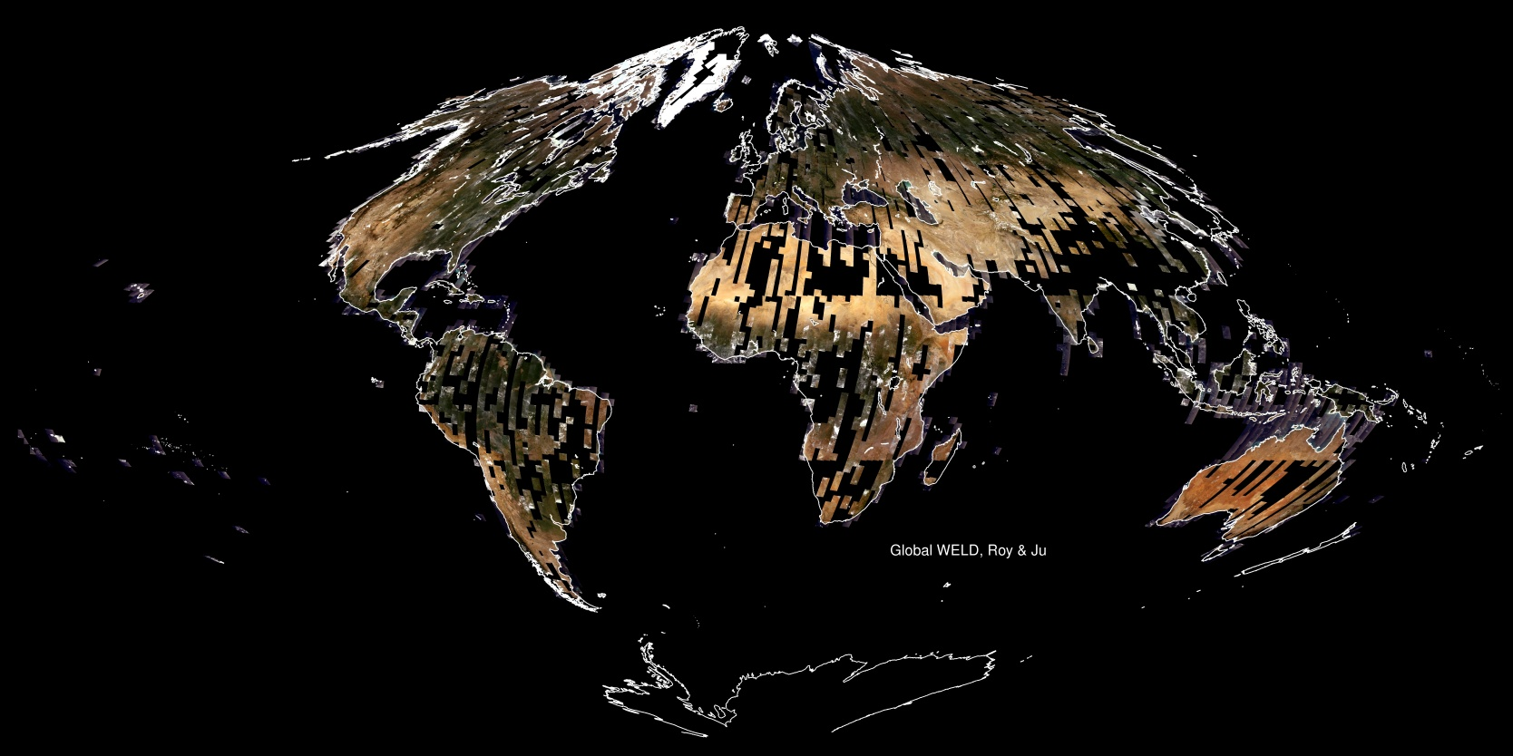
WELD Global Composite (2009/2010) from 6796 Landsat images with <40% cloud cover

Slide 15

Vegetation Index and Phenology ESDRs from Multiple Long Term Satellite Data Records
Kamel Didan (UA), Miura Tomoaki (UH), Friedl Mark (BU), Xioyang Zhang (NOAA), Czapla-Myers Jeff (UA), Van Leeuwen Willem(UA), Jenkerson Calli (LP-DAAC), Meyer David (LP-DAAC)
NASA MEASURES
Notes:
We’re a multi-institution team (main group at the Univ. of Arizona + members from University of Hawaii, Boston Univ., NOAA, USGS-EROS LP-DAAC. We’re also collaborating with the US-NPN).
We’re supported through a NASA MEASURE’s Grant (started Aug. 2008). Our first data release is planned late this year (2010).

Slide 16
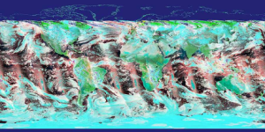
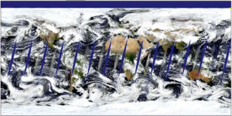



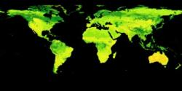

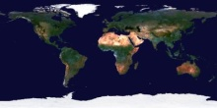
Data and methods
AVHRR record, ‘81 – ‘’99
MODIS record, ‘00 – ’13
‘98-’02 SPOT- VGT Data to
Bridge AVHRR & MODIS records
Data retention filter.
Only retain high quality data
VIIRS ?
Homogenous clusters map.
Areas with same characteristics
Continuity Transfer Function map
1981 -2013 sensor independent surface reflectance record
Notes:
The goal of our project is to combine the AVHRR (1981-1999), MODIS (2000-2013) and VIIRS (when available) into a single seamless data record.
This requires developing a set algorithms to address the across sensors continuity (different spectral and radiometric characteristics).
Because of the lack of overlap between AVHRR and MODIS, we’re using SPOT-VGT to bridge this gap and support the continuity work.
The continuity algorithms are based on the homogeneous clusters approach. Areas with similar vegetation, elevation, precipitation, temperature regimes, etc… are expected to have the
same VI temporal patterns. We’re developing continuity transfer functions for each of these homogeneous clusters from the periods of overlap.
Using these continuity transfer functions we will transform the AVHRR record into a MODIS like record, and consequently a sensor independent records.

Slide 17
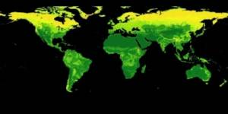
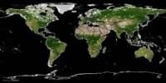
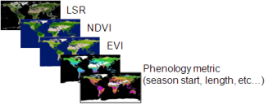

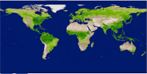

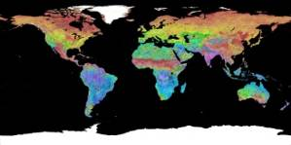
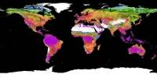
ESDR Products and objectives
  Long term, multi-sensor, reliable, and consistent Earth Science Data Records (ESDR) of
    EVI (2-band version) and NDVI, and
    A set of Remote Sensing based Land Surface Phenology metrics
LSR
1981
..
..
..
2013
NDVI
Product Characterization
Errors/Uncertainty
in EVI/NDVI
EVI
Phenology metrics
(season start, length, etc…)
Errors/Uncertainty
in Phenology metrics
EVI/NDVI & Phenology ESDRs
These ESDRs are expected to be well characterized and of high consistency to support studying climate change impacts on the Earth system.
First generation product to be released late 2010
(check http://measures.arizona.edu & http://measuresvip.cr.usgs.gov )
Notes:
We will generate a sensor independent 2-band EVI - because there is no blue band in AVHRR (see Jiang et al , RSE, 2008).
For completeness we’ll generate an NDVI record too.
And we will also generate a set of phenology parameters (start of season, end of season, length of season, etc…).
All products are at CMG resolution (0.05 Deg).
The VI products will be daily and multi-daily and the phenology metrics will be generated once a year.
The EVI and Phenology Earth Science Data Records (ESDR) will be characterized with field data and from the US-NPN (National Phenology Network)
to assess their error and uncertainty and permit accurate change research.
First products from this project are expected to be released around the end of 2010.

Slide 18
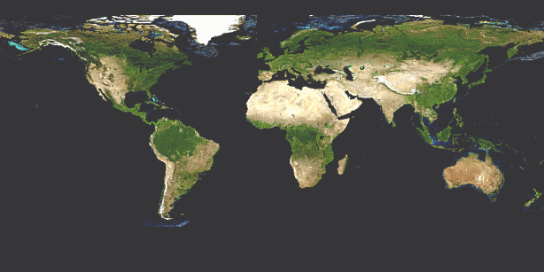
Eric Vermote - Land Climate Data Record
Multi instrument/Multi sensor Science Quality Data Record used to quantify trends and changes in surface reflectance and NDVI (funded by NASA REASON, NOAA CDR Programs)
81
82
83
84
85
86
87
88
89
90
91
92
93
94
95
96
97
98
99
00
01
02
03
04
05
06
07
08
09
10
11
N16
N17
N07
N09
N11
N09
N14
N16
AVHRR
VEGETATION
Terra
MODIS
Aqua
  AVHRR (GAC) 1982-1999 + 2003-2006
  MODIS (MO(Y)D09 CMG) 2000-present
  VIIRS 2010 – 2020
  SPOT VEGETATION 1999-2000
NPP
VIIRS
NPOESS
  Emphasis on data consistency – characterization rather than degrading/smoothing the data
  Calibration, Atmospheric Correction, BRDF Correction

Slide 19
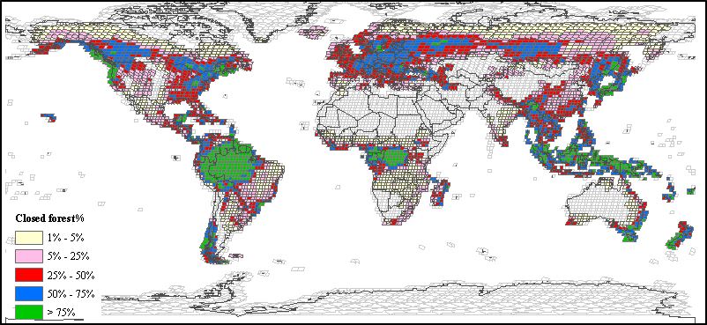
ESDR of Global Forest Cover Change
A NASA MEaSUREs Project (PI: JRG Townshend, UMD)
Global 30m forest cover change from Landsat decadal data (1990, 2000, 2005)
  Forest fragmentation analysis
  Protected area subsets
Global surface reflectance from Landsat (1990, 2000, 2005)
Global 250-m MODIS vegetation continuous field (VCF) harmonized with high-resolution forest cover change

Slide 20
Cryosphere/Hydrology
PI First name | PI Last name | Organization | Title
Ian | Joughin | Applied Physics Lab, University of Washington | Greenland Ice Mapping Project: Measuring rapid changes in ice flow
John | Kimball | Flathead Lake Biological Station | An Earth System Data Record for Land Surface Freeze-Thaw State: Quantifying Terrestrial Water Mobility Constraints to Global Ecosystem Processes.
Ronald | Kwok | Jet Propulsion Laboratory | ESDR of small-scale kinematics of Arctic Ocean sea ice
Eric | Rignot | Jet Propulsion Laboratory | Ice Velocity Mapping of the Great Ice Sheets: Antarctica.
David | Robinson | Rutgers University | Development of Northern Hemisphere Snow and Ice Climate Data Records
Kyle | McDonald | Jet Propulsion Laboratory | An Inundated Wetlands Earth System Data Record: Global Monitoring of Wetland Extent and Dynamics
Eric | Wood | Princeton University | Developing consistent Earth System Data Records for the global terrestrial water cycle.

Slide 21

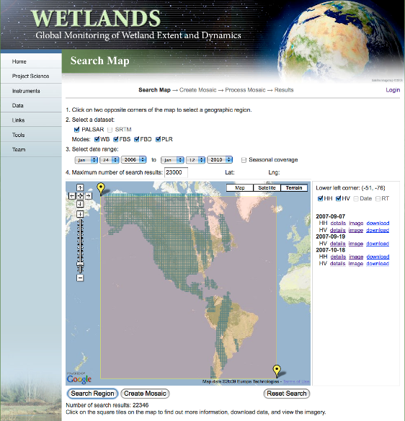
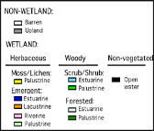
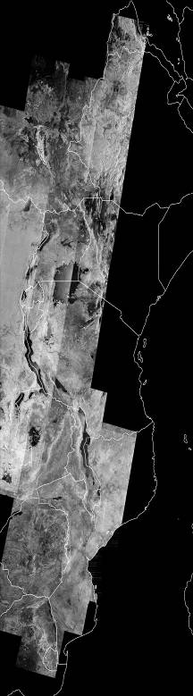
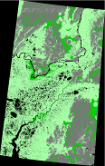
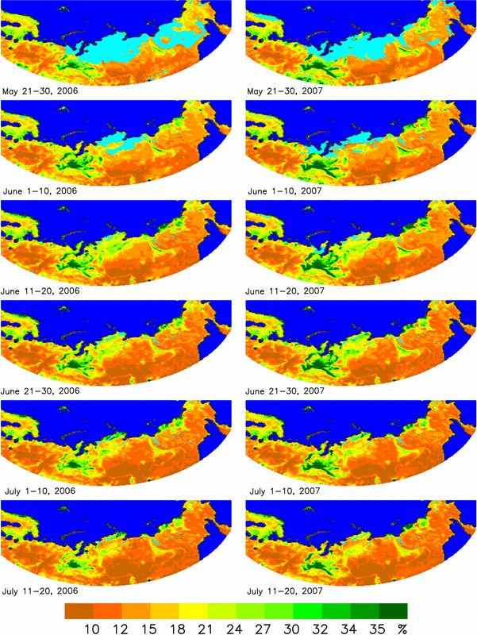
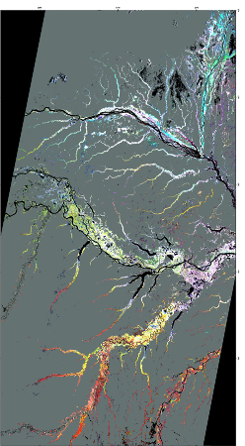
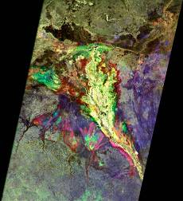
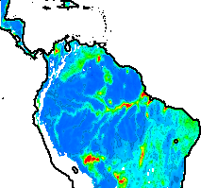

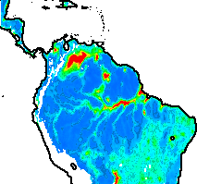
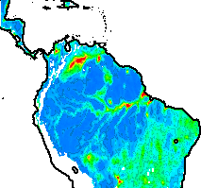











An Inundated Wetlands Earth System Data Record:
Global Monitoring of Wetland Extent and Dynamics
Kyle C. McDonald (JPL/Caltech; PI) kyle.mcdonald@jpl.nasa.gov
Science Products:
Inundated wetland area (swath-by-swath)
Principal wetland vegetation classes (non-vegetated, herbaceous, shrub, woodland, forest)
Seasonally based summary products describing timing and extent of wetland inundation
Global data sets of inundated area fraction at 25 km postings and high temporal fidelity
Production is phased according to ALOS Kyoto & Carbon Initiative data acquisitions
Boreal Wetlands:JERS
ALOS ScanSAR Focus Regions
Boreal Wetlands:
PALSAR
Africa: ScanSAR Inundation Mapping
Amazon: PALSAR ScanSAR
Inundated Area Fraction
Inundation
Timing:
ALOS ScanSAR
Western Siberia
Product Harmonization
This work was carried out at the Jet Propulsion Laboratory, California Institute of Technology under contract with the National Aeronautics and Space Administration.
This work has been undertaken in part within the framework of the JAXA ALOS Kyoto & Carbon Initiative. PALSAR data were provided by JAXA EORC (McDonald et al 2010)

Slide 22




PI Data Sets from TE Program
National Biomass and Carbon Dataset (J. Kellendorfer, WHRC)
North American ASTER Land Emissivity (S. Hook, JPL)
North American Forest Dynamics (S. Goward, UMD)
LEDAPS (J. Masek, GSFC)
Global Fire Emissions Dataset – GFED (J. Randerson, UCI)
VULCAN Fossil Fuel Emissions (K. Gurney, Purdue)
…

Slide 23
NASA
Earth
Exchange
(NEX)
R. Nemani,
NASA ARC

Slide 24
Issues for Discussion (1/2)
1. What additional long-term data records (CDRs, ESDRs) need to be created to support the program science goals ?
  what are the priorities for long-term data records?
  - Earlier MODIS ST White Papers are moribund
    - Need community priorities (ie. from data consumers)
  how to update ESDRs that were created during 5-year projects?
  should we link to international (ECV) and/or interagency (CDR) efforts?
2. What is the strategy for deciding which existing TE products should be maintained or enhanced?
  EOS standard products
  MEASURES/REASON/ACCESS products
  R&A products

Slide 25
Issues for Discussion (2/2)
3. Access to (and archiving of) airborne data sets (e.g. AVIRIS, LVIS), and higher-level products derived from airborne data
4. Are data products as accessible and usable as they need to be? (e.g. via ECHO, DAAC websites, GCMD, Google). What additional web services (beyond search/order) are needed by the community? What does the modeling community need (beyond TimeSat)?
Future evolution of Earth Science data systems – what are current plans for the Decadal Survey missions?
- Terrestrial Ecology Working Group on Data?

Slide 26
Thank You

Slide 27








Earth Science Data Systems (Core and Community)
NCAR, U of Col.
HIRDLS, MOPITT, SORCE
GSFC
GLAS, MODIS, OMI, OCDPS
NSIDC DAAC
SEDAC
LP DAAC
ASF DAAC
1
CDDIS
GES DISC
JPL
MLS, TES
1
1
1
1
1
1
OBPG
1
1
1
2
7
1
1
8
1
1
1
2
1
1
2
4
7
2
1
1
1
1
1
1
1
1
1
LAADS
1
1
2
1
1
9
3
6
1
1
1
1
1
PPS
1
1
1
ASDC
San Diego
ACRIM
1
LaRC
CERES, SAGE III
GHRC
PO.DAAC
GHRC
AMSR-E, LIS
ORNL DAAC
KEY
Core
Community
EOSDIS Data Centers
Related Data Providers
Measurement-based Systems
Science Investigator-led Processing Systems (SIPSs)
41
REASoN
29
MEaSUREs
17
ACCESS

