Slide 1
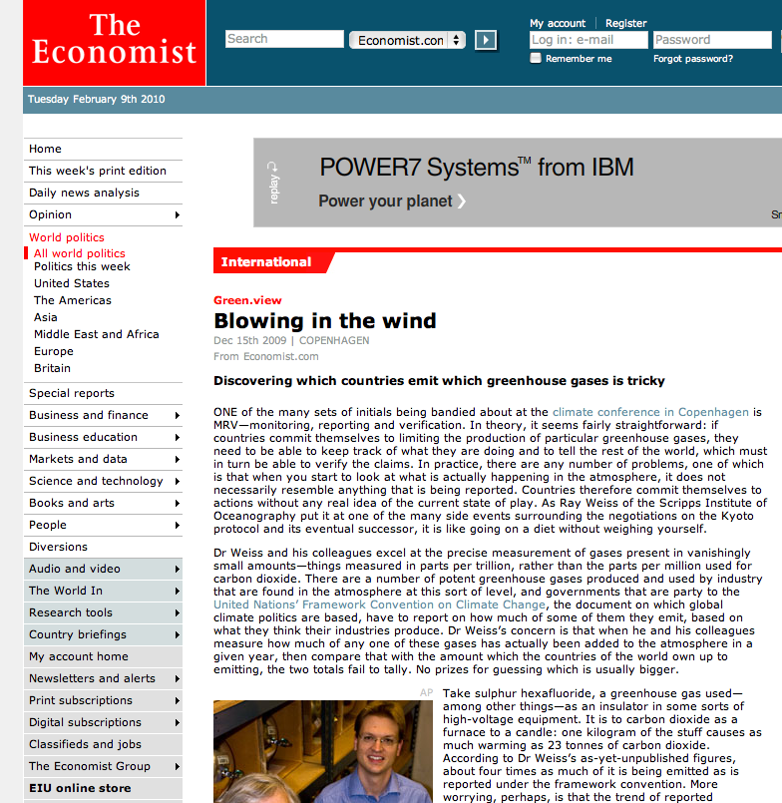
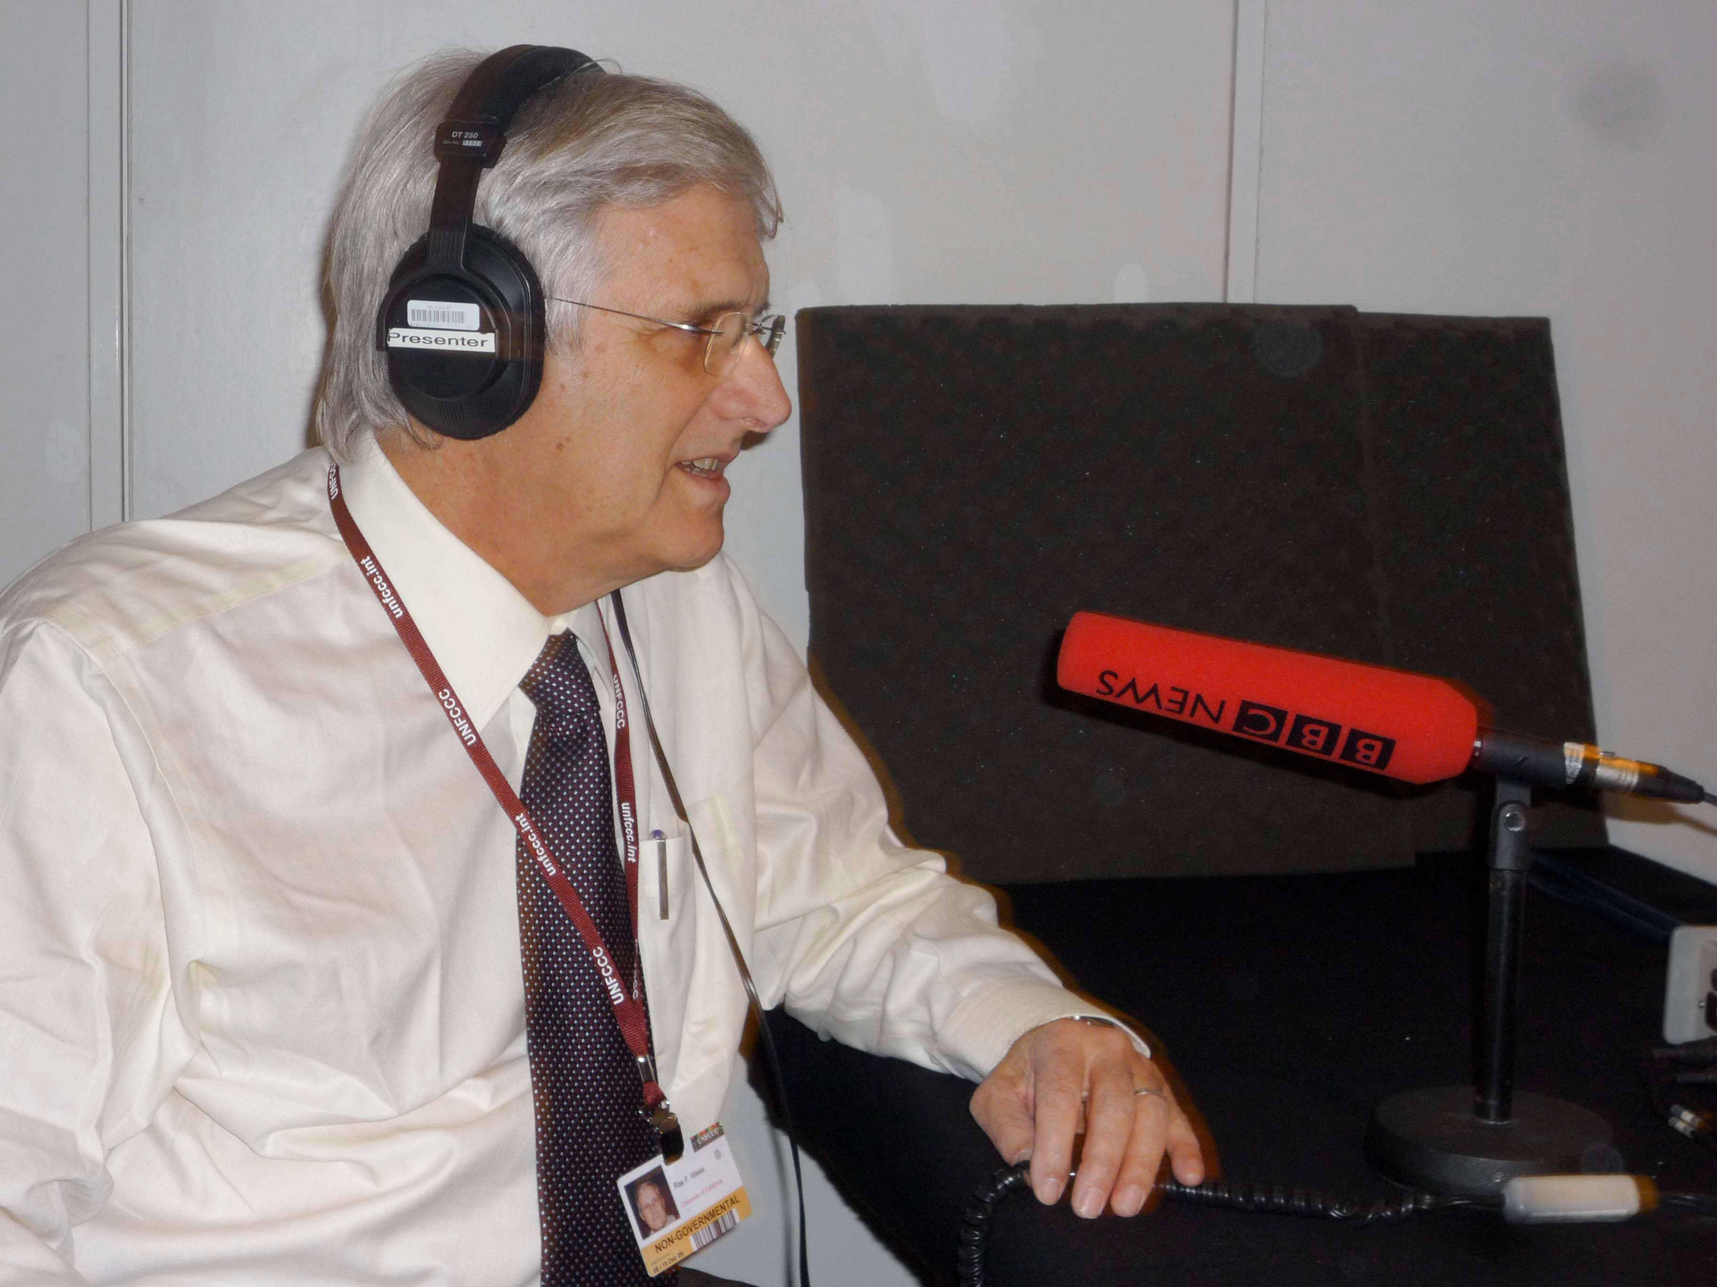
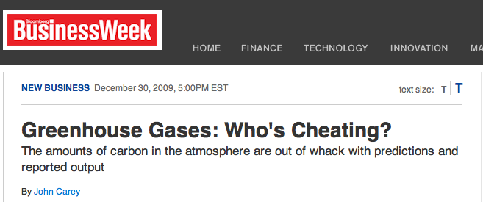
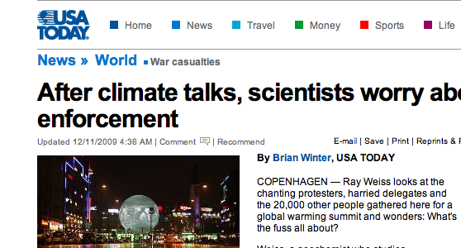
The Sleeper Issue of Copenhagen
Verification a surprise major COP-15 science issue
Photo: Scripps Oceanography
Notes:
During the COP-15 climate talks, my colleague Ray Weiss and I made the case in a news conference for improvements in verification technology, which as I mentioned earlier is an issue on which Ray has been raising awareness for the past few years. A few days after our talk, verification emerged as one of the main points of contention between the United States, which wanted to monitor the emissions of other countries independently, and China, which in so many words told it to buzz off. About the same time this exchange was going, BBC Radio was interviewing Ray during its morning rush hour program and the story exploded from there. We were wondering when people were going to catch up.
1

Slide 2
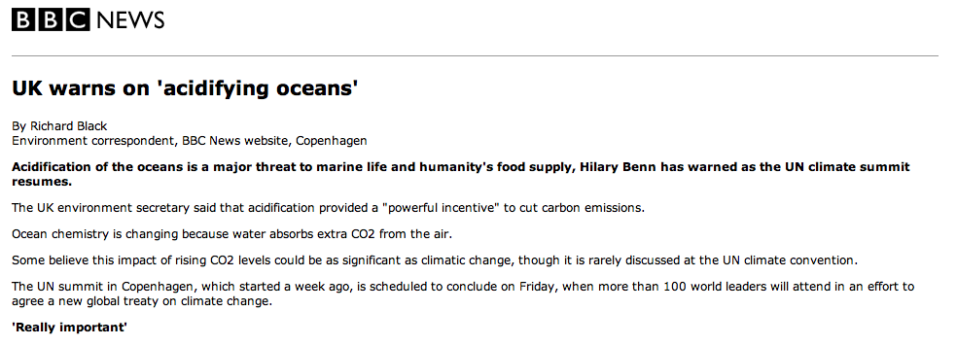
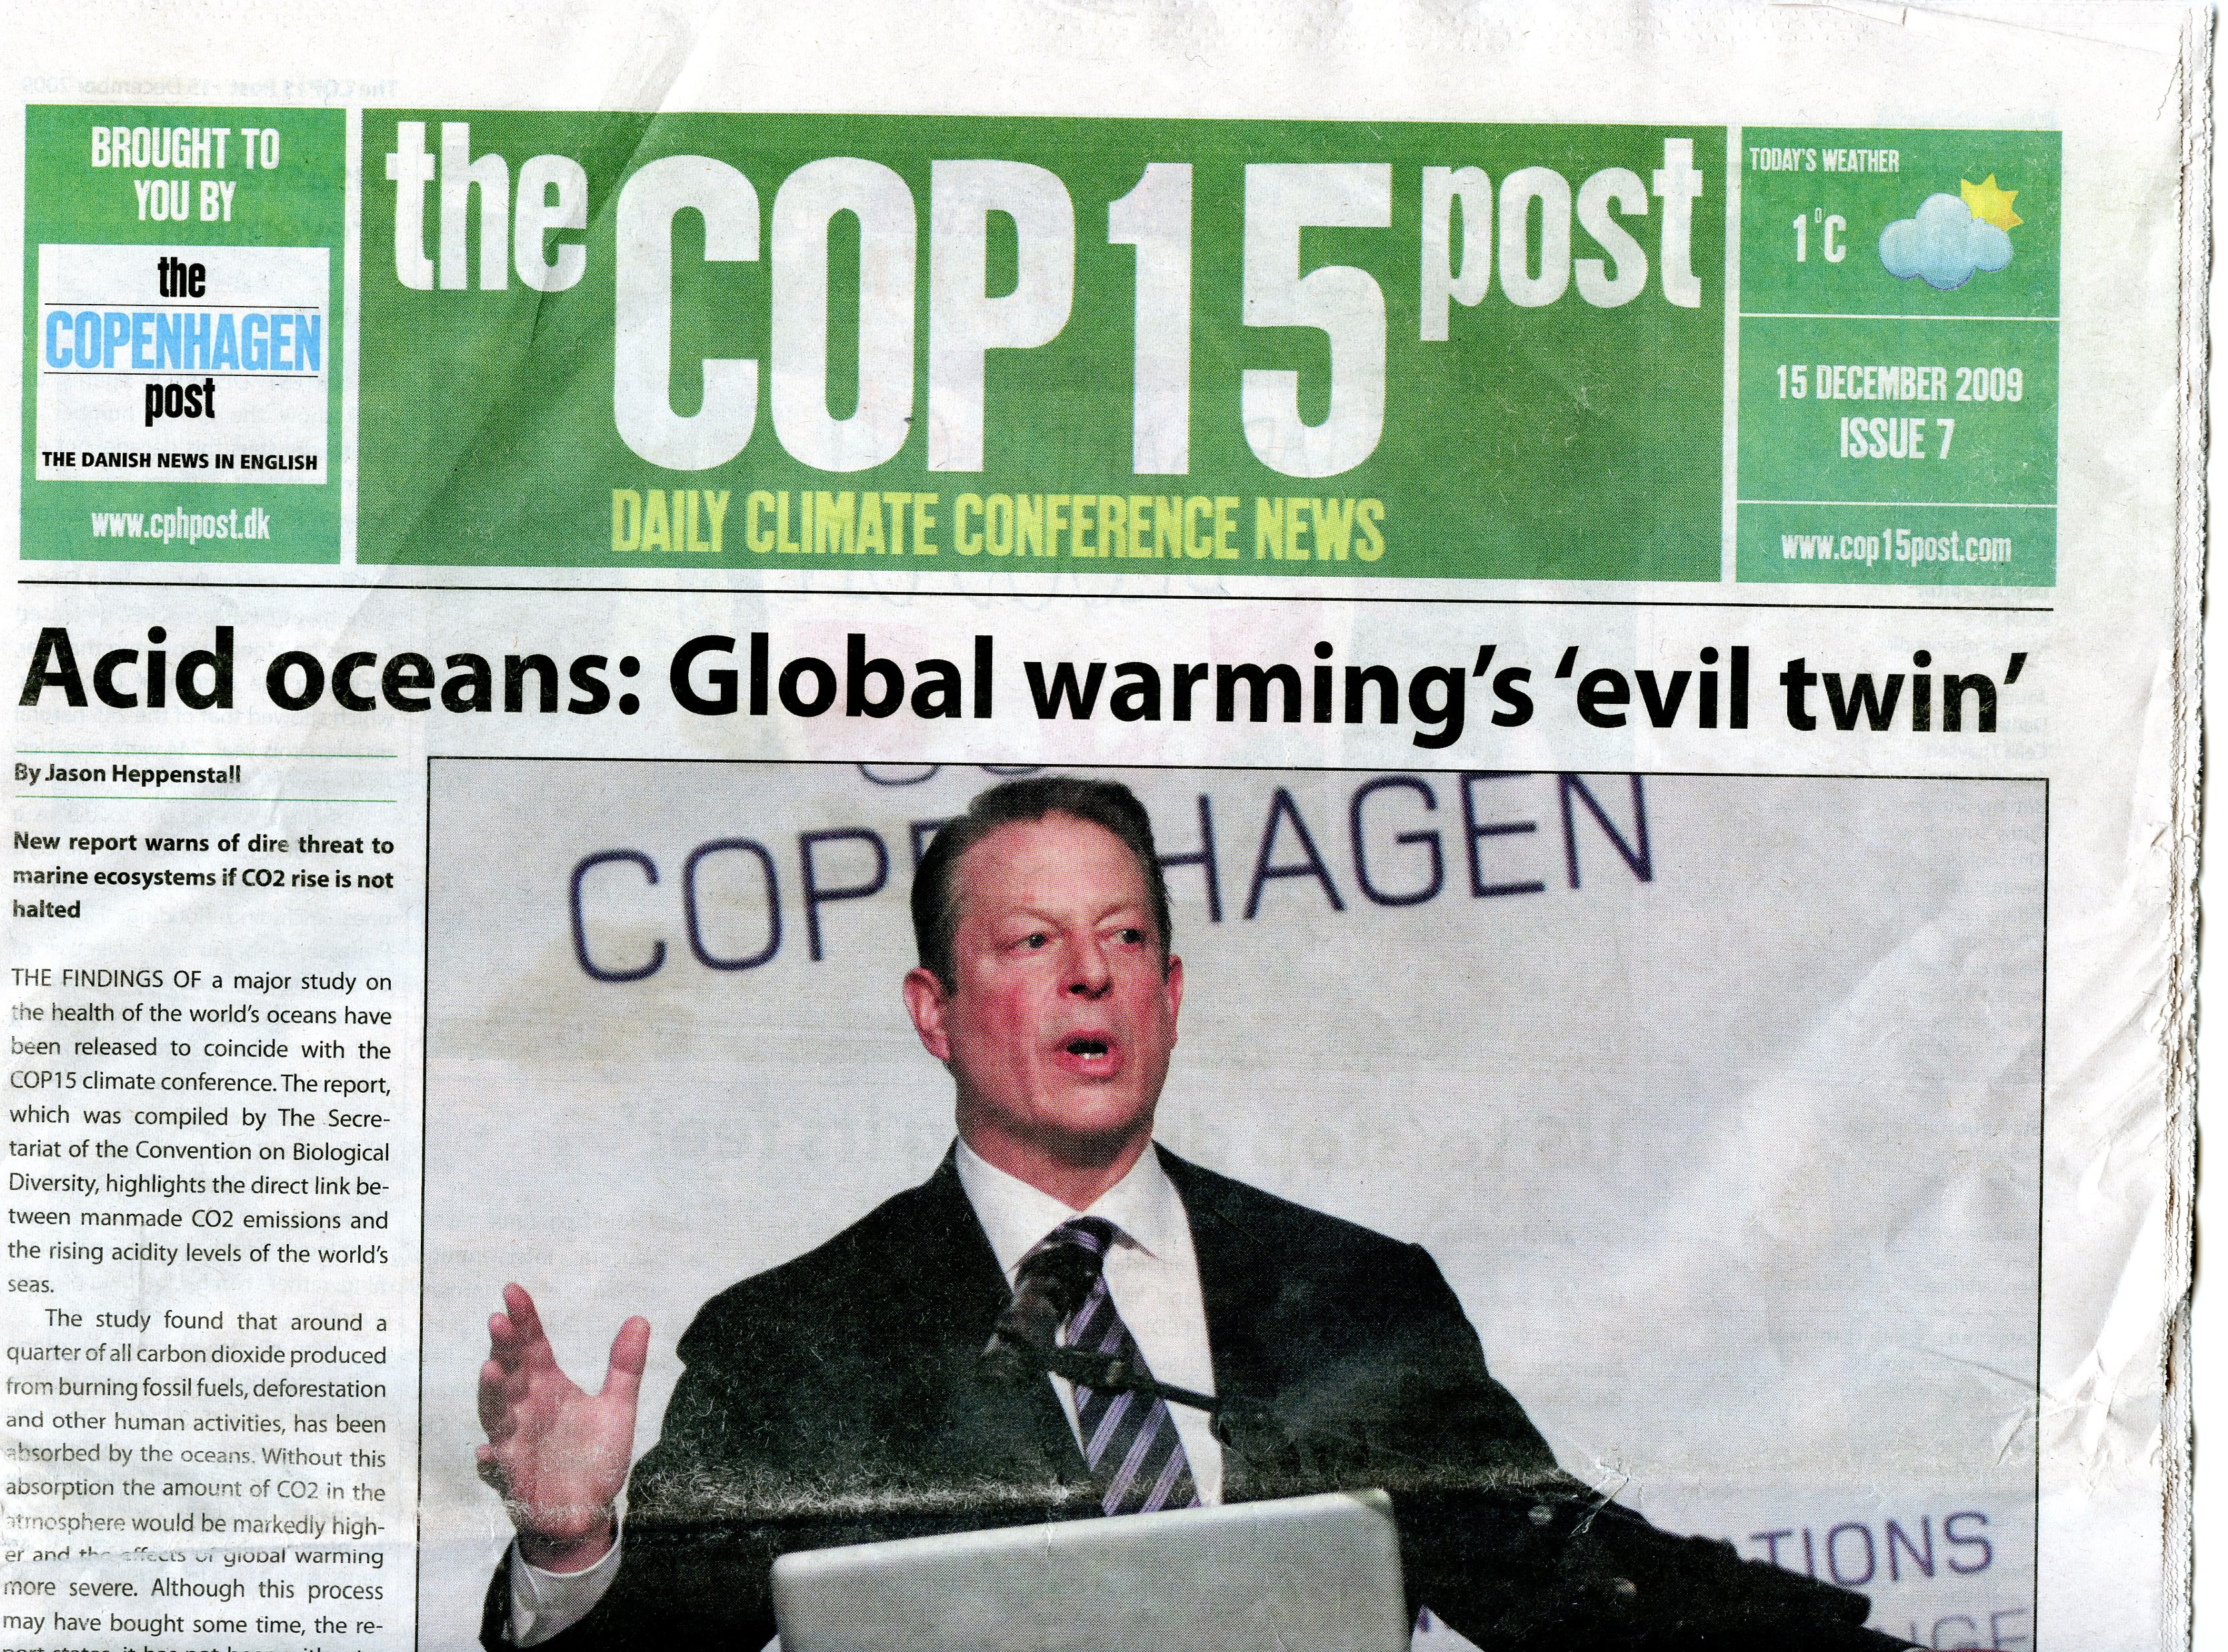
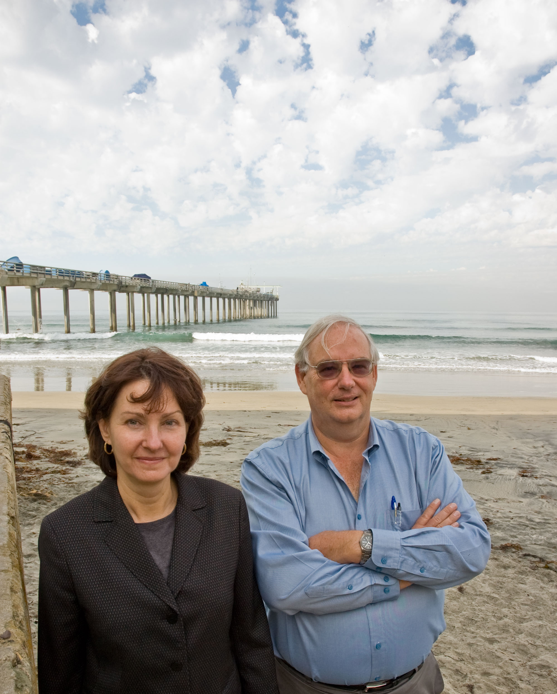
Ocean Acidification Becomes Warming’s ‘Evil Twin’ at COP15
Photos: Scripps Oceanography
Notes:
Ocean acidification finally got the attention it deserved at COP15 – at least from the media.
2

Slide 3
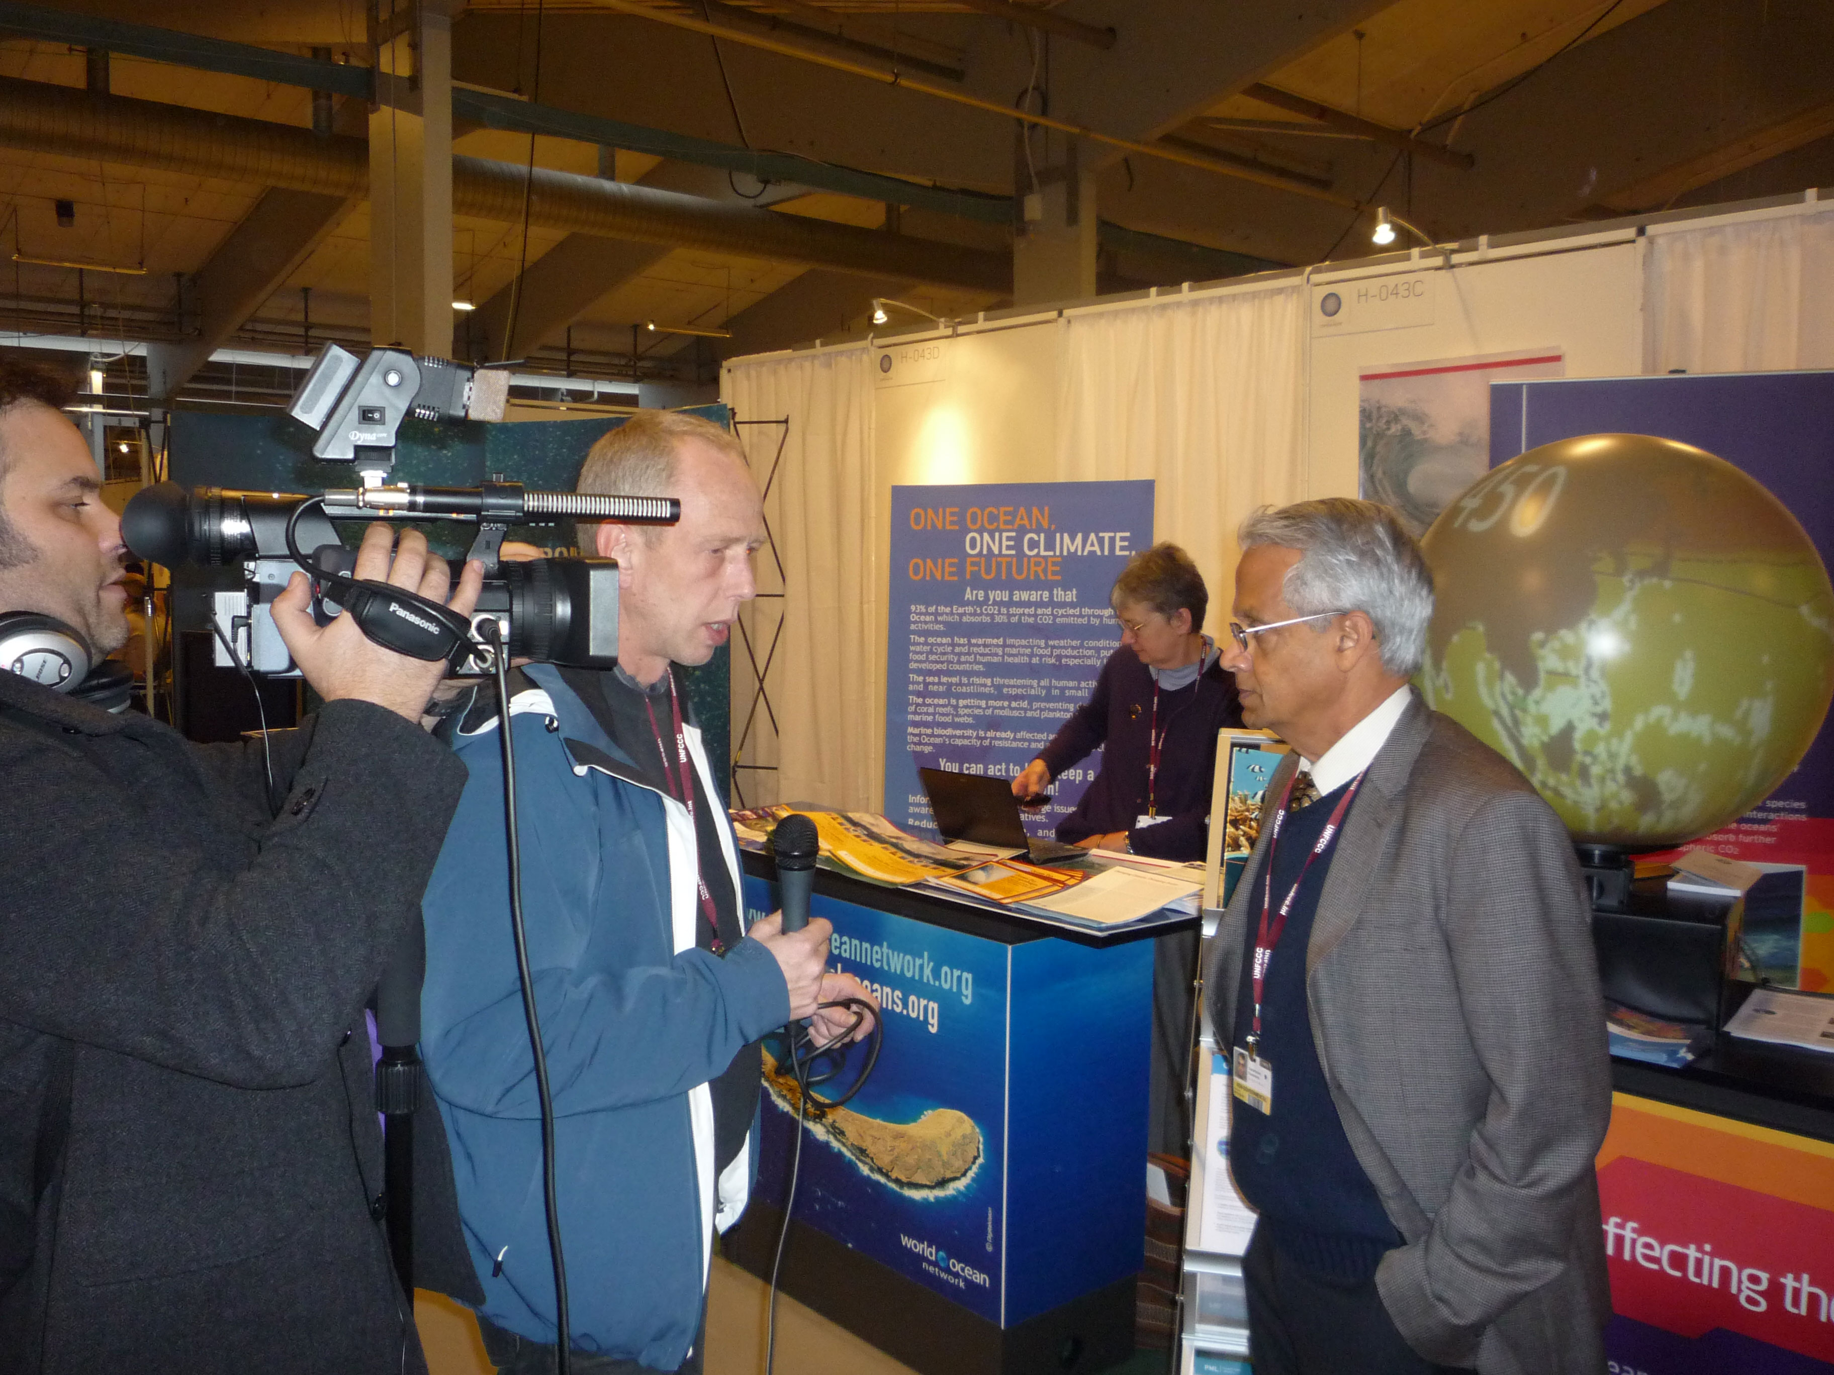
The ‘Low-Hanging Fruit’
An antidote to international gridlock emerges in black carbon control
Photos: Scripps Oceanography
Notes:
COP15 delegates arrived to the conference to find to a special edition of the International Herald Tribune entitled “The Business of Green” distributed widely in hotels and other venues. Featured prominently was the work of Scripps’ Ram Ramanathan, who is measuring the atmospheric effects of soot removal on increasingly large scales. Ram’s Project Surya is providing the means to clean the air by replacing the crude cookstoves used by many of India’s poor with high-efficiency alternatives.
3

