Slide 1


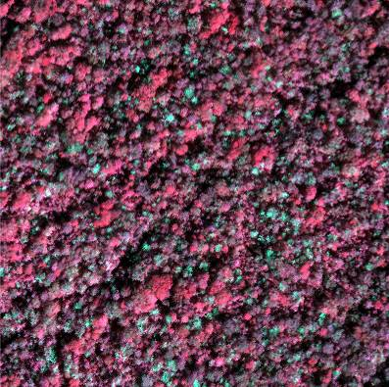
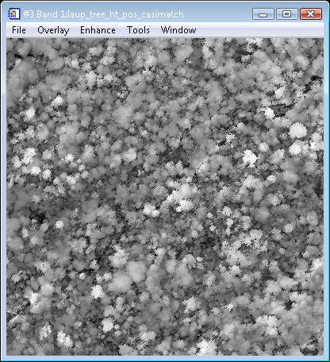
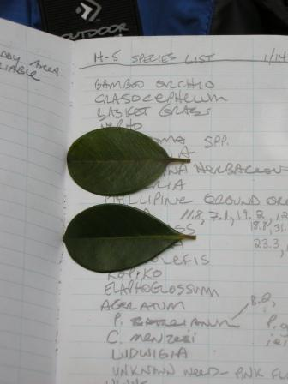
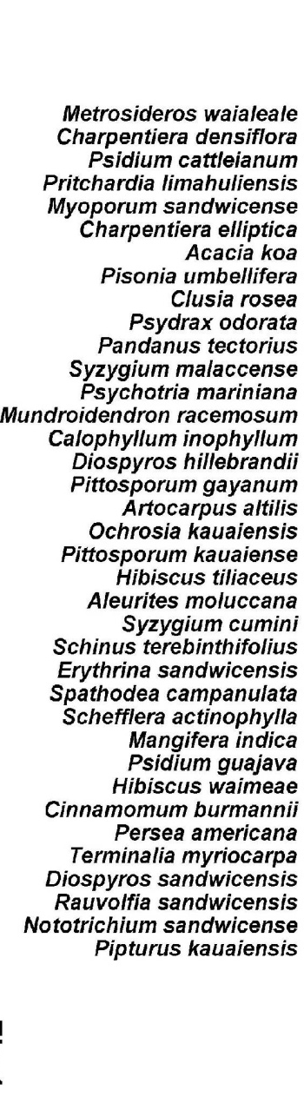
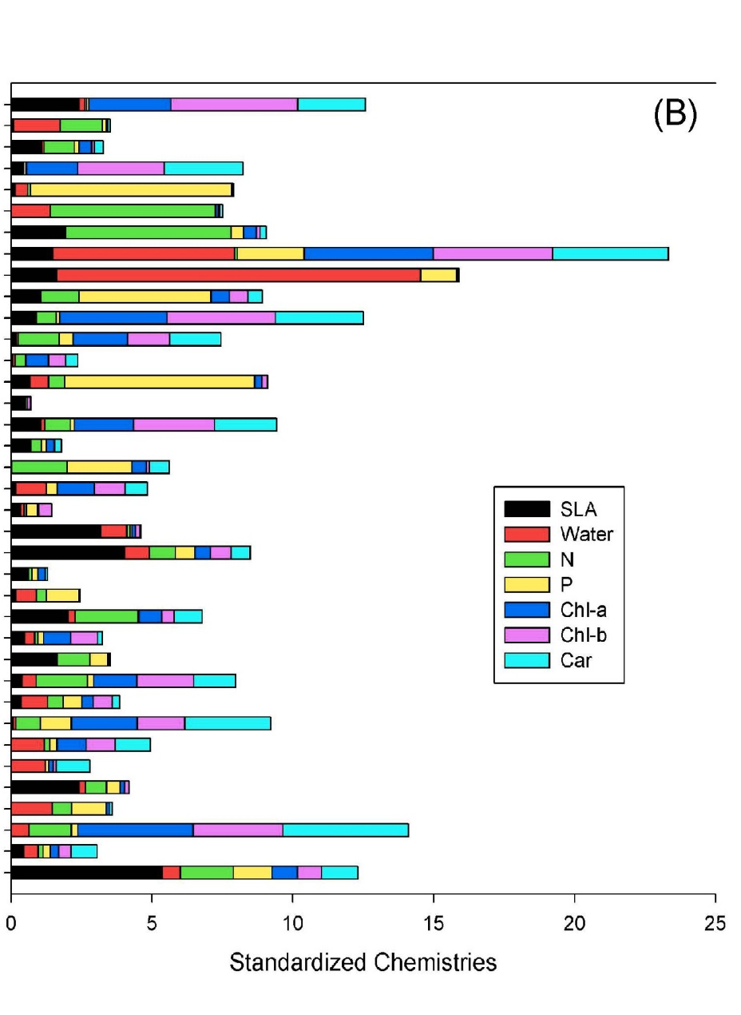
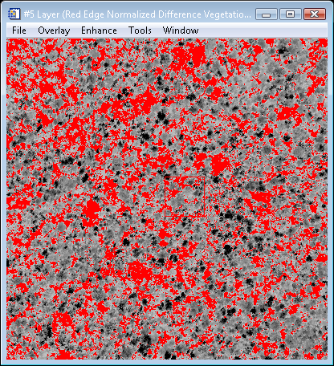
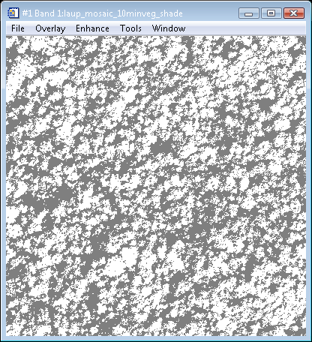
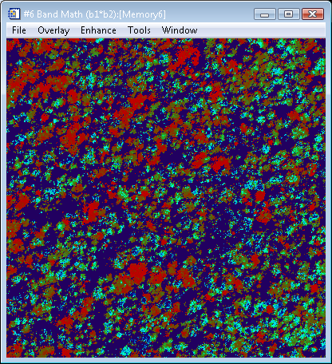

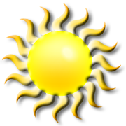
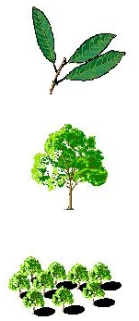
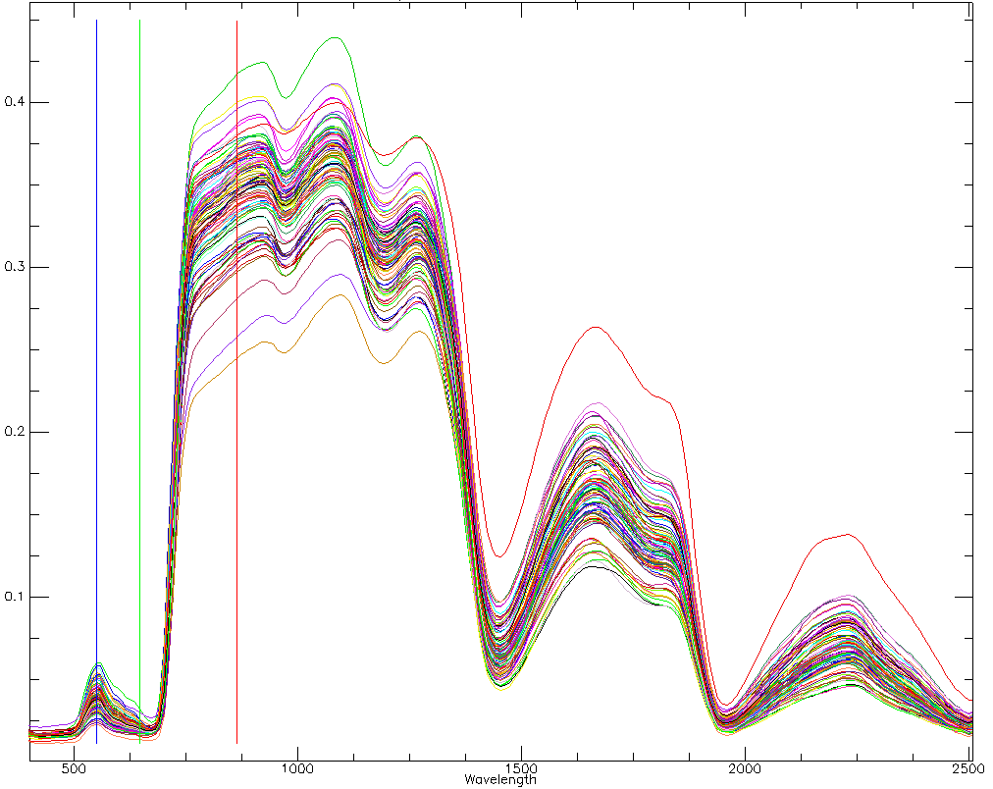
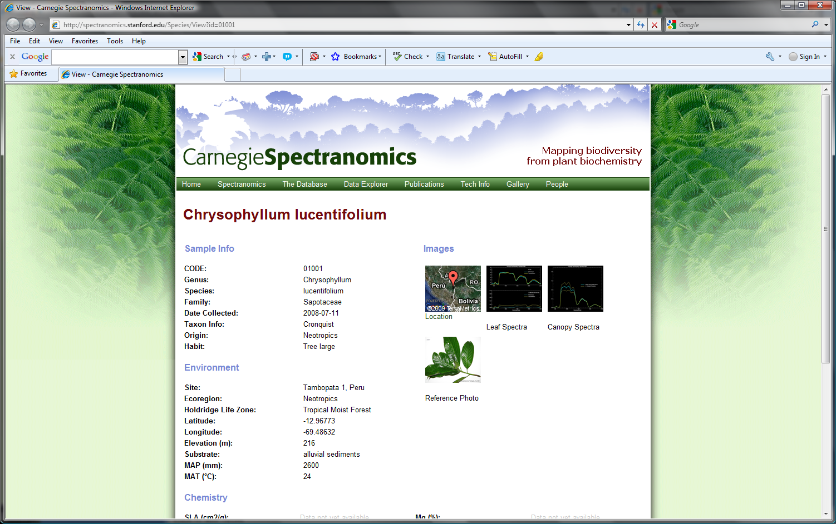
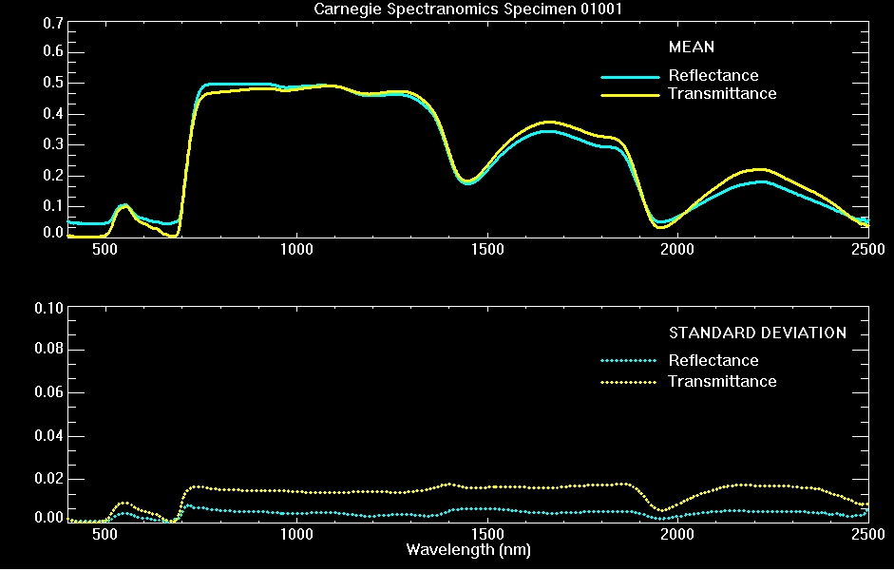
Spectranomics: Remote Sensing of Canopy Chemical and Biological Diversity in Tropical Forests
David E. Knapp, Roberta E. Martin, Gregory P. Asner
Carnegie Institution, Dept. of Global Ecology
The chemical diversity of humid tropical forests is thought to exceed that of all other terrestrial ecosystems combined, with cascading effects on spectroscopic patterns of tropical canopies acquired from new airborne and future space-based imaging spectrometers. To address this new frontier in spectroscopy, we developed the Carnegie Spectranomics Project (CSP), which seeks to quantify and understand linkages between chemical, spectral, and taxonomic patterns among tropical forest species.
(A)
(B)
HiFIS Imagery
LiDAR Data
(C)
Spectral PCA
Constant Sun-View
Geometry
Suitable
Suitable
Pre-screened Image
Unsuitable
High-fidelity Plant Spectroscopy
Water, Protein, Carbon Fractions, Secondary Compounds
Water, Leaf Structure
Pigments
The lidar has been critical in characterizing the 3-D structure of the tree canopies such that best quality image spectra can be used to extract chemistry data remotely. The fusion of these two sources of data make it possible to improve the ability to relate field measurements of leaf spectra to the canopy scale by providing critical data for modeling the observation and illumination parameters under which each pixel’s spectra was collected.

