Slide 1
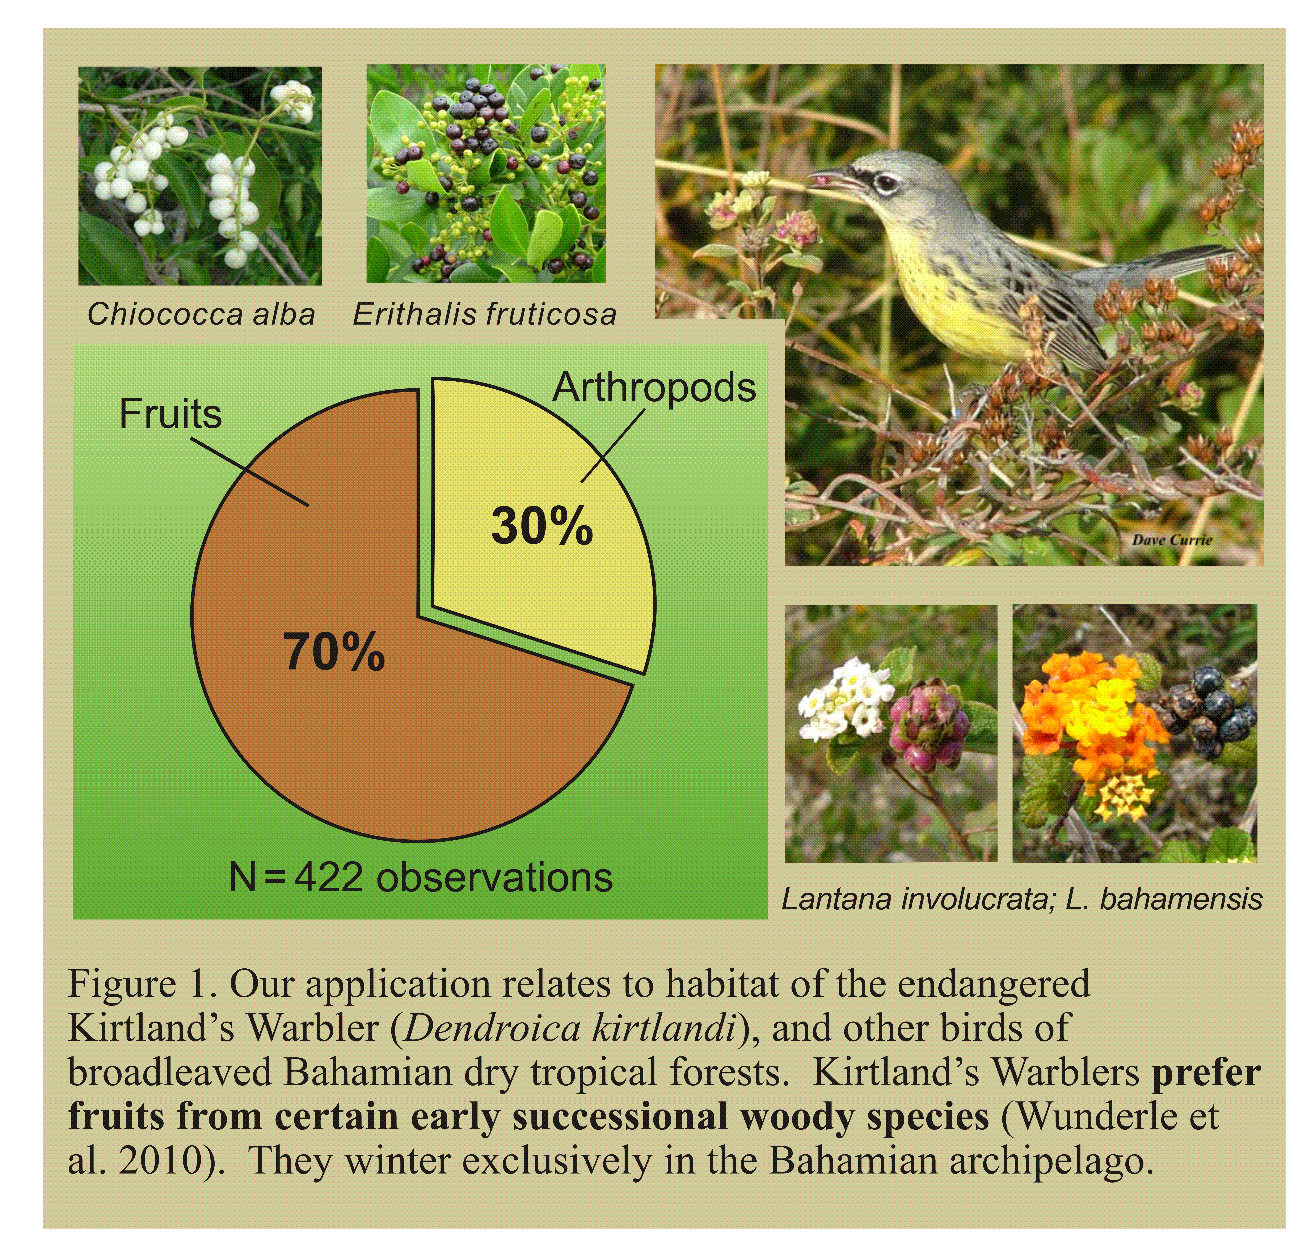
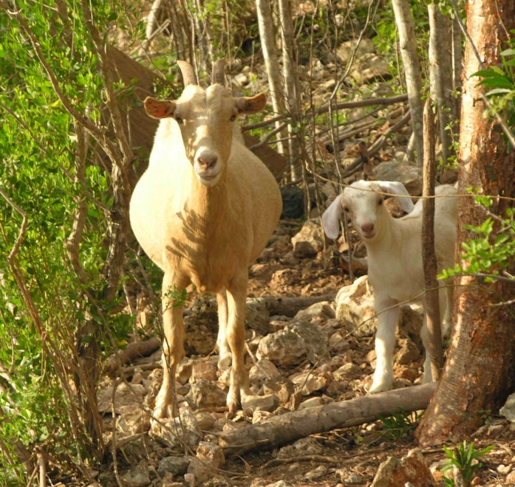
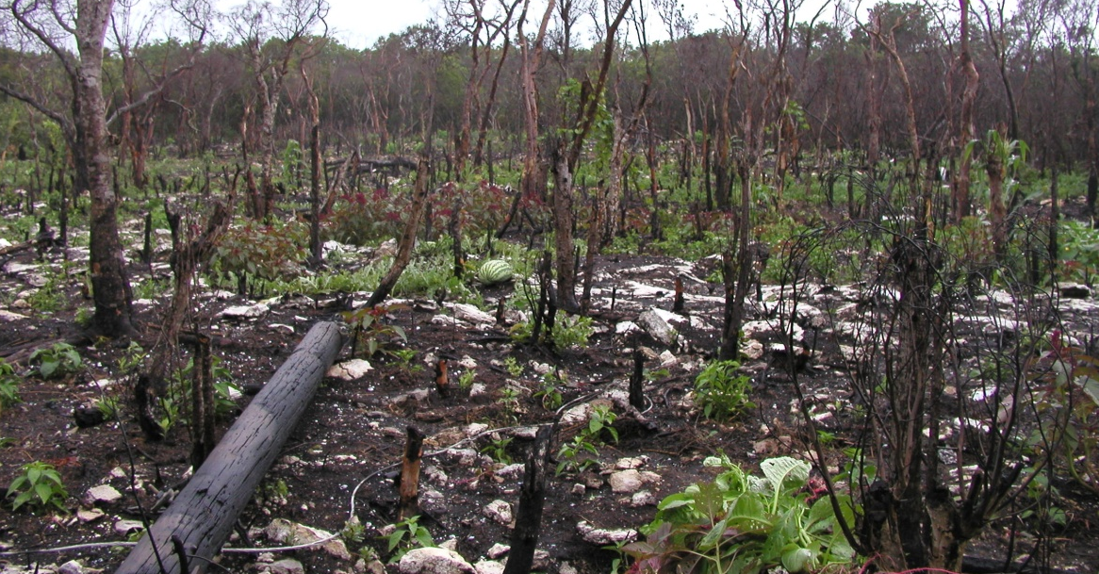
Mapping forest vertical structure and disturbance characteristics with time series of gap-filled Landsat imagery
E. H. Helmer^{a,*}, Thomas S. Ruzycki^{b}, Joseph M. Wunderle Jr.ª,
Shannon M.Vogesser^{b}, Bonnie Ruefenacht^{c}, Charles Kwit^{d,1}, Thomas J. Brandeis^{e}, and David N. Ewert^{f}
ªInternational Institute of Tropical Forestry, USDA Forest Service, Río Piedras, PR 00926; ^{b}Center for Environmental Management of Military Lands, Colorado State University, Fort Collins, CO 80523; ^{c}Remote Sensing Applications Center, USDA Forest Service, Salt Lake City, UT 84119; ^{d}Department of Plant Sciences, University of Tennessee, Knoxville, TN 37996; ^{e}Southern Research Station, USDA Forest Service, Knoxville, TN 37919; ^{f}The Nature Conservancy, Lansing, MI 48906; *Email address: ehelmer@fs.fed.us (E.H. Helmer).
Abstract
For studies of Kirtland’s Warbler habitat, we mapped tropical dry forest height (RMSE = 0.9 m, R² = 0.84, range 0.6-7 m), foliage height profiles, and disturbance type and age with a time series of gap-filled Landsat and ALI imagery on the island of Eleuthera, The Bahamas, substituting time for vertical canopy space (Helmer et al. 2010).
Introduction and Methods
Forest age, vertical structure, disturbance, and species composition are related and affect avian habitat (MacArthur 1958, Johnston and Odum 1956). We tested if we could use a time series of gap-filled Landsat and ALI imagery to: a) map forest height and foliage height profiles, b) map disturbance type and age, and c) relate these variables to counts of winter forage species for the endangered Kirtland’s Warbler (Figure 1). We:
Created a time series of cloud-gap-filled images from 24 Landsat and Advance Land Imager (ALI) scenes with regression tree normalization (Helmer and Ruefenacht 2005) (Figures 2-3); and
Used the stack of bands from the gap-filled image time series to map the following:
Forest disturbance type and age, forest type and land cover with a decision tree model (Figure 4), and
Forest 3-D structure (mean height, height variance and canopy cover at vertical intervals in the canopy) with regression tree models (we measured foliage height profiles for 48 plots of different disturbance types and ages (Figures 5-7)).
Results and Conclusions
Tropical dry forest height, foliage height profiles, and disturbance type and age can be mapped with a time series of gap-filled Landsat and ALI imagery (Figures 6-7), substituting time for vertical canopy space.
The Landsat time series and recent ALI imagery were both critical to accurately mapping forest height; the ALI successor, OLI (on Landsat 8) will improve forest structure mapping.
Principal component analysis illustrated the relationships between forest disturbance type, vertical structure, and woody species composition (Figure 8).
By far the largest single forest disturbance event was escaped fire, likely fueled by downed wood after Hurricane Floyd (1999) (Figure 9).
Scott Johnson measuring foliage height profiles
References
Helmer, E.H., & Ruefenacht, B. (2005). Cloud-free satellite image mosaics with regression trees and histogram matching. Photogrammetric Engineering and Remote Sensing, 71, 1079-1089
Helmer, E.H, T.S. Ruzycki, J.M. Wunderle, Jr., S. Vogesser, B. Ruefenacht, C. Kwit, T.J. Brandeis and D.N. Ewert. 2010. Mapping tropical dry forest height, foliage height profiles and disturbance type and age with a time series of cloud-cleared Landsat and ALI image mosaics to characterize avian habitat. Remote Sensing of Environment 114:2457-2473.
Johnston, D.W., & Odum, E.P. (1956). Breeding Bird Populations in Relation to Plant Succession on the Piedmont of Georgia. Ecology, 37, 50-62
MacArthur, R.H. (1958). Population ecology of some warblers of Northeastern Coniferous Forests. Ecology, 39, 599-619
Wunderle, J.M.J., Currie, D., Helmer, E.H., Ewert, D.N., White, J.D., Ruzycki, T.S., Parresol, B., & Kwit, C. (2010). Kirtand's warblers in anthropogenically disturbed early successional habitats on Eleuthera, The Bahamas. The Condor, 112, 123–137

