Slide 1











Demonstration of a Marine Biodiversity Observation Network (M-BON) in collaboration with the National Marine Sanctuary Program
Leads: F. Muller-Karger University of South Florida (USF)
F. Chavez Monterey Bay Aquarium
Research Institute (MBARI)
Co-PI’s: S. Doney, M. Kavanaugh,
E. Montes, S. Gittings
Partners: (14+ collaborating institutions)
M. Breitbart, L. Rosenfeld, M. Tartt,
K. Thompson, M. Howard, B. Kirkpatrick,
S. Donahue, A. DeVogelaere, J. Brown,
J. Field, S. Bograd, E. Hazen, A. Boehm,
K. O'Keife, G. Graettinger, J. Lamkin,
B. Muhling, E. (Libby) Johns, M. Roffer

Slide 2







Slide 3
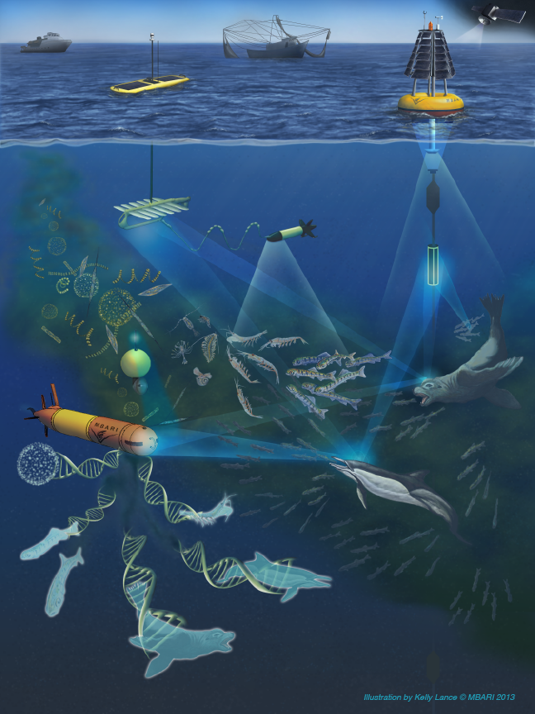
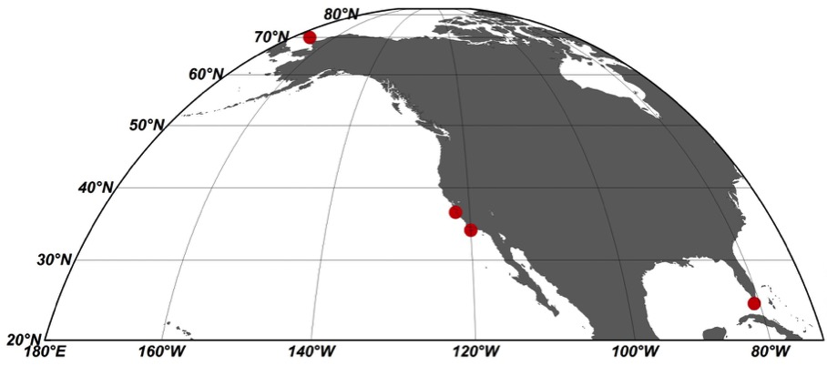
IOOS MBON Demonstration
Chukchi Sea
Monterey Bay
Channel Islands
Florida Keys

Slide 4
Primary goals
Implement a demonstration MBON
Integrate, synthesize and augment information from ongoing programs
Develop environmental DNA technology and autonomous sample collection methods for conducting biodiversity assessments
Bring biodiversity measurements together in a relational database with links to national and international databases
Develop a plan to transition the demonstration MBON into an operational system
Link with international programs (GEO BON)

Slide 5
Critical Issues
MBON Demonstrations are just starting
Each project needs to organize itself. Each is large, complex, with many moving pieces and many groups
Proposals focused on specific science and regions
  X-MBON coordination will take time, and real X-MBON integration will need additional resources
  Integration of DMAC efforts across projects has complexities and costs that were not expected
  Coordination/integration with GEOBON is complex and GEOBON WG5 (marine ecosystems) has no resources

Slide 6
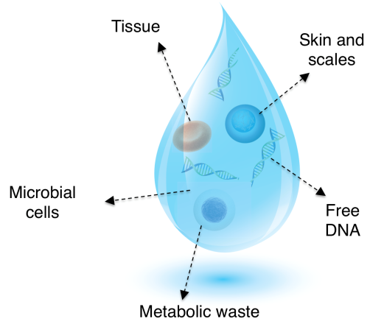
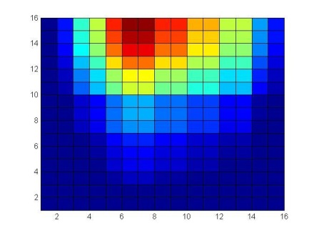
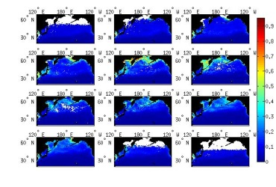
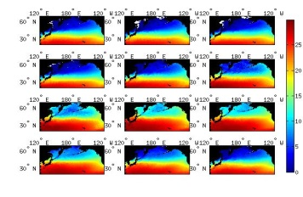
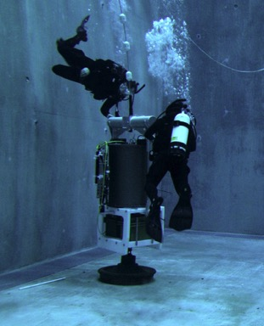
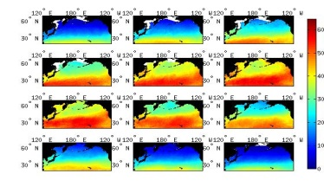
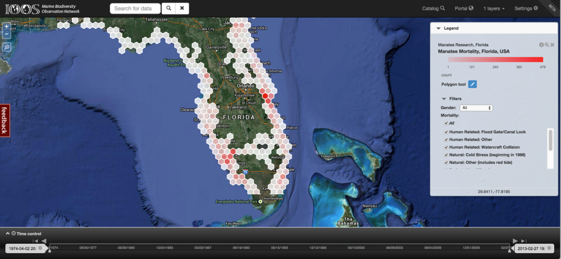
MBON Implementation (2015)
Monterey Bay and Florida Keys
National Marine Sanctuary MBON Pilots
eDNA testing
Integration of environmental and biological datasets
In situ data collection
E&O
Socio-economics
Ecosystem Valuation
Satellite Seascapes
Autonomous eDNA sensor
MBON data portal and mapping tool

Slide 7
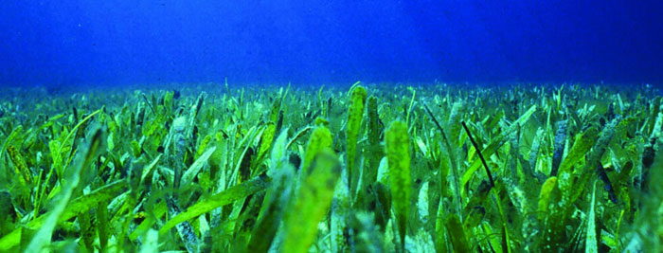
Tropical-Coral Reef System Case Study: Florida Keys National Marine Sanctuary
Goals for 2015
Conceptual vision of observing system
Define strategy for integration of historical/new data
  Inventory environmental observations from separate programs
Establish sampling protocols / Initiate field observations
Initial focus habitats:
  Reefs and overlying water column (Upper, Middle, Lower Keys, Dry Tortugas),
  Pelagic: surface water
(Year 2 +: ) Other habitats: Sea grass, mangroves, hard bottom, +?

Slide 8
ONMS Condition Reports: Questions
Water Quality
What is the eutrophic condition of sanctuary waters and how is it changing?
Do sanctuary waters pose risks to human health and how are they changing?
Have recent changes in climate altered water conditions and how are they changing?
Are other stressors, individually or in combination, affecting water quality, and how are they changing?
Habitat Quality
5) What is the integrity of major habitat types and how are they changing?
6) What are the contaminant concentrations in sanctuary habitats and how are they changing?
Living Resources
7) What is the status of keystone and foundation species and how is it changing?
8) What is the status of other focal species and how is it changing?
9) What is the status of non-indigenous species and how is it changing?
10) What is the status of biodiversity and how is it changing?
Maritime Archaeological Resources
11) What is the archaeological integrity of known maritime archaeological resources and how is it changing?
12) Do known maritime archaeological resources pose an environmental hazard and how is this threat changing?
Human Dimensions
13) What are the levels of human activities that may adversely influence water quality and how are they changing
14) What are the levels of human activities that may adversely influence habitats and how are they changing?
15) What are the levels of human activities that may adversely influence living resources and how are they changing?
16) What are the levels of human activities that may adversely influence maritime archaeological resources and how are they changing
17) What are the states of influential human drivers and how are they changing?

Slide 9
MBON Questions Relevant to Condition Report:
State of biodiversity across core trophic levels
Biodiversity Characterization
What are the baselines of alpha and beta (and gamma) diversity at specific trophic levels in FKNMS coral reef habitat? (Condition Report question #10)
How has biodiversity changed over time with respect to baseline conditions? (Condition Report question #10)
How is the abundance of key species changing over time? (Condition Report questions #7, #8, and #15)
What species can serve and indicators of the overall biodiversity in the FK’s coral reef systems? (Condition Report question #7, #8, #9, #10, #14 and #15).
Other?
Climate and Human drivers
What are the climatic (atmospheric/oceanographic) and human drivers of change in FKNMS coral reef biodiversity? (Condition Report question #2, #7-10, and #15).
What are the climatic (atmospheric/oceanographic) and human impacts on water quality and habitat integrity in FK’s coral reefs? (Condition Report question #2, #3).
Other?

Slide 10

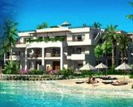


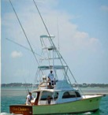

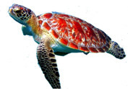
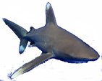

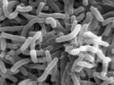
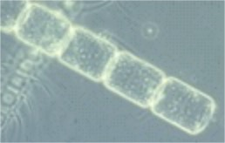




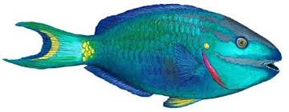

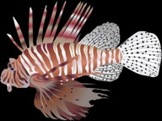
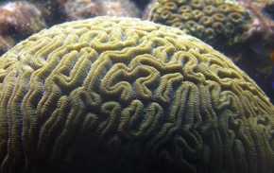


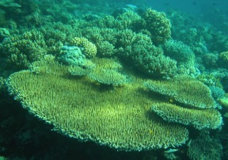
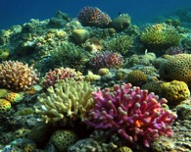
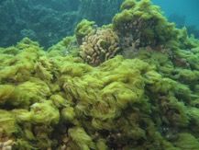
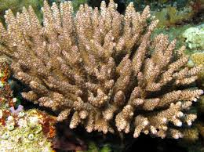
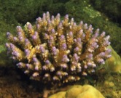
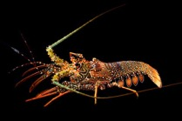
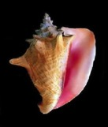

Storms
People
CO₂
Eutrophication
Decreasing
pH
warming
Top predators
Fishes of high
commercial value
Herbivore fishes
Bacteria
Lower trophic levels:
Phytoplankton/zooplankton
Invasive species
Key
invertebrates
Coral cover
Macro-algae

Slide 11
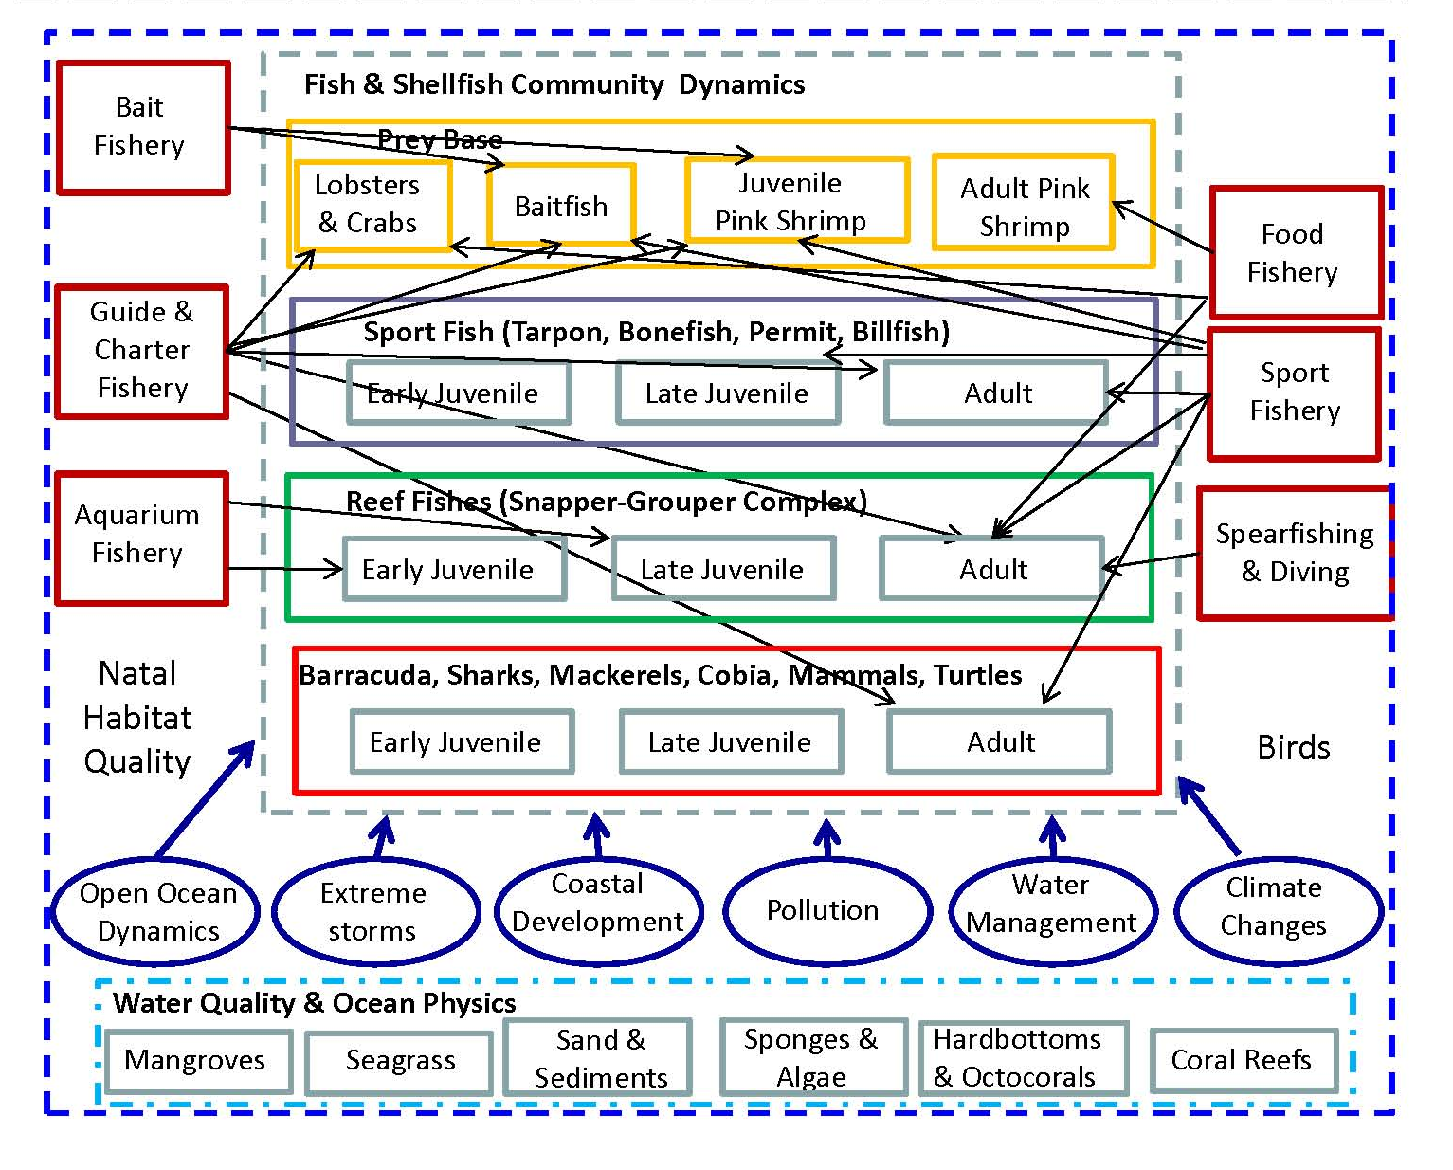
Ecological and fisherydynamics of southern Florida
Ault et al. 2014. Ecological Indicators 44: 164-172.

Slide 12










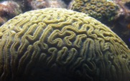





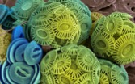
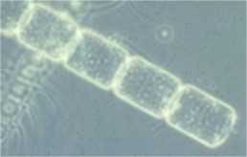
Biological observations: we seek trophic-based biodiversity time series metrics
PROGRAMS
SEFSC
FIM - FWC
GAME
SEFSC
FIM - FWC
CREMP
Florida SE Fisheries
Independent Monitoring
CREST
GAME
CREMP
FRRP
GAME
CREST
SFP
FWRI HAB - phytoplankton
SFP
CREMP and CREST – macro-algae

Slide 13
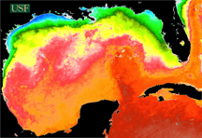
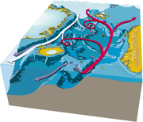
Environmental observations: biological, hydrography, water quality, and climate
Programs:
Geospatial Assessment of Marine Ecosystems (GAME)
Gulf of Mexico Alliance (GOMA)
South Florida Program (SFP) – Walton Smith cruises
Florida Harmful Algal Bloom (HAB’s group)
EPA and SERC Water Quality Protection Program
NOAA’s SE Fisheries Science Center (SEFSC)
GCOOS / SECOORA buoy data
(Many others)
Other resources:
Satellite remote sensing
ECCO2
(simulation)
3. NOAA Climate data

Slide 14
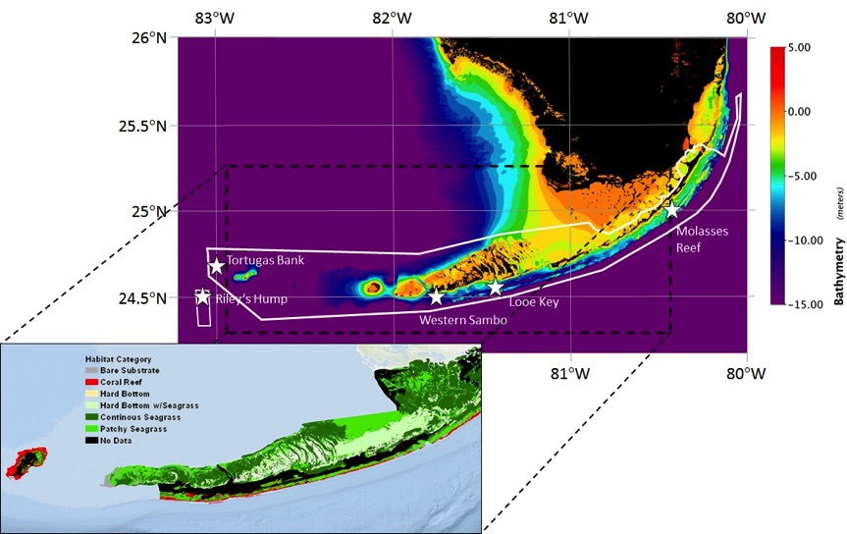
FKNMS MBON time series sites

Slide 15
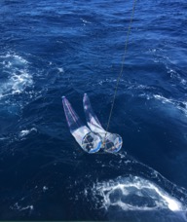
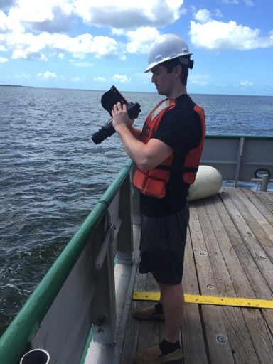
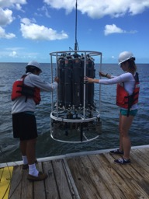
NOAA South Florida Program: 20 y of observations
April 13-17, 2015: R/V Walton Smith cruise
Chl-a
HPLC
CDOM
Phytoplankton
Zooplankton
Remote-sensing reflectance (R_{RS})

Slide 16
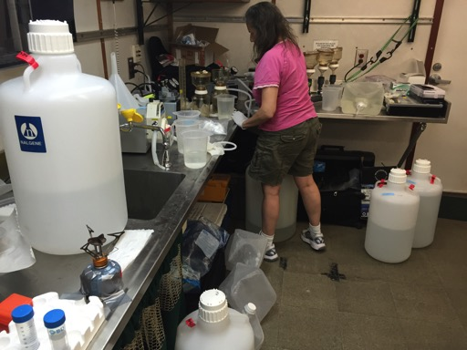
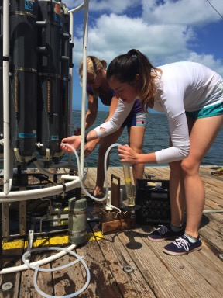
April 13-17, 2015: R/V Walton Smith eDNA observations
16S (microbial), 18S (eukaryotes), and 12S (vertebrates) rRNA genes analyses

Slide 17
2015 (12-month) MBON sampling Calendar
Program | Jan | Feb | Mar | Apr | May | Jun | Jul | Aug | Sep | Oct | Nov | Dec
R/V Walton Smith |  |  |  | Chl-a, phyto, HPLC, Optics, Genes, zooplankton | Chl-a, phyto, HPLC, Optics, Genes, zooplankton |  |  | Chl-a, phyto, HPLC, Optics, Genes, zooplankton |  |  | Chl-a, phyto, HPLC, Optics, Genes, zooplankton
CREST | Phyto* | Phyto* | Phyto* | Phyto* Chl-a HPLC Genes | Phyto* | Phyto* | Phyto* | Phyto* | Phyto* | Phyto* Chl-a HPLC Genes | Phyto* | Phyto*
CREMP |  |  |  |  |  |  | Chl-a, phyto, HPLC, Optics, Genes
Sanctuary | Phyto Chl-a HPLC Genes | Phyto Chl-a HPLC Genes | Phyto Chl-a HPLC Genes | Phyto Chl-a HPLC Genes | Phyto Chl-a HPLC Genes | Phyto Chl-a HPLC Genes |  | Phyto Chl-a HPLC Genes | Phyto Chl-a HPLC Genes | Phyto Chl-a HPLC Genes | Phyto Chl-a HPLC Genes | Phyto Chl-a HPLC Genes
*USGS CREST program includes Pulaski Shoals:
DIC samples will be collected every 3 weeks

Slide 18

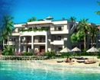













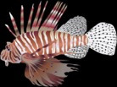





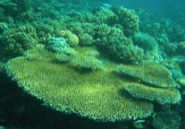
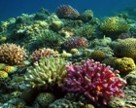




Dynamic support for Condition Reports through MBON
Storms
People
Condition Report Questions
WATER:
Q4: Stressors
Q1: Eutrophication
Q2: Human health risks
HABITAT:
Q5: Habitat dist. / health
Q14: Human impacts
LIVING RESOURCES:
Q10: Biodiversity status
Q17: Fishing status
Q9: Invasive species
Q7: Keystone species
Q8: Focal species
Q17: Human impacts
CO₂
Eutrophication
warming
Decreasing
pH
Top predators
Fishes of high
commercial value
Herbivore fishes
Bacteria
Lower trophic levels:
Phytoplankton/zooplankton
Invasive species
Key
invertebrates
Coral cover
Macro-algae
Good
Good/Fair
Fair
Fair/Poor
Poor
Undet.

Slide 19
Temperate Pacific Ocean Upwelling Ecosystem:
The Monterey Bay National Marine Sanctuary
Goals for 2015
  Conceptual vision of observing system
Define strategies for integration of historical/new data
  Inventory environmental observations from separate programs
Establish sampling protocols / Initiate field observations
Initial focus habitats:
  California Current Upwelling System
  pelagic surface water
(Year 2 +: ) Other habitats: Kelp forests, hard bottom, nearshore, other?

Slide 20
MBON MB Case Study:
How does krill distribution and abundance influence patterns of biodiversity
in the Monterey Bay National Marine Sanctuary?
Anthropogenic Pressures
Red = selected as focus of phase 1 efforts
Harvest
(spatial distribution of effort, catch data)
Vessel Traffic [shipping AIS data; whale watch vessel data?]
Noise
Marine Debris
HABs [frequency, intensity, location; CeNCOOS]
Habitat quality
Humpback whale distribution & abundance
[NFMS at-sea surveys]
Sardine & anchovy
abundance and distribution [NMFS midwater trawls; stock assessments]
Marine mammal relative abundance/diversity [NMFS at-sea surveys, other]
Common Murre reproductive success [surveys at nesting sites, BeachCOMBERS]
Salmon [NMFS]
eDNA (vertebrates, krill, phytoplankton)
Krill
distribution and abundance
[ship-based acoustics]
Midwater fauna [MBARI data]
Rockfish abundance and distribution [NMFS midwater trawls and/or benthic trawls]
Market squid [CDFW or NMFS data]
Microbes?
Phytoplankton
Abundance and spp composition [MBARI]
Chemical oceanography [e.g., Nutrients, pH, DO; MBARI, CeNCOOS]
Physical oceanography [remotely sensed data, buoys; MBARI,
CeNCOOS]
Acidification
Dissolved Oxygen
Climate Change
Upwelling –
timing and intensity
Temperature
Notes:
Pilot could focus on those components with strong expected link to krill hotspots
Krill reproduction synchronized to upwelling and favor cooler oceanographic conditions to warmer years
Krill eat phytoplankton – prefer diatoms
Common Murre (changed from Cassin’s Auklet) – Jarrod Santora noted some recent analysis indicating strong relationship between Murres and krill
Marine Mammal relative abundance or some measure of diversity/richness
ABs/HABs – Are harmful algal blooms likely to occur under the same conditions that promote krill hotspots? Is HAB toxins exposure higher in these areas and have potential to move up food chain?
Vessel traffic – large vessels can cause whale strikes; whale watch vessels may provide alternate source of human activity and whale hotspot information

Slide 21
Monterey Bay partners
Science
Technology
(MBARI, Stanford
Conservation, condiiton
(MBNMS, All)
Fisheries surveys
(SWFSC)
MB MBON
Life in the sea
Archival and
Products
(CeNCOOS)
Climate and Global Change
(MBARI, SWFSC)
Education
(All)
Ecosystem Assessments
(MBNMS, SWFSC)
Ocean Observing (All)
MBNMS = Monterey Bay National Marine Sanctuary
SWFSC = South West Fisheries Science Center (NOAA)
CeNCOOS = Central and Northern Californian Ocean Observing System
Long term sustainability

Slide 22
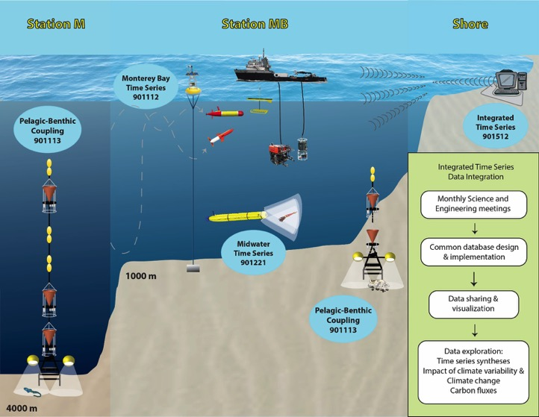
MBARI time series (1989-present)
Messie et al.

Slide 23
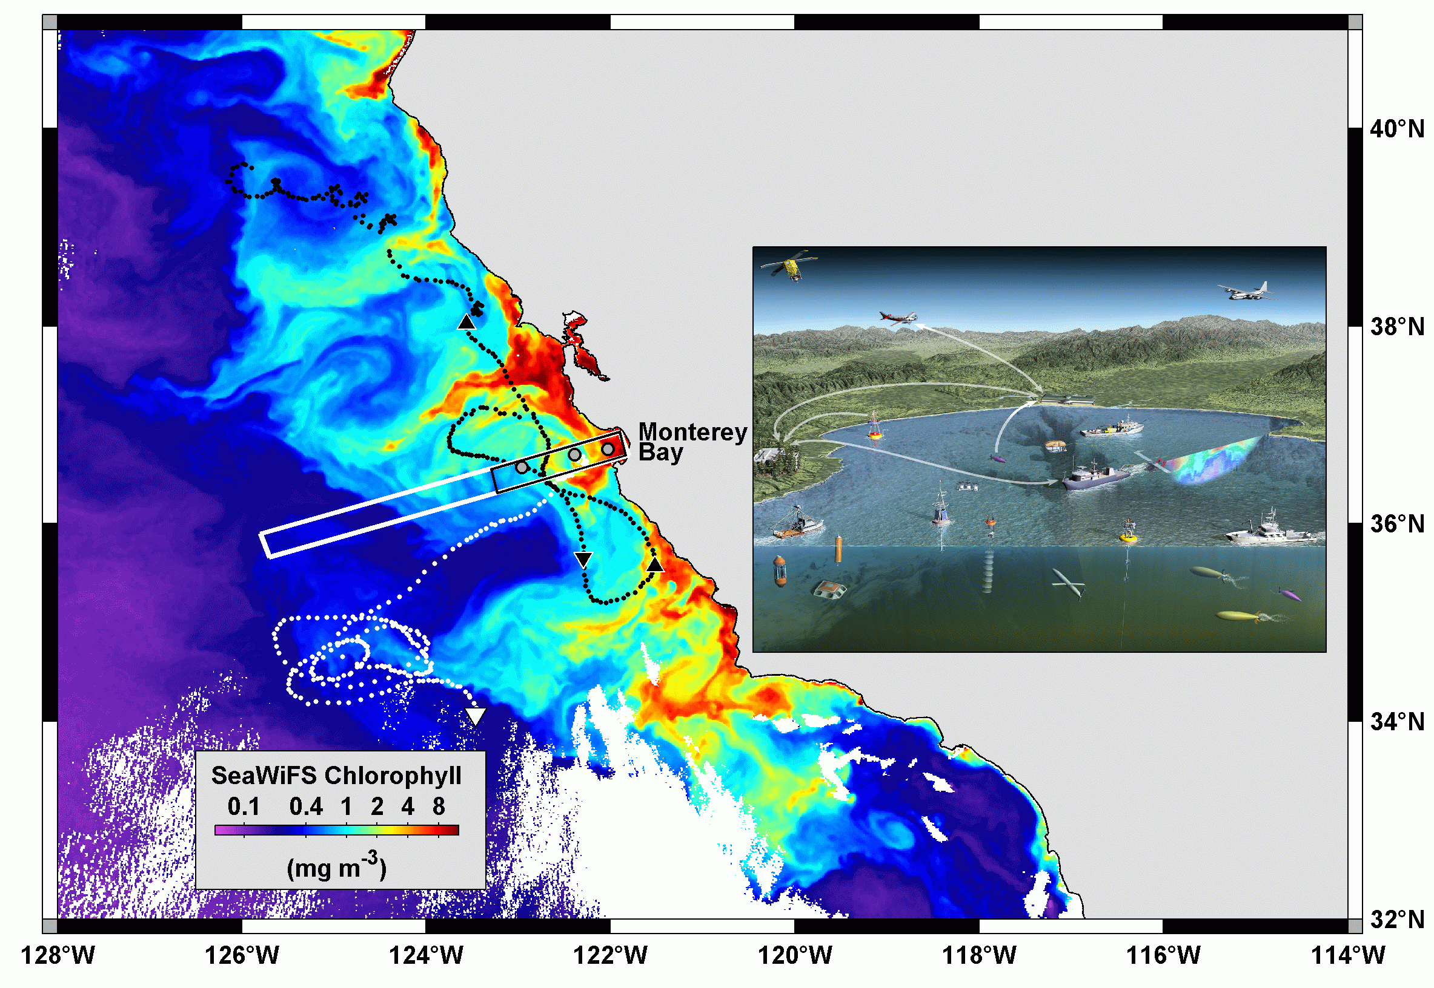

Slide 24
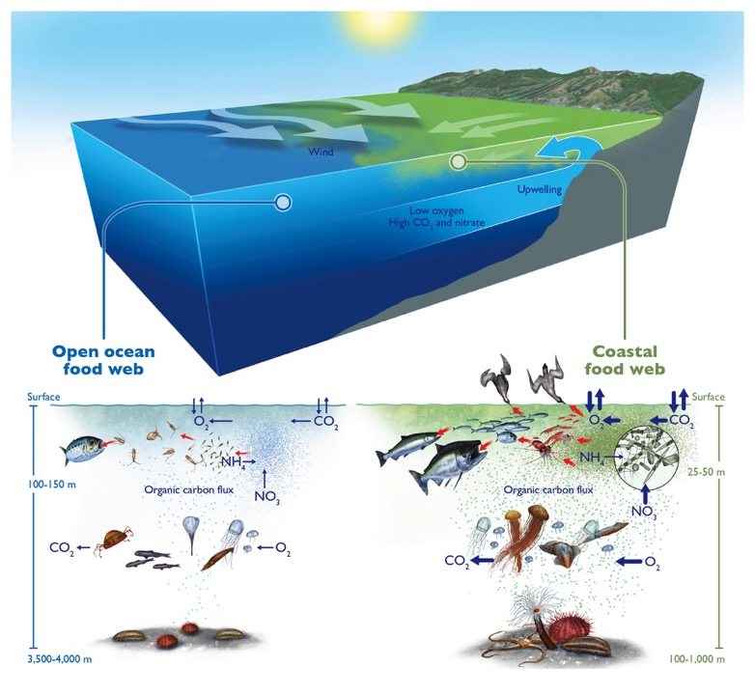
Biological pump
Thermocline
Nutricline
Light,
Low nutrients
Dark,
High nutrients

Slide 25
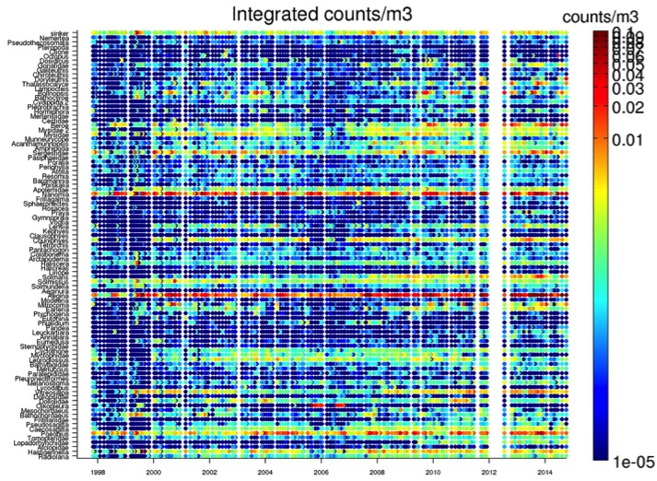
Midwater communities & environment
ROV transects every 3 weeks
(CTD data,
10 min video transects every 100m down to 1000m, identification & counts of species)

Slide 26
From Observations To Remote Sensing and Models

Slide 27
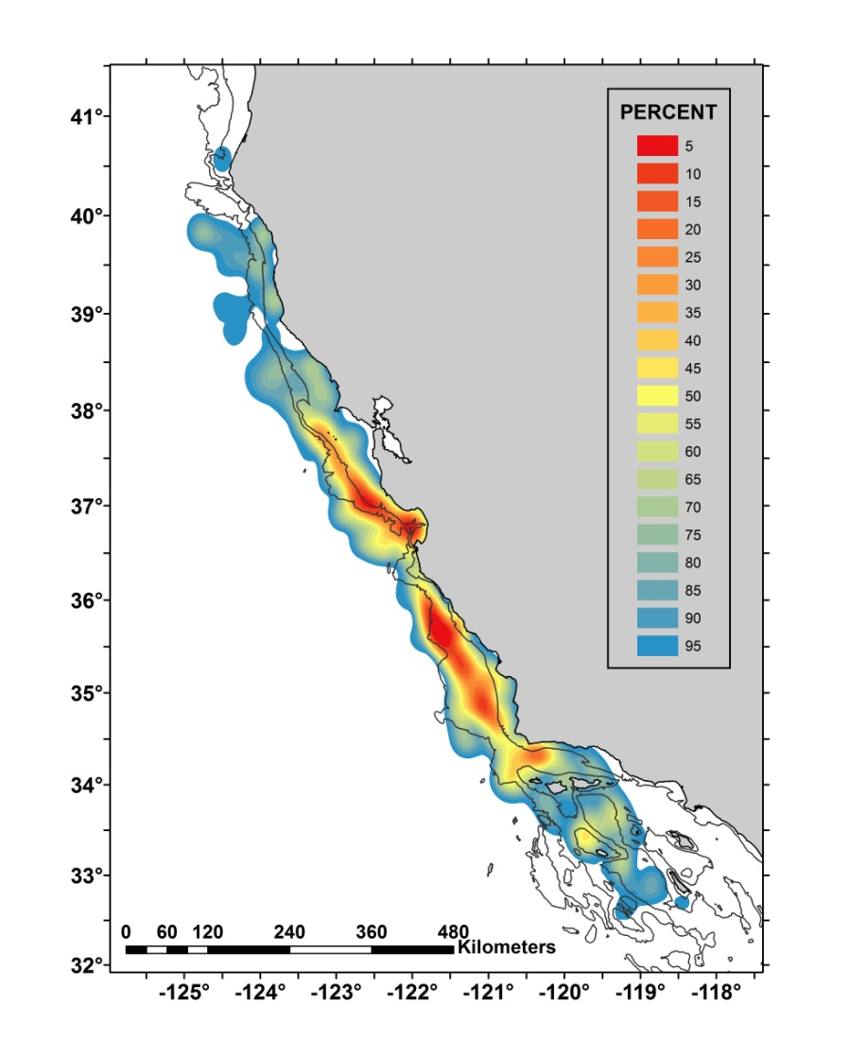
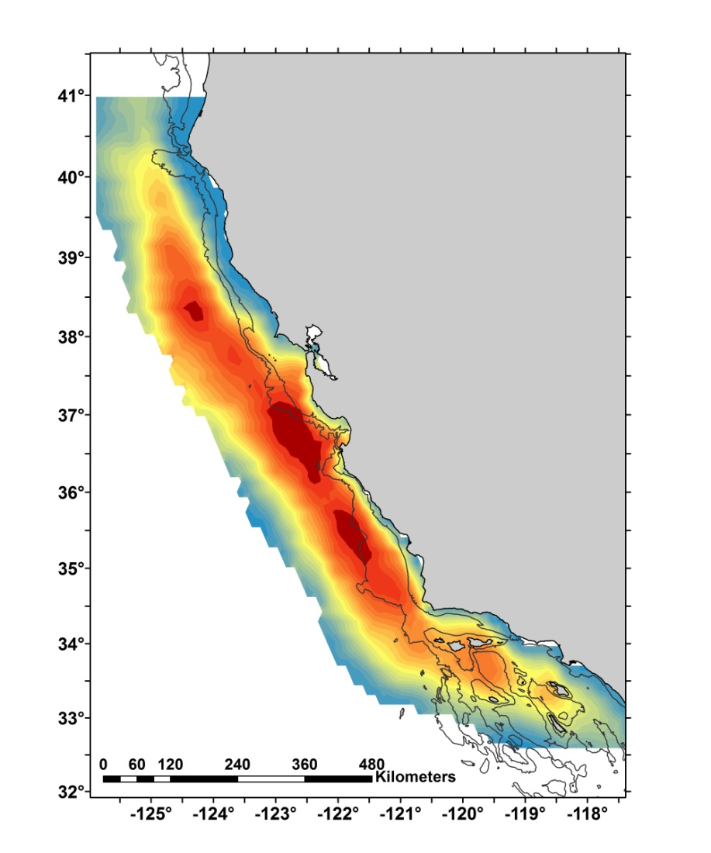
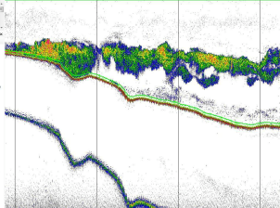
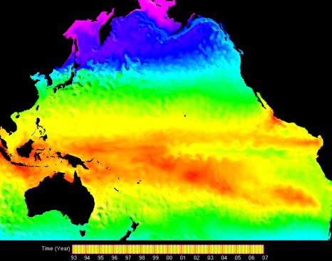
The models can now simulate zooplankton that are important food for salmon and other commercially important species
Observed krill
Modeled zooplankton
From NOAA surveys

Slide 28



In situ: Testing of eDNA technology
(Environmental Sample Processor)

Slide 29
New tools - Genomics
Pioneered by microbial scientists
Well integrated microbial approaches across the three MBON projects
Sanctuary MBON leading the development of genomics from plankton to whales
Present focus on establishing solid and standard methods

Slide 30
Methods – can a single procedure be used from bacteria to whales?
Identify primers for microbes, plankton (phyto and zoo) and vertebrates
Test filters
Test nucleic acid extractions
Test for microbes, plankton (phyto and zoo) and vertebrates using next generation sequencing
Test across kelp beds to coral reefs

Slide 31
Leads
Microbes – USF
Plankton – MBARI
Vertebrates – Stanford/Center for Ocean Solutions

Slide 32


Slide 33


Spatial trends in eDNA and diver visual counts data across habitats
Normalized eDNA
Visual counts
Distance from shore (meters)
Potential for powerful combination of video and genomics

Slide 34



eDNA can also detect organisms that divers don’t
Distance from shore
Notes:
Spatial trends in eDNA and visual count data across the transect and habitats. Plot background is shaded according to habitat type, moving away from shore: seagrass, kelp forest, shallow sandy bottom, rocky reef, deep sandy bottom, and open water.

Slide 35
Remote Sensing of Seascapes:
Maria Kavanaugh / WHOI
Classification of dynamic biological/physical regions: ‘seascapes’
Uses multivariate satellite data
Seascapes characterize the spatial footprint of physical, chemical and biological dynamics that influence individual organisms, populations and biological communities.
Now incorporating less traditional products (nFLH and Rrs 645, altimetry, winds, salinity, and other model output) to better characterize the biological-physical dynamics

Slide 36


MBON Seascape Classifications

Slide 37

FK seascape example based on seasonal mean fields
5 seascapes= ~ 84 % VAR
Sample composite the Florida Keys region:
- Five seascapes characterized > 80 percent of the variance of SST, PAR, chl-a and nFLH.
- Boundaries will vary with time.
- Case studies to validate these time evolving regions are underway.

Slide 38
Outreach and Education
Focus on user needs
Co-design products and dissemination strategies with federal, state, local partners
Better link and integrate existing resources

Slide 39
Data Management And Communications (DMAC)
Well integrated across MBON’s
Regular teleconference and emails:
  among PIs and among DMAC leads
GoM/MB/AK well integrated with IOOS
Developing strategy for partitioning effort among IOOS RA DMACs
Identifying key data sets for each region among partners: State agencies, NASA, NOAA, USGS
Developing means of dealing with genomics
Linkages: NOAA NODC, OBIS and IOBIS, GEOBON

Slide 40


MBON DMAC Portal
Development by Axiom Data Science
IOOS has committed additional funding to support the development of the MBON data portal

Slide 41
Regular Communications:
Specialty Groups Listservers:
  Remote Sensing, Genetics, DMAC, E&O, Monterey Bay, Florida Keys
Bi-weekly and monthly telecons
  Specialty Groups
  Steering PI’s
~Monthly GEO BON teleconferences
  includes Channel Island and AK MBON partners

Slide 42
Communications:
Team meetings
California
  November 2014
  April 2015
Florida
  January 2015
  March 2015
Maryland
  College Park - April 2015
  Silver Spring – May 2015

Slide 43
Activity | 2015 |  |  |  | 2016 |  |  |  | 2017 |  |  |  | 2018 |  |  |  | 2019
 | W | S | Su | F | W | S | Su | F | W | S | Su | F | W | S | Su | F | W | S | Su | F
Research
Establish the framework for addressing Goals 1-6 and corresponding deliverables, defining and testing team communications and coordination strategies, purchasing equipment, and recruiting personnel and students
Draft a Data Sharing Plan, including QC, archiving, and distribution, and transition to operations
Define specific MBON products to address Sanctuary Condition Reports
Develop a framework for sample collection and processing and test it
Conduct trials of automated updates of the Sanctuary Condition Reports with synthetic biodiversity assessment products
Deploy genetic markers on autonomous, in situ monitoring devices
Calibrate eDNA observations
Initiate integration with NODC, OBIS, GBIF, and GEO BON
Analyze patterns in biodiversity, seascape, and environmental data, to detect specific events (coral and fish spawning, fish migrations), contrasting seasons (high, low tourist seasons), and large-scale drivers (ENSO, AMO, etc.)
Test implementation of an operational MBON, including eDNA monitoring and seascape integration at the Sanctuary management level
Examine results of these tests, iterate on aspects that need to be fixed. Further examine the possibility to deploy MBON elements at other Sanctuaries.
Fully test the implementation of an operational MBON through the IOOS RA’s and Sanctuaries programs
Participation in scientific meetings (NASA Biodiversity/Ecological Forecasting Team, AGU, ASLO, OSM, international)
Semi-annual Reporting to NOPP, NASA and NOAA
Project Kick-off and mid-term planning meetings
FKNMS and MBNMS semi-annual meetings
Develop scientific and management publications
Develop a set of specific metrics to help guide the program to success
E&O
Identify existing educational programs, assess content, audiences targeted and dissemination mechanisms
Determine the need for professional development among staff and docents
Assess citizen knowledge and attitudes about biodiversity to support the development of place-based messages and education
Conduct seminars and exhibits at recreational and commercial fishing clubs and association trade shows
Develop and implement of a program for middle schools, Sanctuary learning centers, and informal science education institutions lead by MBNMS
Adapt and implement content of USF's Oceanography Camp for Girls (OCG), Girls Inc., and Girl Scouts programs to FKNMS and MBNMS
Host workshops at MBNMS and FKNMS to engage the regional informal science education network and provide materials to support staff and docent training
GCOOS will deploy its interactive conservation game “Are You an Eco Hero” to the FKNMS visitor centers, Florida state parks, and other informal education venues
Conduct professional development sessions for ERMA stakeholders about MBON data
Develop and implement a Story Map focused on marine biodiversity research using GIS tools

Slide 44

Integration
Feedback

Slide 45
Backup

Slide 46



What is Biodiversity
"Biological diversity" means the variability among living organisms from all sources including, inter alia, terrestrial, marine and other aquatic ecosystems and the ecological complexes of which they are part; this includes diversity within species, between species and of ecosystems.”
- Convention on Biological Diversity
Genetic Diversity
Species Diversity
Ecosystems Diversity
Notes:
Genetic diversity is the variation in the genetic composition of individuals in a population, community or species
Species diversity is the variety of species (group of interbreeding organisms) in a particular habitat or ecosystem
Ecosystem diversity describes the variation in all living and non-living things in a particular geographic or ecological region. Ecosystems comprise unique combinations of animals, plants, micro-organisms and physical characteristics that define a location.

Slide 47
Different Measures of Biodiversity
Ecosphere
↑
Biosphere
↑
Regions and biomes
↑
Landscapes
↑
Ecosystems
↑
Populations
↑
Organisms
↑
Organ systems
↑
Organs
↑
Tissues
↑
Cells
↑
Molecules
Ecosystem Diversity
Feature Diversity
Character Diversity
Community Diversity
Species Diversity
Organismal Diversity
Functional Diversity
Trait Diversity
Phenological Diversity
Taxonomic Diversity
Genetic Diversity
Molecular Diversity

Slide 48
Ecosystem Services
Provisional Services | Supporting Services | Cultural Services | Regulating Services
Food, fuel, fiber | Primary production | Spiritual and religious values | Invasive resistance
Genetic resources | Provision of habitats | Education and inspiration | Pollination and seed dispersal
Freshwater | Nutrient and water cycling | Recreational values | Pest and disease regulation
Biochemicals | Soil formation and retention | Aesthetic values | Climate regulation
 |  | Sense of place | Natural hazard protection
 |  |  | Water purification
Millennium Ecosystem Assessment, 2005. Ecosystem and Human Well-being: Biodiversity Synthesis.

Slide 49
Metrics
Richness Metrics
  Margalef diversity
  Menhinick diversity
  Chao estimated diversity
Diversity Metrics
  Shannon Diversity
  Simpson Diversity
  Hulbert Diversity
High Rarity Metrics
  LogSkew
  PctRare1%
Functional Diversity Metrics
  EcoSim
  Fdiversity
  EstimateS
Dominance Metrics
  Absolute dominance
  Relative dominance
  McNaughton dominance
Evenness Metrics
  Shannon evenness
  Simpson evenness
  Camargo evenness
  Smith Wilson evenness

Slide 50
Thoughts…
Should we place weight on species or traits?
  Option value
What are the indicator species in the ecosystem?
  Krill? Starfish? Herbivores? Etc.
How should we include abiotic factors?
  Temperature, currents, winds, sediment type, tides, disturbances in these, etc.
Which measures should we use?
  Species richness? species evenness? species abundance? functional diversity? etc.

Slide 51
Outreach and Education
We need to understand from the beginning:
  how different groups of people use the Sanctuaries
  How users interact with existing portals/products relevant to MBON
Who exactly are all of the users?
What do users want?
  Are there “high priority” users?
  How does it add value to their job/decision making processes
  What is their preferred level of interaction
    push a button to see a prepackaged report?
    Upload their data and develop customized analysis? Both?
We need to make sure the MBON O&E effort, web site content, etc. meets user needs

Slide 52
Outreach and Education
We are working with ONMS and the IOOS DMAC to review current NOAA Sanctuary, IOOS, and other portals
Create a list of sites, key reports and data sets, and “decisions made” which relate or have influence on biodiversity
Contact program managers in various agencies and other users to explore perspectives and needs
Developing a list of questions to define top priorities for products
Develop recommendations MBON to inter-connect to various NOAA sites
Develop a plan to implement an MBON website with MBON ‘products’ and content
IOOS DMAC to develop action plan for team
  schedule meetings, calls, product timetable
Use existing NOAA websites:
  CRW: Coral Reef Watch
    http://coralreefwatch.noaa.gov/satellite/index.php
  CREMP: Florida Keys Coral Reef Evaluation and Monitoring Project (CREMP)
    http://ocean.floridamarine.org/FKNMS_WQPP/pages/cremp.html

Slide 53
Florida Keys Biological and Environmental Monitoring Programs
Geospatial Assessment of Marine Ecosystems (FWRI GAME)
Gulf of Mexico Alliance (GOMA)
South Florida Program (NOAA SFP)
Florida Harmful Algal Bloom monitoring (FWRI HAB group)
Coral Reef Ecosystem Monitoring Program (FWRI CREMP; 1996 - present)
Coral Reef Ecosystem Studies (CREST – USGS; 2008 - present)
Water Quality Protection Program (EPA)
Southeast Environmental Research Center (SERC) water quality program
Florida Fish and Wildlife Specimen Information Systems
Florida SE Fisheries Independent Monitoring (FIM - Florida’s DEP)
NOAA’s SE Fisheries Science Center (SEFSC)
Florida Reef Resilience Program (FRRP)
Etc.

