Slide 1
Breakout Charge
One of the challenges in supporting interdisciplinary science is that scientific problems are often framed by individual communities. This joint meeting offers an opportunity to bridge these gaps, by purposefully bringing members of different communities together to help pose both disciplinary and interdisciplinary scientific questions that could be targets for future NASA research efforts.
Breakout groups will be asked to identify the top 5 questions that would spur Carbon Cycle and Ecosystem (CC&E) research over the coming decade. These questions can be disciplinary or interdisciplinary in nature, but should focus on science questions, rather than the measurements needed to answer such questions.
As your group considers and discusses potential questions, you can consider the following:
What are problems that you face in your field that require research findings from other fields?
What are the problems in other fields that you think the research findings produced in your field impact?
Can we identify big scientific gaps that keep us from addressing these problems?
If time permits at the end of the session, groups will discuss the sensor(s) and measurements that might be useful for informing the research questions.

Slide 2
Group leads and Schedule
Group 1 -- Room 2112
Chair: Vanessa Escobar, NASA GSFC/ SSAI
Note taker: Lucia Woo, NASA GSFC/ SSAI
Group 2 -- Room 2111
Chair: Nancy Glenn, Boise State University
Note taker: Laura Duncanson, UMD
Group 3 -- Room 2110
Chair: Scott Goetz, Woods Hole Research Center
Note taker: Ben Bond-Lamberty, PNNL
Group 4 -- Chasen Family Room (1st floor)
Chair: Michael Behrenfeld, Oregon State
Note taker: Janet Nackoney, UMD
Group 5 -- Room 1105
Chair: Crystal Schaaf, U Mass - Boston
Note taker: Tiffany Moisan, NASA WFF
Group 6 -- Room 105 (basement)
Chairs: Joaquim Goés, Lamont Doherty Earth Observatory
Note taker: Liz Hoy, NASA GSFC/ GST
Group 7 -- Room Chesapeake Ballroom (here!)
Chairs: Scott Ollinger, Univ. of New Hampshire
Note taker: Mark Carroll, NASA GSFC/ SSAI
Afternoon schedule
Now – 12:00: Breakout groups
12:00 – 1:30 (approx.): Break for lunch
1:30-2:45: Breakout groups
2:45-3:15: Break
3:15 – 4:30: Uncertainty panel (in plenary)
4:30-4:35: Student/early career speed talks
4:35-5:30: Poster session
Report back/panel discussion is Wed 8:30!

Slide 3
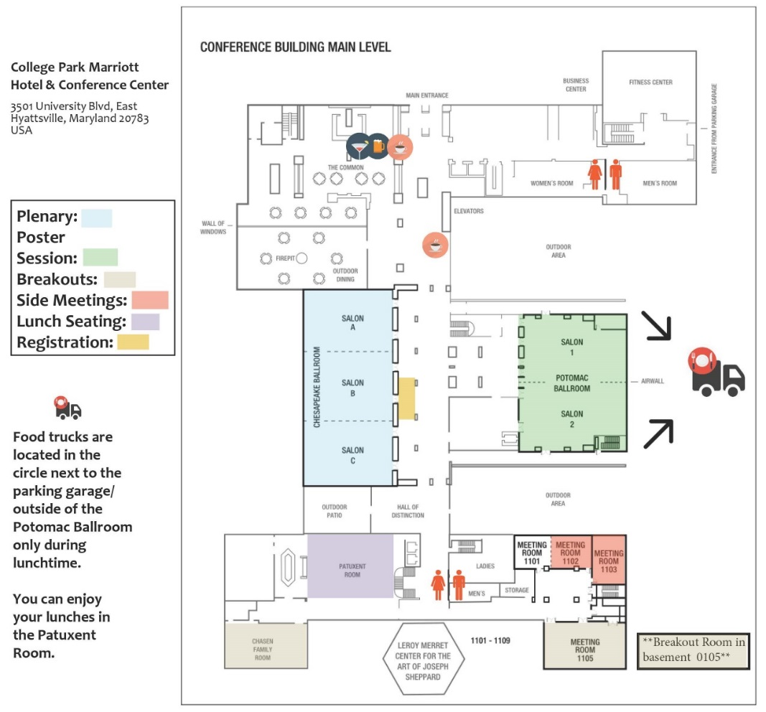
Where to go
Group 1 -- Room 2112
Group 2 -- Room 2111
Group 3 -- Room 2110
Group 4 -- Chasen Family Room (1st floor)
Group 5 -- Room 1105
Group 6 -- Room 105 (basement)
Group 7 -- Room Chesapeake Ballroom (here!)

