Slide 1
Remote Sensing of Forest Genetic Diversity and Assessment of Below Ground Microbial Communities in Populus tremuloides Forests
Mike Madritch - Appalachian State University
Phil Townsend –University of Wisconsin
Karen Mock – Utah State University
Rick Lindroth – University of Wisconsin
Notes:
The goal of this project is to use remote sensing techniques to quantify forest genetic diversity and resulting belowground microbial diversity. Understanding global declines in biodiversity is at the forefront of ecological research. To date, however, remote sensing techniques have yet to be applied to their full potential to address the genetic component of biodiversity. We are combining large-scale remote sensing data with fine-scale genetic data to understand of biological diversity across natural landscapes.

Slide 2
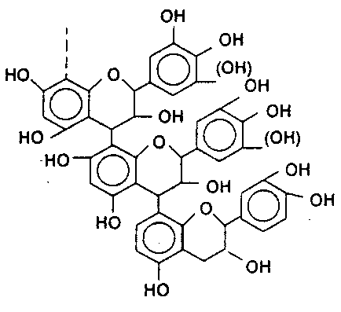
Environment
Genotype
Phenotype
Litter Chemistry
Nutrient Cycles
Notes:
One rationale for studying the decline in biodiversity is its influence on fundamental ecosystem functions (e.g., carbon and nutrient cycling). Despite significant advances in understanding the connections between biodiversity and ecological processes, the vast majority of studies have focused on species or functional group diversity, and most have been limited to grassland ecosystems. However a growing number of studies have demonstrated that genetic diversity also drives ecosystem processes, and that’s really not that surprising since natural processes deal with genetic diversity, and don’t really care whether humans call it a species or not. The underlying process for how genetic diversity influences ecosystem processes is through leaf and litter chemistry.

Slide 3
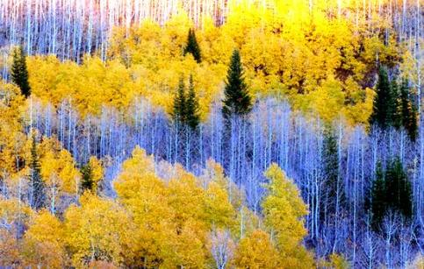
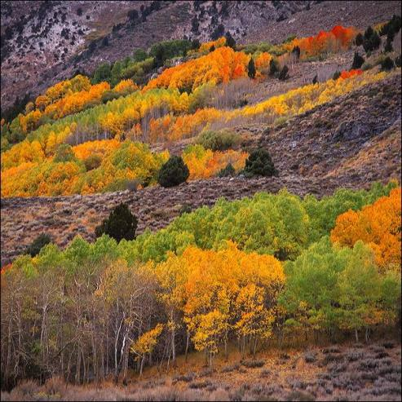
3
Notes:
3
We us aspen as our system becuase

Slide 4
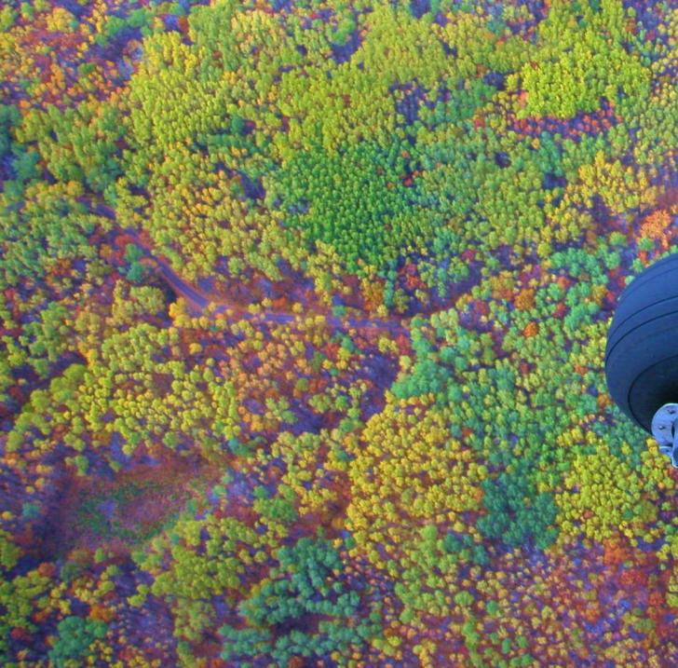
◆
◆
◆
✪
✪
✪
◉
◉
■
◉

■

■




Notes:
Preliminary work showed…
However this is NASA and we want to do something a little more impressive than me sticking my head out of a cessna. In addition, one of the reasons why aspen is so important is because it is so widespread and that lends it to large scale remote sensing.
4

Slide 5
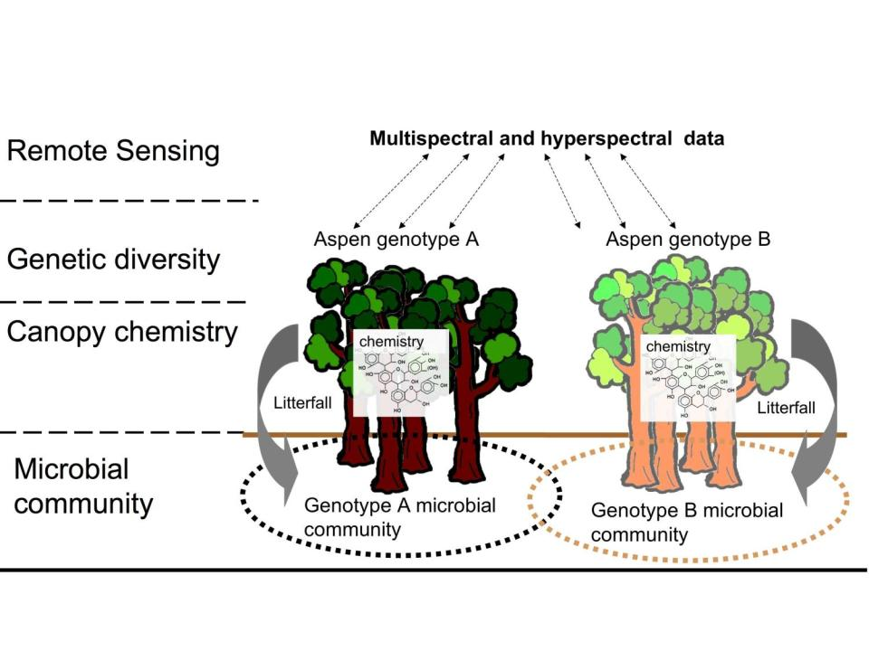
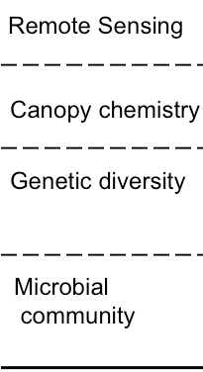
Hyperspectral data
Notes:
5

Slide 6
Objectives
1. Estimate the genetic diversity of aspen stands across multiple ecoregions using remotely sensed data.
2. Build predictive models of genetically-mediated leaf chemistry using remotely sensed hyperspectral data.
3. Measure belowground microbial biodiversity and functional diversity that results from genetically determined variation in plant chemistry.
6

Slide 7
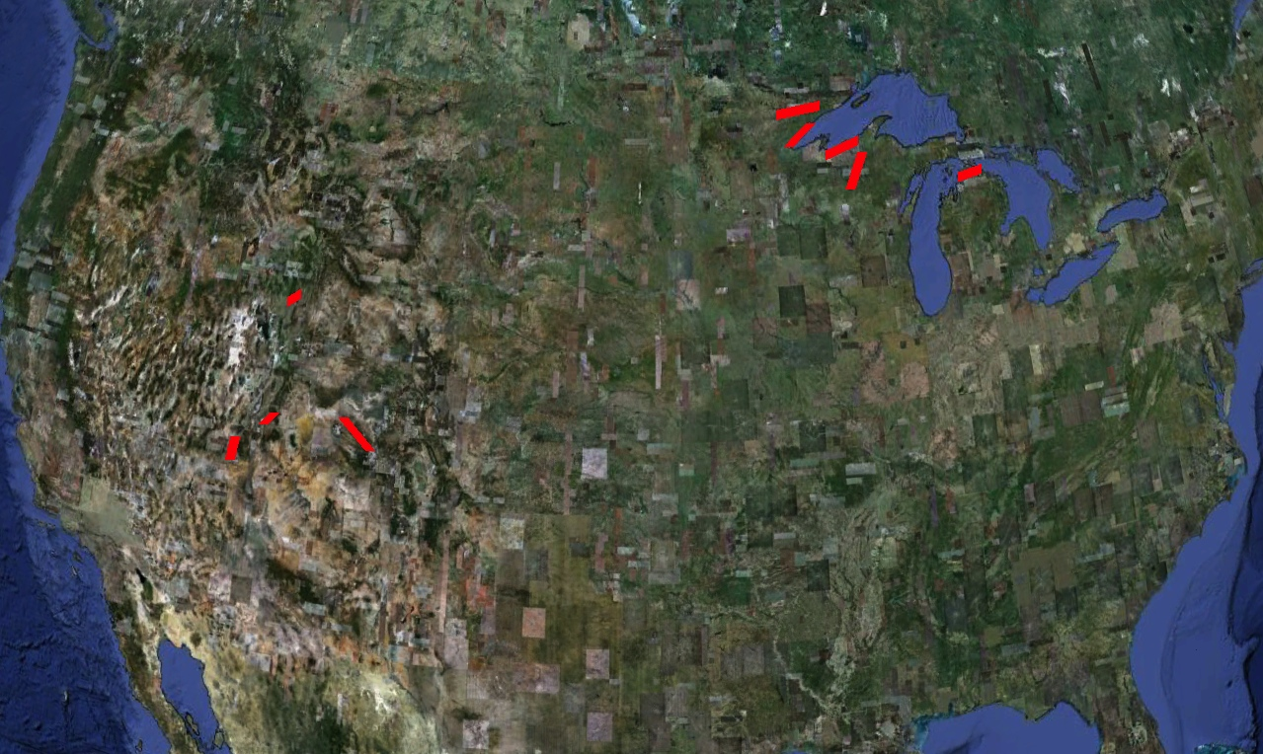

Slide 8
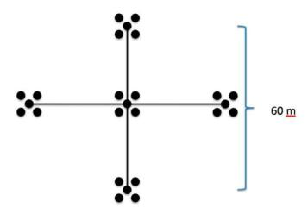
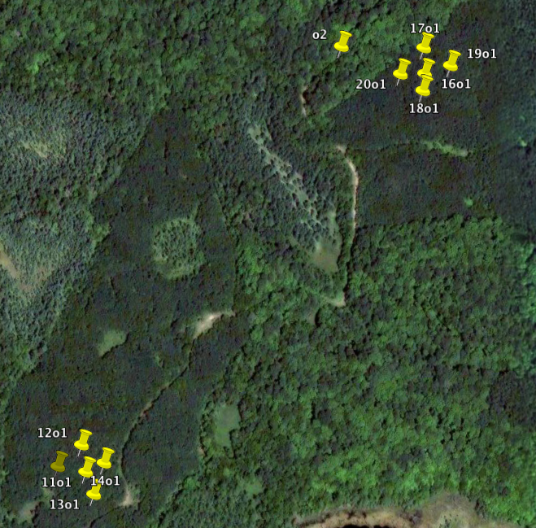
Genetic
Nutrient/microbial
Remotely-sensed
8
Notes:
Midwest sites were sampled in 2009
Western sites were sampled in 2010
In the interest of time and what I think will be most interesting to this audience, I am going to tend to breeze through the genetic and nutrient cycling stuff and spend more time on the remote sensing.

Slide 9
1. Genetic – aspen phylogeography
Hundreds of genotypes with multiple ramets
Midwest tend to be small
West tend to be large
Polyploidy issues
Progress
2009 complete ~8 microsatellites
2010 nearing completion
Notes:
Aspen are clonal. Large clones tend to be triploid, maybe more ancient. With triploid comes reduced sex reproduction, increased clonal reproduction, and potentially the ability to deal with varying habitat better via enzyme multiplicity.

Slide 10
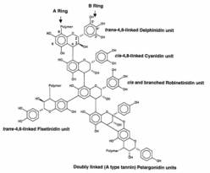
2. Leaf and Soil analyses
Leaf
Carbon, nitrogen
Condensed tannins, lignin
Soil
Nutrient: C, N, NH₄⁺, NO₃⁻
Microbial: extracellular enzymes,
t-RFLP
10

Slide 11
Hyperspectral data
Notes:
We’ve done a lot of work demonstrating that aspen genotypes can influence belowground processes; that patches of aspen have their own patches of canopy chemistry and patches of belowground processing. We’ve done this largely with manipulative experiments where we replicate genotypes through cloning techniques and plant them across landscapes. The same processes are happening in small scale natural settings, and here we’re looking at a much larger scale.
11

Slide 12
3. Remote sensing
LANDSAT time series
Use fall phenology to identify aspen clones
Build time series databases normalized to end of season dates
Mid-summer AVIRIS imagery
Spectral variation to estimate clonal differences
Estimate canopy chemistry

Slide 13
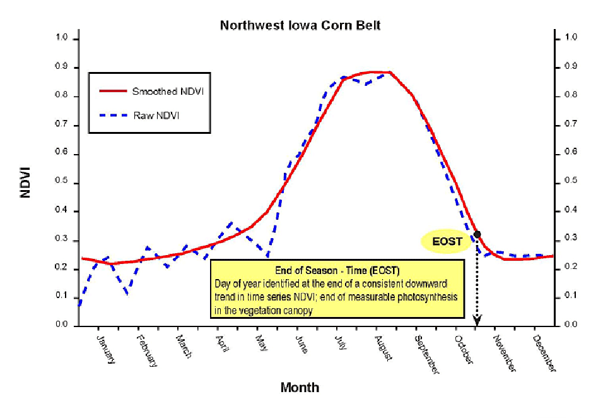
LANDSAT – end of season
USGS remote sensing phenology
Notes:
We are using landsat images from many different years, and we have to put them in the same order based on the end of season date, which does not always match up with the calendar date. End of season date with and end of season NDVI, where downward trend in NDVI levels. Off there are existing models of the smoothing function end of season, but they tend to be over-smoothed so Phil is working on developing their own from MODIS data.

Slide 14
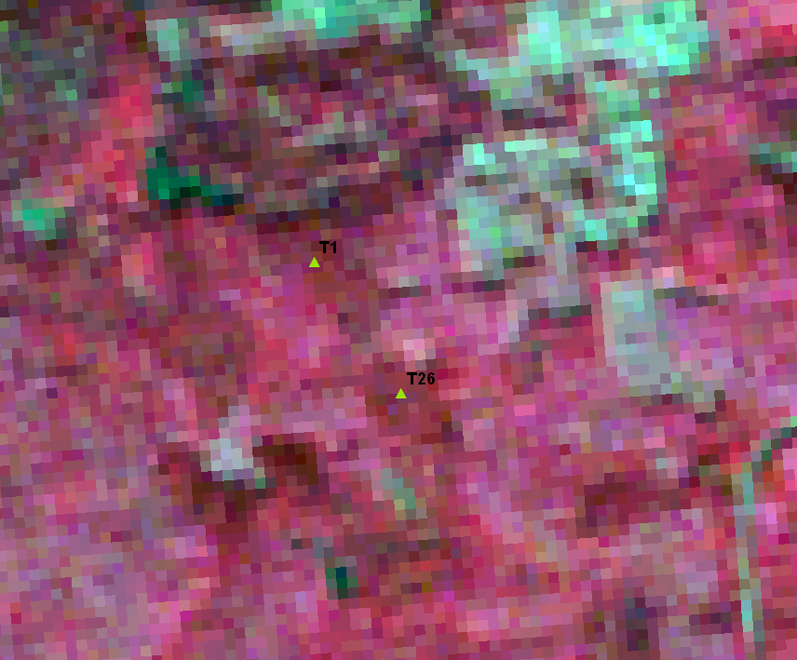

Slide 15
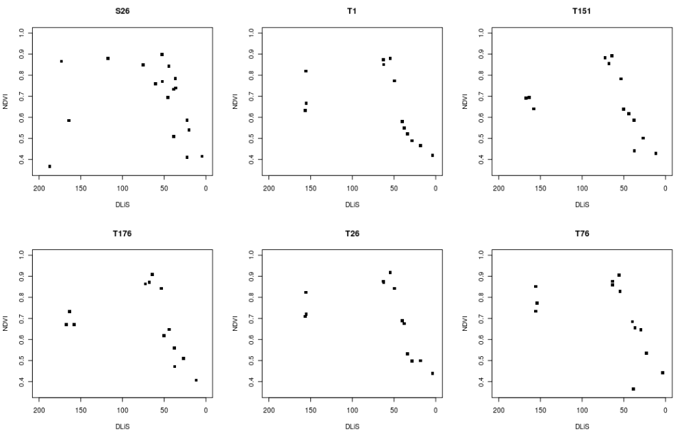
Notes:
NDVII on the y-axis, Days left in season on the x for 6 clones. 6 sites where we have at many ramets of the same genotype in a cluster.

Slide 17
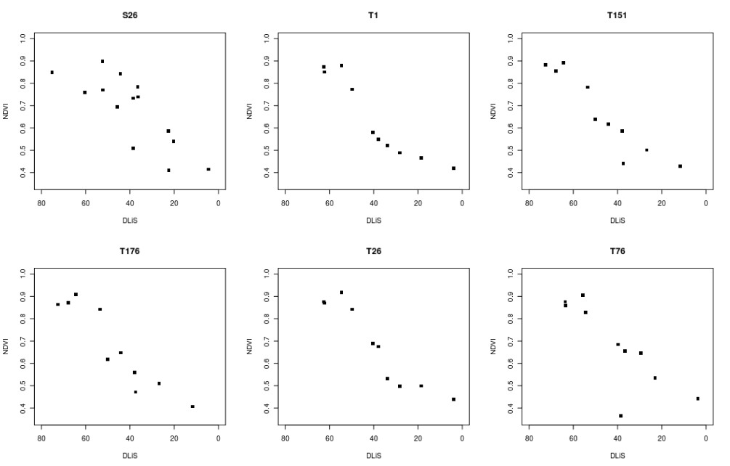

Slide 18
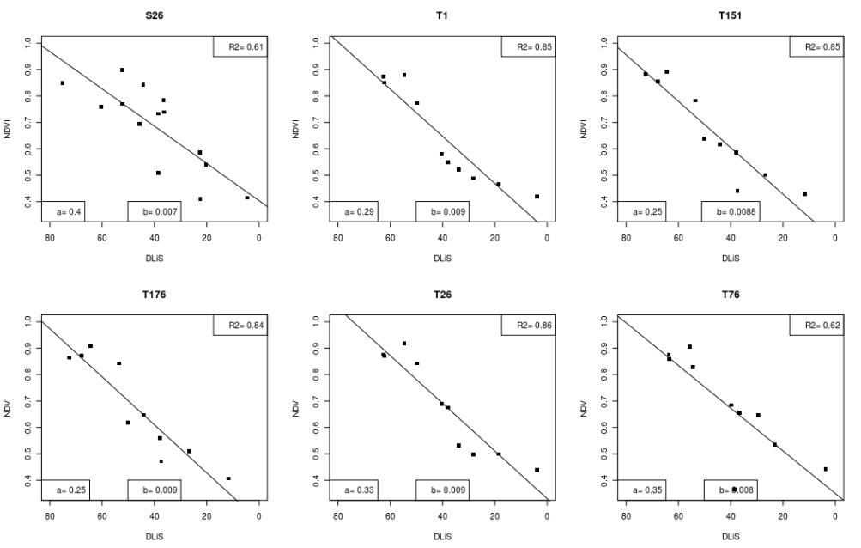
Notes:
With just preliminary data and incomplete LANDSAT history, intercepts are different, slopes are not.

Slide 19
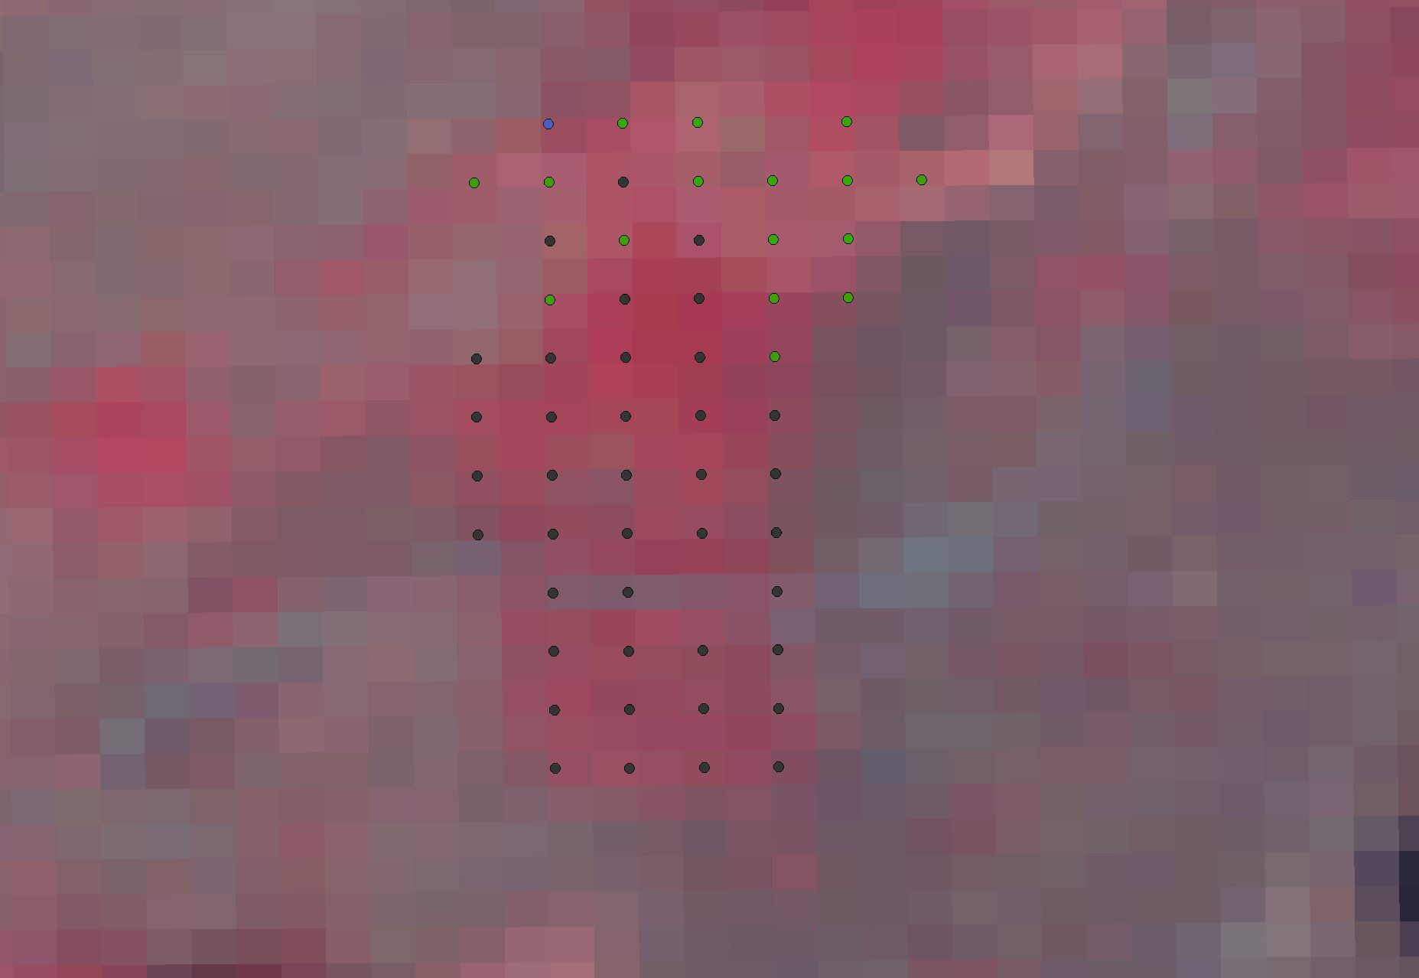
Notes:
20090927 landsat

Slide 20
AVIRIS Pre-processing: Steps
Aditya Singh
Uncorrected image
1) Cloud, shadow, water mask
2) Cross-track correction
3) Remove redundant bands
4) Atmospheric correction
5) Terrain normalization
Notes:
PHIL’S SUMMARY HERE

Slide 21
AVIRIS spectral analysis

Slide 22
Nitrogen Concentration
2.37%
2.31%
2.20%
2.32%
2.11%
Notes:
Curran et al. [5] noted key absorption bands associated with nitrogen bonds at 1020, 1510, 2060, 2130, 2180, and 2300 nm. Other sources also indicate the presence of absorption bands associated with nitrogen, proteins or amino acids at or near 1180–1200 nm, 1460 nm [20], 910 and 2350 nm [5].

Slide 23
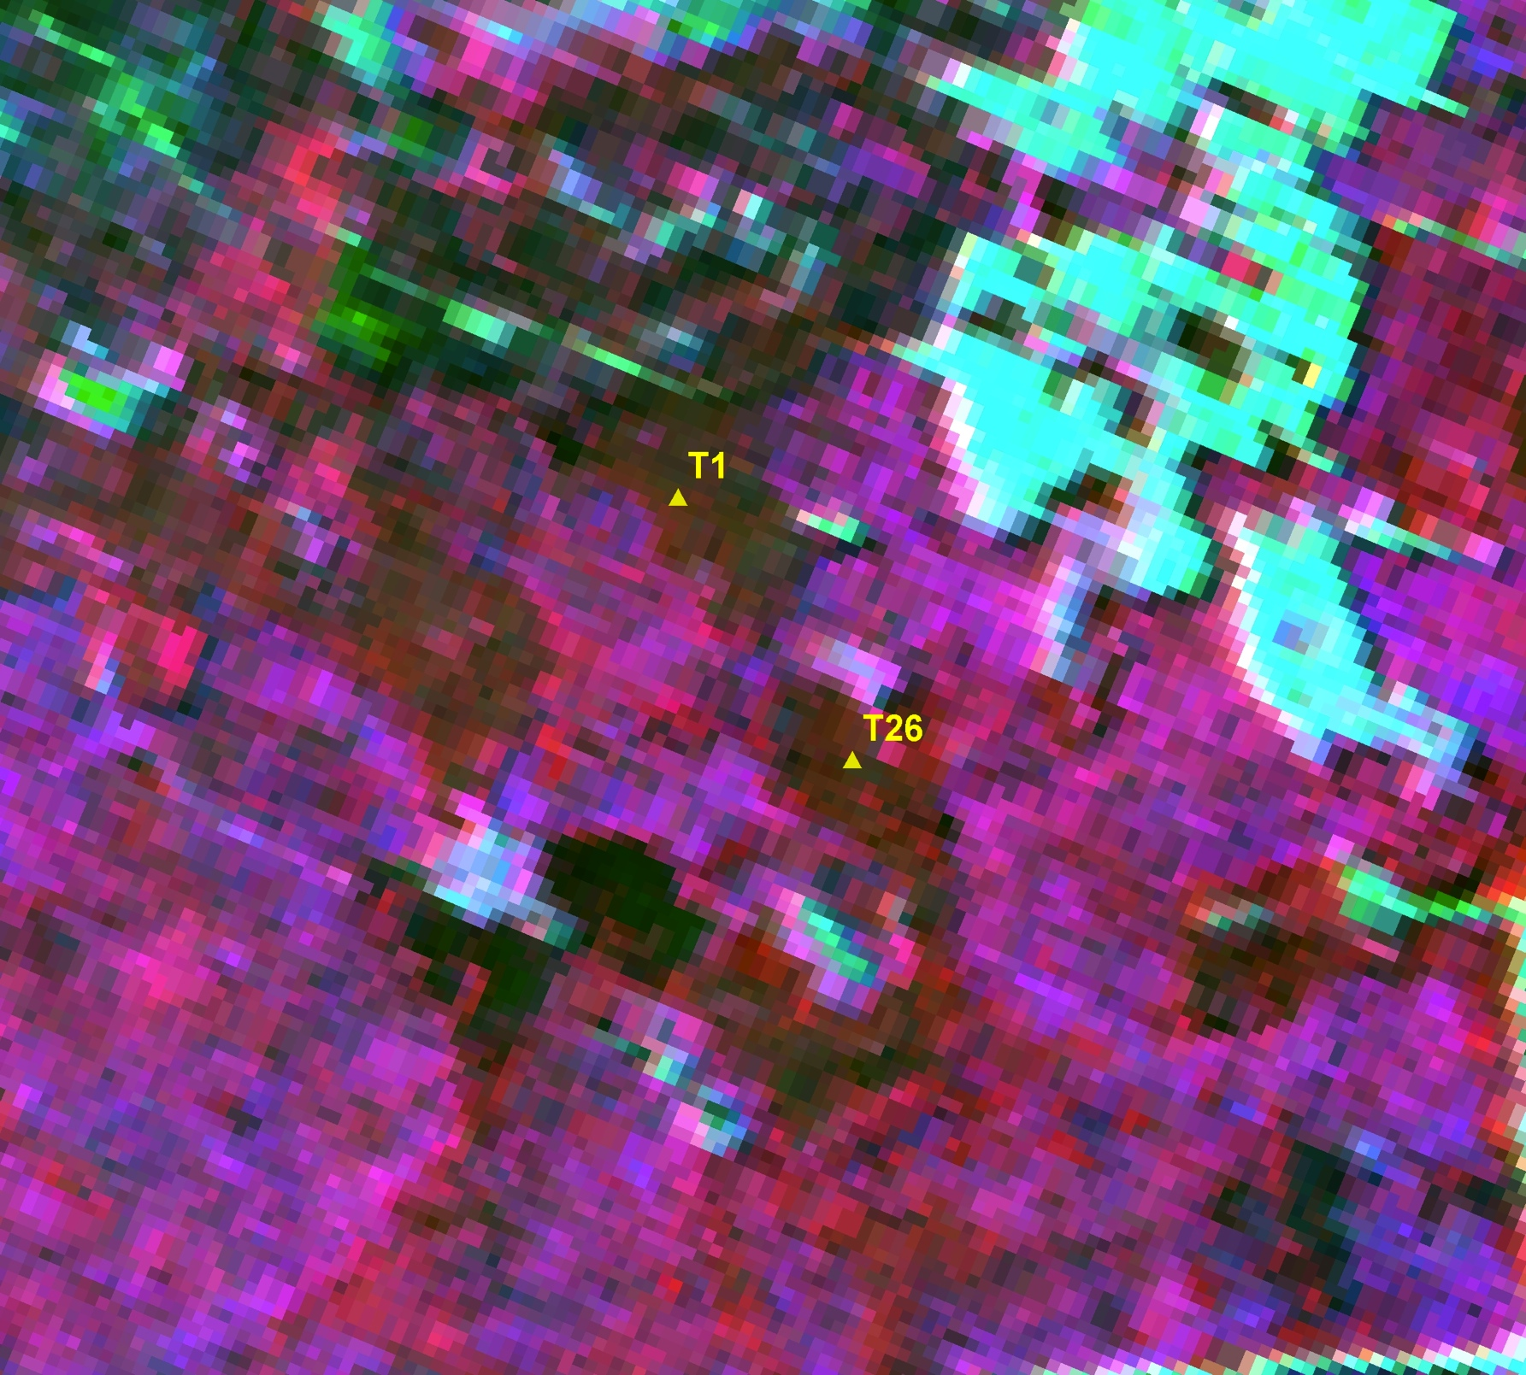
Notes:
'432' and '542' refer to the composite, which is aligned to Landsat bands. So ... 5 ~1650 nm 4 ~830 nm 3 ~660 nm 2 ~560 nm

Slide 24
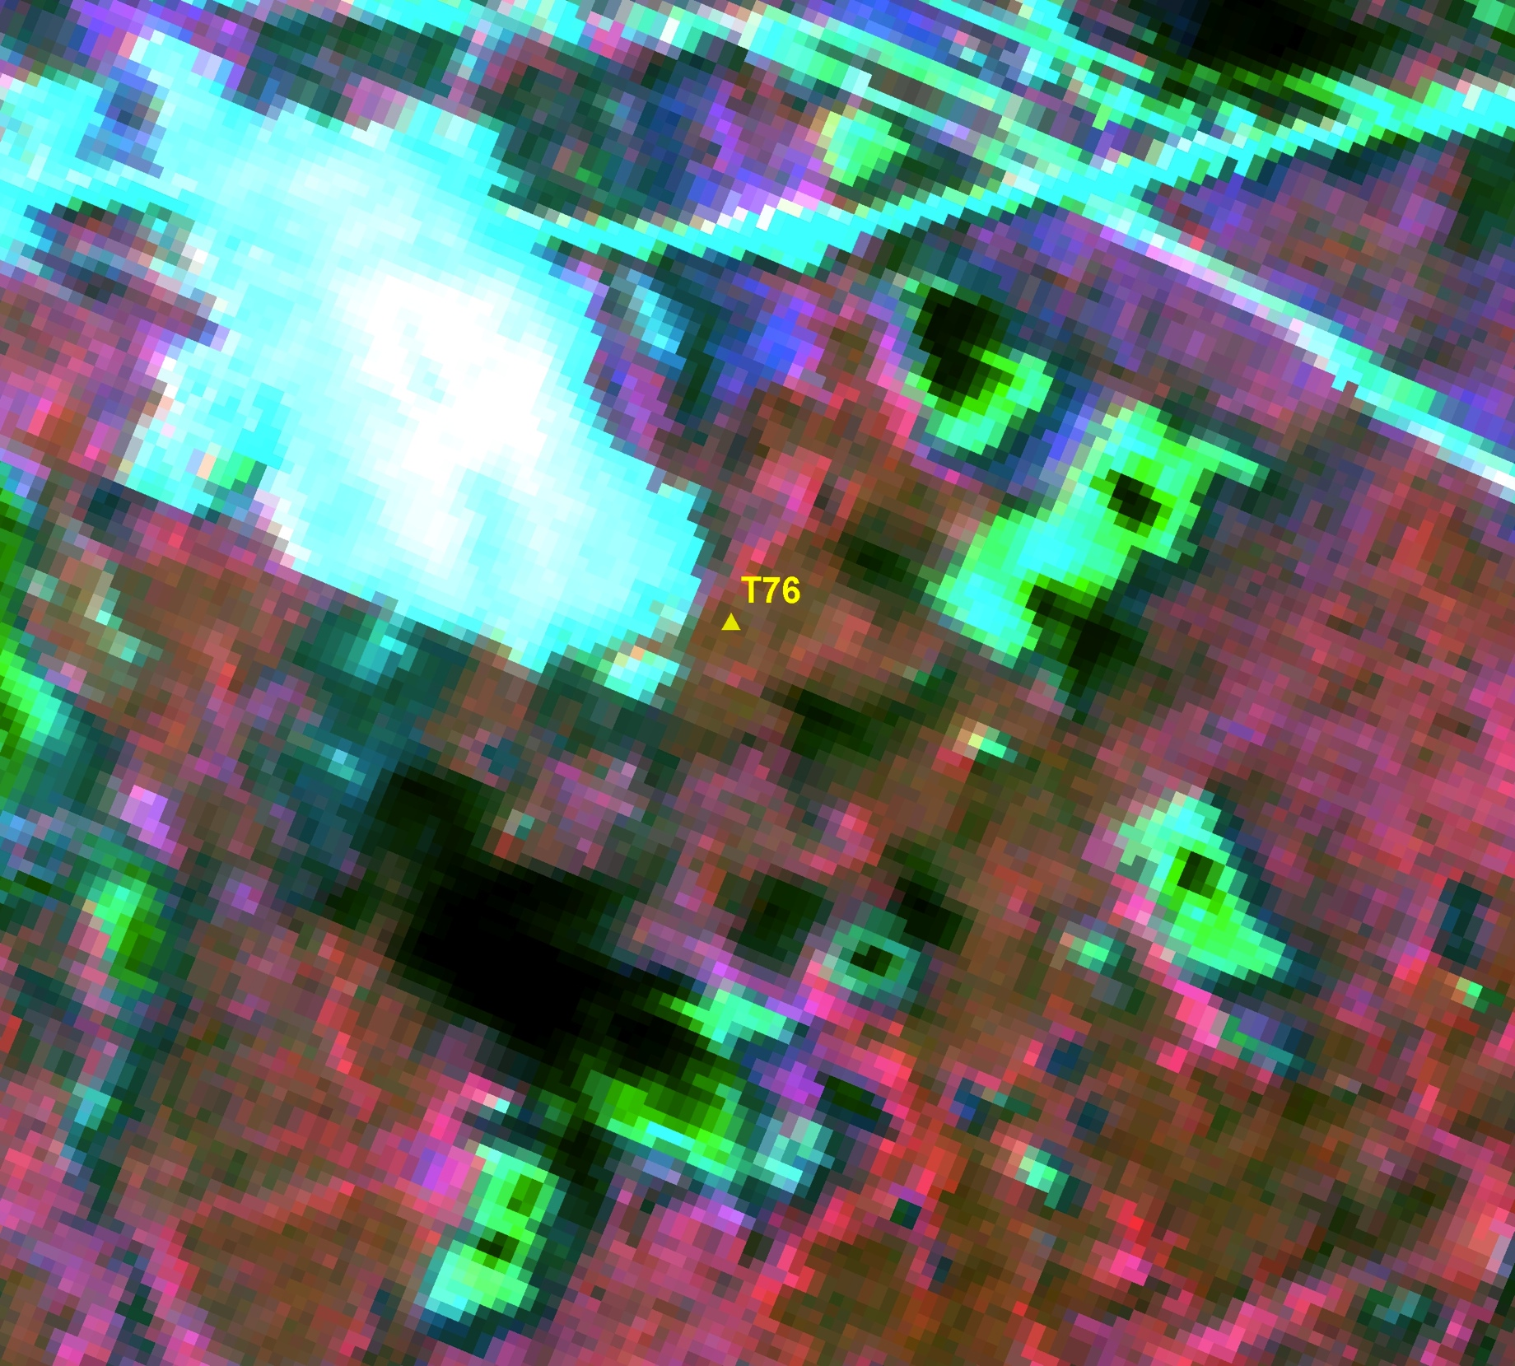

Slide 25
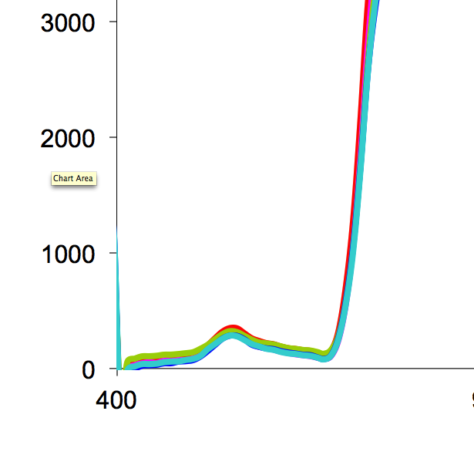
Notes:
Visable spectra 390-750 no difference among clones

Slide 27
Hyperspectral data
Notes:
We are also still working on the belowground stuff. Right now we are only able to say that the belowground patches differ, and we’d like to be able to make a more predictive relationship where canopy chemistry drives enzymes or microbial communities in a specific direction.
27

Slide 28
Remote sensing summary
LANDSAT
Promising, long data series needed, may work better on larger clones
AVIRIS
Expected relationships between canopy % N and reflectance persists within species
MORE PROMISE than with LANDSAT
Visable spectra show no difference, spectra associated with canopy chemistry shows differences among genotypes

Slide 29
Acknowledgements
NASA
Clayton Kingdon
Peter Wolter
Timothy Whitby
Aditya Singh
Jacqui Bryant

Slide 30
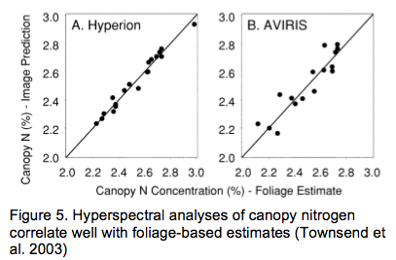
Preliminary analysis shows that bands known to correlate with N agree with canopy nitrogen measurements. Too few corrected AVIRIS images to present correlation.

Slide 31
Aspen genotype influences
Belowground N
Belowground C
Belowground NH4
Notes:
At least 10- fold difference in soil N soil C and belowground NH4. Much of this is due to spatial variation. Even if you correct for spatial autocorrelation, you have a large aspen genotype effect; this is not surprising but it’s never been done before. We’re working on partitioning the spatial vs the genetic component of this effect.
We know that a portion of this is due to aspen genotype litter inputs, We also know that a large amount of what we would like to call genotype effects are actually spatial autocorrelation. We’re working on it. If we calculate
The variogram associated with spatial autocorrelations shows that autocorrelation increases with distance at small distances and then levels off. This general shape is suggestive of a spatial correlation that is positive and strong at small distances and becomes less so as distances increase until reaching a certain distance d. We can incorporate a Gaussian fit to our variogram and use this to account for spatial autocorrelation. We still get significant clone effects on most responses, but I’m not confident the gaussian fit to the variogram is the best approach to account for spatial variation, and I’m going to wait until we get all of the data processed before deciding.

Slide 32
Aspen genotype influences
Canopy tannin
Canopy N
Notes:
5 –fold variation in CT across genotypes, 2-fold variation in canopy N. Again, not surprising, but important for our conceptual model.

Slide 33
Aspen genotype influences
Belowground microbial community
Notes:
beta-glucosidase (degrades cellulose)
cellobiohydrolase (degrades cellulose)
leucine aminopeptidase (degrades proteins)

Slide 34
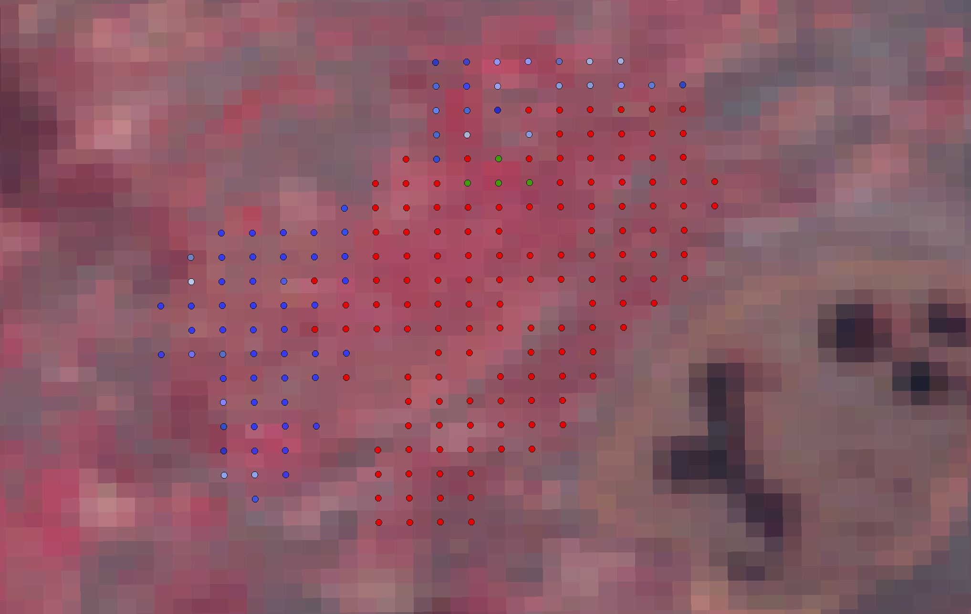

Slide 35
