Slide 1
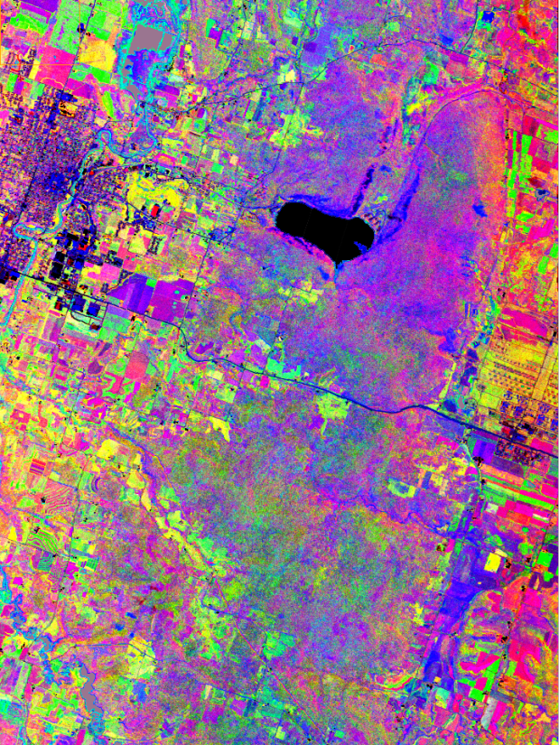
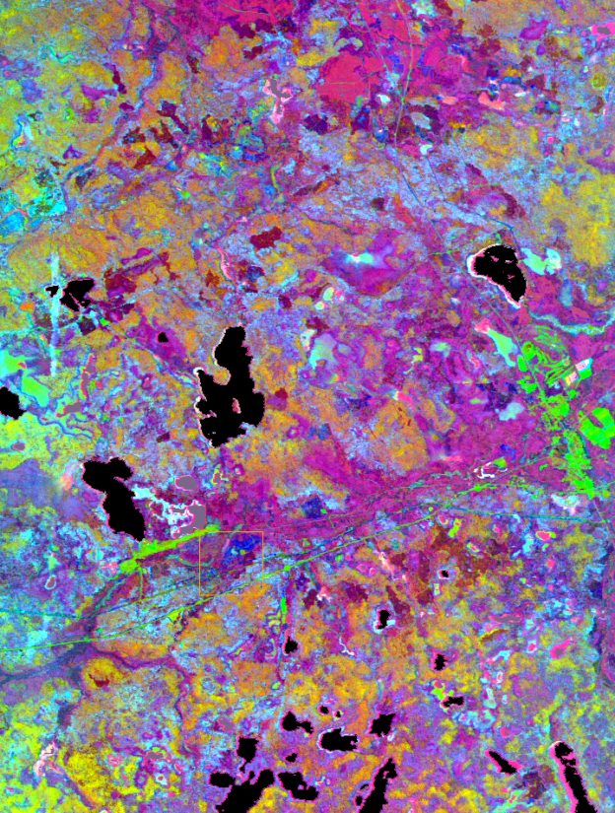
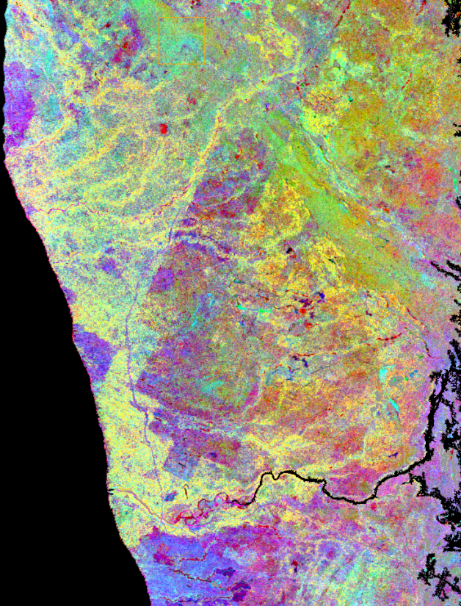
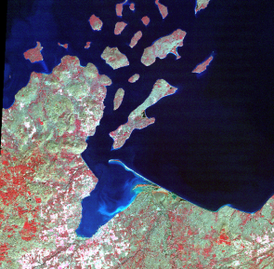
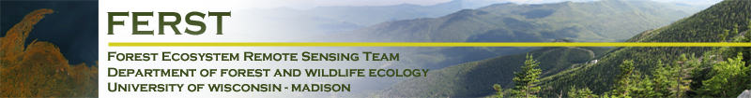

HyspIRI: Temperature and the Measurement of Ecosystem Processes
Phil Townsend, Shawn Serbin, Aditya Singh, Eric Kruger
Notes:
Temperature Mediated Photochemical Reaction
Main Processes:
absorption of photons by pigments
transport of electrons through thylakoid membrane
→ production of NADPH and ATP
Photosynthetic carbon-reduction cycle
Light-independent (dark) reaction
Assimilation of CO2
Synthesis of triose-phosphates

Slide 2
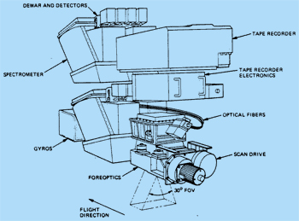
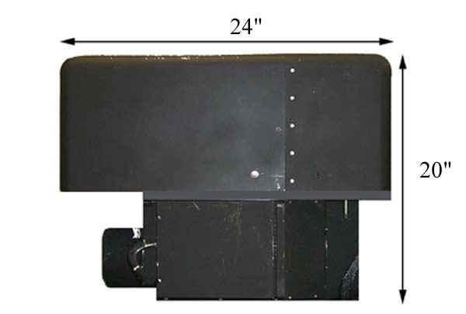
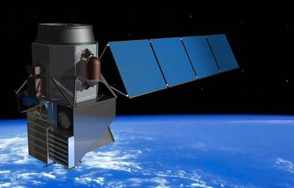
AVIRIS, MASTER and HyspIRI:
AVIRIS (VIS-NIR-SWIR)
224 channels
380-2500 nm
MASTER (Thermal Infrared)
50 channels
0.4-13 μm
VSWIR
380-2500 nm
60m pixels
19-day revisit
TIR
4-12 μm (8 bands)
60m pixels
5-day revisit

Slide 3
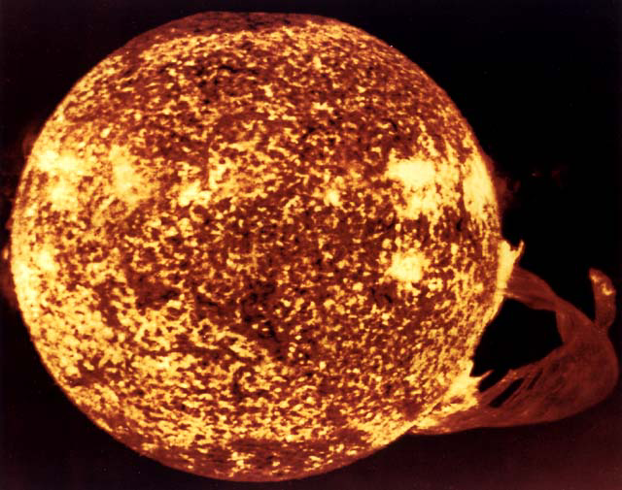
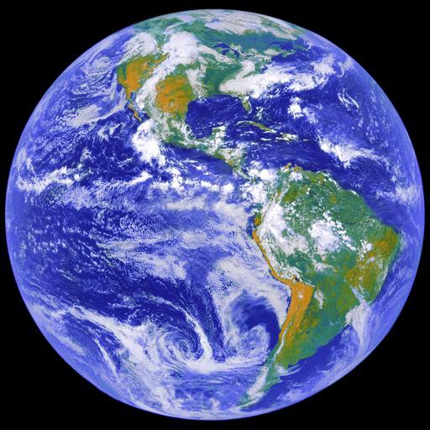
AVIRIS, MASTER and HyspIRI:
Courtesy of Rob Green
HyspIRI VSWIR
HyspIRI TIR
Notes:
HyspIRI captures the areas of the spectrum related to biochemicals and to temperature that are important to understanding the reactions associated with photosynthesis. Importantly – we can look at areas that vary in Temp. and determine the implications that has on photosynthesis and response to CO2 etc. etc.

Slide 4
What are we pretty sure we can do with HyspIRI?
Notes:
Discuss what we are pretty sure we can do with Imaging Spectroscopy

Slide 5
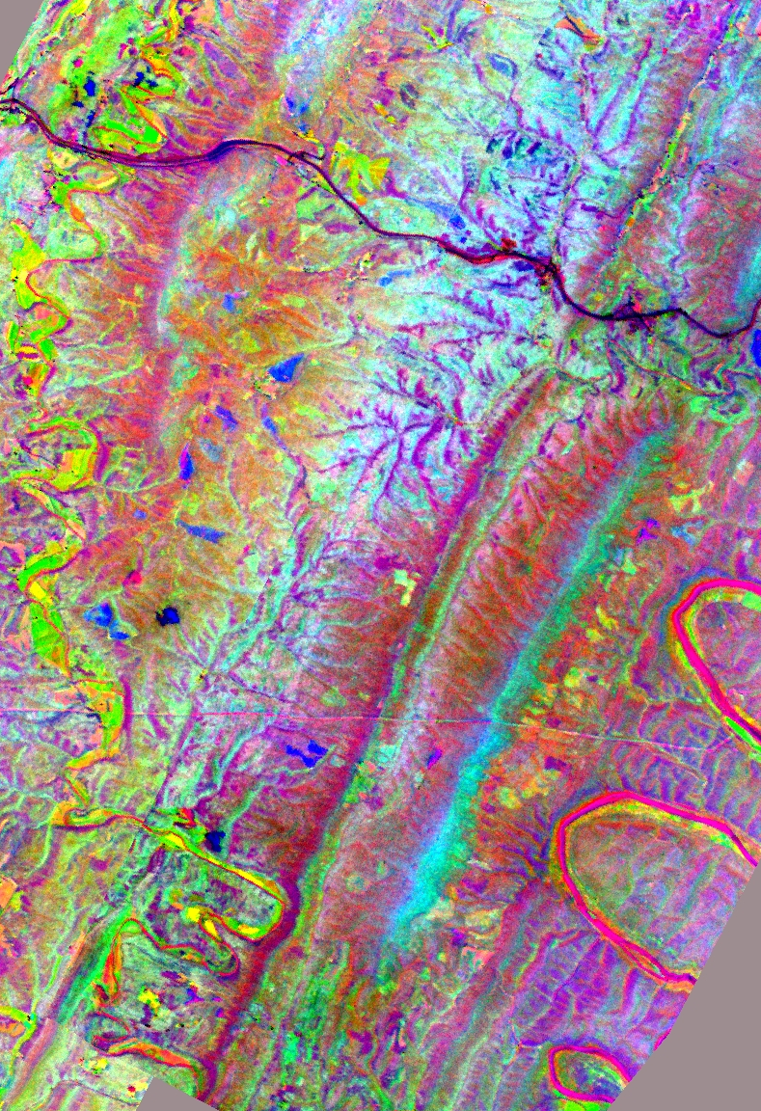
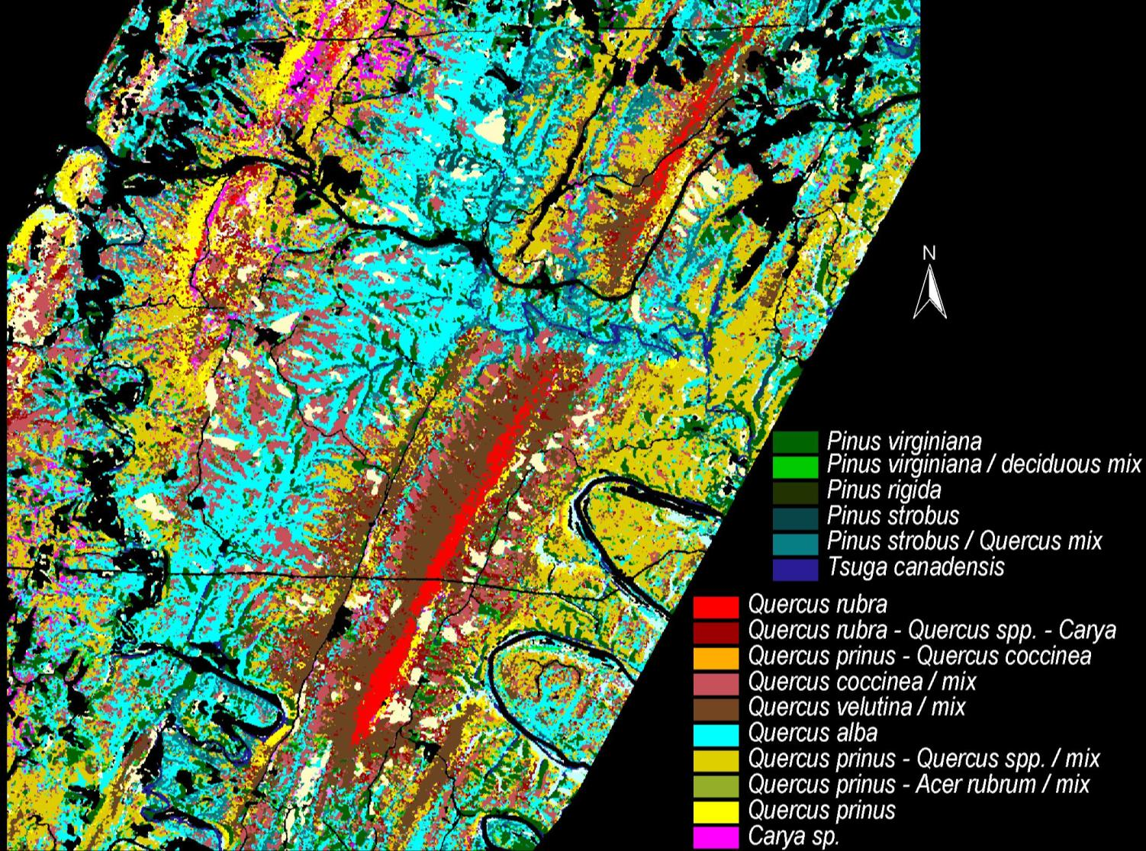
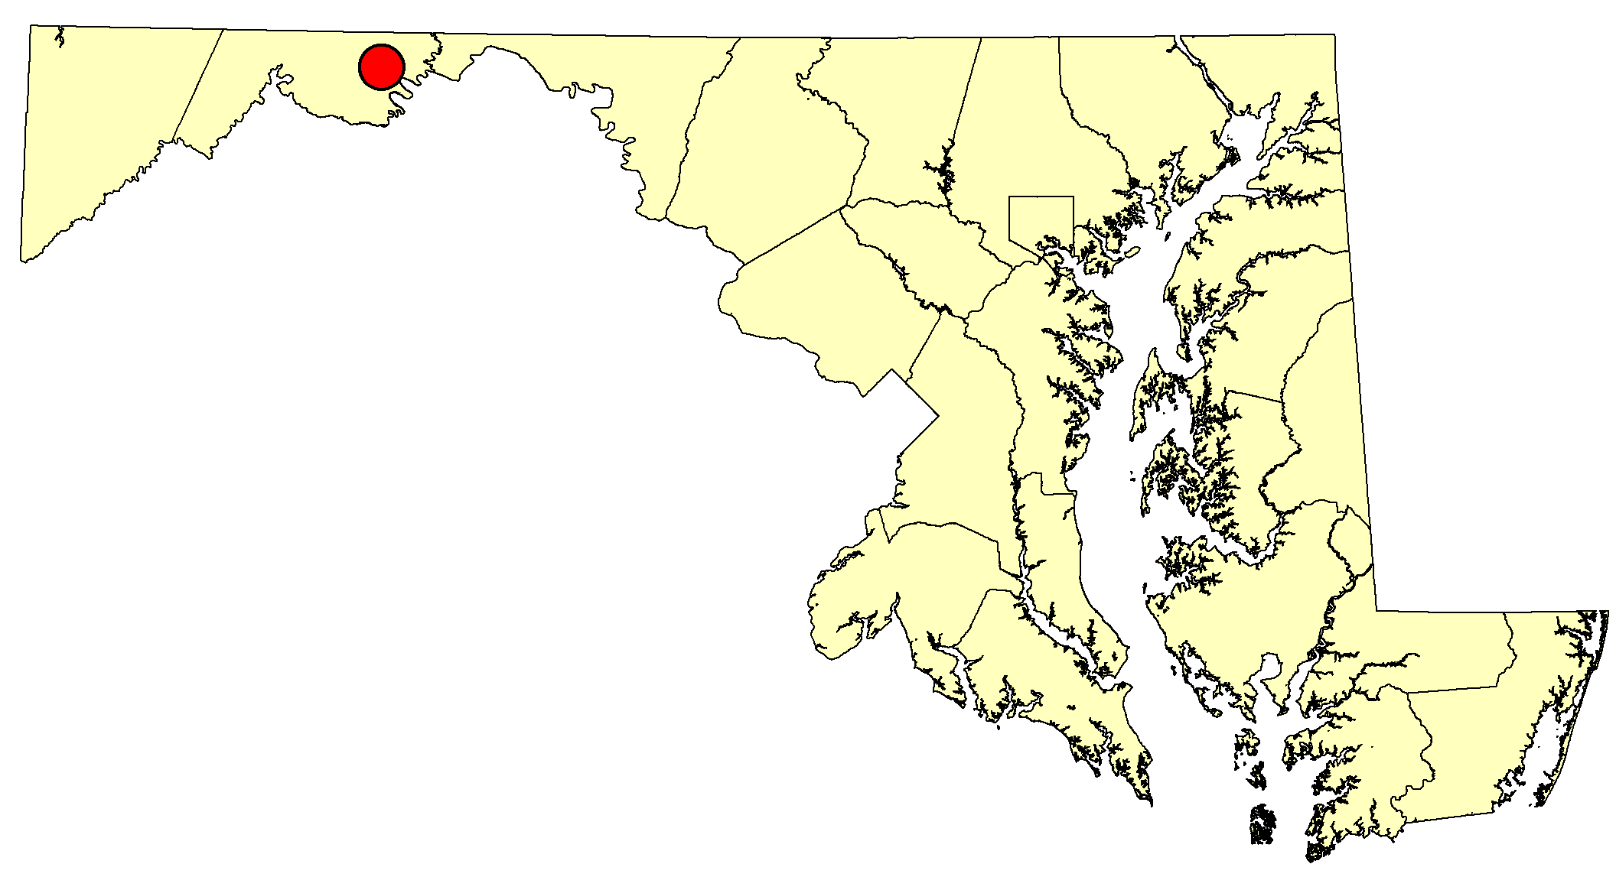
Species composition and biodiversity:
Notes:
We can more accurately characterize species composition using Imaging Spectroscopy. Species and functional types are important because of evolutionary differences in plant responses to the environment.

Slide 6
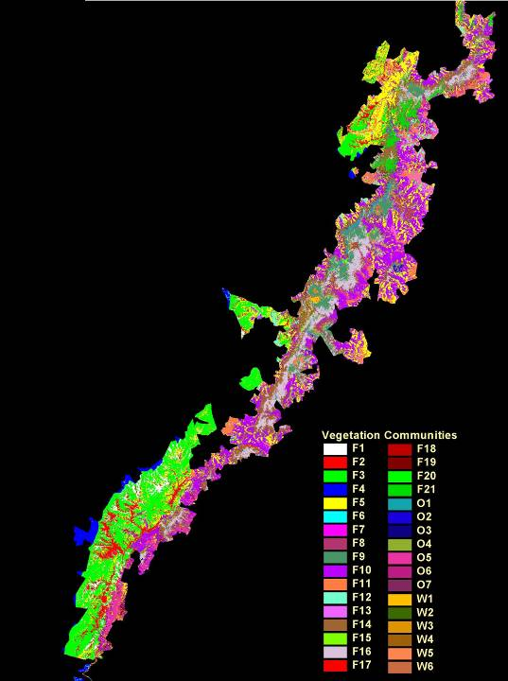
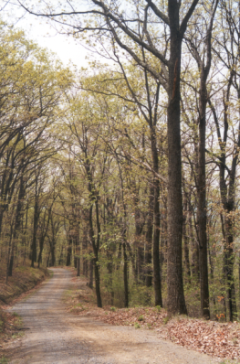
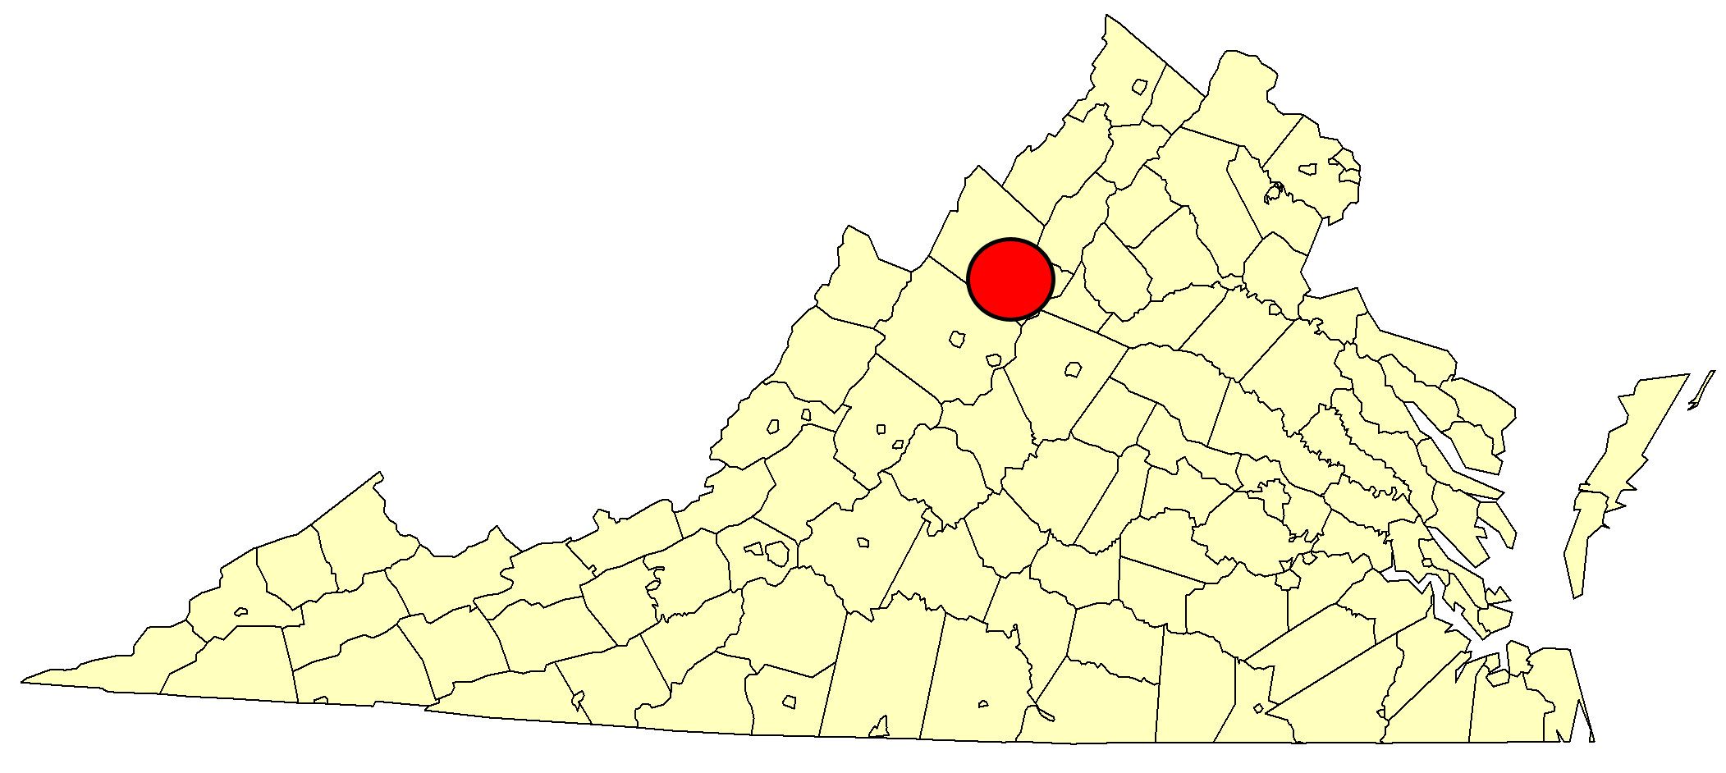
Species composition and biodiversity:
Species/Functional-type
Appalachian Mountains
Notes:
Discuss the results. Better accuracy with AVIRIS>Hyperion>Landsat multi-temporal
Weightings for Landsat incl topo

Slide 7
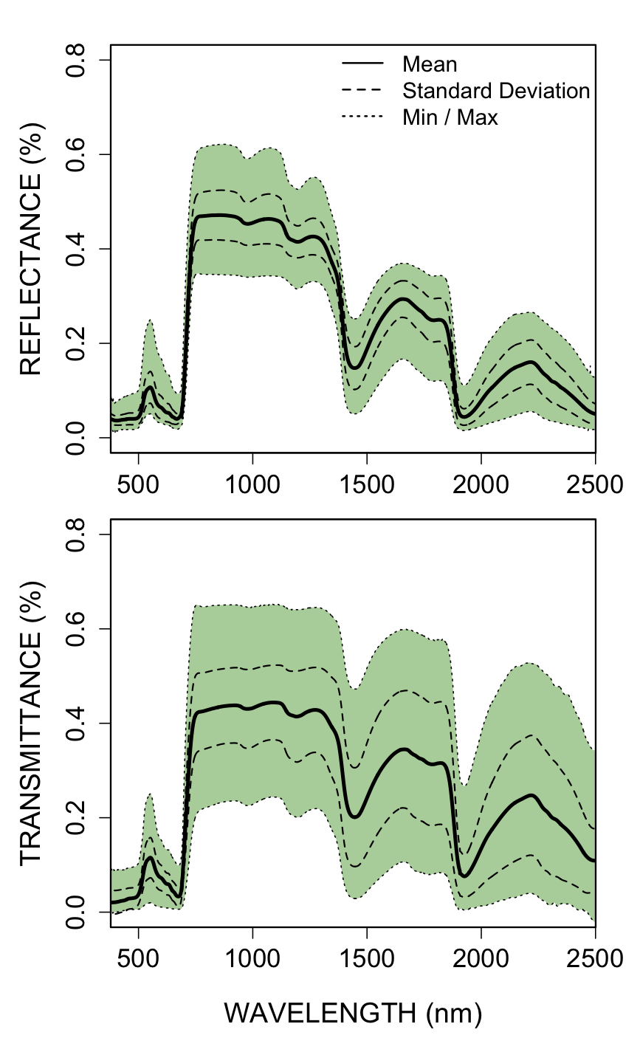
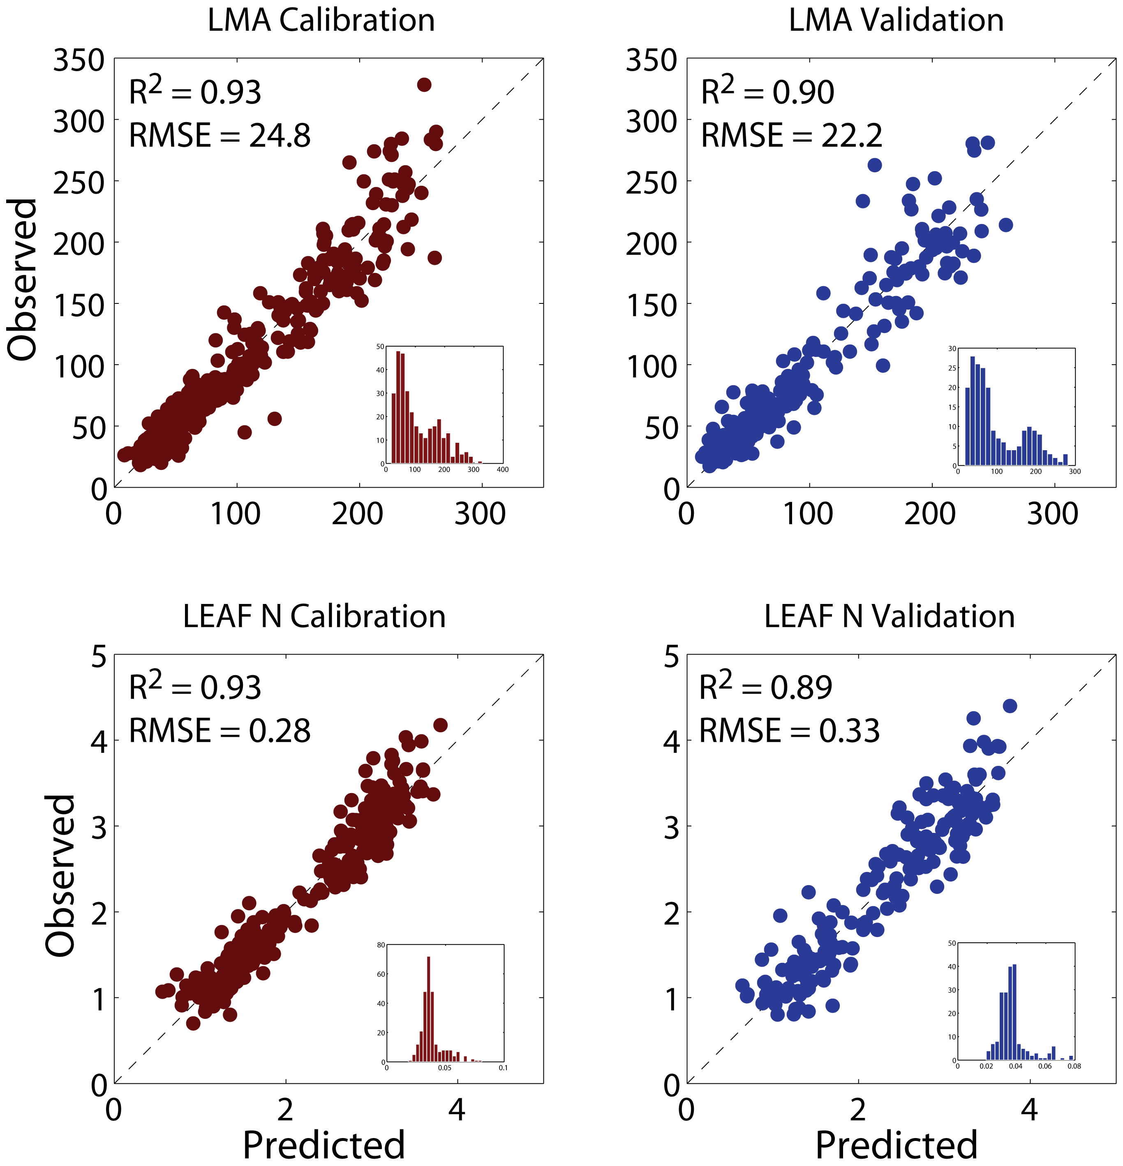

Slide 8
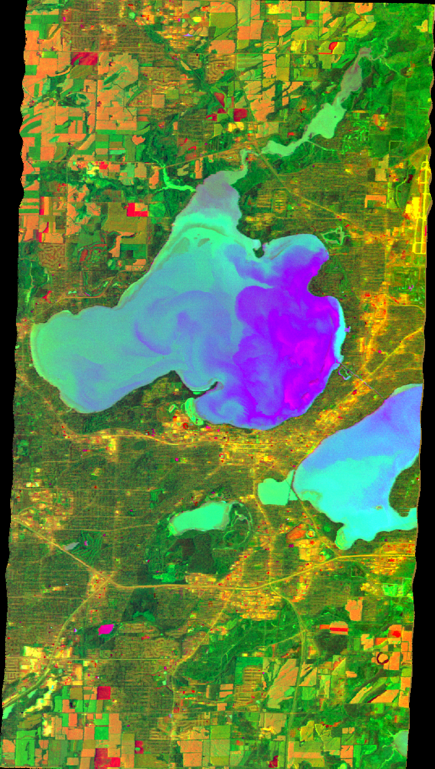
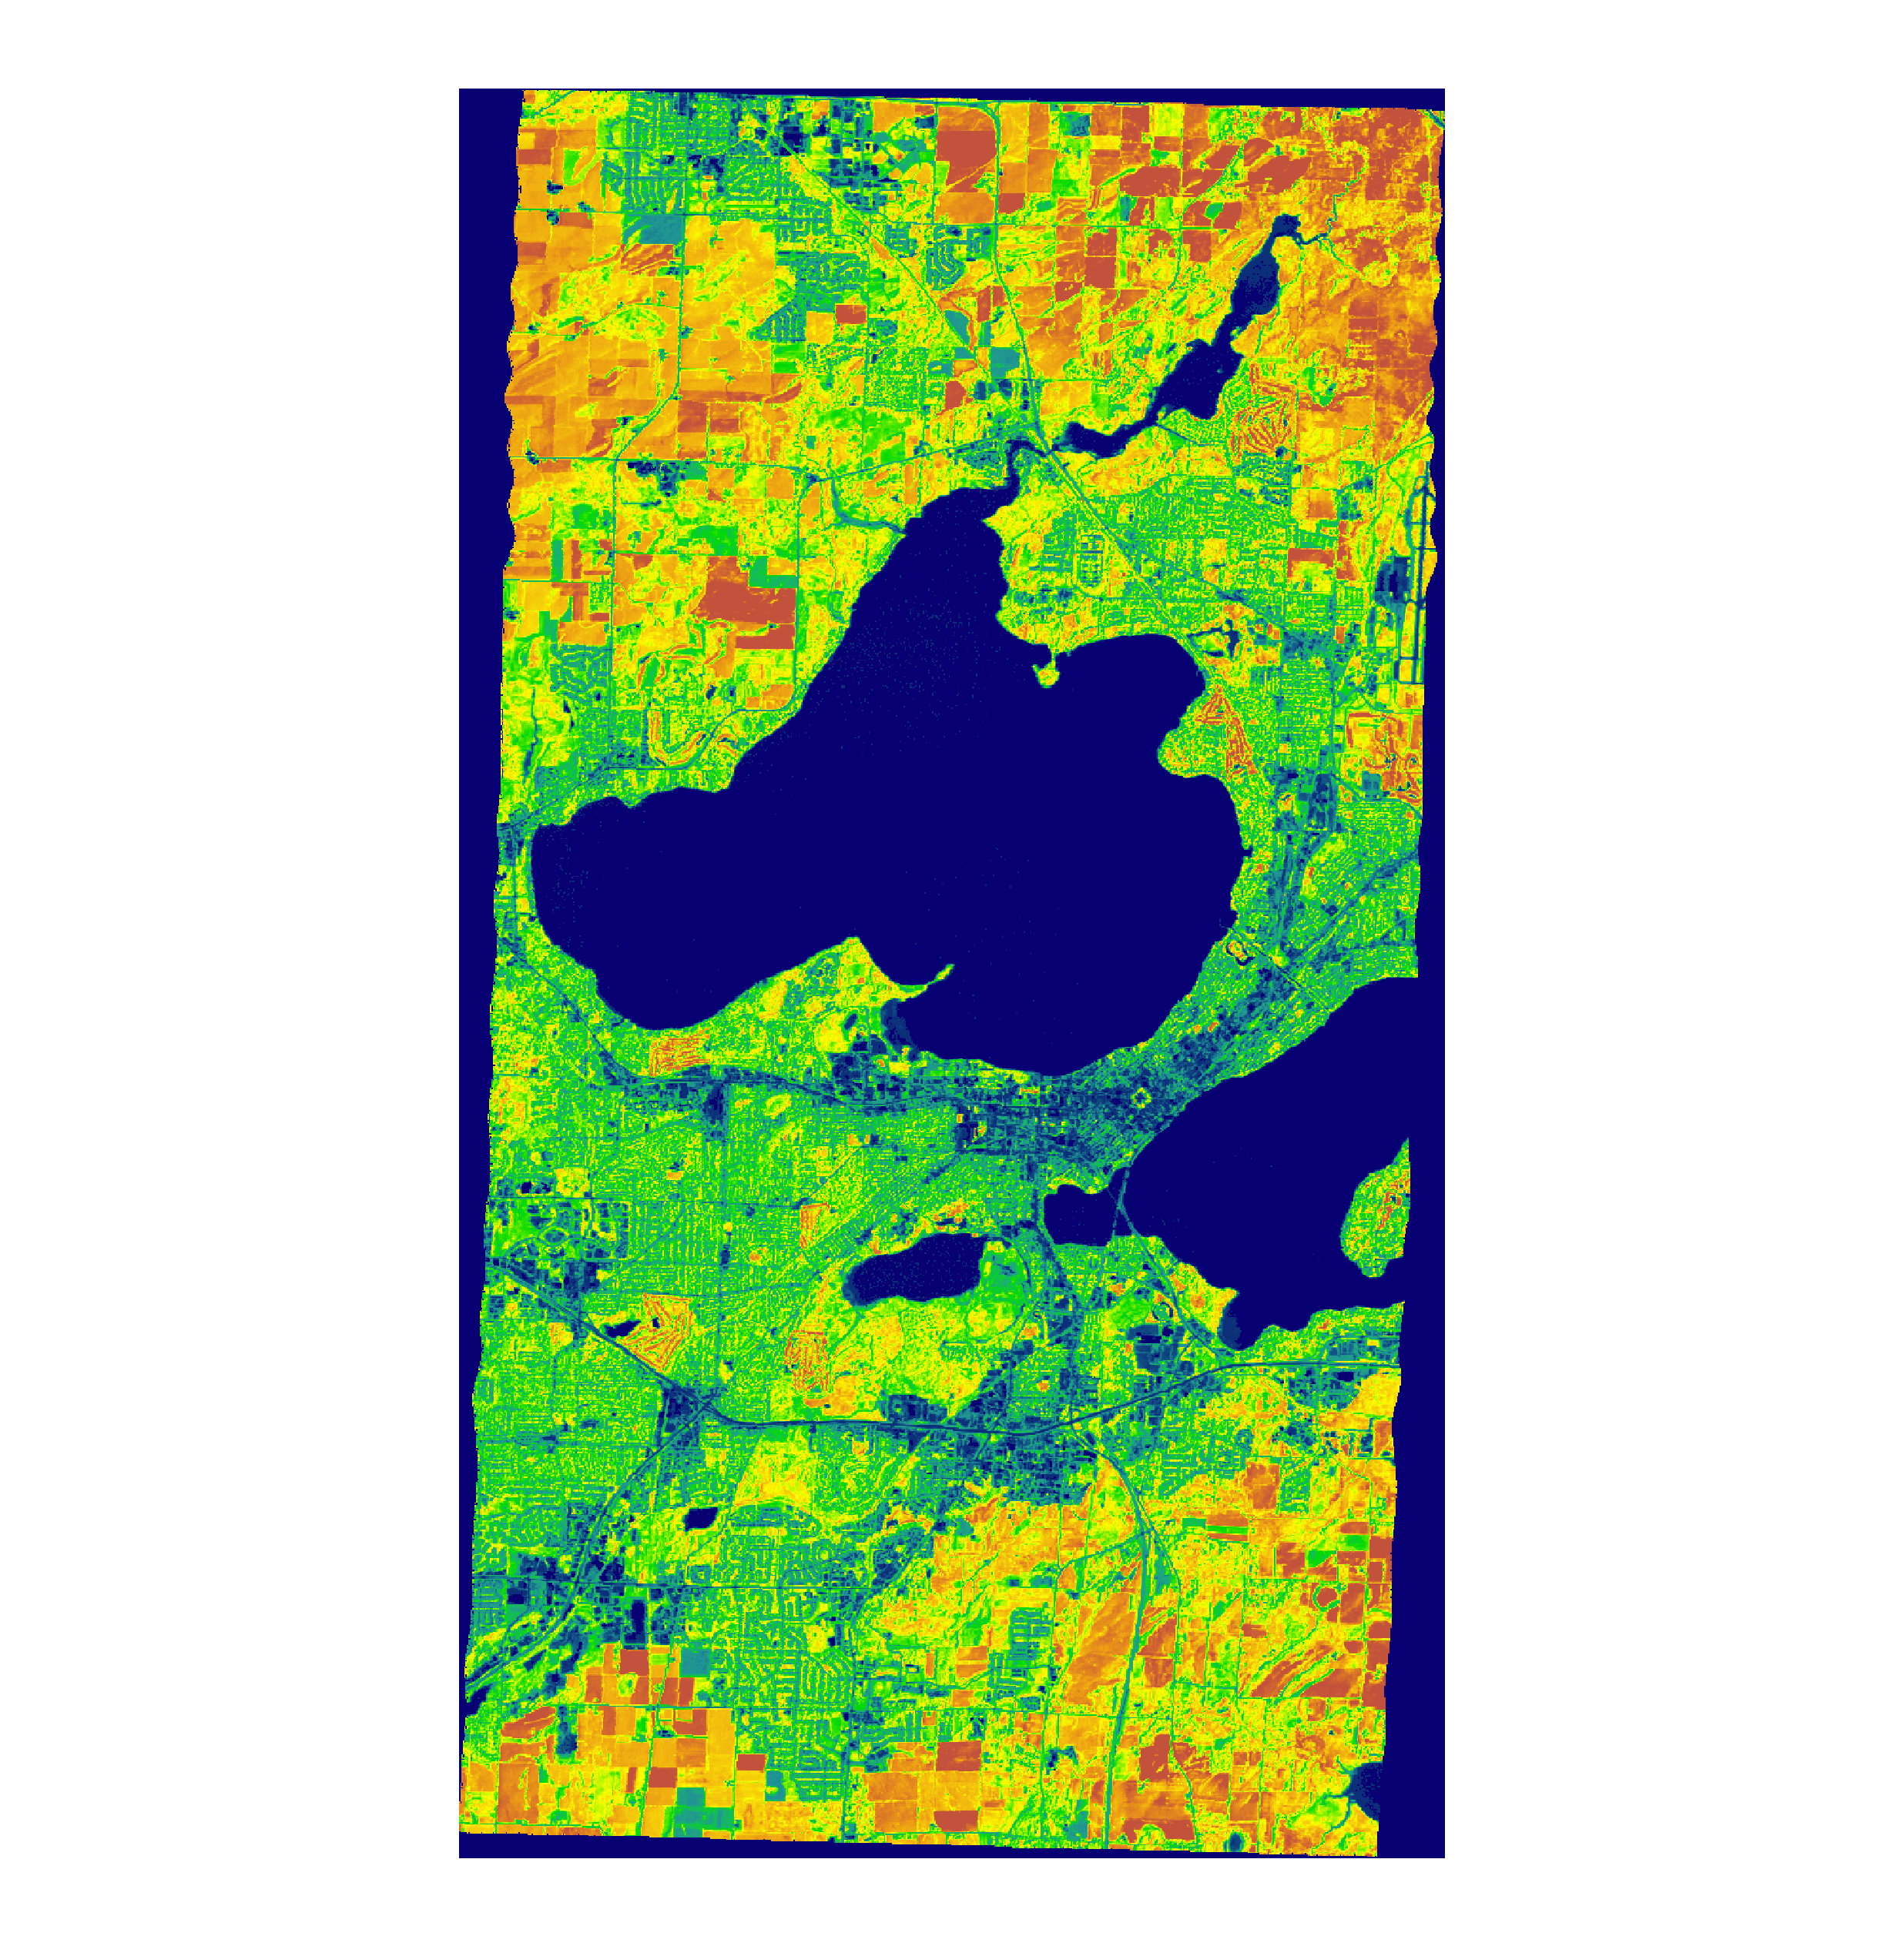
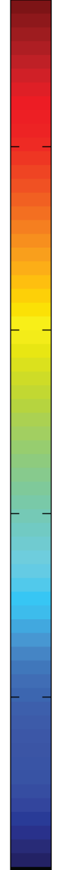
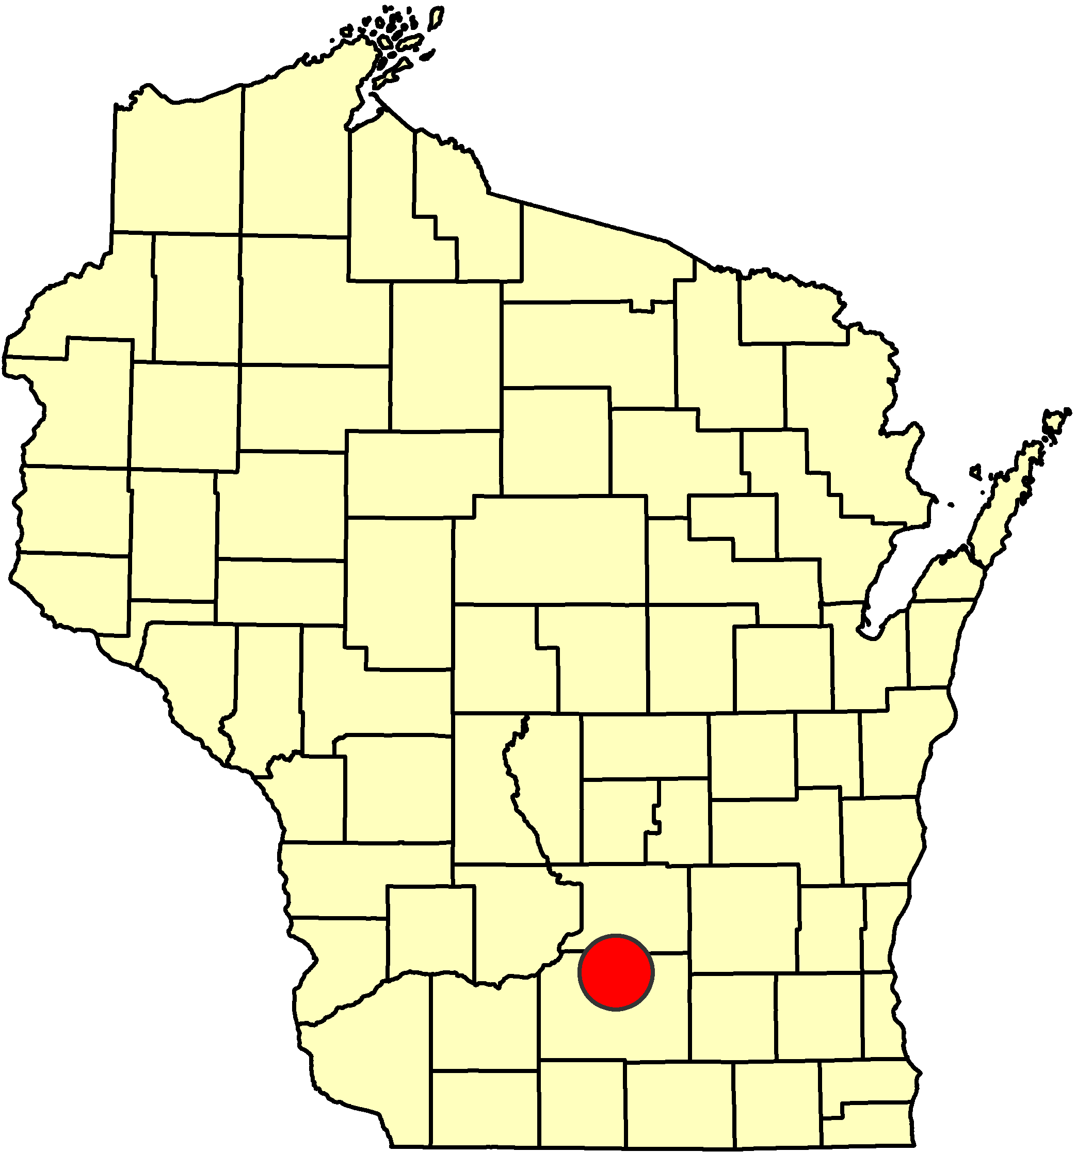
7.9%
Foliar biochemistry: Foliar N concentrations, Madison, WI
AVIRIS Image, Madison 2009 R/G/B = MNFT (4/7/1)
Madison 2009
Foliar N concentration (%)
0%
Notes:
N is the critical nutrient to plant growth and correlates well with growth rates within climatic zones.
Amino acids and proteins require NH4+ ammonium for their synthesis.
RUBISCO
an enzyme involved in the Calvin cycle that catalyzes the first major step of carbon fixation, a process by which the atoms of atmospheric carbon dioxide are made available to organisms in the form of energy-rich molecules such as glucose. RuBisCO catalyzes either the carboxylation or the oxygenation of ribulose-1,5-bisphosphate (also known as RuBP) with carbon dioxide or oxygen
RuBisCO is slow, being able to fix only 3-10 carbon dioxide molecules each second per molecule of enzyme. The reaction catalyzed by RuBisCO is, thus, the primary rate-limiting factor of the Calvin cycle during the day. Nevertheless, under most conditions, and when light is not otherwise limiting photosynthesis, the speed of RuBisCO responds positively to increasing carbon dioxide concentration.

Slide 9
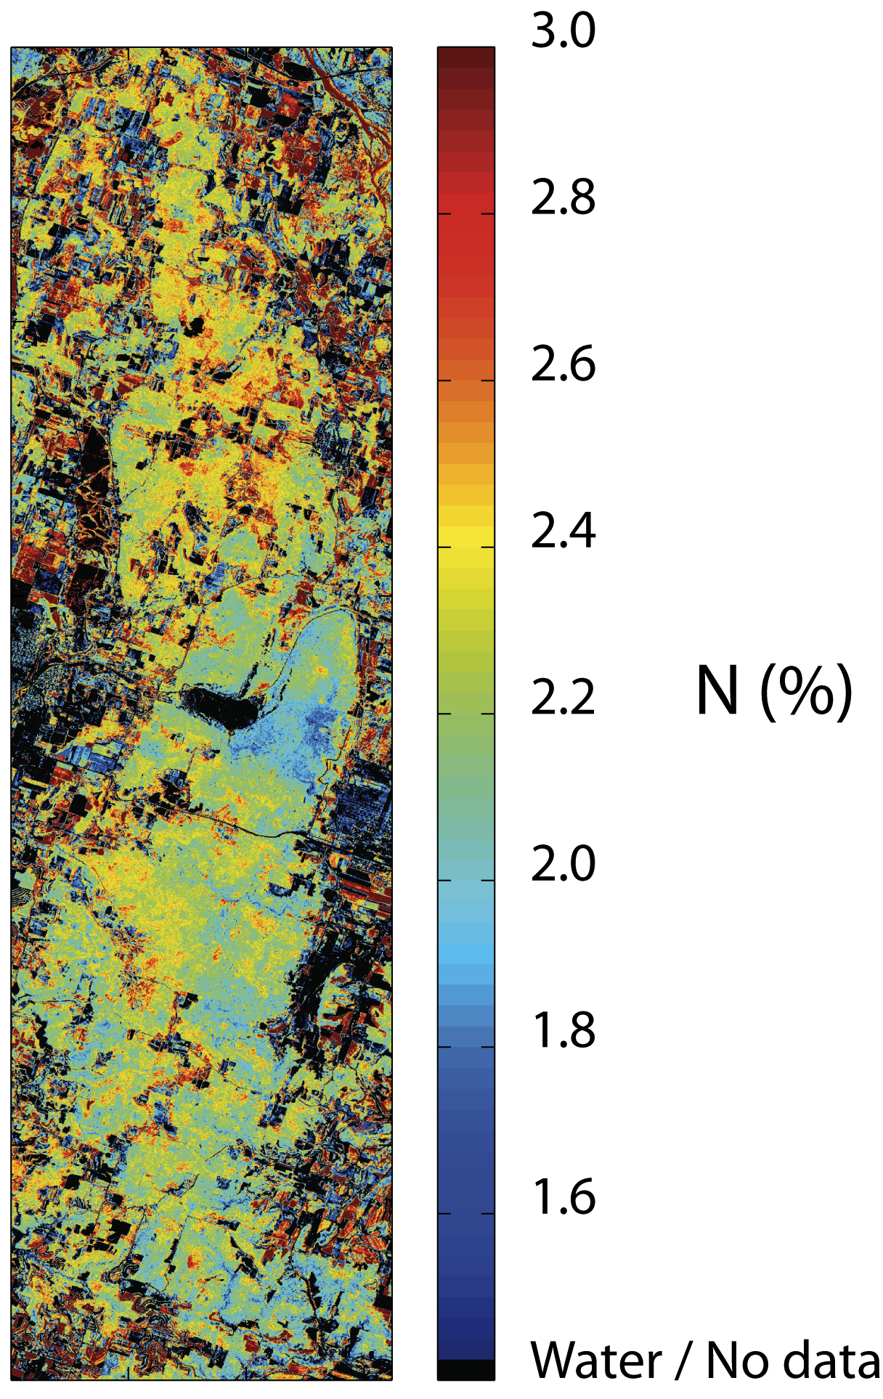

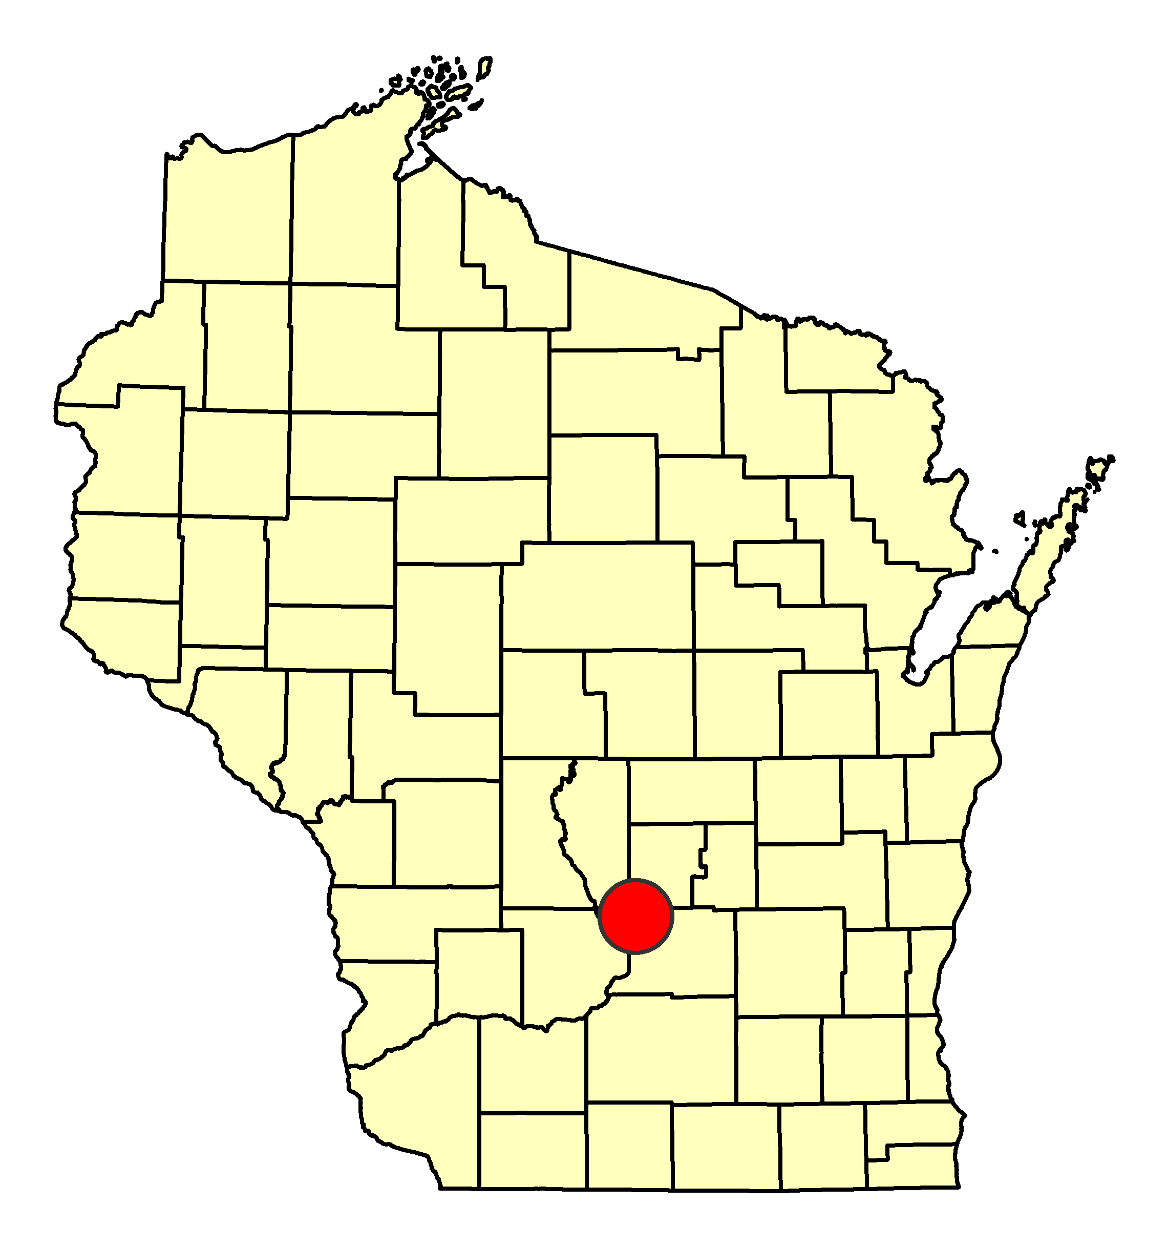
Foliar structure: Foliar N and LMA, Baraboo Hills, WI
3%
100 g/m²
LMA (gm⁻²)
Foliar N (%)
0%
0 g/m²
Notes:
Leaf mass per area (or LMA) is a critical leaf morphological trait that is a measure of leaf thickness and therefore photosynthetic capacity, i.e. ability to assimilate carbon into carbohydrates. LMA is neither good nor bad, but it is an important factor that drives plan growth strategies under different light/temperature (++) and nutrient/water stress (+) conditions. LMA also varies by position in the canopy of vegetation.
LMA = investment (leaf mass) associated with a given rate of return per unit area (Leaf area used for light capture) – Wright et al. 2002
So, lower LMA == potentially faster rate of growth like crops, but less investment in, e.g., longevity of the leaf → more area available for light-capture area (per unit mass) for production, tend to have higher N concentration, shorter diffusion pathlength from stomates to chloroplasts etc etc
Higher LMA (evergreens) == hedge toward long-term performance, i.e. with thicker walled cells == nutrient conservation, water conservation

Slide 10
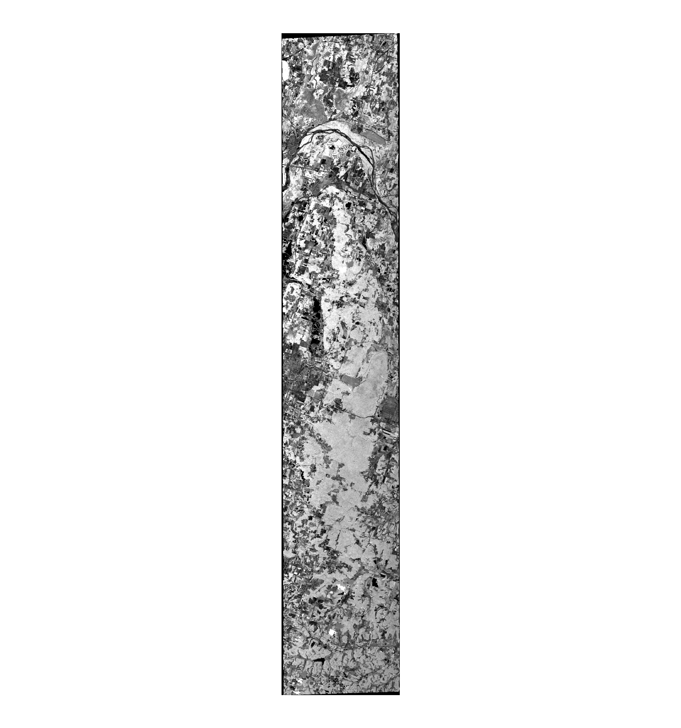
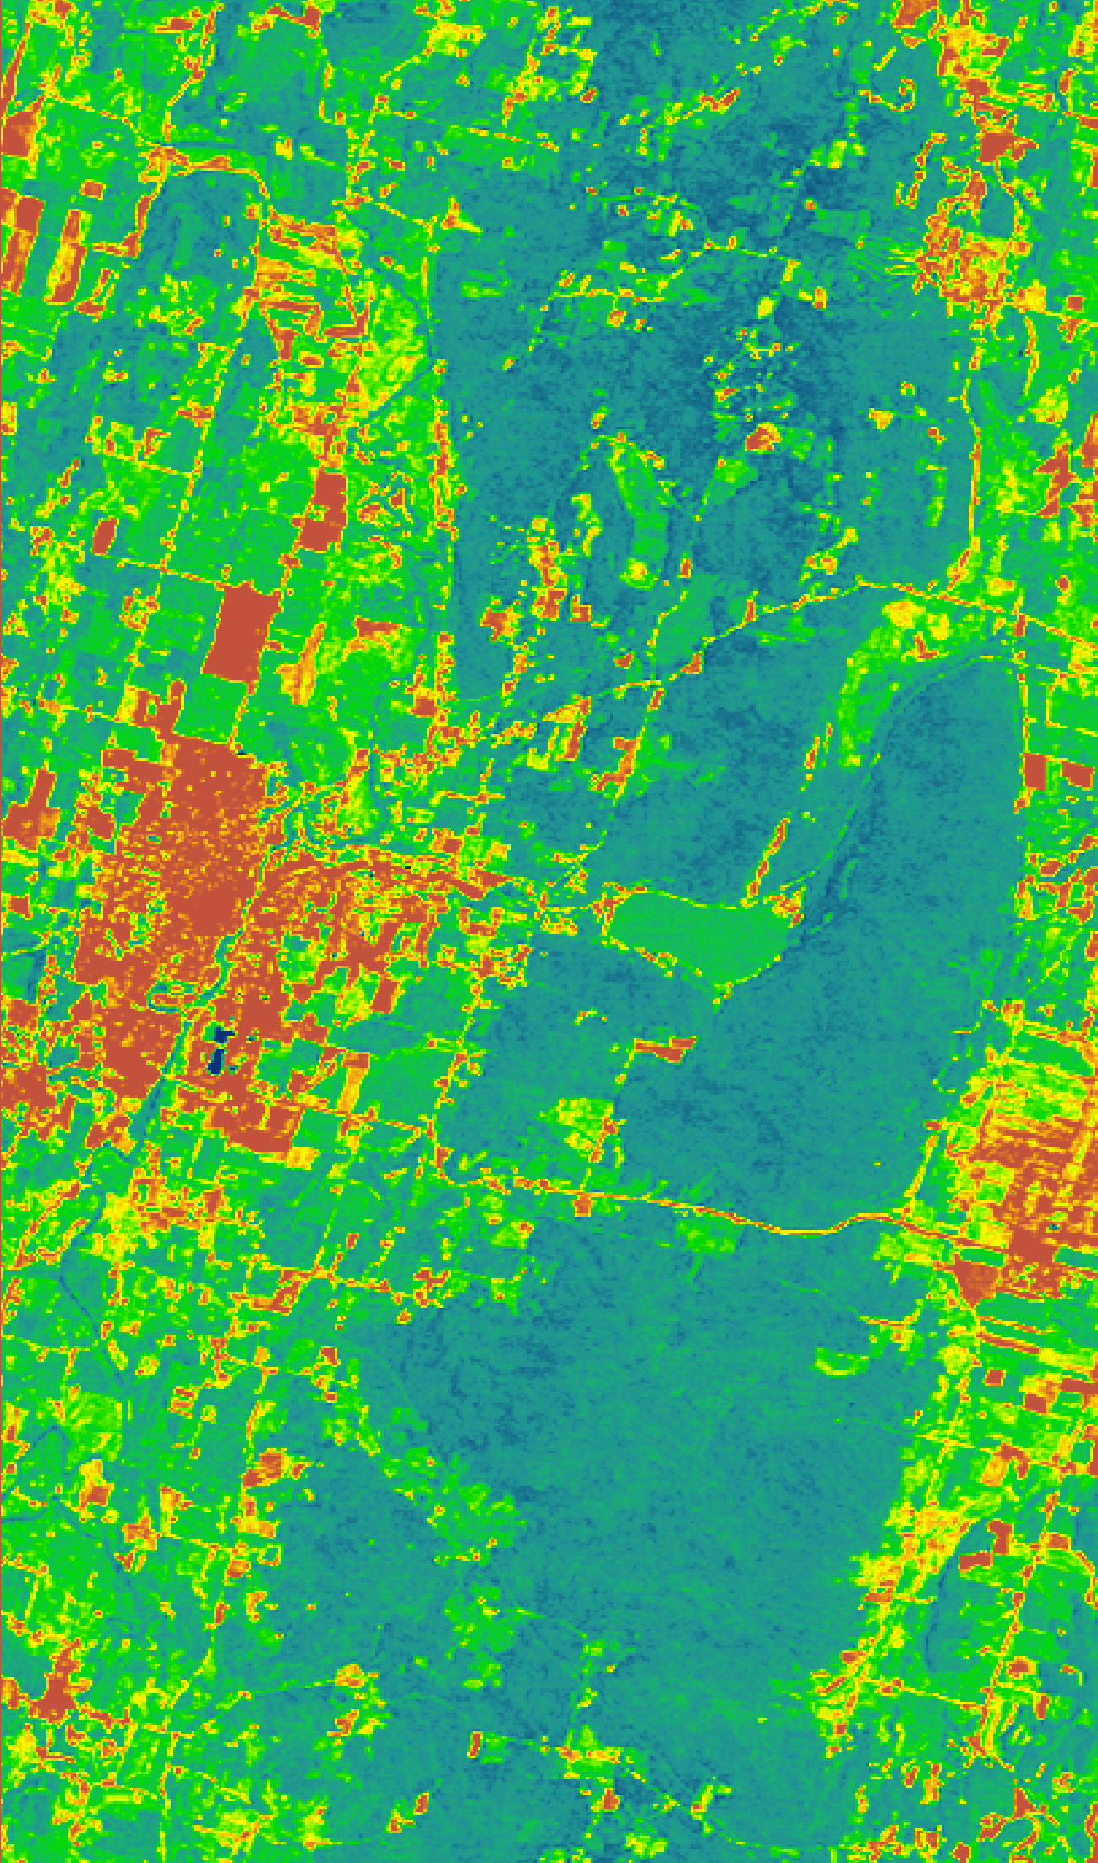
Plant metabolic activity:
PRI
-0.04
0.031
Temp.
316K
295K
SHAWN DOES THIS SLIDE
AVIRIS PRI
MASTER Temp.
Notes:
Photochemical reflectance index John Gamon et al. (1992)
--PRI estimates biochemical limitations on psn based on xanthophyll cycle
Xanthophyll cycle pigments adjust energy distribution at photosynthetic reaction center, and therefore correlates with LUE, key to vegetation production, varies diurnally
SUNLIGHT --> XANTHOPHYLL PIGMENTS --> either (a) dissipate energy to heat OR
(b) pass through to CHL --> electron transport e- --> carboxylation
therefore tracks with physiological state and stress
PRI is sensitive to changes in carotenoid pigments (e.g. xanthophyll pigments) in live foliage. Carotenoid pigments are indicative of photosynthetic light use efficiency, or the rate of carbon dioxide uptake by foliage per unit energy absorbed. As such, it is used in studies of vegetation productivity and stress. Because the PRI measures plant responses to stress, it can be used to assess general ecosystem health using satellite data or other forms of remote sensing. Applications include vegetation health in evergreen shrublands, forests, and agricultural crops prior to senescence. PRI is defined by the following equation:
531-570 / 531+570

Slide 11
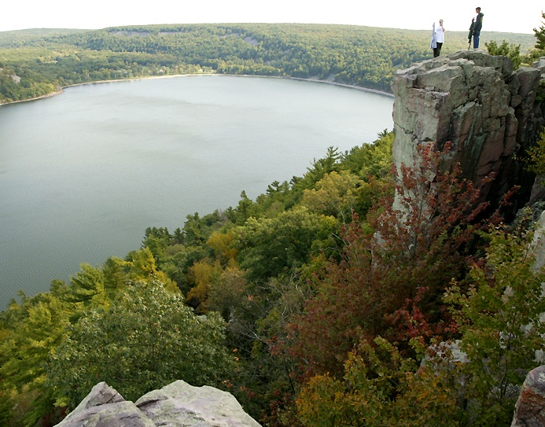
Characterization of processes in the biosphere:
Baraboo Hills, WI
Species composition
Species
N (%)
http://www.richard-seaman.com/Wallpaper/USA/States/DevilsLakeFromWest.jpg
LMA
PRI
Notes:
This is meant to be a summary slide that takes the right panel of the previous 4 slides and places them together on this slide, laid out as I have here. The point that I will make here is that taking all of these things together, we can come as close as possible with current technology to remotely measure the biological processes (rates) associated with the earth’s ecosystem. Combines with Lidar/SAR to get stocks, we would be close to developing a relatively complete characterization of biological properties and potentially how they change.

Slide 12
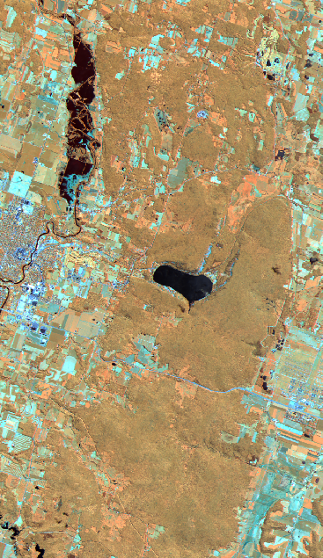
Why do we need concurrent thermal IR?
Temp.
302K
316K
295K
AVIRIS RGB: 54/59/61
MASTER Temp.
Notes:
AVIRIS 2008
MASTER 2011
Here I will discuss photosynthesis as a temperature controlled (or mediated) reaction.

Slide 13
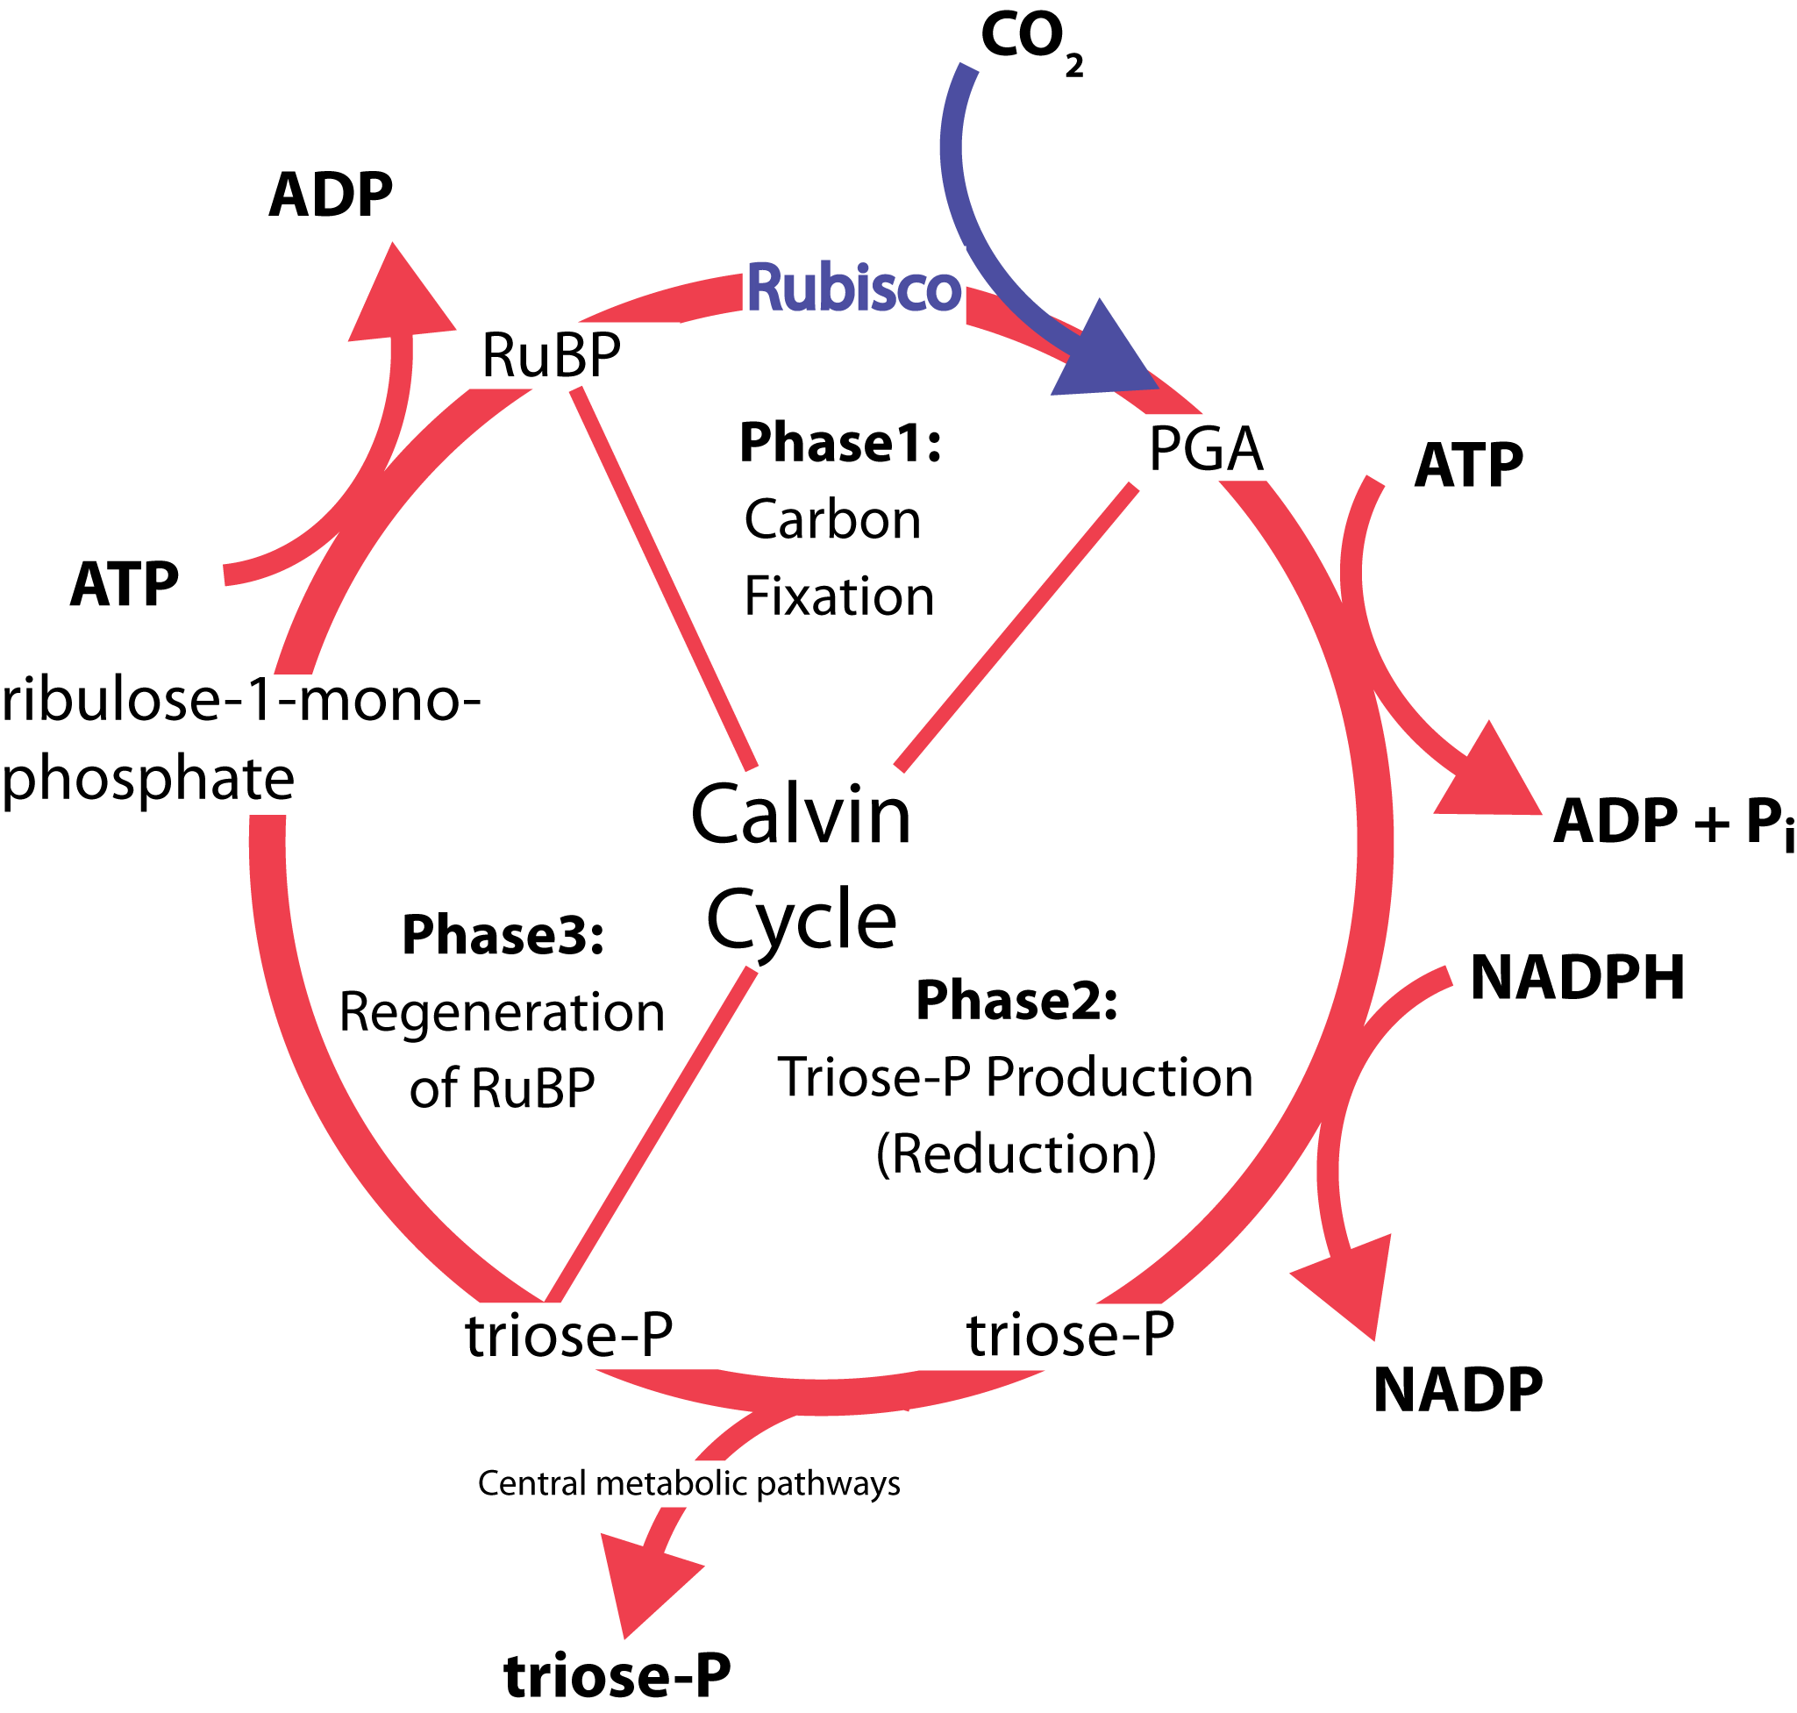
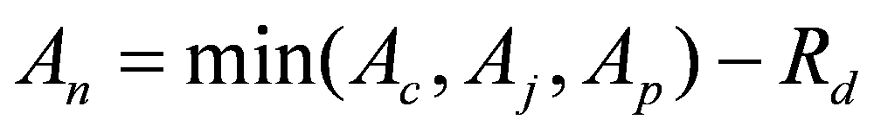
..because chemical reactions vary with temperature
Assimilation (A; µmol m⁻² s⁻¹)
G3P utilization
Vcmax
Jmax
RuBP
Rubisco
Intercellular CO₂ (C_{i}; µmol mol ⁻¹)
Carboxylation (V_{cmax}) – addition of CO₂ to RuBP (catalyzed by RuBisCO). Addition of ATP and NADPH → triose phosphate
Electron Transport Rate (J_{max}) – necessary for the regeneration of RuBP to continue the cycle
Notes:
Vcmax – Maximum rate of carboxylation
-Carboxylation = addition of CO2 to the five-carbon RuBP and the splitting of the resulting unstable six-carbon compound into two molecules of PGA, a three-carbon compound. This reaction occurs three times during each complete turn of the cycle; thus, six molecules of PGA/3PG are produced.
-Rubisco catalyzes RuBP with carbon dioxide in order to synthesize a highly unstable 6-carbon intermediate known as 3-keto-2-carboxyarabinitol 1,5-bisphosphate, which decays virtually instantaneously into two molecules of glycerate 3-phosphate (G3P, triose phosphate).
-G3P is generally considered the prime end-product of photosynthesis and it can be used as an immediate food nutrient, combined and rearranged to form monosaccharide sugars, such as glucose, which can be transported to other cells, or packaged for storage as insoluble polysaccharides such as starch
-ATP provides chemical energy for metabolism
-NADPH produced is then used as reducing power for the biosynthetic reactions in the Calvin cycle
The ultimate rate-limiting factor of the Calvin cycle is the enzyme RuBisCO, which cannot be ameliorated in short time by any other factor. If light is not limiting, then generally RuBisCO processes as much CO2 as can be provided.
Jmax -- Electron transport critical to producing NADPH and ATP:
-NADPH used as reducing power for the biosynthetic reactions in the Calvin cycle producing 2 ATP during photosynthesis
-ATP transports chemical energy within cells for metabolism
TPU = triose phosphate utilization curve

Slide 14
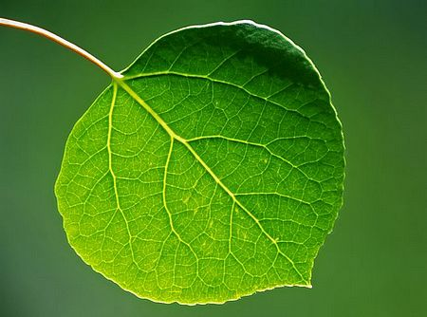
Photosynthesis:
A temperature-mediated photochemical reaction
Nutrient dynamics governed by plant allocation of resources
Climate is key to photo-synthetic potential.
★ Light, temperature, carbon dioxide, water, nutrients
Notes:
Temperature Mediated Photochemical Reaction
Main Processes:
absorption of photons by pigments
transport of electrons through thylakoid membrane
→ production of NADPH and ATP
Photosynthetic carbon-reduction cycle
Light-independent (dark) reaction
Assimilation of CO2
Synthesis of triose-phosphate
Photosynthesis occurs in two stages. In the first stage, light-dependent reactions capture the energy of light and use it to make the energy-storage molecules ATP and NADPH. The light-independent Calvin cycle uses the energy from short-lived electronically excited carriers to convert carbon dioxide and water into organic compounds that can be used by the organism. This set of reactions == carbon fixation. The key enzyme of the cycle is RuBisCO.

Slide 15
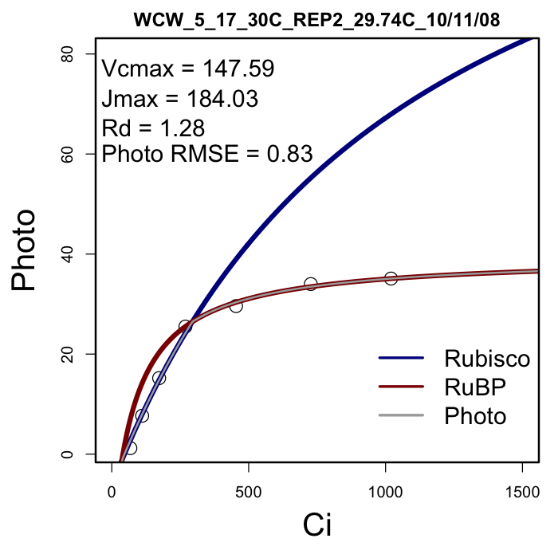
..because chemical reactions vary with temperature
Carboxylation (V_{cmax}) – addition of CO₂ to RuBP (catalyzed by RuBisCO). Addition of ATP and NADPH → triose phosphate
Electron Transport Rate (J_{max}) – necessary for the regeneration of RuBP to continue the cycle
Notes:
Vcmax – Maximum rate of carboxylation
-Carboxylation = addition of CO2 to the five-carbon RuBP and the splitting of the resulting unstable six-carbon compound into two molecules of PGA, a three-carbon compound. This reaction occurs three times during each complete turn of the cycle; thus, six molecules of PGA/3PG are produced.
-Rubisco catalyzes RuBP with carbon dioxide in order to synthesize a highly unstable 6-carbon intermediate known as 3-keto-2-carboxyarabinitol 1,5-bisphosphate, which decays virtually instantaneously into two molecules of glycerate 3-phosphate (G3P, triose phosphate).
-G3P is generally considered the prime end-product of photosynthesis and it can be used as an immediate food nutrient, combined and rearranged to form monosaccharide sugars, such as glucose, which can be transported to other cells, or packaged for storage as insoluble polysaccharides such as starch
-ATP provides chemical energy for metabolism
-NADPH produced is then used as reducing power for the biosynthetic reactions in the Calvin cycle
The ultimate rate-limiting factor of the Calvin cycle is the enzyme RuBisCO, which cannot be ameliorated in short time by any other factor. If light is not limiting, then generally RuBisCO processes as much CO2 as can be provided.
Jmax -- Electron transport critical to producing NADPH and ATP:
-NADPH used as reducing power for the biosynthetic reactions in the Calvin cycle producing 2 ATP during photosynthesis
-ATP transports chemical energy within cells for metabolism
TPU = triose phosphate utilization curve

Slide 16
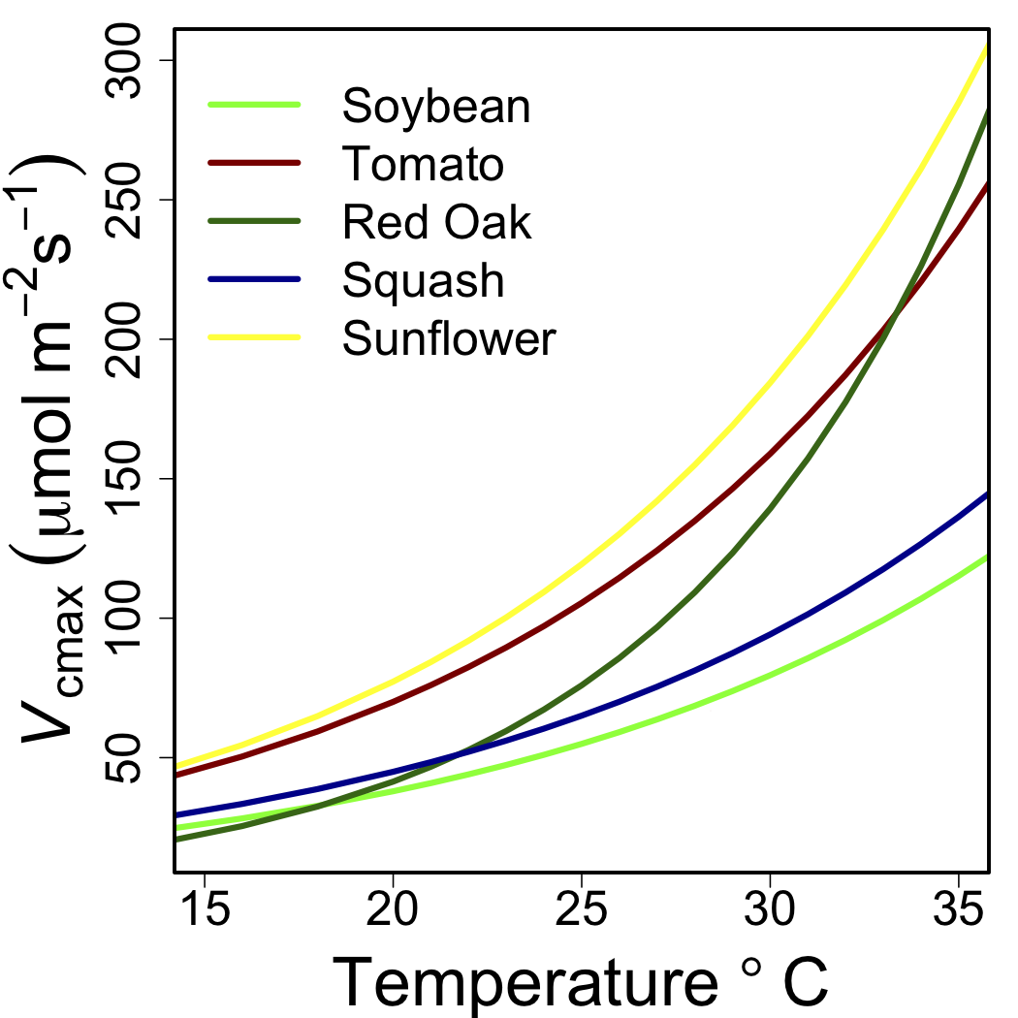
Plant metabolic rates (V_{cmax}, J_{max}) have strong temperature sensitivities….

Slide 17
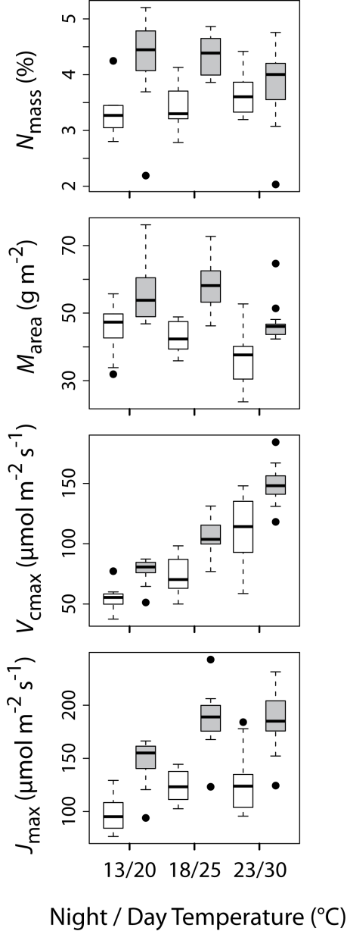
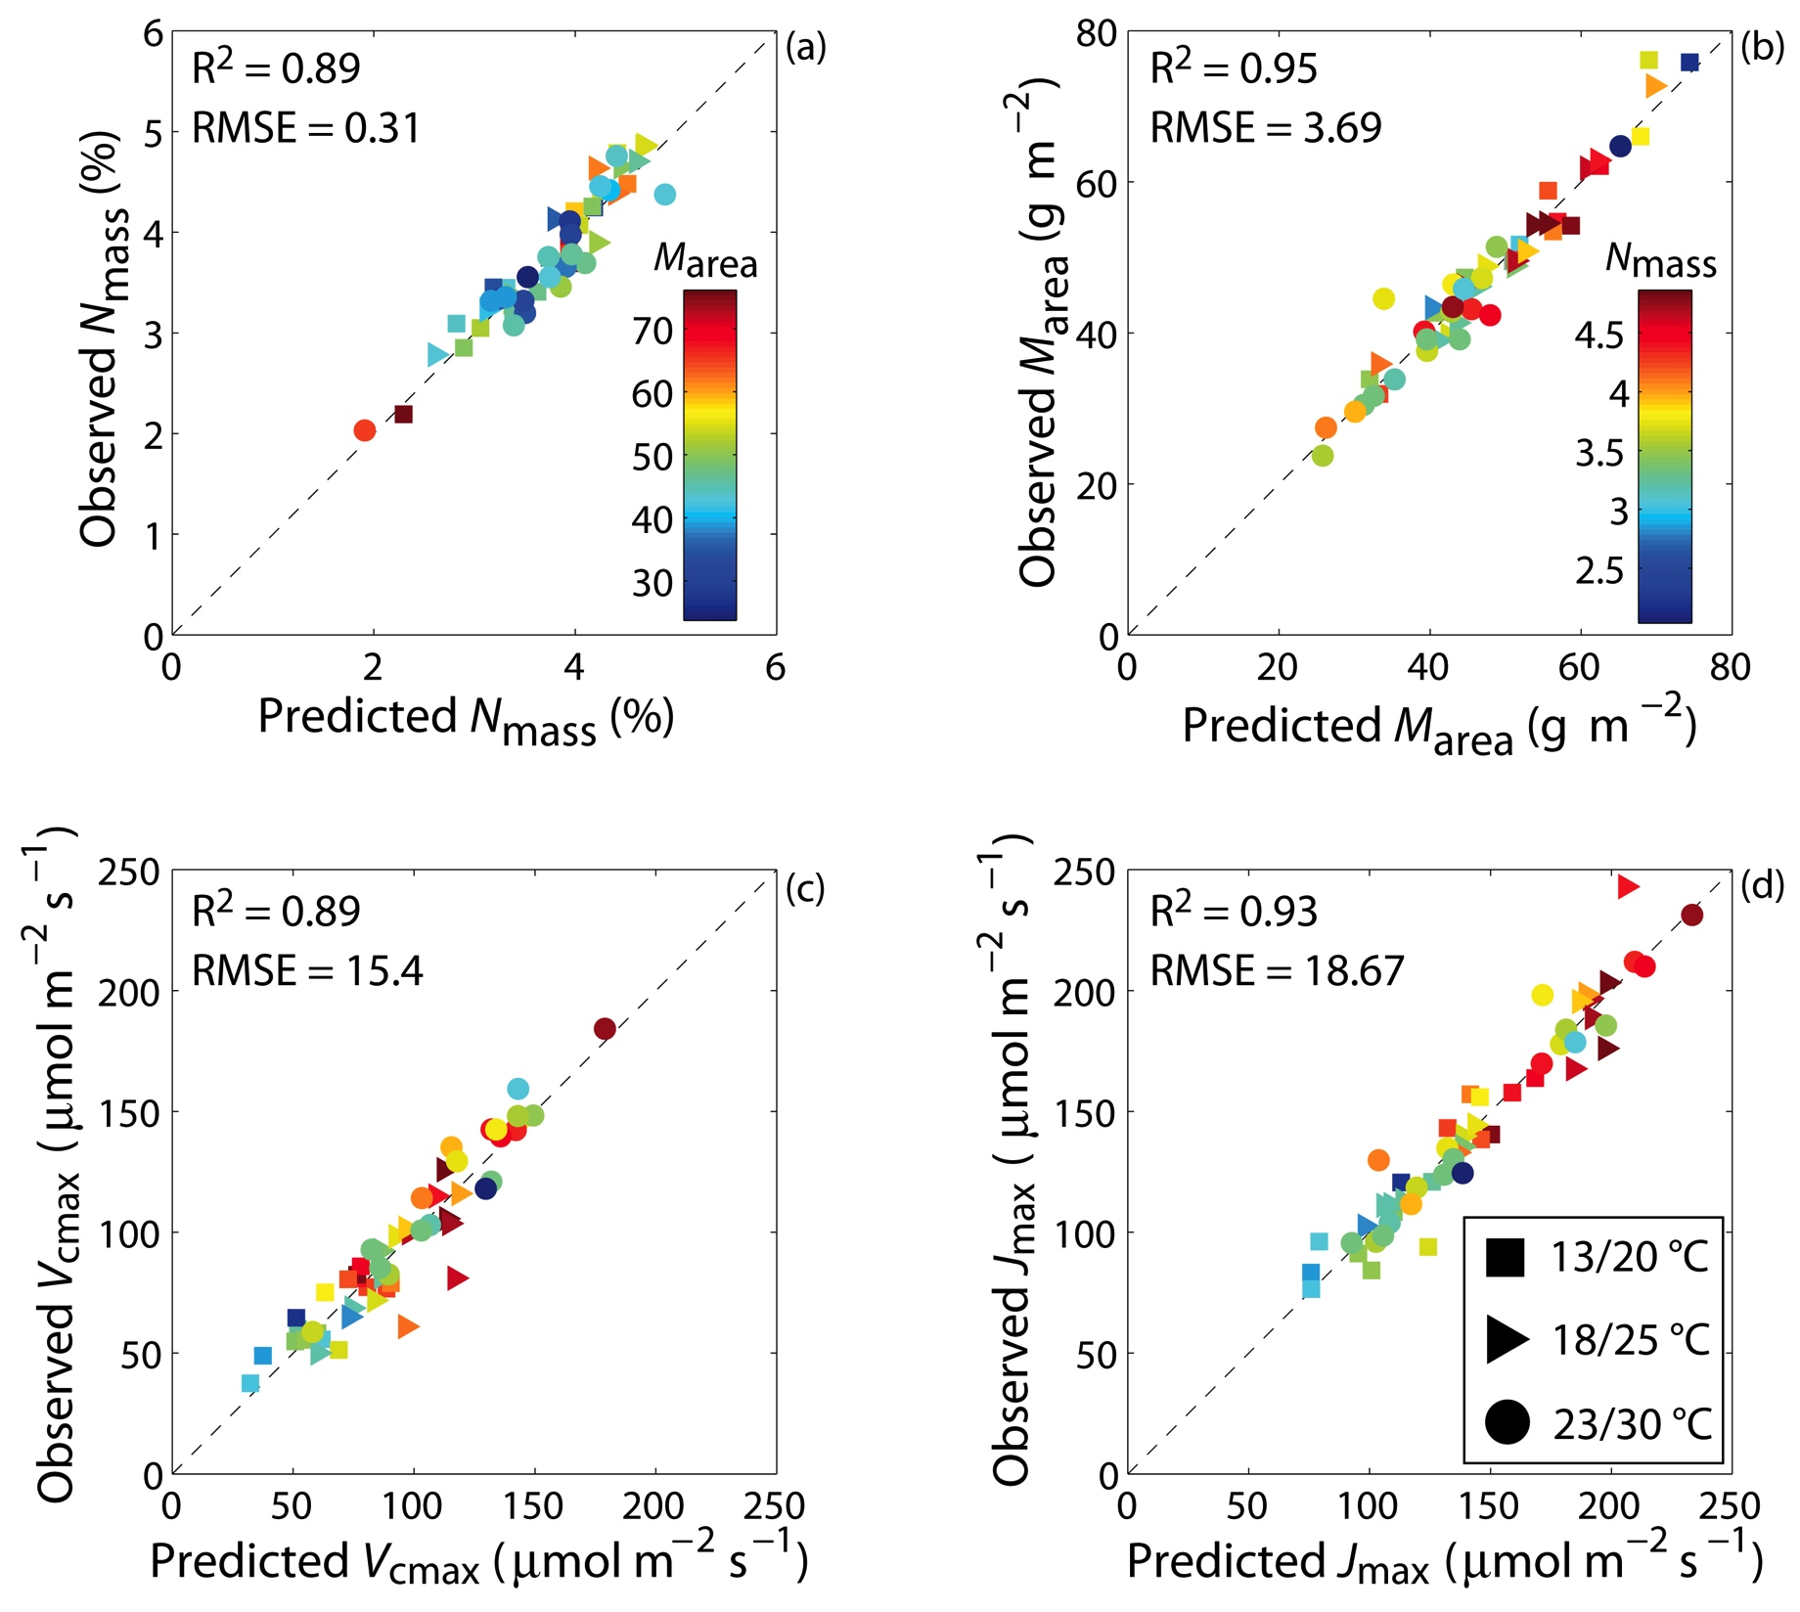
…and spectroscopy reflects the variation in metabolism and it’s sensitivity to temperature:
Notes:
Spectra does respond to plants as the temperature changes. Spectra are responsive to changes in leaf metabolism with temperature (or something like that).

Slide 18
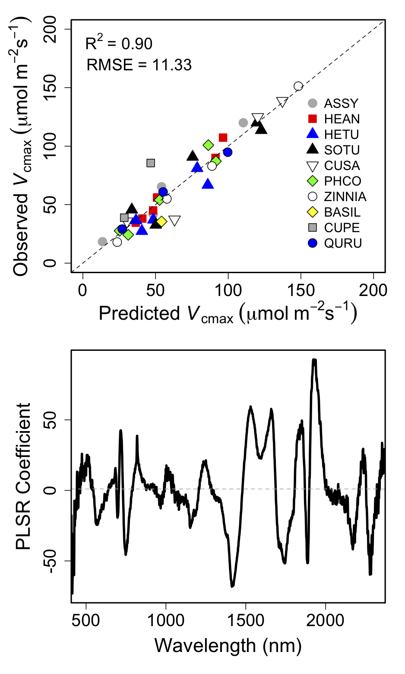
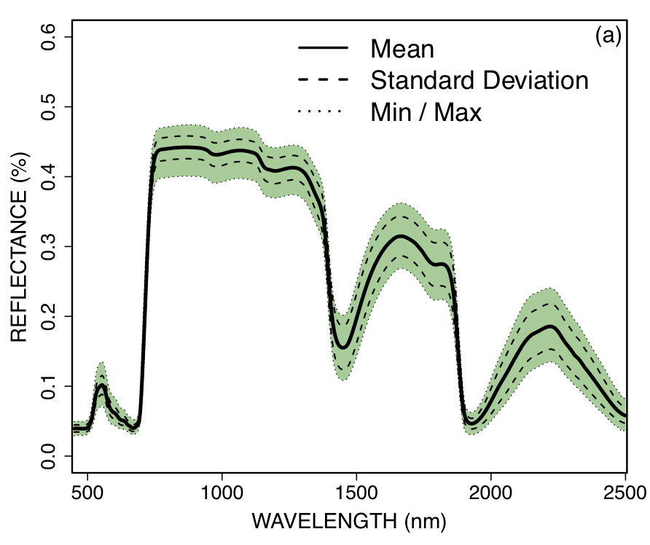
….if we know leaf / canopy temperature, we can detect differences in plant metabolism.

Slide 19
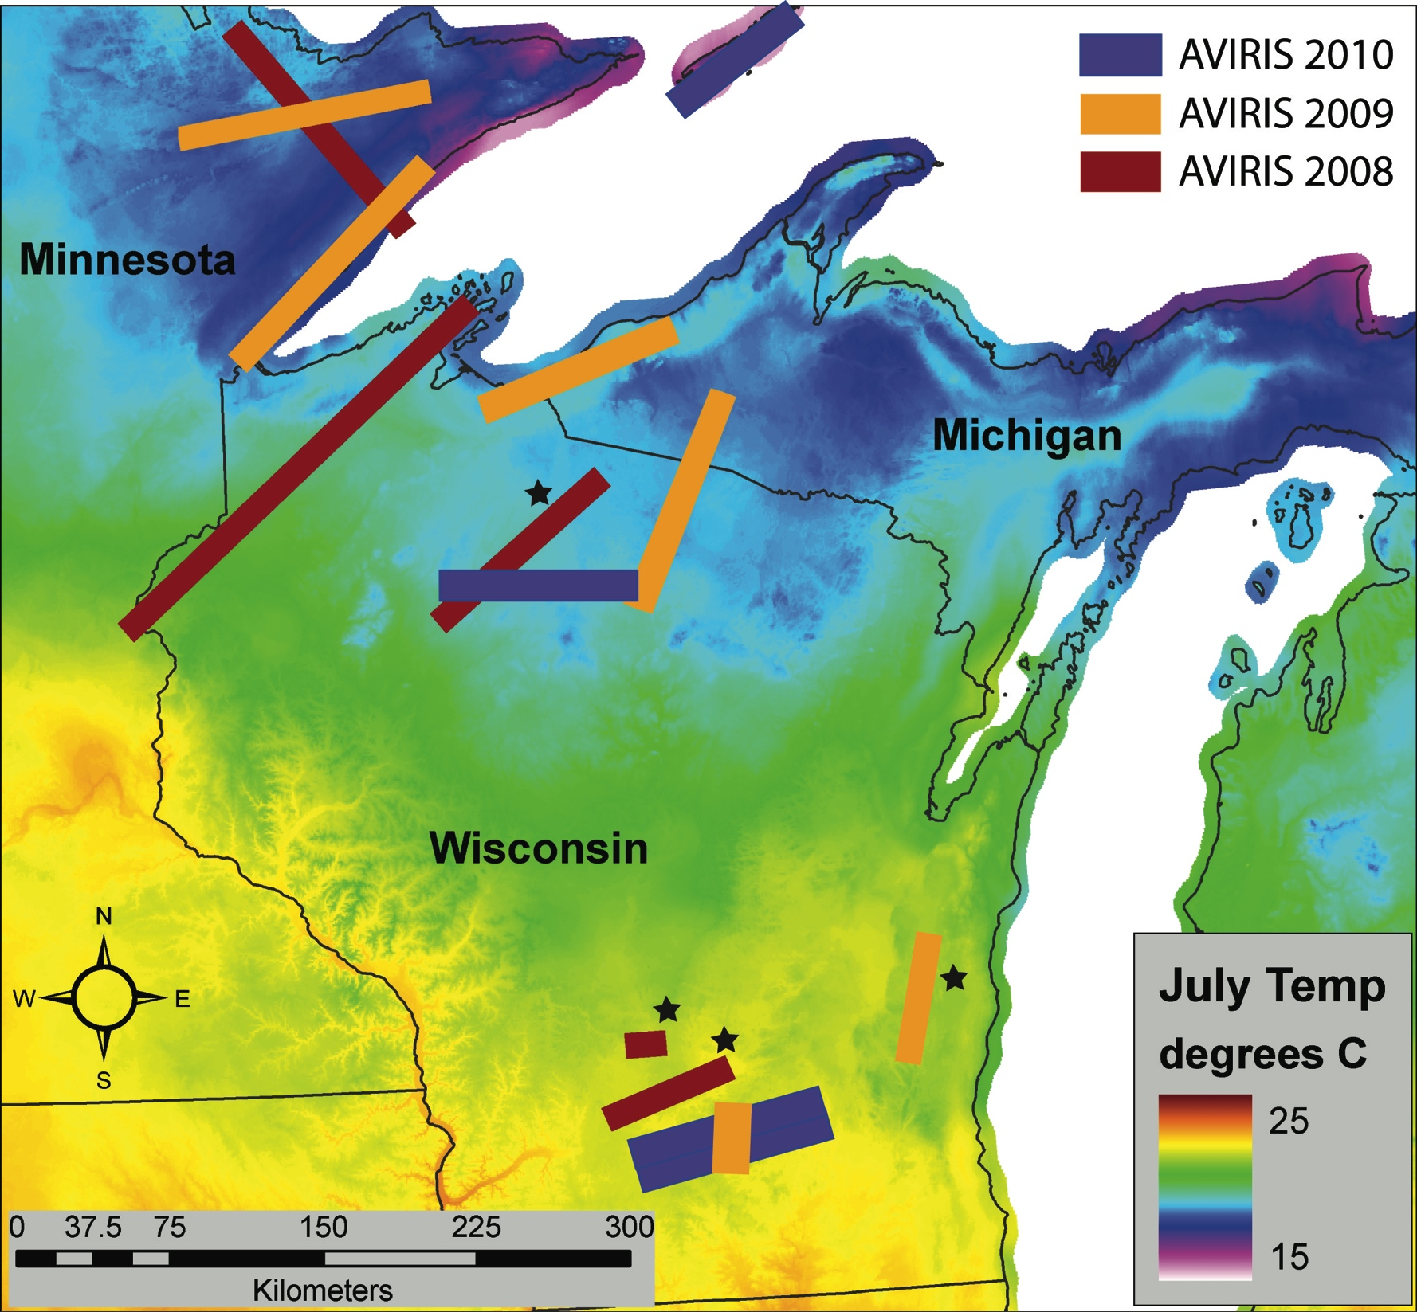
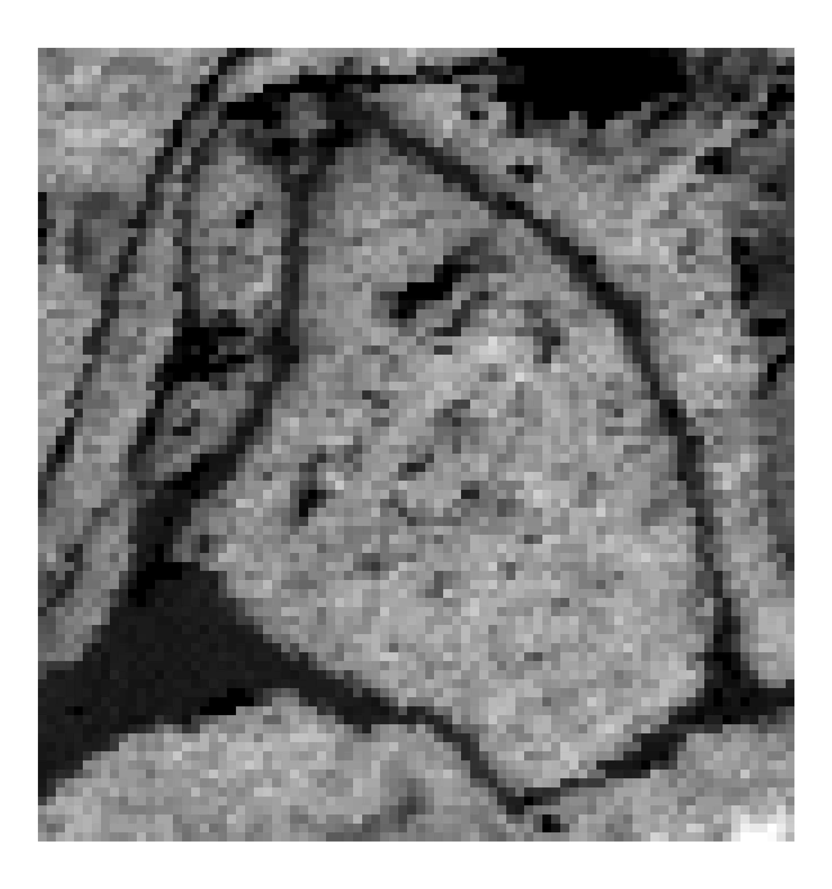
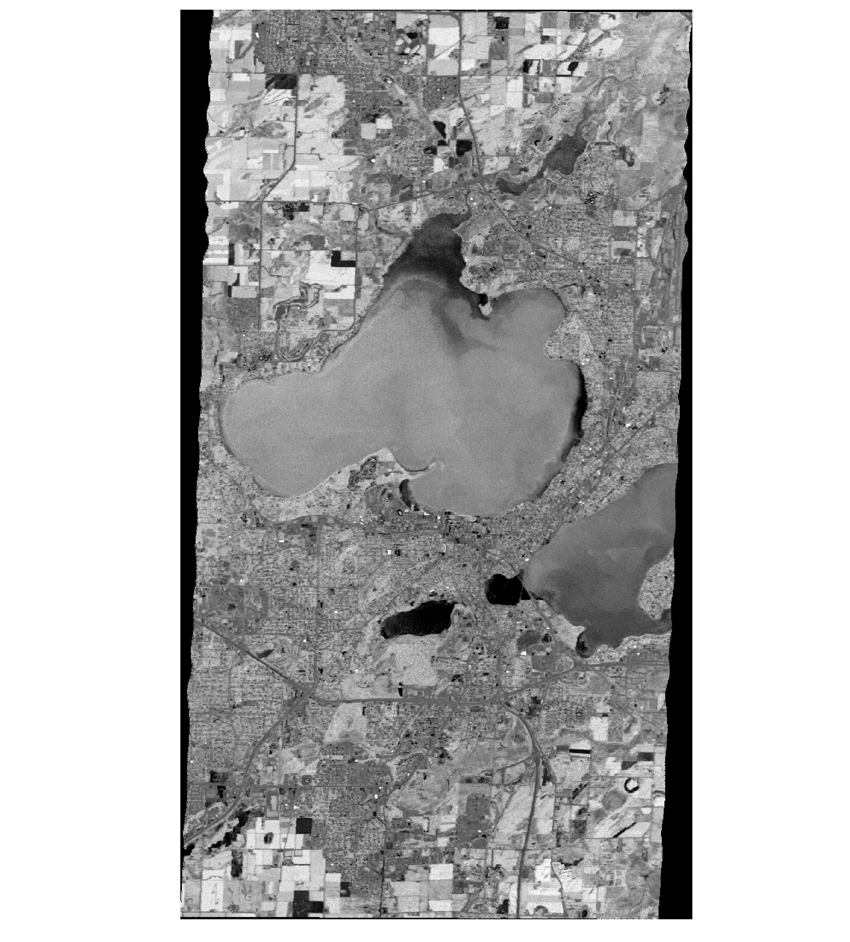
The implications of this are significant.
Blackhawk Island
Barraboo Hills
Madison, Wisconsin
Baraboo Hills
Notes:
Here I will discuss how we can use this information to identify potential changes associated with climate change using space-for-time substitutions. Also, we can predict how species might response, and this will provide important subtleties to modeling efforts by knowing how metabolic rates vary within ecosystem types (biomes).
For this figure, I would like to show four panels with the same variable mapped, i.e. LMA or N or Vcmax or even PRI. The idea that I will try to convey is that we use the T data to understand why there is variability within a forest type over geographic space.

Slide 20
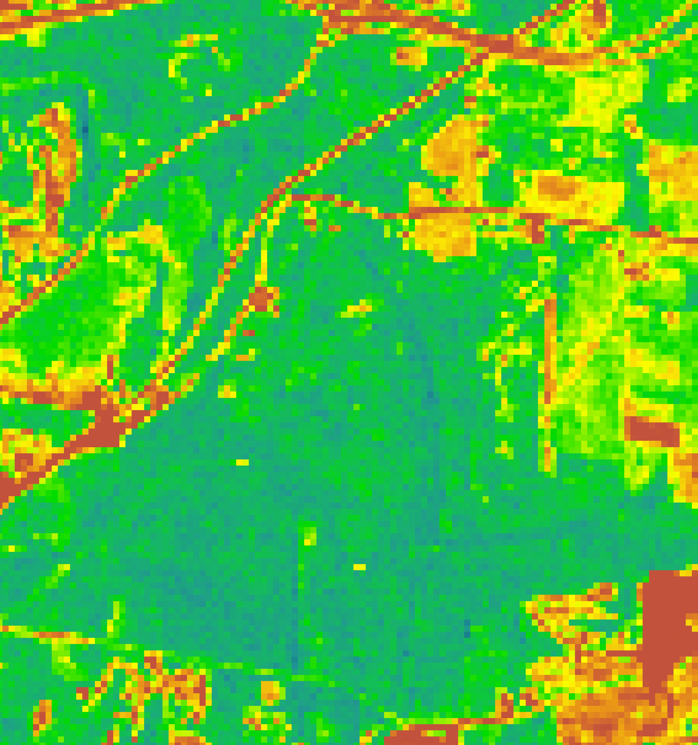
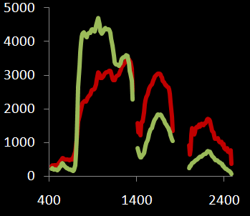
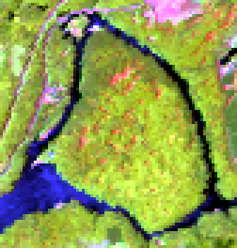
MASTER Temp.
Non-disturbed
296K
Disturbed
299K
Blackhawk Is. PRI
Blackhawk Is. MASTER
Blackhawk Is. AVIRIS
Notes:
Maybe N Minnesota or N Wisc. Probably logging disturbance.

Slide 21
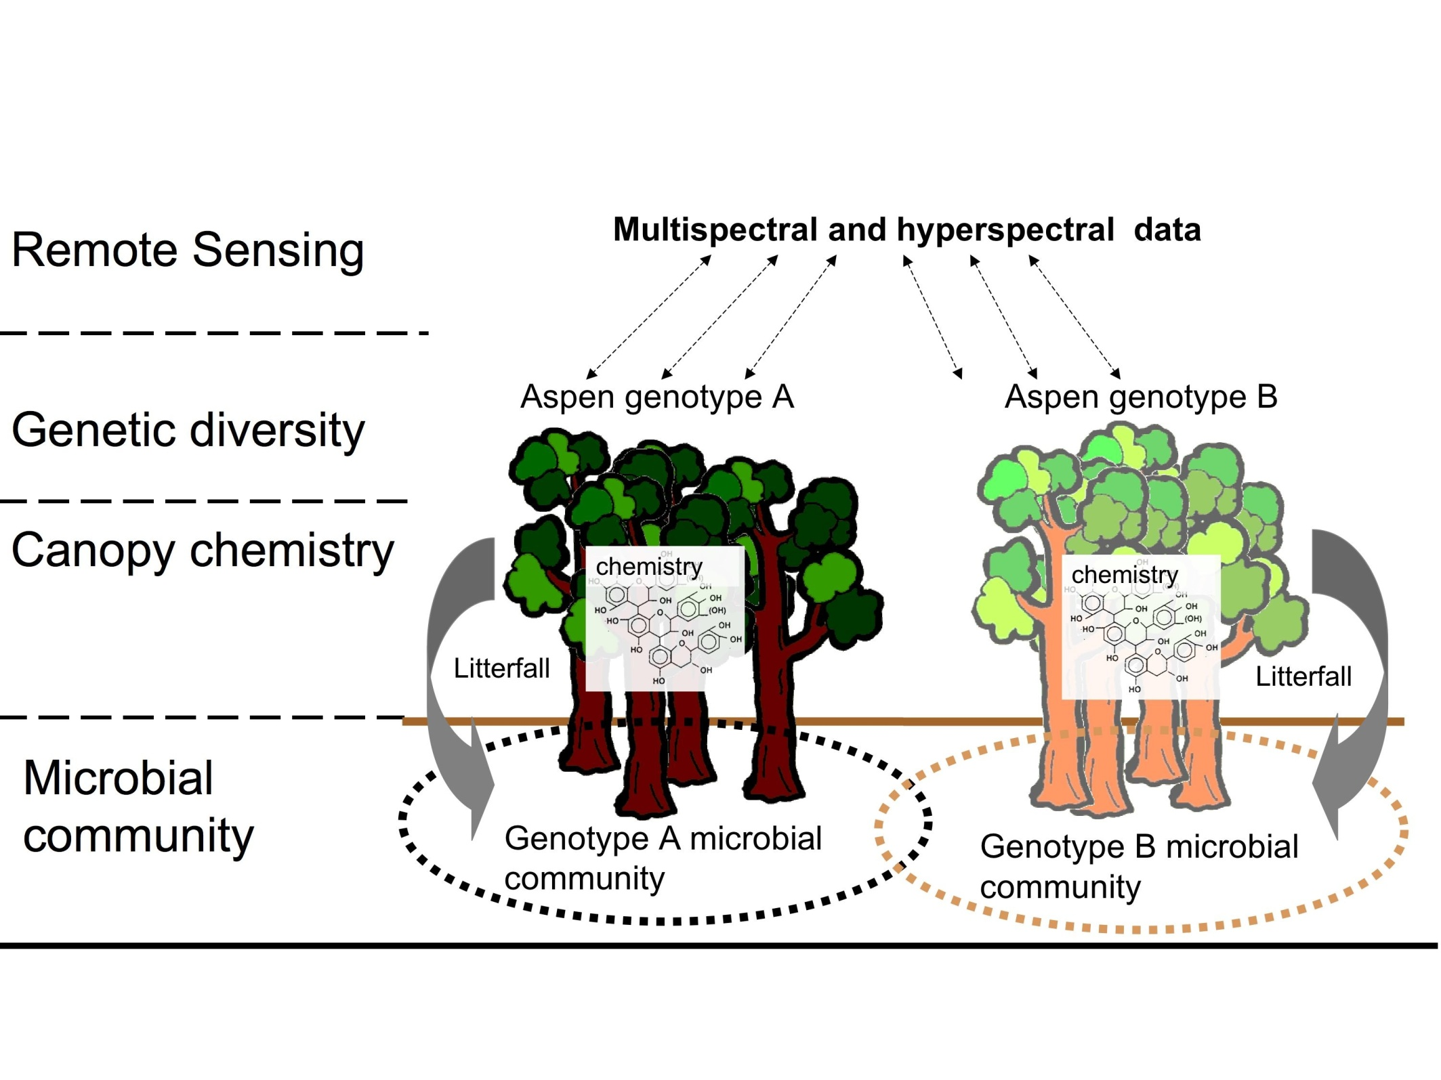
Remote sensing of genetic diversity in aspen:
Directly associated with vegetation response to climate change

Slide 22
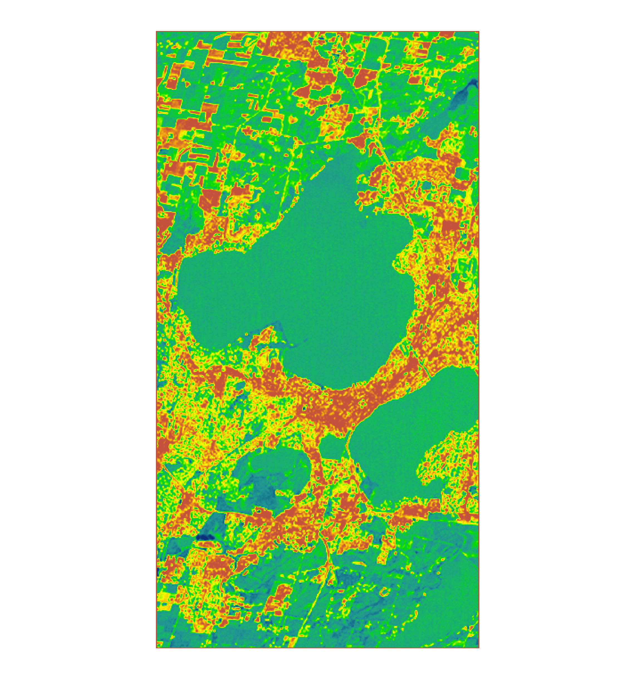
Urban ecosystems:
298K
307K
296K
Madison 2009
AVIRIS PRI
Madison
MASTER 2011: Temp.

Slide 23
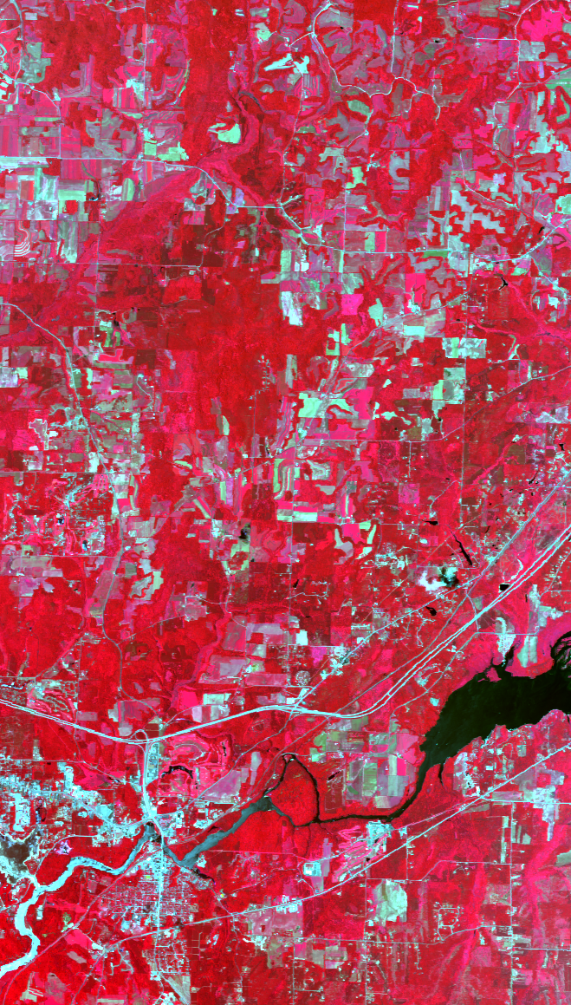
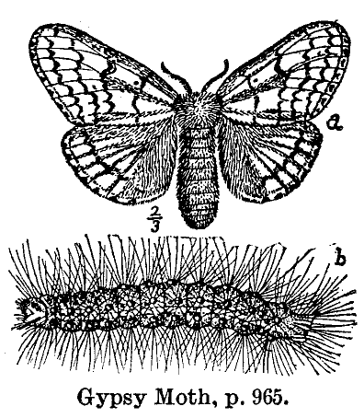
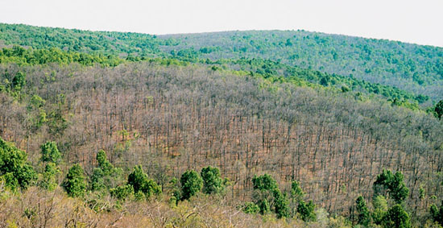
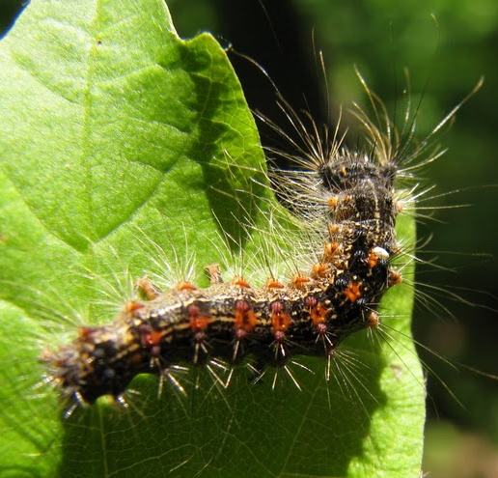
Biological diversity of insects, herbivore activity:
Image: Univ. of Illinois Extension http://hyg.ipm.illinois.edu

Slide 24
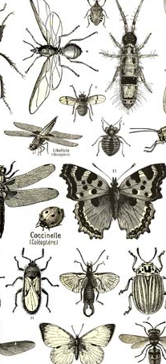
Relationships between insects
and HyspIRI-like measurements:
Notes:
For John: Sampled in July and August, plot contains data only from July.
Also working on detecting induction of secondary chemistry, i.e. defense compounds

Slide 25

Fully characterize an ecosystem at a point in time:
MASTER Temp.
Biomass (LiDAR 2005)
Δ Biomass → NPP
%N (AVIRIS)
Biomass (LiDAR 2010)
Notes:
Canopy chem, biomass and biomass change, and potentiall photosynthetic capacity and thermal properties

Slide 26





Map and understand ecosystem change:
T
Input
Parameters
RTM
PRI (AVIRIS 2010)
Spectra
RTM
Inversion
ΔBiomass (LiDAR 2005-10)

Slide 27


Map and understand ecosystem change:
RMSE = 0.25
LAI = 5.99 (± 1.33)
M_{area} (g m⁻²) = 83.77 (± 19.9)
N_{mass} (%) = 2.7% (± 0.21)
EWT (g cm⁻²) = 0.012 (± 0.002)
Chl a+b (μg cm⁻²)= 42.3 (± 3.5)
Spp = QURU, ASM, FRAM

Slide 28






Acknowledgments
AVIRIS/MASTER/ER-2 Teams
ASDI and Nate Bloomingdale
John Couture
Dylan Dillaway
Jane Foster
Huan Gu
Bernard Isaacson
Clayton Kingdon
Mike Madritch
Brenden McNeil
Peter Wolter

