Slide 1
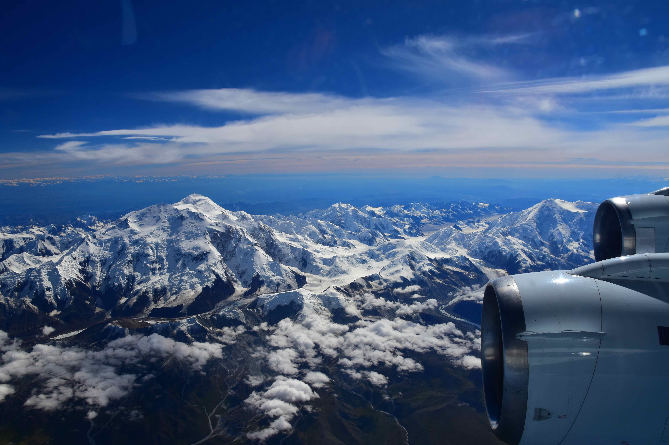
The Arctic-Boreal Vulnerability Experiment Airborne Campaign 2017
A1
B1
C1
Peter C. Griffith (GSFC)
Charles Miller (JPL)
Twitter @NASA_ABoVE
Facebook @NASA.ABoVE
A2
B2
C2
A3
B3
C3

Slide 2
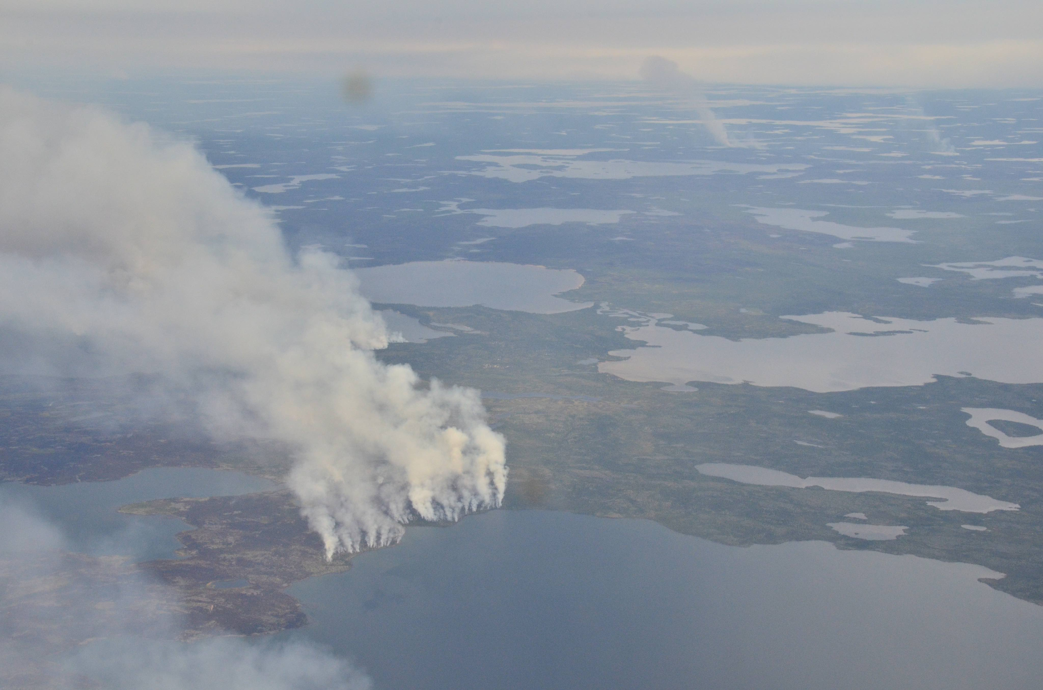
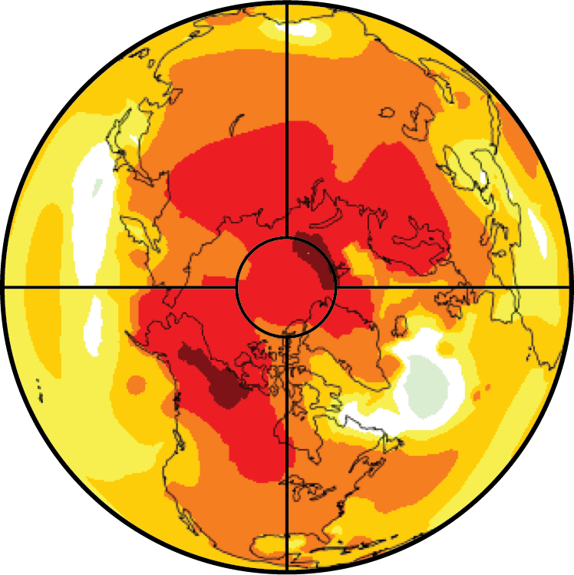
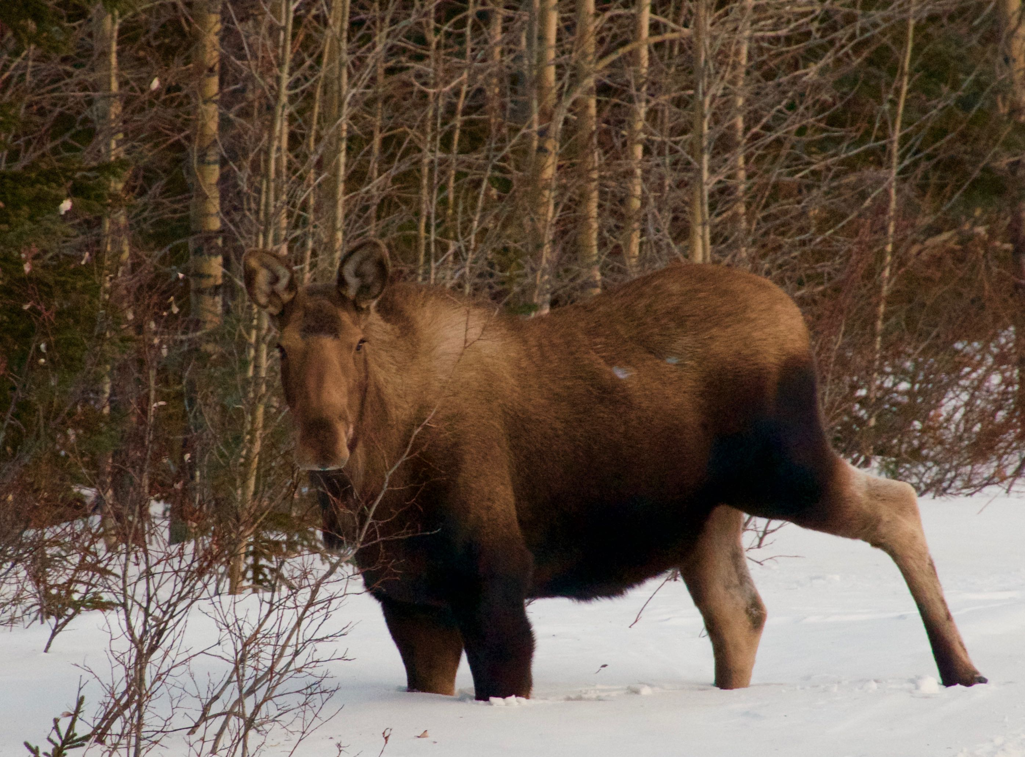
Vulnerability-Resilience Framework
A1
Causes of Change
Changes to Ecosystems
Social Systems
Ecosystem Services
Photos: Peter Griffith, NASA GSFC

Slide 3
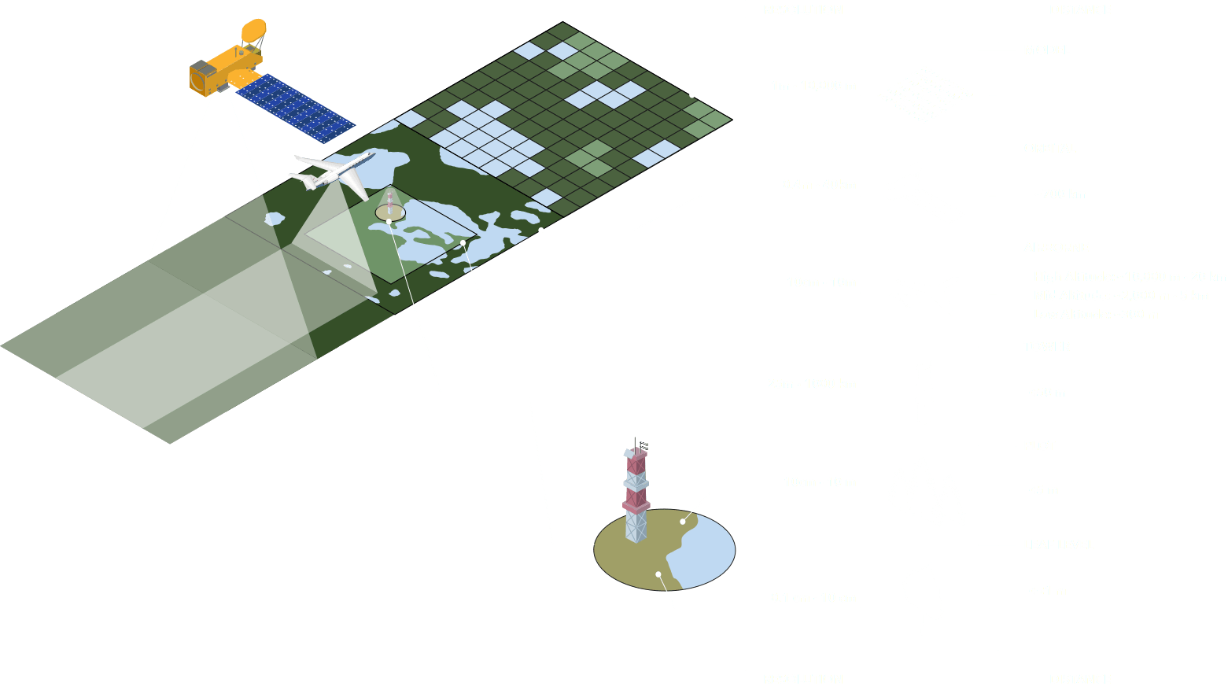

Slide 4
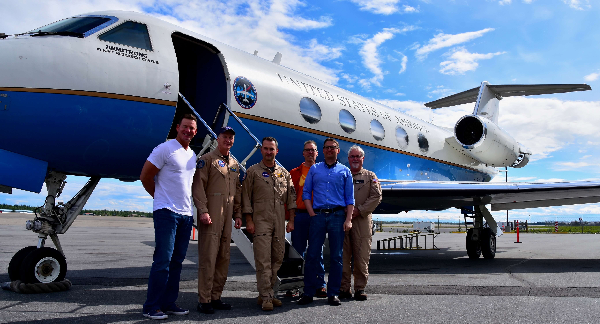
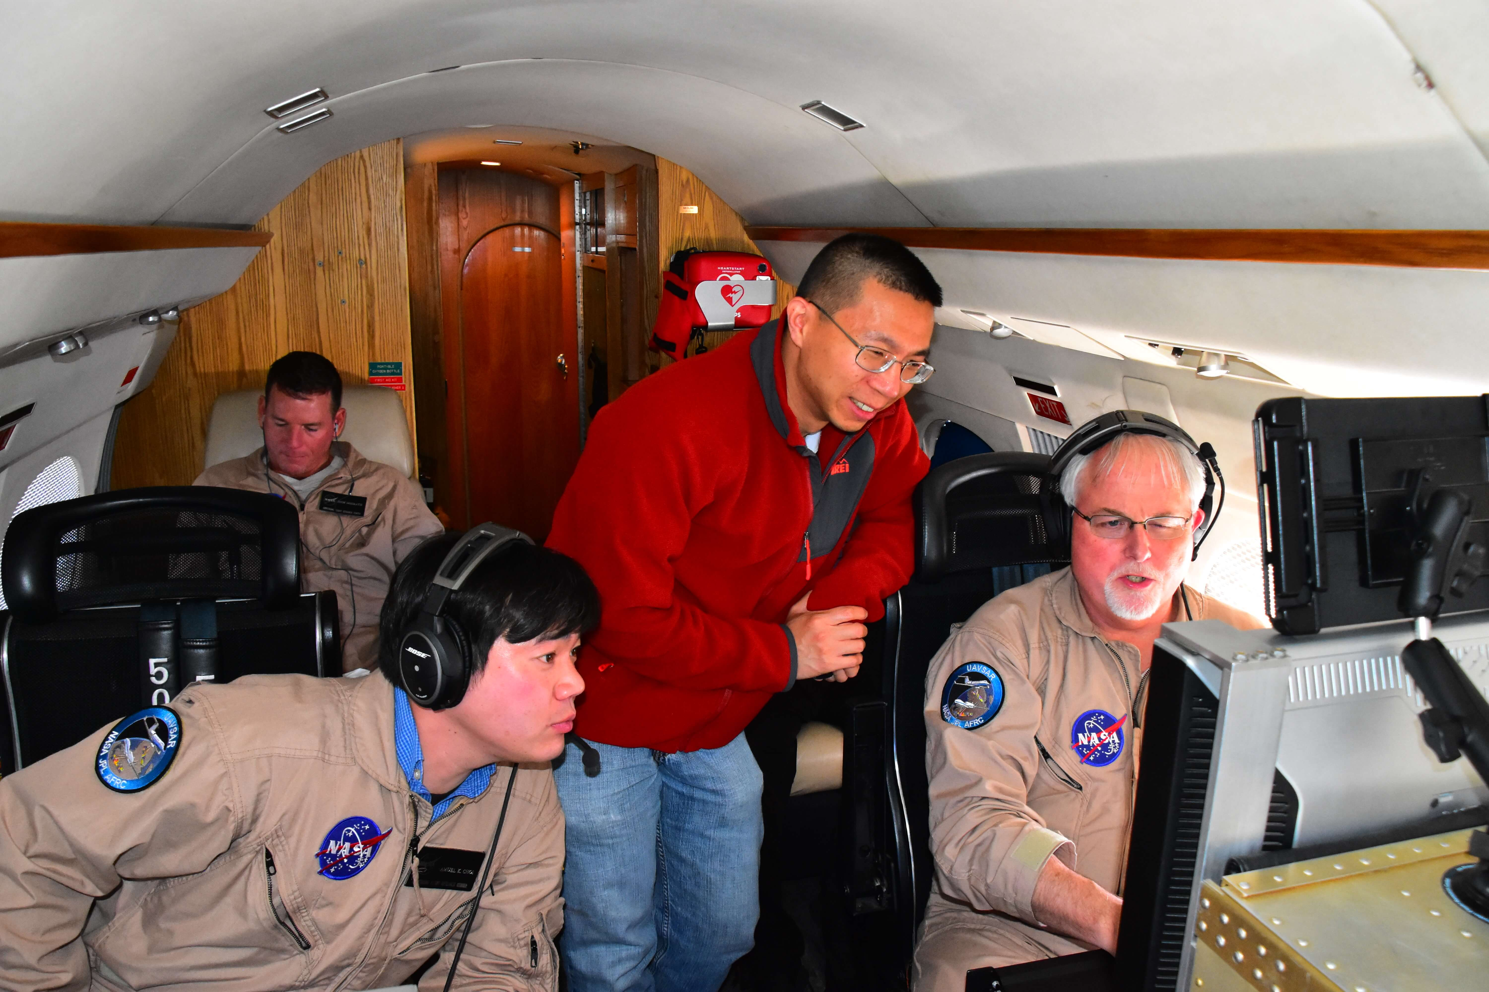
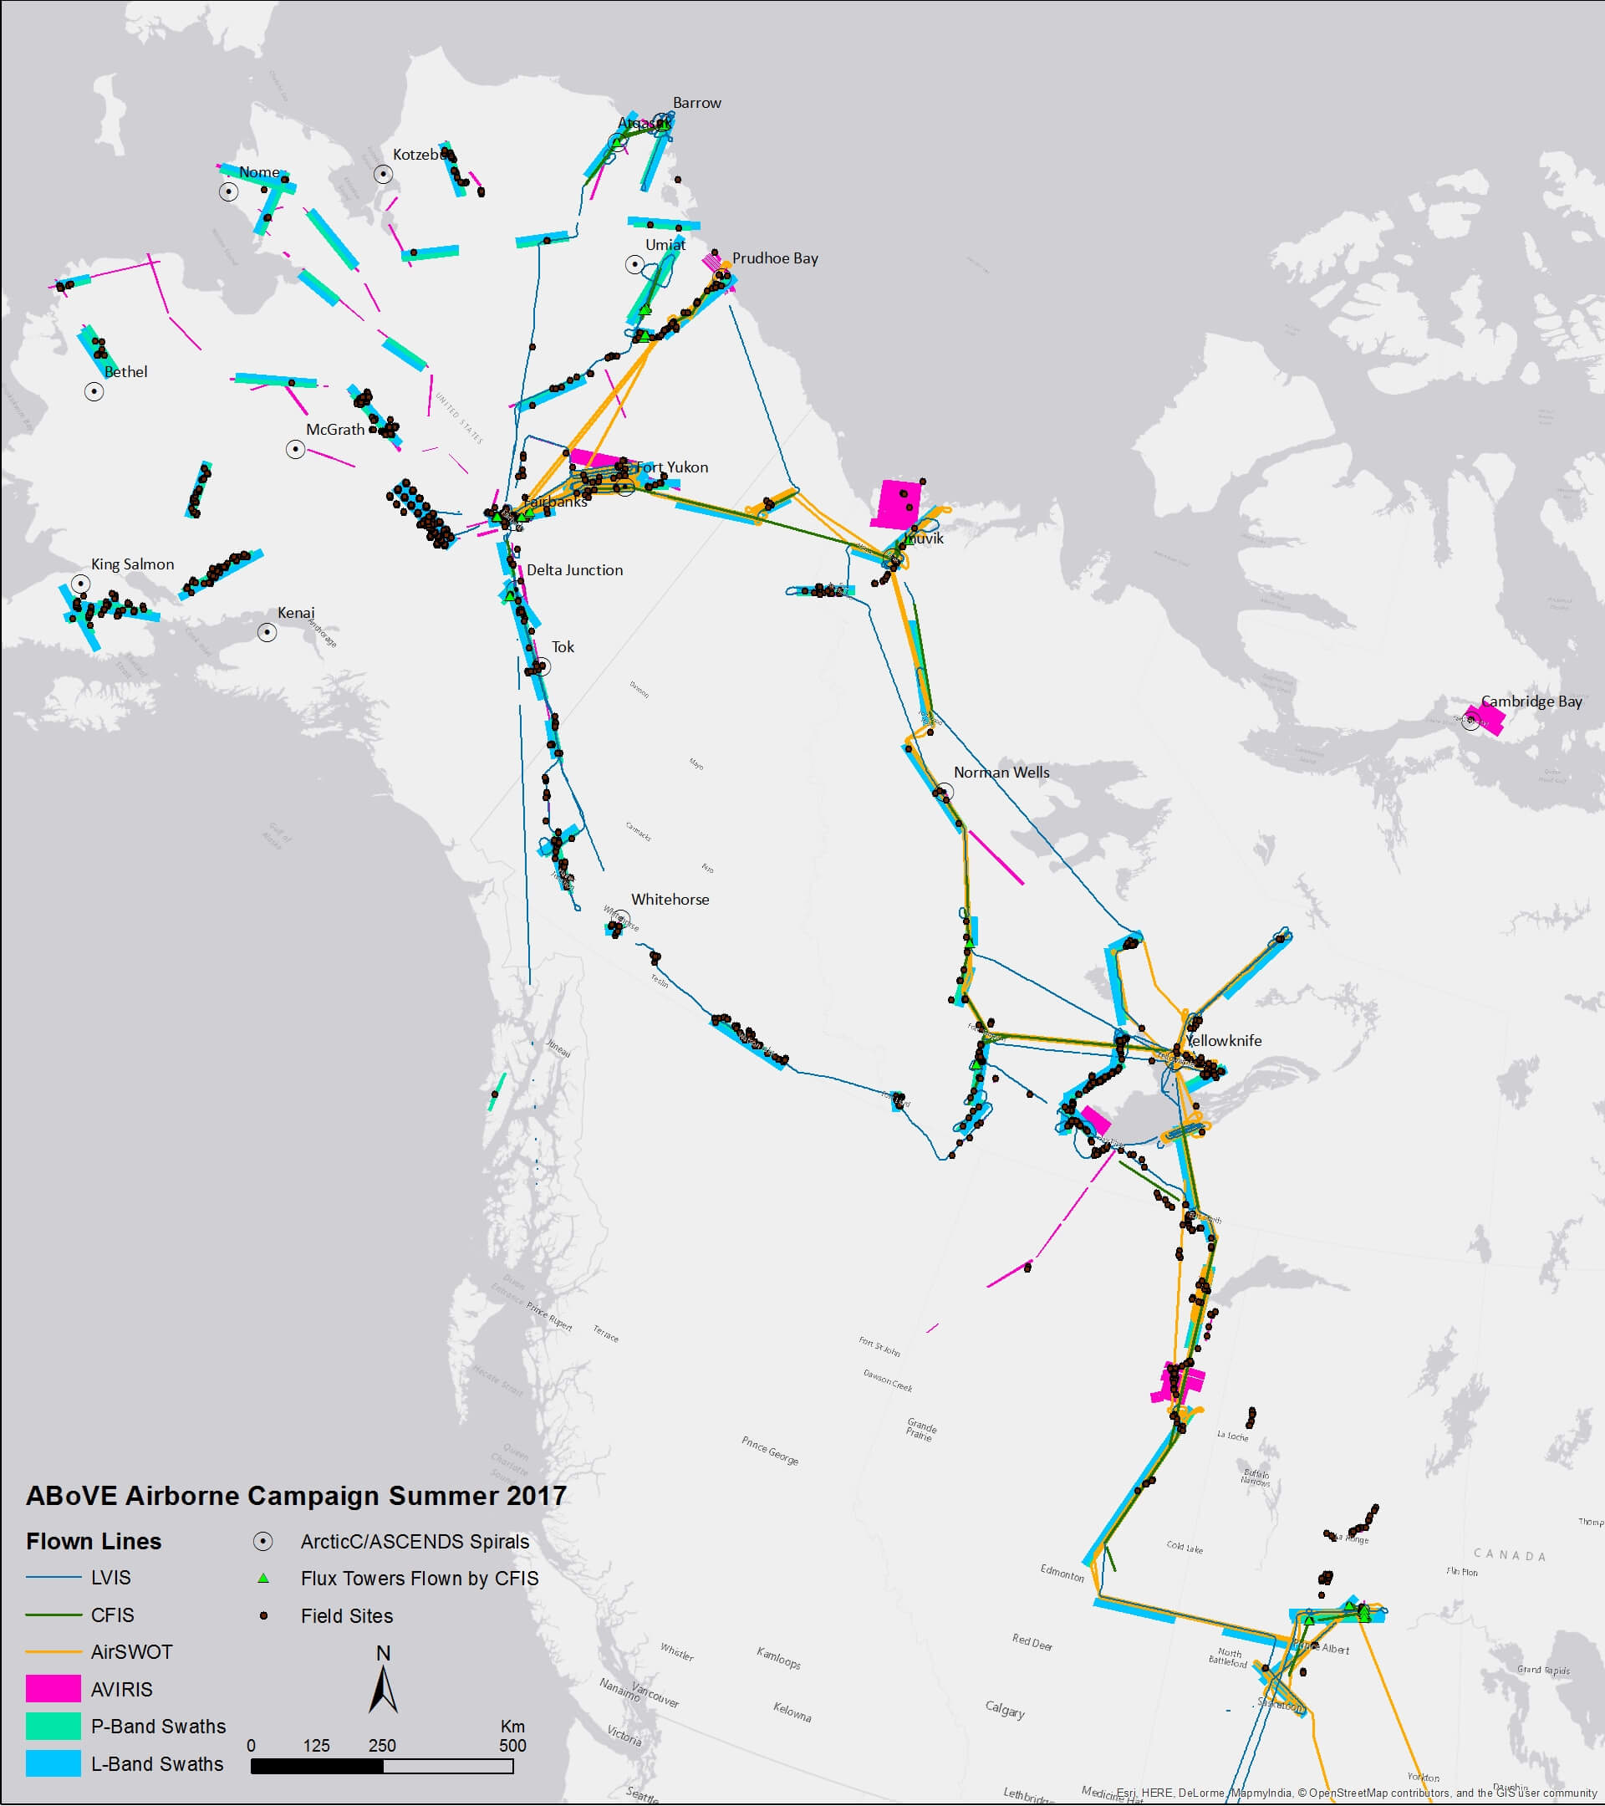
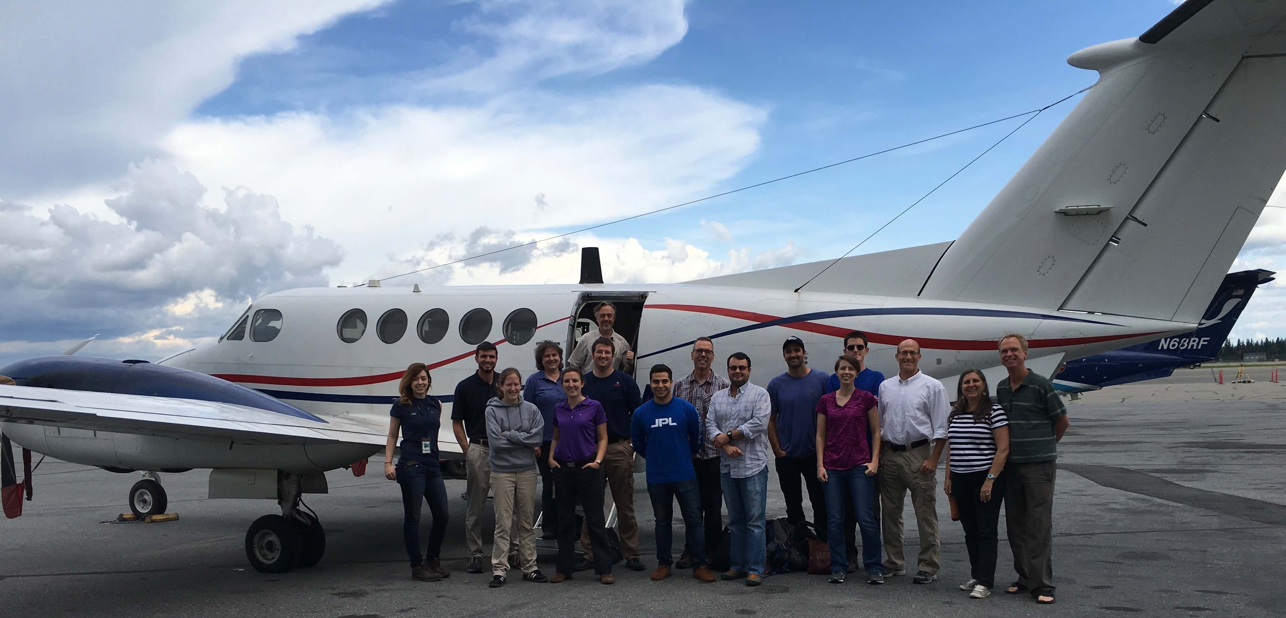
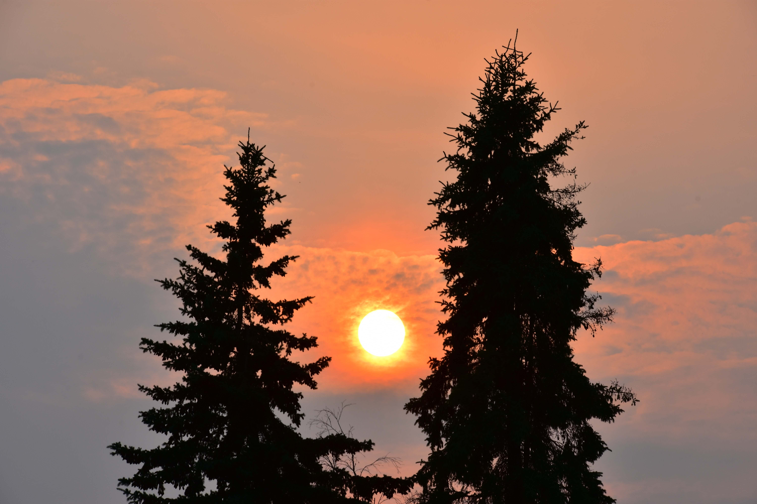
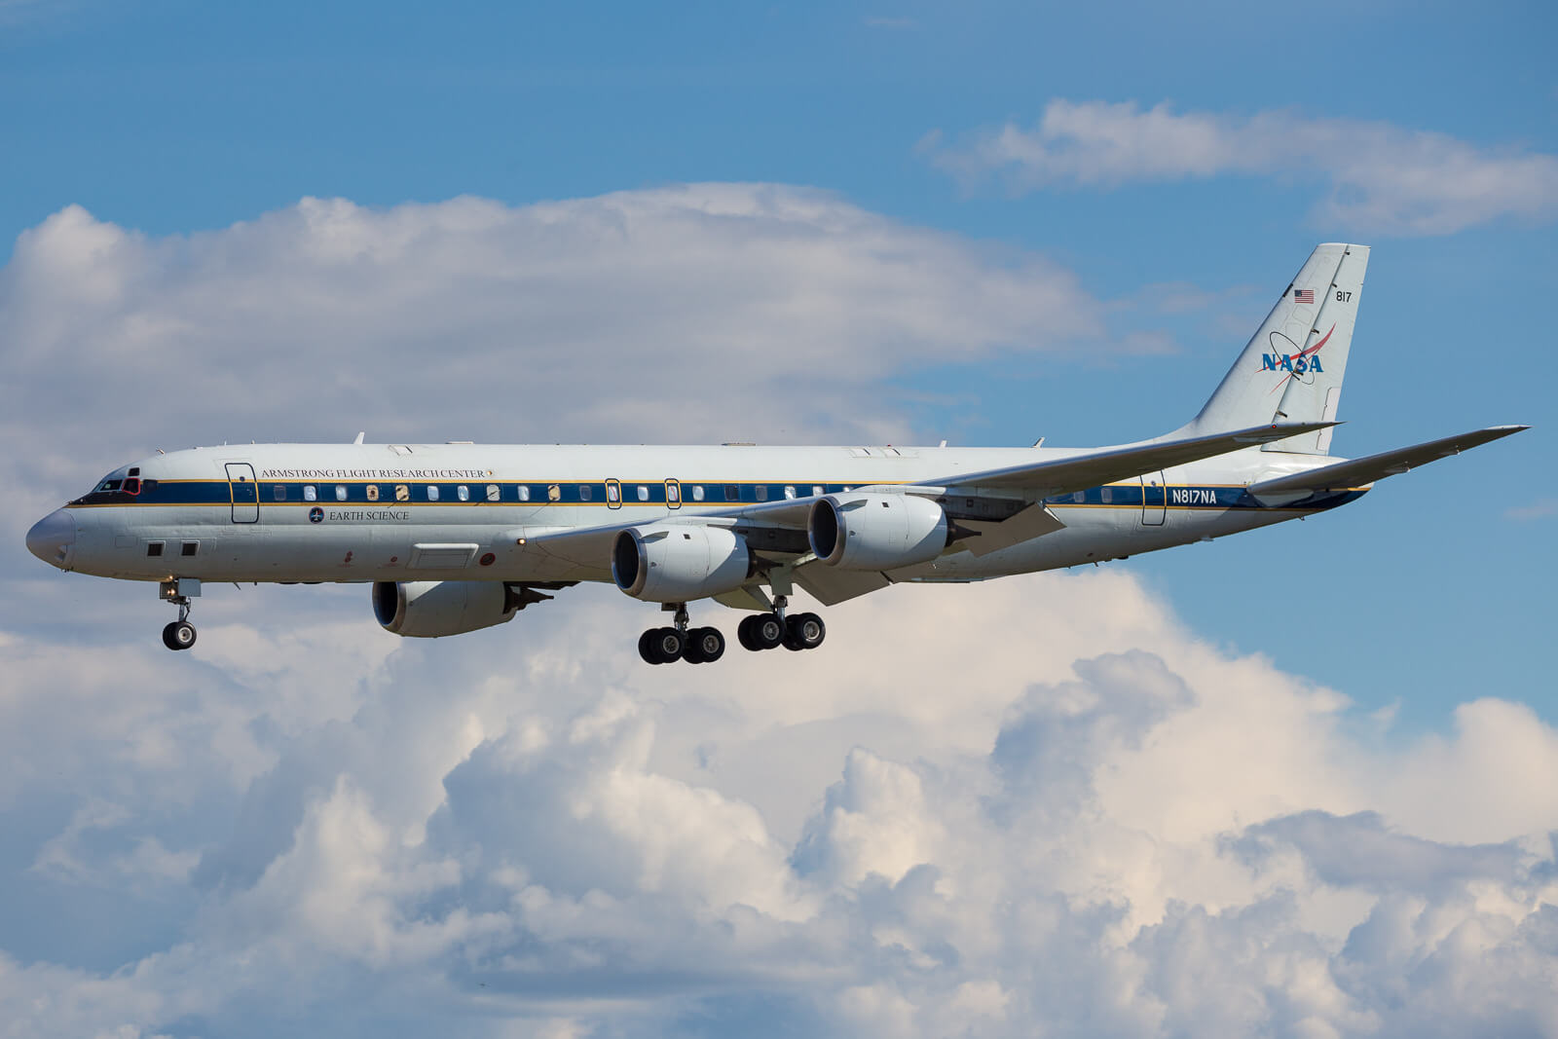
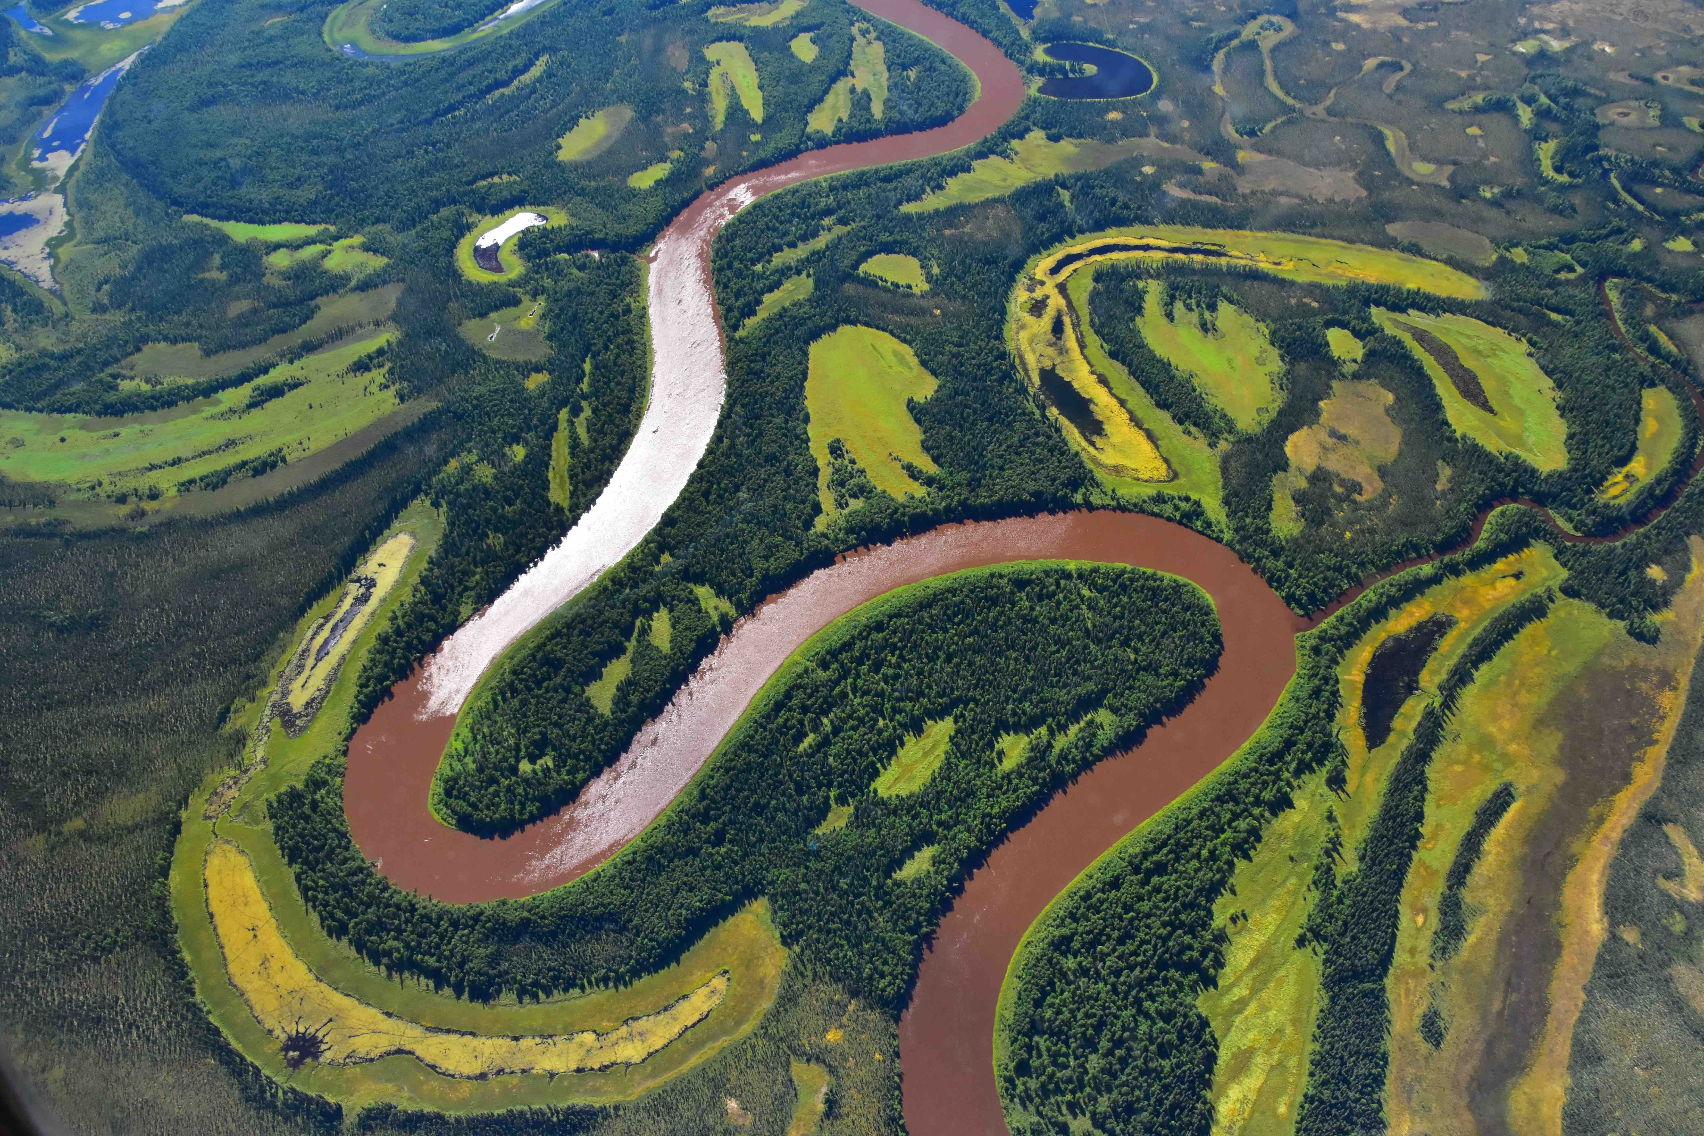
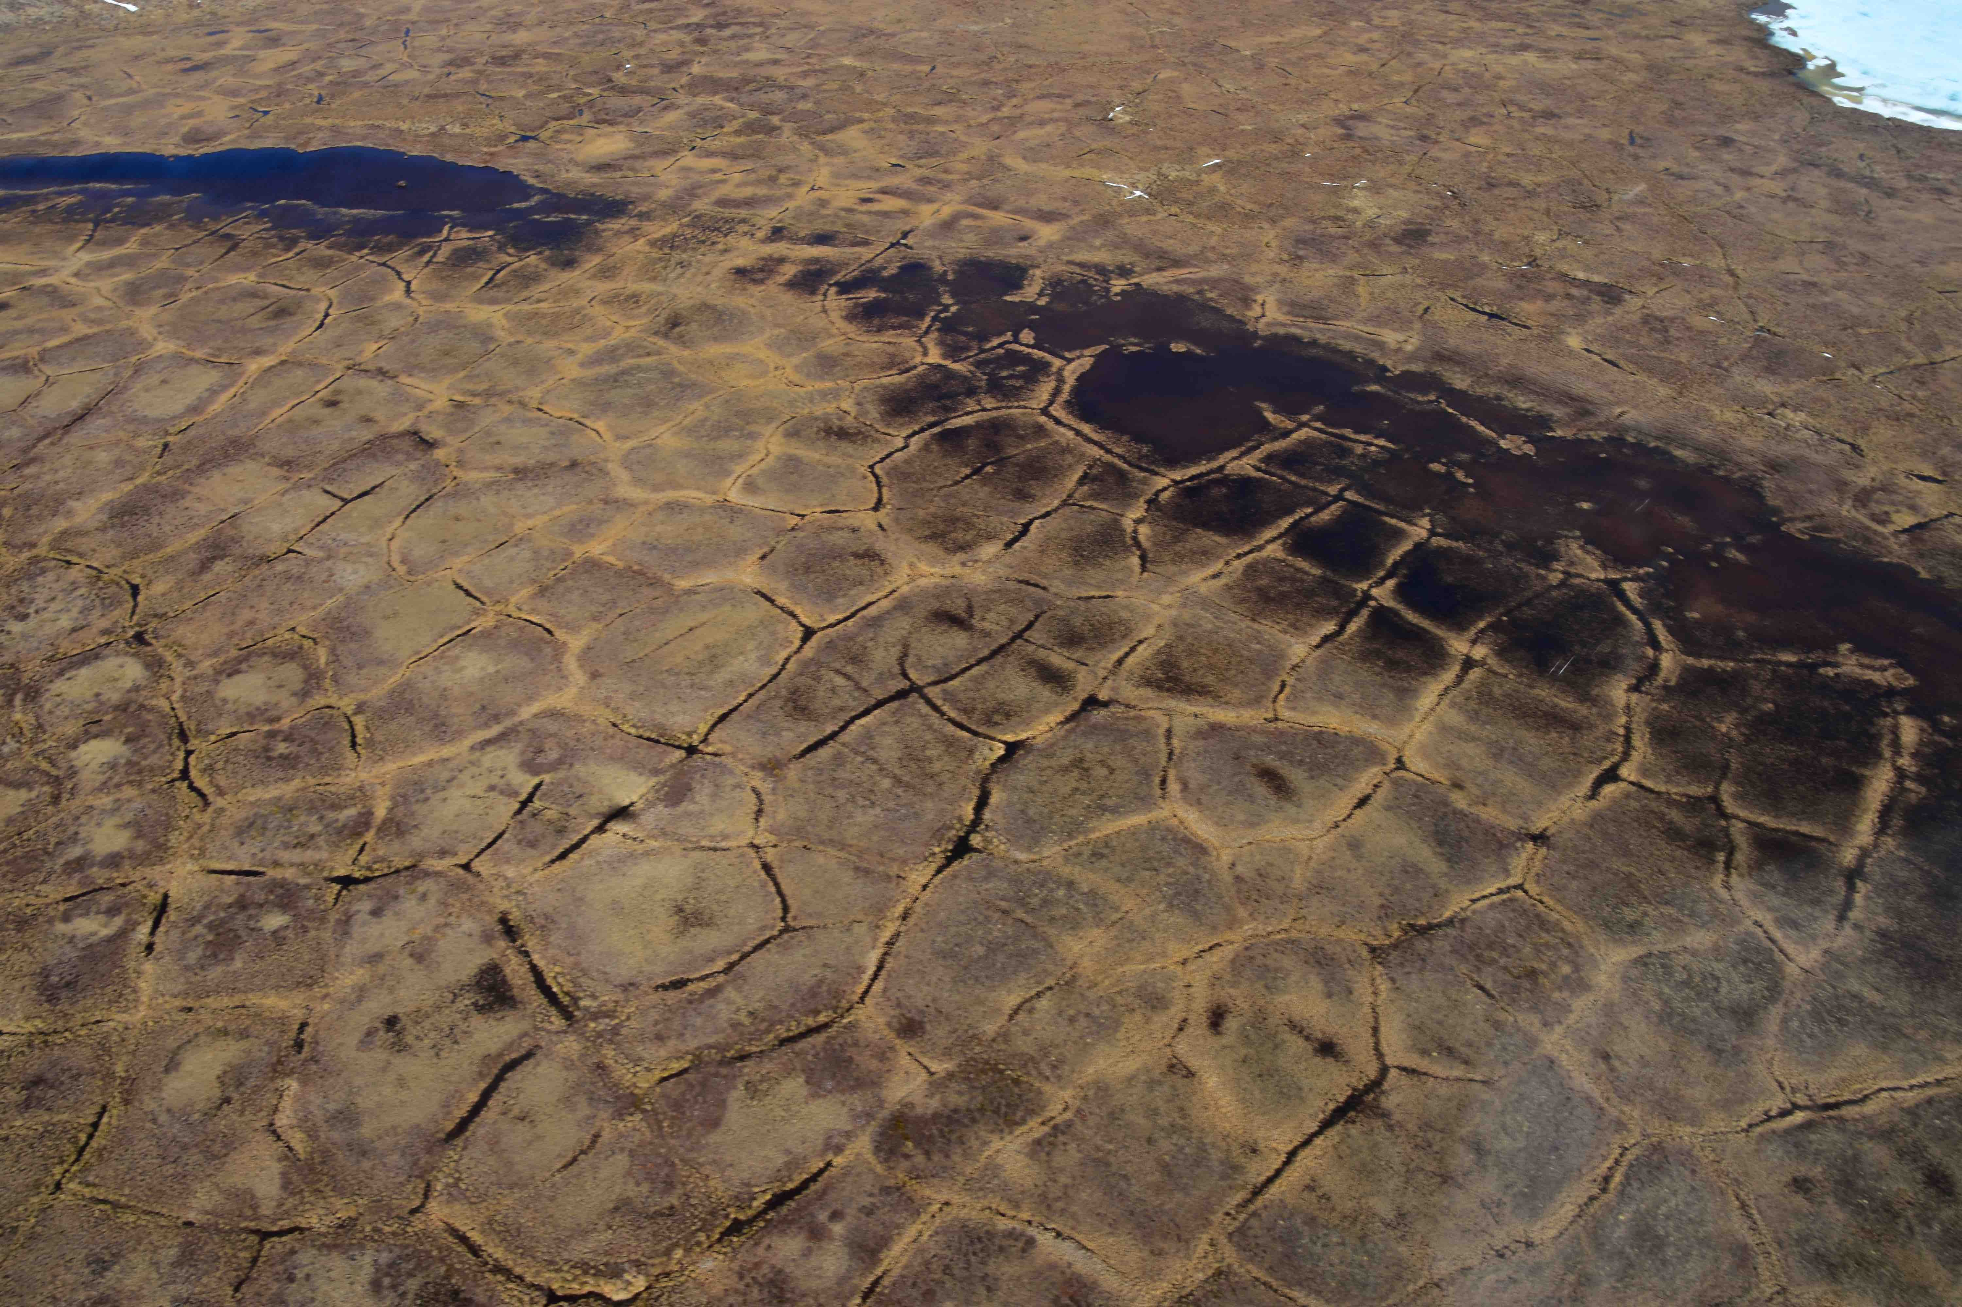
A1
B1
C1
A2
C2
A3
B3
C3
Notes:
The Arctic-Boreal Vulnerability Experiment (ABoVE) Airborne Campaign (April–October 2017) gathered remote sensing and in situ data over 4 million km2 of tundra and boreal forest across North America. Airborne data are staged with critical ground calibration/validation measurements in the ABoVE Science Cloud, hosted on GSFC’s ADAPT high-performance computing environment. ADAPT provides the 400-member science team an unusual opportunity to analyze a petascale dataset acquired by 9 aircraft, 10 science payloads, and 200 sorties.

Slide 5
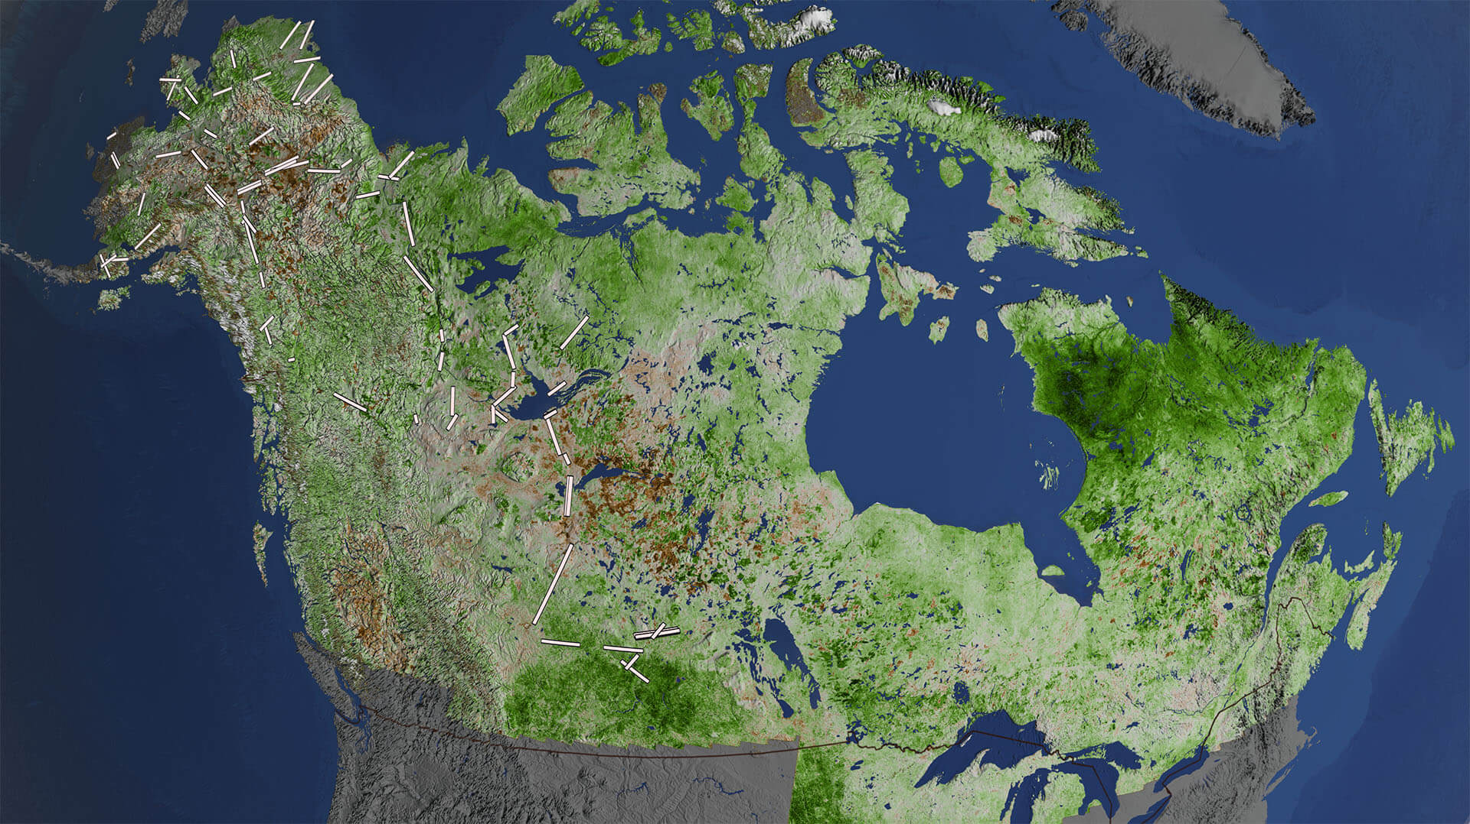
A1
B1
C1
A2
B2
C2
A3
B3
C3

Slide 6
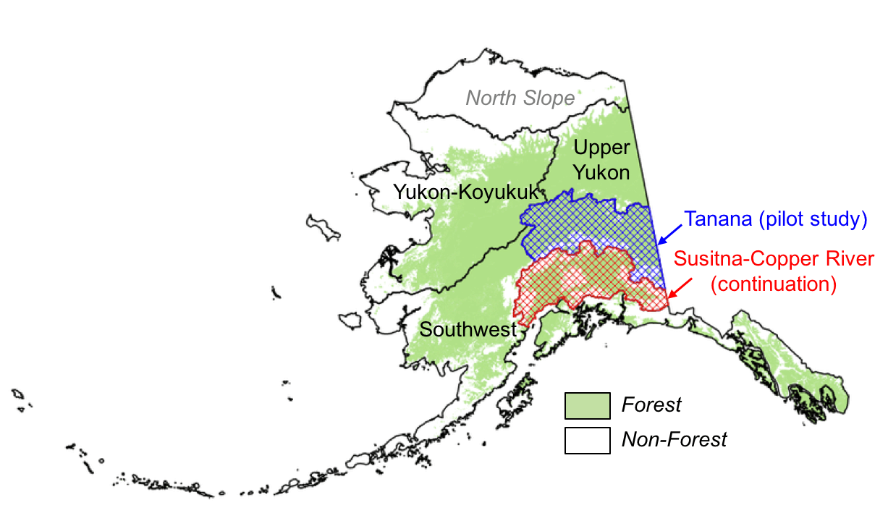
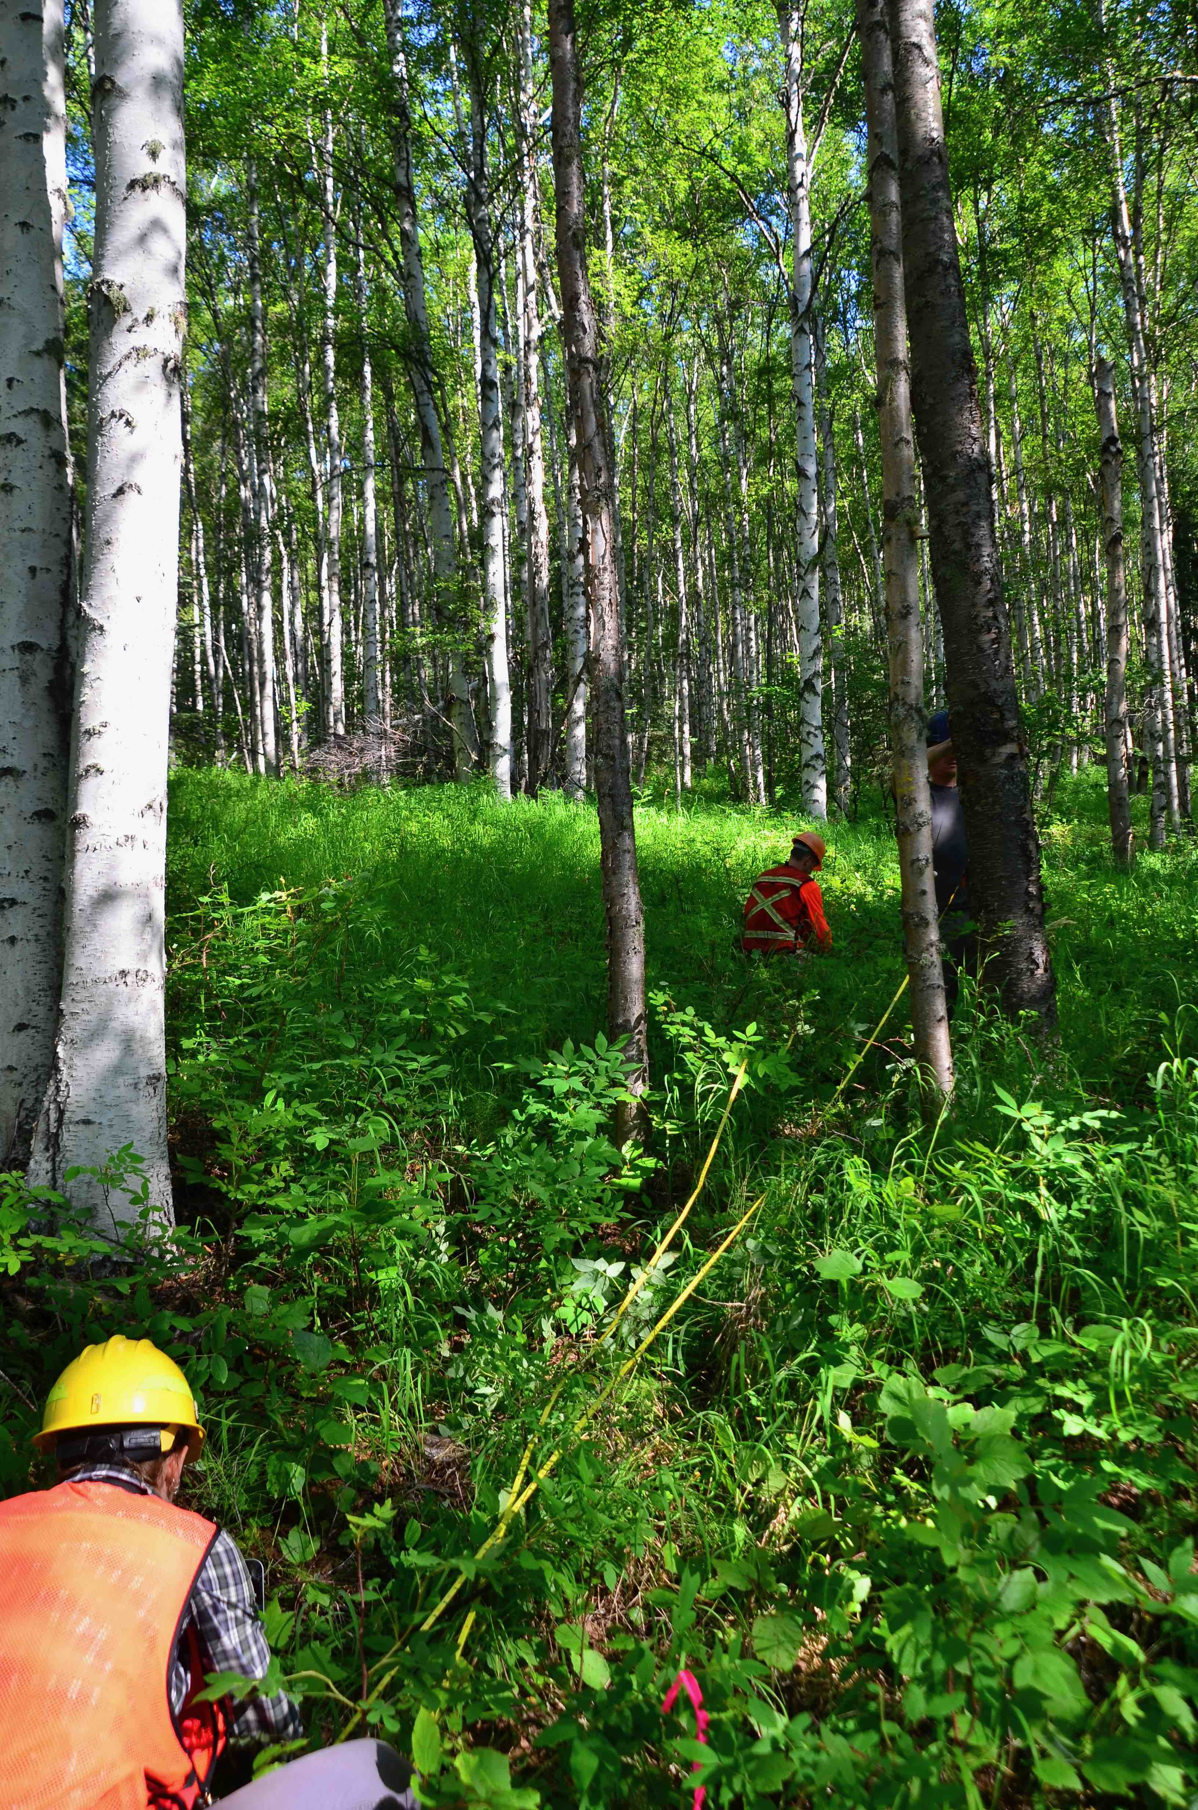
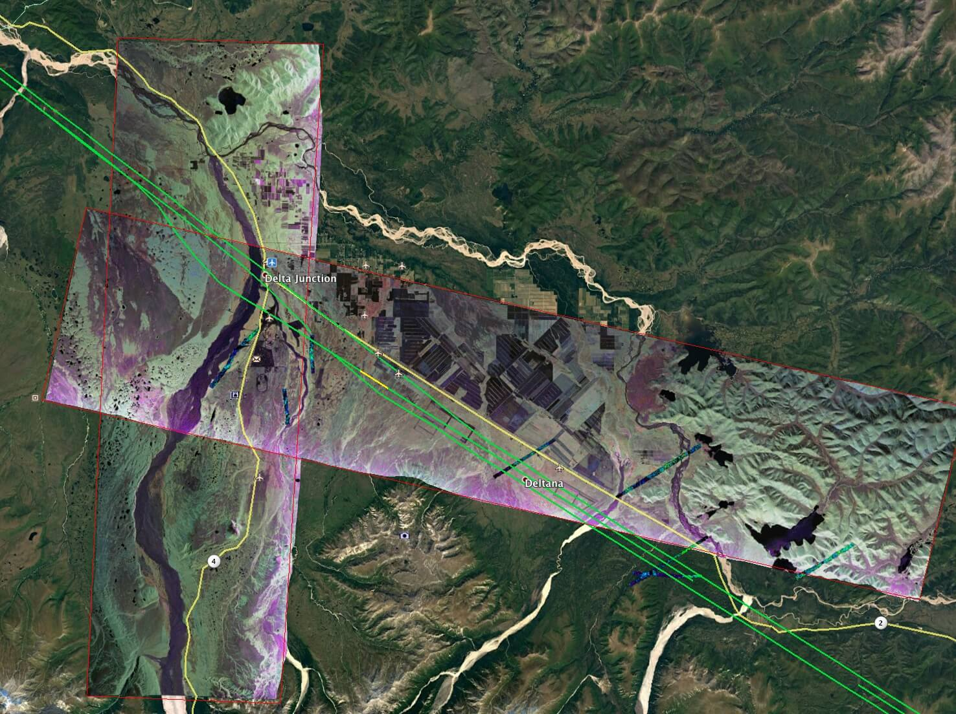
Delta Junction: NASA-USFS interior Alaska forest inventory project; NASA ABoVE radar and LVIS lidar overflights; an experimental evaluation of radar tomography (TomoSAR); and a ground and airborne radar validation effort for an upcoming satellite mission NISAR (NASA and Indian Space Agency SAR)
A1
Notes:
Near Delta Junction we had the opportunity to draw on multiple projects: the NASA-USFS interior Alaska forest inventory project; NASA ABoVE radar and LVIS lidar overflights; an experimental evaluation of radar tomography (TomoSAR); and a ground and airborne radar validation effort for an upcoming satellite mission, NISAR, between NASA and the Indian Space Agency.
Goal: Design and implement an operational, forest inventory in Interior AK, by extending a sparse network of ground samples with G-LiHT airborne multi-sensor data.
Motivation:
>450,000 km2 of forest land in interior Alaska (15% of US total) are not included in the USFS FIA program.
G-LiHT system uses well-calibrated, commercial-off-the-shelf instruments.
Builds on NASA-funded studies throughout North America (Nelson, Andersen, Morton, Cook), and leverages a new 10-year, $25M USFS FIA plan for AK.
MRV prototype for large, remote areas of the world where field data is sparse.
Web map and data user interface
https://glihtdata.gsfc.nasa.gov/tanana.html

Slide 7
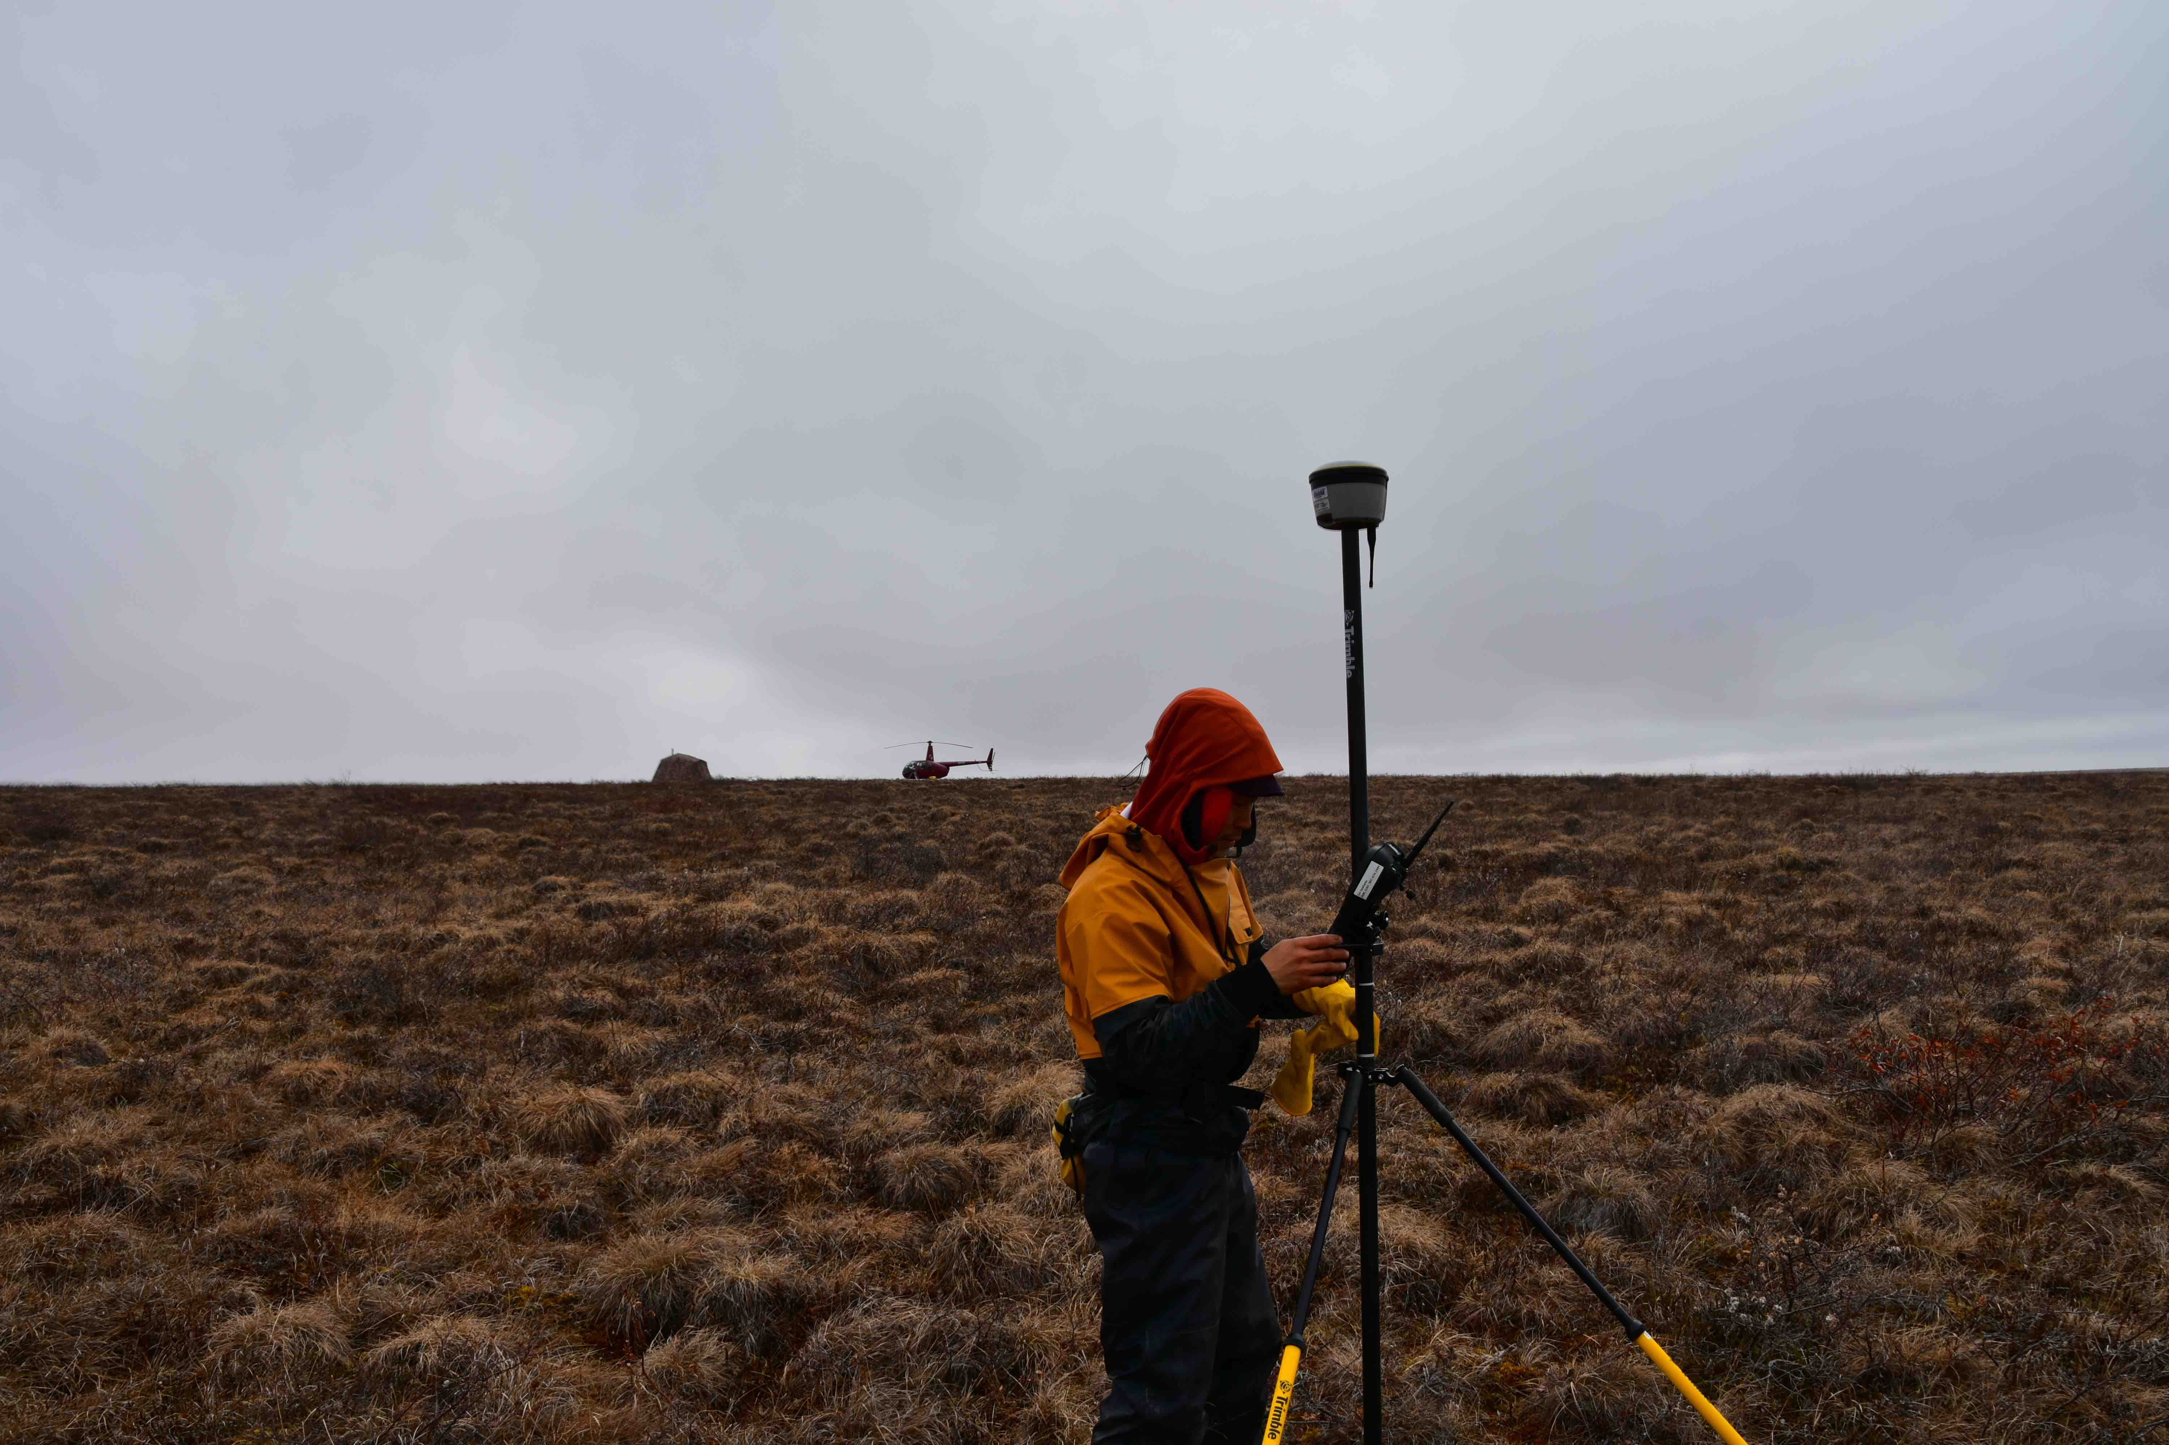
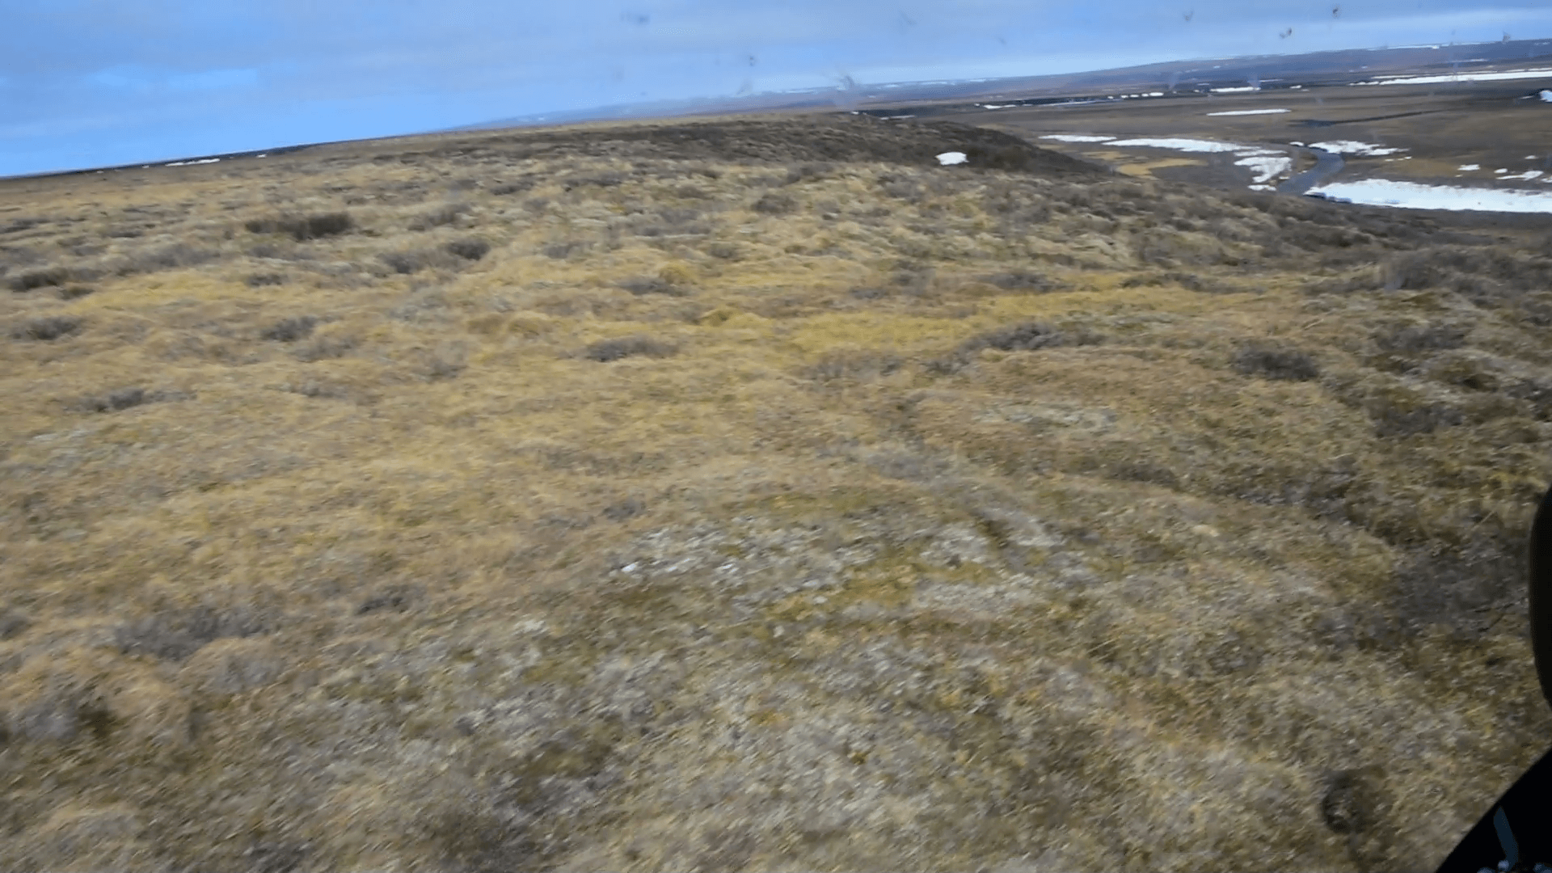
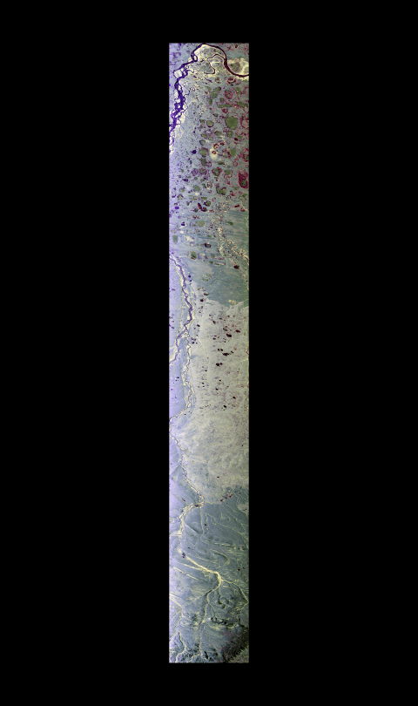
Anaktuvuk Tundra Fire Scar
C1
C2
C3
Notes:
Video Link 1 (upper left) :https://cce.nasa.gov/cce/powerpoints/hyperwall/griffith2017_videos/media1.mp4
Video Link 2 (right): https://cce.nasa.gov/cce/powerpoints/hyperwall/griffith2017_videos/media2_2.mp4
In 2007, the Anaktuvuk River tundra fire burned ~1,000 km2 in northern Alaska. Analysis of multi-resolution spaceborne optical data showed that ~50% of the area burned at high severity. In this severely burned tundra, the fire burned the surface vegetation layer and consumed nearly 30 cm of the insulating surface soil organic layer, often down to mineral soil.
In 2017, Go Iwahana and his students returned to the burned area to assess impacts of the loss of the insulating layer. NASA aircraft also flew the area with a variety of instruments. This synthetic aperture radar image clearly shows the burned area 10 years after the event.

Slide 8
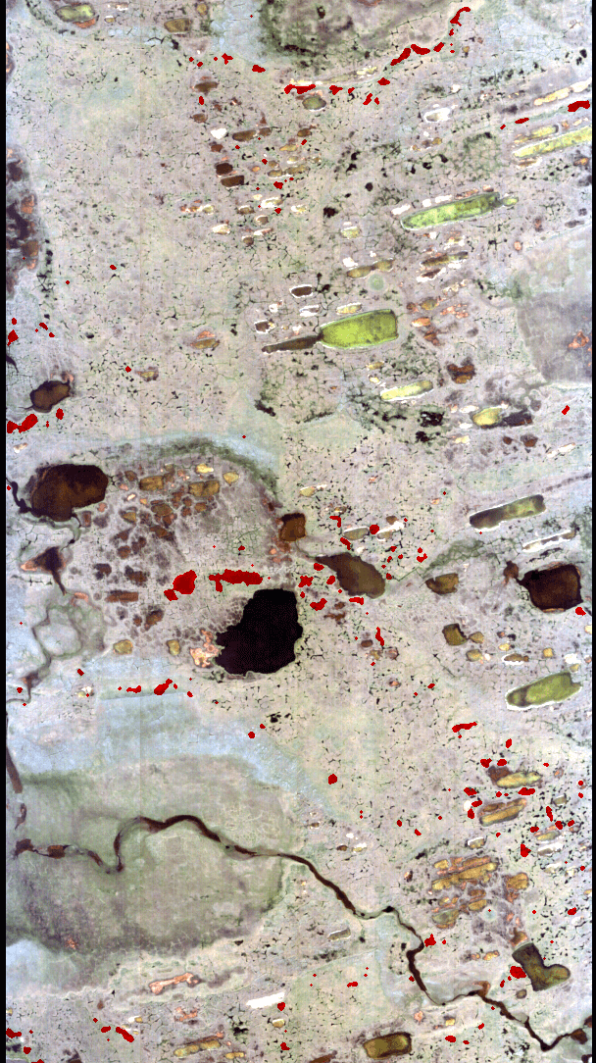
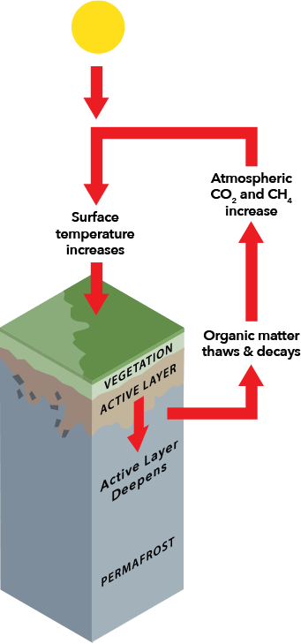
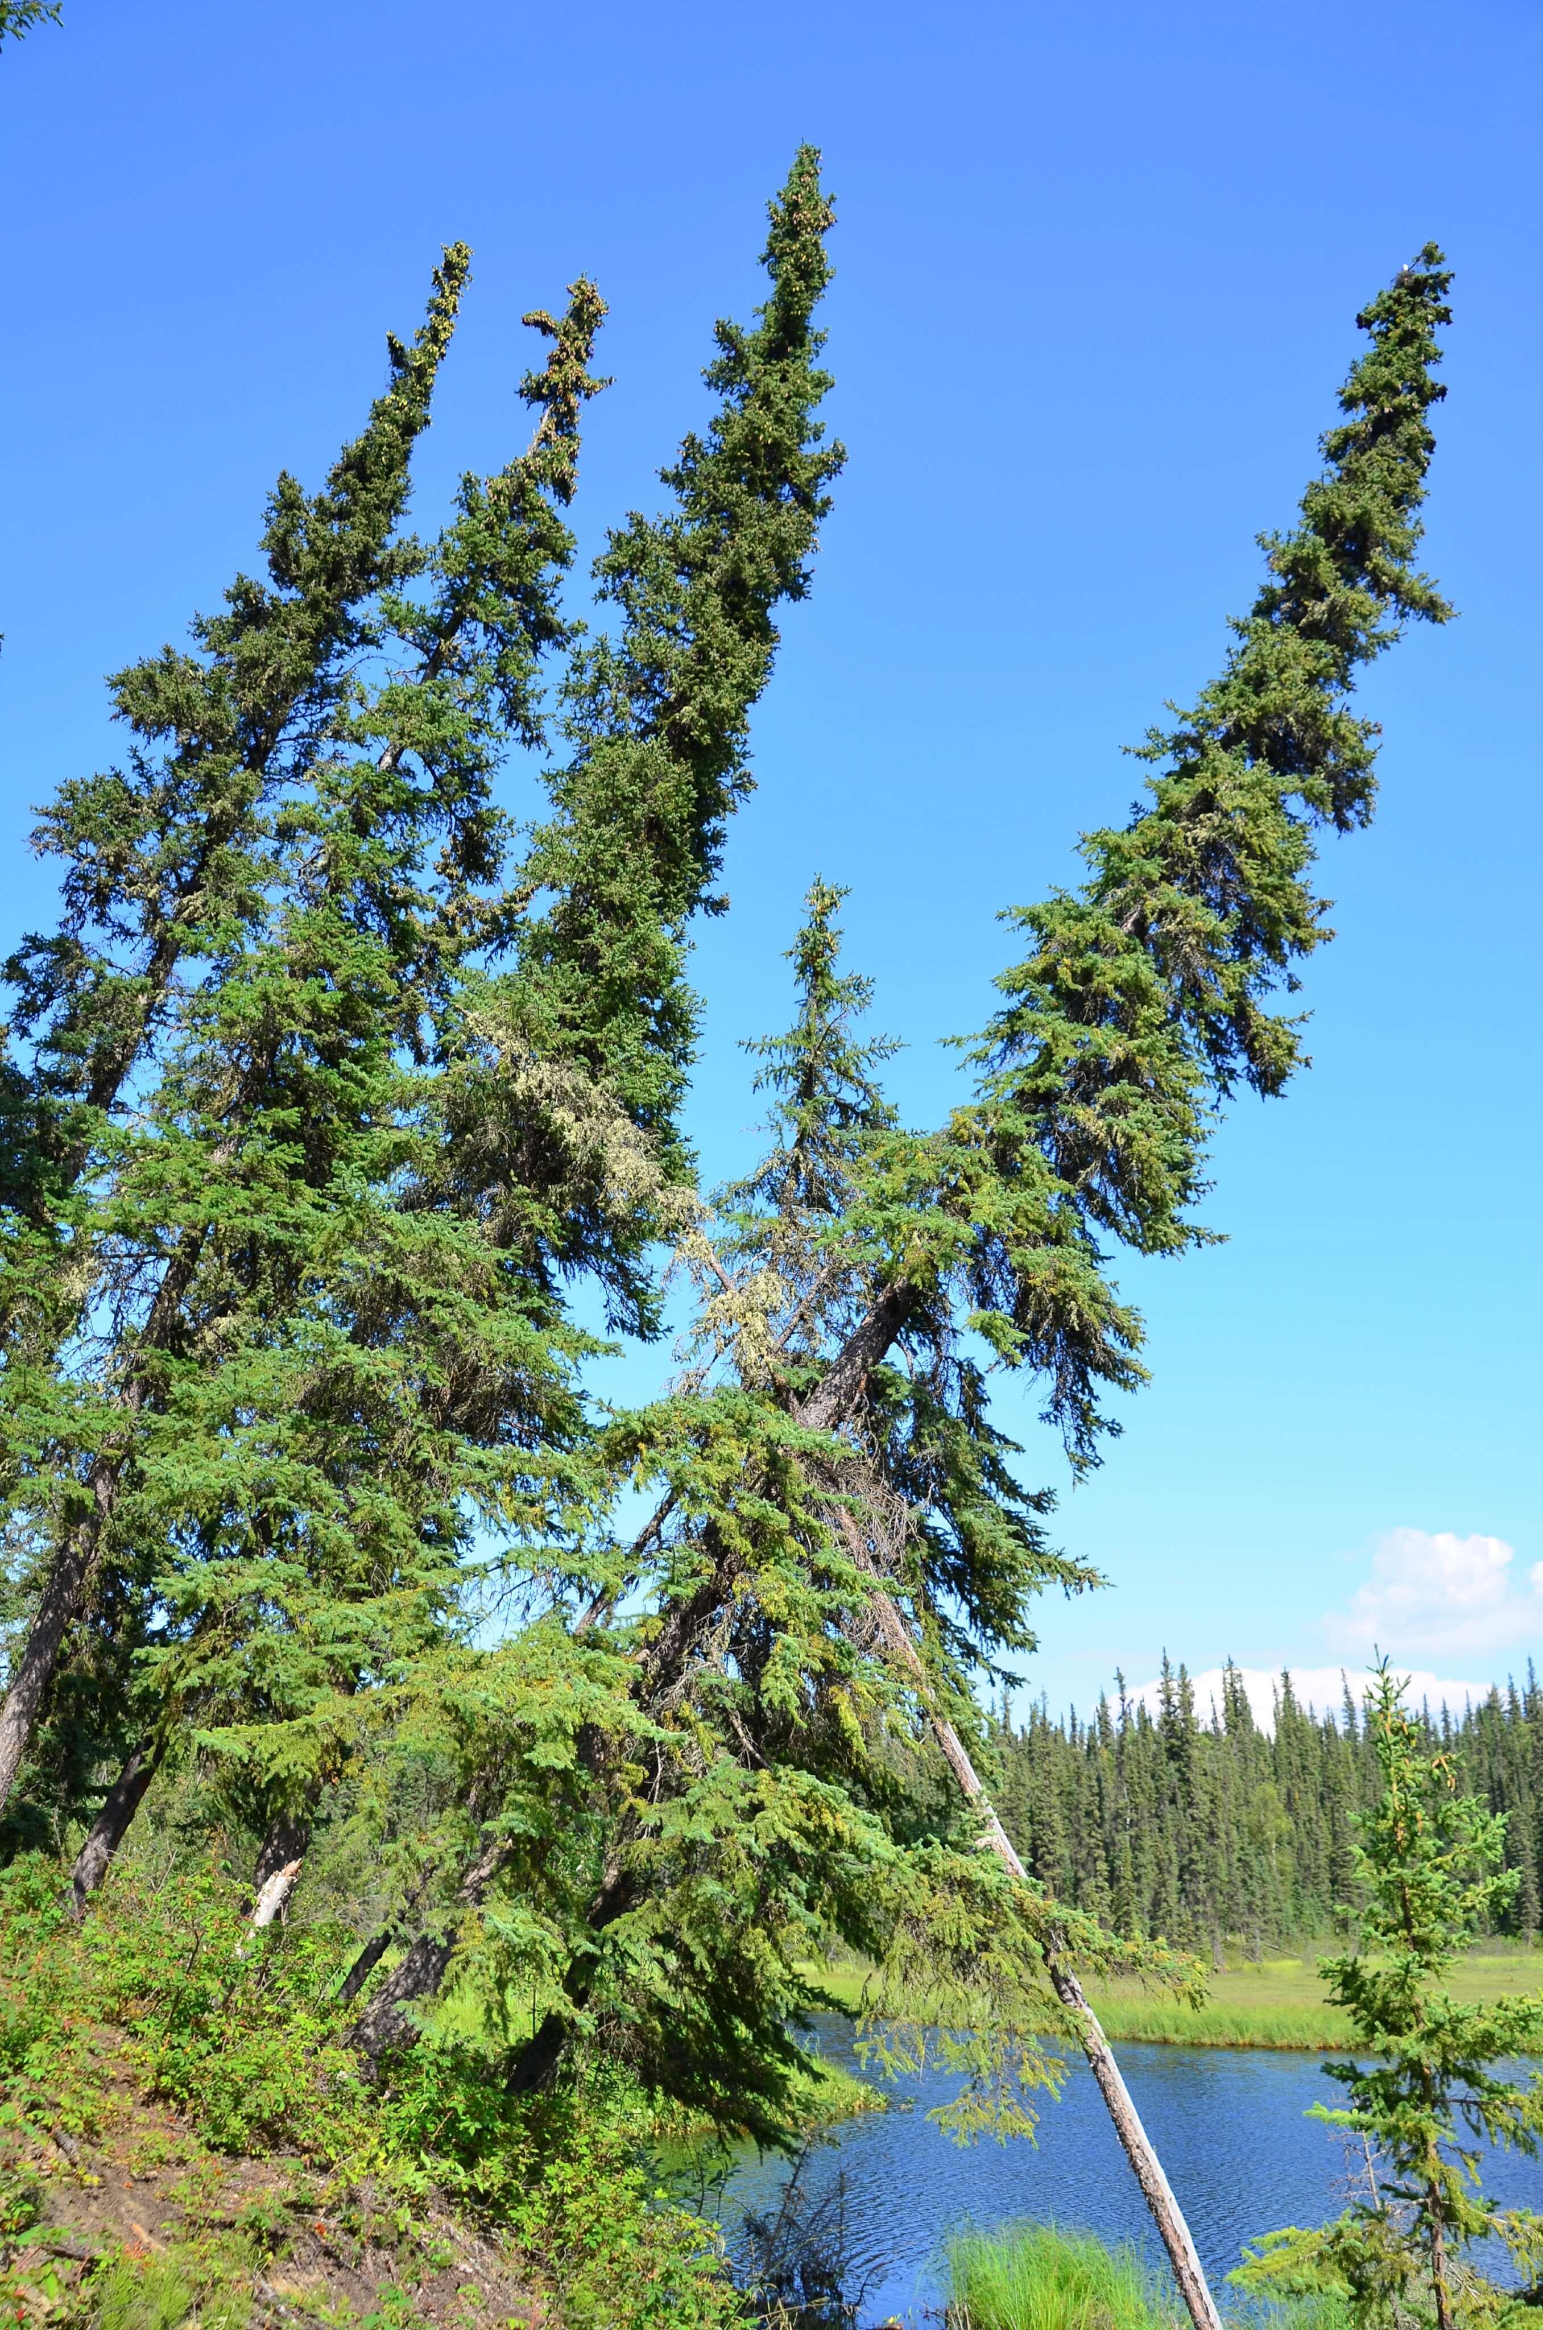
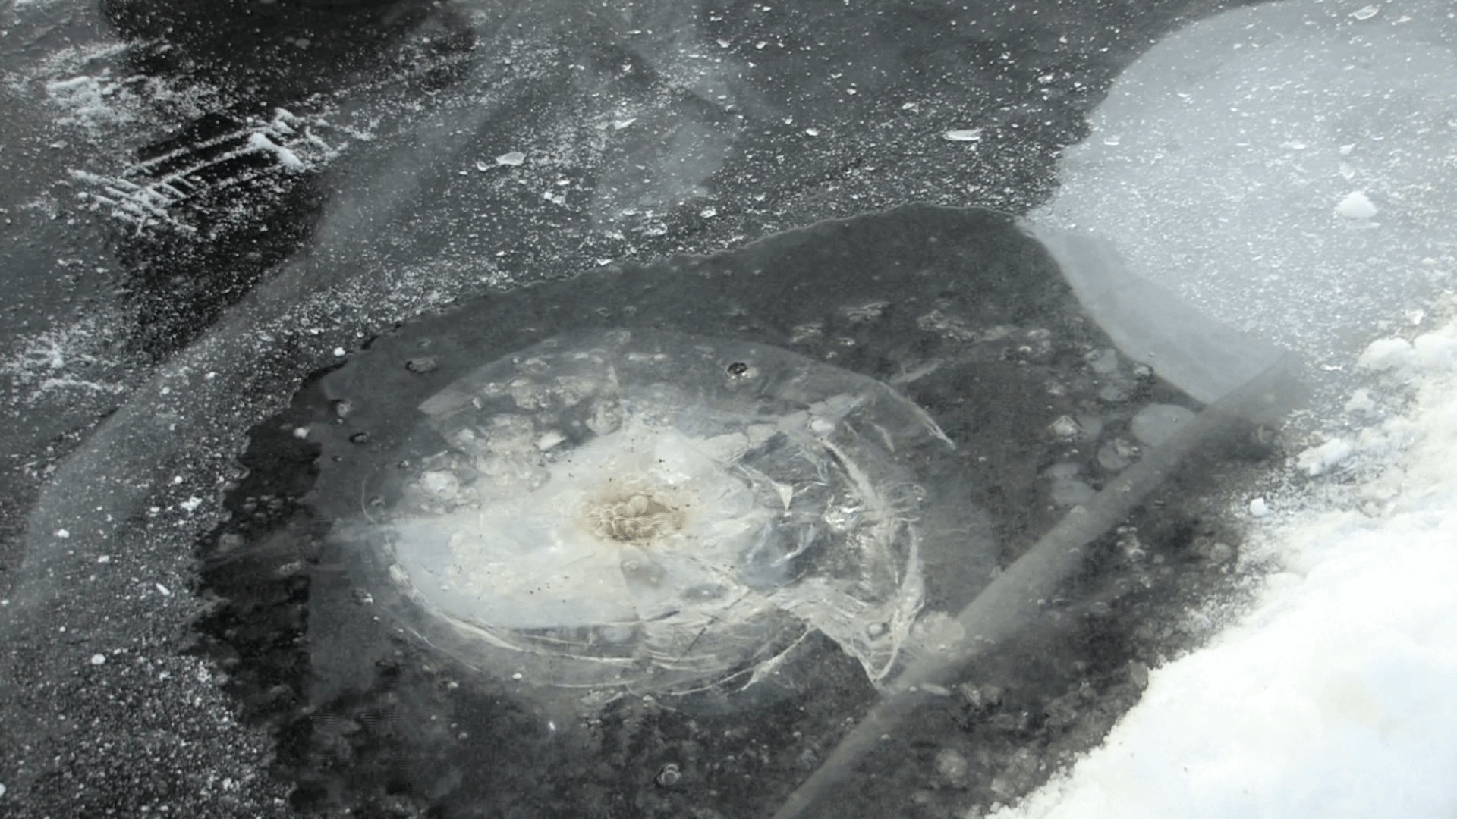
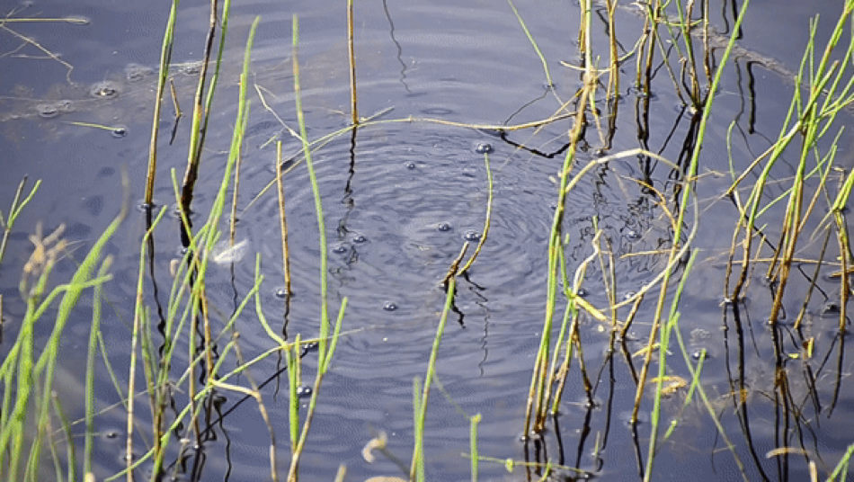
Impacts and feedbacks to local, regional, and global systems
C1
methane lake flare video clip
C2
Notes:
Video link 1 (middle right): https://cce.nasa.gov/cce/powerpoints/hyperwall/griffith2017_videos/media3.mp4
Video link 2 (bottom right): https://cce.nasa.gov/cce/powerpoints/hyperwall/griffith2017_videos/media2.mp4
Why should you care? Of all the impacts on local, regional, and global systems we’re studying during ABoVE, the permafrost thaw carbon-climate connection is the 7.5 billion person question.
As the region warms, thaw depth increases, making old frozen organic matter subject to degradation by bacteria. Microbial activity releases CO2 or methane into the atmosphere, where these gasses absorb more heat, further increasing warming.
And it’s the impact not subject or responsive to changes in governance or enforcement. So pay close attention to our results in the coming years!

Slide 9
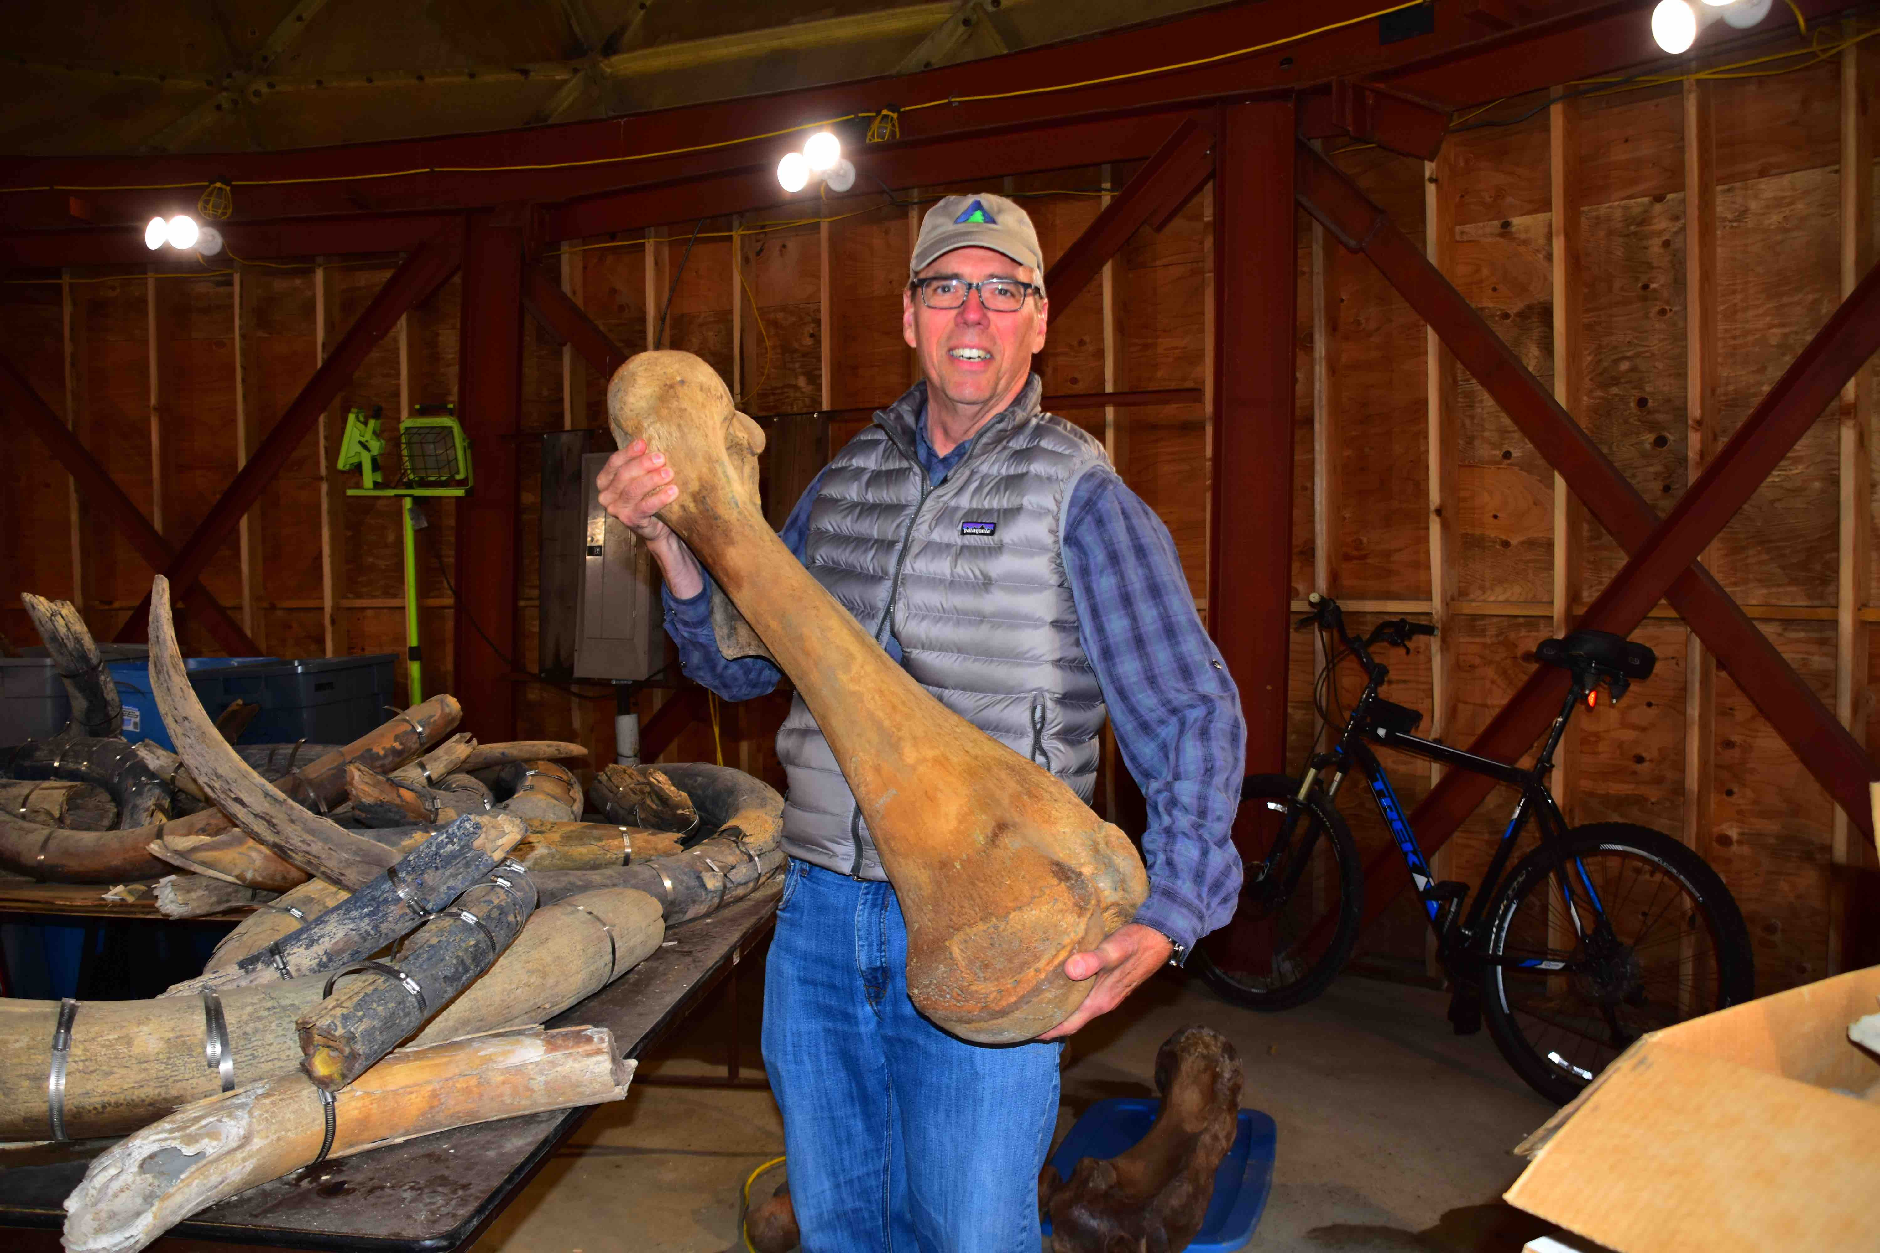
A1
B1
C1
A2
B2
C2
A3
B3
C3

Slide 10
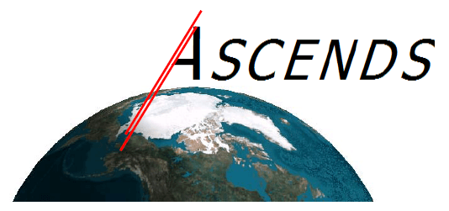
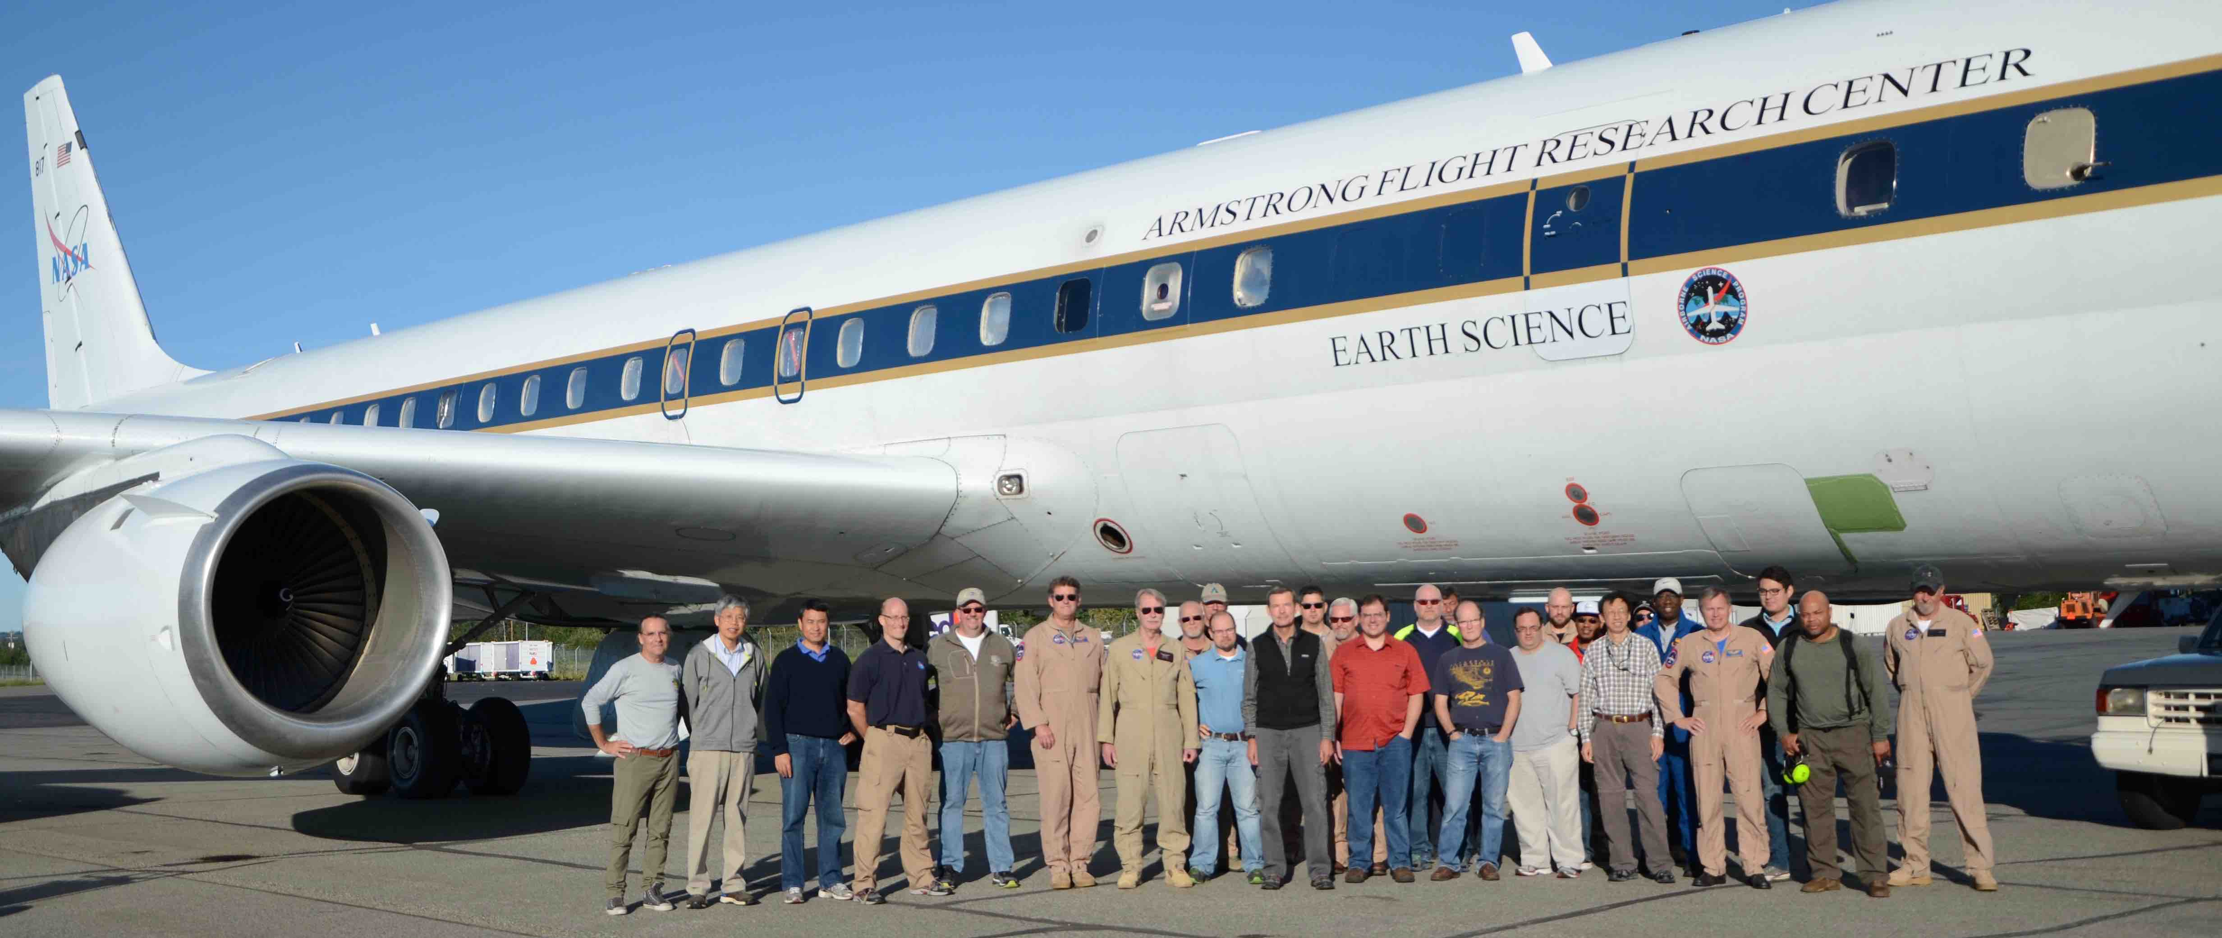
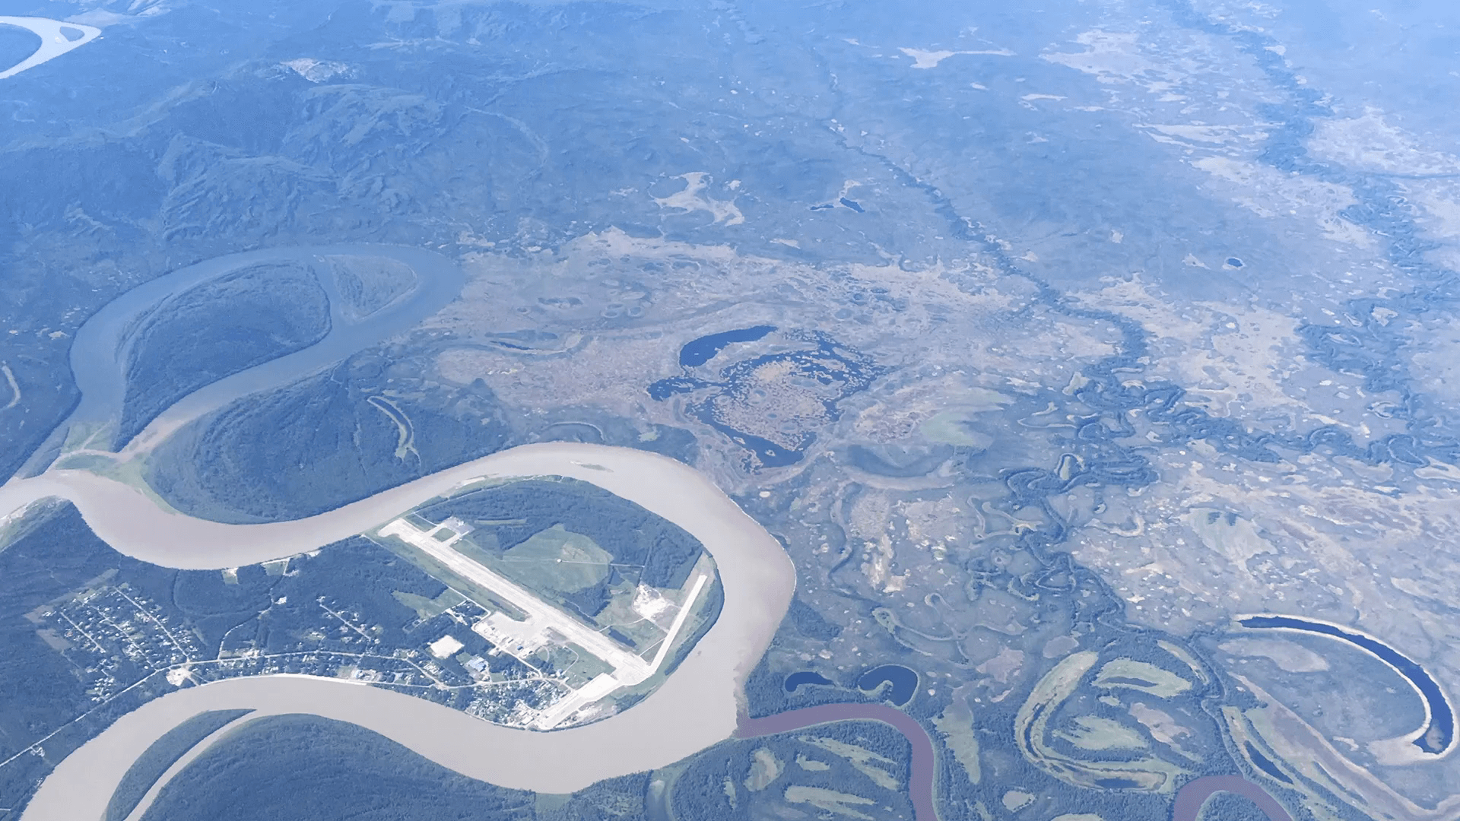
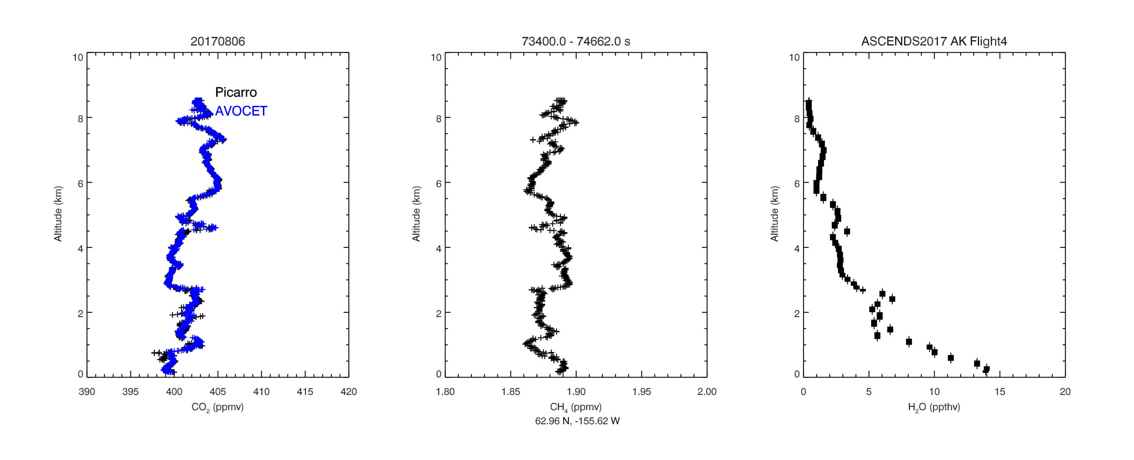
in situ
A1
B1
C1
A2
B2
C2
A3
B3
C3
Notes:
Video Link: https://cce.nasa.gov/cce/powerpoints/hyperwall/griffith2017_videos/media4.mp4

Slide 11
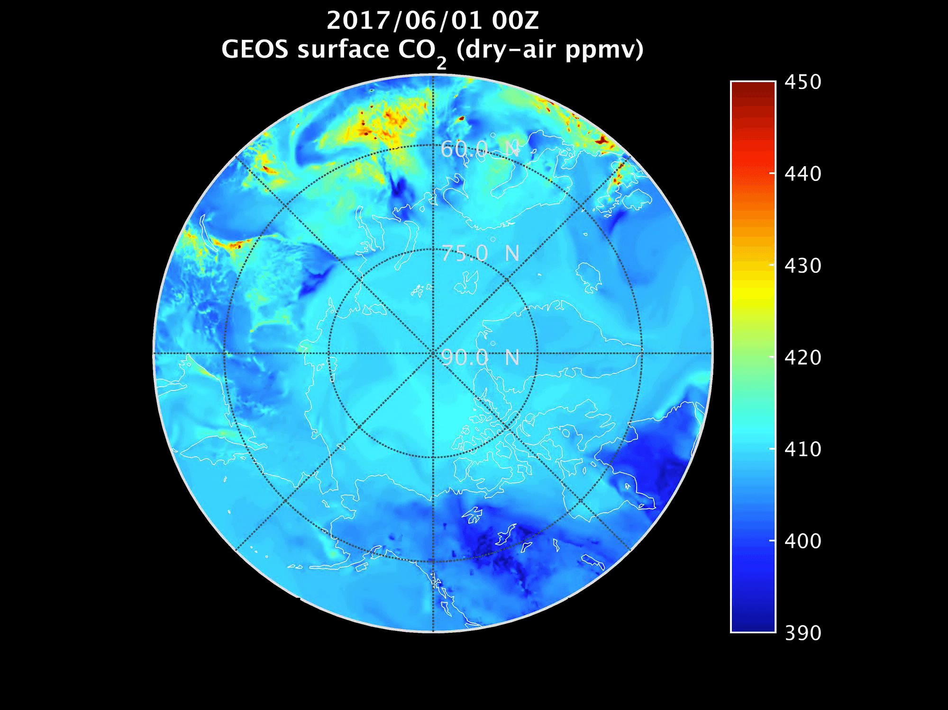
B1
B2
B3
Brad Weir and Abhishek Chatterjee (NASA GMAO)
Notes:
Video Link: https://cce.nasa.gov/cce/powerpoints/hyperwall/griffith2017_videos/media5.mp4

Slide 12
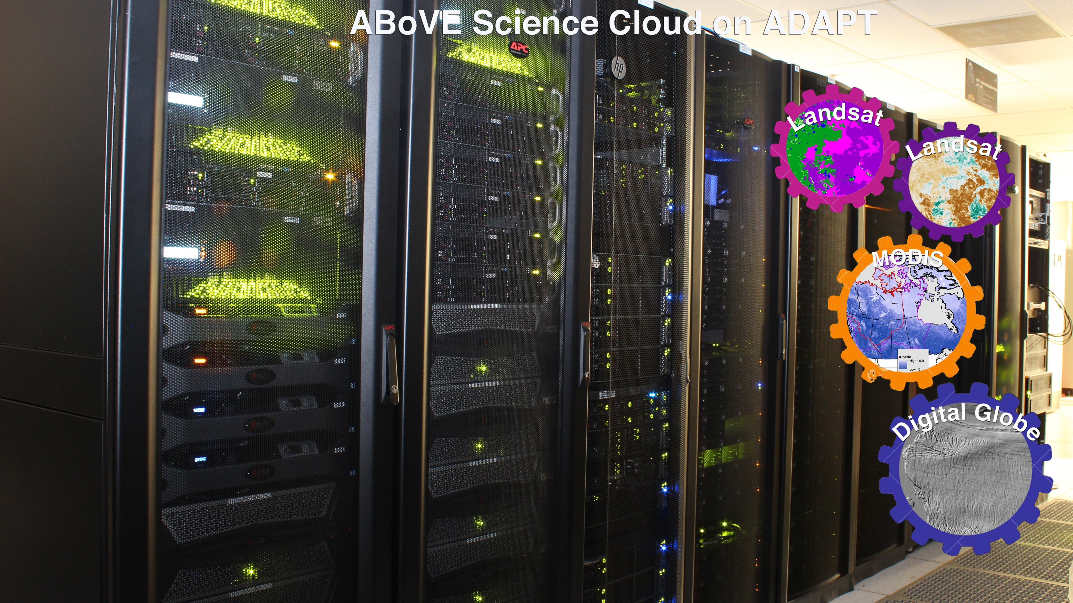

Slide 13
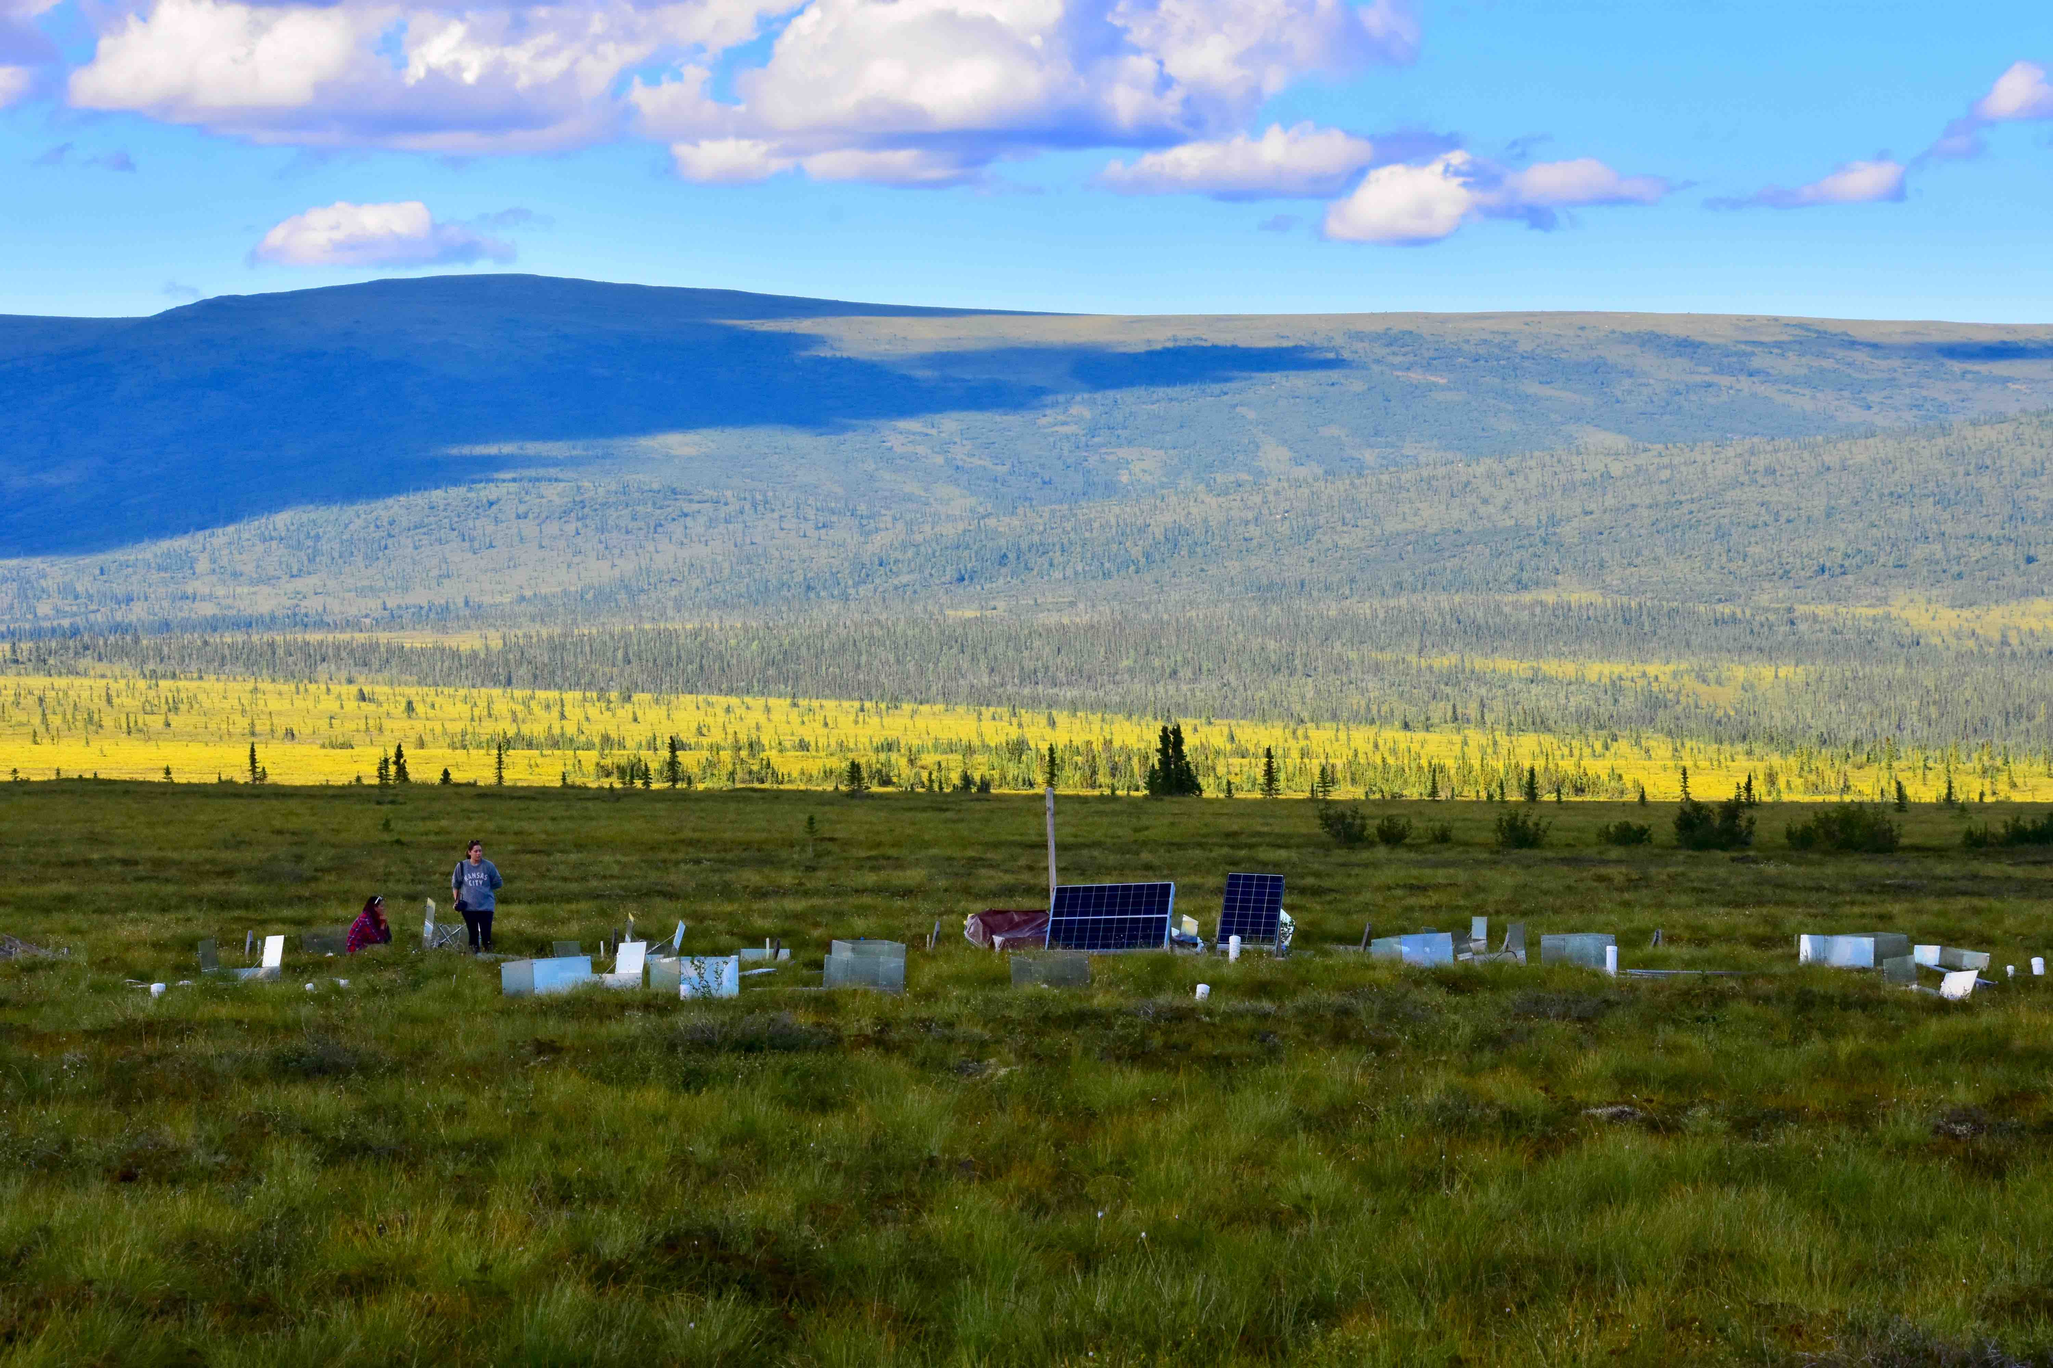
B1
C1
A2
B2
C2
A3
B3

