Slide 1
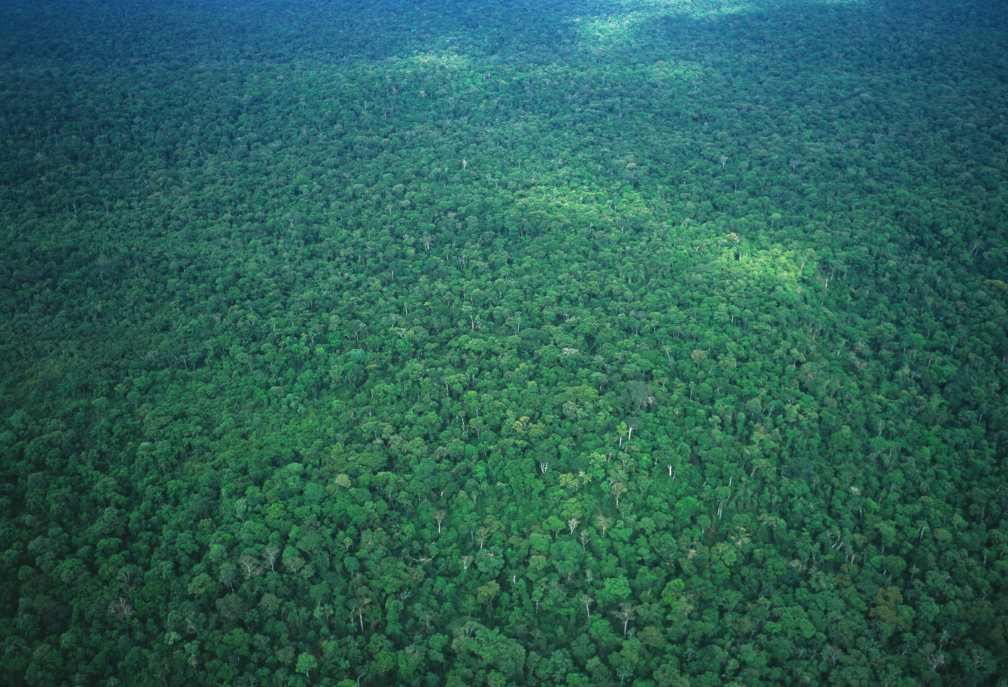

The Assembly and Evolution of the
Amazonian Biota and its Environment
Dimensions of Biodiversity US-BIOTA-São Paulo
Joel Cracraft
American Museum of Natural History
Kyle McDonald
City University of New York
Sharon Cowling
University of Toronto
www.amazoniabiodiversity.org
Notes:
project took several years to get off the ground, but here we are, we made it together
We are here because of the great wisdom of FAPESP, NSF, and NASA
They decided to take a chance on an audacious project: it is large in scope, interdisciplinary beyond normal interdisciplinary studies
Yet if all of us collaborators do our jobs, the payoff could be huge

Slide 2
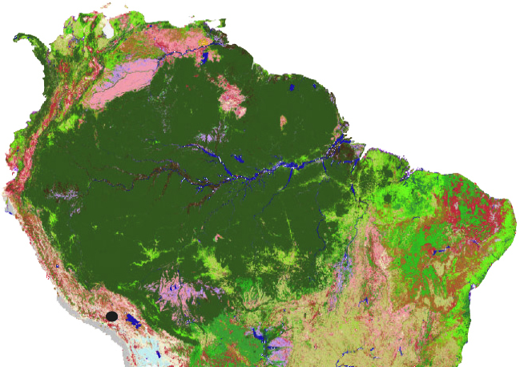
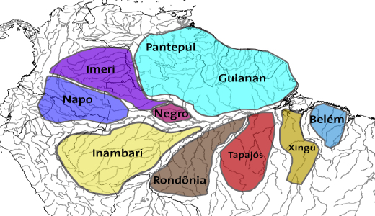

Amazonia: vast, diverse and important
Vast
Portions of nine nations
Seven million square kilometers
Diverse
Huge taxonomic/ecological diversity
Complex and deep environmental history
Globally important
Total forest biomass ~100 billion tons C
20% of atmospheric O₂
10% global terrestrial NPP
15-20% global freshwater flows
25 million people (2010)
forest cover continues to be lost

Slide 3
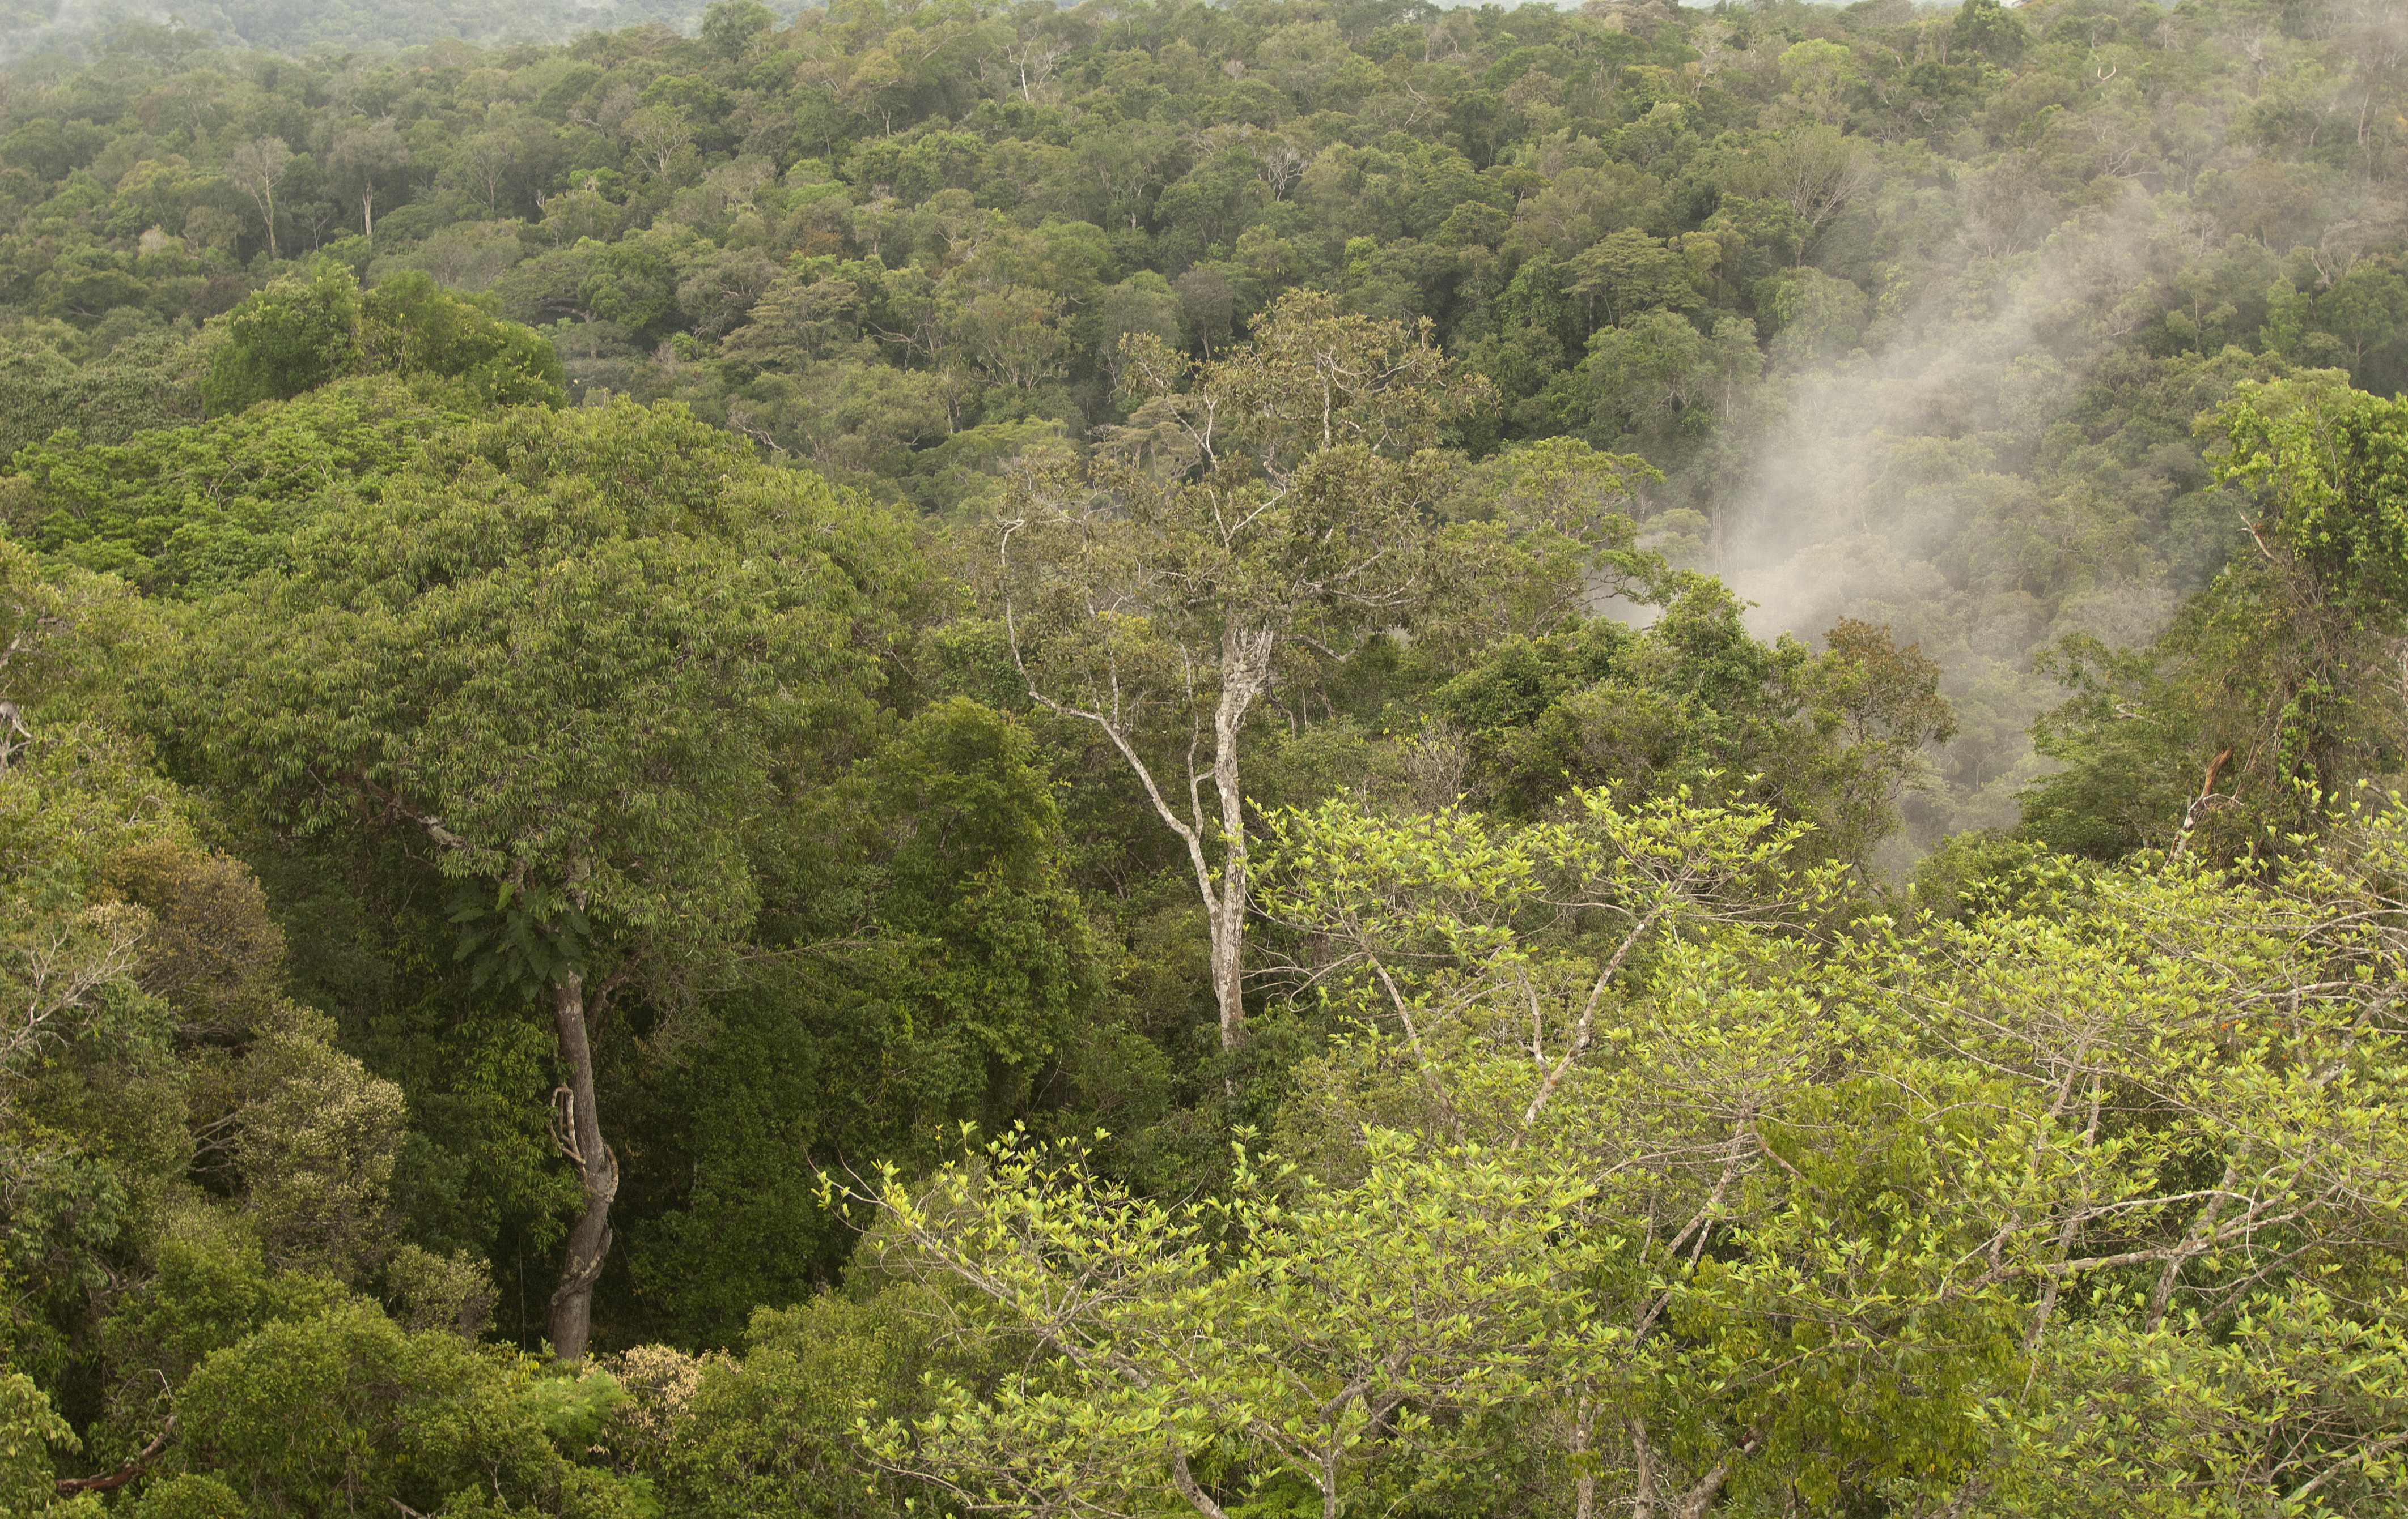
Scientific challenges and goals
How is genetic, taxonomic, and ecological
diversity distributed within Amazonia?
What has been the evolutionary history of the
Amazonian biota and how was it generated?
What has been the history of the Amazonian
aquatic and terrestrial environments?
How has the Amazonian environment and its
biota evolved together, and what have been
the global effects of this evolutionary-
ecological system over time?
Requires a new integrated approach

Slide 4
NSF-NASA-FAPESP project: broad-scale
collaboration
Brazil
Canada
Universidade de São Paulo
University of Toronto
Universidade Federal de Goiás
United States
Universidade Federal do Pará
American Museum of
Natural History
Universidade Estadual
de Campinas
City University New York
Museu Paraense Emílio Goeldi
Field Museum of
Natural History
Instituto Nacional de
Pesquisas da Amazônia
Middle Tennessee
State University
Argentina
Natural History Museum
Los Angeles County
CONICET-Instituto Superior
de Entomologia, Tucumán
New York Botanical Garden
Great Britain
University of Michigan
University of Edinburgh
University of Colorado

Slide 5
Integration across disciplines
Systematics
Historical biogeography
Phylogeography
Paleogeography
Tectonics
Geochronology
Remote sensing
Amazonian
History
Population
genetics
Landscape ecology
Ecosystem function/
biogeochemical flows
Paleoclimatology
Palynology
Paleoclimate modeling

Slide 6
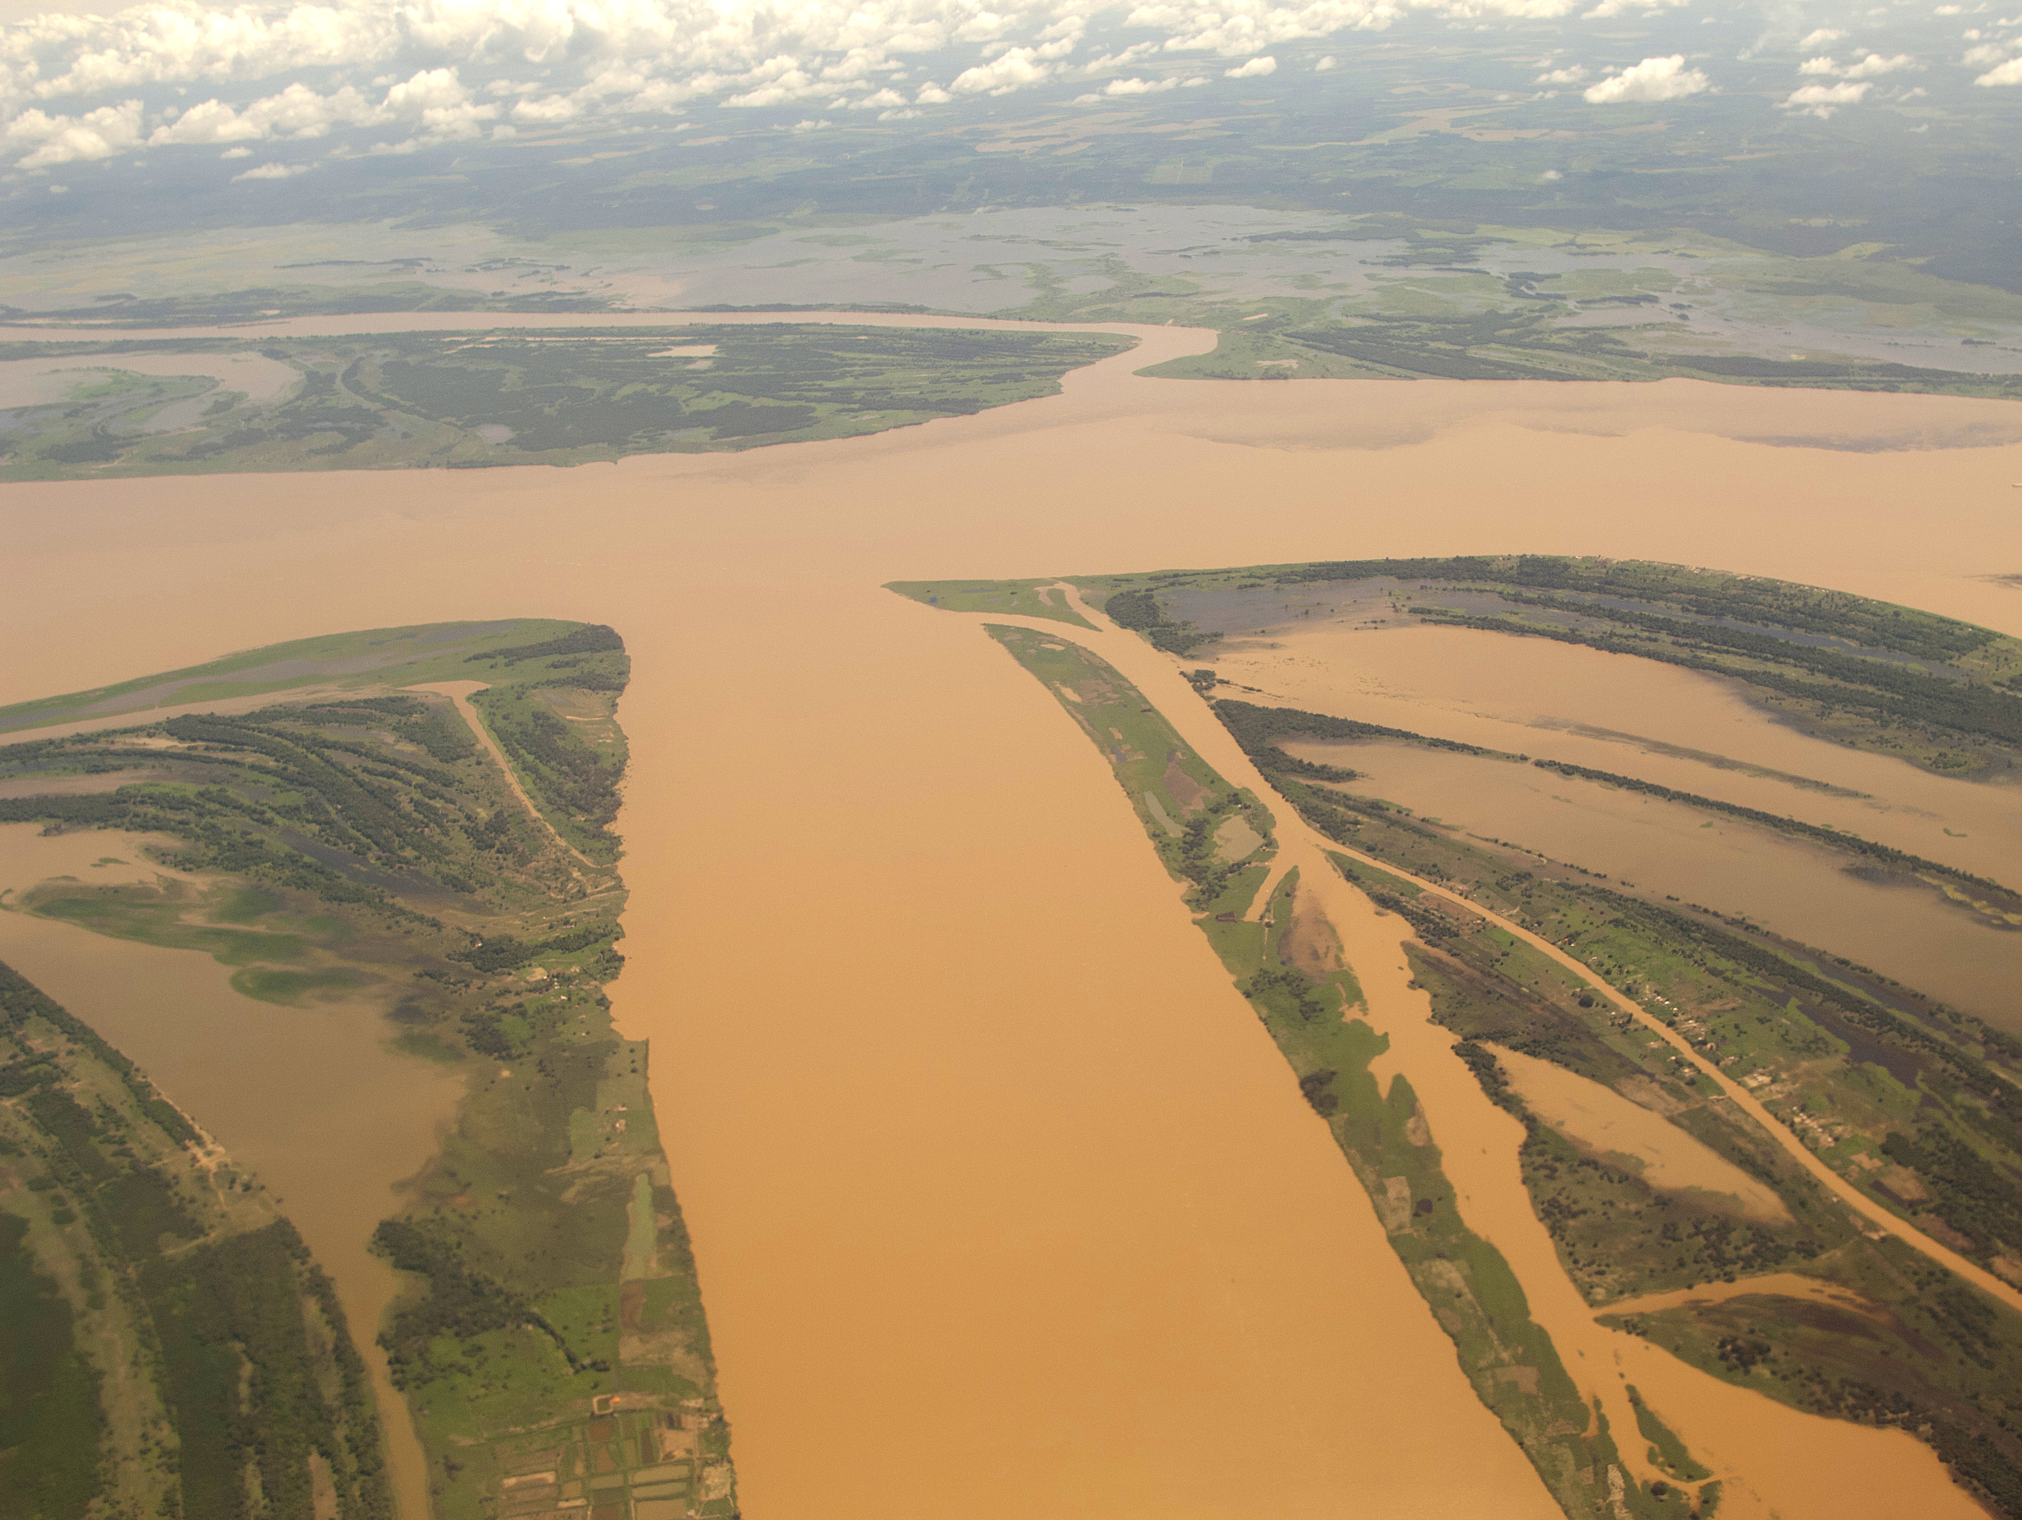
Reconstructing the history of the
Amazonian biota and environment:
some examples of integration

Slide 7
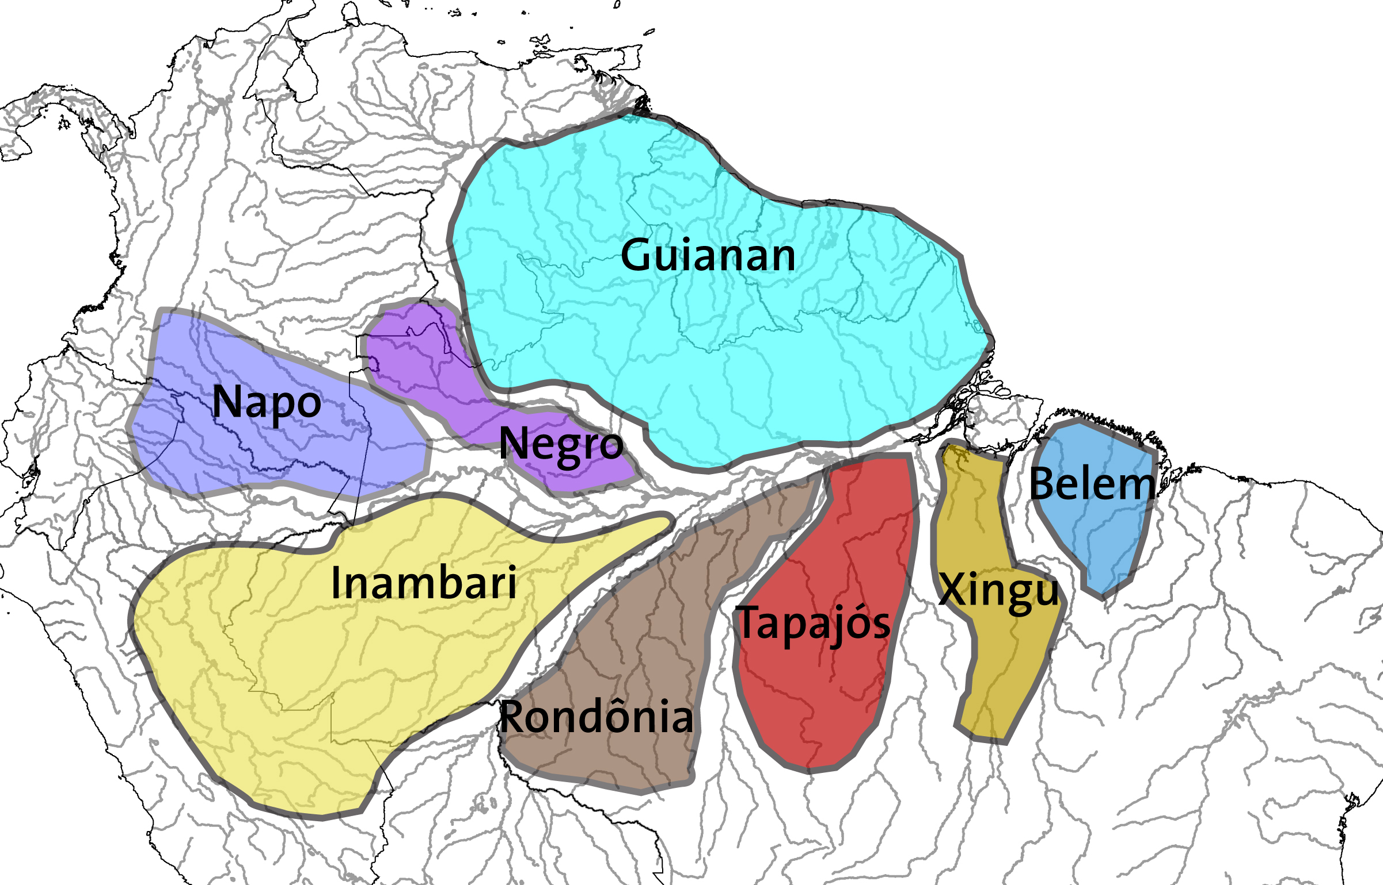
Integrating phylogenetic history and
paleogeography
QUANTITATIVE
DISTRIBUTION &
ENDEMISM
KEY TARGET TAXA
birds
primates
butterflies
vascular plants
FINE TAXONOMIC
SCALE
NEXT-GEN SEQ.
Areas of endemism

Slide 8
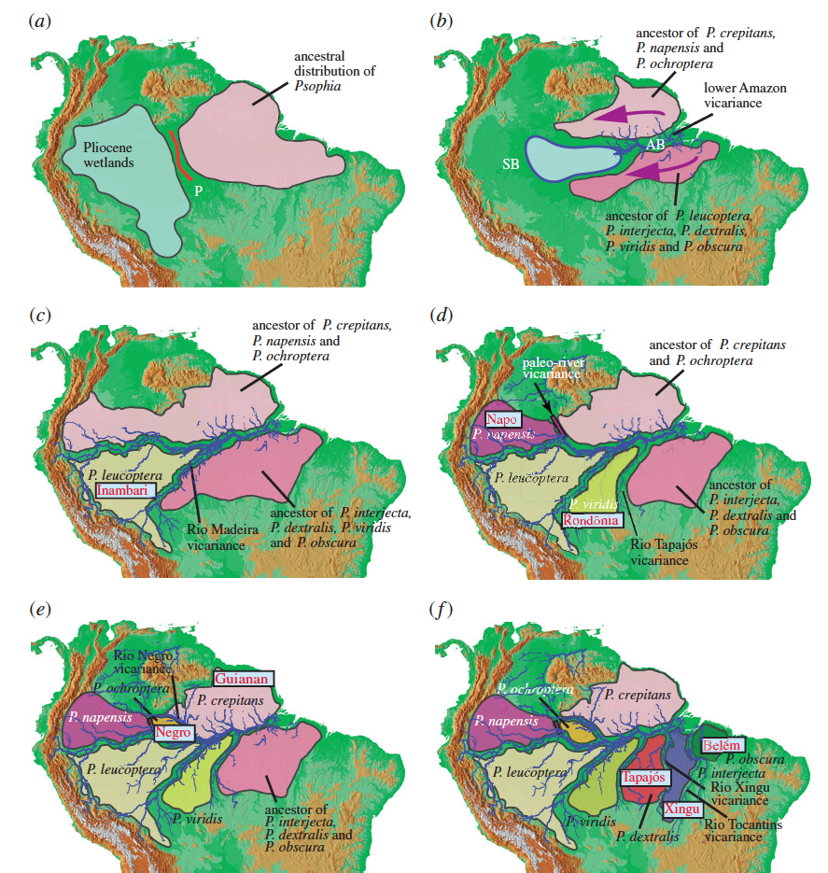

Paleogeographic
model based on
Psophia
3.0-2.7 Myr
2.7-2.0 Myr
2.0-2.1 Myr
1.3-0.8 Myr
Testable:
by other taxa
1.0-0.7 Myr
0.8-0.3 Myr
by geology
Ribas et al. PRS
2012

Slide 9
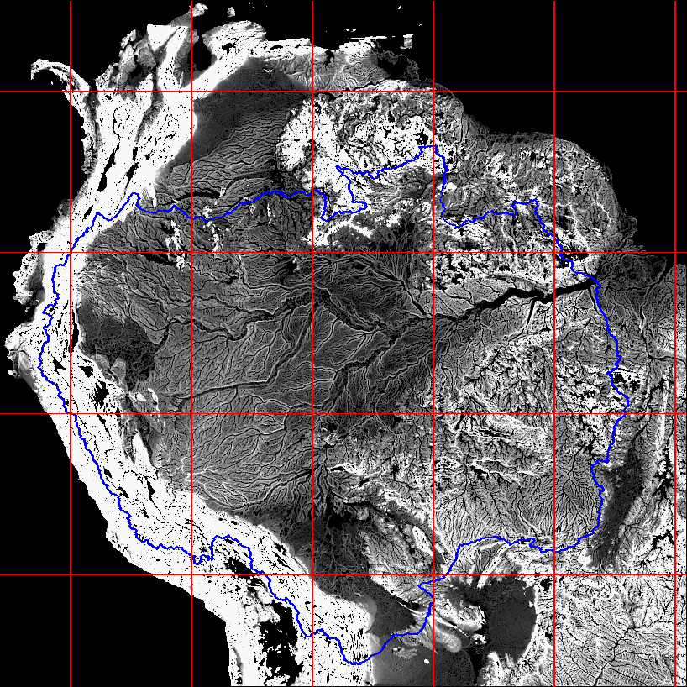
SRTM
% slope at 5 km scale

Slide 10
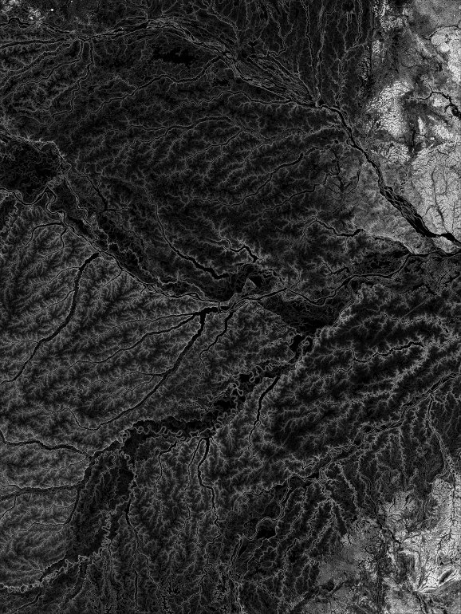
Integrating paleogeography
and remote-sensing using
SRTM
SRTM
% slope at 5 km scale

Slide 11
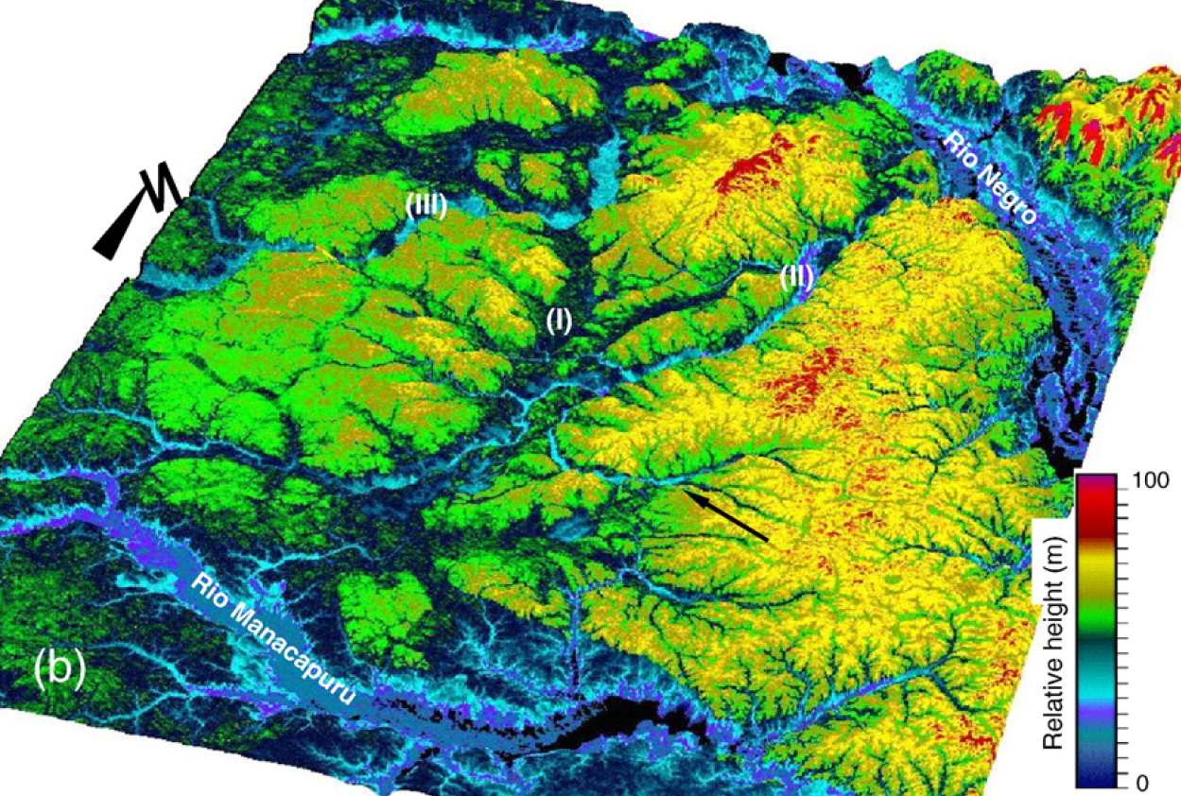
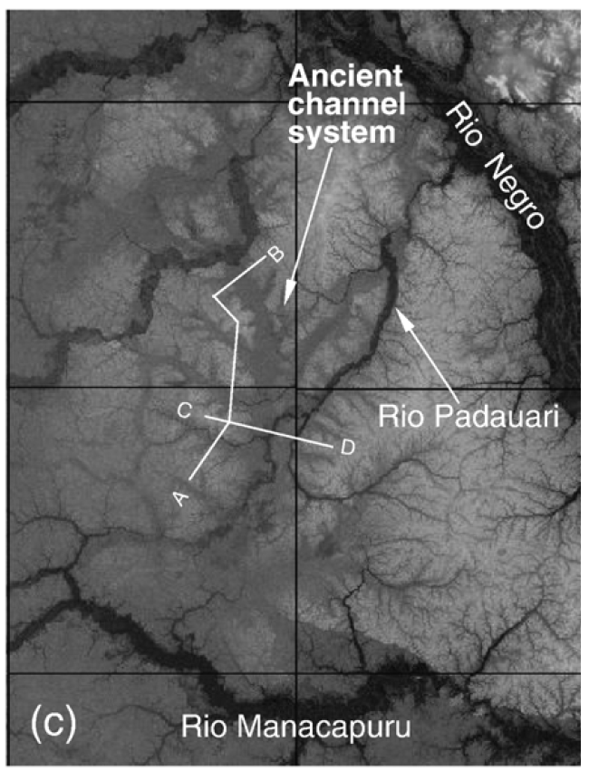
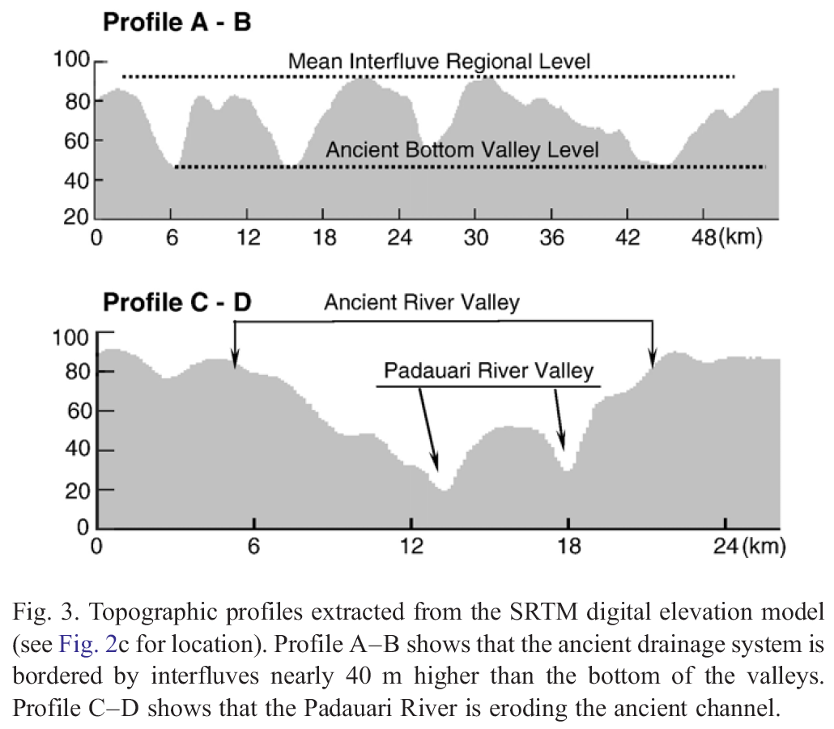
SRTM and Rio Negro
paleogeography
Rio Padauari
Rio Carabinini
paleoriver
SRTM digital
elevation model
Almeida-Filho & Miranda. 2007.
Remote Sensing Environ. 110:387-392

Slide 12

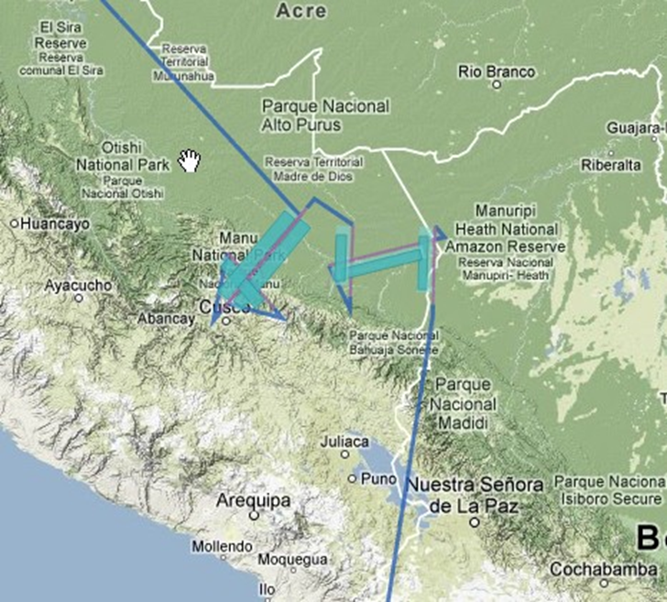

Slide 13
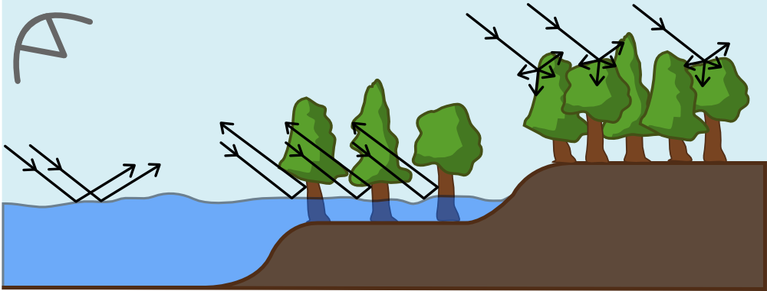
L-band SAR Sensitivity to Vegetation Structure and Inundation

Slide 14
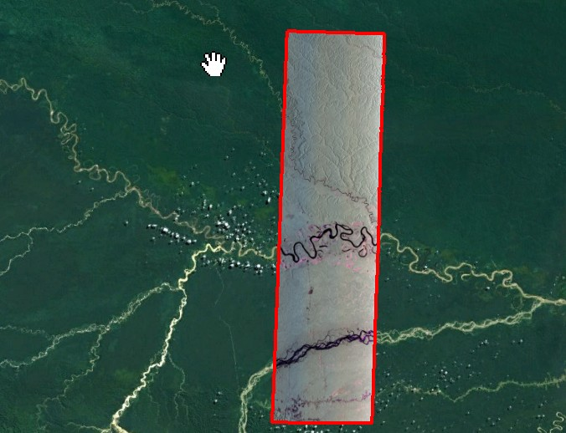
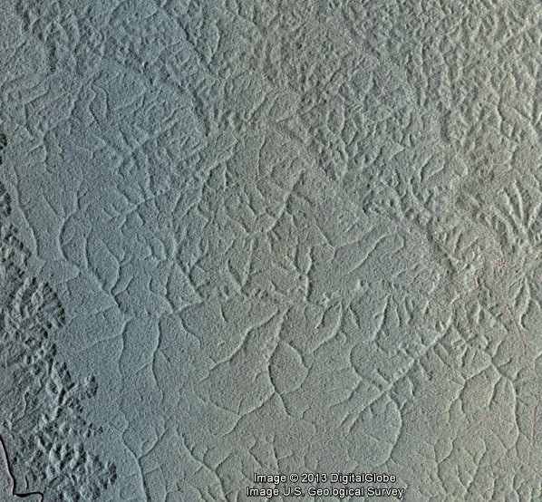
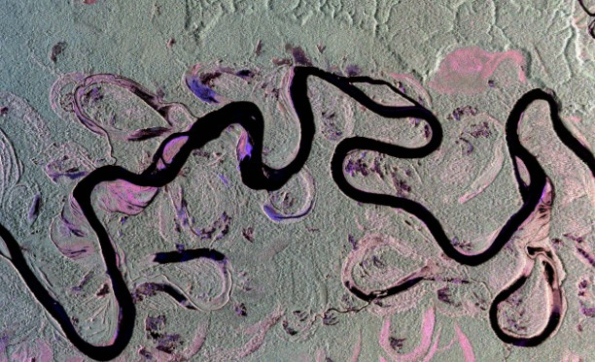
NASA UAVSAR
Madre de Dios
Peru

Slide 16

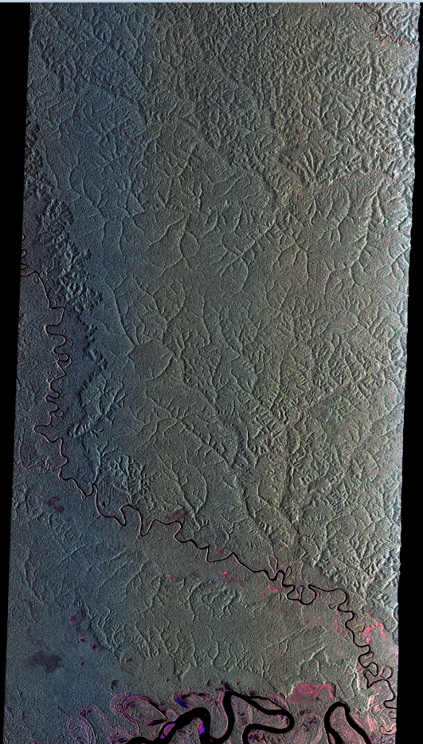
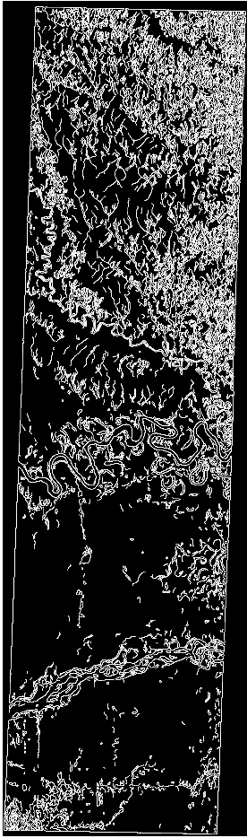
Recent NASA UAVSAR Data Collections Support Study of Biodiversity Evolution in the Amazon
NASA UAVSAR L-band Polarimetric SAR Image of Madre de Dios, Peru

Slide 17

JAXA ALOS Kyoto and Carbon Initiative
ALOS Successfully launched on January 24, 2006
  operated until 2011
Instruments:
  PALSAR (L-band SAR)
  AVNIR-2 (side-looking visible and near IR)
  PRISM (Stereo high-resolution nadir panchromatic for mapping topography)
Systematic Global Observation Strategy
International science team to produce products
Seasonal coverage of high priority areas
3 Science Themes:
  Forests
  Wetlands
  Desert and Water
McDonald et al. An Inundated Wetlands Earth System Data Record
Notes:
PALSAR acquisition strategy for wetland areas planned for assessment under this effort
Covers major global wetland regions
Inundated wetland area on a swath-by-swath basis (i.e. not using a mosaic product for the classification)
Principal wetland vegetation classes (non-vegetated, herbaceous, shrub, woodland, forest),
Seasonally based summary products describing timing and extent of wetland inundation
Production is phased according to K&C acquisitions

Slide 18
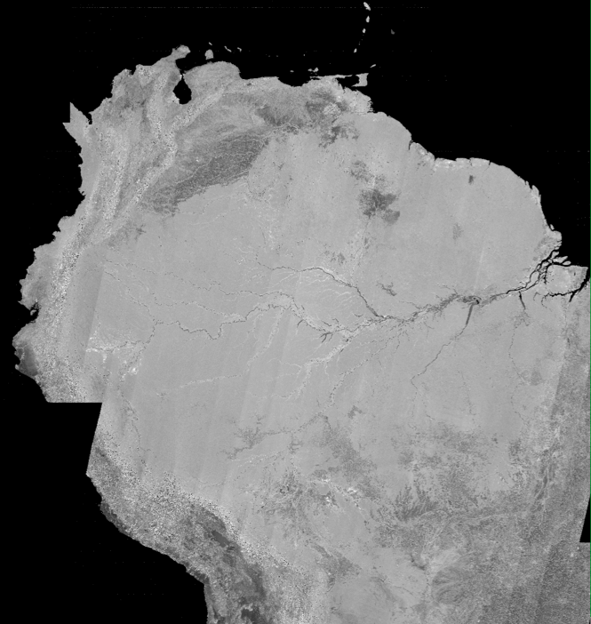
SCANSAR mosaic 2007
3 arcsecond postings (~90m)
(same as SRTM)
The Amazon river basin was imaged ~every 46 days by ALOS (2006-2011), so that inundation dynamics can be monitored
Notes:
18

Slide 19
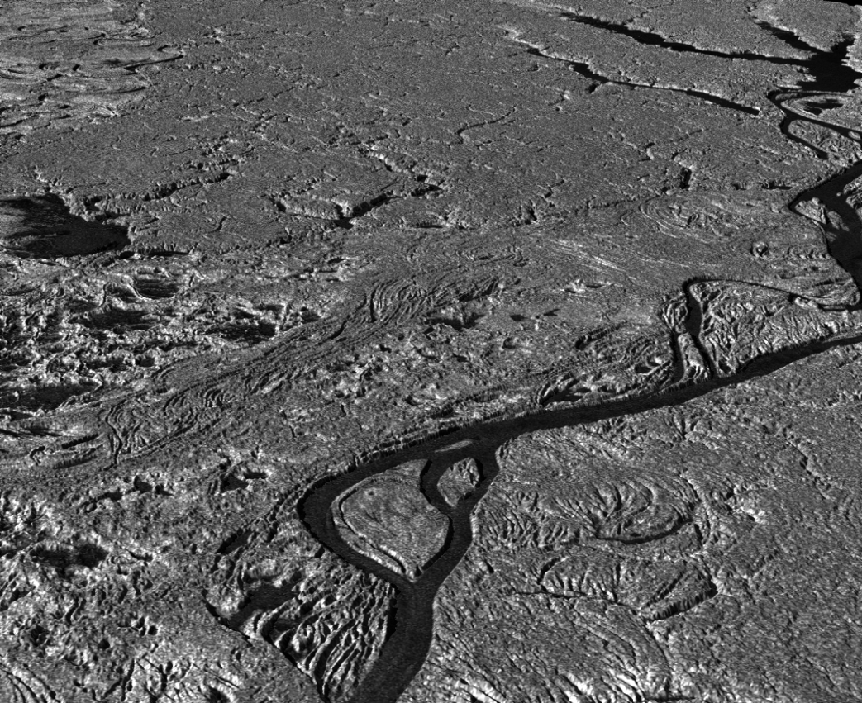
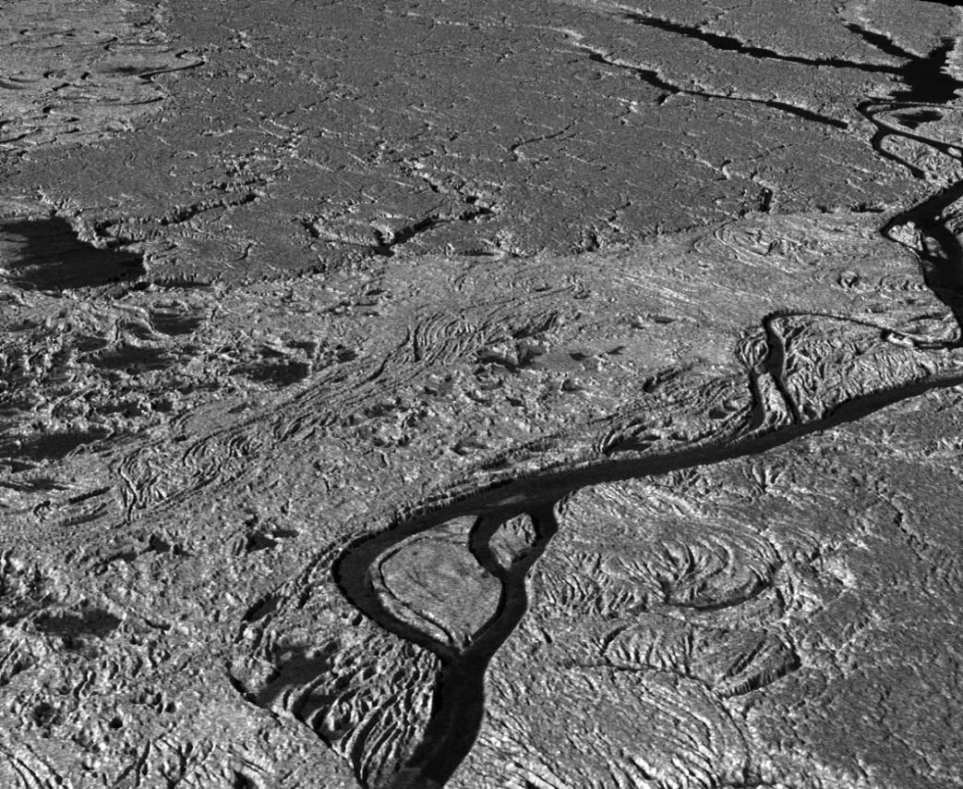
Feb 4, 2007
Jun 22, 2007
3D visualization

Slide 20
Inverse vegetation-climate modeling
New ~600 Kyr
cores in the
region also
LGM
Area of instability
Area of stability
Cowling et al. 2001.
Quat. Res. 55:140-149
(Cowling et al. 2001)
Continuous forest of high leaf area
Invading grasslands or woodland of low leaf area
Prescribed climate: 5ºC cooling, 20% reduction in precipitation (relative to today) and reduction in atmospheric CO₂ (200 ppmv)
Notes:
model for two areas implies more difference in relative stability when CO2 is reduced compared to a model when CO2 is not reduced (360 ppmv)

Slide 21
Other ongoing activities
Assembled ~500,000 digital distribution records for birds
& ~80, 000 primates. (Authority files: collection localities
and geographical locations
New postdocs, grad & undergrad students on board
(Brazil programs: Science without Borders; CAPES)
Other integrative activities moving forward:
geology-palynology-paleoclimate
phylogeography-environmental modeling
phylogenetics-paleogeography
Website is launched: www.amazoniabiodiversity.org

Slide 22
Acknowledgement
Portions of this research were undertaken within the framework of the ALOS Kyoto & Carbon Initiative. The ALOS data were provided by JAXA EORC

Slide 23
Extra Charts

Slide 24
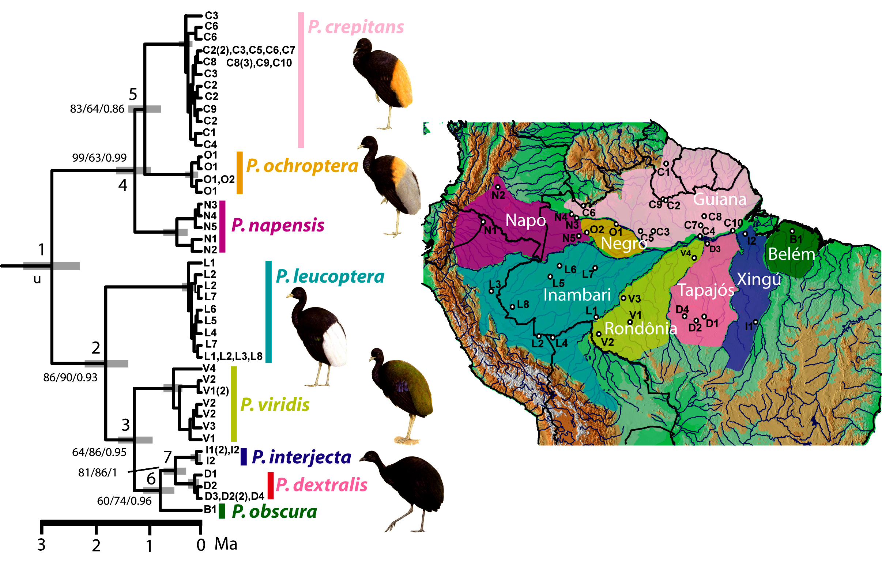
Ribas et al. PRS
2012
Phylogenetic and biogeographic
patterns of Psophia
North Amazon/South Amazon
east/west patterns
Leads to a predictive Amazonian
paleogeography: testing
alternative models
Timeline estimated by two
independent methods

