Slide 1
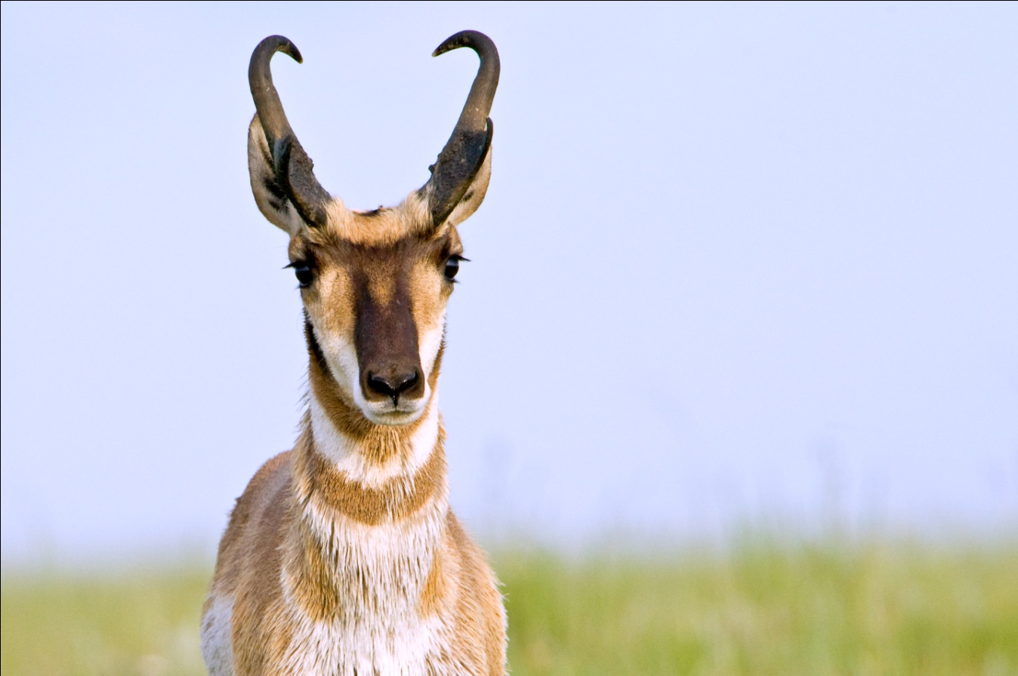
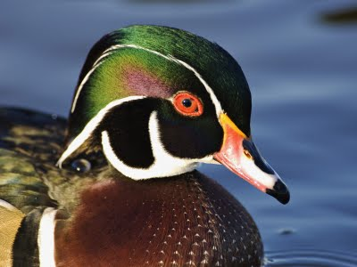







Ecosystems in Transition: Decision Support Tools to Measure, Monitor and Forecast Climate Impacts on Migratory Species
Bob Crabtree, YERC/Univ. Montana
Rex Johnson, USFWS
Kathy Fleming, USFWS
Scott Boomer, USFWS
Emily Silverman, USFWS
Qing Zhao, Colo. State Univ.
Christopher Potter, NASA
John Kimball, Univ. Montana
Daniel Weiss, YERC
Steven Jay, YERC
Maggi Kraft, YERC
… many other NGOs, Universities, and State Fish & Game Dept.’s
Notes:
Of course, thank the many who have collaborated on this project but most importantly our agency partner, the US Fish and Wildlife Service, who helped conceive the proposal idea and is provided access to incredible data and funding for a post-doc, Qing Zhao who is leading the analysis of migratory waterfowl. Special thanks to the co-Is at the folks at Patuxent Wildlife Research Center and the HAPET joint venture in PPR. Also DU Canada.
Well obviously ecosystems are in transition due to the primary and secondary impacts of climate change and migratory species, like waterfowl, face particularly difficult challenges as they leave their winter ranges at set photoperiod times and encounter mistimed events that affect their energetics and ultimately their fitness.
Now, rather than dive into the goals and objectives, I think it’s worth understanding what decision-making activity we are modifying and what huge potential it has due to the large scale it operates at and affects.

Slide 2

Background on science-based, empirically-driven Adaptive Harvest Models
Continental working group formed in 1992 to review the scientific basis for managing waterfowl harvest in NA
Uses annual field data (1955 to present) to inform population models on an annual cycle to set harvest
Information-theoretic criteria (model weights) reflect the relative confidence in alternative hypotheses—e.g., D-D reproduction and/or additive mortality
The AHM is not currently constrained by environmental variables (extreme weather, persistent drought, forage)
Major challenges to modification are continuity, continuance, data access and processing, and validation
Notes:
One of the sterling examples of adaptive management in the world is the continental-scale Adaptive Harvest Model. Agencies and flyway councils across the continent formed a working group 20 years ago to review the scientific basis for managing waterfowl harvest. See slide and end with: besides using waterfowl as an indicator, surrogate species the AHM has numerous windfalls to biodiversity and conservation of wetlands, for example guiding wetland restoration which affects many other human systems.

Slide 3
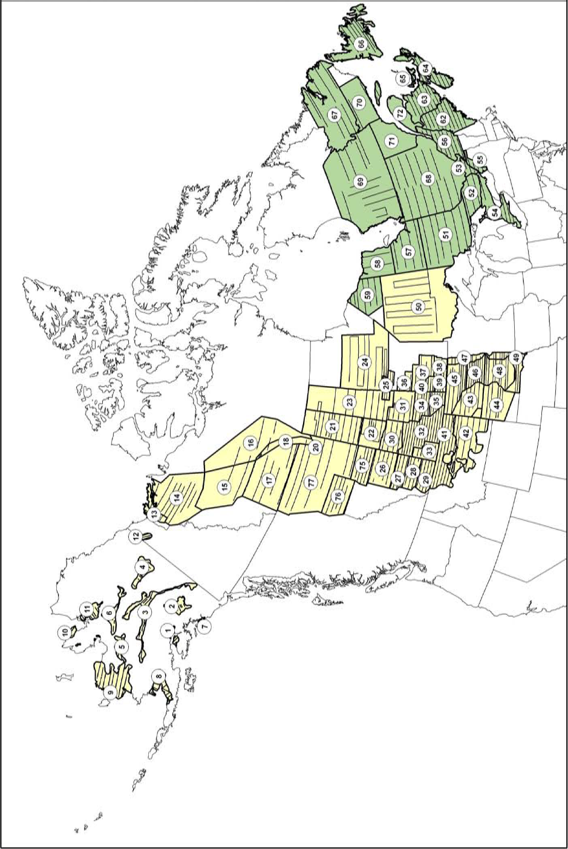
. . . build the framework to ingest and process the datasets for diagnostic analysis and modeling to propose candidate constraints to AHMs
RESPONSE DATA: aerial surveys of waterfowl breeding pair density (1955 to 2011 ) brood production, harvest and non-harvest mortality, and age ratios; possibly the best long-term demographic data set in the world. Higher spatial resolution starting 2000
Notes:
AHMs will not be easily modified or changed so our main work task is to build a framework—of tools and techniques—for potential future adaptive modeling and use that same framework to conduct diagnostic analysis and modeling to determine which temporally-dynamic environmental variables (or covariates) are important as candidate constraints to AHMs. Mallards and now an additional seven species serve as the migratory species examples for our project. We have a very strong bias towards careful pre-modeling exploratory analysis of all kinds BEFORE you build a diagnostic model capable of forecasting and suggesting a environmental constraint on a species AHM. Predictions are everywhere and unvalidatible. Nearly all prognostic models is see have very low inference ability.

Slide 4
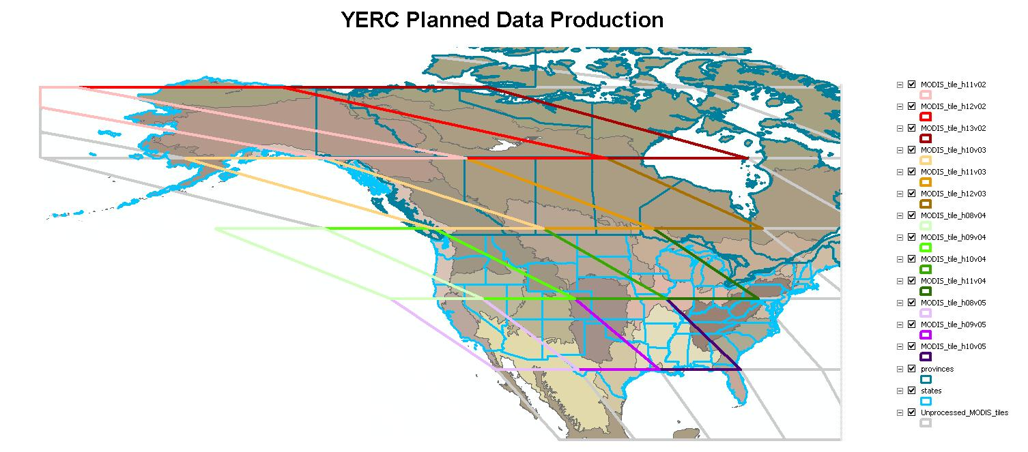
A.30 BioClim: Mid-Continent Study Region
combined Central and Mississippi flyways
MODIS tile coverage of the study area. MODIS data was used to generate many explanatory variables used in analysis & modeling efforts
Notes:
Back to our second project, our A.30 BioClim project… our study site is the mid-continent region. A continental scale study is a good match for new NASA data and data products, many of which we will be producing at a per MODIS tile basis using a variety of modeling approaches to get at a variety of temporally-dynamic covariates … We are in data production mode now for those needed covariates…

Slide 5
Goals/Hypothesis
End-user applications science goal(s):
Provide needed tools and techniques for ecosystem assessments and to quantify environmental impacts (e.g., climate, land use, harvest, invasives) on species populations
Create and increase access to those environmental datasets needed (e.g., NASA data) to understand cause & consequence; avoid DEFICIENT MODELS and errors of attribution leading to…
Science question(s): — with hypotheses regarding mistiming strategies
(3) Can we predict [migratory] species movements in response to climate disruptions and other related disturbance impacts?
(4) What are the past, present, and future demographic consequences of these combined impacts and movements?
Notes:
We have both application goals and science questions with many embedded hypothesis regarding migration strategies… the two really should go hand-in-hand because both the AHM and our diagnostic modeling simultaneously lead to decision-making while testing scientific hypotheses. These are general questions with many hypotheses embedded in our multi-model testing framework using many metrics including Information-theoretic approaches to simultaneously test hypotheses AND provide decision-making outcomes—such as management (harvest) decisions and habitat/wetland restoration programs and adaptation strategies. Must be pointed our overarching goal is to sustain resilient populations…. that implies temporally dynamic datasets—the BIGGEST CHALLENGE OF OUR PROJECT and for population analysis in general…

Slide 6
Goals/Hypothesis
End-user applications science goal(s):
Provide needed tools and techniques for ecosystem assessments and to quantify environmental impacts (e.g., climate, land use, harvest, invasives) on species populations
Create and increase access to those environmental datasets needed (e.g., NASA data) to understand cause & consequence; avoid DEFICIENT MODELS and errors of attribution leading to…
Science question(s): — with hypotheses regarding mistiming strategies
(3) Can we predict [migratory] species movements in response to climate disruptions and other related disturbance impacts?
(4) What are the past, present, and future demographic consequences of these combined impacts and movements?
Notes:
OK, let’s look at tools and techniques capable of manipulating enormous temporally dynamic datasets over large ecosystems/regions.

Slide 7
Overview of Species Decisions Tools
(called EAGLES: Ecosystem Assessment, Geospatial Analysis, and Landscape Evaluation System)
EAGLES Tools
Management Decision-Question
Geospatial Data WIKI
Interpretation & Decision Making
COASTER (web & ArcGIS)
Covariate Data Integration
Exploratory Data Analysis
RRSC or ‘Risk’ models
What-if-Scenarios (EF)
free use/download at www.yellowstoneresearch.org
Notes:
The original tools and techniques collectively called EALGES tools were developed as part of previous NASA and NSF awards. The form a processing chain leading that carefully build diagnostic models capable of prediction. All free if you have: ArcGIS, a computer, and access to the internet—and fairly user-friendly. Most were updated as part of this project and we built three additional tools…

Slide 8
Three new EAGLES toolsets
Temporal Regression Tools – for analysis of time-series datasets to detect and map trends, goodness-of-fit for size effects.
CASA_Wetlands_Mountains* – modified CASA to use Landsat and MODIS data in highly variable landscapes using a sub-gridded approach.
ATV (Access To Validation) – initial design to create an agency crowdsourcing site for model validation and monitoring datasets.
*this new version of the CASA model is proprietary but its products are free

Slide 9
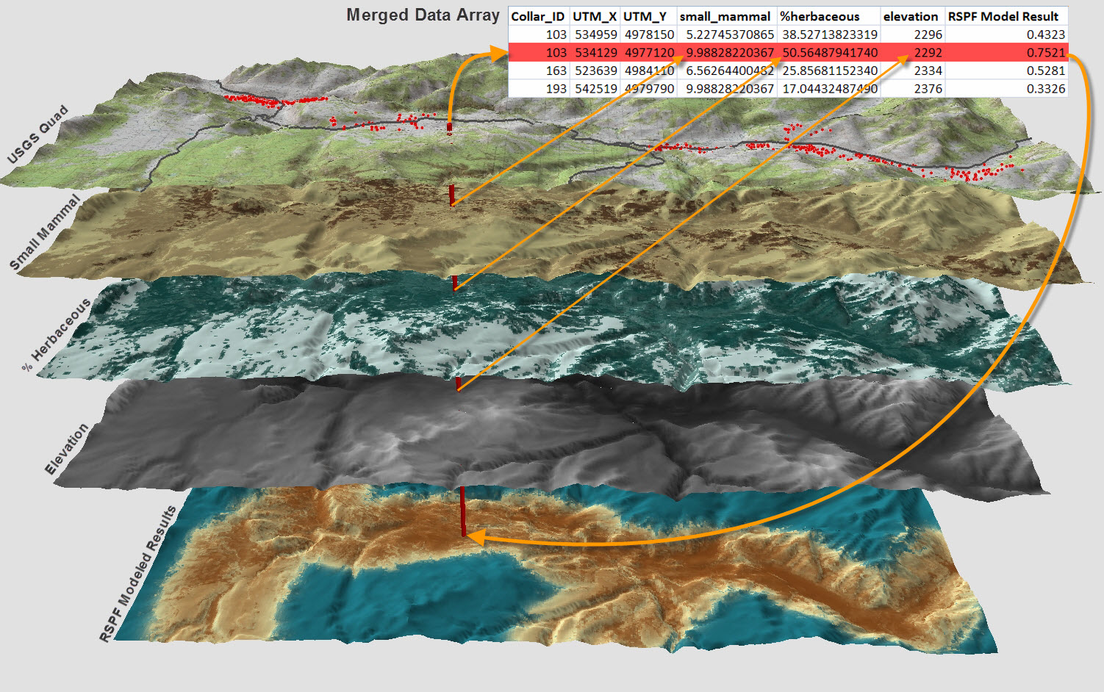
Visual MDA and Model Output
Example: Resource Selection Analysis (RSF tool)
Merged Data Array
1
2
3
4
=
Model prediction
Single point ‘drilling down through’ data layers is basis for all modeling approaches
Notes:
Here is a visualization of about 80% of the work flow process—merging species observations (red dots) with NASA covariates layers (explanatory variables). As many of you know, is tedious, complex, manifold, and in too many cases more of an art than a science. So rather than a whole lot of ONE-OFFS, we decided to engage our federal agency assessment team, listen to their specific needs—careful not to impose our own constraints—and then carefully develop the TOOLS to standardize the workflow and make it transparent and rigorous so that land management agencies can do the analysis themselves. --No small task—

Slide 10
Goals/Hypothesis
End-user applications science goal(s):
Provide needed tools and techniques for ecosystem assessments and to quantify environmental impacts (e.g., climate, land use, harvest, invasives) on populations
Create and increase access to those environmental datasets needed (e.g., NASA data) to understand cause & consequence; avoid DEFICIENT MODELS and errors of attribution leading to…
Science question(s): — with hypotheses regarding mistiming strategies
(3) Can we predict [migratory] species movements in response to climate disruptions and other related disturbance impacts?
(4) What are the past, present, and future demographic consequences of these combined impacts and movements?
Notes:
What took the most time in our project was the creation of temporally dynamic environmental datasets OR ecosystem metrics that can be divided into 2 related functions . . . . .

Slide 11
Temporally Dynamic Variables (n=77)
Climate: TOPOMET (daily, 1 km, 1950-2009); t-min, t-max, precipitation, solar radiation, VPD; other NCEP datasets
MODIS data products: existing + Percent Surface Water (PSW)—fraction of H₂0 w/in 500m every 8 days
Freeze-thaw (AM, PM, and transition); NTSG datasets
Ecosystem modeled (CASA): NPP, litter biomass, ET/PET, soil moisture (4 levels), water stress, SWE, snowmelt
Annual Disturbance (250m binary); forest/non-forest fire, wetland gain/loss, etc.
. . . providing direct, easy access to standardized datasets to avoid deficient and biased models for terrestrial species
Notes:
We have come up with a fairly standard set of temporally dynamic variables, many of which have been used in many of the species data sets we analyzed, and are producing them at various resolution across the continent. Those in red are what our agency partners are telling us to include at this point for waterfowl and initial analysis suggests they are important ... Mention that most of these will be posted very soon on COASTER for direct access and manipulation.

Slide 12
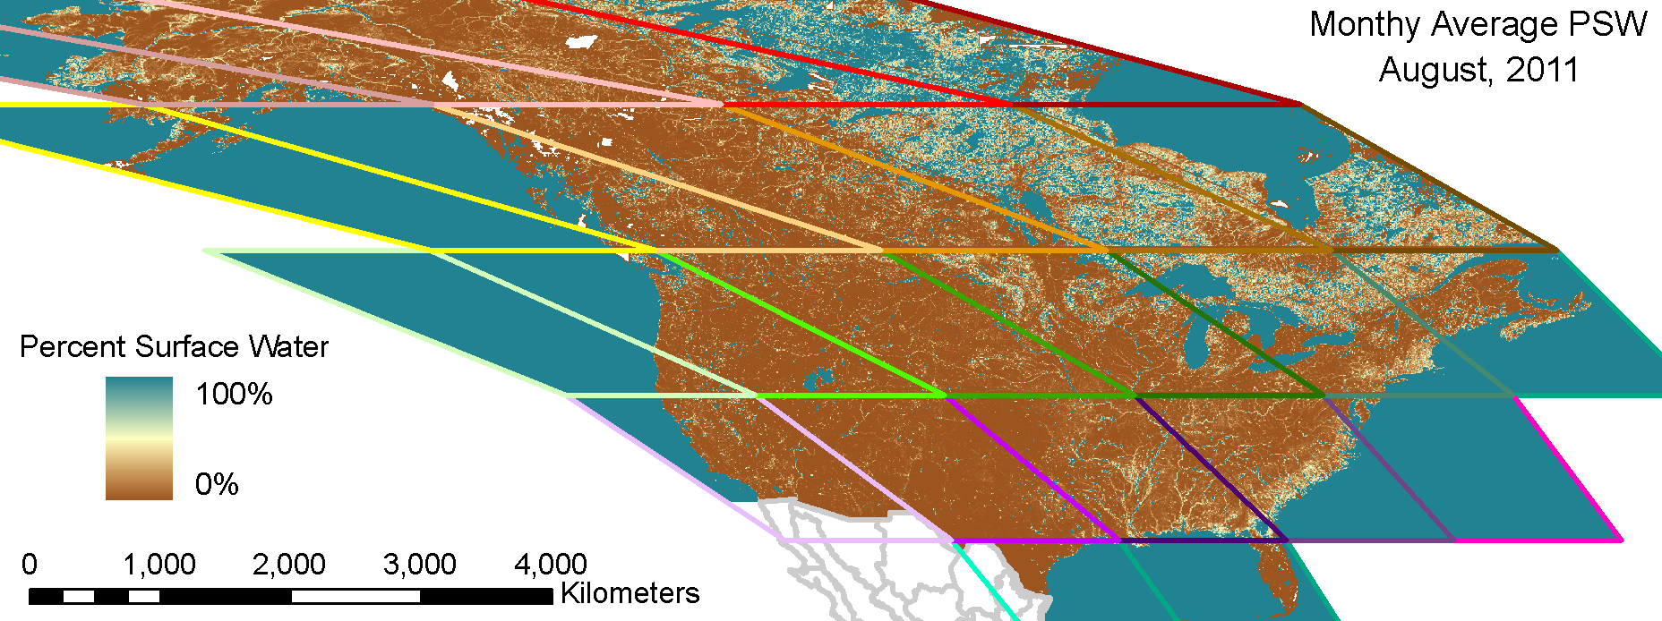
Adjusted PSW Model Results at 500-m every 8-days
Notes:
This is actually a mosaiced image for a single date, just over 1GB in size.

Slide 13
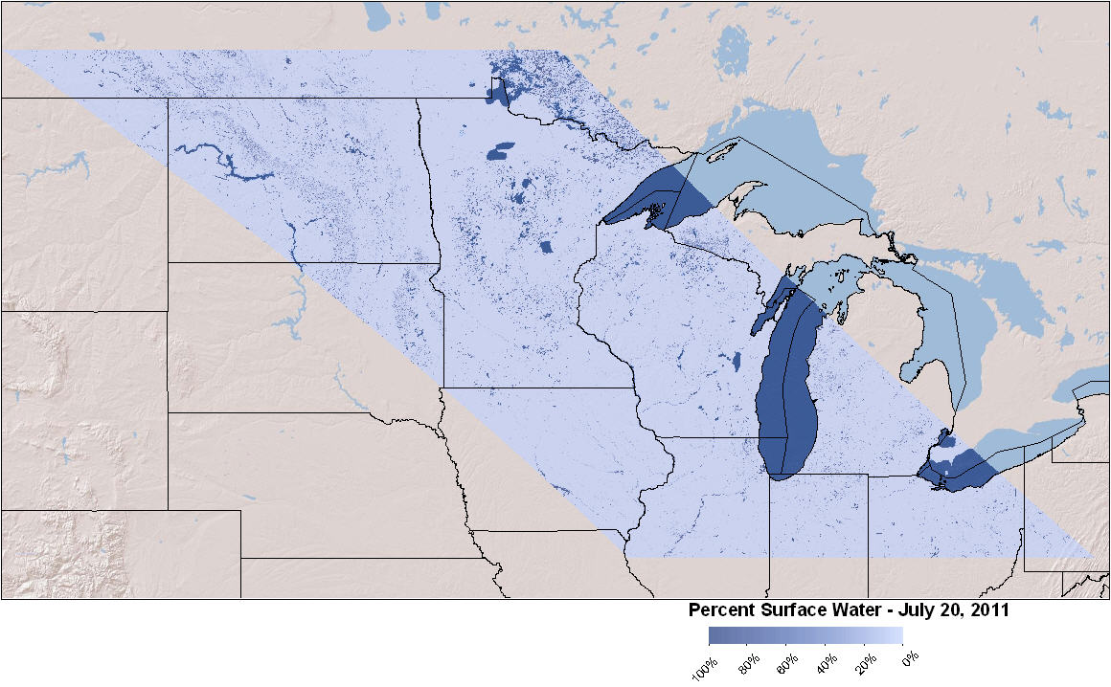
Example Results (Single Tile/Date)

Slide 14
Model Validation (Single Tile)
Landsat Date | Validation Accuracy | Validation Kappa | Measured PSW | MODIS date | PSW R² | PSW RMSE
2001_274 | 0.9876 | 0.9752 | 1.10% | 2001_173 | 0.849 | 3.22%
2002_183 | 0.9754 | 0.9507 | 1.37% | 2002_185 | 0.679 | 4.85%
2002_184 | 0.9522 | 0.9043 | 7.30% | 2002_185 | 0.752 | 9.93%
2002_195 | 0.9794 | 0.9588 | 6.56% | 2002_193 | 0.805 | 8.75%
2002_236 | 0.9236 | 0.8473 | 12.44% | 2002_233 | 0.881 | 10.11%
2005_157 | 0.9095 | 0.8190 | 1.66% | 2005_161 | 0.655 | 5.36%
2005_200 | 0.9740 | 0.9457 | 7.38% | 2005_201 | 0.954 | 5.15%
2005_219 | 1.0000 | 1.0000 | 13.84% | 2005_217 | 0.948 | 7.23%
2007_122 | 0.9880 | 0.9760 | 7.45% | 2007_121 | 0.886 | 7.56%
2008_132 | 0.9738 | 0.9476 | 6.36% | 2008_129 | 0.716 | 10.39%
2008_196 | 0.9777 | 0.9554 | 6.11% | 2008_193 | 0.856 | 7.26%
2008_260 | 0.9855 | 0.9710 | 5.96% | 2008_257 | 0.758 | 9.45%
2010_197 | 0.9960 | 0.9920 | 5.04% | 2010_201 | 0.884 | 7.24%
2011_164 | 0.9980 | 0.9960 | 3.42% | 2011_161 | 0.579 | 5.87%
2011_229 | 0.9940 | 0.9880 | 6.54% | 2011_233 | 0.802 | 9.89%
2011_244 | 0.9980 | 0.9960 | 3.60% | 2011_241 | 0.701 | 4.60%
2011_248 | 0.9920 | 0.9840 | 6.22% | 2011_249 | 0.791 | 9.67%
2011_254 | 0.9940 | 0.9880 | 7.75% | 2011_257 | 0.903 | 7.75%
Mean Values |  |  |  |  | 0.800 | 7.46%
Notes:
This is the accuracy assessment for tile h11v04.
The validation accuracy and kappa values relate to the quality of the validation dataset (i.e., the Landsat water/not-water classification). The validation data were re-scaled to 500m to match the PSW model results. The rescaled validation data and the PSW model results were then compared statistically to show their R-square value as well as the Root Mean Squared Error (RMSE). RMSE indicates the average difference (regardless of sign) in percent surface water between the validation data and the PSW model output.

Slide 15
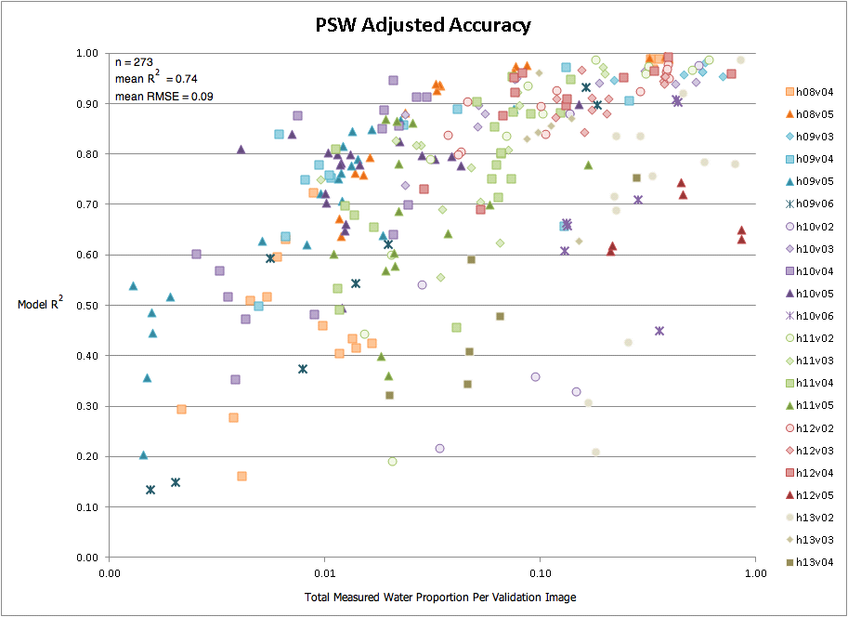
Model Validation (All Tiles)
Notes:
The adjusted model is better than the raw model, particularly in areas where open water is scarce on the landscape.

Slide 16
CASA for Wetlands and Mountains validation
using Ameriflux eddy flux tower measurements.

Slide 17
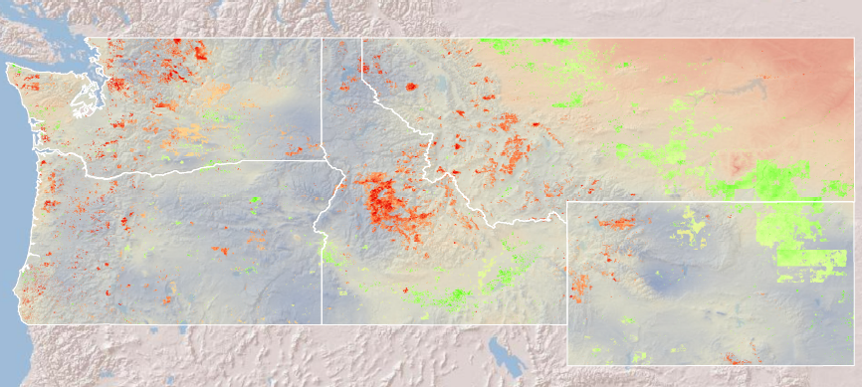
Ecosystem Assessments in COASTER
(Customized On-line Aggregation and Summarization Tool for Environmental Rasters)
Analysis of drought impacts in the Northern Rockies using NPP responding to temp/precip.
Changing Onset of Green-up (a predictive model)
Changing Snow-Rain Transition Zone
Early trend detection in Alaska
Your own analysis on-line . . . . the first analysis took 37 model runs with ingestion into ArcGIS—a total of 6 hours from start to finished product/report for end-users & agency partners
see www.coasterdata.net
Weiss et al. 2013
Notes:
COASTER is not just a data download site but has huge enormous functionality to conduct your own ecosystem assessments . . .

Slide 18
Goals/Hypothesis
End-user applications science goal(s):
Provide needed tools and techniques for ecosystem assessments and to quantify environmental impacts (e.g., climate, land use, harvest, invasives) on species populations
Create and increase access to those environmental datasets needed (e.g., NASA data) to understand cause & consequence; avoid DEFICIENT MODELS and errors of attribution leading to…
Science question(s): — with hypotheses regarding mistiming strategies
(3) Can we predict [migratory] species movements in response to climate disruptions and other related disturbance impacts?
(4) What are the past, present, and future demographic consequences of these combined impacts and movements?
Notes:
Science questions/hypothesis tests within the AHM structure . . . . We have been building large nested MDA with various statistical models with a Generalized Linear Mixed Model (GLMM) framework. This is all prior to actually proposing to modify the AHM for mallards and other waterfowl species. Our approach is to test covariates individually and combined in many preliminary diagnostic models then make predictions and projections using climate and other impact scenarios. We began this whole approach with a test data set on lesser scaup at Yukon Flats National Wildlife Refuge.

Slide 19
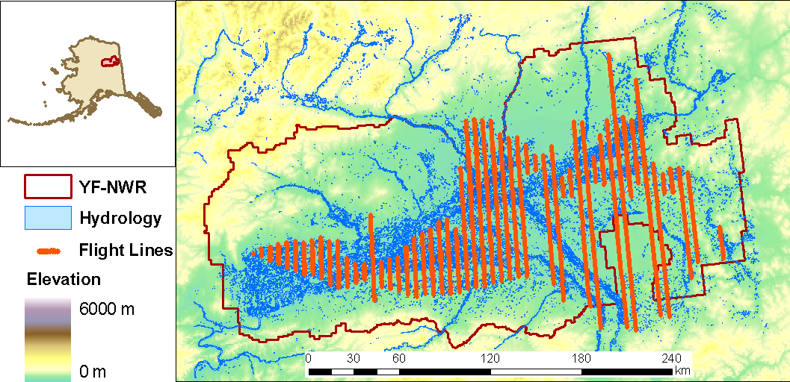
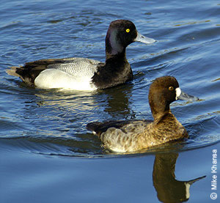
Example 2: Lesser Scaup Response to Climate
Aerial observations from 2001 to 2009
First built a traditional habitat model using static covariates:
  - Preferred emergent wetlands and bigger, more round ponds
  - Preferred still water over turbid water; avoid wooded wetlands
Model | AIC score
GLM (negative binomial) | 21701
GLMM (negative binomial) | 21708
GLM (negative binomial) including Min. Temp. Anomaly | 21697 ** Best Model
* Then added minimum temperature anomaly
Notes:
We got our feet wet with waterfowl data by analysis of a 9 year data set from Yukon Flats NWR in Alaska to examine why lesser scaup have been declining. Major challenge in dealing with both spatial and temporal variability. Are analysis concluded that mistiming is indeed ocurring—early warming leading to declines; cooler weather leading to increase and ability to adapt (move, relocate, adaptive foraging). The analysis also highlights the major need for temporally-dyanmic variables in population analysis, even habitat and SDMs!

Slide 20
POND MODEL
Predictors of pond(t+1) | Spatial autocorrelation | AICc | delta AICc
pond(t) | none | 1186.64 | 1186.64
 | in both | 940.32 | 940.32
pond(t), climate (annual) | none | 978.94 | 978.94
 | in both | 809.58 | 809.58
pond(t), climate (Apr-May) | none | 1165.05 | 1165.05
 | in both | 926.05 | 926.05
pond(t), climate (winter-spring) | none | 1161.60 | 1161.60
 | in both | 925.38 | 925.38

Slide 21
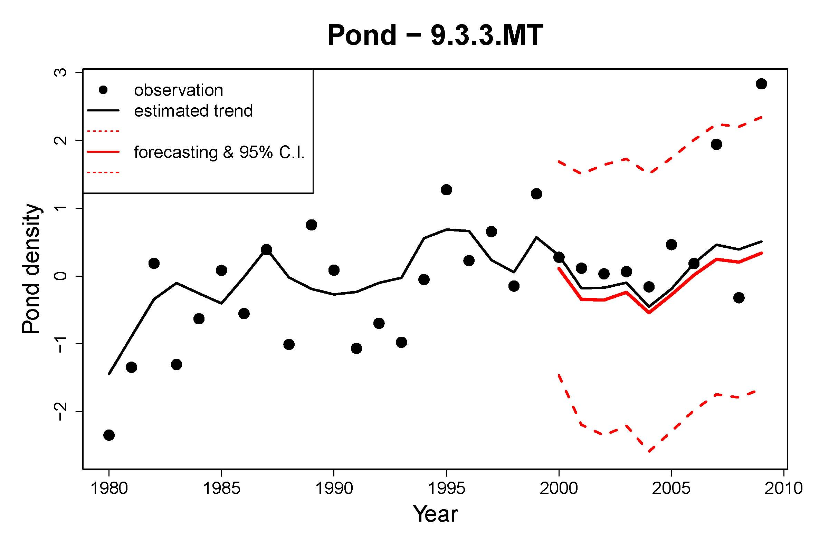
POND FORECAST MODEL

Slide 22
A Multivariate Auto-Regressive State-Space (MARSS) model to understand factors driving the spatio-temporal variation of waterfowl populations, takes the form:
x(t) = B x(t−1) + u + C c(t) + w(t) , where w(t) ~ MVN(0, Q) (1.1a)
y(t) = x(t) + v(t) , where v(t) ~ MVN(0, R) (1.1b)
x(0) ~ MVN(pi, L) (1.1c)
in which x is the latent population status, c is the time varying covariates(pond, Percent Surface Water, precipitation, and temperature), and y is the observed population density (at log scale). B, u, C, Q, R, and pi are the parameters to estimate. Note that in the formulas lower case letters are vectors and upper case letters are matrix. Spatial auto-correlations are considered in Q and R (but not in B, C). B, C, and L are diagonal matrices, and the diagonal entries of L are set to 1 (thus x(0) is considered as fixed and unknown elements). The model thus is a AR(1) model which allows the parameters to vary between areas. EM algorithm is applied to calculate maximum-likelihood estimates of the parameters of interest.

Slide 23
Initial Results - Mallard
Predictors of Nt+1 | Spatial autocorrelation | AICc | delta AICc
Nt | none | 123.57 | 123.57
 | in both | 142.91 | 142.91
Nt, pond | none | 183.92 | 183.92
 | in both | 242.46 | 242.46
Nt, psw (raw) | none | 206.10 | 206.10
 | in both | 268.43 | 268.43
Nt, climate (annual) | none | 310.08 | 310.08
 | in both | 472.36 | 472.36
Nt, pond, climate (annual) | none | 599.80 | 599.80
 | in both | 999.01 | 999.01
Nt, psw (raw), climate (annual) | none | 632.84 | 632.84
 | in both | 1057.08 | 1057.08

Slide 24
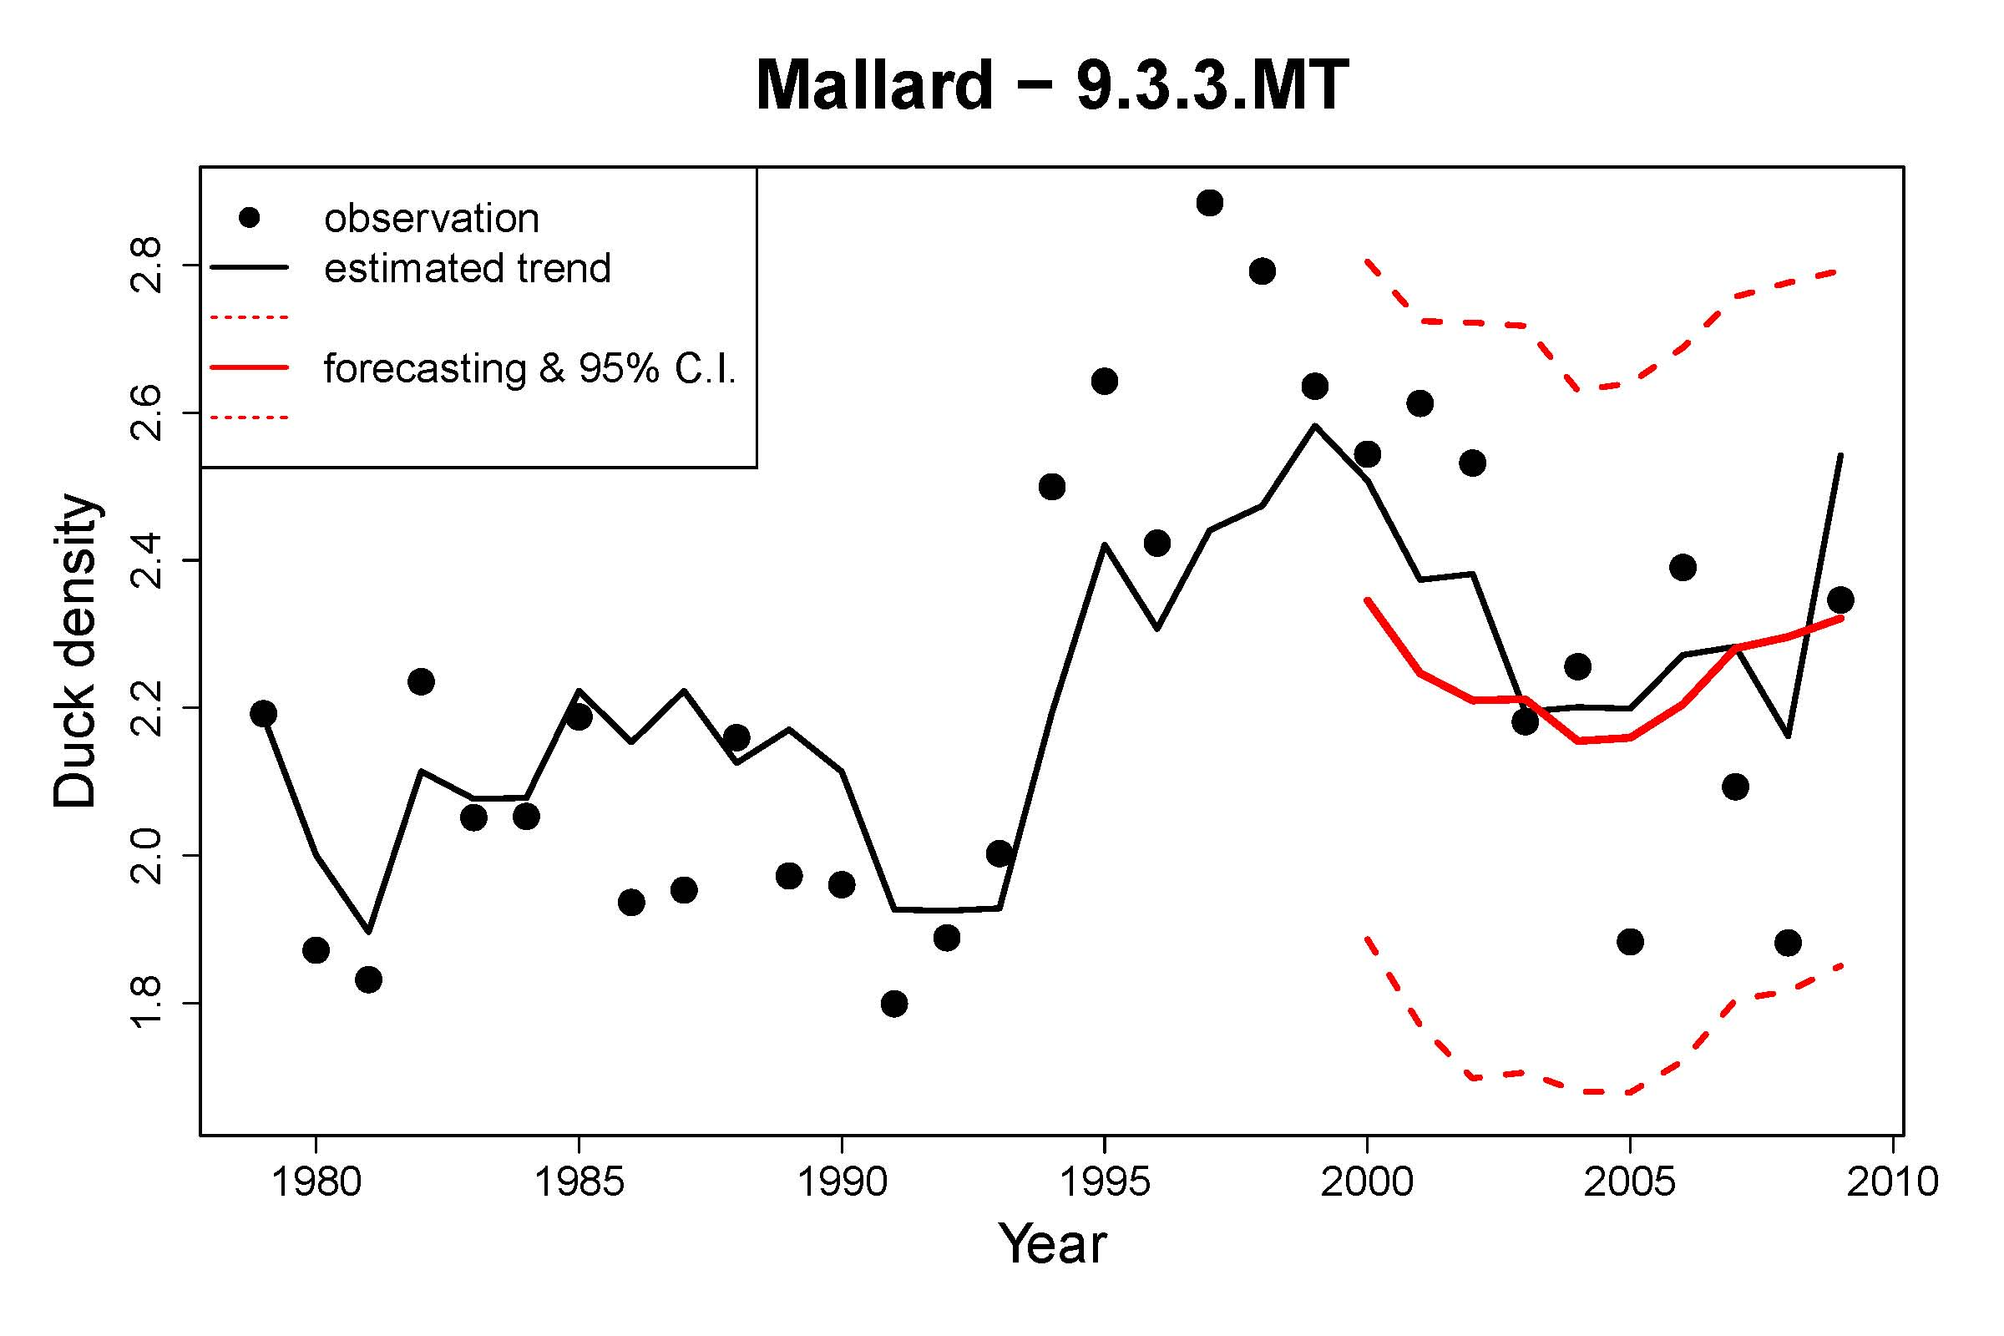
MALLARD FORECAST

Slide 25
Final Preliminary Model Results
Predictors of Nt+1 | Spatial | AICc | delta AICc |  | AICc | delta AICc |  | AICc | delta AICc
 |  | Mallard |  |  | Blue-winged Teal |  |  | Northern Pintail
Nt, psw (raw), climate (annual) | none | 632.84 | 632.84 |  | 853.75 | 853.75 |  | 1006.93 | 1006.93
 | in both | 1057.08 | 1057.08 |  | 1253.91 | 1253.91 |  | 1561.27 | 1561.27

Slide 26
Left to do…
Preliminary modeling nearly completed
Conduct ecosystem assessment of mid-continent region for consideration of further covariates in a modified model structure
Conduct final analysis of 2000-2011 datasets to create predictive model for forecasting future climate scenarios and impacts.

Slide 28
General EAGLES Workflow Architecture
Modeling Options
Ecosystem Assessments
Focal Species (RRSC)
Future Forecasts
Adaptation Strategies:
Landscape and
Management Plans
Track 1
Environmental Geospatial Data (explanatory)
How can we develop rational, evidence-based decisions
for adaptation strategies to environmental change?
Notes:
You might be interested in just the environmental data layers about changing habitat conditions and want to know what factors are driving that change. We developed a number of tools to work with ArcGIS to conduct such habitat analysis and ecosystem assessments, for example, the impacts of climate and disturbance on the landscape.

Slide 29
General EAGLES Workflow Architecture
Track 2 – Modeling species populations
Species legacy
datasets (response)
Modeling Options
Ecosystem Assessments
Focal Species (RRSC)
Future Forecasts
Adaptation Strategies:
Landscape and
Management Plans
Environmental Geospatial Data (explanatory)
How can we develop rational, evidence-based decisions
for adaptation strategies to environmental change?
Notes:
We designed this generalized workflow and build many tools to do the work in an efficient manner based on the input from end-users (you) and experience from analysis of many species datasets. In this software system of many tools, you merge your species observations or legacy data sets with their corresponding environmental data layers, OR what we call the geospatial data products, to learn—USING ONE OF MANY MODELING OPTIONS—why your trust resources are changing, for example, what factors might account for a declining population. You can then use your models to forecast future scenarios of climate change, habitat restoration, or the outcome of any number of single or multiple impacts OR what if scenarios ALL leading to informed site-level decisions. A nice feature of EAGLES is it’s flexibility… for example, you don’t need a species data set….

Slide 30
Bottom line:
Identification of, and Access to (probably have to create them) the needed covariates
Lessons from working groups, experts, and literature
Lessons from analysis of 17 time series species datasets
Thinking like the species you’re modeling, the right:
  Spatial scales (maybe many)
  Temporal window(s) and resolution
A full or complete model?
Avoid deficient models at all costs (errors of attribution)

Slide 31
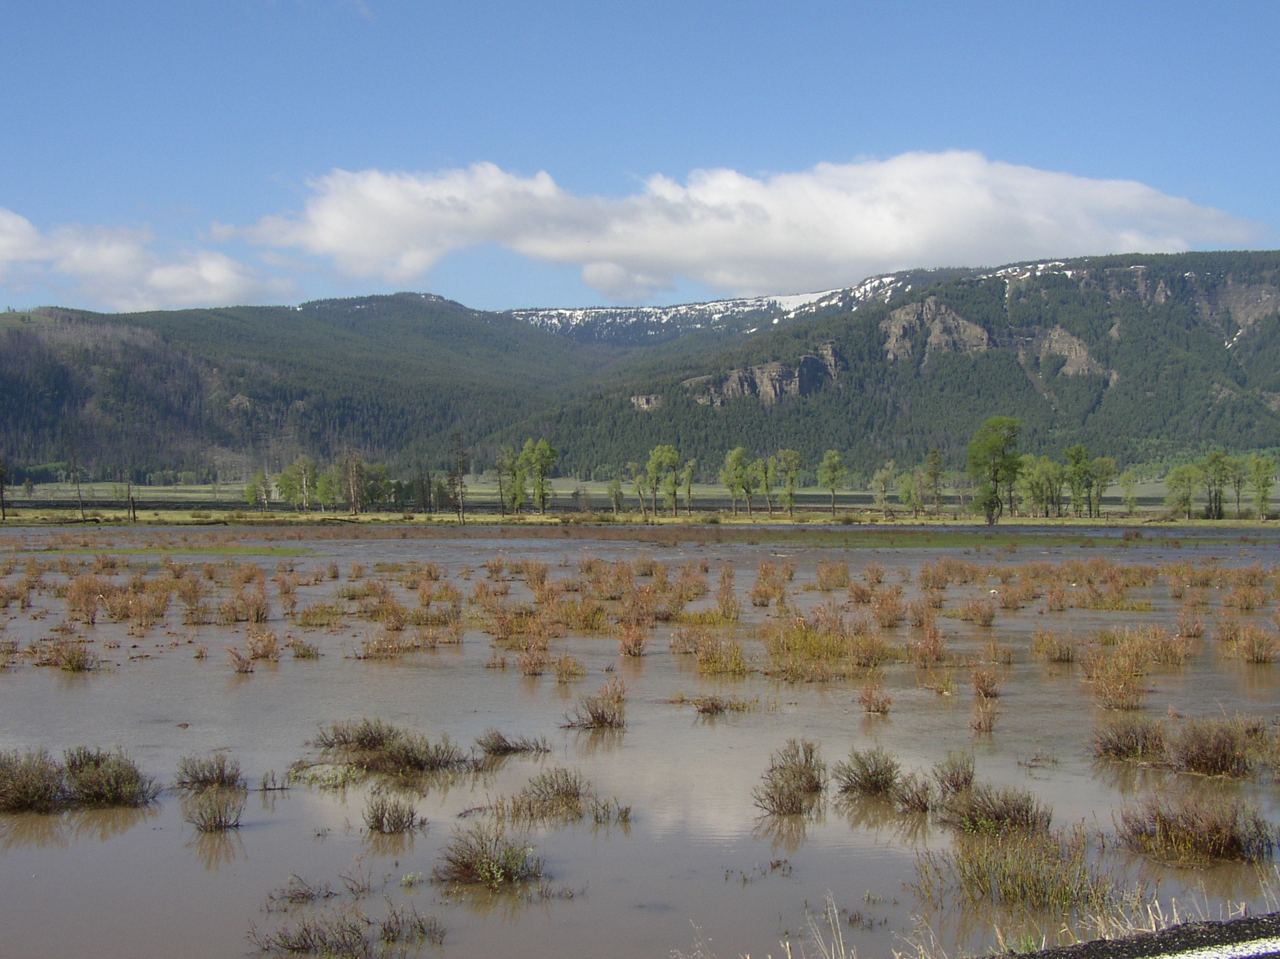
BTW, how do wolves cause seedling establishment ?
Notes:
Yes, many factors besides wolves have caused ecosystem change in Yellowstone. And don’t get me started on errors of attribution— that is, pinning all changes on wolves. Or claiming it’s climate change when in fact, species respond primarily to habitat changes possibly caused by climate.

Slide 32
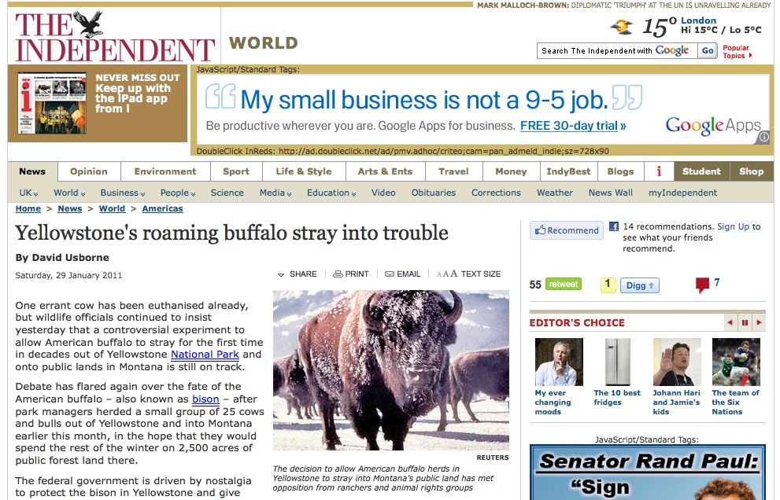
Example 1: Getting started with migratory species: Yellowstone Bison
What are the determinants (predictors) of when bison leave the park during winter?
And can we use them to predict movements to engage in management actions?
Notes:
Another example: would you build a predictive model of bison movement or habitat use during the winter without explanatory variables like snow and forage?

Slide 33
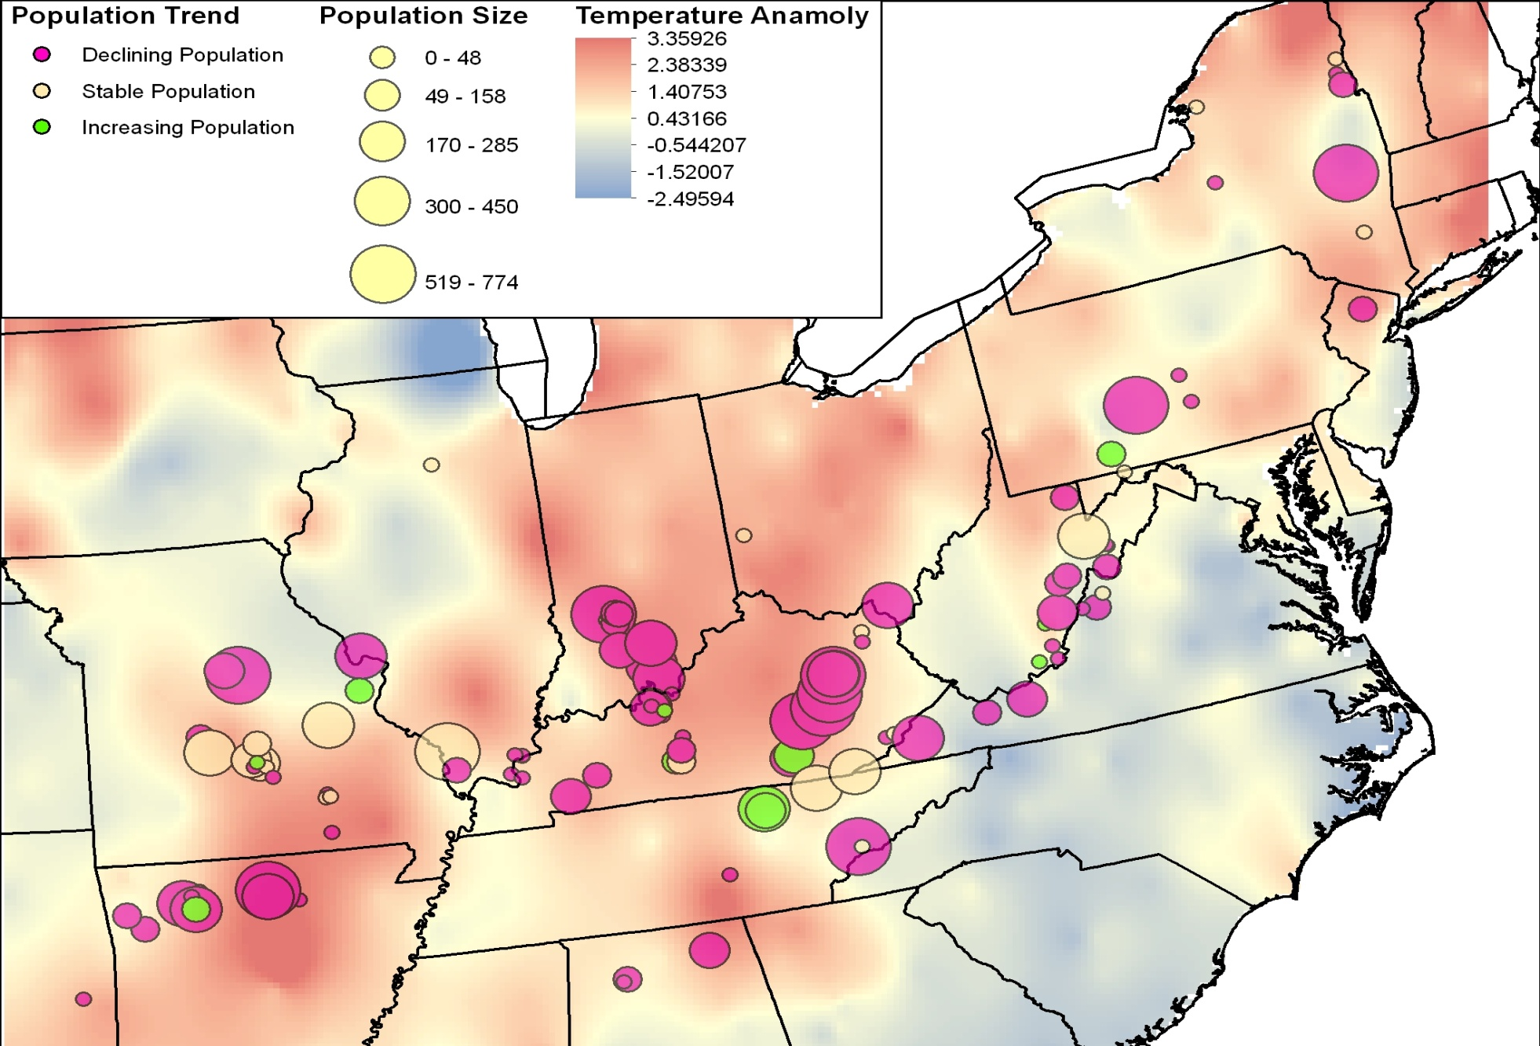
Example 3: 30-year spatio-temporal I-Bat analysis
30-yr anomaly trend against year 2000 via COASTER

Slide 34
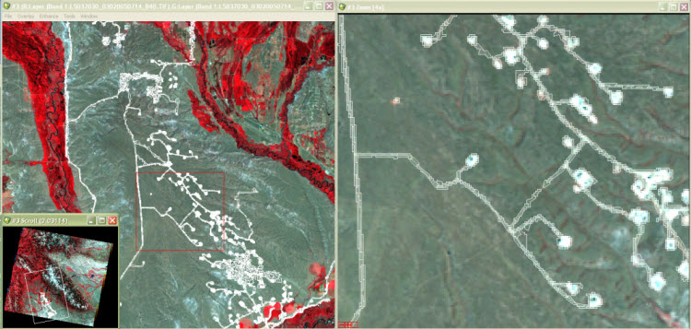
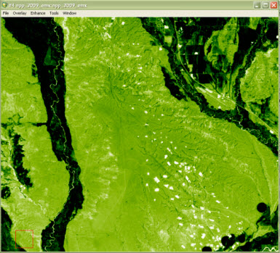
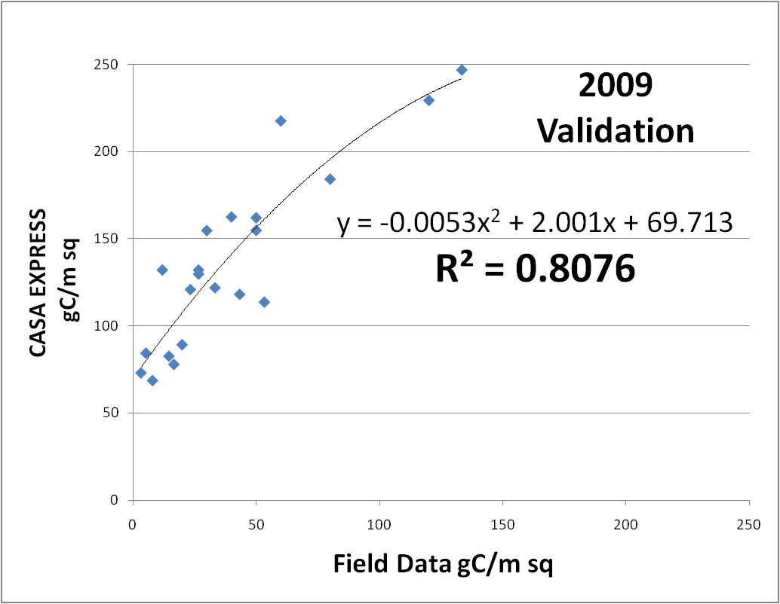
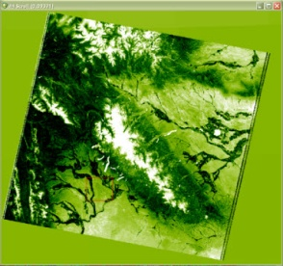
12 years of data layers for Sage Grouse analysis, Wyoming
Roads & Drill Pads
30 meter resolution
Forage Biomass (gC/m²)
Notes:
Often it’s not the sufficient resolution, so on another project we had to create accurate maps of roads/drill pads and forage production for each of 12 years, both at 30 meter spatial resolution for analysis of sage grouse habitat use and demography. 28 data layers in all. Just two quick examples to give you an idea of what’s possible. BTW, forage biomass was also a important predictor of chick survival (litter biomass).

Slide 35
General EAGLES Workflow Architecture for species population decision-making
Species legacy
datasets (response)
Modeling Options
Ecosystem Assessments
Focal Species (RRSC)
Future Forecasts
Adaptation Strategies:
Landscape and
Management Plans
NASA and RS Geospatial Data (explanatory)
EAGLES Tools & Work Flow
“Within year (annual) adaptive decision cycle”
?
Potential Outcomes — ‘beyond the honest broker’:
Modification of the aerial survey methodologies
Constraining the Adaptive Harvest Model
Prioritize existing wetland management activities
Notes:
… remember our deliverables to the Service are geospatial data and analysis tools that move these data through the workflow architecture within an ArcGIS environment (that’s EAGLES in a nutshell).
-- Now we are going to go from 10,000 feet here and down to about 1,000 (get into some of the more detailed concepts) to show you how our TOOLS get you, the decision-makers to the end point that addresses our challenge here (point to the challenge question).

Slide 36
Ecosystem Metrics for modeling species:
Combining 2 NASA Projects with
LCC funding added
DECISIONS: Development of Risk-Reward Spatial Capacity Models for use with the USFWS Strategic Habitat Conservation Framework (SHC) LCCs
A.30 BioClim: Ecosystems in Transition: Decision Support Tools to Measure, Monitor and Forecast Climate Impacts on Migratory Species (e.g., waterfowl)
Notes:
Now Woody asked me to address two awards that overlap by one year—and we are currently in that overlap year.
Essentially, the techniques and models developed in the first project HERE (development of spatially-explicit population models for the new DOI Landscape Conservation Cooperative program) are being enhanced and applied (HIT SLIDE CHANGE) …

Slide 37
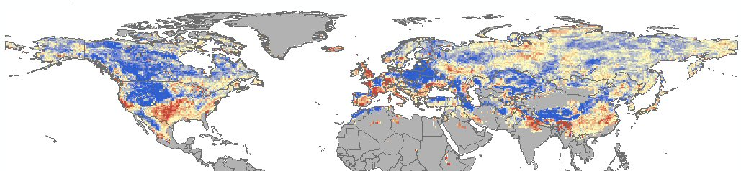

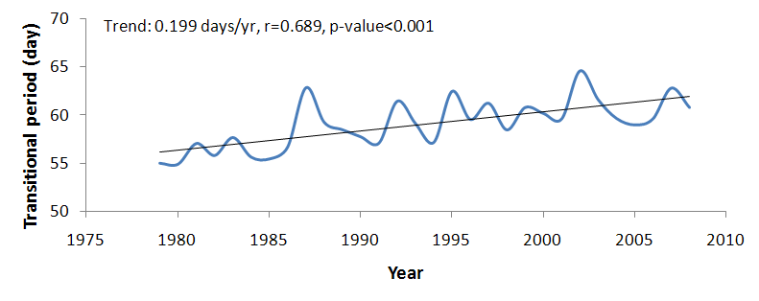
¹Transitional Period Trend (1979-2008)
Days yr⁻¹
Mean Northern Hemisphere trend
Mean Latitudinal Trends
¹Transitional days: AM frozen and PM non-frozen
Notes:
Many ways to capture and test extreme weather events, for example…… variation in freeze/thaw during winter-spring transition has increased nearly one week over thirty years with a north-south reversal in the mid-continent region of NA. Trend for winter (Dec, Jan, Feb) transitional+thaw days is 0.169 days/yr (r=0.673, p<0.001). This has potential significance for reducing winter cold hardiness and increasing potential vulnerability to frost damage. Good for renesting waterfowl and shorebirds but not for inflexible species that require synchronicity—like lesser scaup.

Slide 38
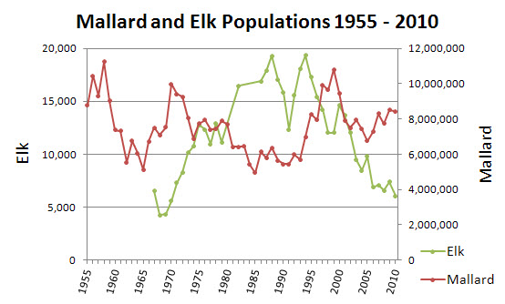
Legacy Data: continuous quasi-experiments
How do we explain this variation in time & space?
What is this variation attributable to?
And what actions should we take?
Notes:
In fact, another way of looking at both projects is: Making the most of out of agencies’ long-term ‘legacy’ data sets to inform management decisions that recover and sustain species populations.

Slide 39
Legacy Data: continuous quasi-experiments
Models: a common language for scientists and practitioners
Y_{ij} = X1_{ij} + X2_{ij} + X3_{ij} + X4_{ij} ....
Response or dependent variable
Explanatory variables… COVARIATES
Notes:
The common language for both practitioners (managers, biologists, conservationists) and scientists: Answer: Models from narrative to quantitative. We need explanations and hypotheses to test, which comes in the form of the explanatory variables or COVARIATES for short. Agencies have oodles of legacy datasets just begging for analysis, however they require covariates that MATCH the temporal variation in response—that is a HUGE challenge. 98% of datasets in databasin.org are static—poorly suited for population or habitat models.
Build diagnostic then predictive models for ECOLOGICAL FORECASTING. How can we first “mine” these species data sets and assign signal to appropriate causal explanatory variables or ‘covariates’, such as: CHANGE SLIDE:
…. For both scientists, practitioners, decision-makers. This generalized modeling approach is the basis for rational, evidence-based decision-making and the ultimate goal and challenge of EAGLES.

Slide 40
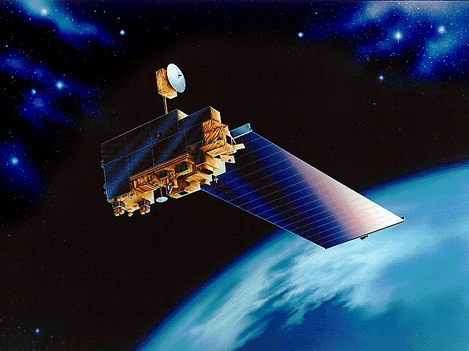
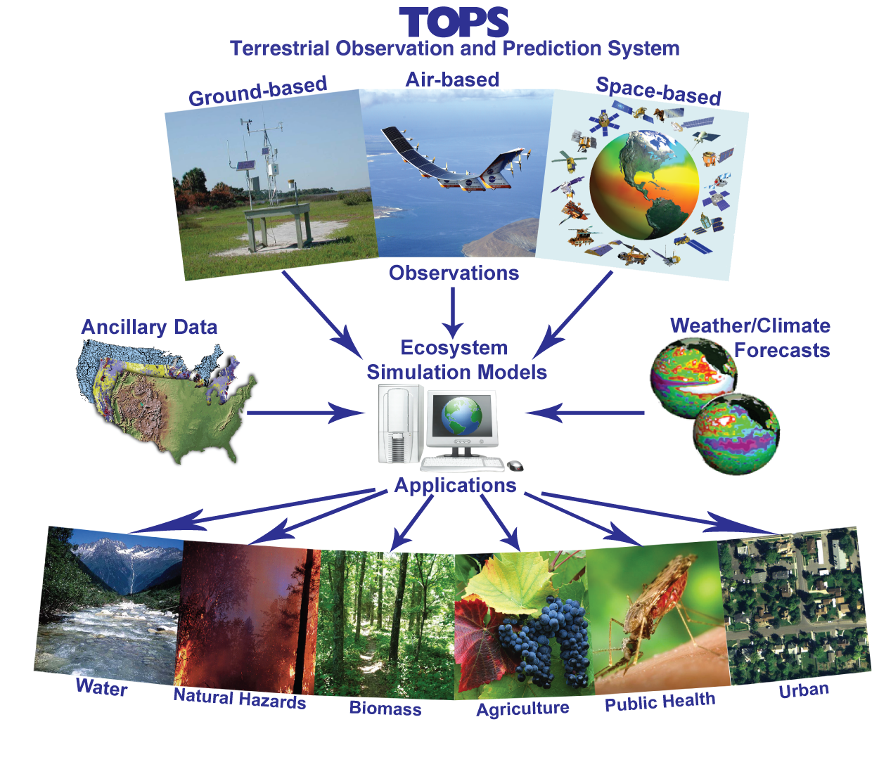
Recent Advances in Remote Sensing
Not just satellites . . .
but remote sensing of all kinds….
Now add IP DSNs (distributed sensor networks)
DATA INTEGRATION (spatial & temporal)
Direct
Indirect
Relative
Fusion
Assimilation Models
Notes:
The partial answer is Remote Sensing, not just new satellite sensors like MODIS that provides coverage of the entire earth daily. I say partial because remote sensing rarely gives us a direct measure of the metric we are interested in—usually always proxies. That’s why we have to use fusion approaches to get at some of them or at least better proxies that can be calibrated and validated. YERC has specialized in deriving new environmental variables—many of them did not previously exist. We’ve used a variety of approaches primarily fusion and mechanistic ecosystem models that assimilate RS data to create…, for example, using the CASA ecosystem model to create wall-to-wall estimates of NPP at 30 m resolution to examine the effects of a 100 year….

Slide 41
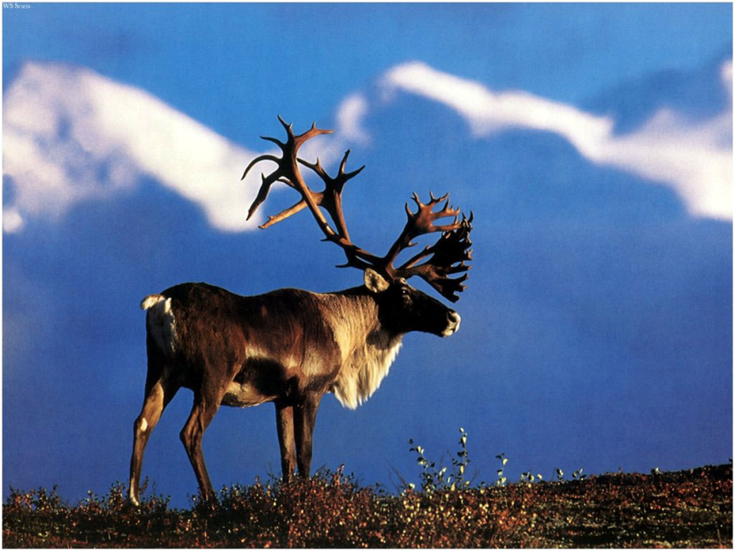
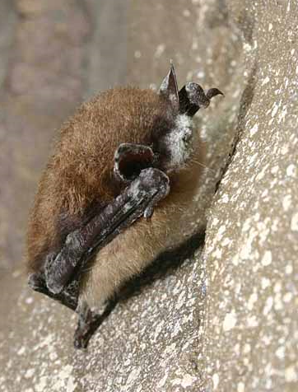
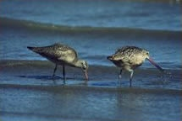
Focal Species (Legacy) Data Sets Analyzed
Bison – migration and habitat
Lesser Scaup – demography w/ climate/water
Indiana Bat – demography w/ climate change
Coyote – habitat and demography
Small Mammals (5 species) – habitat
Red Fox – winter habitat w/ snow dynamics
Elk – habitat with path & memory functions
Sage Grouse – habitat and demography
Pronghorn – demography, recruitment
Pronghorn habitat w/ scenarios
Caribou – habitat and path movements
Evening Primrose – habitat w/ climate scenarios
Swift Fox – habitat with variable availability
Grasshopper Sparrow – habitat
Moose – habitat and path movements
Many factors at many scales . . .
Notes:
Developed our RRSC population modeling framework based on analysis of 17 agency ‘legacy’ or species time-series datasets.

