Slide 1


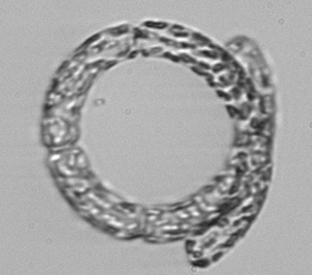


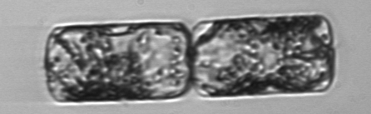
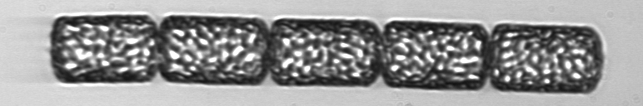
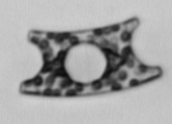
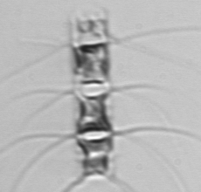

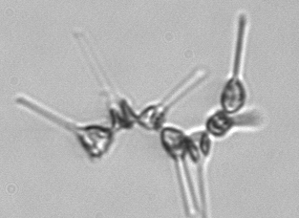
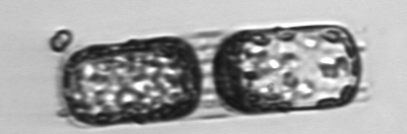
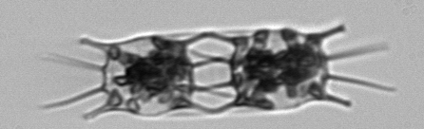
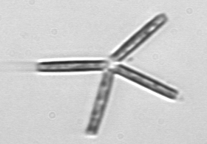

Seasonal to Interannual Variability in
Phytoplankton Biomass and Diversity on the New England Shelf
In Situ Time Series for Validation and Exploration
of Remote Sensing Algorithms
Heidi M. Sosik Hui Feng
Woods Hole
Oceanographic Institution
University of
New Hampshire
Notes:
Good afternoon. My co-PI on this work is Hui Feng at the University of New Hampshire.

Slide 2
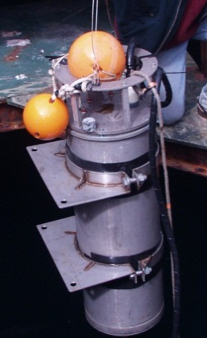
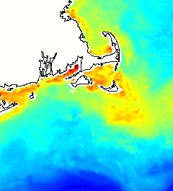


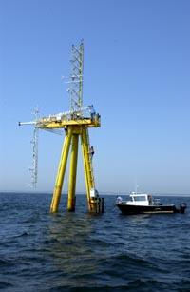


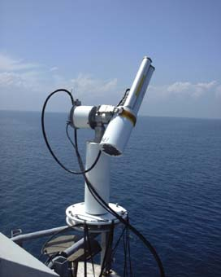
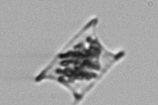


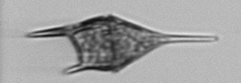
Project Overview
Goal: Use unique time series to evaluate algorithms that extend MODIS ocean color data beyond chlorophyll to functional type or size-class-dependent phytoplankton retrievals
Approach: End-to-end time series observations, with step-by-step algorithm evaluation and error analysis
single cells → phytoplankton community → bulk water optical properties → sea surface optical properties (air and water) → MODIS optical properties
Martha’s Vineyard Coastal Observatory
Tower mounted
AERONET-OC
Submersible Imaging
Flow Cytometry
MODIS products
Notes:
One of our main goals is to evaluate a wide range of algorithms for retrieving phytoplankton functional types from ocean color radiometry in temperate coastal waters. A critical element of our approach is that we have nested, multi-level time series that allow us to examine the links between phytoplankton cells, their contributions to the community and bulk water properties including inherent and apparent optical properties, and ultimately remotely sensed signals.
To do this we are taking advantage of cabled observatory facility on the New England shelf – the Martha’s Vineyard Coastal Observatory or MVCO for short. The offshore tower with power and real time communications at this site make it possible to use demanding automated in situ technologies like submersible flow cytometry and above water radiometry. This study site is also a good choice for this kind of project because it is part of a productive and dynamic system with seasonal and interannual variability in environmental forcing that leads to recurring and fairly dramatic changes in phytoplankton community structure.

Slide 3
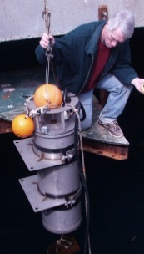
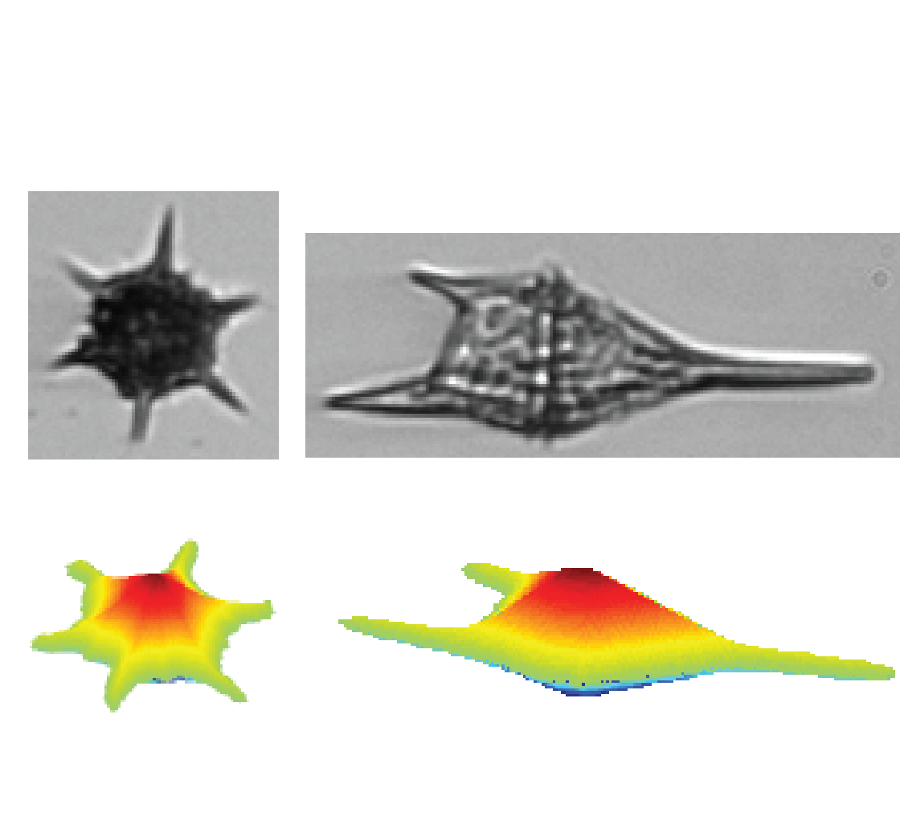
Approach
Phytoplankton Observations
  Single cells to communities
  Biomass, size- and taxon-resolved
Phytoplankton Algorithms
  Absorption spectral shape → size structure
  Diagnostic pigments → size structure
  Diagnostic pigments → taxonomic structure
Notes:
No time to explain in detail how we characterize phytoplankton with submersible flow cytometry – happy to discuss more later. Briefly these instrument measure thousands of individual microscopic cells every hour for months to years. From the measurements we can estimate size structure, biomass, and taxonomic composition.
Update last year I focused on analysis of approaches for remotely detecting size structure. This time address determination of more details about taxonomic composition.

Slide 4
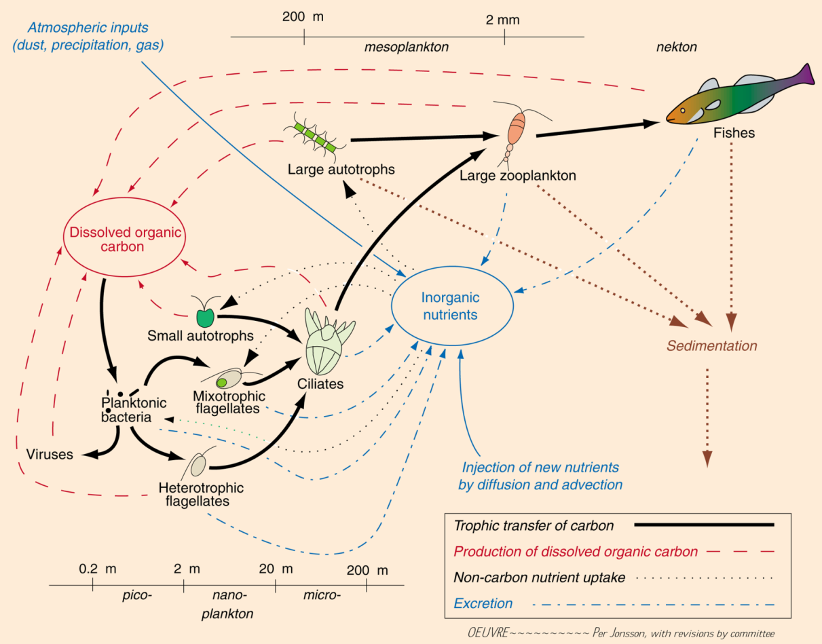
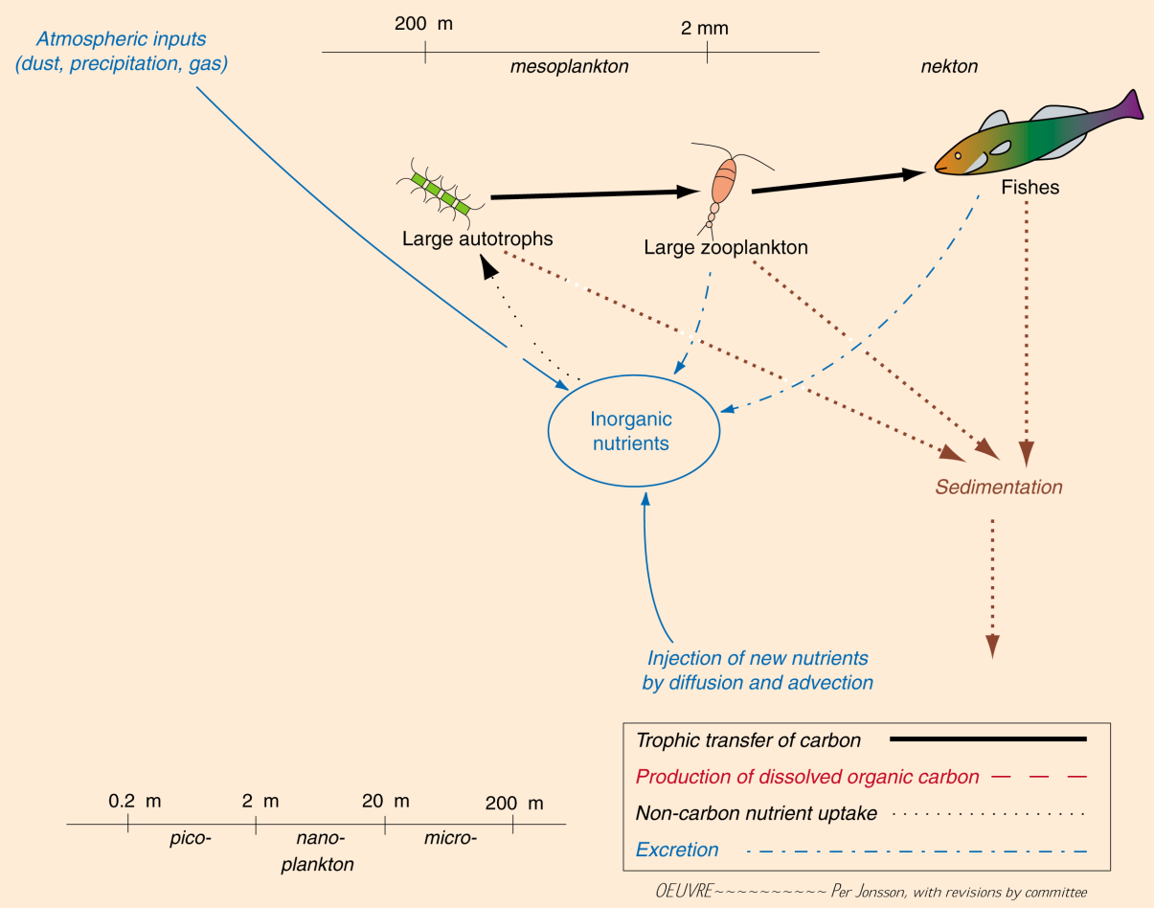
Variability in community structure
.
μ
μ
Diatoms
Cyano-
bacteria
μ
μ
μ
μ
μ
μ
μ
μ
Notes:
This study site provides ideal case for evaluating impt changes in community composition.
Example species specific time series from in situ fcm show that the dominant diatom and the dominant pico-cyanobacterium are consistently out of phase, with reg seasonal shifts in which is more abundant.
These organisms are 2-3 orders of magnitude different in size and are expected to structure different ecosystems, where diatoms typically support relative short food chains and export to higher trophic levels, while picoplankton are part of much larger web of interactions largely recycling.
Seasonal patterns in diatoms and cyanos in genl echo patterns shown by 2 example species.
C:\work\ifcB\code_svn\analyze_by_class\carbon_summary_plots.m
C:\work\ifcB\code_svn\analyze_by_class\SynGuinCarbon.m

Slide 5
Pigment-based retrieval of taxonomic groups
Diatoms
In situ FCM
“CHEMTAX” Mackey et al. 1996
Total Chl a = diatom Chl a + dinoflagellate Chl a + cyanobacteria Chl a + …
with partitioning according to accessory pigment ratios
Notes:
Since the 1990s oceanographers have taken advantage of differences in accessory pigment composition betw taxa to characterize communites.
We have compared this approach to estimates of group-specific biomass from flow cytometry. Pooled across all seasons and years, the two approaches provide similar patterns in diatom biomass.
C:\work\IFCB\code_svn\analyze_by_class\compare_chemtax_fcm.m

Slide 6
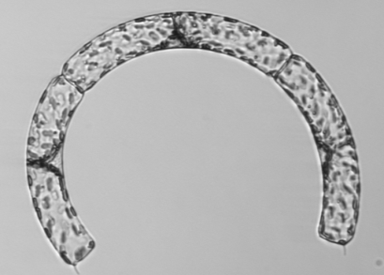
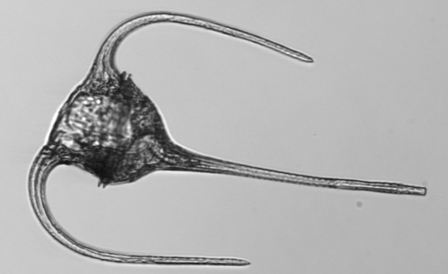
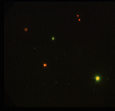
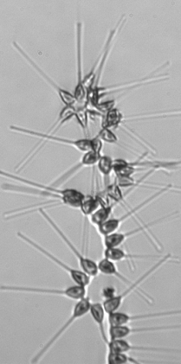
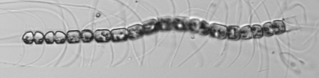
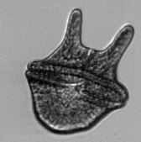
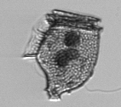







Pigment-based retrieval of taxonomic groups
Diatoms
Dinoflagellates
Cyanobacteria
~1 μm cells
10 μm
Notes:
Dinoflagellates trickier in part due to > evolutionary diversity and assoc pigm diversity, and for cyanos results are well correlated at high biomass but the pigm approach seems to break down at very low concentrations, typical of winter conditions in this system.
Going forward we’ll explore whether some seasonal tuning of pigm approach can help.
C:\work\IFCB\code_svn\analyze_by_class\compare_chemtax_fcm.m

Slide 7
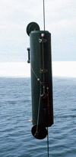
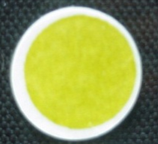
Diagnostic pigment retrieval from Rrs
Pan et al. 2010 band ratio algorithms
Chl a
AERONET-OC
SeaPRISM, R_{rs}(λ)
Discrete samples
HPLC pigment analysis
Notes:
Next step is to explore how well we can retrieve these diagnostic pigm from algs based on Rrs. In this case we’ve started with sea-surface measurements to avoid anything assoc with atm correction or other satellite product issues.
Here we’re showing the band ratio alg of Pan et al. 2010 for total Chla where MVCO match ups fall well within range of obs used to develop alg.
Considering in situ vs. remotely retrieved on linear scale does emphasize systematic underest at high conc.
C:\work\mvco\Discrete_chl\SeaPRISMcomp\

Slide 8
Diagnostic pigment retrieval from Rrs
Pan et al. 2010 band ratio algorithms
Chl a
Fucoxanthin
Zeaxanthin
Notes:
Pan’s algs for fucoxanthin – primary diag pigm for diatoms – and zeaxanthin – primary diag for cyanos – show similar patterns of general agreement at MVCO, but tendency for retrievals to be biased low for higher concs.
C:\work\mvco\Discrete_chl\SeaPRISMcomp\Pan_algorithm_v2.m, Pan_algorithm_v2_fuc.m, Pan_algorithm_v2_zea.m

Slide 9
Seasonality – pigment retrievals
Diatoms
Cyano-
bacteria
Diatom
indicator pigment
Cyanobacteria
indicator pigment
Notes:
Propagate this through to consider impact on seasonal climatologies – here based on MODIS retrievals – we find that seasonality is esp damped in fucox retrievals compared to in situ. The in situ pigm patterns echo seasonal dynamics implied from cell analysis by fcm.
We are currently looked at regional data to explore whether this problem is specific to MVCO or more gen’l.
C:\work\mvco\MODIS\fromHui_Jun2011\seasonal_plots.m

Slide 10
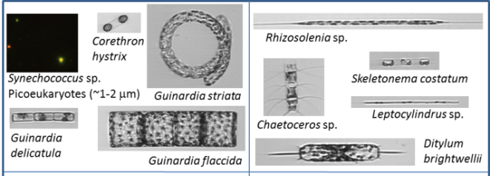
Ecosystem characterization
Cyanobacterium
Diatoms
Taxa with positive response to warmer winters
Taxa with negative response to warmer winters
Interannual variability – taxon specific
Seasonally adjusted
Biomass anomalies vs Temperature anomalies
Notes:
Conclude by emphasizing aspect of why we are interested in being able to make these kinds of functional group characterizations.
We have been analyzing patterns of interann var. Here I’m just showing examples for 3 taxa in mid-winter. Seasonally adj biomass anomalies in Syn, pico cyano, are correl with temperature anomalies. Such that anomalously warm winters favor much higher pico biomass. While diatoms have variable respsonses – some like Corethron are favored like Syn, while other such as Ditylum are favored by colder winters.
Extend to other species and ID groups of species favored by warmer winters as well as those with neg response to warmer conditions. Suggests hypotheses about possible long term trends with continued warming.
C:\work\ifcB\code_svn\analyze_by_class\syn_anomaly_trend.m

Slide 11
Ecosystem characterization
Decadal increase in pico-cyanobacteria at MVCO
Local detail
→ Trends and patterns of change
→ Regional to basin scales
Notes:
In fact records long and detailed enough that we can now detect just this kind of trend in Syn.
Seasonal and interann var is very high, but seasonally adjusted anomalies shows v. strong pos trend over last decade.
We want to use RS data with quantified uncertainties to explore how this kind of local detail may scale up to similar regional responses.

Slide 12
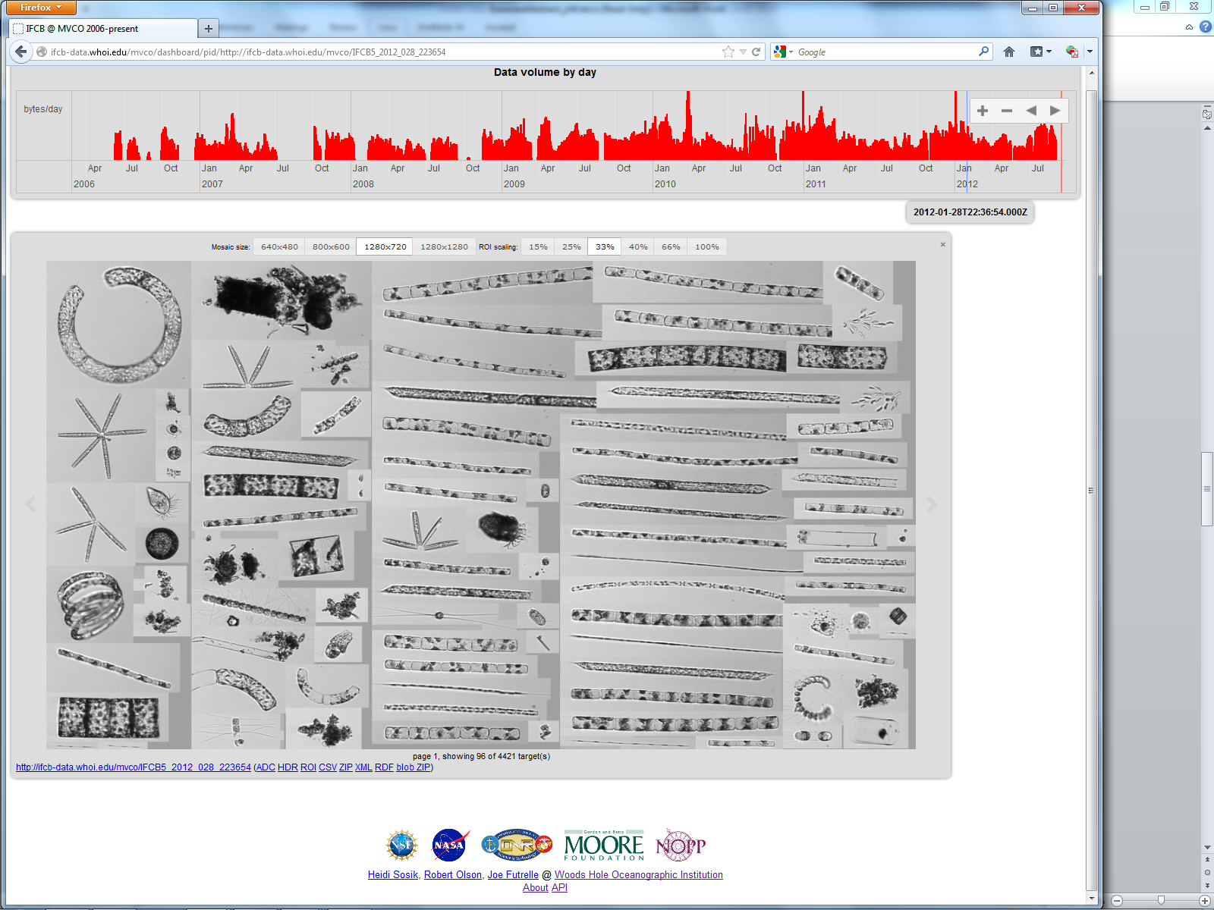
http://ifcb-data.whoi.edu/
Open data access
Standard formats
Processing pipelines
End-to-end provenance
Notes:
Image Informatics

