Slide 1
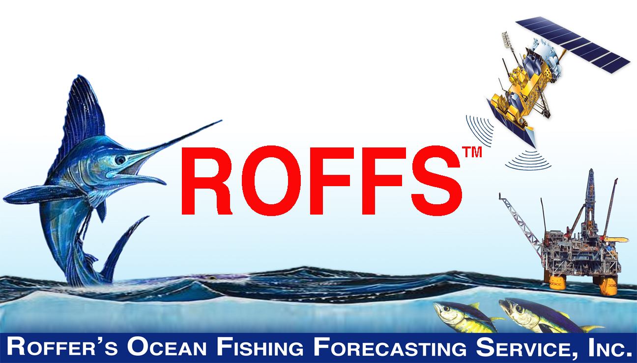
NASA Biodiversity and Ecological Forecasting Science Team Meeting
April 23, 2013
Notes:
Welcome

Slide 2
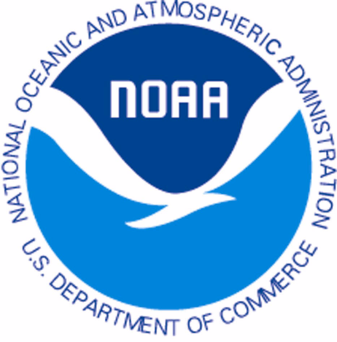
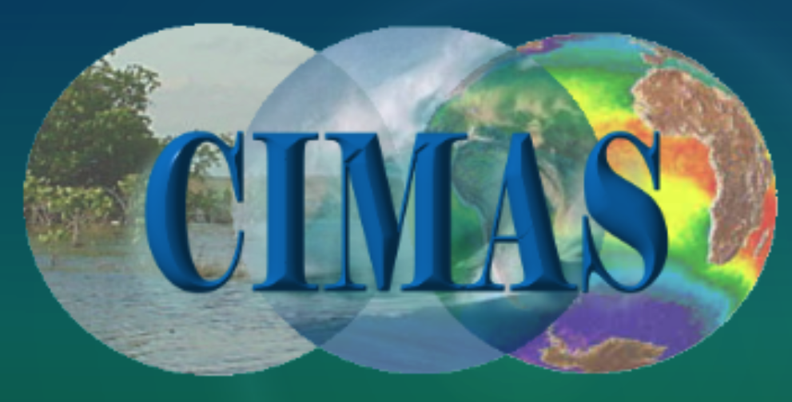
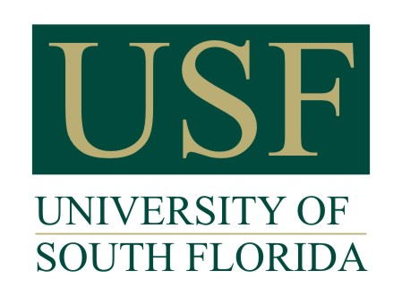
NASA PROJECT
Management And Conservation Of Atlantic Bluefin Tuna (Thunnus Thynnus) And Other Highly Migratory Fish In The Gulf Of Mexico Under IPCC Climate Change Scenarios: A Study Using Regional Climate And Habitat Models.
  PI: M. A. Roffer – ROFFS™
  Co-I: J.T. Lamkin (NOAA), F.E. Muller-Karger (USF), S-K Lee (UM CIMAS), B.A. Muhling (UM CIMAS), G.J. Goni (NOAA)
  Other Investigators: Y. Liu (UM CIMAS), G.W. Ingram (NOAA)
  Others named in proposal M.A. Upton, (ROFFS™) & G. Gawlikowski (ROFFS™)
  Other collaborators added: W. Nero (NOAA), J. Franks (USM), J. Quattro (USC)
    D. Enfield (NOAA), A. Bakun (UM RSMAS, F. Alemany (IEO), A. Garcia (IEO) . .
  Start date September 06, 2011 – End date September 05, 2015
Multi-sector and multi-disciplinary partnership,
including government fishery scientists and managers
Notes:
Intergovernmental panel on Climate Change

Slide 3
NASA Applications Research
Focuses on enhancing the management of Atlantic bluefin tuna (Thunnus thynnus) and other highly migratory tunas and billfishes in the Gulf of Mexico and surrounding waters.

Slide 4
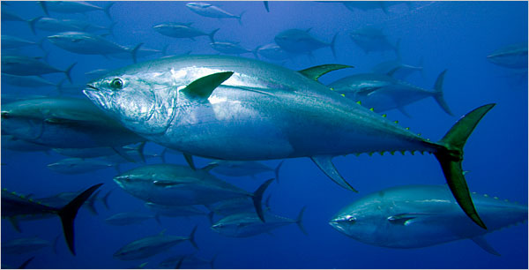
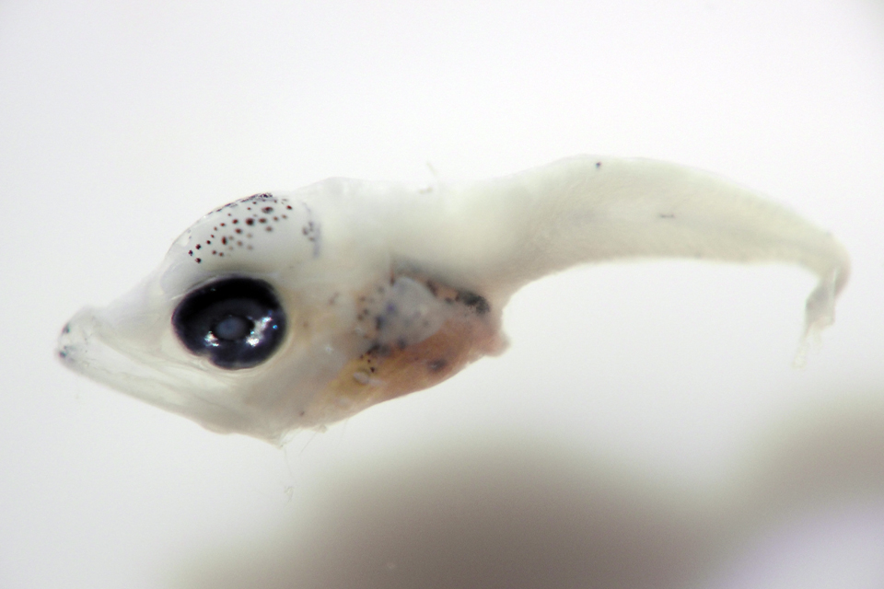
Bluefin Tuna: Adults & Larvae
Meters to Millimeters
Charismatic mega fauna

Slide 5
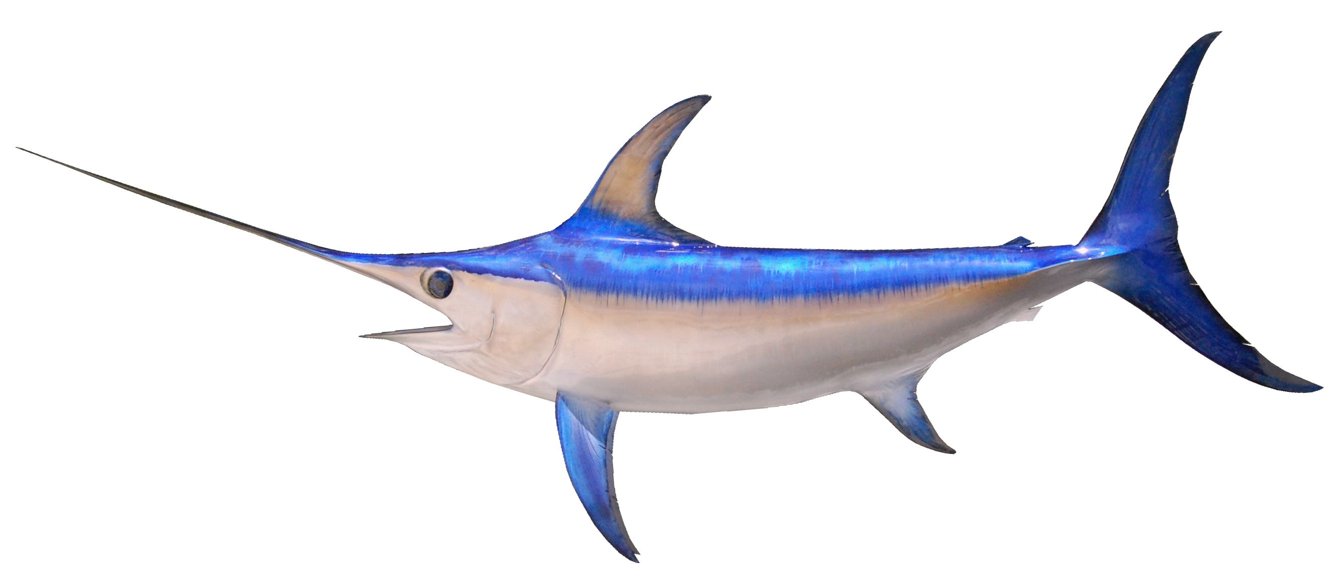
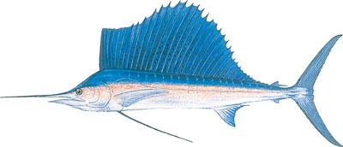
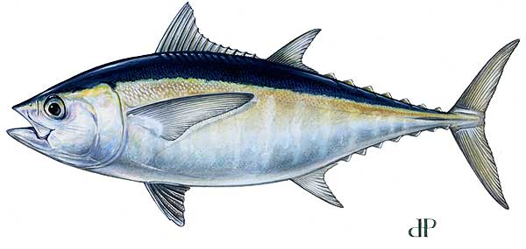
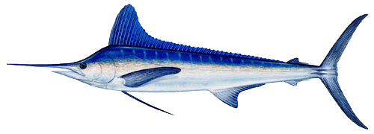
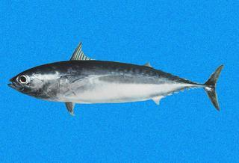
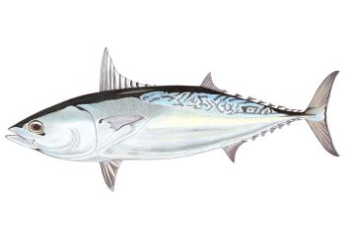
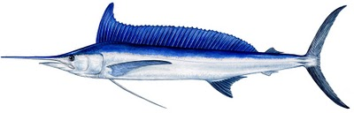
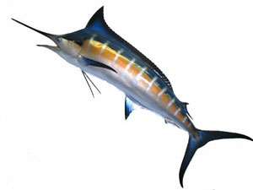


Other HMS Species
Atlantic blue marlin (Makaira nigricans),
Atlantic sailfish (Istiophorus platypterus),
Atlantic white marlin (Tetrapturus albidus),
Blackfin tuna (Thunnus atlanticus),
Bullet mackerel (Auxis rochei),
Frigate mackerel (Auxis thazzard),
Longbill spearfish (Tetrapturus pfluegeri),
Swordfish (Xiphias gladius),
Yellowfin tuna (Thunnus albacares)
Skipjack tuna (Katsuwonis pelamis)

Slide 6

Importance
The expected outcomes of the research include essential enhancements to NOAA fisheries management applications:
  1: Improved fisheries assessments->
  2: Adaptive harvest management strategies->
  3: A better understanding of possible scenarios for future stock rebuilding.
  Linked to recruitment processes, changes in distribution, vulnerability, availability, fishing and natural mortality

Slide 7

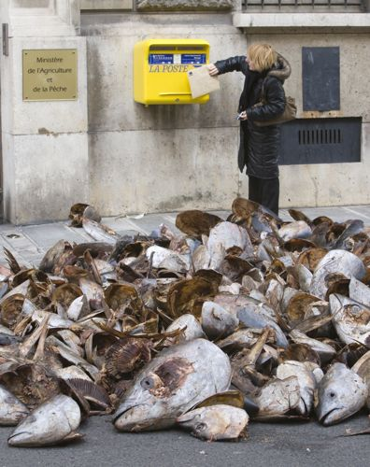
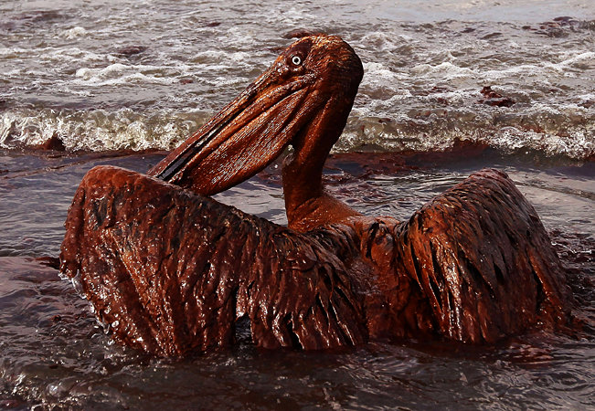
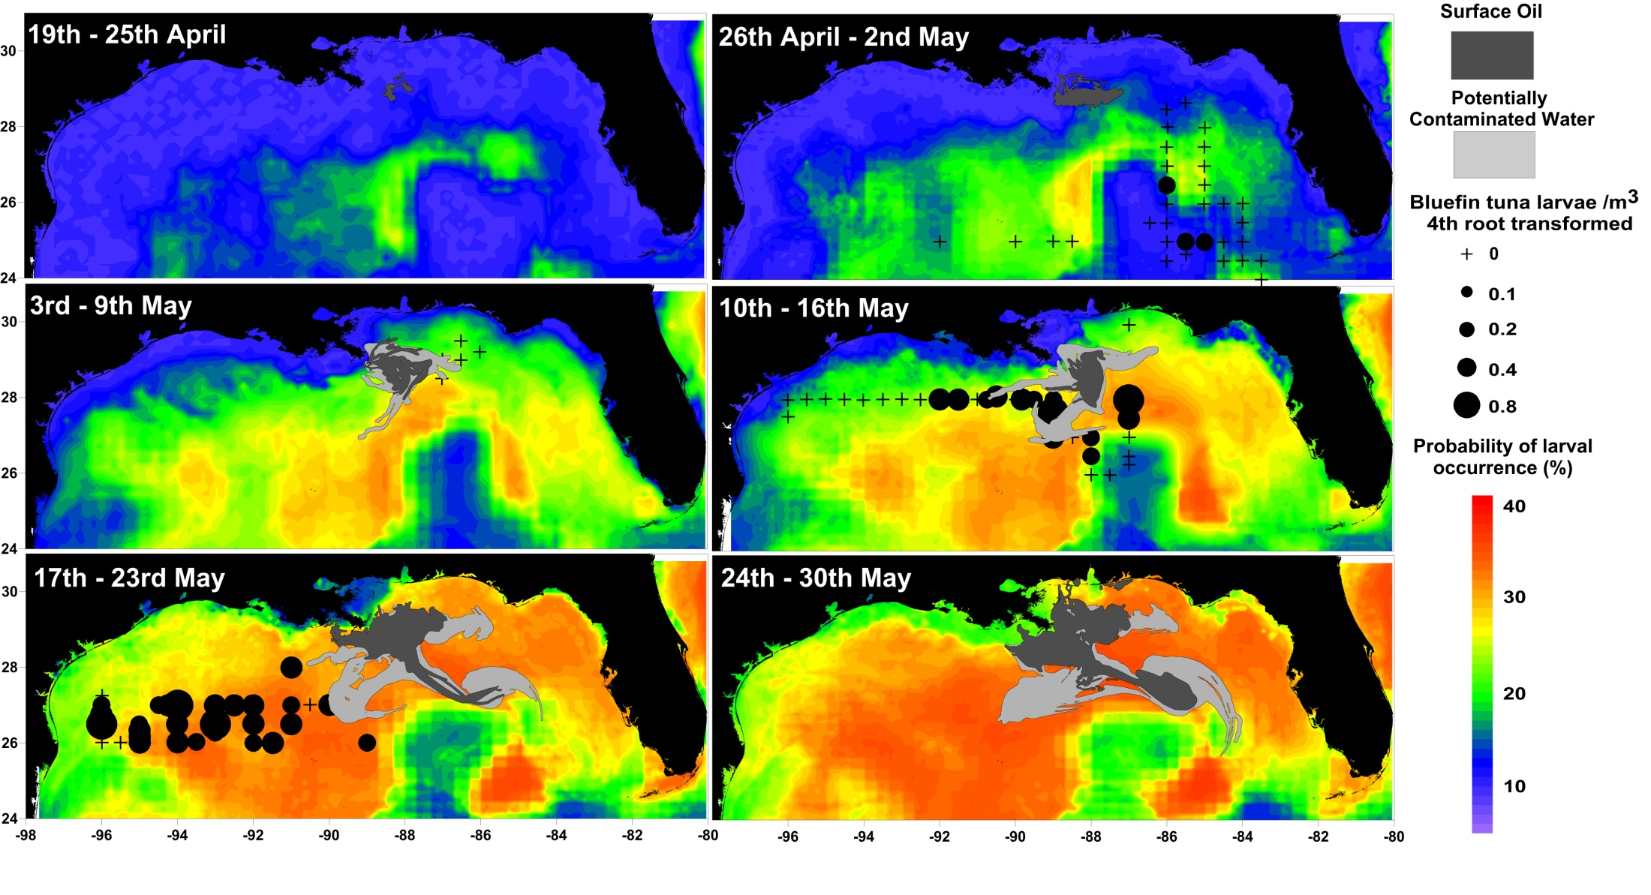
Increased Importance
Convention on International Trade In Endangered Species (CITES) Endangered Species Listing - “CITES Listing” for bluefin and marlin
Effects of the Deepwater Horizon

Slide 8

Additional Significance
The research will significantly contribute to understanding some functional links between climate variability, regional-scale oceanographic processes, and fisheries recruitment.
  Bluefin tuna and other highly migratory fish
  species that use the Gulf of Mexico as their
  essential habitat are still largely managed under the assumption that ecosystem parameters do not change over time.

Slide 9

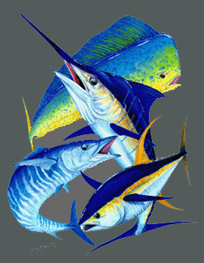
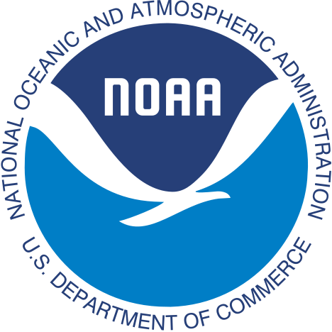
Results
Will guide our nation's input to the International Commission for the Conservation of Atlantic Tunas (ICCAT) the international governing organization for tunas and billfishes.
The approach developed here can then be applied by others (e.g. NOAA) to assess options for other important fisheries, as well as, to the management of other resources including marine protected areas*.
*Already happening: IOOS SECOORA Project
South Atlantic Fisheries Management Council

Slide 10
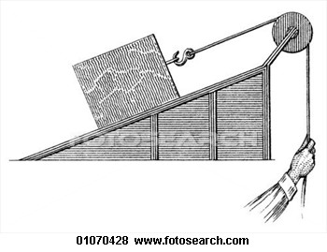
Leveraging:
Past & Present -> Future
This study is leveraging our collaborative research with bluefin tuna managers to develop and refine habitat models from 30+ years of historical fish, physical, satellite data….
  Using IPCC climate models and
  Scenario analysis to assess possible effects of climate change on the spawning habitat and fish population dynamics.

Slide 11
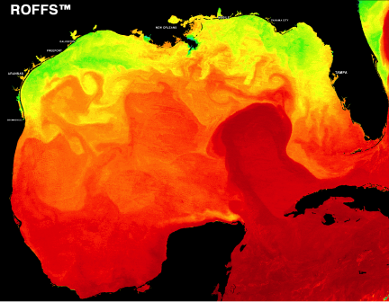
Gulf of Mexico Research Focus
We are improving the present classification model:
  1: By re-analyzing a 30+ year time series of NOAA NMFS SEAMAP ichthyoplankton surveys and data from other NMFS cruises and sources;
  2: With historical fisheries data (commercial pelagic longline fishing observer data) in the Gulf of Mexico and in North Atlantic Ocean;
  3: Using relevant historical oceanographic data including archival and current satellite imagery.

Slide 12

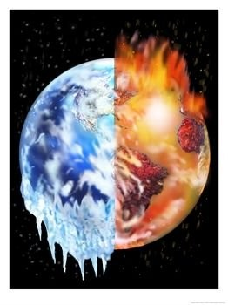
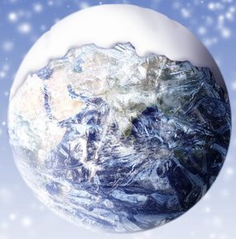
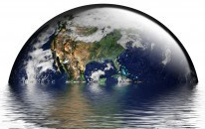
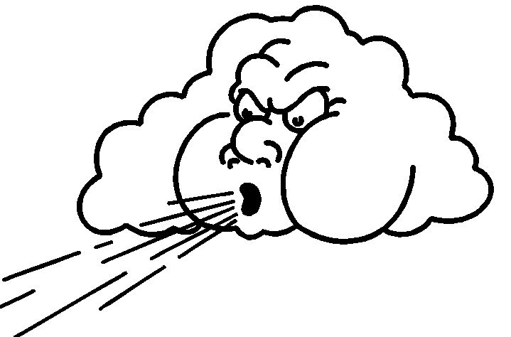
Climate Change Framework
We are assessing the potential changes in habitat extent:
  Using outputs from the numerical simulations constructed for the fourth assessment report of the Intergovernmental Panel on Climate Change (IPCC AR4),
    Being refined in preparation for the fifth assessment report (IPCC AR5).

Slide 13
Climate Modeling Methods
Lee & Liu (Project leads)
Completed and Moving on
  Downscaling IPCC_AR4
  ROMS and HYCOM initially
    0.1° grid resolution over the Gulf
      0.25° elsewhere
    Under 20th century scenario (20C3M)
      Under A1B CO₂ scenarios
    Model domain: 20°E-100°W & 70°N-20°S
  Evaluated natural variability & reproduced it
  Projection of conditions to 2100

Slide 14
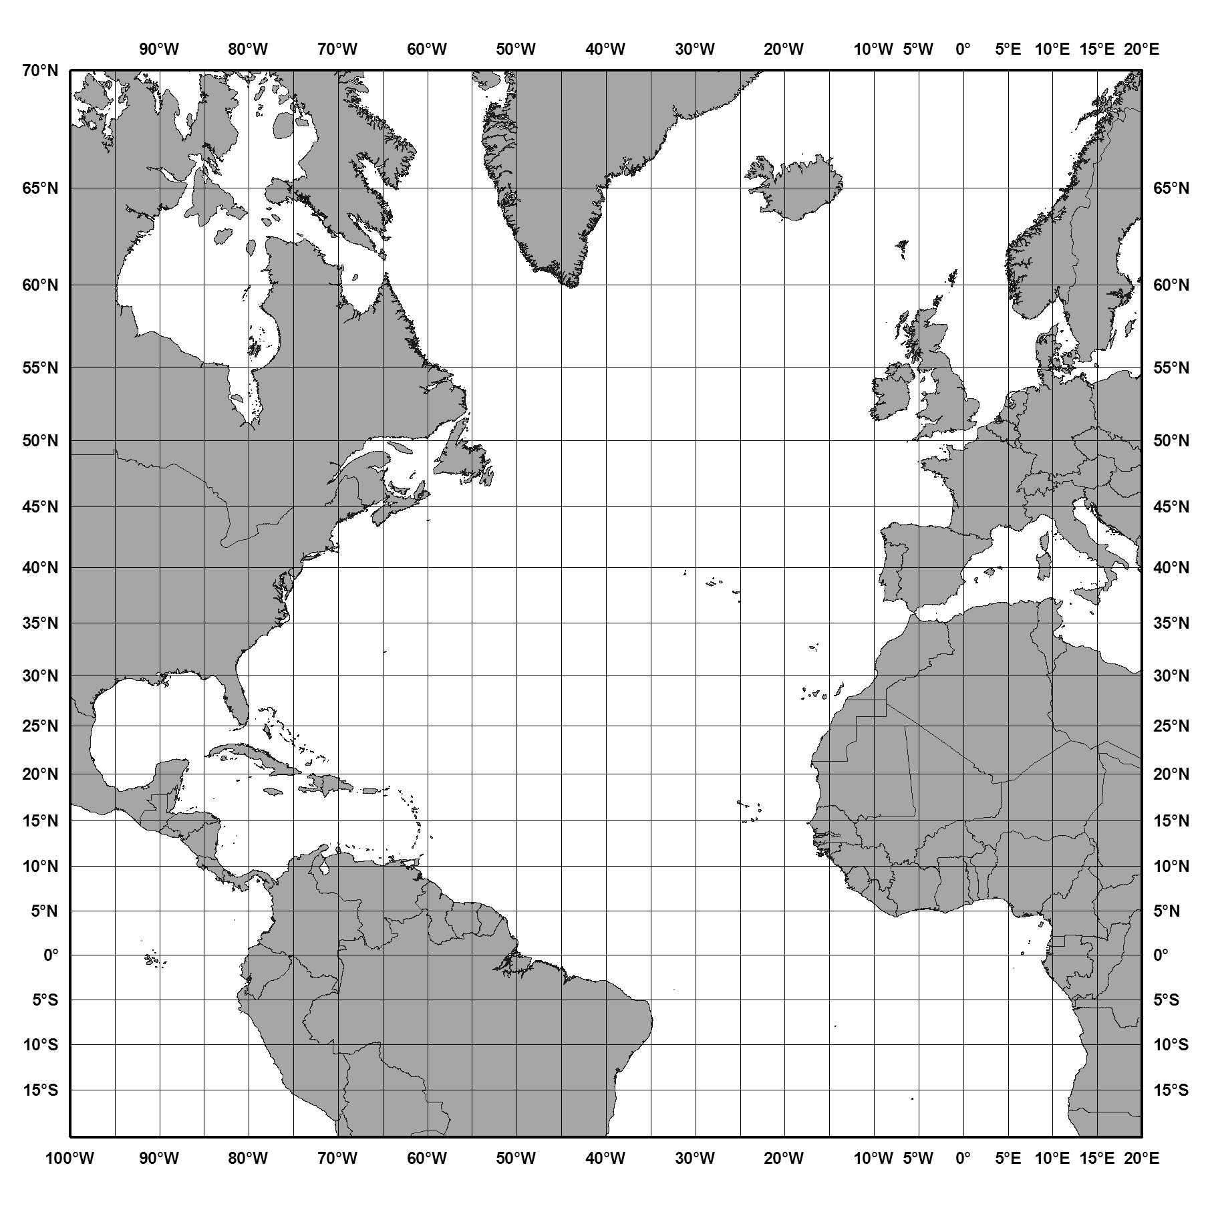
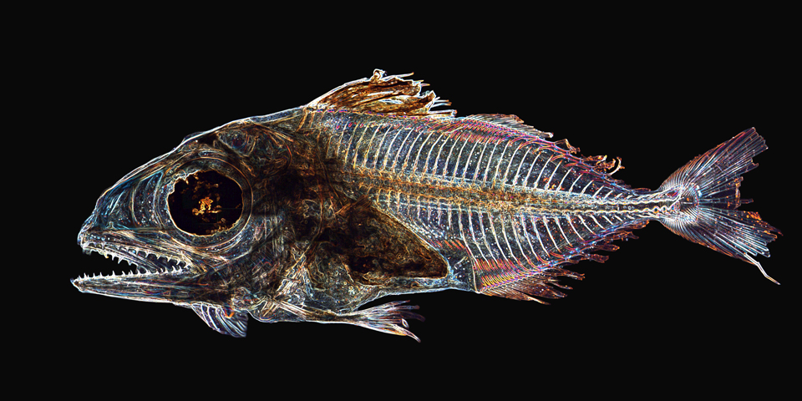
Climate Change Framework Downscaling IPCC4 Project Domain:
Big Journeys Begin With Small Steps
6 MM

Slide 15
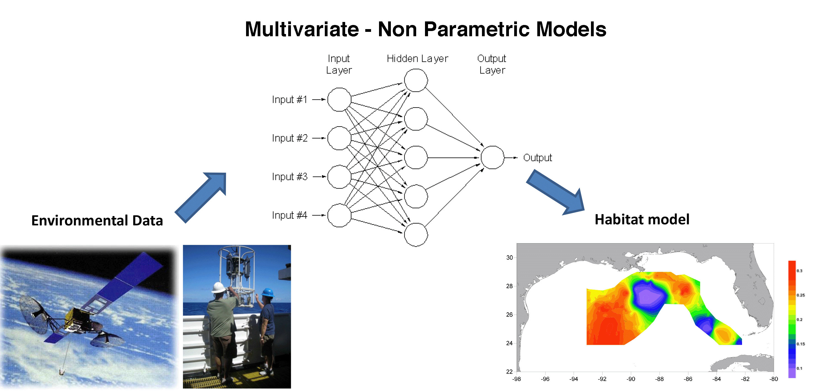
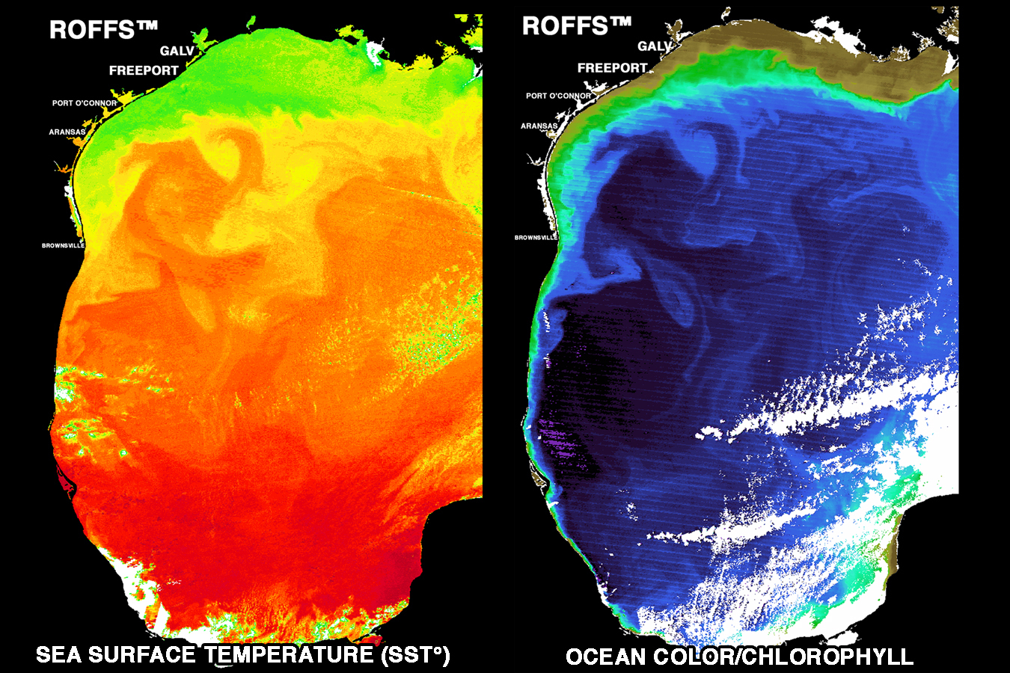
Habitat Modeling Methods
Muhling and Lamkin (Project leads)
  Habitat modeling using multivariate non-parametric techniques such as classification trees and neural networks using DTREG.
Notes:
MOM4-Topaz is being setup and tested

Slide 16
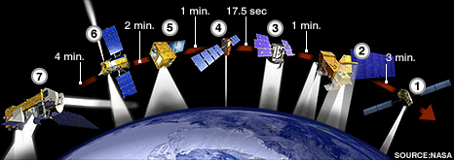
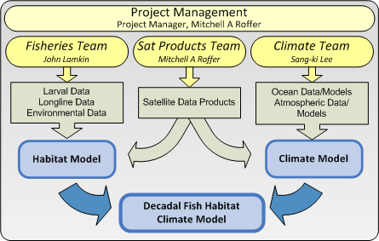
Satellite Methods
    Roffer & Muller-Karger (project leads), Goni
    SST, Chlorophyll, Sea Surface Height
  Larvae cruise real-time support for targeted sampling
    Calibrating/validating MODIS and VIIRS
  Habitat modeling development and refinement
  Validation of climate models
  Automated ID of meso-scale features
  Serve customized data products to NOAA NMFS
    Polar orbiting
      SeaWiFS, MODIS, AVHRR, VIIRS
      Altimeters
    Geostationary - GOES
Notes:
The NPOESS Preparatory Project (NPP) was renamed to Suomi National Polar-orbiting Partnership (SNPP) in honor of Verner E. Suomi, University of Wisconsin meteorologist, widely recognized as the "Father of Satellite Meteorology."

Slide 17
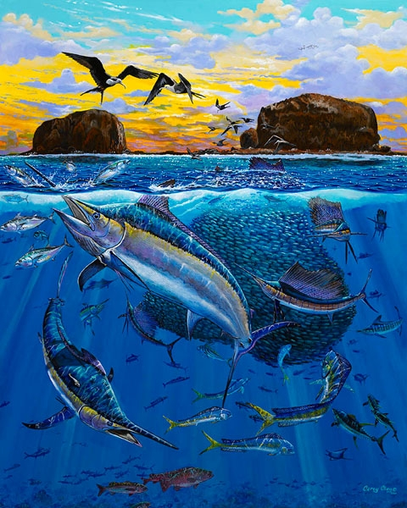
Fisheries Managers Want to Understand Possible Effects of Climate
Changes in lengths of spawning seasons (dates of spawning commencement and end)
Changes in spatial and temporal extent of 3D habitat of adult fish.
Implications for potential effects on recruitment, species – species guilds and sustainability of stocks.

Slide 18

Some Results
HYCOM (Hybrid Coordinate Ocean Model)
  Did produce realistic Yucatan Channel transport and 3D circulation in Caribbean Sea – Gulf of Mexico
    But has no biogeochemical modeling component
ROMS (Regional Ocean Model)
  Has biogeochemical component
  But did not produce realistic transport or circulation
GFDL’s MOM4 (Modular Ocean Model)
  Has biogeochemical component
  Does produce realistic transport and circulation
  CMIP5 is used to constrain initial/boundary conditions
(see posters too)
Notes:
Hybrid Coordinate Ocean Model - Regional Ocean Modeling System (ROMS), Modular Ocean Model (used at NOAA’s GFDL Geophysical Fluid Dynamics Laboratory

Slide 19

Benefits of Using Downscaled Models
IMPORTANT RESULT
With HYCOM our results showed that the Loop Current transport is reduced by 20-25% for the 21st century under A1B scenario.
  Results in a “weakening” of the Loop Current
    Velocity & penetration of Loop Current reduced
  Results in substantial reduction in the warming
    Only as little as 1°C by end of 21st C in the northern Gulf of Mexico
    IPCC-AR4 global predicts a ~2°C warming
  All due to the reduction of Atlantic Meridional Overturning Circulation (AMOC)
    See Liu et. al, 2012 (J. Geophys. Res: 117)
Notes:
(1°-2°C in southern part)

Slide 20
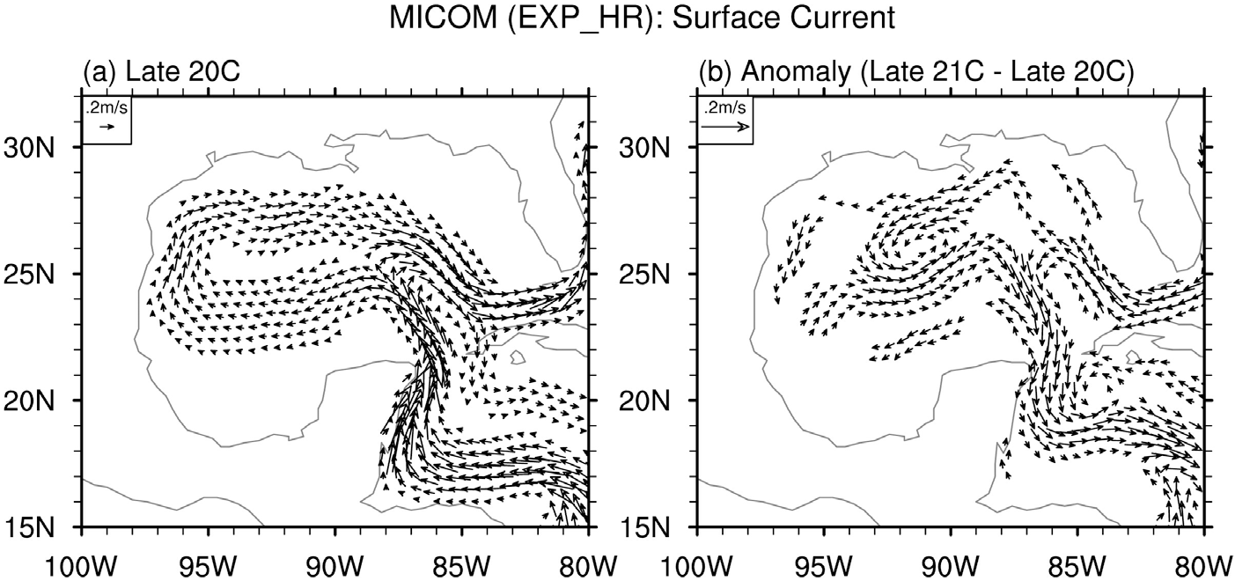
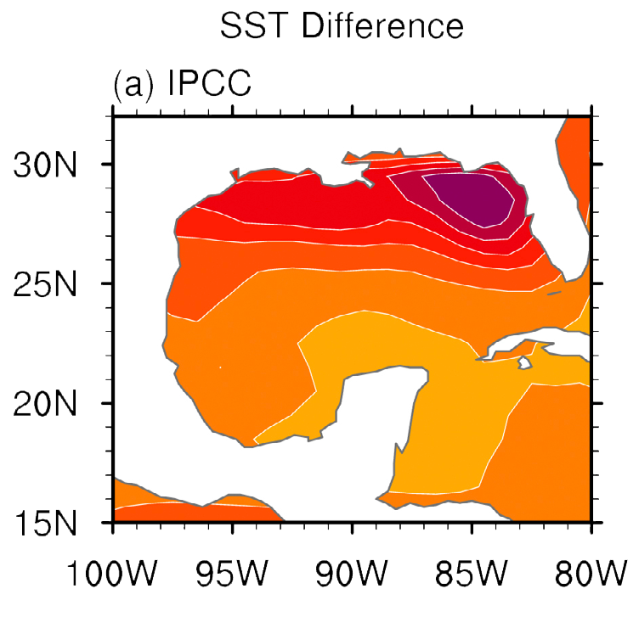
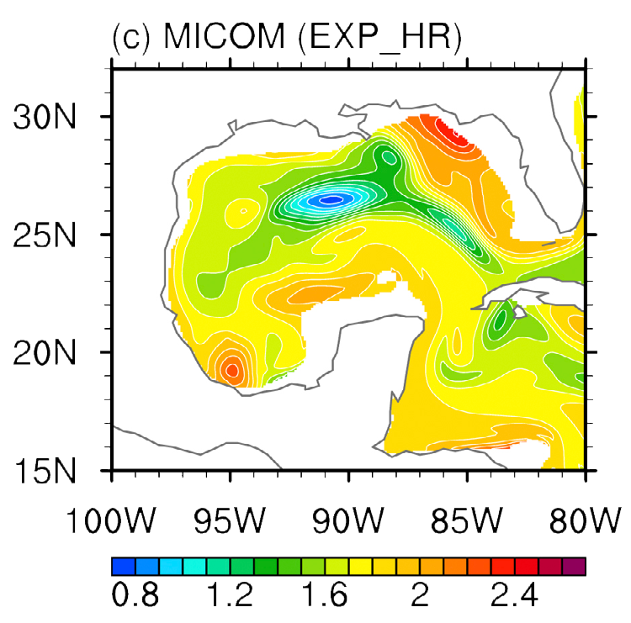
Long-term mean surface current in the late 20th century during AMJ
(b) Anomalous (i.e., late 21st century to late 20th century)
SST difference between the late 21st century and late 20th
during AMJ obtained from (a) the weighted ensemble of 11 IPCC-AR4
models, and (c) the high-resolution MICOM experiment (EXP_HR).

Slide 21
Downscaling simulations with MOM4* in Gulf of Mexico
First three separate runs:
Late 20C run (1981-2000) -> no larger than 0.5°C bias !
Mid 21C run (2041-2060) under RCP4.5 and RCP8.5
Late 21C run (2081-2100) under RCP4.5 and RCP8.5
Now running as continuous simulation 1901-2100
Next step to setup and test MOM4 – TOPAZ biogeochemical model
*Representative concentration pathways of CO₂ representing radiative forcing values 4.5 and 8.5 Watts/m²

Slide 22
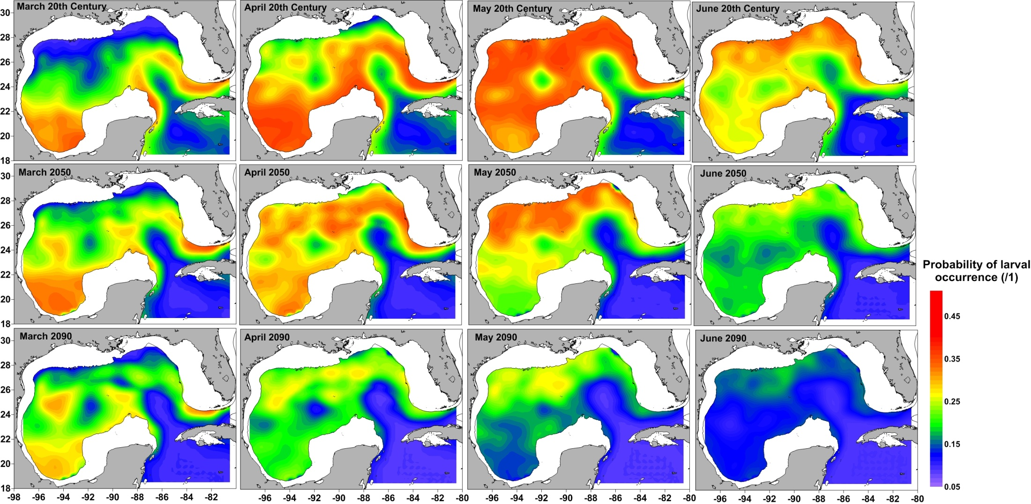
Results: Spawning habitat changes for bluefin tuna
During the late 20th century, bluefin tuna spawned in the northern Gulf of Mexico in May and June, with less activity in April. Larvae were rarely collected from within the Loop Current or warm eddies
By the end of the 21st century, habitat in the northern Gulf was slightly more suitable in March and April, however much of the May and June habitat was predicted to disappear

Slide 23
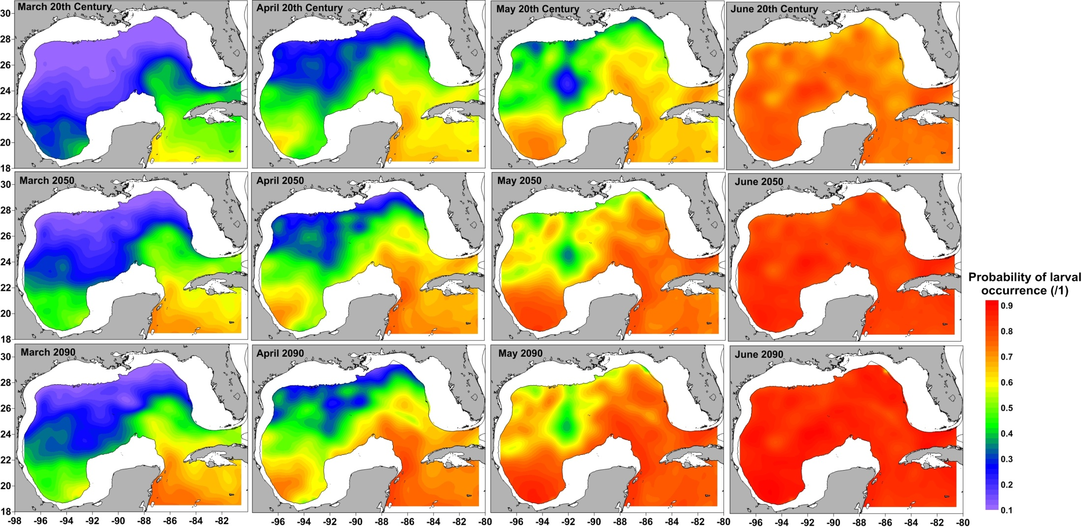
Results: Spawning habitat changes for Yellowfin/blackfin tuna
During the late 20th century, Thunnus spp. increased spawning activity throughout spring
By the end of the 21st century, warming temperatures are predicted to increase the suitability of spawning habitat in all spring months

Slide 24
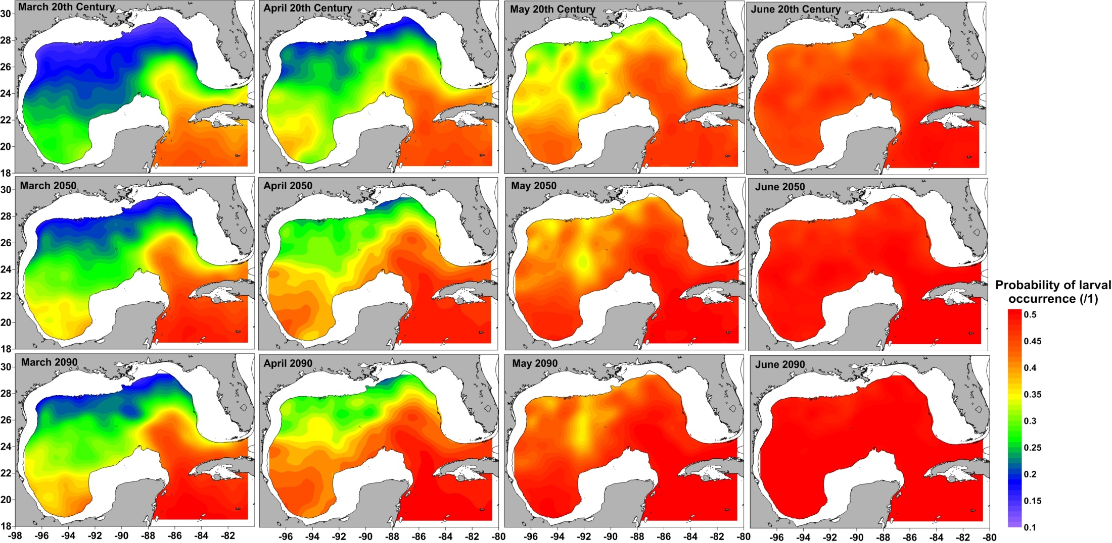
Results: Spawning habitat : Skipjack tuna
Similarly to yellowfin/blackfin tuna, skipjack tuna spawning grounds were predicted to increase in suitability through to the end of the 21st century

Slide 25


Always thinking about Transition & Outreach !
The goal at the end of the third year is to pass on the basic knowledge of satellite oceanography so that our partner NOAA researchers can routinely use satellite data for this and future projects.

Slide 26
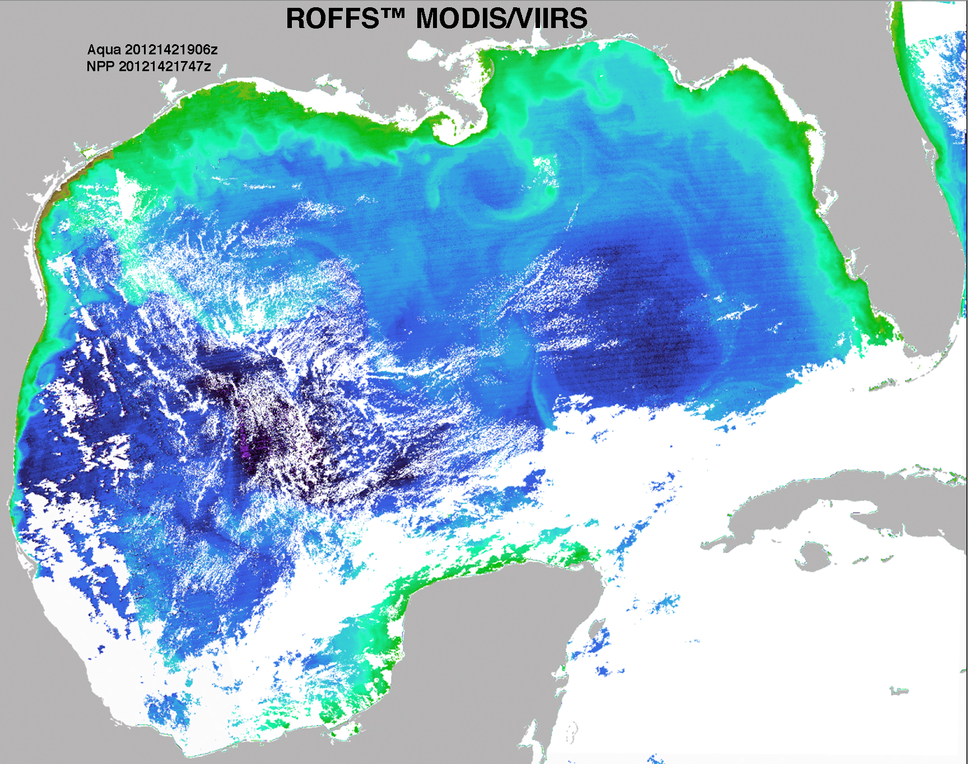
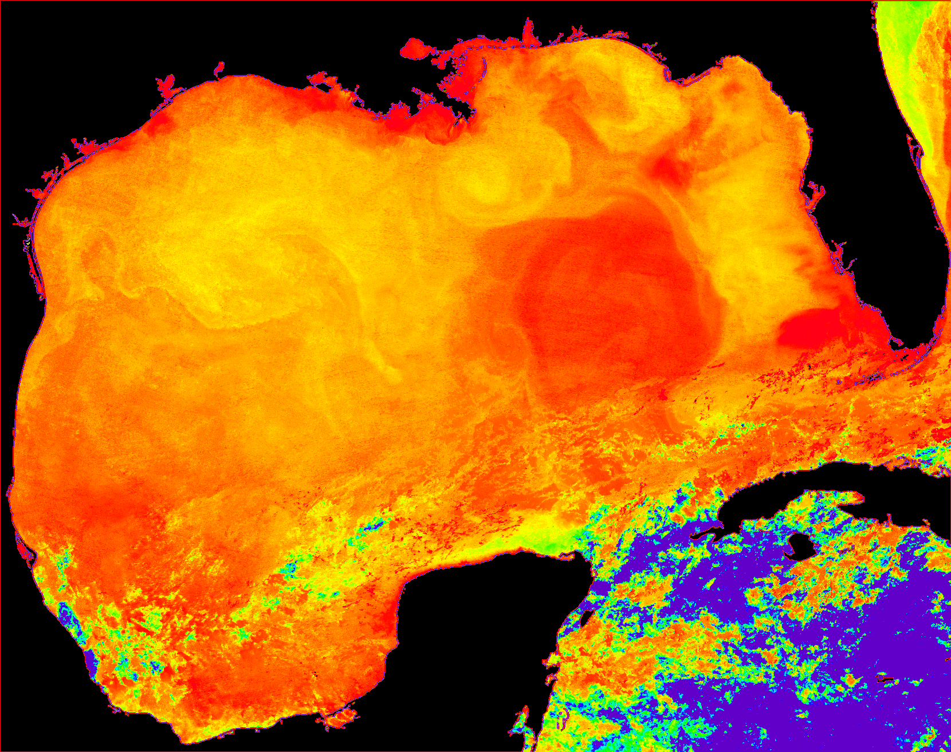
Thanks - Questions
12142 Comparison
Ocean color (MODIS & VIIRS) versus Infrared

Slide 27
Publications
Muhling, B.A., Lamkin, J.T., Roffer, M.A. (2010) Predicting the occurrence of bluefin tuna (Thunnus thynnus) larvae in the northern Gulf of Mexico: Building a classification model from archival data Fisheries Oceanography 19: 526-539.
Muhling, B.A., Lamkin, J.T., Quattro, J.M., Smith, R.A., Roberts, M.A., Roffer, M.A., Ramirez, K.A. (2011) Collection of larval bluefin tuna (Thunnus thynnus) outside documented western Atlantic spawning grounds. Bulletin of Marine Science 87: 687-694.
Muhling, B.A., Lee, S-K, Lamkin, J.T. (2011) Predicting the effects of climate change on bluefin tuna (Thunnus thynnus) spawning habitat in the Gulf of Mexico. ICES Journal of Marine Science 68: 1051-1062.
Muhling, B.A., Roffer, M.A., Lamkin, J.T., Ingram, G.W. Jr., Upton, M.A., Gawlikowski, G., Muller-Karger, F., Habtes, S., Richards, W.J. (2012) Overlap between Atlantic blueﬁn tuna spawning grounds and observed Deepwater Horizon surface oil in the northern Gulf of Mexico. Marine Pollution Bulletin, doi:10.1016/j.marpolbul.2012.01.034.
Liu Y., S.-K. Lee, B. A. Muhling, J. T. Lamkin and D.B. Enfield, 2012: Significant reduction of the Loop Current in the 21st century and its impact on the Gulf of Mexico. J. Geophys. Res., 117, C05039, doi:10.1029/2011JC007555
Liu, Y., S.-K. Lee, C. Wang, D. B. Enfield, B. A. Muhling and J. T. Lamkin, 2013: Impact of the Atlantic multidecadal oscillation on North Atlantic Ocean gyre circulation variability. To be Submitted.

Slide 28
