Slide 1
A Decision Support System for Ecosystem-Based Management of Tropical Coral Reef Environments
M. Vega-Rodriguez, F. Muller-Karger, M. Eakin, J. Li,
L. Guild, S. Lynds, R. Nemani, C. Hu, G. Quiles – Perez,
T. Christensen, L. Wood, C. Fitzgerald

Slide 2
A Partnership
NOAA NESDIS/CRW (M. Eakin, J. Li, G. Liu, T. Christensen)
NOAA AOML / ICON/CREWS (J. Hendee, L. Gramer)
NASA Ames (L. Guild, R. Nemani)
UNEP-WCMC (L. Wood, C. Ravilious, C. Fitzgerald)
U. South Florida (F. Muller-Karger, C. Hu, M. Vega, B. Barnes)
U. Colorado-CIRES (S. Lynds)
NOAA NESDIS/CRW-Australia (W. Skirving, S. Heron / NOAA)

Slide 3
Acknowledgements
Funding provided by:
NASA Applied Sciences Program
Woody Turner
2008 Ecological Forecasting application area
4-year program (2009-2013)
NOAA
Coral Reef Conservation Program
UNEP WCMC (World Conservation Monitoring Centre)

Slide 4
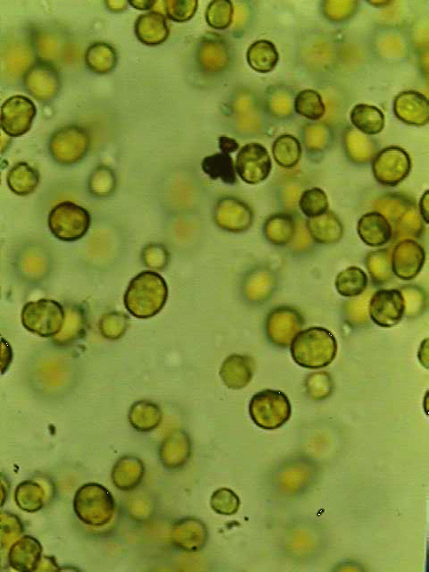
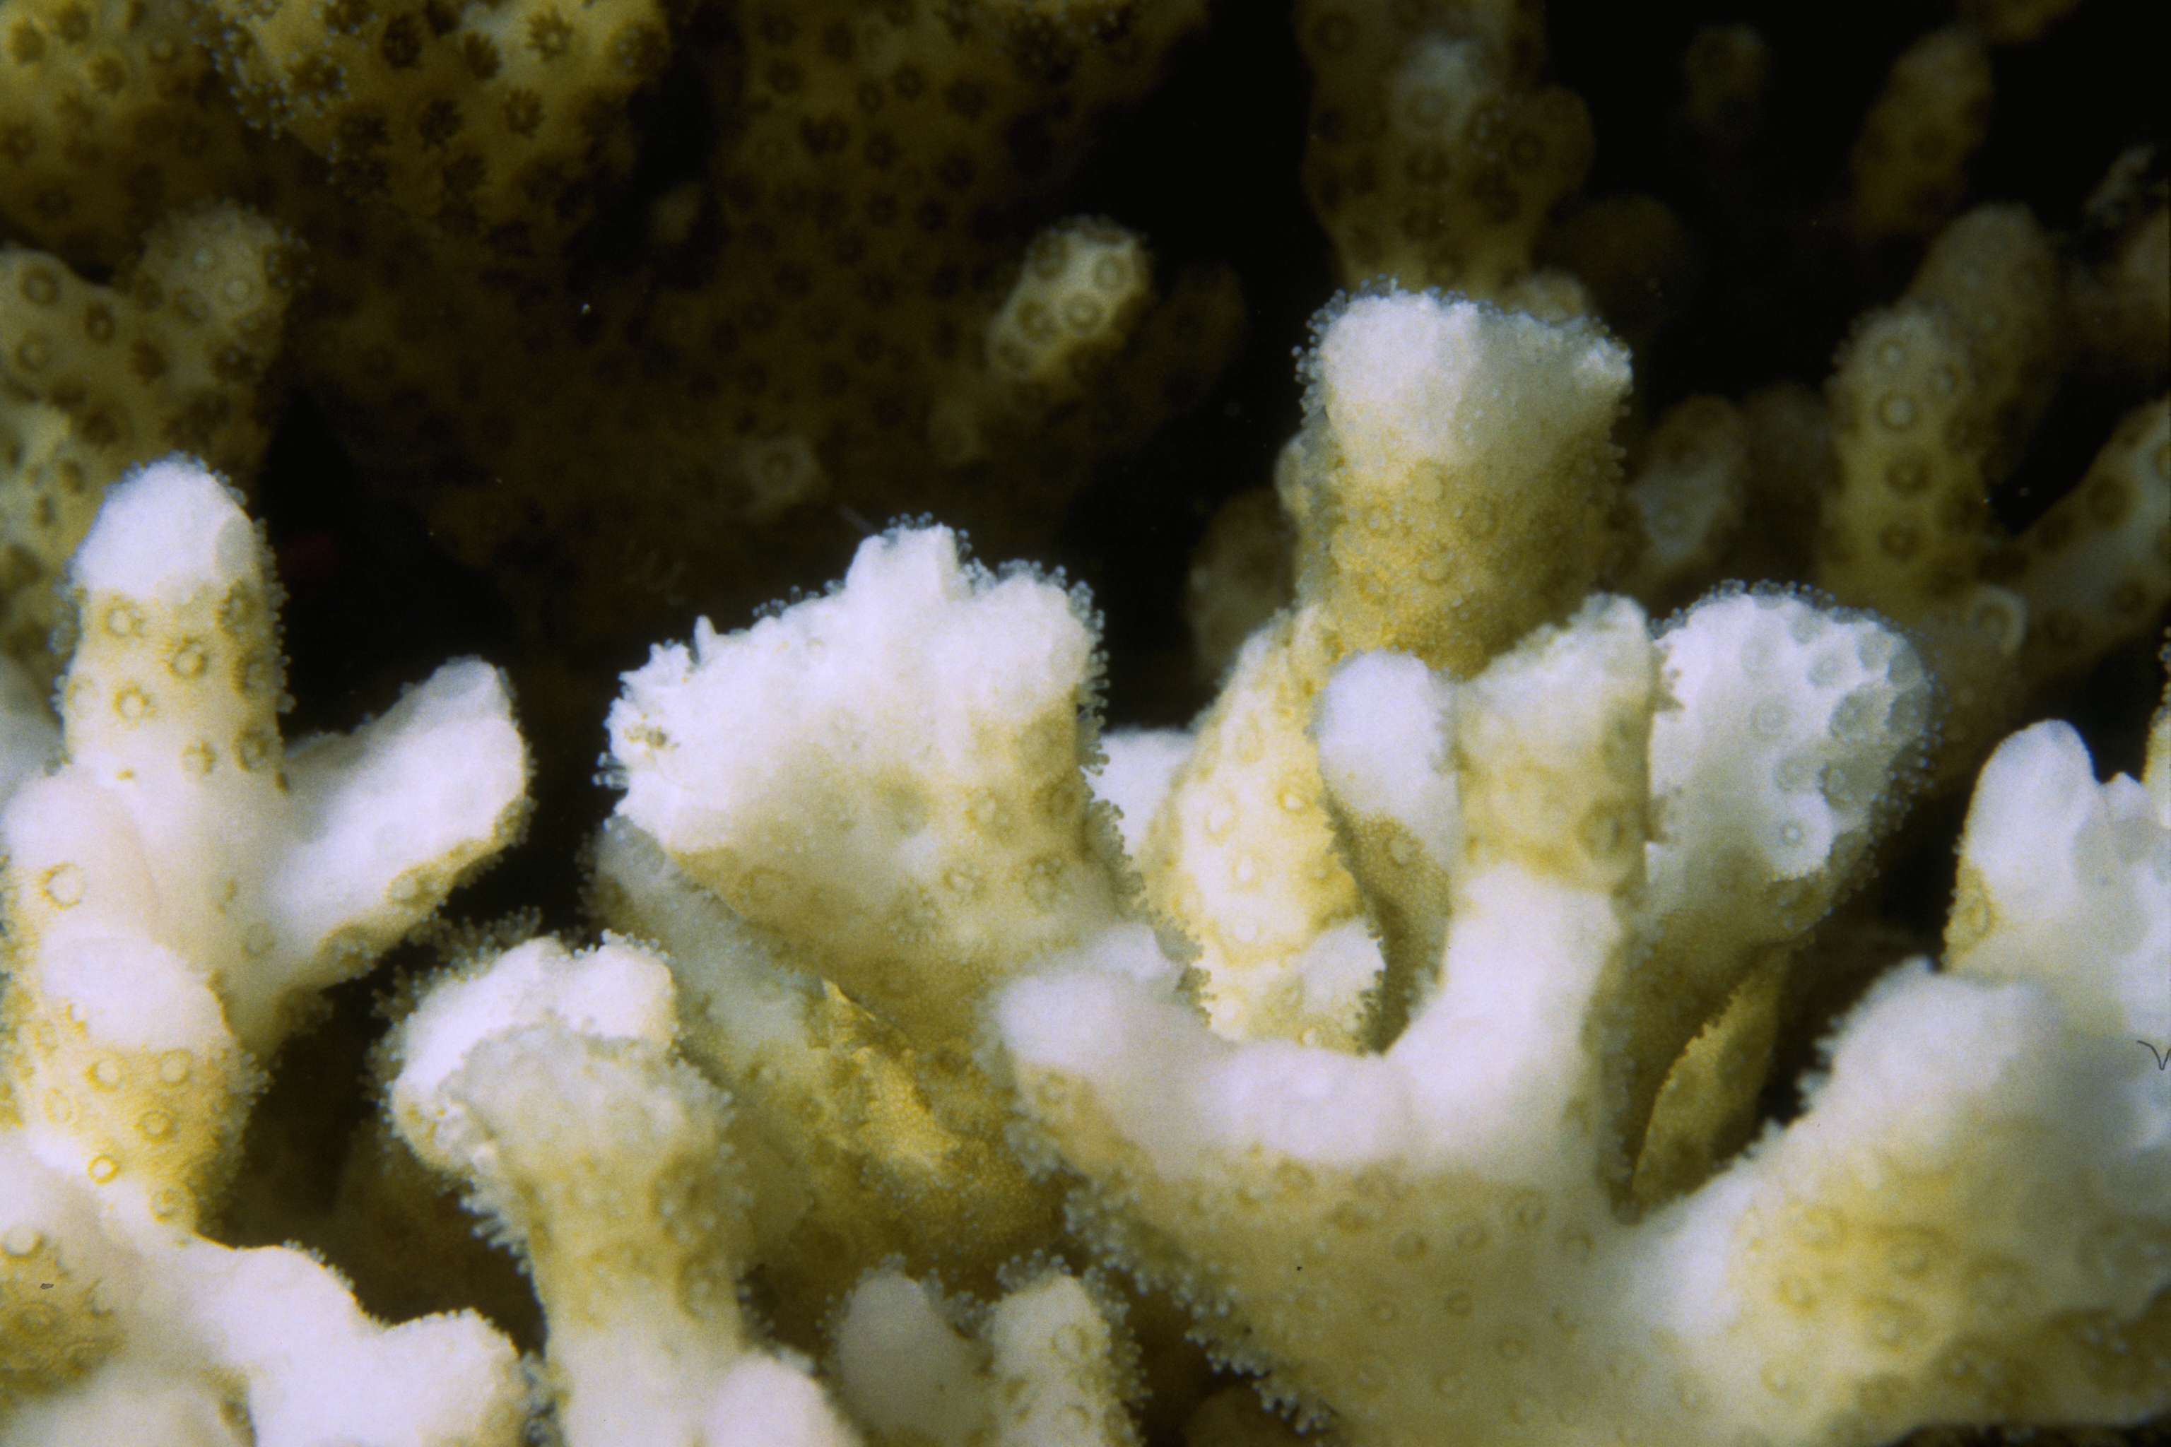
Coral Bleaching: Impact of Climate Change
Most of corals’ food comes from photosynthesis
Scott R. Santos
Corals exposed to high temperatures and/or high light become stressed
Corals eject their algae; coral appears “bleached
If stress is mild or brief, corals recover, otherwise they die
zooxanthellae
Symbiotic algae
Mass bleaching covers 100-1000’s km2

Slide 5
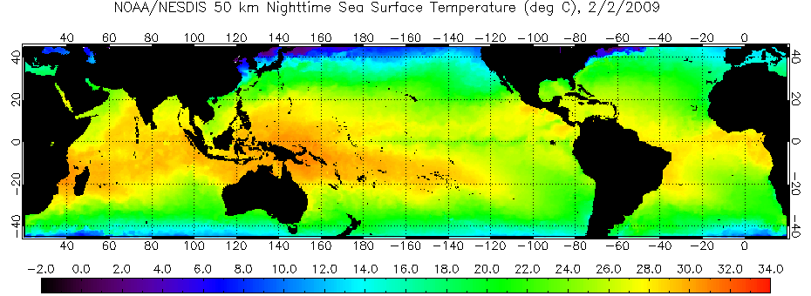
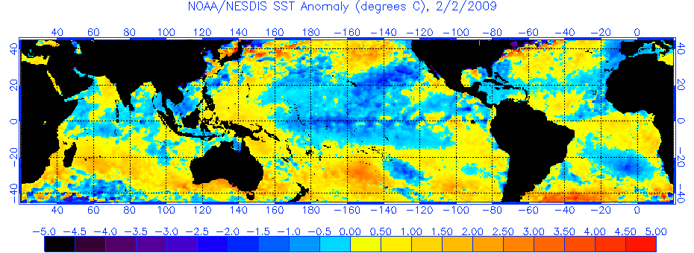
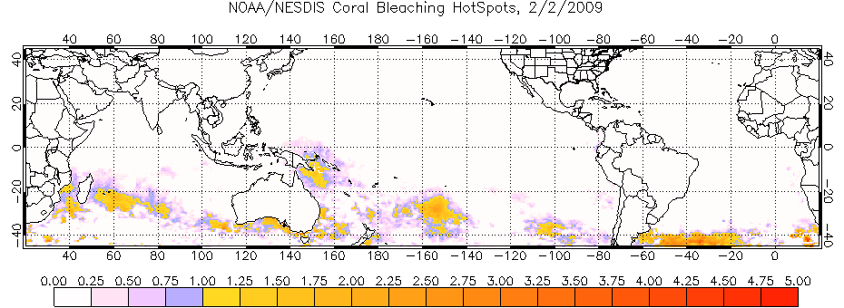
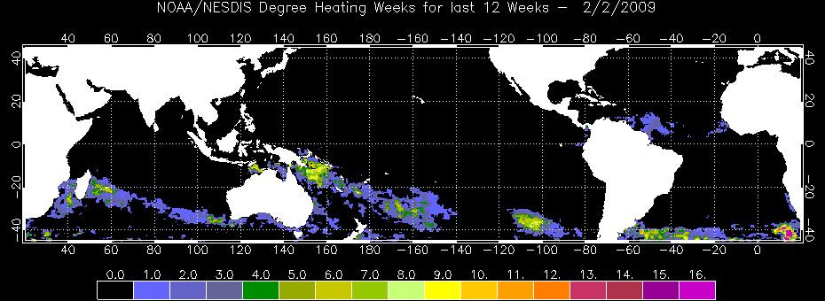
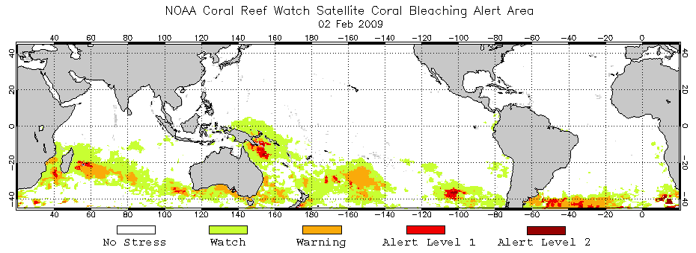
Coral Reef Watch Satellite-Based Products
Primary Products: SST-based
50km Nighttime Sea Surface Temperature (SST)
Coral –
specific
SST Anomaly
HotSpot
Degree Heating Week
Bleaching Alert Areas

Slide 6
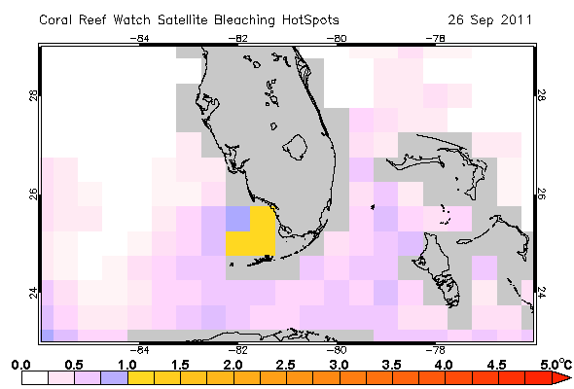
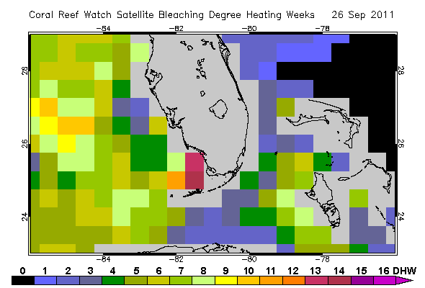
Global
Coral Thermal Stress Products
-produced at 50 km resolution
HotSpot
DHW
6

Slide 7
Objectives
Improve present NOAA NESDIS Coral Reef Watch (CRW) program using NASA technologies
Use high-resolution (1 km ) satellite data
(MODIS, AVHRR, other)
Link to higher-resolution maps
Global Coral Reef Millennium Map
Landsat, other present and future sensors
Assess value of product in test cases

Slide 8
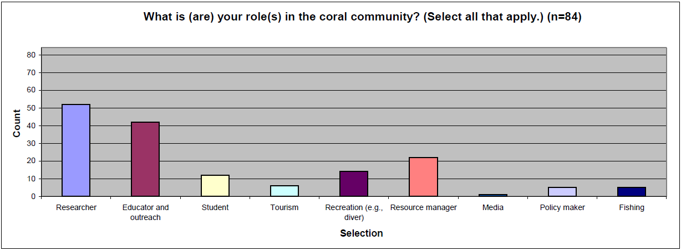
User surveys (S. Lynds / CIRES)
Respondents from 23 countries

Slide 9
Users are interested in higher spatial resolution products

Slide 10
New products and climatology based on:
Night-time 4 km AVHRR Global Pathfinder
1985-2006; 2003-2006 (for comparison with LAC)
Gap – filled climatology
Night-time MODIS and AVHRR LAC (1 km)
2003-3006
1, 4, 11 km products
AVHRR, MODIS Aqua SST, GOES
Test areas: Florida and Australia

Slide 11
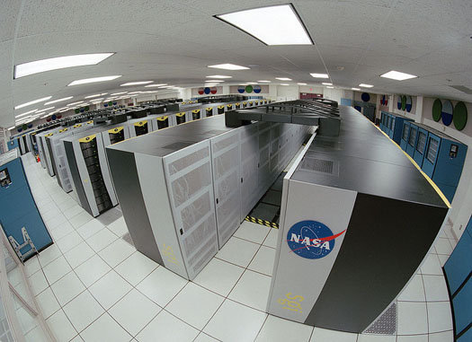
Approach:
High-resolution climatology prototypes developed using NEX at NASA Ames

Slide 12
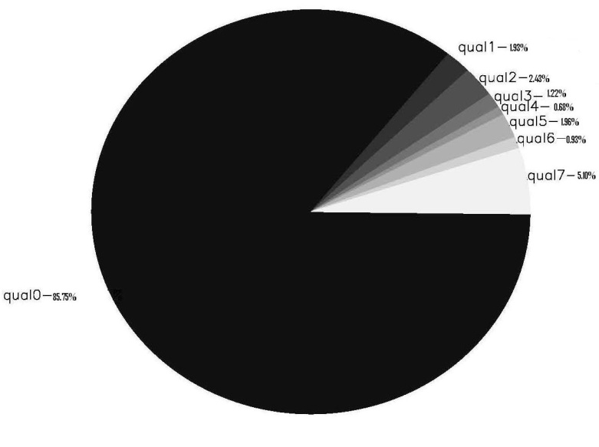
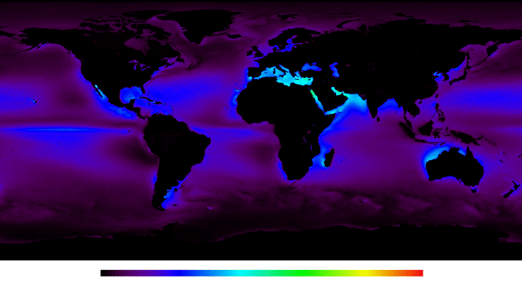
Data Density
4km-Resolution PF v5.0
Daily Nighttime only SST
Globally, 8.67% of Pathfinder data have quality ≥ 4 (useable)
Data Gaps
0
20
40
60
80
100
0 20 40 60 80 100
% Data Available

Slide 13
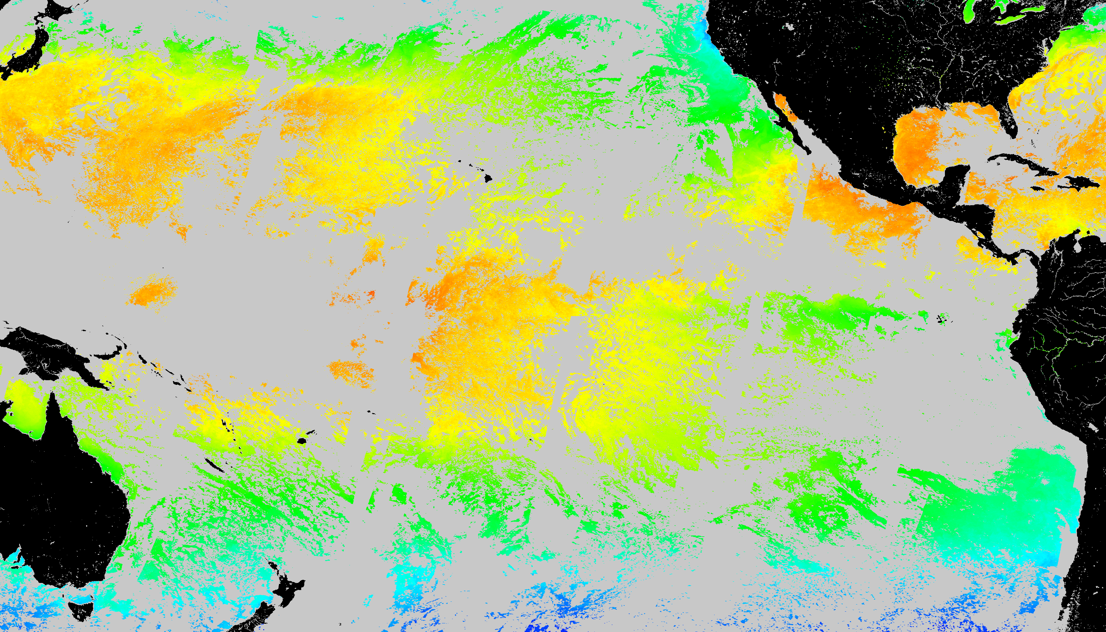
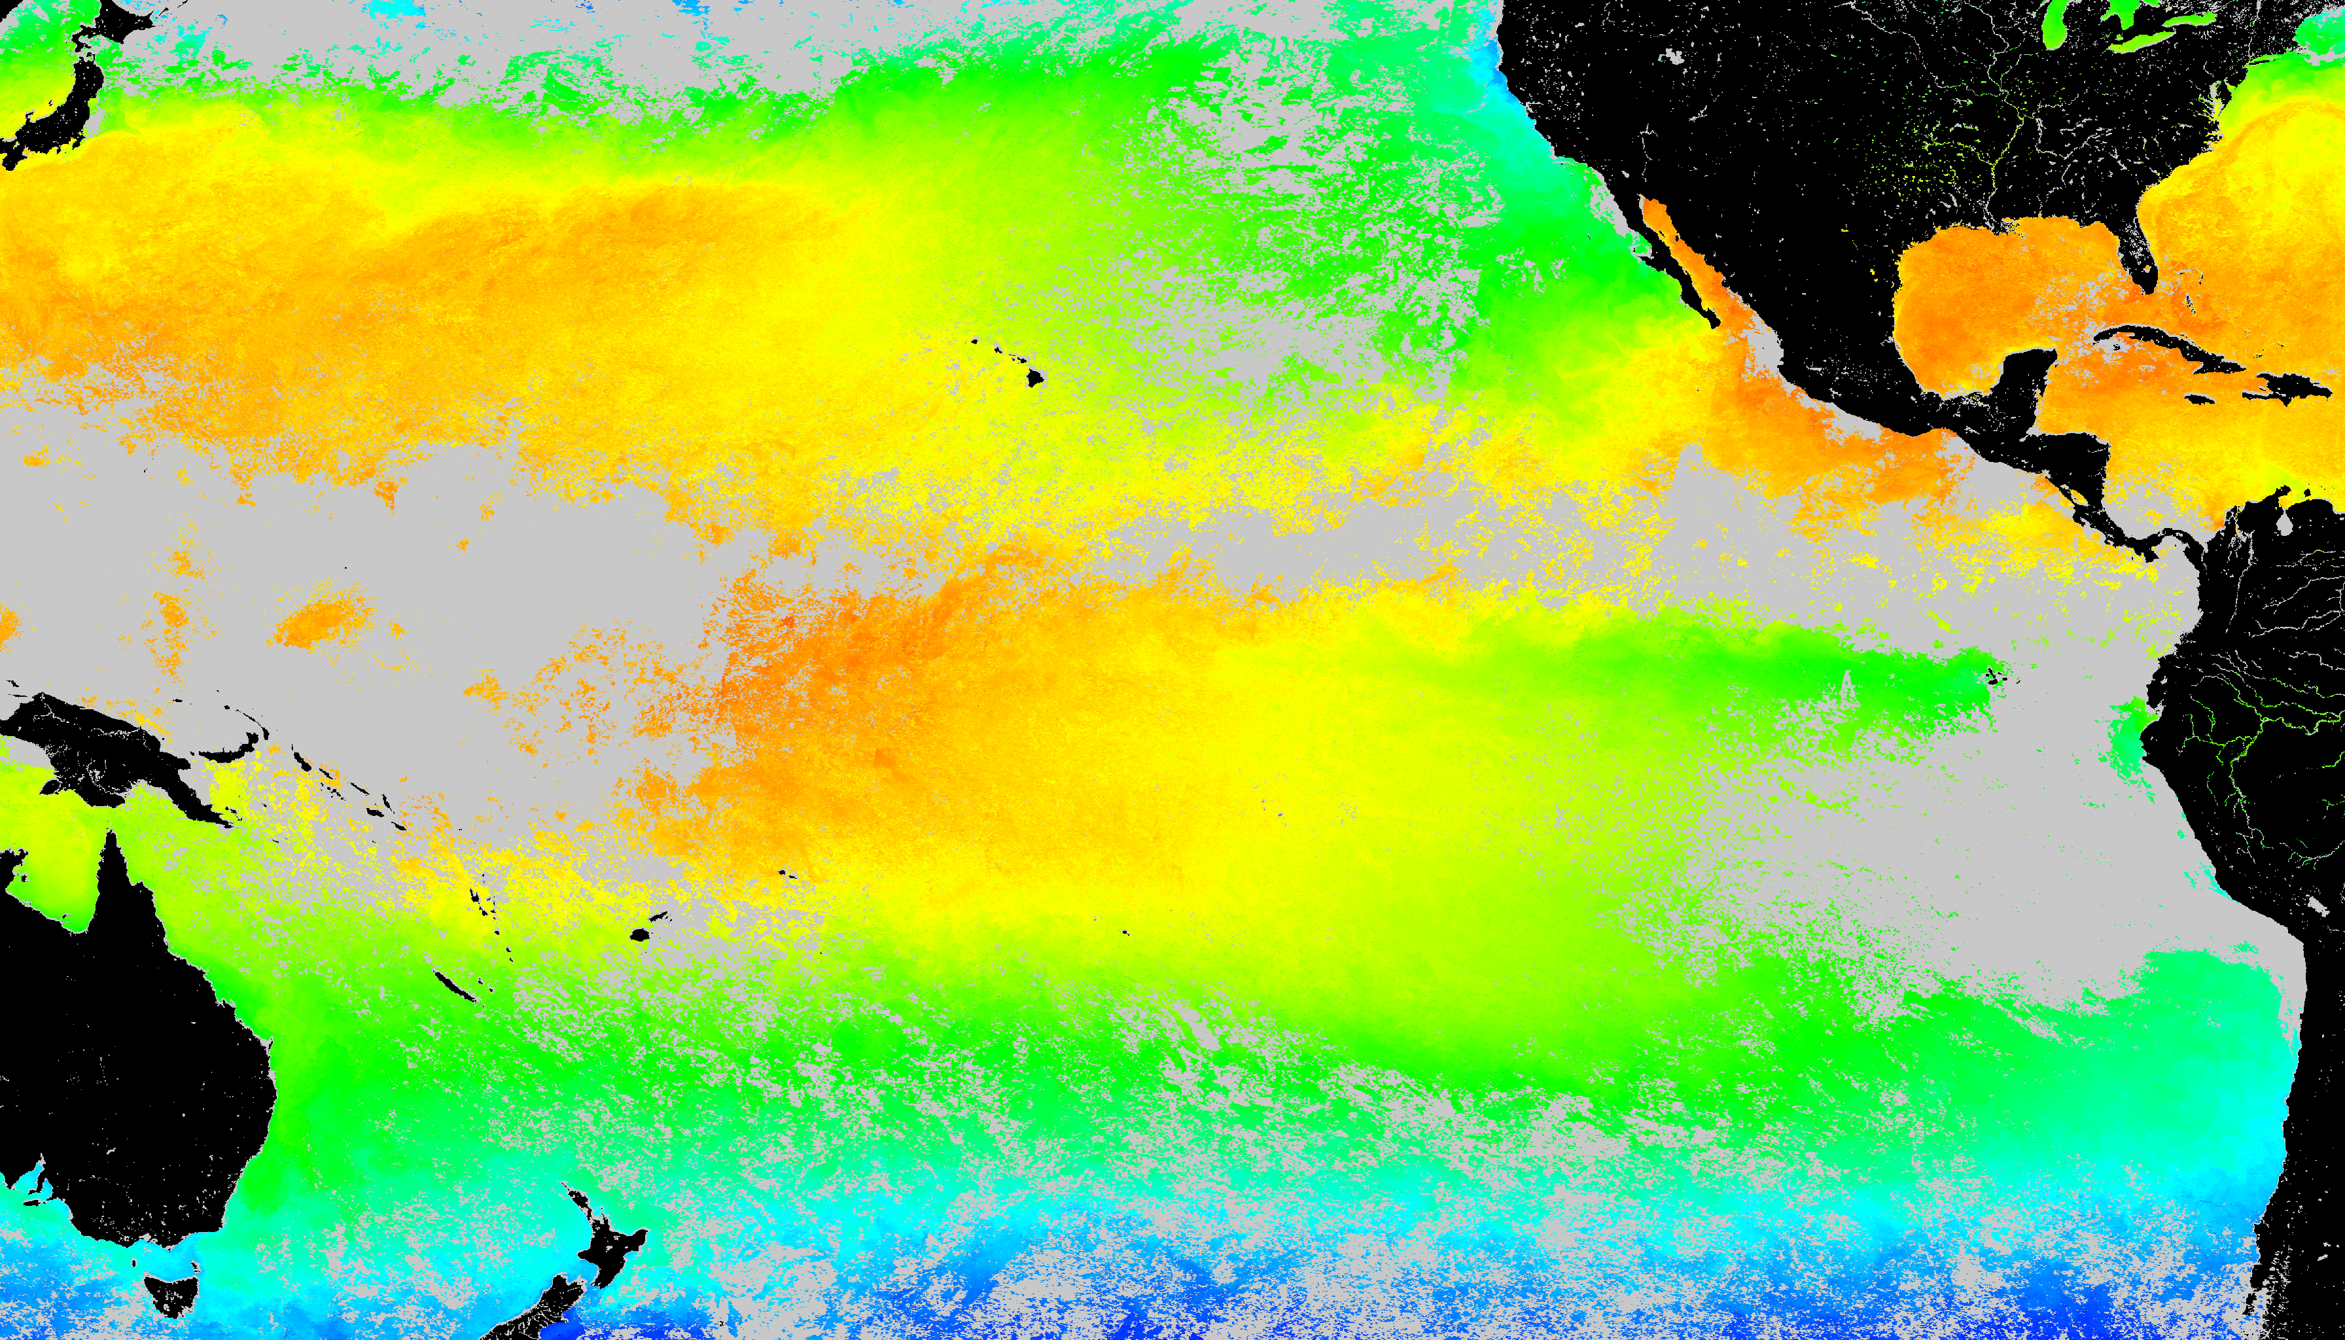
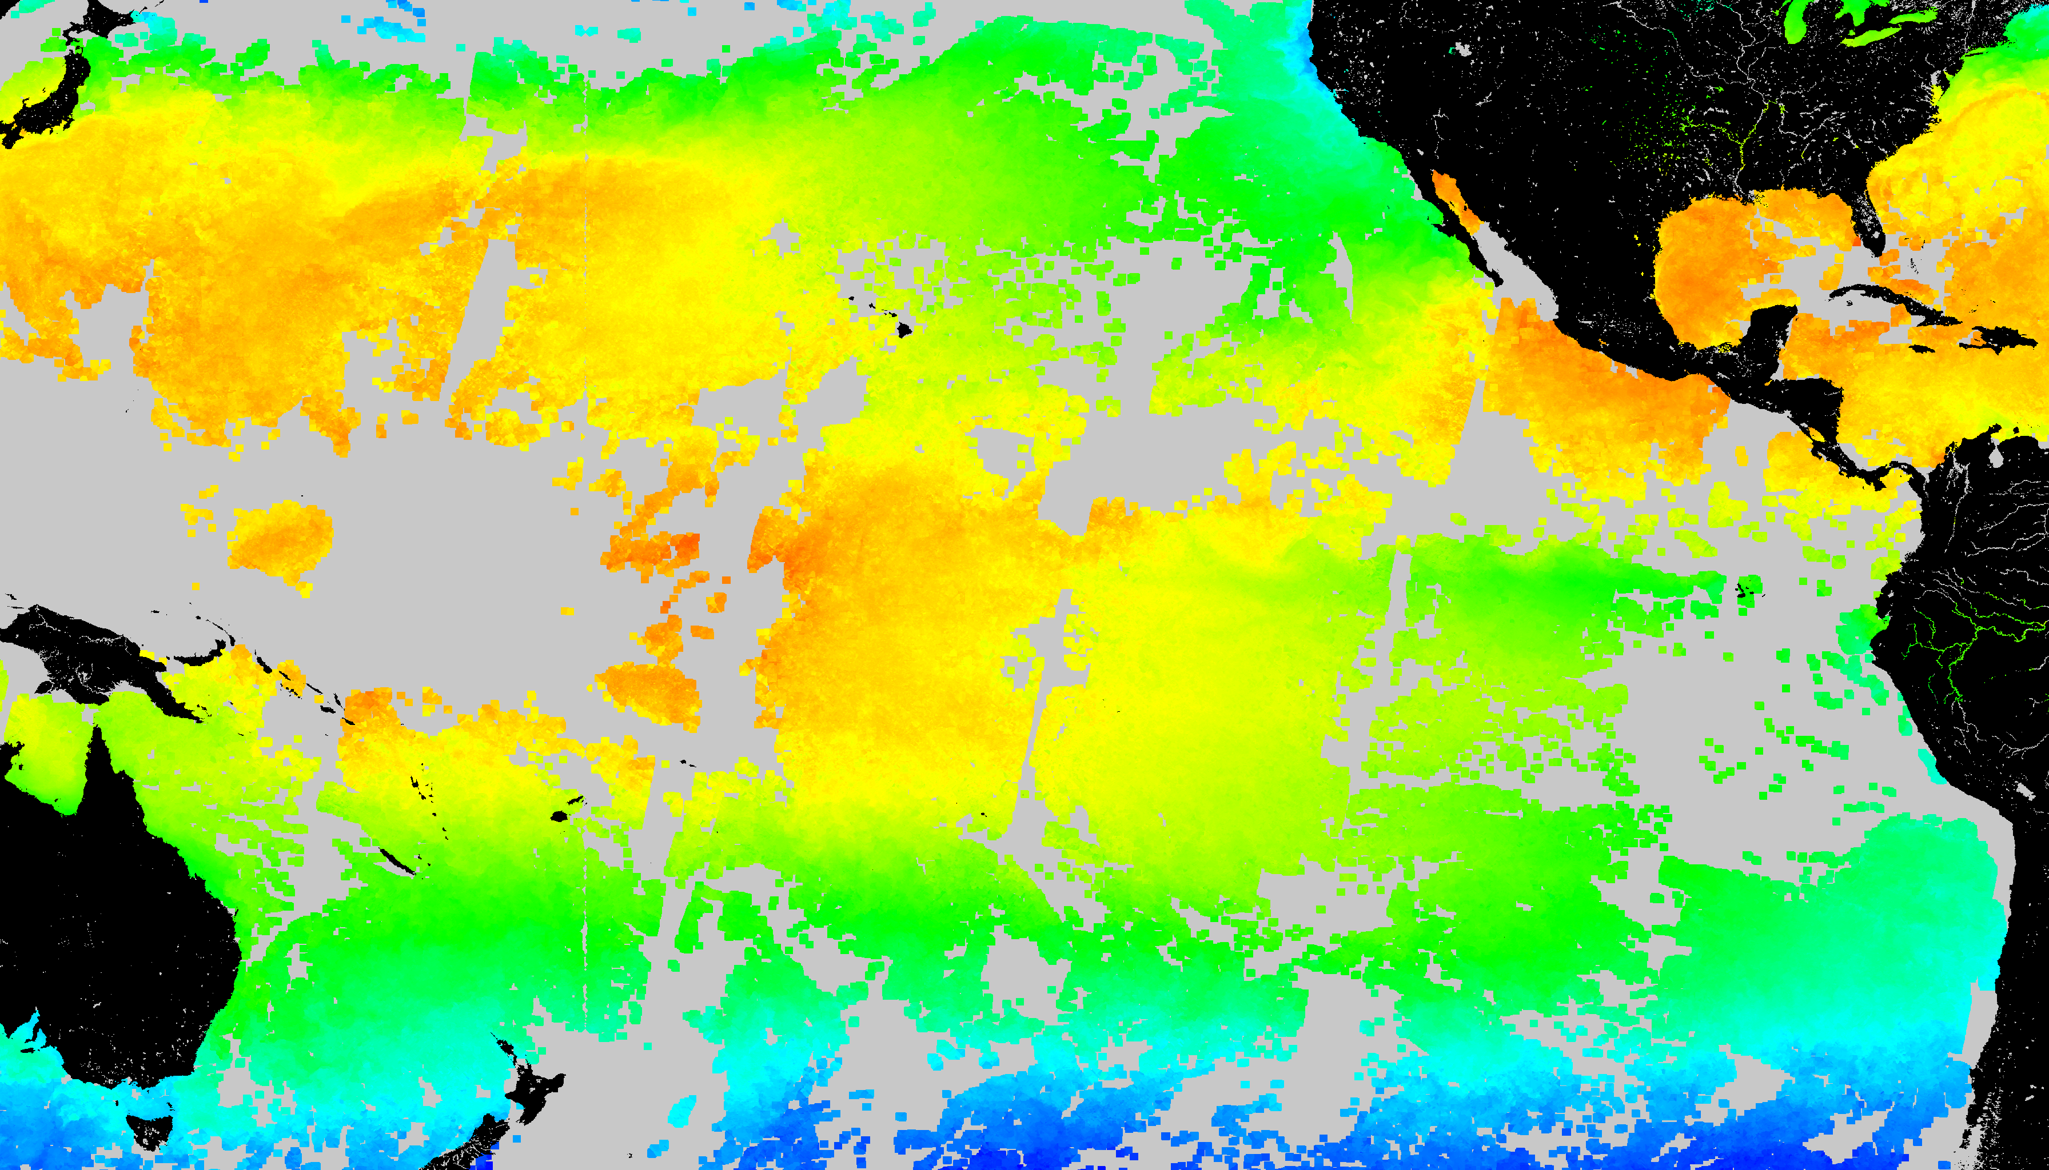
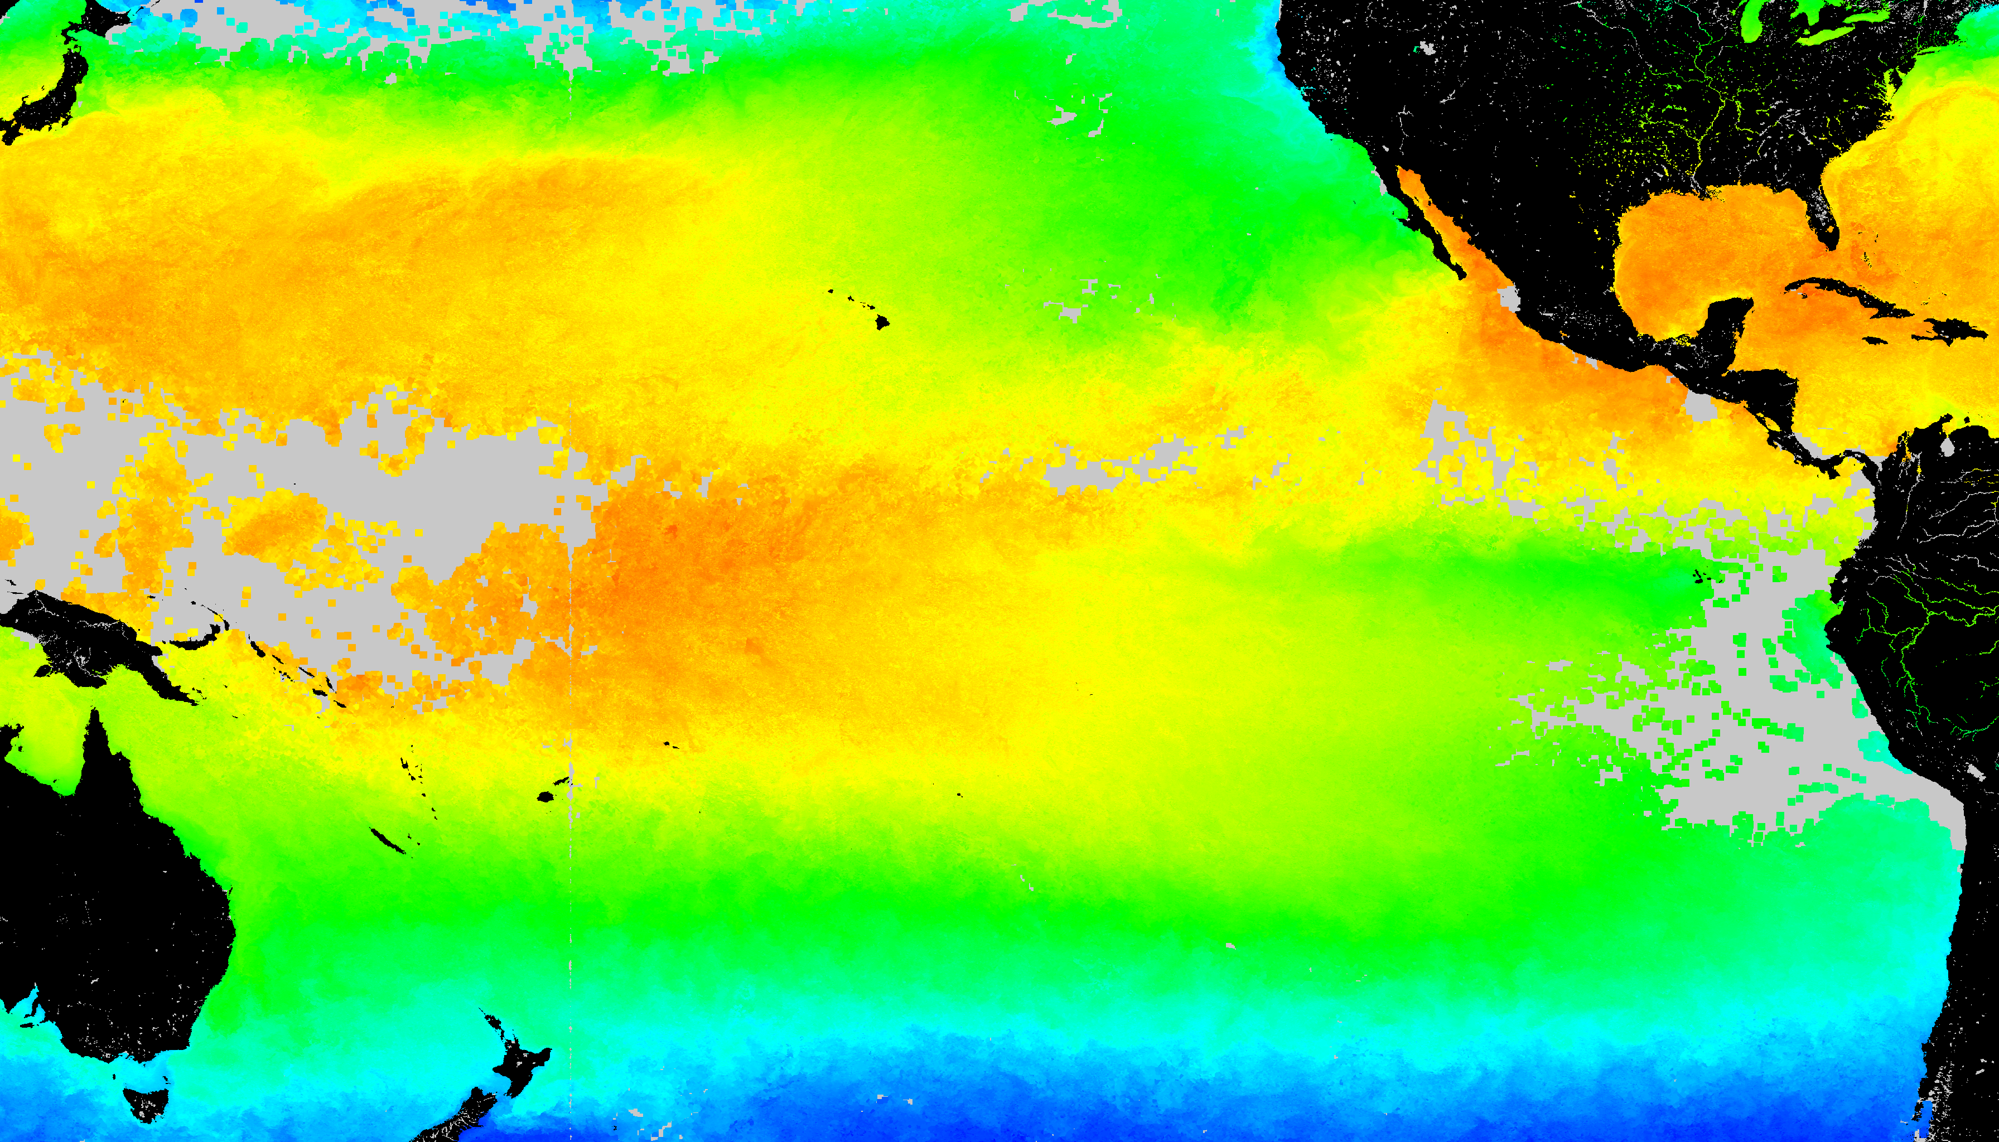
SST Coverage (August 10 2002)
With Gap
Temporal gap filling (≤ 30d)
Spatial gap filling (≤ 50 km)
Temporal + spatial gap filling

Slide 14
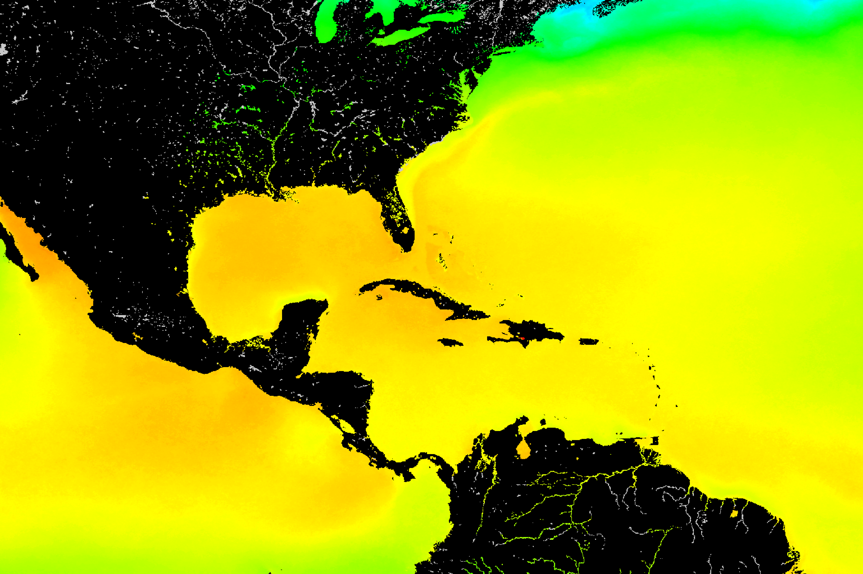
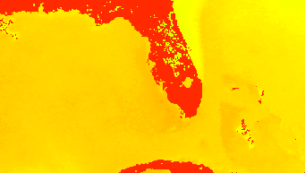
Maximum Monthly Climatology (MMM) based on Pathfinder SST
Global 4 km
Regional pseudo-1 km

Slide 15
USF 1 km HotSpot
http://imars.usf.edu
July 25, 2011
August 8, 2011

Slide 16
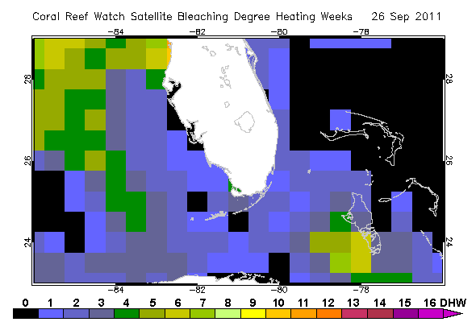
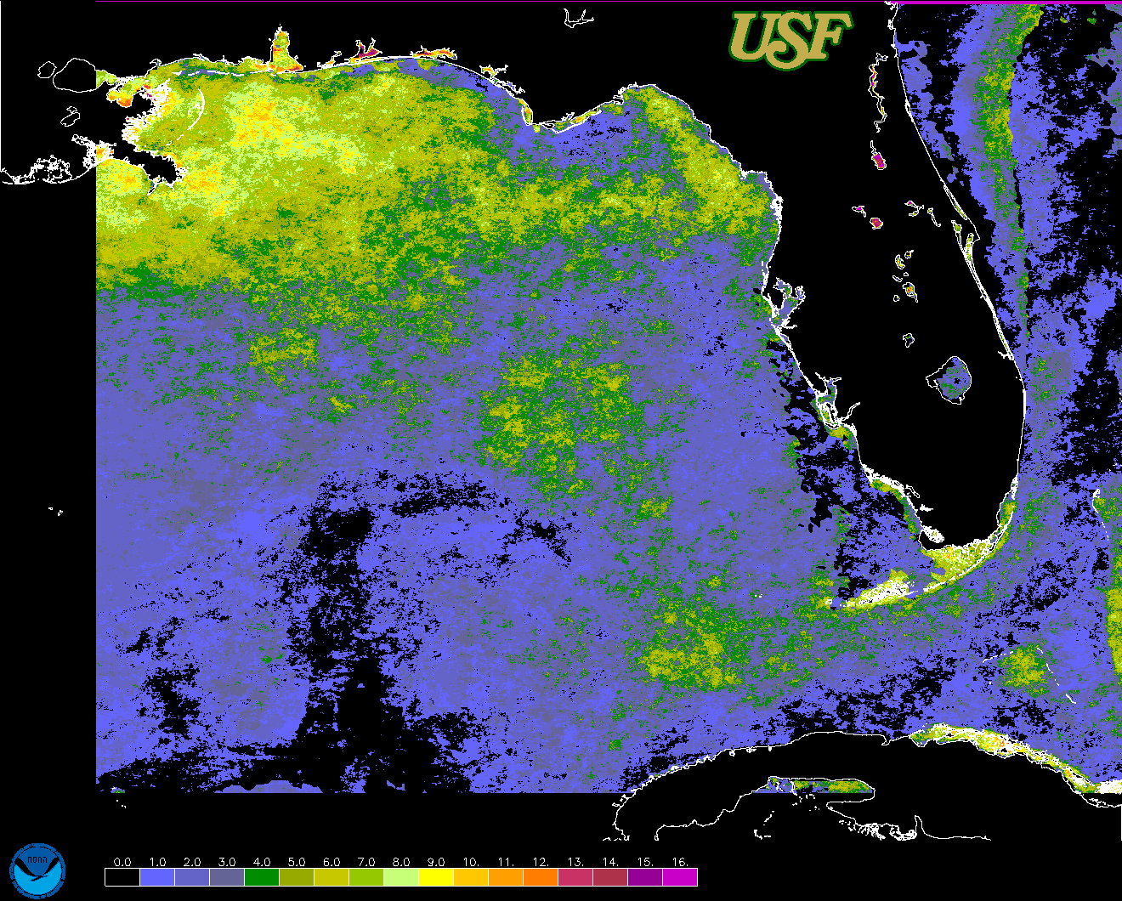
Degree-Heating Weeks (DHW) products for Florida
(September 15, 2011)
Enhanced 50 km NOAA product
E4km_DHW.20110915.florida.png

Slide 17
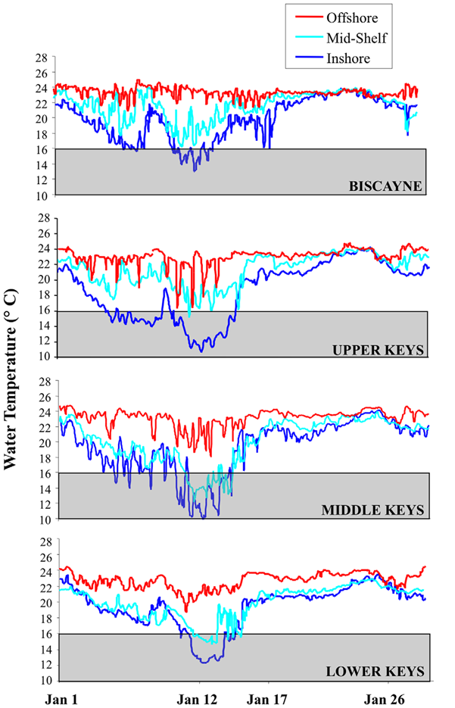
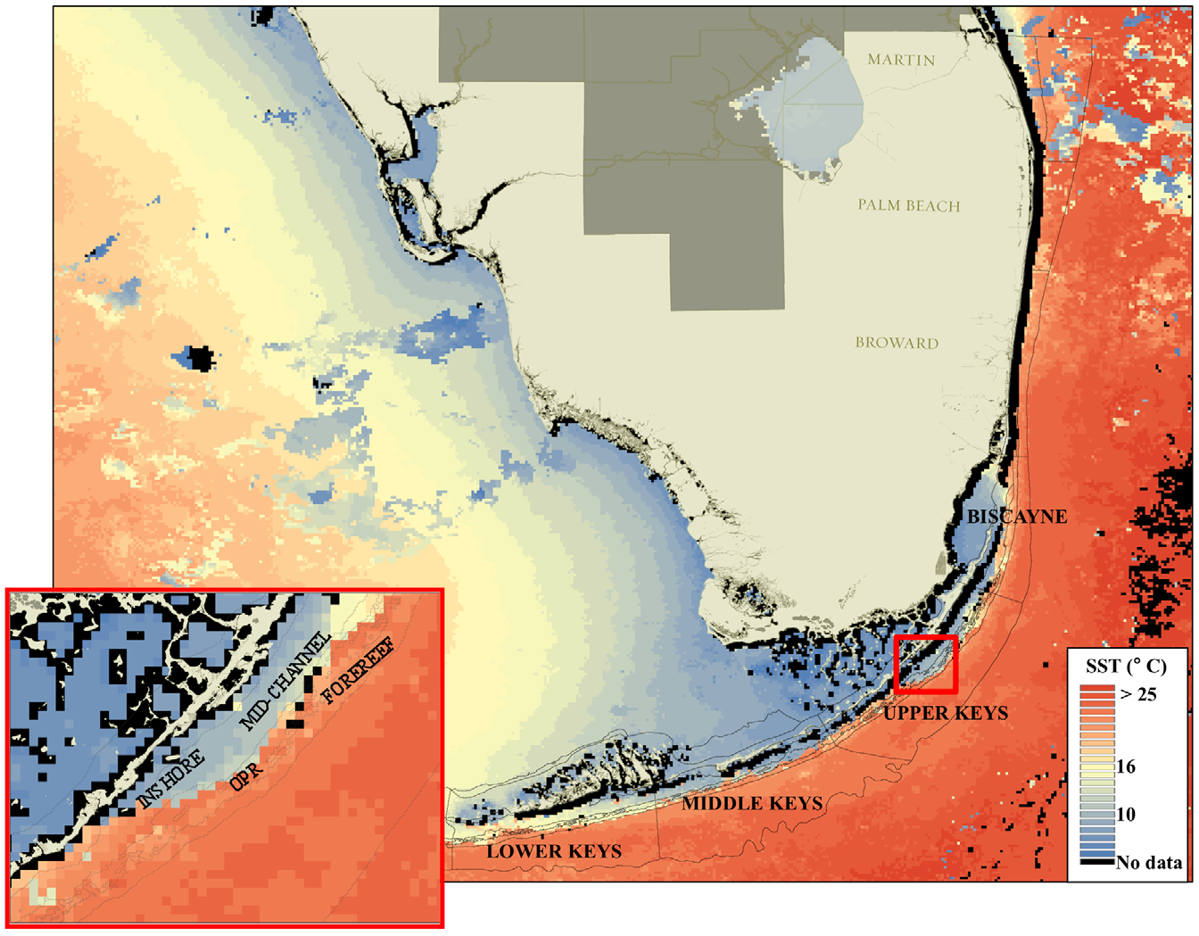
Cold Stress: 2010 Florida Keys Case Study
JAN 2010: Anomalously cold temperatures
Widespread mortality in coral reefs
SST observations helped guide a field survey
In situ temperatures
(from Lirman et al., 2011)

Slide 18
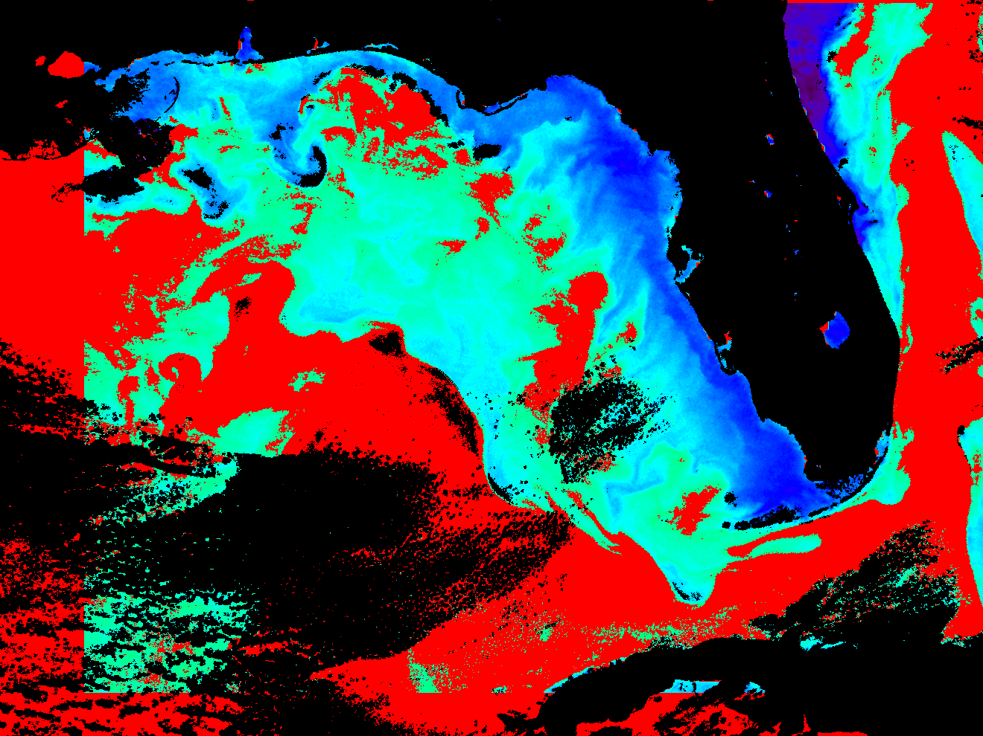
Preliminary Cold Snap Index: SST anomalies 1 SD or larger
below minimum SST climatology around January 27, 2010
Purple and blue are the largest (coolest) deviations, light green and red are the smallest deviations (close to zero index, i.e. closest to the climatology).

Slide 19
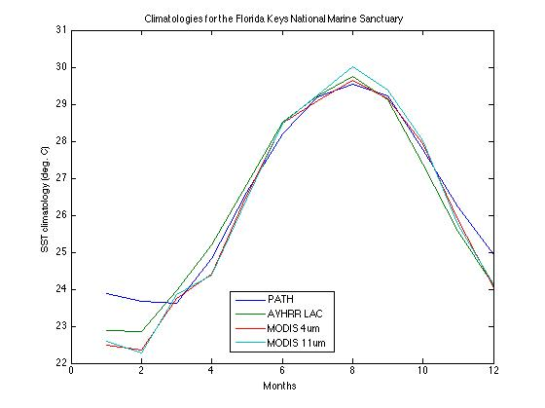
Issues: Climatologies, AVHRR vs MODIS SST
Example: SST in Florida Keys: 2003 to 2006
Pathfinder is warmer in winter in the FL Keys
AVHRR Pathfinder and AVHRR LAC: 1994 – 2006
MODIS Aqua: 2003 - 2006

Slide 20
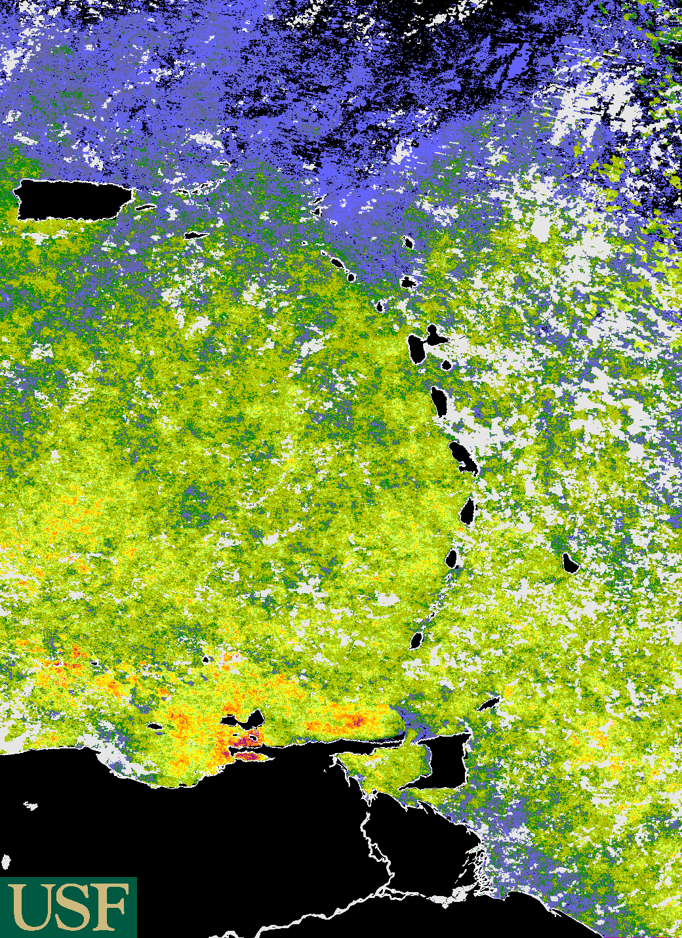
MODIS
CRW DHW product for the Eastern Caribbean
(E. Montes, M. Vega-Rodriguez,
E. Klein, A. Croquer,
M. Eakin, F. Muller-Karger, J. Li)
Los Roques
Archipelago
Based on MODIS Aqua (11um) nighttime only SST & PF
gap-filled climatology

Slide 21
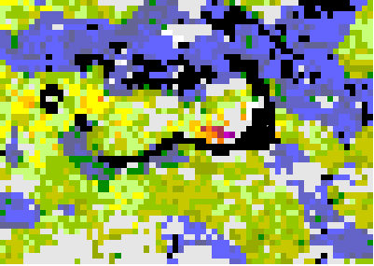
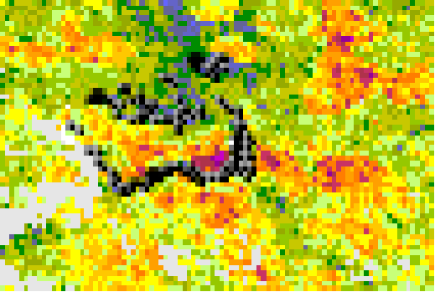
Preliminary results: bleaching years 2005 & 2010
in Los Roques, Venezuela
Degree-heating Weeks [C]
October 22, 2005
October 18, 2010
Thermal stress accumulated slower in 2005 compared to 2010.
With high resolution data, we can examine stress in different parts of an island in one year, and compare conditions in different years

Slide 22
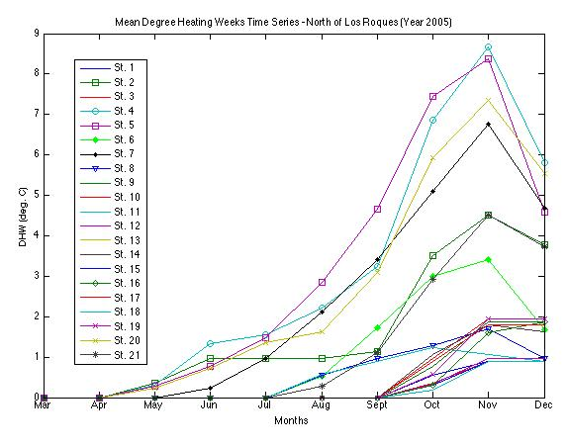
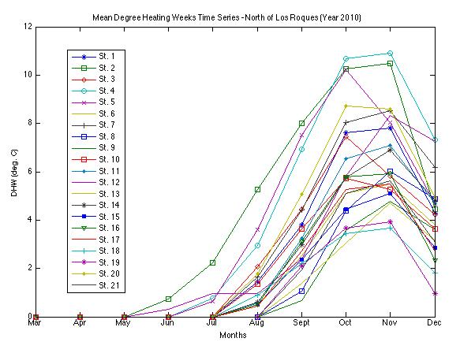
Preliminary results: bleaching in
Los Roques (Venezuela)
Degree Heating Weeks (DHW)
Northern coast of archipelago
Southern
coast of archipelago
Heating stress started 1 month earlier in 2005 but was weaker overall than 2010. In 2010 corals also showed stronger stress starting in the north side and across islands

Slide 23
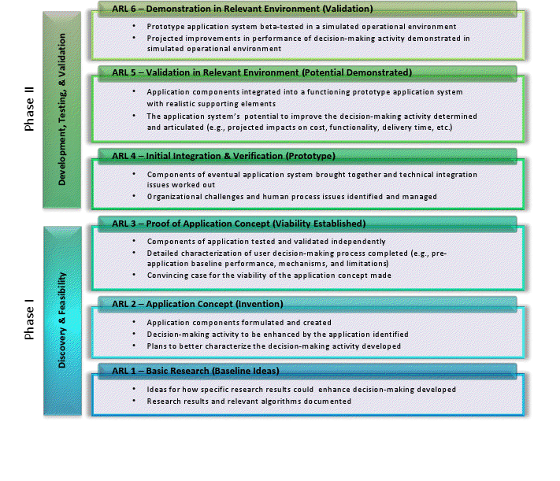
Applications Readiness Level (ARL)
ENDING
ARL
5 or >6
Present
ARL: 3-4
START
ARL 2

Slide 24
Summary: 2011-2012
Completed user survey for NOAA Coral Reef Watch products.
Developed prototype of global high-resolution 4 km SST climatology
New gap-filled trial versions being developed with NEX at NASA Ames
NOAA deployed website: 11 km global CRW products
USF website: 1 km CRW products for Florida Keys (AVHRR and MODIS)
Prototype cold water event index (cold snap index) for the Florida Keys
Applying new CRW data to test cases in the FL Keys and Caribbean
UNEP WCMC integrated the NASA Coral Reef Millennium Map into their online databases with a Map server interface (http://data.unep-wcmc.org/datasets/13).

