Slide 1
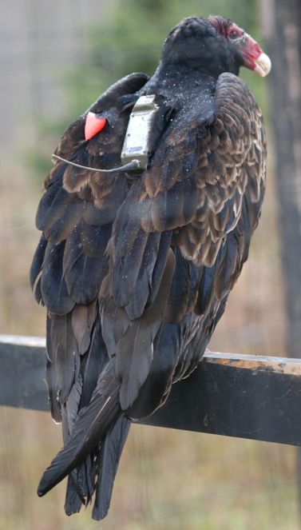
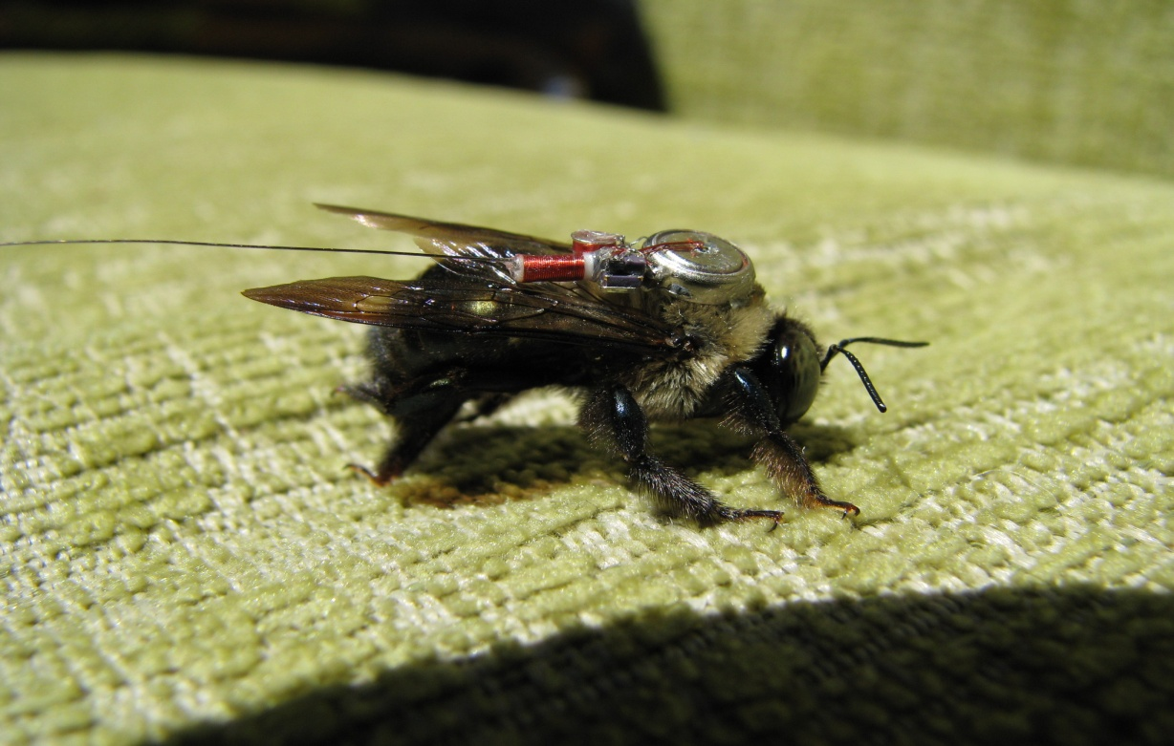
Discovering Relationships between Climate and Animal Migration with New Tools for Linking Animal Movement Tracks, Weather and Land Surface Data
Gil Bohrer, Somayeh Dodge
Department of Civil, Environmental & Geodetic Engineering The Ohio State University
Martin Wikelski, Rolf Weinzierl
Max Plank Institute for Ornithology
Roland Kays
North Carolina Museum of Natural Sciences
David Brandes
Lafayette College
Steve Garrity
Los Alamos National Laboratory
Jiawei Han
University of Illinois Urbana Champaign
David Douglas
USGS
NASA Biological Response PI Meeting Seattle 4/2012

Slide 2
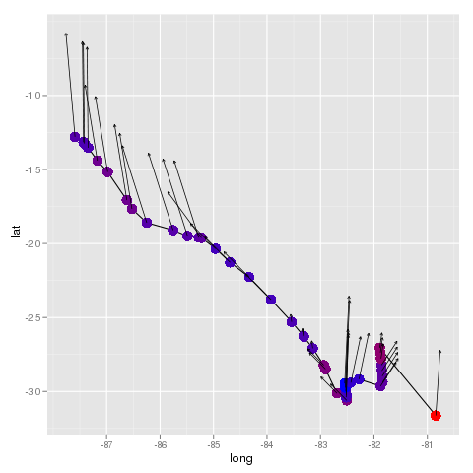
Approach:
Track annotation – linking environmental data to observed track points
Albatross movement to Galapagos

Slide 3
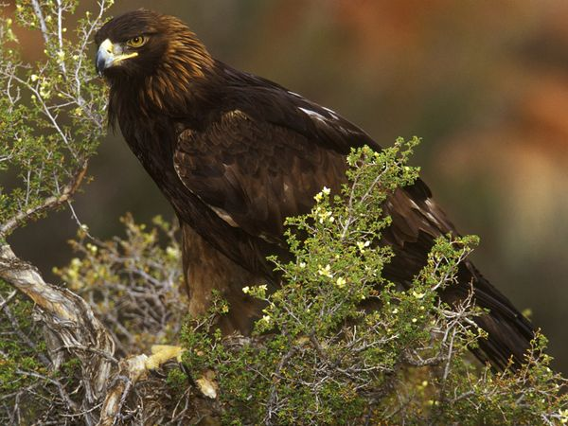
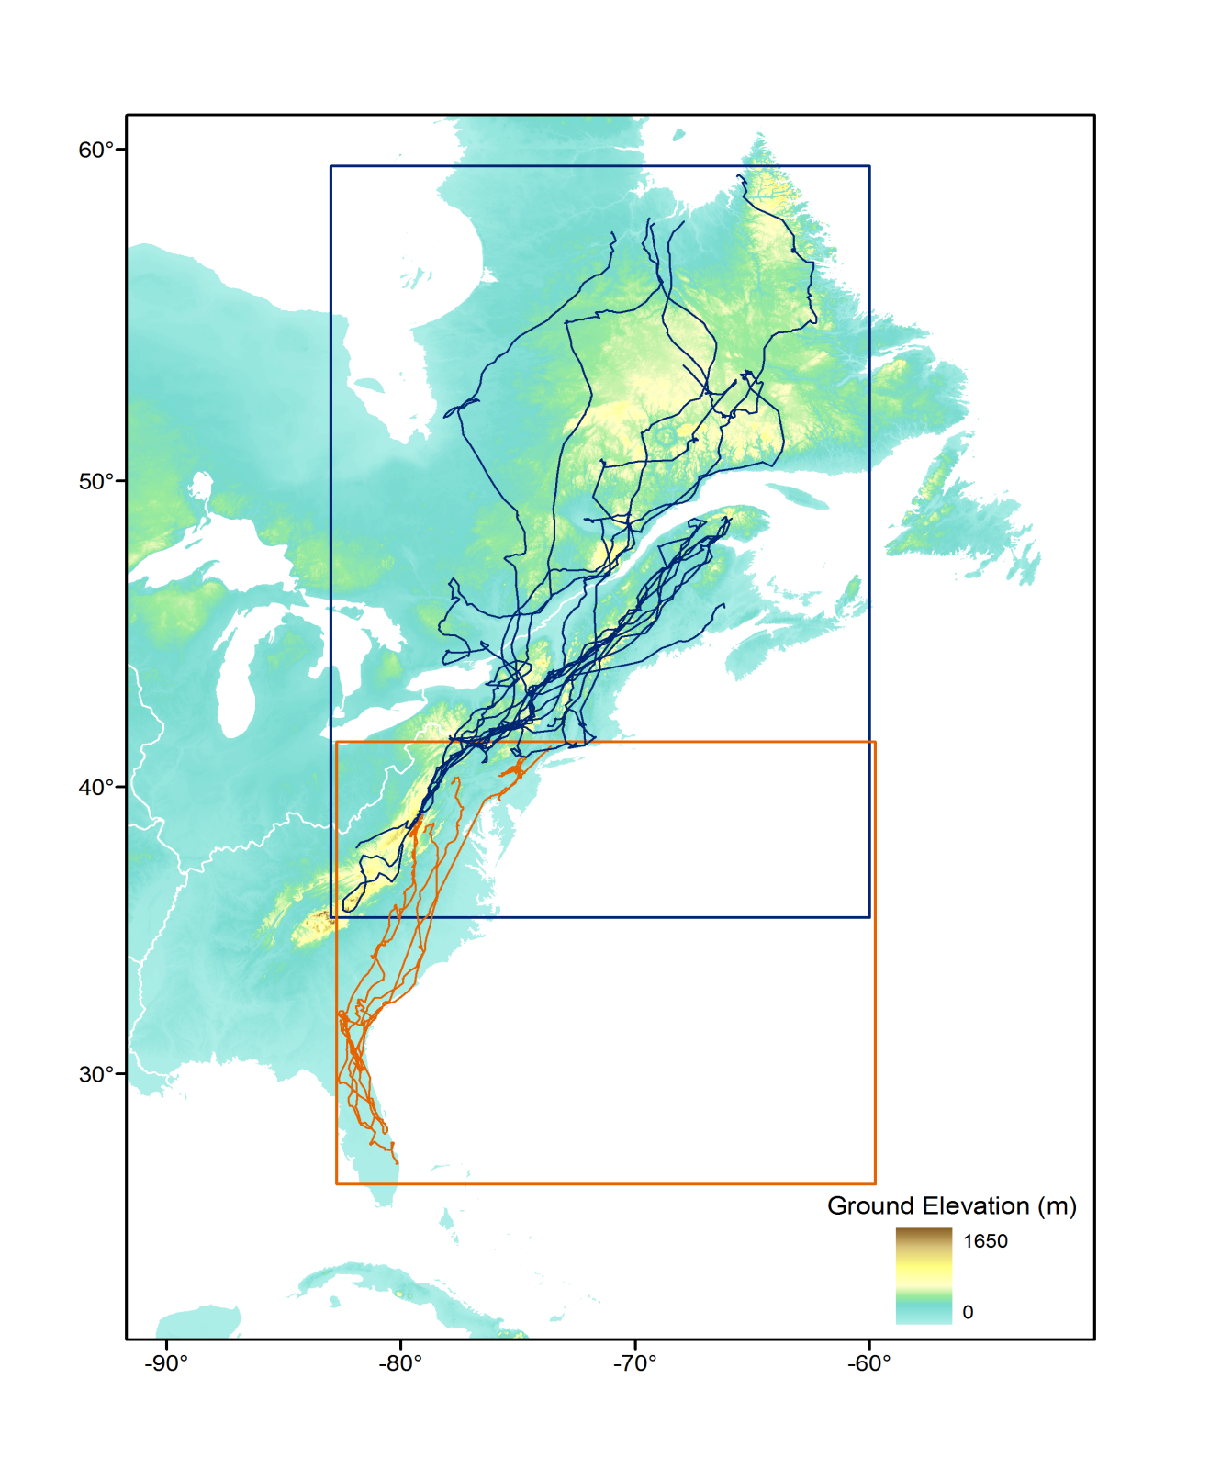
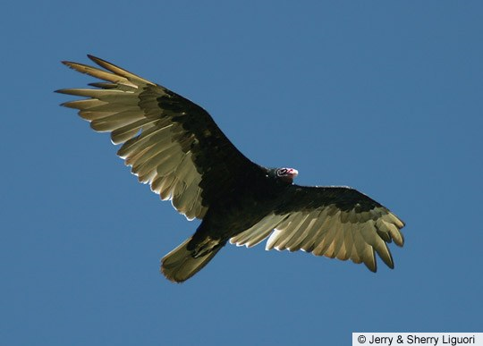
Showcase 1 - Flight preferences of Turkey Vultures and Golden Eagles
Key Questions:
Do Turkey Vultures and Golden Eagles have the same preference for wind conditions?
Do they actively target specific uplift modes?
Challenge
Partial overlap in space and time between Vulture and Eagle experiments limits direct comparison
Golden Eagles 2007-2009
Turkey Vultures 2005-2007

Slide 4
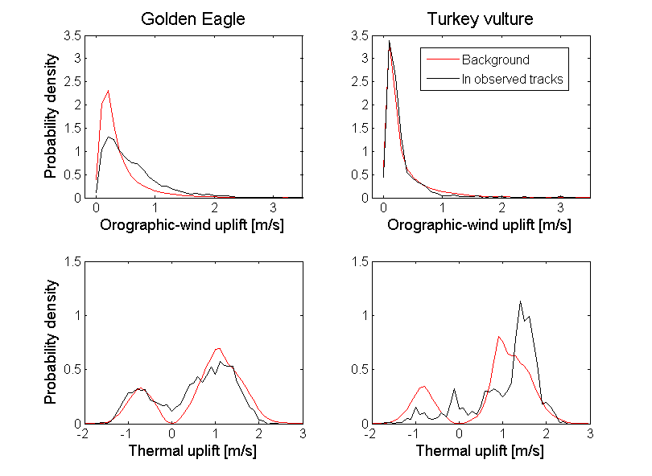
Conclusions – Contrasting uplift-mode preferences

Slide 5
Showcase 2 – Wind support in water birds
Albatross feeding migration Galapagos - Peru
click here to open 25M mp4 movie in separate window

Slide 6
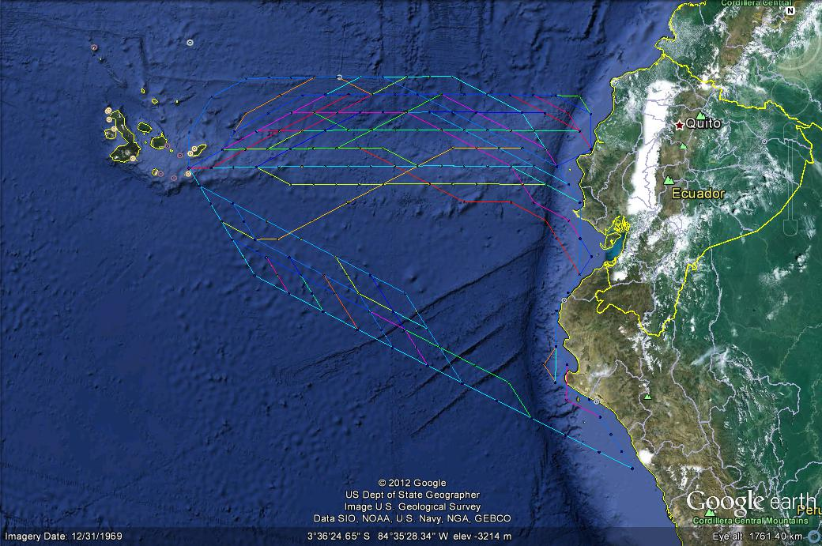
Optimization of wind support drives albatross path choice

Slide 7
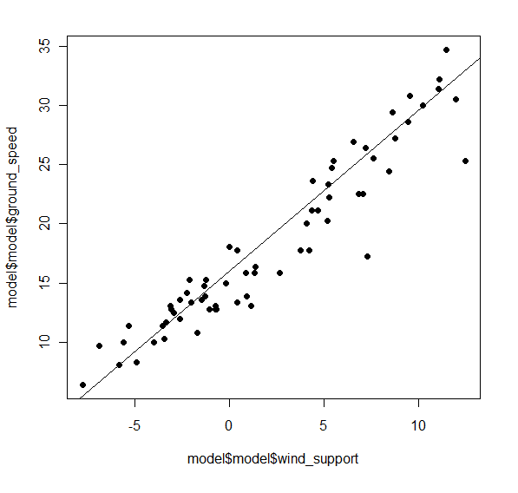
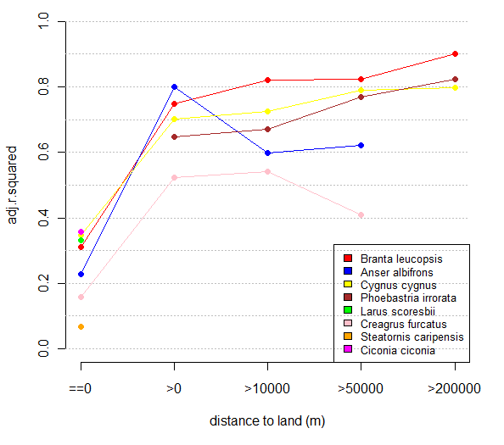
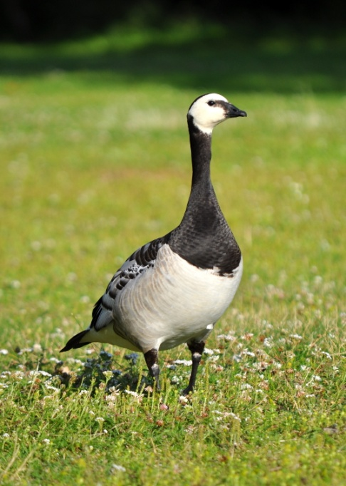
Not only albatrosses – Most water birds make smart use of offshore wind
Branta Leucopsis

Slide 8
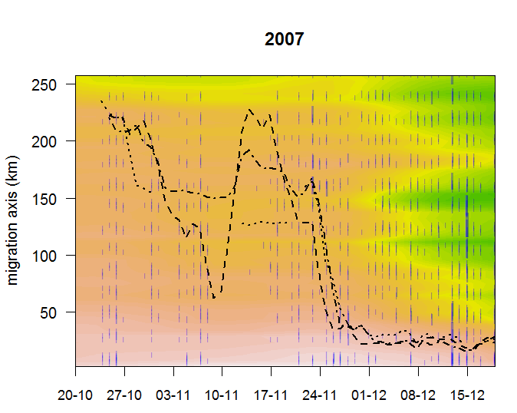
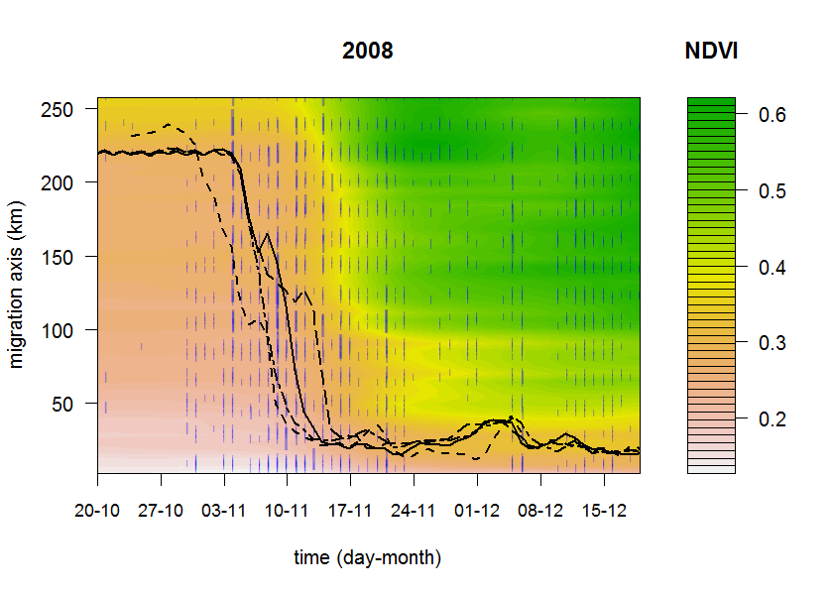
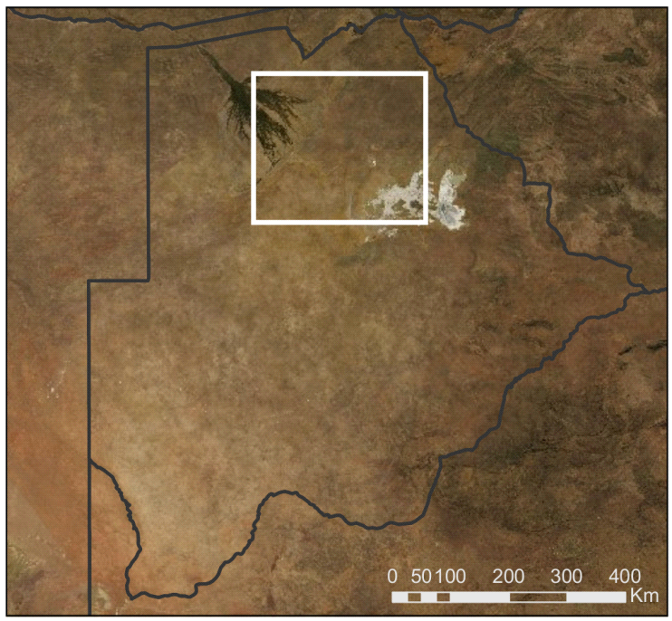
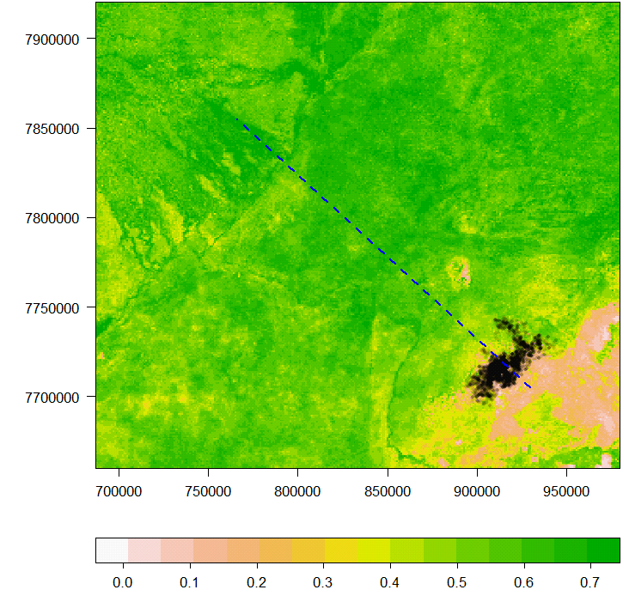
Showcase 3 - Landuse and timing of migration: Zebras NDVI and TRMM
A
)
m
(
e
d
u
t
i
t
a
L

Slide 9
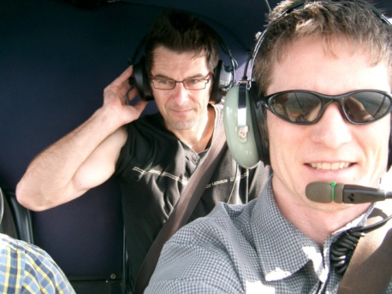
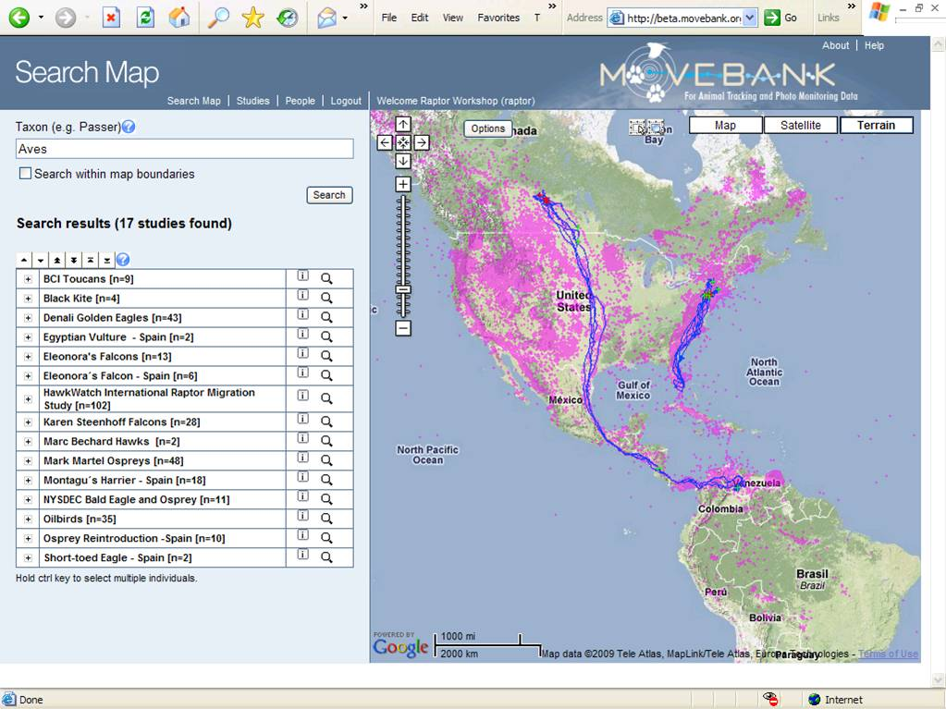
www.movebank.org

Slide 10
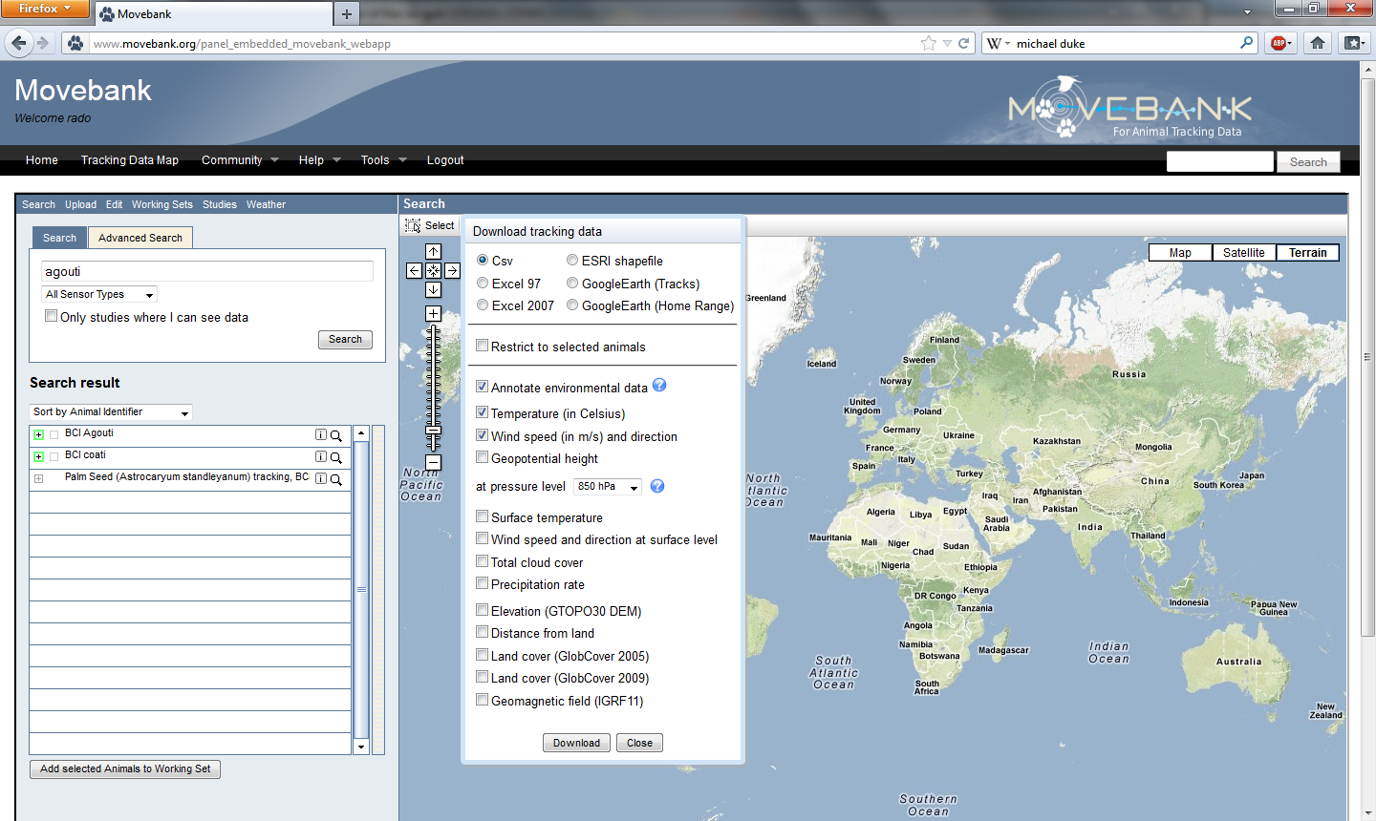
Track annotation GUI

Slide 11
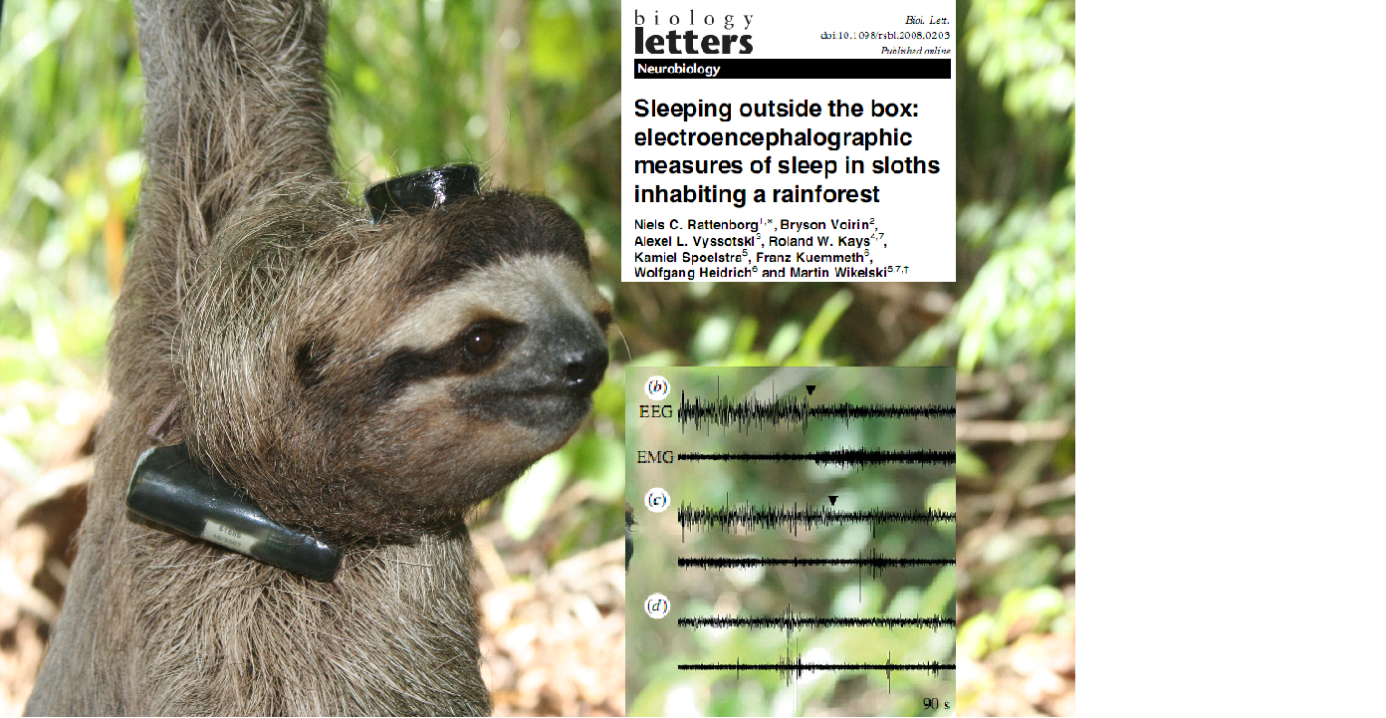
Additional data support – Physiological sensors, accelerometers, environmental sensors, Argos satellite telemetry, Geolocators Additional data analysis support – MoveMine, track segmentation, Habitat and niche classification (MaxEnt), Random track generation

