Slide 1





SHRINKING SNOWCAPS & RISING TIDES: RESPONSE OF THE ARABIAN SEA ECOSYSTEM TO RECENT CLIMATE CHANGE
Richard Barber Nicholas School of Environment Duke University
NASA Grant No - NNX07AK82G

Slide 2
RESEARCH TEAM
Joaquim I. Goes (lead PI) & Helga do Rosario Gomes , Bigelow Laboratory, ME, USA
Fei Chai, University of Maine, ME, USA
Sergio de Rada & John Kindle and Prasad Thoppil Naval Research Laboratory, MS, USA
John Fasullo, NCAR, Boulder, CO, USA
Prabhu Matondkar, National Institute of Oceanography, Goa, INDIA
Rashmin Dwivedi, Space Applications Centre, ISRO, INDIA
Adnan Al-Azri, Sultan Qaboos University, Muscat, OMAN

Slide 3
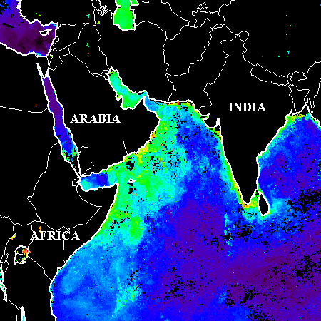
SUMMER MONSOON
LOW
HIGH
0.1
0.5
1.0
2.0
5.0
10.0
20.0
Schematic showing the reversal in wind direction during the southwest monsoon (Jun-Sept), superimposed on satellite derived chlorophyll fields

Slide 4
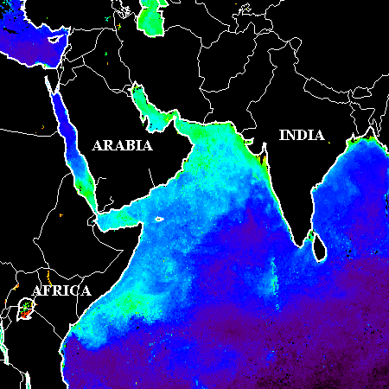
WINTER MONSOON
HIGH
LOW
0.1
0.5
1.0
2.0
5.0
10.0
20.0
Schematic showing snow cover extent and wind direction superimposed on an ocean color chlorophyll image for the northeast monsoon season (Nov-Feb).

Slide 5
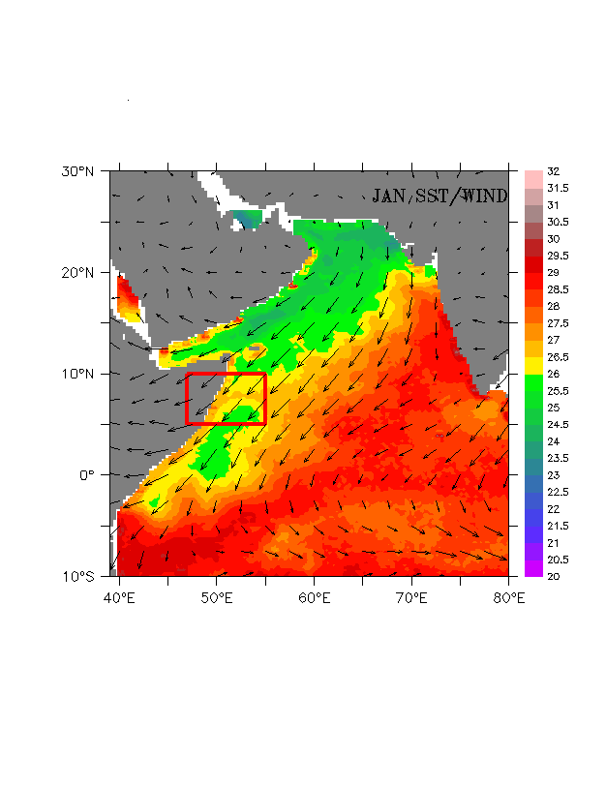
ARABIAN SEA - A UNIQUE ECOSYSTEM
Comes under the influence of seasonally reversing monsoon winds
Winds drive one the most energetic current systems and the greatest seasonality in phytoplankton productivity and carbon fluxes observable in all oceans
Intensity of winds is regulated by thermal gradient between land and the sea

Slide 6
SUMMER MONSOON
LOW
HIGH
0.1
0.5
1.0
2.0
5.0
10.0
20.0
Schematic showing the reversal in wind direction during the southwest monsoon (Jun-Sept), superimposed on satellite derived chlorophyll fields

Slide 7
HIGHER ALBEDO
LOWER ALBEDO
LESS SNOW
STRONGER LAND SEA PRESSURE GRADIENT
MORE SNOW
WEAKER LAND SEA PRESSURE GRADIENT
STRONGER SW MONSOON WINDS
LESS PHYTO
WEAKER SW MONSOON WINDS
SEA
WARMER LANDMASS
SEA
COLDER LANDMASS
WEAKER UPWELLING
Schematic showing the SW Monsoon response of the Arabian Sea to snow cover over the Himalayan-Tibetan Plateau

Slide 8
Interannual changes in chlorophyll in the core of upwelling region along coast of Somalia linked to the intensification of SW monsoonal winds
Goes et al. (2005) - Science

Slide 9
Trend line showing anomalies (departures from monthly means) of snow cover extent over Southwest Asia and Himalayas-Tibetan Plateau between 1967 and 2003.

Slide 10
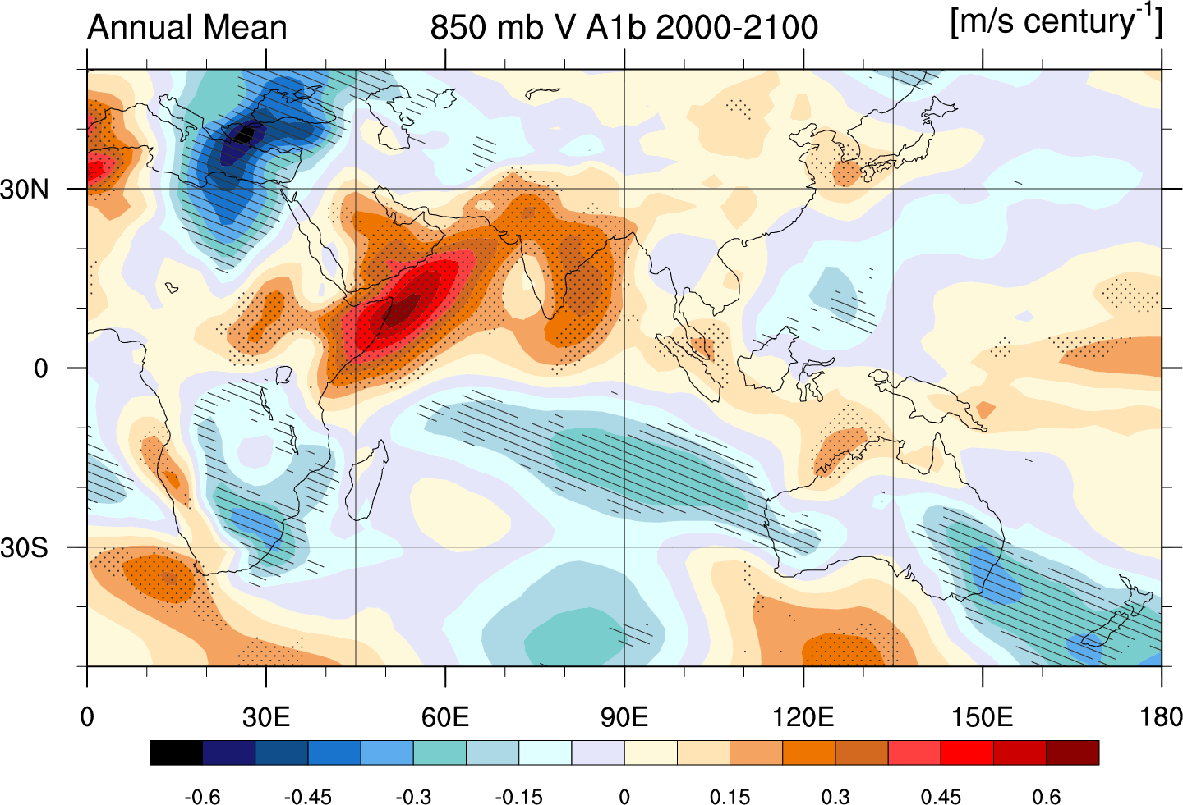
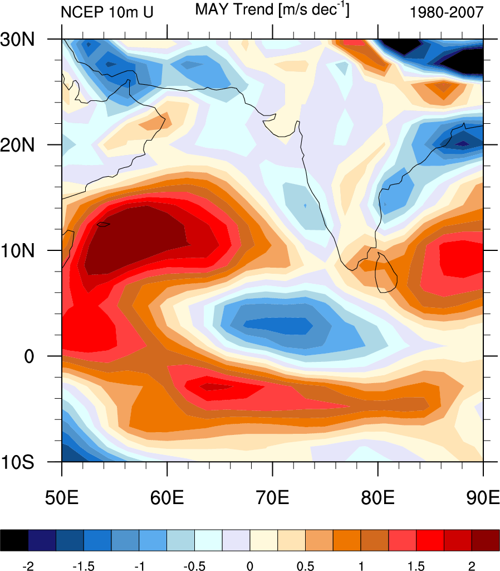
WIND SPEED TRENDS (1980-2007) NCEP/NCAR
Coupled Model Intercomparison project (CMIP3)-mean 21st Century trends in Annual Mean Meridional Wind in the Indo-Pacific Region

Slide 11
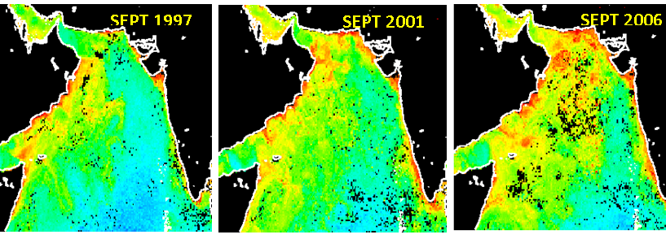
Chlorophyll fields during the peak southwest monsoon seasons of 1997, 2001 and 2006 showing continued increase in phytoplankton biomass due to intensification of winds and coastal upwelling

Slide 12
WINTER MONSOON
HIGH
LOW
0.1
0.5
1.0
2.0
5.0
10.0
20.0
Schematic showing snow cover extent and wind direction superimposed on an ocean color chlorophyll image for the northeast monsoon season (Nov-Feb).

Slide 13
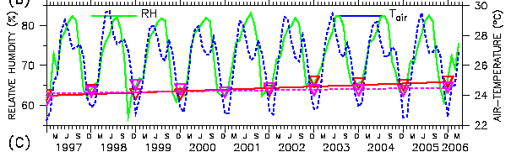
Air-temperature and Relative humidity for the northern Arabian Sea (60°E-70°E, 14°N-25°N) indicating that winds coming off the Indian subcontinent are becoming warmer and humid.
Notes:
13

Slide 14
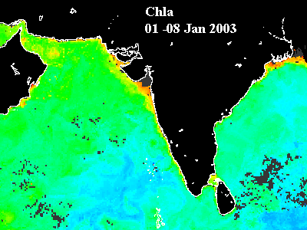
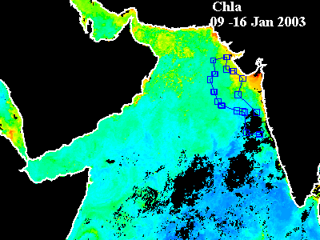
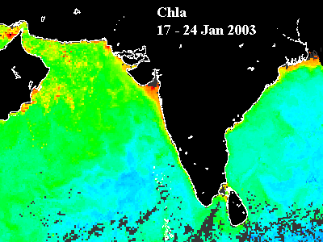
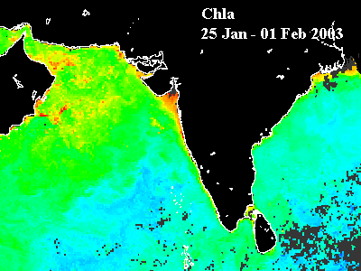
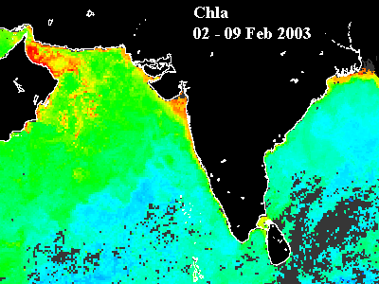
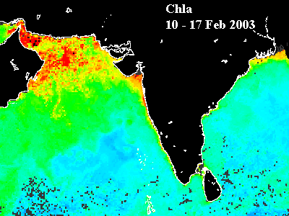
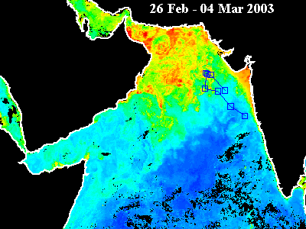
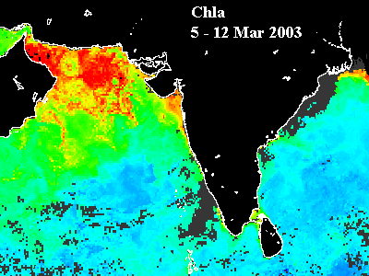
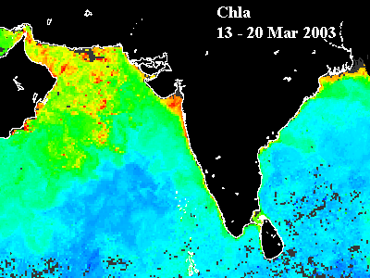
2003
DESPITE WEAKENING CONVECTING MIXING, ARABIAN SEA IS WITNESSING UNPRECEDENTED BLOOMS OF PHYTOPLANKTON

Slide 15
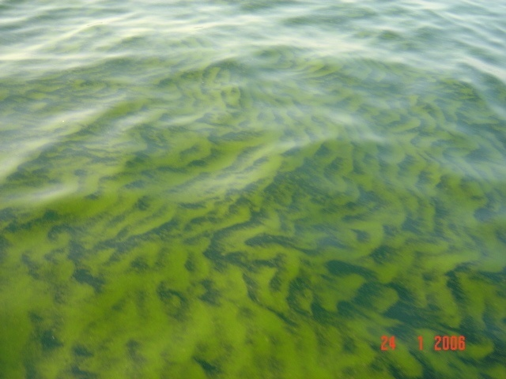
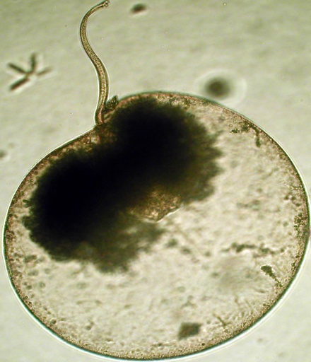
NOCTILUCA MILIARIS BLOOM OF 2006
Dinoflagellate, thrives in (cold) <22ºC, nutrient rich and oxygen poor waters

Slide 16
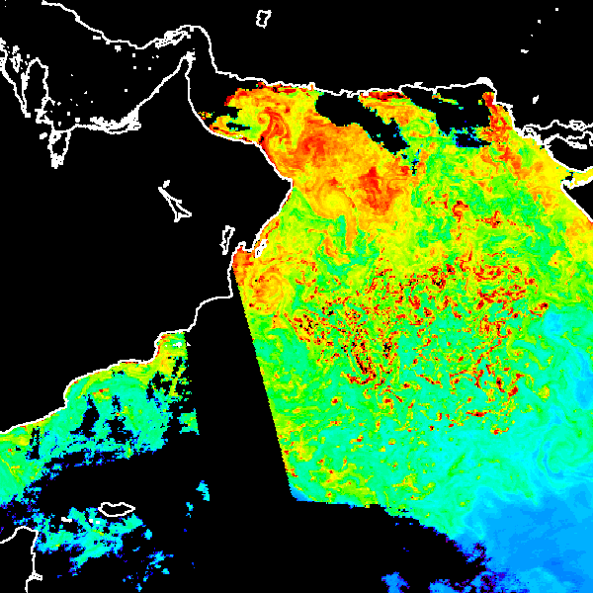
20th Feb 2008
OMAN

Slide 17
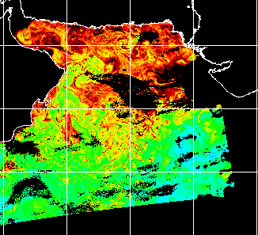
18th Feb 2010
INDIA
OMAN

Slide 18
ARABIAN SEA PHYTOPLANKTON COMMUNITY STRUCTURE

Slide 19
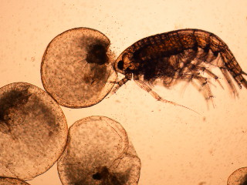
NOCTILUCA CAUSING ALTERATIONS IN FOOD WEB STRUCTURE

Slide 20
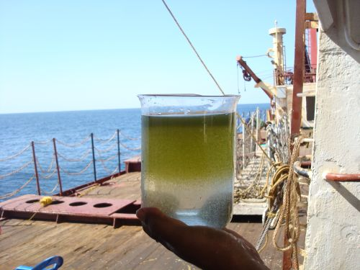
THICKNESS OF BLOOMS SUGGEST POSSIBLE BIOLOGICAL FEEDBACK FROM NOCTILUCA

Slide 21
Photophysiological properties of Noctiluca Blooms
80 to 90% of light absorbed by Noctiluca is dissipated as heat through NPQ.

Slide 22
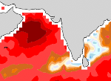
PHYTOPLANKTON BLOOM - MONSOON CONNECTION?
SSM/I PRECIPITABLE WATER TRENDS (June 1988-2006, mm decade⁻¹)
IS MOISTURE BUILDUP OVER ARABIAN SEA DUE TO BIOLOGICAL HEATING BY NOCTILUCA BLOOMS?
Notes:
22

Slide 23
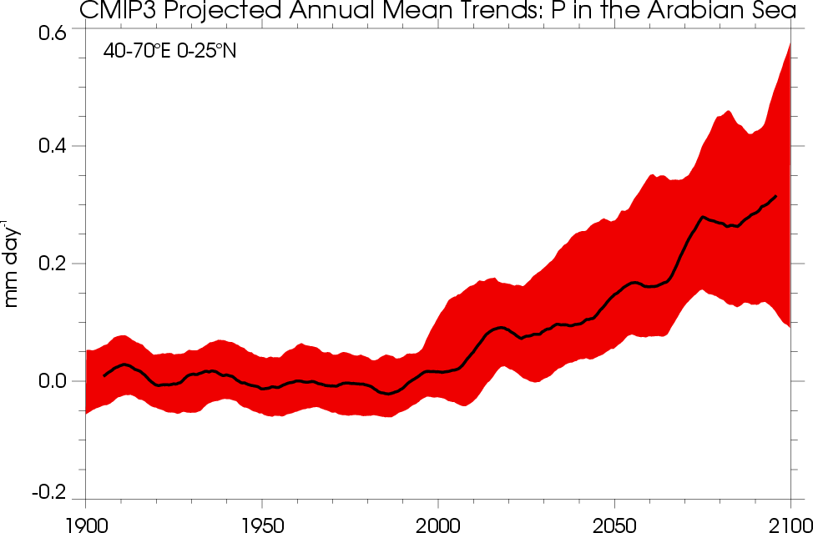

Slide 24
COUPLED MODEL DEVELOPMENT
Physical Model
Naval Coastal Ocean Model (NCOM)
  1/8-degree
  30S to 30N, 30.5E to 121.5E
  Mercator grid (~12km)
  40 Layer σ/z (19/21
  Data Assimilative
Coupled with Chai 9 component “COSiNE” Ecosystem Model
Notes:
24

Slide 25
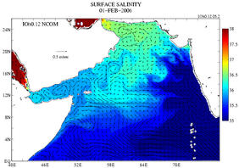
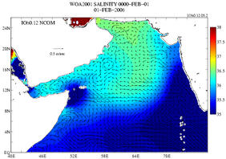
Sea Surface Salinity (1st Feb 2006)
Comparison of Sea Surface Salinity from NCOM Arabian Sea Model (left) with World Ocean Atlas Data. Model currents overlaid on both figures.

Slide 26
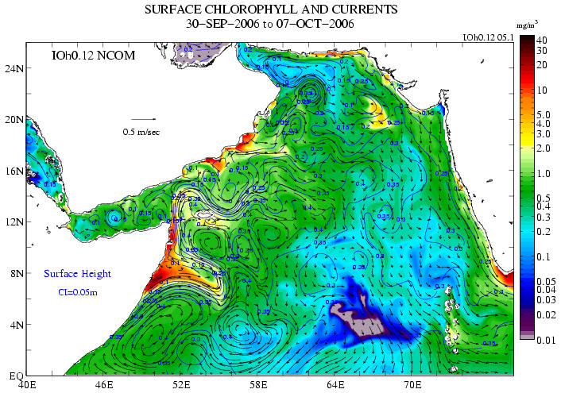
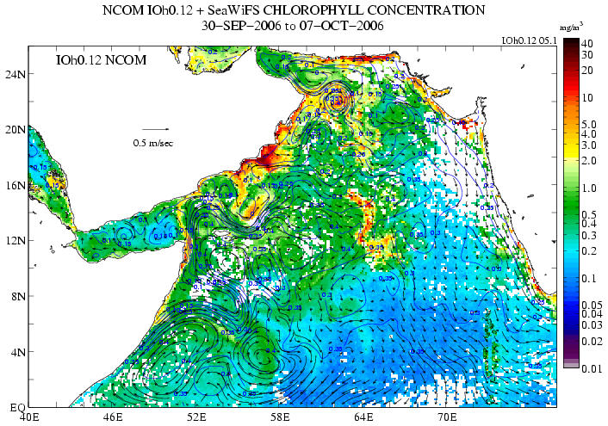
Biology (Sep 30-Oct 7, 2006)
Chlorophyll from NCOM IO Model (left) vs. SeaWIFS (right). Model currents overlaid on both figures.

Slide 27
NEXT STEPS
Modify Chai Ecosystem Model to include oxygen to understand the seasonal and inter-annual changes in the hypoxia and the emergence of Noctiluca blooms
Use model outputs to assess potential impacts of Noctiluca blooms on surface heating and moisture buildup during the Winter Monsoon of the Arabian Sea
Use outputs from coupled biogeochemical model into Weather Research Forecasting (WRF Ver.3) model to understand influence of blooms on rainfall over the Indian subcontinent.

Slide 28
THANK YOU

