Slide 1

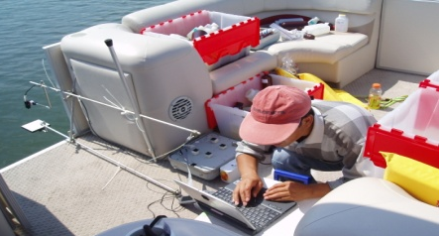

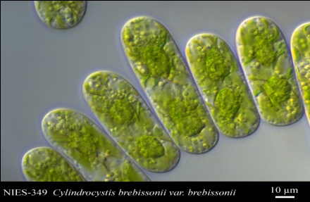
Remote Sensing of Global Warming-Affected Inland Water Quality
Lin Li (PI)
Meghna Babbar-Sebens (Co-I)
Kaishan Song (Postdoc)
Lenore Tedesco (Collaborator)
Graduate Students: Slawamira Bruder, Shuai Li, Shuangshuang Xie
Tingting Zhang
Department of Earth Sciences
Indiana University Purdue University Indianapolis
NASA Biodiversity and Ecological Forecasting Team Meeting
May 17-19, 2010

Slide 2
Outline
1. Cyanobacteria and Drinking Water Quality
2. Cyanobacteria and Global Warming
3. Pigments of Cyanobacteria
4. Study Sites
5. Questions to Be Addressed
6. Acknowledgement

Slide 3
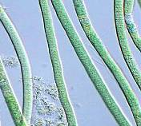


1. Cyanobacteria and Drinking Water Quality
Public Health
  Toxins
    Microcystin
    Cylindrospermopsin
    Anatoxin-a
  Alter taste and odor of drinking water
    MIB
    Geosmin
Ecological Effects
  Fish kills
  Additional effects
(Chorus and Bartram, 1999; Falconer, 2005)

Slide 4
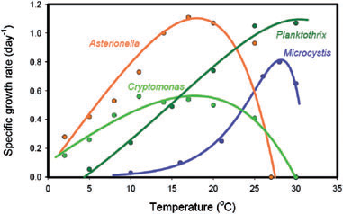
2. Cyanobacteria and Global Warming
Paerl and Huisman (2009), Environmental Microbiology Reports 1(1), 27-37.
Notes:
Temperature dependence of the specific growth rates of the cyanobacteria Microcystis aeruginosa (Reynolds, 2006) and
Planktothrix agardhii (Foy et al., 1976), the diatom Asterionella formosa (Butterwick et al., 2005) and the cryptophyte Cryptomonas
marssonii (Butterwick et al., 2005). The data are from controlled laboratory experiments using light-saturated and nutrient-saturated
conditions. Solid lines are least-squares fits of the data to the temperature response curve of Chen and Millero (1986).

Slide 5
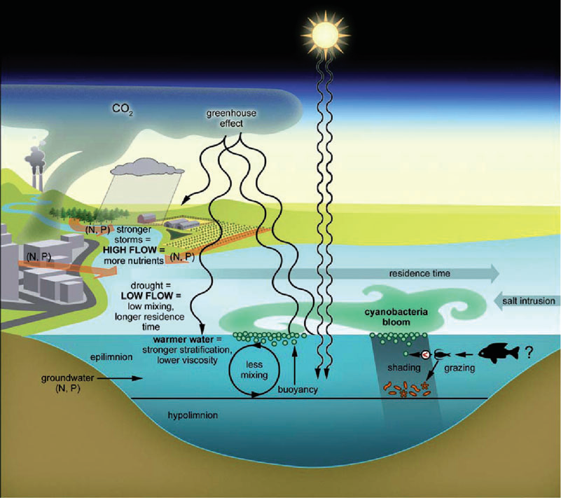
2. Cyanobacteria and Global Warming
Paerl and Huisman (2009), Environmental Microbiology Reports 1(1), 27-37.
Notes:
The formation of dense surface blooms (scums). When the water is turbulent, for instance, in cold waters with intense wind
mixing, the cyanobacteria are evenly distributed over the water column (left). However, when temperatures increase and there is
little wind mixing, the water column becomes stagnant and buoyant cyanobacteria will float upwards forming dense scums at the water
surface (right)

Slide 6
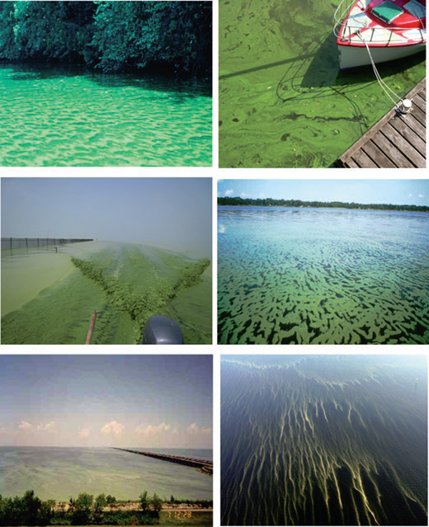
2. Cyanobacteria and Global Warming
Neuse River Estuary,North Carolina, USA
Lake Volkerak, the Netherlands
Lake Taihu,
China
St. Johns River, Florida, USA
Lake Ponchartrain, Louisiana,
USA
Baltic Sea-Gulf of Finland
Paerl and Huisman (2009), Environmental Microbiology Reports 1(1), 27-37.

Slide 7
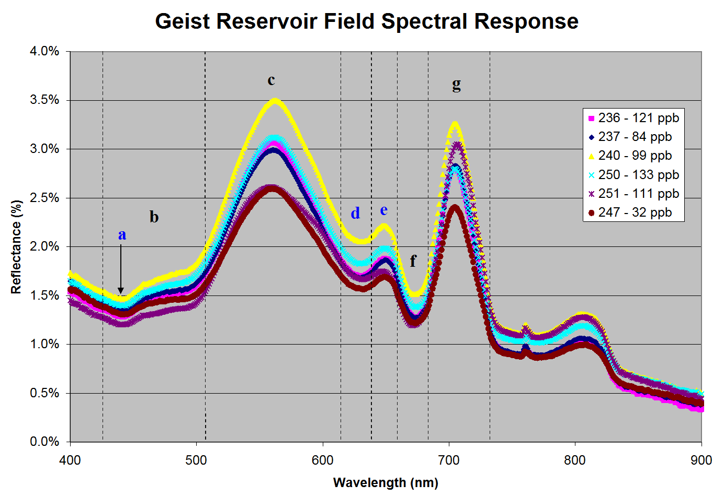
3. Pigments of Cyanobacteria
Cyanobacteria contain pigments
  Chlorophyll
  Phycocyanin
  Carotenoids/ Xanthophylls
Varies
  Species
  Light levels
  Other conditions
Optical properties
  Absorption
  Reflectance
  Cell Scattering

Slide 8
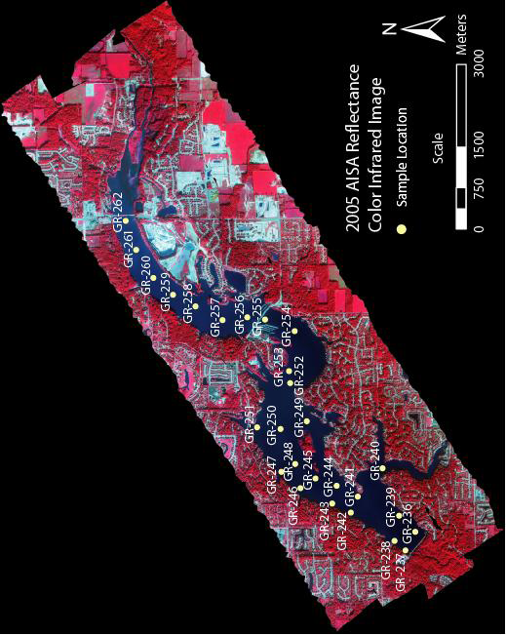
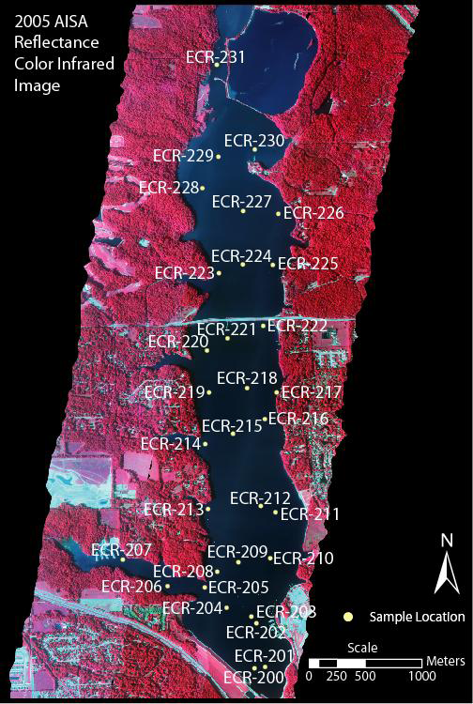
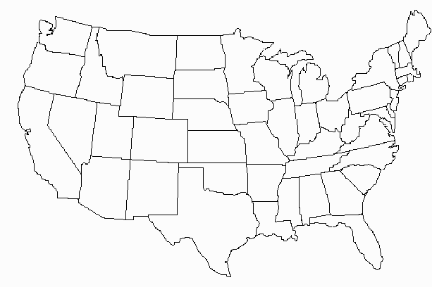
3. Study Sites

Slide 9
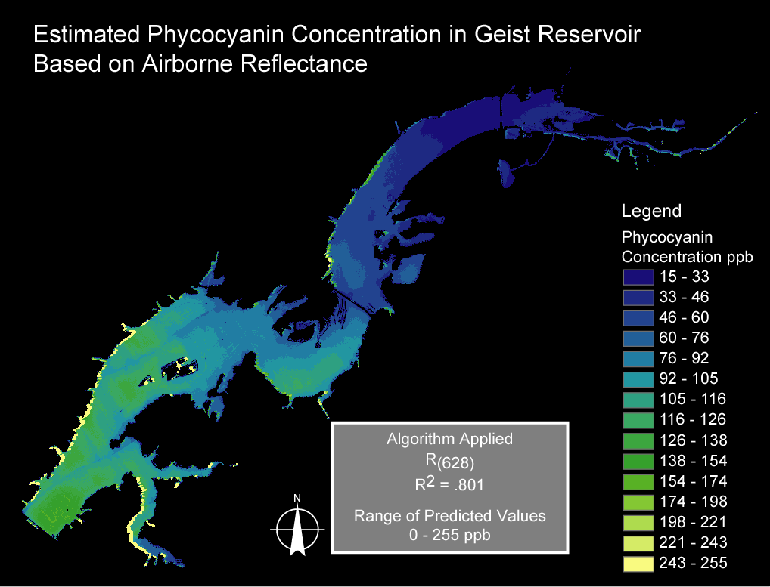
4. Questions to be Addressed
I) For a given reservoir, what spectral parameters are more sensitive to Chl-a and PC concentration and what interfering parameters affect the performance of these spectral parameters.

Slide 10
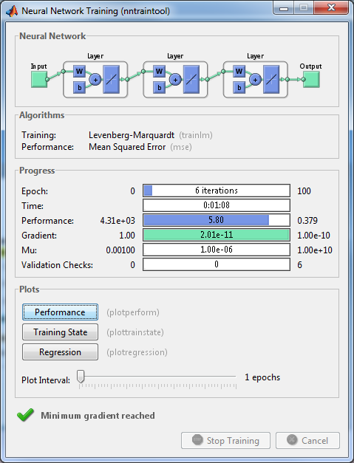
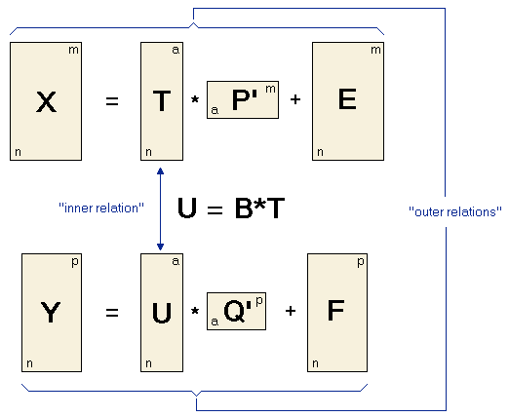
4. Questions to Be Addressed
II) For a given pigment, which mapping algorithm has good instrumental, temporal and spatial transferability.
Initialization
Evaluation
Fitness
function
Crossover
Mutation
Computer model to simulate biological evolution
Goal is to minimize F while maximizing the correlation between X and Y

Slide 11
4. Questions to be Addressed
III) What spectral parameters highly correlate to a nutrient constituent in drinking water and whether a correlation is causal; if not, what other water quality parameters are responsible for this correlation.
Analysis Result for TP Concentration

Slide 12
4. Questions to be Addressed
Correlation analysis TP with other water parameters

Slide 13
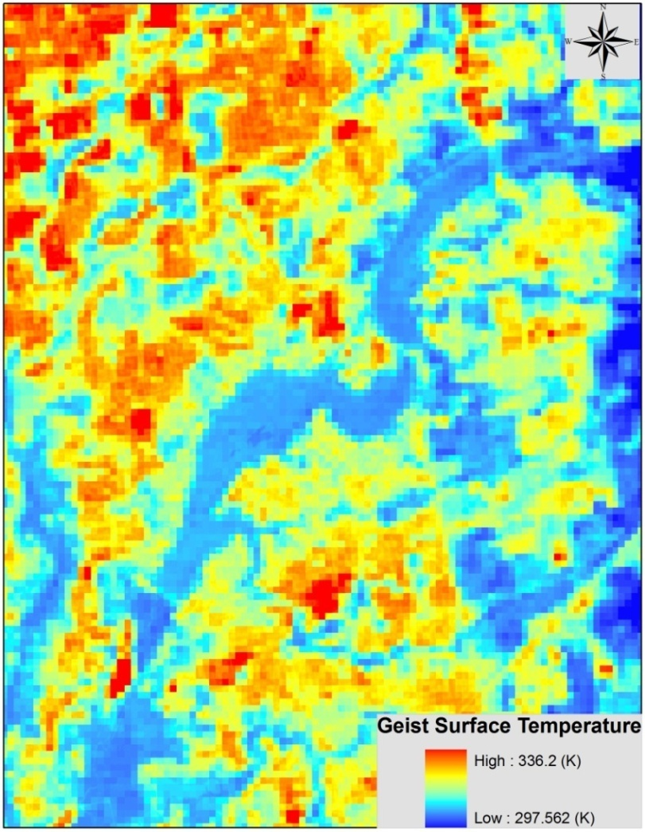
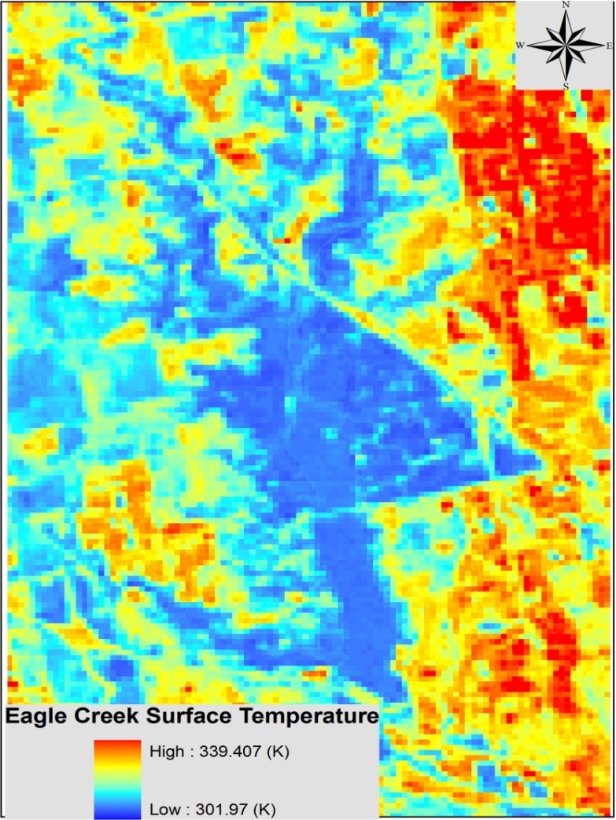
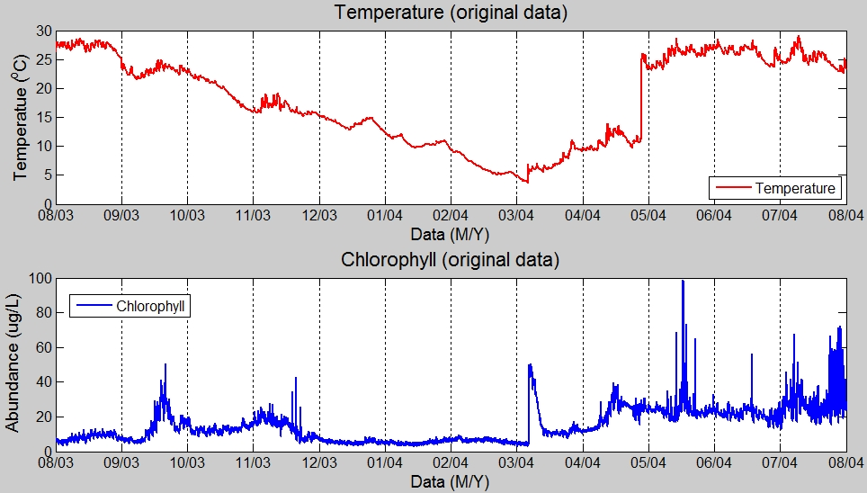
4. Questions to be Addressed
IV) Given the fact that temperature and nutrients are important factors for the occurrence of CYBB, whether high correlations can be observed among the spatial patterns of Chl-a, PC, nutrient constituents and temperature in these reservoirs

Slide 14
4. Questions to be Addressed
V) Whether remote sensing mapping improves the parameterization of water quality models and thus their prediction accuracy.

Slide 15
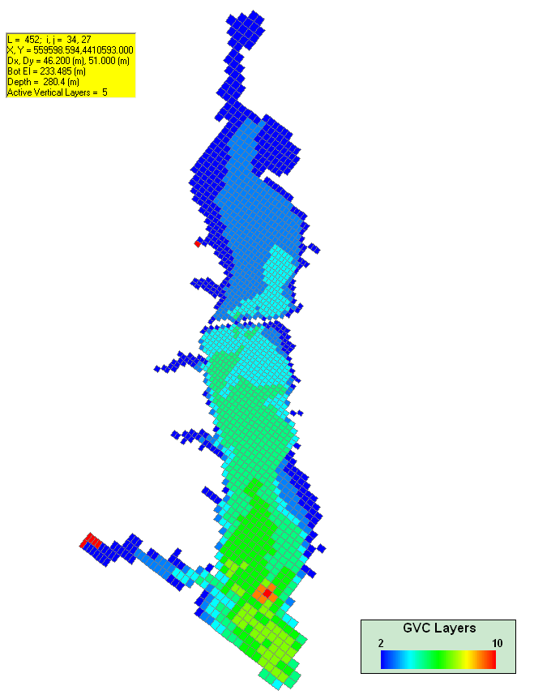
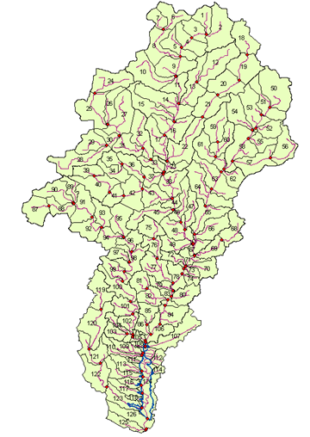
Spatial Representation of Land and Water Processes
1D and 2D hydrologic Processes
3D Hydrodynamic and Water Quality Processes

Slide 16
Data Assimilation Overview
Remote Sensing Reflectance Data
Satellite Image from NASA
Integrated Mechanistic Modeling Framework
Concentrations Derived from Remote Sensing Reflectance
ECR in-situ Field Measurement by CEES
Update Model States and Parameters
Concentrations Derived from Model Results
Ũ (t, x, y, z)
Model noise
Observed Concentrations
U (t, x, y, z)
Measurement noise and Process noise
Error
Within error bound?
Output Model Results
No
Yes

Slide 17
6. Acknowledgement
This project is supported by the National Aeronautics Space Administration (NASA) HyspIRI preparatory activities using existing imagery (HPAUEI) program and partially by the NASA Energy and Water Cycle program.

