Slide 1


Integrating remotely sensed data and ecological models to assess species extinction risks under climate change
Richard Pearson (AMNH)
Resit Akçakaya (Stony Brook University)
Jessica Stanton (SB)
Peter Ersts (AMNH)
Ned Horning (AMNH)
Chris Raxworthy (AMNH)

Slide 2
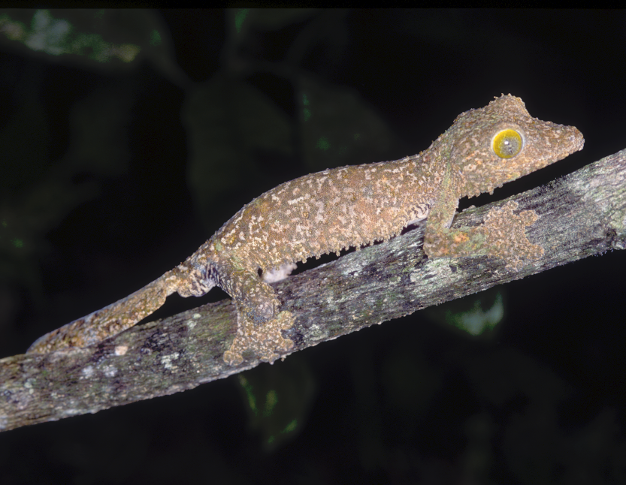
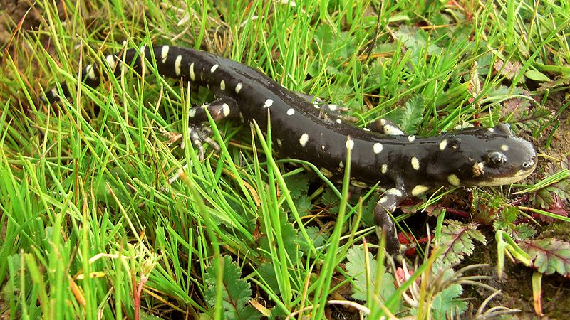
Key objectives:
Develop and test methods for incorporating remotely sensed data in predictions of habitat suitability under climate change
Link habitat and metapopulation models to assess extinction risk under climate change
Case studies:
amphibians and reptiles in the United States and Madagascar
Uroplatus samieti
California tiger salamander
Photo: Chris Raxworthy
Photo: John Cleckler (FWS)

Slide 3
Data assimilation:
1. In situ biological data (species occurrence records):
  United States: 49 species, records from NatureServe and GBIF
  Madagascar: 46 species, records from recent surveys and natural history collections
Remotely sensed data, for both USA and Madagascar:
  MODIS:
    EVI monthly L3 Global (MOD13A3) for 2001/2009
    GPP for 2004/2006 Collection 5 (C5.1)
    NPP for 2004/2006 Collection 5 (C5.1)
    VCF for 2003/2005 Collection 4 (C4)
  Global Land Cover 2000
3. Climate data:
  USA: Generating future scenarios based on PRISM baseline and using MAGICC/SCENGEN to draw on IPCC FAR database
  Madagascar: Worldclim
4. Demographic data (e.g., life span, age of first reproduction):
  Extensive literature search

Slide 4
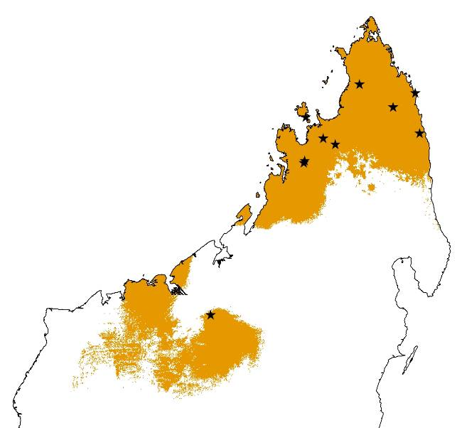
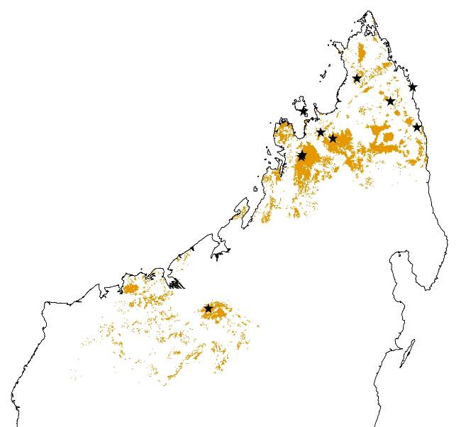
Key objective 1:
Incorporating remotely sensed data in predictions of habitat suitability under climate change
Predictions of habitat suitability that rely on climate data alone (‘bioclimate envelopes’) are prone to over-predict
Climate and forest cover (Landsat ETM+)
Climate-only
Remotely sensed data provide a crucial, yet under-exploited, resource for incorporating habitat fragmentation into climate change assessments

Slide 5
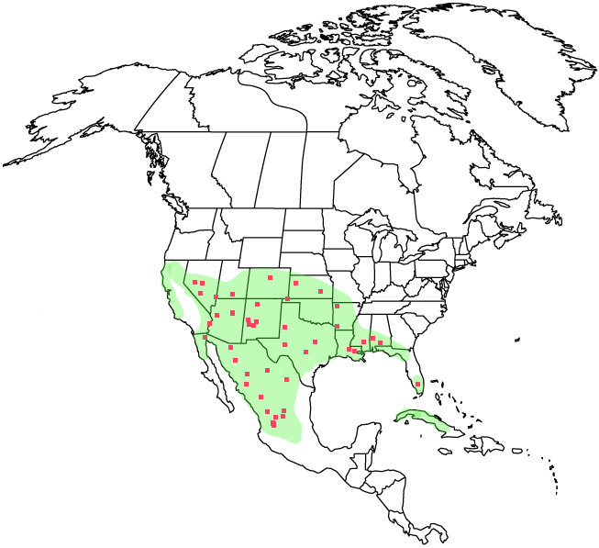
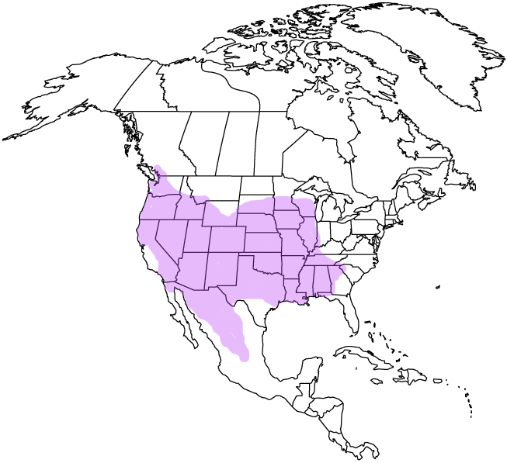
Correlation Models
Present Conditions
Future Projection
What is the best way to combine static and dynamic variables in species distribution models?
Climate model
Dynamic layers
(climate)
Projected climate
Static layers
(remote sensing)
Notes:
5

Slide 6
Testing alternative methods for modeling with
static and dynamic variables
Artificial species, with known ‘niches’
Dynamic variables: temperature and precip.
Static variables:
  Land-cover (non-interacting with dynamic variables)
  Soil (interacting with dynamic variables)
(included as predictor variables)
Correlation between true and fitted maps
(included if interacting; as a mask otherwise)
(used as a mask post-modeling)
(left out of the model completely)

Slide 7


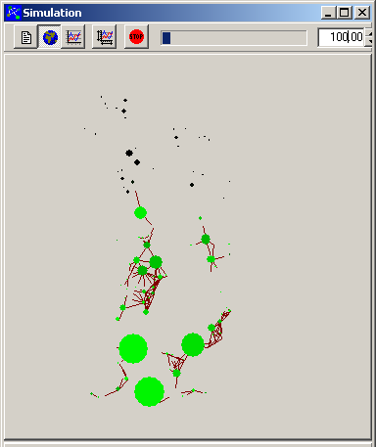
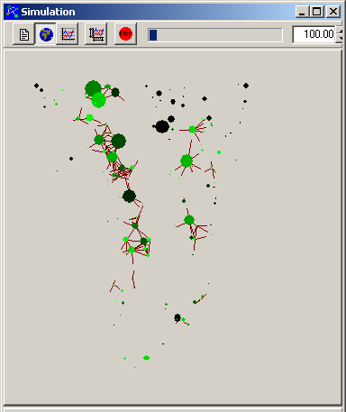
Key objective 2:
Adding demography to projections
Species occurrence locations
Current climate (2010)
Current distribution (2010)
Habitat model
Demography (metapopulation model)
Projected climate (2080)
Future distribution (2080)
Habitat model
Notes:
H. Resit Akcakaya
Resit.Akcakaya@gmail.com
7

Slide 8
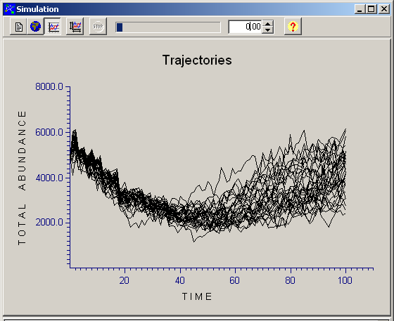
Simulating population dynamics under climate change
2080
Number of occupied patches
Total population size
Risk of decline or extinction
2010

Slide 9
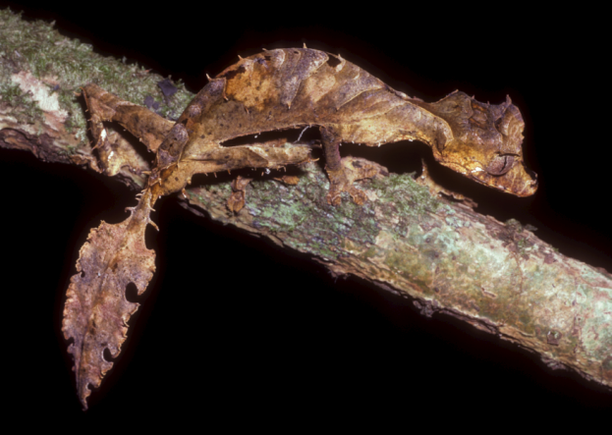
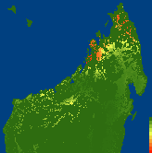
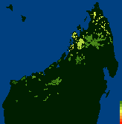
Leaf-tailed gecko
Uroplatus ebenaui in northern Madagascar
wildmadagascar.org
Click on Madagascar maps to play animations
Photo: Chris Raxworthy
.0
.3
.6
.9
0
4
8
12
16
Habitat Suitability
Population Density

Slide 10
3-generation declines
Area (25% decline)
Carrying capacity (44%)
Population size (68%)
Population size; increasing variability (77%)

Slide 11
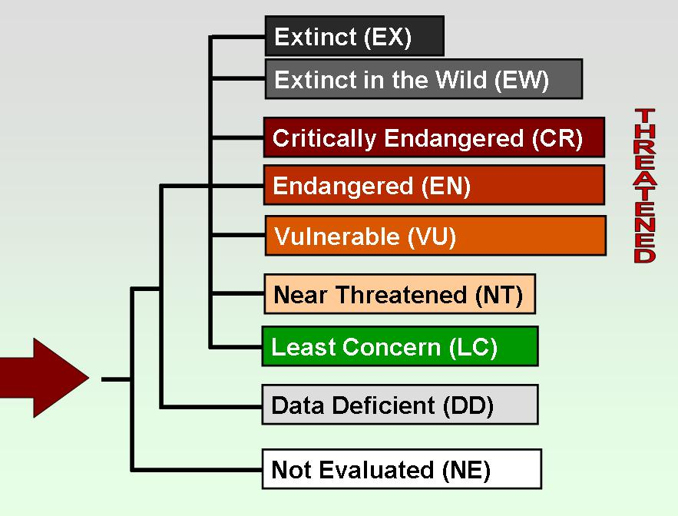


Future directions
Integrate results from multiple taxonomic groups (international working group)
  Madagascar amphibians and reptiles
  North American amphibians and reptiles
  South African plants (Keith et al. 2008)
  Australian plants (workshops in 2009 & 2010)
  Mediterranean plants
  European hare-Lynx interactions
  Florida seabirds
Generalization
  Sensitivity analyses to find species’ traits and landscape pattern combinations that make species vulnerable to climate change
  Develop guidelines for red-listing under the IUCN Red List Categories and Criteria

Slide 12
END

Slide 13
Dealing with Static and Dynamic Variables
Tested with artificial species
Static variables either included in the model, used as a mask, or left out

Slide 14
Dealing with Static and Dynamic Variables
Tested with artificial species
Static variables either included in the model, used as a mask, or left out
Species 1
 | Present |  | 2050 |  | 2080
Static variables: | AUC | r | AUC | r | AUC | r
modeled | 0.990 | 0.719 | 0.992 | 0.875 | 0.985 | 0.857
masked | 0.978 | 0.487 | 0.969 | 0.602 | 0.975 | 0.625
excluded | 0.963 | 0.378 | 0.950 | 0.479 | 0.945 | 0.421
Species 2
 | Present |  | 2050 |  | 2080
Static variables: | AUC | r | AUC | r | AUC | r
modeled | 0.990 | 0.918 | 0.990 | 0.899 | 0.994 | 0.916
masked | 0.992 | 0.929 | 0.985 | 0.883 | 0.993 | 0.915
excluded | 0.971 | 0.691 | 0.942 | 0.592 | 0.949 | 0.501

