Slide 1


Experiments for ascends
Dorit Hammerling
Anna M. Michalak, Randy Kawa,Vineet Yadav,
Abhishek Chatterjee, Sharon Gourdji,
Deborah Huntzinger, Kim Mueller,
Chris O’Dell,

Slide 2
Recommended experiments from 2009 workshop
Flux Sensitivity
Mapping of XCO₂
Signal Detection
Inversions

Slide 3
Benefits
 | Sensitivity | Mapping | Detection | Inversion
Day / night observations | X |  | somewhat | X
Vertical weighting functions | X |  | X | X
Orbit |  | X | X | X
Error variance / correlations |  | X | X | X
Cloud / aerosol cutoffs/ errors |  | X |  | X
Achievable spatio-temporal flux resolution |  |  | somewhat | X
Value of more than one dof in vertical |  |  |  | X
Based on 2009 workshop

Slide 4
Flux Sensitivity
Who: 2 global models, 2 mesoscale
What: Sensitivity footprints of alternative measurement options, 4 seasons, 3 hourly,
multiple latitudes, land/ocean
When: 4 months
Where:
Why: day / night observations, vertical weighting functions
How: 2 person months X 4 groups + coordinator
Recommendations from 2009 workshop

Slide 5
Flux Sensitivity
Volunteered models:
  Global models: PCTM (Baker), LMDZ (Rayner)
  Regional models: LPDM (Denning),
  WRF-STILT (AER; Michalak as needed)
Experiment outline by Baker:
  Point-input runs, in which a short pulse of measurement information is input into the model at a specific time and place, then turned off quickly
  Time-integrated runs, in which the measurement information is input continuously at locations based on possible ASCENDS orbits; the model is run backwards for weeks to generate an average sensitivity field for the particular orbital configuration.

Slide 6
Mapping XCO2
Who: 2 or more global models
What: global maps and uncertainties
When: 4-6 months
Where:
Why: orbit, error variance / correlations, cloud / aerosol cutoffs/errors, correlation of errors w/ clouds/aerosols
How: 2 months per model
Recommendations from 2009 workshop

Slide 7
Mapping XCO2
Volunteered global models: LMDZ, PCTM
Applied to AIRS, GOSAT, OCO-like data
Experimental outline by Michalak:
  Generate flux maps.
  Generate space-time fields of atmospheric CO2
  Develop sampling strategies.
  Sample model output.
  Develop / adapt mapping tools.
  Perform mapping.
  Repeat for alternate design options (e.g. orbit, measurement error, vertical weighting function)
  Quantify errors as both predicted errors, and actual errors from true 4d distributions from models.

Slide 8
Inversions
Who: Global batch inversions (2 or 3 models); Global inversions using ensemble and variational methods (2 or 3 models)
What: Test ability to infer flux using alternate measurement scenarios
When: “first answers” 3-6 months; “complete experiment” 9 – 12months
Where:
Why: Spatial / temporal scale of flux estimates; Added value of more than one dof in vertical; Daytime / nighttime measurement (+ value at high lat in winter); Impact of clouds/aerosols on retrieval errors
How: Experimental design: 2 months; Global: 6 months; Ensemble / variational: 3 months per group
Recommendations from 2009 workshop

Slide 9
Inversions
Volunteered models:
  Global batch inversions: ?
  Global ensemble and variational methods: PCTM + variational (Baker), LMDZ + variational (Rayner), PCTM + ensemble (Denning),
Experimental outline by Rayner:
  Each model will simulate perfect observations at each location and time with a full vertical profile.
  Each model will carry out an inversion with the given observing system.
  Each model will carry out an inversion using simulated concentrations from one other model.
  Experiments: Surface Use the existing surface network as used in the A-SCOPE study; GOSAT (e.g. Chevallier et al. 2009); ASCENDS

Slide 10
Mapping global CO₂ from space – OCO-2
Hammerling, Michalak, Kawa (JGR, in press)
See also Alkhaled et al. (GRL 2008; JGR 2008)

Slide 11
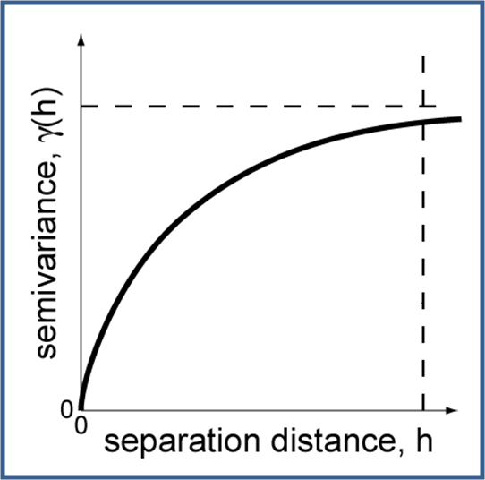
Methodology
Geostatistical method – concepts:
  The XCO₂ field is continuous and spatial
  correlation is a function of distance
  Spatial correlation is used to gap-fill
  and derive a probability distribution for
  the XCO₂ concentration at each location
Features of geostatistical method:
  No transport model or prior assumption required
  Correlation structure derived from the data - locally varying
  Measurement error incorporated - locally varying
  Uncertainties derived along with global XCO₂ concentrations
Source: A. M. Michalak, University of Michigan

Slide 12
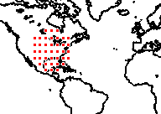
Methodology (cont.)
Quasi-stationarity: process is assumed stationary within local neighborhood, but nonstationary globally
gridcell
2000 km
A. Alkhaled, Kuwait University

Slide 13
Mapping global CO₂ from space – OCO-2
Hammerling, Michalak, Kawa (JGR, in press)
See also Alkhaled et al. (GRL 2008; JGR 2008)

Slide 14
Mapping CO₂ from space – OCO-2
Hammerling, Michalak, Kawa (JGR, in press)

Slide 15
Evaluation: prediction accuracies
1-day
2-day
4-day
8-day
16-day
RMSPE [ppm]
January
April
July
September
low noise
medium noise
high noise
covariance derived from truth
covariance derived from observations
Hammerling, Michalak, Kawa (JGR, in press)

Slide 16

Evaluation: prediction uncertainties
1-day
1-day
2-day
2-day
4-day
4-day
8-day
8-day
16-day
16-day
January
January
April
April
July
July
September
September
low noise
low noise
medium noise
medium noise
high noise
high noise
covariance derived from truth
covariance derived from truth
covariance derived from observations
covariance derived from observations
Percent of grid cells with error > 3
Percent of grid cells with error > 3
Hammerling, Michalak, Kawa (JGR, in press)

Slide 17
Mapping XCO2
Similar setup and evaluation could be used for ASCENDS
  …..

Slide 18
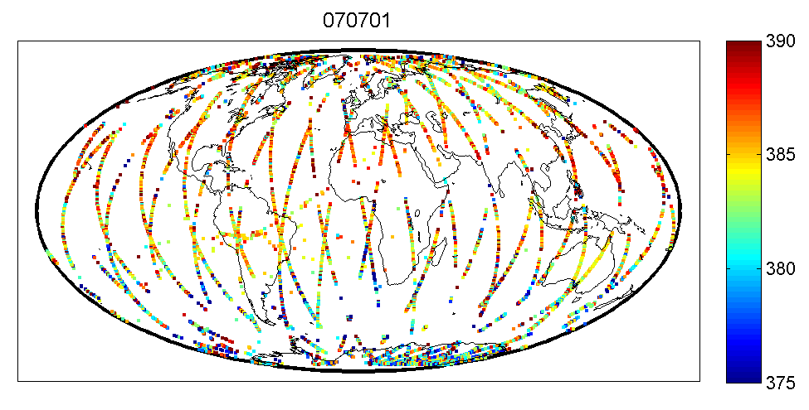
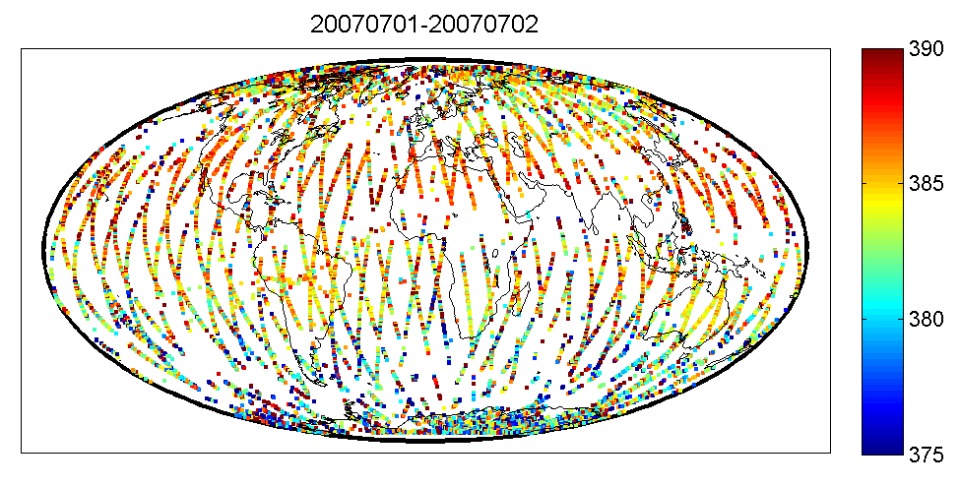
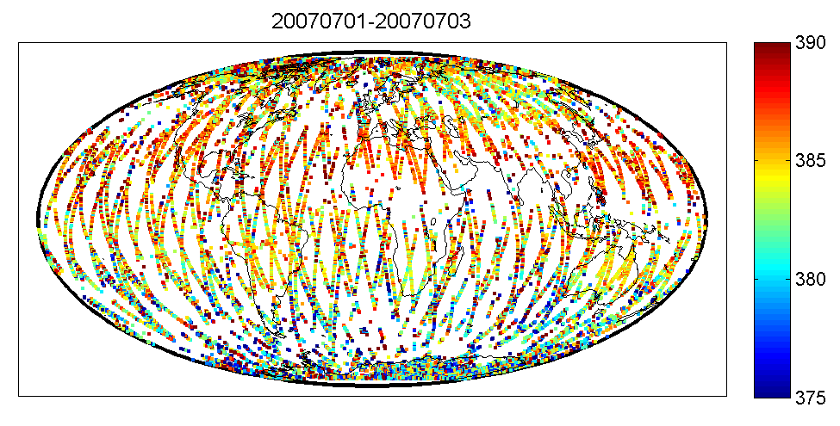
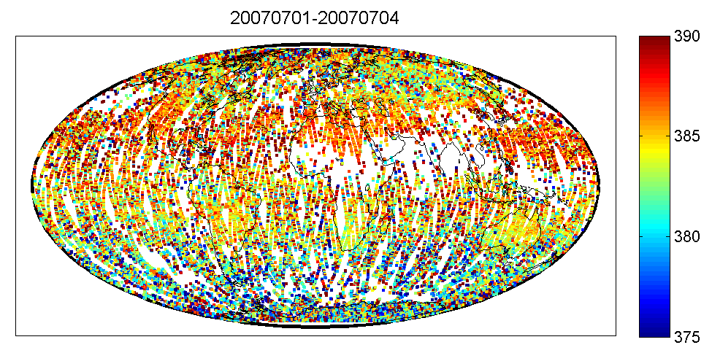
Simulated ASCENDS observations (July)
1 day
2 day
3 day
4 day
[ppm]
[ppm]

Slide 19
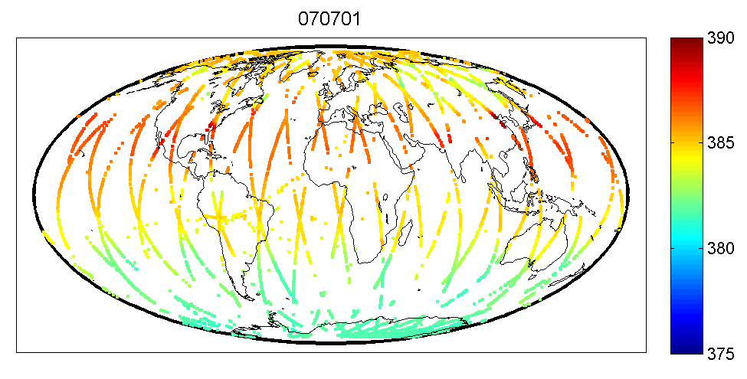
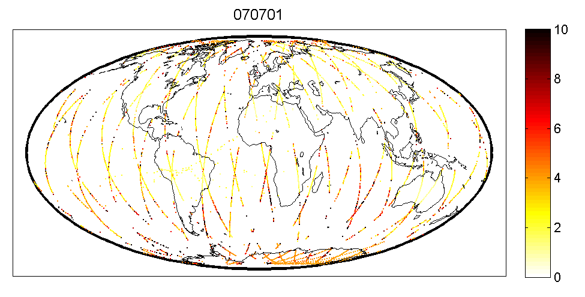
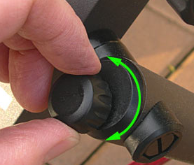
Simulated ASCENDS observations (July)
1 day (no errors)
1 day (with errors)
Errors based on Calipso
[ppm]
[ppm]

Slide 20
Signal Detection
Who: 2 or more global models
What: Investigate impact of flux variations on observations
When: 4-6 months
Where:
Why: Evaluate orbits, error variance / correlations, weighting functions, some contribution to question re. spatial / temporal scale of fluxes that can be resolved, question of day/night measurements
How: 2 person weeks per scenario, couple of days to implement, 3-4 months for central organizer, 1 month per model for participants
Recommendations from 2009 workshop

Slide 21
Signal Detection
Volunteered global models: LMDZ (Rayner),
PCTM (Kawa)
Experimental outline by Kawa:
  Baseline forward run
  Perturbation fluxes (e.g. missing NH terrestrial sink: scaling CASA GPP; mean transcom posterior; tropical land use source flux distribution; scale FF source to some IPCC future; el nino flux distribution)
  Compare Baseline and Perturbation pseudo-measured fields and error bars
  Vary sampling and/or error characteristics in 3)

Slide 22
Specific scenario already set up
“Increase of fossil fuel emissions in China”
In order to model the case where emissions from China gradually increase, a simulation was run which only included the "extra" amount of CO₂, above the baseline values. The field was initialized to zero. Fossil fuel emissions began at zero, and were increased linearly in the region of China, such that the flux at the end of 10 years would match the 2006 CDIAC/ORNL emission rates for that region. There were no additional ocean or biosphere fluxes. [ASCENDS project webpage]

Slide 23
Signal Detection
Maybe we could combine signal detection with mapping?

Slide 24
GOSAT Level 2: July to December 2009

Slide 25
GOSAT Level 3: July to December 2009

Slide 26
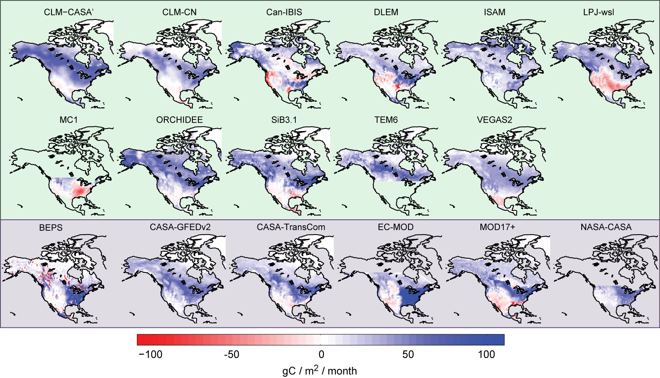
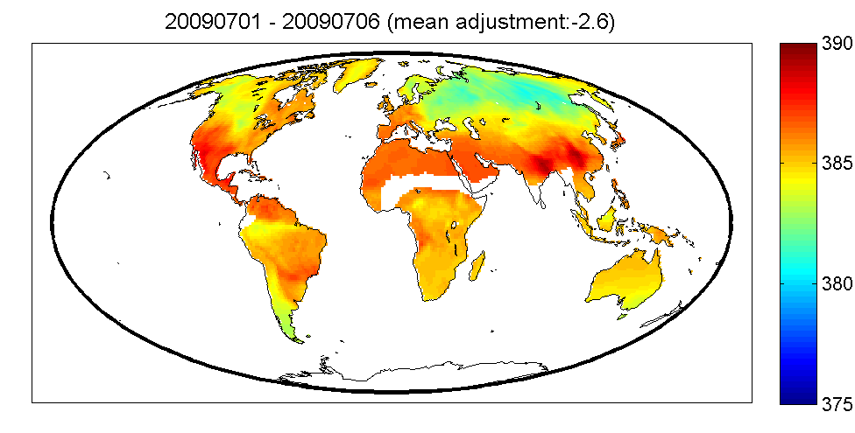
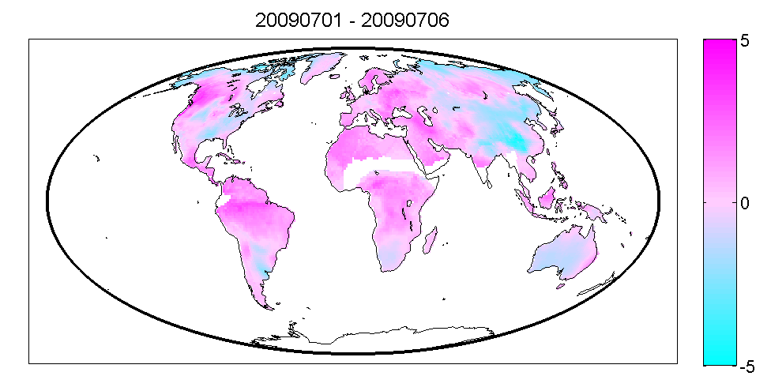
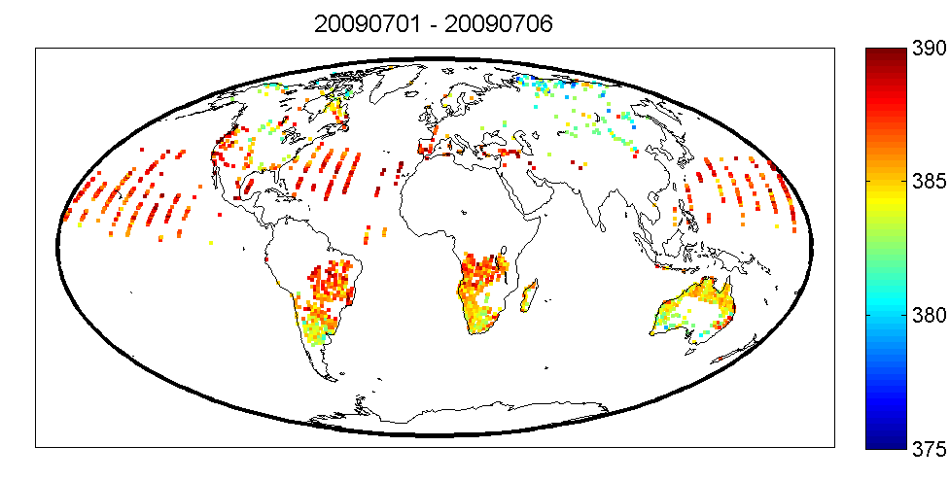
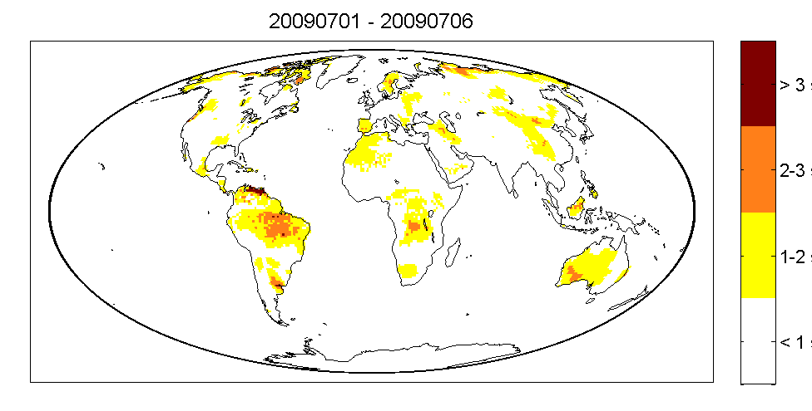
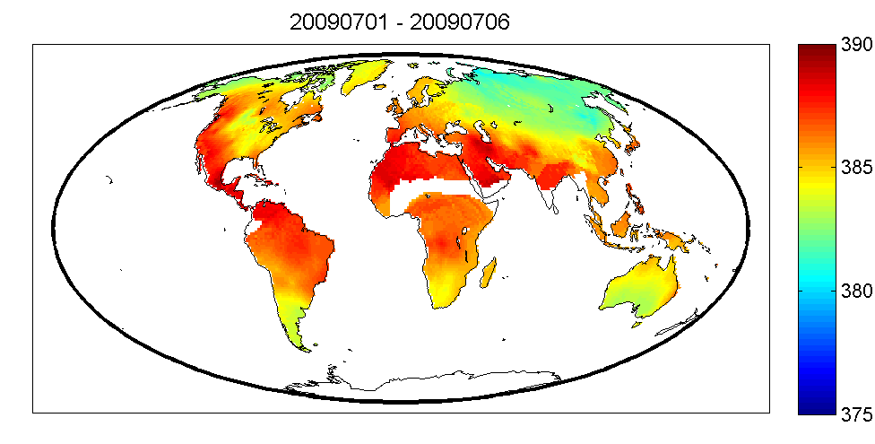
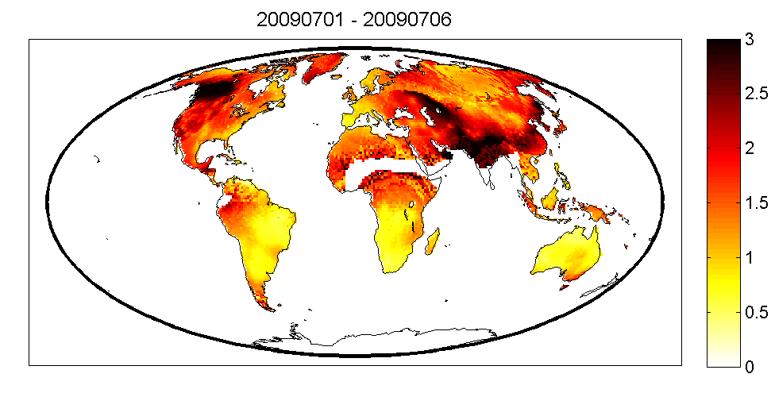
?

Slide 27
GOSAT Level 3: used for model comparison
Summary for 2009
Same idea could be applied for signal detection.
August 7-12 2009
August 7-12 2009
[Hammerling et. al. (in revision)]
[Hammerling et. al. (in revision)]
[Hammerling et. al. (in revision)]
Notes:
Especially well suited as GOSAT has comparatively high measurement noise

Slide 28
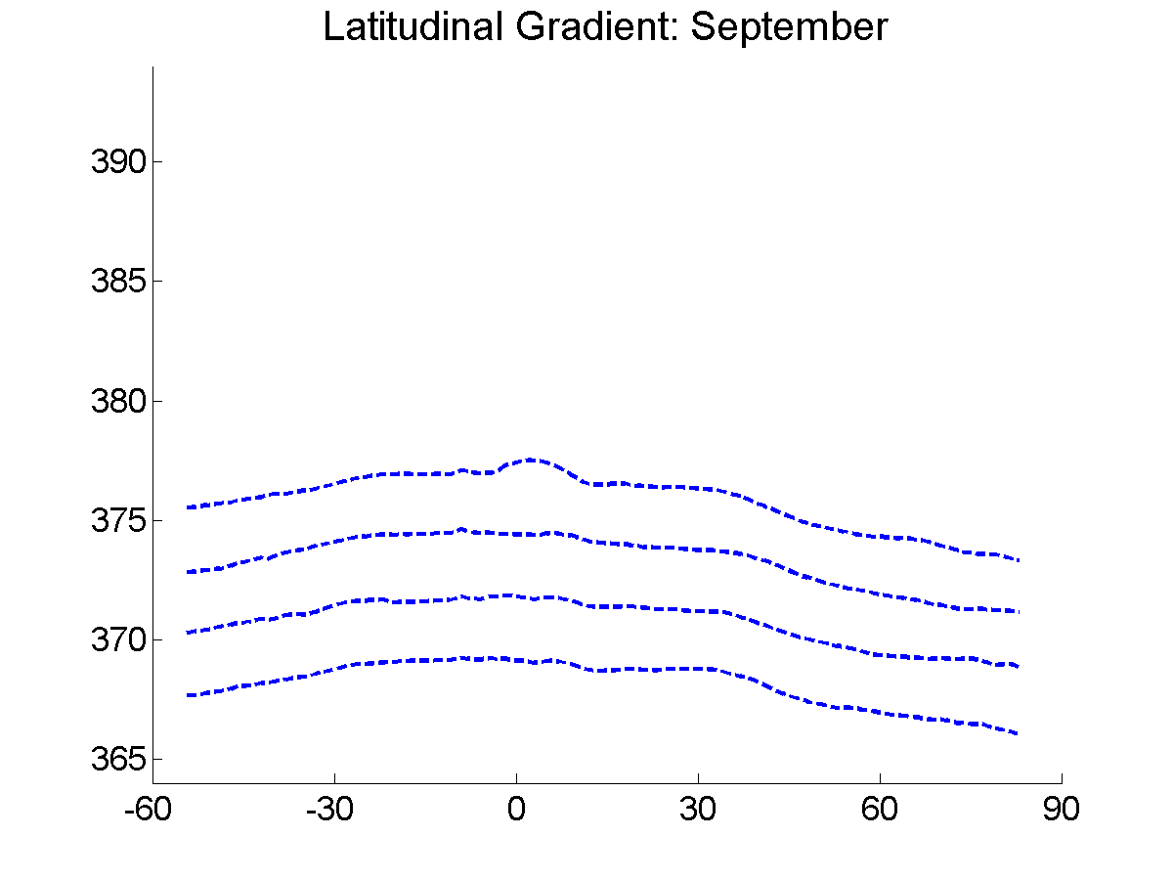
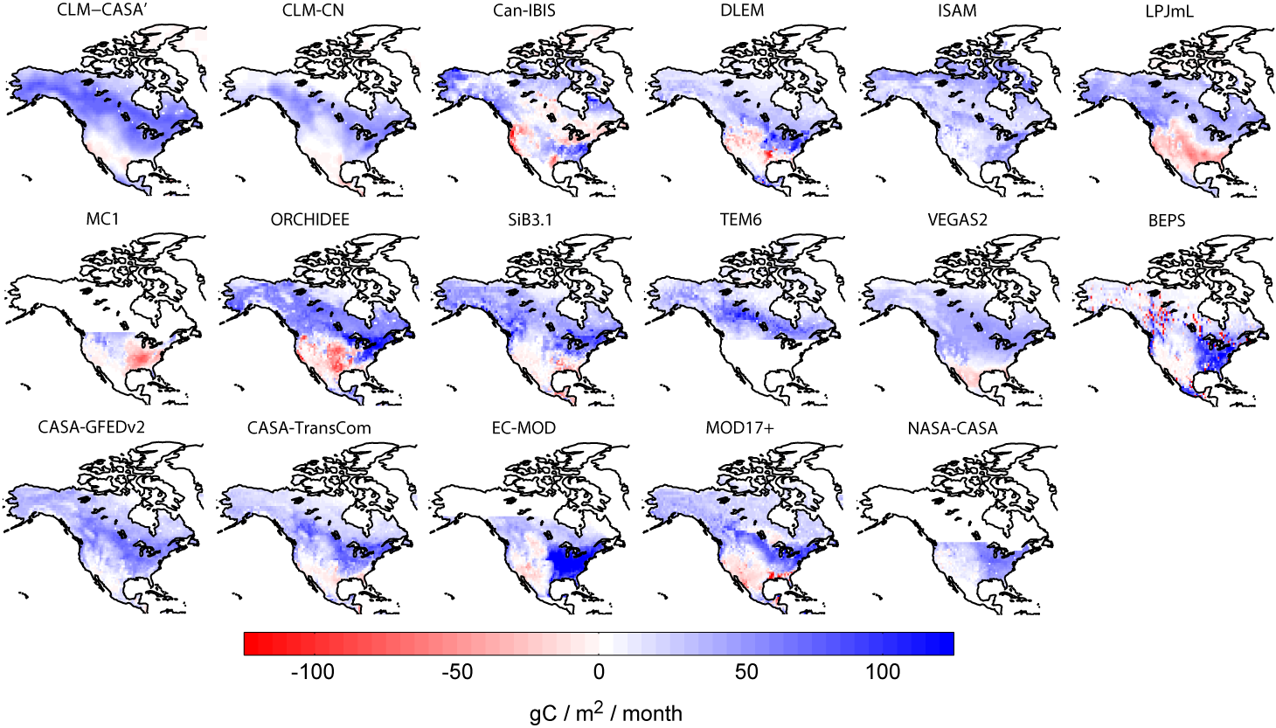
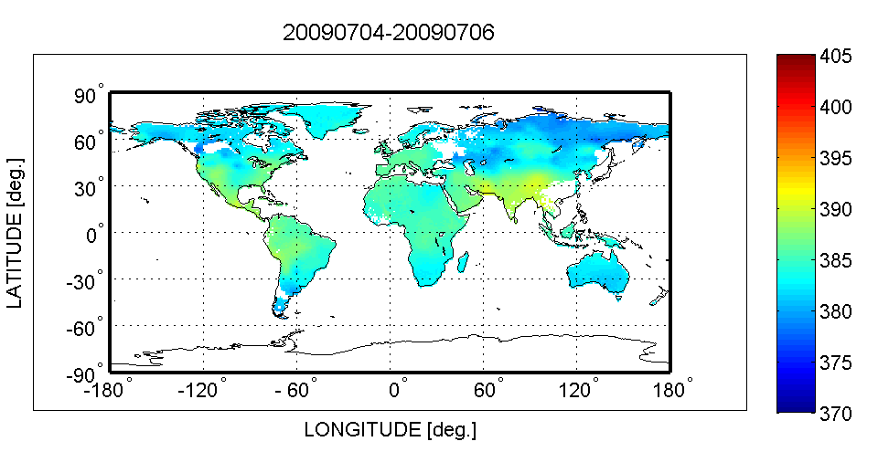
How consistent are models with satellite-derived XCO₂ field?
[ppm]
Source: Huntzinger et al., 2011
[ppm]

Slide 29
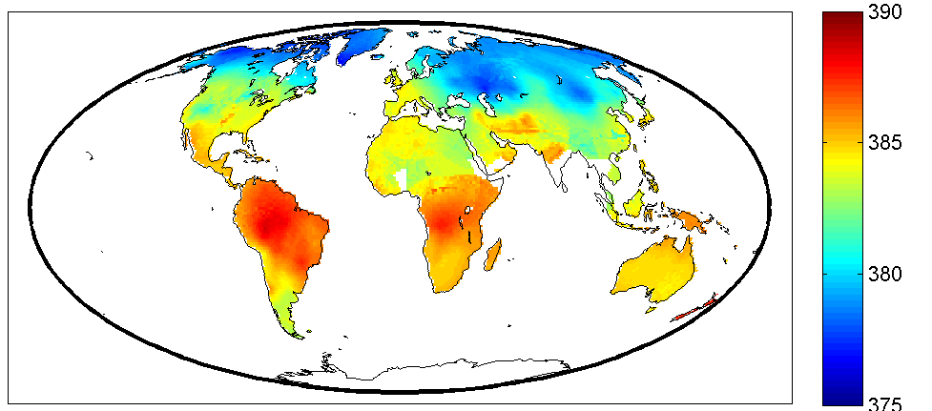
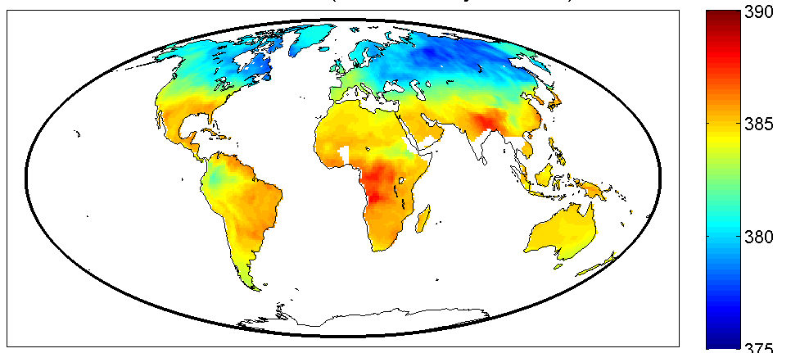
For which locations are difference in the XCO₂ probability distribution detectable ?
Scenario 1
Scenario 2
[ppm]

Slide 30
Ideas for Contributions to ASCENDS
Combining mapping and signal detection
Additional scenarios of interest:
“Difficult” scenarios:
  Change in pattern of flux
  Change in timing
  …….

Slide 31
Which experiments moving forward?
Flux Sensitivity
Mapping of XCO₂
Signal Detection
Inversions

Slide 32







Acknowledgments
PUORG: Abhishek Chatterjee, Vineet Yadav, Dan Obenour, Yoichi Shiga, Vineet Yadav, Yuntao Zhou, (Alumni:) Alanood Alkhaled, Charles Antonelli, Sharon Gourdji, Debbie Huntzinger, Meng-Ying Li, Kim Mueller, Jill Ostrowski, David Sena, Shahar Shlomi (+ many ugrad students)
NOAA-ESRL: Pieter Tans, Adam Hirsch, Lori Bruhwiler, Arlyn Andrews, Gabrielle Petron, Mike Trudeau
AER: Thomas Nehrkorn, John Henderson, Janusz Eluszkiewicz
NACP Regional Interim Synthesis Participants
Kevin Schaefer (NSIDC), Tyler Erickson (MTRI), Kevin Gurney (Arizona State U.), John C. Lin (U. Waterloo), Peter Curtis (OSU), Christian Rödenbeck (MPIB), Amy Braverman (JPL), Noel Cressie (OSU), Randy Kawa (NASA GSFC), Clay Scott, Long Nguyen, Mike Cafarella, Kristen Lefevre (UM)
NOAA-ESRL Cooperative Air Sampling Network
NASA HEC Project Columbia, Pleiades, and technical support staff
Notes:
32

