Slide 1
ASCENDS End-to-End System Performance Assessment: Analysis of Atmospheric State Vector Variability Analysis for Surface Pressure and Vertical Temperature/Moisture Profile
Alison Chase¹, Lesley Ott², Steven Pawson², Hailan Wang² and Scott Zaccheo¹
¹Atmospheric and Environmental Research, Lexington, MA, USA
²Global Modeling and Assimilation Office, NASA GSFC, VA, USA
February 2012

Slide 2
Outline
Objectives
Methodology
NWP model comparisons
NWP analysis vs forecast comparisons
Comparisons of model data to in situ measurements
Summary
Next Steps

Slide 3
Objectives
Objectives
Develop a common set of error characteristics for atmospheric state variables that impact the ASCENDS mission
Surface Pressure (Dry Air Surface Pressure)
Vertical moisture and temperature profiles
Assist in addressing the question
Are standard analysis/model fields adequate for the ASCENDS mission?
Provide common baseline statistics and metrics for
Use in OSSEs
Instrument sensitive studies
Potentially provide bounds for source selection criteria
Note: Contributors are currently working on collecting current analyses into a summary report.

Slide 4
Methodology
Inter-comparison of standard analysis/model fields
Models
Deterministic: ECMWF,GEOS-5, NCEP-GFS and WRF
Ensembles: NCEP-GFS
Scales: 5km-0.5° resolution
Temporal variability: Representative time periods (week/month) for each season
Comparison of standard analysis/model data with in situ measurements
Analysis/Models: GFS, MERRA and WRF analysis and forecast fields
Observations: Surface, aircraft and radiosonde data

Slide 5
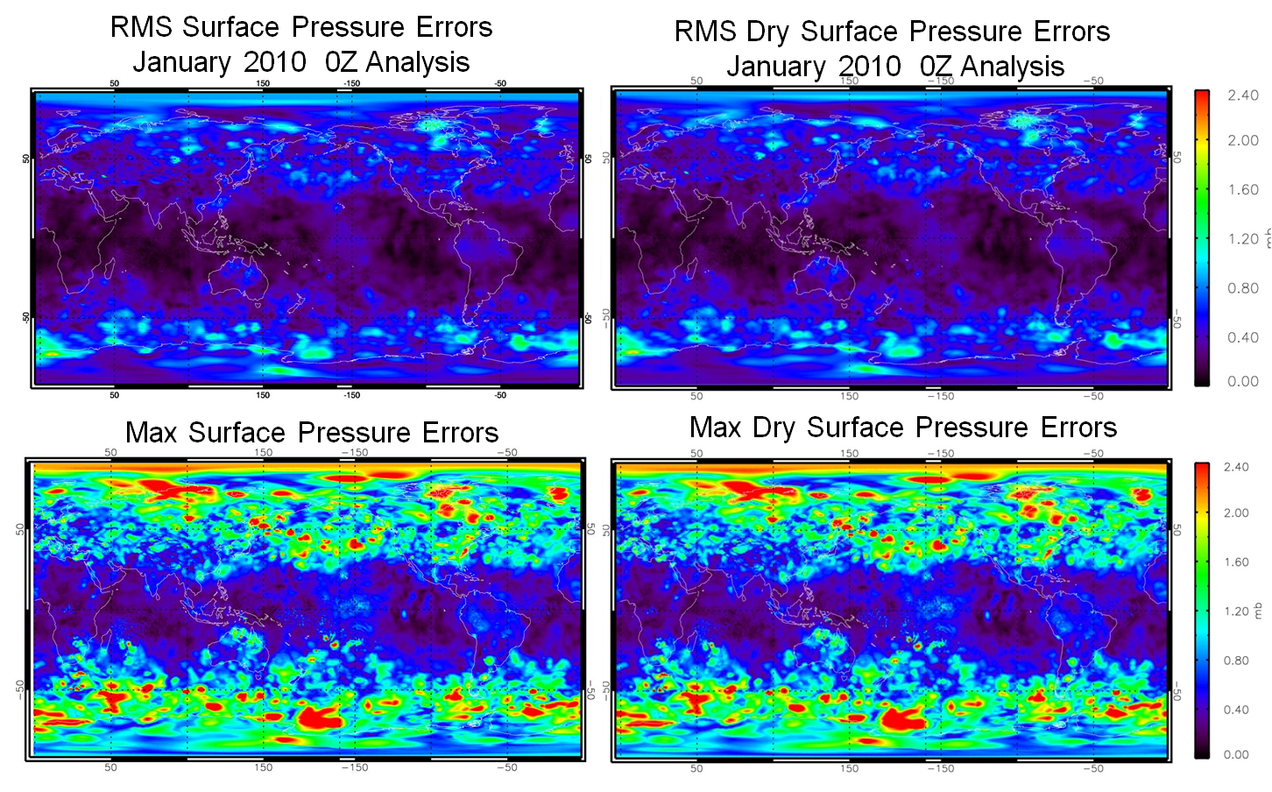
Surface Pressure Error Characterization Example GFS Analysis
Comparison for 0.5º GFS analysis-forecast field for single week in January
Typical difference < 0.8 mbars however non trivial number of differences excess of 2 mbars

Slide 6
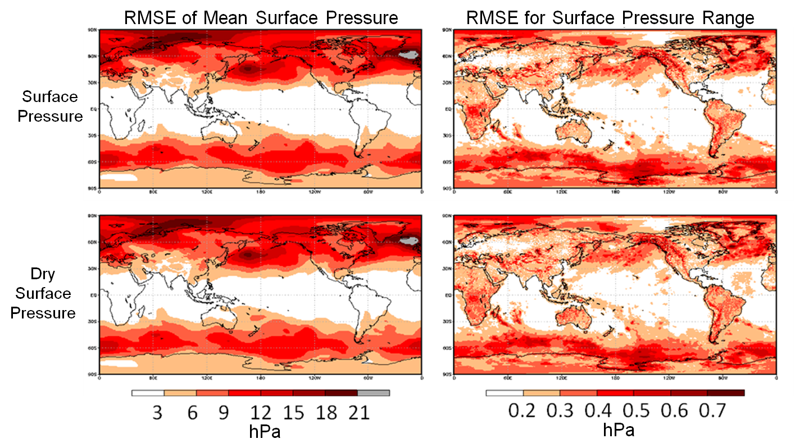
Surface Pressure Error Characterization Example Model Inter-Comparison
Comparison for MERRA, NCEP and ECMWF global analysis data
Variability in surface pressure are greatest over land and mid-high latitude oceans
Variability of dry and moist surface pressure is similar indicating that water vapor is not the main factor driving surface pressure variability

Slide 7
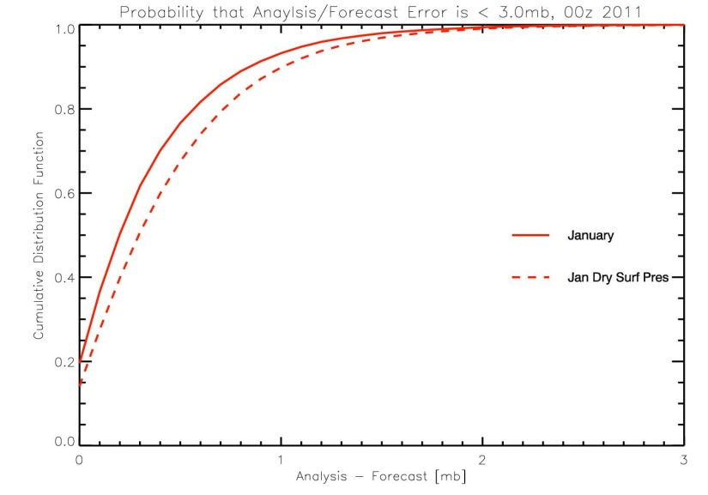
Model Based Surface Pressure
Example Error PDFs/CDFs
PDFs of Absolute Differences in Surface Pressure
CDFs of Absolute Differences in Surface Pressure
All Cells
Clear Cells
Ocean
Ocean
Solid Line: GFS analysis-forecast surface pressure
Dotted Line: GFS analysis-forecast dry air surface pressure
Land
Land
Blue: Absolute differences between ECMWF and MERRA
Red: Absolute differences between NCEP and MERRA

Slide 8
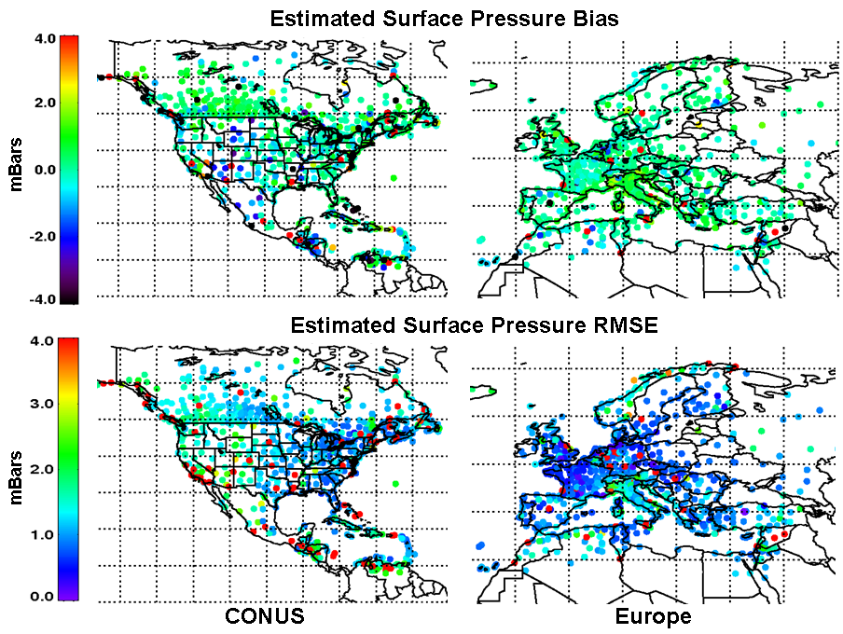
Surface Pressure Error Characterization Observations-Analysis Comparison
Comparison of surface observations and mesoscale analysis for ~3 million observations between 2006-07
Comparisons include adjustments of NWP data to station height based on lapse rate

Slide 9
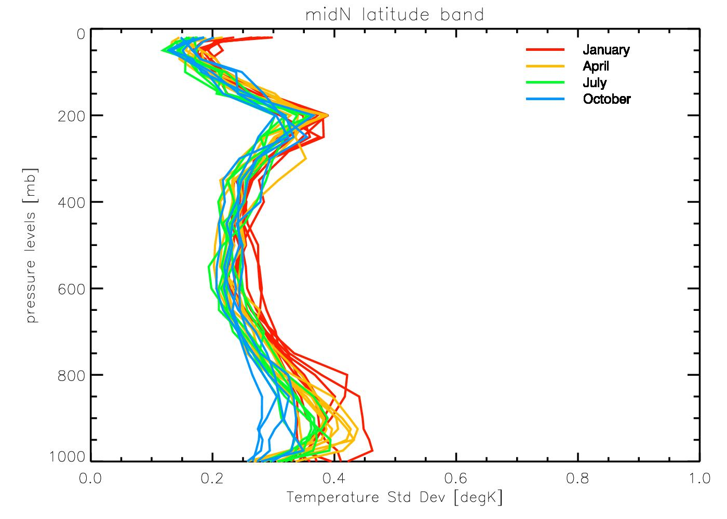
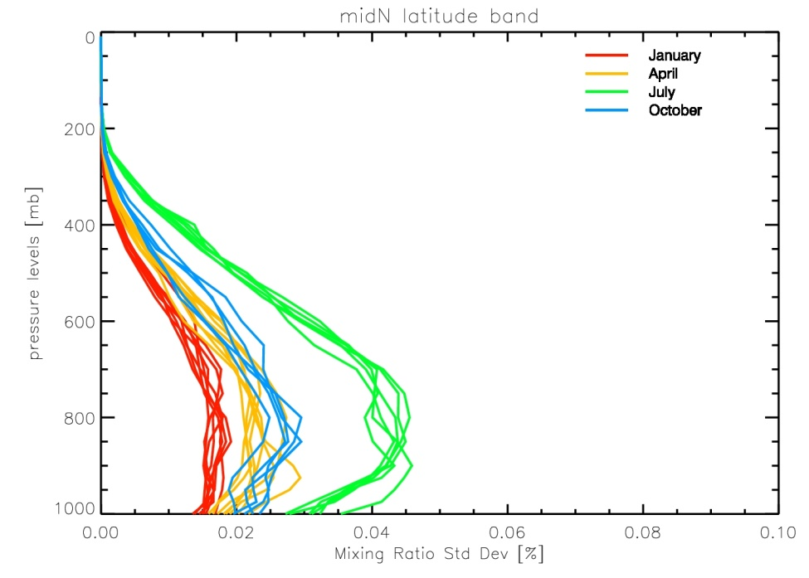
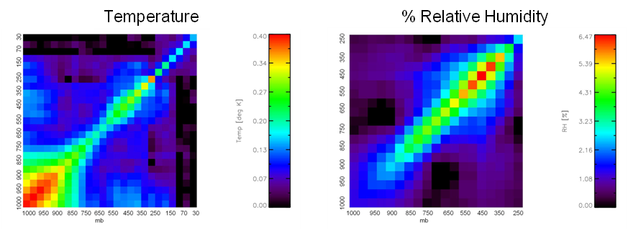
T/Water Vapor Error Characterization Example Analysis-Forecast Comparison
Temperature [K]
WV Mixing Ratio [g/kg]
Comparison of January 2009 GFS analysis – forecast profile data
Unrealistic estimates of temperature and water vapor error characteristics
May however provided reasonable covariance matrices that can be scaled to describe correlated error characteristics for sensitivity studies

Slide 10
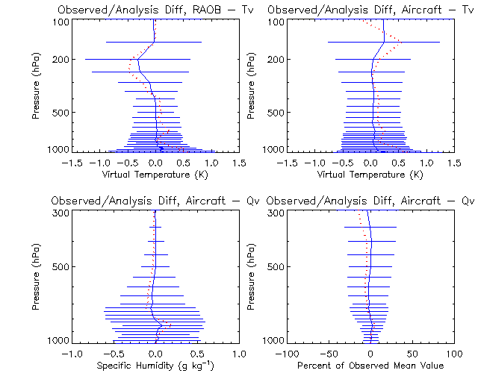
T/Water Vapor Error Characterization Example Observation/Analysis Comparison
Comparison of observations with MERRA analysis data
Temperature and water vapor observation from radiosonde and aircraft data
Solid blue profile represents average observation – analysis and horizontal lines indicate one standard deviation.
Dashed red profile represents average differences between observations and input forecast fields

Slide 11
Summary
Surface Pressure
Analysis – Forecast analysis provide an optimistic estimate observed error
Inter model comparison show non trivial differences between model implementations
Strongly influenced by topography effects
Slight increase in variability of dry-air surface pressure over moist surface pressure
Temperature and Moisture Profile Errors
Analysis – Forecast analysis under estimate observed error
Comparison to radiosonde and aircraft data provide better estimate of model errors, but may not adequate capture correlated errors

