Slide 1
Impact of systematic errors on flux estimates
David Baker
27 Feb 2012
ASCENDS Science Working Group Meeting

Slide 2
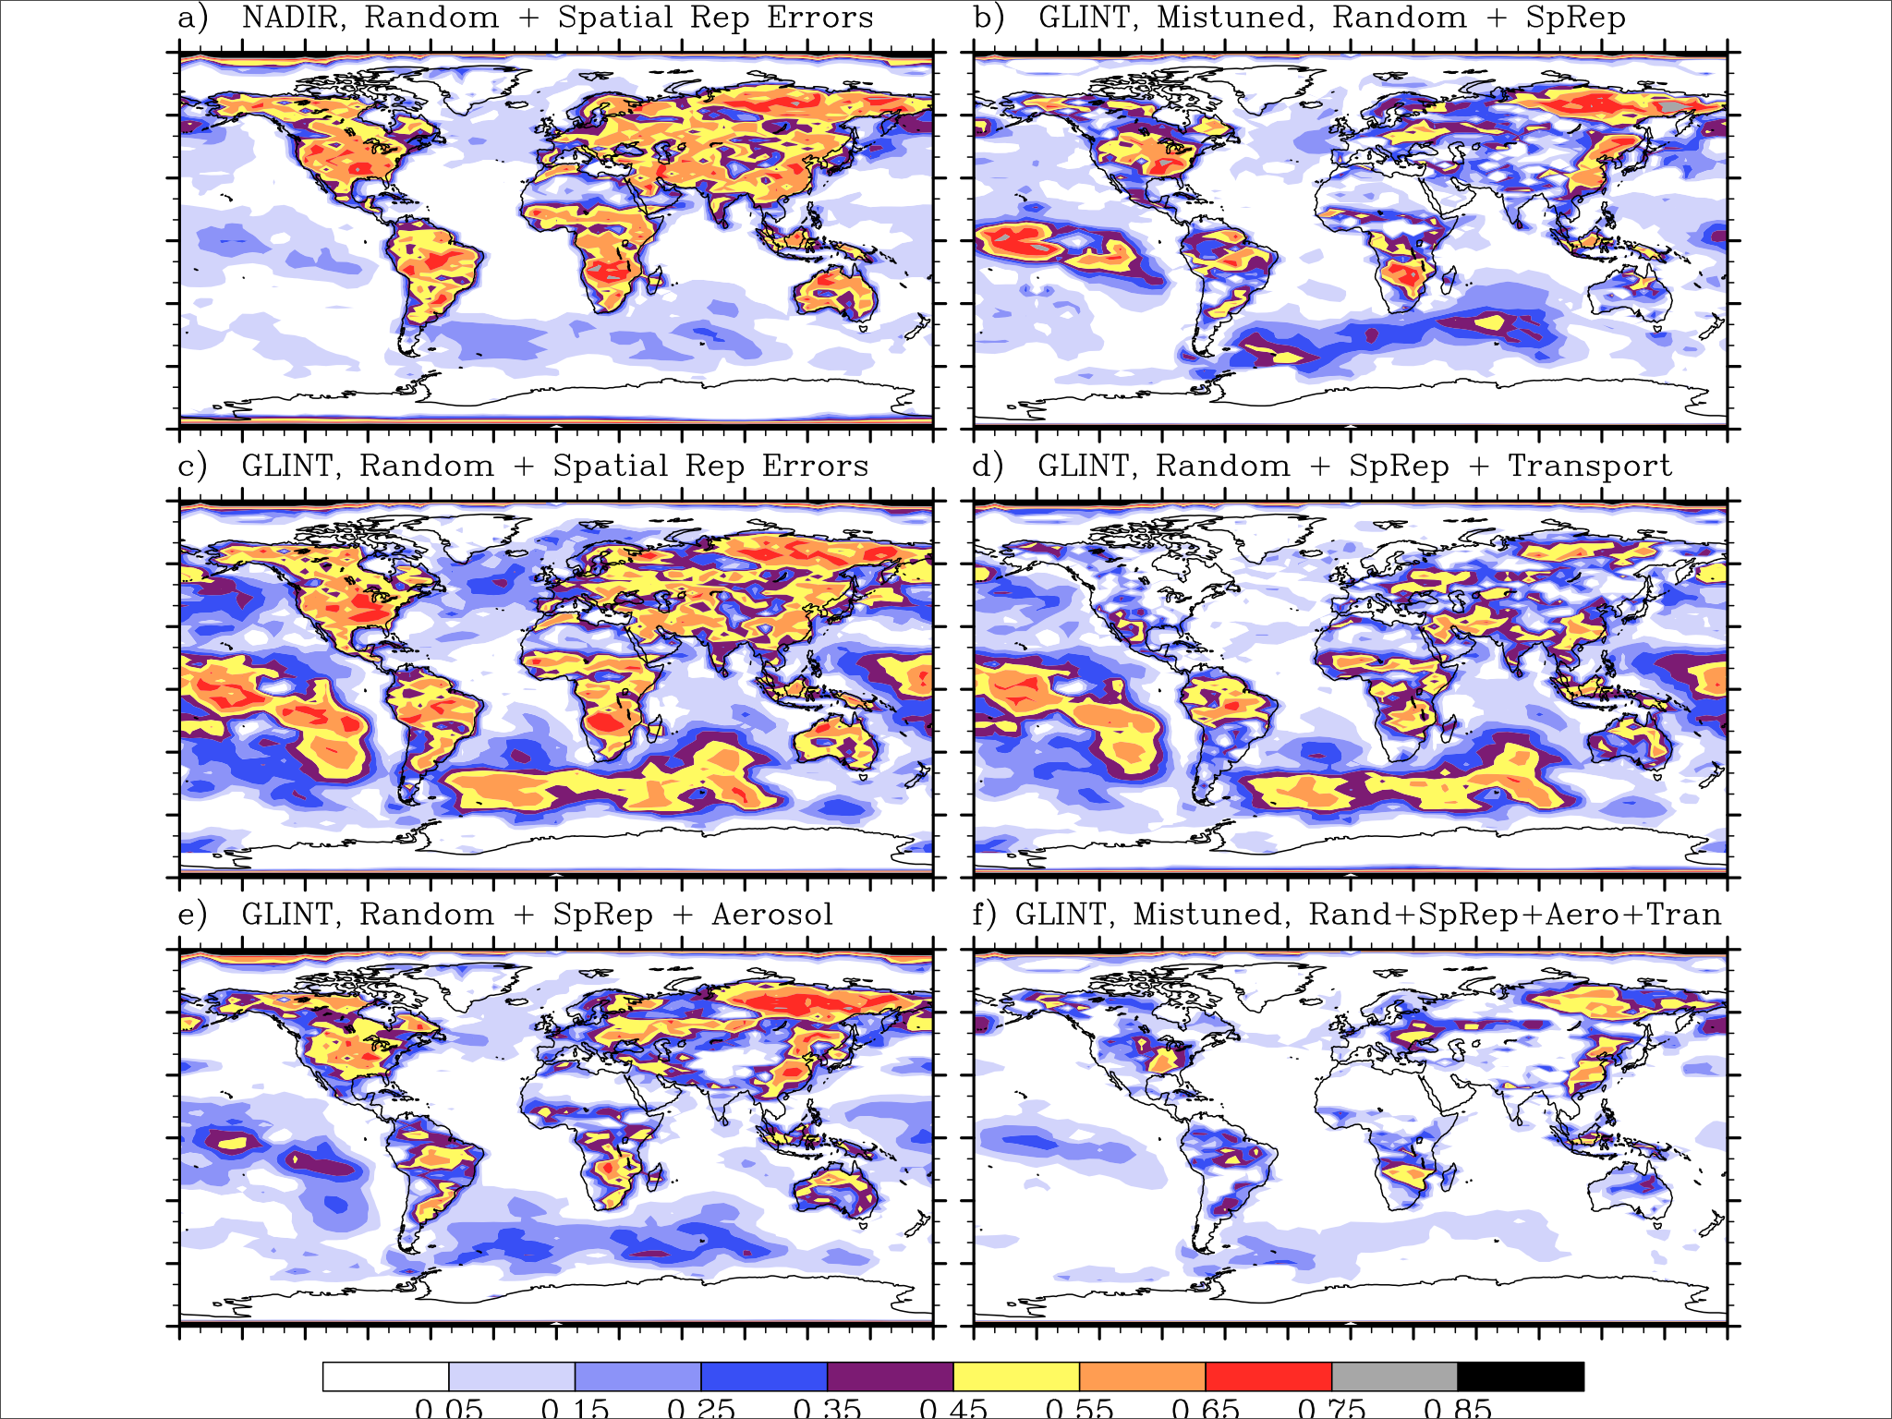
Fractional
uncertainty
reduction,
for OCO:
degradation
due to the
impact of
systematic
errors

Slide 3
Four systematic-error OSSEs for ASCENDS
All four use the 0.5 ppm 2.06 μm random error case as a base,
then add systematic errors on top:
#1: b = +1 ppm * cos(SZA) day/night-side bias
#2: b = +1 ppm* (1 – σ_{RRV}/σ) bias over low-signal areas
#3: b = -1 ppm* (OD/0.3) bias over high-OD areas
#4: b = 0.4 ppm over snow-covered forested areas:
North of 40° N: Jan, Feb, Mar
50° N: Nov, Dec, Apr
60° N: Oct, May
Look at impact in terms of:
Increase in the weekly posterior-truth errors (RMS)
Increase in the seasonal posterior-truth errors (RMS)
Shift in the seasonal and annual flux estimates (= a flux bias error)

Slide 4
Measurement
uncertainties
specified in
proportion to
reference values
at Railroad Valley
= measurement
uncertainty
= diffuse reflectivity
(MODIS/MERRA)
= 1-way optical depth
(CALIPSO, 5 km)

Slide 5
Average 1-way optical depths

Slide 6
7-day flux estimation errors, RMS of 52 weeks
Prior
Posterior, random errors only
Posterior, random + case #1 biases
Posterior, random + case #2 biases
Posterior, random + case #3 biases
Posterior, random + case #4 biases
[10⁻⁹ kgCO₂ m⁻² s⁻¹]

Slide 7
Fractional error reduction,
RMS of 52 weekly flux errors
Posterior, random errors only
Posterior, random + case #1 biases
Posterior, random + case #2 biases
Posterior, random + case #3 biases
Posterior, random + case #4 biases

Slide 8
Fractional error reduction,
RMS of four seasonal fluxes
Posterior, random errors only
Posterior, random + case #1 biases
Posterior, random + case #2 biases
Posterior, random + case #3 biases
Posterior, random + case #4 biases

Slide 9
Annual flux estimates and shift due to biases
Prior flux
Posterior flux, random errors only
Shift in flux due to case #1 biases
Shift in flux due to case #2 biases
Shift in flux due to case #3 biases
Shift in flux due to case #4 biases
[10⁻⁹ kgCO₂ m⁻² s⁻¹]

Slide 10
July-Sept flux estimates and shifts due to biases
Prior flux
Posterior flux, random errors only
Shift in flux due to case #1 biases
Shift in flux due to case #2 biases
Shift in flux due to case #3 biases
Shift in flux due to case #4 biases
[10⁻⁹ kgCO₂ m⁻² s⁻¹]

Slide 11
Jan-Mar flux estimates and shifts due to biases
Prior flux
Posterior flux, random errors only
Shift in flux due to case #1 biases
Shift in flux due to case #2 biases
Shift in flux due to case #3 biases
Shift in flux due to case #4 biases
[10⁻⁹ kgCO₂ m⁻² s⁻¹]

