Slide 1


Ocean-Atmosphere Carbon Flux: What to Consider
Scott Doney (WHOI)
ASCENDS Science Working Group Meeting (February 2012; NASA Goddard Space Flight Center)
Acknowledgements & Collaborators
-RECCAP Ocean Carbon Working Group
-R. Wanninkhof and G.-H. Park (NOAA/AOML)
-N. Gruber (ETH-Zurich)
-C. LeQuere (U. East Anglia)
Biogeosciences RECCAP Special Issue
Wanninkhof et al (in prep.) Global ocean carbon uptake: magnitude, variability and trends

Slide 2
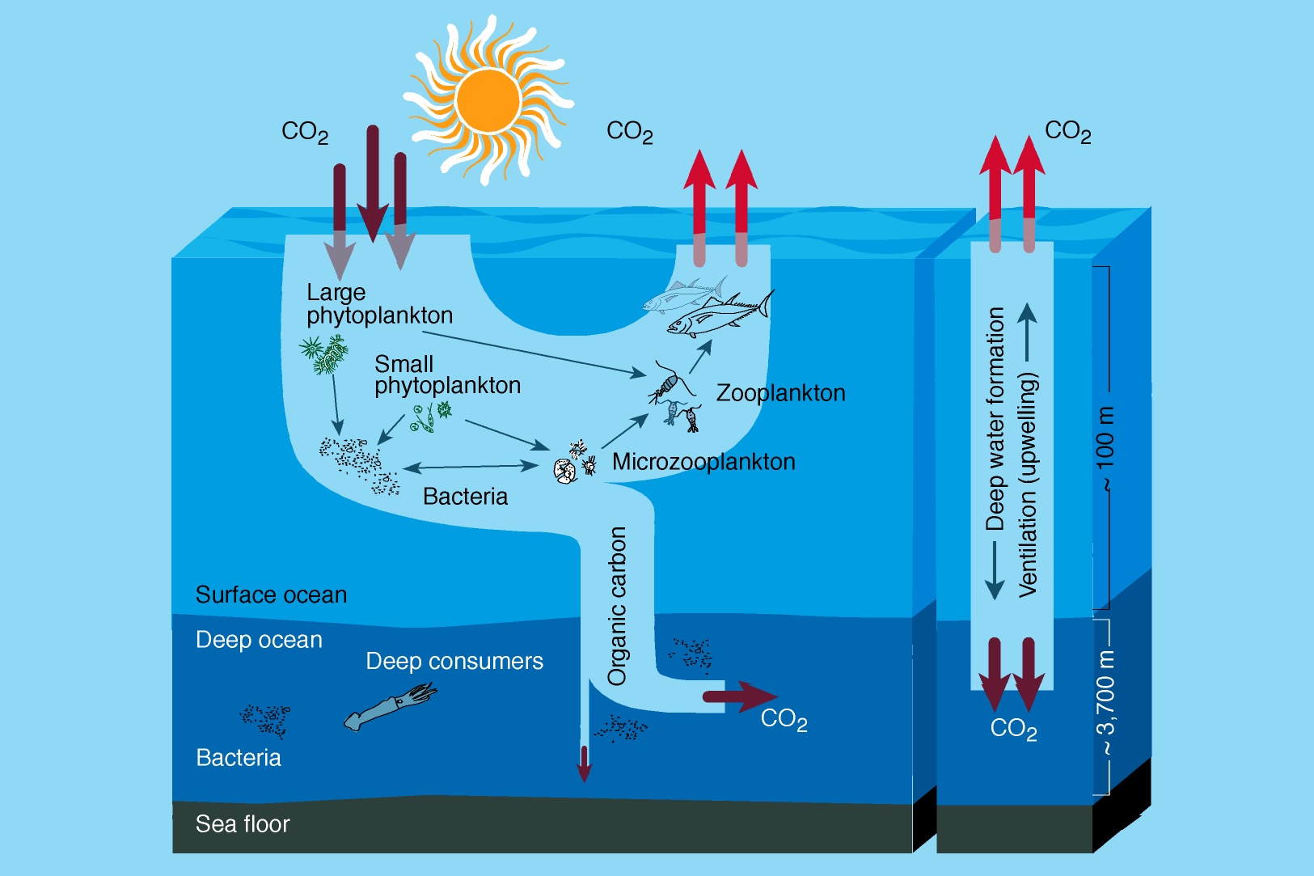
Ocean Solubility & Biological Carbon Pumps
Air-Sea CO₂ flux reflects both physical & biological processes
-Changes in physics impact both carbon pathways, nutrients & oxygen

Slide 3
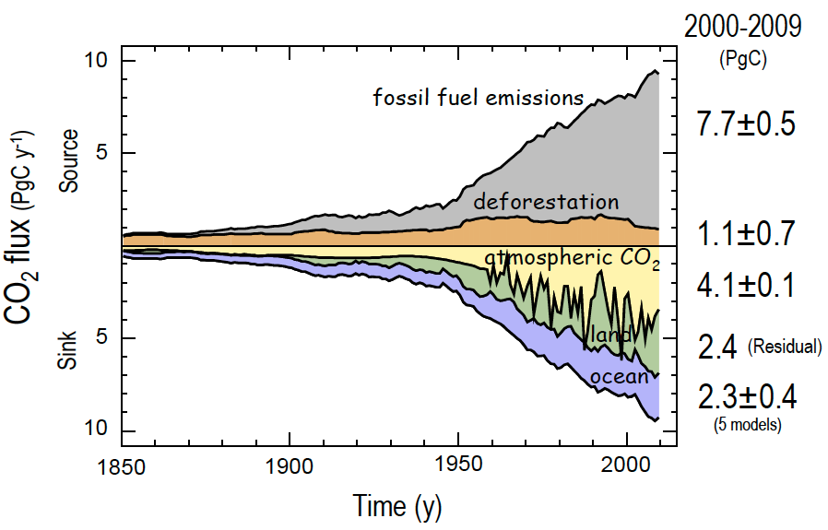
Human Perturbation to Global Carbon Cycle
Global Carbon Project
Canadell et al. PNAS 2007; LeQuere et al. Nature Geosciences 2009

Slide 4
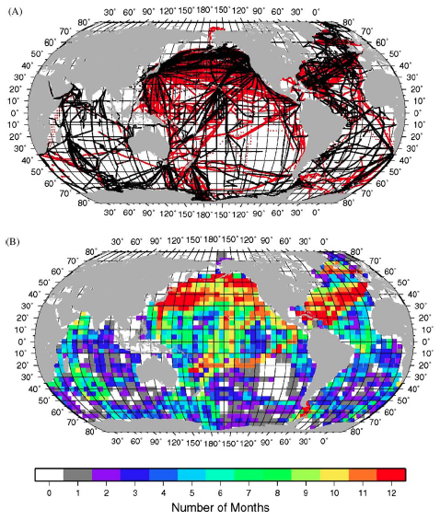
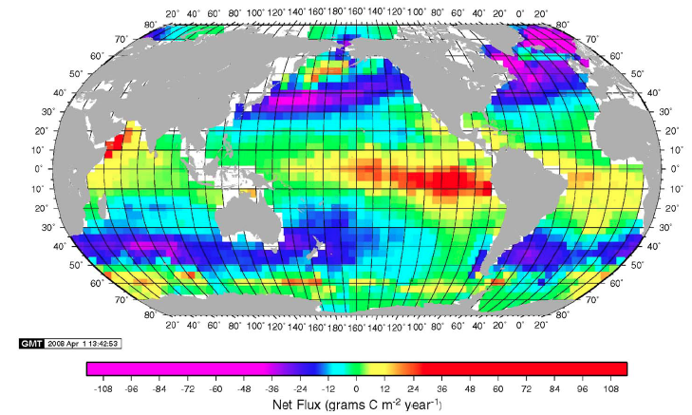
Underway Data & Sea-air CO₂ Flux
Sampling Density
Sea-Air CO₂ Flux
Seasonal Coverage
Estimate seasonal climatology of CO₂ Flux from:
    Flux = k α ΔpCO₂
Measured sea-air ΔpCO₂ data
Wind-speed from reanalysis or scatterometer
Empirical gas transfer velocity (k) relationship
Correct sea-air ΔpCO₂ to common reference year
Takahashi et al. Deep-Sea Res. II 2009
Notes:
Black dots Takahashi et al. 2002 (0.94 M)
Red new points => 3M total obs.

Slide 5
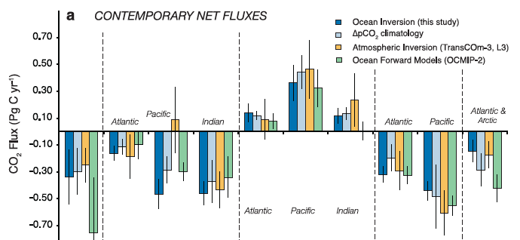
Observations, Inverse Models & Forward Models
Gruber et al., Global Biogeochemical Cycles, 2009

Slide 6
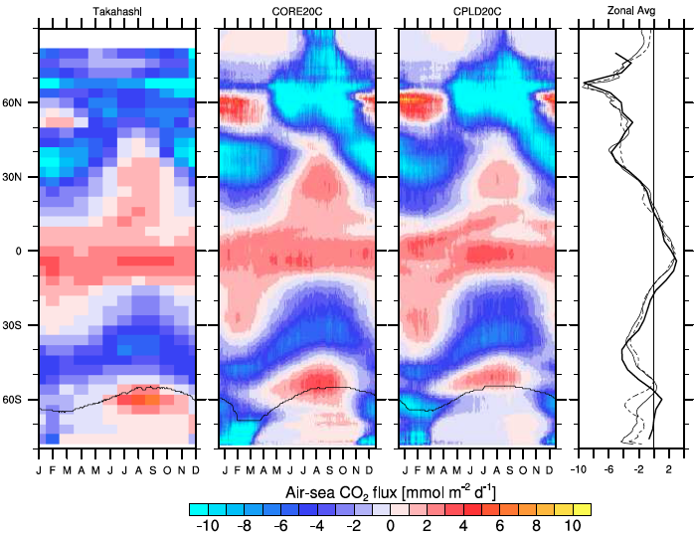
Seasonal Ocean Air-Sea CO₂ Flux
Zonal Mean (latitude vs. month)
Seasonal Variability
Takahashi et al.
Deep Sea.
Res. II 2009

Slide 7
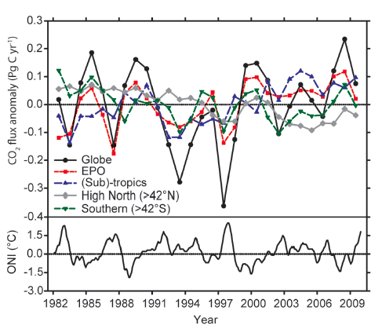
Sea-air CO₂ Flux Interannual Variability
Time-varying pCO₂ diagnostic from regional pCO₂-SST regressions
(possible errors in Southern Ocean)
Park et al. Tellus 2010

Slide 8
Oceanic vs. Atmospheric Estimates of Air-sea CO₂ Flux Interannual Variability

Slide 9
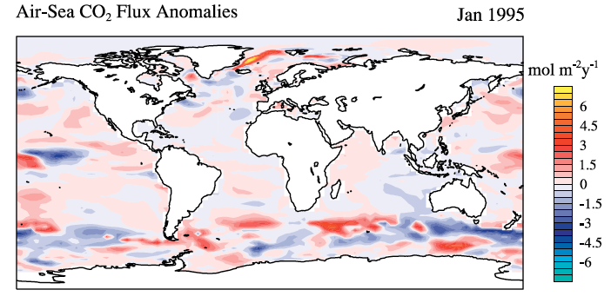
Air-Sea CO₂ Flux Hindcasts
-Global ocean hindcast simulations (1958-present)
-ENSO and Southern Annular Mode (SAM)
-Partitioning of d/dt flux, pCO₂, and DIC
-DIC, sea surface height & altimetry
Doney et al., Deep-Sea Res. II, 2009

Slide 10
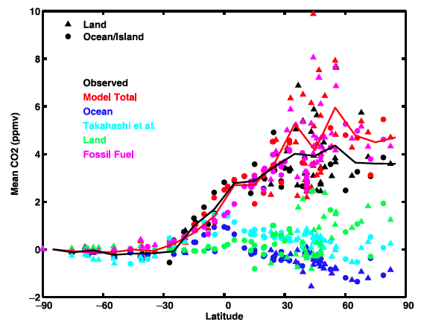
Contributions to Latitudinal Gradient
Nevison et al., J. Geophys. Res. Biogeosci., 2008

Slide 11
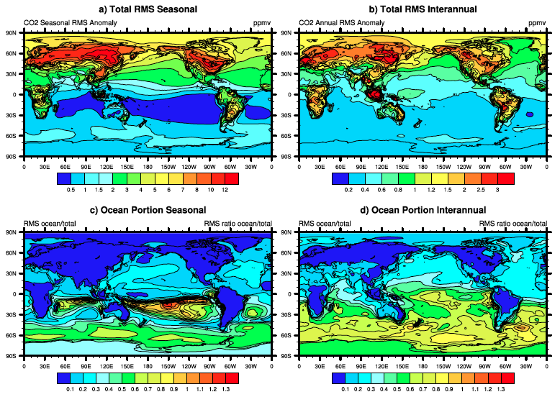
Surface Atmosphere CO₂ Variability (rms ppmv)
seasonal
interannual
Ocean Fraction of Total Variability (rms ppmv)
seasonal
interannual
Nevison et al., J. Geophys. Res. Biogeosci., 2008

Slide 12
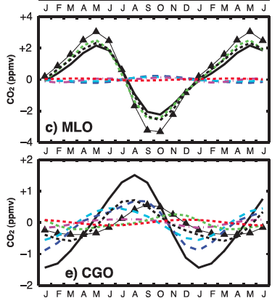
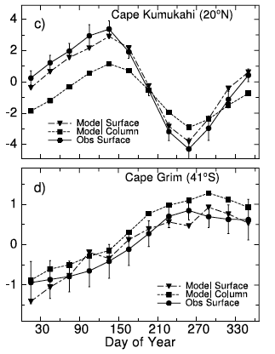
Nevison et al., J. Geophys. Res. Biogeosci., 2008
Olsen & Randerson J. Geophys. Res. 2004

Slide 13
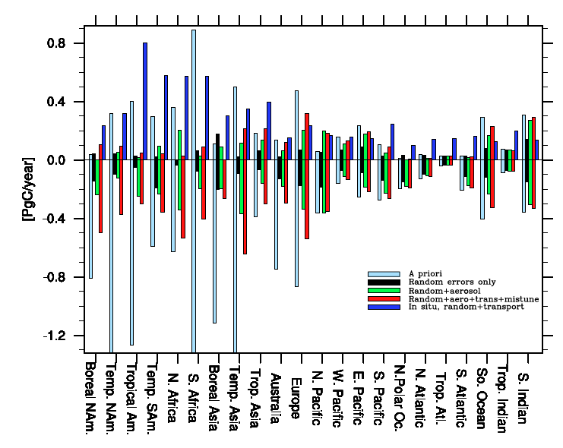
Estimated Regional Ocean Flux Errors
Annual mean error
Seasonal error
Baker et al. Atmosp. Chem. Phys. 2010

