Slide 1
CO₂ Flux Inversion Error Analyses for ASCENDS
David Baker
CIRA/Colorado State
27 Feb 2012
OUTLINE
Acknowledgements:
Randy Kawa, Jim Abshire, Ed Browell, Bob Menzies, Gary Spiers, Peter Rayner, Ken Jucks, et al.
Motivation
4-D Var Assimilation
Simulation strategy
Simulation results:
Random errors
Systematic errors

Slide 2
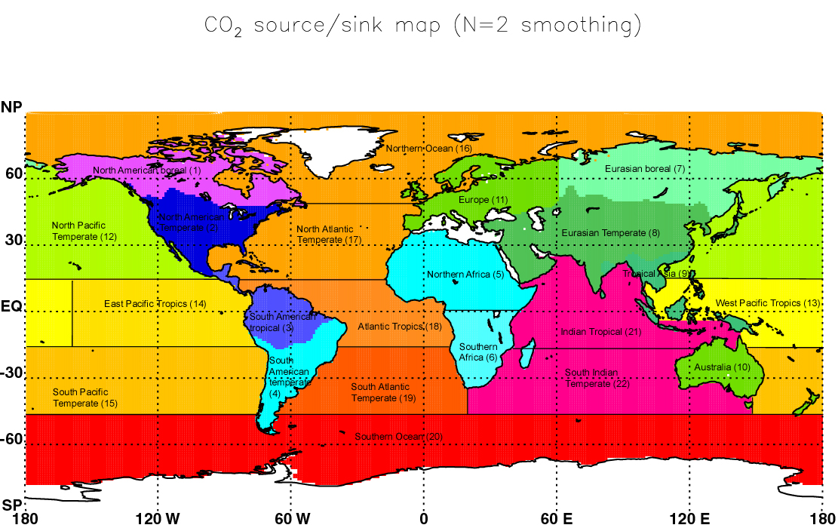
Motivation
Resolve CO₂ sources/sinks at regional scales (here, weekly on a 4½°x6° lat/lon grid)
Notes:
Hopefully we can tell what processes drive the global carbon cycle at these regional scales …

Slide 3
Goal: assess the ability different measurement approaches to pin down regional carbon fluxes
Metric: flux estimation accuracy
Tool: Simulation studies (OSSEs) using a high-resolution flux inversion method
Needed:
Atmospheric transport model to link fluxes to measurements: PCTM, driven by GEOS5 analysis products, run at 4½°x6° (lat/lon), 40 layers
Inverse method to infer optimal fluxes from measurements: variational data assimilation (“4DVar”), solves for weekly fluxes at 4½°x6° across a full year
Simulation set-up:
CO₂ flux inputs: LPJ land/Doney ocean as “truth”, CASA land/Takahashi ocean as prior, no diurnal cycle, no FF
Assumptions: diagonal P_{o} and R, P_{o} consistent with prior-truth flux difference, strong dynamical constraint
Inputs on measurement approaches
➔Error statistics from (a posteriori – true) fluxes

Slide 5
4-D Var Data Assimilation Method
Find optimal fluxes u and initial CO₂ field x_{o} to minimize
subject to the dynamical constraint
where
x are state variables (CO₂ concentrations),
h is a vector of measurement operators
z are the observations,
R is the covariance matrix for z,
u_{o} is an a priori estimate of the fluxes,
P_{uo} is the covariance matrix for u_{o},
x_{o} is an a priori estimate of the initial concentrations,
P_{xo} is the covariance matrix for x_{o,}
is the transition matrix (representing the transport model), and
G distributes the current fluxes into the bottom layer of the model
Notes:
Note change in notation: fluxes are now denoted u, and concentrations x. The delta in the measurement-mismatch term implies a summation over all measurements j that fall within flux timespan i -- if flux at time j falls within i, then δ_{ij} =1, otherwise it =0.

Slide 6
4-D Var Iterative Optimization Procedure
∇₀
x₀
°
Estimated
Fluxes
Forward
Transport
Forward
Transport
“True”
Fluxes
∇₁
∇₂
Modeled
Concentrations
“True”
Concentrations
°
x₁
°
Measurement
Sampling
Measurement
Sampling
x₂
Modeled
Measurements
“True”
Measurements
Assumed
Measurement
Errors
∇₃
Δ/(Error)²
x₃
°
Weighted
Measurement
Residuals
Flux
Update
Adjoint
Transport
Adjoint
Fluxes
= ∇
Minimum of cost function J
Notes:
Figure showing minimization approach with the 4-D Var method. Flow chart?

Slide 7
Measurement
uncertainties
specified in
proportion to
reference values
at Railroad Valley
= measurement
uncertainty
= diffuse reflectivity
(MODIS/MERRA)
= 1-way optical depth
(CALIPSO, 5 km)

Slide 8
Vertical Averaging Kernels
ASCENDS
Others
1.57 μm, +3 pm
AIRS
(JPL)
1.57 μm,
+10 pm
TES
2.06 μm
OCO

Slide 9
Nine random-error OSSEs
Estimate 52 weekly fluxes
on 4½°x6° (lat/lon) grid
Averaging kernel
1.57 μm,
+10 pm
& +3 pm
1.57 μm,
+10 pm
2.06 μm
0.50 ppm
Assumed
measurement
uncertainties
(at Railroad
Valley, NV,
across 10 s,
or ~70 km )
1.00 ppm
2.00 ppm
Notes:
2 other things to look at: divide into day/night and look at 1) whether night (with its shallower PBL) can be estimated better/worse than day, and 2) how much data on both sides of orbit improves things over just passive-coverage (day-side) data.

Slide 10
RRV measurement
uncertainty,
10 s averaging
7-day flux estimation errors, RMS of 52 weeks
2.06 μm
1.57 μm, +10 & +3 pm
1.57 μm, +10 pm only
0.5
ppm
1.0
ppm
2.0
ppm
A priori
[10⁻⁹ kgCO₂ m⁻² s⁻¹]

Slide 11
RRV measurement
uncertainty,
10 s averaging
Fractional error reduction, RMS of 52 weekly fluxes
2.06 μm
1.57 μm, +10 & +3 pm
1.57 μm, +10 pm only
0.5
ppm
1.0
ppm
2.0
ppm

Slide 12
RRV measurement
uncertainty,
10 s averaging
Fractional error reduction, RMS of four seasonal fluxes
2.06 μm
1.57 μm, +10 & +3 pm
1.57 μm, +10 pm only
0.5
ppm
1.0
ppm
2.0
ppm

Slide 13
Measurement constraint vs. horizontal resolution
2.06 μm, 0.5 ppm
1.57 μm, +10 pm only, 0.5 ppm
4½°x6°
lat/lon
9°x11¼°
lat/lon
Fractional error reduction, RMS of 52 weekly fluxes

Slide 14
Four systematic-error OSSEs
All four use the 0.5 ppm 2.06 μm random error case as a base,
then add systematic errors on top:
#1: b = +1 ppm * cos(SZA) day/night-side bias
#2: b = +1 ppm* (1 – σ_{RRV}/σ) bias over low-signal areas
#3: b = -1 ppm* (OD/0.3) bias over high-OD areas
#4: b = 0.4 ppm over snow-covered forested areas:
North of 40° N: Jan, Feb, Mar
50° N: Nov, Dec, Apr
60° N: Oct, May
Look at impact in terms of:
Increase in the weekly posterior-truth errors (RMS)
Increase in the seasonal posterior-truth errors (RMS)
Shift in the seasonal and annual flux estimates (= a flux bias error)

Slide 15
7-day flux estimation errors, RMS of 52 weeks
Prior
Posterior, random errors only
Posterior, random + case #1 biases
Posterior, random + case #2 biases
Posterior, random + case #3 biases
Posterior, random + case #4 biases
[10⁻⁹ kgCO₂ m⁻² s⁻¹]

Slide 16
Fractional error reduction,
RMS of 52 weekly flux errors
Posterior, random errors only
Posterior, random + case #1 biases
Posterior, random + case #2 biases
Posterior, random + case #3 biases
Posterior, random + case #4 biases

Slide 17
Fractional error reduction,
RMS of four seasonal fluxes
Posterior, random errors only
Posterior, random + case #1 biases
Posterior, random + case #2 biases
Posterior, random + case #3 biases
Posterior, random + case #4 biases

Slide 18
Annual flux estimates and shift due to biases
Prior flux
Posterior flux, random errors only
Shift in flux due to case #1 biases
Shift in flux due to case #2 biases
Shift in flux due to case #3 biases
Shift in flux due to case #4 biases
[10⁻⁹ kgCO₂ m⁻² s⁻¹]

Slide 19
July-Sept flux estimates and shifts due to biases
Prior flux
Posterior flux, random errors only
Shift in flux due to case #1 biases
Shift in flux due to case #2 biases
Shift in flux due to case #3 biases
Shift in flux due to case #4 biases
[10⁻⁹ kgCO₂ m⁻² s⁻¹]

Slide 20
Jan-Mar flux estimates and shifts due to biases
Prior flux
Posterior flux, random errors only
Shift in flux due to case #1 biases
Shift in flux due to case #2 biases
Shift in flux due to case #3 biases
Shift in flux due to case #4 biases
[10⁻⁹ kgCO₂ m⁻² s⁻¹]

Slide 21
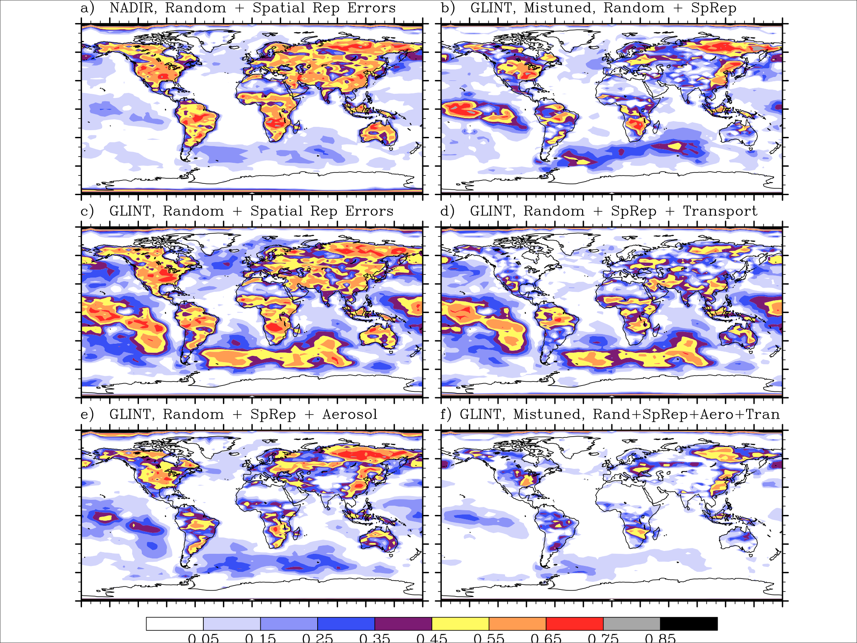
IMPACT of
SYSTEMATIC
ERRORS:
fractional
uncertainty
reduction,
for OCO

Slide 22
Conclusions
Regional CO₂ fluxes errors estimated in simulation setup
Estimation errors computed by accumulating (estimate-truth) flux statistics
2.06 μm averaging kernel provides better surface constraint than 1.57 μm with +10 pm data alone
Use of both +3 pm & +10 pm averaging kernels at 1.57 μm provides similar constraint to 2.06 μm
If only random measurement errors present, even 1 ppm noise case (or better) provides ≥50% improvement in fluxes over vegetated land areas at ~500 km resolution
Systematic errors degrade this
Notes:
conclusions

Slide 23
4-D Var Data Assimilation Method
Adjoin the dynamical constraints to the cost function using Lagrange multipliers λ
Setting ∂F/∂x_{i} = 0 gives an equation for λ_{i}, the adjoint of x_{i:}
The adjoints to the control variables are given by ∂F/∂u_{i} and ∂F/∂x_{o} as:
The gradient vector is given by ∂F/∂u_{i} and ∂F/∂x_{o}º, so the optimal u and x₀ may then be found using one’s favorite descent method. I have been using the BFGS method, since it conveniently gives an estimate of the leading terms in the covariance matrix.
Notes:
Note that there are no matrixes to store (other than R-1 and P-1, which can be computed once) or invert, and no basis functions H to pre-compute.

Slide 24
Atmospheric Transport Model
Parameterized Chemical Transport Model (PCTM; Kawa, et al, 2005)
Driven by reanalyzed met fields from NASA/Goddard’s GEOS-DAS3 scheme
Lin-Rood finite volume advection scheme
Vertical mixing: diffusion plus a simple cloud convection scheme
Exact adjoint for linear advection case
Basic resolution 2°x 2.5°, 25 σ layers, Δt≈30 min, with ability to reduce resolution to
4°x 5°, Δt≈60 min
6°x 10°, Δt≈120 min <⎯ we’ll use this in the example
12°x 15°, Δt≈180 min
Measurements binned at Δt resolution
Notes:
We will run at reduced resolution to reduce the required CPU time for full runs

