Slide 1
Near-Real Time Analysis of the Modern Carbon Cycle by Model-Data Fusion: Applying to ASCENDS
Andrew Schuh
Lots of help from Scott Denning, David Baker, Chris O’Dell, Denis O’Brien, Tomohiro Oda, Nick Parazoo, Ian Baker, Becky McKeown (CSU Atmospheric Science & CIRA),
Andy Jacobson, Pieter Tans (NOAA ESRL), Scott Doney, Ivan Lima (WHOI),
Jim Collatz, Randy Kawa (NASA GSFC)
Acknowledgements:
Support by NASA

Slide 2
Outline
Current Data-Assimilation/Fusion System
Geos-Chem/MERRA forward CO2 runs
Case study w/ hypothetical source/sinks
Kernel-integrated interpretation of “case study”
No Inversions at this point!!!

Slide 3
Outline
Current Data-Assimilation/Fusion System
Geos-Chem/MERRA forward CO2 runs
Case study w/ hypothetical source/sinks
Kernel-integrated interpretation of “case study”

Slide 4
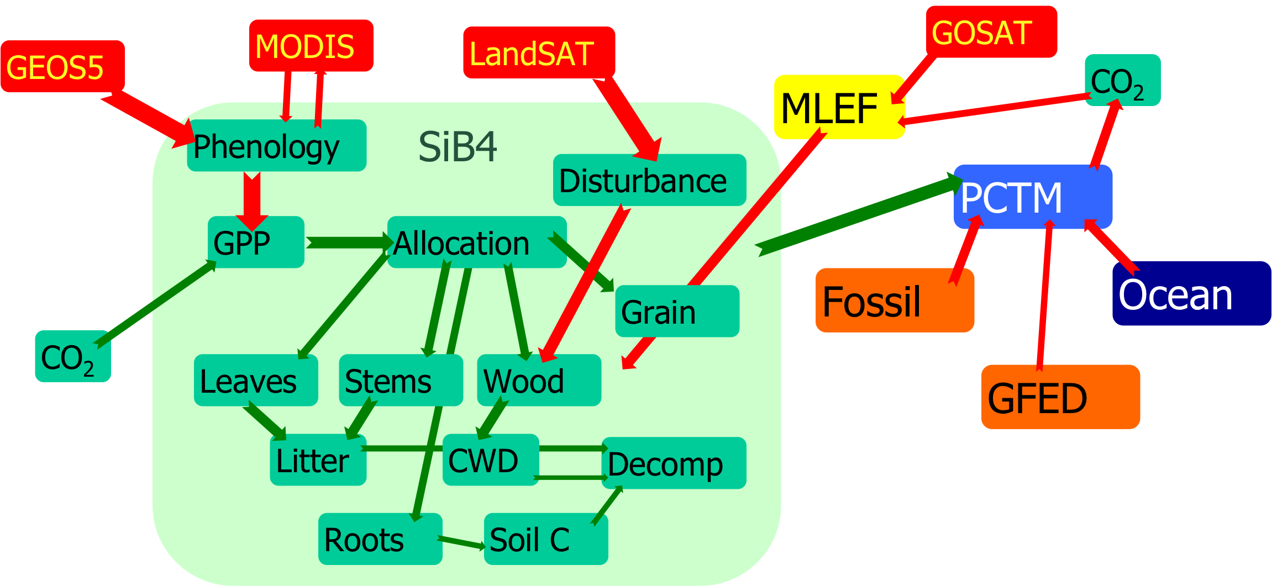
Overall Design (Model-data fusion)
ASCENDS?

Slide 5
where are we at ?

Slide 6
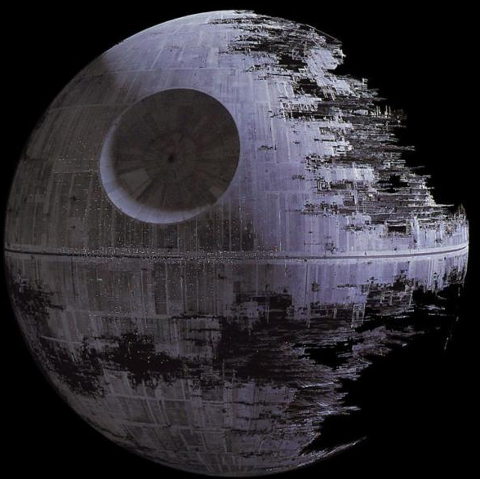

Slide 7
Component Models to System
Fossil Fuel Emissions (EDGAR plus DMSP, monthly, ODIAC night-lights based emissions)
Ocean Biogeochemistry, Ecosystems, & Air-Sea Gas Exchange (WHOI, daily)
Terrestrial photosynthesis & respiration (SiB4, hourly), SiB4 is phenology based and includes carbon pools now
Biomass burning (GFED, 8-day)
Atmospheric Transport (GEOS5-driven, 3-hourly)

Slide 8
Outline
Current Data-Assimilation/Fusion System
Geos-Chem/MERRA forward CO2 runs
Case study w/ hypothetical source/sinks
Kernel-integrated interpretation of “case study”

Slide 9
Surface Comparisons (i.e. sanity checks of forward CO2 against NOAA surface network)
Run Geos-Chem forward from 1/1/2009 with realistic initial CO2 (anonymous JPL donor, care of N. Parazoo)
Check seasonal cycles against NOAA surface network used by CarbonTracker (good times of day, nice, checked, “clean” data)

Slide 10
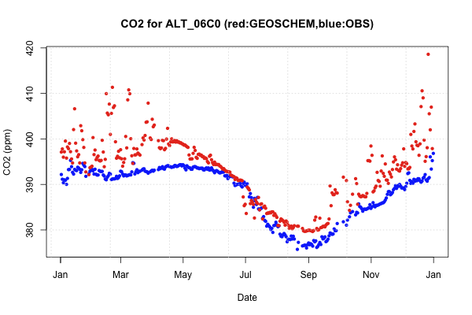
Surface Comparisons: Alert

Slide 11
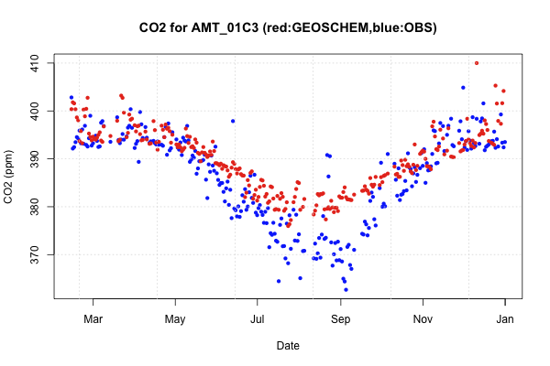
Surface Comparisons: Argyle (ME)

Slide 12
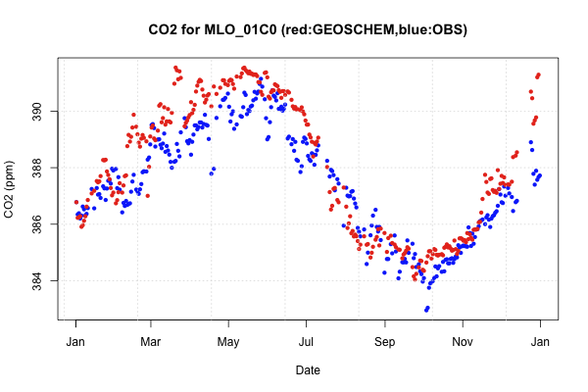
Surface Comparisons: Mauna Loa

Slide 13
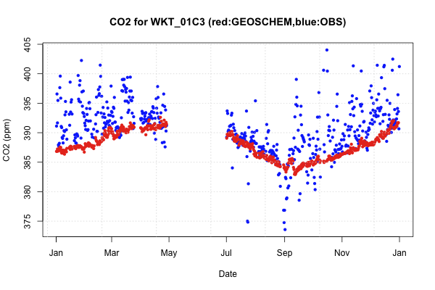
Surface Comparisons: WKT

Slide 14
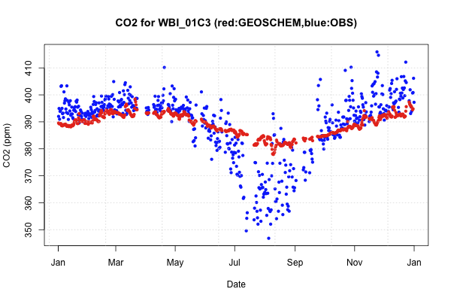
Surface Comparisons: WBI

Slide 15
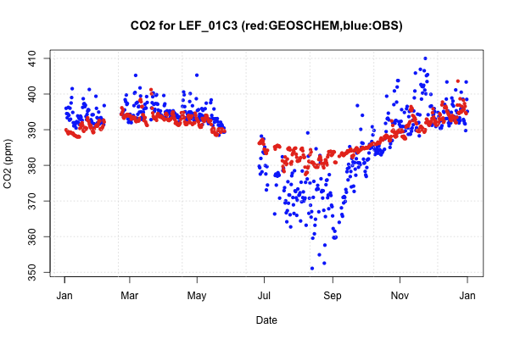
Surface Comparisons: LEF

Slide 16
Outline
Current Data-Assimilation/Fusion System
Geos-Chem/MERRA forward CO2 runs
Case study w/ hypothetical source/sinks
Kernel-integrated interpretation of “case study”

Slide 17
Adding pseudo-sinks and investigating impact with ASCENDS kernels
Take “base” case of CO₂ fluxes
Annually balanced SiB3 fluxes
Takahashi 2009 Ocean Fluxes (-1.4 PgC annual sink)
Andres 2010 Fossil
Create “realistic” case of CO₂ fluxes
Add “Fertilization” effect in tropics
Add forest “regrowth” effect in N.E. U.S.
Nitrogen deposition downwind of industry
Weaken ocean circulations

Slide 18
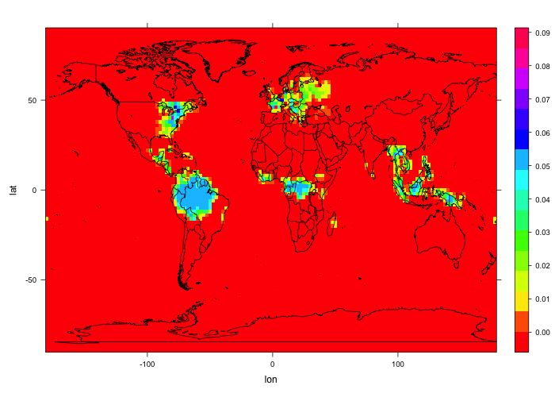
Annual Pseudo-biases (GPP) ( new GPP = (1+bias)*GPP )
Nitrogen
deposition
CO2 fertilization

Slide 19
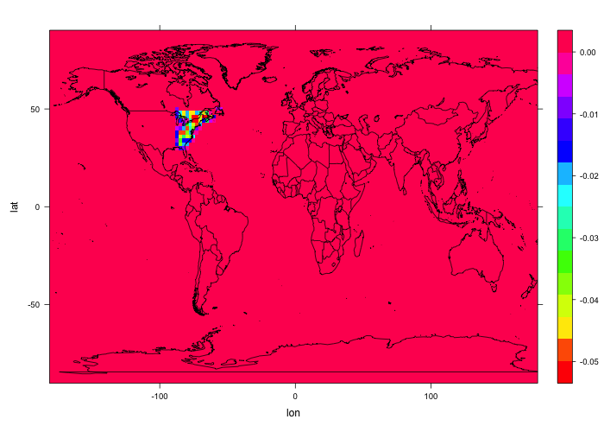
Annual Pseudo-biases (Resp) ( new Resp = (1+bias)*Resp )
Forest regrowth

Slide 20
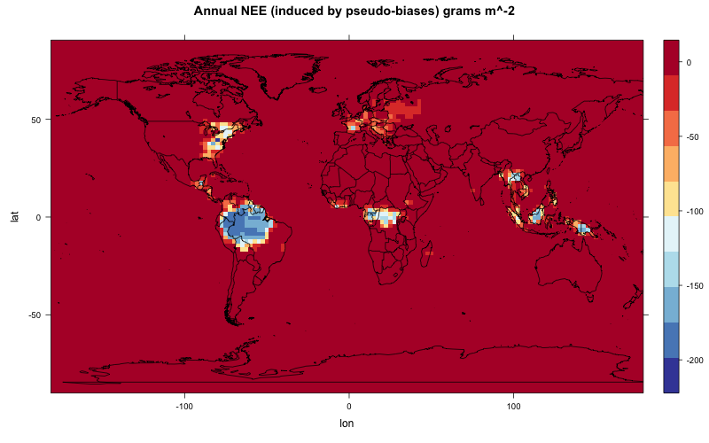
Annual Land NEE difference induced by these sinks
(Global total ~ -2.6 PgC)

Slide 21
Annual Pseudo-biases (Ocean) ( new NEE = (1+bias)*NEE )

Slide 22
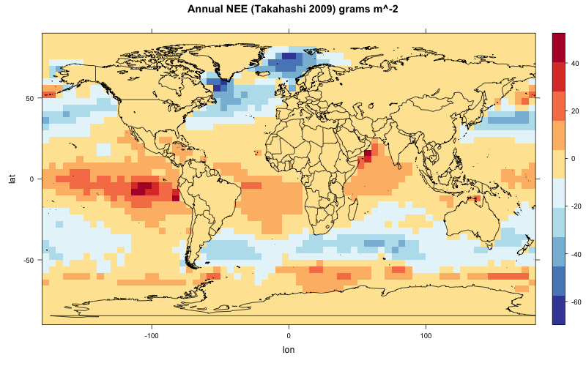
‘base’ Annual Ocean Sink

Slide 23
‘Science Fiction’ Annual Ocean Sink adjustment
Weakened southern ocean sink

Slide 24
Outline
Current Data-Assimilation/Fusion System
Geos-Chem/MERRA forward CO2 runs
Case study w/ hypothetical source/sinks
Kernel-integrated interpretation of “case study”

Slide 25
Transport both scenarios
Run Geos-Chem w/ regridded 1x1.25 MERRA (GEOS5 reanalysis), start from the SAME initial conditions @ 1/1/2009
Run Geos-Chem with 4 tracers
Ocean Flux Tracer
Land Flux Tracer
Fossil Flux Tracer
Total Flux Tracer
Do this over both scenarios, “base” and “pseudo-reality”
Investigate the differences in these two runs when viewed through the different possible ASCENDS averaging kernels for the next year (2010). Unless otherwise noted, using 2.06um

Slide 26
Snapshot Plot of average of bottom 10 levels of model “No Bias” – “Bias”

Slide 27
Comparison Specifics
Take CO₂ output from control (base) and test (sinks) and normalize to model CO₂ at Mauna Loa. Our aim then is to compare cyclo-stationary anomaly patterns.
Apply the different kernels to each of these realizations at hourly resolution
Calculate the difference in the kernel-integrated CO₂ between the two scenarios by month and hour
Divide this difference by an estimate of measurement uncertainty (D. Baker, R. Kawa, etc?) based upon 1ppm RRV base uncertainty to get signal to noise (SNR) ratios.

Slide 28
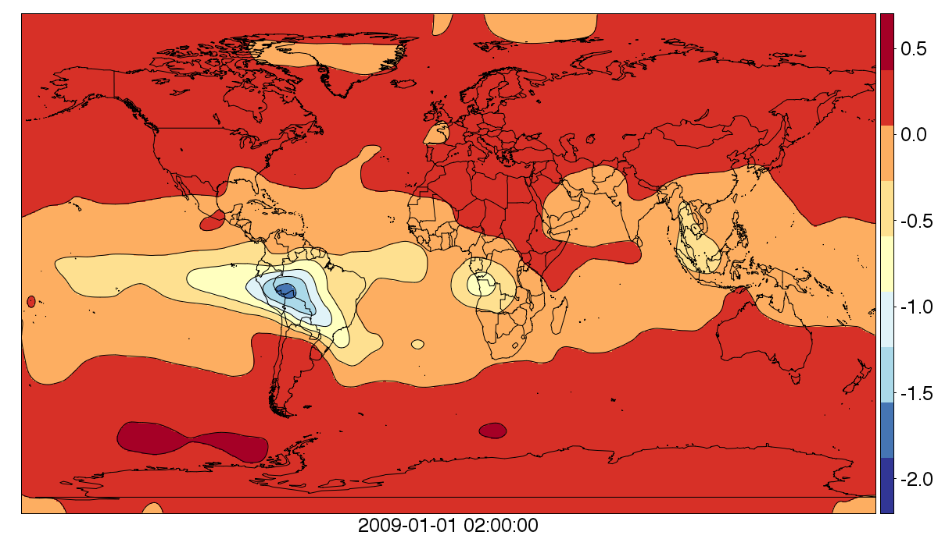
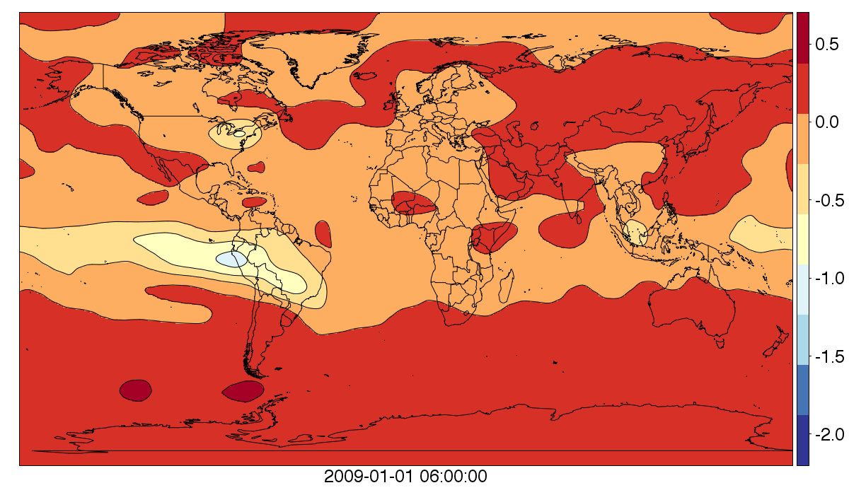
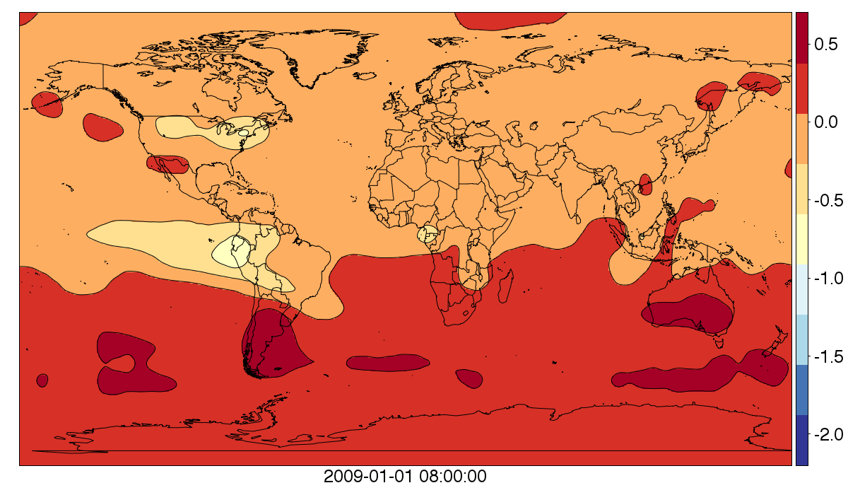
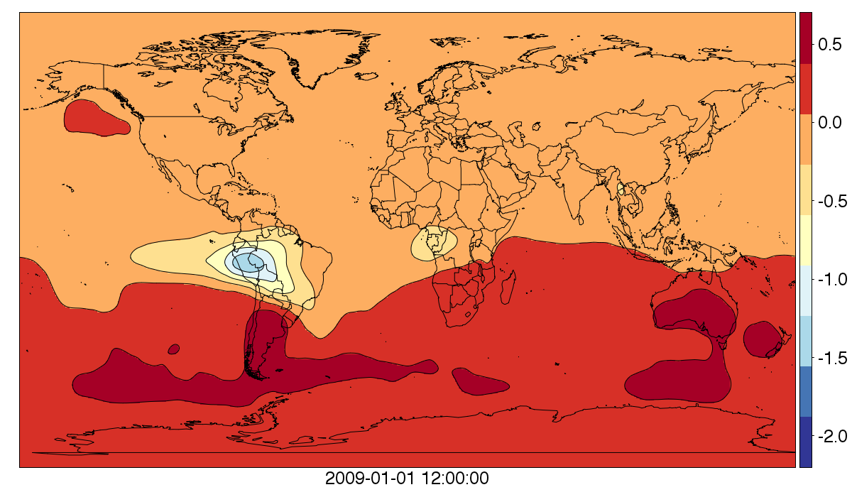
Signal to Noise ( “No Bias” – “Bias” CO2 )
February 2010
June 2010
August 2010
December 2010
2.06μm kernel

Slide 29
Hourly variability in SNR (May 15, 2010 – June 15, 2010)
2.06μm kernel

Slide 30
Early Comparison of kernels

Slide 31
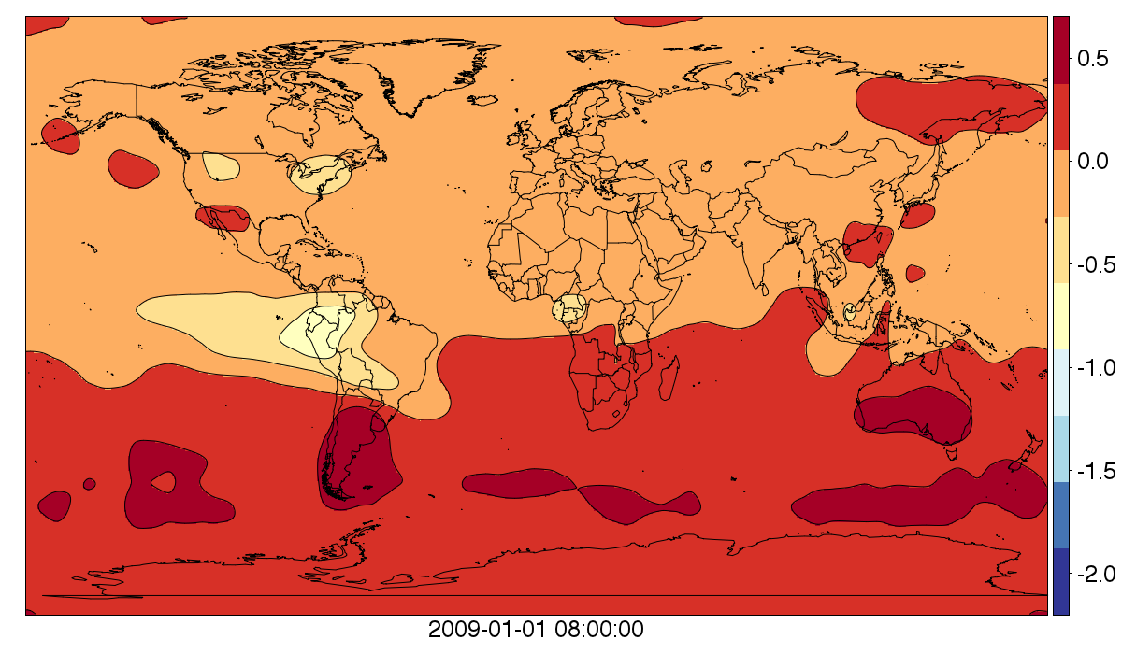
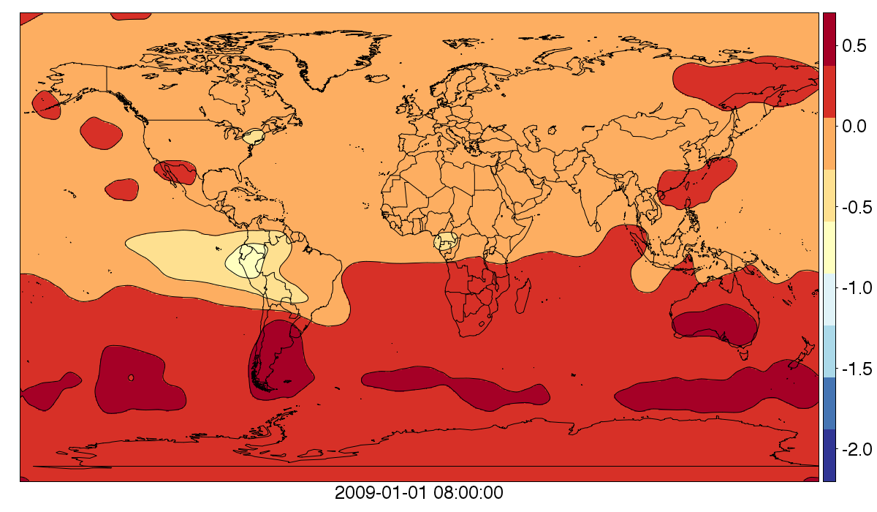
Kernel Comparisons (Aug 2010)
σ_{RRV}= 1ppm
Kernel-integrated SNR much more similar than I would have guessed.
Uncertainty higher over 2.06 kernel contributes some
Quick looks in vertical show pretty strong mixing up to tropopause at equator
Kernel: 1.57um + 3pm
Kernel: 2.06um
Kernel: 1.57um + 10pm

Slide 32
Summary
First, VERY PRELIMINARY STUFF
Initial thoughts are that the instrument is promising for recovering stationary patterns of CO2 resulting from persistent global source/sink structure
Might need errors on the “lower range” of what we current have to get SNR > 1
The ability to “peek” through cloudy scenarios very exciting
Probably need to formalize comparisons to passive instruments w/ respect to cloud masking, seeing in dark, etc.
“Dark scenarios” may often involve signal being trapped near ground…

