Slide 1
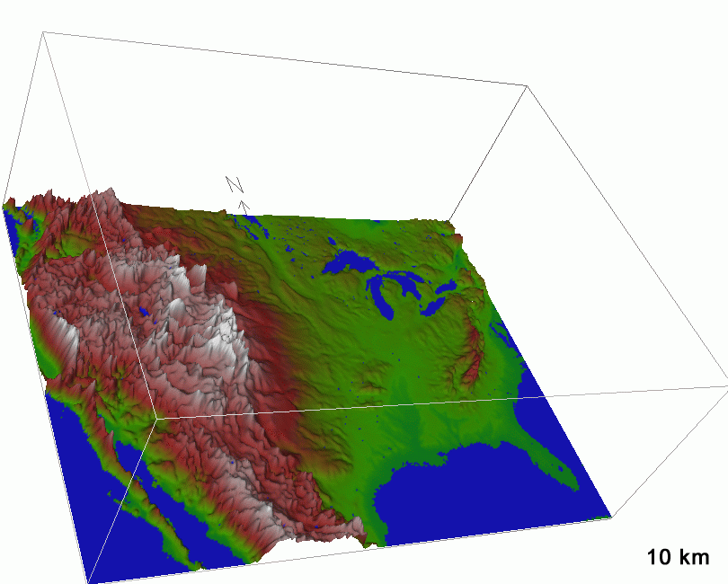
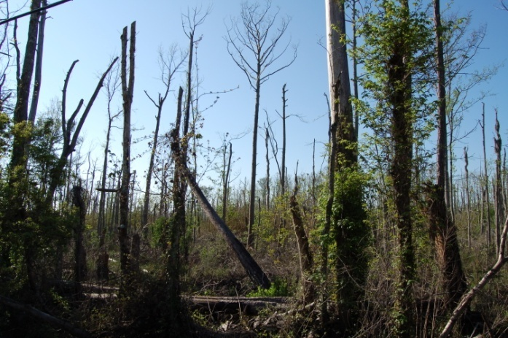
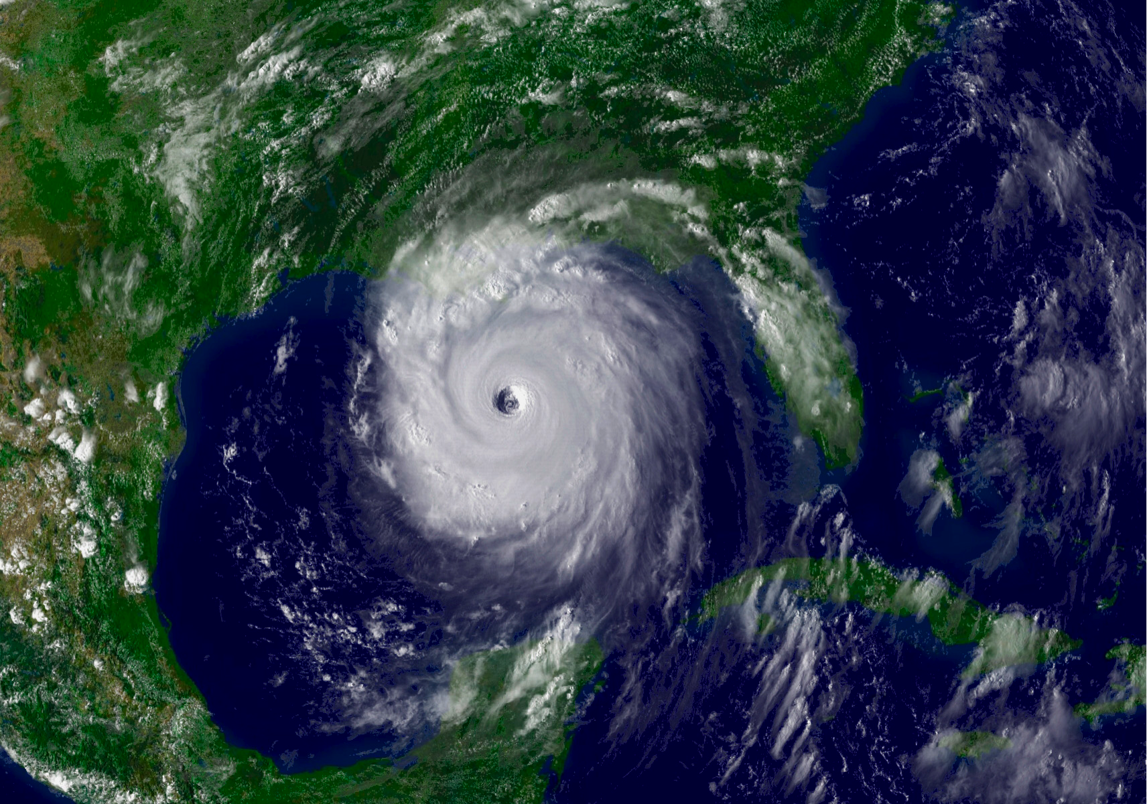
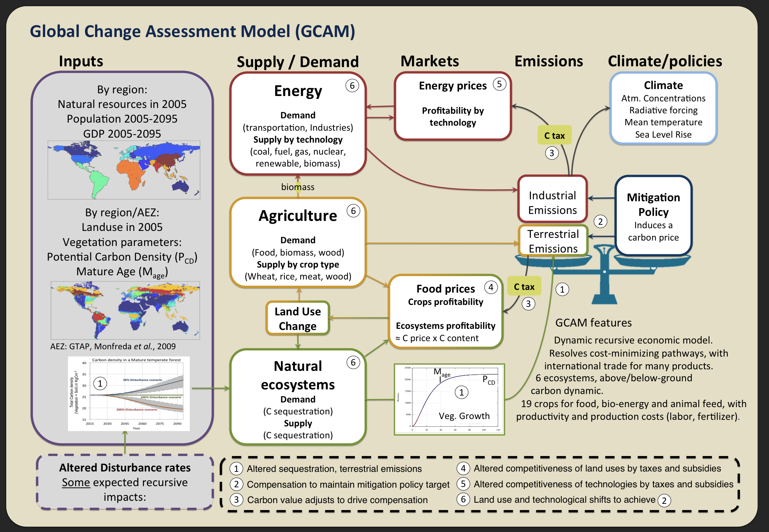
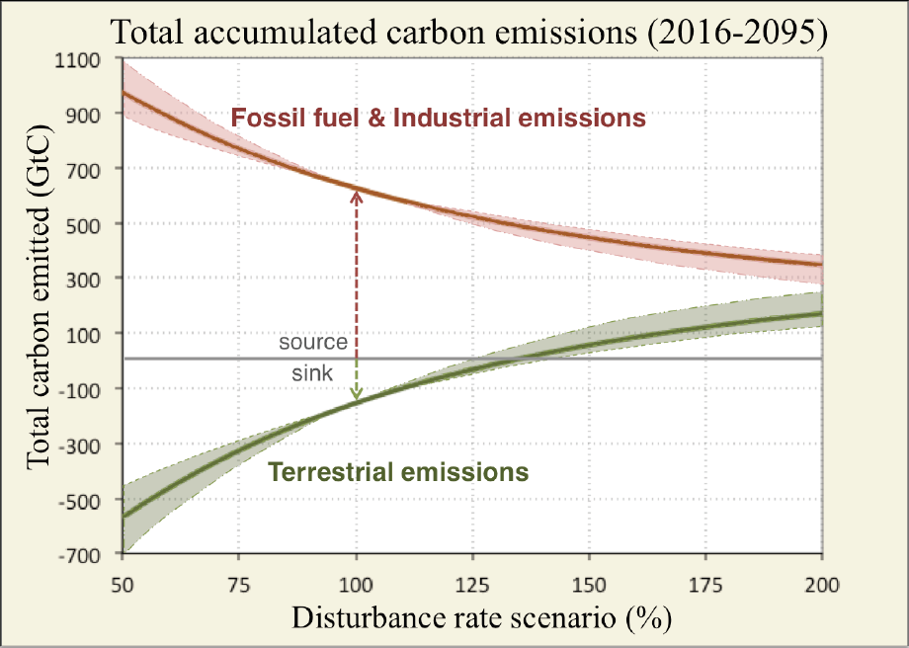
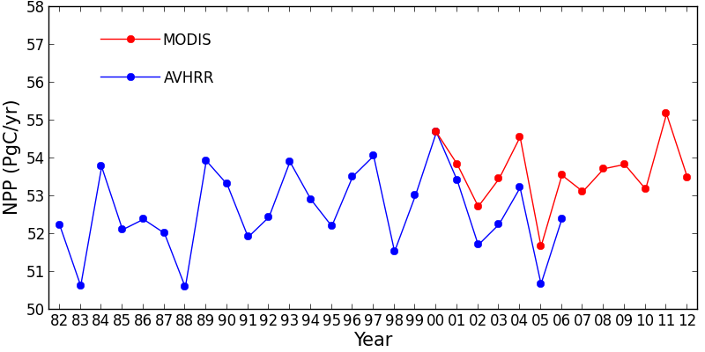


Ecosystems in 2100:
Changing climate, shifting biomes, altered disturbances, land-use, and implications for carbon-climate, human feedbacks
George Hurtt (gchurtt@@umd.edu)
With Contributions from: Jeff Chambers, Louise Chini, Katelyn Dolan, Joshua Fishe,
Justin Fisk, Richard Houghton, Doug Morton, Steve Running, Dongdong Wang,
Xiangming Xiao, Yongkang Xue, Hongcheng Zeng, Maosheng Zhao
2013 NASA TE Science Team Meeting
La Jolla, CA

Slide 2
Summary Perspective/Questions
Models are at the core of most of our science, relating measurements to quantities of interest (diagnostic), to conduct experiments at scales otherwise prohibitive or impossible, and providing projections into the future (prognostic).
Has the remote sensing capability exceeded the quality/resolution of the data needed to understand the observations?
Do existing models include all the necessary processes at sufficient spatial and temporal resolution to appropriately utilize data and minimize averaging errors in future projections?
Do our modeling approaches adequately account for human activities, and report the most decision-relevant variables?
How can modeling capabilities best advance and quantify, propagate, and track all relevant uncertainties?

Slide 3


Scientific Approach
Data
Detection and mapping of changes
Attribution of causes of change
Field cal/val
Experiments
Input data for models
Model development, parameterization
Model initialization, projections, testing
MIPs, DiPS,…

Slide 4
uncertainty
With Remote Sensing
time

Slide 5
NRC (2007)
“Understanding … changes and their implications requires a foundation of integrated observations – taken from land-, sea-, air-, and space based platforms – on which to build credible information products, forecast models, and other tools for making informed decisions.”
NASA TE Primary Science Questions
How are global ecosystems changing?
How do ecosystems, land cover and biogeochemical cycles respond to and affect global environmental change?
What are the consequences of land cover and land use change for human societies and the sustainability of ecosystems?
How will carbon cycle dynamics and terrestrial and marine ecosystems change in the future?

Slide 6
Green-up dates in the Tibetan Plateau have continuously advanced from 1982 to 2011
Zhang et al. 2013

Slide 7
Dobrowski et al 2013

Slide 8
Global Terrestrial Net Primary Production (1982-2012)
+/- 1Pg or about 2%
Nemani et al 2003, Zhao and Running 2010

Slide 9
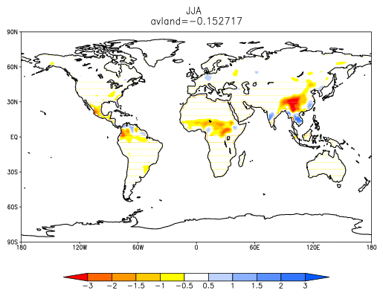
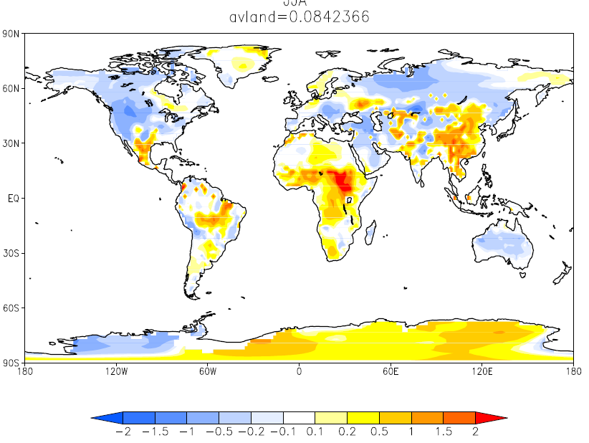
Difference Between LULCC runs and Control runs
(In 1980s)
JJA Precipitation (mm/day) Surface Temperature (C)
Y. Xue Pers com.
Notes:
Xue\

Slide 10
Houghton et al 2011
Notes:
The bars show net and gross sources and sinks of carbon from global land use and land-cover change (LULCC) (from Houghton, 2011). One message is that degradation (reduction of biomass within forests) accounts for little of the net flux but for ~60% of gross emissions. Deforestation, on the other hand, accounts for most of the net flux but ~40% of gross emissions.

Slide 11
IPCC AR4

Slide 12

Most models suggest an increase in the frequency of extreme events:
RCP 4.5
RCP 8.5
HadGEM2-ES
RCP 4.5
RCP 8.5
BCC-CSM1-1
Extreme events per decade
Wang et al., in prep
Notes:
HadGEM2-ES is high (4.5), middle (8.5), whereas BCC is low (4.5) and high (8.5) for overall trends in US PE. Here, an extreme event is a 1 mm per day PE anomaly (>2012 PE anomaly in western US).

Slide 13
Drier conditions by 2050 increase projected burned area under middle and high emissions scenarios:
 | Alaska | No. Plains | So. Plains | Midwest | Northwest | Southeast | Southwest | US
RCP 4.5 | 13% | 73% | 264% | 125% | 19% | 135% | 34% | 78%
RCP 8.5 | 101% | 117% | 407% | 164% | 44% | 202% | 61% | 125%
US Burned Area
1984-2009
Morton et al. 2013
Notes:
Percent increase in US burned area (relative to 1984-2009 mean) by 2050-2060, based on the multi-model average increase in PE.

Slide 14
Wise et al. (2009)
Notes:
Figure XX. Projected global land use from MiniCAM 450ppm stabilization scenario when ALL carbon is valued(top) and when terrestrial carbon is NOT valued (bottom). (Wise et al. 2009a,b).

Slide 15
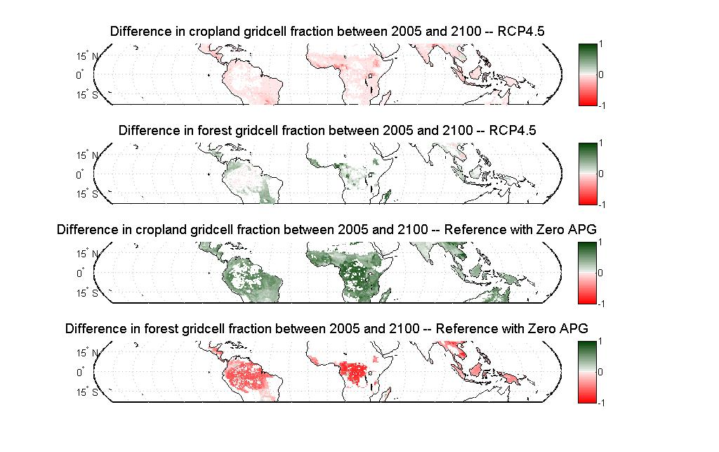
Thomson et al. (2010)
Notes:
Mitigation requires: value terrestrial carbon, and APG

Slide 16
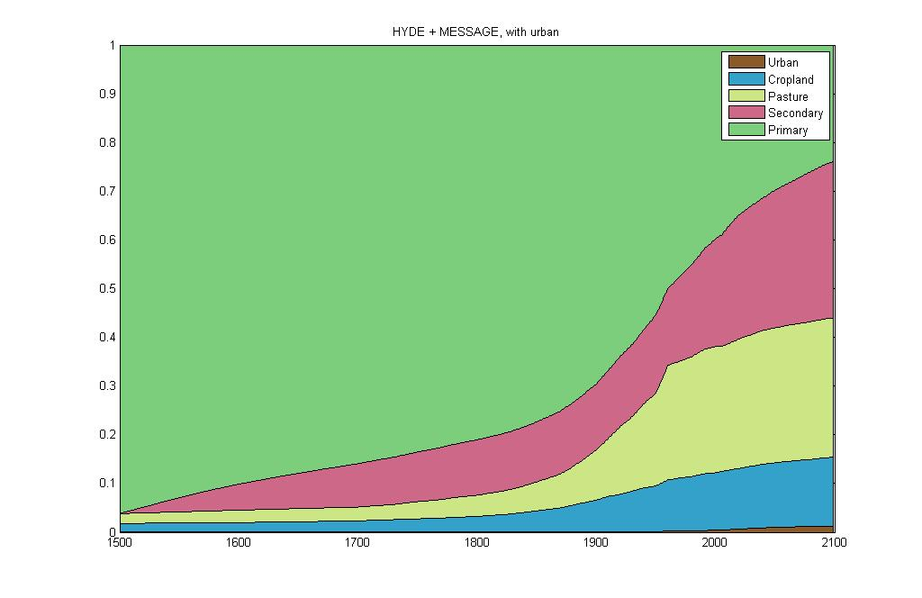
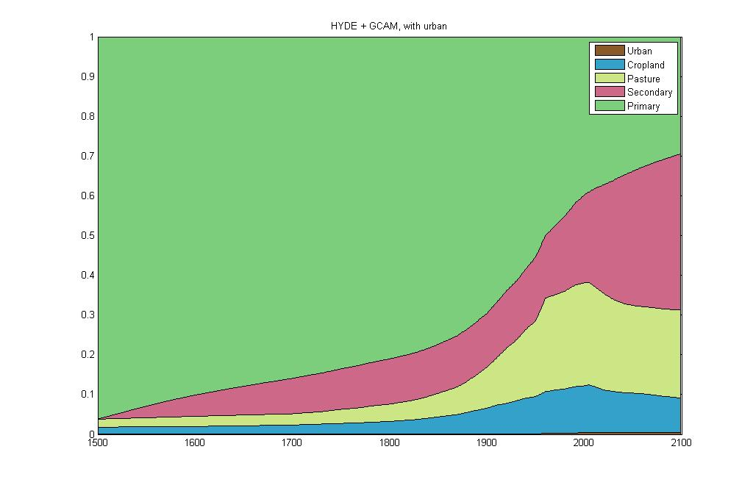
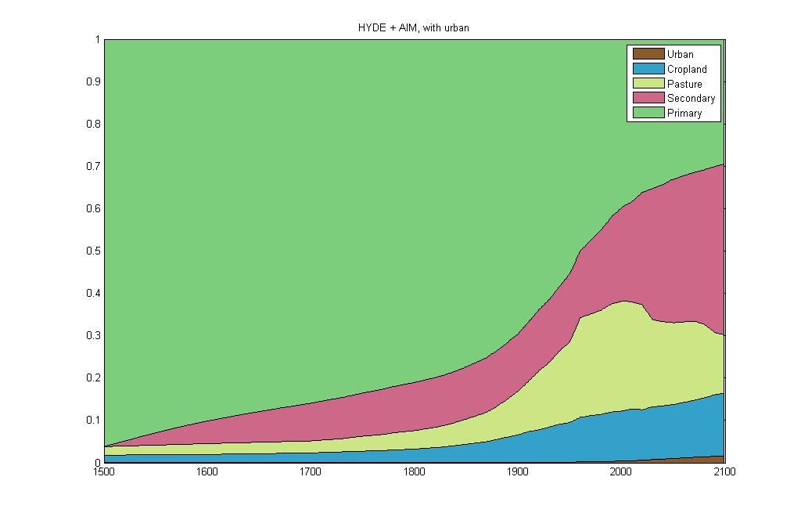

LUH-MESSAGE (8.5)
LUH-GCAM (4.5)
GLM Model Structure
l(x,y,t+1) = A(x,y,t) l(x,y,t)
LUH-AIM (6)
a₁₁ a₁₂ a₁₃ …
a₂₁ a₂₂ a₂₃ …
a₃₁ a₃₂ a₃₃ …
… …
LUH-IMAGE (2.6)
l₁
l₂
l₃
…
l₁
l₂
l₃
…
t+1
t
Hurtt et al. (2011)

Slide 17
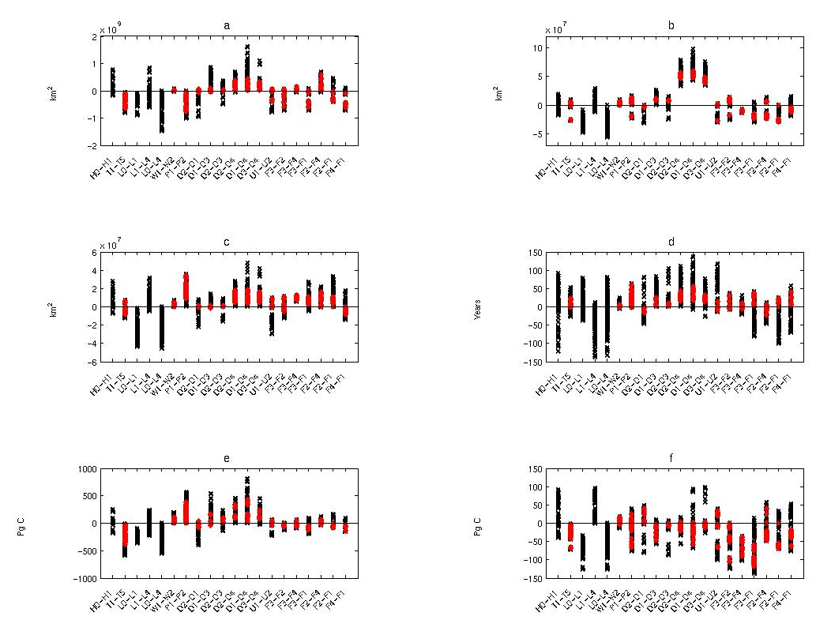
Gross T.
Net T.
Future Scenario
Start Date
Wood harvest
Sec.
Shifting Cultivation
Sec. Age
Total C
Net C
Hurtt et al. (2011)
Notes:
Model sensitivity to factors for (a) total gross land-use transitions from the start of the simulation to 2100, (b) total net land-use transitions from the start of the simulation to 2100, (c) total secondary land area in 2100, (d) global mean age of secondary land in 2100, (e) cumulative global loss of above-ground biomass carbon from the start of the simulation to 2100, and (e) cumulative net loss in above-ground biomass carbon from the start of the simulation to 2100. Each symbol represents the difference in simulated values for a pair of simulations that differ in only the factor identified on the horizontal axis. Red symbols represent paired data-based simulations (i.e., that do not use H0, L0, or L4 in Table 2) while black symbols represent simulations that do use H0, L0, or L4.

Slide 18
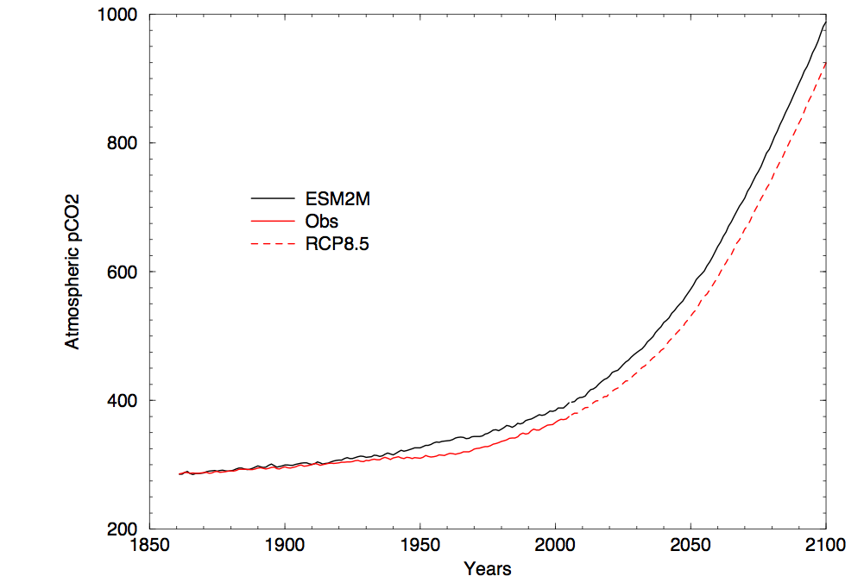
Simulated Atmospheric CO2 in
GFDL ESM model
Stouffer, pers. Comm.

Slide 19
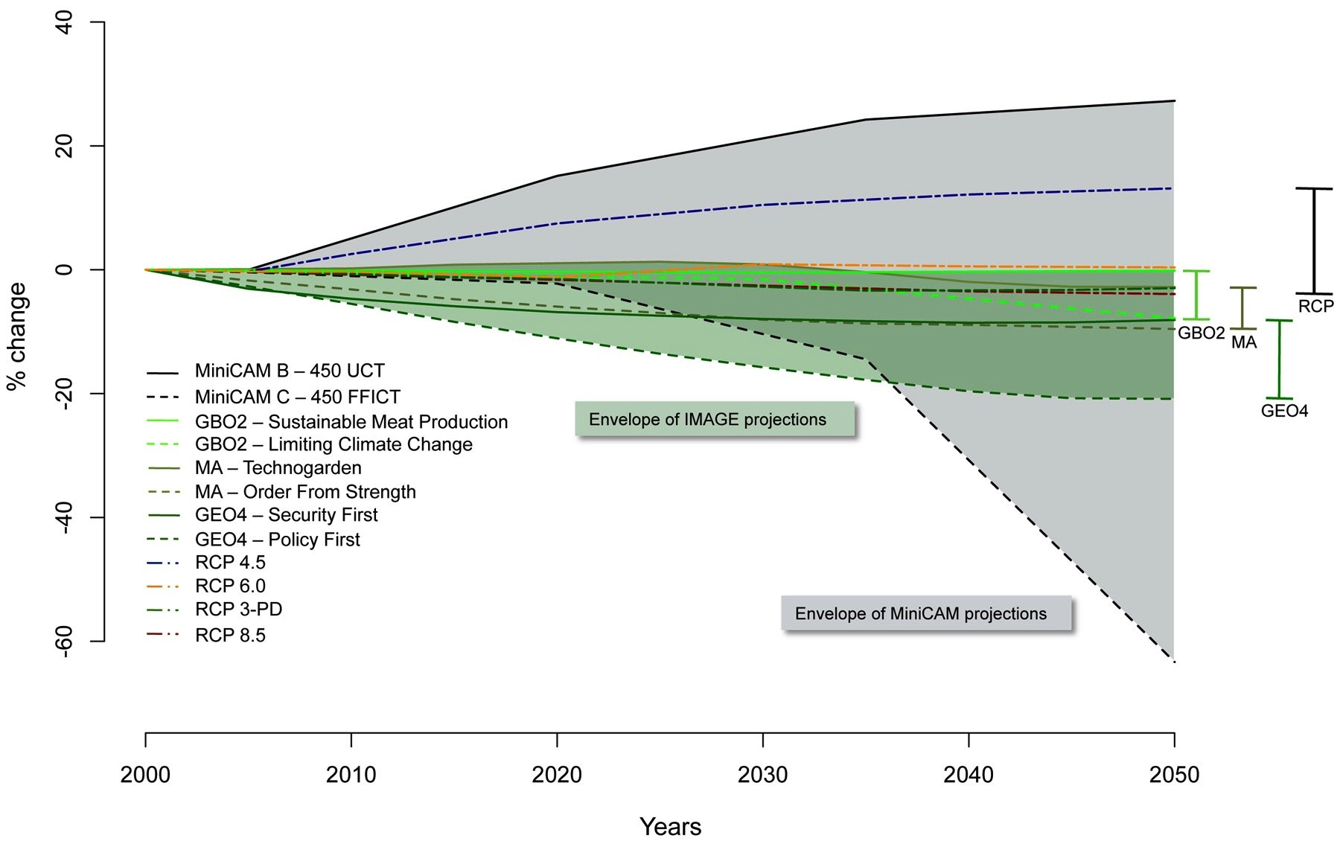
Pereira et al. (2010)

Slide 20
Hurricane Katrina
Chambers et al. (2007)
Dolan et al. (2010)
Notes:
Hurricane Katrina:
Huge event
~320 million trees killed or severely damaged
~105 Tg C biomass loss
Committed emissions equivalent to the annual U.S. carbon sink from forest trees
-Detectable by optical and active structural remote sensing

Slide 21
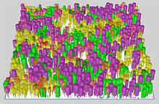
Ecosystem Demography (ED) Model
Plant
Physiology
Ecosystem Demography
Individual
Vital
Rates
Stand-Level
Structure and
Fluxes
Regional-Scale
Ecosystem
Structure and
Fluxes
Ecosystem
Biogeochemistry
Disturbance
and
Land Use
Change
Ecosystem
Physiology
Moorcroft et al 2001

Slide 22
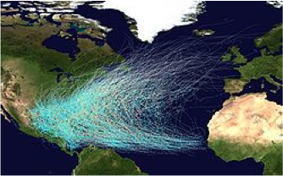
Biomass Loss
ΔNEE
ΔStock
Fisk et al. (In rev.)

Slide 23
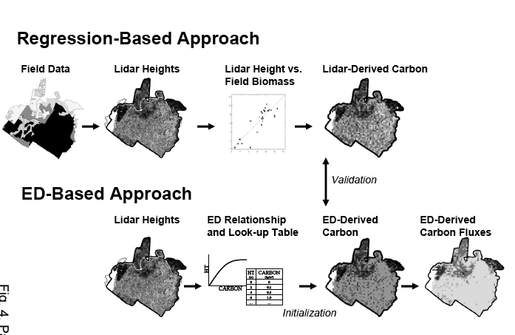
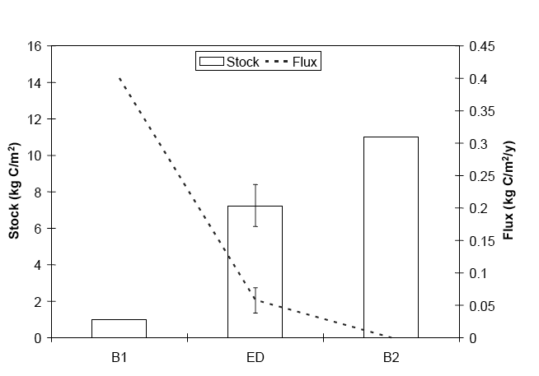
ED-Lidar (La Selva)
Hurtt et al. 2004

Slide 24
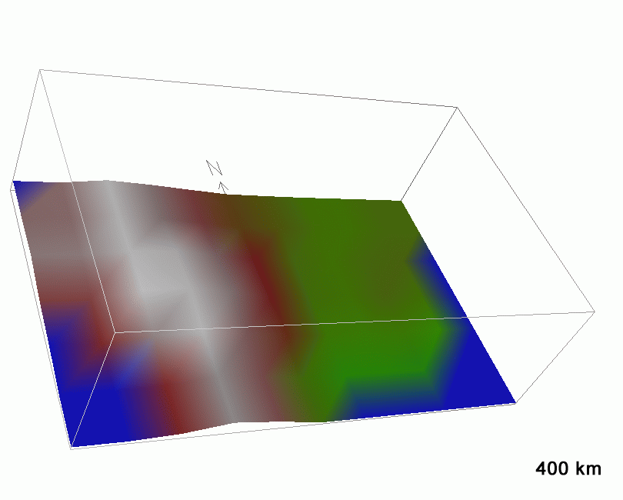
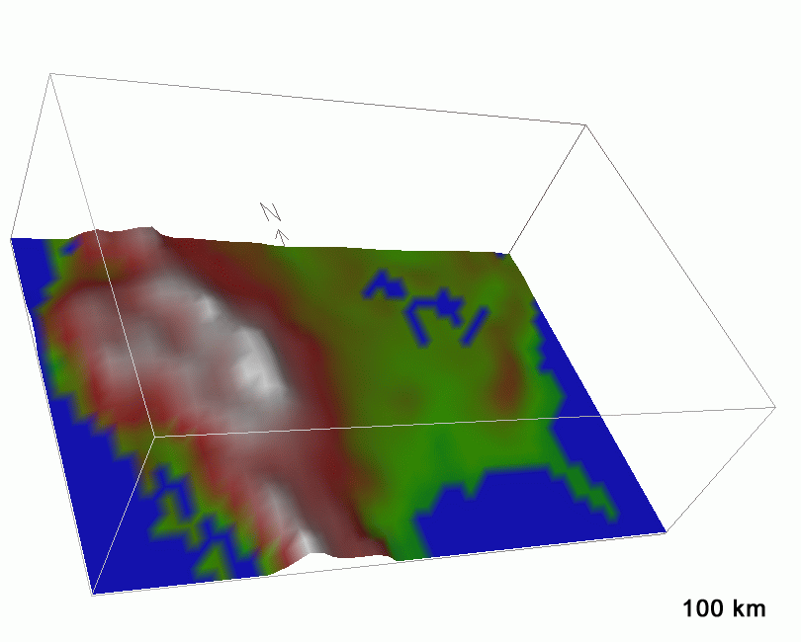
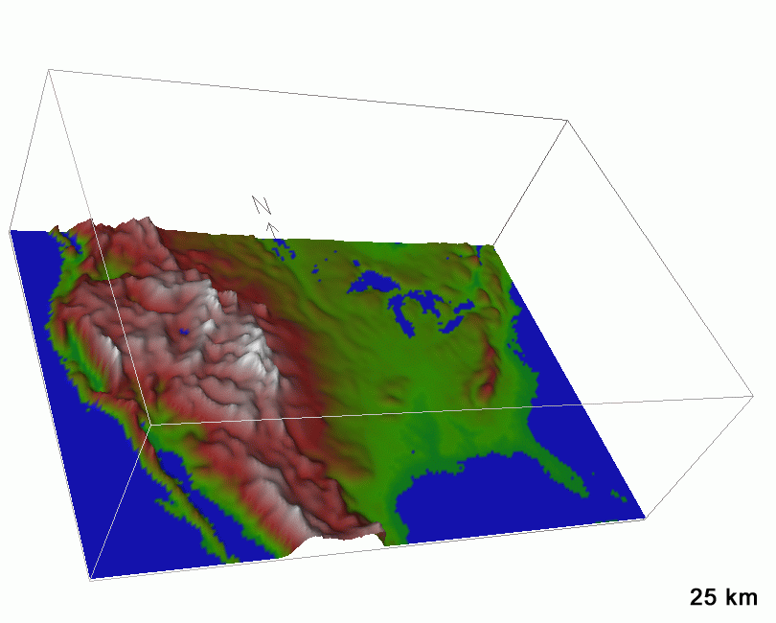
Resolution
Mearns (Pers. Comm.)
Notes:
Slide from Rick Anthes – NARCCAP runs are at 50 km – not quite as fine as the lower left panel.
Received from L. Mearns, pers. Com..

Slide 25
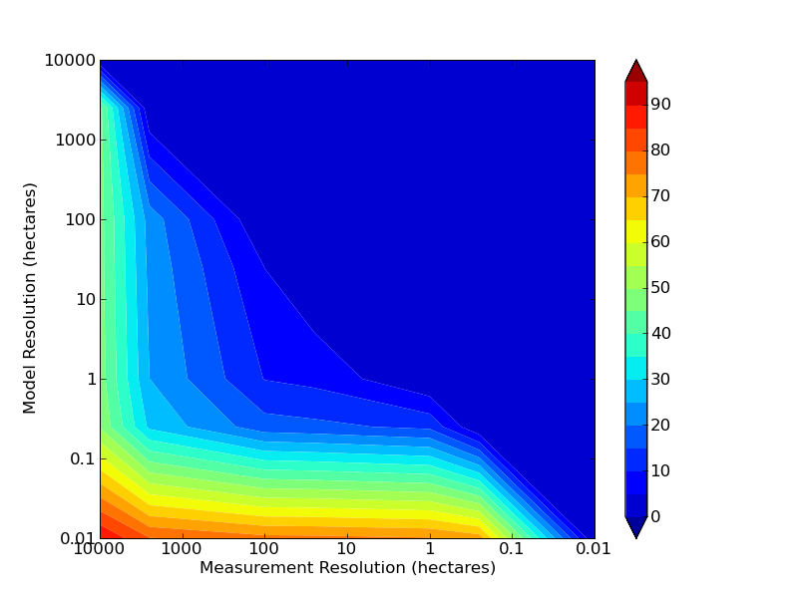
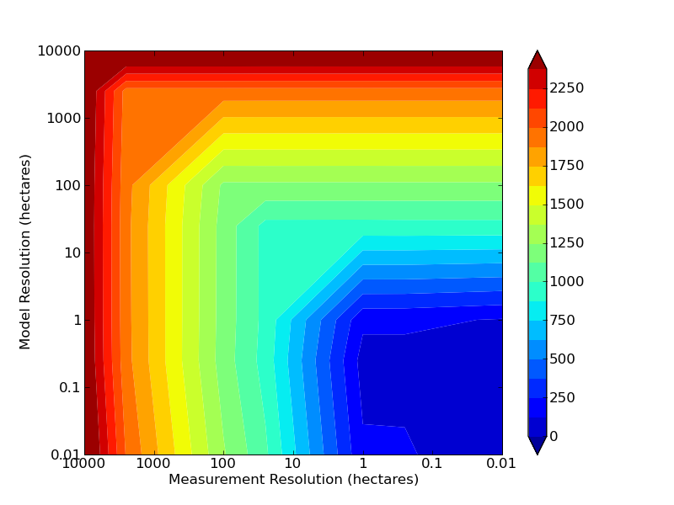
Biomass Error (AAE)
Flux Error (AAE)
R_{model} < R_{data}
R_{model} < R_{data}
R_{model} > R_{data}
R_{model} > R_{data}
Data too coarse
for env. gradient
Efficient solution
Model too coarse
for env. gradient
Hurtt et al. 2011

Slide 26
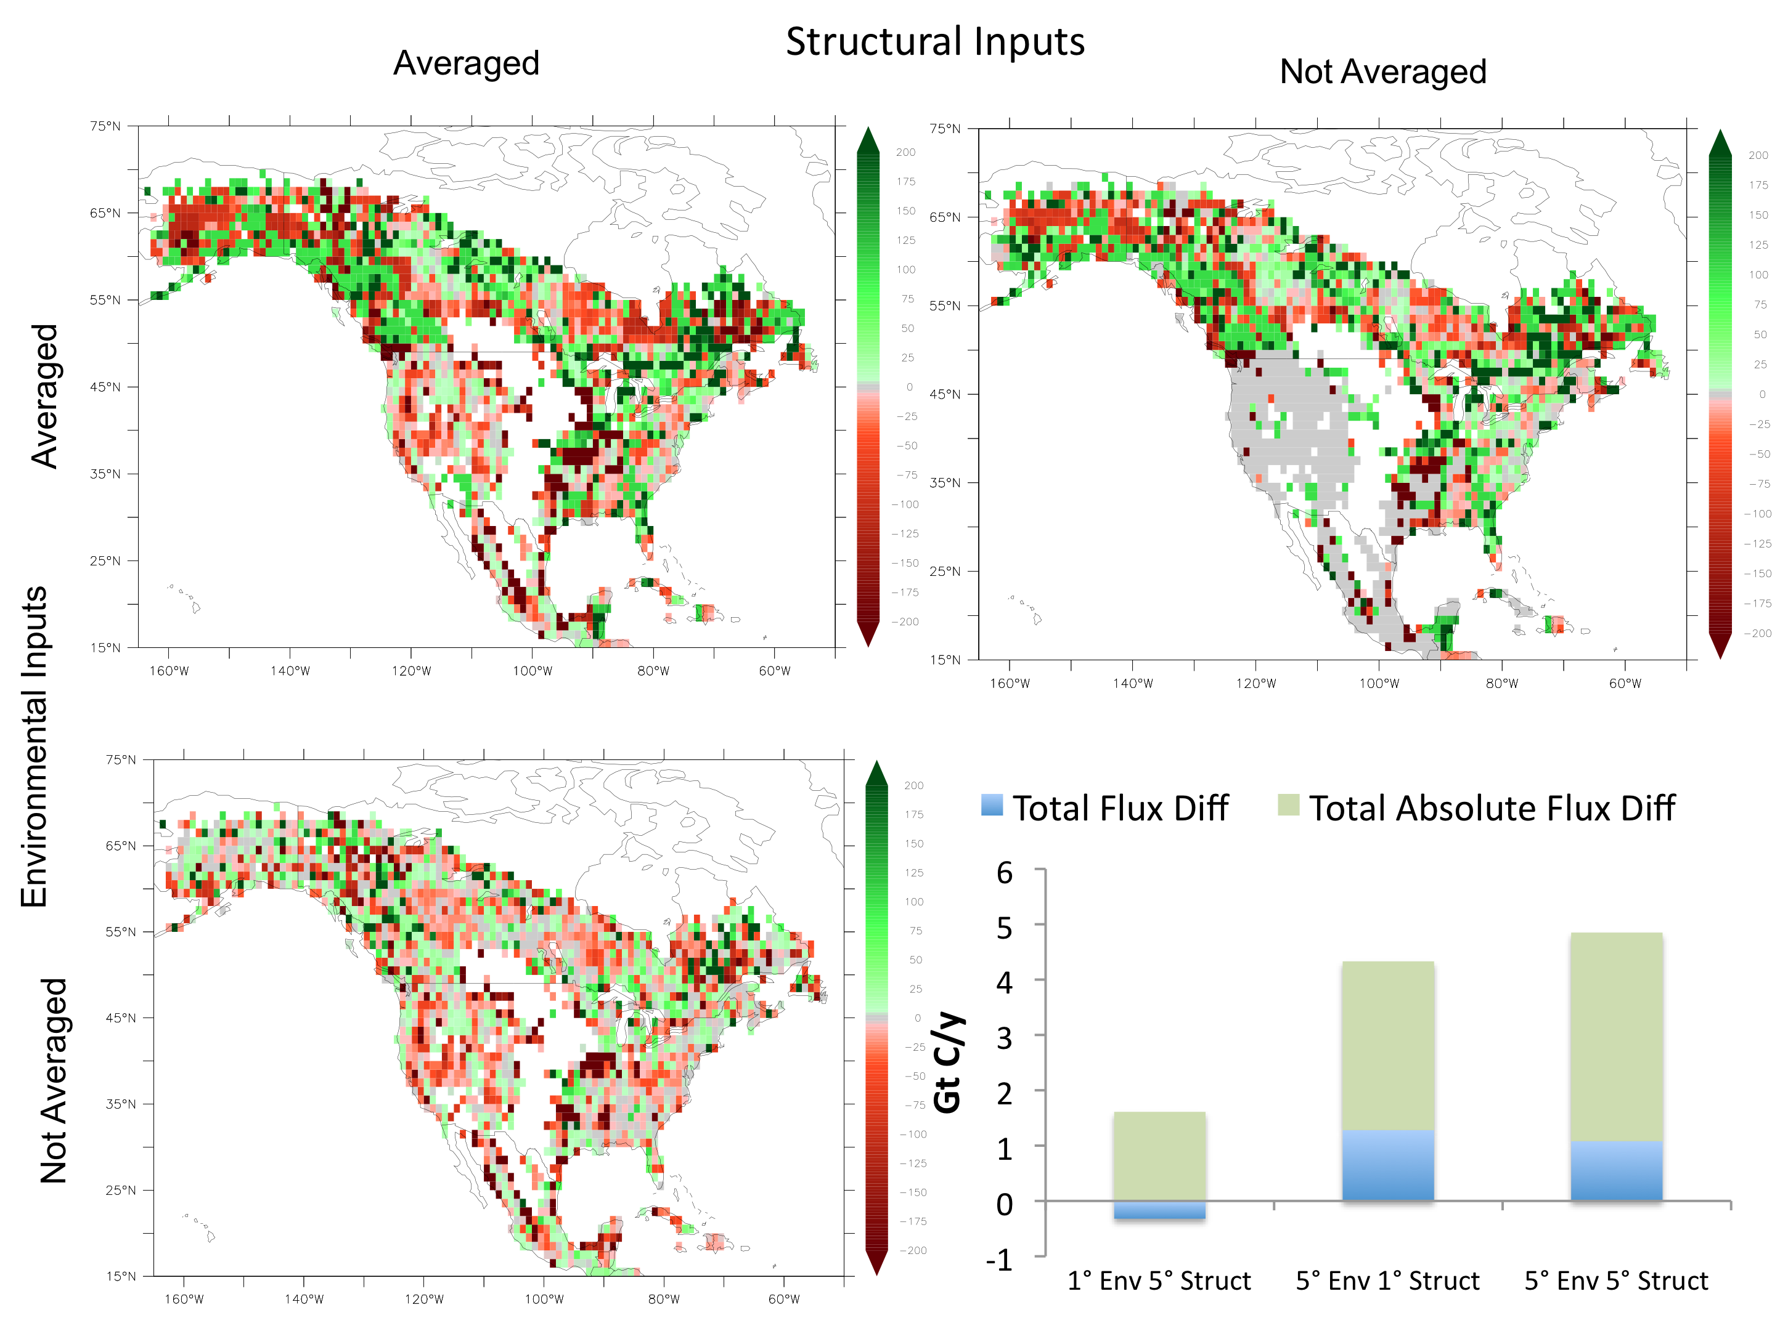

Slide 27
Global Change Assessment Model (GCAM)
More details:
http://wiki.umd.edu/gcam - Wise et al., Science 2008 – Thomson et al., Climatic Change 2011
Edmonds et al. pers comm.

Slide 28
Impacts on mitigation strategies
Policy to limit atmospheric radiative forcing at 3.7 W m⁻² in 2095 (≈3° warming), universal carbon tax.
500$/tC
100$/tC
Le Page et al., ERL 2013

Slide 29

iED: Framework
ED
Vegetation and carbon dynamics
Gridded
land-use
1- Global carbon budget
2- Carbon $ potential
iED coupler
GLM
Spatial land-use decisions
GCAM
Regional
Economy, energy, agriculture
Regional
Land-use

Slide 30
Updated carbon market projections with detailed ecosystem dynamics representation: impacts of model resolution (parametric versus process) on the carbon price.
GCAM
Doubled
iED
Today’s rate
Halved
Y. LePage, pers. comm.

Slide 31
iESM Multi-phase Coupling Strategy
iESM Control (RCP 4.5)
Fossil fuel emissions
IMAGE/GCAM
CLM/CCSM
GLM
landuse
C stocks, Productivity
phase 1
Climate
phase 2
Up/down scaling
(space and time)
Up/down scaling
(space and time)
Atm CO₂
phase 3
Edmonds et al. (2010)

Slide 32
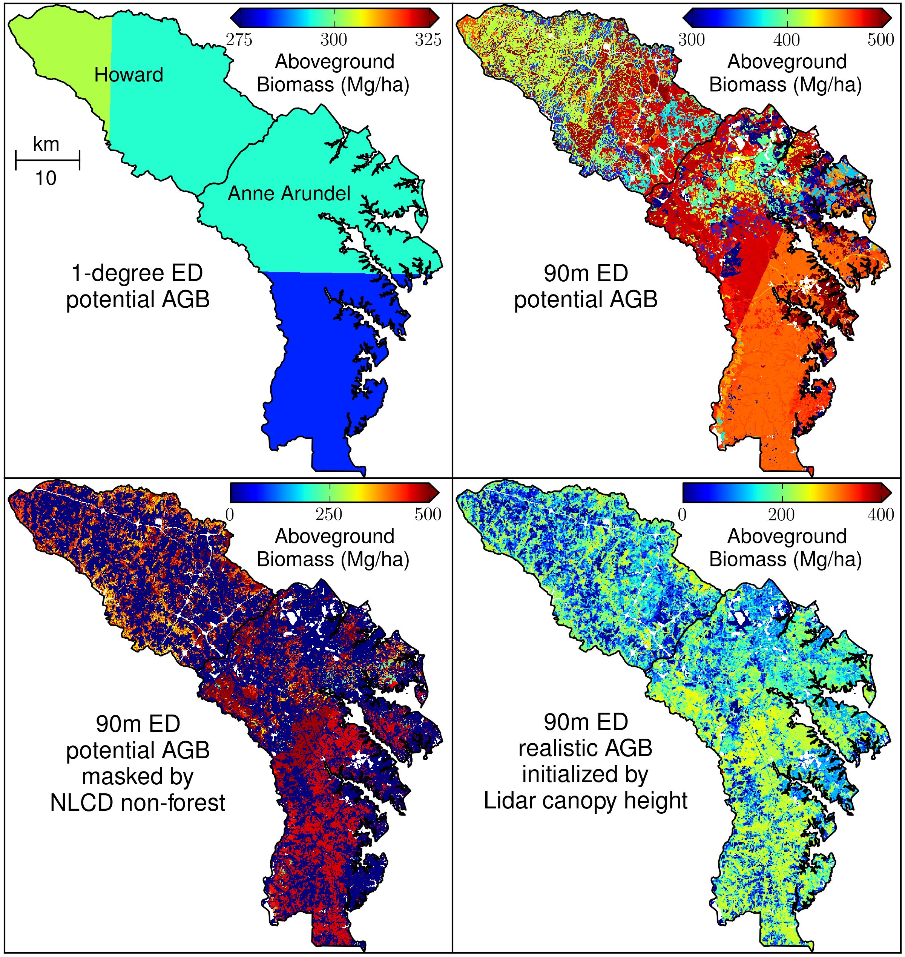
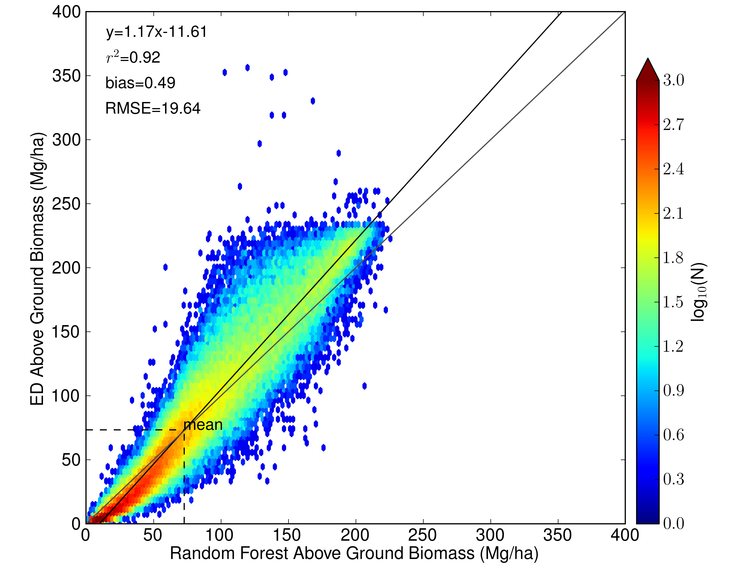
High resolution ED model-data integration for CMS
Density scatter plot between ED realistic AGB and AGB estimated by Random Forest
Hurtt et al., in preparation

Slide 33
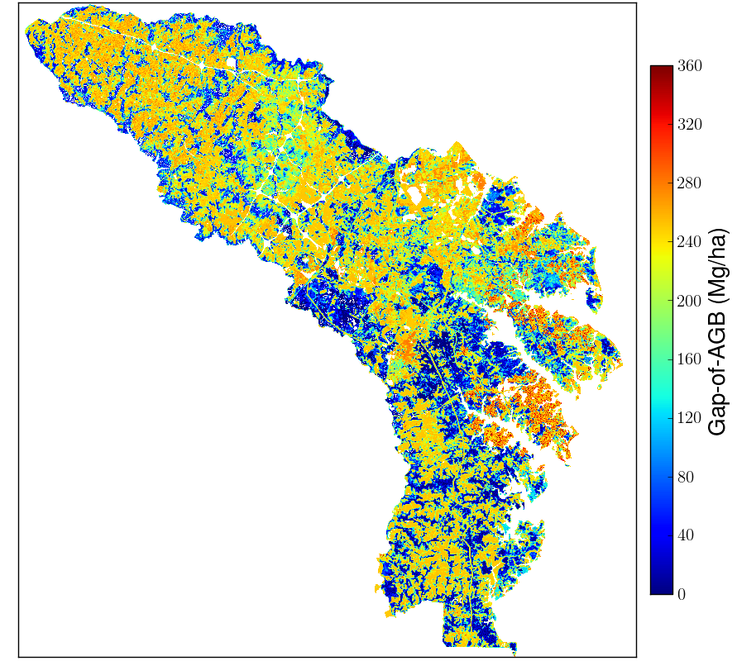
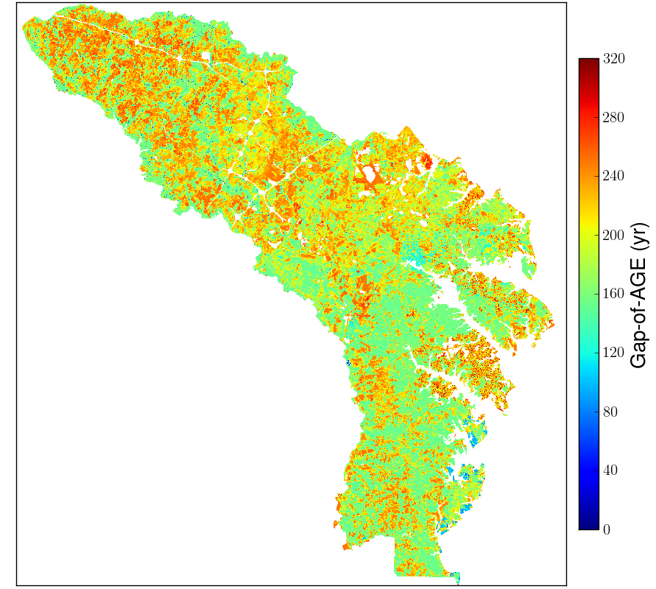
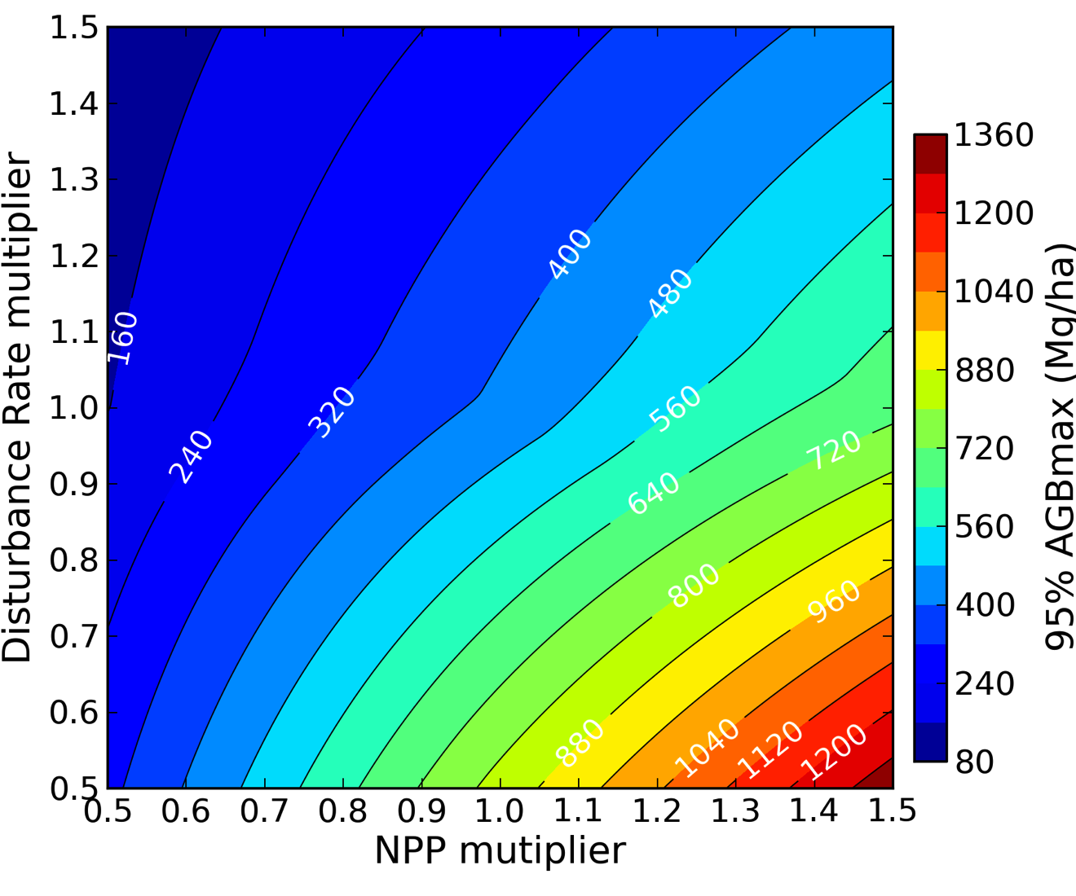
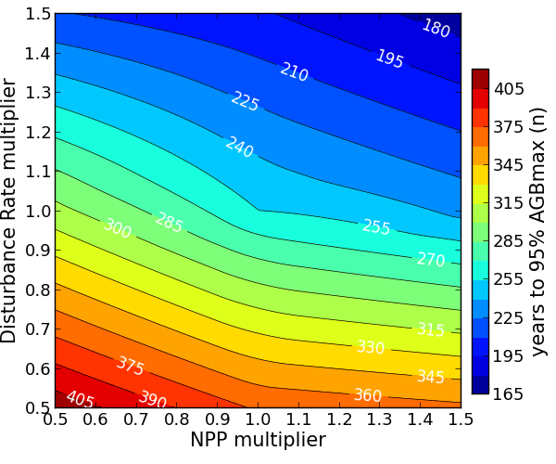
Carbon Sequestration Potential
Hurtt et al., in preparation

Slide 34

NASA-CMS Phase 2
Mass balance,
One pool
ΔStock=Σ(Flux_{j})
e.g. Global atmospheric
Carbon budget
Mass balance,
multiple pools
ΔStock_{i}=Σ(Flux_{i,j})
e.g. atmoshere, land,
Ocean, etc.
Mass balance,
multiple pools,
gridded
ΔStock_{i,k}=Σ(Flux_{i,j,k})
e.g. Potential NASA-CMS
-> Refine, detail
-> Overlay relevant NASA products
-> i.d. capabilities, gaps, priorities
-> match to user needs

Slide 35
Summary Perspective/Questions
Models are at the core of most of our science, relating measurements to quantities of interest (diagnostic), to conduct experiments at scales otherwise prohibitive or impossible, and providing projections into the future (prognostic).
Has the remote sensing capability exceeded the quality/resolution of the data needed to understand the observations?
Do existing models include all the necessary processes at sufficient spatial and temporal resolution to appropriately utilize data and minimize averaging errors in future projections?
Do our modeling approaches adequately account for human activities, and report the most decision-relevant variables?
How can modeling capabilities best advance and quantify, propagate, and track all relevant uncertainties?

