Slide 1
Using NASA Remote Sensing Data to Reduce Uncertainty of Land-Use Transitions in Global Carbon-Climate Models
Louise Chini
University of Maryland
Co-I’s: George Hurtt, Matt Hansen, Peter Potapov

Slide 2
Land-use Harmonization
LUH datasets combine historical and future land-use data and compute all transitions between land-use states, in a consistent format for Earth System Models.
Widely adopted by ESM community, but LUH transitions are estimates from the solution of an under-determined problem that is constrained with data and modeling assumptions
uncertainty
time
Notes:
In preparation for the 5th IPCC Assessment Report (IPCC AR5) new gridded products of land-use and land-use transitions were produced that have been harmonized to ensure a continuous time-series from the historical to the future data in a consistent format for all models.
However, the LUH land-use transitions (i.e. annual changes in land use) are estimates, derived from the solution to an under-determined system that has been constrained with data, where available, and with modeling assumptions, as necessary. Very large problem – 0.5 degree fractional resolution, annually, 1500-2100 10^9 unknowns!

Slide 3
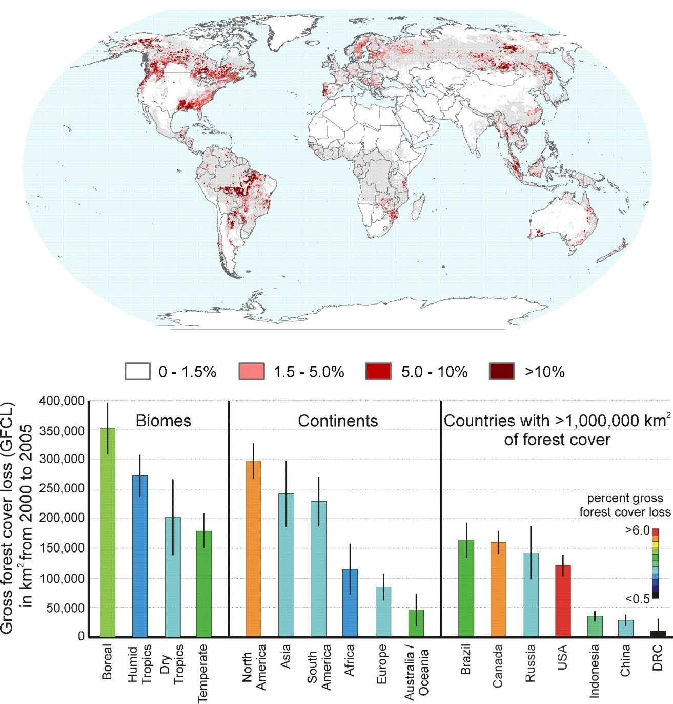
Global Forest Extent and Change
Global Forest Cover Loss between 2000 and 2005 at 18.5km spatial resolution generated using medium resolution Landsat Enhanced Thematic Mapper Plus data (Hansen et al. 2010).
Currently generating a 30 meter spatial resolution version between 2000 and 2010 that gives both gain and loss.
A stratified random sample approach is used to validate these estimates and determine product uncertainties.
Notes:
Of particular importance are the forest-related land-use changes, which have a large impact on the coupled carbon-climate system, as well as on biodiversity and ecosystem services.

Slide 4
Objective 1
Use GFEC data products as an additional constraint in our LUH process to produce an entirely new generation of land-use transitions
Produce global, gridded, annual, land-use states and transitions at 0.5° × 0.5° fractional resolution for the years 1500 to 2100, that are consistent with NASA RS data

Slide 5
Objective 2
We will characterize the inherent uncertainty in the remote-sensing-based maps of GFEC
Will then propagate this uncertainty through our LUH process via a large ensemble of simulations
This will enable us to characterize the uncertainty in the LUH land- use transitions themselves.

Slide 6
Expected Outcomes
Will generate new, improved LUH datasets
Will characterize and reduce uncertainty in these datasets
Data will be available to scientific community – expect it to be rapidly employed by ESMs for coupled climate carbon simulations
Data will be archived at ORNL DAAC. Will follow best practices for producing metadata and preparing datasets for public dissemination
New GLM framework should enable us to use additional layers of RS data in future to further constraint LU transitions

