Slide 1
State of the Carbon Cycle (NACP and GCP): Have components and their uncertainties changed over time?
Source: Griffith et al. (2013)
Anna M. Michalak
With contributions from:
Kevin Bowman, Ken Davis, Yuanyuan Fang,
Debbie Huntzinger, Tony King,
Andrew Richardson, Kevin Schaefer, Christopher Schwalm

Slide 2
NOT MUCH
Anna M. Michalak

Slide 3
North American Carbon Sources and Sinks: Magnitude, Attribution and Uncertainty
Anthony King
Daniel Hayes
Deborah Huntzinger
Tristram West
Wilfred Post
4th NACP All Investigators Meeting
February 4, 2013
Albuquerque, New Mexico

Slide 4
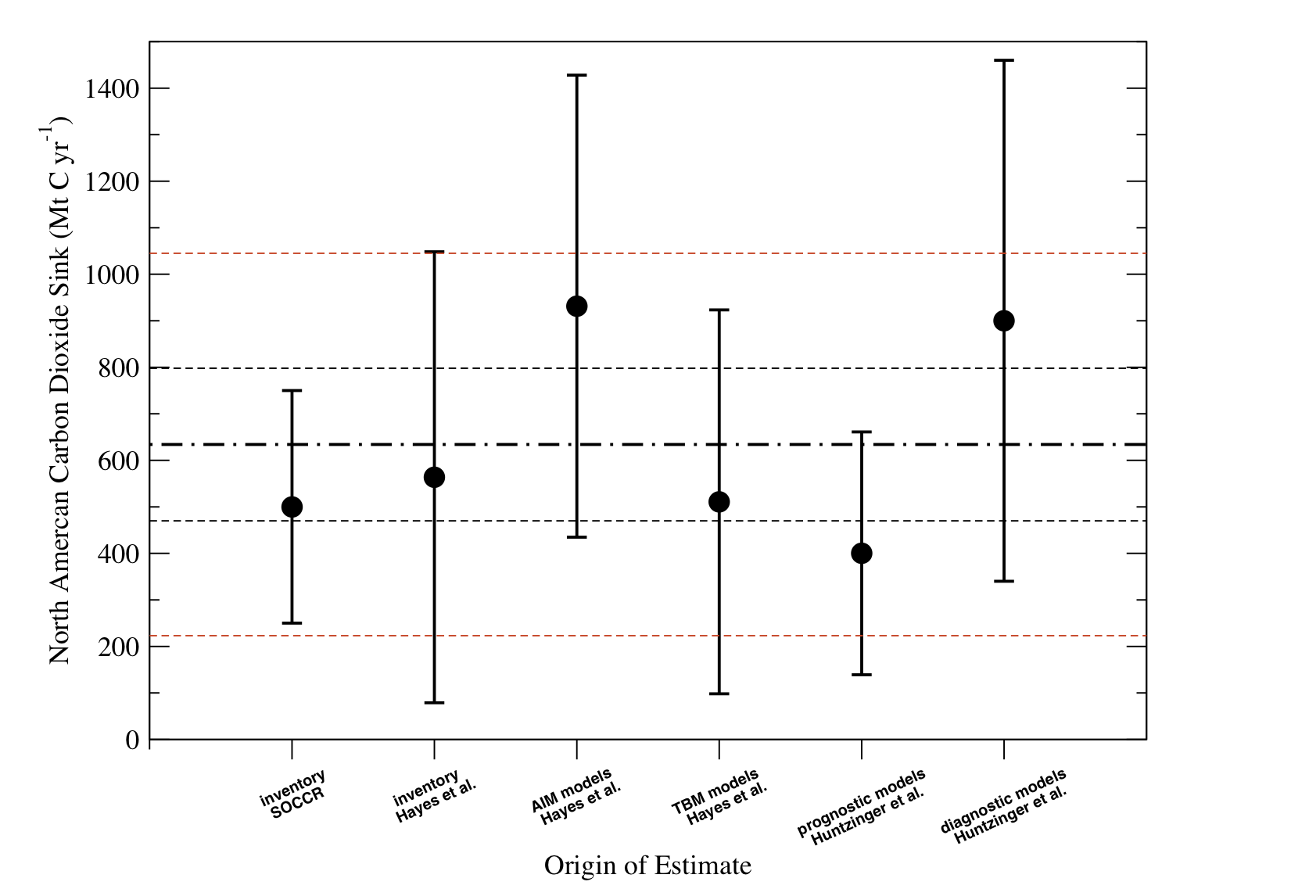
Terrestrial sink (2000-2005): meta-synthesis of NACP regional interim synthesis
Slide from: Tony King (ORNL)

Slide 5
NACP and RECCAP comparison
Slide from: Tony King (ORNL)
UNPUBLISHED RECCAP DATA REMOVED
FROM PRESENTATION HERE
For reference:
SOCCR (2007) estimate was -500 ± 250 Tg C yr⁻¹
NCA (King et al 2012) synthesis estimate was -634 ± 165 Tg C yr⁻¹
Notes:
1 sigma
Two sigma standard error vs. standard deviation.

Slide 6
Inter-method comparison
Slide from: Tony King (ORNL)
UNPUBLISHED RECCAP DATA REMOVED
FROM PRESENTATION HERE
Notes:
Forest inventory
Production approach: puts co2 back where it grew.
Small sink in inventories in 1990 is erroneous because it includes tundra fluxes. But these have data problem according to Dave McGuire

Slide 7
The trouble with …
“Small”
residuals
Boundary
conditions
“Intermediate”
scales

Slide 8
The trouble with …
“Small”
residuals
Boundary
conditions
“Intermediate”
scales

Slide 9
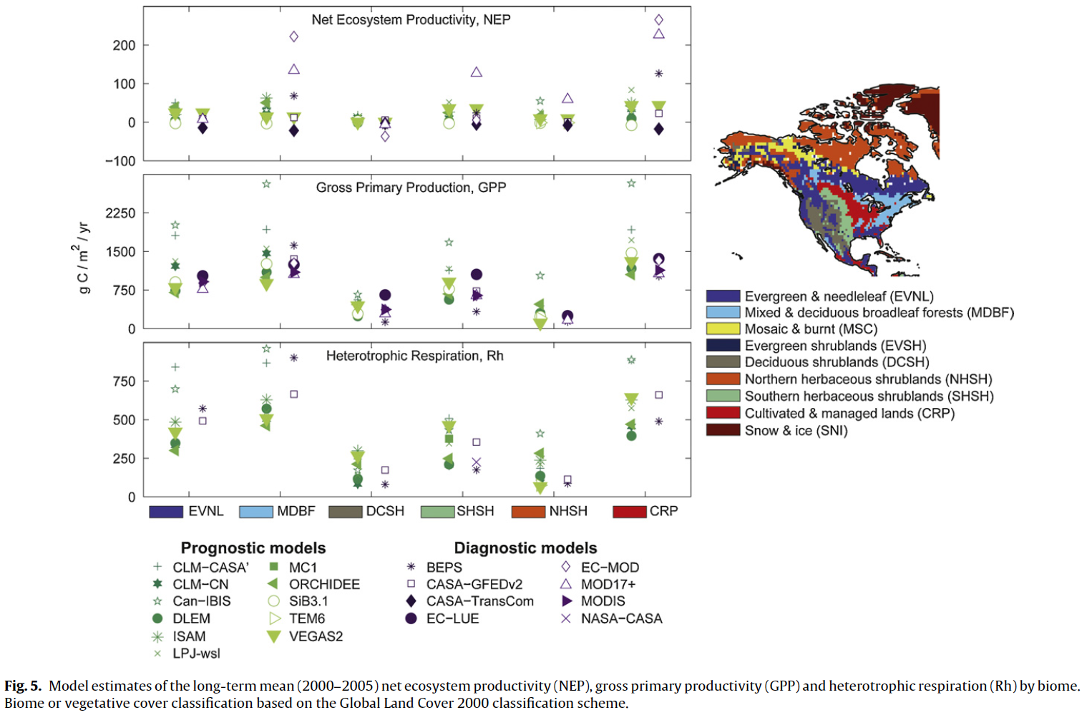
Net sink is small residual of photosynthesis and respiration
Huntzinger et al. (Ecol. Model. 2012)
e.g. Over NA:
GPP: 12.2 to 32.9 PgC yr⁻¹
NEP: -0.7 to 2.2 PgC yr⁻¹

Slide 10
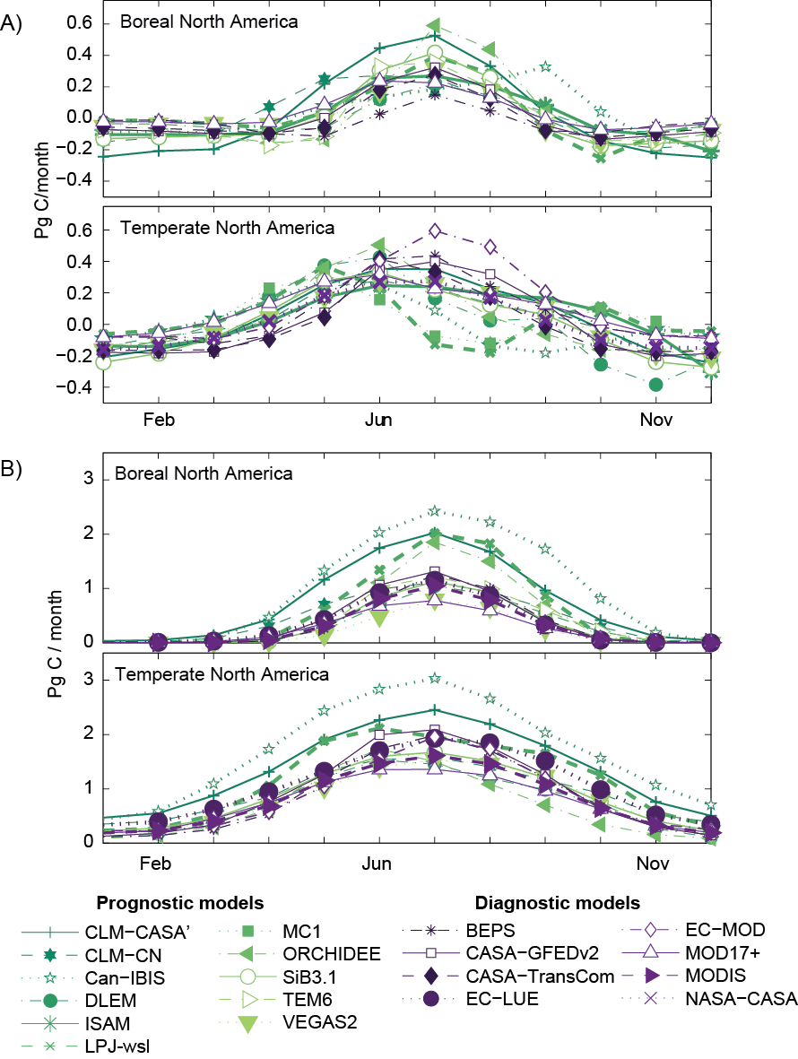
Net annual sink is small residual of large seasonal cycle
Huntzinger et al. (Ecol. Model. 2012)
e.g. Over NA:
Monthly: up to 0.8 PgC mt⁻¹
Annual: up to 2.2 PgC yr⁻¹
~ 0.2 PgC mt⁻¹

Slide 11
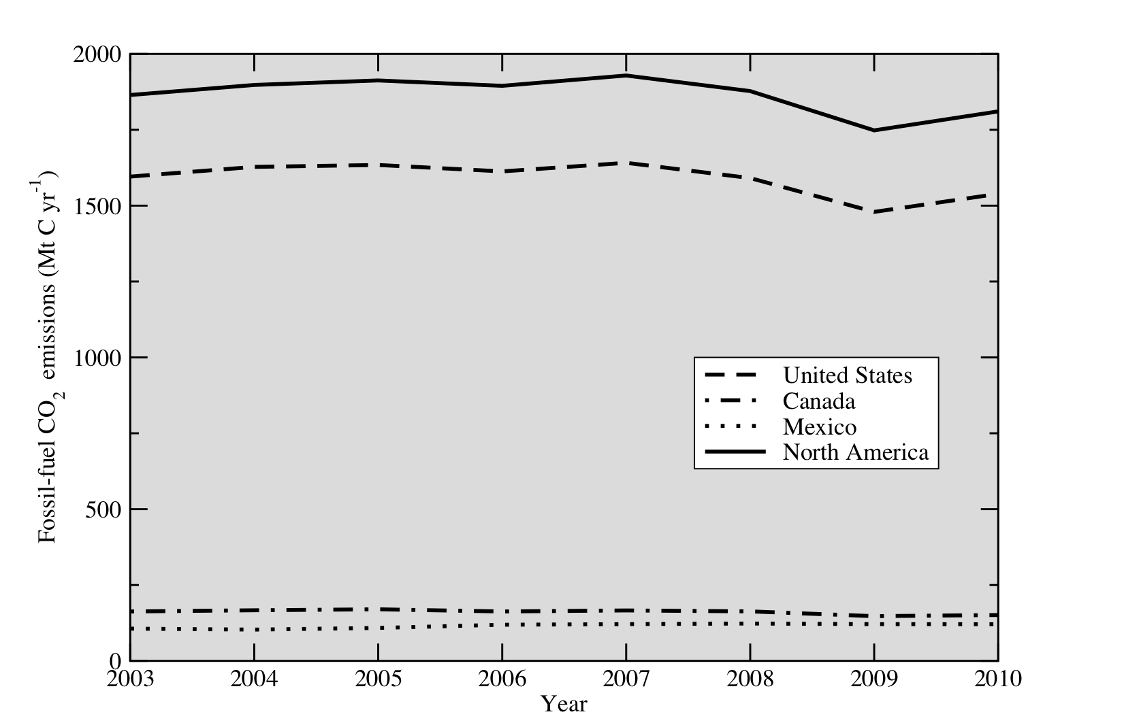
Net biospheric sink is small residual of total flux and fossil fuel emissions
King et al. (SOCCR report, 2007)
e.g. Over NA:
FF: 1.85 PgC yr⁻¹
Bio: ~ 0.5 PgC yr⁻¹

Slide 12
The trouble with …
“Small”
residuals
Boundary
conditions
“Intermediate”
scales

Slide 13
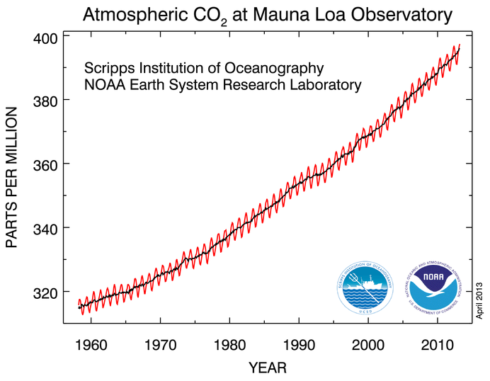
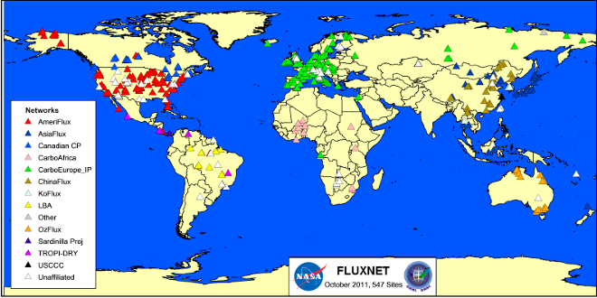
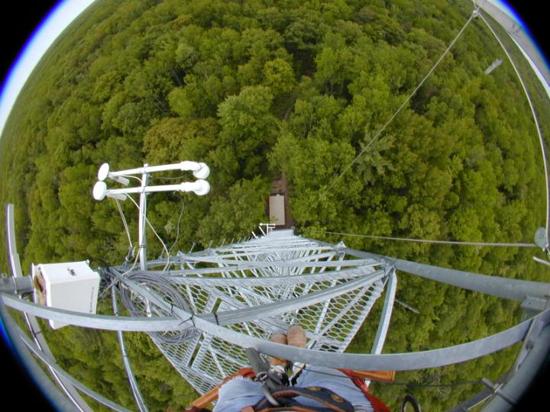
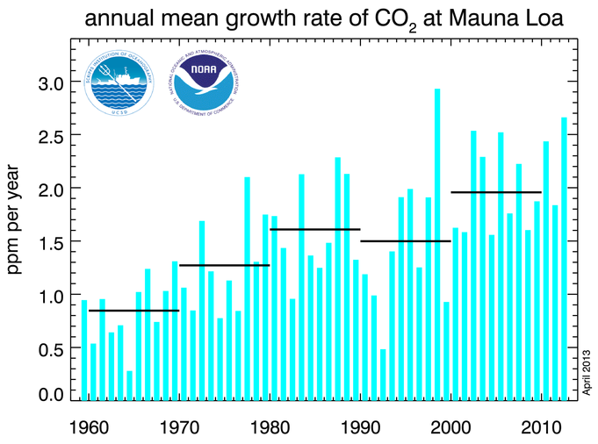
Global constraint and local constraint, but…
Requires:
Downscaling or upscaling
in space and time

Slide 14
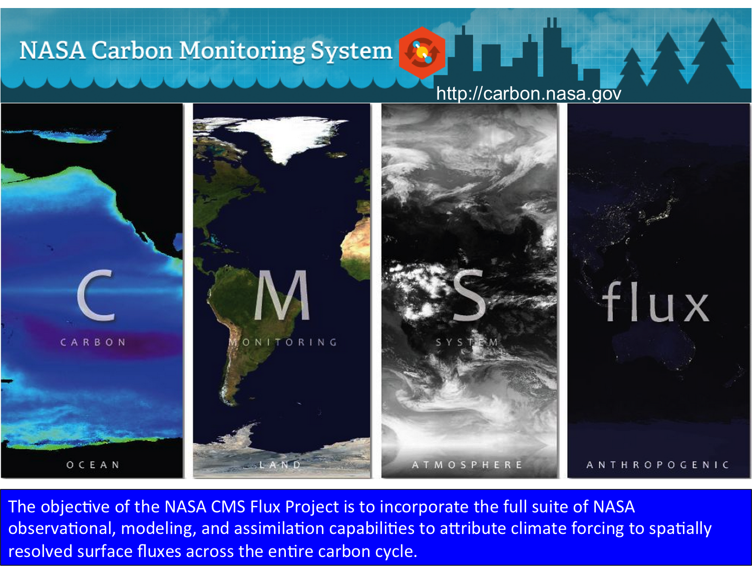
Spatial attribution of CO₂
Annual mean prior flux (gC/m²/day)
Annual mean posterior flux (gC/m²/day)
Post-prior (gC/m²/day)
PRELIMINARY UNPUBLISHED RESULTS
Slide modified from: Kevin Bowman (JPL)
Notes:
Zonal redistribution of carbon uptake in the Northern Hemisphere between Europe (stronger) and North America (weaker)
Zonal redistribution in the tropics with reduced uptake in Africa but increased uptake in the Amazon
India and China become net sinks.

Slide 15
RECCAP-TransCom3 results
Slide from: Tony King (ORNL)
UNPUBLISHED RECCAP DATA REMOVED
FROM PRESENTATION HERE
Updated inversions
UNPUBLISHED RECCAP DATA REMOVED
FROM PRESENTATION HERE

Slide 16
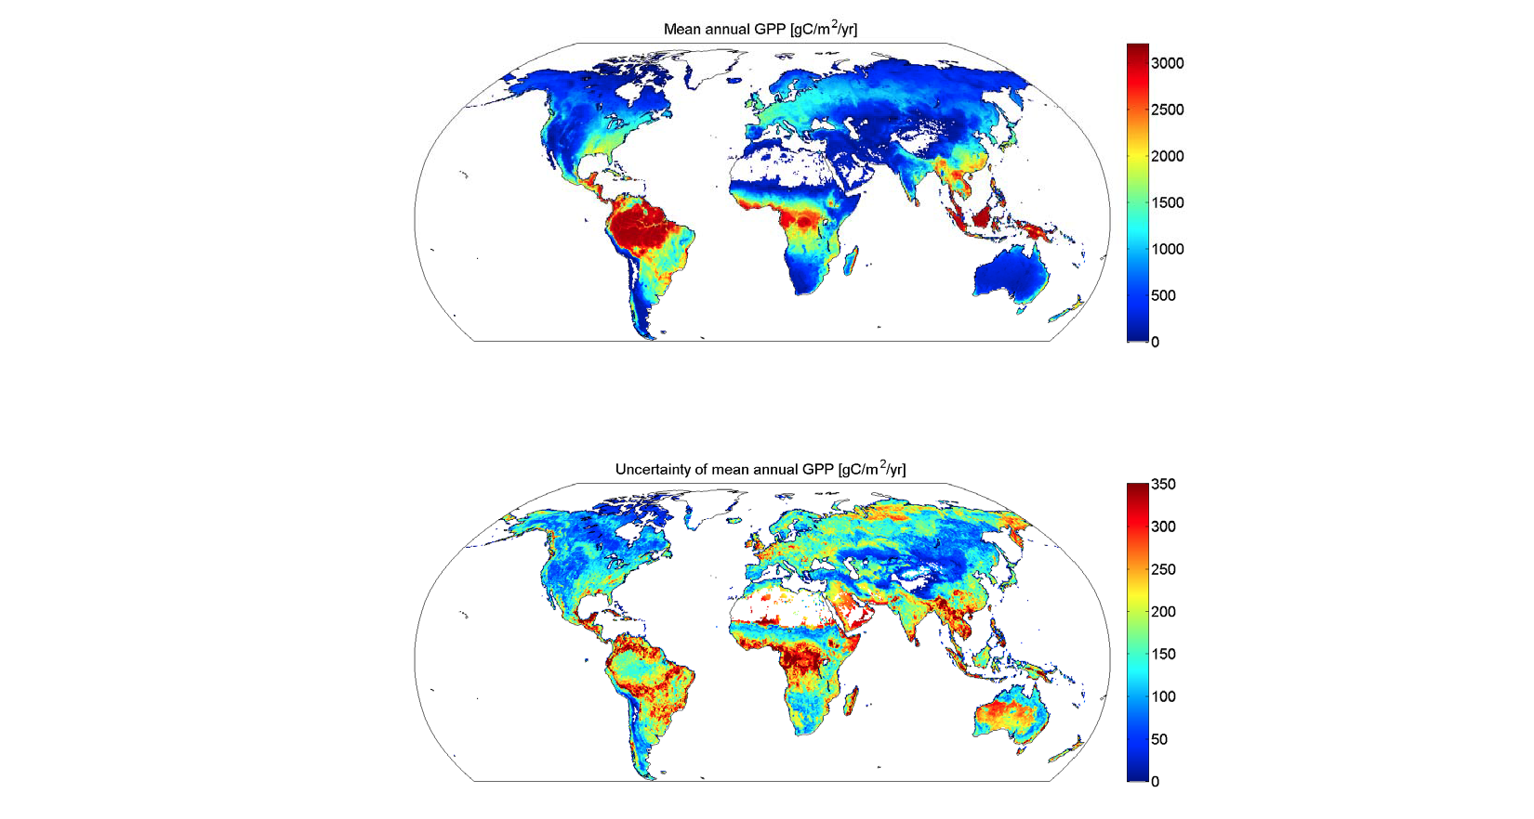
Upscaling of eddy covariance data
Slide from Martin Jung, MPI-BGC
Figures from: Martin Jung (MPI-BGC)

Slide 17
The trouble with …
“Small”
residuals
Boundary
conditions
“Intermediate”
scales

Slide 18

e.g. 0.5ppm uncertainty on incoming [CO₂]

Slide 19
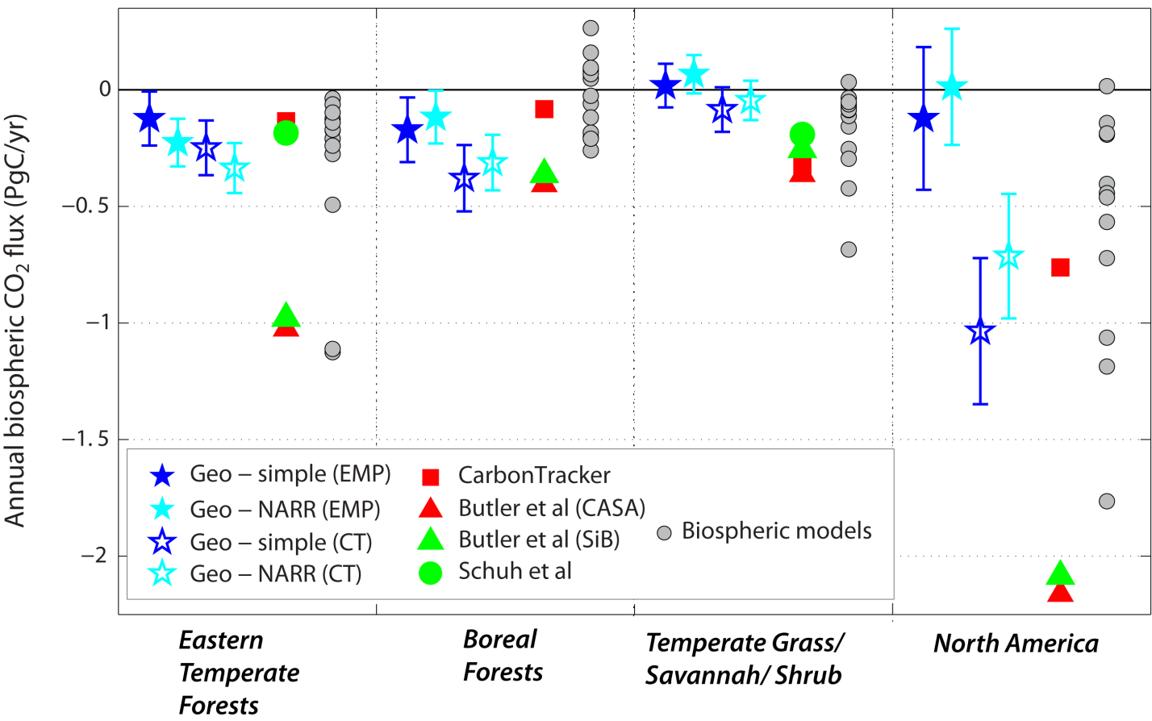
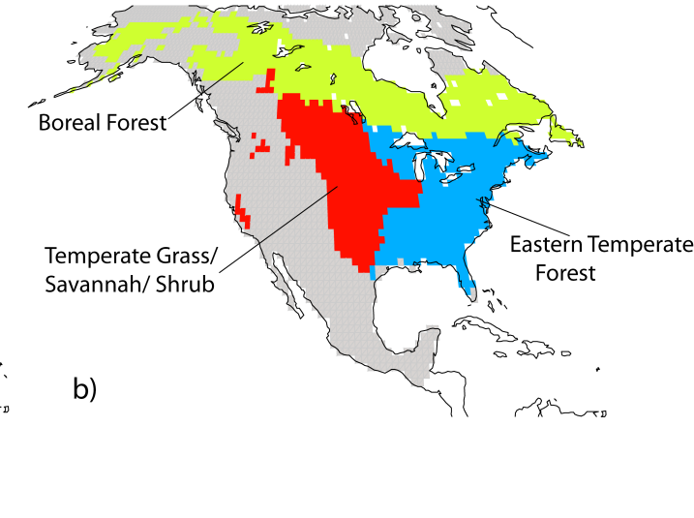
Gourdji et al. (BG 2012)

Slide 20
The trouble with …
“Small”
residuals
Boundary
conditions
“Intermediate”
scales

Slide 21
Paths forward…
“Small”
residuals
Boundary
conditions
“Intermediate”
scales

Slide 22
Combine multiple estimates…
“Small”
residuals
Boundary
conditions
“Intermediate”
scales
e.g. Averaging, binning, prescribing simulation protocol, etc.

Slide 23
Inter-method comparison
Slide from: Tony King (ORNL)
UNPUBLISHED RECCAP DATA REMOVED
FROM PRESENTATION HERE
Notes:
Forest inventory
Production approach: puts co2 back where it grew.
Small sink in inventories in 1990 is erroneous because it includes tundra fluxes. But these have data problem according to Dave McGuire

Slide 24
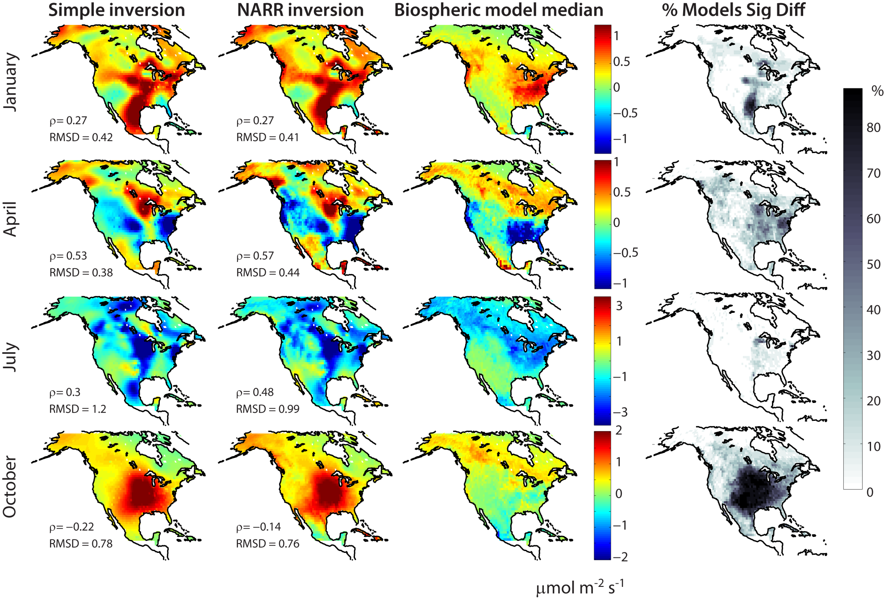
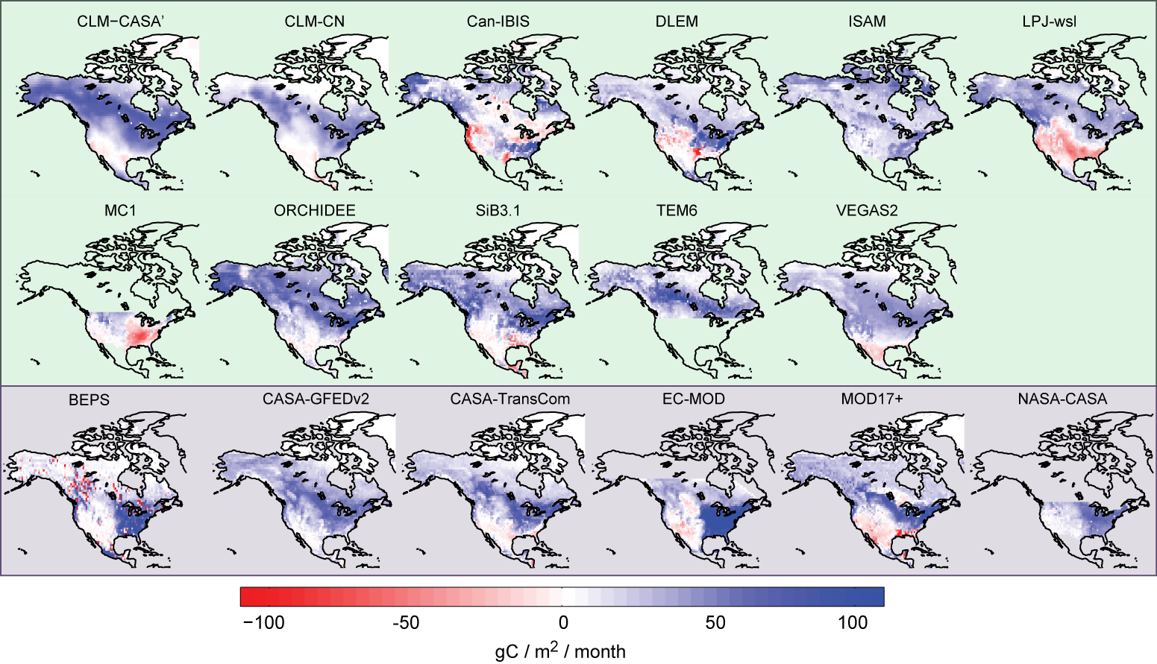
Seasonal spatial patterns
Gourdji et al. (BG 2012); Yadav and Michalak (GMD, in press)

Slide 25
RECCAP-TRENDY Terrestrial biosphere model (TBM) results for North America
Slide from: Tony King (ORNL)
UNPUBLISHED RECCAP DATA REMOVED
FROM PRESENTATION HERE

Slide 26
Paths forward…
“Small”
residuals
Boundary
conditions
“Intermediate”
scales

Slide 27
Tackle bigger components…
Big
signals
Boundary
conditions
“Intermediate”
scales
e.g. Component fluxes, phenology, seasons, etc.

Slide 28
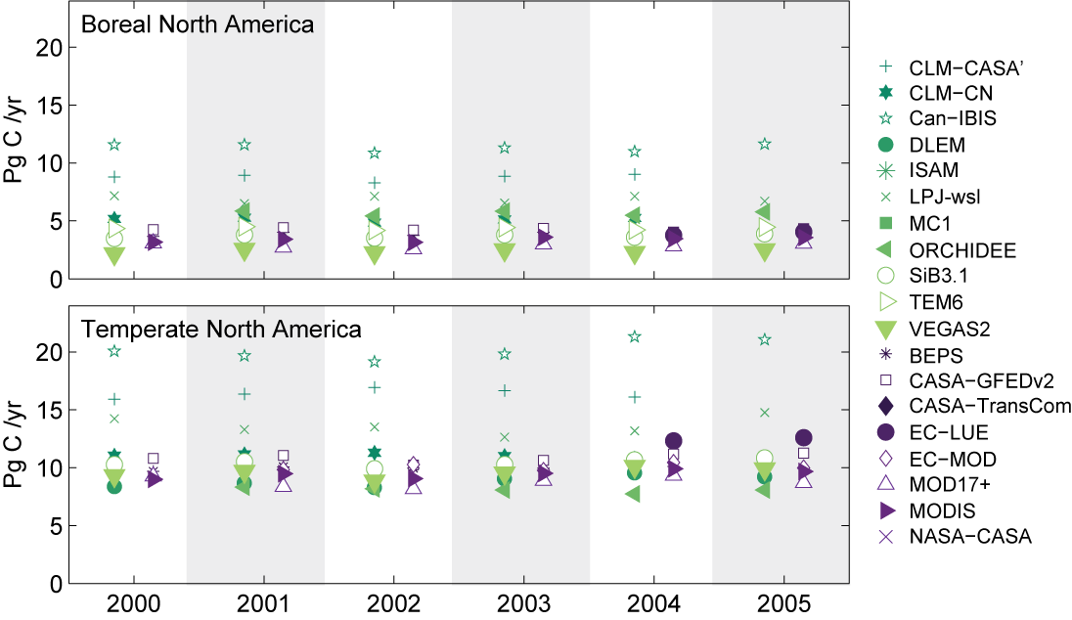
Huntzinger et al. (Ecol. Model. 2012)
Gross Primary Productivity
Net Ecosystem Productivity

Slide 29
NACP Regional Interim Synthesis Activity
Slide from: Debbie Huntzinger (NAU)
Huntzinger et al.
(2012) Ecological Modeling
Long-Term Mean (2000-2005) Summer (June, July, August)
Net Ecosystem Productivity
Notes:
In hand model simulations: makes comparison difficult

Slide 30
Combining multiple estimates of big components
Big
signals
Boundary
conditions
“Intermediate”
scales

Slide 31
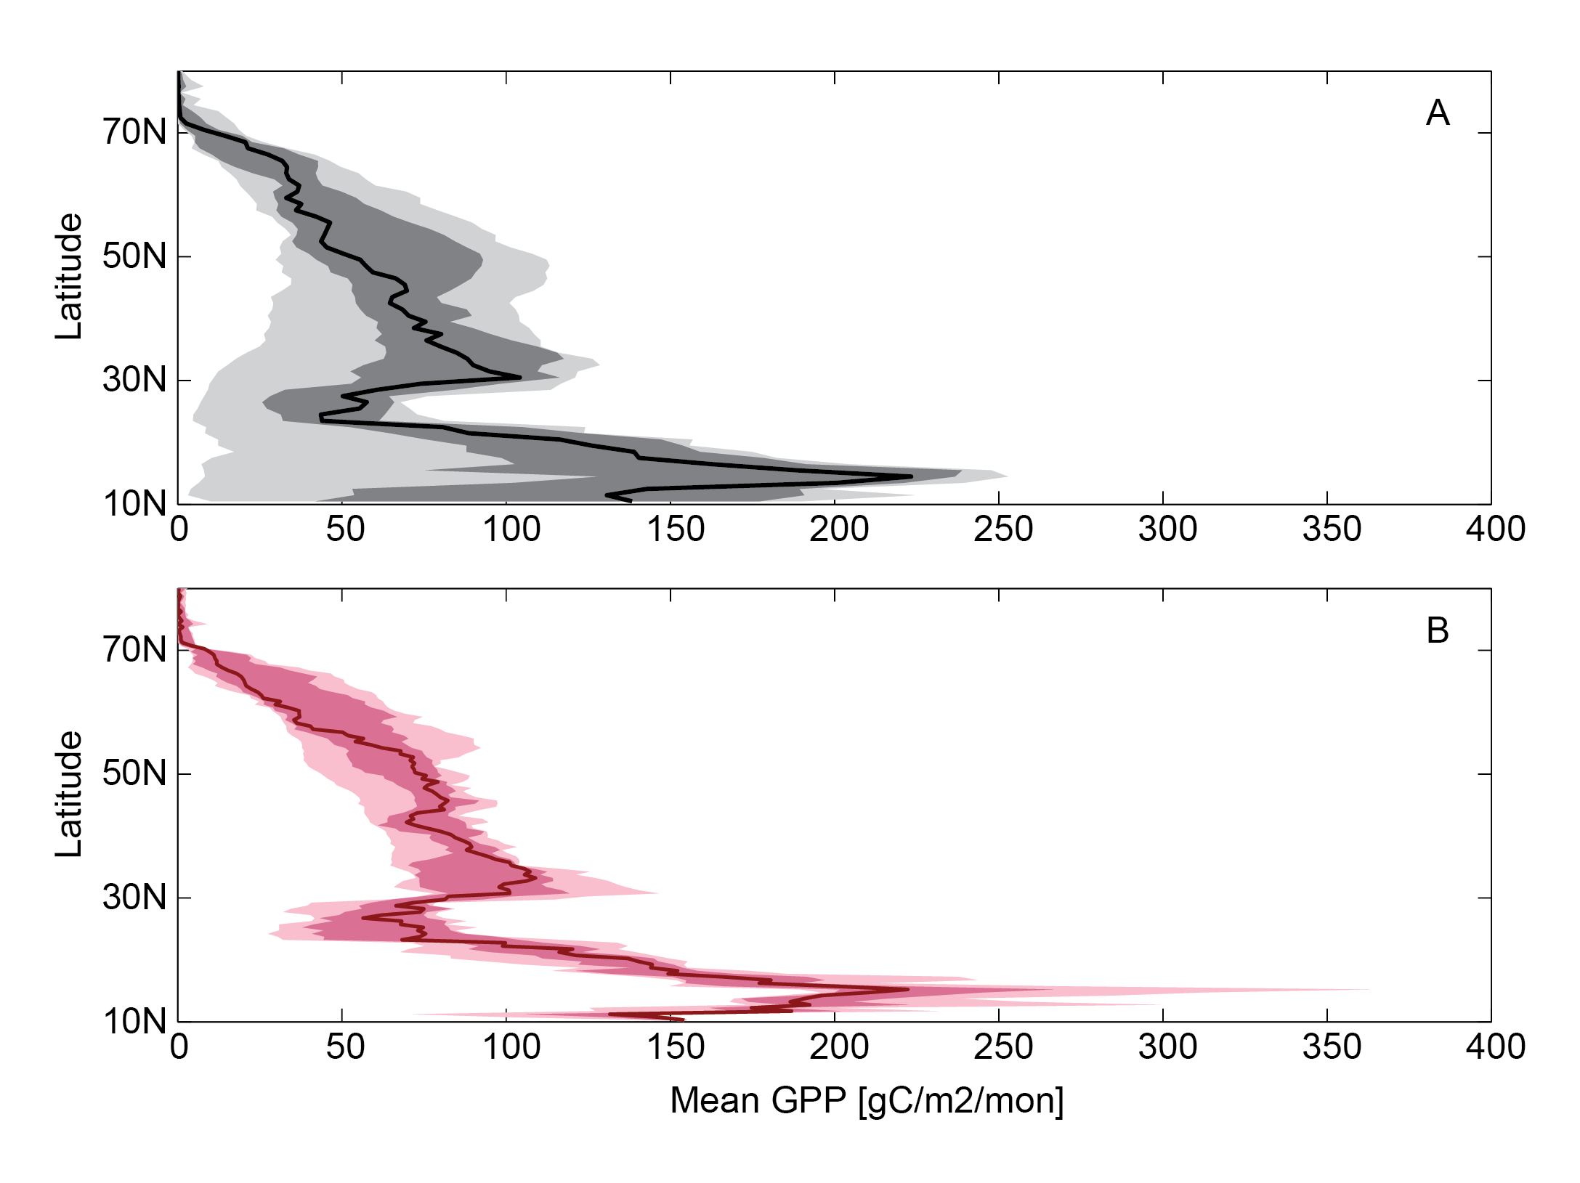
NACP Regional Interim Synthesis vs. MsTMIP
Mean GPP for North America (2000-2005)
Does strict protocol help to isolate sources if different in model output?
Range
Interquartile range
Median
PRELIMINARY UNPUBLISHED RESULTS
5 models (CLM, DLEM, LPJ, ORCHIDEE, VEGAS)
Slide from: Debbie Huntzinger (NAU)

Slide 32
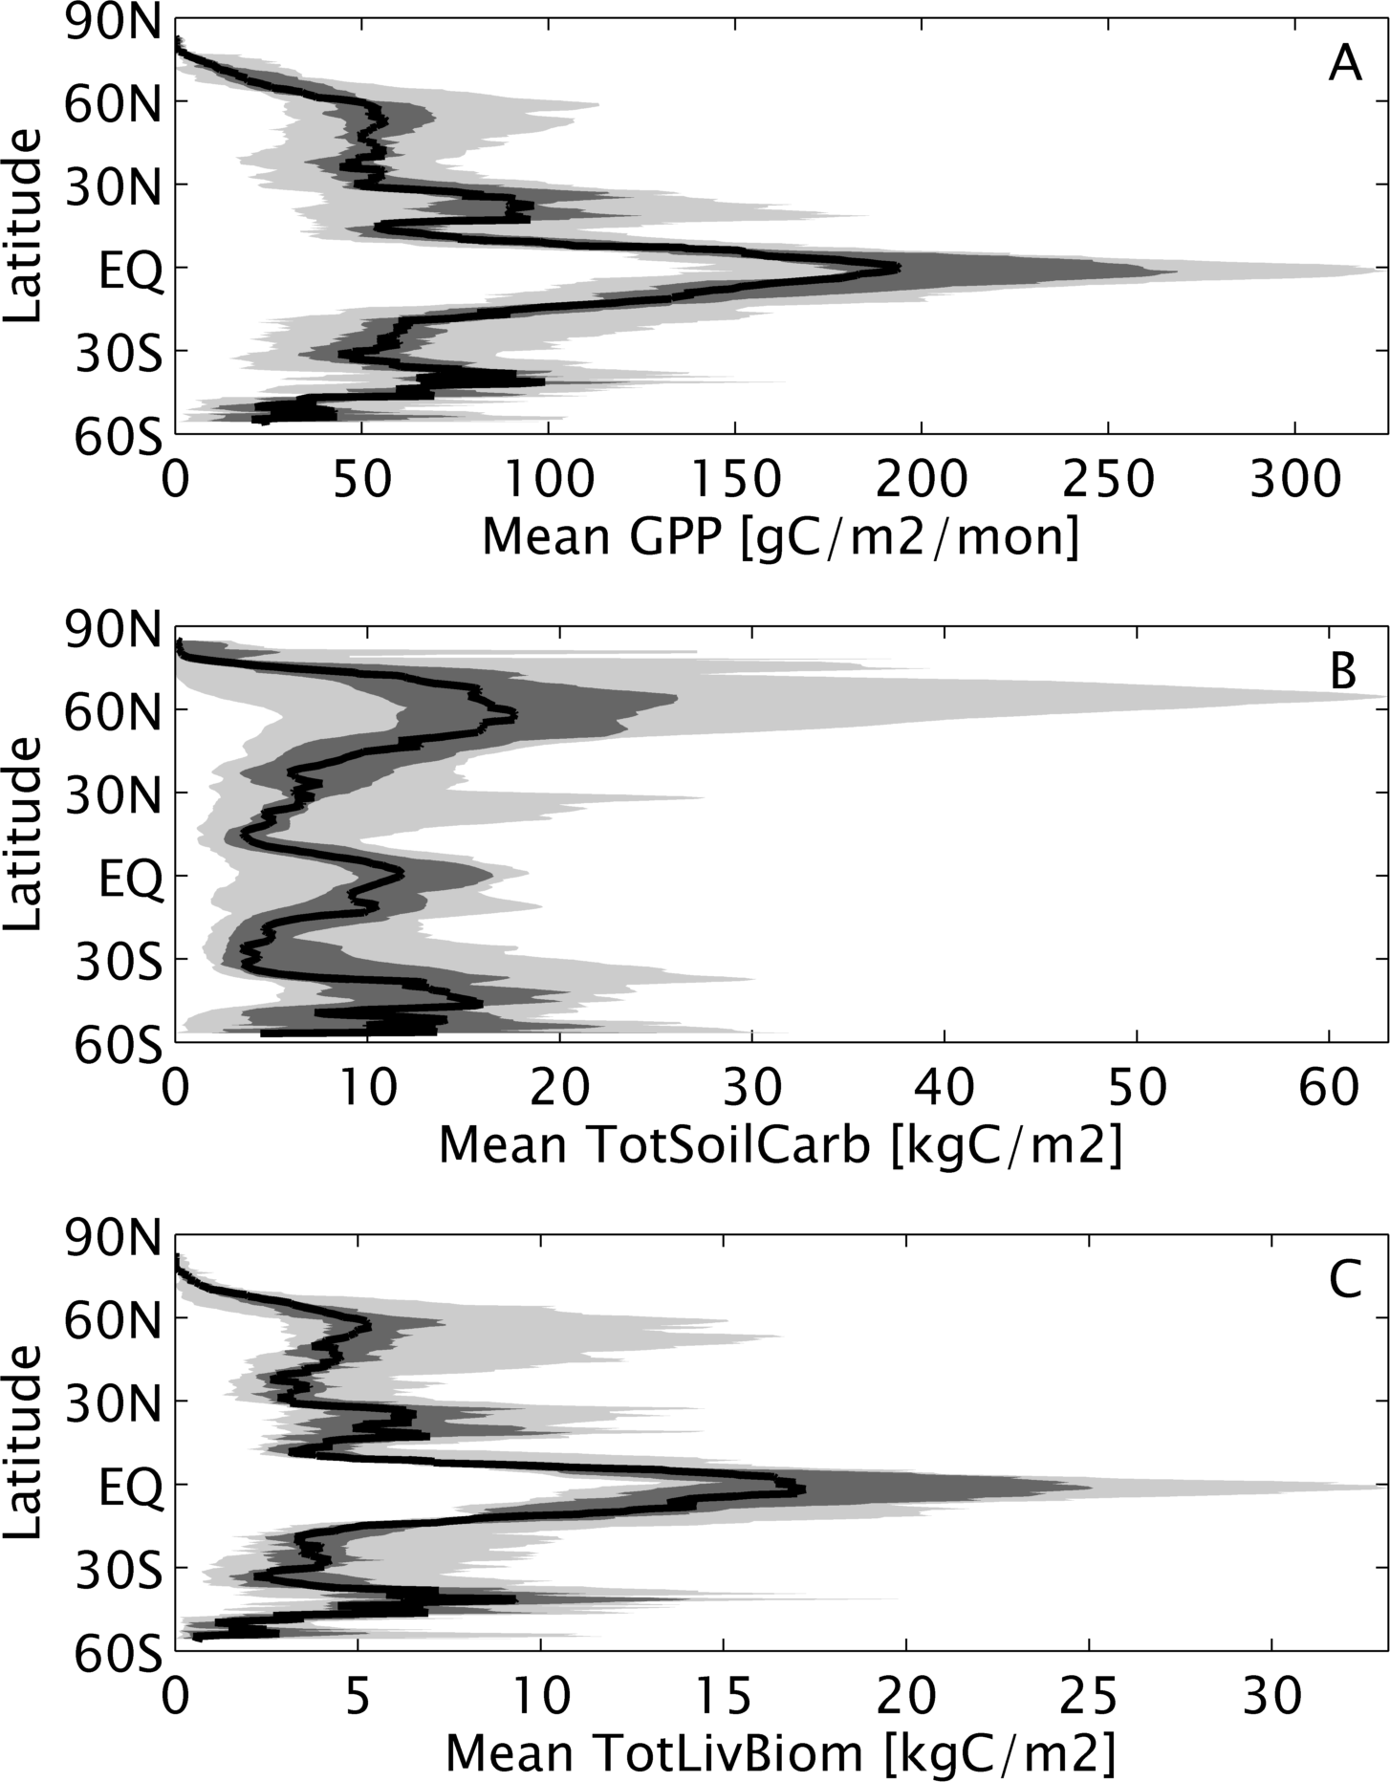
Slide from: Debbie Huntzinger (NAU)
MsTMIP models
Steady-state results
10 models
GPP varies by factor of 2 in tropics
Soil carbon pool size in NHL ranges from 5 – 60 kg C m⁻²
Total living biomass varies by factor of 3.5 in tropics
Range
Interquartile range
PRELIMINARY UNPUBLISHED RESULTS
Median

Slide 33
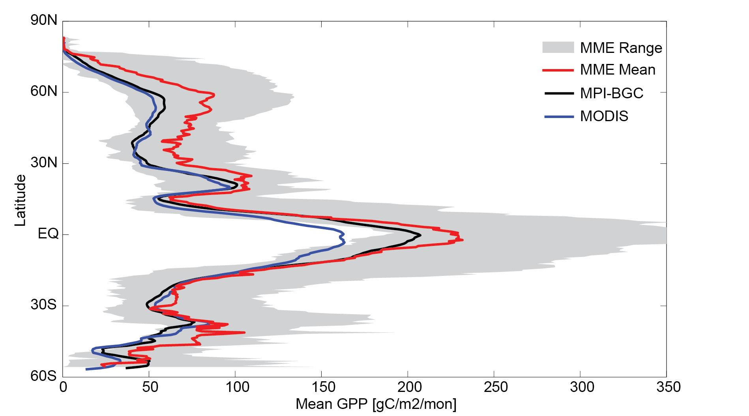
Compare simulated GPP to other GPP products:
MODIS-GPP (Zhao and Running, 2010)
MPI-BGC (Jung et al., 2011, Beer et al., 2010)
PRELIMINARY UNPUBLISHED RESULTS
Slide modified from: Debbie Huntzinger (NAU)

Slide 34
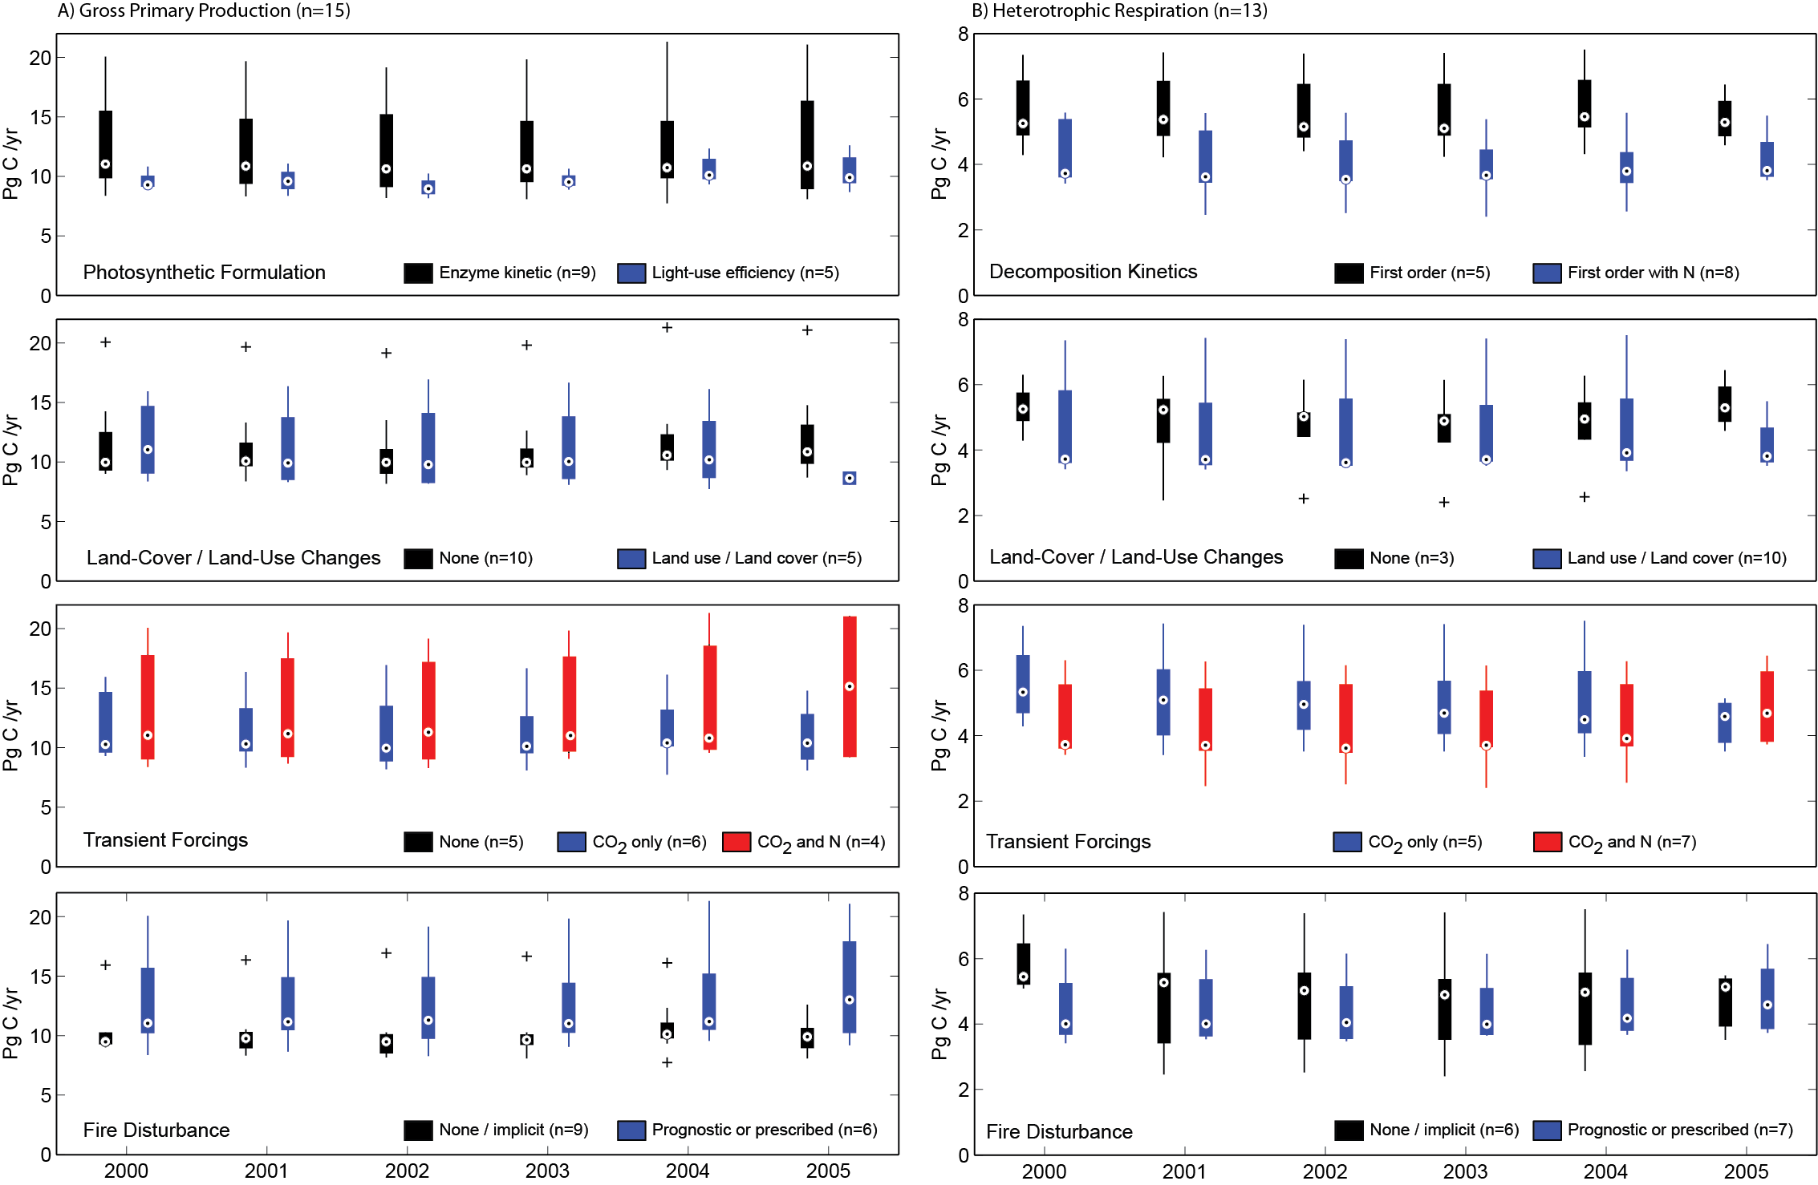
Slide modified from: Debbie Huntzinger (NAU)
Binning / grouping of models
Group model estimates of GPP based on model’s treatment of photosynthesis, disturbance and other factors.
The entire modeling framework influences a model’s results
Huntzinger et al. (2012) Ecological Modeling

Slide 35
Paths forward…
“Small”
residuals
Boundary
conditions
“Intermediate”
scales

Slide 36
Tackle different scales…
“Small”
residuals
Boundary
conditions
Non-continental
scales
e.g. Eddy covariance towers, regional intensives, etc.

Slide 37
Regional measurement campaigns
INFLUX, 2010-201?
Midcontinent intensive, 2007-2009
Gulf coast intensive, 2013-201?
N. American tower CO2 network circa 2008
Slide from: Ken Davis (Penn State)

Slide 38
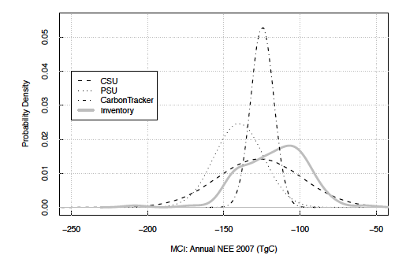
Atmospheric inversions and agricultural inventory agree!
Inversions and inventory have similar uncertainty bounds!
Schuh et al, in press, GCB
Slide from: Ken Davis (Penn State)
Notes:
Note that the agricultural inventories are small per grid box, but highly correlated across space, so when aggregated they do not reduce much due to averaging. The atmospheric inversion uncertainties are large for any grid box, but errors are more random in nature, hence reduce compared to the mean when aggregated across space, resulting in similar uncertainties at the scale of the MCI

Slide 39
Tackle different scales for big components
Big
signals
Boundary
conditions
Non-continental
scales

Slide 40
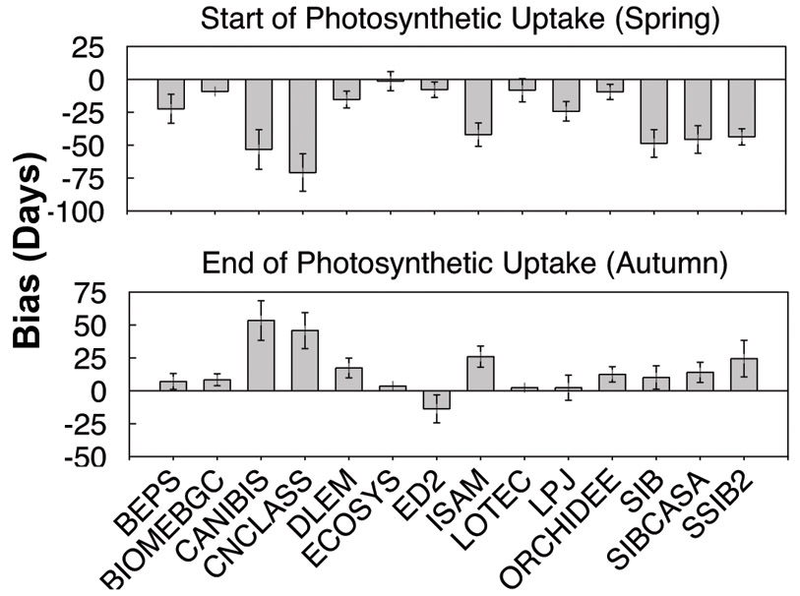
Phenology (Richardson et al.)
NACP Site
Synthesis
Early/late uptake means positive GPP bias
Models need better phenology
Slide from: Kevin Schaefer (NSIDC)
Notes:
With respect to the seasonality of gross ecosystem photosynthesis, I identified the spring and autumn dates at which different thresholds, specifically 20%, 50% and 80% of the seasonal maximum, were reached.
For deciduous sites, models were consistently biased towards predicting that photosynthetic uptake starts too early in the spring, and ends too late in the autumn. I’m showing results here for the Harvard Forest; on the x-axis we have the 14 different models in this analysis, arranged by name, and on the y-axis the bias, across multiple years of data, in predicting the spring and autumn dates of 20% GEP. Here a negative error in spring means early, and a positive error in autumn means late.
The bias here was quite large: across all models, sites and years, nearly a month early in spring, and two weeks late in autumn. For evergreen sites, the biases were quite a bit smaller; overall the phosynthetically active period was over-estimated by about 6 weeks in deciduous forests and two weeks in evergreen forests.
Spring DBF –28±21 d, ENF –11±15 d
Fall DBF +15±23 d, ENF +3±14 d
40

Slide 41
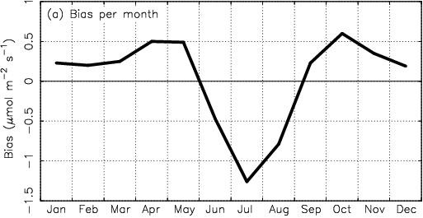
GPP Biases (Schaefer et al., 2012)
Spring too early
Fall too late
GPP Bias (μmol m⁻² s⁻¹)
Need Low Temperature Shutoff
Need Improved LUE/Vcmax
Slide from: Kevin Schaefer (NSIDC)

Slide 42
Tackle specific features…
“Small”
residuals
Patterns
“Intermediate”
scales
e.g. Patterns, trends, anomalies, sensitivities…

Slide 43
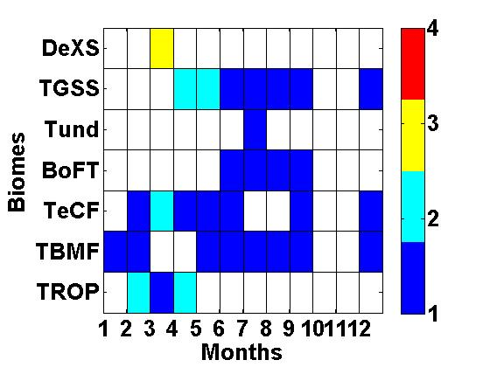
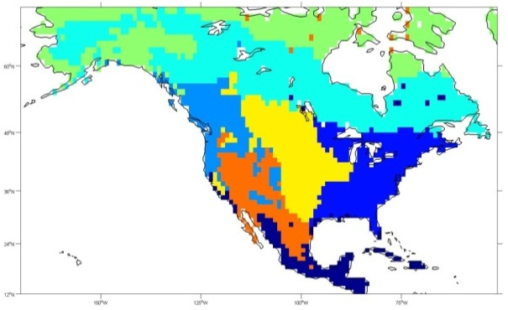
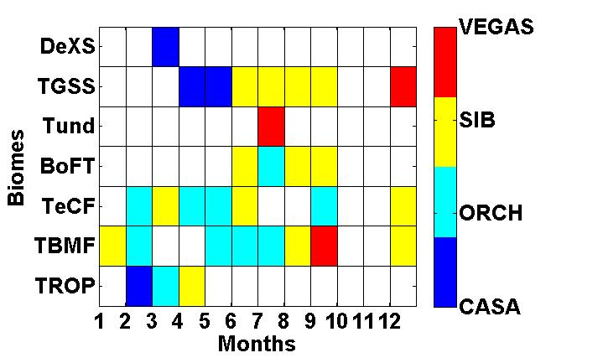
7
6
5
4
3
2
1
5
4
3
6
7
2
1
7
6
5
4
3
2
1
Fine scale inversion for selecting TBMs at biome scale from among NACP RIS models with
sub-diurnal variability
Slide from: Yuanyuan Fang (Carnegie Inst. Sci.)

Slide 44
Tackle features of big components
Big
signals
Patterns
“Intermediate”
scales

Slide 45
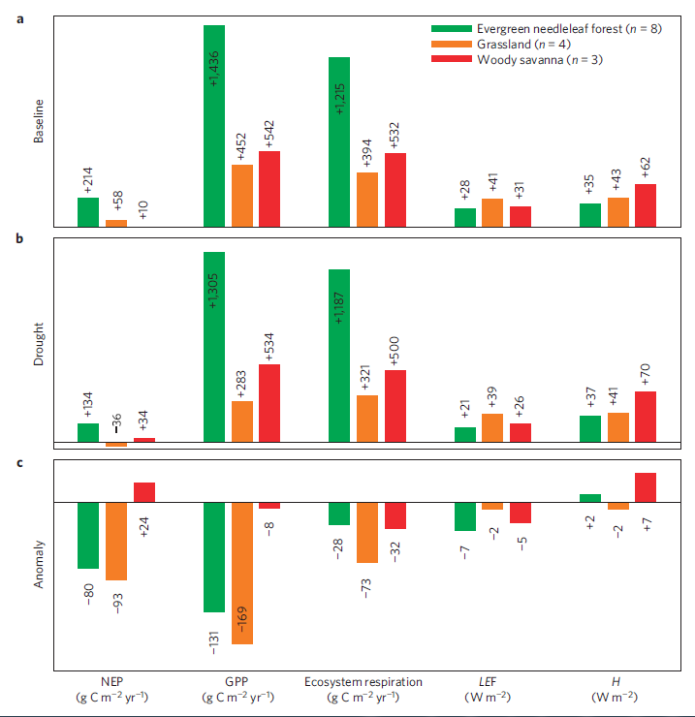
Reduced Carbon Uptake and Evaporation, Increased Heating
Anomaly = Drought – Baseline Mean
Carbon uptake decreased by 37% and 160% in forests and grasslands
  increased in woody savannas… respiration slowed more than productivity
Evaporation decreased by 25%, 5%, and 16% for ENF, GRA, and WSA
temperatures increased by ~0.4 °C
“Carbon and Water Impacts of the Turn of the Century Drought in Western North America 2000-2004”
Slide from: Christopher Schwalm
Notes:
Micrometeorological stations also recorded decreased latent heat flux for each of the three land cover classes but with markedly different magnitudes (Fig. 3). At the four grassland sites, latent heat flux decreased only modestly. In evergreen needleleaf forests however latent heat flux decreased by ~33%, with woody savannas intermediate between these two extremes. Sensible heat flux varied less overall with the largest change observed at the woody savanna sites (~11% increase). The observed increase in sensible heat flux for evergreen needleleaf forests and woody savannas (Fig. 3) was consistent with temperature increase (mean = 0.40 °C and 0.41 °C respectively for June-to-September, see Supplementary Table 1). For the grassland sites both latent and sensible heat fluxes decreased. This decline in available energy was likely linked to increased albedo of water limited grasslands as senescence and dieback exposed more soil and bright dead leaf tissue (Wang & Davidson, 2007).

Slide 46
Reduction in Carbon Uptake Offset 45% of Normal Sink
Term [Tg C y⁻¹] | Source | Drought Anomaly* | Baseline Flux | Percent Reduction
GPP | MODIS | -234 | 2424 | 10%
GPP | Upscaled FLUXNET | -182 | 2148 | 8%
NEP | Inversions | -30 -83 | 177 188 | 17% 44%
NEP | Flux Tower Network | -298 | 623 | 48%
*Anomaly = Drought Mean – Baseline Mean
Slide from: Christopher Schwalm
Notes:
Micrometeorological stations also recorded decreased latent heat flux for each of the three land cover classes but with markedly different magnitudes (Fig. 3). At the four grassland sites, latent heat flux decreased only modestly. In evergreen needleleaf forests however latent heat flux decreased by ~33%, with woody savannas intermediate between these two extremes. Sensible heat flux varied less overall with the largest change observed at the woody savanna sites (~11% increase). The observed increase in sensible heat flux for evergreen needleleaf forests and woody savannas (Fig. 3) was consistent with temperature increase (mean = 0.40 °C and 0.41 °C respectively for June-to-September, see Supplementary Table 1). For the grassland sites both latent and sensible heat fluxes decreased. This decline in available energy was likely linked to increased albedo of water limited grasslands as senescence and dieback exposed more soil and bright dead leaf tissue (Wang & Davidson, 2007).

Slide 47
Paths forward….
Big
signals
Patterns
Non-continental
scales

Slide 48
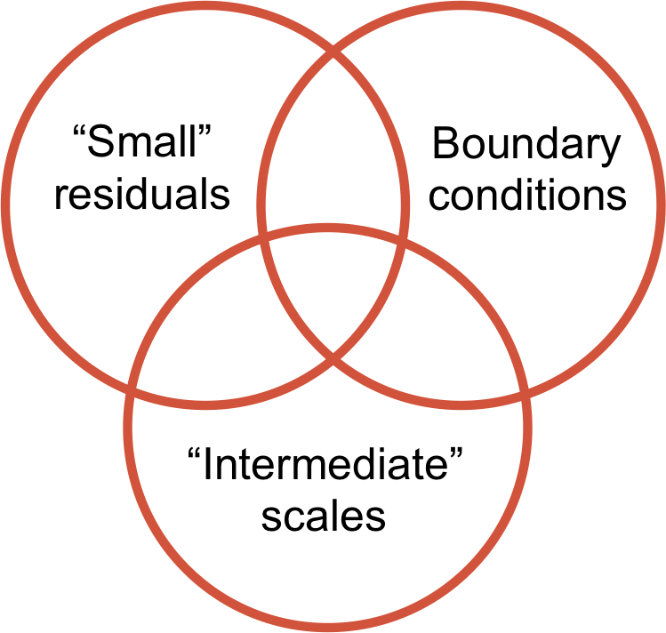
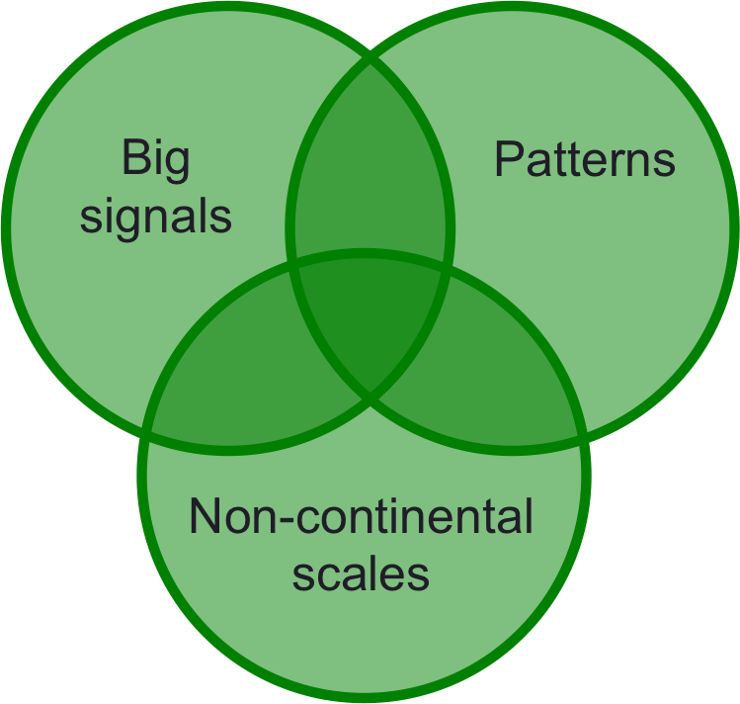
Address first and look for convergence

Slide 49
Acknowledgments:
Cited intercomparison, synthesis, and collaborative observational efforts
NOAA ESRL Cooperative Air Sampling Network
FLUXNET / AmeriFlux
TransCom3
SOCCR
MCI
NACP Site Synthesis
NACP RCIS
TRENDY
RECCAP
NASA Carbon Monitoring System
National Climate Assessment
MsTMIP

