Slide 1

Carbon Cycle & Ecosystems Focus Area
Paula Bontempi
Earth Science Division
NASA Headquarters
20 April 2015

Slide 2
Carbon Cycle & Ecosystems Focus Area
Research and Analysis (R & A) Programs:
Biodiversity - Woody Turner
Land Cover and Land Use Change (LCLUC) - Garik Gutman
Ocean Biology and Biogeochemistry (OBB) - Paula Bontempi
Terrestrial Ecology (TE) – Kathy Hibbard and Eric Kasischke
Also relevant: Tropospheric Chemistry, Upper Atmosphere, Terrestrial Hydrology
Applied Sciences Programs:
Agriculture; Water Resources - Brad Doorn
Ecological Forecasting - Woody Turner
Also relevant: Air Quality & Public Health, Disasters
(plus many other contributors)

Slide 3
NASA Science Plan Questions and
Carbon Cycle & Ecosystems Goal
How is the global Earth system changing?
What causes these changes in the Earth system?
How will the Earth system change in the future?
How can Earth system science provide societal benefit? What are the consequences of land cover and land use change for human societies and the sustainability of ecosystems?
CC&E Goal (one per focus area): Detect and predict changes in Earth’s ecological and chemical cycles, including land cover, biodiversity, and the global carbon cycle
More information on 2014 NASA Science Plan:
(http://science.nasa.gov/media/medialibrary2014/05/02/2014_Science_Plan-0501_tagged.pdf)

Slide 4
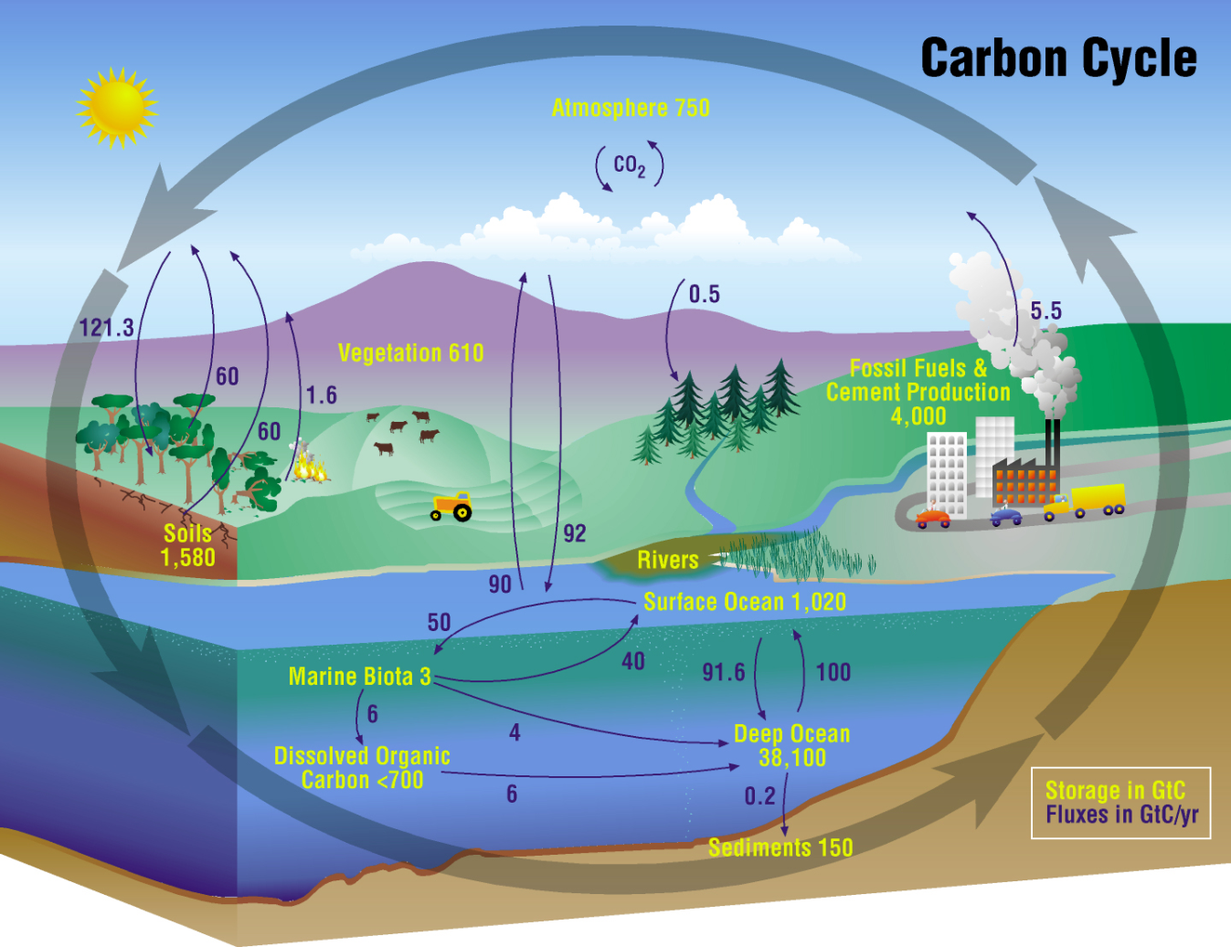
NASA Carbon Cycle Research
To improve understanding of the global carbon cycle and to quantify changes in atmospheric CO₂ and CH₄ concentrations as well as terrestrial and aquatic carbon
storage in response to fossil fuel combustion, land use and land cover change, and other human activities and natural events.

Slide 5
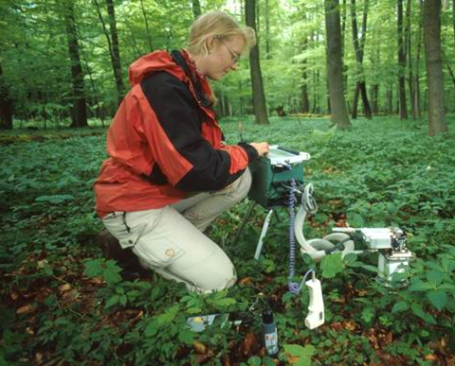
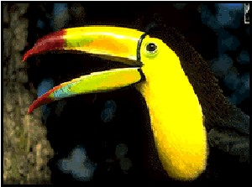
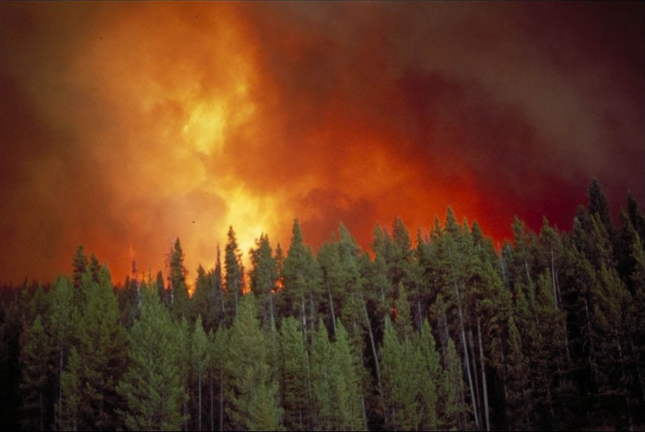
NASA Ecosystems Research
To understand how ecosystems respond to changes in climate in combination with other contemporary environmental changes such as changes in land use and management, invasions of exotic species, nitrogen deposition, and acidification of the ocean.
To understand ecosystem controls on and feedbacks to the Earth system.

Slide 6
NASA’s Approach to CC&E Research
NASA’s approach to investigating global ecosystems and the carbon cycle is broad-based, emphasizing NASA’s unique capabilities and strengths. NASA research:
Focuses on utilizing existing satellite data and developing new capabilities for space-based global observations of land cover, ocean color, greenhouse gases, carbon stocks, primary productivity, vegetation composition, physiology, phenology, successional processes, biodiversity, and the biophysics of remote sensing these phenomena.
Uses spatial information from remote sensing data to scale up site-based measurements to regional and global scales
Analyzes time series of remote sensing data records to document and understand variability and changes over time in ecosystems, land cover, biodiversity, and carbon cycling
Conducts calibration/validation of satellite data; algorithm development; airborne field campaigns; process investigations; and data analysis/integration/assimilation
Develops and exercises advanced, quantitative carbon and ecosystems models, data assimilation models, and coupled land-ocean-atmosphere models
Demonstrates innovative uses and practical benefits of NASA Earth science data, scientific knowledge, and technology
Develops and demonstrates technologies that enable improved future capability for the nation

Slide 7
R & A: Terrestrial Ecology Program
Goals & Objectives
To improve understanding of the structure and function of global terrestrial ecosystems, their interactions with the atmosphere and hydrosphere, and their role in the cycling of the major biogeochemical elements and water.
  remote sensing to observe terrestrial ecosystems/carbon and their responses
  field campaigns and related process studies to elucidate ecosystem/carbon cycle function; and modeling to analyze and predict responses
Missions & Instruments
Systematic: Terra/Aqua MODIS, AMSR-E; AVHRR; Landsat; VIIRS; MISR, ASTER, MOPITT
Recently Launched: OCO-2; SMAP
Exploratory: ECOSTRESS, GEDI
Decadal Survey: HyspIRI, ICESat-2, ASCENDS, others
Airborne: AVIRIS; users of LVIS ,UAVSAR, and investigator instruments
Funded Research (FY2015)
Terrestrial Ecology R&A: $13.5M
  ABoVE (~$4.2M)
  Ecosystems
  Remote Sensing Science
Carbon Cycle Science $ 0.4M
Terra/Aqua Science $ 2.1M
Interdisciplinary Science $ 3.8M
Carbon Monitoring System $ 5.2M
Key Interactions
ORNL and other DAACs
Carbon Cycle Interagency Working Group on North America Carbon Program
USDA, NSF, DOE, DOI
GEO Carbon Community of Practice
CEOS Carbon Task Force
CarboNA, SILVACarbon
CHARS, NRCan, + new partnerships being identified for ABoVE

Slide 8
R & A: Land-Cover/Land-Use Change (LCLUC) Program
Goals & Objectives
Develop the capability to perform repeated global inventories of land-use and land-cover from space
Develop the scientific understanding and models necessary to simulate processes taking place
Evaluate consequences of observed and predicted changes
Further understanding of consequences of land-use/cover changes on environmental goods and services, the carbon and water cycles and management of natural resources
Improve understanding of human interaction with the environment and provide a scientific foundation for sustainability, vulnerability, and resilience of land systems
Missions & Instruments
Terra/Aqua MODIS
Landsat
Radars (including SRTM), lidars
EO-1 Hyperion, ALI
Non-US missions/sensors (e.g. Sentinel-1,2)
Funded Research
Carbon-2013 $0.5M
ROSES-2014 (MSLI) $1.3M
ROSES-2013 $2.5 M
ROSES-2012 $2.7M
ROSES-2011 $1M
IDS $1.5M
Terra/Aqua $0.6M
Key Interactions
NASA: ESD programs
National: USGCRP, NRC
International: GLP, GOFC-GOLD, GEO, CEOS
ESA (Landsat-Sentinel 1,2 projects)

Slide 9
R & A: Biodiversity Program
Biodiversity - the variability of life on Earth at all levels, including: ecosystems, species, and genes.
Goals & Objectives
Use NASA observations and related models to improve our understanding of biodiversity within the Earth system and its effects on the Earth system. For example:
- What drives the diversity of life?
- How is biodiversity changing and why?
- How do elements of biodiversity (e.g.: species richness)
affect other elements of the Earth system?
- Why do organisms/ecosystems exist where they exist and what drives their abundance/condition?
Key Missions & Instruments
Terra/Aqua
  MODIS: land and ocean surface measures
  ASTER: land surface (vegetation, T), elevation
  AMSR-E: sea ice
Landsat
  TM/ETM+/OLI/TIRS: land surface, coral reefs, kelp
GPM: rainfall
SMAP: soil moisture
EO-1 ALI/Hyperion: land surface
OSTM/Jason-2: SSH
SARs: land surface (cloudy areas), surface water
Scatterometers: wind speed, land surface parameters
Funded Research
~25 projects in various stages of work
Funding ~$5M per year (includes projects under Biodiversity, IDS, Climate and Biological Response, and HyspIRI activities)
Key Interactions
CENRS Subcommittee on Ecological Systems
US Global Change Research Program Biodiversity and Ecosystems Cluster
Group on Earth Observations (GEO) Biodiversity Observation Network (GEO BON)
National Climate Assess. Biodiversity/Ecosystems
NSF, USGS, NOAA, US Fish & Wildlife, NPS
Academia, Non-profit sector
GSFC, ARC, JPL, MSFC
Sustainable Land Imaging; HyspIRI, PACE/ACE, GEO-CAPE, DESDynI, ICESat-2 - Decadal Survey

Slide 10
R & A: Ocean Biology and Biogeochemistry Program
Goals & Objectives
Understanding/quantifying impacts & feedbacks of Earth System processes (oceanographic forcings) on global and regional spatial and temporal variability of ocean biology and ecology & of ocean biogeochemistry, including carbon sources and sinks and the fate of other chemical species or components in the ocean;
Development of new biological, ecological, and biogeochemical observations beyond traditional ocean color
Improving future climate predictions by incorporating a dynamic understanding of ocean biology, ecology, and biogeochemistry into models to understand the ocean's role in the Earth System.
Missions & Instruments
Systematic: SeaWiFS (R.I.P); MODIS-Aqua; Suomi NPP/JPSS (VIIRS)
Exploratory: Aquarius; HICO; OCO-2; AVHRR; QuikSCAT
Decadal Survey: ACE; GEO-CAPE; HyspIRI; ASCENDS
Climate Initiative: PACE
Airborne: PRISM
Funded Research (FY2015)
OB&B R&A: $7.6M
  Ocean Biogeochemistry, Ocean Ecology
  Biological Oceanography
Carbon Cycle Science $ 2.5M
Terra/Aqua Science $ 3.0M
Suomi NPP Science Team $ 1.2M
Interdisciplinary Science $ 1.6M
Carbon Monitoring System $ 0.3M
PACE Science Team $ 3.1M
Key Interactions
Ocean Biology Processing Group NASA GSFC
IOCCG – Working Groups
CEOS OCR-VC and INSITU-OCR
USGCRP CCIWG, CCSSG, NACP SSG
EXPORTS, Arctic-COLORS, ICESOCC
National Ocean Council/Policy
NSF, NOAA
OCB
IGBP IMBER, SOLAS; EU on Horizon 2020/BG

Slide 11
Applied Sciences: Water Resources
Goals & Objectives
The NASA Applied Sciences Program Water Resources application area supports the integration of NASA Earth observations and technologies into management tools for the water resources management community. The Water Resources application area currently supports a diverse range of projects in its portfolio, addressing topics including drought monitoring and mitigation, snow monitoring and runoff forecasting, water quality, soil moisture, groundwater change, and climatic and ecological impacts on water resources.
Missions & Instruments
Terra/Aqua
  MODIS: land surface
Landsat
  TM/ETM+: land surface
TRMM/GPM
  Precipitation Radar
EO-1
  ALI/Hyperion: land surface
Jason/OSTM: In-land water body heights
SMAP
  radar & radiometer: soil moisture
Funded Research
22 projects in various stages of work
Funding ~$6M per year
Key Interactions
USDA
USGS
USAID-DoS
EPA
USACE
NOAA
World Bank
Academia, Non-profit and For-profit sectors
Group on Earth Observations Agriculture and Water Tasks

Slide 12
Applied Sciences: Ecological Forecasting
Key Missions & Instruments
Terra/Aqua
  MODIS: land and ocean surface measures
  ASTER: land surface (vegetation, T), elevation
  AMSR-E: sea ice
Landsat
  TM/ETM+/OLI/TIRS: land surface, coral reefs, kelp
GPM: rainfall
SMAP: soil moisture
EO-1 ALI/Hyperion: land surface
OSTM/Jason-2: SSH
SARs: land surface (cloudy areas), surface water
Scatterometers: wind speed, land surface parameters
Goals & Objectives
Ecological Forecasting is an applications (i.e., NASA Applied Sciences) program seeking to provide environmental managers and other decision makers with reliable forecasts, based upon NASA products, to project changes in ecosystems and among species of management concern. These forecasts should incorporate knowledge of uncertainty and error estimates and allow decision makers to compare outcomes of alternative policies.
Particular focus: Conservation Biology applications
Funded Research
~17 projects in various stages of work
Funding ~$3.4M per year
Key Interactions
CENRS Subcommittee on Ecological Systems
US Global Change Research Program Biodiversity and Ecosystems Cluster
Group on Earth Observations (GEO) Biodiversity Observation Network (GEO BON)
National Climate Assess. Biodiversity/Ecosystems
NSF, USGS, NOAA, US Fish & Wildlife, NPS
Academia, Non-profit sector
GSFC, ARC, JPL, MSFC
Sustainable Land Imaging; HyspIRI, PACE/ACE, GEO-CAPE, DESDynI, ICESat-2 - Decadal Survey

Slide 13

Opportunities and Challenges Ahead

Slide 14
Opportunities
ROSES – large range of opportunities beyond the core programs (e.g., USPI, sensor science teams, IDS, carbon cycle science, etc.)
Creating and optimizing synergies across Earth science missions, field programs, data collections, basic and applied research.
Defining the next generation of field campaigns and/or focused, integrative studies within the Focus Area.
Next Decadal Survey – 2015-2017 – advanced science planning

Slide 15
Issues (2011) and still in 2015
Securing the long-term time series observations of land cover, vegetation properties, ocean color/biological/biogeochemical properties, and fire. Suomi NPP, JPSS, and LandSat are the path forward for most of these. There is a worry about ocean color, with concerns about VIIRS, PACE not due to launch before 2022/2023, and complexities of international data exchanges.
Filling the gap in our carbon observation strategy caused by the cancellation of the DESDynI lidar.
Flying HyspIRI (an imaging spectrometer and a thermal infrared sensor) sometime in the foreseeable future.
Bringing the research and applied sciences communities closer together; also natural, economic, social scientists in key topic areas
Providing appropriate and useful documentation of errors and uncertainties associated with our data, data products, analyses, and model results.
What next for science from space, field work and modeling?

Slide 16
About this Workshop

Slide 17
Carbon Cycle and Ecosystems Roadmap
Integrated global analyses
Human-Ecosystems-Climate Interactions (Model-Data Fusion, Assimilation); Global Air-Sea Flux
Funded
T
High-Resolution Atmospheric CO₂
Sub-regional sources/sinks
Unfunded
Southern Ocean Carbon Program, Air-Sea CO₂ Flux
Process controls; errors in sink reduced
Partnership
T = Technology development
T
Physiology & Functional Types
Models w/improved ecosystem functions
Coastal Carbon
Reduced flux uncertainties; coastal carbon dynamics
= Field Campaign
Global Ocean Carbon / Particle Abundance
Reduced flux uncertainties; global carbon dynamics
Report
Goals: Global productivity and land cover change at fine resolution; biomass and carbon fluxes quantified; useful ecological forecasts and improved climate change projections
T
Vegetation 3-D Structure, Biomass, & Disturbance
Terrestrial carbon stocks & species habitat characterized
Global CH₄; Wetlands, Flooding & Permafrost
CH₄ sources characterized and quantified
Knowledge Base
Global Atmospheric CO₂ (OCO)
Regional carbon sources/sinks quantified for planet
N. American Carbon Program
N. America’s carbon budget quantified
Land Use Change in Amazonia
Effects of tropical deforestation quantified; uncertainties
in tropical carbon source reduced
2002: Global productivity and land cover resolution coarse; Large uncertainties in biomass, fluxes, disturbance, and coastal events
Models & Computing Capacity
Process Understanding
Improvements:
Case Studies
P
Land Cover (Landsat)
LDCM
Land Cover (OLI)
Ocean Color (SeaWiFS, MODIS)
Systematic Observations
Vegetation (AVHRR, MODIS)
Ocean/Land (VIIRS/NPP)
Ocean/Land (VIIRS/NPOESS)
Vegetation, Fire (AVHRR, MODIS)
2002
2004
2006
IPCC
2008
2010
IPCC
2012
2014
2015
NA Carbon
NA Carbon
Global C Cycle
Global C Cycle

Slide 18
2015 Carbon Cycle and Ecosystems Focus Area Joint Science Workshop
Workshop Objectives:
To share scientific research results and foster interdisciplinary interactions within the Carbon Cycle & Ecosystems (CC&E) Focus Area
To delineate progress (and gaps) regarding the science themes, considering have we exploited our on orbit and historical data to the fullest extent?
To discuss “what’s next?” for our focus area science in the breakout sessions – considering science questions, field work, modeling, observations, technology, etc.
To serve as the next regular science team meeting for each of these programs: Biodiversity and Ecological Forecasting, Land Cover and Land Use Change and Terrestrial Ecology

Slide 19
2015 Carbon Cycle and Ecosystems Focus Area Joint Science Workshop
Desired Outcomes:
Days 1-3: New ideas and collaborations; an informal assessment of NASA program accomplishments and progress toward goals; perhaps some suggestions on how to improve program content and management; a refreshed community (i.e., we want you to have fun!); a discussion of what is next scientifically for NASA (i.e., systematic observations, new science, etc.), ideas for the next decadal survey science
Day 3: For some, additional sharing of scientific results; for others, receive program updates and participate in problem solving; make recommendations for program activities and new directions (i.e., we are hoping you can help us address some problems, react to new ideas, and/or set new priorities)
Day 3-4: Disciplinary Science Team Meetings
Day 5: Marine Biodiversity Observation Network Project Meeting

Slide 20
2015 Carbon Cycle and Ecosystems Focus Area Joint Science Workshop: Format
Plenary Sessions Organized around Four Themes:
  Landscapes to coasts: understanding Earth system connections
  Tracking habitat change through new integrative approaches and products
  Future research direction and priorities: perspectives relevant to the Next Decadal Survey
  Human influence on global ecosystems
Plenary Sessions Include
  Invited Theme Synthesis Talks – centered around four themes
  Breakout Group Discussions
  Keynote Address – Diane Wickland (ret) former CC&E Focus Area Lead
  Panel Discussions - Uncertainties
Poster Sessions (this is where all the primary research will be reported!) with Student Speed Talks
Bonus Events (Data Workshop, Arctic-COLORS Town Hall, NASA ISRO SAR (NISAR) Town Hall)
Wrap-Up Panel with all CC&E and other Focus Area Program managers
Generous breaks and lunch periods to allow for community interactions
Wednesday -Thursday-Friday Discipline Team Meetings (TE, LCLUC, BEFT)
Friday - Marine Biodiversity Observation Network Projects Meeting

Slide 21
2015 CC&E Focus Area Joint Science Workshop Meeting Planning Committee
Meeting Planning Committee
Paula Bontempi, NASA HQ
Emmanuel Boss, University of Maine
Jessica Bussard, NASA GSFC / SSAI
Jim Collatz, NASA GSFC
Brad Doorn, NASA HQ
Carla Evans, NASA GSFC / SSAI
Josh Fisher, JPL
Anand Gnanadesikan, Johns Hopkins
Peter Griffith, NASA GSFC / SSAI
Garik Gutman, NASA HQ
Sean Healey, USDA Forest Service
Kathy Hibbard, NASA HQ
Walter Jetz, Yale University
Chris Justice, University of Maryland
Eric Kasischke, NASA HQ
Libby Larson, NASA GSFC / SSAI
Allison Leidner, NASA HQ / USRA
Jon Ranson, NASA GSFC
Woody Turner, NASA HQ
Thank you!
CC&E Office and Other Support
Jessica Bussard
Carla Evans
Peter Griffith
Amy Hodkinson
Leanne Kendig
Libby Larson
Lisa Wilcox
ZantechIT: Mary Floyd
NASA HQ: Amy Marshall
The Community
Plenary speakers
Poster presenters
Breakout group leaders
Note takers
Panelists
Session chairs
Lunch mentors
You!
21

Slide 22
Back Up

Slide 23
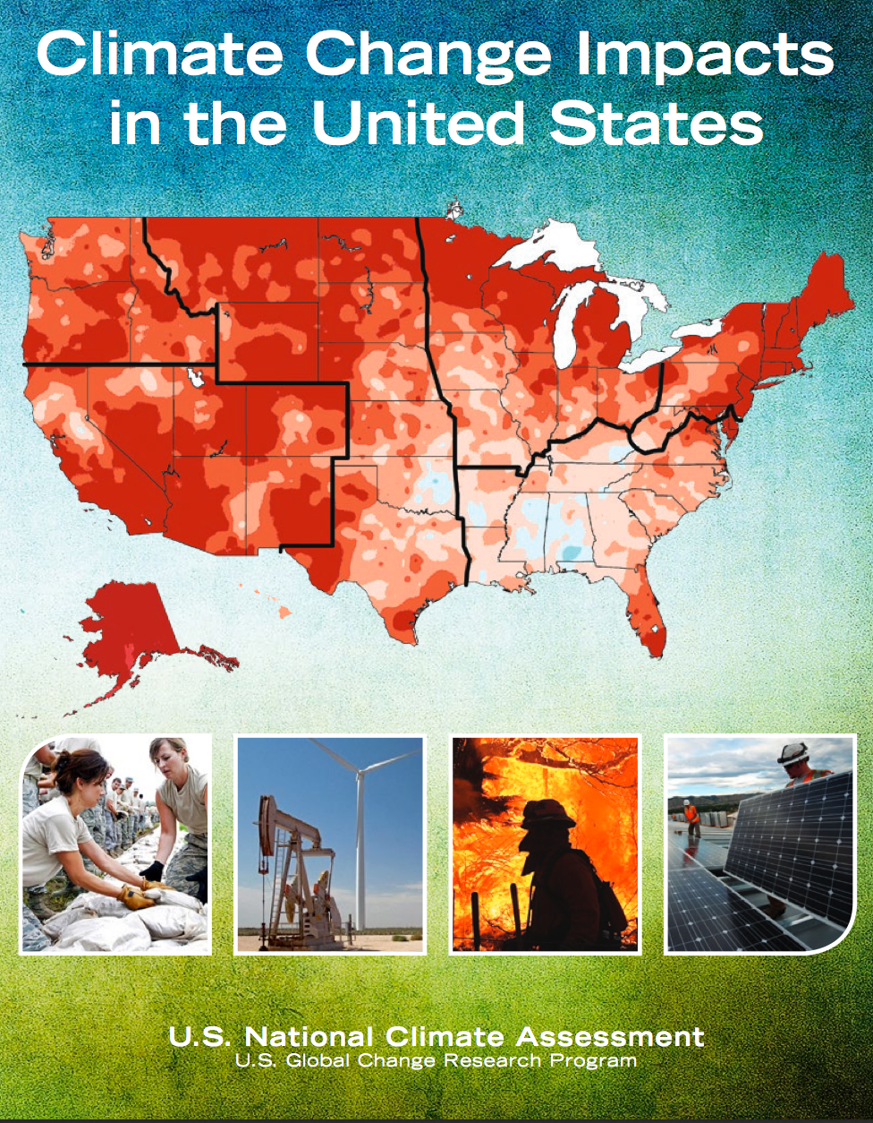
NASA Support of the
National Climate Assessment
The National Climate Assessment (NCA) is a congressionally mandated activity to produce a
quadrennial report that evaluates, integrates and interprets the findings of USGCRP, analyzes the
effects of global change on various sectors, and analyzes current trends in global change.
The Third NCA Report, released May 2014, features NASA CC&E science in chapters including forestry,
biogeochemical cycles, biodiversity/ecosystems/ecosystem services, and land use/cover change.
NASA is a key supporter of the NCA sustained assessment process that is facilitating ongoing
involvement of scientists and stakeholders, enabling new information and insights to be synthesized
as they emerge. NASA participates in USGCRP working groups related to the development of the
Fourth NCA Report, scenarios of global change, indicators, and special assessment reports.
Additionally, NASA is supporting assessment-relevant science through:
Assessment capability (2011-2014) and enabling tools projects (2011-2017) at NASA Centers
ROSES solicitation for the development and testing of potentially new indicators of climate change (2013-2014)
ROSES solicitation for climate indicators and data products for future NCAs (proposals under review)
How can you get involved:
Respond to upcoming Requests for Information and Public Comment Periods in the Federal Register
Work with NCAnet, a network of organizations working with the NCA to engage producers and users of assessment information. http://ncanet.usgcrp.gov/
For more information:
Third NCA report http://nca2014.globalchange.gov/ and NCA website: http://www.globalchange.gov/what-we-do/assessment
NASA’s NCA activities (including funded projects): http://weather.msfc.nasa.gov/nca/index.html
USGCRP Climate and Health Assessment Report - draft for public comment http://www.globalchange.gov/health-assessment

