Slide 1
Breakout Group 6
Terrestrial Group
Ocean and Atmosphere Group

Slide 2
Questions
How are human activities altering variability, vulnerability, and resilience in ecosystems and transitions between ecosystems?
What are the missing pieces of carbon and nutrient budgets?
How do disturbances, extreme events and degradation affect ecosystems and their recovery?
How do composition and structure/function interact to drive ecosystem processes in a changing world?
What are the critical indicators to monitor ecosystem condition?

Slide 3
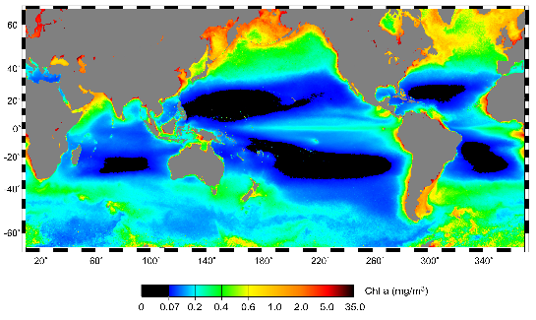
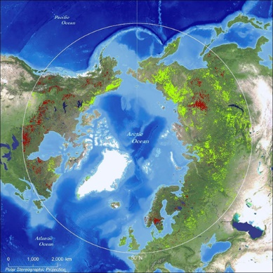
1. How are human activities altering variability, vulnerability, and resilience in ecosystems and transitions between ecosystems?
Human activities such as climate change, agriculture, aquaculture, urbanization
With a focus in sensitive ecosystems (Arctic, rainforests, etc.) and ecosystems on the margins (tidal wetlands)
Across scales (local, regional, global)
How well are we managing regional ecosystems and the ecosystem services under global change? What are the processes that underlie ecosystem health?
What human impacts most degrade regional ecosystems? How are ecosystems changing human activities?

Slide 4
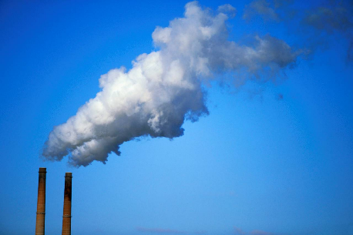
2. What are the missing pieces of carbon and nutrient budgets?
For example: day and night effects, respiration, role of dust and trace elements, nitrogen loading
Global methane budget (worthy molecule to study)
Carbon storage and dynamics in water limited ecosystems (e.g. fog abundances and patterns)
Carbon fluxes/stocks/budget/rates
Interactions, thresholds, and feedbacks with climate

Slide 5
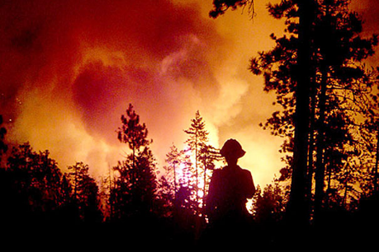
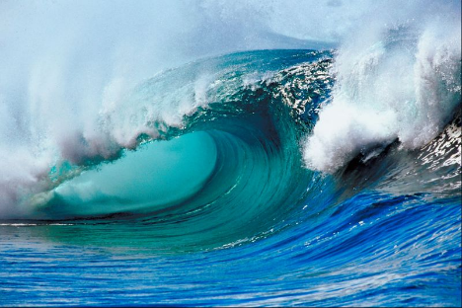
3. How do disturbances, extreme events and degradation affect ecosystems and their recovery?
What are the drivers of disturbances and extreme events?
Fire, drought, deforestation, red tides, hypoxia/eutrophication, logging, insects, etc.

Slide 6
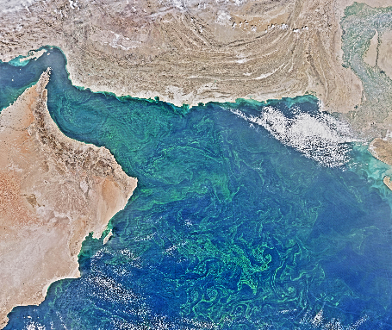
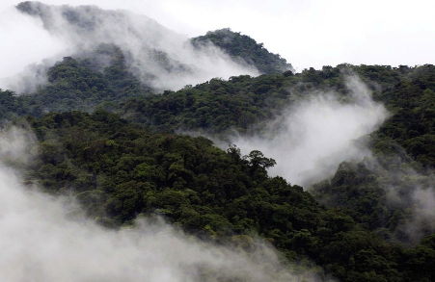
4. How do composition and structure/function interact to drive ecosystem processes in a changing world?
Physiological responses of vegetation to climate (stress, biome shifts)
Nutrient and water interactions
Biodiversity/productivity – impact of biodiversity

Slide 7
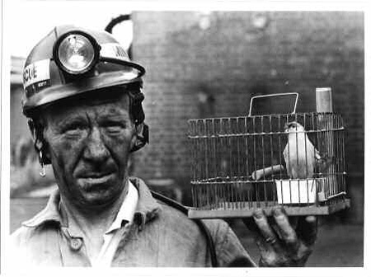
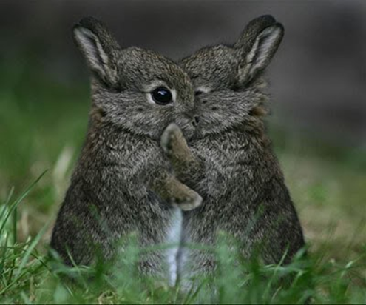
5. What are the critical indicators to monitor ecosystem condition?
How can critical indicators be developed to inform more sustainable use in developing communities under global change?
Assessing mitigation of emissions (geoengineering, how can sinks be managed and preserved?)

