Slide 1
Forest Monitoring: Progress and Trends
Exciting Time!
Key Points
  Much exciting stuff in the last year
    almost entirely Landsat-based!!!
  Importance of Continuity
  Research to Operations
  Exciting new opportunities – NISAR and Sentinels

Slide 2
Why Landsat? Why now?
Consistent data formats
Computing capabilities
Archive consolidation
Calibration
Free Access – data policy, NASA + USGS
  Prior to 2008, less than 10% of the images in the archive had ever been used! Now it is over 80% and only the completely cloud covered images have never been used
The Landsat archive is the most valuable record we have of the history of the surface of Earth!
After 40+ years, we are still learning what we can do with Landsat data – fair to say we are learning more about cool things to do with Landsat at a faster rate than anytime in the past!

Slide 3
Recent Growth of the EROS Landsat Archive
Year | Landsat Global Archive Consolidation (LGAG) | EROS Landsat Archive (millions)
2010 | - | 2.49
2011 | - | 2.73
2012 | 500,185 | 2.91
2013 | 1,531,899 | 3.76
2014 | 2,550,354 | 4.66
2015 | 3,164,701 | 5.52
An estimated 3 million additional historical images are expected to be added to the Landsat archive over the next 2 years (600k MSS, 2m TM, and 400K ETM+).

Slide 4
Daily global Landsat acquisitions
Landsat 5 and Landsat 7 era (circa 2010)
  Landsat 5: 200 images/day
  Landsat 7: 300 images/day
  Total – 500 images/day added to the archive
Landsat 7 and Landsat 8 era (circa 2015)
  Landsat 7: 470 images/day
  Landsat 8: 725 images/day
  Total – 1,195 images/day added to the archive

Slide 5
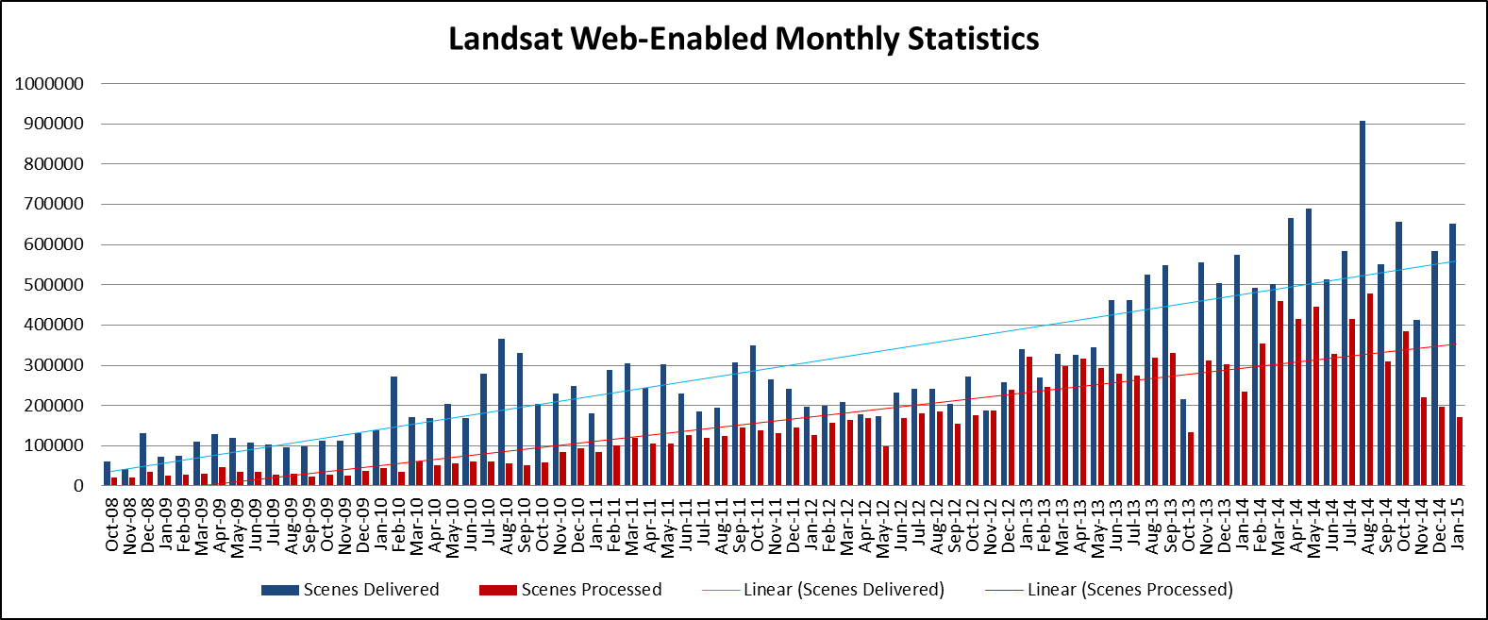
Monthly Downloads / Processed
FY09
Delivered: 1.14M
Processed: 358K
FY10
Delivered: 2.45M
Processed: 567K
FY11
Delivered: 2.92M
Processed: 1.27M
FY12
Delivered: 2.73M
Processed: 1.82M
FY13
Delivered: 4.32M
Processed: 3.28M
FY14
Delivered: 6.76M
Processed: 4.19M
FY15 (Oct-Jan)
Delivered: 2.31M
Processed: 972K

Slide 6
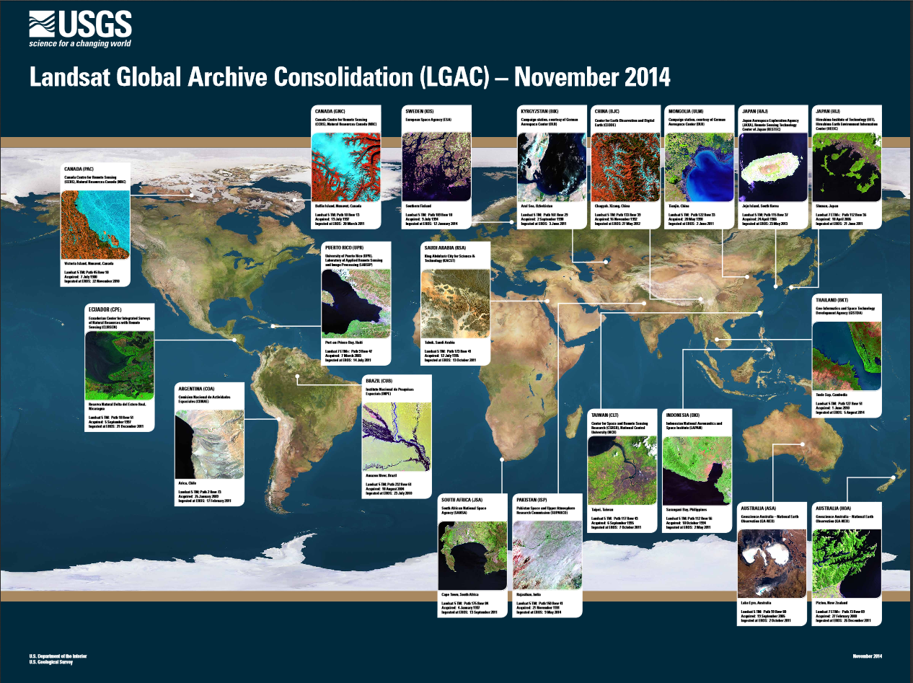


Slide 7
2000 to 2013 tree cover extent
and forest loss and gain
Slide from Matt Hansen

Slide 8
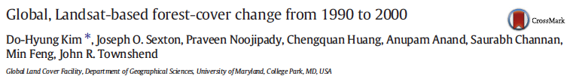
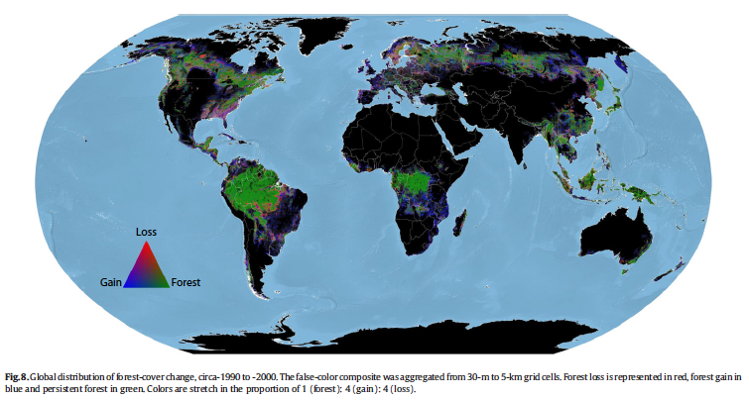

Slide 9
North America Forest Dynamics (NAFD):
Phase III (Annual, W-to-W)
S. Goward, C. Huang, W. Cohen, J. Masek, G. Moisen and R. Nemani
21 April 2015

Slide 10
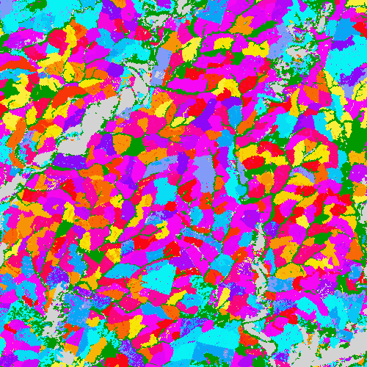
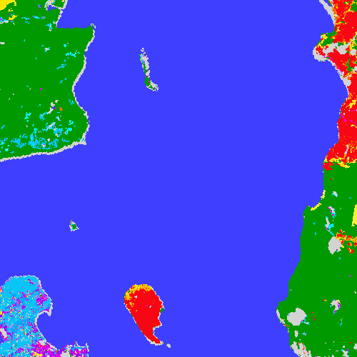
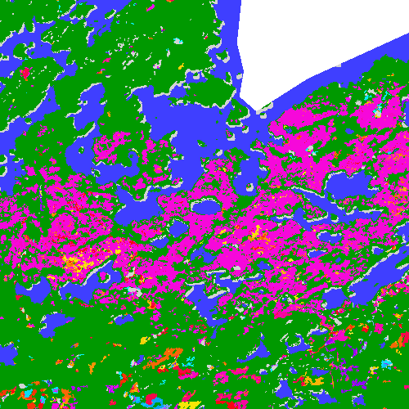
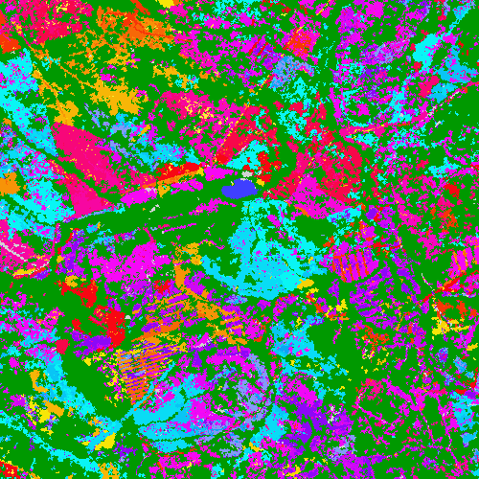
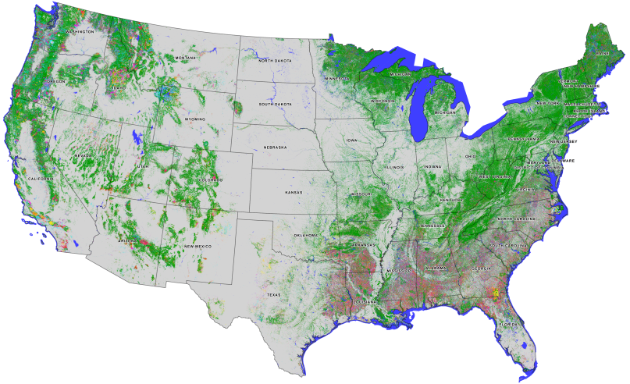
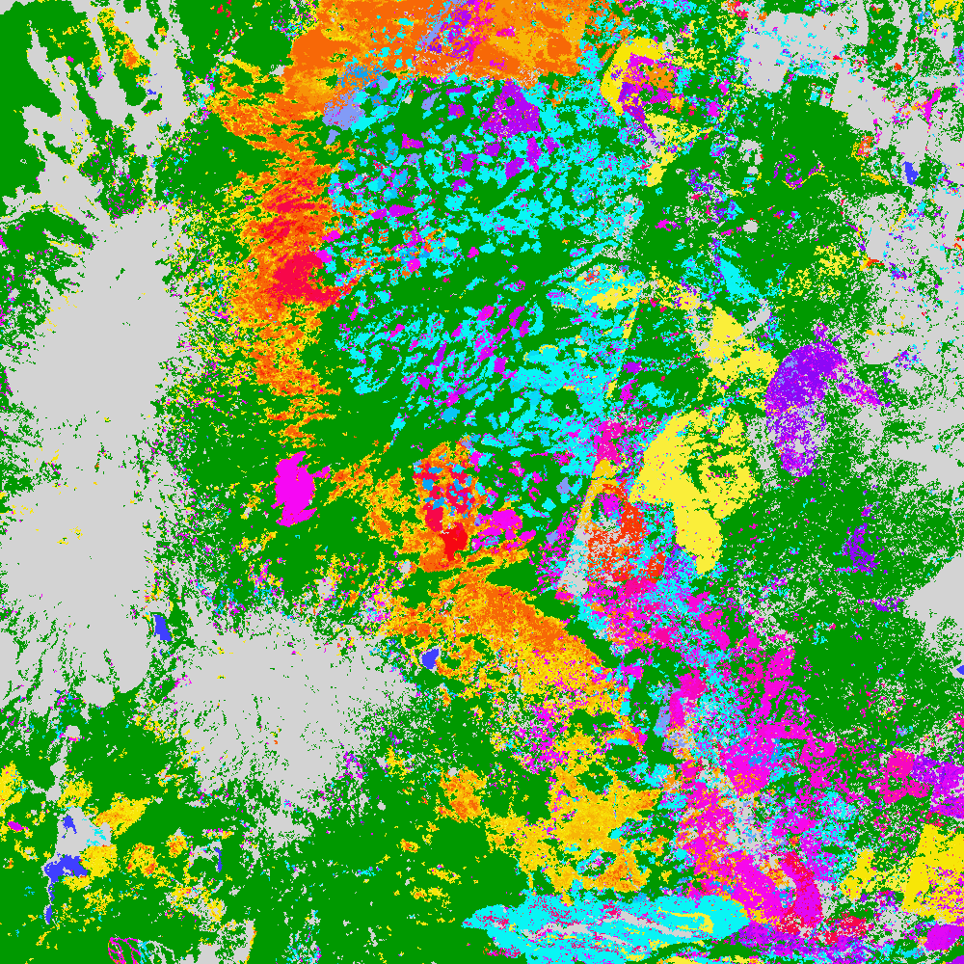
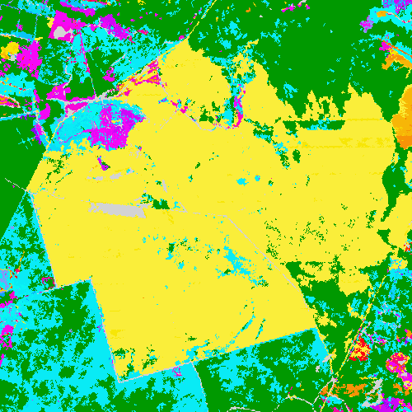
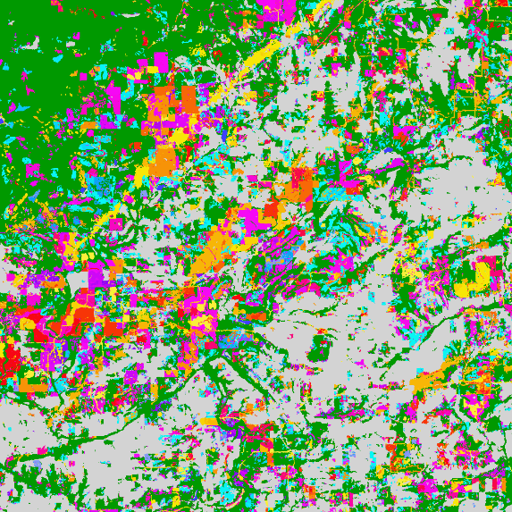
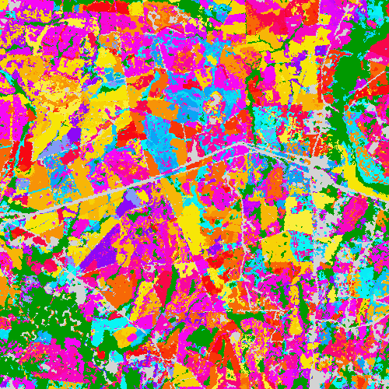
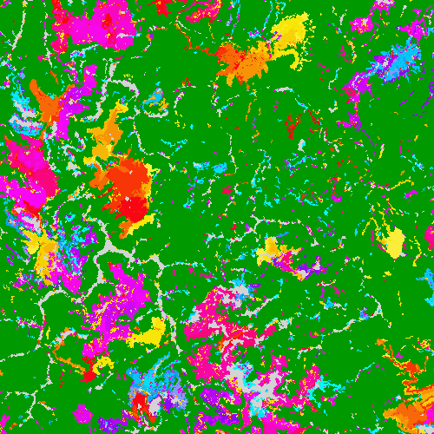
Little left undisturbed
Whole Island burned
Severe wind blow-down
Logging industry
Fires and insects
Lightening induced fire
Mountain top mining
Parallel tornados tracks
Intensive logging
A 25-year History of US Forest Disturbances
(Goward, Huang, Zhao, Rishmawi, Schleeweis, et al)

Slide 11
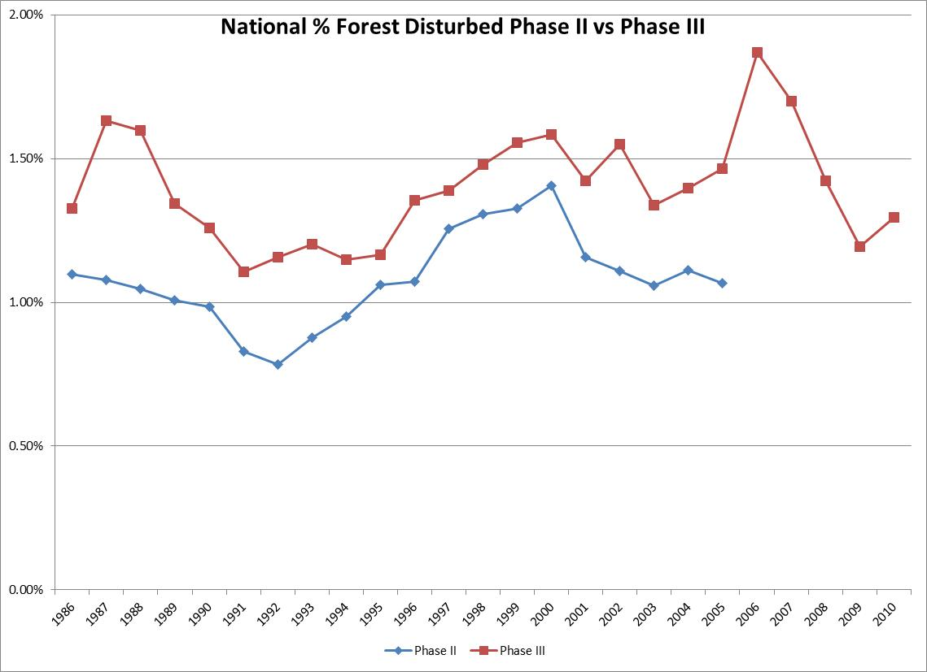
(Goward, Huang, Zhao, Rishmawi, et al)

Slide 12
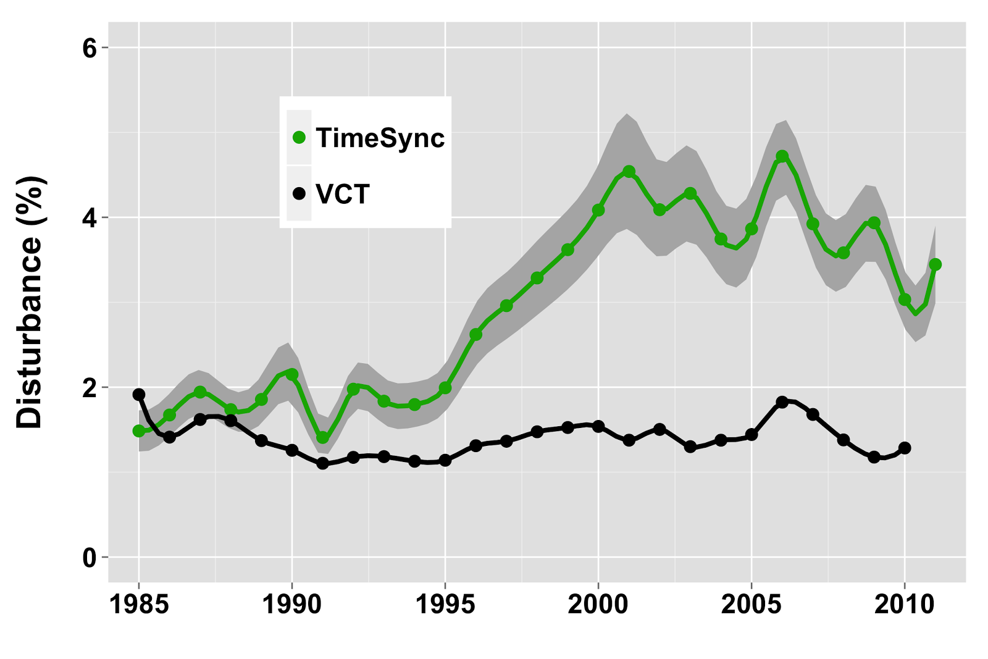
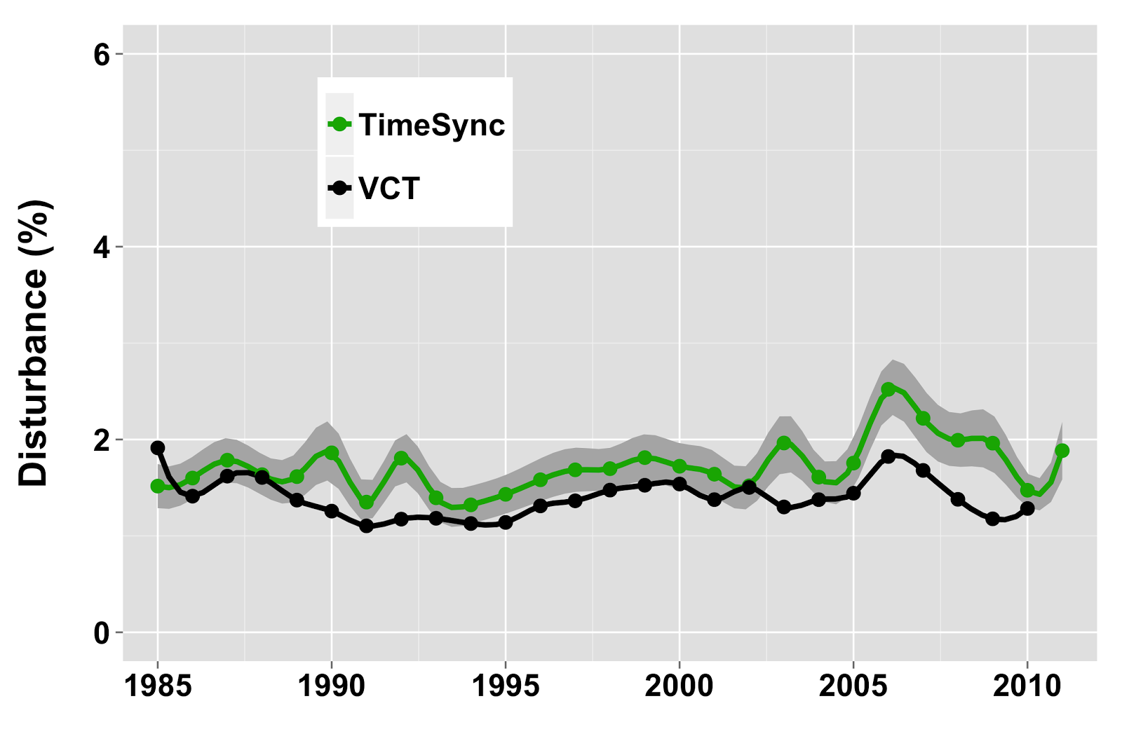
Disturbance Rate Estimates
When TS stress is labeled as disturbance
When TS stress not labeled as disturbance
(Cohen, Yang et al.)

Slide 13
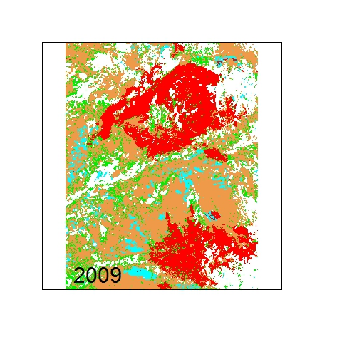
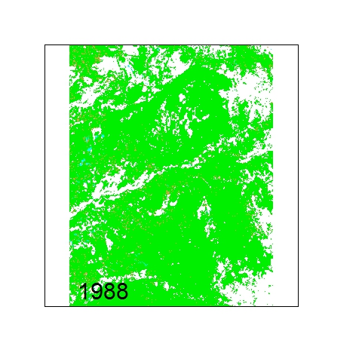

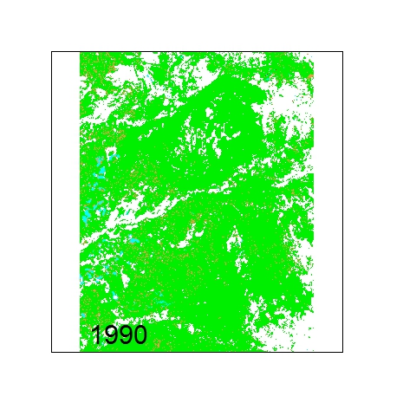
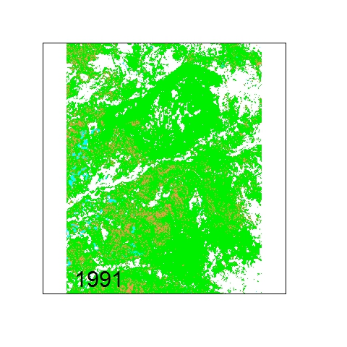
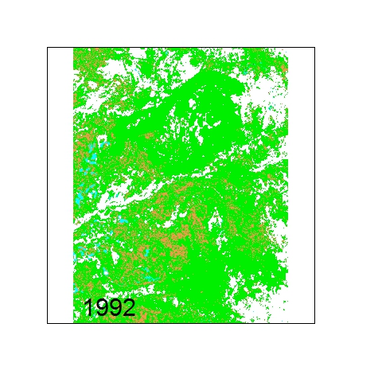
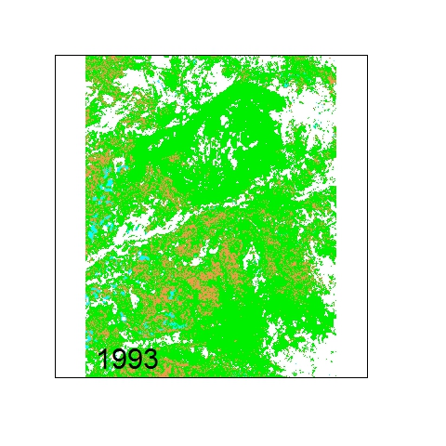

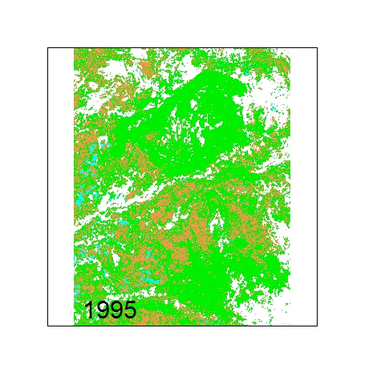
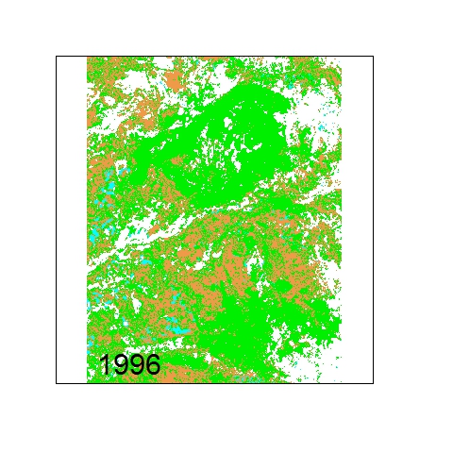

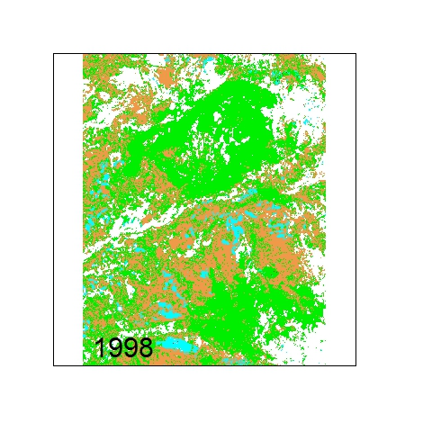
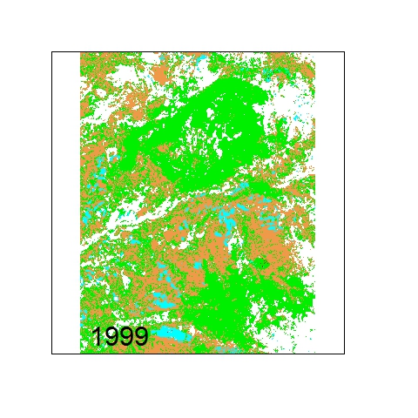


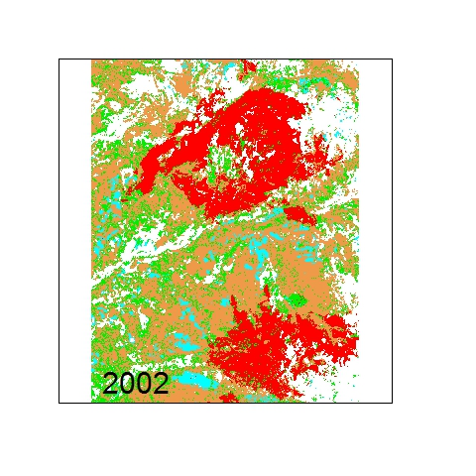






Disturbance Attribution
Stable
Harvest
Fire
Stress
Non-forest
Confusion matrix: |  | OOB error rate : 15.45%
 | Fire | Harvest | Stable | Stress | Error
Fire | 73 | 1 | 2 | 2 | 0.06
Harvest | 6 | 20 | 2 | 3 | 0.35
Stable | 1 | 0 | 55 | 5 | 0.09
Stress | 1 | 2 | 9 | 38 | 0.24
Colorado 1988 - 2009
(Moisen, Schleeweis, Shroeder et al.)

Slide 14
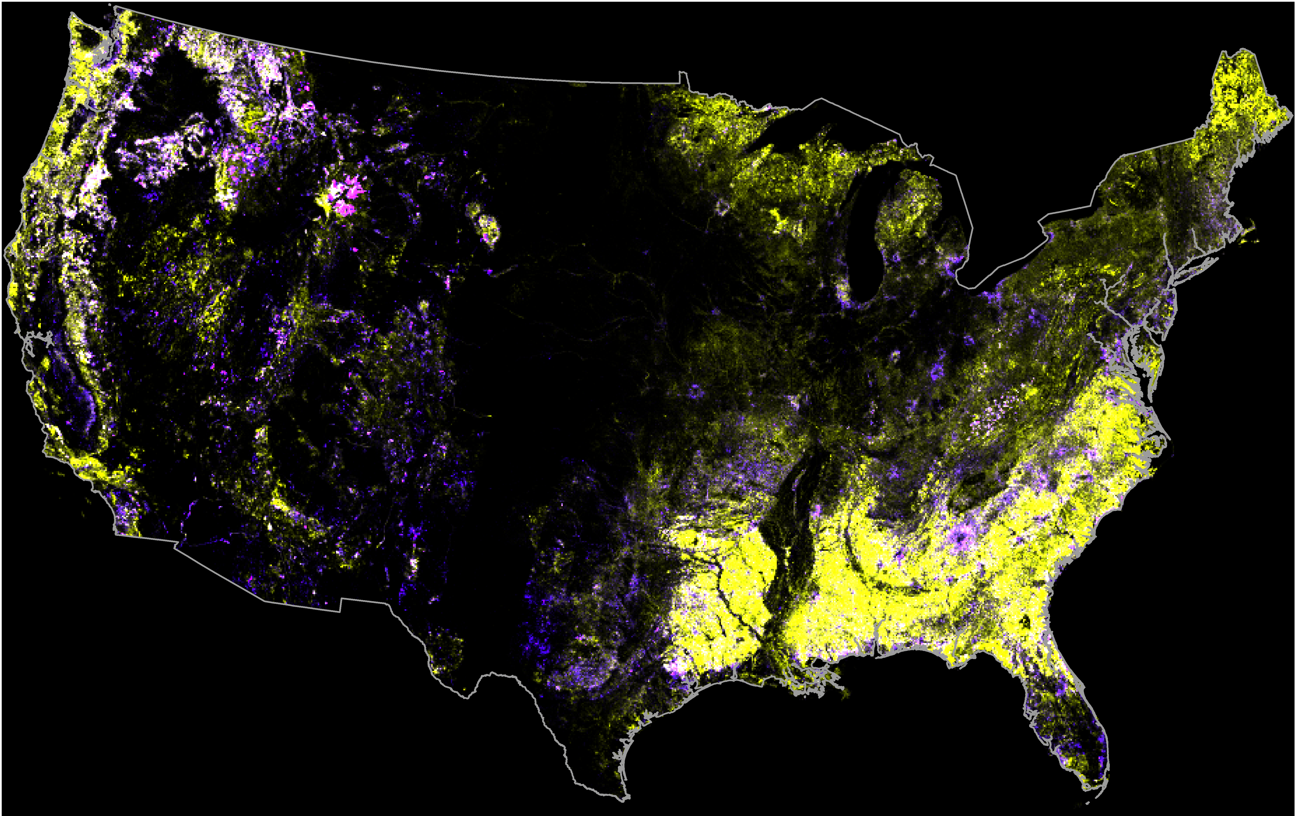
Recovery of pre-2000 disturbances
high-mod disturbance / high-mod recovery
low disturbance / mod-low recovery
high-mod disturbance / low-no recovery
(Masek, Zhao & UMD Team)
Bright yellow areas — highly disturbed and highly recovered locations; Dark yellow areas — less disturbed and recovered locations; bright blue—moderate to low disturbance, most of which had no recovery, dark blue — moderate to low disturbance, with some recovery, Light Pink — high disturbance, low recovery, Dark pink—moderate disturbance, low recovery; heavily managed forests areas in the Southeast, Northeast and west coast regions reveal the highest disturbance and recovery. More protected forests reveal lower disturbance. In the East, developing urban-suburb areas reveal little to no forest recovery once developed. The lower disturbances in the west (blueish tones) are regions of low forest cover and little recovery once disturbed. The pink tones, particularly in the Yellowstone National Park region, note the heavily burned western forests with little of no recovery.

Slide 15
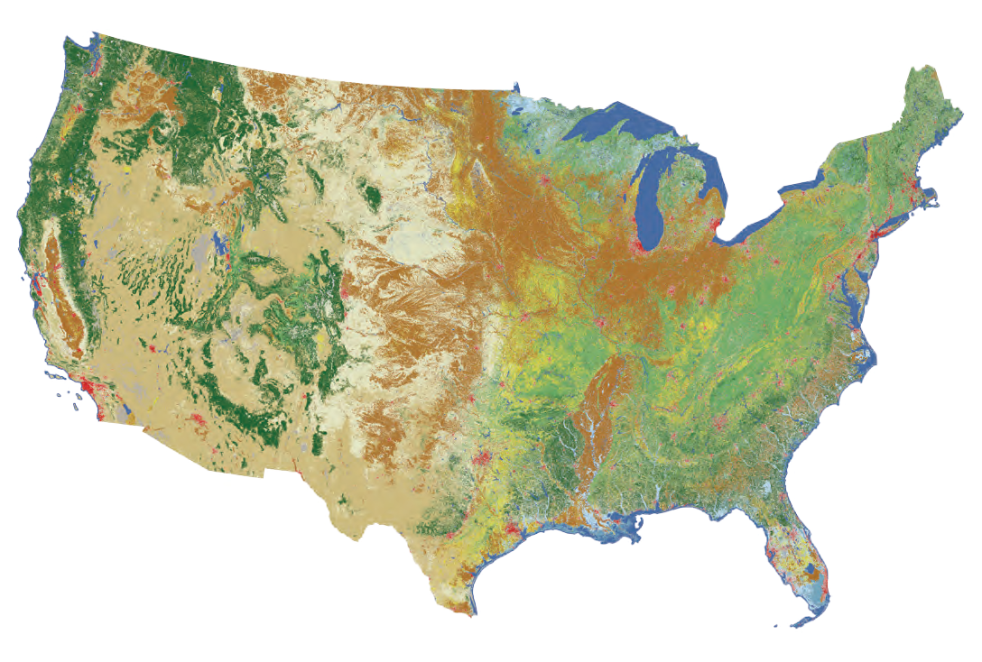
2011 U.S. Land Cover
NLCD – National Land Cover Database
Notes:
Talk about accuracy…NLCD has consistently provided accuracy stats, thought they are limited due to design.

Slide 16
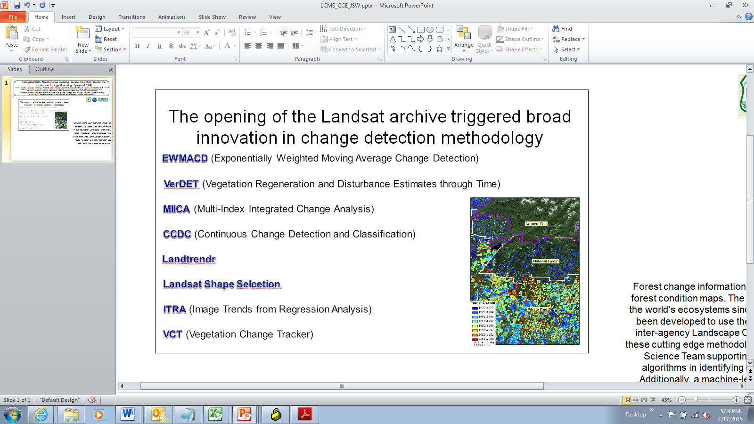



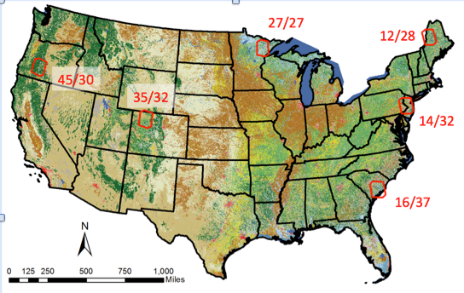
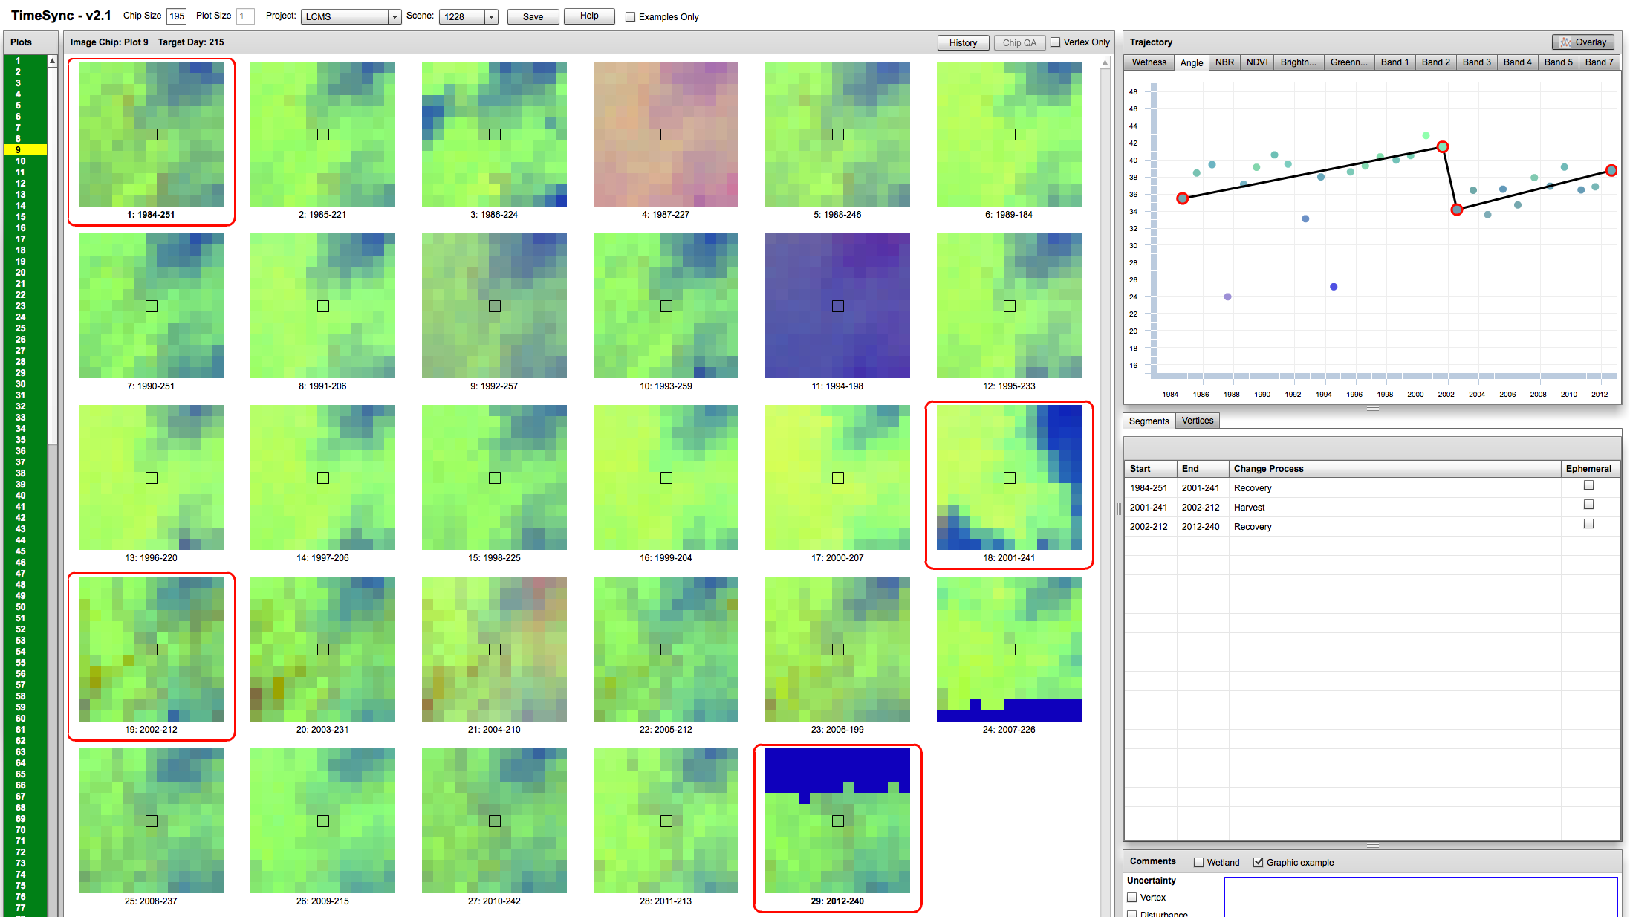
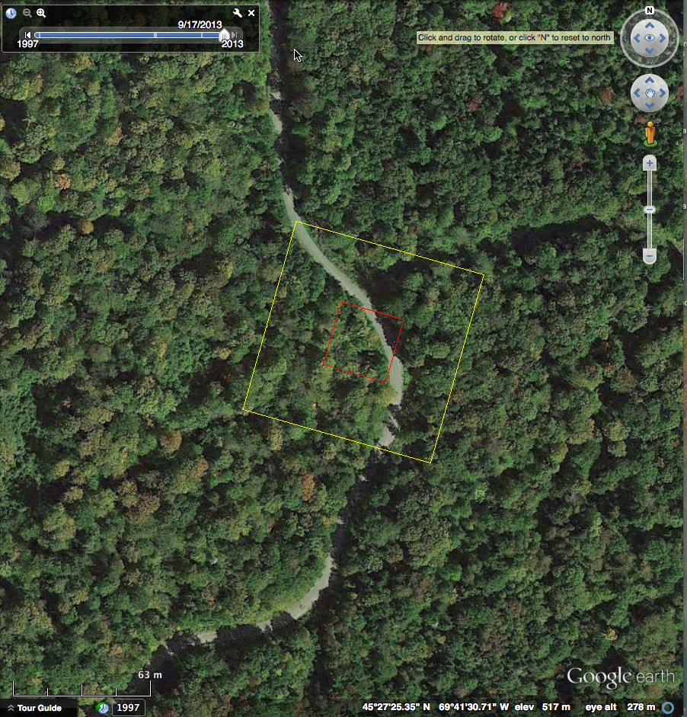
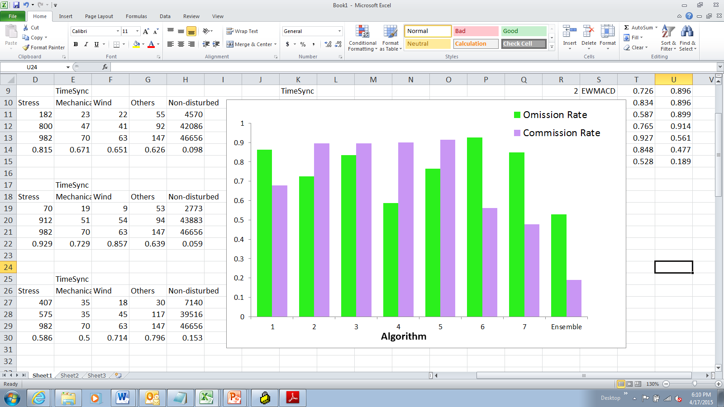
Next-generation forest change mapping across the United States: the Landscape Change Monitoring System (LCMS)
Sean P Healey¹, Warren B. Cohen¹, Zhiqiang Yang², Evan Brooks³, Noel Gorelick⁴, Mathew Gregory², Alexander Hernandez⁵, Chengquan Huang⁶, Joseph Hughes², Robert E Kennedy², Tom Loveland⁷, Kevin Megown¹, Gretchen Moisen¹,Todd A. Schroeder¹, Brian Schwind¹,
Stephen Stehman⁸, James E. Vogelmann⁷, Curtis Woodcock⁹, Limin Yang⁷, Zhe Zhu⁷
1 - USDA Forest Service, 2 - Oregon State University, 3 - Google Corporation, 4 - Virginia Polytechnical Institute, 5 - Utah State University, 6 - University of Maryland, 7- US Geological Survey 8 - SUNY College of Environ Science & Forestry, 9 - Boston University
Summary - Forest change information is critical in forest planning, ecosystem modeling, and in updating forest condition maps. The Landsat satellite platform has provided consistent observations of the world’s ecosystems since 1972. A number of innovative change detection algorithms have been developed to use the Landsat archive to identify and characterize forest change. The inter-agency Landscape Change Monitoring System (LCMS) has been launched to engage these cutting edge methodologies in a national-scale, sustained change monitoring operation. A Science Team supporting LCMS has evaluated the relative strengths of several leading algorithms in identifying different types of forest change across a variety of ecosystems. Additionally, a machine-learning approach has been developed that uses an ensemble of algorithm outputs to predict a surface which best matches independently collected reference data. This ensemble technique integrates the strengths of each individual algorithm in different situations, and has been shown to reduce overall error in LCMS trials. The LCMS Science Team has also, in collaboration with Google, overcome significant data processing hurdles associated with analyzing tens of thousands of large images. Following Science Team recommendations, LCMS is quickly moving toward production and maintenance of validated, nationally consistent maps of the causes and timing of historical forest change.
LCMS anticipates Parallel Learning Ensembles (PLEs) through cloud computing
The inter-agency Landscape Change Monitoring System (LCMS) has been researching leading algorithms
Native code from several different change detection algorithms has been ported to Java, enabling their operation upon the Landsat archive stored by Google Earth Engine. LCMS is exploring the idea of running the algorithms in parallel and integrating outputs by using them as inputs to an empirical tree-based model.
Conclusions
Algorithms frequently disagree, but each has its own strengths
Subtle forest change is very common, but is a real challenge to map
Using strengths of each type of map
Algorithms are used in situations, sometimes in combination, where the model finds them most “informative”
Ensemble maps are more accurate than individual learners
Results from the 6 study scenes using only change detection outputs as independent variables in a Random Forests model
0
Algorithm 1
Not disturbed
1
0
1
Disturbed
Algorithm 2
Algorithm 3
0
1
0
1
ΔDN (Band 5) > 10%
Slope > 10%
no
yes
no
yes
0
0
1
1
0
1

Slide 17

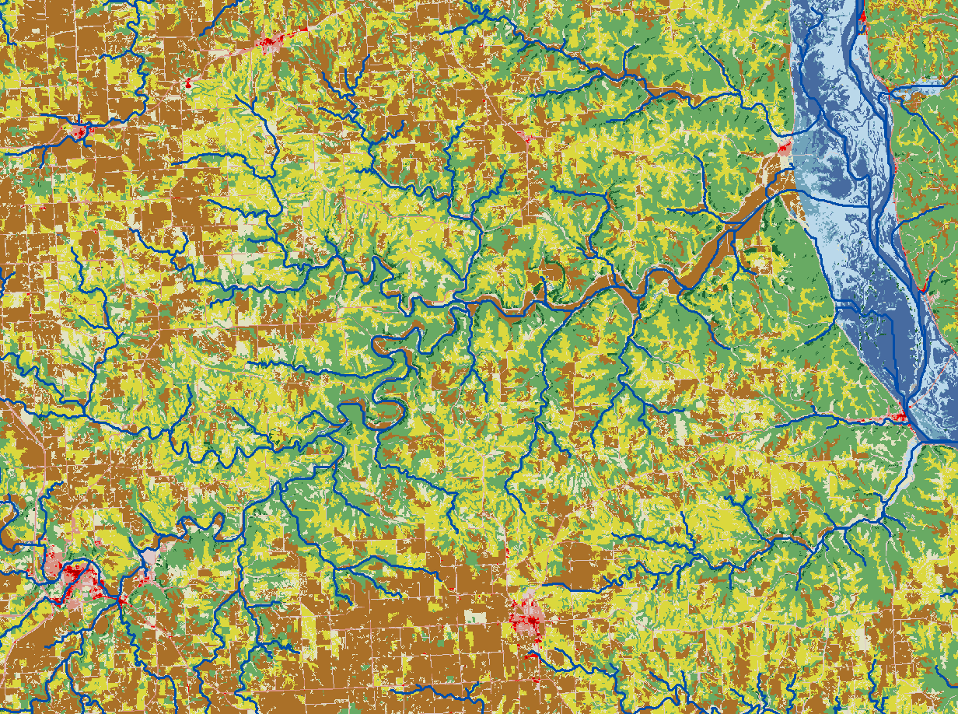

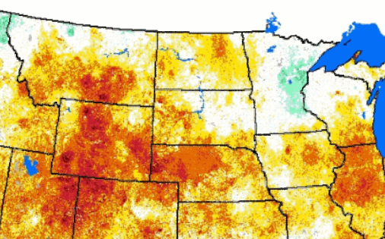
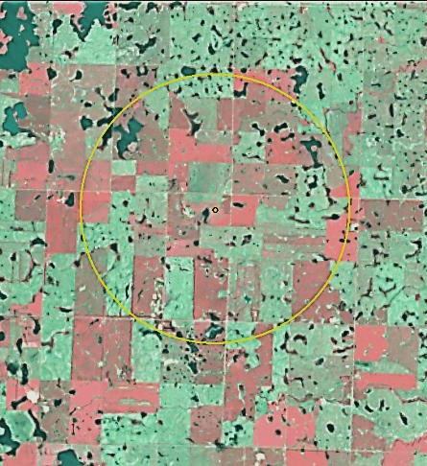
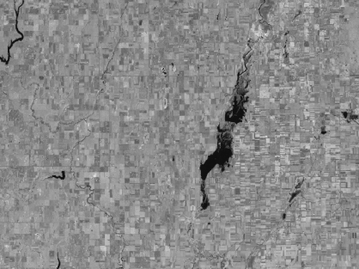
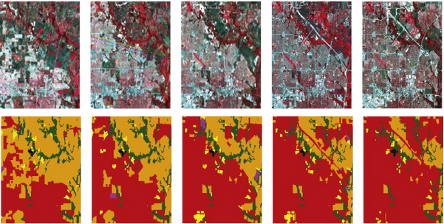
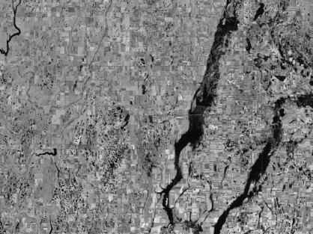
Land Change Monitoring, Assessment, and Projection
A capability to continuously track and characterize changes in land cover, use, and condition and translate such information into assessments of current and historical processes of change as a science foundation to support evaluations and decisions relevant to environmental management and policy.
Energy development
Carbon consequnces
Pollinator
landscapes
Drought monitoring
Land-cover change
Wet / dry cycles

Slide 18
Broad Land Cover, Use, and Condition Change Questions
Where, when, how, and why is land cover, use, and condition changing?
  How has change varied over time, and what are the current (near real time) changes?
What specific drivers or events are causing change?
  Particular interest is in isolating land changes associated with weather events and climate variability.
Can we detect both historical change at frequent intervals and change as it is occurring - in all regions and sectors, and with relatively similar accuracy and consistency?

Slide 19
One trend is increasing use of the entire Landsat archive – often in the form of a time series
New kinds of information from Landsat
  Detection of more subtle disturbance
  More reliable disturbance detection
  Trends in ecosystem health and growth
  Forest phenology – both average and interannual
  Peak greenness – as indications of trends in ecosystem health and climate response
  Improved ability to map forest composition

Slide 20
Continuous Change Detection and Classification
(Zhu and Woodcock, RSE 2014)
Use all available Landsat Data, removing clouds, cloud shadows, and snowy observations
Treat each pixel as a time series
Fit empirical models (usually based on sinusoids) and compare new observations with those predicted by the existing time series model to find change
Treat image data as noisy and require seeing change multiple consecutive times before mapping
Result is maps for any time period that can be compared between time periods to find change

Slide 21
NASA IDS Project – Urban-rural gradients and carbon
Notes:
This is the first time big area, include five state, six landsat images. In the long time, we can monitong earth globally

Slide 22
Boston Scene Annual Land Cover Change Histogram

Slide 23
Mapped land categories, IDS map of NE
Stable categories
Unclassified* (0.30%)
High/Medium Imp. (4.1%)
Low Impervious (8.9%)
Herb/Ag (8.4%)
Forest (61%)
Wetlands (5.4%)
Water (5.9%)
Change categories
Forest → High/Medium Imp. (0.51%)
Forest → Low Imp. (0.53%)
Forest → Other (0.96%)
Forest → Forest (3%)
Herb/Ag → Forest (0.15%)
Other → Forest (0.49%)
*The area of this stratum should be allocated to the other strata and thus have an accuracy and estimated area of zero

Slide 24
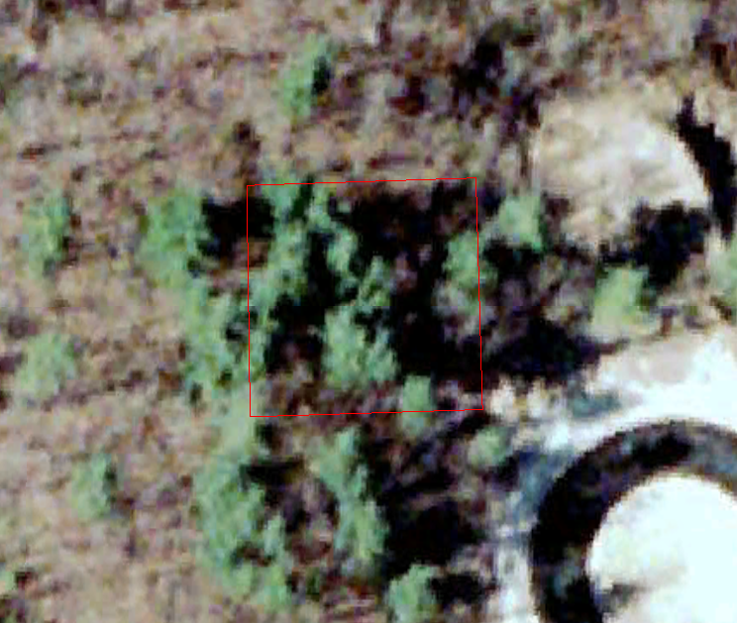
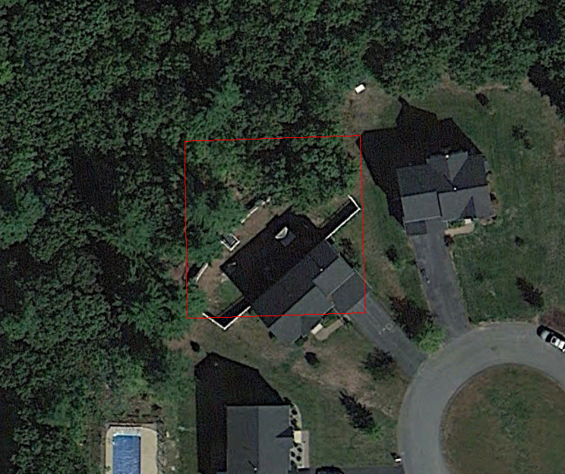
Mixed forest partly cleared for residential development in June 2001.
March, 1995
March 2001
September 2010

Slide 25
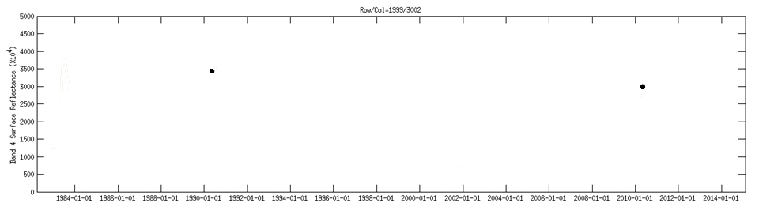
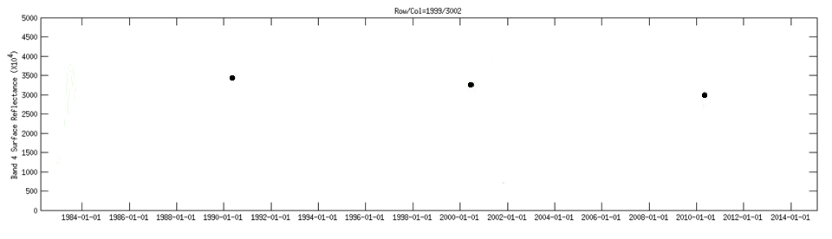
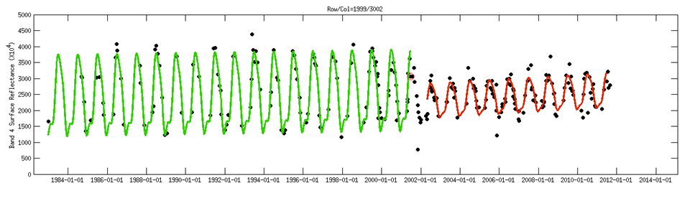
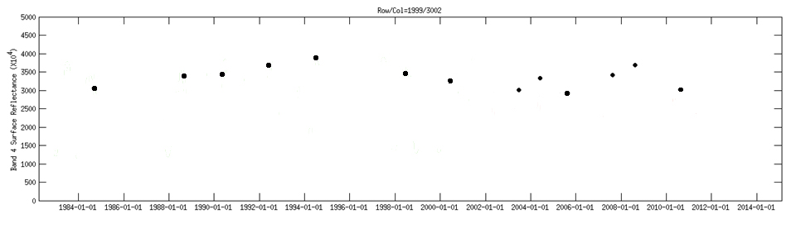
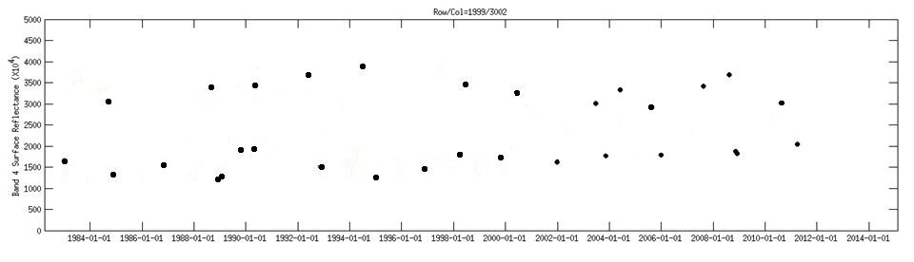
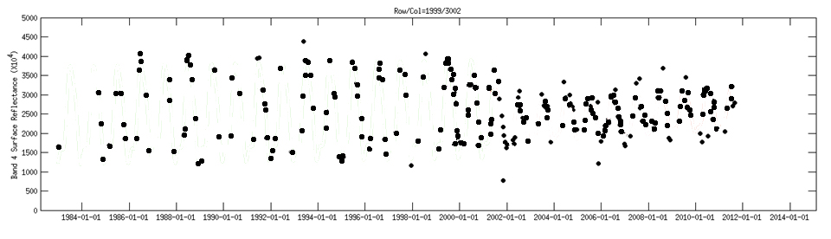
Prediction model applied with predictions classified by land cover
Mixed Forest
Low Density Residential

Slide 26
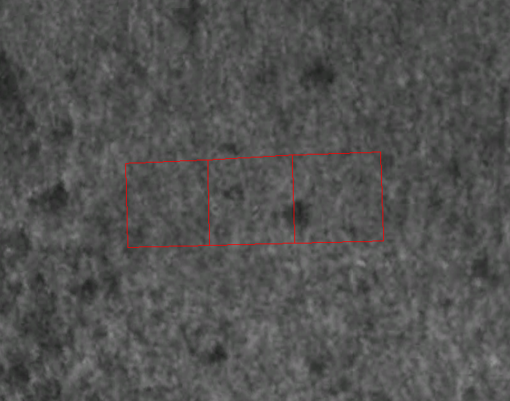


Residential development, Mass. Time-series displayed for pixel represented by yellow square. CCDC classified pixel as Dec. Forest until April 2001 and then as Low Dens. Residential.
March, 1995
June, 2010

Slide 27

Residential development, Mass. Time-series displayed for pixel represented by yellow square. CCDC classified pixel as Dec. Forest until May 2001 and then as Low Dens. Residential.
March, 1995
June, 2010

Slide 28

Residential development, Mass. Time-series displayed for pixel represented by the yellow square. CCDC classified pixel as stable Dec. Forest.
March, 1995
June, 2010

Slide 29



Abandoned farmland near New Bedford, MA. Time-series displayed for the pixel represented by the red square. CCDC classified pixel as Pasture/Row Crops until Jun 1998 and then as Dec. Forest.
March, 1995
April, 2012

Slide 30



Harvest Regeneration
September 07, 1999
October 27, 2011

Slide 31


Slide 32



Pest Infestation
June 2, 1984
June 21, 2013

Slide 33

Examples from boreal Canada of fire (top), harvest and fire (middle) and thinning (bottom)

Slide 34

Peak Growing Season NDVI: The importance of calibration/sensor differences (From D. Sulla-Menashe)

Slide 35

NDVI and NBR trends in Boreal Canada are primarily a function of disturbance history/timing
(Slide from D. Sulla-Menashe)

Slide 36

Maps showing relationships between disturbance history and trends in NBR (slide from D. Sulla-Menashe)

Slide 37

Geographic Variability in trends in NDVI and NBR is climate related (Slide from D. Sulla-Menashe)

Slide 38

Average annual phenology and inter-annual phenology for a deciduous forest from Landsat (slide from E. Meelas)

Slide 39

Landscape patterns of inter-annual phenology – at the patch scale from Landsat (slide from E. Meelas)

Slide 40
Sentinel 2a+b (and Sentinel 1)
New set of optical “Landsat-like” satellites with high frequency revisit from ESA and Copernicus Project
First one to launch in a couple of months
Outstanding opportunity for synergistic use with Landsat
USGS to “harvest” the data and archive it and make it available
NASA to build higher-order products by combining with Landsat

Slide 41
NISAR For Ecosystem Disturbance Monitoring
Josef Kellndorfer, WHRC

Slide 42





NISAR – Cloud Free 12 Day-Repeat Time Series
12 Day global repeat time series data stacks will be generated from optimal radiometric terrain correction and multi-temporal filtering
Unfiltered L-HH-LHV/Ratio
Filtered L-HH-LHV/Ratio
Blended Multi-temporal
SAR over Google Earth

Slide 43


NISAR Concept for Ecosystem Disturbance Monitoring
Use the calibrated, precisely overlapping L (and S) -band SAR time series stacks to capture backscatter change associated with natural and anthropogenic disturbance.
Time Steps
L-Band HH Backscatter
0 2006-12-04
1 2007-01-19
2 2007-03-06
3 2007-07-22
4 2007-10-22
5 2008-01-22
6 2008-03-08
7 2008-04-23
8 2008-06-08
9 2008-07-24
10 2008-09-08
11 2008-10-24
12 2009-01-24
13 2009-03-11
14 2009-07-27
15 2009-09-11
16 2009-10-27
17 2010-03-14
18 2010-04-29
19 2010-06-14
20 2010-07-30
21 2010-09-14
22 2010-12-15
23 2011-01-30
24 2011-03-17
Cerrado Area, Brazil
ALOS PALSAR DATA from
2006 to 2011
Periodic patterns from
seasonal flooding
Abrupt drop in
Backscatter
Gradual drop in
Backscatter

Slide 44

NISAR Concept for Ecosystem Disturbance Monitoring
Use calibrated, precisely overlapping L/S-band SAR 12-day repeat capture backscatter change associated with natural and anthropogenic disturbance.
Time Steps
L-Band HH Backscatter
0 2006-12-04
1 2007-01-19
2 2007-03-06
3 2007-07-22
4 2007-10-22
5 2008-01-22
6 2008-03-08
7 2008-04-23
8 2008-06-08
9 2008-07-24
10 2008-09-08
11 2008-10-24
12 2009-01-24
13 2009-03-11
14 2009-07-27
15 2009-09-11
16 2009-10-27
17 2010-03-14
18 2010-04-29
19 2010-06-14
20 2010-07-30
21 2010-09-14
22 2010-12-15
23 2011-01-30
24 2011-03-17
Cerrado Area, Brazil
ALOS PALSAR DATA from
2006 to 2011
Periodic patterns from
seasonal flooding
Abrupt drop in
Backscatter
Gradual drop in
Backscatter

Slide 45

Algorithms for Change Detection and Cal/Val Needs
Algorithms for annual disturbance mapping are based in the time series signal processing domain like CPD (Change point detection) or ARMA (Auto-regressive Moving Average Analysis)
Calibration of algorithms requires time-series analysis over a set of different ecosystems with varying moisture and freeze/thaw regimes and various biomass gradients. Algorithms will be tuned to these conditions with respect to sensitivity of backscatter change to disturbance event.
Calibration will require to target predictable disturbance (logging concessions, known areas of insect infestation) and targets of opportunity (fires, wind throw, flooding)
Validation:Validation of the mission goals will be performed through stratified sampling in the ecosystem types and training/testing population splits
Opportunity for collaboration:
  Known sites with field data of past disturbance events monitored with ALOS/ALOS-2
  Establish collaboration on sites with controlled disturbance events, e.g., burn experiments, experimental forests for timber management
  Strong collaboration with fire community envisioned

Slide 46








NISAR Concept for Ecosystem Disturbance Monitoring
> Use calibrated, precisely overlapping L/S-band SAR 12-day repeat data stacks with
change point analysis algorithms to monitor natural and anthropogenic disturbance.
L-Band HH Backscatter
L-Band HV Backscatter
Thinning
Regrowth
Degradation
Thinning
Regrowth
Degradation
HH Obs.
Dates:
HV Obs.
Dates:
Thinning
Regrowth
Degradation
Obs.
1,7,9
Obs.
5,10,17
Obs.
5,10,17

Slide 47


NISAR Concept for Ecosystem Disturbance Monitoring
> Use calibrated, precisely overlapping L/S-band SAR 12-day repeat data stacks with
change point analysis algorithms to monitor natural and anthropogenic disturbance.
L-Band HH Backscatter
L-Band HV Backscatter
Thinning
Regrowth
Degradation
Thinning
Regrowth
Degradation
HH Obs.
Dates:
HV Obs.
Dates:
Thinning
Regrowth
Degradation
Obs.
1,7,9
Obs.
5,10,17
Obs.
5,10,17

Slide 48
NISAR Concept for Ecosystem Disturbance Monitoring
> Use calibrated, precisely overlapping L/S-band SAR 12-day repeat data stacks with
change point analysis algorithms to monitor natural and anthropogenic disturbance.
L-Band HV Backscatter
0 2007-07-22
1 2007-10-22
2 2008-06-08
3 2008-07-24
4 2008-09-08
5 2008-10-24
6 2009-07-27
7 2009-09-11
8 2009-10-27
9 2010-06-14
10 2010-07-30
11 2010-09-14
12 2010-12-15
Cerrado Area, Brazil
ALOS PALSAR DATA from
2006 to 2011
Periodic patterns from
seasonal flooding
Abrupt drop in
Backscatter
Gradual drop in
Backscatter

Slide 49

NISAR Concept for Ecosystem Disturbance Monitoring
> Use calibrated, precisely overlapping L/S-band SAR 12-day repeat data stacks with
change point analysis algorithms to monitor natural and anthropogenic disturbance.
0 2007-07-22
1 2007-10-22
2 2008-06-08
3 2008-07-24
4 2008-09-08
5 2008-10-24
6 2009-07-27
7 2009-09-11
8 2009-10-27
9 2010-06-14
10 2010-07-30
11 2010-09-14
12 2010-12-15
L-Band HV Backscatter
Cerrado Area, Brazil
ALOS PALSAR DATA from
2006 to 2011
Small variations in
Backscatter over time
Abrupt drop in
Backscatter
Gradual drop in
Backscatter

Slide 50
Concluding Thoughts
Exciting times, indeed – and that’s going to continue
Ironic how rapid advances are being made using our longest running satellite system
Future holds plenty of challenges associated with integrating data from multiple sensors
New observations shouldn’t come at the expense of continuity in successful programs

Slide 51
Acknowledgements
Sam Goward and NAFD group
Matt Hansen
Mark Frield’s group (including Eli Meelas and Damien Sulla-Menashe)
My group (Zhe Zhu, Pontus Olofsson, Chris Holden, Val Pasquarella, Shixiong Wang, Xioajing Tang, Eric Bullock)
Josef Kellndorfer
Tom Loveland

