Slide 1
FIVE THINGS THAT MATTER IN PREDICTING DISTURBANCES & ECOSYSTEM RESPONSES
Richard Waring
NASA’s Carbon Cycling and Ecosystems Joint Science Workshop
April 20-22th, 2015

Slide 2
1st
CLIMATIC
VARIATION

Slide 3
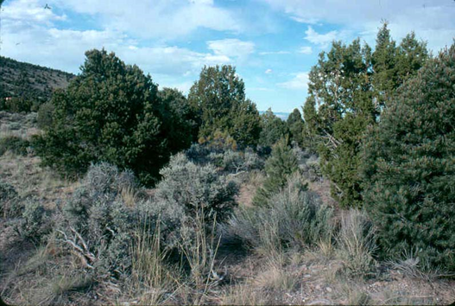
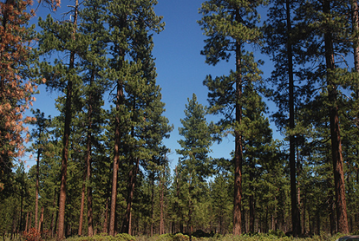
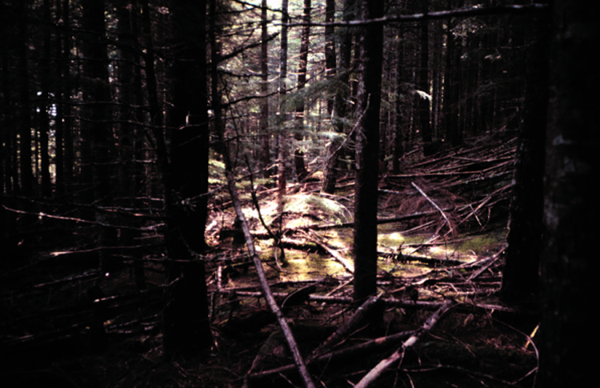
The most general response to climate change is a change in maximum leaf area index
1 m2/m2
2 m2/m2
10 m2/m2
Waring, Coops, Mathys, Hilker, Latta(2014) Process-based modeling to assess the effects of recent climatic variation on site productivity and forest function across western North America. Forests 5:518-534.
Notes:
photos from places along part of the Oregon Ecosystem Transect, a NASA funded project

Slide 4
2nd MANAGEMENT PRACTICES

Slide 5
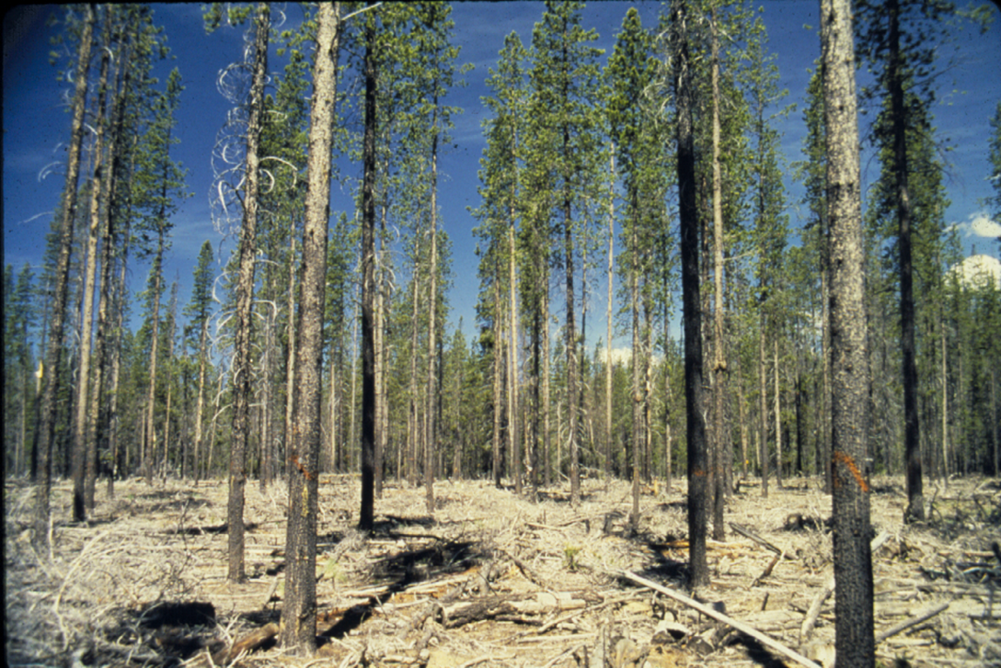
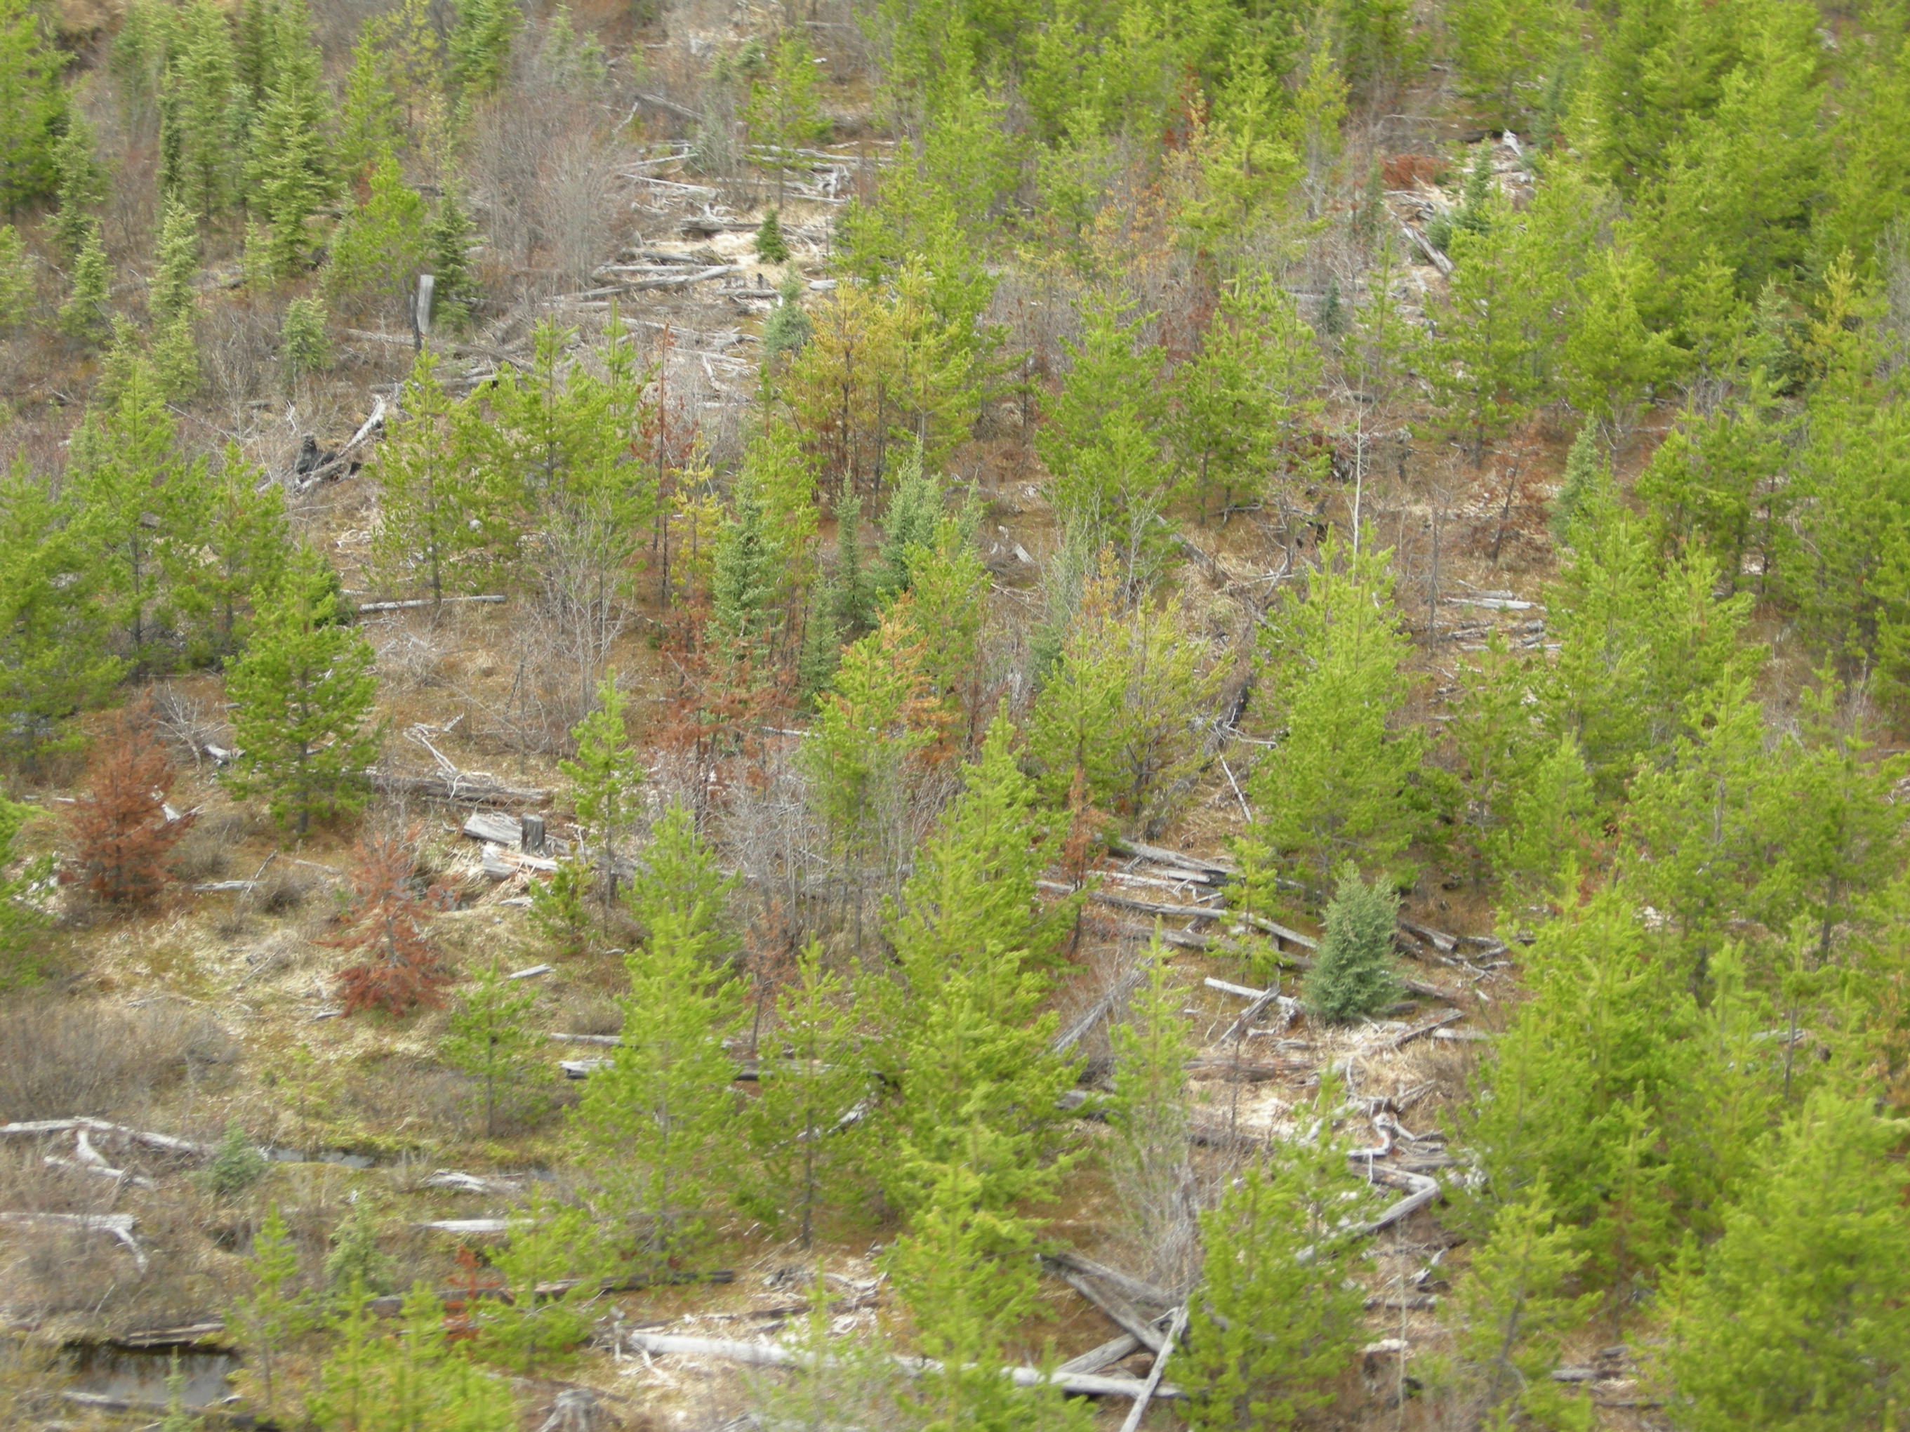
Option to thin forests to increase residual tree growth rates and resistance to bark beetles while reducing canopy leaf area
120 year-old lodgepole pine in Oregon’s
Deschutes National Forests, photo by R.H. Waring
Thinning by nature via rust on lodgepole pine
(note presence of other tree species)
Photo by Alex Woods
Notes:
Photo by Waring

Slide 6
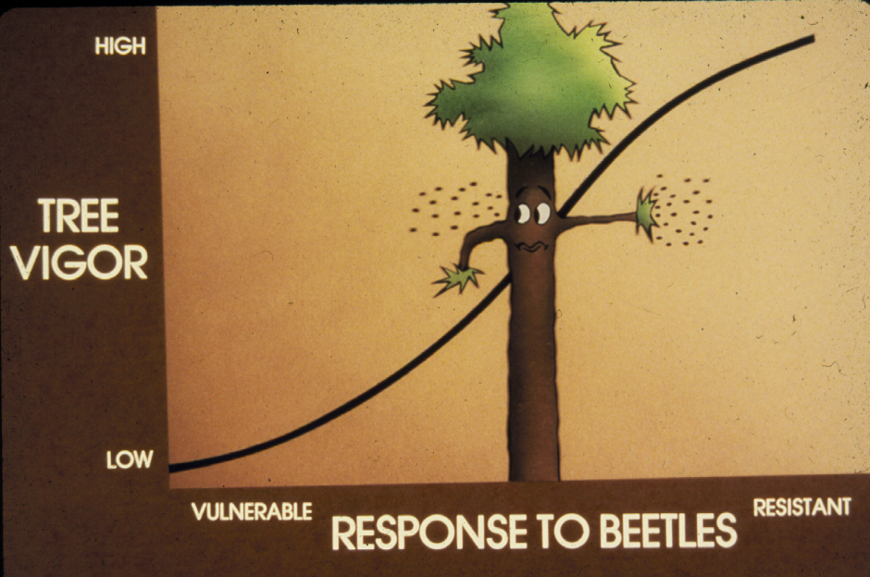
Exposed tree crowns produce more defenses per unit of leaf area against insects than shaded crowns
Christiansen, E., R.H. Waring, and A.A. Berryman (1987) Resistance of conifers to bark beetle attack: Searching for general relationships. Forest Ecol. & Mgmt. 22:89-106

Slide 7
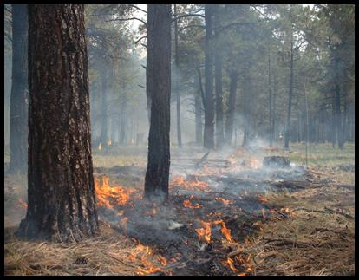
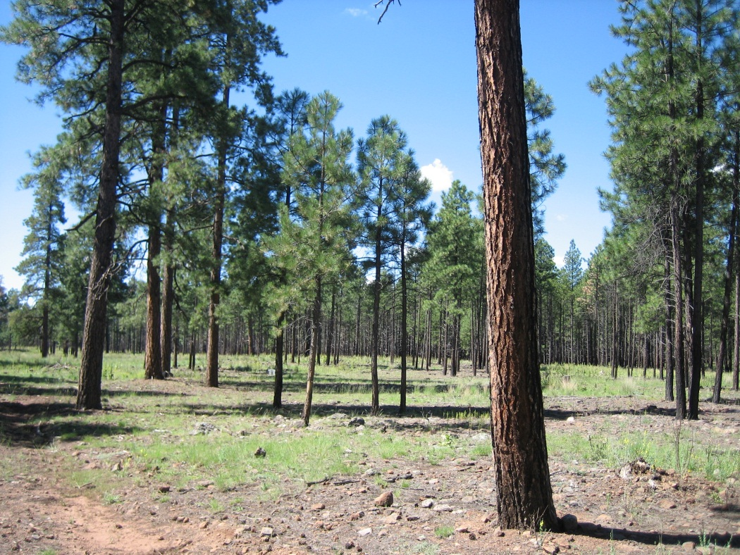
Option to make disturbances more frequent but less destructive
Photos courtesy of John Bailey, OSU College of Forestry

Slide 8
3rd
BIOLOGICAL DIVERSITY

Slide 9
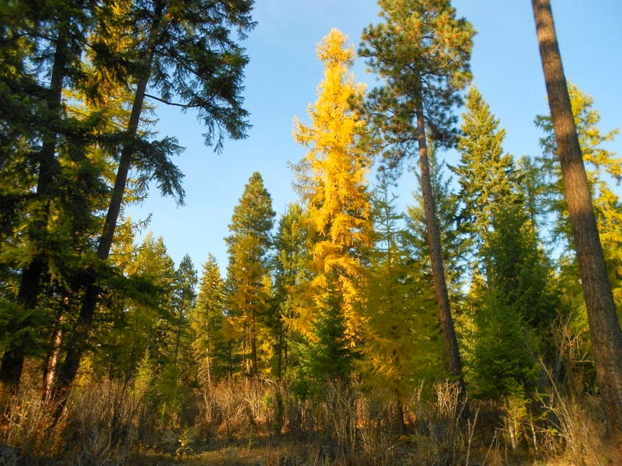
Biological diversity buffers forests against climate change, insects and pathogens

Slide 10
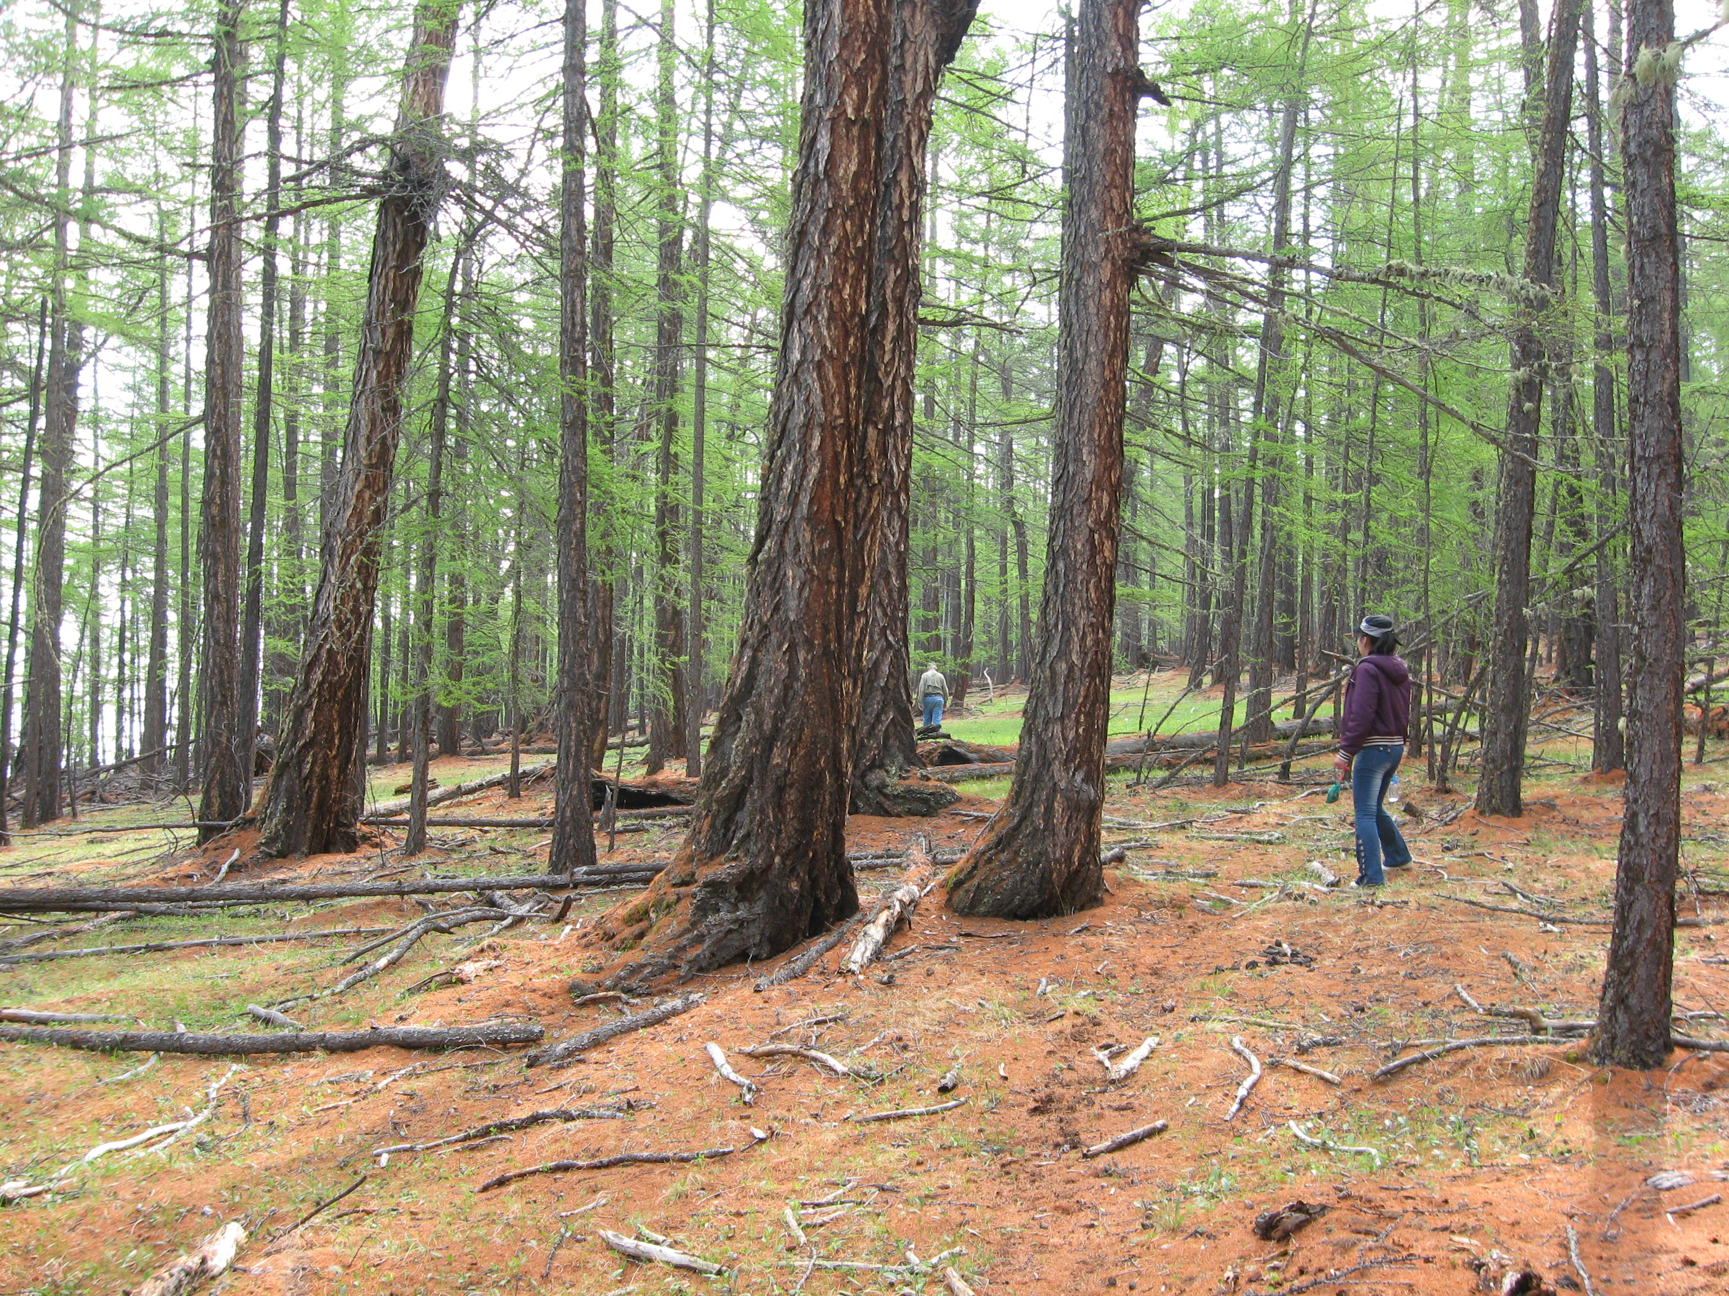
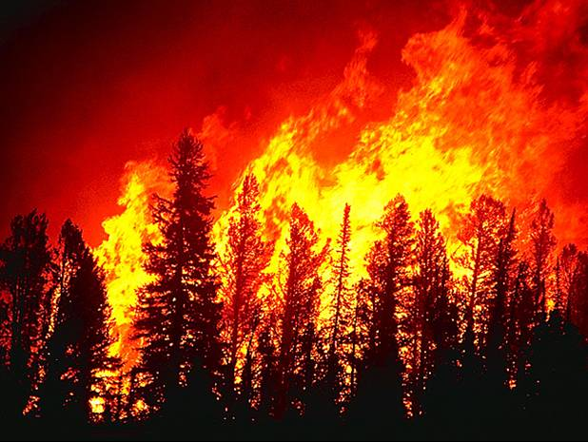
North America
SIMILAR WILDFIRE DANGER
Eurasia
Mostly ground fires
Little tree mortality
Mostly crown fires
High tree mortality
Rogers et al. (2015)Influence of tree species on continental differences in boreal fires and climate feedback. Nature Geoscience DOI:10.1038/NGE02352

Slide 11
4rd
SOILS

Slide 12
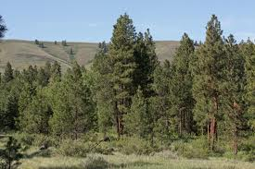
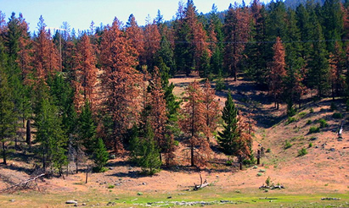
SOIL TEXTURE MAY DETERMINE WHERE INSECT OUTBREAKS OCCUR
Peterman and Waring (2015) Overshoot in leaf development of ponderosa pine in wet years leads to bark beetle outbreaks on fine-textured soils in drier years. Forest Ecosystems (in press)
Photos courtesy of Dr. Wendy Peterman, Conservation Biology Institute, OR

Slide 13
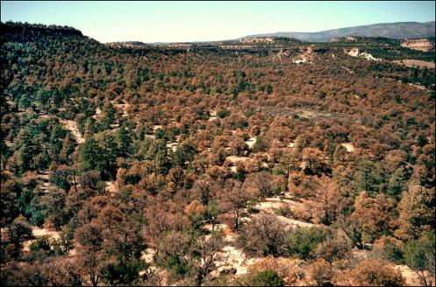
Deeper soils store more water and limit mortality of pinyon pine
Peterman, W., R.H. Waring, T. Seager, and W.L. Pollock (2013) Soil properties affect pinyon pine-juniper response to drought. Ecohydrology 6:455-463

Slide 14
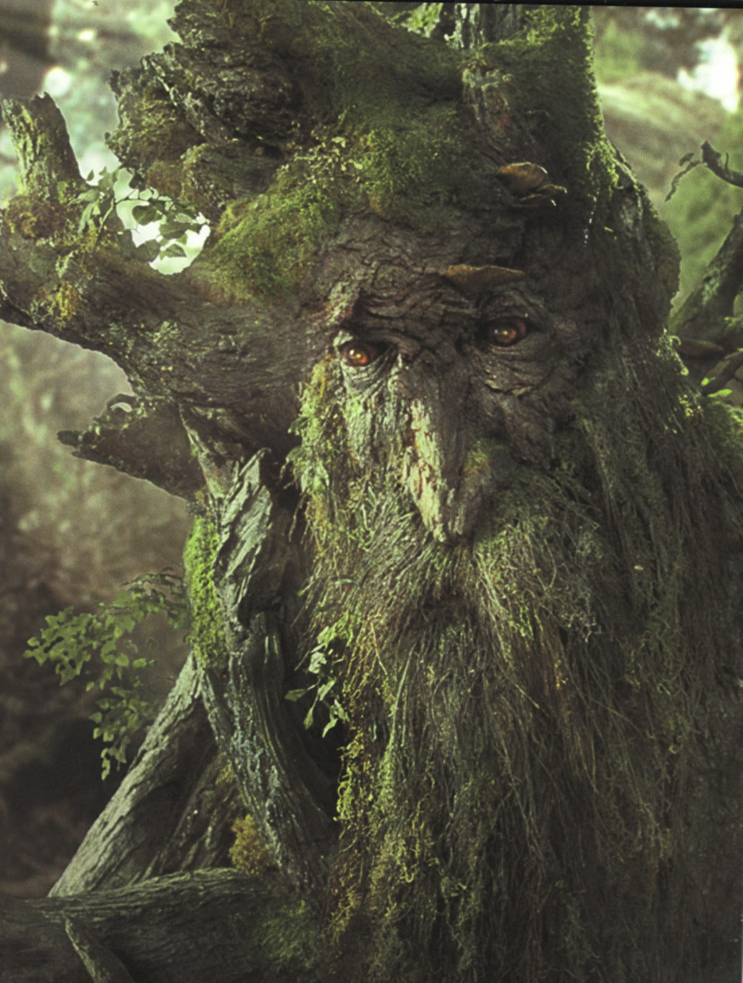
5th
TREE AGE MATTERS
Slide provided by Wendy Peterman

Slide 15
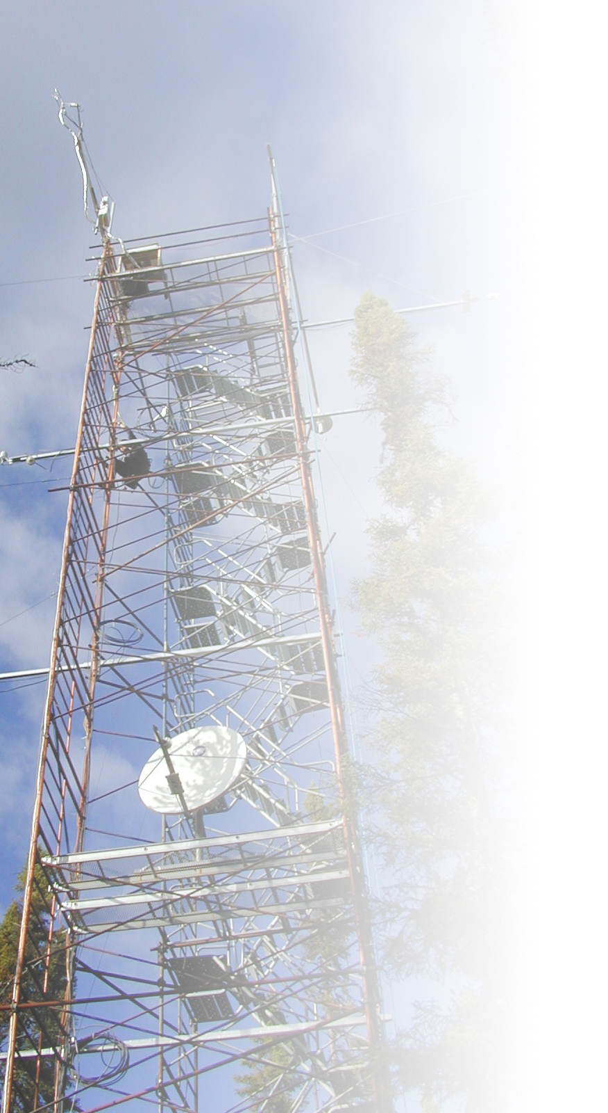
Tree Age affects Annual Carbon Budgets
Sink
Interannual
Variability
Source
Margolis. 2010. The Canadian Carbon Program and Fluxnet-Canada: Advancing our understanding of the carbon cycle of Canada’s forests and Peatlands using a research network approach. 44th Annual Canadian Meteorological and Oceanographic Society.

Slide 16
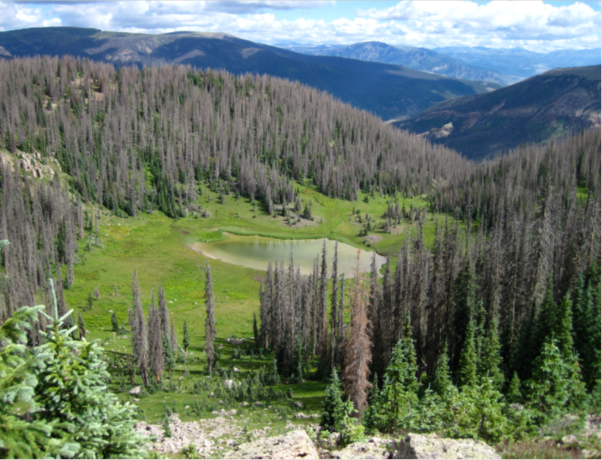
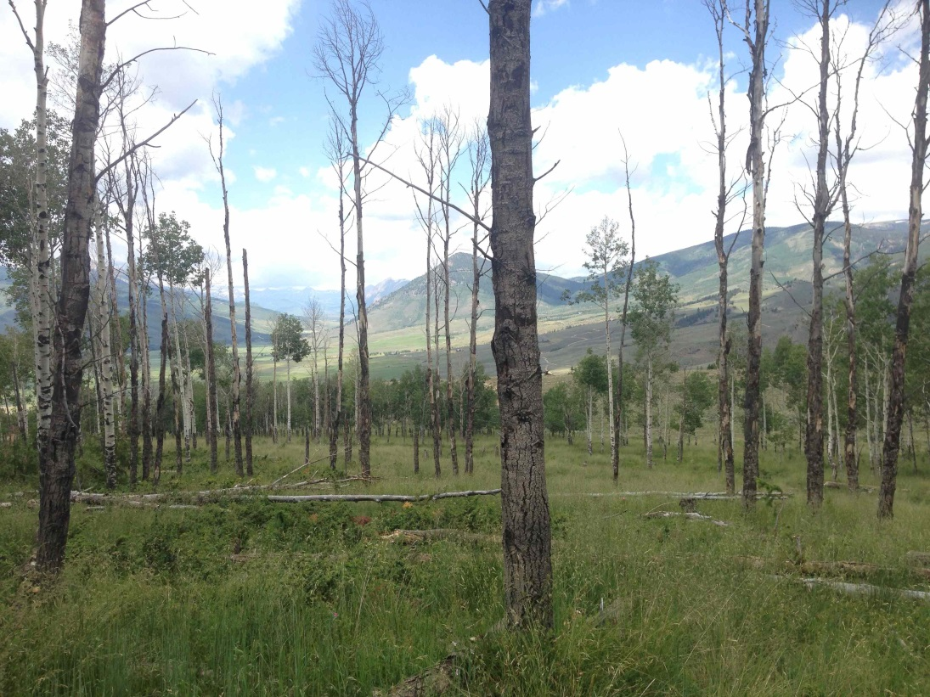
Climate change may result in killing dominant old trees with fragile plumbing
Photo by Steve Wondzell
Research Scientist, USFS
Corvallis, OR
Photo by Burke Greer
Ph.D. candidate, Oreg. State Univ
Soil water deficits combined with high evaporative demand can break water columns in tall trees more easily than in shorter ones
Anderegg et al. (2012) Trends in Plant Science 17: 693-700

Slide 17
Tree age also affects the hydrologic balance
Old forests use < 50% of the H₂0 transpired by young forests, even with similar LAI
Macfarlane et al. (2010) Transpiration and hydraulic traits of old and regrowth eucalypt forests in southwestern Australia. For. Ecology & Mgmt. 260:96-105
Roberts et al. 2001. Transpiration from Eucalyptus sieberi forests of different ages. For. Ecol. & Mgmt. 143:163-161.

Slide 18
THINGS THAT MATTER IN PREDICTING DISTURBANCES & ECOSYSTEM RESPONSES
CLIMATE
FOREST MANAGEMENT
BIOLOGICAL DIVERSITY
SOILS
TREE AGE

Slide 19
PROGRESS TO DATE
Global satellite monitoring of climate-induced vegetation disturbances
Nate G. McDowell, Nicholas C. Coops, Pieter S.A. Beck, Jeffrey Q. Chambers, Chandana Gangodagamage, Jeffrey A. Hicke, Cho-ying Huang, Robert Kennedy, Dan J. Krofcheck, Marcy Litvak, Arjan J.H. Meddens, Jordan Muss, Robinson Negro´ n-Juarez, Changhui Peng, Amanda M. Schwantes, Jennifer J. Swenson, Louis J. Vernon1, A. Park Williams, Chonggang Xu, Maosheng Zhao, Steve W. Running, and Craig D. Allen
REVIEW IN: Trends in Plant Science (2015) 20:114-123

Slide 20
Discriminating types of disturbance
Schroeder et al. (2014) Improving estimates of forest disturbance by combining observations of Landsat time series with U.S. Forest Service Forest Inventory and Analysis data. Remote Sensing of Environment 154:61–73.

Slide 21
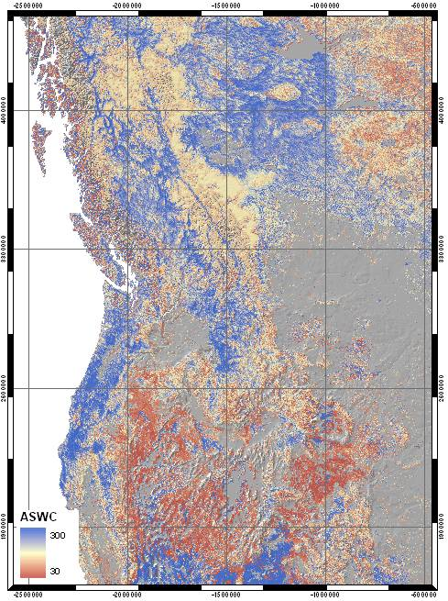
Measure LAI, invert process-based forest growth model to map soil water storage
Coops et al. (2012) Remote Sensing of Environment 126:160-173. http://databasin.org/maps/5ba4c2f2e158403da090f22b024d37e5/active

Slide 22
MAPPING FOREST AGE CLASSES
Pan et al. (2011) Age structure and disturbance legacy of North American forests. Biogeosciences 8:715-732

Slide 23
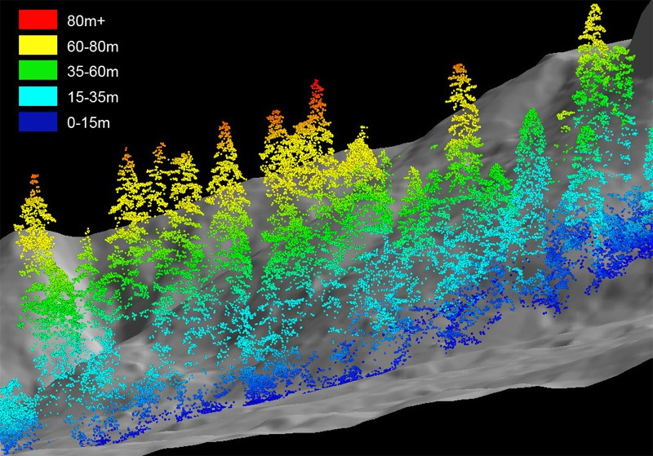
Lidar analysis of multi-layered old-growth Douglas-fir/hemlock on the H.J. Andrews Expt. Forest
Generated with USFS Fusion program by Keith Olsen, Oregon State University. Slide provided by Dr. Tom Spies, USFS, Corvallis, OR

Slide 24
WHY YOUR ABCsMatter
Age matters
Biology matters
Climate matters
soils matters
Management matters

