Slide 1
Land use and land cover change, socioeconomic shocks, and effects on biodiversity
Volker C. Radeloff, et al.

Slide 2
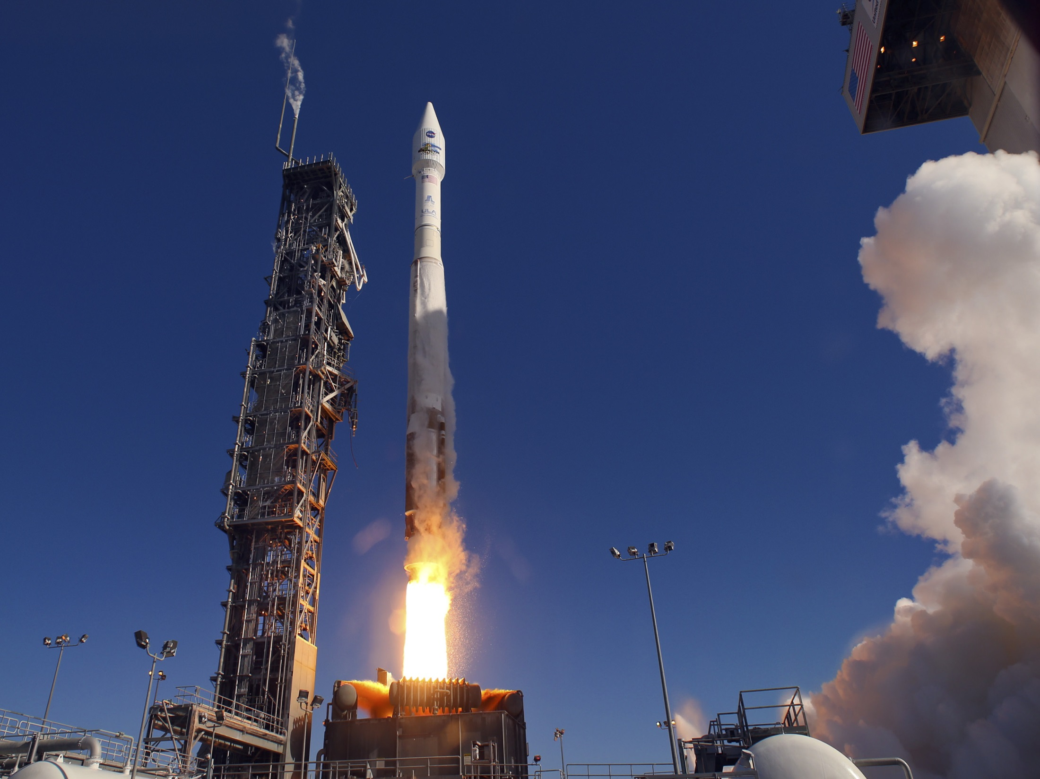

Slide 3
Resolution
Area

Slide 4
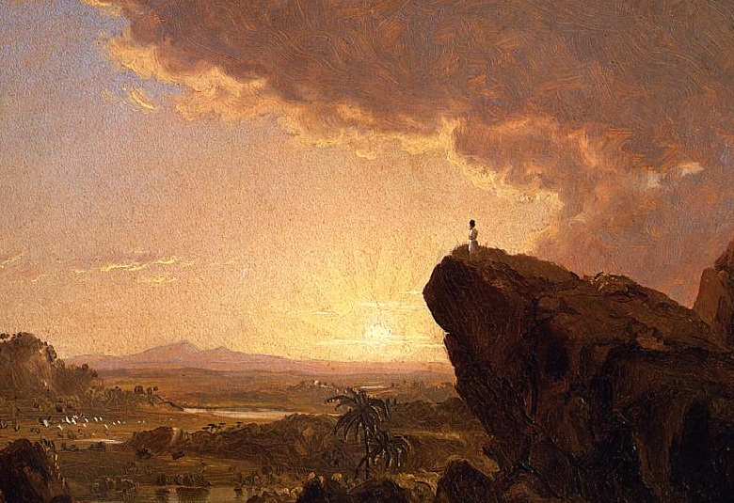
Resolution
Area

Slide 5
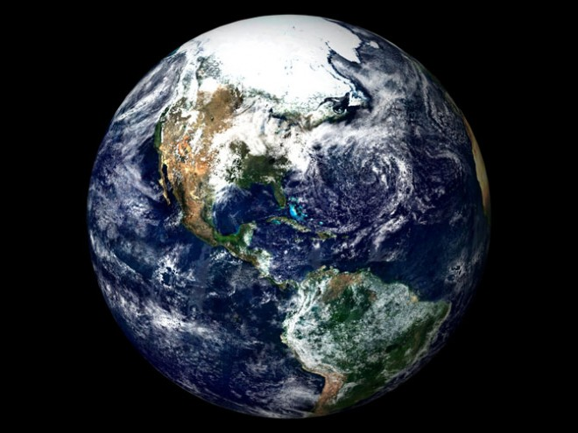
Remote
Sensing
Bio-
diversity
LCLUC

Slide 6
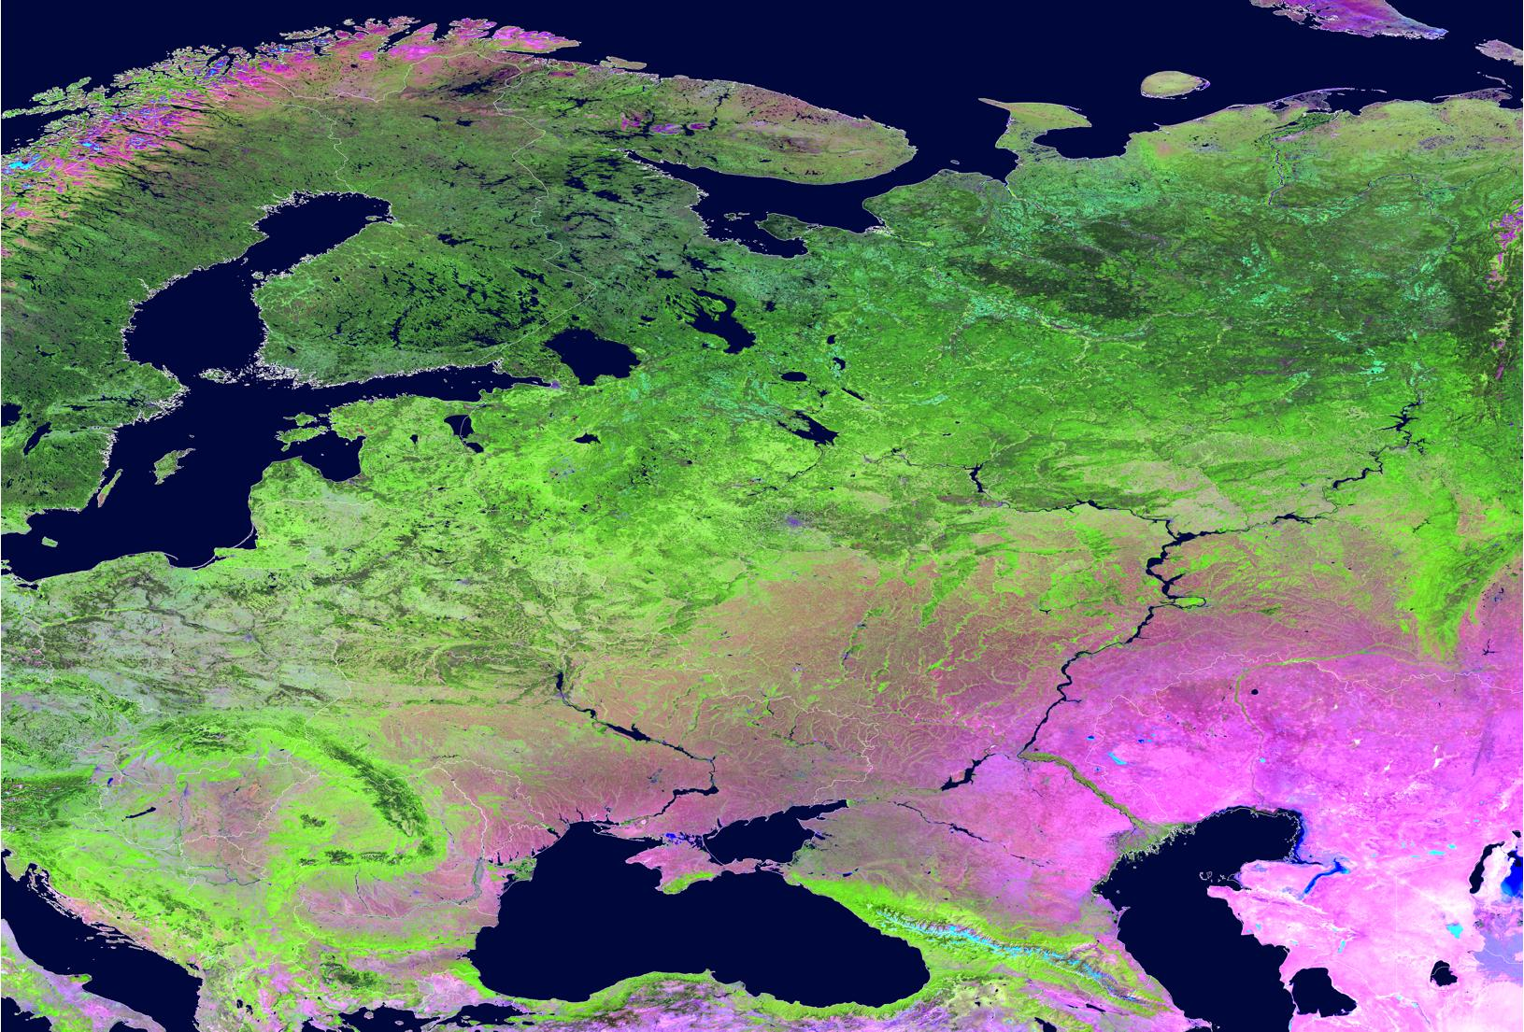

Slide 7
P. Potapov, J. Alix-Garcia, K. de Beurs, S. Gehlbach, M. Hansen, G. Henebry, J. McCarty, A. Pidgeon, M. Ozdogan, C. Woodcock, … C. Alcantara, M. Baumann, E. Bragina, V. Butsic, M. Dubinin, A. Krylov, T. Kuemmerle, C. Munteanu, P. Olofsson, A. Prishchepov, S. Turubanova, A. Tyukavina, D. Uvsh, S. Walker, K. Wendland, … D. Aksenov, I. Barton, L. Baskin, B. Bleyhl, O. Chaskovskyy, P. Griffith, L. Halada, P. Hostert, G. Kiraly, D. Kaim, J. Knorn, E. Konkoly-Gyuro, J. Kozak, I. Kruhlov, J. Lievskovsky, A. Lushchekina, M. Main, D. Mueller, M. Nita, K. Ostafin, K. Ostapowiscz, K. Perzanowski, A. Rabe, F. Schierhorn, O. Shandra, A. Sieber, T. Sipko, E. Ziolkowska …

Slide 8
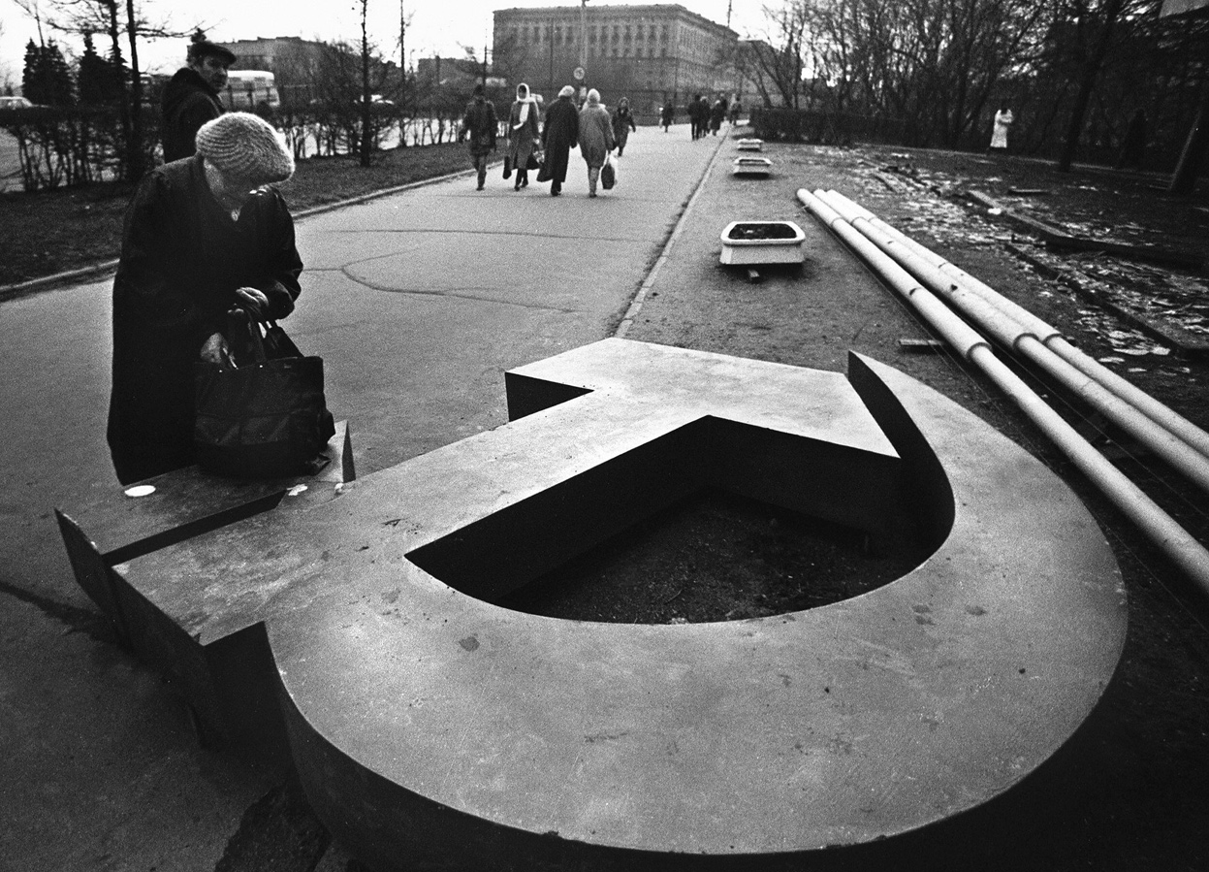

Slide 9
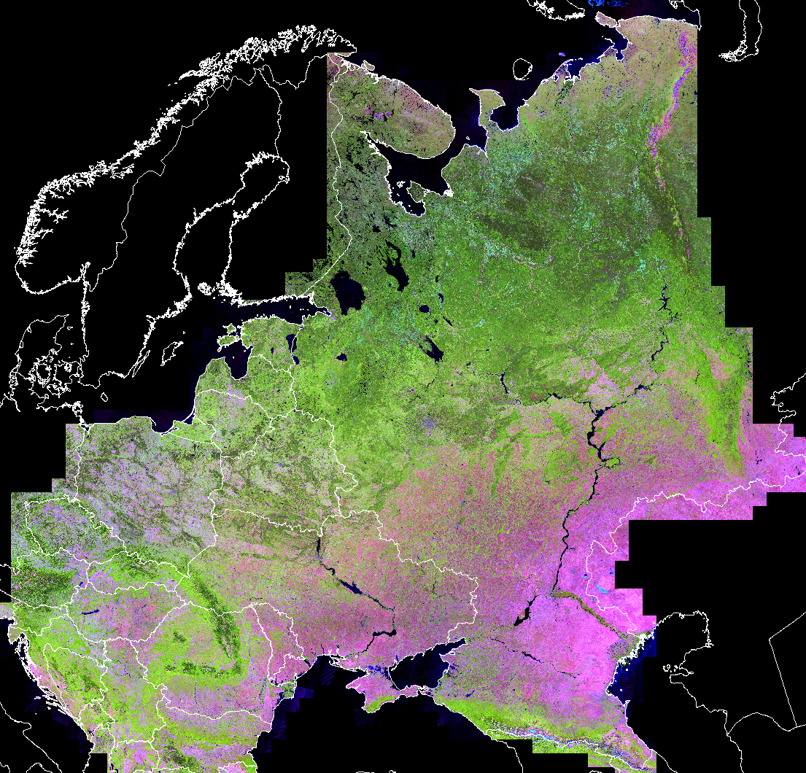
2012
Potapov et al., 2015

Slide 10
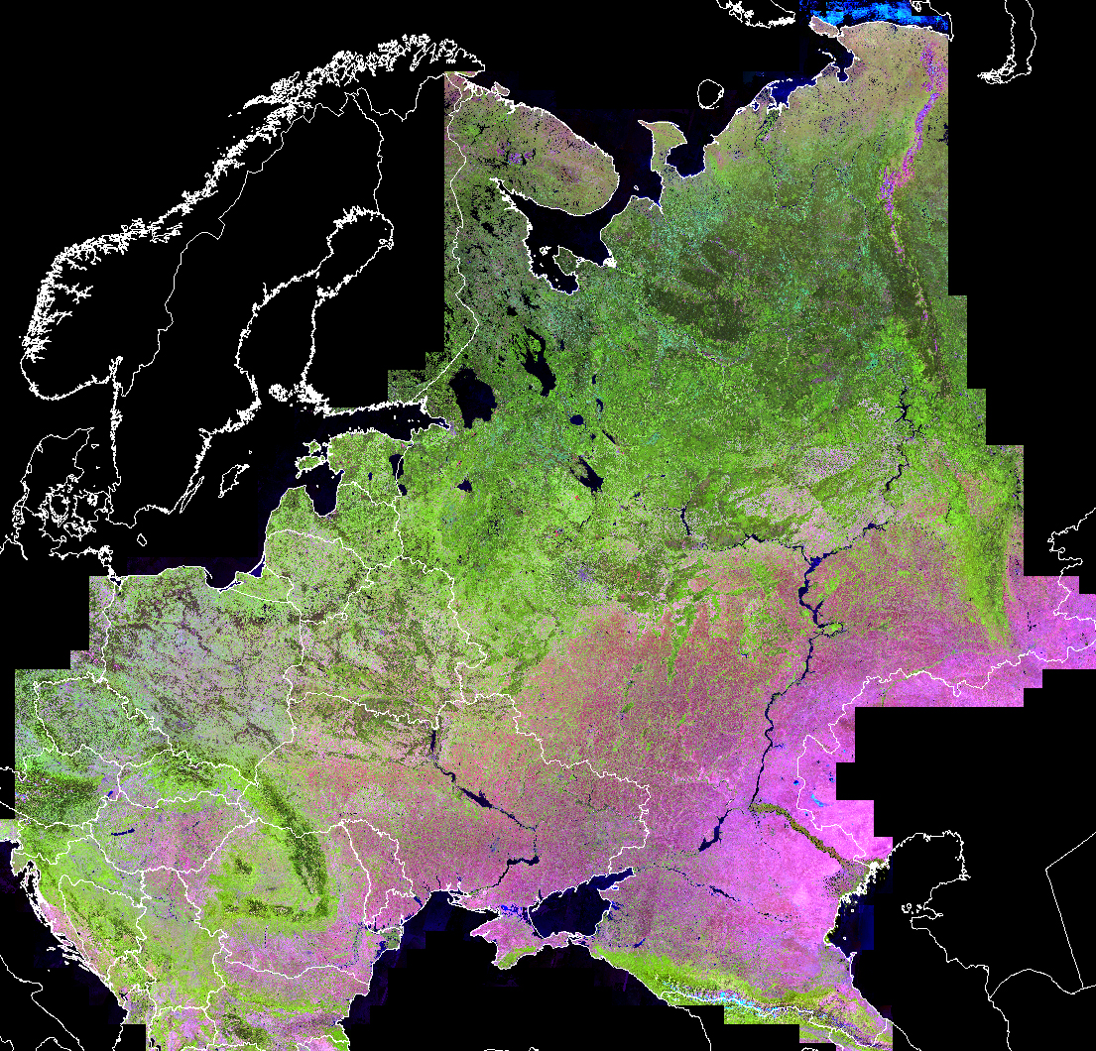
1985
Potapov et al., 2015

Slide 11
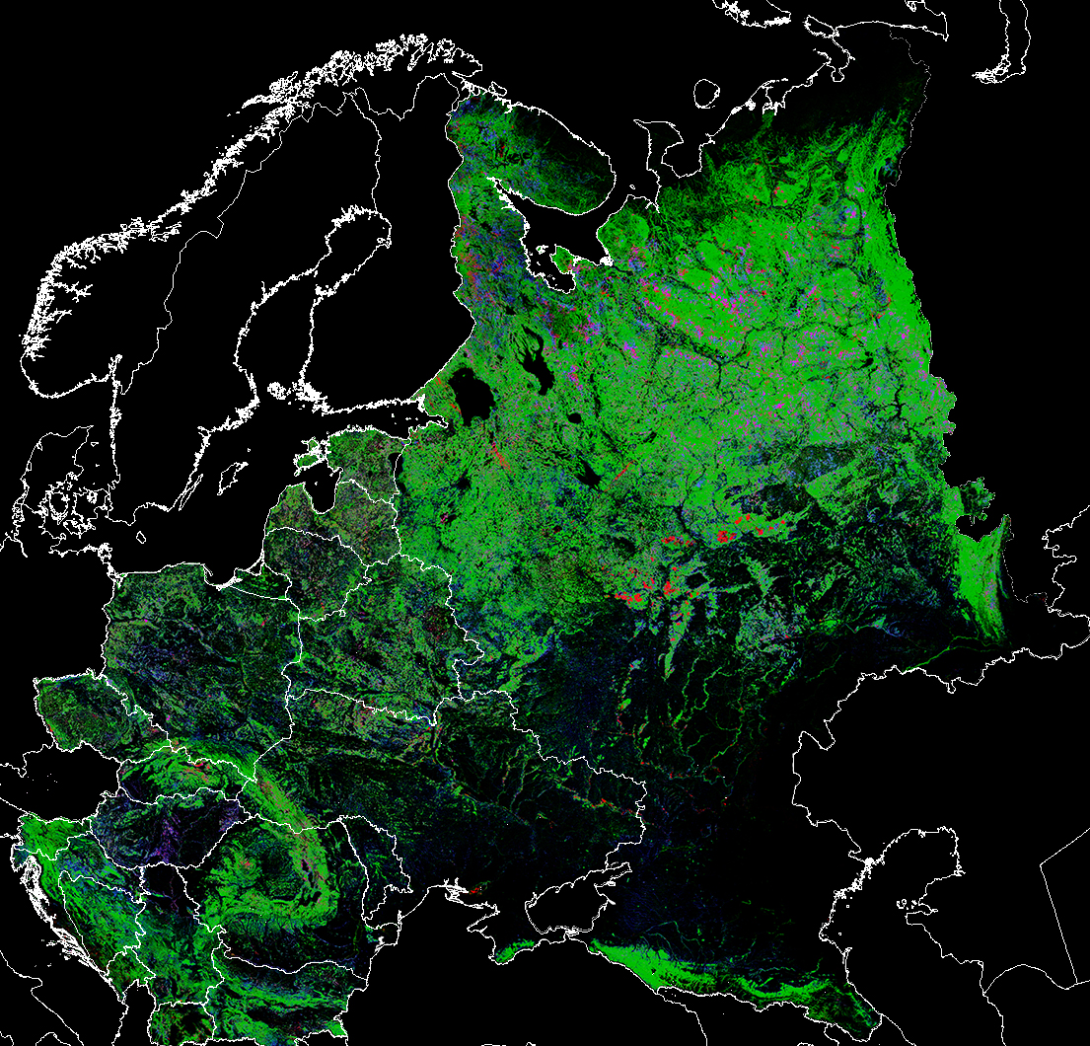
Forest cover dynamics
1985-2012
low high
Forest cover
Forest loss
Forest gain
Forest rotation
Potapov et al., 2015

Slide 12
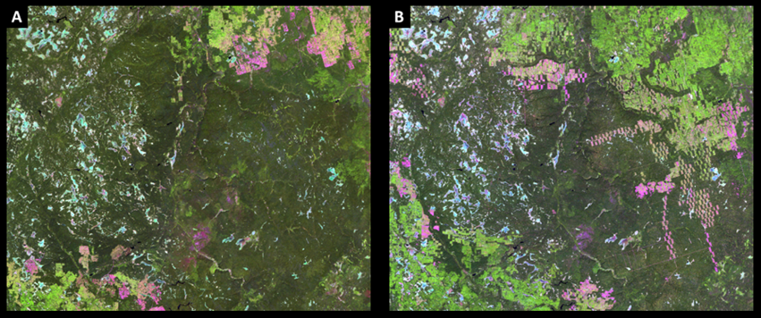
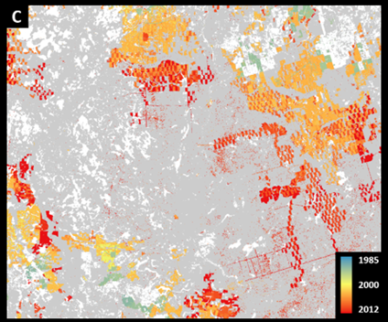
1985
2012
Potapov et al., 2015

Slide 13
Potapov et al., 2015

Slide 14
Eastern European Countries
Alix-Garcia et al.

Slide 15
Eastern European Countries
Latvia
Slovakia
Estonia
…..
Russia
Post-Yugoslavia
Alix-Garcia et al.

Slide 16
Eastern European Countries
Alix-Garcia et al.

Slide 17
Potapov et al., 2015

Slide 18
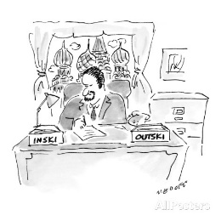
Russian regions
Gehlbach et al.

Slide 19
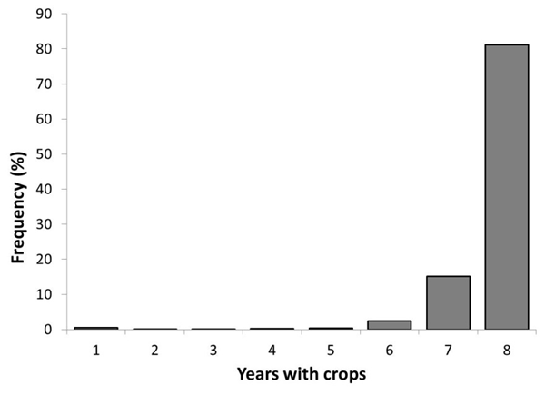
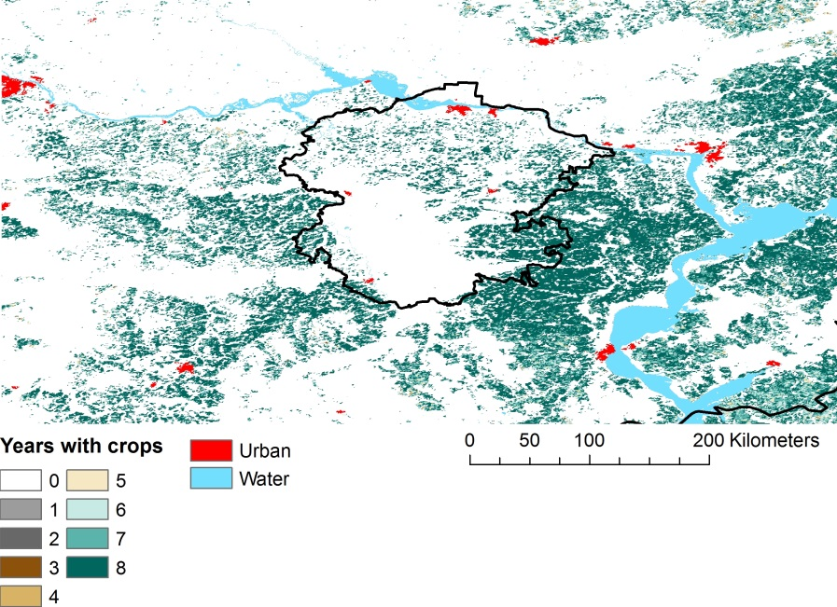
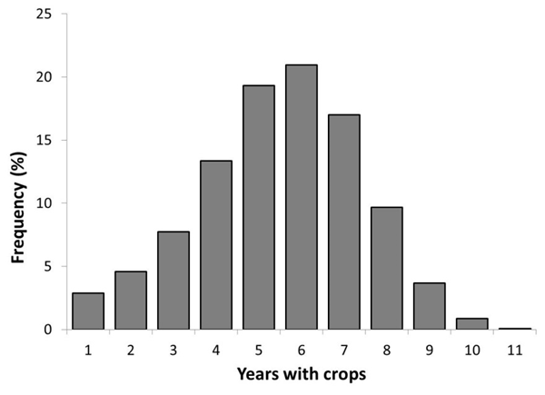
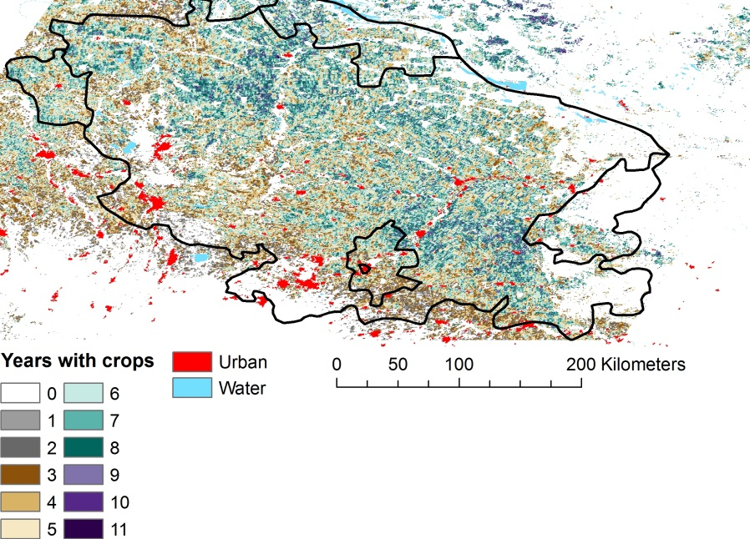
Russian regions
Chuvash
Stavropol
De Beurs & Ioffe, 2013

Slide 20
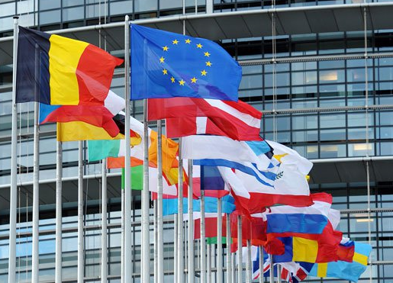
Policies and institutions

Slide 22
1860
Munteanu et al., in review

Slide 23
1930
Munteanu et al., in review

Slide 24
1960
Munteanu et al., in review

Slide 25
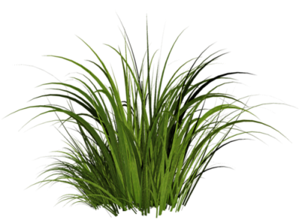
Legacies
1860
1960
1985
2005
Munteanu et al., in review

Slide 26
Legacies
1860
1960
1985
2005
Munteanu et al., in review

Slide 27
Legacies

Slide 28
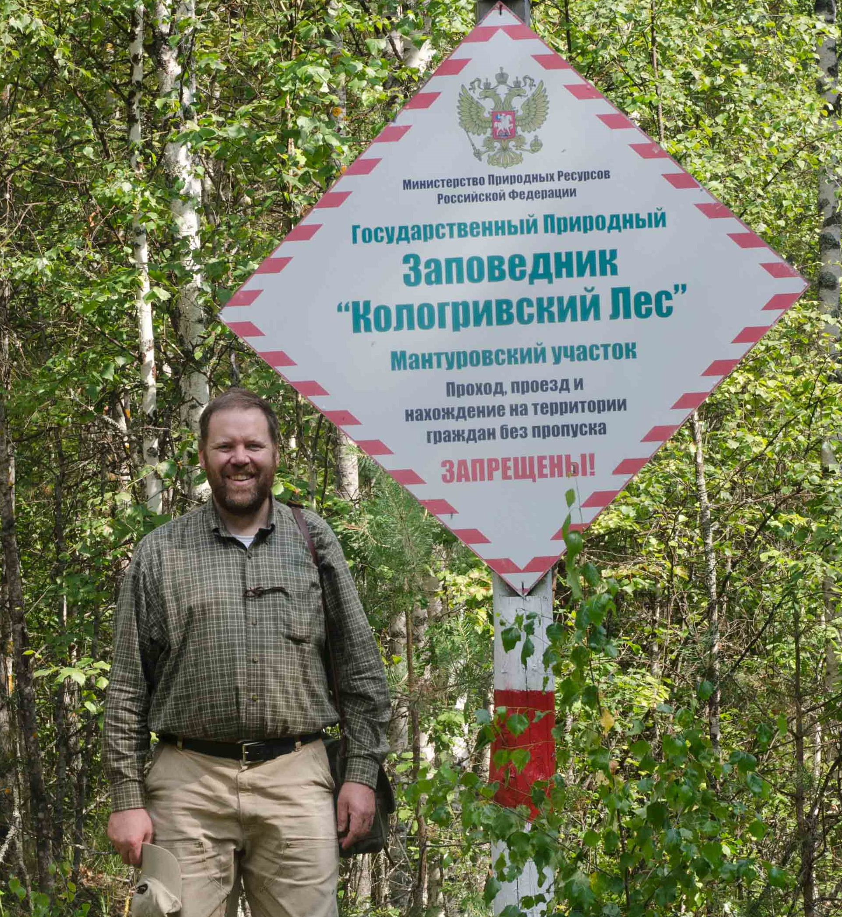
Protected areas

Slide 29
Protected areas

Slide 30
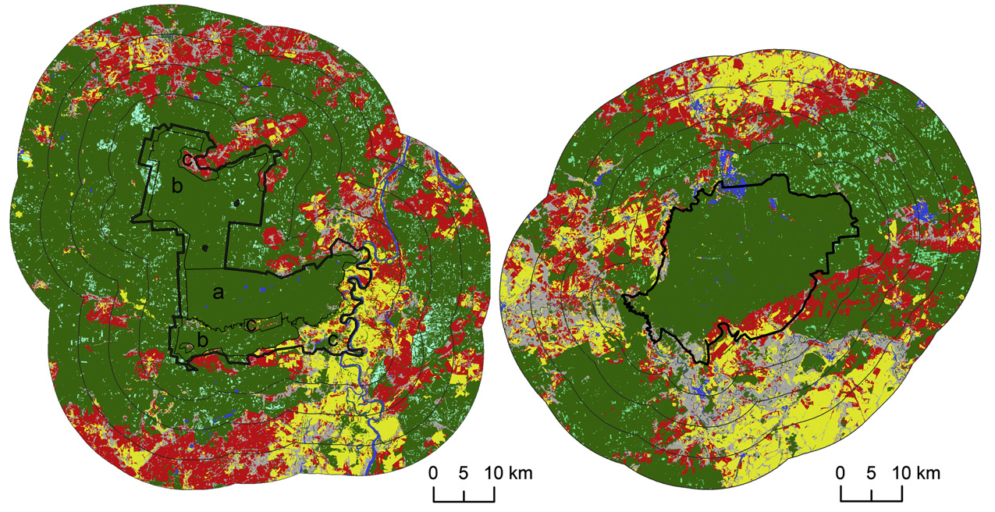
Protected areas
Sieber et al., 2013

Slide 31
Protected areas
Sieber et al., 2013

Slide 32
Protected areas
Butsic et al.

Slide 33
Protected areas
Butsic et al.

Slide 34
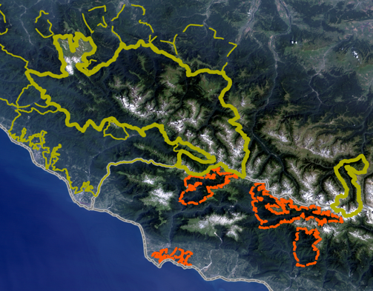
Protected areas
Bragina et al., 2015

Slide 35
Protected areas
Bragina et al., 2015

Slide 36
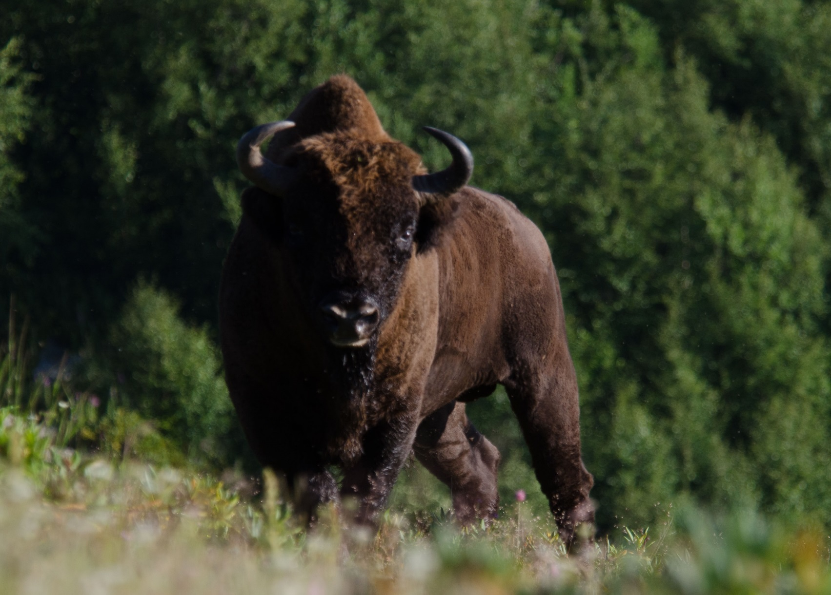
Wildlife

Slide 37
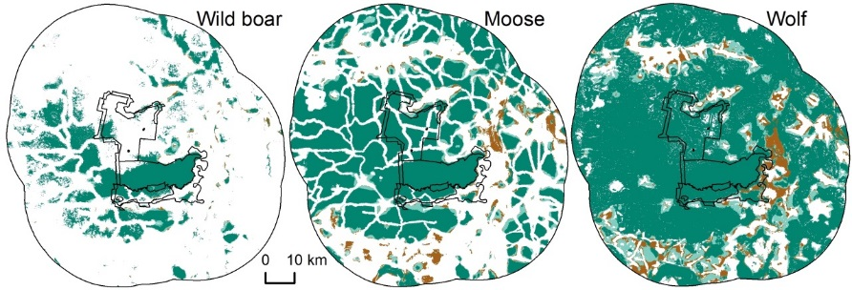
Wildlife Habitat
Sieber et al., in press

Slide 38
Wildlife Habitat
Sieber et al., in press

Slide 39
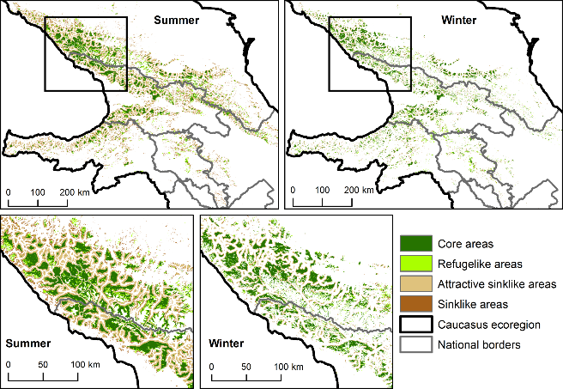
Wildlife Habitat
Bleyhl et al., in press

Slide 40
Wildlife Habitat
Bleyhl et al., in press

Slide 41
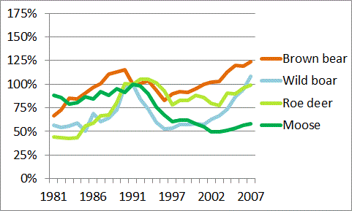
Wildlife Populations
Bragina et al., 2015

Slide 42
Wildlife Populations
Bragina et al., 2015

Slide 43
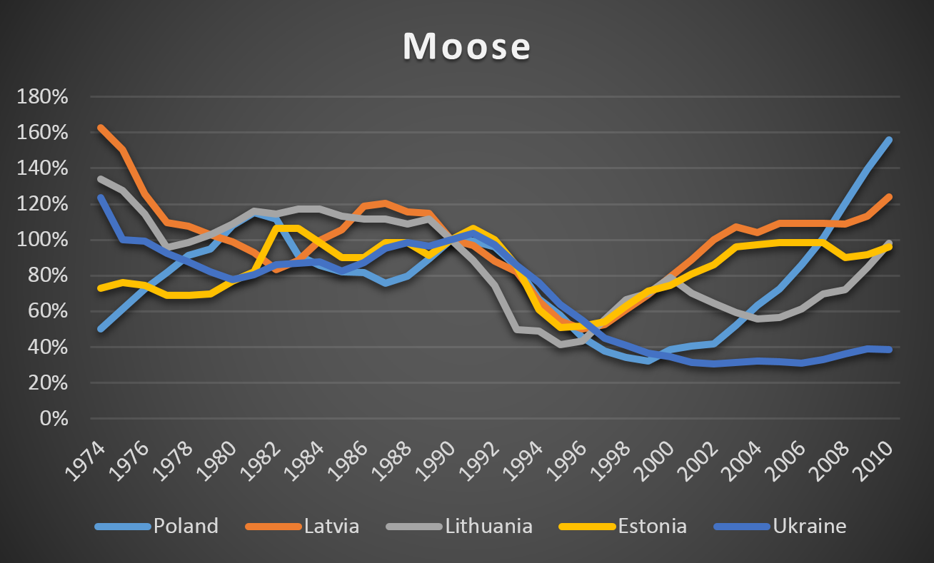
Wildlife Populations
Bragina et al.

Slide 44
Land use

Slide 45
Biodiversity
People
Land use/cover
Parks
Habitat
Biodiversity

Slide 46
Biodiversity
People
Land use/cover
Parks
Habitat
Biodiversity

Slide 47
Biodiversity
People
Land use/cover
Parks
Habitat
Biodiversity

Slide 48
Remote
Sensing
Bio-
diversity
LCLUC

Slide 49
Key measurements
MODIS products at Landsat resolution
Vegetation structure

Slide 50
Key questions
People as drivers of the earth system
Adaptation
Rare events

Slide 52
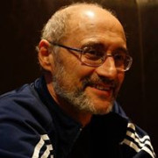
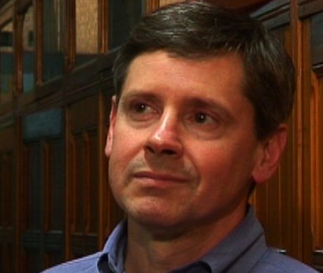
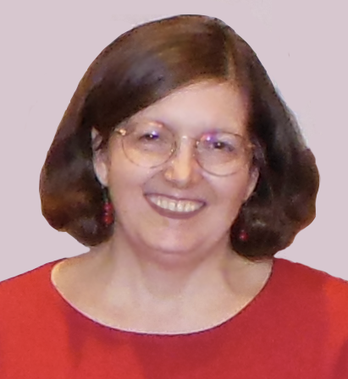
Thank you!

