Slide 1
Welcome to the Carbon Cycle & Ecosystems 4th Joint Science Workshop
College Park Marriott Hotel and Conference Center April 20-22, 2015
http://cce.nasa.gov/meeting_2015
#NASAcce
Wireless network: NASA | Password: NASA

Slide 2
Who is here?
Principal Investigators, Co-Investigators, Collaborators and Students funded through NASA’s Carbon Cycle and Ecosystems (CC&E) Focus Area and related programs:
Research: Terrestrial Ecology, Ocean Biology & Biogeochemistry, Land Cover & Land Use Change, Biodiversity
Applied Sciences: Ecological Forecasting, Agriculture, Water Resources
And others (e.g. Terrestrial Hydrology, Data Systems)
NASA Earth Science Division (ESD) CC&E Program Managers, ESD Senior Managers, and other ESD personnel
Say hello to someone new!

Slide 3
Why are we here?
Foster interdisciplinary interactions within CC&E
Highlight progress and accomplishments
Identify challenges and opportunities
Discuss the research questions that will drive CC&E research over the coming decade (including breakout groups)
Wednesday afternoon – Thursday: Team meetings for Terrestrial Ecology, Biodiversity and Ecological Forecasting, Land Cover and Land Use Change

Slide 4
What are we doing?
Program updates: ESD, Research & Analysis, CC&E Focus Area
Synthetic talks in plenary organized around four themes:
Tracking habitat change through new integrative approaches and products
Landscapes to coasts: understanding Earth system connections
Future research direction and priorities: perspectives relevant to the Next Decadal Survey
Human influence on global ecosystems
Three poster sessions
Session 1 (Monday early afternoon): Habitat change, Landscapes to coasts, Carbon Monitoring System
Session 2 (Monday late afternoon): Future research, Human influences
Session 3 (Tuesday late afternoon): General Contributions
Student/Early Career Speed Poster Talks: Plenary prior to poster sessions
See website for talk and poster abstracts
Speakers, bring your talks to the A/V table well in advance

Slide 5
What else are we doing?
Keynote address (Tuesday morning): “Perspective on Past Generations of NASA Science and Lessons Learned Relevant for Your Future” Diane E. Wickland (sign the book!)
Breakout groups (Tuesday): Identifying research questions that would spur CC&E research over the coming decade
Report back in plenary Wednesday morning, followed by a panel discussion with early career scientists
Special panel discussion (Tuesday): Knowing what you don't know: The problem of uncertainty. Cartoons involved!
Open side meetings: Data Management Workshop (Sunday), Arctic Colors (Tuesday lunch), NISAR (Tuesday evening)
Student/early career mentoring lunch (Monday)
No host social Monday and Tuesday evening

Slide 6
Who should we thank?
Meeting Planning Committee
Paula Bontempi, NASA HQ
Emmanuel Boss, University of Maine
Jessica Bussard, NASA GSFC / SSAI
Jim Collatz, NASA GSFC
Brad Doorn, NASA HQ
Carla Evans, NASA GSFC / SSAI
Josh Fisher, JPL
Anand Gnanadesikan, Johns Hopkins
Peter Griffith, NASA GSFC / SSAI
Garik Gutman, NASA HQ
Sean Healey, USDA Forest Service
Kathy Hibbard, NASA HQ
Walter Jetz, Yale University
Chris Justice, University of Maryland
Eric Kasischke, NASA HQ
Libby Larson, NASA GSFC / SSAI
Allison Leidner, NASA HQ / USRA
Jon Ranson, NASA GSFC
Woody Turner, NASA HQ
CC&E Office and Other Support
Jessica Bussard
Carla Evans
Peter Griffith
Amy Hodkinson
Liz Hoy
Leanne Kendig
Libby Larson
Lisa Wilcox
Zantech IT: Mary Floyd
NASA HQ: Amy Marshall
The Community
Plenary speakers
Poster presenters
Breakout group leaders
Note takers
Panelists
Session chairs
Lunch mentors
You!

Slide 7
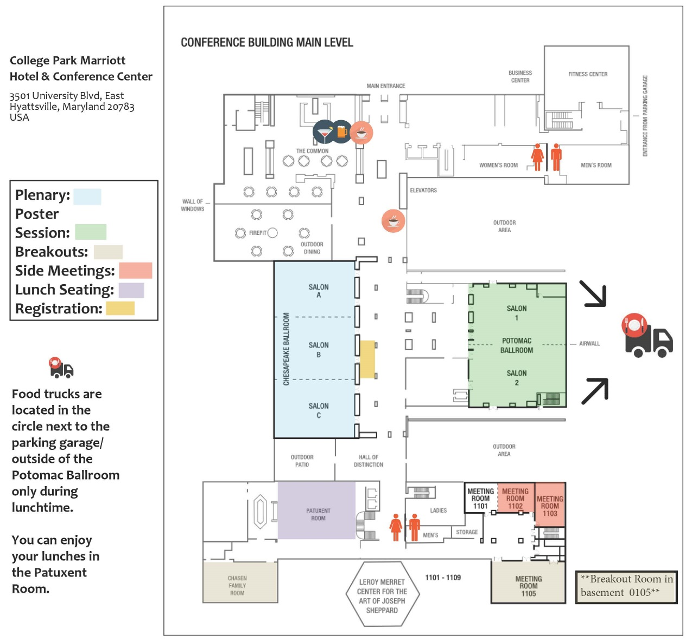
Where am I? And the food/coffee?
The Commons Restaurant (table service)
Food Trucks
Jimmy the Hot Dog Man
Nann Stop
Nann Stop Taco
Curley's BBQ
Dee's Sweets (also Savory cuisine)
Bear with us and be a little patient! You can eat outside or in the Patuxent Room

