Slide 1

Characterizing marine habitats and their changes using satellite products and numerical models
Stephanie Dutkiewicz
Massachusetts Institute of Technology
Maria Kavanaugh (WHOI) , Tihomir Kostadinov (U Richmond) ,
Tim Moore (U New Hampshire) , Colleen Mouw (Michigan Technology U) ,
Barbara Muhling (NOAA) , Matt Oliver (U Delaware) ,
Cecile Rousseaux (NASA)

Slide 2
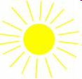
MARINE FOODWEB
sunlight
sharks/mammals/birds
phytoplankton
zooplankton
nutrients
fish
big fish
detritus
corals
benthic
organisms
stored in deep ocean
Phytoplankton responsible for 50% of earth’s photosynthesis

Slide 3
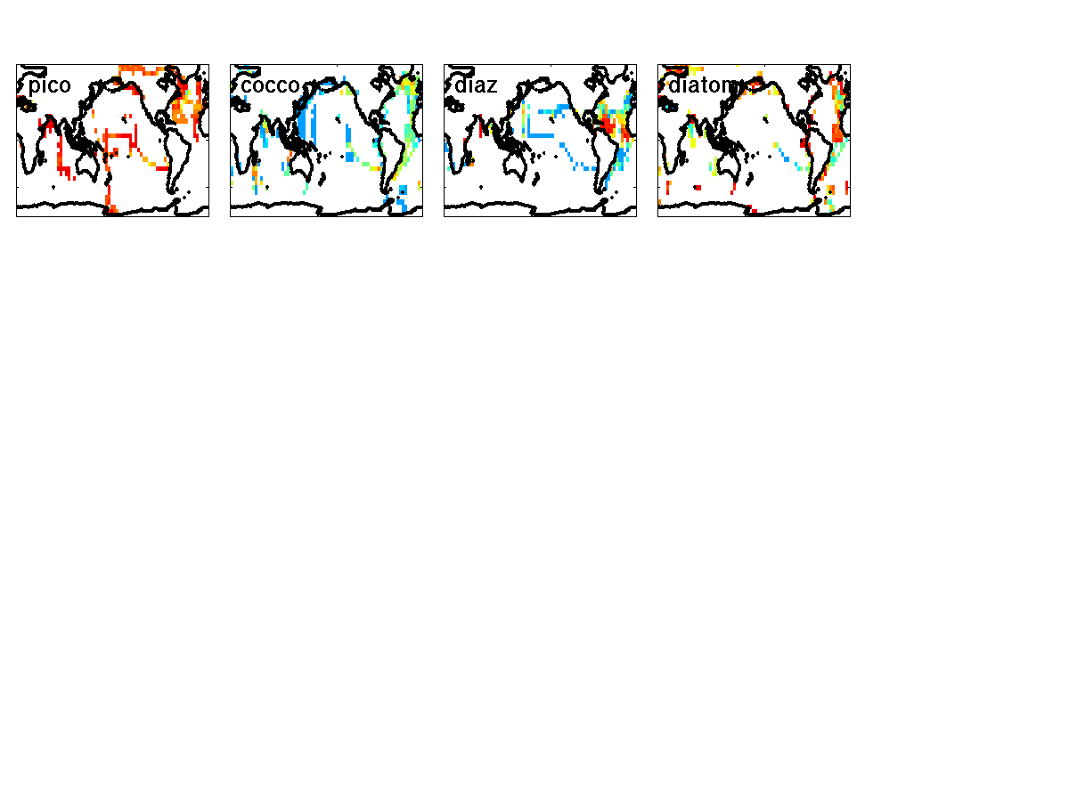
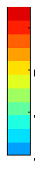
MARINE HABITATS
important for biogeochemistry, food web, fisheries
in situ measurement sparse
phytoplankton functional groups:
mgC/m³
10
1
0.1
0.01
pico
calcifiers
N₂ fixers
silicifiers
MAREDAT: Buitehuis et al, ESSD, 2012
(and papers in same issue)

Slide 4
HABITATS AND THEIR VARIABILITY
OUTLINE OF TALK
habitats from satellite (taxonomic/group )
biomes/provinces from satellite
habitats from numerical models

Slide 5
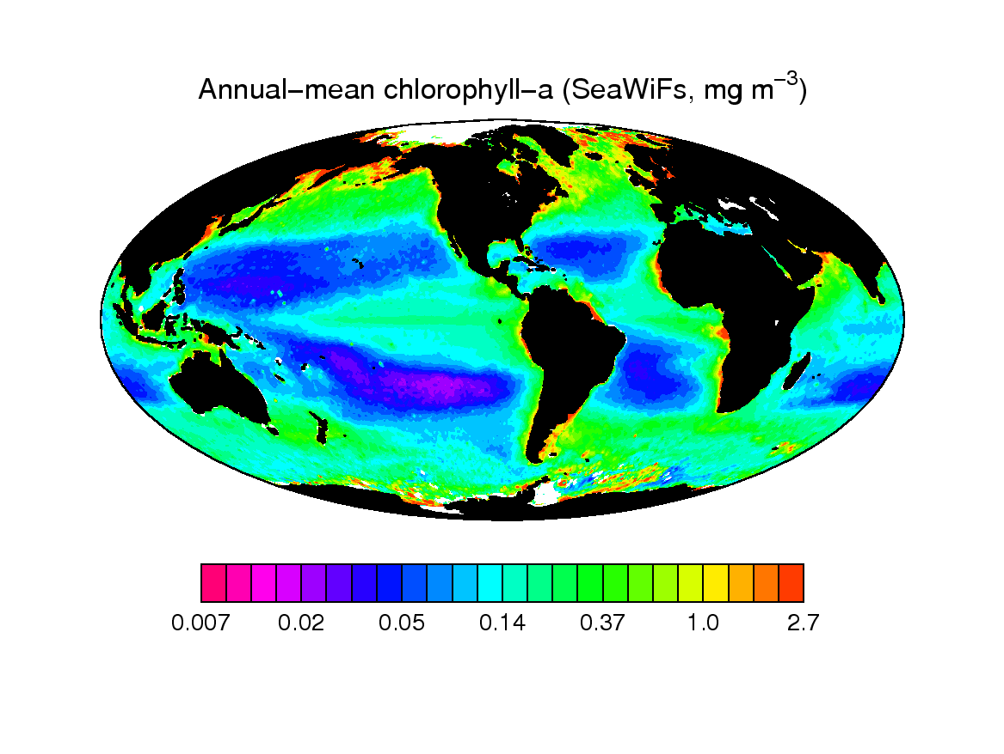
PHYTOPLANKTON FROM SPACE
Satellite Derived Chl-a Concentration (mg Chl/m³)
Notes:
Satellites have provided unprecedent view of phytoplankton from space

Slide 6
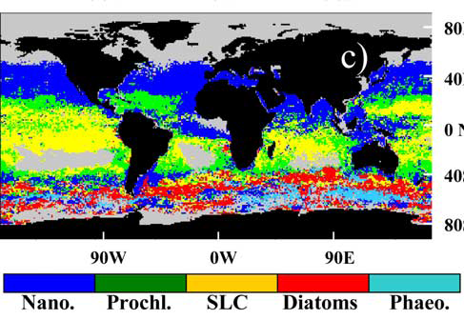
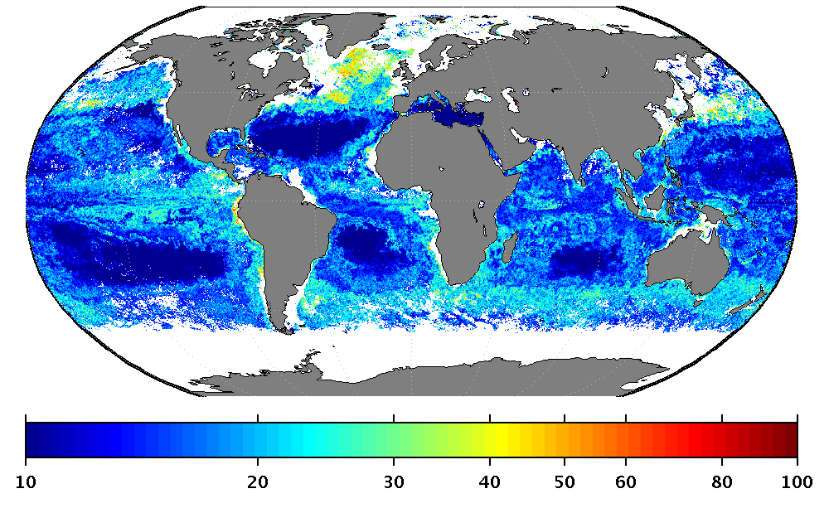
PHYTOPLANKTON HABITATS FROM SPACE
FUNCTION
OCEAN COLOR
PRODUCTS
(chl, radiance,
absorption, scattering)
empirical algorithm,
optical model
e.g. Alvain et al, 2008
SIZE
Synthesis from “PFT” group:
- Mouw and Hardman-Mountford et al, in prep
- IOCCG report 15
Abundance: Brewin, Hirata, Uitz
Radiance: Alvain, Li
Absorption: Mouw, Bracher, Ciotto,
Bricaud, Roy, Devred
Scattering: Kostindinov
e.g. Mouw and Yoder, 2010
Notes:
What is eta?

Slide 7
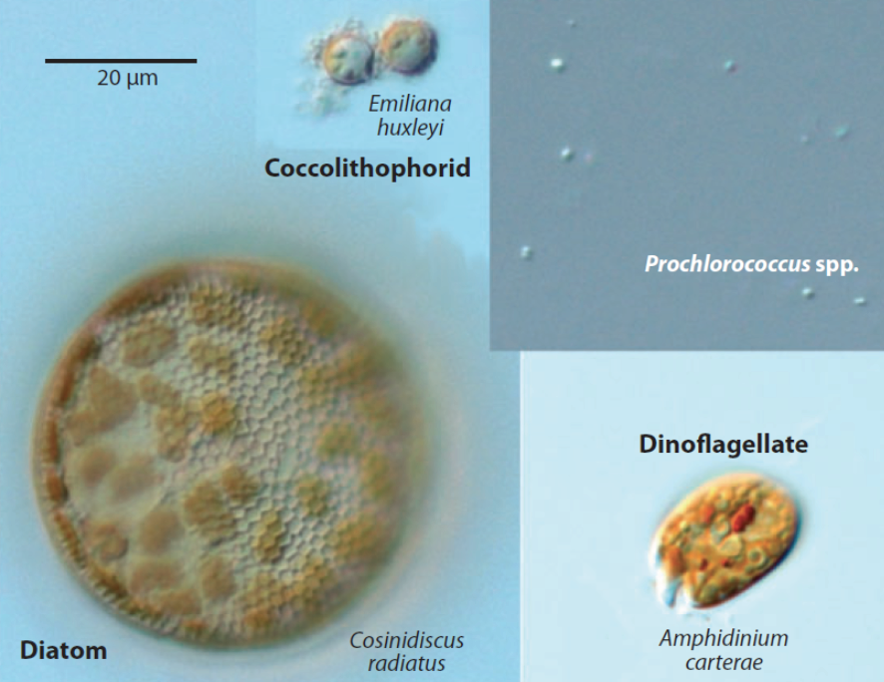
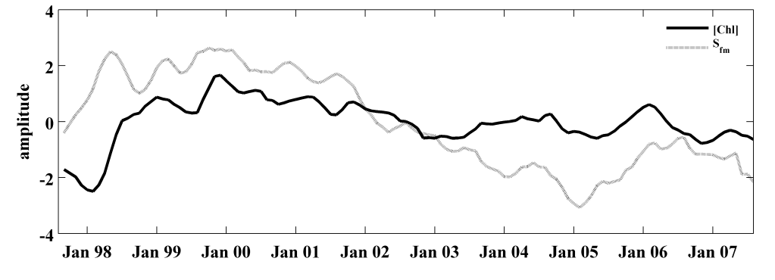
PHYTOPLANKTON HABITATS FROM SPACE
SIZE DISTRIBUTION
MAY 2006
Follows and Dutkiewicz, 2011
Percent Microplankton
first standardized principal component
Mouw and Yoder, J. Geophys Res, 2010
Mouw et al, in prep
slide: Colleen Mouw (Michigan Tech. Univ. )
Notes:
Using reflectance, chl and a_cdom
many of the other studies use empirical algorithms to link OC products to know distributions of sizes/functional types,
The technique of Mouw and Yoder uses know differences in the optical properties between large and small types
- Thus is likely to be better at picking up actual changes over time

Slide 8
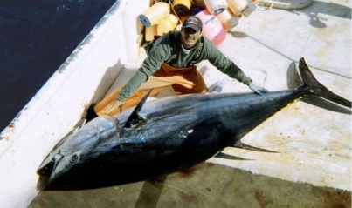
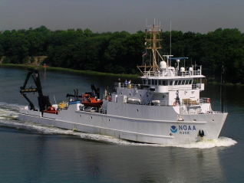
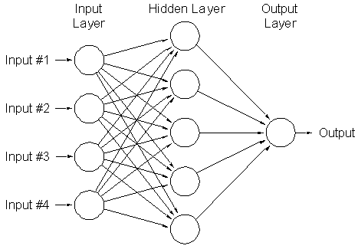
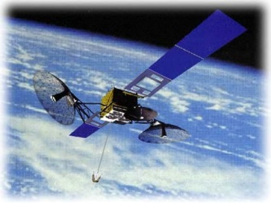
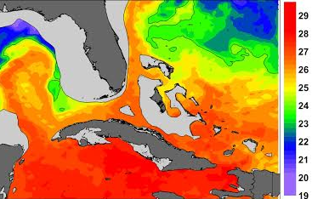
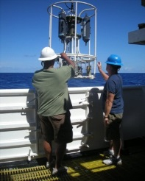
FISH HABITATS FROM SPACE
Biological Data
Fisheries logbooks
Shipboard surveys
Artificial neural
network
Predictive habitat models
Predicted and actual larval bluefin tuna distributions: May 2010
High
probability
Environmental Data
Extracted satellite data
Derived analyses
Instrument data
Low
probability
SST, SSH, Chl
SEE POSTER 49: Roffer et al
Muhling et al, Mar. Pollut. Bull., 2012
Muhling et al, J. Mar. Systems., 2015
slide: Barbara Muhling (SFSC-NOAA)
Notes:
Biological responses to environmental conditions are often complex, non-linear, and interacting
As a result, multivariate non-parametric methods are most useful: we used artificial neural networks
Habitat models are trained using biological observations from: Fisheries logbooks Government observers Fisheries-independent surveys
Environmental conditions at sampling locations extracted from in situ instruments, or satellite datasets, such as: SST (AVHRR Pathfinder, MODIS Aqua) SSSH(AVISO), Chl(SeaWIFS, MODIS Aqua)
Also additional variables from data-assimilating ocean models, such as HYCOM

Slide 9
HABITATS AND THEIR VARIABILITY
OUTLINE OF TALK
habitats from satellite (taxonomic/group )
- MANY other examples
- whales e.g. Pat Halpin et al, Helen Bailey et al
- penguins e.g. Cimino et al (SEE POSTER 14)
biomes/provinces from satellite
habitats from numerical models

Slide 10
HABITATS AND THEIR VARIABILITY
OUTLINE OF TALK
habitats from satellite (taxonomic/group )
- MANY other examples
- whales e.g. Pat Halpin et al, Helen Bailey et al
- penguins e.g. Cimino et al (SEE POSTER 14)
biomes/provinces from satellite
habitats from numerical models

Slide 11
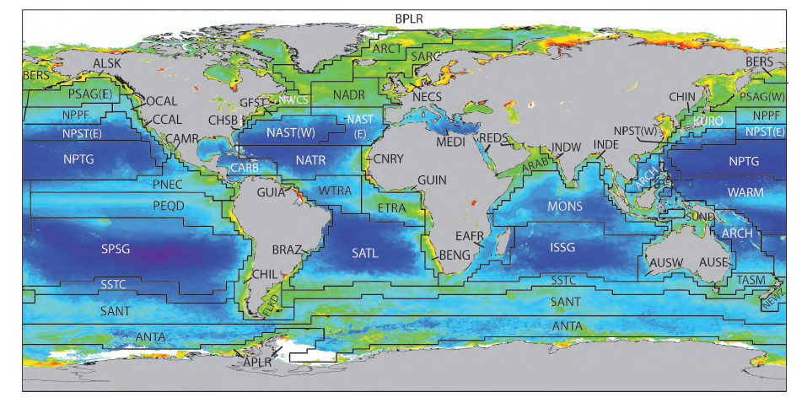
PROVINCES/BIOMES
Longhurst (2006)
Notes:
Division of ocean along physical and biogeochemical properties.
Similar to defining land habitats such as desert, tropical rainforest etc

Slide 12
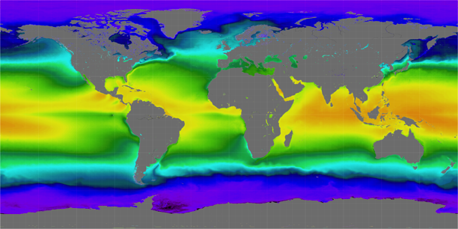
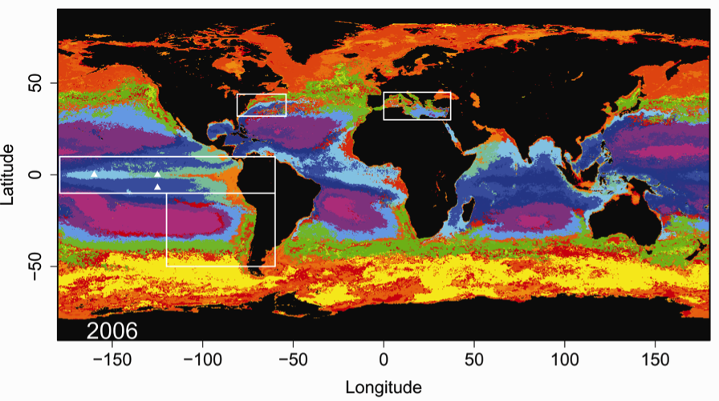
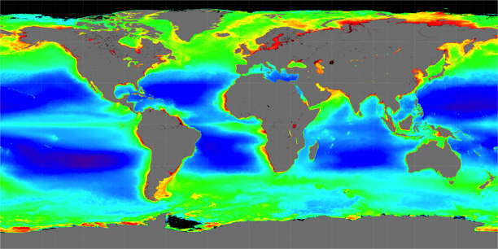
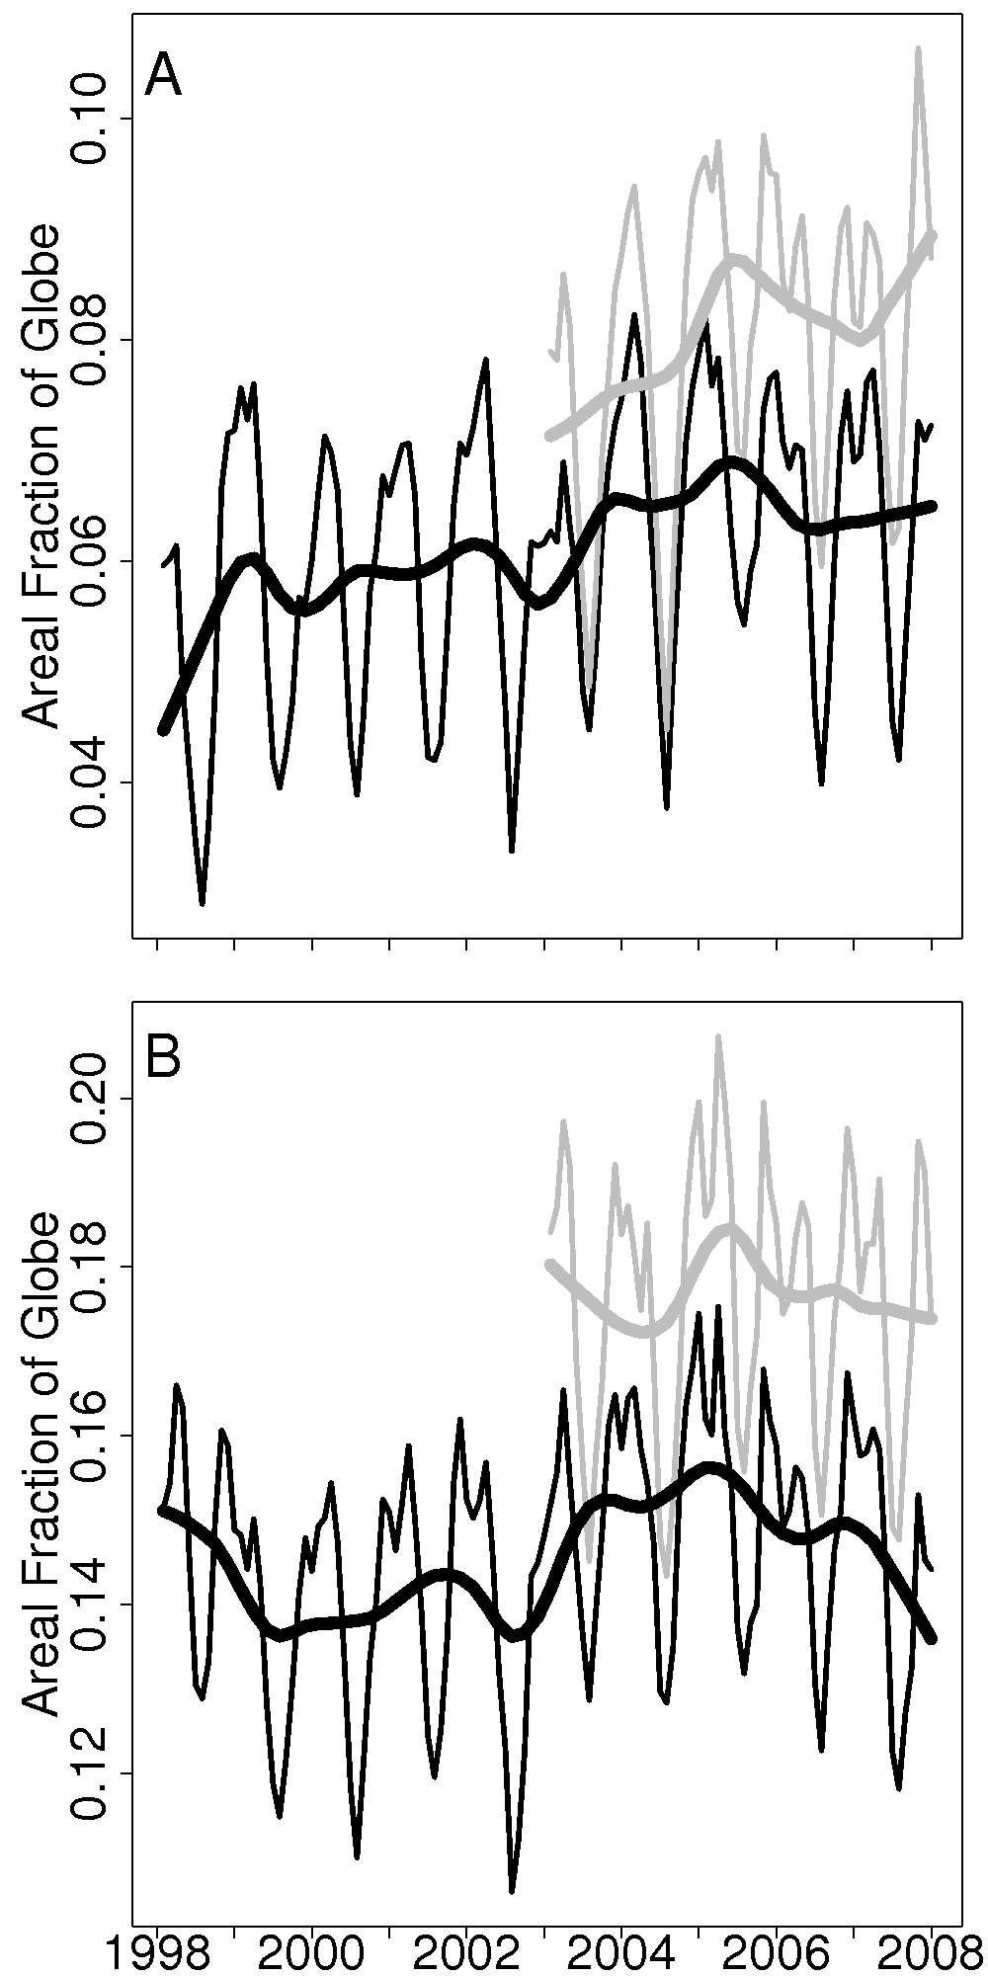
PROVINCES FROM SPACE
Sea Surface Temperature
Sea-Scape of Ocean Biomes
Ocean Color
Similar approaches:
Emmual Devred , Tim Moore,
Maria Kavanaugh (See Poster 2)
Oliver and Irwin, Geoph. Res. Letters, 2008
Irwin and Oliver, Geoph. Res. Letters, 2009
slide: Matt Oliver (Univ. Delaware)
Notes:
Objective classification on global remote sensing data to automatically produce time and space resolved ocean provinces. boundaries are
verified by in-situ ship track data and province distributions in the equatorial Pacific correlate well with ENSO indexes.
Note that provinces are found in different oceans
Because dynamic – it can be use to track changes
e.g. Consider most purple province

Slide 13
HABITATS AND THEIR VARIABILITY
OUTLINE OF TALK
habitats from satellite (taxonomic/group )
biomes/provinces from satellite
habitats from numerical models

Slide 14
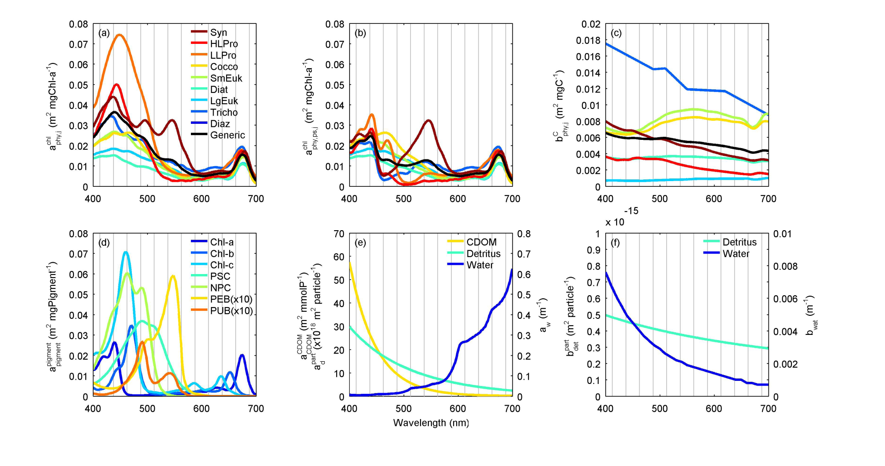
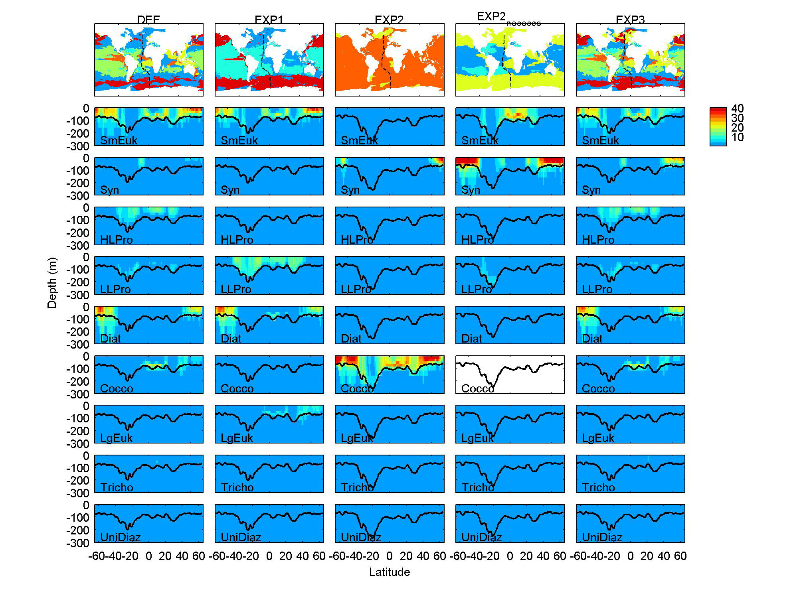
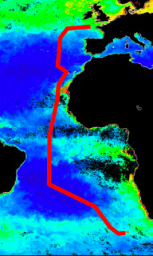
USING MODEL AS A LABORATORY
EXP2: optically different,
other traits identical
EXP1: default
absorption
wavelength(nm)
Hickman, Dutkiewicz, Jahn, Follows, in prep

Slide 15
CHANGING FUTURE WORLD
Drivers of changes in habitats:
warmer
ocean acidification
more stratified, changing circulation leads to
- lower nutrient supply
- altered light environment
de-oxygenation

Slide 16
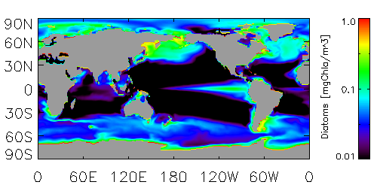
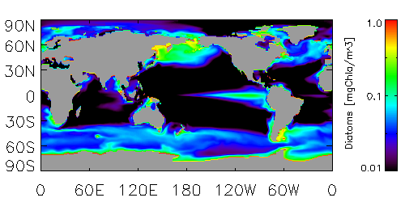
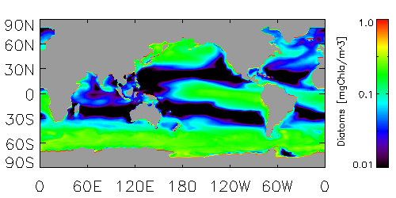
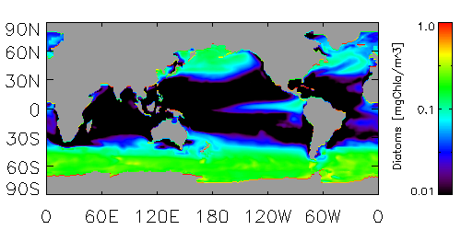
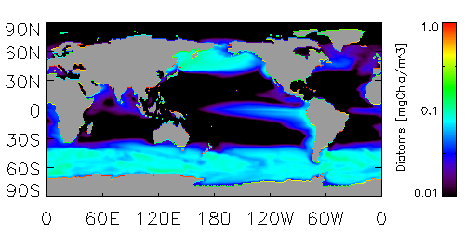
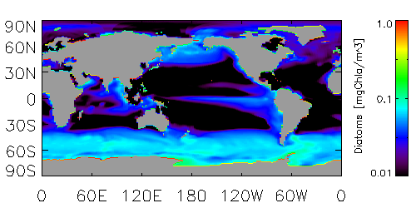
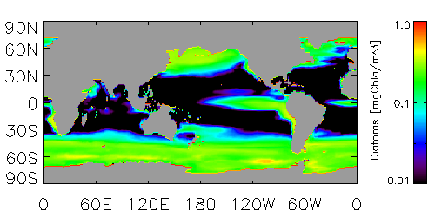
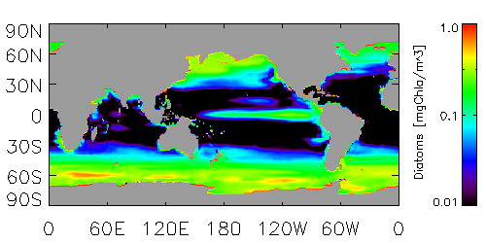
MODELLING LONG TERM CHANGES IN PHYTOPLANKTON HABITATS
MAREMIP
MARine Ecosystem Model
Intercomparion Project
http://pft.ees.hokudai.ac.jp/maremip/index.shtml
present day
2100
GFDL
HU/
JAMTEC
MRI
DIATOMS
(mg Chl/m³)
NASA
slide: Cecile Rousseaux (USRA-GMAO, NASA)
Notes:
Loss habitat for diatoms in low nutrient regimes (due to lower nutrient supplies)
In contrast models show increase in habitat range (though not abundance) of smaller phytoplankton

Slide 17
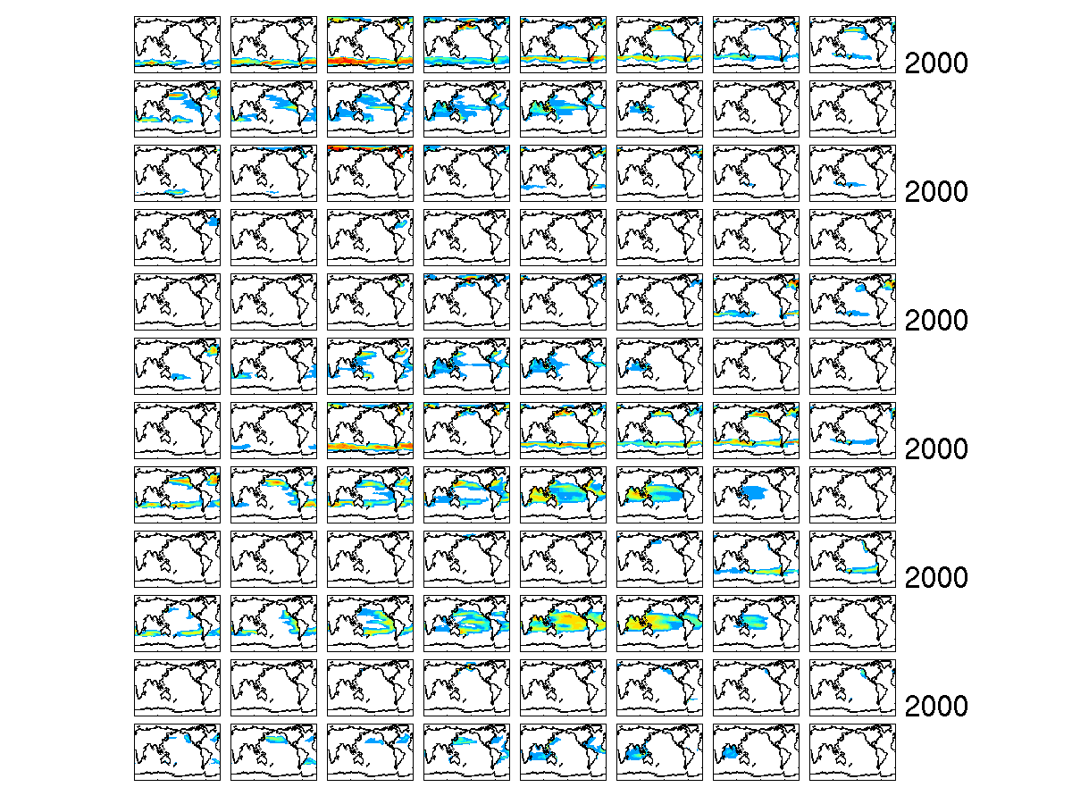
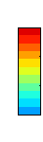
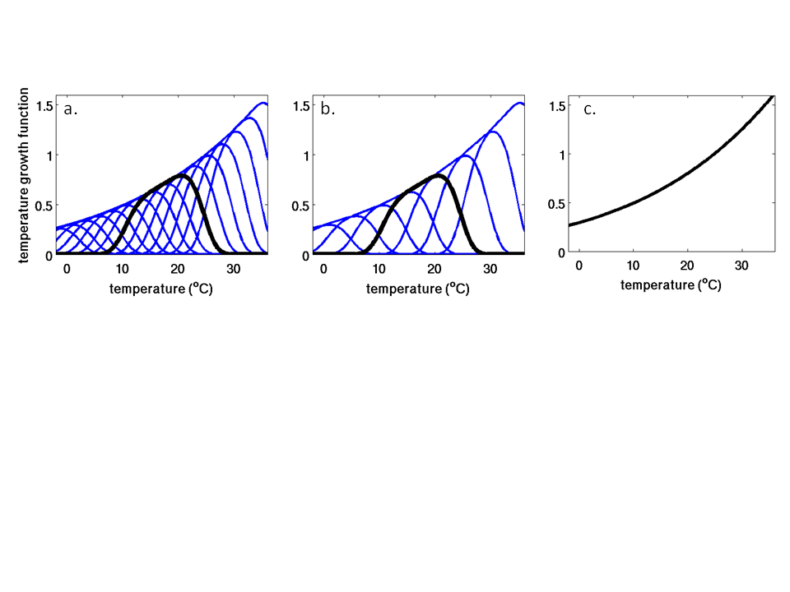
MODELLING LONG TERM CHANGES IN PHYTOPLANKTON HABITATS
mgC/m³
diatoms
100
10
other
large
1
0.1
Cocco
Syn
Prochl
Diaz
Dutkiewicz et al, Global Biogeo. Cycles, 2013; in review
SEE POSTER 15: Dutkiewicz et al
Notes:
Different drivers can enhance or counteract each other. Important to understand each process

Slide 18
SOME FINAL THOUGHTS
phytoplankton habitats characterization (from satellite and models):
- need more validation
- synthesis of techniques
e.g. Mouw et al, Kostidinov /Marinov (also IOCCG report 15)
province delineation:
- linking to taxonomic/group level e.g. Tim Moore, Matt Oliver (POSTER 43, Breece et al)
- connecting to numerical models e.g. Kavanaugh et al (POSTER 2) ,
higher trophic level habitat characterization:
- essential for monitoring and conservation
need better links between lower and higher levels
numerical models
- help understand processes delineating habitats/provinces and their changes

Slide 19
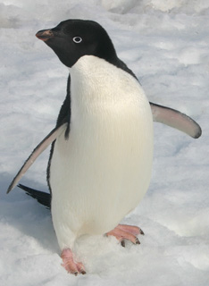
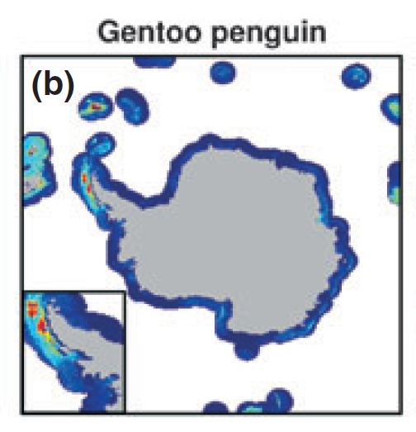
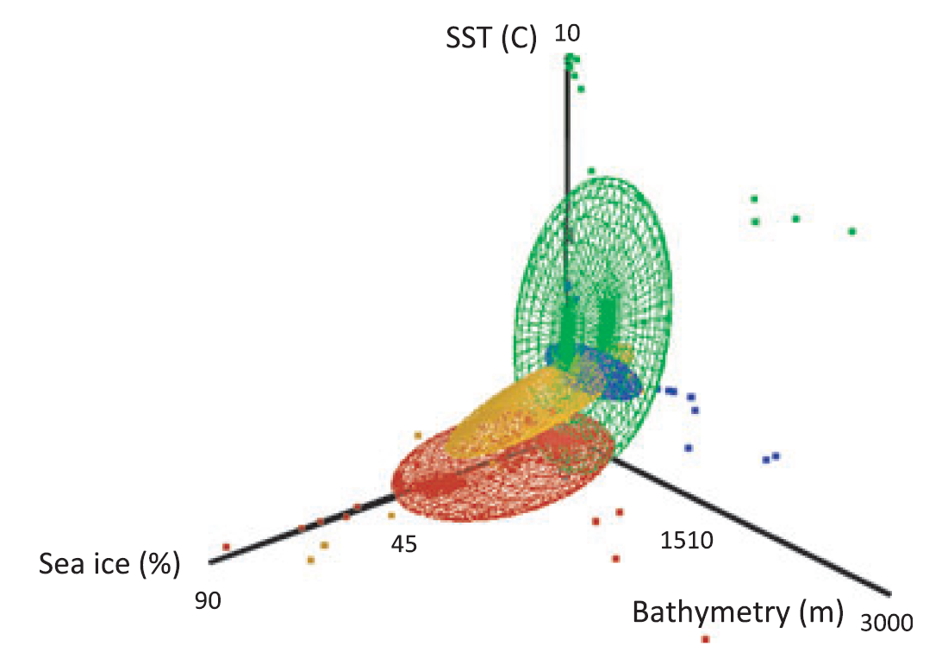
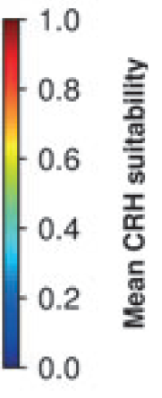
PENGUIN HABITATS FROM SPACE
Continental Adélie
WAP Adélie
Chinstrap
Gentoo
Satellite Derived “Niche” for
Chick Rearing Habitat
SEE POSTER 14: CIMINO ET AL
Cimino et al, Global Change Biology, 2014
slide: Matt Oliver (Univ. Delaware)
Notes:
Define habitat in terms of phase space of SST, Sea Ice (both from satellite) and depth of ocean
WAP; western Antarctic peninsula
0 and 1 of probability of presence.

Slide 20
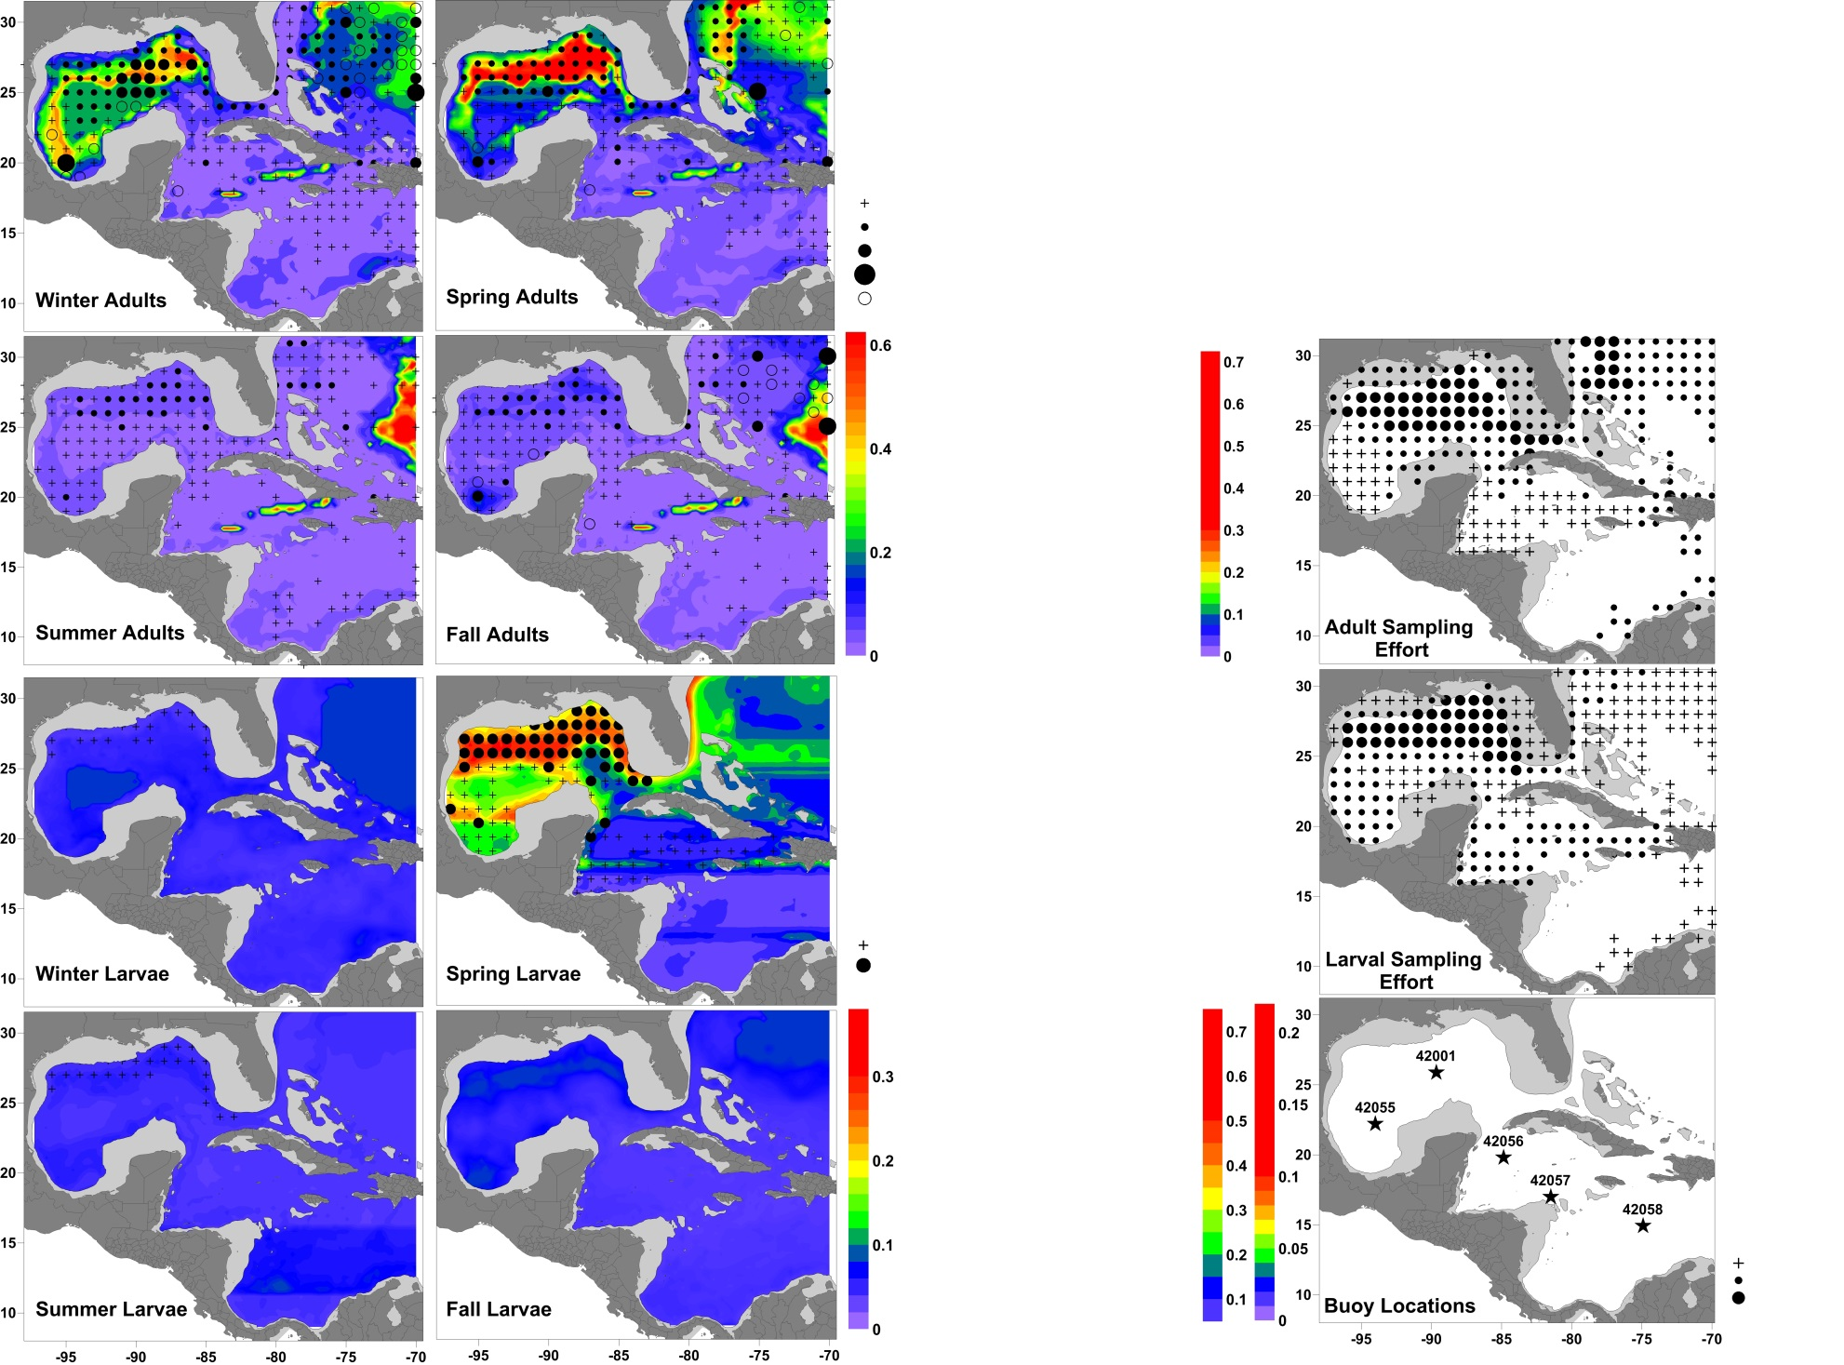
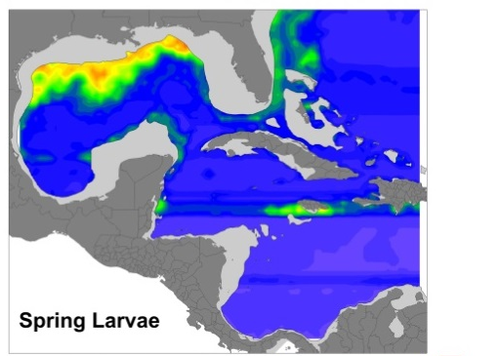
MODELLING LONG TERM CHANGES IN FISH HABITATS
Habitat loss for bluefin tuna (both larvae and adults)
Present Day (2000s)
Future (2090s) under RCP 8.5
Observed Probability
of Occurrence
0%
SEE POSTER 49: Roffer et al
1 to 100%
Muhling et al, J. Mar. Systems., 2015
slide: Barbara Muhling (SFSC-NOAA)
Notes:
predictive habitat models for bluefin tuna and skipjack tuna adult s and larvae in the Intra-Americas Sea
Adult fish: Catch data from International Commission for the Conservation of Atlantic Tunas (ICCAT) Environmental data from satellites, and ECCO II
Larval fish: Catch data from NOAA shipboard surveys: Environmental data from CTD casts and satellites
Outputs from a dynamically downscaled regional climate model were run through habitat models to give projections of future habitat suitability
Results show temperature-induced habitat loss all seasaons for bluefin tuna larvae and for adults.
In contrast, habitat suitability for skipjack tuna increased with increasing temperatures (not shown here)

