Slide 1
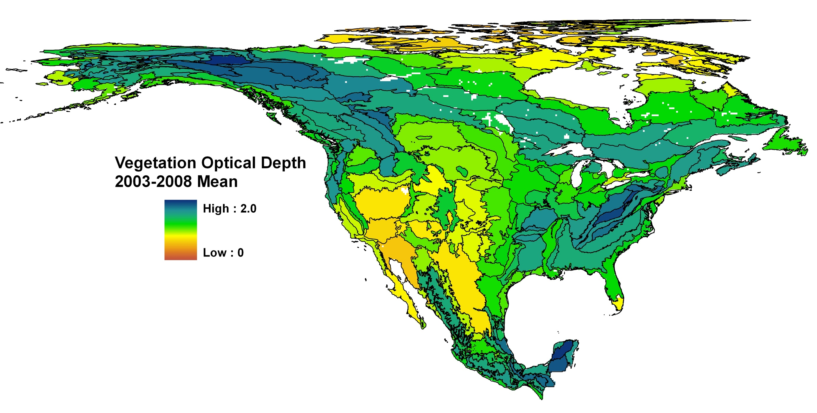
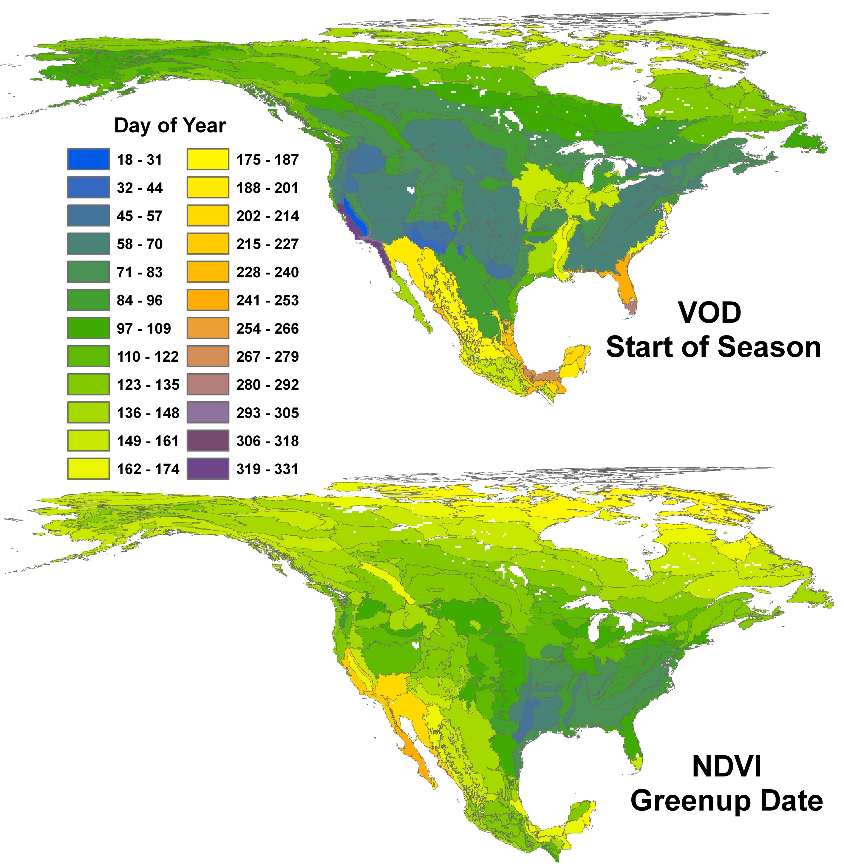
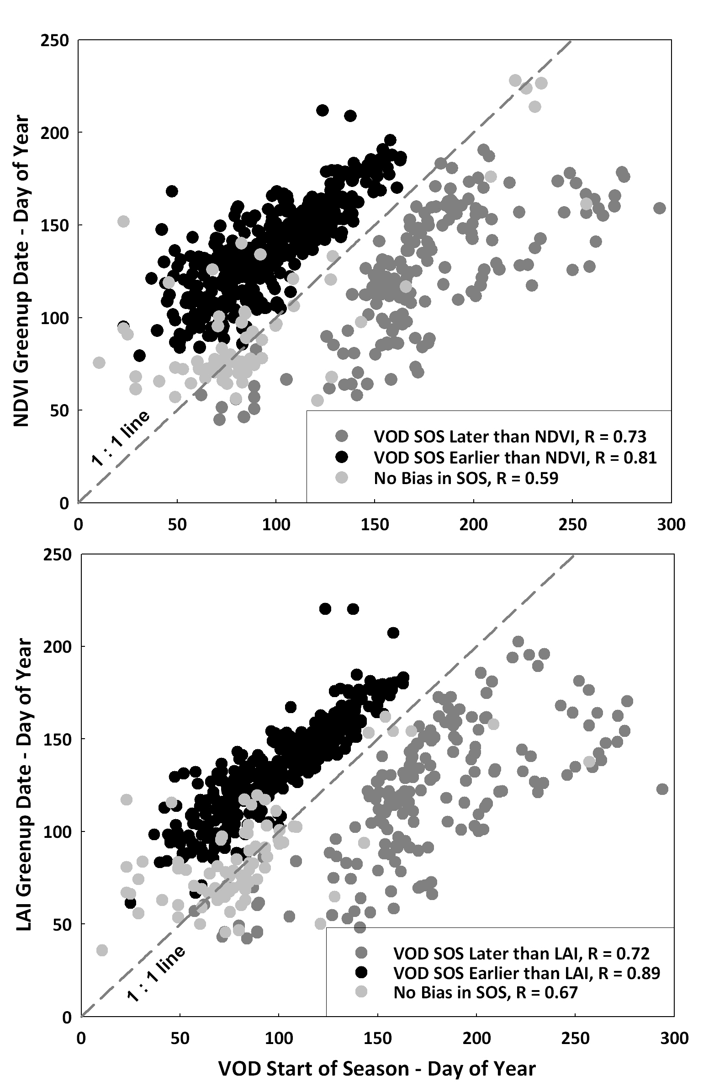
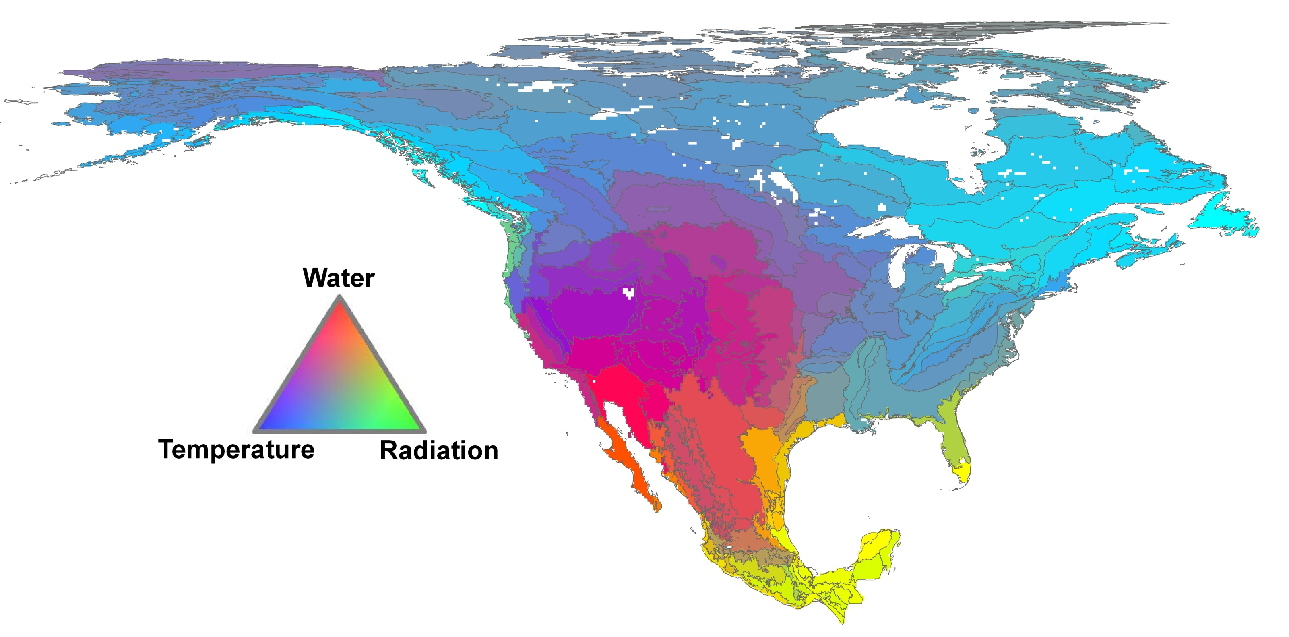
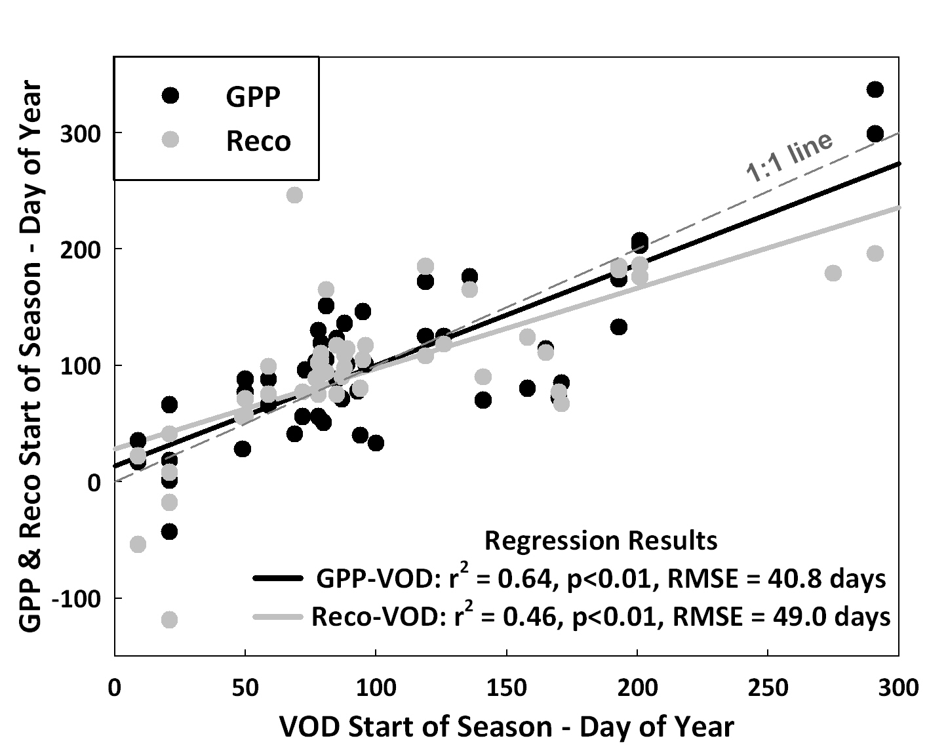
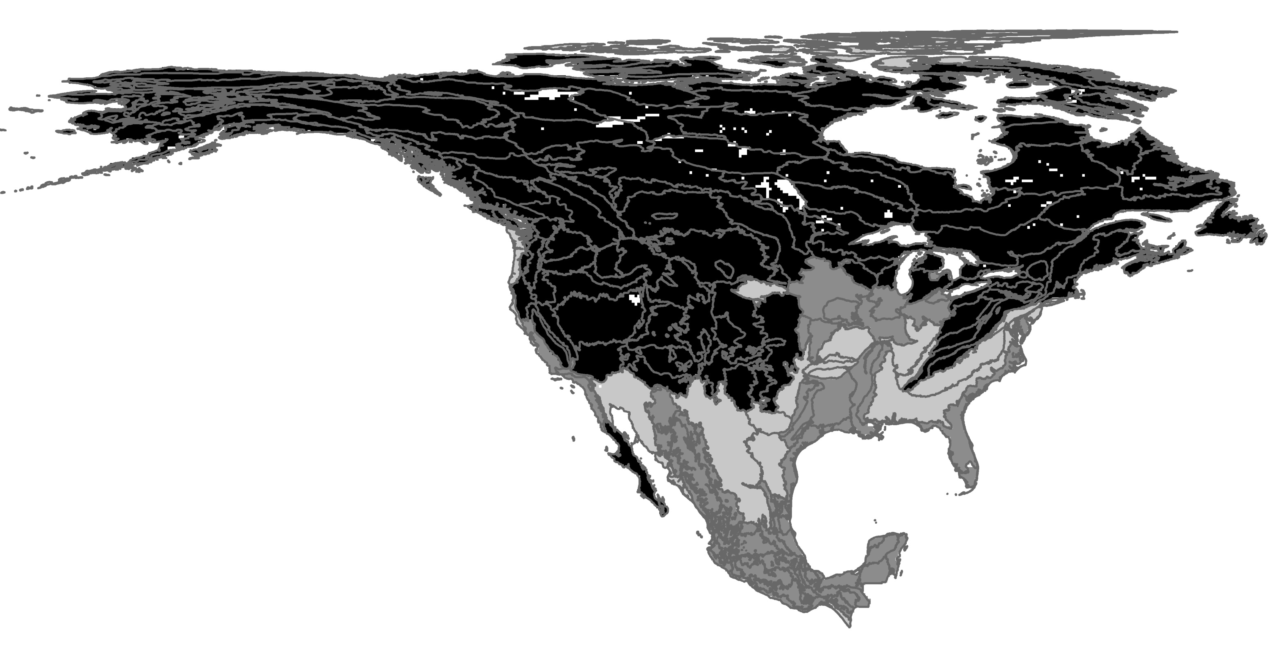
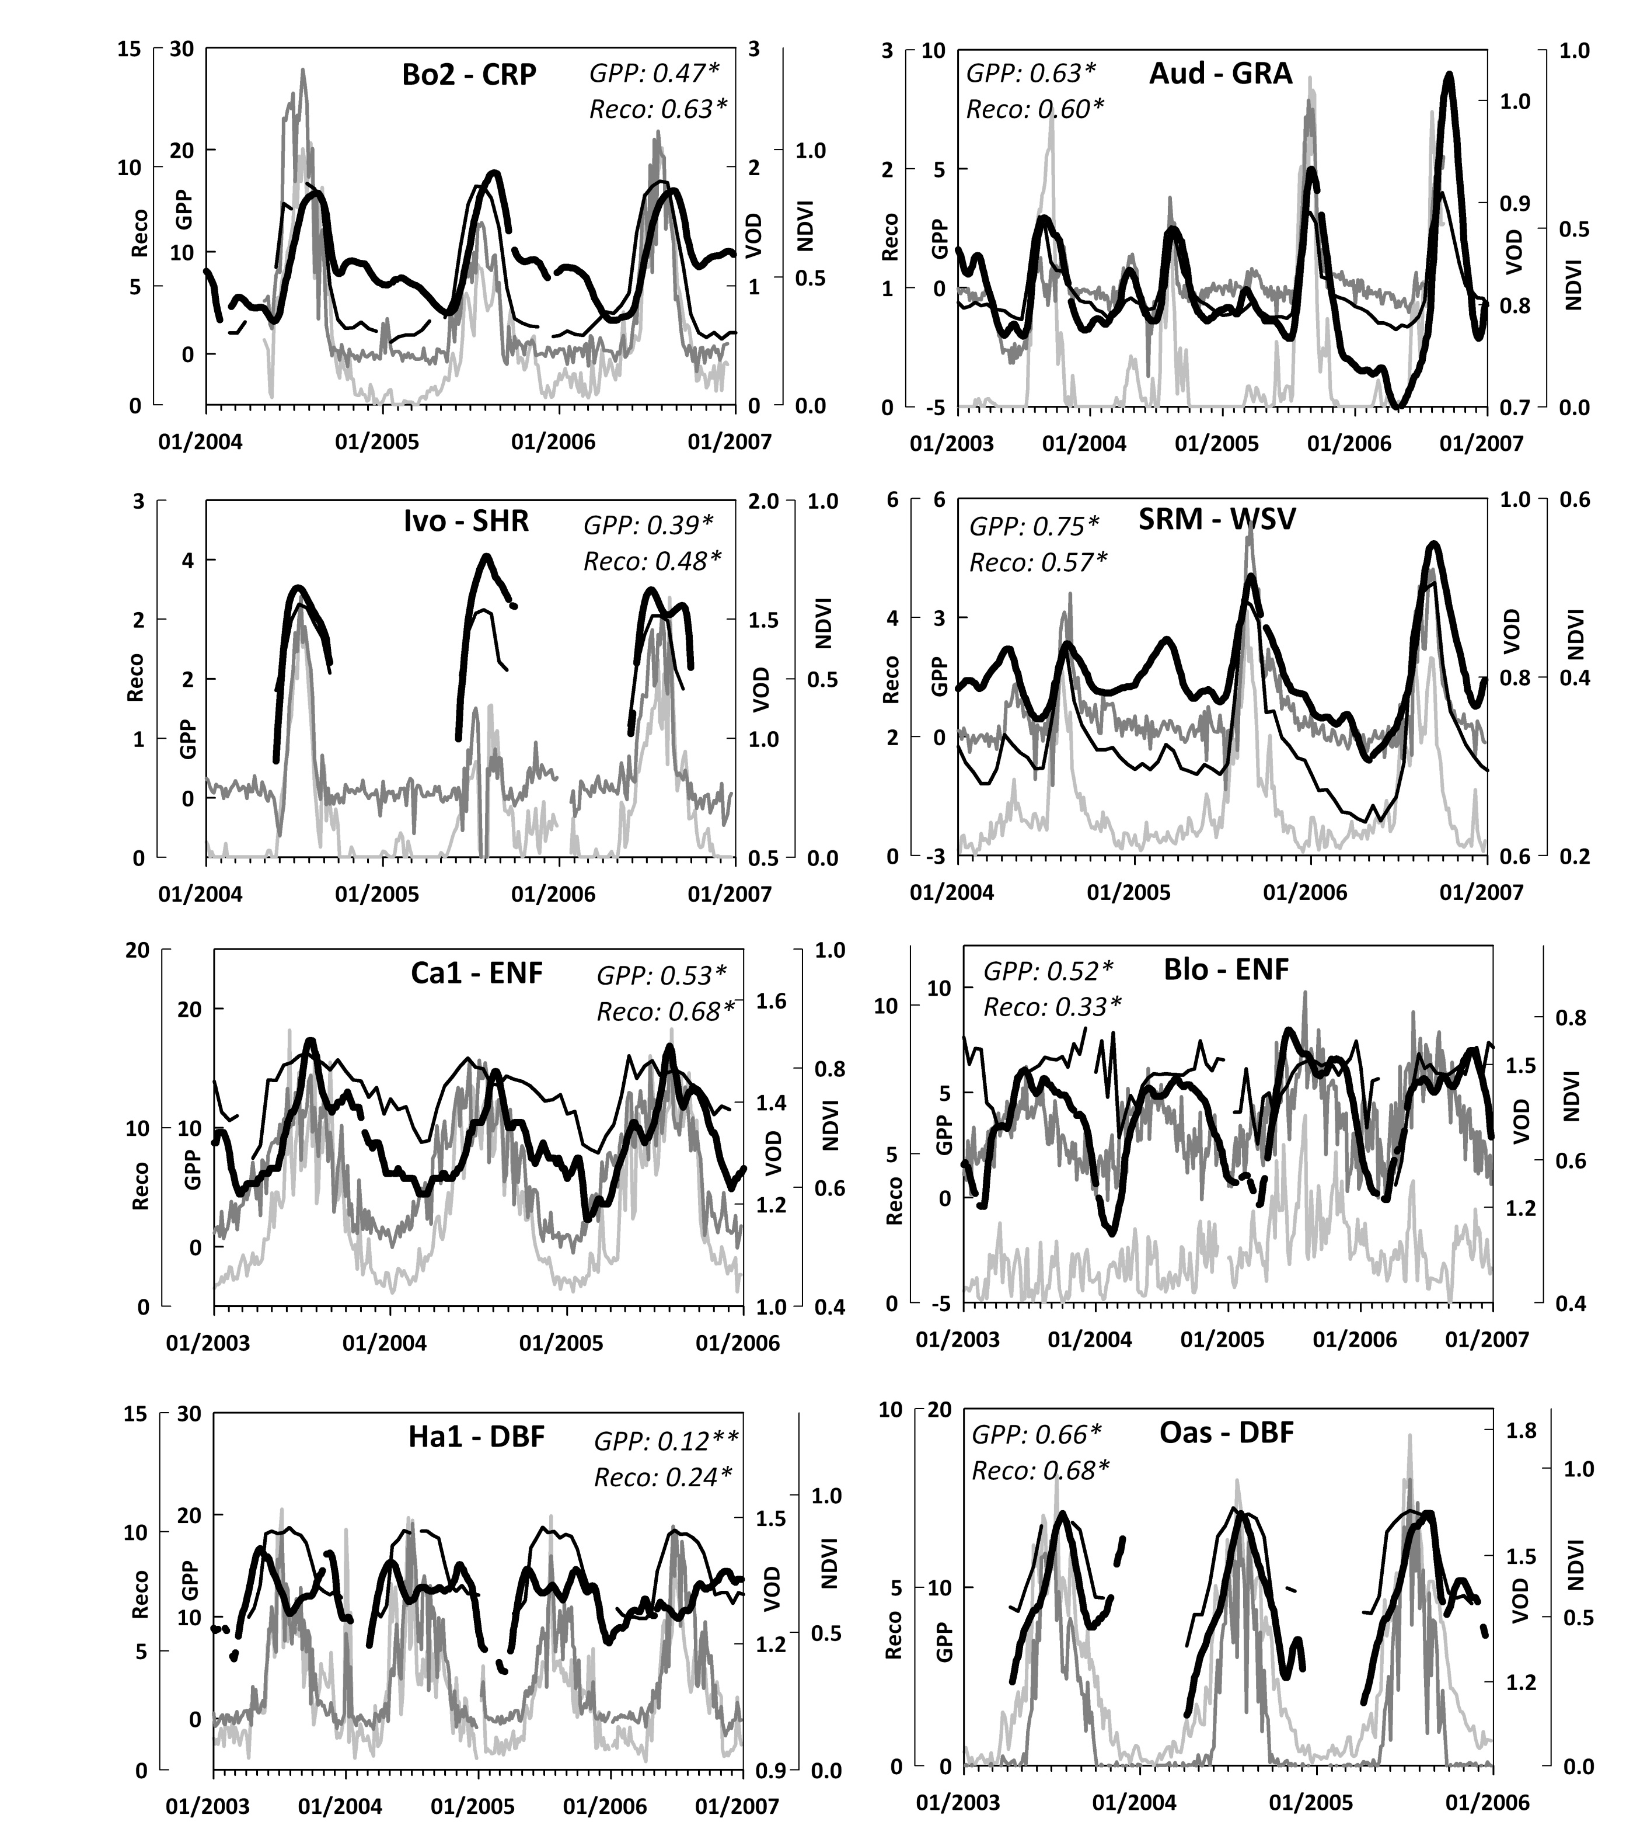
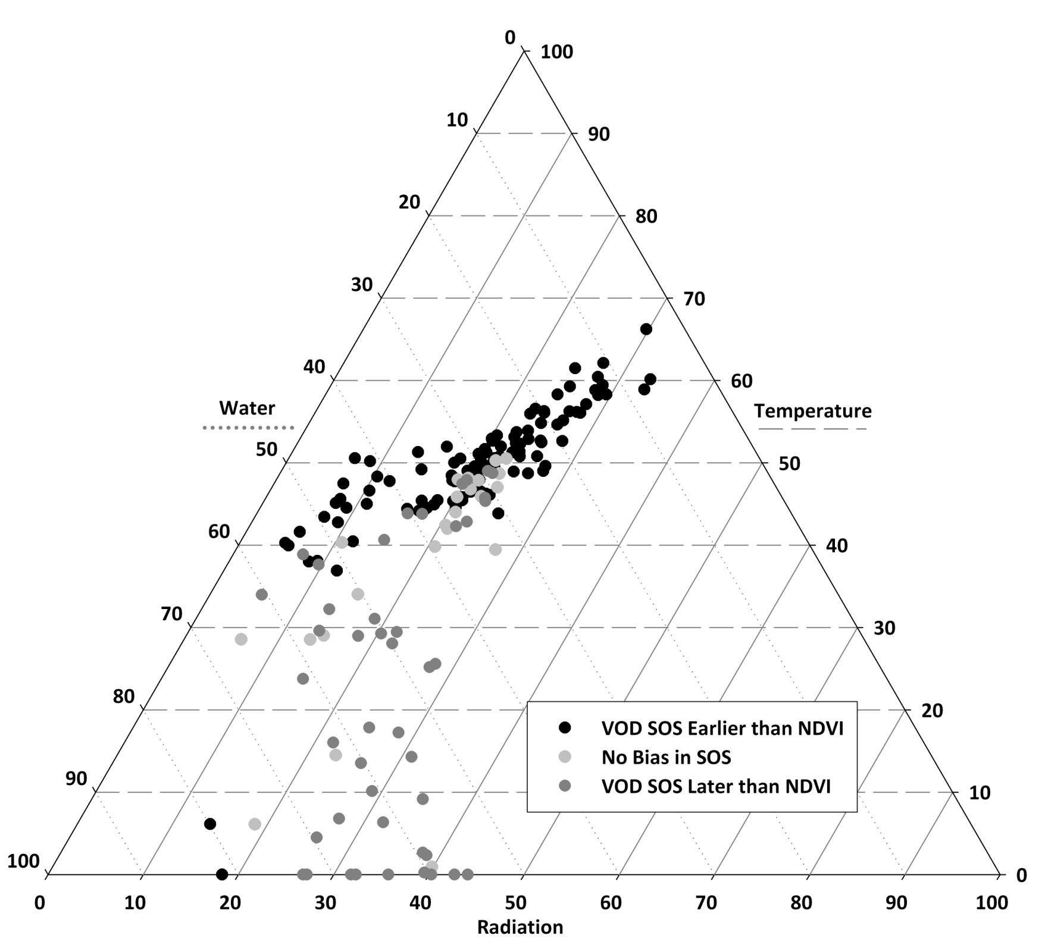
Satellite Microwave Detection of Phenological Start of Season for North America using AMSR-E Matthew O. Jones^{1,2}, John S. Kimball^{1,2}, Lucas A. Jones^{1,2}, Kyle C. McDonald^{3,4} ¹The University of Montana Flathead Lake Biological Station, Polson, MT ²Numerical Terradynamic Simulation Group, The University of Montana, Missoula, MT ³Jet Propulsion Laboratory, California Institute of Technology, Pasadena, CA
⁴CUNY Environmental Crossroads Initiative and CREST Institute, City College of New York, New York, NY Email Contact: matt.jones@ntsg.umt.edu Websites: www.umt.edu/flbs & www.ntsg.umt.edu
Abstract *
AMSR-E Global Vegetation Optical Depth (VOD) by Level III North America Ecoregion
The carbon cycle and land-atmosphere water and energy exchanges are influenced by the timing, rate and duration of vegetation phenology events. The Vegetation Optical Depth (VOD) parameter from satellite passive microwave remote sensing provides a unique phenology signal responsive to changes in canopy water content and biomass. The VOD signal is insensitive to atmosphere and solar illumination effects, and provides high (4-day or better) temporal fidelity at moderate (25-km resolution) spatial scales. We used VOD retrievals from AMSR-E 10.7 GHz, V and H polarization brightness temperature series with TIMESAT to classify vegetation start of season (SOS) phenology metrics over a four year record (2003-07) for North America at the Level III Ecoregion scale. The VOD SOS phenology metric at the ecoregion scale was strongly correlated (0.66<R<0.89) with MODIS-for-NACP NDVI and LAI Greenup Date and SOS derived from tower eddy covariance CO₂ flux measurements of gross primary productivity (R=0.80) and ecosystem respiration (R=0.68). In some regions microwave VOD displayed a temporal shift (SOS bias) relative to the optical-IR based Greenup Date that followed geographic patterns of climate constraints (temperature and water) on net primary productivity. The SOS bias is attributed to temporal differences in seasonality between canopy greenness versus canopy water content or biomass changes. The results indicate that the VOD signal captures changes in canopy water content and biomass, independent of NDVI greenness, which can better inform regional to global scale carbon, water and energy cycle models.
This work was conducted at the University of Montana and Jet Propulsion Laboratory under contract to NASA (NNH07ZDA001N-TE).
Daily 25 km resolution global EASE Grid brightness temperatures from AMSR-E were used to derive daily 10.7 GHz frequency VOD retrievals over a global domain; the VOD retrievals were temporally composited into 4-day median values and further scaled to Level III North America Ecoregions (left). The VOD¹ product integrates canopy attenuation related to vegetation canopy biomass and water content, while minimizing effects from sub-grid scale open water variability and soil moisture. The detailed VOD algorithm and analysis is described elsewhere^{1,2}. The AMSR-E VOD and global land parameter database is available online through the University of Montana (http://freezethaw.ntsg.umt.edu) and the NASA NSIDC DAAC (http://nsidc.org/data/nsidc-0451.html).
VOD Start of Season & NDVI Greenup Date 2004-2007 Mean
VOD Start of Season Bias & Climate Constraints on Net Primary Productivity
Tower Fluxes & VOD Start of Season
We selected 33 North America FLUXNET tower sites covering a range regional biomes. SOS estimates were derived from tower Gross Primary Productivity (GPP) and Ecosystem Respiration (Reco) fluxes using TIMESAT and regressed against VOD SOS for corresponding ecoregions (left).
Ecoregion level climate constraints on vegetation NPP³.
GPP, Reco, VOD and MODIS NDVI pixel-scale series are shown below for selected tower sites. The VOD is significantly correlated (0.12<R<0.75) with both ecosystem carbon uptake and respiration.
AMSRE VOD NDVI Reco GPP * p<.01 ; **p<.05
TIMESAT software was used to calculate VOD SOS by ecoregion (top). The MODIS-for-NACP NDVI Greenup Date mean was also calculated for each ecoregion (right).
VOD SOS earlier
VOD SOS later
No bias present.
Scatter plots and correlations of VOD SOS and MODIS-for-NACP NDVI and LAI Greenup Dates by ecoregion from 2003-07. Points are annotated by VOD SOS bias matching regions on the accompanying map (right).
VOD SOS bias by ecoregion relative to NDVI Greenup date.
The VOD displays a SOS bias (temporal shift) relative to the NDVI Greenup Date. The regional bias pattern coincides with major climate constraints to vegetation NPP (See center panel).
Summary
The VOD SOS bias pattern follows the distribution of low temperature and water constraints to NPP. Cold temperature constrained regions show generally earlier VOD SOS bias, while water constrained regions show later or no VOD SOS bias relative to NDVI spring Greenup Date.
The biases are attributed to VOD sensitivity to vegetation water content and canopy biomass versus NDVI sensitivity to vegetation greenness. Seasonal frozen temperatures constrain vegetation growth at higher latitudes and elevations. Spring thaw coincides with increasing plant-available moisture and a rise in canopy (stem, branch and leaf) water content, which precedes the vegetation green-up signal by ~4-6 weeks.
In water constrained regions VOD SOS is concurrent with or follows NDVI Greenup Date by up to 7 weeks; seasonal increases in canopy water content and green-up follow large precipitation events, while the VOD SOS temporal lag increases for higher woody biomass levels.
For croplands, VOD SOS and NDVI Greenup are influenced by planting and harvest dates, and associated changes in canopy cover and biomass; spring green-up coincides with initial growth stages, whereas VOD SOS occurs later under greater canopy biomass levels.
Acknowledgements & References
We thank the tower site principal investigators for the La Thuile Fluxnet Database used in this study. The MODIS-for-NACP MOD09PHN and MOD15PHN Collection 5 products were acquired via the ftp://ladsweb.nascom.nasa.gov site. We also thank Lars Eklundh and Per Jonsson for providing the free TIMESAT software package and the NASA Terrestrial Ecology Program for funding this research.
*Jones, M.O., Kimball, J.S, Jones, L.A., & McDonald, K.C. (2011). Microwave and Optical-IR Vegetation Land Surface Phenology Metrics: Comparisons at the Ecoregion Scale. Submission pending
¹Jones, L.A., Ferguson, C.R., Kimball, J.S., Zhang, K., Chan, S.K., McDonald, K.C., Njoku, E.G., & Wood, E.F. (2010). IEEE J-STARS, 3, 111-123.
²Jones, M.O., Jones, L.A., Kimball, J.S., McDonald, K.C. (2011). Satellite passive microwave remote sensing for monitoring global land surface phenology. Remote Sensing of Environment, 115, 1102-1114
³Nemani, R.R., Keeling, C.D., Hashimoto, H., Jolly, W.M., Piper, S.C., Tucker, C.J., Myneni, R.B., & Running, S.W. (2003) Science, 300, 1560-1563.
Ternary plot of climate constraints on vegetation NPP¹ by ecoregion; annotated by the VOD SOS bias.

