Slide 1
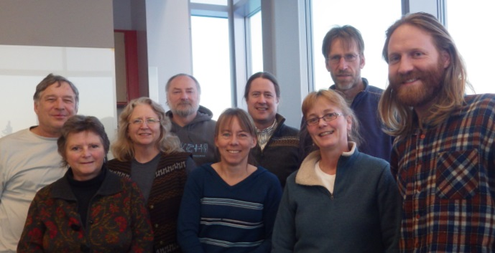



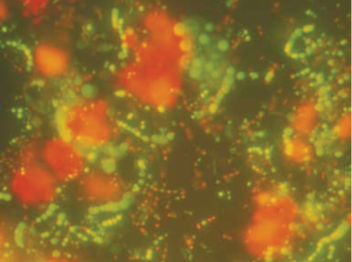
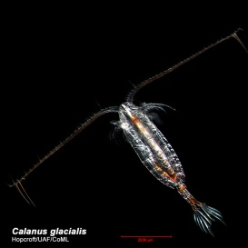
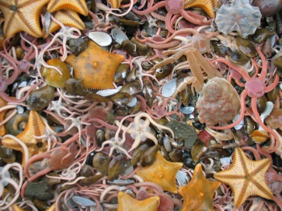
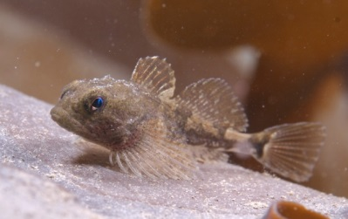
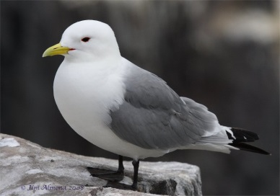
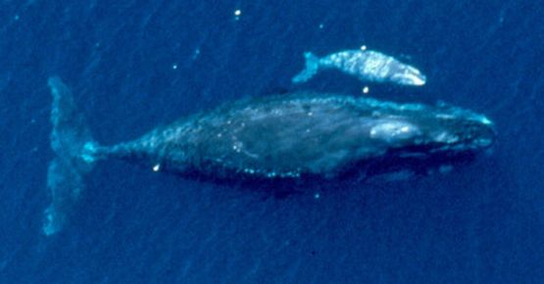
AMBON
Arctic Marine Biodiversity Observing Network
Demonstration project of a national network to monitor biodiversity in the Arctic from microbes to whales
Science partners
University of Alaska Fairbanks: Katrin Iken, Seth Danielson, Russ Hopcroft, Eric Collins, Bodil Bluhm, Franz Mueter
University of Maryland: Jacqueline Grebmeier, Lee Cooper
University of Washington: Kate Stafford
NOAA: Sue Moore
USFWS: Kathy Kuletz
AOOS/Axiom: Rob Bochenek, Molly McCammon
Funding partners
AMBON PI meeting, Jan 2015
All BON meeting
24 April 2014, College Park
Arctic biodiversity from microbes to whales

Slide 2
Goals
To continue time series and close current gaps in taxonomic and spatial coverage in biodiversity observations on the Chukchi shelf.
To integrate and synthesize with past and ongoing research programs on the US Arctic shelf into an Arctic biodiversity observation network with publicly accessible data.
To demonstrate how a sustainable observing network could be developed for this and other regions and ecosystems.
To link with international programs on the pan-Arctic level.
Arctic biodiversity from microbes to whales

Slide 3
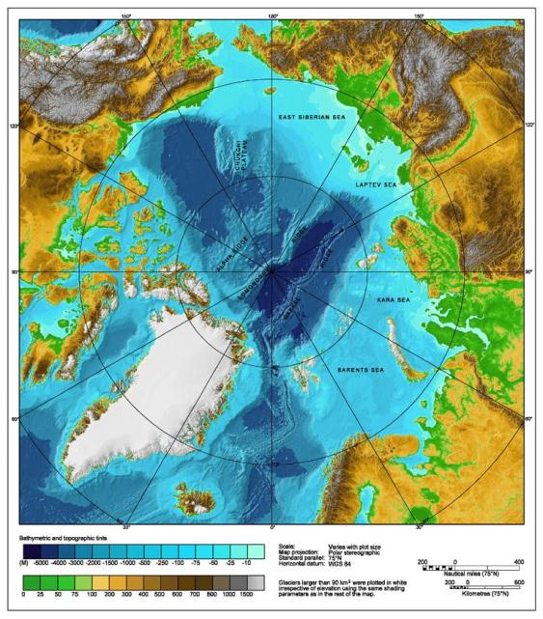
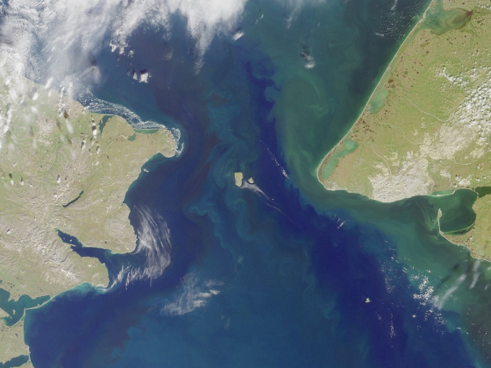
The Arctic Chukchi Sea
Inflow shelf
Bering Strait connection:
82 km wide, ~50 m deep
Shallow shelf (~ 50 m)
Receives nutrient-rich water from Gulf of Anadyr
Freshwater inflow from Yukon River

Slide 4
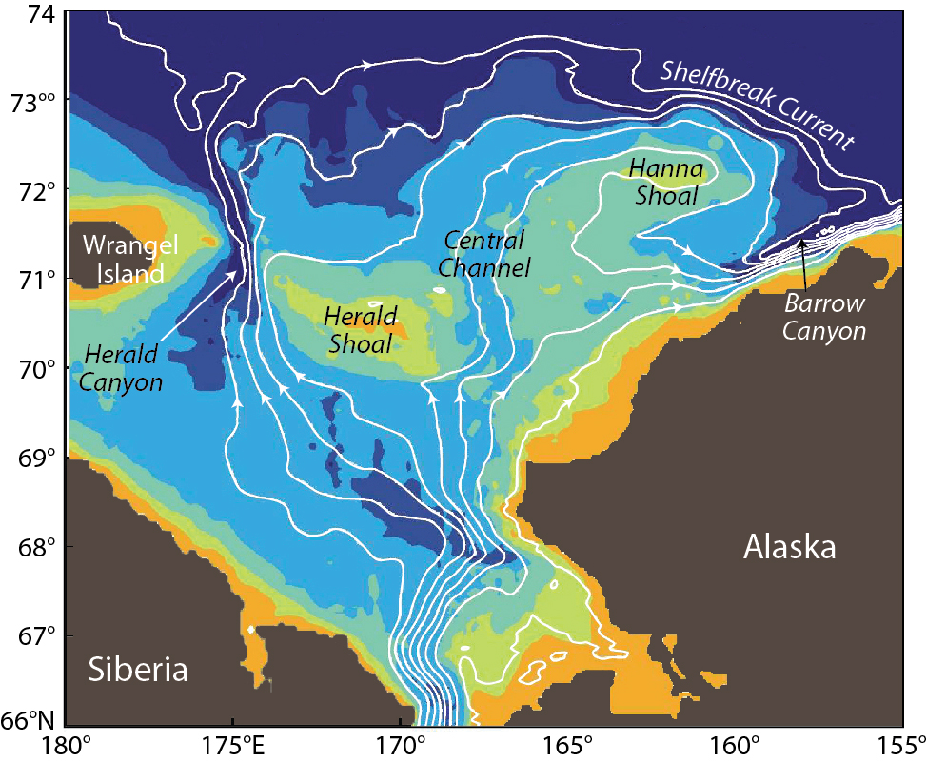
The Arctic Chukchi Sea

Slide 5
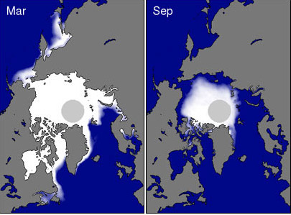
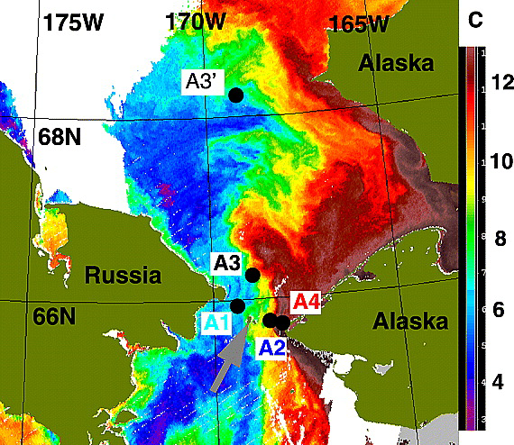
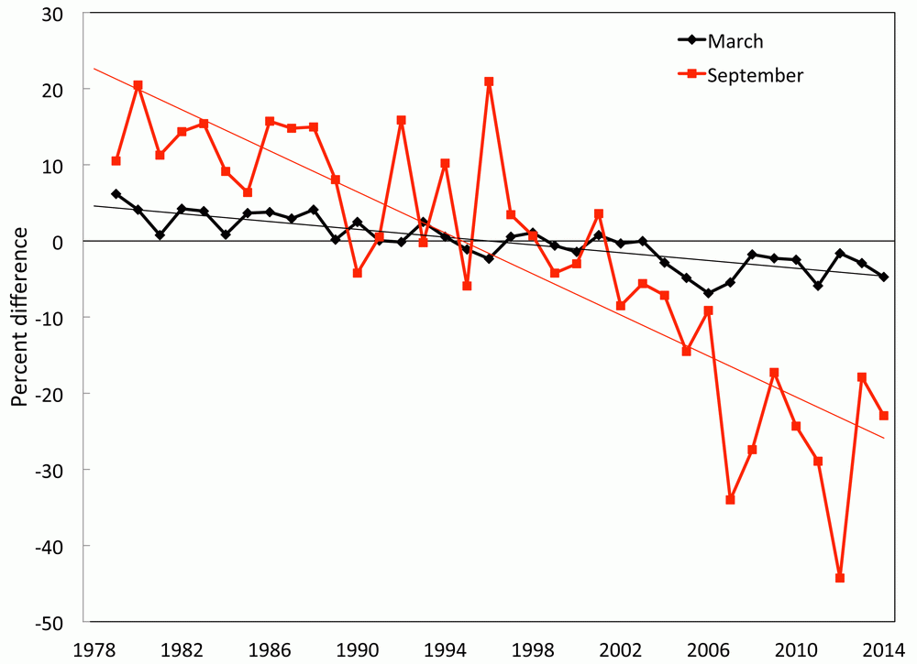
Region of change
Increased sea ice melt
Record low sea ice cover in 2007, 2012
Increased freshwater and heat influx by ~50% since early 2000’s

Slide 6
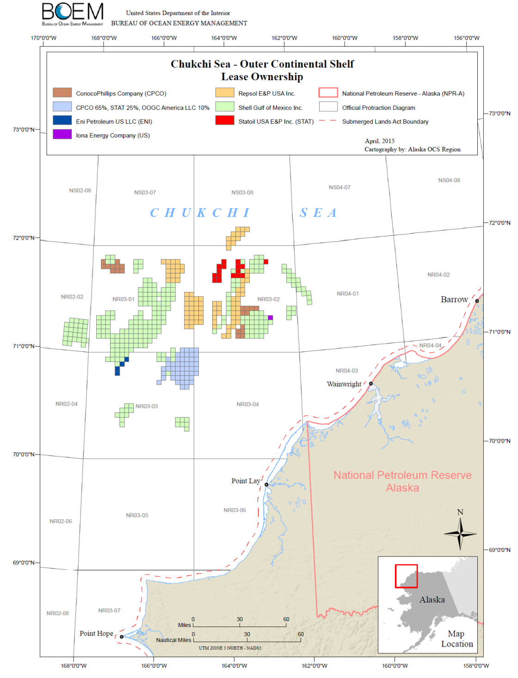
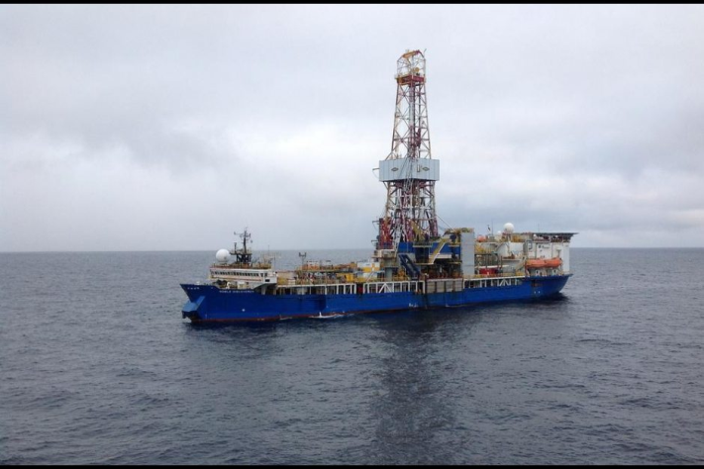
Region of industry interest
Oil and gas lease sales
2012 drilling of pilot holes
Approval process for 2015 drilling
Environmental assessment needs
Need for regulatory assessments
NEPA

Slide 7
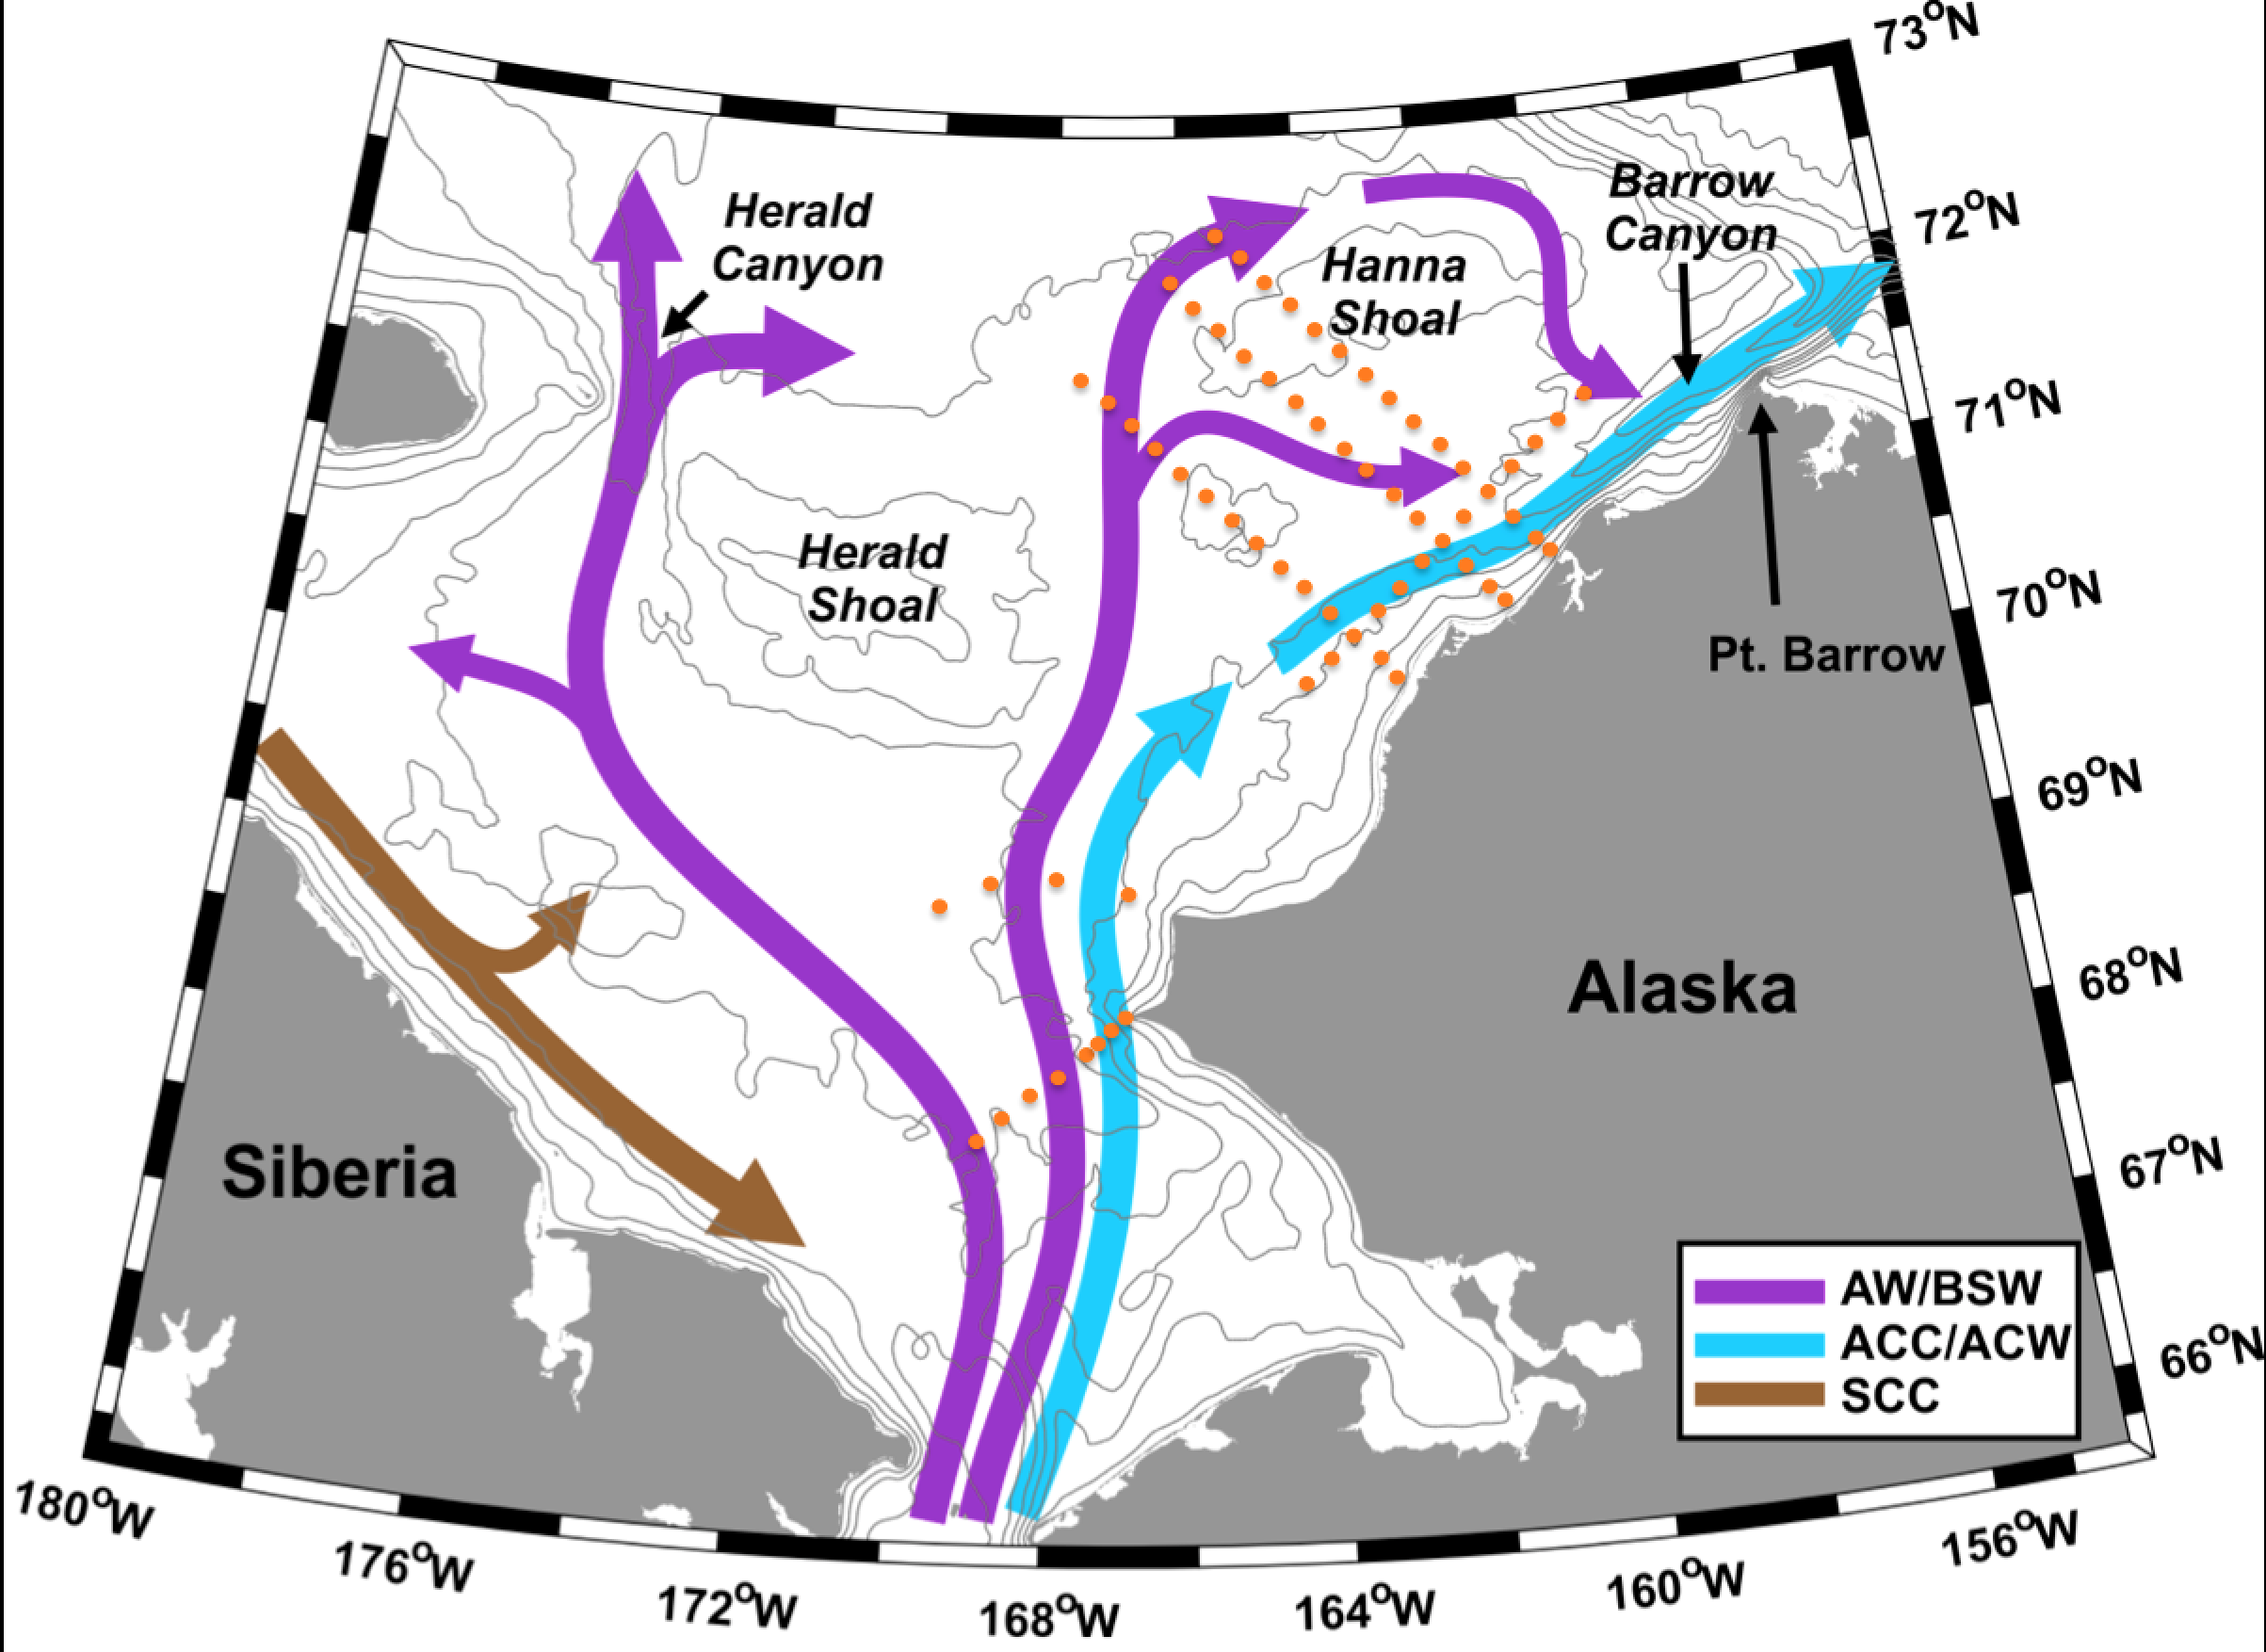
AMBON survey transects

Slide 8
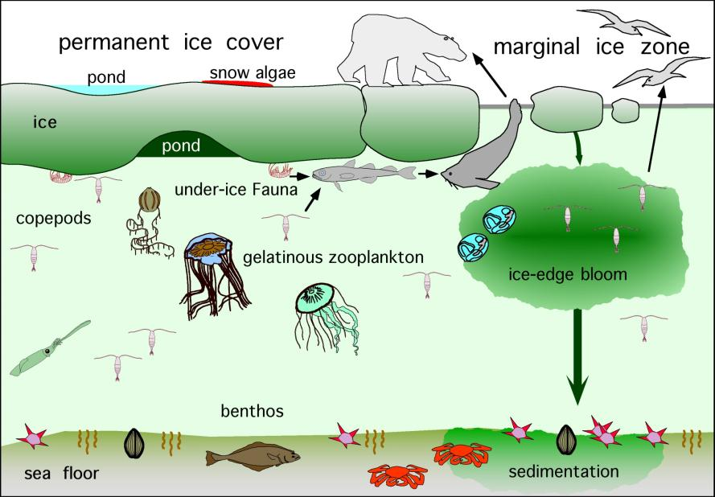
The Arctic ecosystem

Slide 9
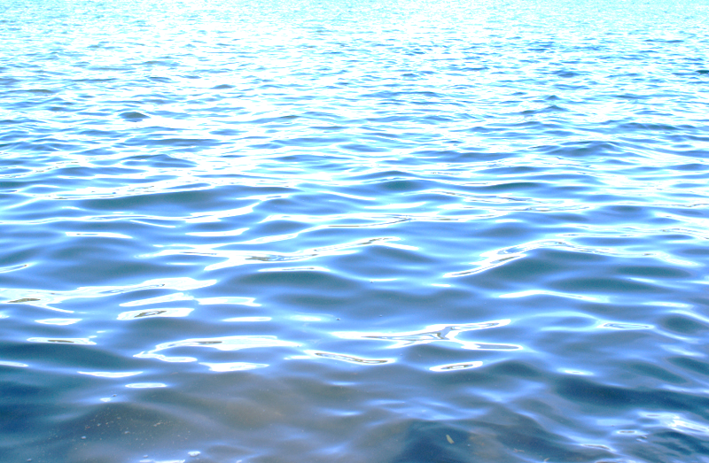
What do we measure?
Environment
Hydrography (synoptic measurements,
link to long-term moorings)
Chlorophyll a (water column, sediment)
Nutrients (nitrate, ammonia, silicate,
phosphate)
Sediment (grain size, organic content, δ¹³C and δ¹⁵N)

Slide 10
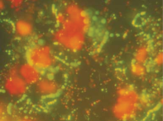
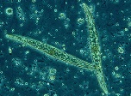
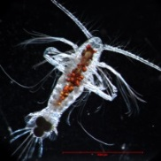
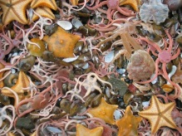

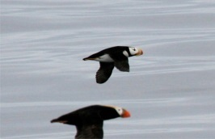
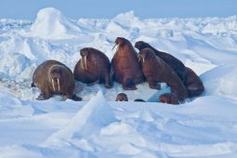
What do we measure?
Biodiversity
Microbes – water column and sediment microbes
Phytoplankton – species composition
Zooplankton – zooplankton diversity
Benthos – infauna and epifauna , also meiofauna
Fish – demersal fish diversity
Seabirds – seabird observations
Marine mammals – seals and whale observations

Slide 11
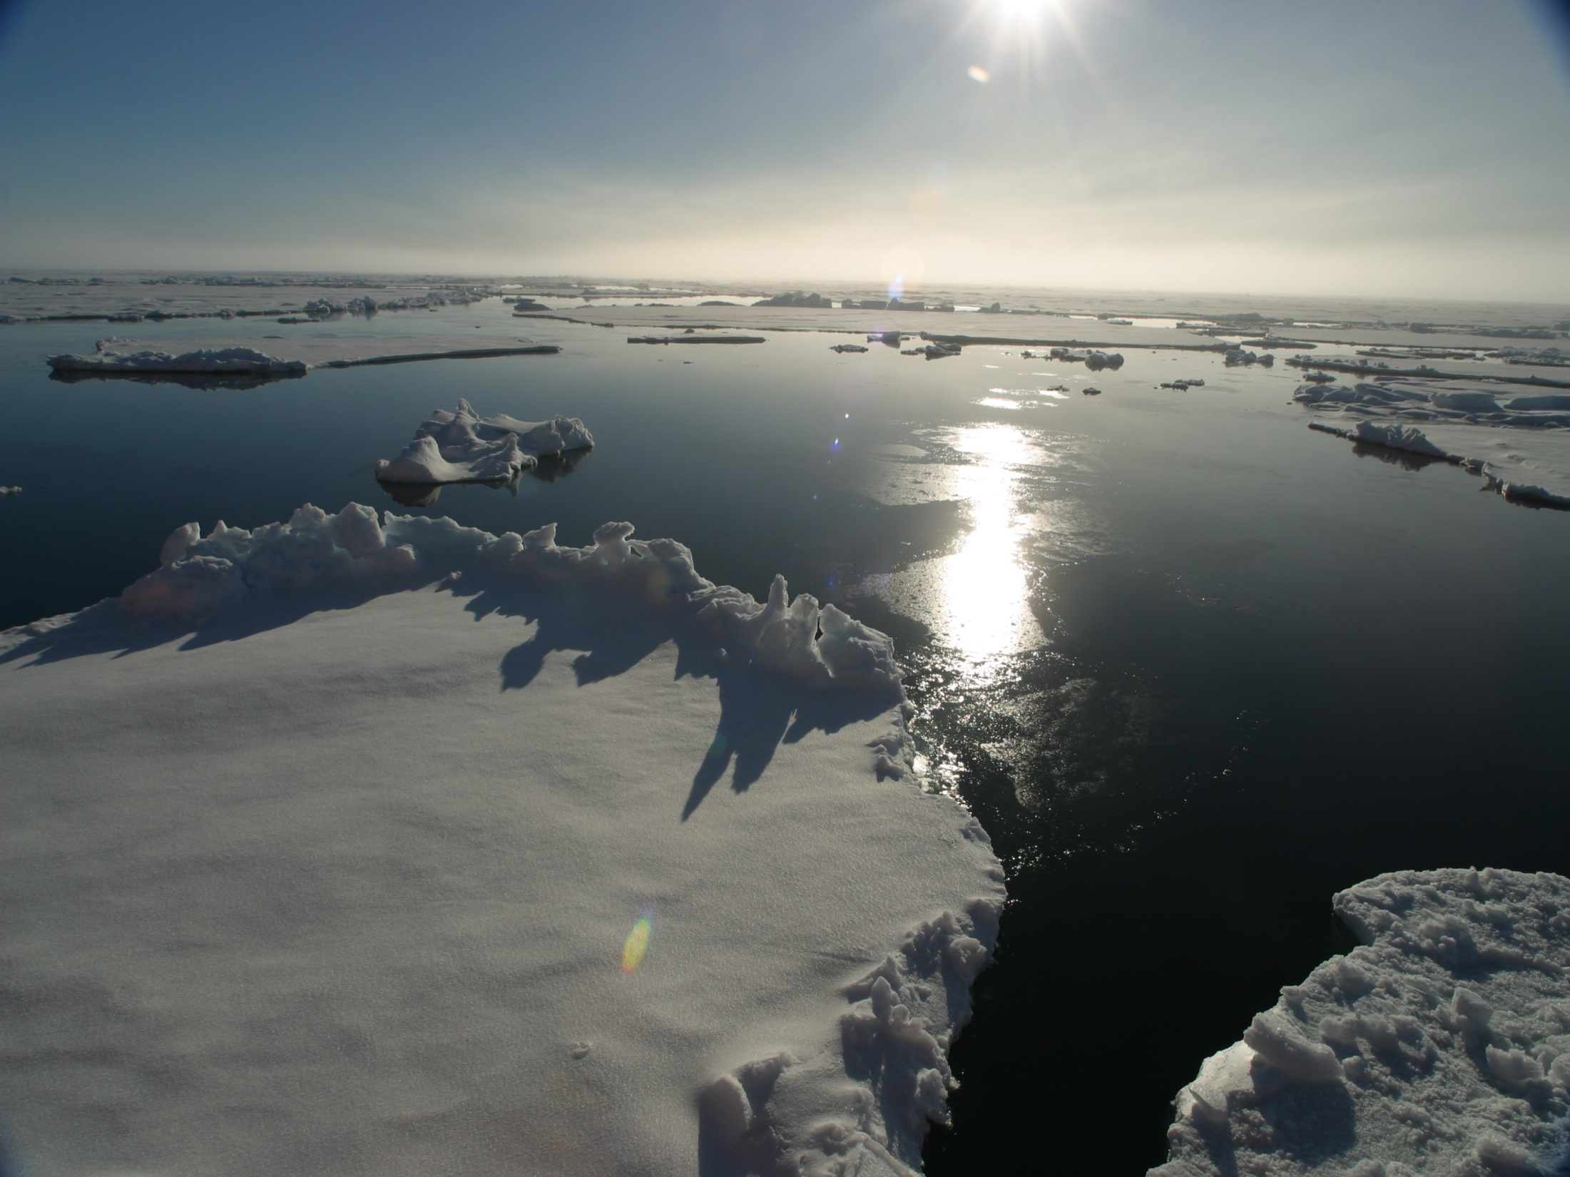
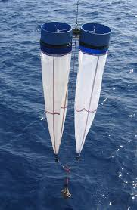
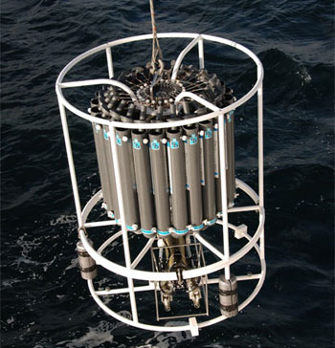
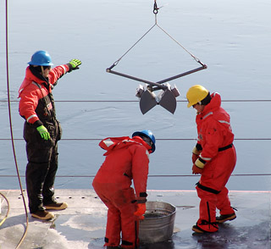
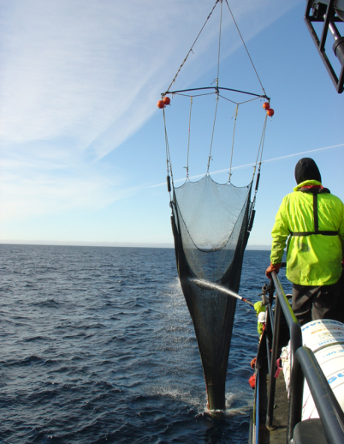
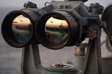
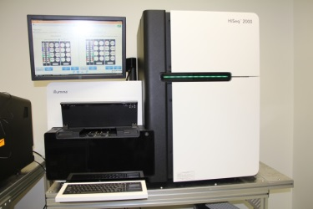
Tools
Zooplankton nets
CTD – physics, phytoplankton, microbes
Grab – sediment, infauna, microbes
Trawl – epifauna, fish
Observation – birds, mammals
Next generation sequencing –
microbes
meiofauna

Slide 12
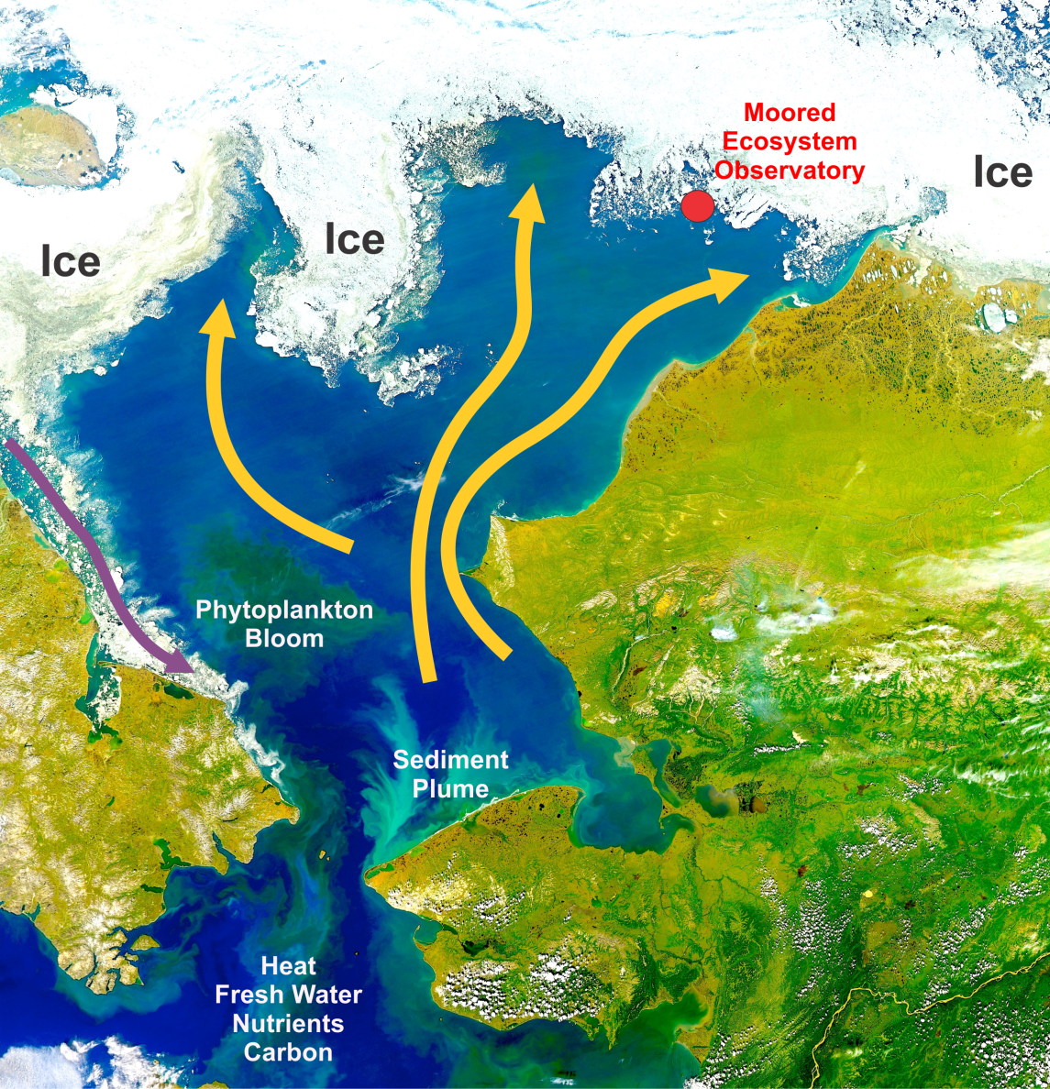
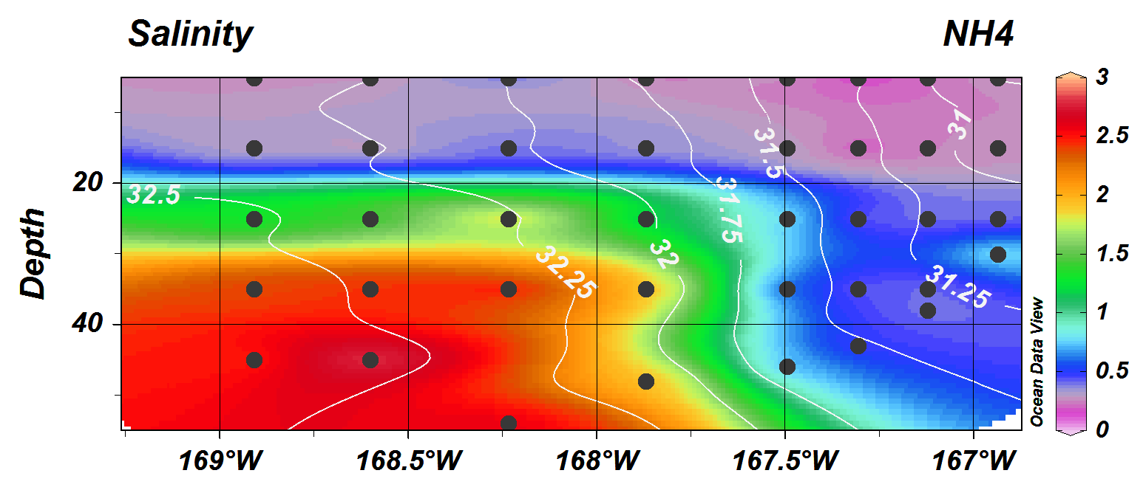
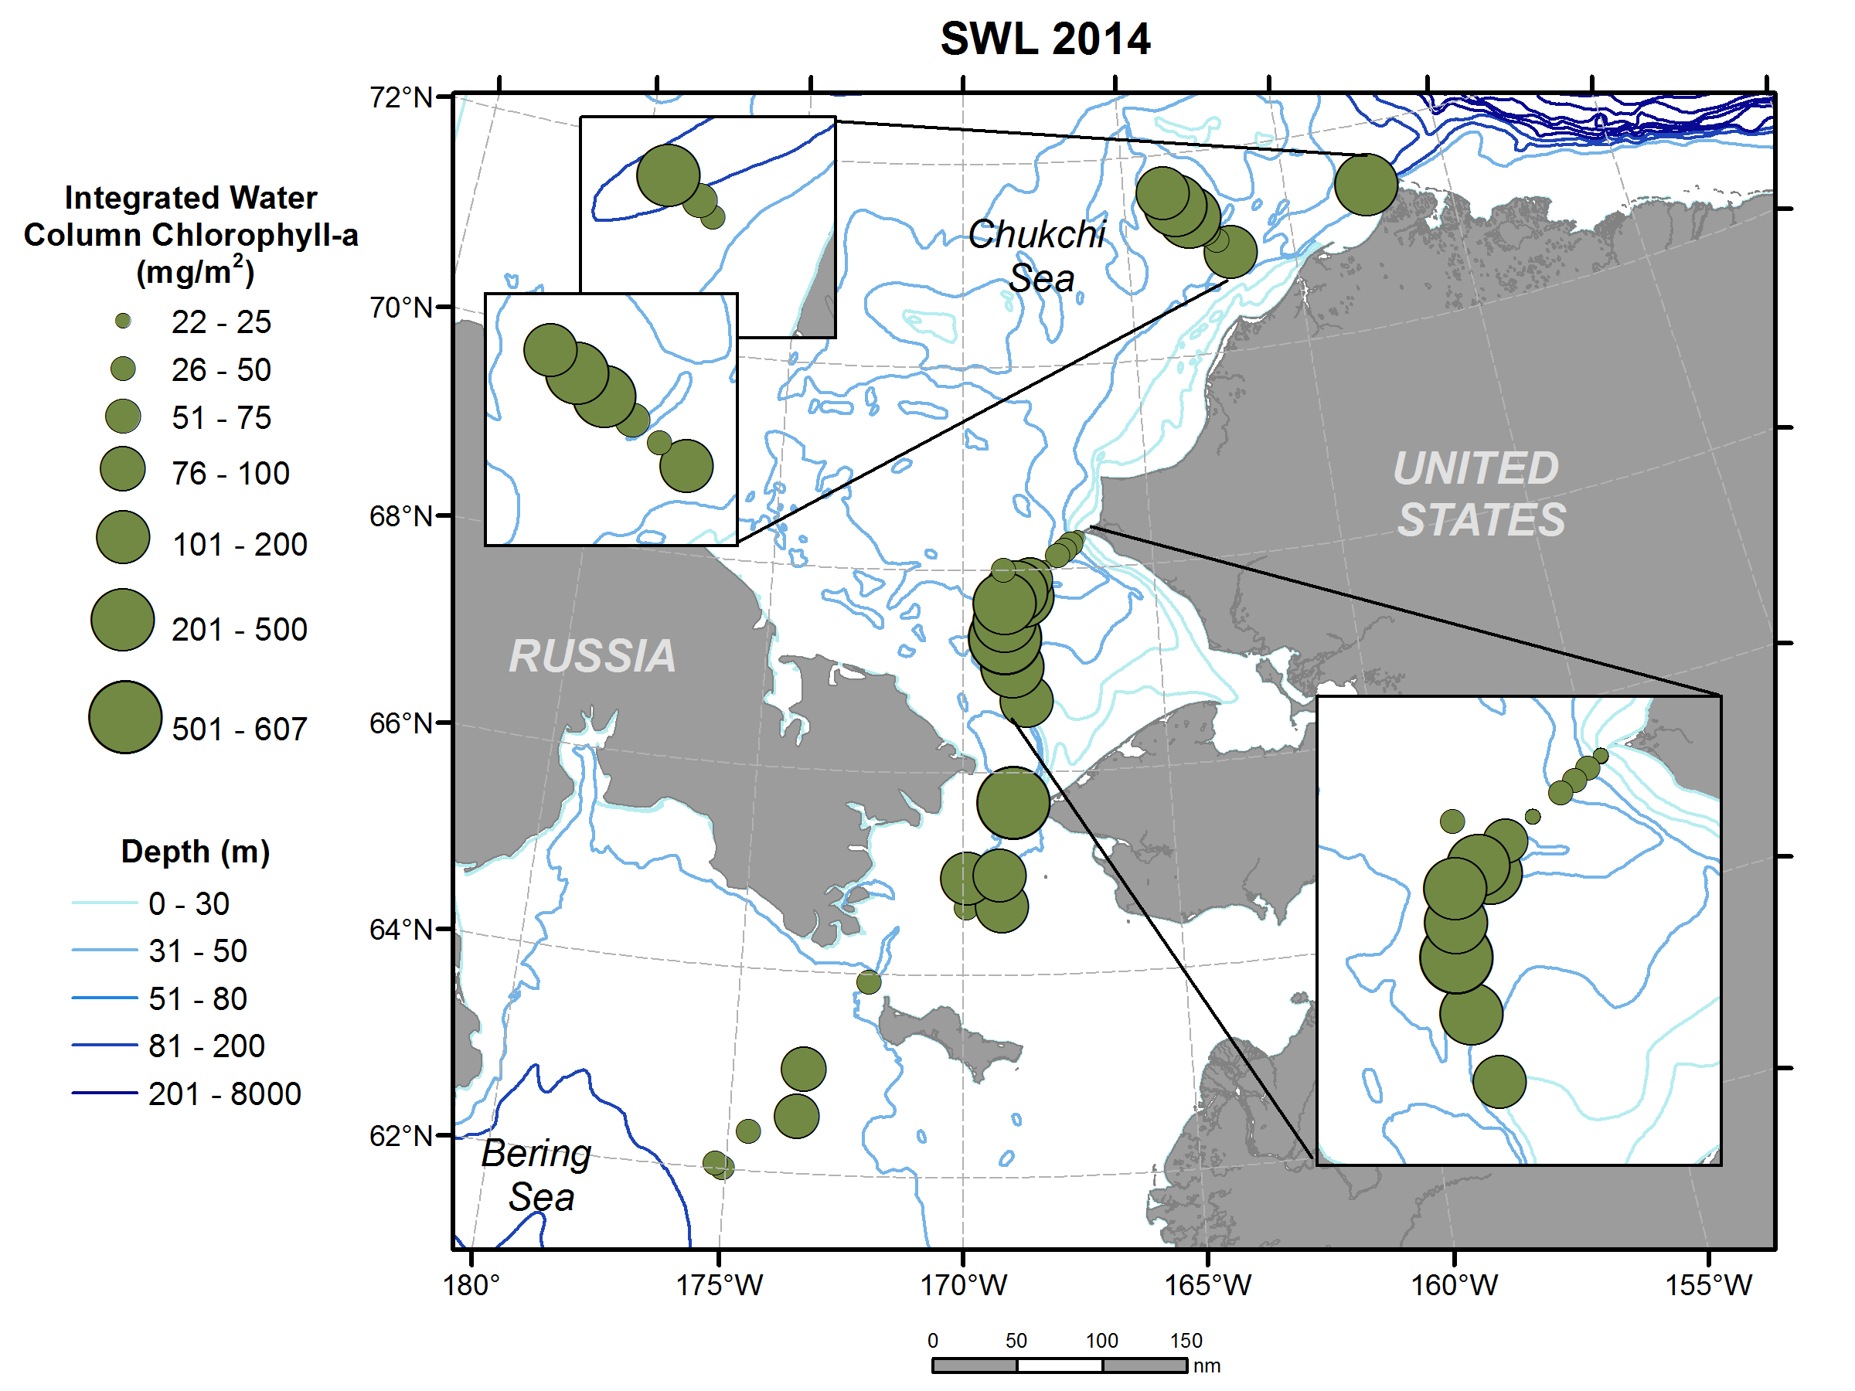
Hydrography
Differences in water masses
Nitrate (W to E)
Integrated Chl-a

Slide 13
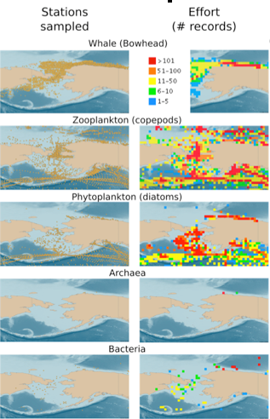
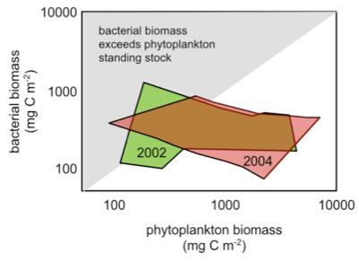
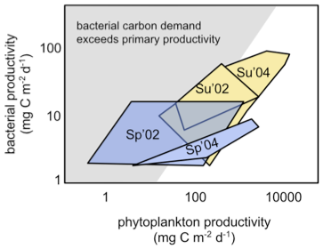
Mircobes
data from OBIS (Ocean Biogeographical Information System)
Replotted from Kirchman et al. 2009
Notes:
On the left is plotted some of the few abundance/productivity measurements of bacterioplankton from the Chukchi Sea, showing that they sometimes outweigh the phytoplankton, and are often in a position to utilize all of the primary productivity for bacterial production, which has consequences for higher trophic levels. On the right is plotted information from OBIS, showing that the bacterioplankton and archaeaplankton are vastly undersampled compared to traditional monitoring targets like mammals, zooplankton, and even phytoplankton [left panel shows sampling stations, right panel shows # of records in each grid cell].

Slide 14
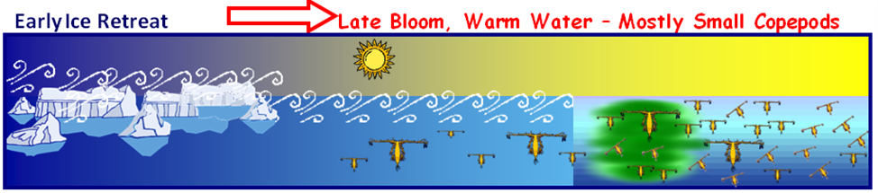
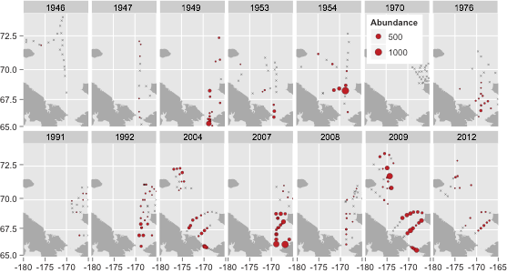

Zooplankton
Metridia pacifica
Pacific immigrant
More abundant
Reaches farther north

Slide 15
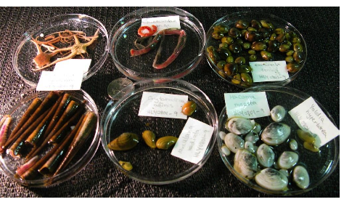
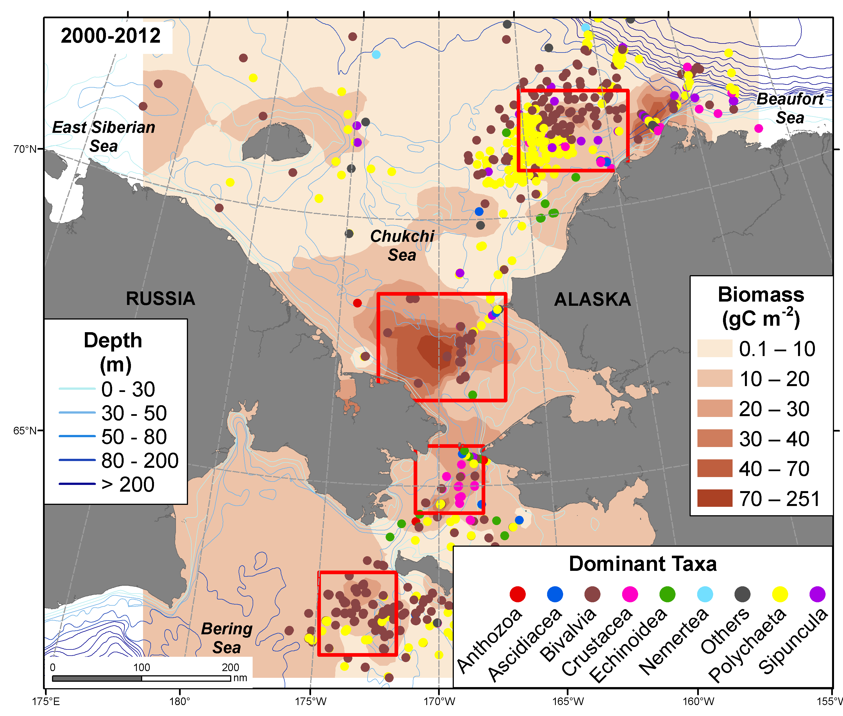
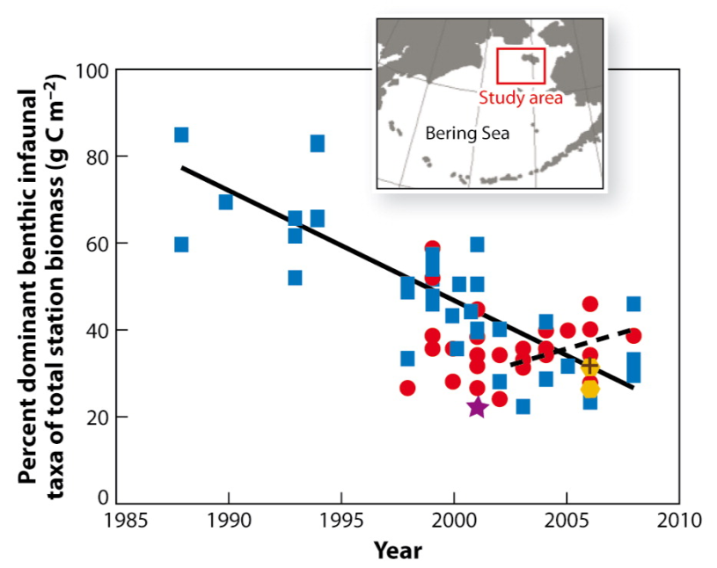
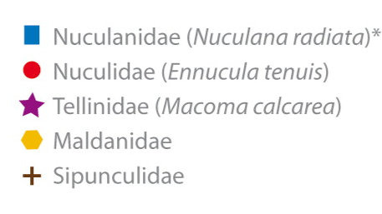
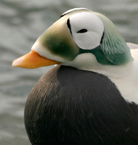
Tight pelagic-benthic coupling
Biomass hotspots important feeding regions for birds and mammals
Changing bivalve community poses energetic challenges to eiders
Infauna

Slide 16
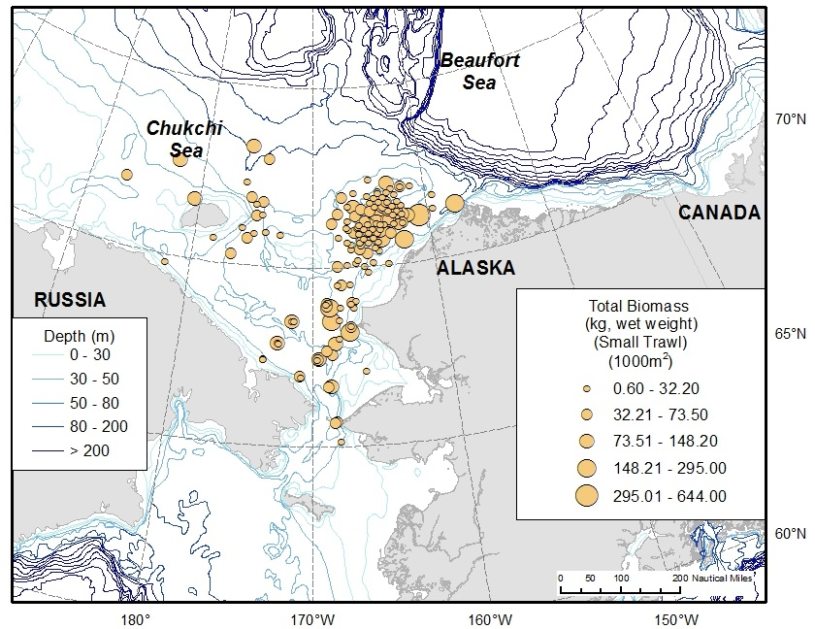
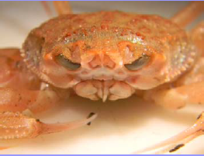
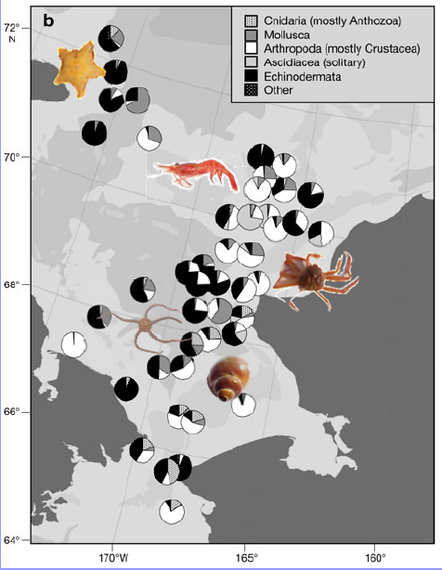
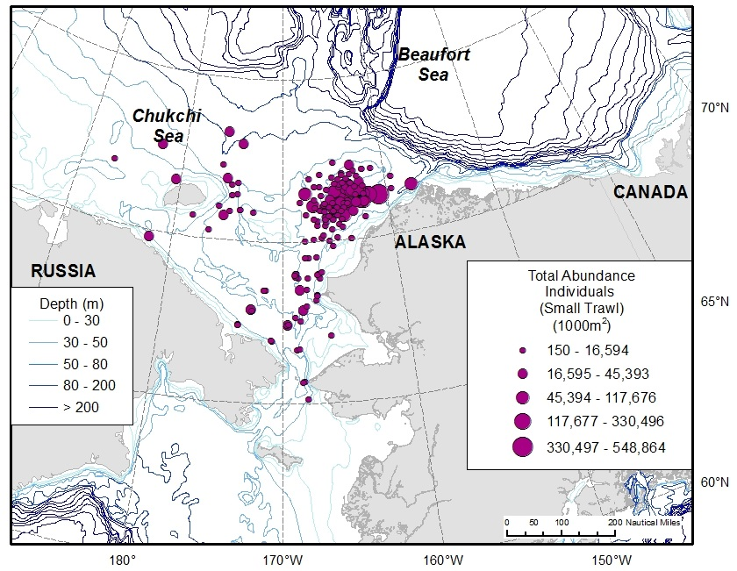
Epifauna
Important in mineralization
Food for higher trophic levels
Species of commercial interest?

Slide 17
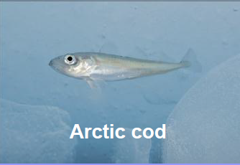
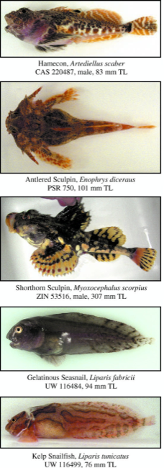

Species richness
Fishes

Slide 18





Seabirds
~40 species
Local breeders
Migrants
Auklet
Interannual variability in distribution and abundance
Link to environmental conditions and food
Long-term change in dominant feeding guilds?
Foraging ‘groups’:
Surface feeders
Planktivores, Piscivores
Sub-surface (divers) Planktivores, Piscivores
Benthic feeders
Eiders, seaducks
Omnivores
Shearwaters, Gulls
Feed on copepods, some krill & fish;
Nest in N. Bering Sea
Shearwater
Omnivorous on krill & fish.
Migrate to Alaska for summer
Notes:
In the AMBON study area, there are about 40 species of marine birds, but about 10 species account for the majority of birds present. We will conduct seabird surveys during daylight hours along the track lines between sampling stations. Bird density (birds/km2) will be calculate and used to determine what factors drive seabird community structure and distribution. The seabird species can be broken into feeding guilds for some analyses.

Slide 19









Marine mammals
Chukchi is important migration corridor and feeding ground for bowhead whales
35,000 walrus hauled out in Point Lay, AK in 2015
Diminished sea ice causes central place foraging
Increasing sub-Arctic species including fin, humpback, minke and gray whales

Slide 20

Functional diversity – food web
δ¹³C and δ¹⁵N

Slide 21


Data management

Slide 22

Data management – Workspace

Slide 23

Public Database

Slide 24
Timeline
PSG meeting
2015
AMSS
All BON meeting
Sample analysis, data entry
1
2
3
4
5
6
7
8
9
10
11
12
CBMP meeting
cruise prep
1st cruise
PI meeting
CBMP meeting
Gordon conference
Arctic Summit Week
Local outreach
Workspace created
2016 – cruise
2017 – cruise
2018 – analysis, integration, assess sustainability
2019 – synthesis, integration, assess sustainability

Slide 25



Outreach
Targeted venues:
Arctic indigenous peoples
Port of call, cruise reports, community meetings
Website
Project info, updates, link to database
Museum of the North
Talks, exhibits, classroom visits
ID guide, Activity books, etc
Online resource through website
Teachers at Sea program
Lesson plans, etc.
Newspaper contributions
Local, national, international
Children activity book developed during Census of Marine Life Program

Slide 26
Leveraging – Links to other programs
Regional (Arctic)
Other arctic field programs
Arctic data bases, data integration
AMBON
National
Other marine BON
St. Barbara Channel Islands
Florida and California Sanctuaries
International
CBMP (Arctic Council)
PAG (Pacific Arctic Group)
Geo-BON
Databases (e.g., OBIS)

Slide 27









Links – Regional
Distributed Biological Observatory (DBO)
DBO sites are regional productivity and biodiversity “hotspot” areas along a latitudinal gradient
Sites occupied by national and international entities with shared data plan
Link to AMBON sampling for seasonal resolution and comprehensive ecosystem component sampling
Leverage satellite image analysis
[modified by Karen Frey from Grebmeier et al. 2010, EOS 91]

Slide 28


Links – Regional
Russian American Long-term Census of the Arctic (RUSALCA)
2004, 2009, 2012
Conduct long-term research to better understand causes and consequences of the reduction of ice cover in the arctic Chukchi Sea.
Focus on physical measurements (incl. moorings) with biological sampling every ~4 years
Across US-Russian Chukchi region
AMBON uses RUSALCA “long-term” lines for sampling, coordinated data structure, adds ecosystem components, uses moorings as long-term environmental context, extension into Russian waters
NOAA-OE
2016 ?
2016, 1018, 2020 (?)

Slide 29



Links – National
Other MBON
3 Demonstration Projects
Arctic MBON
Marine Sanctuaries MBON
Santa Barbara Channel MBON
Each with historical data and biodiversity measures
Identify common biodiversity metrics
Use common data management platform
Coordinate genetic sampling and analysis
Common goal of demonstration and sustainability

Slide 30




Links – International
Circumpolar Biodiversity Monitoring Program
Working group of Arctic Council under CAFF
Assess pan-Arctic marine biodiversity trends under pressures such as
climate change, contaminants, shipping, fishing, etc.
Coordinated pan-Arctic monitoring programs (indicators)
Link to AMBON through CBMP expert members (microbes, plankton, benthos, mammals), “State of the Arctic Marine Biodiversity Report”, link to Arctic Biodiversity Data Service
CBMP partners: • Global Biodiversity Information Facility (GBIF)
• Group on Earth Observations Biodiversity Observation Network (GEO BON)

Slide 31

Links – International
GEO BON task team MBON
Coordinate biodiversity monitoring efforts internationally
Identify useful (and practical) biodiversity measurements
What are good and useful universal metrics?
Integrate across multiple temporal and spatial scales
Quantitative data in environmental setting ?
Data sharing platform, data management
→ e.g., OBIS

Slide 32

Questions?

