Slide 1
REVISED Terrestrial Ecology Agenda
8:30 AM Welcome – Logistics, Agenda [Peter Griffith, NASA GSFC/Sigma; Diane Wickland, NASA HQ]
8:40 AM Terrestrial Ecology Program Update and Meeting Goals [Diane Wickland, NASA HQ]
9:10 AM Next Terrestrial Ecology Field Campaign [60 min]
o Heritage and Scoping Studies from TE08 Solicitation [5 min]
o Update on Challenges and Opportunities in Remote Sensing of Global Savannas [15 min / Niall Hanan, South Dakota State University]
o ABoVE [15 min / Eric Kasischke, University of Maryland]
o Review of ABoVE Scoping Study Report [15 min / Fred Huemmrich, NASA GSFC/UMBC]
o NASA Recommendation on ABoVE (if known) [10 min /Diane Wickland, NASA HQ]
10:10 AM BREAK

Slide 2
REVISED Terrestrial Ecology Agenda
10:40 AM Reports from TE Working Groups [15 min each]
o Data Products and Data Access [Bob Cook, ORNL]
o Modeling [George Hurtt, U. Maryland]
o Vegetation Structure [Ralph Dubayah, U. MD and Forrest Hall, UMBC]
o Airborne Science [Dar Roberts, U. California Santa Barbara]
o Field Campaigns [Fred Huemmrich, NASA GSFC/UMBC]
11:55 AM LUNCH
1:30 PM Open Discussion of Issues / Challenges / Opportunities for TE Program (to identify topics for break-out discussions and follow-on action) [60 min.]
2:15 PM Breakout Discussions on Selected Topics OR Continued Plenary Discussion [75 min]
3:30 PM BREAK
4:00 PM Plenary Reports of Break-out Groups [~5-10 min. each]
4:30 PM General Discussion & Wrap Up
5:00 PM ADJOURN

Slide 3
Terrestrial Ecology Program
Diane E. Wickland
October 6, 2011

Slide 4
Goals and Science Questions
Goal: The goal of NASA’s Terrestrial Ecology research is to improve understanding of the structure and function of global terrestrial ecosystems, their interactions with the atmosphere and hydrosphere, and their role in the cycling of the major biogeochemical elements and water.
Primary Science Questions:
How are global ecosystems changing?
How do ecosystems, land cover and biogeochemical cycles respond to and affect global environmental change?
What are the consequences of land cover and land use change for human societies and the sustainability of ecosystems?
How will carbon cycle dynamics and terrestrial and marine ecosystems change in the future?

Slide 5
NASA’s Approach to TE Research
NASA’s approach to investigating global ecosystems and the carbon cycle is broad-based, emphasizing NASA’s unique capabilities and strengths. NASA research:
Focuses on utilizing existing satellite data and developing new capabilities for space-based global observations of carbon stocks, primary productivity, vegetation composition, physiology, phenology, successional processes, biodiversity, and the biophysics of remote sensing these phenomena.
Uses spatial information from remote sensing data to scale up site-based measurements to regional and global scales
Analyzes time series remote sensing data records to document and understand variability and changes over time in ecosystems and carbon cycling
Conducts calibration/validation of satellite data; algorithm development; field campaigns; process investigations; and data analysis/integration/assimilation
Develops and exercises advanced, quantitative carbon and ecosystems models, data assimilation models, and coupled land-ocean-atmosphere models
Demonstrates innovative uses and practical benefits of NASA Earth science data, scientific knowledge, and technology
Develops and demonstrates technologies that enable improved future capability for the nation

Slide 6
NASA TE Research Cooperation
NASA conducts its ecosystems and carbon cycle research in close coordination with other U.S. agencies, other nations, and relevant international programs. Important cooperation includes:
Close partnerships with other federal agencies (principally USDA, DOE, USGS, NOAA, and NSF), especially for ensuring efficient links to surface measurement networks, process studies, and decision support (coordination is primarily through the U.S. Global Change Research Program’s Interagency Working Groups)
The Global Carbon Project (GCP) of IGBP, WCRP, IHDP; Global Land Project (GLP) of IGBP and IHDP, Integrated Land Ecosystem-Atmosphere Processes Study (iLEAPS) of IGBP, and Analysis, Integration and Modeling of the Earth System (AIMES) project of IGBP
The Group on Earth Observations (GEO) Carbon Community of Practice (and Forest Carbon Tracking Project) and the U.S. SilvaCarbon program in support of FCT and United Nations Collaborative Programme on Reducing Emissions from Deforestation and Forest Degradation in Developing Countries (REDD+)
The Committee for Earth Observing Satellites (CEOS) and its Carbon Task Force; virtual Constellations for Land Surface Imaging and Atmospheric Composition; and Working Groups on Calibration/Validation and Information Systems
CarbonNA for Canada-Mexico-U.S. cooperation on North American carbon dynamics

Slide 7
R & A: Terrestrial Ecology Program
Goals & Objectives
To improve understanding of the structure and function of global terrestrial ecosystems, their interactions with the atmosphere and hydrosphere, and their role in the cycling of the major biogeochemical elements and water.
remote sensing to observe terrestrial ecosystems/carbon and their responses
field campaigns and related process studies to elucidate ecosystem/carbon cycle function; and
modeling to analyze and predict responses
Missions & Instruments
Systematic: Terra/Aqua MODIS, AMSR-E; AVHRR; Landsat/LDCM; NPP/JPSS (VIIRS)
Exploratory: Terra MISR, ASTER, MOPITT; EO-1, OCO-2
Decadal Survey: DESDynI-Radar, HyspIRI, SMAP, ICESat-2, ASCENDS, others
Climate Initiative:
Airborne: AVIRIS; users of LVIS and UAVSAR
Funded Research (FY2011)
Terrestrial Ecology R&A: $12.8M
Carbon
Ecosystems
Remote Sensing Science
Carbon Cycle Science $ 1.9M
Terra/Aqua Science $ 3.5M
NPP Science Team $ 1.7M
Interdisciplinary Science $ 3.7M
Carbon Monitoring System $ 2.4M
Key Interactions
ORNL DAAC, others
Carbon Cycle Interagency Working Group (also Ecosystems IWG)
USDA, NSF, DOE
GEO Carbon Community of Practice
CEOS Carbon Task Force
CarboNA

Slide 8
Future Orbital Flight Missions: 2011 – 2022
XX
XXXXXXXXXX
(Important for TE)
? - earthquake
Notes:
8

Slide 9
Opportunities
Defining the next generation of field campaigns and/or focused, integrative studies for Terrestrial Ecology Program investment.
There is a compelling call out for problem-oriented global change research with strong elements of both social and natural sciences.
Creating and optimizing synergies across Earth science missions, field programs, data collections, basic and applied research.
Some are suggesting it may be time to consider developing a community model; are we ready, should we step up and try?
Every year we learn more about the Earth system using satellite data, yet there is little public appreciation of these accomplishments. What can we do more or differently to effectively communicate our results?

Slide 10
Major Issues
Securing the long-term time series observations of land cover, vegetation properties, and fire. NPP, JPSS, and LDCM are the path forward for most of these. VIIRS EDR assessment and, likely, improvement will be crucial for next decade.
Filling the gap in our carbon observation strategy caused by the cancellation of the DESDynI lidar.
Flying HyspIRI sometime in the foreseeable future.
Prioritizing TE investments in light of these mission-related issues and challenges.
Providing appropriate and useful documentation of errors and uncertainties associated with our data, data products, analyses, and model results.

Slide 11
Major Program Management Challenges
Timely obligation and costing of funded projects (we have been losing funds due to “excessive” uncosted carryover every year!)
[Definition: Costing is what happens when an institution receiving NASA funding reports back to NASA through official financial channels that that it has spent funds awarded. If you have not spent or reported back some of your year’s allocation, that amount will be considered “uncosted.”]
→ This is serious and important because our research program is losing money every year.

Slide 12
Major Program Management Challenges
Reporting our accomplishments both within and outside the agency. We need help!
Copies of publications, ideally with an accompanying ppt slide(s) and narrative explaining the result(s) and their scientific and societal significance would be most helpful [at time of publication, or, if newsworthy, at time of acceptance for publication]
Growing pressure to compile lists of publications?
Data stewardship, in all of its forms, has presented us with many challenges (archiving research data and data products; creating custom products for priority end uses; selecting new products to produce; ATBD reviews, and, especially, setting priorities)
Nurturing , promoting and maintaining a healthy, constructive, and cooperative discourse within the community so as to foster interdisciplinary collaboration and ensure our scientific results are properly understood and receive appropriate recognition.

Slide 13
CC&E Objectives from NASA Science Plan and GPRA (Government Performance and Reporting Act)
Objective 2.1.3: Progress in quantifying, understanding, and predicting changes in Earth's ecosystems and biogeochemical cycles, including the global carbon cycle, land cover, and biodiversity.
Results from the interagency North American Carbon Program’s (NACP) interim synthesis studies (effects of differing types of disturbances quantified at continental scales; forest age shown to be a useful surrogate for analyses of forests’ ability to sequester and store carbon).
New regional and global satellite data products and analyses: national biomass and carbon maps at 30 m resolution; a global, 30 m surface reflectance product; a decadal analysis of global LST hot spots; a new area estimate for global mangroves; and a new map of carbon storage in tropical forests.
Important progress has been made in identifying, characterizing, and/or quantifying processes critical to marine productivity and biodiversity; e.g., a first ever satellite-based analysis of primary production associated with major phytoplankton classes (micro‐, nano‐, and picophytoplankton).
Remotely-sensed data and ecological models to define the habitats of organisms and how they change, or are likely to change, in response to physical, chemical, and biological variations in their environment.
Special issues/sections of JGR reporting on results of the Southern Ocean Gas Exchange Experiment (SO GasEx) and on vegetation three-dimensional structure from space
Airborne observations of the 2010 Deepwater Horizon oil spill in the Gulf of Mexico acquired in support of the broad national response to the oil spill and the assessment of it ecological impacts.

Slide 14
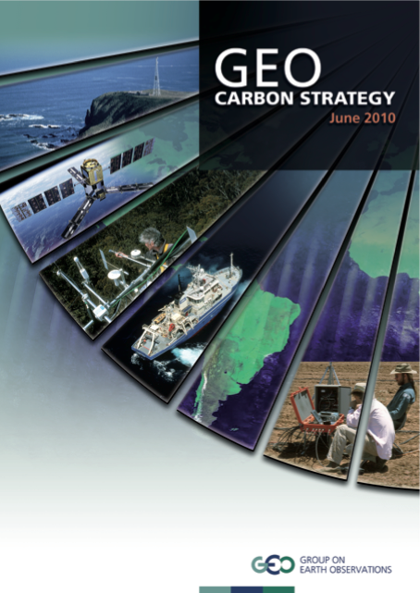
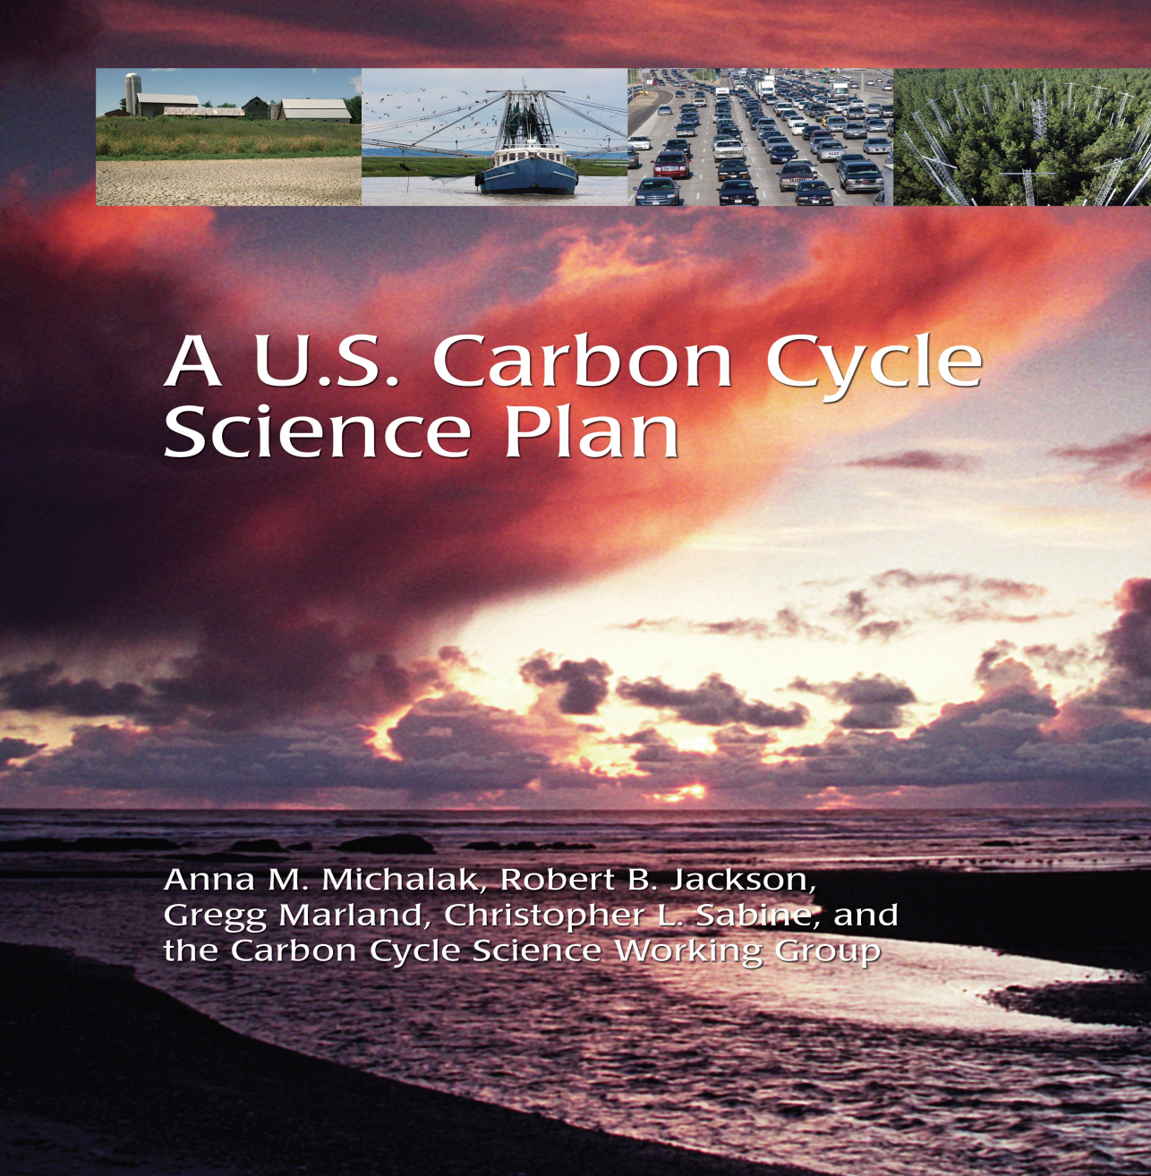
Science Priorities for the Future
There are excellent, up-to-date plans available for carbon cycle research. Defining NASA’s role is our main challenge.
Coming soon!
We lack such comprehensive plans for ecosystems science would benefit from some advance planning in this area . . .

Slide 15
Science Priorities for the Future
Conducting integrative, cross-disciplinary research, focusing on major societal problems (e.g., land-ocean-atmosphere; carbon, water, people)
Advancing our models; many needs, several perspectives on what NASA should address (data set needs, model interoperability and integration, improvement of existing models, developing a new community model . . .)
Documenting global change (quantitatively), attributing causes, projecting impacts and feedbacks and providing useful uncertainty assessments

Slide 16
About this Meeting

Slide 17
Terrestrial Ecology Meetings
To cultivate a continuing sense of community and involvement in setting future directions for NASA TE
To engage TE researchers in some problem solving and priority setting for the program
To exchange research results (this time during JSW!)
Currently striving for meetings every ~18 mos. So next meeting should be spring 2013.
We should discuss and agree if this timing is acceptable
We should identify a steering committee

Slide 18
My Aspirations for this Meeting
I would like to receive some inputs on TE community response to the proposed ABoVE field campaign scoping study report before acting on the community recommendation
I would like to hear from the TE community regarding other recommendations from the 4 Working Groups established as a result of our last meeting.
where is there consensus about a proposed action?
what are your priorities for near-term investments?
what recommendations need further study/analysis or broader inputs?
what do you think about my sense of priority for TE (if expressed)
I would like to jointly determine the future of Working Groups
should the existing groups continue? If so, with the same membership or renewed and what issues (new or old) will be addressed?
should new groups be formed to tackle new issues?
I would be pleased to consider suggestions on how to better manage / implement the TE program

Slide 19
NASA Terrestrial Ecology Meeting Structure
Plenary Session – Morning
To provide information on current scientific activities, programs, plans, issues from the perspective of the NASA Terrestrial Ecology Program
To receive reports from the Terrestrial Ecology Working Groups and then to consider how to respond to their recommendations
Open Discussion (after lunch)
To walk through recommendations and identify what to do about them (triage)
To allow for new ideas, opportunities, and/or issues to be raised for consideration and potential action
To make some decisions about future actions, next steps
Break-out Discussions (or continuing Plenary?)
To give TE meeting participants the opportunity to discuss issues / recommendations / new ideas in smaller groups before attempting to make decisions, set priorities, or recommend next steps (we will have 3 rooms, think in advance about what makes sense for that time slot)
General Discussion (at end)
Finalize decisions & next steps; assign actions; agree on next TE meeting

Slide 20
Thank you!

Slide 21
NASA TERRESTRIAL ECOLOGY (TE) PROGRAM NEXT FIELD CAMPAIGN
As of 2008, no national or international program had proposed/developed an idea for a next major field campaign for TE participation – nor had the NASA TE community
In ROSES-2009, TE solicited for scoping studies for a major field campaign or related large project and 2 studies were selected and funded for 12 month scoping studies:
Challenges and Opportunities in Remote Sensing of Global Savannas: A Scoping Study for a New TE Field Campaign (Hanan)
Vulnerability and Resiliency of Arctic and Sub-Arctic Landscapes (VuRSAL) - The Role of Interactions between Climate, Permafrost, Hydrology, and Disturbance in Driving Ecosystem Processes (Kasischke); name later changed to Arctic-Boreal Vulnerability Experiment (ABoVE)
Other ideas will be entertained; there is no commitment to conduct one or the other or both.

