Slide 1
Airborne Science Working Group
D. A. Roberts: Chair (UCSB)
Bruce Chapman (JPL), Ralph Dubayah (UMd), Matthew Fladeland (Ames), Nancy French (MTU), Robert Green (JPL), Peter Griffith (NASA HQ), Simon Hook (JPL), Brian Johnson (NEON), Jim Kellner (UMd), Susan Ustin (UCD)

Slide 2
2010-2011 Agenda
1) Discussion of optimal strategies for use of remote sensing assets in the Gulf Oil Disaster.
What is the best possible ecosystem science that can be done to support work in the gulf given airborne assets?
2) How best to prepare for AVIRIS Next Generation.
Important questions include
(a) how best to transition from AVIRIS Classic to AVIRIS-NG
What to do with AVIRIS Classic? (a) How much overlap should occur between sensors? (b) At what point does AVIRIS classic no longer fly and what will be done with it?
3) Overview of the recommendations from La Jolla in 2010, update.
4) Discussion of flight planning tools.
5) HyspIRI large area campaign for either 2011 or 2012.
When will the flights occur?
What is the role of a science team?
6) MASTER upgrades and a discussion of HyTES.

Slide 3
Readers Digest Version of La Jolla
How can we make NASA airborne assets more accessible to ecologists?
Improved information
Which sensors are available?
Which data sets are available and how can you get them?
Flight requests and ways to link them to the proposal writing process
Improved access
Ready access to UAVSAR and MASTER
Lack of access to others (AVIRIS archive)
Improved utilization
Improved flight planning tools
Targets of opportunity

Slide 4
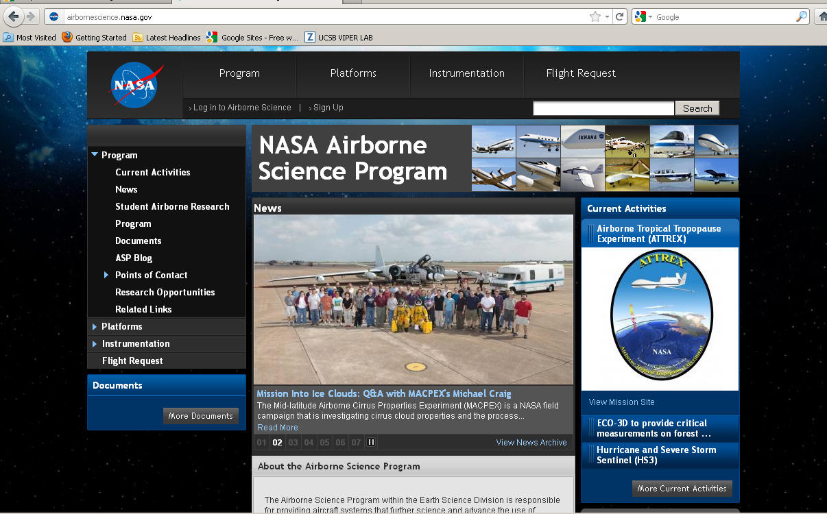
Existing Airborne Assets
NASA has an immense number of sensors available
The classics: UAVSAR, MASTER, LVIS, AVIRIS, AIRMISR, UAS
Others: POLSCAT
Excellent source website
http://airbornescience.nasa.gov/
Points of Contact
Platforms (aircraft)
Instrumentation
Flight requests

Slide 5
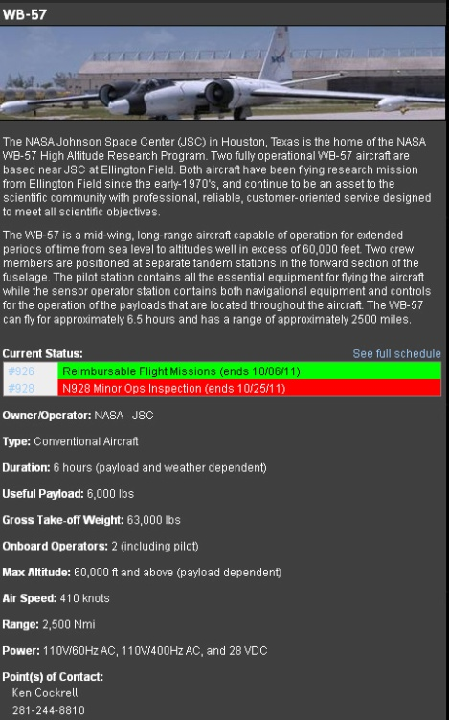
Example Platforms

Slide 6
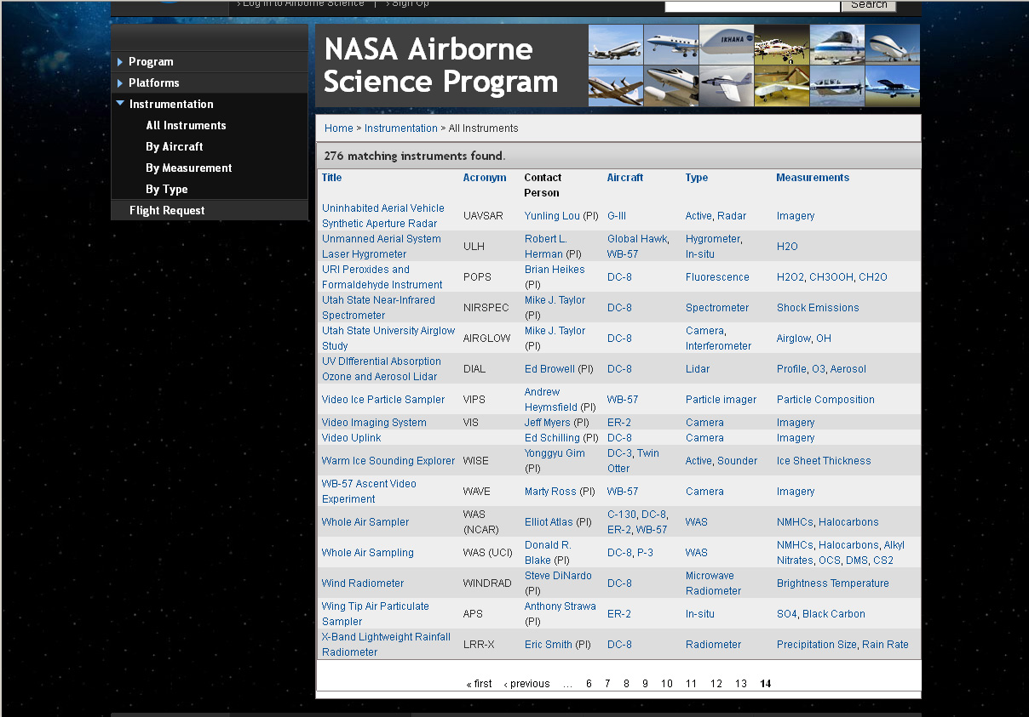
Example Instruments

Slide 7
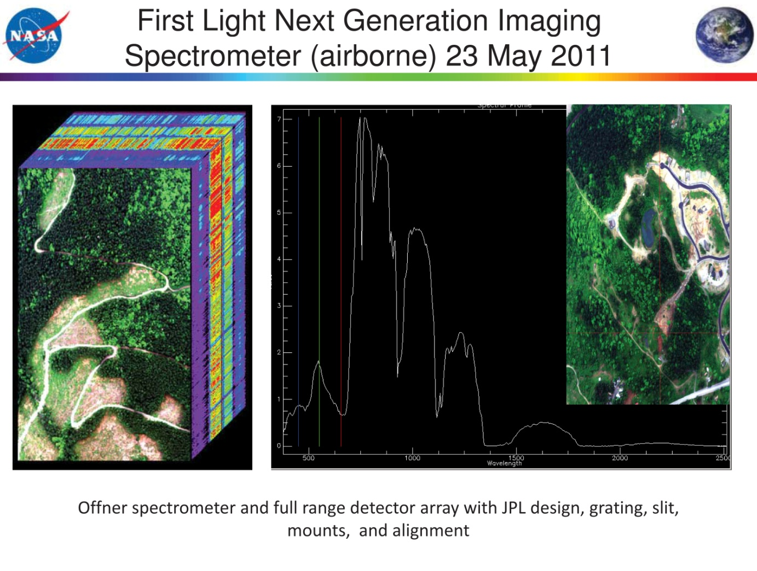
Instruments on the Horizon
AVIRIS Next Generation
HyTES
EMAS
PRISM
NEON Airborne Observational Platform

Slide 8
Deployment: First test flights, January 2012
Performance Evaluation: 2012?
2011 Terrestrial Ecology call
Should there be a science team?
Currently limited to a low altitude
platform

Slide 9
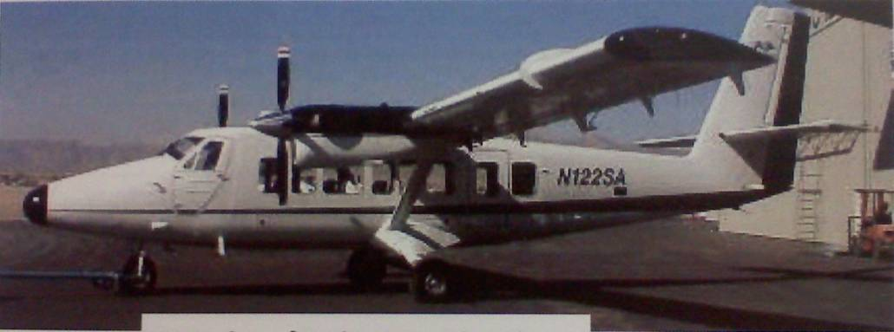
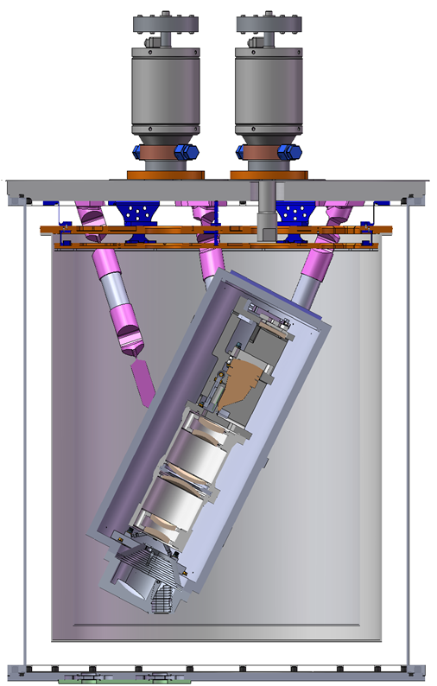
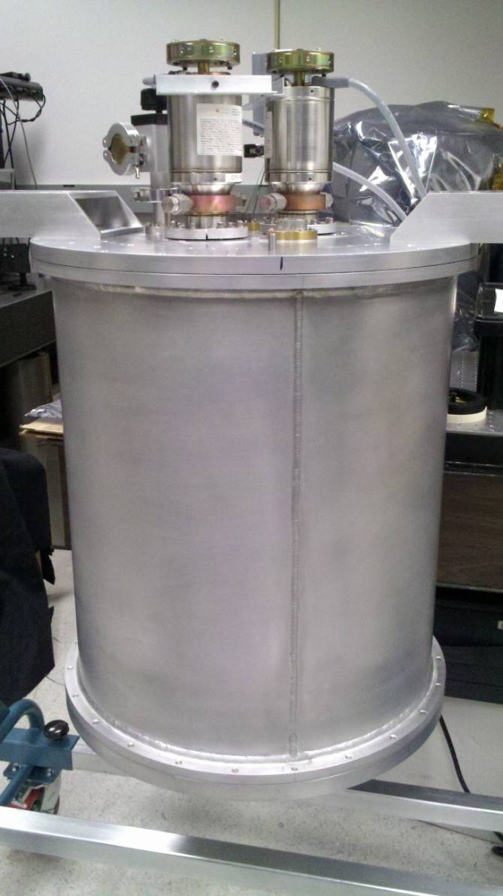
Hyperspectral Thermal Emission Spectrometer (HyTES)
Flights in Late 2011
Instrument Characteristic | HyTES
Number of pixels x track | 512
Number of bands | 256
Spectral Range | 7.5-12 um
Integration time (1 scanline) | 30 ms
Total Field of View | 50 degrees
Calibration (preflight) | Full aperture blackbody
QWIP Array Size | 1024x512
QWIP Pitch * | 19.5um
QWIP Temperature | 40K
Spectrometer Temperature | 100K
Slit Width | 39 um
Pixel size at 2000 m flight altitude | 3.64
Pixel size at 20,000 m flight altitude | 36.4
© 2011 California Institute of Technology. Government sponsorship acknowledged.

Slide 10
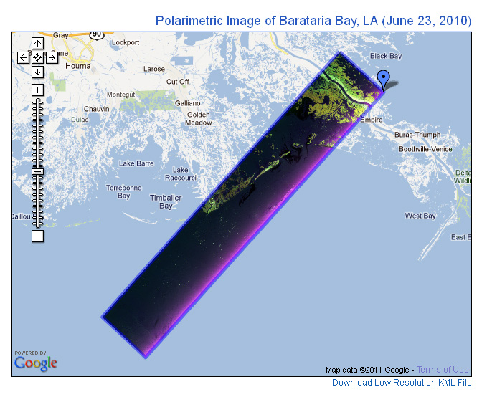
Improved Access: UAVSAR
http://uavsar.jpl.nasa.gov/gulfoilspill.html
June 22-24, 2010

Slide 11
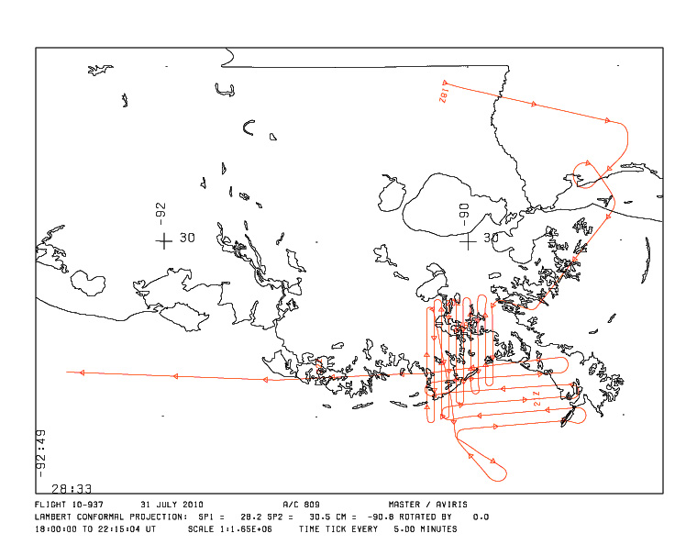
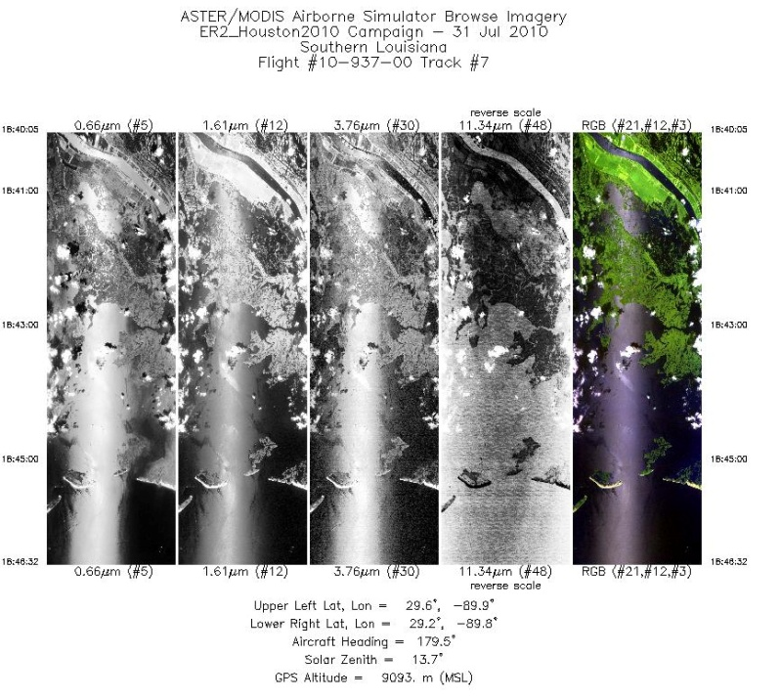
Improved Access: MASTER
http://master.jpl.nasa.gov/data/
7-31-2010
8-28 to 8-31-2010
8-15 to 8-18-2011

Slide 12
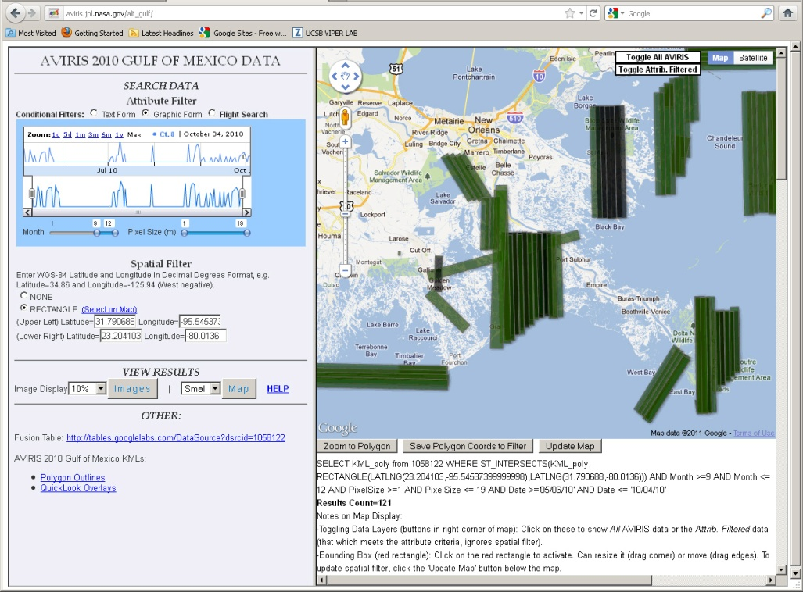
Improved Access: AVIRIS
http://aviris.jpl.nasa.gov/html/gulfoilspill.html
May 2010 (ER2)
July 2010 (Twin Otter)
August 2010 (ER2)
September-October 2010 (Twin Otter)
April –May, 2011, August 2011 (Twin Otter)

Slide 13
Issues/Recommendations
Improved Access
The AVIRIS archive. Can the entire archive be made available to ecologists?
The Gulf Oil Archive is available
What is the cost?
Improvements in current websites – continuity between websites
New Sensors
AVIRIS NG
Should there be a science activity centered around performance evaluation (Science Team)?
A pathway to a high altitude platform is essential
Cannot retire “Classic” or simulate HyspIRI without this
Gulf Ecosystem data
Data quality
Develop a catalog for each sensor assessing data quality, overlap between sensor coverage (UAVSAR, MASTER, AVIRIS)
AVIRIS catalog is complete through 2010.
Platform
Twin Otter preferred due to fine resolution (< 20 m) of impacted zones
ER2 required for MASTER-AVIRIS flights
Deliverables
Georectified radiance
NEON AOP
Need to define complementarity between NEON AOP and NASA
NEON – more restricted to LTER, NEON sites

