Slide 1
NASA-TE Modeling Working Group
TE Meeting
October 6, 2011

Slide 2
Membership
Berry, Joseph Carnegie
Buermann, Wolfgang UCLA
Collatz, George NASA GSFC
Davis, Kenneth Penn State
Denning, Scott CSU
Fung, Inez Berkeley
Gower, Stith U. Wisconsin
Hanan, Niall CSU
Hoffman, Forrest ORNL
Hollinger, David USDA Forest Serv.
Houghton, Richard WHRC
Huntzinger, Deborah U. Michigan
Hurtt, George (Chair) U. Maryland
Kawa, Stephan NASA GSFC
Kimball, John U. Montana
Li, Changsheng UNH
Moorcroft, Paul Harvard
Moore, David Neon Inc
Ojima, Dennis Heinz Center
Ollinger, Scott UNH
Potter, Christopher NASA ARC
Prince, Stephen UMD
Randerson, James UC Irvine
Running, Steven U. Montana
Schaefer, Kevin NSIDC
Thornton, Peter ORNL
Treuhaft, Robert JPL
Turner, David OSU
West, Tristram JGCRI
Wolf, Adam Carnegie
Xiao, Xiangming U. Oklahoma
Xue, Yongkang UCLA

Slide 3
Resources
TE Working Groups:
http://cce.nasa.gov/terrestrial_ecology/wkg_groups.html
TE Modeling Working Group Charter:
http://cce.nasa.gov/terrestrial_ecology/WGmodeling.html
TE Modeling Working Group Membership list:
http://cce.nasa.gov/cgi-bin/terrestrial_ecology/wg_members.pl?pgid=519
TE Modeling Working Group Email list:
te_wg_modeling@cce.nasa.gov

Slide 4
Charter
The Modeling Working Group will consider ways to improve/advance modeling activities within the TE program. The initial focus will be on how to target and maximize resources to fully exploit current modeling capabilities as well as identifying new activities and resource needs.
Recommendations from the WG should include clear indication of priorities.
The Modeling WG should have connections with other WGs including the Data Products WG and the Field Campaigns WG.
Provided an issue is relevant to TE modeling science and of importance to the TE community (e.g. identified at a recent TE workshop), the WG will have the ability identify a new issue for its consideration and develop the agenda to address it.
Details regarding the operations of the WG will be determined by the WG in consultation with the CC&E Office and the TE Program Manger. Recommendations from the WG will be conveyed to the CC&E Office and the TE Program Manager for their consideration and potential implementation. Recommendations will be shared with the broad TE community through the TE Web site and other appropriate means.

Slide 5
Charter (continued)
Specific suggestions of issues to consider by this WG might include but are not limited to:
Model intercomparisons. What lessons from previous and current ongoing model intercomparison efforts can be used to identify useful intercomparisons in the future and frameworks for implementation?
Infrastructural needs for modeling. Can common community standards for data be identified? What are the needs for centralized hardware and/or software?
Identification of data products for driving and evaluating models.

Slide 6
Formulation
What specific issues does the group want to address?
How does the group want to organize itself to address these issues?
What is the timeframe for addressing these issues?
How can we help ensure that what we do has the greatest positive impact possible?

Slide 7
What new data products would advance TE research goals? (Data WG)
Global re-GAP data set, incorporating LIDAR
High spatial and temporal resolution climate and soil data, Global coverage.
Data publications containing raw data produced in funded projects, as well as that used in journal articles, so that others can use data for other purposes.
High spatial (30-m) and temporal resolution (every 3 to 5 years) Land Cover (LandSat based).
High spatial resolution remote sensing products that match better with cropland data layers (e.g., MODIS at 250-m; crops at 30-m (TM-type) resolution). Option 1: Fusing MODIS and LandSat to downscale MODIS. Option 2: LandSat and Spot to obtain higher temporal resolution (seasonal).
Data set of leaf-level hyperspectral optical properties (full spectrum; biogeochemical content) and soil reflectivity. Hyperspectral Reference Library, along with contextual information. Standard measurement techniques.
Recommend that accuracy and uncertainty be fully characterized and included with each product (integral part of the data product) for remote sensing and ground-based (in situ) data.
Multi-faceted product containing height, biomass, and age. (Combining many existing products (LIDAR, LEDAPS)).
Global database of ground-based in situ validation data for remote sensing products. Forest inventory data (e.g., height, biomass, and age). For DESDynI.
Improve the spatial representativeness of ground-based validation data. Match ground-based spatial resolution with that of the satellite data.
Gridded species richness and occurrence data to look at biodiversity (??at xx-km resolution??). Plants and animals (eBird database). (PPBio-INPA in Amazonia)
Continued support for existing PI data products (e.g., Kellndorfer, GFED, MODIS-for-NACP, etc.).
Temporal integration of data from multiple sources into a consistent / cohesive long-term data record (includes calibration / recalibration). For example, dynamics of inland waters, cloud corrected global irradiance, atmospheric optical properties, in addition to the existing MEASURES products (landsat, NDVI, etc.).
High-spatial resolution soil data for use in hydrologic models
Ancillary data to support interpretation of data from new NASA sensors (e.g., DESDnyI)
Data products for evaluating and improving model performance

Slide 8
How could the TE program invest resources to make data sets easier to prepare (Field campaign data sets) access, manipulate, and combine with other sources of information and/or models? (DATA WG)
Single portal that enables exploration and access to Earth Science data including visualization; data are readily integrated.
Data coordinator to act as a liaison between investigator and data center; make it easier for investigator to compile and submit data to a data repository. Responsible for seeing that data from PI gets into the archive in a suitable form and well documented.
Require a policy to make data readily available 12 months after collection in a standard format to facilitate use (and metadata readily available after 30 days).
NASA could facilitating the expeditious preparation of data and metadata for sharing, including preparing data products in a standard formats with standard variables.
Develop tutorials/ curricula / class room material on how to access and use data products.
Develop tutorials/ curricula / class room material tutorials on how to prepare data to share.
Obtaining large volume data in an efficient manner (faster internet transfer rates)
Extract and integrate multiple remote sensing products for a small area over time (AVHRR, MODIS, LEDAPS (reflectance and disturbance), LandSat, etc.).
Additional methods to access data in time centric methods.
Tools to propagate uncertainty (in quadrature)
Community standards for TE-relevant variables and data files
Timely access to airborne data
Tools to discover and visualize data

Slide 9
Up-scaling
Terrestrial Carbon Flux Upscaling Synthesis Effort
Mission: To organize a research team and engage in discussing a multi-group experiment to test the terrestrial carbon flux upscaling methods.
Meeting objective: Discuss developing a proposal or organizing a working group for model intercomparison and synthesis effort to address the terrestrial carbon upscaling question. We’re considering to submit a proposal. MsTMIP style. Late October deadline, ROSES.
Motivation: Several flux-tower based flux maps have been created. What are the differences among these products? What causes them? Global/continental products: Jung/Beer, Xiao, Hilton (in prep), Turner (in prep). Regional products (among many?): Moore (ACME); Naithani/Xiao (ChEAS).
Research questions:
How much does spatial resolution in…driver data and model resolution…influence upscaled flux estimates? Uncertainty in upscaled fluxes?
What is the best way to divide the landscape into maps? Species, pfts, stand ages, … ?
Can we assess (more comprehensively) the “representativeness” of the input data (flux towers at present) used to create the flux maps?
Group list created. Kusum Naithani, Penn State, leading for the present, with assistance from Davis and Smithwick. Open to any interested parties for discussion. Possible late October proposal.

Slide 10
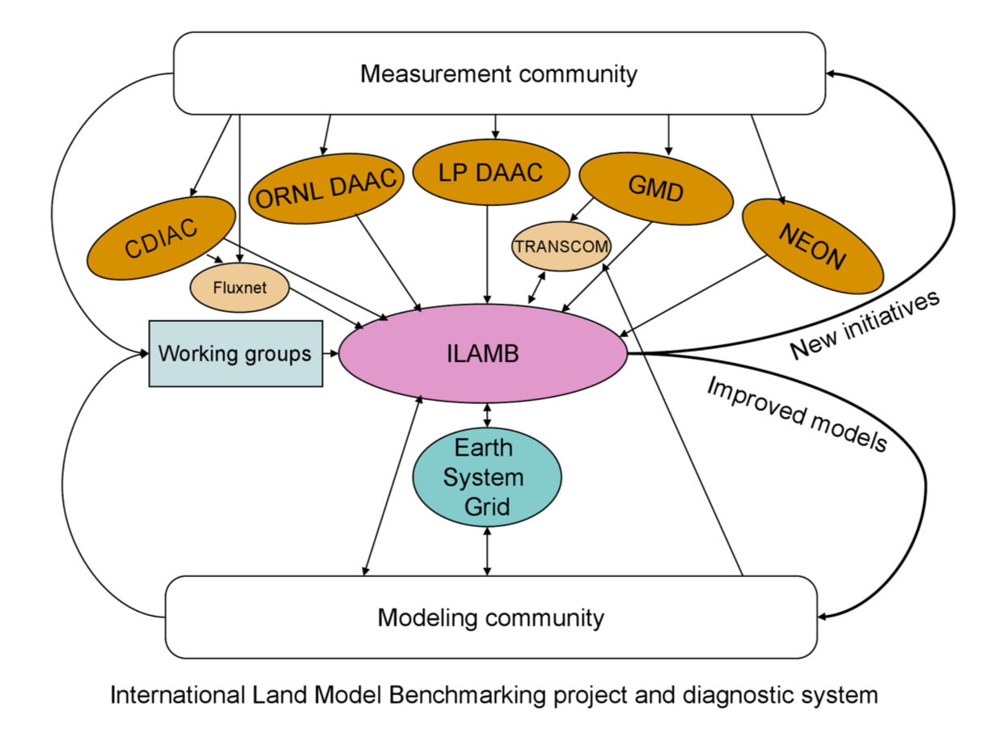
Model-data Inter-comparison
e.g., DataOne ILAMB working group
MsTMIP; TRENDY; CMIP5; LBA-DMIP
ILAMB and MIPS, such as MsTMIP, working to develop community-accepted benchmarks to assess land model performance
ILAMB and DataOne goal: strengthen linkages between experimental, monitoring, remote sensing, and climate modeling communities

Slide 11
Actions
Hold series of telecons
Work on data/data services priorities together with Data WG
Establish 3 sub-working groups:
Model-data inter-comparison
Up-scaling
Data continuity
Finalize input on data priorities
Continue work of sub-WGs
Hold WG telecons, ~quarterly
Establish WG project page
Consider tighter relationship to Data-WG
…

Slide 12
Discussion
Should the working group continue, shrink, grow, change?
How can inter-pi/project communication be enhanced?
How can the WG increase it’s effectiveness?
Is it time for the development of a community model?
How can modeling be pulled forward to major role in field campaign design, operation, and synthesis?
Has our ability to observe ecosystems exceeded the availability of other critical data sets needed to interpret the measurements (e.g. climate, soils, LU)?
What are the lessons from past MIPS, are there missing MIPS?
How do we prepare to move from MIPs to DAs?

