Slide 1

The NASA Terrestrial Ecology Tree-Grass Project (Scoping Study)
“Challenges and Opportunities in Remote Sensing of Global Savannas: A Scoping Study for a New TE Field Campaign”
Niall Hanan, Michael Hill & Scoping Study Participants
NASA TE Workshop, October 6, 2011

Slide 2
Thoughts from yesterday…
Piers Sellers: “Where are the weak spots…?” and “Where are our blind spots…?”
  Remote sensing: Vegetation canopies are not homogeneous (horizontally or vertically)
  Modeling: ditto, vegetation canopies are not homogeneous…
More from Piers: “Comfort zones…”
  Must RS and modeling of the land surface be limited to aggregate descriptors (e.g. aggregate LAI, f_{PAR}, etc.)…?

Slide 3
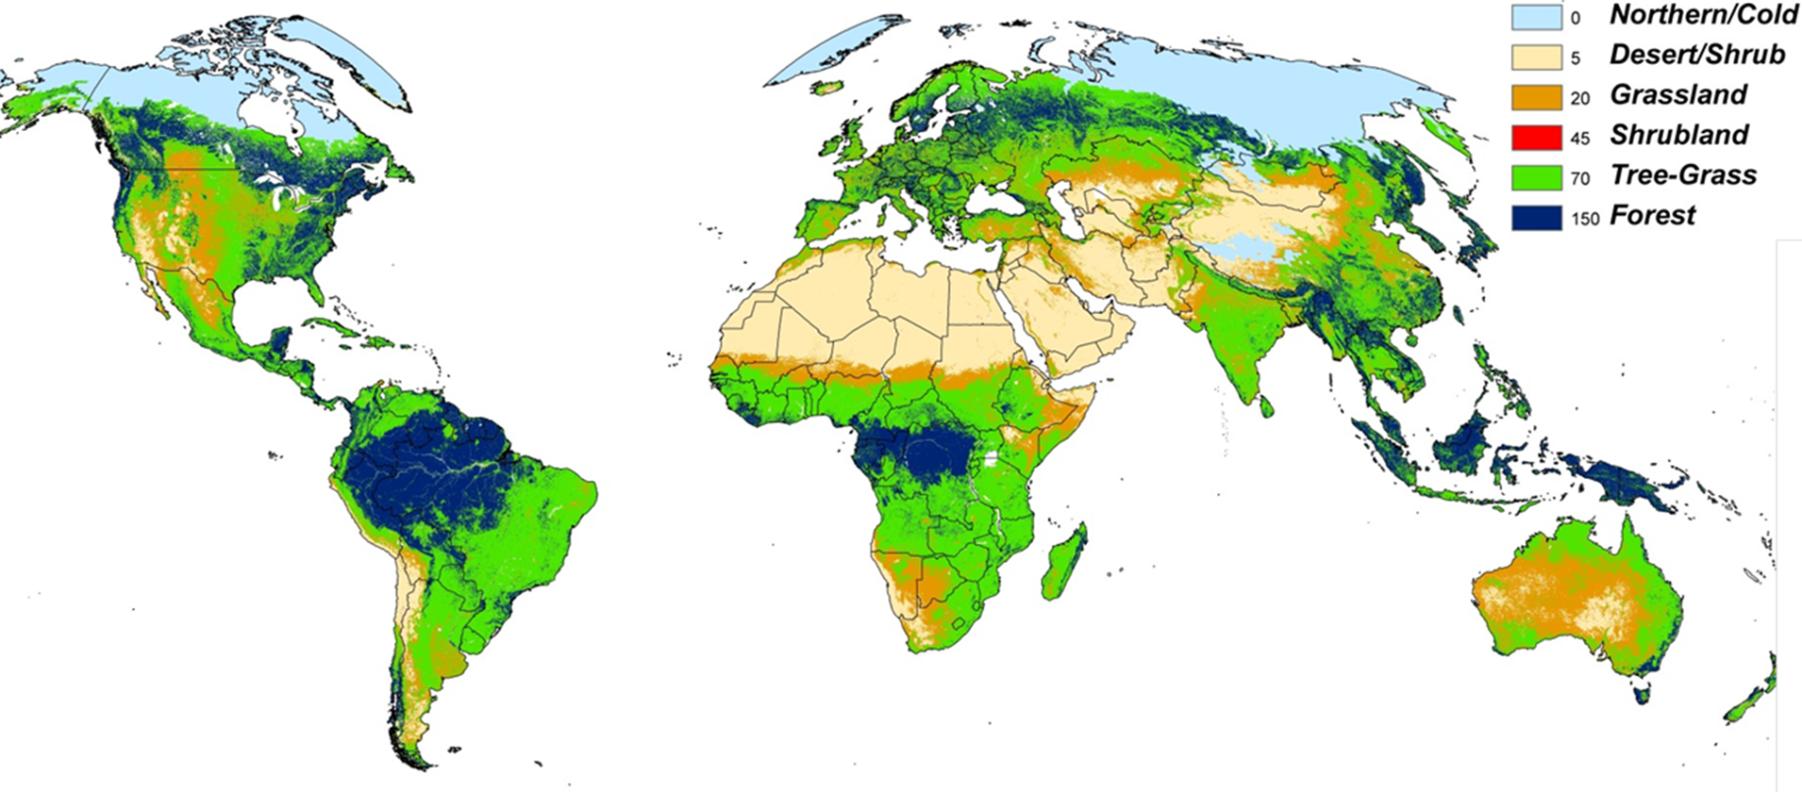
The Global Importance of Tree-Grass Systems
Global distribution of tree-grass mixtures based on classification of MODIS Vegetation Continuous Field data

Slide 4
Tree-Grass Systems
Globally diverse tree-grass vegetation associations, with regions typically classified as “savanna” in the upper row, and regions typically not classified as savanna in the lower row.
(a) Sahel of Mali, West Africa (Photo: F Dembele); (b) Northern Territory savannas, Australia (Photo: A Marks); (c) Cerrado, Brazil (Photo: M Bustamante); (d) Edwards plateau shrublands, Texas (Photo: MJ Hill); (e) Oklahoma oak woodlands (Photo: J Burton); (f) Dry deciduous woodlands of southern Western Ghats, India (Photo: J Ratnam).

Slide 5
Why Tree-Grass?
Tree-grass systems are:
Functionally radically different:
  Heterogeneity, land-atmosphere, fire, herbivory, human dimensions…
Sensitive to climate change and centers of land-use change:
  likely radical transformation in the coming decades
Regionally & globally significant areas:
  transformation will significantly impact the earth system, via changes in energy flows, hydrological and biogeochemical cycles
Globally vital centers of livestock & grain production for often poor and marginalized populations:
  change will impact human livelihoods, food security, economic and ecological sustainability
Structurally & functionally more complex than many other biomes:
  capabilities developed in TG should be relevant to other terrestrial systems (“if we can solve EO challenges in tree-grass … the rest will be easy”)

Slide 6
Tree-Grass Concepts
Conceptual diagram for global tree-grass systems, showing drivers of change, ecosystem processes and provision of goods and services
Notes:
Broad concepts for TG – showing linkages between global change process, biotic and biophysical processes, and TG goods and services, all mediated via TG structure and function
Globally diverse suites of global change/biophysical/Social-ecological conditions – different role of humans etc

Slide 7
Tree-Grass Concepts
Conceptual diagram for global tree-grass systems, showing drivers of change, ecosystem processes and provision of goods and services (center)
and interactions between global change, biophysical and social-ecological domains (left)
Notes:
Broad concepts for TG – showing linkages between global change process, biotic and biophysical processes, and TG goods and services, all mediated via TG structure and function
Globally diverse suites of global change/biophysical/Social-ecological conditions – different role of humans etc

Slide 8
Tree-Grass Concepts
Conceptual diagram for global tree-grass systems, showing drivers of change, ecosystem processes and provision of goods and services (center), interactions between global change, biophysical and social-ecological domains (left)
and key science questions for the Tree-Grass activity (right).

Slide 9
TG Key Science Questions
How are climate change and land-use altering the structure, function and productivity of tree-grass systems at landscape, regional and global scales?
How will changes in tree-grass structure, function and productivity interact in the earth system and feed-back on the major cycles of carbon, water and nutrients and energy flows?
How will global change and biophysical interactions in tree-grass systems impact human wellbeing, food security and sustainability into the future? Conversely, what is the potential of savannas for global change mitigation, and can human populations in savanna regions benefit from this potential?

Slide 10
Tree-Grass Science Framework
Tree-Grass science framework showing key science questions, TG Science Themes, Earth Observation (EO)-Science Focal Areas and emergent Tree-Grass applications

Slide 11
TG Science Themes
TG Science Themes
Land surface-atmosphere interactions
Global carbon cycle
Water resources
Degradation & shrub encroachment
“Goods and Services”
TG Science Framework
Science Themes explore the continuum of biophysical, ecological and social-ecological interactions in tree-grass regions and how they will respond to, and feedback on, the earth system and societal wellbeing.

Slide 12
TG Earth Observation Focal Areas
TG Science Framework
EO Focal Areas
“Challenge & Opportunity”
Remote sensing science
Modeling
Data assimilation
EO Focal Areas will enhance measurement and modeling capabilities to better contribute to TG Science Themes and address Key Questions

Slide 13
TG Interdisciplinary Applications
TG Science Framework
  monitor trends in tree-grass function, sustainability & vulnerability;
  provide integrated predictions of changing tree-grass roles in the earth system;
  assess impacts and trade-offs in provision of goods & services with changing climate and land use;
  contribute to local, national and international management;
  benefit poor & vulnerable human populations that rely on tree-grass ecosystems
Notes:
NASA aims to develop earth observation systems for management of the earth system to the benefit of mankind. This is particularly pertinent in tree-grass systems that often support economically and politically marginalized rural communities.

Slide 14
Tree-Grass Implementation Strategy
Proposed implementation strategy for the Tree-Grass research program

Slide 15
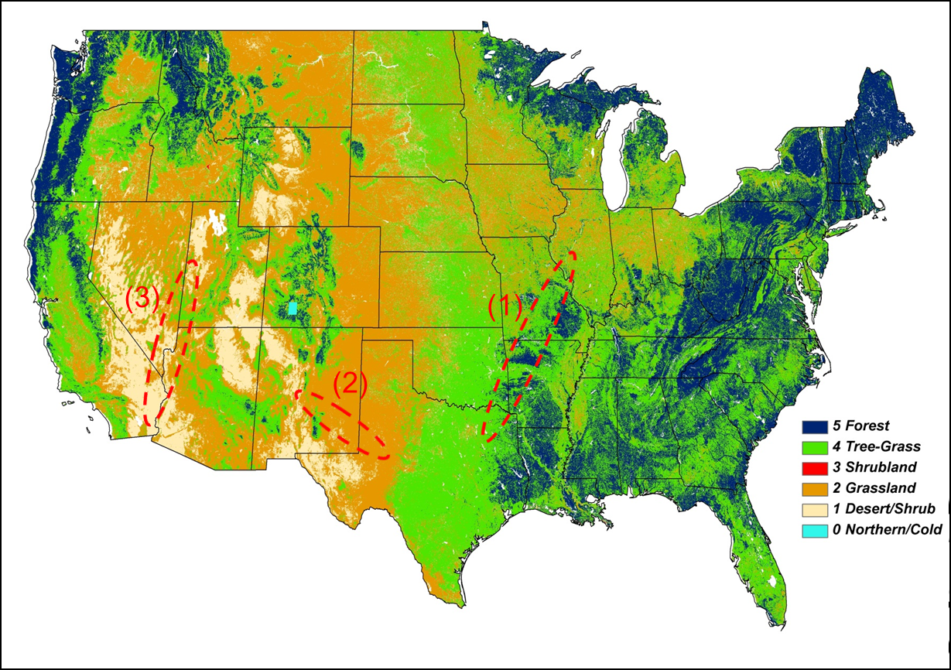
TG Phase 2 - Field Campaign
Intensive field sites
Intensive Site Strategy: Intensive sites with detailed process studies will address TG Science Themes and EO Focal Areas.
NASA concentration in North America, with possible additional Intensive Sites supported in collaboration with international partners
Candidate Intensive Study Regions
Tree-grass transect
Shrub-grass transect
Hot-cold desert-shrublands

Slide 16
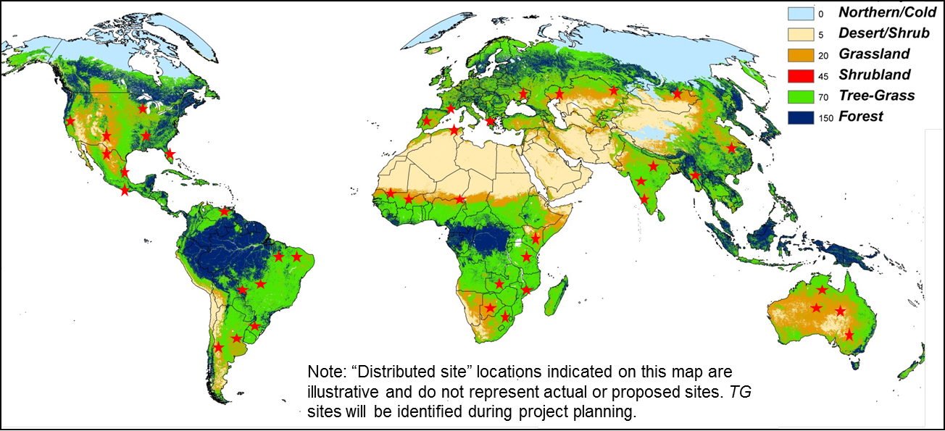
TG Phase 2 - Field Campaign
Distributed field sites
Distributed Site Strategy: Globally distributed, low intensity measurement sites, will sample climatic, biotic and anthropogenic diversity for parameterization, calibration and validation of TG technologies and models in global tree-grass systems (modest logistical/financial investment)

Slide 17
Tree-Grass Deliverables
Revolutionize EO science through improved consideration of woody-herbaceous functional groups in remote sensing and modelling of terrestrial ecosystems
Transform our ability to use satellite data & earth system models for the sustainable management of tree-grass systems in the face of changing climate, land use & human populations
Engage and inspire next generation earth scientists, and enhance public appreciation of the crucial role NASA technologies can play in understanding & managing the earth system

Slide 18
Tree-Grass Innovations
  Interdisciplinary emphasis (5 TG Science Themes spanning biophysics to socio-ecological ‘goods and services’)
  Human dimensions and disturbance as central components of research
  Focus on RS science, model improvements and data assimilation (3 TG Research Foci)
  Intensive and globally distributed sampling strategies

Slide 19
Recent Savanna Book
Edited book reviews ecology, modeling, remote sensing and human dimensions in global savanna and “tree-grass” systems
CRC Press, 2011

Slide 20
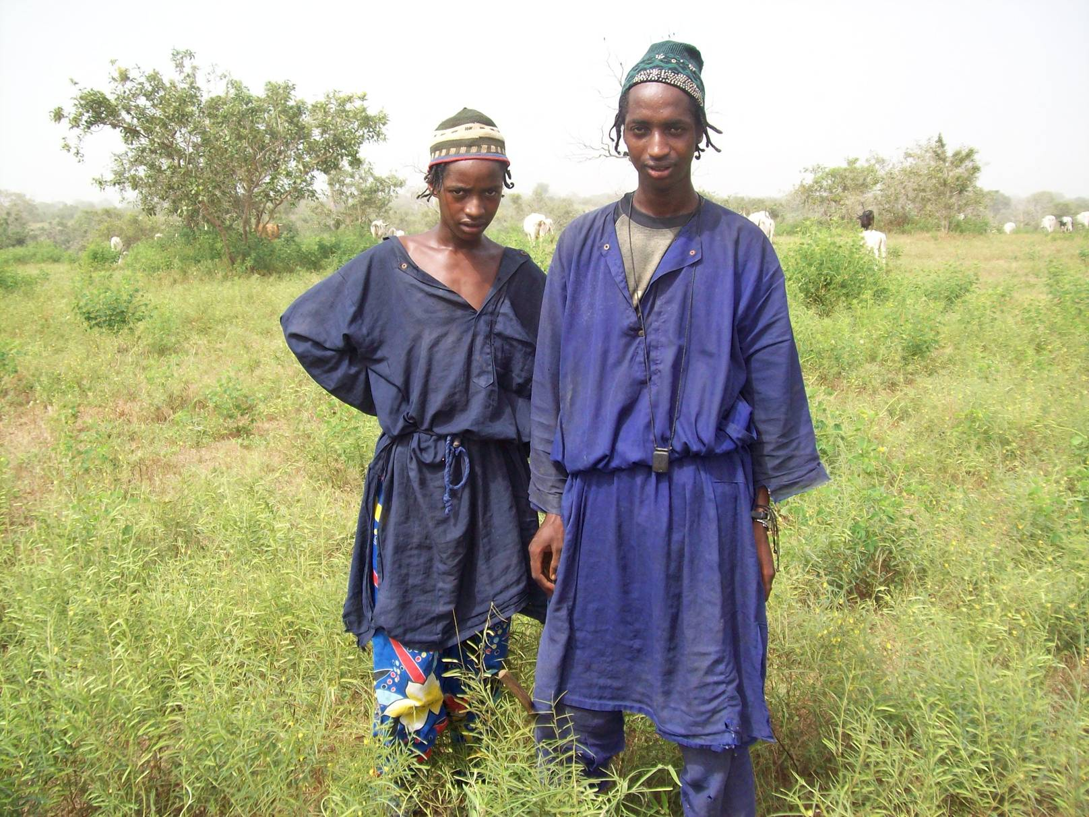
Done – Thanks!
Draft TG White Paper Available for Review at
http://www.nrel.colostate.edu/projects/srs/
Or web-search <Savanna Remote Sensing>
Fulani pastoralists in the West African sahel
Niall.Hanan@sdstate.edu

Slide 21
The Global Importance of Tree-Grass Systems
Global distribution of tree-grass mixtures based on classification of MODIS Vegetation Continuous Field data

Slide 22
TG Science Theme & Models
Relationships between earth system model classes and Tree-Grass (TG) Science Themes (X/+ symbols indicate primary/secondary importance of a model class in a TG Theme)
Model Classes : TG-LSM = Land surface models adapted for tree-grass systems; TG-DVM = Dynamic vegetation models; TG-BGC = Biogeochemical cycle models; TG-SIM = Spatially interactive models; TG-G&S = Goods and services models.

Slide 23




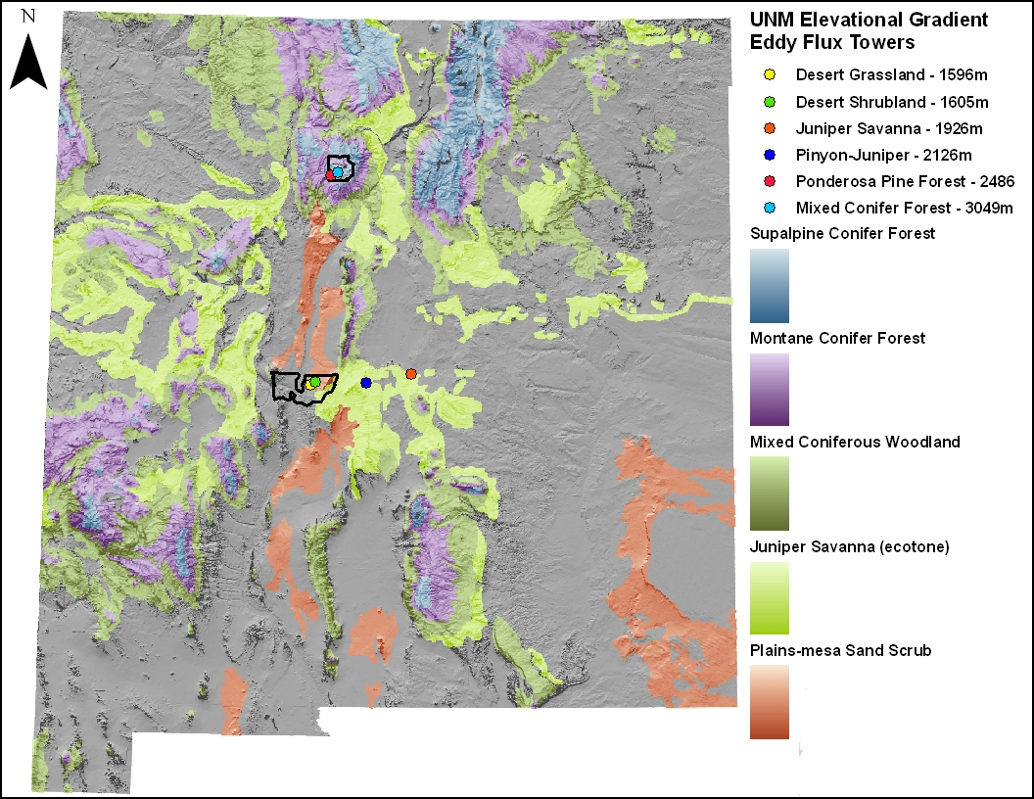
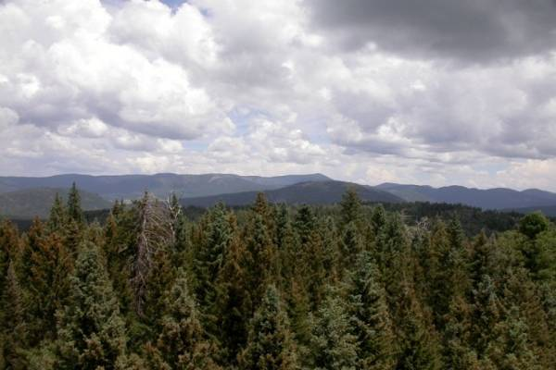
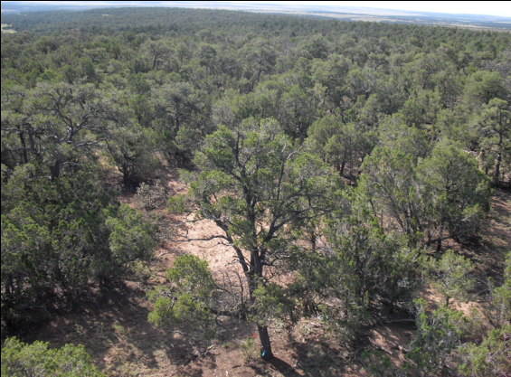
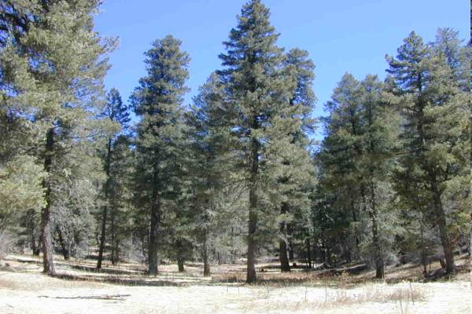
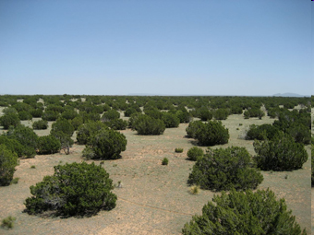
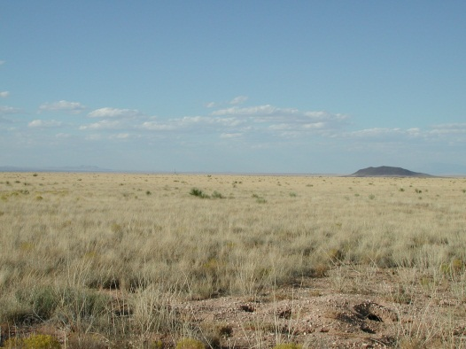
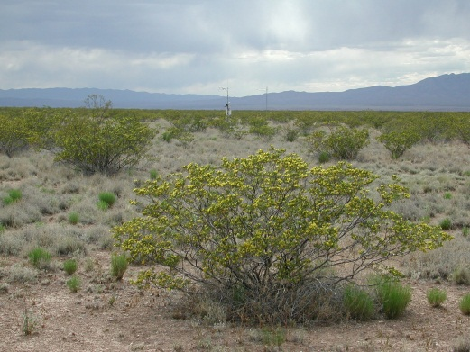




New Mexico Elevation Gradient eddy covariance sites
Subalpine conifer 3049 m
Piñon-juniper 2126 m
Ponderosa pine 2486 m
Juniper savanna 1926 m
Desert grassland 1596 m
Desert shrubland 1605 m

Slide 24
Tree-Grass Education & Outreach
GRFP = Graduate Research Fellowship Program
E4S = Earth System Science Summer Schools
TTAP = Technology Transfer & Adoption Program

