Slide 1
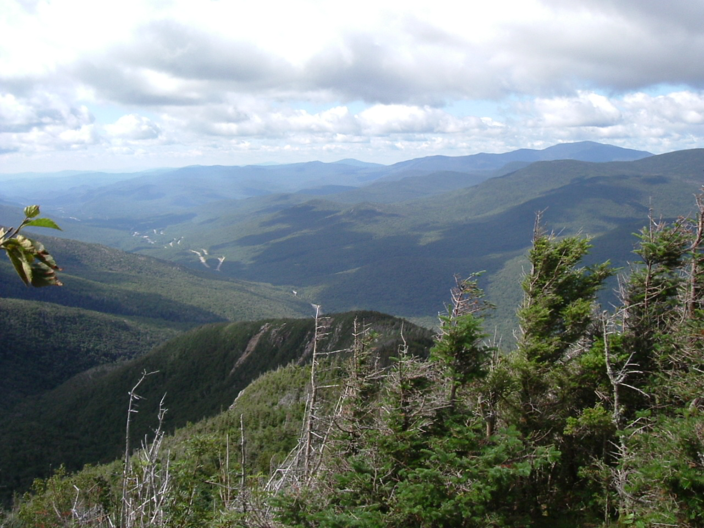
Ecosystem Structure Working Group Report to the Terrestrial Ecology Business Meeting October 6, 2011
Ralph Dubayah
University of Maryland, College Park
Forrest Hall
University of Maryland, Baltimore Campus & NASA/GSFC

Slide 2
Outline
Overview of ESWG
Mission Development and Support
Field Activities
Publications on Ecosystem Structure Requirements and Science
Potential Activities with European Scientists
Upcoming Meetings

Slide 3
Overview of ESWG
ESWG meets on as needed basis
Teleconferences about once per month (with large gaps)
Membership comprised mostly of TE scientists actively engaged in remote sensing of structure
Provides community guidance and input to TE program manager
Guidance on mission science requirements
Assistance developing and executing field experiments in support of TE goals
Ad hoc analyses in support of specific TE objectives as asked
e.g. effects of off-nadir pointing on lidar
Updates to TE program on funded and unfunded activities of relevance to ecosystem structure
Forum for interchange of ideas

Slide 4
DESDynI Status and Activities
ESWG and DESDynI Science Steering Group (DSSG) undertook many activities for DESDynI
Evaluation of one vs. two platforms
Evaluation of combined ICESAT-2/DESDynI lidar (LIVEx)
Planning and execution of airborne field experiments and algorithm assessment
Development of Level 1 Science requirements
Publication of two special issues (RSE & JGR-A)
Publication of two papers on requirements (biomass & biodiversity
President’s FY12 Budget Proposal (February 2011) reset DESDynI
Lidar segment deleted (NASA should seek contribution)
Radar mission to be implemented more affordably
Mission now called DESDynI-R

Slide 5
NASA’s Proposed DESDynI* Mission
Radar designs for proposed DESDynI mission being studied in pre-Phase A
L-band 5-80 MHz BW Quad-pol Radar
9-15 m mesh reflector
12-24 element transmit and receive array
12-24 dual-pol receive channels
180-360 km swath, full res, full-pol
Better than -25 dB NES0 at 20 MHz BW
TDRSS downlink
*DESDynI - Deformation, Ecosystem Structure, and Dynamics of Ice
Pre-decisional – for Planning and Discussion Purposes Only
Notes:
DESDynI is the second radar of the DS missions. DESDynI is a mission with ambitious science requirements in three distinct science disciplines as the name implies, and as such, we’ve been having some difficulty getting it off the ground. In its current form, DESDynI is an L-band polarimetric repeat pass SAR mission. We are currently studying a wide range of parameters for the design. We have been enjoying a strong technical partnership with DLR on technique and technology development, and have been exploring the exciting possibility of flying two such spacecraft in Tandem with them.

Slide 6
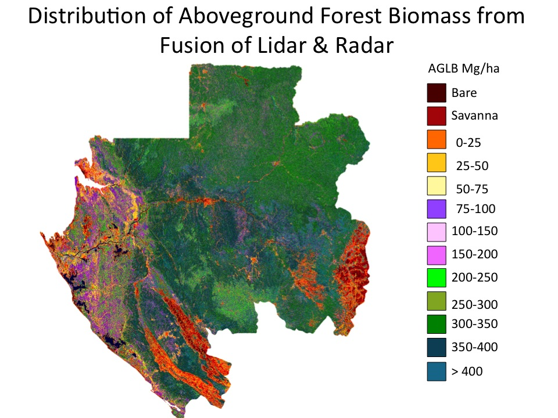
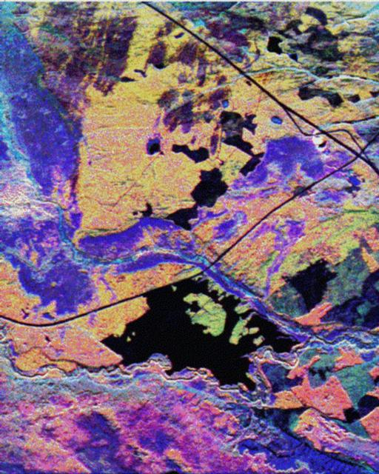
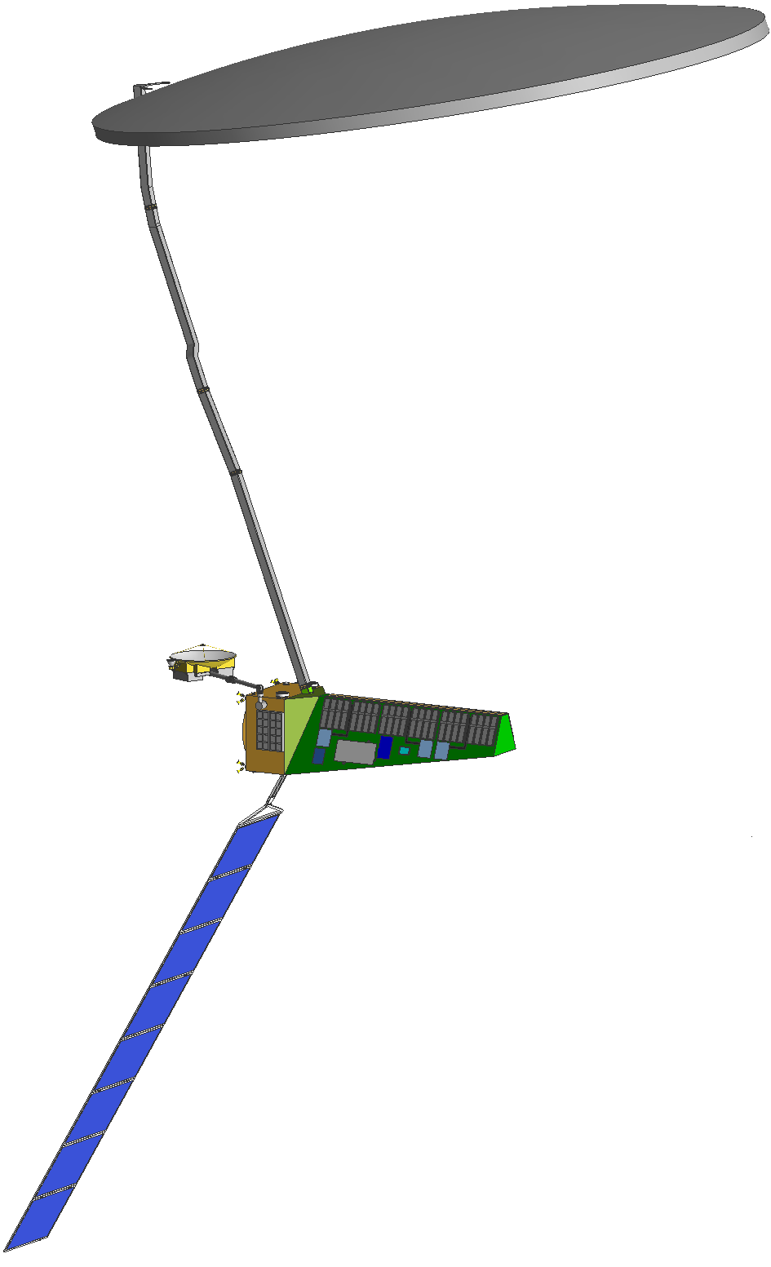
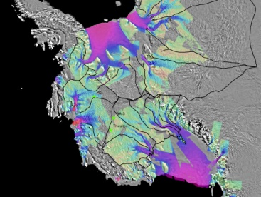
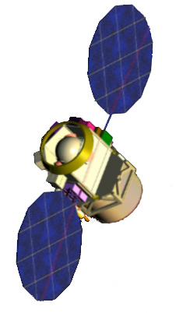
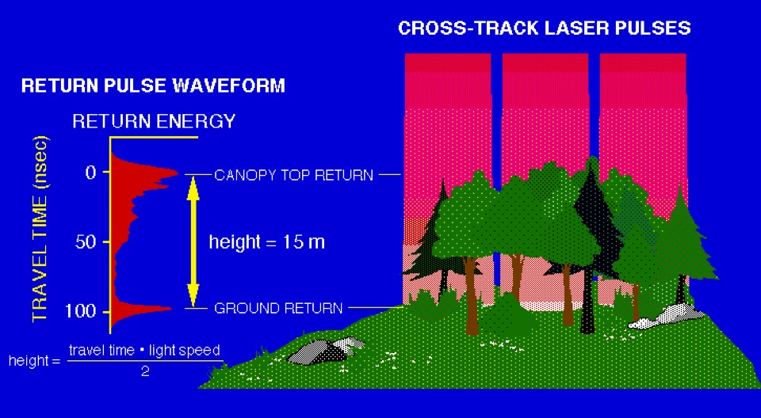
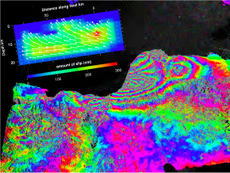
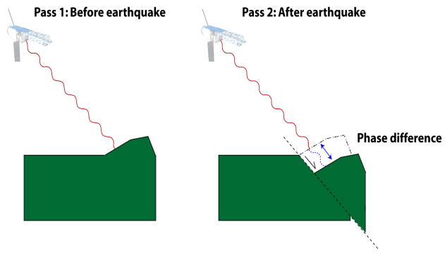
January 2011 MCR DESDynI Concept
Must be Re-thought Due to Current OMB Direction
?
L-band Polarimetric SAR
Ecosystem Structure
Canopy Height
Biomass
Biomass, Vegetation Structure,
Effects of changing climate on habitats and CO_{2,}, disturbance
91-day repeat
~370 km orbit
25 m spot
5 beams
Multibeam Profiling LIDAR
?
?
Cryosphere
Two spacecraft not at same scale
?
Ice velocity, thickness
Response of ice sheets to climate change & sea level rise
?
13 day repeat
~600 km orbit
250-500 m orbit control
220 km swath
Full resolution over swath
5,20+5,40,80 MHz modes
SP, DP, QQP, QP modes
?
L-band Repeat Pass InSAR
?
Solid Earth
Pass 1
Pass 2
?
Surface Deformation
Geo-Hazards
Water Resource Management

Slide 7
Outlook for DESDynI
NASA continues to invest in DESDynI
Competing a Science Definition Team
Continuing trade studies at JPL
NASA currently exploring options for reducing cost
Reducing number and scope of science requirements levied on DESDynI
DESDynI in combination with other satellites to approach DESDynI requirements
Find international partners interested in the science and technology
Ongoing Tandem-L studies with DLR
Ongoing discussions with several potential partners
Find domestic partners that would increase utility of DESDynI data

Slide 8
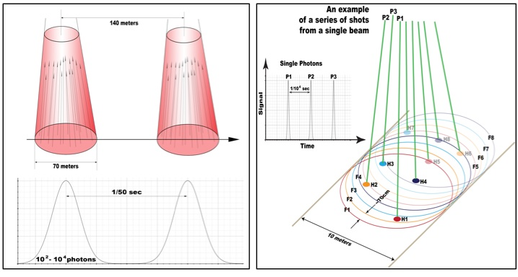
ICESat-2 Measurement Concept
Current Configuration:
Single laser pulse, split into 6 beams, 3 km spacing between pair
Original Concept “Analog” Pulsed Laser
50 Hz laser repetition rate
70 m footprint
140 m between footprints
Now → MicroPulsed Laser
10 KHz laser repetition rate
1 (or more) photon from 10 m footprint
70 cm between adjacent footprints

Slide 9
ICESat-2 Ecosystems Application
Level 1 Requirement:
ICESAT-2 shall produce elevation measurements that enable independent determination of global vegetation height with a ground track spacing of less than 2 km over a 2-year period
SDT conducting tests and simulations to determine what ICESat-2 will meet the ecosystem science objective.
Using low altitude airborne Photon Counting flights over Pine Barrens and SERC in October 2009 and High altitude flights (MABEL) are planned for Fall 2011
Data down-sampled to “ICESat-2 like” spacing and solar background noise was added to simulate various noise conditions
Develop algorithms to extract ground surface and canopy height in presence of noise
Airborne data:
Sigma Space, Smithsonian Environmental Research Center, September 2009

Slide 10
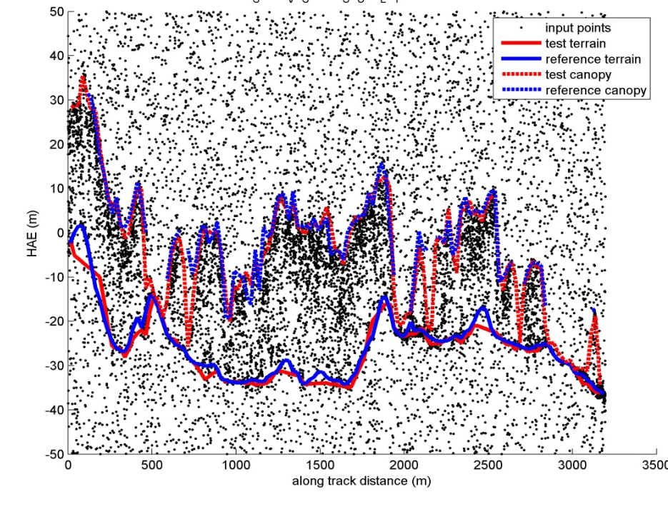
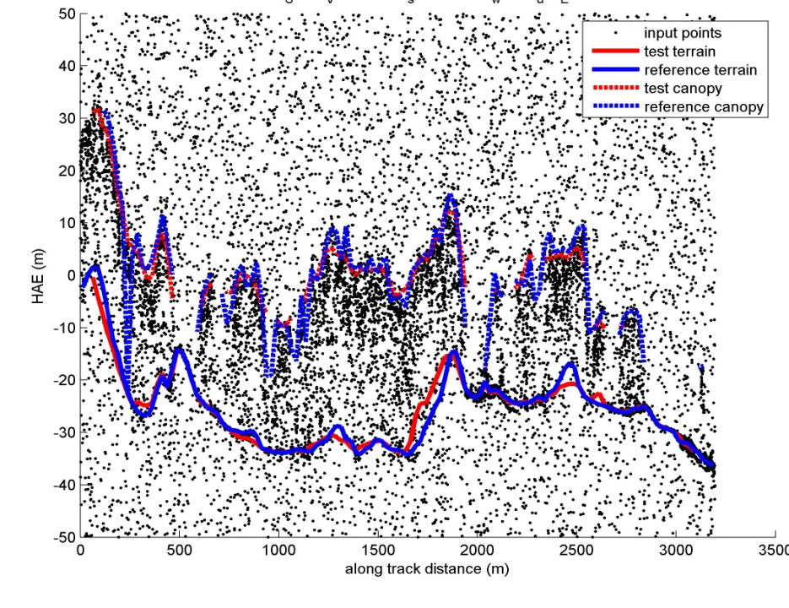
ICESat-2 Simulated Data Algorithm Results
Results from two different methodologies. Residuals were computed between simulated “ICESat-2” (i.e. down-sampled) ground/canopy height estimates (RED) and full-rate micropulse data (i.e. truth) (BLUE).
Col. State – Multiscale Curvature
U. Texas – Hybrid Kalman filter
Canopy Height RMS 4.0 m
Canopy Height RMS 3.9 m
SERC –Line 5
Ground RMS 1.8m
Ground RMS 1.9 m
SERC –Line 5
Airborne data:
Sigma Space, Smithsonian Environmental Research Center, September 2009

Slide 11
ICESat-2 Moving Forward
ICESat-2 launch date currently targeted as April 2016
The ICESat-2 satellite will be off-nadir pointed over non-polar areas (~60S → 60N) to increase the spatial density of measurements in terrestrial ecosystems.
The ICESat-2 SDT team will soon develop the Algorithm Theoretical Basis Documents (ATBDs) for the Vegetation/Land data products

Slide 12
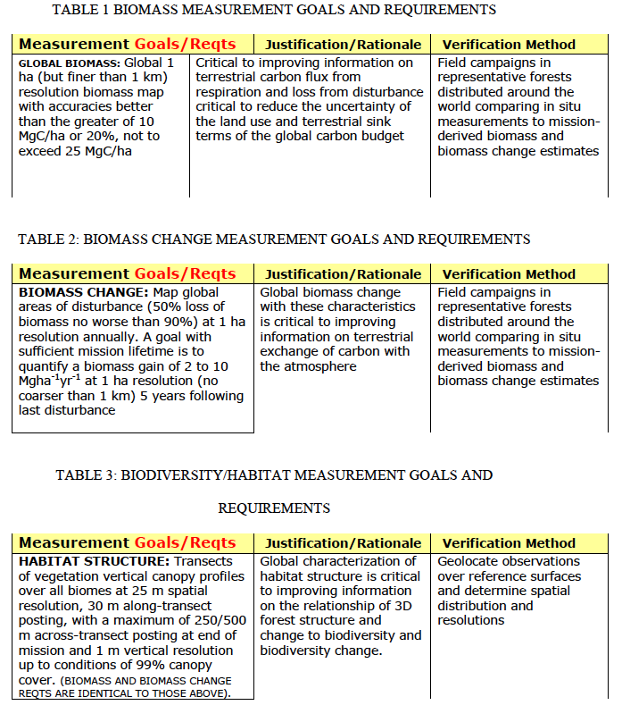
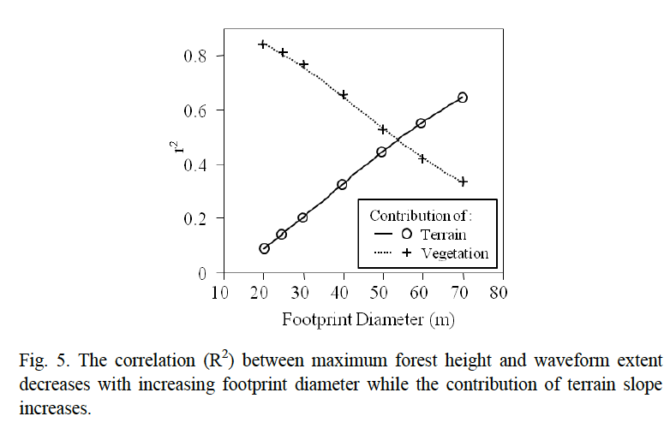
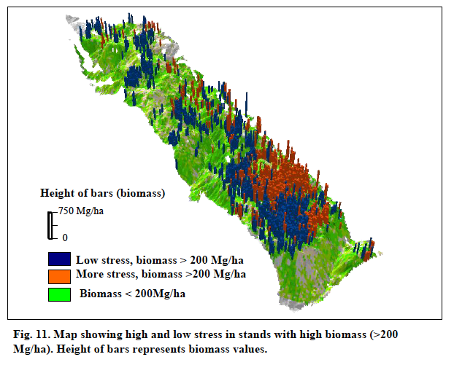
Publications: RSE Special Issue on DESDynI
18 papers: Biomass, Veg Structure, Biodiversity
Overview, 5 Lidar, 6 Radar, 4 sensor fusion, 2 in situ methods
A Few Highlights
From
DESDynI RSE Special Issue
Biomass Requirements
Structure & Stress
Slope effects on lidar

Slide 13
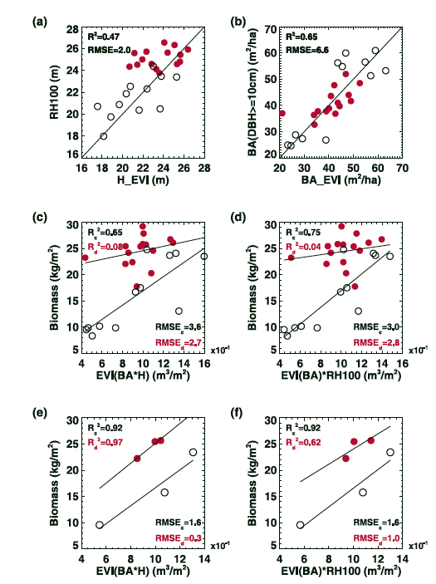
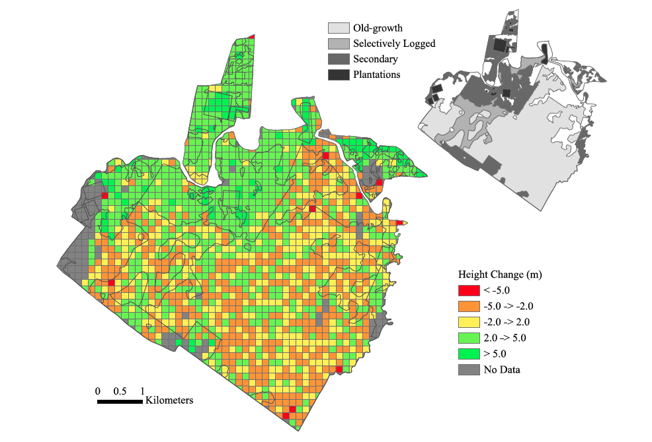
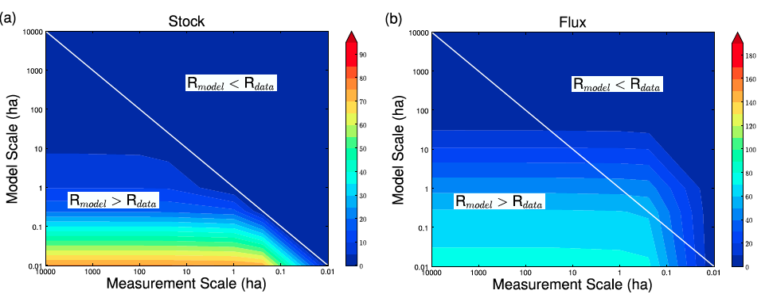
Publications: JGR-A DESDynI Special Issue
12 Papers
Biomass, biodiversity and vegetation structure
4 review papers
(remote sensing, biomass, structure, disturbance and regrowth)
8 papers lidar, radar, fusion, requirements, etc
Biodiversity requirements, biomass dynamics, radar/lidar fusion, waveform validation, GLAS/Landsat fusion, etc

Slide 14
Field Activities: California & East Coast
California Sierra Nevada (2008)
Revisit of 1 ha plots (1999/2000)
~25 1 ha biomass plots (2008)
Stem-maps for 30 m plots
UAVSAR, LVIS, discrete return lidar (DRL)
East Coast (2009)
Legacy sites with existing field and remotely-sensed data
Hubbard Brook and Bartlett EF, Howland, Harvard, etc
Additional PI-led activity in Quebec & Costa Rica (Simard)
New 1 ha and prism plots
UAVSAR, LVIS, DRL at sites
Time-series of lidar data at some sites
Data archived and available

Slide 15
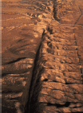
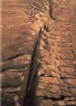
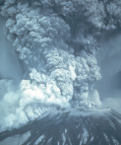
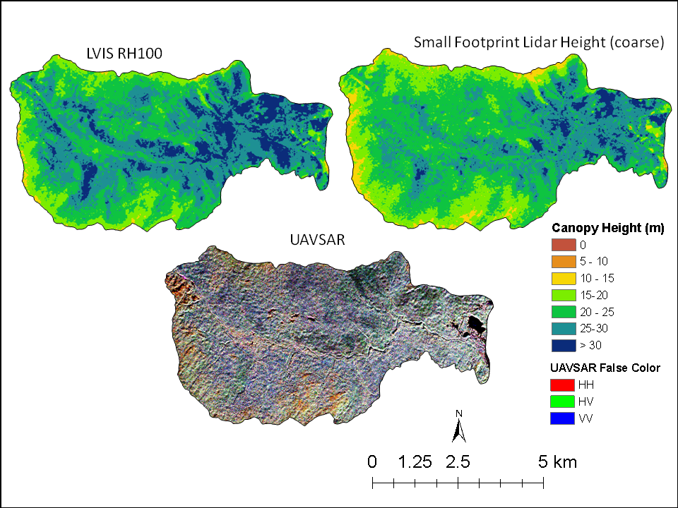
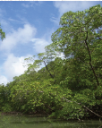
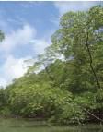
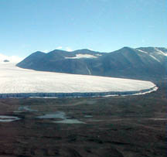
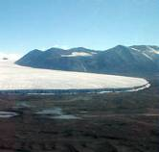
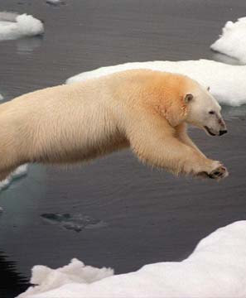
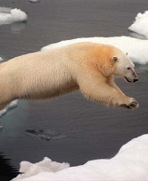
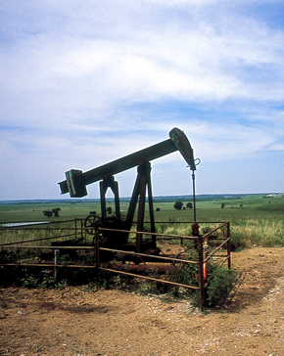
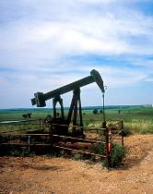
Hubbard Brook Remote Sensing
LVIS Waveform Lidar
Small Footprint Discrete Return Lidar
UAVSAR
DESDynI

Slide 16
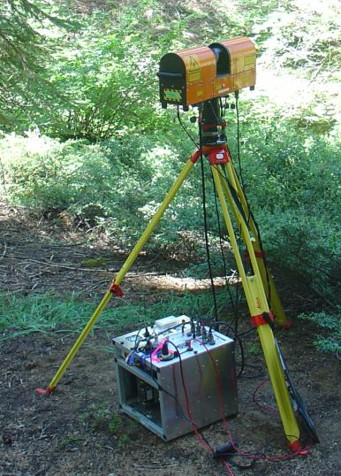
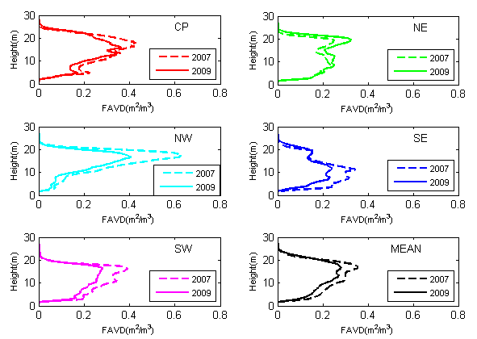
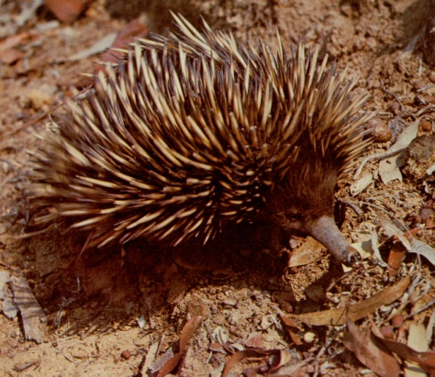
Echidna® and DWEL
Echidna ® Full Waveform Lidar
1064nm, 4 mrad resolution
US Deployments with NASA support
Harvard, Howland, and Bartlett Forests
(2007, 2009, 2010)
Sierra National Forest (2008)
DWEL: Dual Wavelength Echidna® Lidar
Full Waveform Echidna Heritage
1064 and 1550nm (separation of foliage and woody returns)
Improved angular resolution (2mrad)
Under development at BU with NSF support
In collaboration with CSIRO
Currently undergoing integration and testing

Slide 17
Potential Activities with Europeans
Joint Ecosystem Structure Science Meeting
Planning to begin this fall
Exchange of ideas and mutual understanding on:
Existing research activities and advances
Potential mission development and deployment
E.g. TANDEM-L & BIOMASS
Applications and science requirements of each community
Joint Ecosystem Structure Field Experiment
Europeans promoting potential of PolInSAR
Lack of published studies, availability of field and aircraft data hinder mutual advancement
Suggest development of joint field experiment to test efficacy of remote sensing techniques for derivation of ecosystem structure
Potentially help inform DESDynI-R partnerships (BIOMASS & TANDEM-L)
Please attend the PolInSAR meeting tomorrow morning

Slide 18
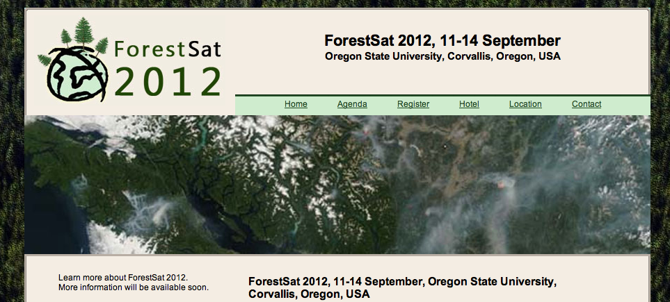
Upcoming Meetings: ForestSat 2012
Promote scientifically-based understanding of how remote sensing describes and monitors forested systems
Fifth conference, first outside of western Europe
Contact Warren Cohen

Slide 19
Upcoming Meetings: SilviLaser 2012
Premier conference on remote sensing of forest structure
Held in conjunction with ForestSat (immediately follows)
Contact Mike Wulder or Nicholas Coops

