Slide 1
The Flux Pilot Project
NASA’s Carbon Monitoring System
Steven Pawson, Mike Gunson, and the project team
Global maps of carbon fluxes derived from space-based observations

Slide 2
Flux-Pilot Project: The Team
HQ: Ken Jucks
ARC: Chris Potter, Steve Klooster
GSFC: Steven Pawson, Jim Collatz, Watson Gregg, Randy Kawa, Lesley Ott, Cecile Rousseaux, Zhengxin Zhu
JPL: Mike Gunson, Kevin Bowman, Holger Brix (UCLA), Annmarie Eldering, Josh Fisher, Chris Hill (MIT), Meemong Lee, Junjie Liu, Dimitris Menemenlis

Slide 3
Objectives
NASA Satellite Data
Other Observations
MERRA reanalysis
NASA Models:
Land, Ocean, Atmosphere
Level-3 and Level-4 products relevant to carbon monitoring
Use models to transform from observations to meaningful quantities for carbon cycle science (and policy)
Bottom-up flux estimates over land and ocean
Atmospheric forward modeling: fluxes to concentrations
Atmospheric inversions for (land biosphere) fluxes

Slide 4
Year-1 Objectives/Achievements
Learned (almost) how to communicate and exchange data among several different groups
Bottom-up flux estimates for July 2009-June 2010, from:
Two versions of the CASA model, constrained by data
Two different ocean models, constrained by data
Assessments of these fluxes:
Comparisons with other datasets
Comparisons of atmospheric concentrations using GEOS-5 forward model
Top-down (inverse) estimates using ACOS/GOSAT data:
GEOS-CHEM adjoint used for land biosphere fluxes
Evaluation against bottom-up computations

Slide 5




Enhancing communications among the land, ocean and atmosphere groups: Basic understanding
NPP = GPP – Ra
NEP = NPP – Rh
NEE = – NEP
… the increments in 3D-Var are positive …
…the posteriors in the 4D-Var include corrections to the prior fluxes …
… 5D-Var includes rose-colored glasses
What’s up?
The physicist said the Atlantic is a basin, the biologist said it’s a sink …
Am I 44.0096 grams or 12.0107 grams ?

Slide 6
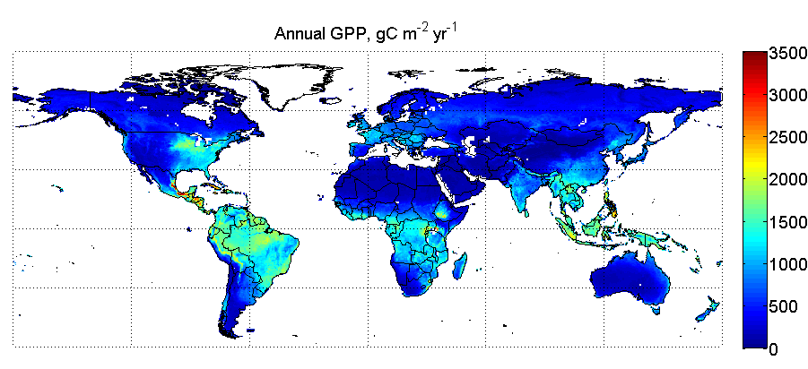
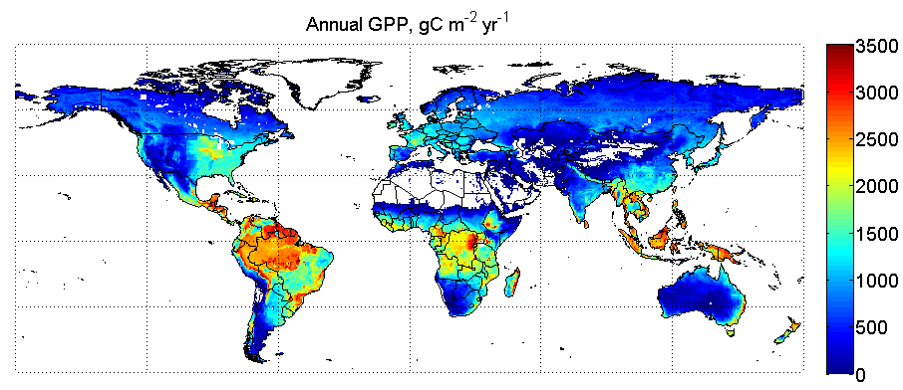
Schematic of the data flow in the two versions of the CASA land biosphere systems, with the annual GPP (gC m⁻²yr⁻¹) from NASA-CASA (left) and CASA-GFED (right)
MODIS: EVI, land cover
MERRA: T_{surf}, precip, PAR
Soil type map
NASA-CASA
Maps of land biosphere:
GPP, NPP, NEP, NBP, …
MODIS: reflectance, fire, vegetation
AVHRR GIMMS NDVI
MERRA: T_{surf}, precip, PAR
Soil type map
CASA-GFED
NASA-CASA (ARC)
CASA-GFED (GSFC)
Gross Primary Productivity (GPP): the rate of uptake of Carbon from the environment

Slide 7
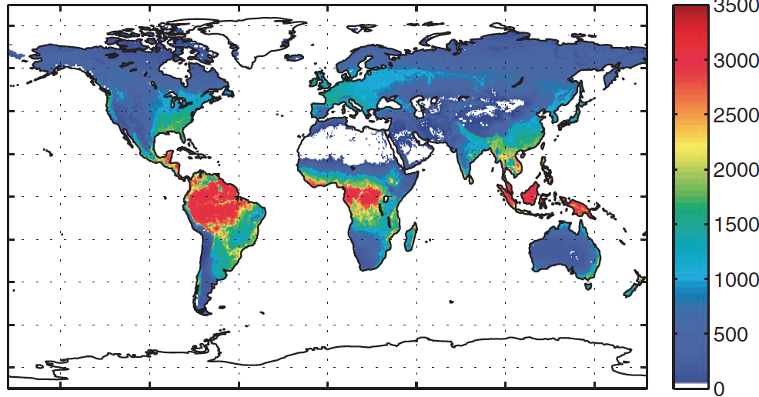
Comparison of the annual GPP (gC m⁻²yr⁻¹) estimated from flux towers (MPI dataset) with the two estimates from this project, from NASA-CASA (left) and CASA-GFED (right)
Upscaled FLUXNET (MPI-BGC)
NASA-CASA (ARC)
CASA-GFED (GSFC)
Gross Primary Productivity (GPP): the rate of uptake of Carbon from the environment

Slide 8
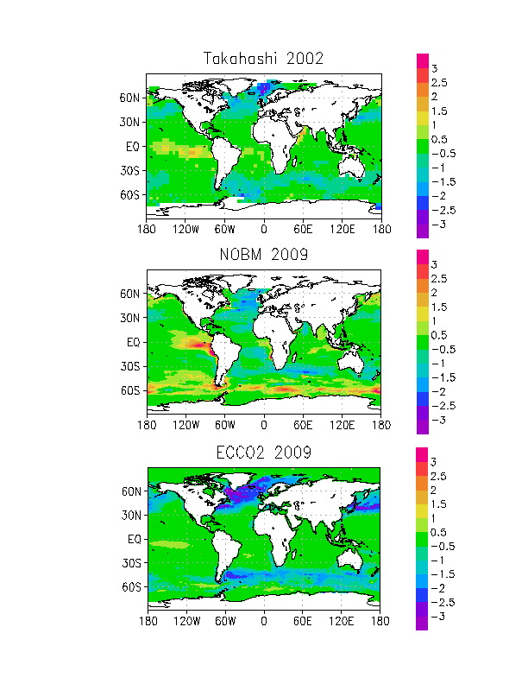
The ocean carbon flux estimates from the NOBM and ECCO/Darwin systems differ in model structure and in the observational constraints imposed – annual mean fluxes (10⁻⁹ gCm⁻²s⁻¹) for 2009
MODIS: Chlorophyll
MERRA: Surface wind speed/stress; clouds, total ozone, humidity
NOBM
Maps of ocean state, including pCO₂, fCO₂, etc.
Jason-1, OSTM/Jason-2, & Envisat sea-surface anomaly
AMSR-E SST
Quikscat wind stress
ECCO/Darwin
NOBM
ECCO-2/Darwin

Slide 9
Comparison of the annual flux of CO₂ from ocean to atmosphere according to Takahashi (LDEO) “climatology” and the two “CMS” ocean products, NOBM and ECCO for 2009.
LDEO/Takahashi “climatology”
NOBM
ECCO-2/Darwin

Slide 10
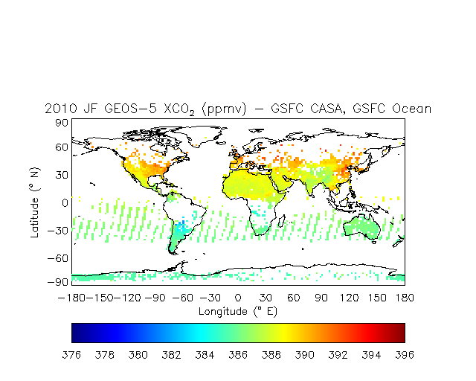
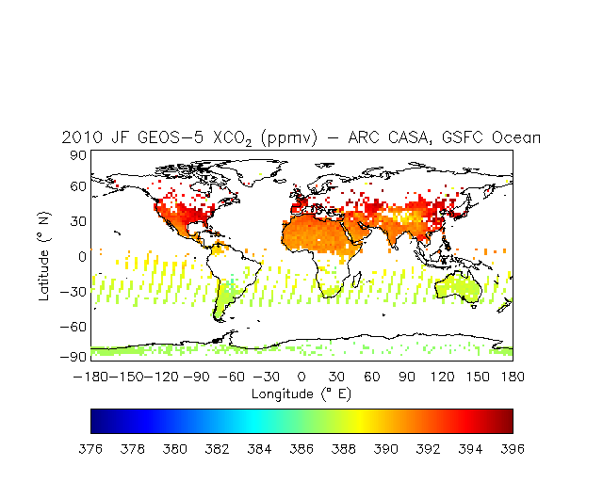
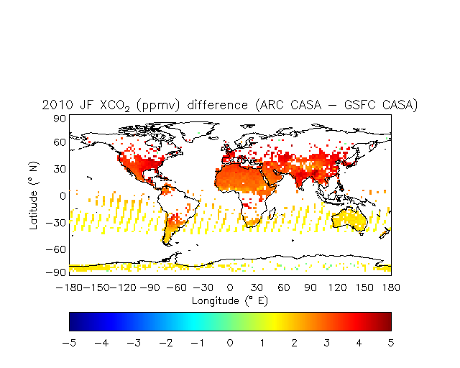
Testing the impact of differing flux estimates in GEOS-5 simulations on surface CO₂ concentrations at NOAA GMD monitoring stations: the run with GFED/CASA and NOBM fluxes is the most realistic
MERRA: Meteorology
Bottom-up fluxes
GEOS-5
CO₂ concentrations
CASA/GFED + NOBM
NASA CASA + NOBM
NASA CASA – CASA/GFED
X_{CO2} [ppmv]: deep-layer mean concentrations
X_{CO2} [ppmv]: difference
Forward model computations with different combinations of fluxes (fossil fuel, biofuel, … are from the same inventories) interpolated to GOSAT observation locations for Jan-Feb 2009 (working on the comparison with ACOS/GOSAT)

Slide 11
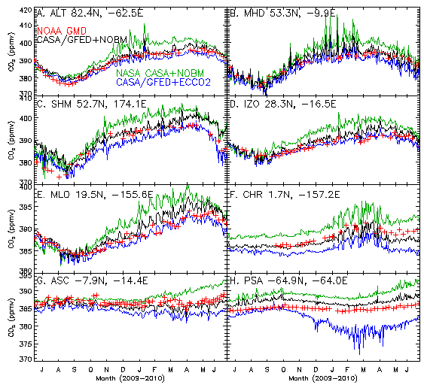
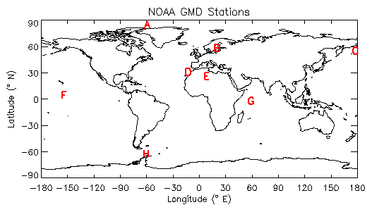
Testing the impact of differing flux estimates in GEOS-5 simulations on surface CO₂ concentrations at NOAA GMD monitoring stations: the run with GFED/CASA and NOBM fluxes is the most realistic
Comparing three simulations, for July 2009-June 2010, with the NOAA GMD Observations (red) shows that the two model runs with GFED/CASA (black and blue) are most realistic in the NH and the model runs with NOBM (black and green) are most realistic in the SH (same FF emissions in all runs)

Slide 12
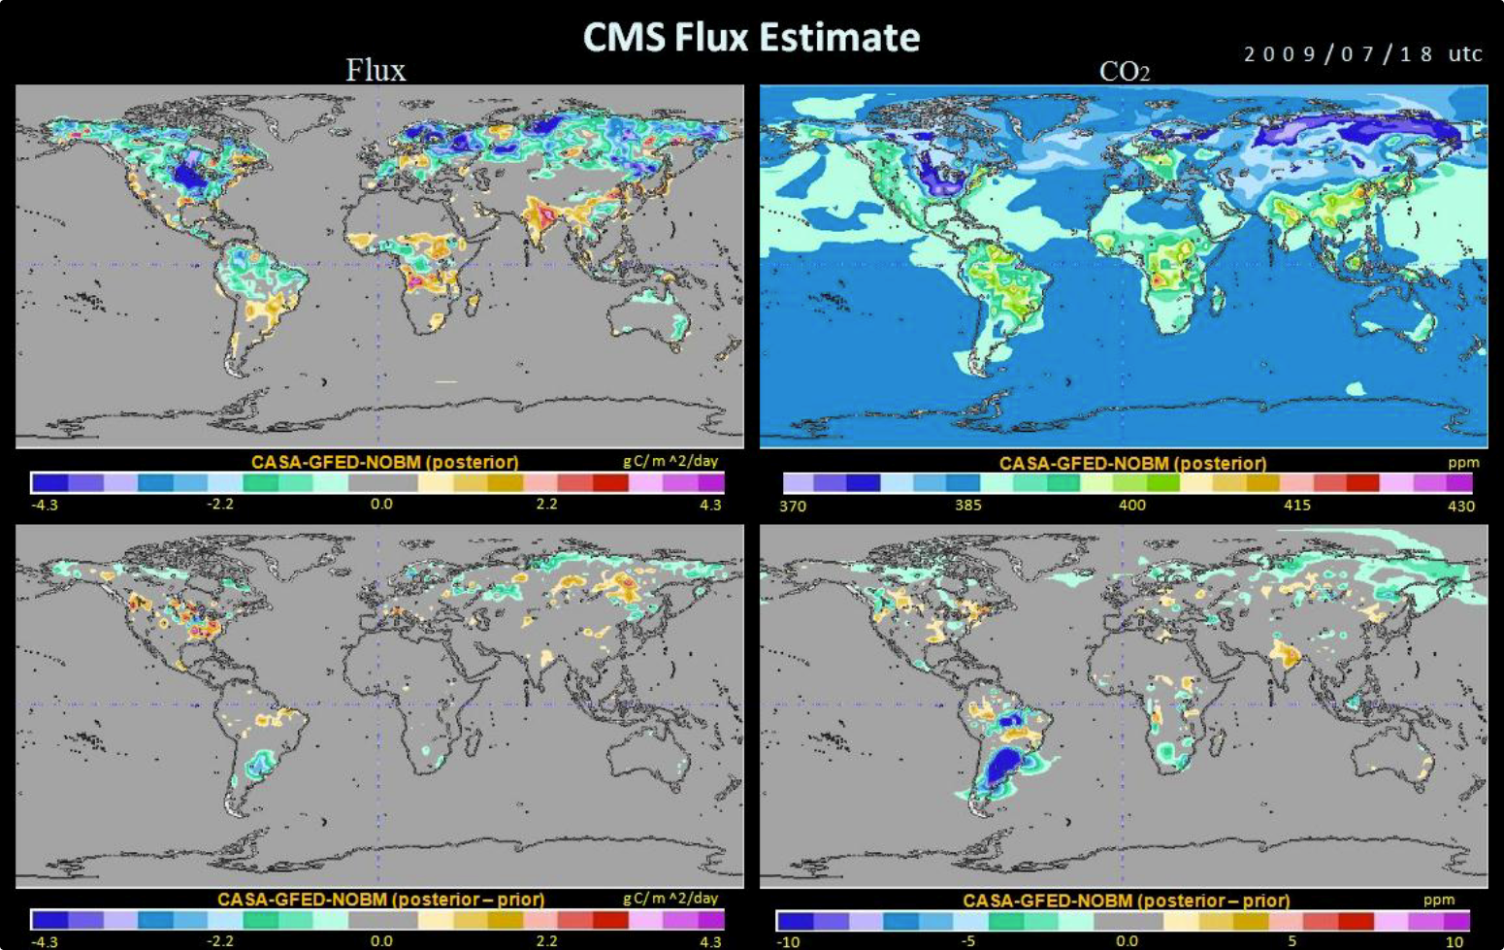
The “top-down” inverse flux estimates for land biosphere computed using the adjoint of GEOS-Chem with the CASA-GFED computations as the prior
MERRA: Meteorology
GOSAT: ACOS CO₂ retrievals
CMS bottom-up fluxes as priors
GEOS-CHEM adjoint
Posterior maps of land biosphere flux
POSTERIOR (after inversion) minus PRIOR (CASA/GFED)
Land Biosphere Flux
(gCm⁻²day⁻¹)
Surface CO₂ concentration (ppmv)

Slide 13
Land biospheric CO₂ fluxes from the inversion estimates (based on ACOS/GOSAT) are in closer agreement than the prior states with CarbonTracker (based on surface network)
Inverse estimate has a stronger NH sink and a weaker tropical sink than the prior estimate (GFED/CASA)
Posterior: -4.97801 GtC/year
POSTERIOR MINUS PRIOR
Prior: -5.13972 GtC/year
GtC/year | North America | Amazon | Europe | Africa
Prior (7/09-6/10) | -0.67 | -0.98 | -0.10 | -1.21
Posterior | -0.75 | -0.47 | -0.56 | -0.75
Carbon Tracker (2009) | -0.90 ± 0.41 | 0.16 ±0.67 | -0.36 ± 0.72 | -0.60 ± 0.57
Land Biosphere Flux
(gCm⁻²day⁻¹)

Slide 14
Land biosphere carbon flux estimates by country, for CASA-GFED, NASA-CASA, and the inverse method, compared to the MPI-BGC estimates (which are based on a different type of model)
ACOS-Inversion
NASA CASA
CASA-GFED
MPI-BGC
Annual CO₂ flux (Petagrams)

Slide 15
Summary
Observations
NASA Models:
Land, Ocean, Atmosphere
Products relevant to carbon monitoring
Our strength comes from our diversity: team members’ expertise in developing and using NASA’s observations and models – connections
Bottom-up (ocean and land biophysical) and top-down (land biophysical) flux computations completed for 2009-2010 and evaluated using forward model simulations
Some weaknesses isolated (related to data use and models)
Evaluation underway
Can discriminate between different sets of fluxes
Evaluation and uncertainty estimates are ongoing

Slide 16
Plans for FY 2012
Improve estimates (models, use of data, …):
Bottom-up and forward (transport) model for 2005-2011
Inverse flux estimates for July 2009-June 2011
Evaluation and validation (independent data)
Use other data types (e.g., TES as well as ACOS)
Error analysis:
Propagation of observation errors through sub-systems
Potential model error (parameters, transport)
Absolute accuracy:
Provide a benchmark for atmospheric inversion (~OSSE)

Slide 17
Outreach and Communication
Publish results in peer-reviewed literature
Provide data to the community (web interface)
Identify and communicate areas for additional scientific participation
Meeting with community at AGU: Thursday evening in San Francisco
Enhance communications with policy makers

