Slide 1
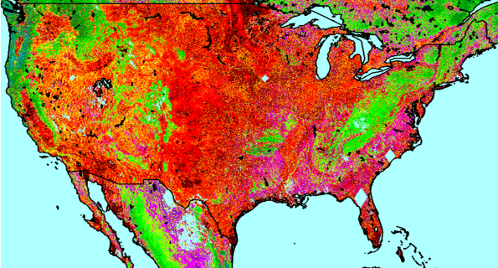
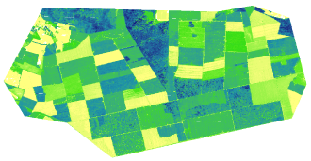
NASA Carbon Monitoring System
Forest Biomass Pilot Project
Community Forum
October 5, 2011
Alexandria, Virginia
Parker Tract, North Carolina
National Forest Biomass Effort:
JPL – Ames
Local Forest Biomass Effort:
GSFC-UMD-USFS

Slide 2
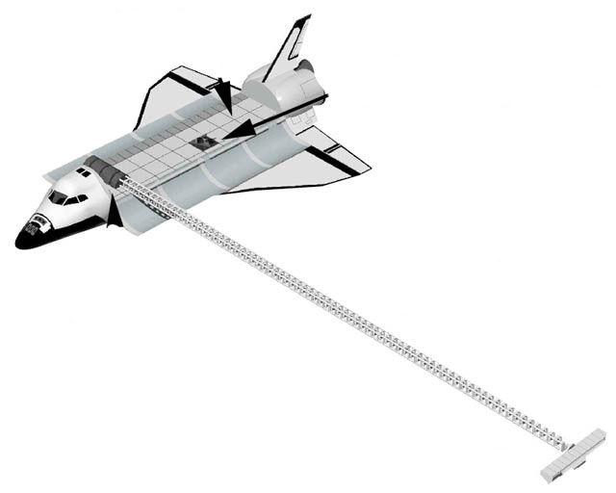
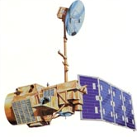
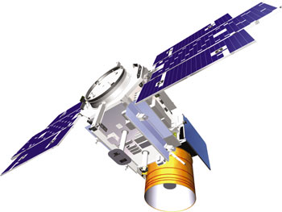
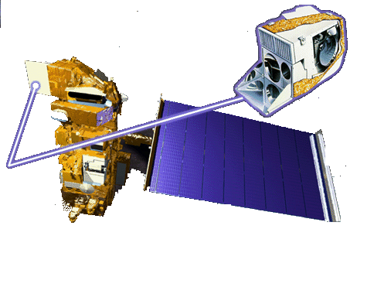
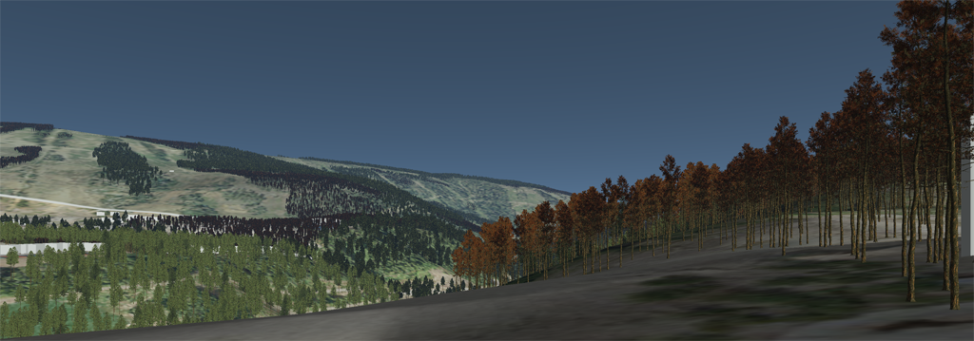
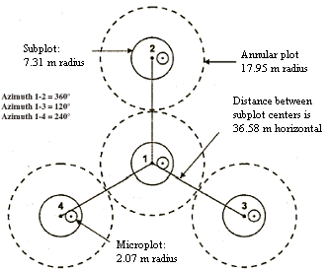
Satellite and In Situ Observations
LANDSAT
ICESat
SRTM
MODIS
ALOS PALSAR
Airborne Lidar
USDA FS, FIA Data

Slide 3
Roles of National and Local Mapping
USFS FIA data (sample)
National reporting of US C stocks
training, validation
Geospatial distribution of C stocks
Continental “bottom up” flux calculations
Comparison with atmospheric inversions
Increasing Geospatial Detail
National Biomass @1-100 ha
validation
Validation of national mapping
Prototype project/county MRV
Ecological controls on C sequestration
Local Biomass @ 1 ha

Slide 4
Local Mapping
NASA GSFC:
Compton Tucker
Jeff Masek
Bruce Cook
Lola Fatyombo
Forrest Hall
Chris Neigh
University of Maryland:
Ralph Dubayah
George Hurtt
Chengquan Huang
Naira Pinto
Jackie Rosette
Juan Suarez
US Forest Service:
Richard Birdsey
Yude Pan

Slide 5
Study Sites (Year 1)
Bartlett/Hubbard Brook, New Hampshire (Mixed hardwood w/strong elevation and climate gradients)
DESDynI Field Study SF lidar (2009)
USFS Landscape monitoring site; dense historical plot network
Parker Tract, North Carolina (Even-aged Loblolly Pine)
USFS SF lidar (2005), Photon Counting lidar (Oct 2010), G-LiHT SF lidar (Summer 2011)
USFS Landscape monitoring site; well characterized biomass & treatment history
Anne Arundel & Howard County MD (mixed hardwood/softwood; suburban)
SF lidar (2005), Photon Counting (Feb/June 2011 @ Jug Bay)
UMD field campaigns during winter 2010-11 to collect FIA-style plot data
Dense plot network at Jug Bay
Comparison with county-level estimates from FIA
4) Garcia Track, Mendicino County CA (recovering coastal Redwood/Doug Fir)
SF lidar surveys 2005 and 2009; reflight in 2011
Carbon credits awarded through Climate Action Reserve (CAR) program

Slide 6
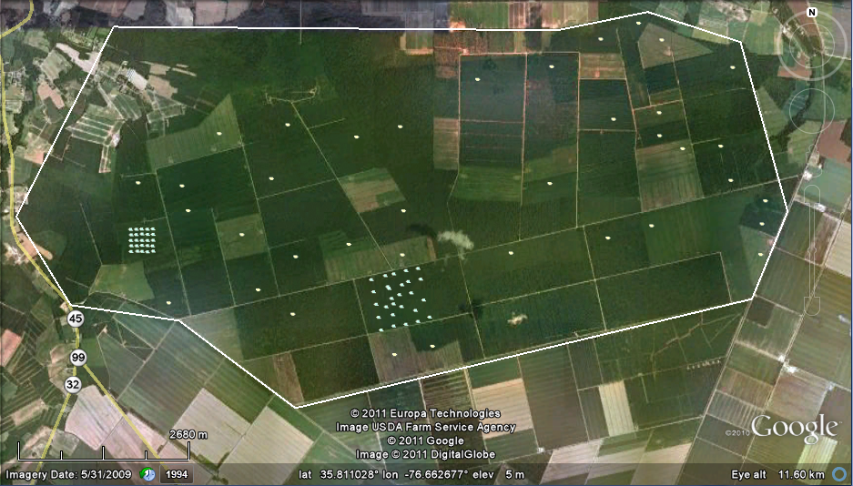
Field Measurements
Parker Tract, NC
Sites chosen to represent range of stand types, ages
Flux towers & high density of FIA plots
Field measurements collected by NCSU and Weyerhaeuser
7 m diameter, fixed-radius plots (n ≈ 100)
Species, dbh, live/dead for trees ≥2.54 cm
Biomass calculated using Jenkins equations

Slide 7
CMS-Biomass Data Processing
Field plot data:
Collection
Input
DBH, species, live/dead
Compute biomass
Plot coordinates
Airborne Lidar data:
- Separate ground/feature returns
- Compute metrics
Create layer stack and extract plot data
Radar:
Process ALOS
Forest/Non-Forest mask
Modeling, validation and error analysis
Other data sources:
Landsat reflectances (Chris)
Landsat disturbance products(Chris/Chengquan)
NLCD/Enhanced NLCD (Img Tree)
Site boundaries (Naiara)
Prediction
Mapping
Error Analysis

Slide 8
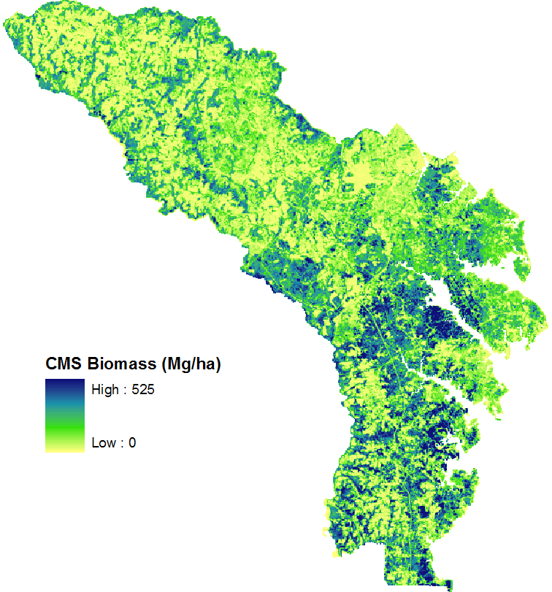
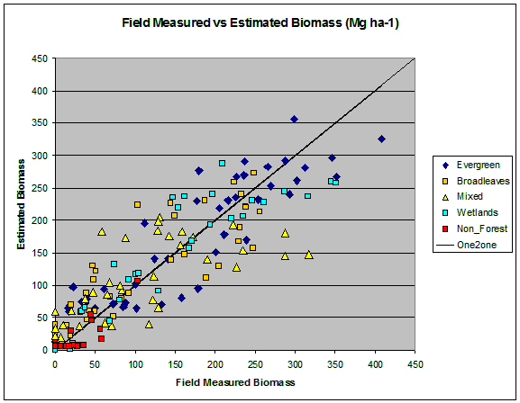
Forest Biomass (Maryland)
PRESS RMSE = 48.86 Mg/ha

Slide 9
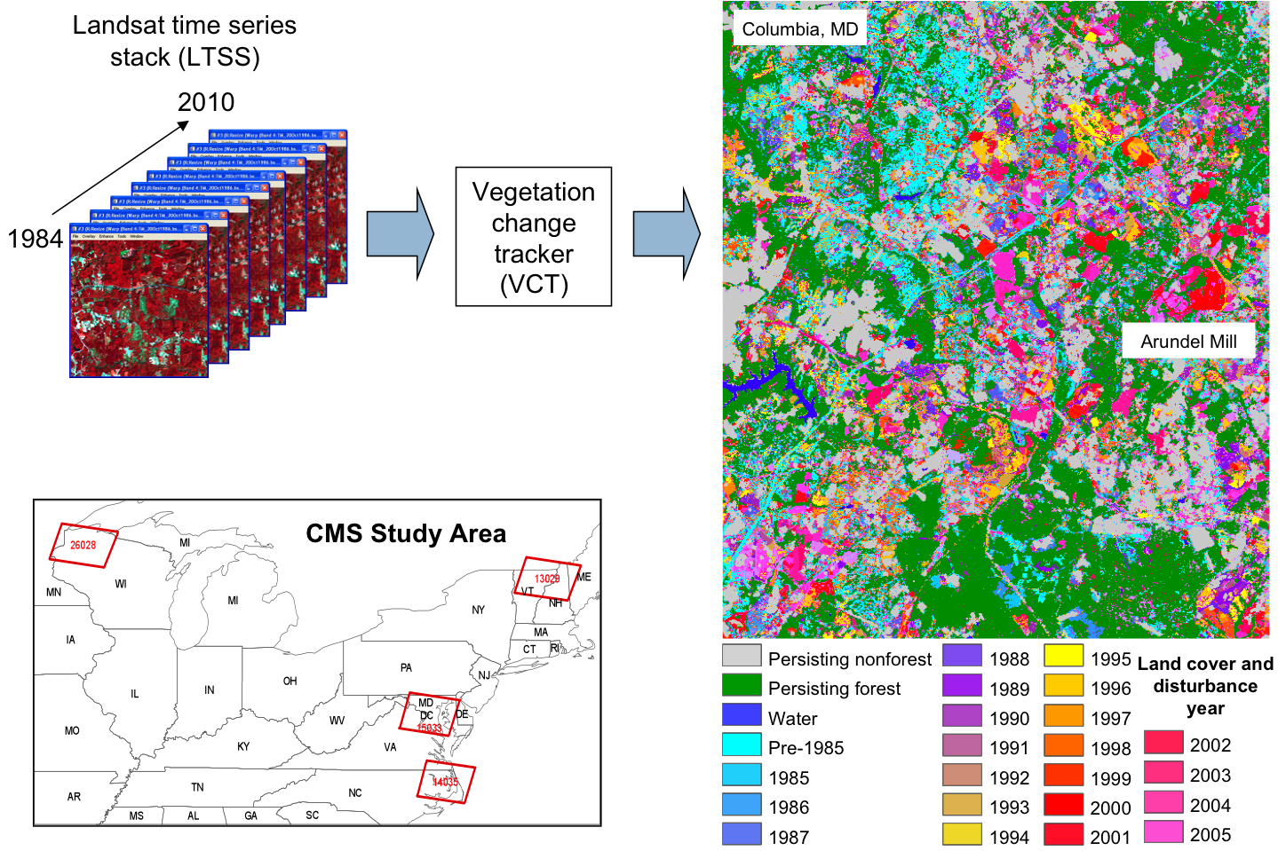
Landsat Disturbance

Slide 10
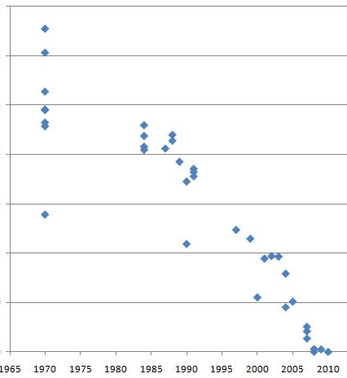
Growth rates from Landsat-LiDAR data
Parker Track, NC
35
30
25
20
15
10
5
0
Canopy height (LiDAR), m
Vertical growth rates can be estimated by combining LiDAR-derived canopy heights with Landsat disturbance history (Dolan et al., JGR, 2009).
undisturbed
Year since last disturbance (Landsat)

Slide 11
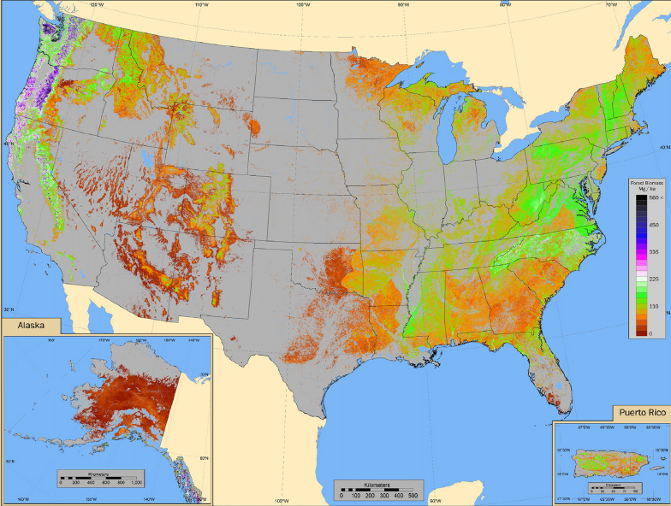
National Biomass Pilot Project
Estimating Biomass and Carbon Storage by Combining
Satellite and Ground Observations
Center Leads:
Sassan Saatchi (JPL)
Rama Nemani (ARC)
Cook, Masek & Tucker (GSFC)
Co-investigators:
Richard Birdsey (USDA/FS)
Michael Lefsky (CSU)
Project Domain

Slide 12
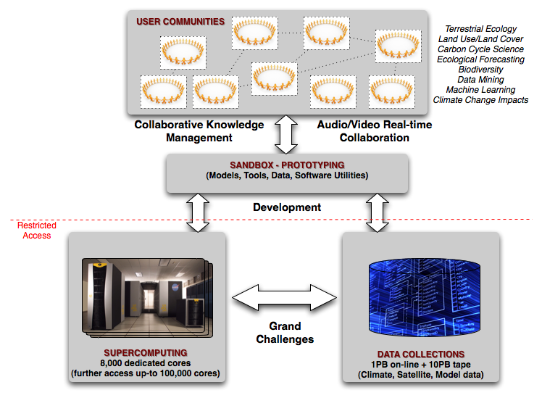
National Data Processing
NASA Earth Exchange: Collaborative Computing

Slide 13
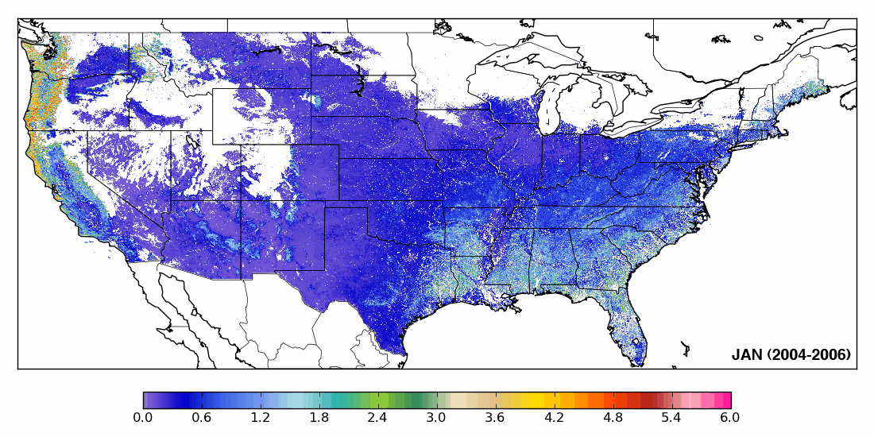
250-m LAI derived from MODIS
MODIS monthly LAI Mosaic is provided at 250 m resolution
Three years (2004-2006) of MODIS data were processed to improve image quality
LAI estimation was implemented using the NLCD land cover map.

Slide 14
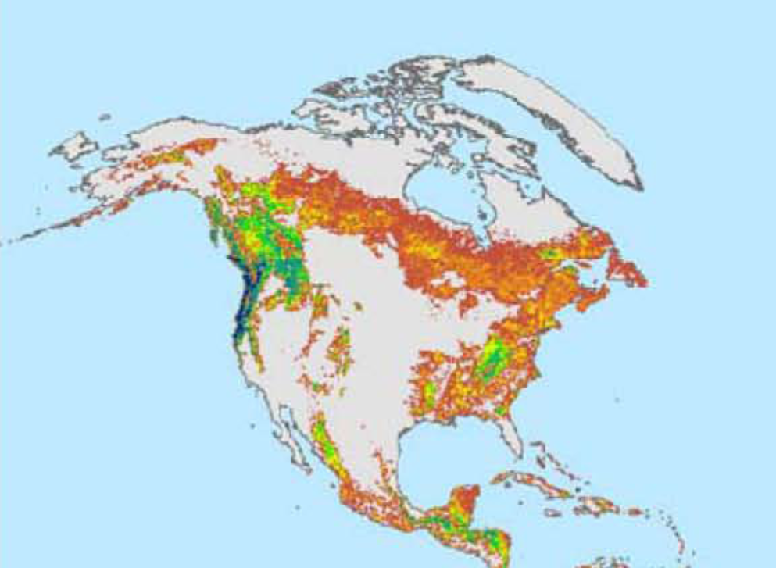
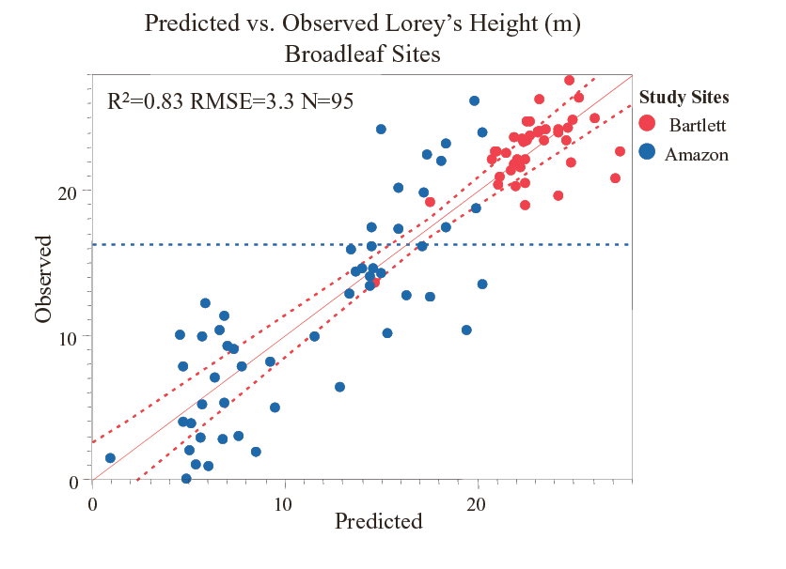
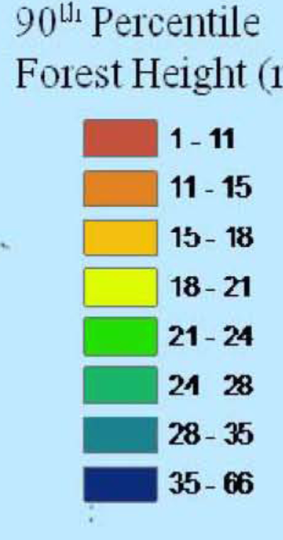
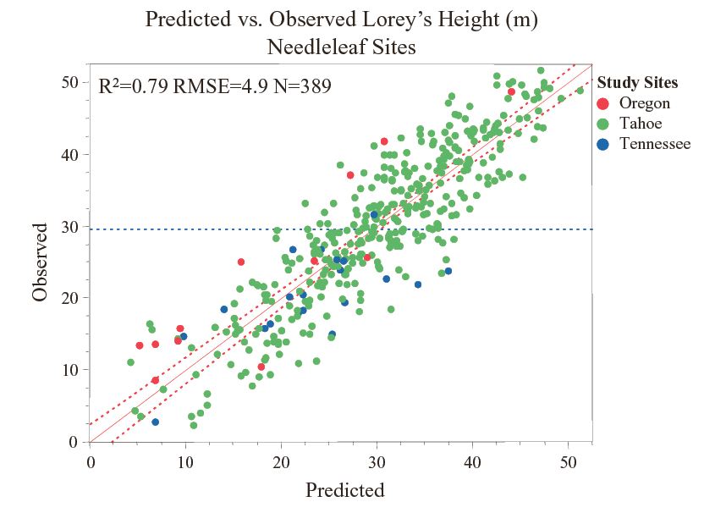
ICESAT GLAS Forest Height Metric
Lorey’s Height Predicting Forest Biomass
(Lefsky et al., 2010)

Slide 15
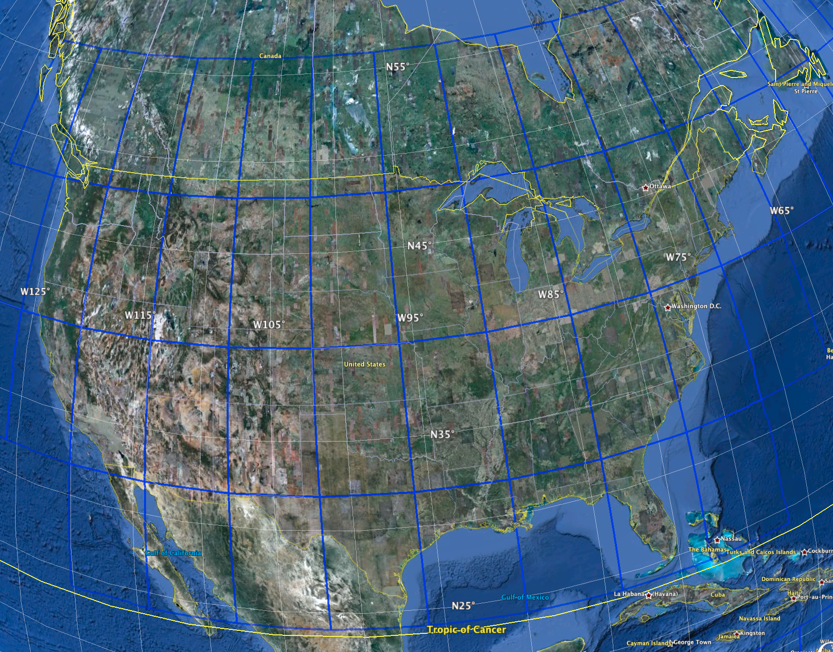
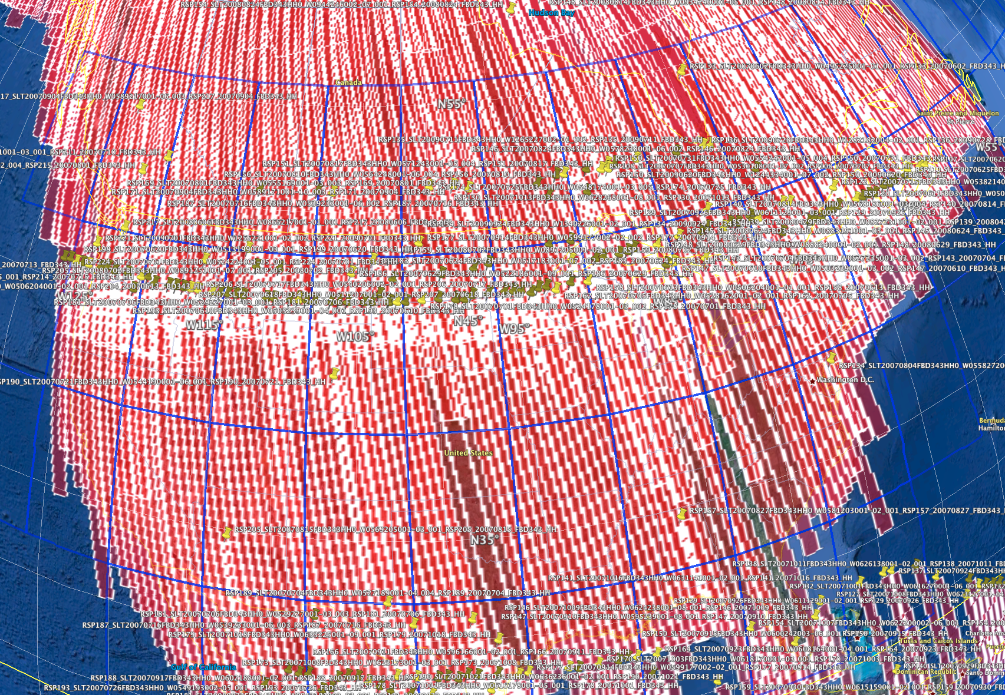
From acquisition to image mosaic
ALOS PALSAR acquires data
JAXA EORC processes special K&C slant range image strips
Thousands of km long, rather than image frames typically created
Reduced resolution dual pol data (~50m)
Next, orthorectify the data using the SRTM DEM, and apply radiometric corrections if necessary
Including radiometric terrain correction
Assemble orthorectified images into image mosaics
31 UTM tiles, 6x 8 deg in size
396 Image Strips

Slide 16
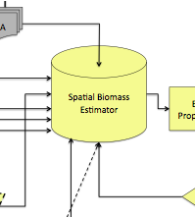
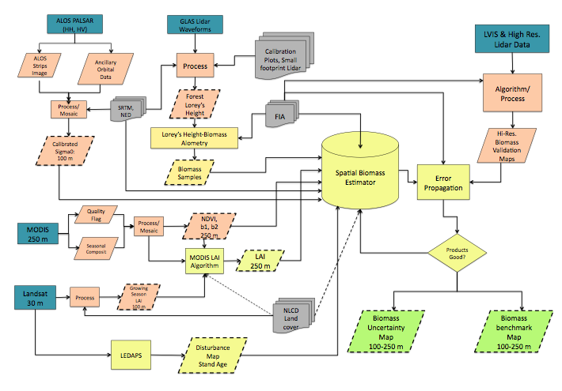
Spatial Biomass Estimator
Parametric Models:
Multivariate Regressions:
AGB = f (VI, SAR, SRTM)
Non Parametric Models:
Coloring by numbers (use of land cover maps)
Image Segmentation Approach (Lefsky et al., 2010; Mitchard et al., 2011)
Decision Rule, Random Forest (Saatchi et al., 2007; Kellndorfer et al., 2010)
Maximum Entropy Approach (Saatchi et al., PNAS 2011)

Slide 17
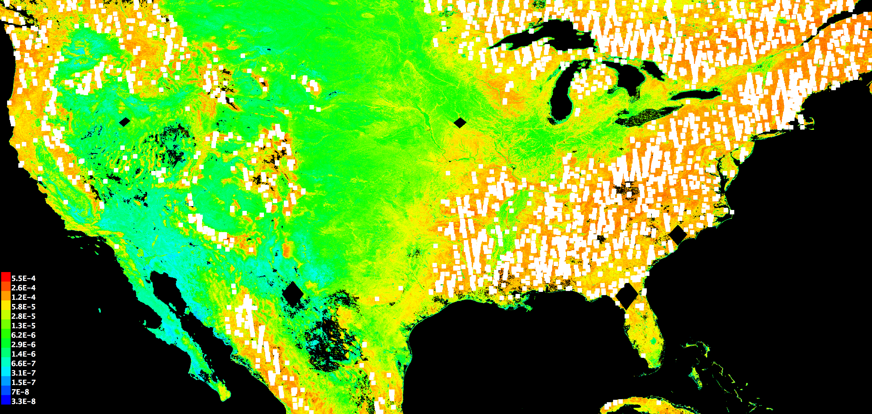
Maximum Entropy Model
Integrative Approach to Map Biomass (Cont.)
1. A probabilistic framework
Develop incomplete empirical probability
distribution based on the occurrences
Approximate with a probability distribution of
maximum entropy
Use environmental variables as constraints
A rule classifier to produce forest biomass map
Statistical Model Biomass Estimator
Sample Probability Space
Maximum Entropy Estimation Model

Slide 18
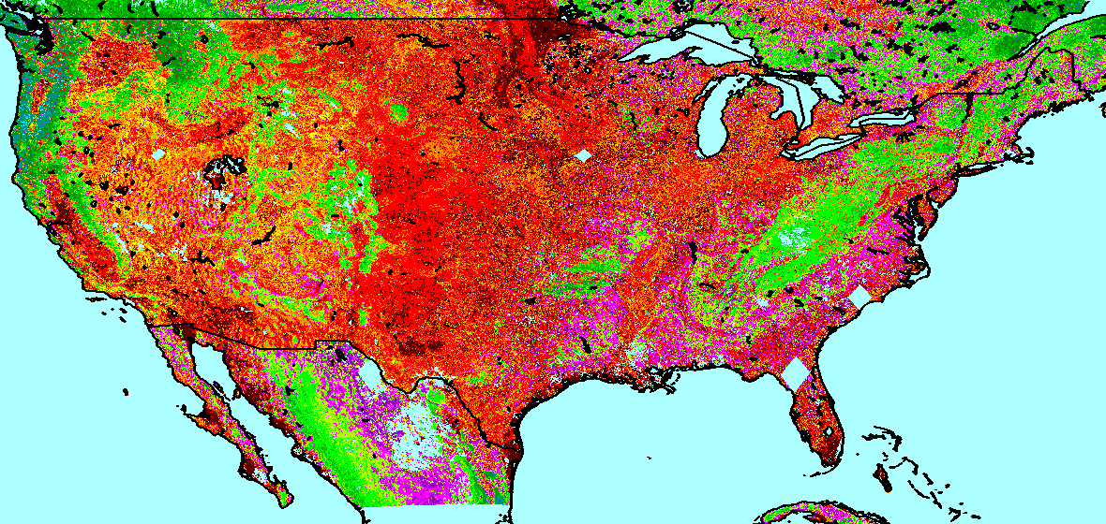
Preliminary Aboveground National Biomass Map

Slide 19
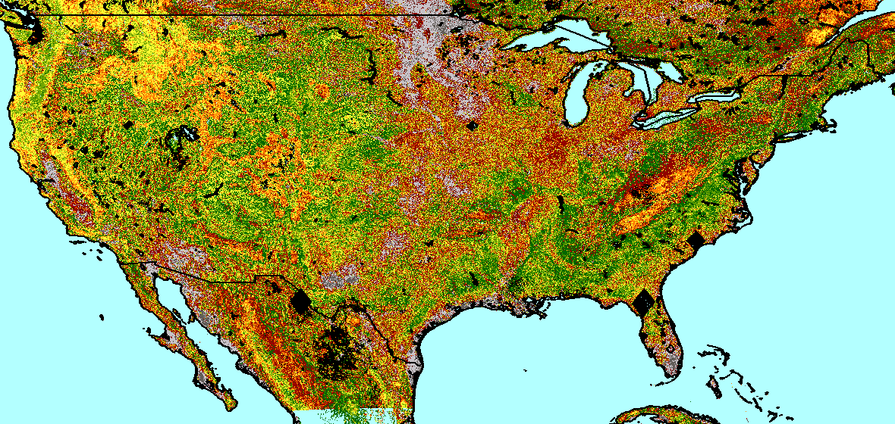
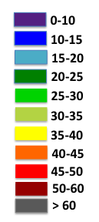
AGB Prediction Uncertainty
AGB Prediction
Uncertainty (±%)
Potential Validation Sites

