Slide 1




Synergistic Analyses of Data from Active and Passive Sensors to Assess Relationships between Spatial Heterogeneity of Tropical Forest Structure and Biodiversity Dynamics:
Further Steps toward Synergy
Geoffrey M. Henebry
Jordan D. Muss
Eric Ariel L. Salas
Geographic Information Science Center of Excellence
South Dakota State University
and
Naikoa Aguilar-Amuchastegui
World Wildlife Fund–US
Research supported through the NASA Biodiversity program: NNX09AK23G. Thank you!

Slide 2
Overview
Update on alternative metrics to characterize waveform lidar data
Study areas in Costa Rica
Sampling biodiversity in the managed forests in Costa Rica
Current results
Next steps

Slide 3
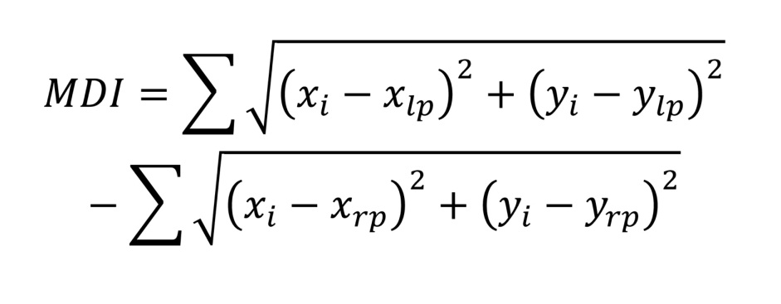
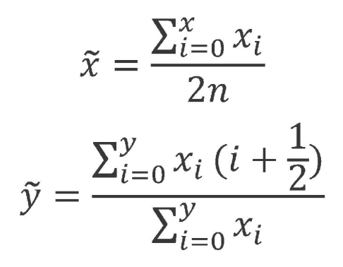
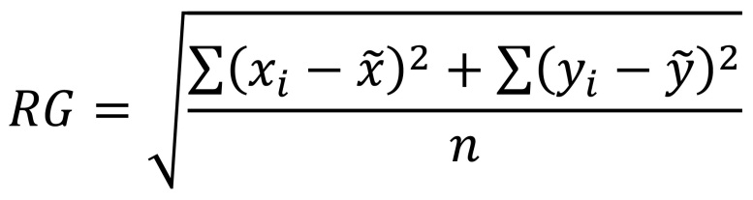
An update on alternative methods to characterize lidar waveforms
We have adapted two methods from mechanical engineering:
(1) Moment Distance Index describes waveform shape using two user-defined reference points, the left pivot (lp) and right pivot (rp):
(2) Radius of Gyration describes the waveform from a single well-defined reference point, the centroid of the waveform:
where

Slide 4
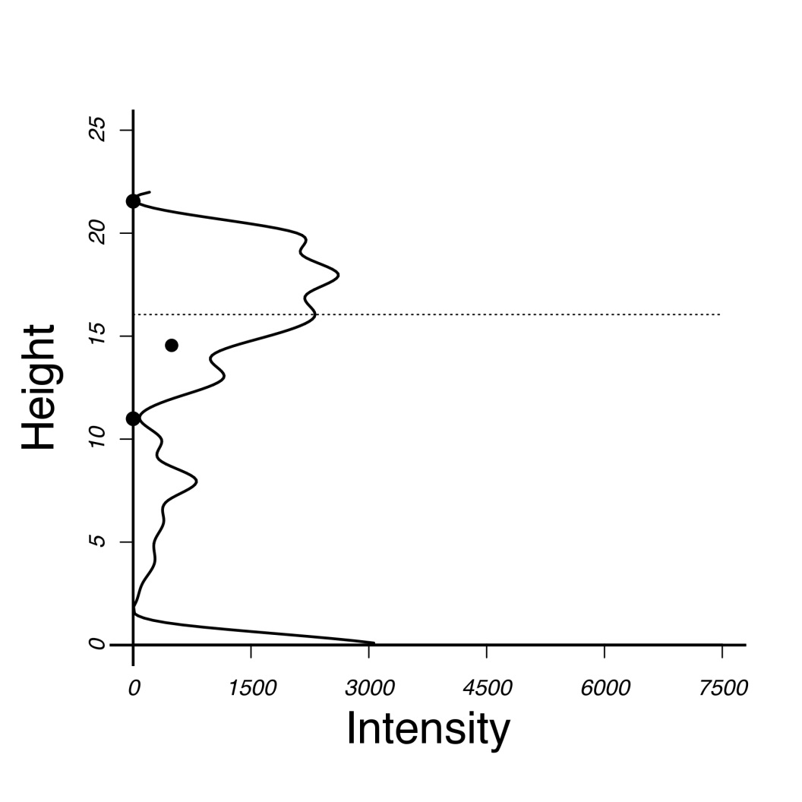
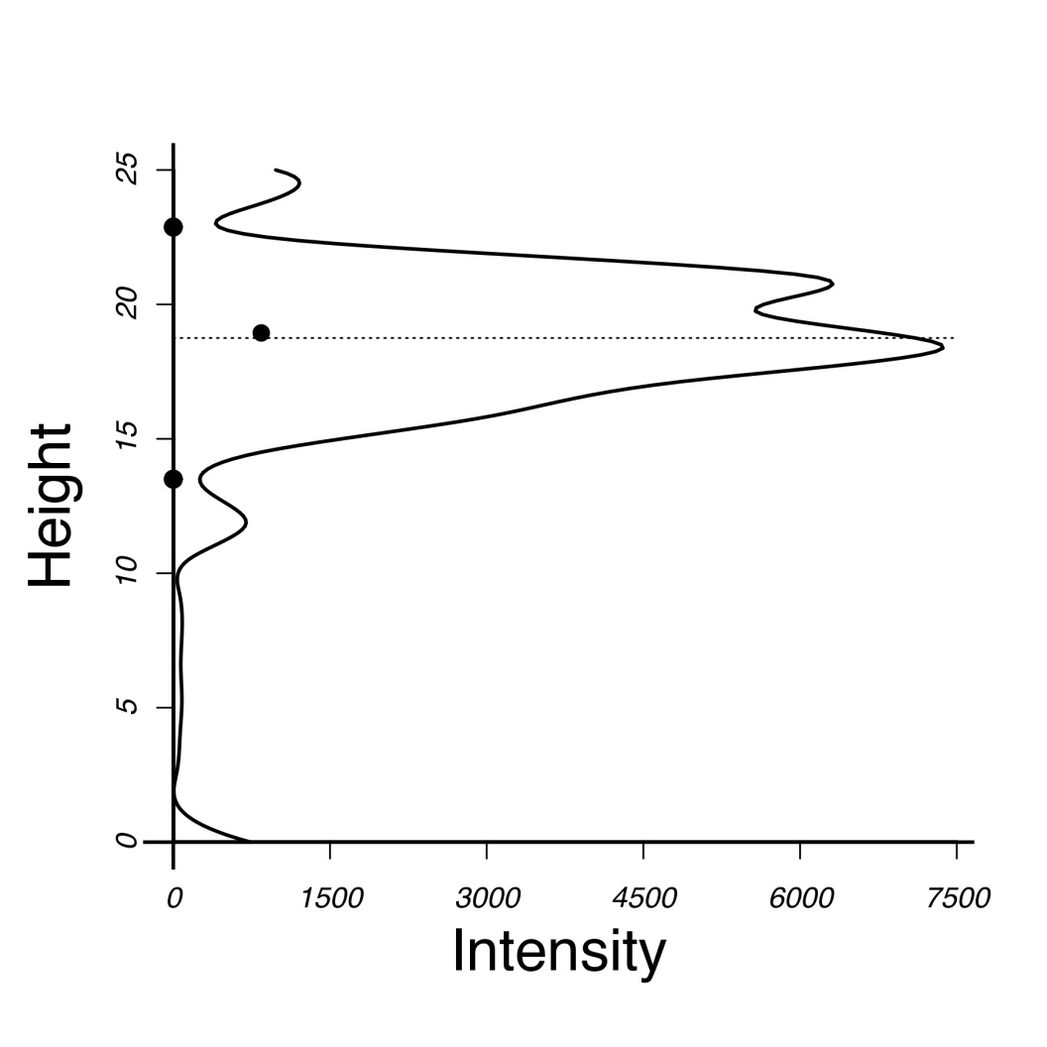
The height corresponding to the centroid offers an alternative metric to HOME (height of median energy). The centroid can coincide with HOME, but it need not, because it characterizes a different aspect of the waveform.
In poster #199 Jordan Muss applied centroid height, radius of gyration, and moment distance index to pseudo-waveforms generated from discrete return lidar data from deciduous and coniferous plots in northern Wisconsin.
White Pine: DRL 1m bins
Red Maple: DRL 1m bins
lp
lp
centroid
HOME
HOME
centroid
rp
rp

Slide 5
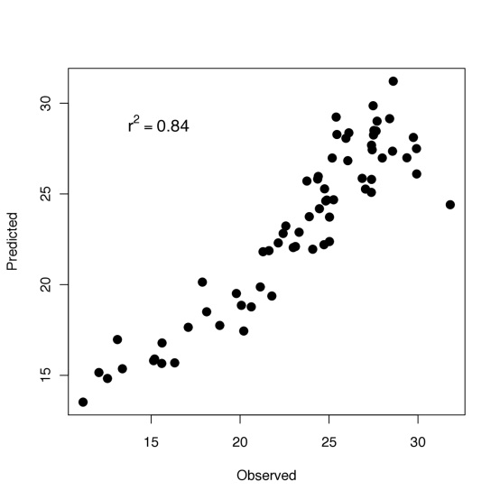
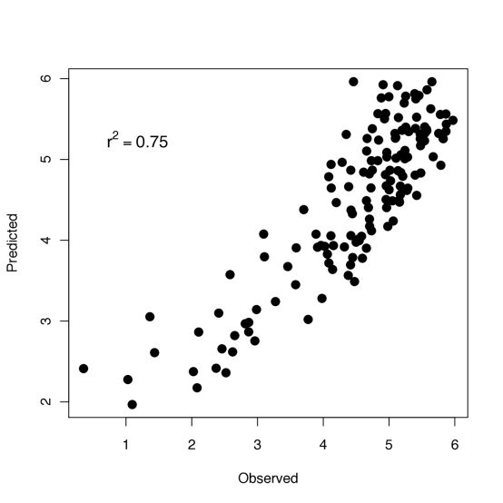
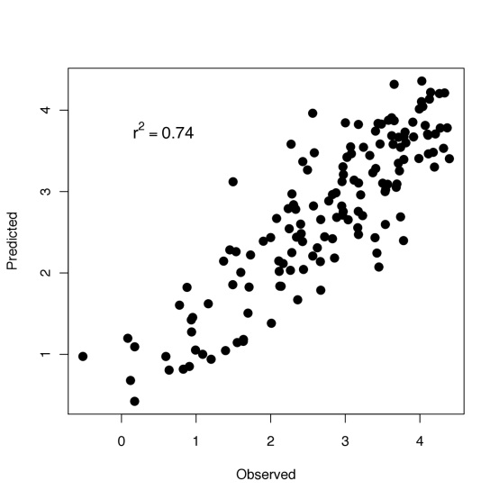
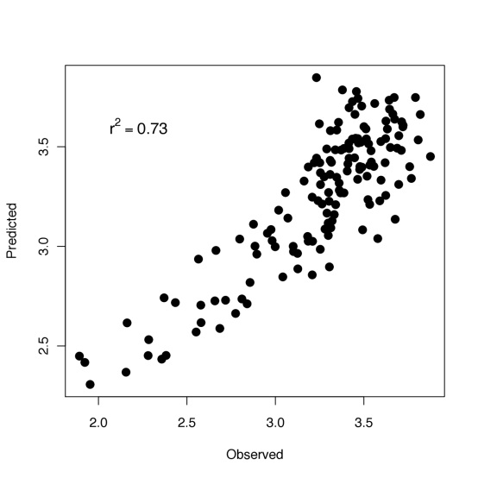
 | Measurement | Model | Adj. r² | RMSE
A | Tree height (max) | 0.4Max + 1.4RG + 3.8 | 0.84 | 1.98
B | ln(Total biomass) | 0.2Max - 0.0004MDI – 0.2 | 0.75 | 0.56
C | ln(Branch biomass) | 0.1Max - 0.2RG – 1.5 | 0.74 | 0.56
D | ln(Mean QMSD) | 1.9Max – 0.004MDI – 8.7 | 0.73 | 0.22
E | Lowest live branch (mean) | 0.4Max + 0.7RG – 13.8CRR + 10.7 | 0.66 | 1.67
F | Crown length (mean) | 1.1Centroid_{Y} – 1.2RG – 9.7CRR + 11.7 | 0.60 | 1.45
A
B
C
D

Slide 6
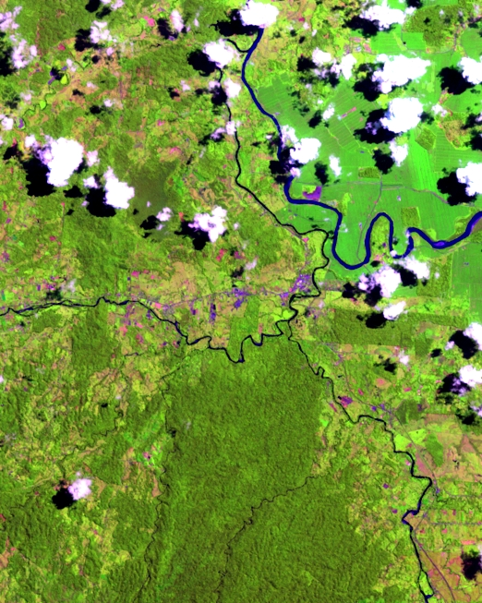
Study Areas
L7 15JUN2001
RGB=543

Slide 7
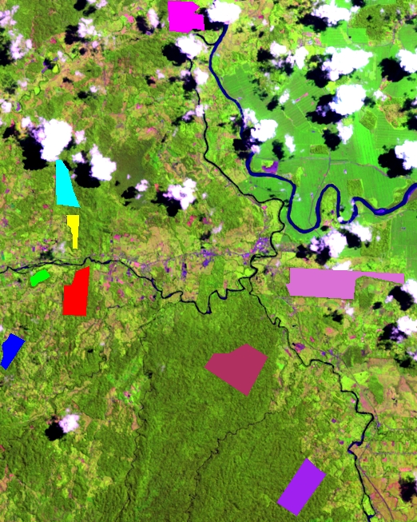
⬅ Rojomaca
⬅ Ecovida
Study Areas
L7 15JUN2001
RGB=543
⬅ Ladrillera 1
⬅ ⬅ Ladrillera 3
⬅ Selva Verde
⬅ Starke
9 forested sites
3 natural reference:
1 natural & intact
2 natural but fragmented
6 managed units:
5 primary
1 old secondary
⬅ Kay Rica
⬅ La Selva
⬅ Tosi

Slide 8
Study Areas
L7 15JUN2001
RGB=543

Slide 9
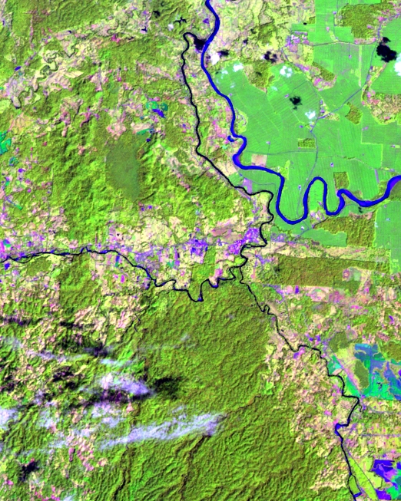
Study Areas
L7 26JAN2008
RGB=543

Slide 10
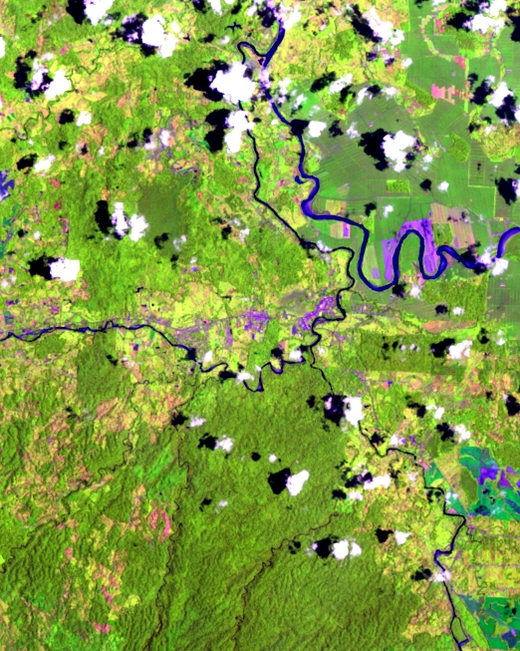
Study Areas
L7 05APR2010
RGB=543

Slide 11
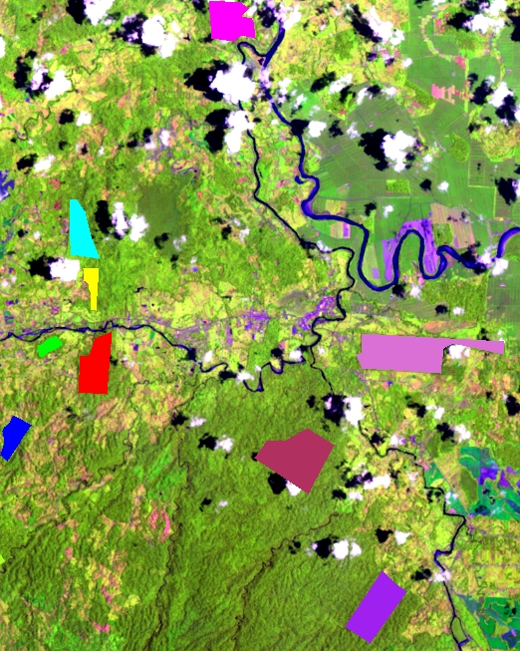
Each FMU is under FSC certification as being sustainably managed (granted to FUNDECOR in 1993).
Study Areas
L7 05APR2010
RGB=543

Slide 12
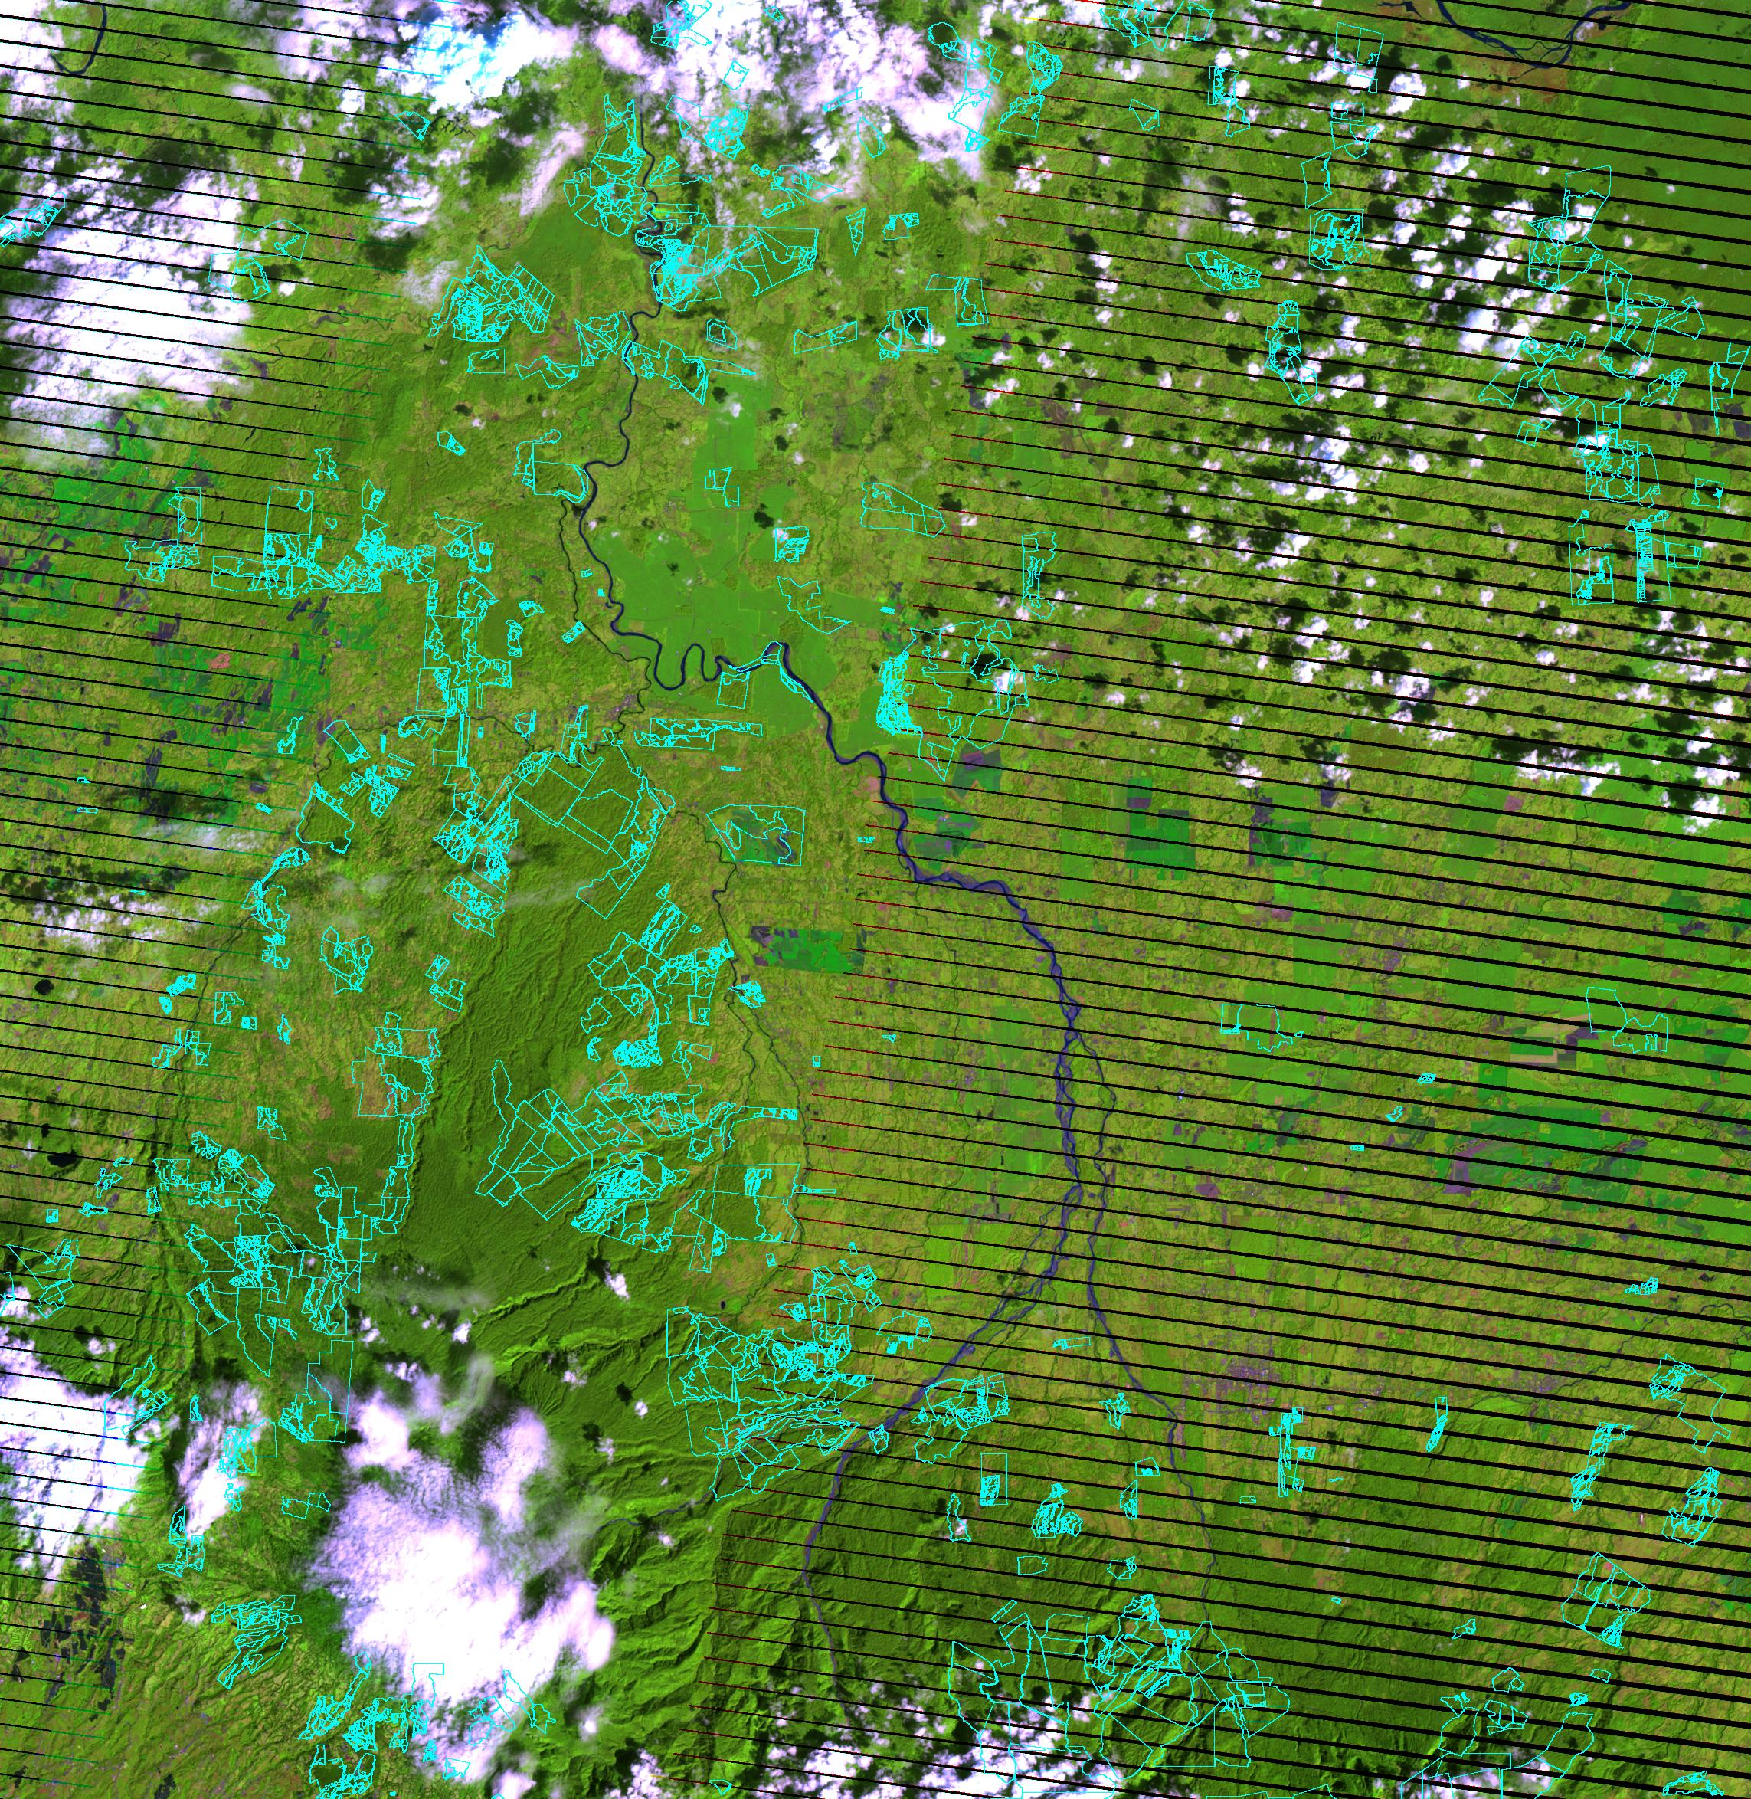
Polygons with FSC certified management agreements with FUNDECOR for 1 of 3 uses:
Production
Protection
Plantations
⬅ La Selva

Slide 13
Methods for Ongoing Biodiversity Surveys
through collaboration with ICOMVIS at UNA and FUNDECOR
Transects in each forest with survey points each 200-250m.
For dung beetles, pitfall traps at each point for 1 week.
For butterflies, point counts and traps for 3 days.
For birds, calls recorded with digital recorders from 0530-0730 x 3 days (= 48 h per forest).
For mammals, 16-30 camera traps per forest 250m apart set for 2 weeks, half were baited with perforated sardines cans.

Slide 14
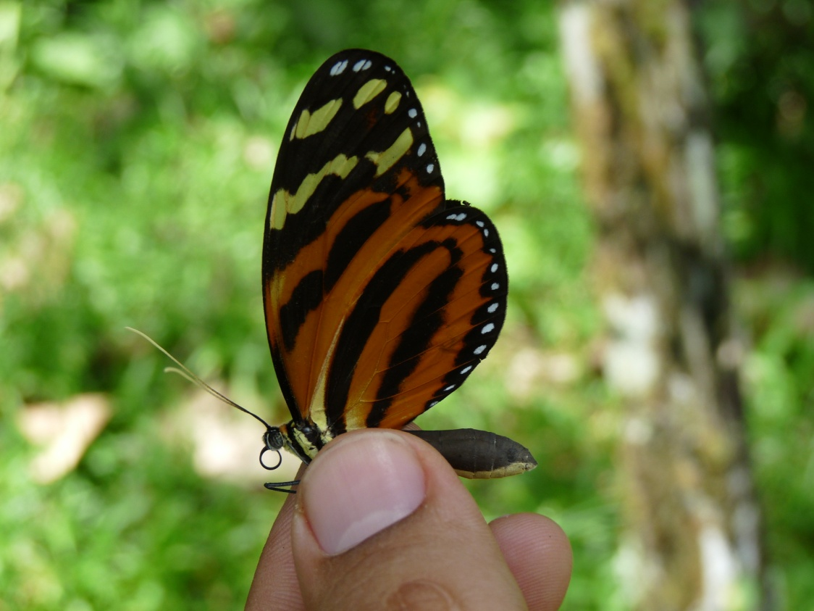
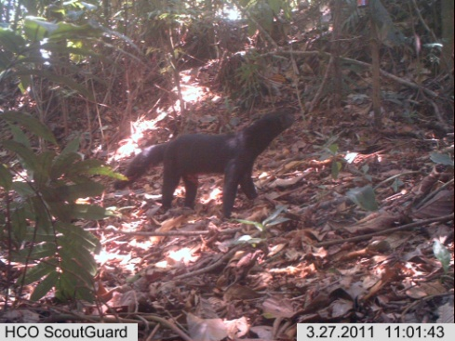
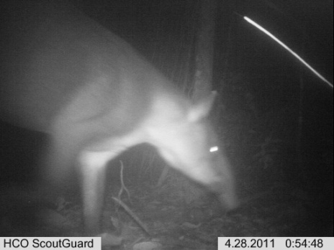
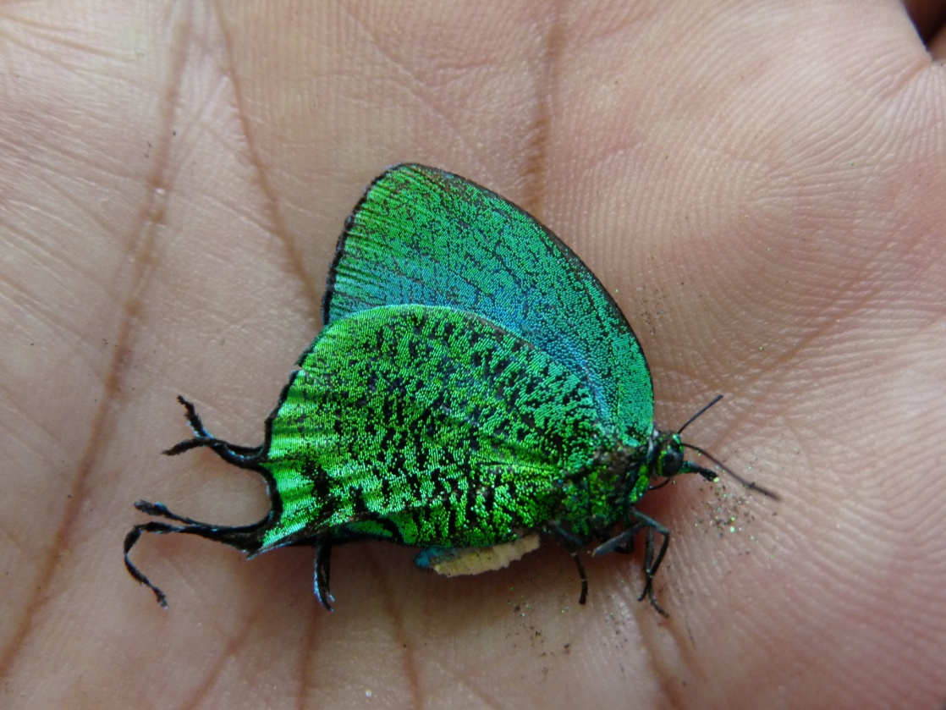
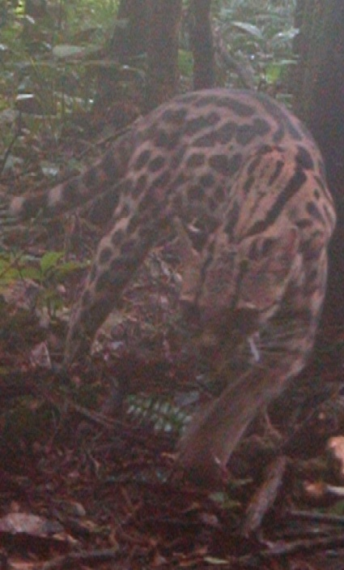
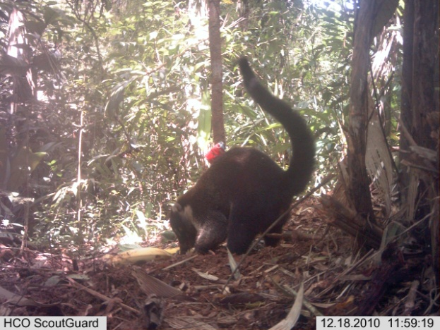
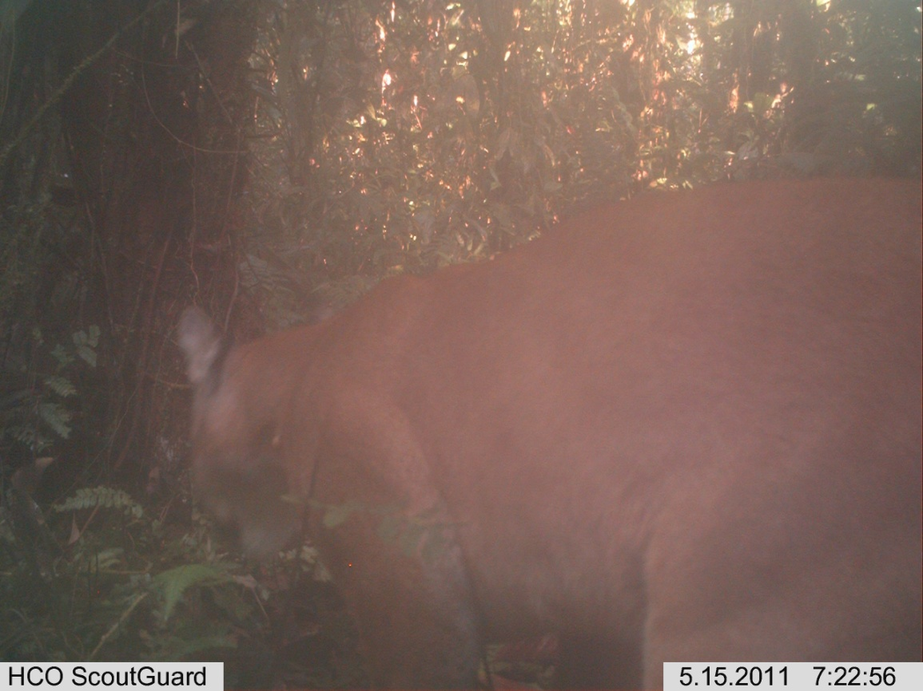
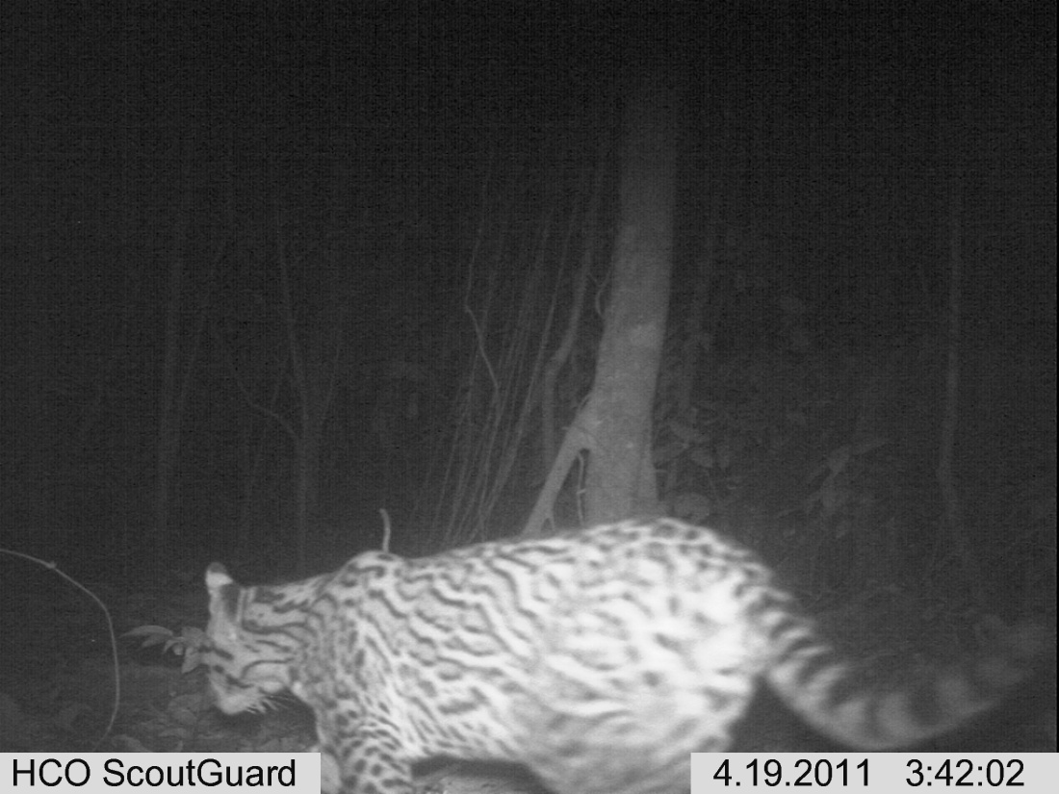
Hypothyris euclea,
an understory specialist
tayra
tapir
Arcas imperialis, found in understory gaps
ocelot
raccoon
puma
ocelot

Slide 15
Current results of biodiversity surveys in selected forest stands
Forest Type | Status | Surveyed Forests | Years since last harvest | Disturbance Index | Area under harvest | Estimated Species Richness Dung Birds Mammals Beetles Butterflies
Primary Forest | FMU | Kay Rica | 4 | 22.7 | 33.3 | 68.9 | 4 | 6.0 | 30
 |  | Ecovida | 4 | 10.3 | 93.1 | 46.5 | 1 | NYA | 32
 |  | Ladrillera 3 | 8 | 7.0 | 35.2 | 47.6 | 8 | 6.0 | 40
 |  | Tosi | 10 | 7.6 | 56.0 | 43.1 | 9 | 7.9 | 27
 |  | Ladrillera 1 | 10 | 7.2 | 21.0 | 37.5 | 8 | 13.5 | 26
 | Natural | La Selva | -- | -- | -- | 74.6 | 9 | 3.5 | NYA
 |  | Rojomaca |  |  |  | 45.3 | 5 | NYA | 28
 |  | Selva Verde |  |  |  | 33.0 | 11 | NYA | 35
Secondary Forest | FMU | Starke | 12 | 2.5 | 344.2 | 33.0 | 5 | 8.0 | 34
DI = h * i * r * y ⁻¹
h: number of harvest events
i: intensity of last harvest (e.g., trees/ha)
r: years required for sustainable rotation
y: years since last harvest
⬅ Need to integrate effects of fragmentation.

Slide 16
Primary
Secondary
Natural Forests
Managed Forests

Slide 18
Primary
Secondary
Natural Forests
Managed Forests

Slide 21
Next Steps
complete the biodiversity surveys & compositional analyses
complete assessment of RS indicators of structural heterogeneity
dissimilarity modeling to link composition with indicators from RS data
apply models to indicate other FMUs in need of biodiversity surveys
verify models’ predictions
Significance
Multiple linkages exist between Biodiversity & Carbon in tropical forests:
  habitat structure,
  ecosystem function,
  ecological resilience,
  livelihoods & development,
  sustainable management
REDD changed to REDD+ at COP14 in Poznan 2008
Biodiversity preservation and low-impact logging are part of the “+” in REDD+
FSC certification is thus a leverage point for managing Biodiversity through Carbon

