Slide 1
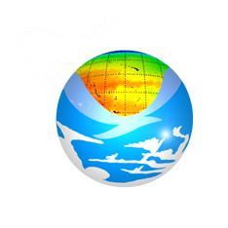
A Decision Support System for Ecosystem-Based Management of Tropical Coral Reef Environments
F. Muller-Karger, M. Eakin, L. Guild,
M. Vega, R. Nemani, T. Christensen, L. Wood, C. Ravillious,
C. Hu, C. Nim, J. Li, C. Fitzgerald, J. Hendee, L. Gramer, S. Lynds
NASA and Earth Science Earth Science Division
Applied Sciences Program

Slide 2
Partnerships
NOAA NESDIS/CRW (M. Eakin, J. Li, G. Liu, T. Christensen)
NOAA AOML / ICON/CREWS (J. Hendee, L. Gramer)
NASA Ames (L. Guild, R. Nemani)
UNEP-WCMC (L. Wood, C. Ravilious, C. Fitzgerald)
U. South Florida (F. Muller-Karger, C. Hu, M. Vega, B. Barnes)
U. Colorado-CIRES (S. Lynds)
NOAA NESDIS/CRW-Australia (W. Skirving, S. Heron / NOAA)

Slide 3
Acknowledgements
Funding provided by:
NASA Applied Sciences Program
Woody Turner
2008 Ecological Forecasting application area
4-year program (2009-2013)
NOAA
Coral Reef Conservation Program
UNEP WCMC (World Conservation Monitoring Centre)

Slide 4
Objectives of the Program
Assess and meet needs in coral reef research, management, education
Assess value of high-resolution (1 km ) data
(MODIS, AVHRR, other)
Link to higher-resolution maps
Global Coral Reef Millennium Map
Landsat, other present and future sensors

Slide 5
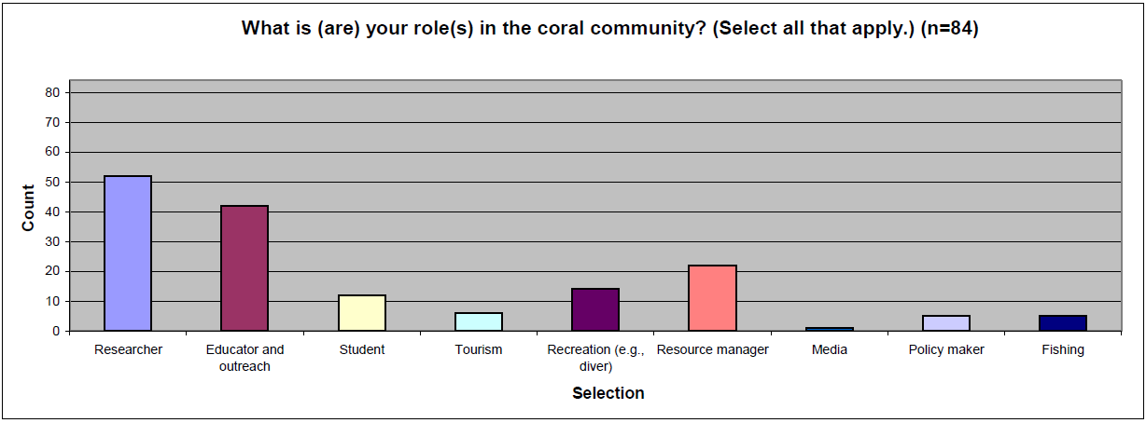
User surveys (S. Lynds / CIRES)
Respondents from 23 countries

Slide 6
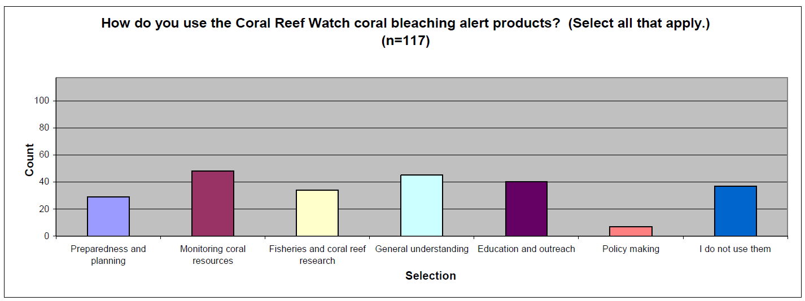
User surveys (S. Lynds / CIRES)
Uses:
-Preparedness and planning -Monitoring coral -Fisheries
-Education -Policy research

Slide 7
User surveys (S. Lynds / CIRES)
Users are interested in higher spatial resolution products

Slide 8
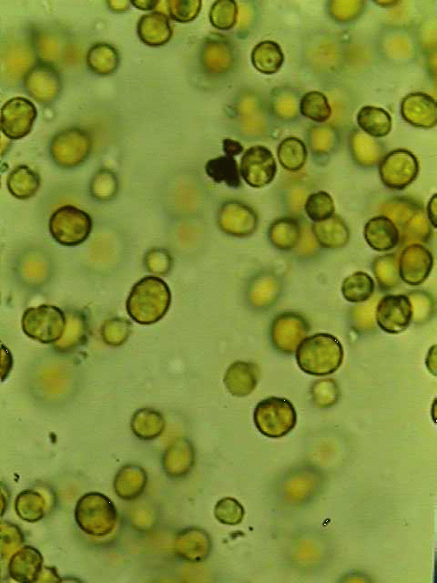
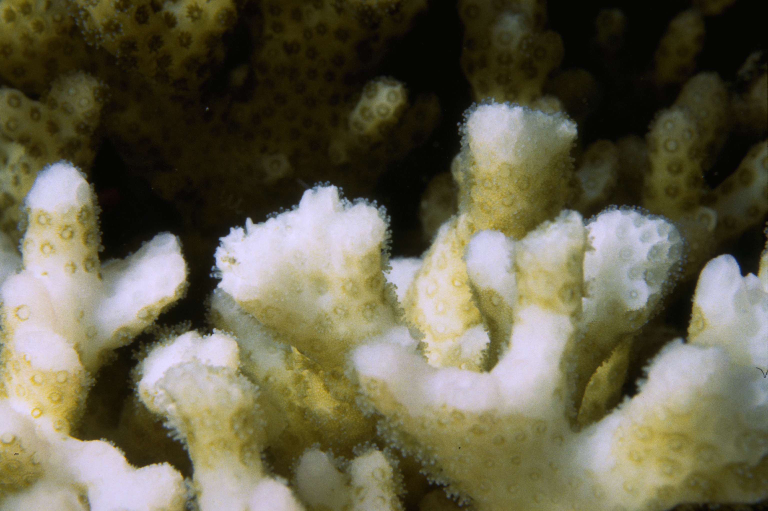
Coral Bleaching: Impact of Climate Change
zooxanthellae
Most of corals’ food comes from photosynthesis
Scott R. Santos
Corals exposed to high temperatures and/or high light become stressed
Corals eject their algae; coral appears “bleached
If stress is mild or brief, corals recover, otherwise they die
Symbiotic algae
Mass bleaching covers 100-1000 kms

Slide 9
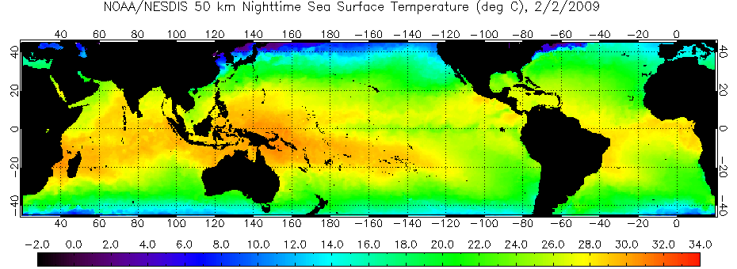
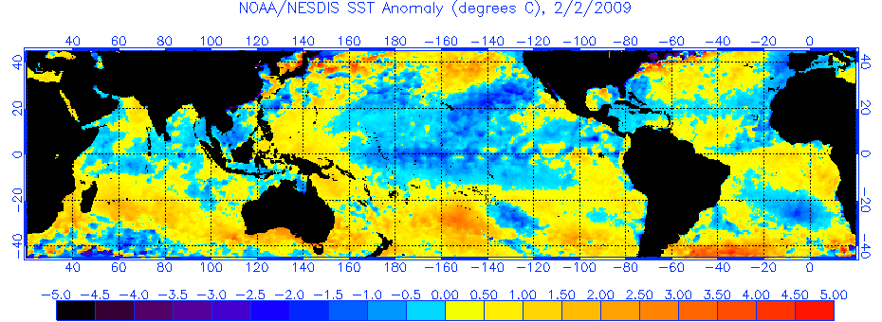
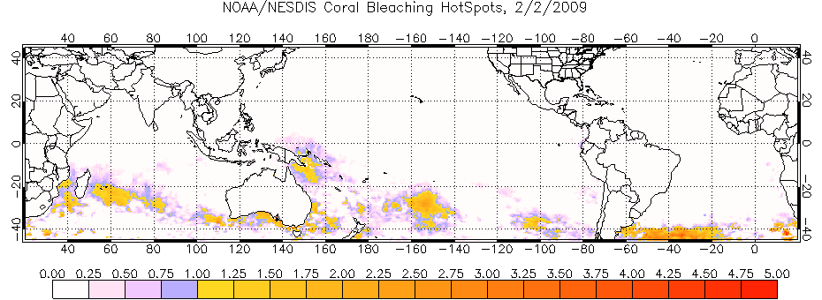
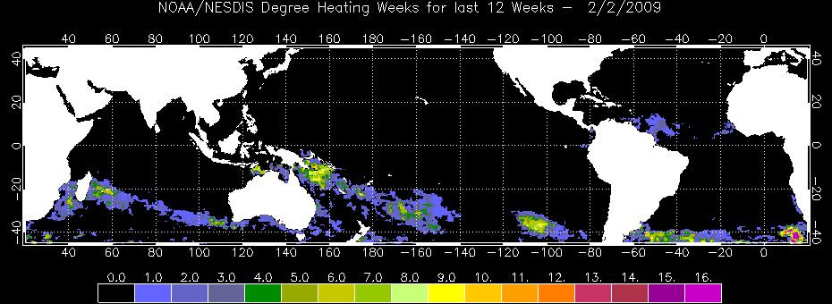
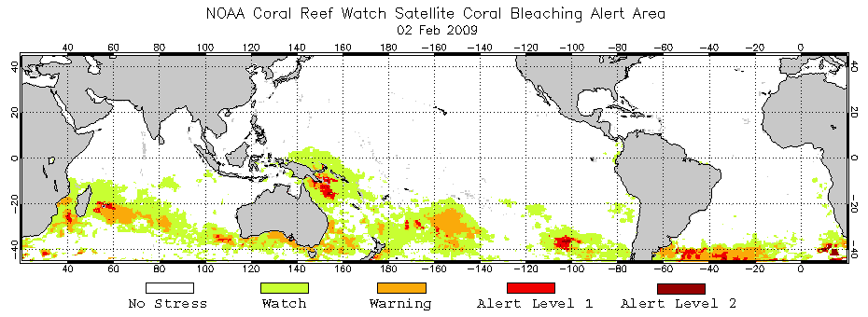
Coral Reef Watch Satellite-Based Products
Primary Products: SST-based
50km Nighttime Sea Surface Temperature (SST)
Coral –
specific
SST Anomaly
HotSpot
Degree Heating Week
Bleaching Alert Areas

Slide 10
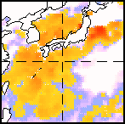
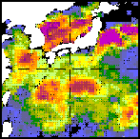
Degree Heating Week Product Algorithm
SST
Bleaching threshold
(MMMSST+1ºC)
Maximum Monthly Mean SST
Climatology (MMMSST)
Week-0
a
b
Time
c
d
Week-12
HotSpots
12 weeks
Σ( HotSpot value × duration )
≥ 1°C
Degree Heating Weeks
≥ 4 DHWs coral bleaching is expected
≥ 8 DHWs mass bleaching and mortality are expected

Slide 11
NOAA Coral Reef Watch: New Decision Support System
Approach:
Develop and test new, high-resolution climatologies
Global 4 km Pathfinder daily SST data
Application of NEX for handling large data volumes
Develop 5-10 km global products (CRW)
Develop 1 km regional products (USF, Australia)
Develop full suite of high-resolution tools for coral reef managers

Slide 12
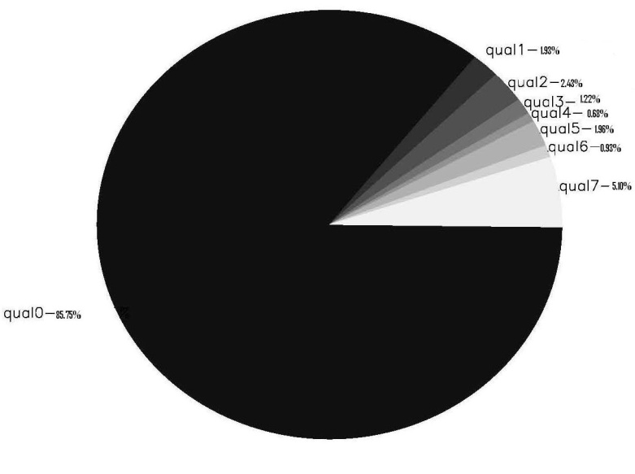
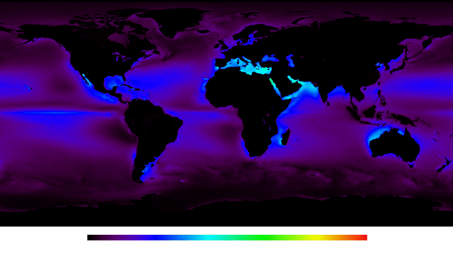
Data Density
4km-Resolution PF v5.0
Daily Nighttime only SST
Globally, 8.67% of Pathfinder data have quality ≥ 4 (useable)
Data Gaps
0
20
40
60
80
100
0 20 40 60 80 100
% Data Available

Slide 13
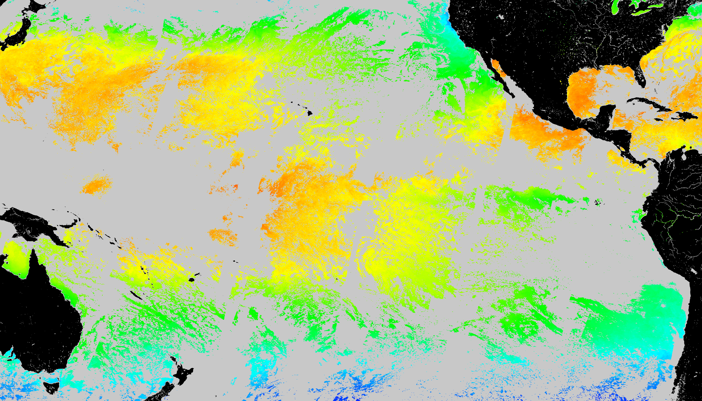
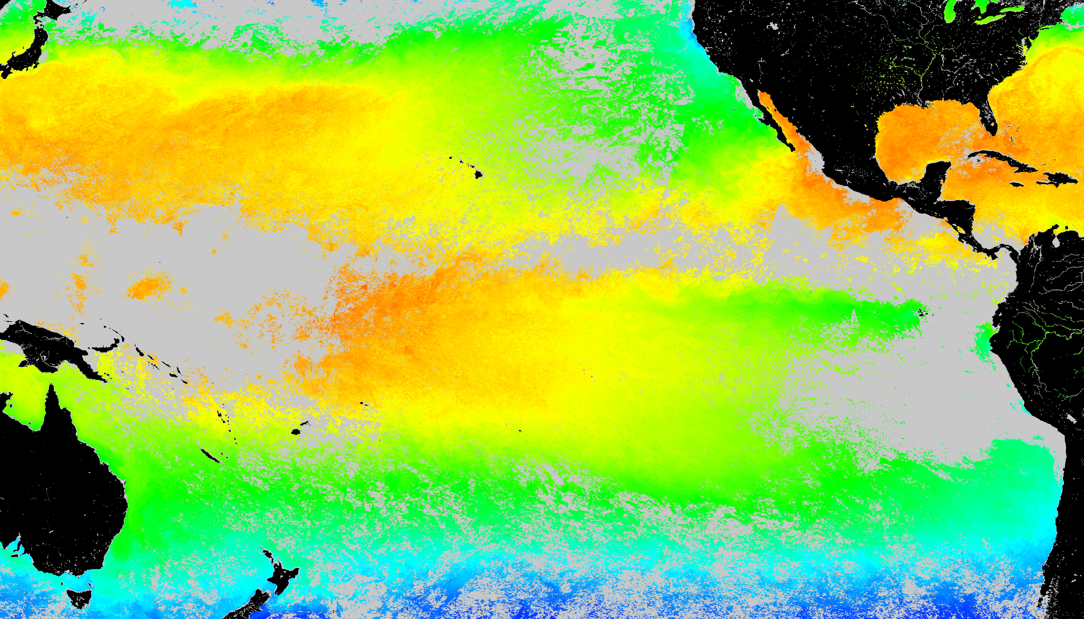
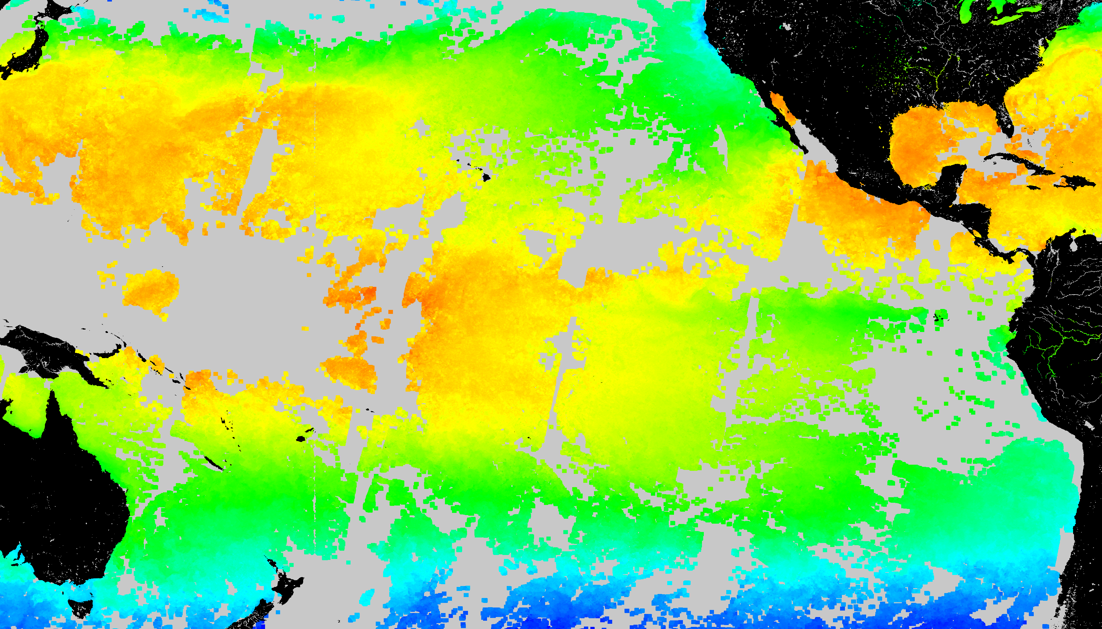
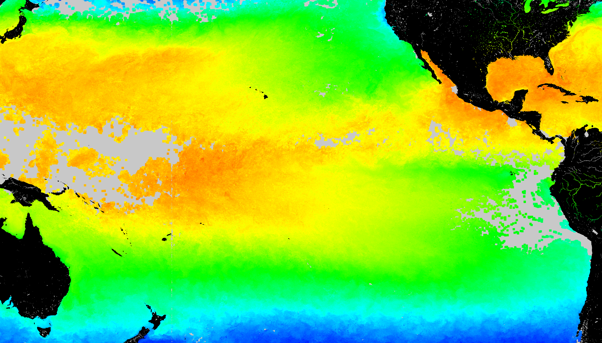
SST Coverage (August 10 2002)
With Gap
Temporal gap filling (≤ 30d)
Spatial gap filling (≤ 50 km)
Temporal + spatial gap filling

Slide 14
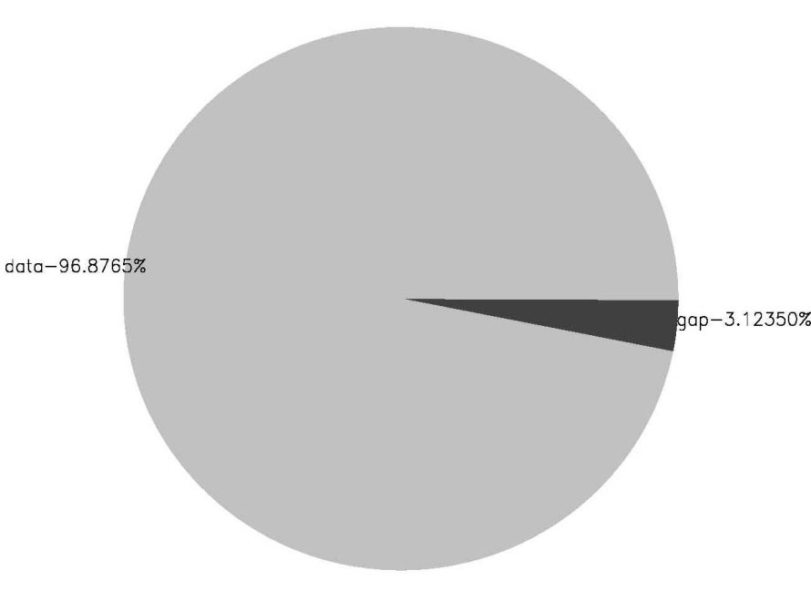
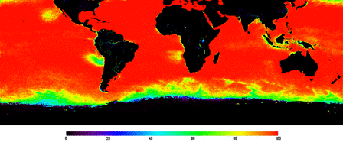
Data Density
4km-Resolution PF v5.0
Daily Nighttime only SST
Non-Gap
Data Gaps
Globally, 76.50% gap-free.
“Tropics” 35°N-35°S latitude, 96.88%
0
20
40
60
80
100
0 20 40 60 80 100
% Data Available

Slide 15
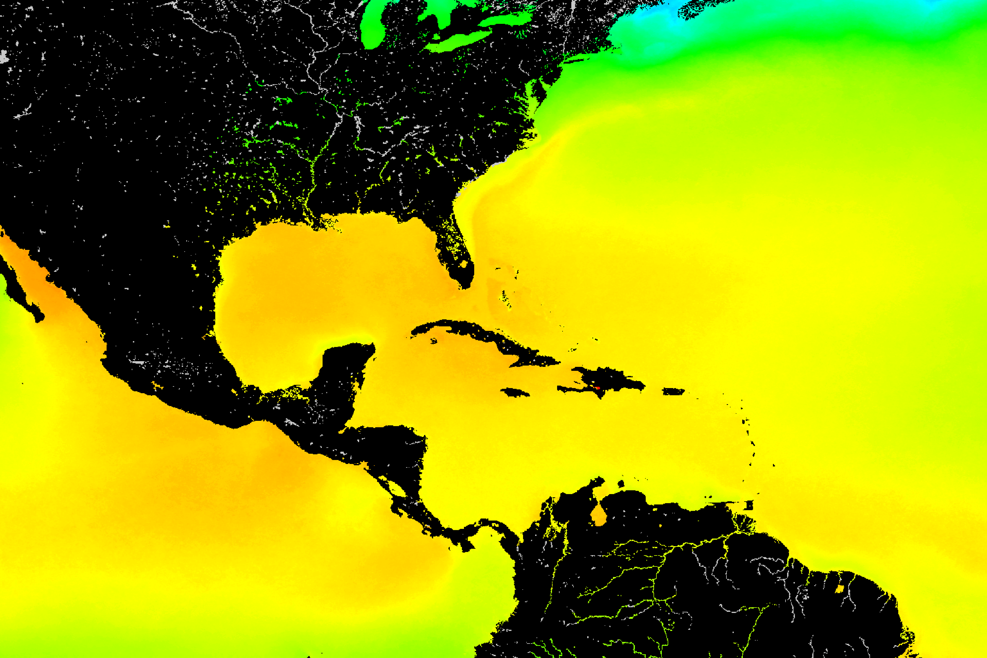
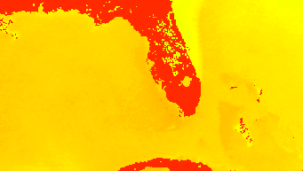
Maximum Monthly Climatology (MMM) based on Pathfinder SST
Global 4 km
Regional pseudo-1 km

Slide 16
High Resolution Global CRW Products based on:
Climatology: 4 km AVHRR Global gap-filled Pathfinder
Data: 11 km Operational Blended
Polar-orbiters (2) + Geostationary (4)
Up to 24-100 scenes/day
5 km coming soon
5th geostationary coming

Slide 17
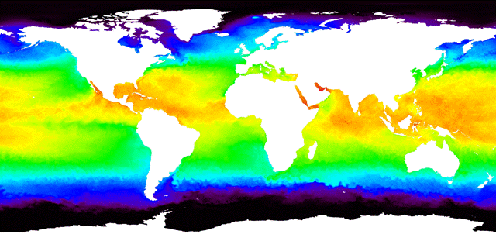
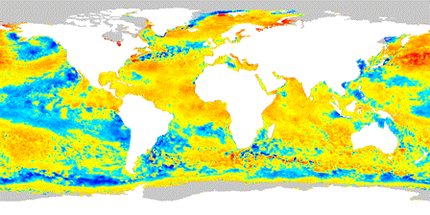
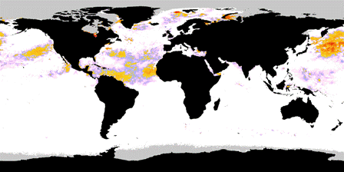
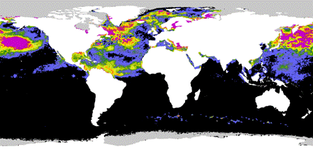
11km – Resolution, Global
Coral Thermal Stress Products
Based on NOAA Operational GOES-POES SST, 09/25/11
SST
SST Anomaly
HotSpot
DHW
17

Slide 18
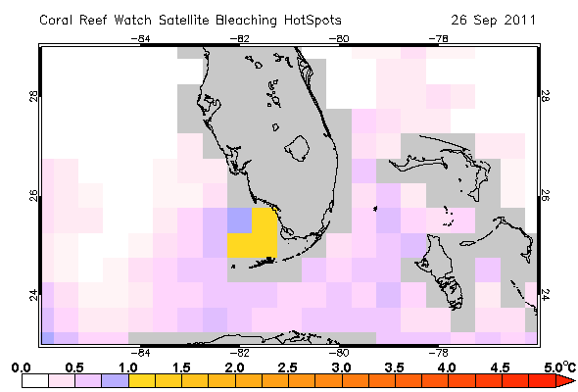
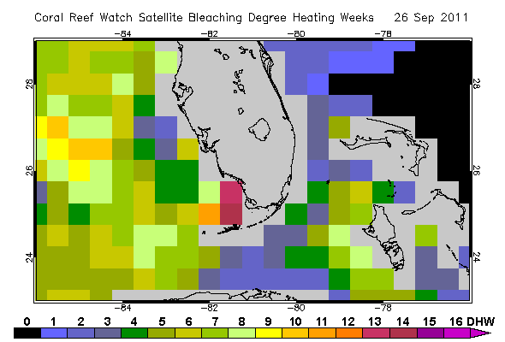
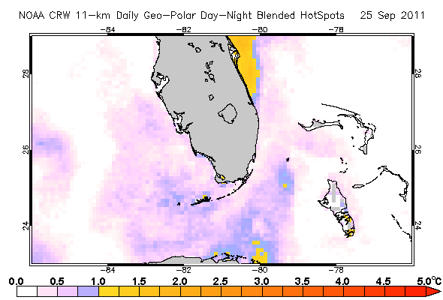
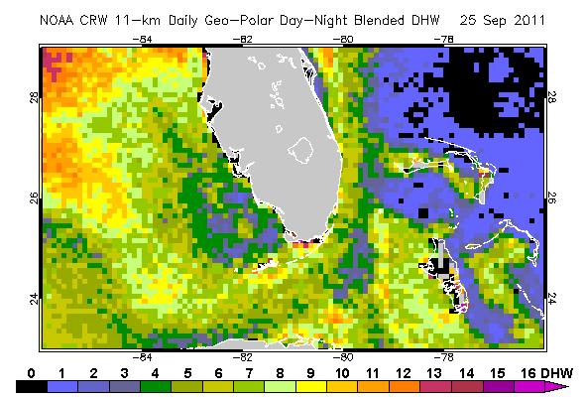
11km – Resolution, Global
Coral Thermal Stress Products
Based on NOAA Operational GOES-POES SST, 09/25/11
50 km
11 km
HotSpot
DHW
18

Slide 19
High Resolution Prototype CRW Products based on:
4 km AVHRR Global Pathfinder
Climatology
1 km MODIS and AVHRR
(Test area: Florida Keys National Marine Sanctuary)

Slide 20
USF 1 km HotSpot
July 25, 2011
August 8, 2011

Slide 21
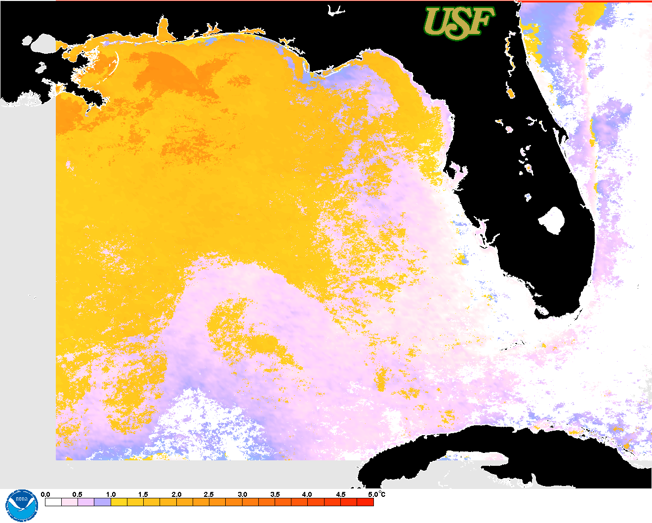
HotSpot products for the West Florida Shelf
(August 29, 2011)
NASA MODIS HotSpot
Based on Pathfinder 4km MMM
USF AVHRR HotSpot
Based on Pathfinder 4km MMM

Slide 22
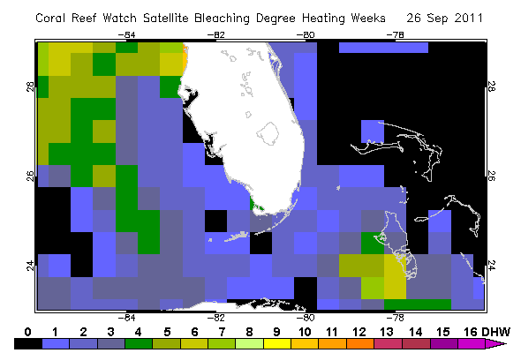
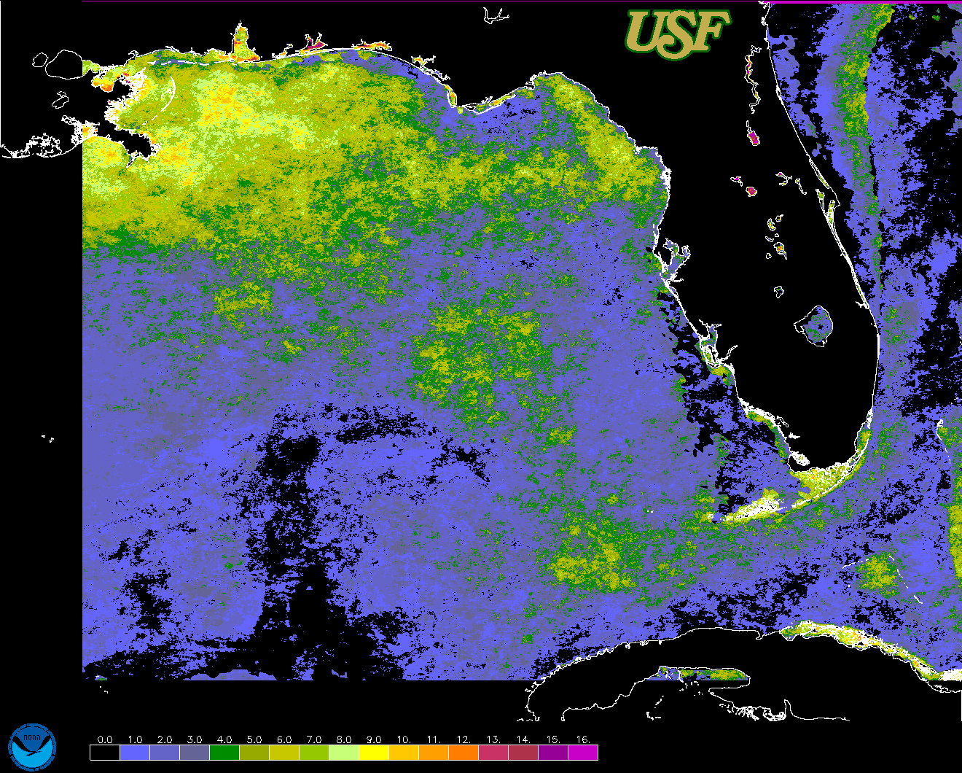
DHW products for the West Florida Shelf
(September 15, 2011)
Enhanced 50 km NOAA product
E4km_DHW.20110915.florida.png

Slide 23
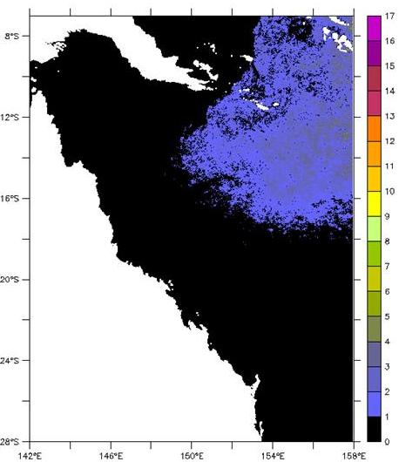
CRW DHW product for Australia (May 3, 2011)
1 km DHWs on May 3, 2011 for the Great Barrier Reef
based on 1 km AVHRR data 4km PF climatology
Product of Coral Reef Watch-Australia and
Australian Institute of Marine Science

Slide 24
Cold Stress Index
Corals have a lower temperature limit under which they are susceptible to stress and death
Objective:
develop high spatial resolution cold-stress index to help monitor and forecast coral bleaching or mortality due to cold stress.

Slide 25
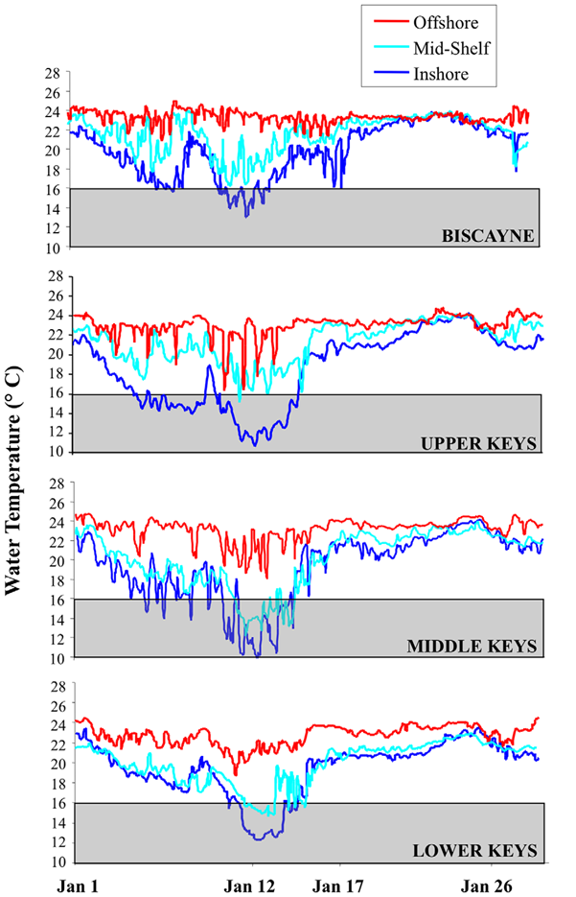
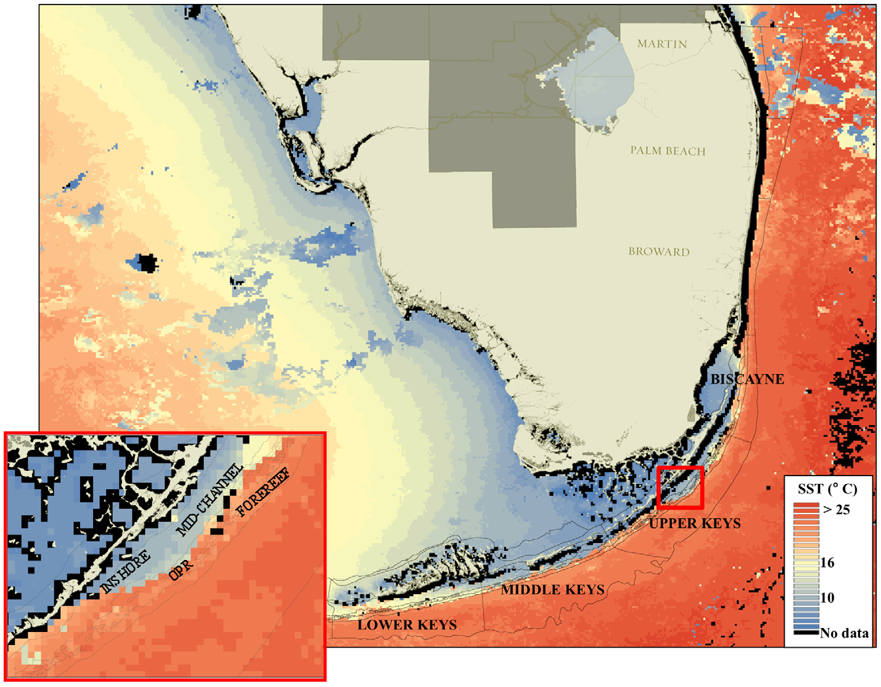
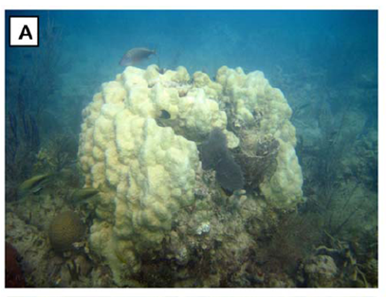
2010 Florida Keys Case Study
JAN 2010: Anomalously cold temperatures
Widespread mortality in coral reefs
SST observations helped guide a field survey
In situ temperatures

Slide 26
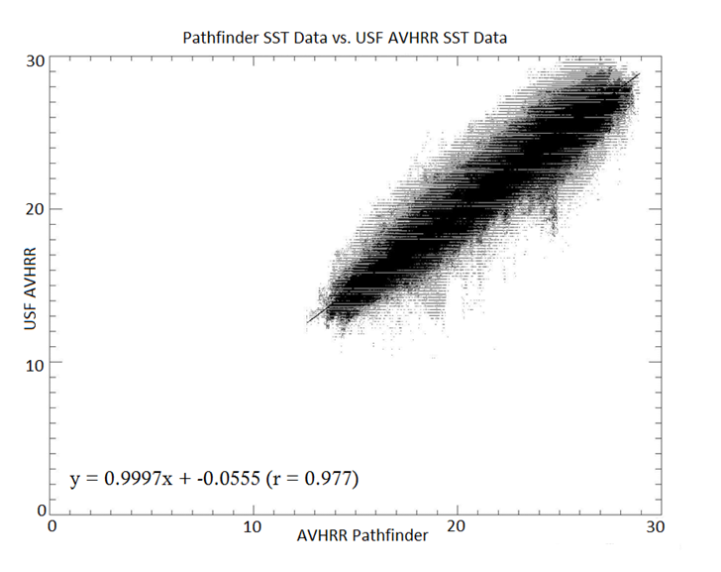
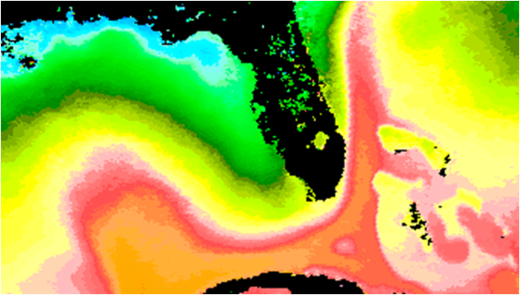
Developing a ‘Cold Snap’ Index
Approach:
Nighttime-only AVHRR Pathfinder (v5.0) SST data at a 4 km spatial resolution (no gap filling) used to create higher resolution climatologies from 1985 – 2006
Daily AVHRR Pathfinder SST
(4 km – remapped to 1km)
vs. daily USF daily SST
(AVHRR 1 km LAC)

Slide 27
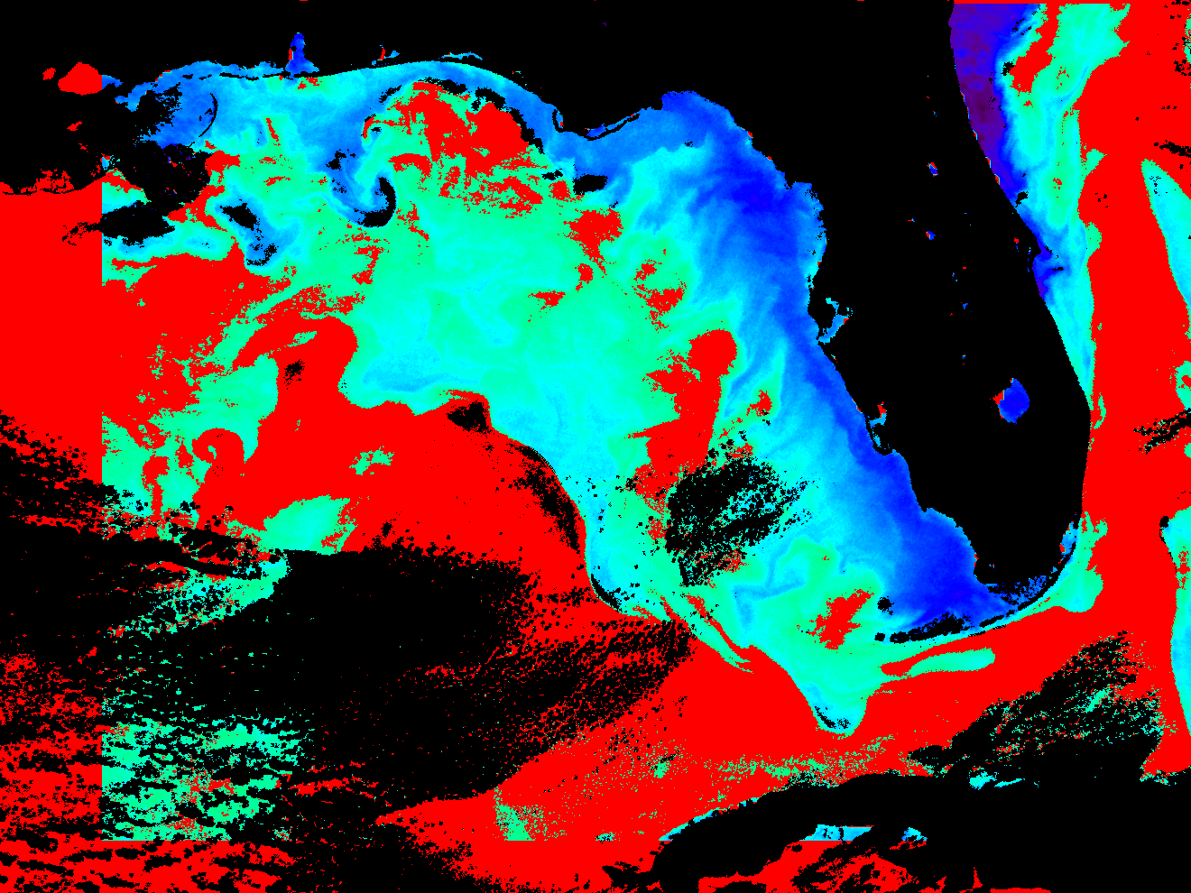
SST anomalies 1 SD or larger below minimum SST climatology
around January 10, 2010

Slide 28
‘So what?’ Linking science and management
Ultimately, the goal is to improve our ability to alert reef managers around the world of bleaching-level stress, so they can take appropriate actions.
In the Florida Keys, the CRW products have helped:
Guide Rapid Response efforts to assess reef conditions
Inform the public about what may be happening on the reef when corals are visibly stressed
Restrict access to a reef during thermal stress and disease
Increase confidence in management decisions

Slide 29
Visit our Posters!!!

Slide 30
Accomplishments: 2010-2011
Completed user survey for NOAA Coral Reef Watch products.
Developed global high-resolution 4 km SST climatology
Deployed a website with 11 km Coral Reef Watch (CRW) products globally.
Deployed website with 1 km Coral Reef Watch (CRW) products for the Florida Keys and advanced application of MODIS
Developed prototype cold water event index (cold snap index) for the Florida Keys.
UNEP WCMC integrated the NASA Coral Reef Millennium Map into their online databases with a Map server interface (http://data.unep-wcmc.org/datasets/13).

